Slide 1
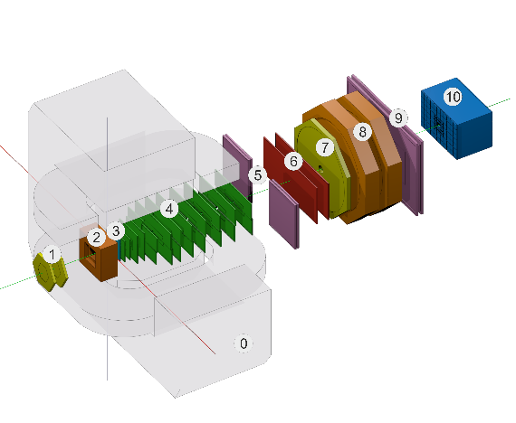
Production of the Configuration Information system for the BM@N experiment
Evgeny Alexandrov¹, Igor Alexandrov¹, Alexander Chebotov¹, Irina Filozova¹, Konstantin Gertsenberger¹,
Daria Priakhina¹, Ilya Romanov¹, Galina Shestakova¹,
Alexander Yakovlev¹
¹JINR, Dubna
MMCP, Yerevan, Armenia, 20-25 October, 2024

Slide 2
Configuration Information system Possibilities
can store and provide configuration data for online processing
set of various detectors configuration parameters (working voltage etc.)
setup data including sequences of software tasks with their dependencies
can start, stop and monitor setup tasks during experiment sessions
can use web interface to supports data bases and operations with setup tasks
Notes:
set of various configuration hardware parameters
required for setting the detectors into operation modes (like working voltage)

Slide 3
General Architecture of the BM@N Online Configuration System
Dynamic Deployment System (FAIR)
Application launch service
DDS
Agent
DDS
Agent
DDS
Agent

Slide 4
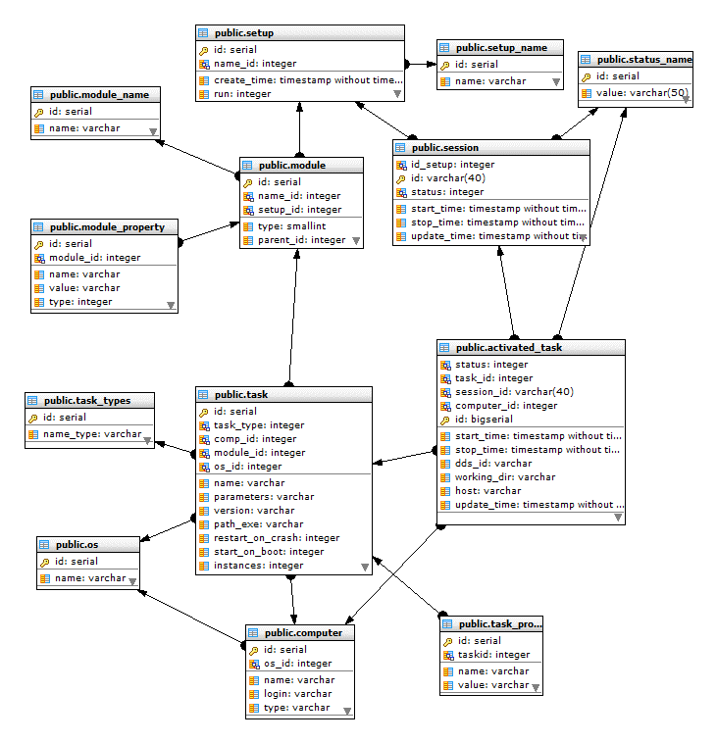
DB Object model
MMCP, Yerevan, Armenia, 22 October, 2024

Slide 5
BM@N Configuration Information System and online processes diagram
bmn-config-he.jinr
bmn-config-w1-he.jinr
bmn-config-he.jinr
bmn-config-he.jinr

Slide 6
BM@N online processes to be controlled by Configuration manager

Slide 7
BM@N online processes to be controlled by Configuration manager

Slide 8
BM@N online processes to be controlled by Configuration manager

Slide 9
Configuration Manager: functionality
listens and performs commands (REST API in use)
Start all setup tasks
Stop all setup tasks
Update setup
Get log of the activated task
Check if configuration manager is alive
Stop configuration manager
Get agent session log
reads from DB setup data using setup ID
prepares tasks for start using DDS system (convert data into DDS topology form)
starts all tasks of topology using DDS
gets from DDS server info about all started tasks
stores in the DB the info about DDS session and tasks

Slide 10
Configuration Manager: session/task states
States of the session and its tasks
Starting
Configuration Manager (ConfigMan) got command to start setup, activated the command and have sent response to sender
NotInited
Problem with task start
Started
ConfigMan got response from DDS server that task was started and updated database with this info
Stopping
ConfigMan got command to stop setup, activated this operation and have sent response to sender
Stopped
ConfigMan got response from DDS server that task is stopped and updated databse with this info
Done
Task was finished
Crashed
Task was crashed

Slide 11
Configuration Manager started panel.
Online processes to be controlled by Configuration manager

Slide 12
Configuration Manager tasks started panel.
Online processes to be controlled by Configuration manager

Slide 13
Configuration Manager finished panel.
Online processes to be controlled by Configuration manager

Slide 14
Configuration: Example of task view (zoomed)

Slide 15
Example of task view

Slide 16
Example of task view (zoomed)

Slide 17
Web-interface. Configuration Manager and Task Monitor panels

Slide 18
Configuration manager log states

Slide 19
Configuration manager log in DB

Slide 20
Configuration manager log view

Slide 21
Configuration information system status
All parts of the system are ready for production
Configuration information system to be used in next BM@N run.

Slide 22
Conclusion
Possibilities of the system were clarified
Design of the Configuration information system was developed
Database is implemented in PostgreSQL
WEB interface implementation was produced
Dynamic Deployment System (DDS, FAIR) is used for applications launch
Configuration manager that control application using DDS API is implemented
Configuration information system is ready for production and supposed to be used in next BM@N run.

