Slide 1
Optimisation of the Accelerator Control by Reinforcement Learning: a Simulation based approach
Faculty of Computer Science
LAMBDA
Yerevan 2024
Anwar Ibrahim¹, Denis Derkach¹, Alexey Petrenko², and Fedor Ratnikov¹
¹ Laboratory of Methods for Big Data Analysis, HSE University,
² Budker Institute of Nuclear Physics

Slide 2
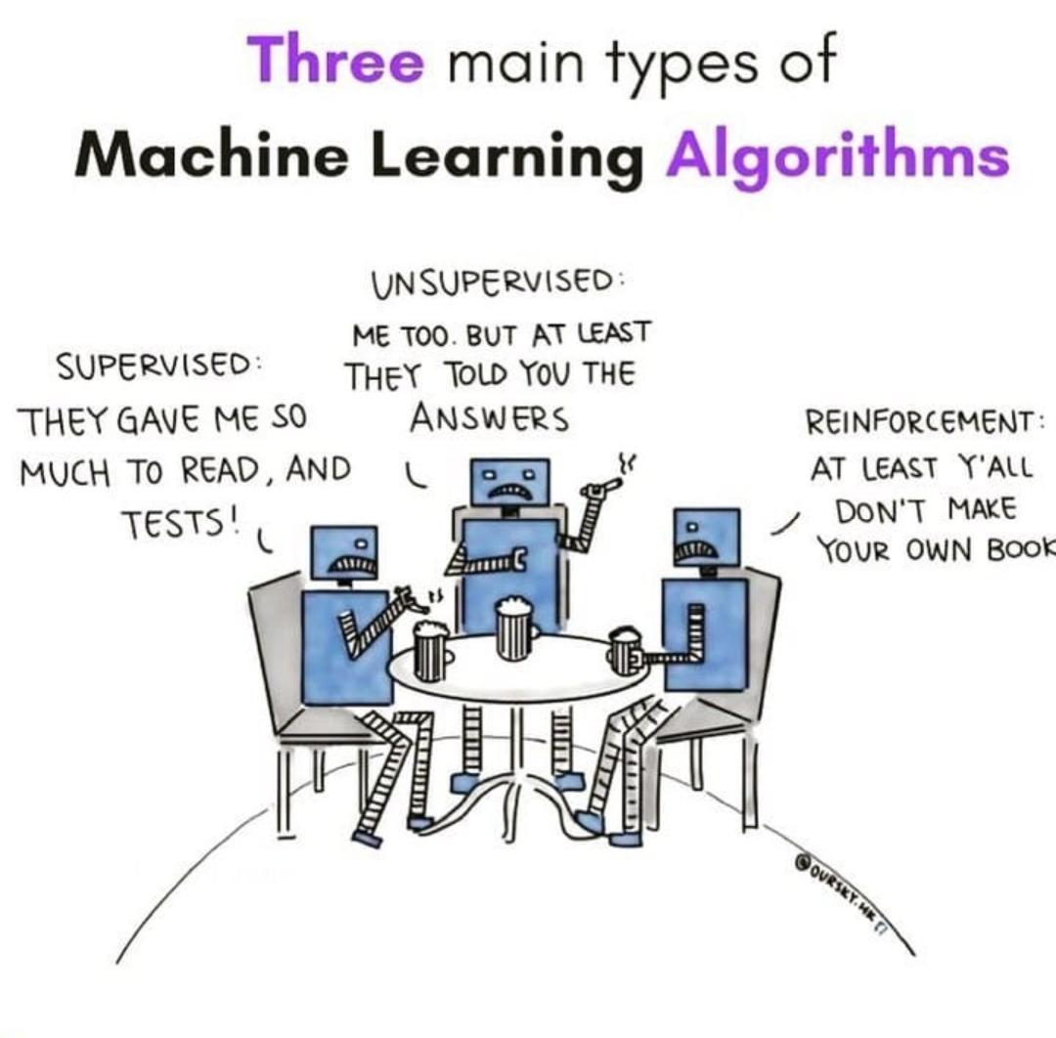
Content
Particle accelerators and Beamlines .
Reinforcement learning.
Our approach.
Real world problem to reinforcement learning problem.
Agent
Results.
Conclusion.
2
Notes:
Reinforcement learning is a type of machine learning where an agent learns to make decisions by taking actions in an environment to achieve a certain goal. The agent receives feedback in the form of rewards or penalties based on its actions, and uses this feedback to adjust its decision-making process over time. Essentially, the agent learns through trial and error, gradually improving its decision-making abilities to maximize its cumulative reward. This process is similar to how humans learn from experience, making reinforcement learning a powerful tool for solving complex problems and optimizing control systems.

Slide 3
Particle Accelerators and Beamlines.
Accelerators:
Beamlines:
Essential components of accelerators.
Transport the accelerated particle beams to experimental stations where valuable data can be collected.
Devices that use electromagnetic fields.
Accelerate charged particles to high speeds and energies.
Used in wide range of scientific and industrial applications.
Physics research.
Materials science.
Medical applications.
…
3
Notes:
Controllable elements are the ones that our agent can control…
The uncontrollable ones are the one that our agent can’t control..

Slide 4
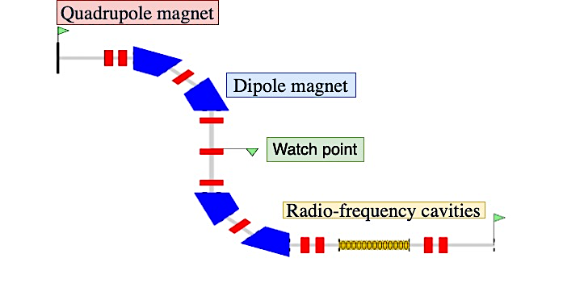
Beamlines
Components of the beamline
Non-controlling components:
Accelerator Elements: Such as radiofrequency (RF) cavities that accelerate particles to high speeds.
Diagnostic Tools: Devices that monitor the beam's properties, such as intensity, position, and energy, to ensure optimal performance.
Controlling components:
Magnetic Elements: Including quadrupole and dipole magnets that focus and steer the particle beam.
4
Notes:
Controllable elements are the ones that our agent can control…
The uncontrollable ones are the one that our agent can’t control..

Slide 5
Why Reinforcement learning.
Reinforcement learning
Games
Control
Chemistry
Robotics
Finance
Business
5
Notes:
Reinforcement learning is a type of machine learning where an agent learns to make decisions by taking actions in an environment to achieve a certain goal. The agent receives feedback in the form of rewards or penalties based on its actions, and uses this feedback to adjust its decision-making process over time. Essentially, the agent learns through trial and error, gradually improving its decision-making abilities to maximize its cumulative reward. This process is similar to how humans learn from experience, making reinforcement learning a powerful tool for solving complex problems and optimizing control systems.

Slide 6
Reinforcement Learning Problem Statement
Agent:
performs actions on the environment.
observes its feedback (states and rewards)
learns how to maximizes a numerical signal (total expected reward) over time.
Environment:
playground where our agent is going to operate.
State: describes the environment at a timestamp.
Actions: how the agent interacts with the environment.
Reward: scalar value.
6
Notes:
agent uses only what it can observe.
fully or partially observable. Chess and Go are examples of games that are considered fully observable.
Autonomous driving is a classic example of a partially observable environment. The vehicle's sensors provide information about the surrounding environment. POKER

Slide 7
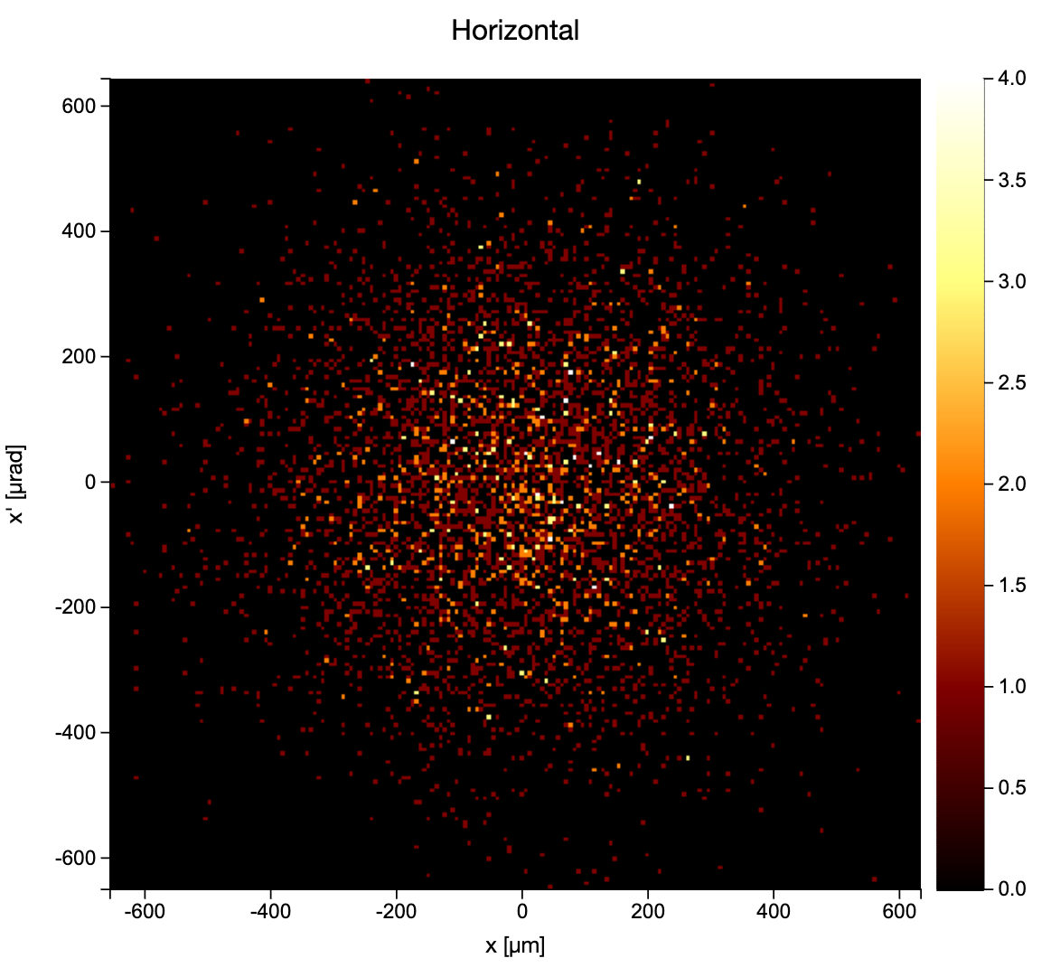
Real world to Reinforcement learning
Environment:
Virtual environment: “Elegant Simulation”
Real world environment: “beamline”
State:
The output of Elegant: “values that describes the particles at different point of the beamline”.
Actions:
Controls we/intelligent agent can change to affect particles in beamline. “Current in the Quadruples magnets”.
Reward:
Next slide…
7
Notes:
agent uses only what it can observe.
fully or partially observable. Chess and Go are examples of games that are considered fully observable.
Autonomous driving is a classic example of a partially observable environment. The vehicle's sensors provide information about the surrounding environment. POKER

Slide 8
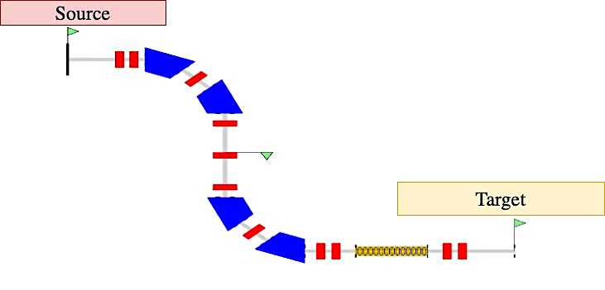
Reward
Feedback that leads the agent to the correct behavior.
Objective: Maximize the number of particles transferred from the source to the target in the beamline.
$rFinal=numOfParticles\left[s_{end}\right]−$ $numOfParticles\left[s_{beg}\right]$
$rCurrent= numOfParticles\left[s_{i}\right]−$ $numOfParticles\left[s_{beg}\right]$
$f\left(s_{i}\right)=\sqrt{{(s_{end})}^{2}−{s_{i}}^{2}}$
$s_{i}$: is the point that we are examining particles at.
$Reward=2∗rFinal+rCurrent+f\left(s_{i}\right)$
$$s_{beg}$$
$$s_{i}$$
$$s_{end}$$
8
Notes:
agent uses only what it can observe.
fully or partially observable. Chess and Go are examples of games that are considered fully observable.
Autonomous driving is a classic example of a partially observable environment. The vehicle's sensors provide information about the surrounding environment. POKER

Slide 9
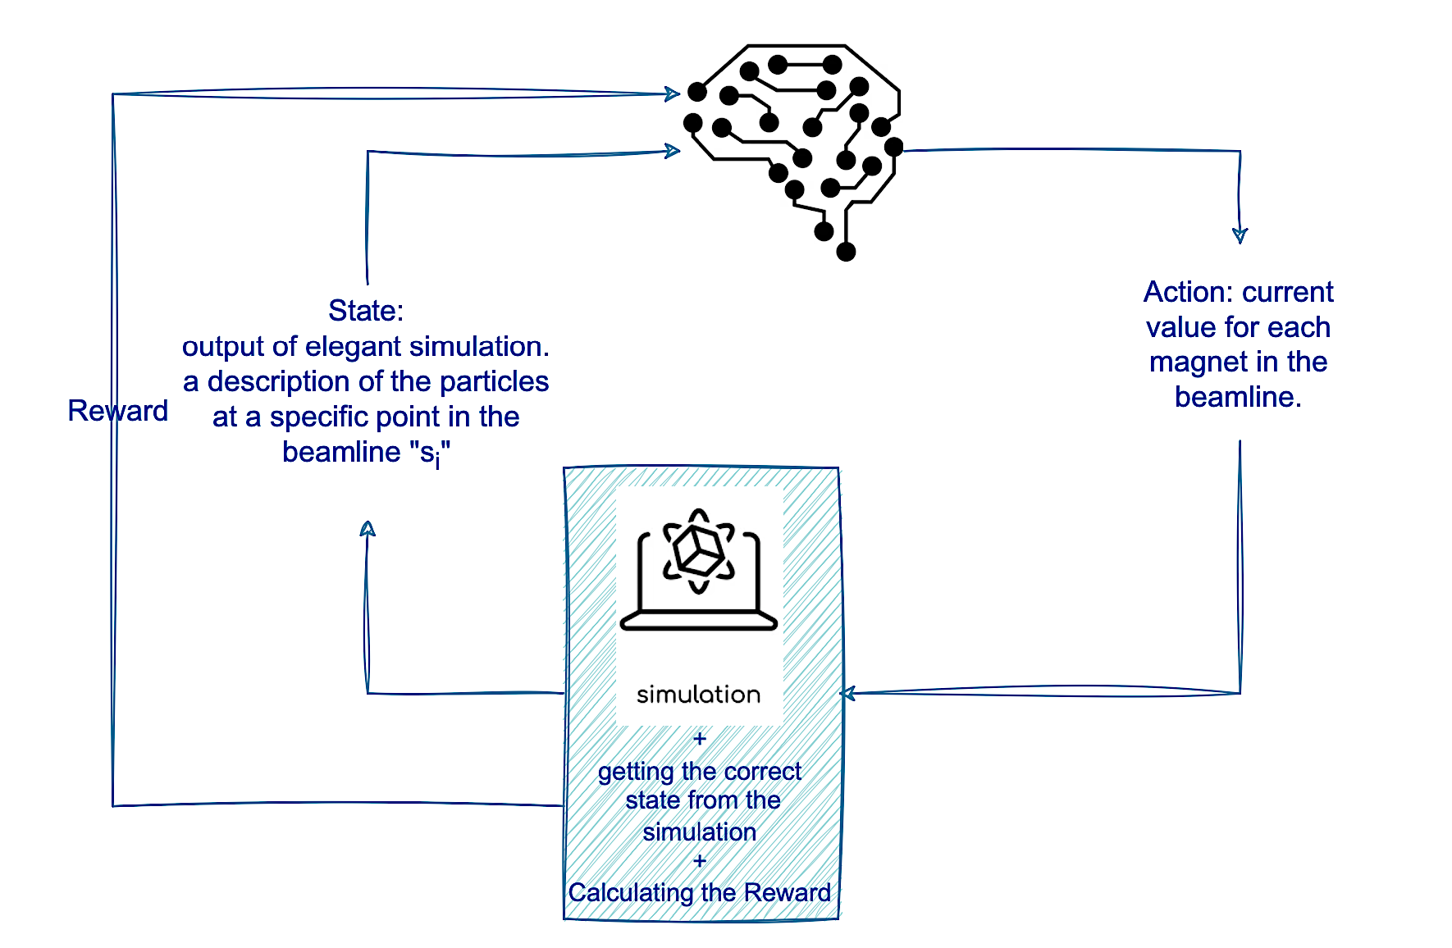
Agent
Decision Making: Learns to make decisions through trial and error.
Feedback Mechanism: Receives rewards for positive actions and penalties for negative actions.
Evaluation and Optimization: Uses rewards to evaluate decisions and optimize beamline control.
Algorithm Options: Various reinforcement learning algorithms can be employed to create the agent, such as SAC, DDPG, and PPO.
9
Notes:
agent uses only what it can observe.
fully or partially observable. Chess and Go are examples of games that are considered fully observable.
Autonomous driving is a classic example of a partially observable environment. The vehicle's sensors provide information about the surrounding environment. POKER

Slide 10
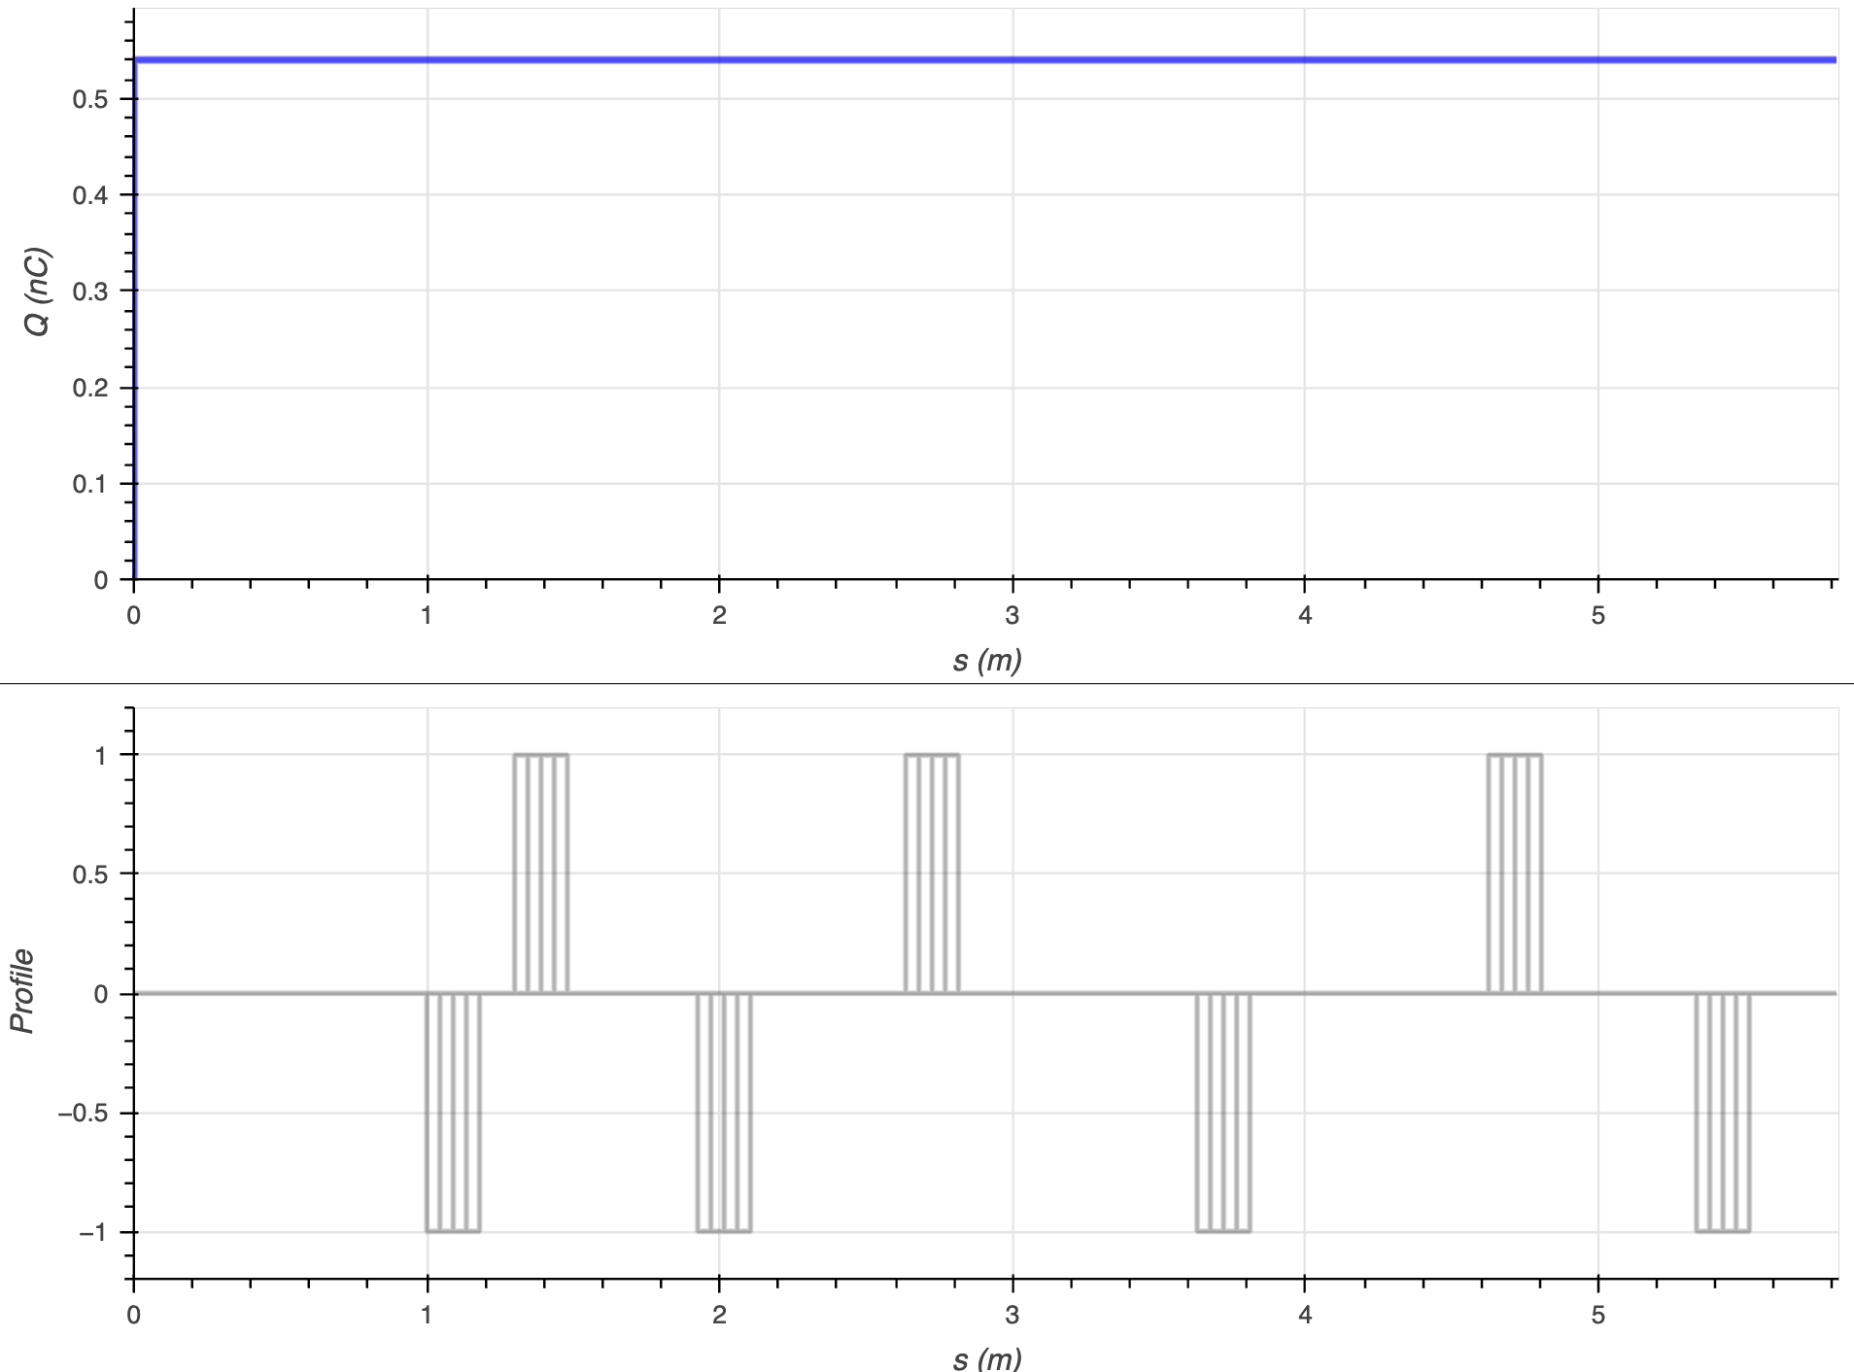
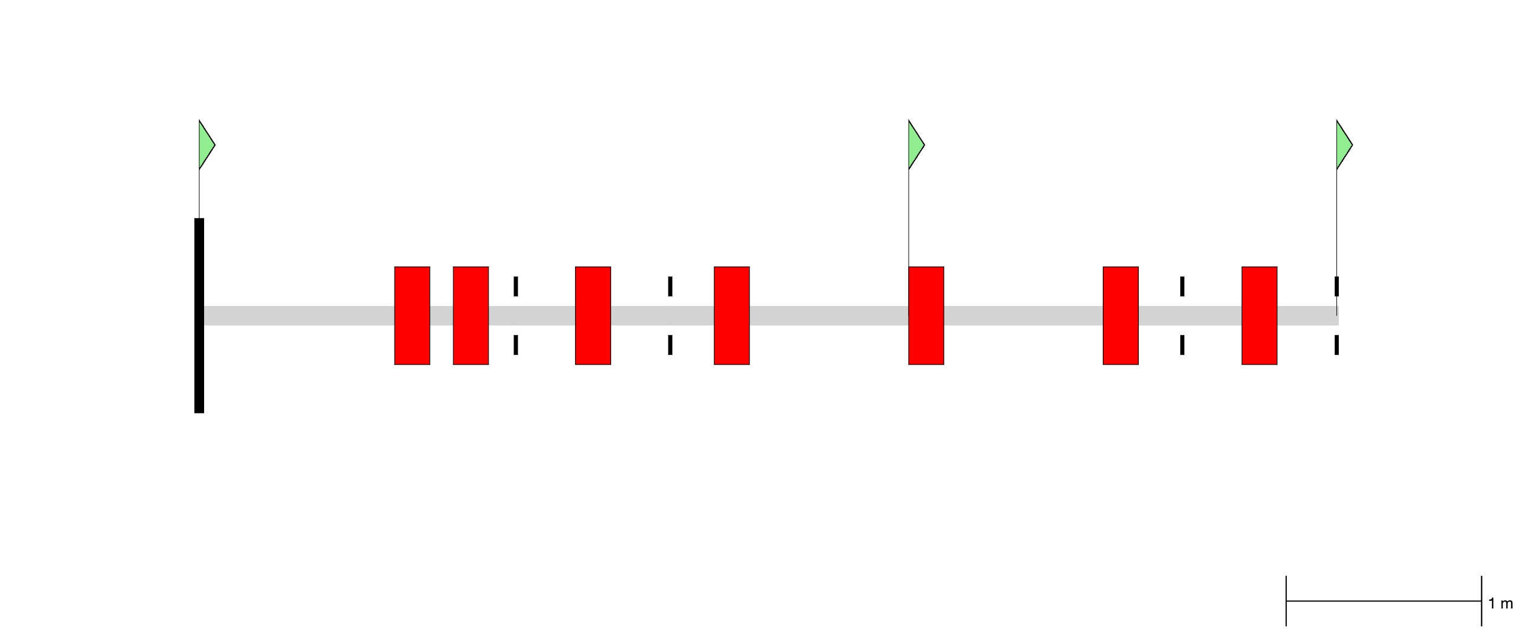
Results
Using a beam line with 7 quadruple magnets.
We used the Reinforcement learning algorithm soft-actor-critic.
we were able to deliver all the particles.
Number remaining particles
Magnets positions and configurations along the beamline (m)
Beam size (mm)
10
Notes:
agent uses only what it can observe.
fully or partially observable. Chess and Go are examples of games that are considered fully observable.
Autonomous driving is a classic example of a partially observable environment. The vehicle's sensors provide information about the surrounding environment. POKER

Slide 11
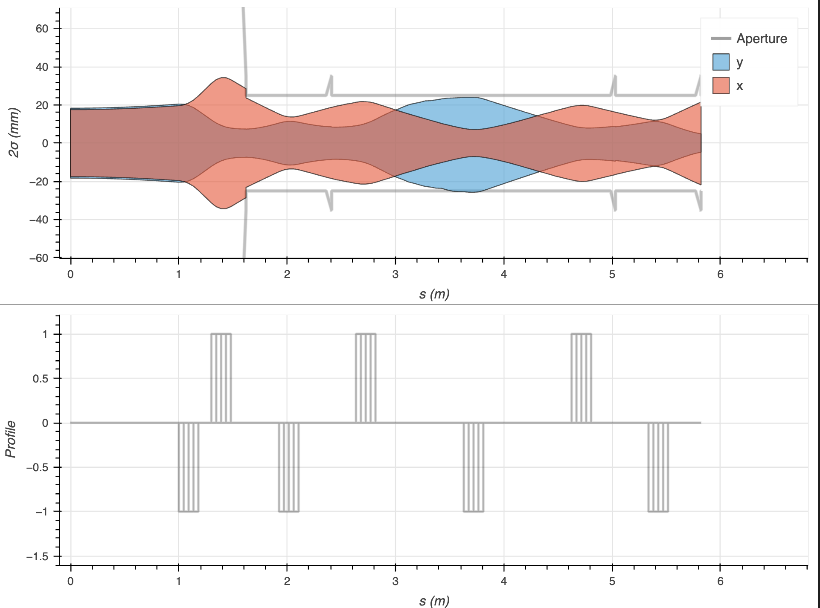
Results
The same beam line structure but with increased emittance by a factor of 16.
Emittance reflects how "tight" or "messy" the beam is.
We lost only 32.4% out of the beam
Beam size (mm)
Magnets positions and configurations along the beamline (m)
Number remaining particles
11
Notes:
What is Emittance?
Emittance measures how spread out the particles in a beam are in both their position and movement direction.
It reflects how "tight" or "messy" the beam is.
Low Emittance vs. High Emittance
Low Emittance: Particles are tightly packed and move almost parallel, creating a focused and controlled beam.
High Emittance: Particles are more spread out, moving in different directions, making the beam wider and harder to control.
Why Does Emittance Matter?
Beam Size: Higher emittance means a larger, more spread-out beam.
Focus & Control: Beams with higher emittance are harder to focus on a target.
Efficiency: Low emittance beams are more efficient for precision tasks like particle collisions or medical applications.
Key Takeaway: Lower emittance = better beam focus and control.

Slide 12
Conclusion
Developing a system that optimizes beam optics with multiple benefits:
For physicists, acts as a co-pilot, offering intelligent suggestions for potential solutions to improve beamline performance.
For reinforcement learning (RL) researchers, provides an easy-to-use setup to train various agents in optimizing different beamline architectures.
We have demonstrated that this system can deliver useful and innovative solutions, for improved accelerator control and efficiency.
12
Notes:
agent uses only what it can observe.
fully or partially observable. Chess and Go are examples of games that are considered fully observable.
Autonomous driving is a classic example of a partially observable environment. The vehicle's sensors provide information about the surrounding environment. POKER

Slide 13
Thank you
13
Notes:
agent uses only what it can observe.
fully or partially observable. Chess and Go are examples of games that are considered fully observable.
Autonomous driving is a classic example of a partially observable environment. The vehicle's sensors provide information about the surrounding environment. POKER

Slide 14
Results
Top: The charge of the remaining particles along the beamline (measured in nanocoulombs) is equivalent to the number of remaining particles.
Bottom: the magnets positions along the beamline.
Top: The beam size along the beamline.. We lost only 32.4% out of the beam
Bottom: the magnets positions along the beamline.
14
Notes:
agent uses only what it can observe.
fully or partially observable. Chess and Go are examples of games that are considered fully observable.
Autonomous driving is a classic example of a partially observable environment. The vehicle's sensors provide information about the surrounding environment. POKER

Slide 15
Results
magnets positions and configurations along the beamline
Top: The charge of the remaining particles along the beamline (measured in nanocoulombs) is equivalent to the number of remaining particles.
Bottom: the magnets positions along the beamline.
Top: The beam size along the beamline.
Bottom: the magnets positions along the beamline.
15
Notes:
agent uses only what it can observe.
fully or partially observable. Chess and Go are examples of games that are considered fully observable.
Autonomous driving is a classic example of a partially observable environment. The vehicle's sensors provide information about the surrounding environment. POKER

Slide 16
Conclusion
We are developing a system that optimizes beam optics; this system will do:
For physicists, acts as a co-pilot, providing suggestions for potential solutions.
For RL researchers, we would develop an easy-to-use setup for training various agents to optimize different beamline architectures.
We demonstrated that such system provides useful and interesting solutions.
16
Notes:
agent uses only what it can observe.
fully or partially observable. Chess and Go are examples of games that are considered fully observable.
Autonomous driving is a classic example of a partially observable environment. The vehicle's sensors provide information about the surrounding environment. POKER

Slide 17
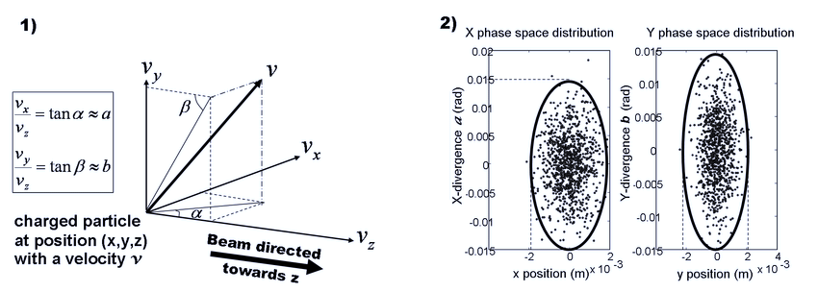
Results
The same beam line structure but with increased emittance by a factor of 16.
Emittance reflects how "tight" or "messy" the beam is.
Which means:
Beam Size: Higher emittance means a larger, more spread-out beam.
Focus & Control: Beams with higher emittance are harder to focus on a target.
Efficiency: Low emittance beams are more efficient for precision tasks like particle collisions or medical applications.
17
Notes:
What is Emittance?
Emittance measures how spread out the particles in a beam are in both their position and movement direction.
It reflects how "tight" or "messy" the beam is.
Low Emittance vs. High Emittance
Low Emittance: Particles are tightly packed and move almost parallel, creating a focused and controlled beam.
High Emittance: Particles are more spread out, moving in different directions, making the beam wider and harder to control.
Why Does Emittance Matter?
Beam Size: Higher emittance means a larger, more spread-out beam.
Focus & Control: Beams with higher emittance are harder to focus on a target.
Efficiency: Low emittance beams are more efficient for precision tasks like particle collisions or medical applications.
Key Takeaway: Lower emittance = better beam focus and control.

Slide 18
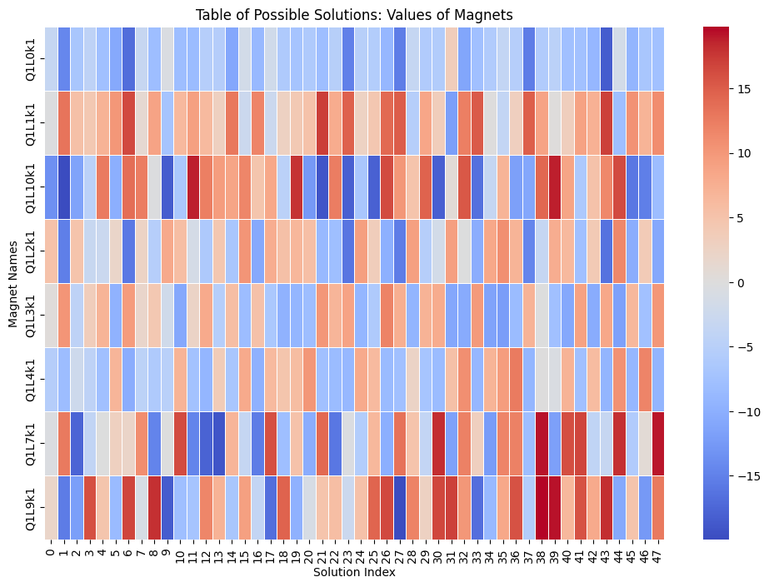
Results
Using RL allowed us to find different solutions.
“Positive values => focusing magnets. Negative values =>defocusing magnets.”
18
Notes:
agent uses only what it can observe.
fully or partially observable. Chess and Go are examples of games that are considered fully observable.
Autonomous driving is a classic example of a partially observable environment. The vehicle's sensors provide information about the surrounding environment. POKER

