Slide 1
Track Reconstruction Transformer (TRT): A Scalable Deep Learning Approach for Particle Tracking in High-Energy Physics
Never-ending journey of model design
Nikolskaia A., Rusov D., Goncharov P., Ososkov G., Zhemchugov A.
MMCP 2024, 24 October 2024

Slide 2
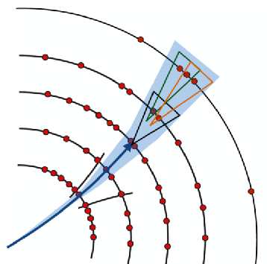
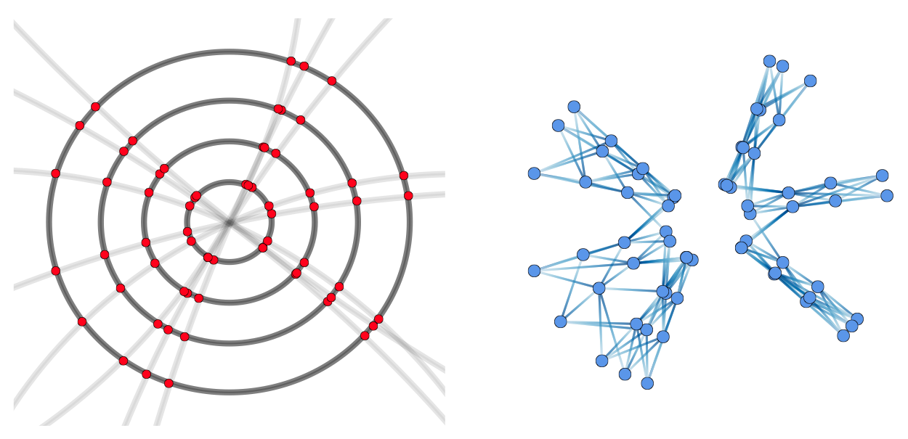
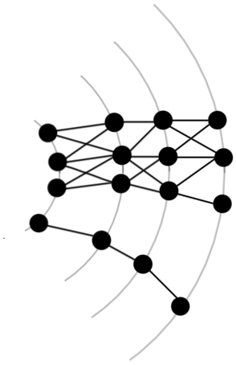
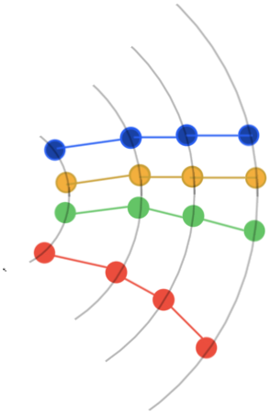
Track reconstruction methods
Local Tracking
Works with event fragments (hits, track segments, detector parts).
Examples: Kalman Filter, Cellular Automaton.
Pros: Highly parallel, fast, and memory-efficient.
Cons: Needs post-processing for full event reconstruction; prone to false positives.
Global Tracking
Uses full event data for track reconstruction.
Examples: Graph Neural Networks, Hopfield Networks, Point Cloud Processing.
Pros: Higher accuracy, fewer false positives, supports event-level parallelism.
Cons: High memory demands.
CNNs on FPGAs for Track Reconstruction
Hybrid Tracking
Combines local and global methods.
Stages: Track seeding, candidate ranking, graph building.
Goal: Maximize recall while minimizing false positives.
Pros: Balances performance and efficiency.
Cons: Errors depend on multiple models
Graph Neural Networks in Particle Physics
Clustering hits into track segments
Event graph construction
Graph Sparsification

Slide 3
Event as an point cloud
Graph-based event representation is not compact; segments increase rapidly with pile-up. Even hybrid methods are limited with memory bound.
Point-cloud representation offers better scalability, allowing models to learn signal relations (e.g., attention).
Point-clouds enable unsupervised pretraining on experimental data (e.g., predicting hits in selected areas like masked language modelling).
Such representation allows to use powerful encoding techniques such as PointNet, event digitalization using voxelization, etc.
Voxel-based partitioning of event helps to unravel hits even for big time slices (details are provided in appendix).
Example: Point Cloud Transformers (PCT) have been successfully applied for signal segmentation.
This modeld achieved precision of 90% and recall of 93% or more for pileups of events.
PCT model

Slide 4
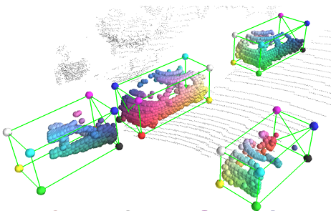
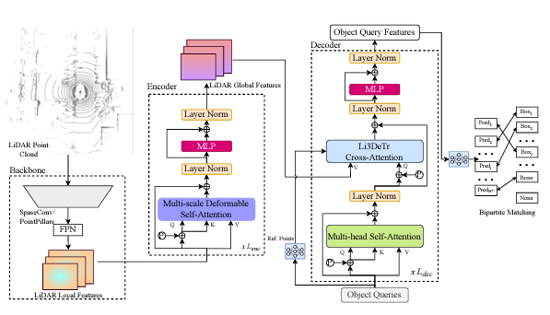
Transformers for event representation
Transformer-based models use the whole input to encode local and global dependencies and have proven the ability to model complex changing patterns.
Using bare hit coordinates causes information loss; it's better to work with raw data (e.g. fakes after signal digitalization in microstrip detectors). Transformer models are data-agnostic, allowing direct use of raw detector data.
Transformers are actively developing in the field of detection of 3D point clouds. However, these tasks use both data and targets that are positional in nature.
Adoption of detection has serious limitations: the track can’t be represented with bounding box, it’s more important to select track positions or particle parameters themselves.
Detection architecture example*
* Li3DeTr: A LiDAR based 3D Detection Transformer

Slide 5
DETR
Detr model was proposed for image detection task and was recently tried* in 3D point clouds detection.
The main idea is to use small set of “queries” as an additional input of decoder and to generate candidate bounding boxes based on that queries.
Such design helps to generate all candidates simultaneously in the end-to-end manner.
Each candidate object (bounding box) gets the estimate of “objectness” – the probability that it contains the object. These estimates are trained simultaneously with bounding box predictions
To train such model, bipartile matching loss was proposed.
Nicolas Carion, Francisco Massa, et al. End-to-End Object Detection with Transformers
Vanilla DETR uses a CNN backbone to learn a representation of an input. The model flattens it and supplements it with a positional encoding before passing it into a transformer encoder. A transformer decoder then takes as input a small fixed number of learned queries, and additionally attends to the encoder output.
3D point cloud DETR also follows this scheme, but using appropriate feature encoders. However, point cloud tasks are more complicated, and this field is evolving now.
SEED: A Simple and Effective 3D DETR in Point Clouds

Slide 6
DETR Bipartile matching loss
Let y be the ground truth (GT) set of objects, $\hat{y}$ - set of N predictions made by the model. N >= number of GT objects.
The first step is to find a matching between the ground truth objects and the model’s predictions. Optimal matching is defined as:
There $L_{match}(y_{i}, \hat{y_{j}})$ is some loss measure between i-th ground-truth and j-th predicted objects (weighted sum of distance, IoU and cross-entropy loss in case of detection).
After we matched the predictions and GT, we apply Hungarian loss for matched pairs:
Note that all unmatched predictions are matched with virtual “no object” GTs. Thus, additional no-object class is used.
Nicolas Carion, Francisco Massa, et al. End-to-End Object Detection with Transformers

Slide 7
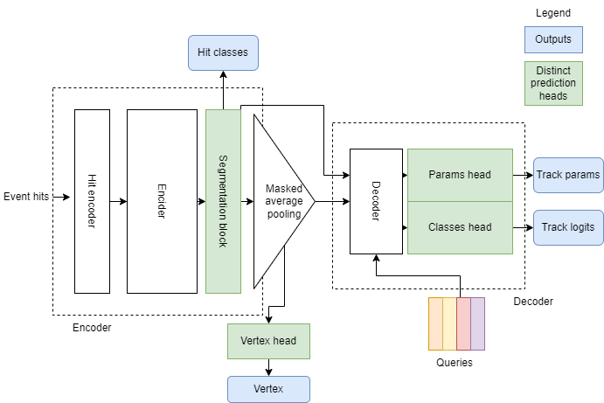
Tracking model design details
Particle parameters prediction may allow to reconstruct tracks with missing hits, secondary particles and even low-momentum tracks if needed, etc. This also helps to remove stage of track building during inference.
We don’t predict bounding boxes, hence, the architecture was redesigned to meet current targets.
Encoder is based on the PCT and is the update of it for more complex tasks
The model has three outputs: classification mask of individual hits, predicted vertex position, set of candidate track parameters + corresponding probabilities.
The final loss uses weighted sum of vertex loss, hit-classification cross-entropy, track params hungarian loss and queries crossentropy.

Slide 8
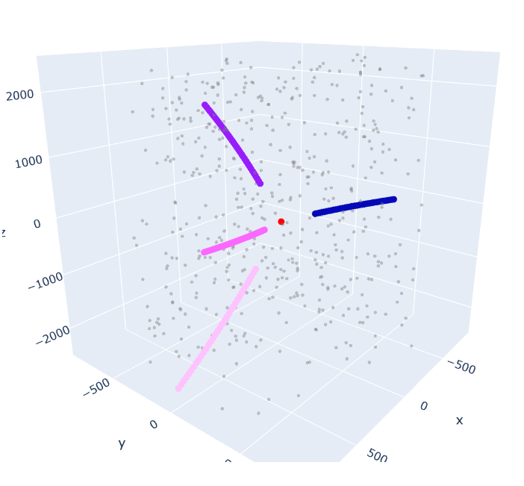
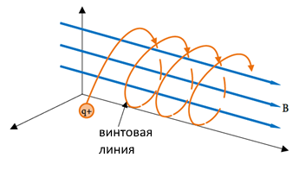
Simulated Toy Data
Python script generates events with 1-5 random tracks.
Transverse momentum: 100-1000 MeV/c (uniform).
Random vertex coordinates within the collision area.
Trajectories follow a helical path, defined by the pitch and radius equations.
Simulated detector with 35 stations.
Fake and noise hits simulated using randomly sampled points in detector space.
Statistics
Around 4 tracks per event.
Mean number of hits: 380
~64% of hits are fake.
Helix
Notes:
A custom Python script is used to generate toy data for track reconstruction.
Each event contains a random number of particle tracks, ranging from 1 to 10.
The transverse momentum of each particle is randomly sampled from a uniform distribution between 100 and 1000 MeV/c.
Vertex coordinates are randomly positioned within the volume representing the collision area.
Particle trajectories are modeled as segments of a helical path, with the pitch and radius defined by ℎ= 2𝜋/𝐵|𝑚/𝑞|𝑣𝑐𝑜𝑠𝛼 and radius 𝑅=1/𝐵|𝑚/𝑞|𝑣𝑠𝑖𝑛𝛼 .
A detector setup with 35 stations is simulated.
Detector inefficiency is incorporated by assigning each hit a probability of being missed, with detector efficiencies set at 99% and 98%.

Slide 9
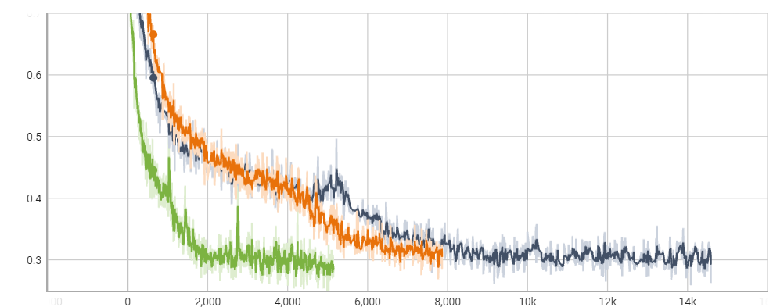
Training and inference setup
Training:
64k training,
10k validation events
Events batched with padding, truncated to 1024 hits
Inference: Processed event-by-event
Metrics: vertex distance, parameter error, hit segmentation
Track Filtering:
Applied probability threshold. Candidates below this value were removed.
Note: this component is highly unstable and should be tuned further
Train process example
Schematic formula of the used loss function:
$Loss=w_{seg}∗HitCrossEntropy+w_{vert}∗VertexMAE+w_{para}∗ParaMAE+w_{class}∗QueryFocalLoss$

Slide 10
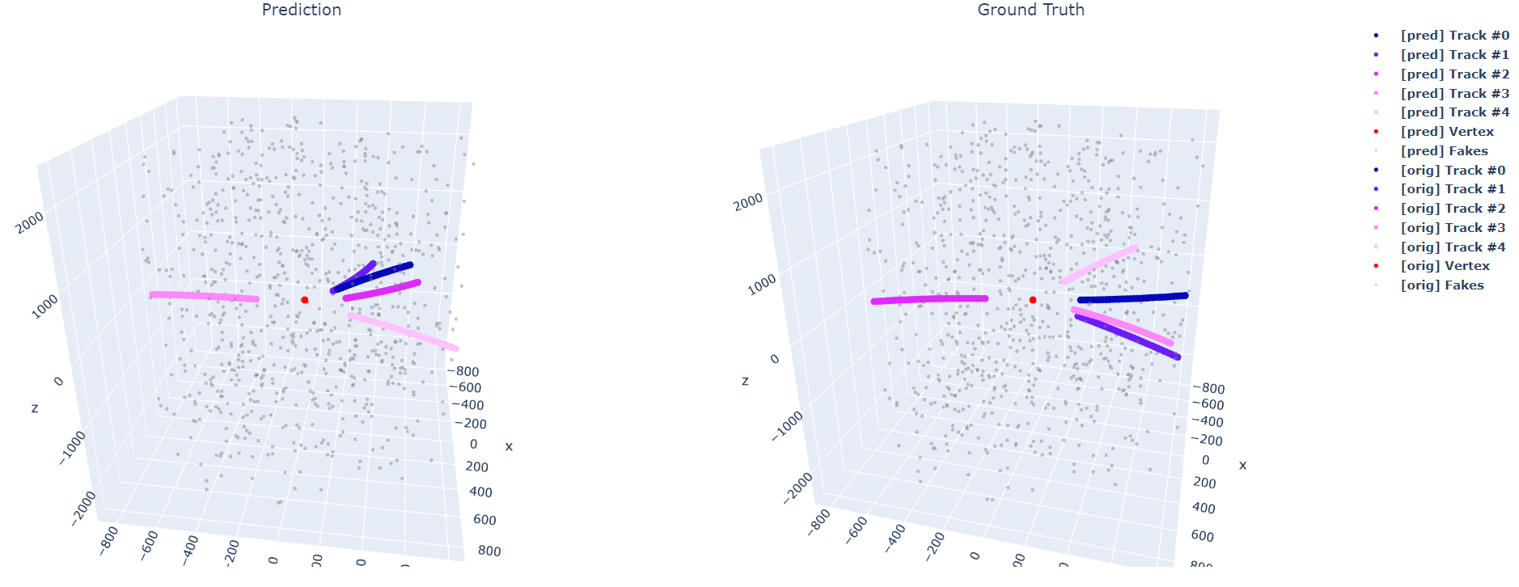
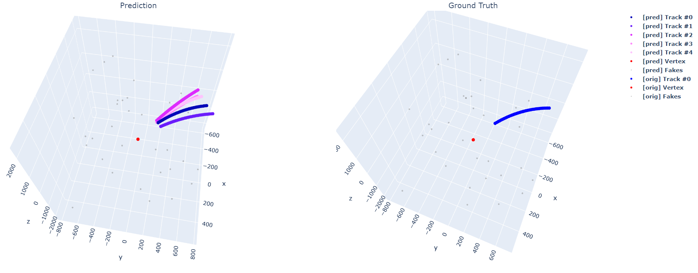
Test results
Mean vertex distance (L1) : 54
Hit segmentation precision: 0.99
Hit segmentation recall: 0.92
10

Slide 11
Test results (2)

Slide 12
Discussion and limitations
The training is very unstable. Proper pretraining procedure should be designed. This limitation comes from DETR architecture, which main problem is slow convergence.
The resulting reconstructed tracks highly depend on accurate vertex position prediction. For now, only one vertex is used, but in more realistic scenarios multiple vertices may be produced
Prediction of raw angles faces 2pi problem, also the parametrization seems to be suboptimal because of different parameter ranges and high dependence on all of them.
The higher number of queries slows down the convergence, and more sophisticated queries should be used
To get accurate metrics, we should map parameters to hits, and this is still questionable because of hit loss in ground-truth tracks and possible different lengths both of predicted and real tracks.
It’s possible to combine model with common point cloud encoders: PointNet, VoxelNet, move to dynamic query selection or other kinds of attention layers. E.g, we want to overcome quadratic complexity of attention.

Slide 13
Conclusion
The task was highly ambitious: to develop an end-to-end tracking method, a single model that could replace all phases of the hybrid approach.
Tracking is a very complex problem, both in terms of combinatorics and how to train the model.
A number of hypotheses were tested on what an end-to-end tracking model might look like.
The results, combined with the successfully solved hit segmentation task, demonstrate that the chosen direction is correct and there is great potential for improvement.
The model is rapidly evolving. For example, unsupervised training of query bases or adopting of voxelization shoud be tested to get final results. Also, the segmentation head may be changed to instance segmentation.

Slide 14
Track Reconstruction Transformer (TRT): A Scalable Deep Learning Approach for Particle Tracking in High-Energy Physics
Never-ending journey of model design
Nikolskaia A., Rusov D., Goncharov P., Ososkov G., Zhemchugov A.
MMCP 2024, 24 October 2024

Slide 15
Appendix

Slide 16
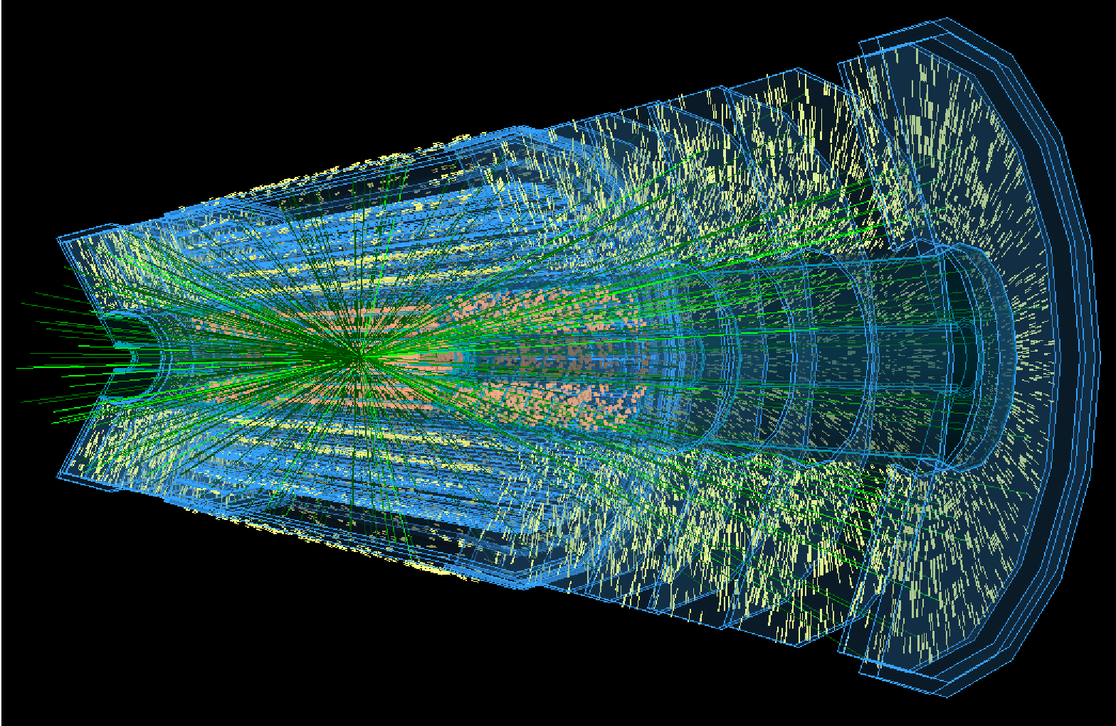
Problem Statement: The Need for Advanced Tracking Methods
Unprecedent scale of modern experiments:
Up to 200 simultaneous proton-proton interactions is expected at High Luminosity Large Hadron Collider
200 particle tracks on average, 40K of tracks considering pile-up
Traditional tracking methods struggle with dense, overlapping particle tracks due to computational complexity and time constraints
Deep Learning for Efficient Track Reconstruction:
DL models can handle high-dimensional data and complex spatial correlations between tracks
Coulomb scattering and inhomogeneous magnetic field effects could be learned from training data
Effective parallelization using GPUs out of the box
TrackML Challenge was launched to explore new scalable approaches for particles tracking
https://webific.ific.uv.es/web/en/content/taking-lhc-higher-luminosity
To cope with immense data volumes a new high-throughput deep-learning based approach for tracking is needed
Notes:
Particle track reconstruction in dense environments such as the Run 4 of CERN High Luminosity Large Hadron Collider (HL-LHC) is a challenging pattern recognition problem.
Expected that High Luminosity Large Hadron Collider (HL-LHC) will allow for up to 200 simultaneous proton-proton interactions (pile-up events) during each bunch crossing, compared to around 40 in the current LHC operations.
Each collision event is anticipated to produce approximately 200 particle tracks on average, 40K of tracks considering pile-up. This leads to even greater complexity in track reconstruction.
Challenges:
Traditional methods like Kalman filter struggle with dense, overlapping particle tracks due to computational complexity and time constraints
Harnessing Deep Learning for Efficient Track Reconstruction:
Deep learning models can handle high-dimensional data and complex spatial correlations between tracks, offering a scalable solution that could be easily parallelized on high-throughput architectures such as GPUs
Multiple scattering and inhomogeneous magnetic field effects could be learned from a massive training data sample
The TrackML Challenge was launched to explore deep learning solutions for fast track reconstruction in high-luminosity environments

Slide 17
PCT pipeline
Input: Raw event
Output: Cleaned event
Combine into one event
Divide the detector space into M voxels, i.e. smaller subspaces
Take hits from each voxel and form a batch of M x N x F samples pretending that each sample is a mini-event
PCT model
M samples
Classify hits on true and fakes
N hits
F features

Slide 18
Experiments using event partition
Events per time slice | Number of voxels | Precision | Recall | Event segmentation time (sec)
1 | 16 | 0.96 | 0.98 | 0.06
1 | 32 | 0.97 | 0.97 | 0.7
1 | 64 | 0.96 | 0.99 | 0.07
2 | 64 | 0.97 | 0.95 | 0.17 (0.34)
5 | 64 | 0.93 | 0.97 | 0.27 (1.37)
10 | 64 | 0.90 | 0.97 | 0.59 (5.96)

Slide 19
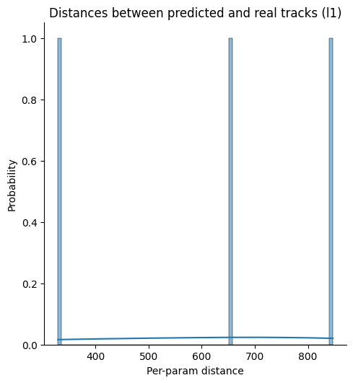
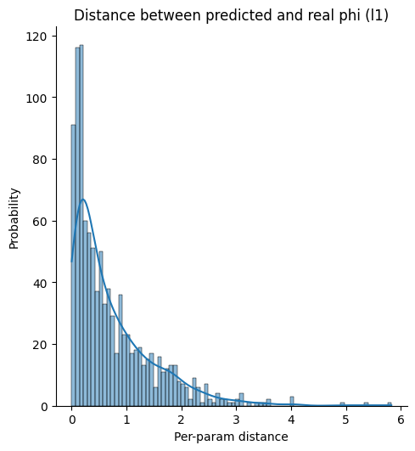
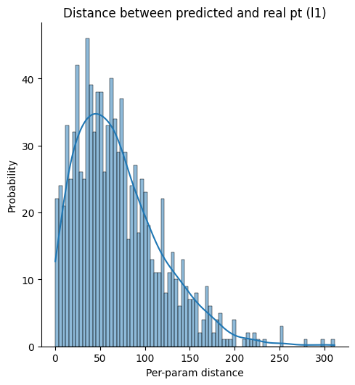
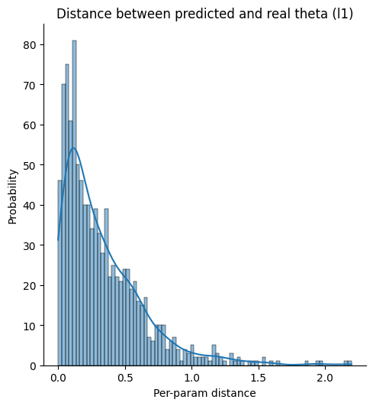
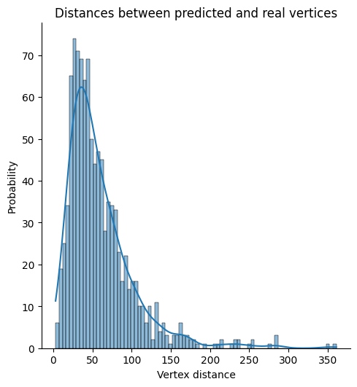
Parameter errors histograms

