Slide 1
Cold mass design and manufacturing status
H. Khodzhibagiyan
MSC-230 Design Review Video Meeting, Dubna, March 14, 2024

Slide 2
Cold mass composition
- Helium refrigerator including transfer line from refrigerator to the coil
- Model coil with a cryostat
- Main coil with own cryostat and HTS current leads
MSC-230 Design Review Video Meeting, Dubna, March 14, 2024

Slide 3
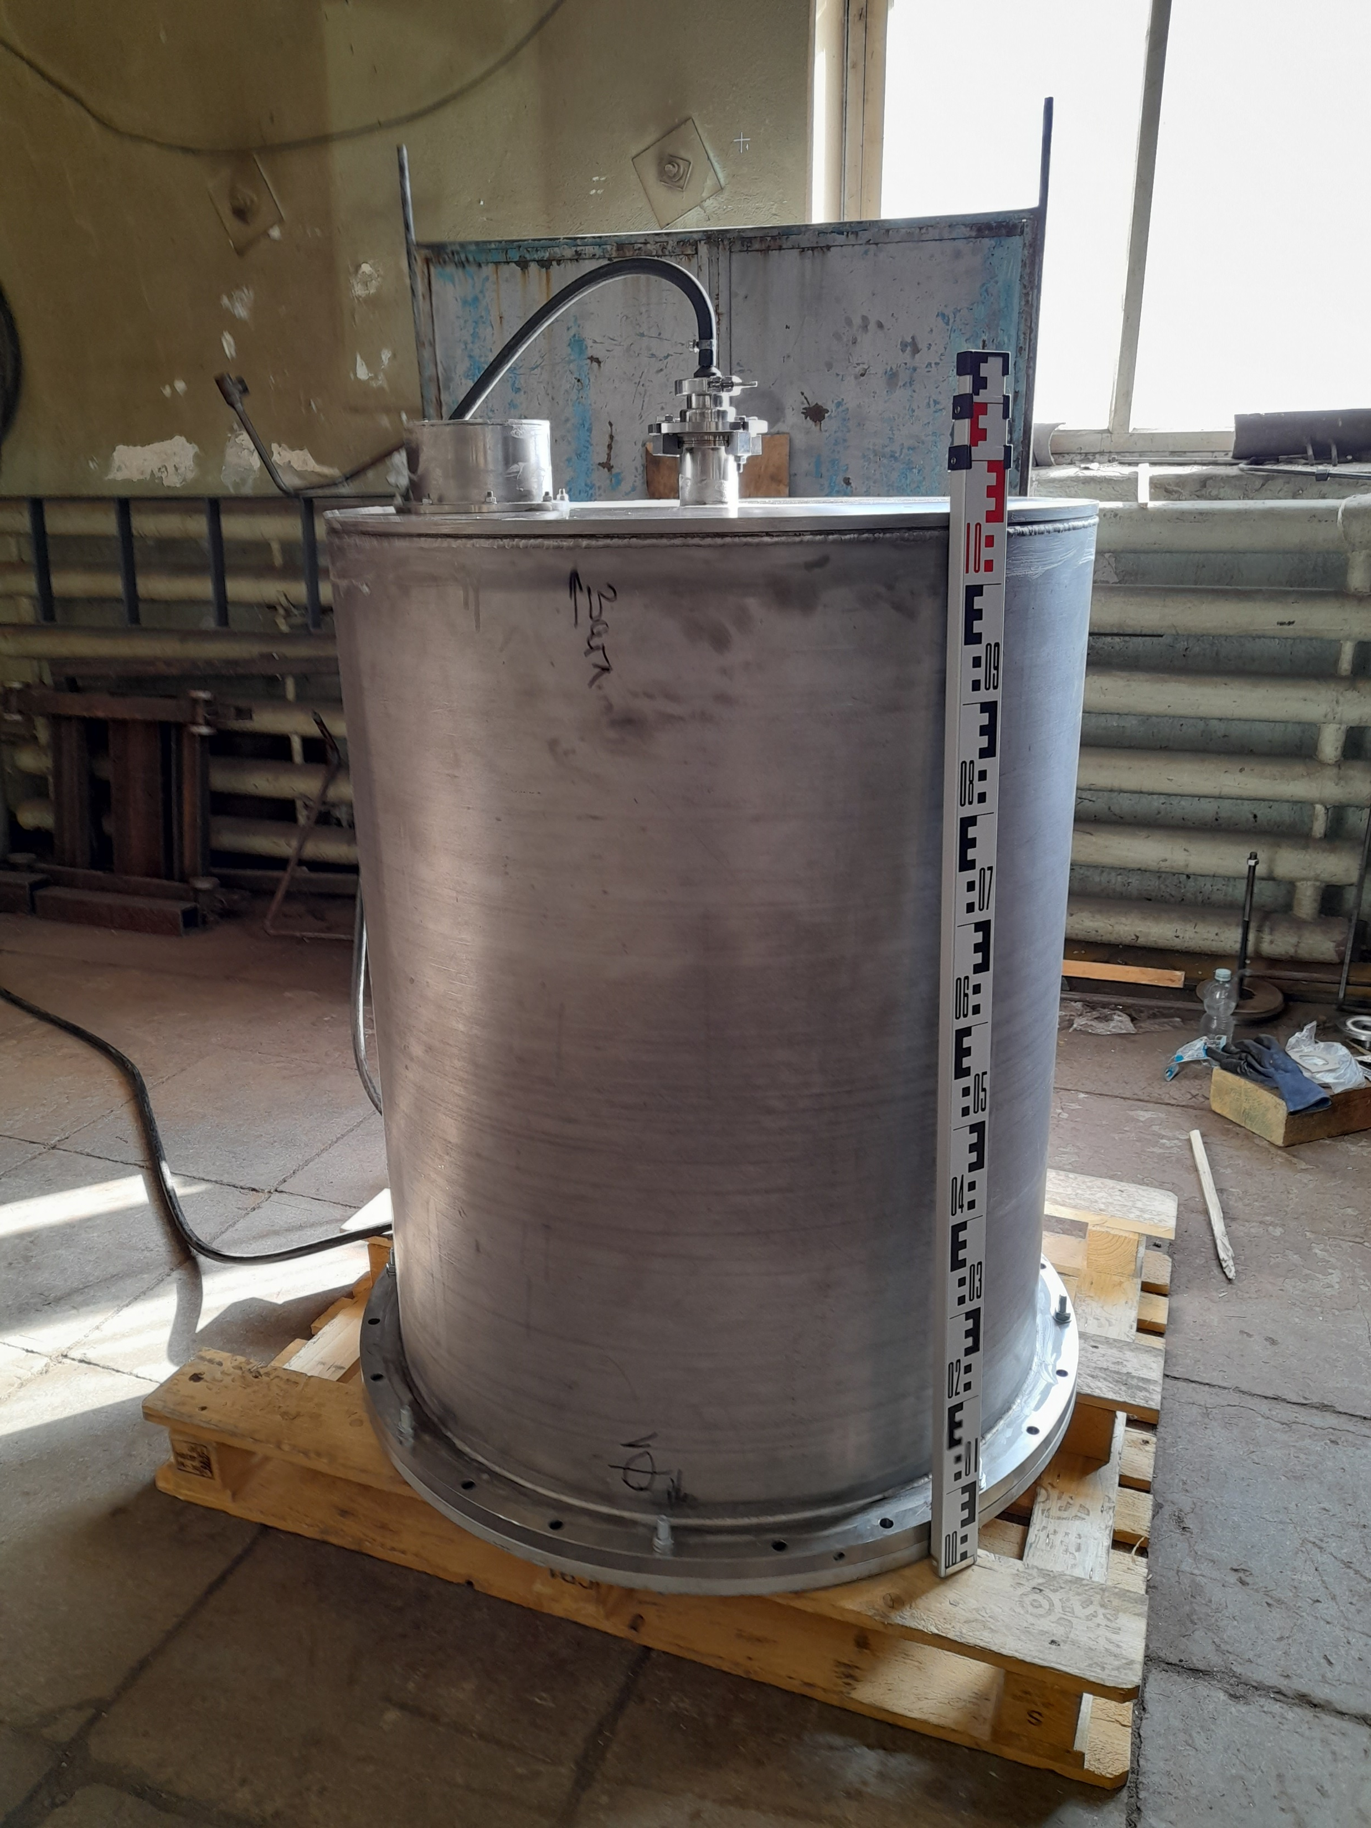
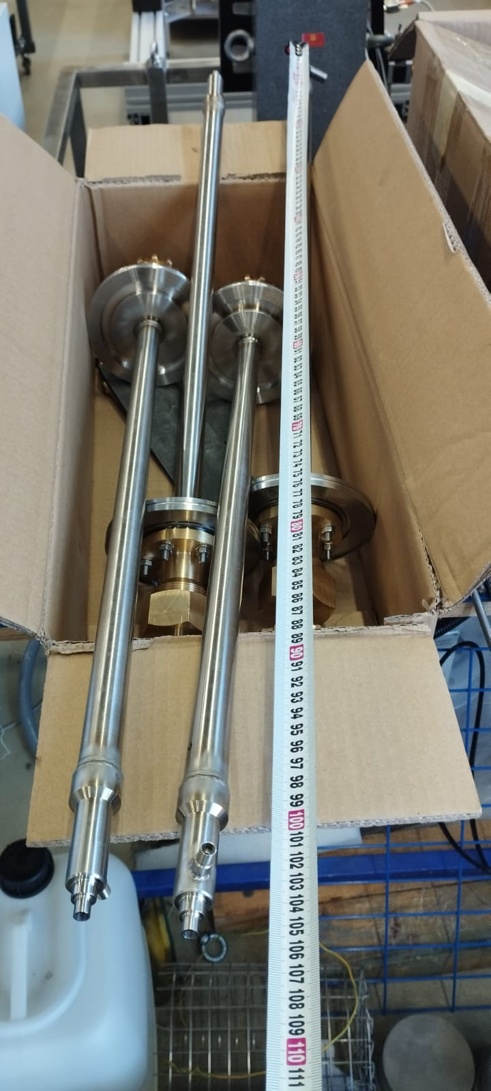
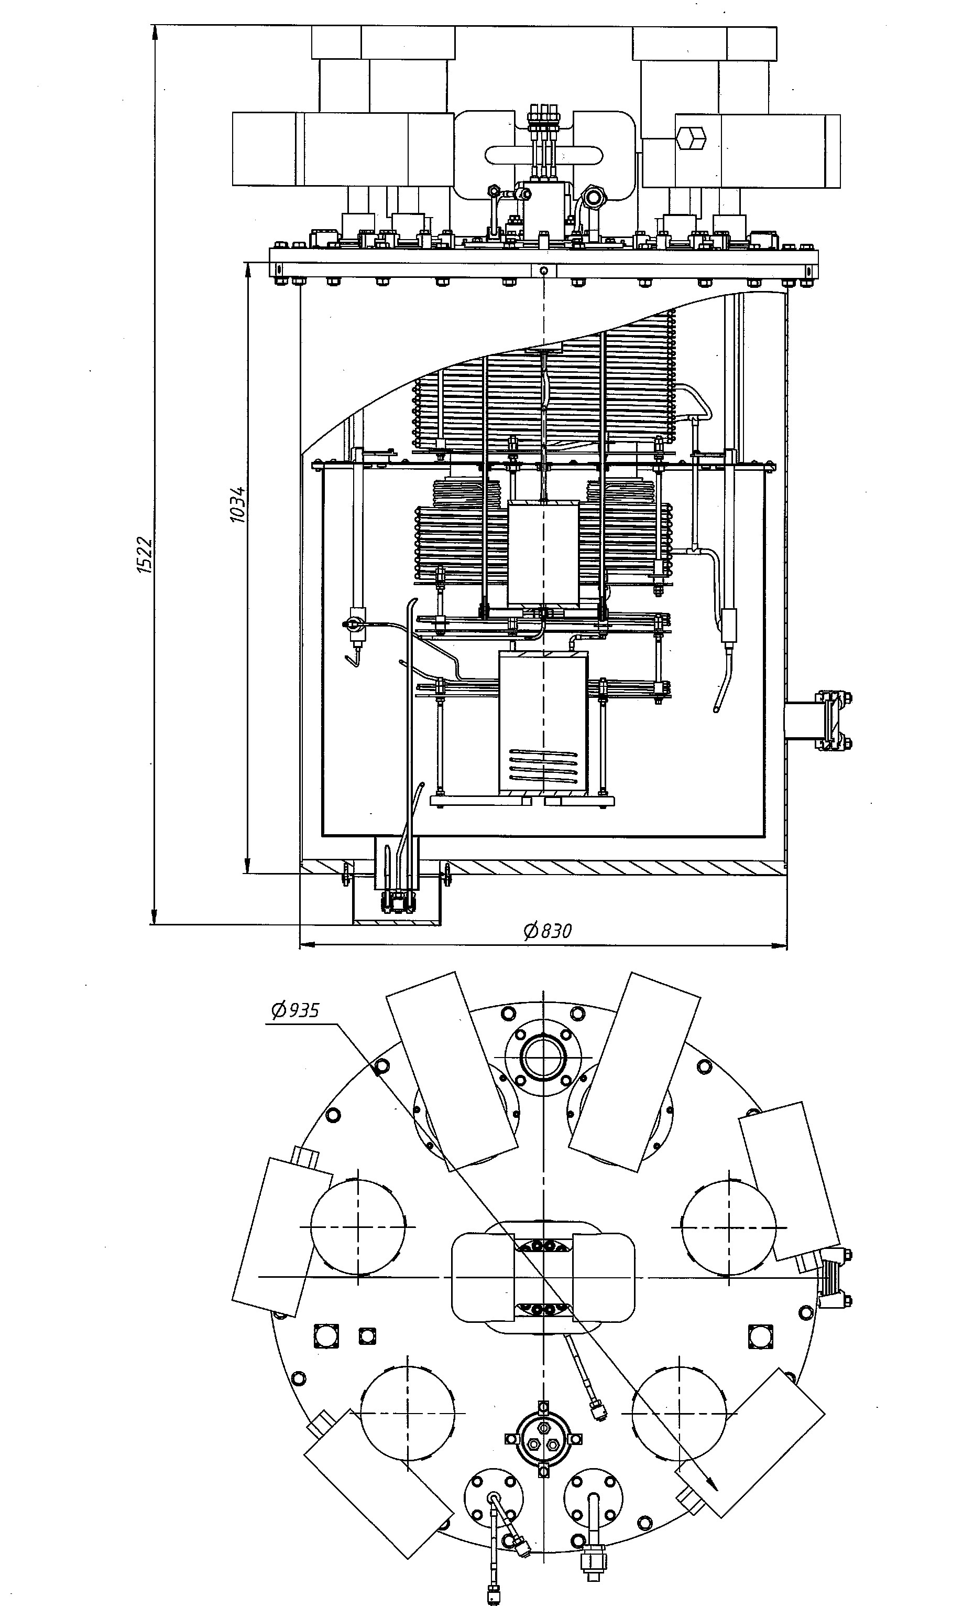
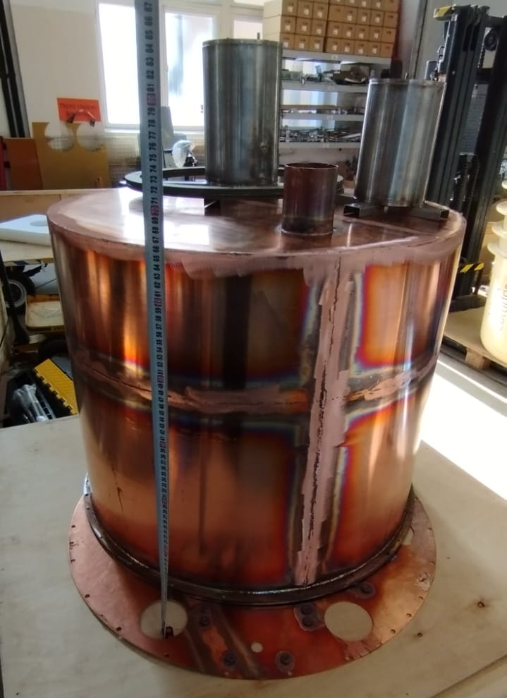
Helium refrigerator
Development has been completed, manufacturing and assembly is underway, launch and measurement of cooling capacity is planned in the 2nd quarter 2024.
MSC-230 Design Review Video Meeting, Dubna, March 14, 2024

Slide 4
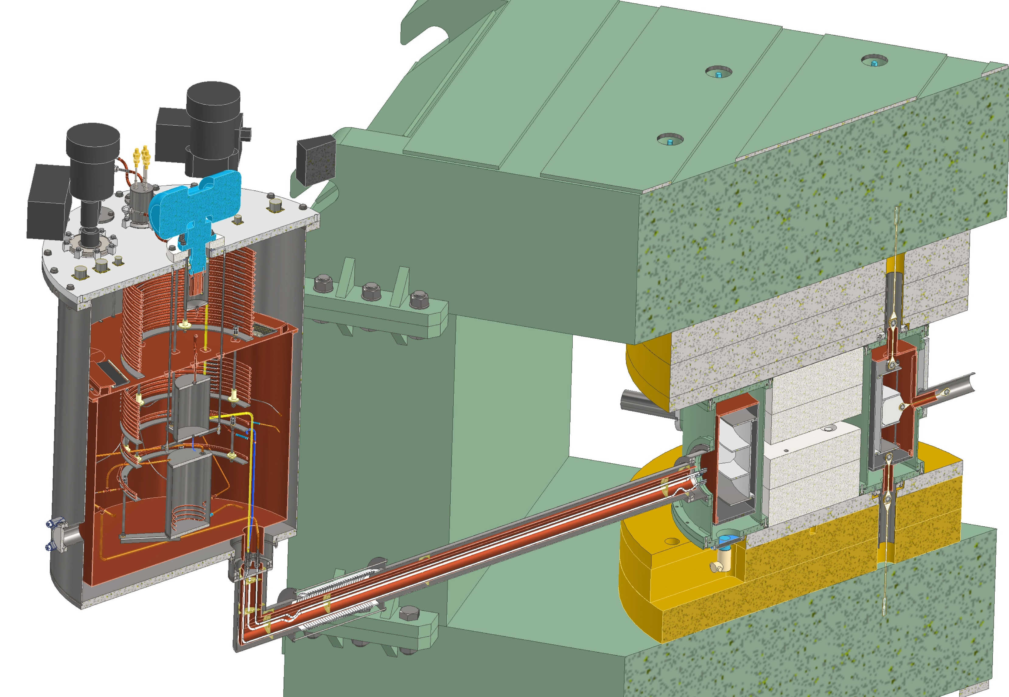
Model coil with a cryostat
Due to the design features of the cable and the presence of shunt-heaters, a high rate of propagation of the normal zone during quench should be achieved. The model coil is designed to check new technological solutions, namely: sectioning the coil, using shunt - heaters and profiled copper inserts.
Completion of cryogenic test bench for model coil and refrigerator is planned for 2 quarter 2024.
MSC-230 Design Review Video Meeting, Dubna, March 14, 2024

Slide 5
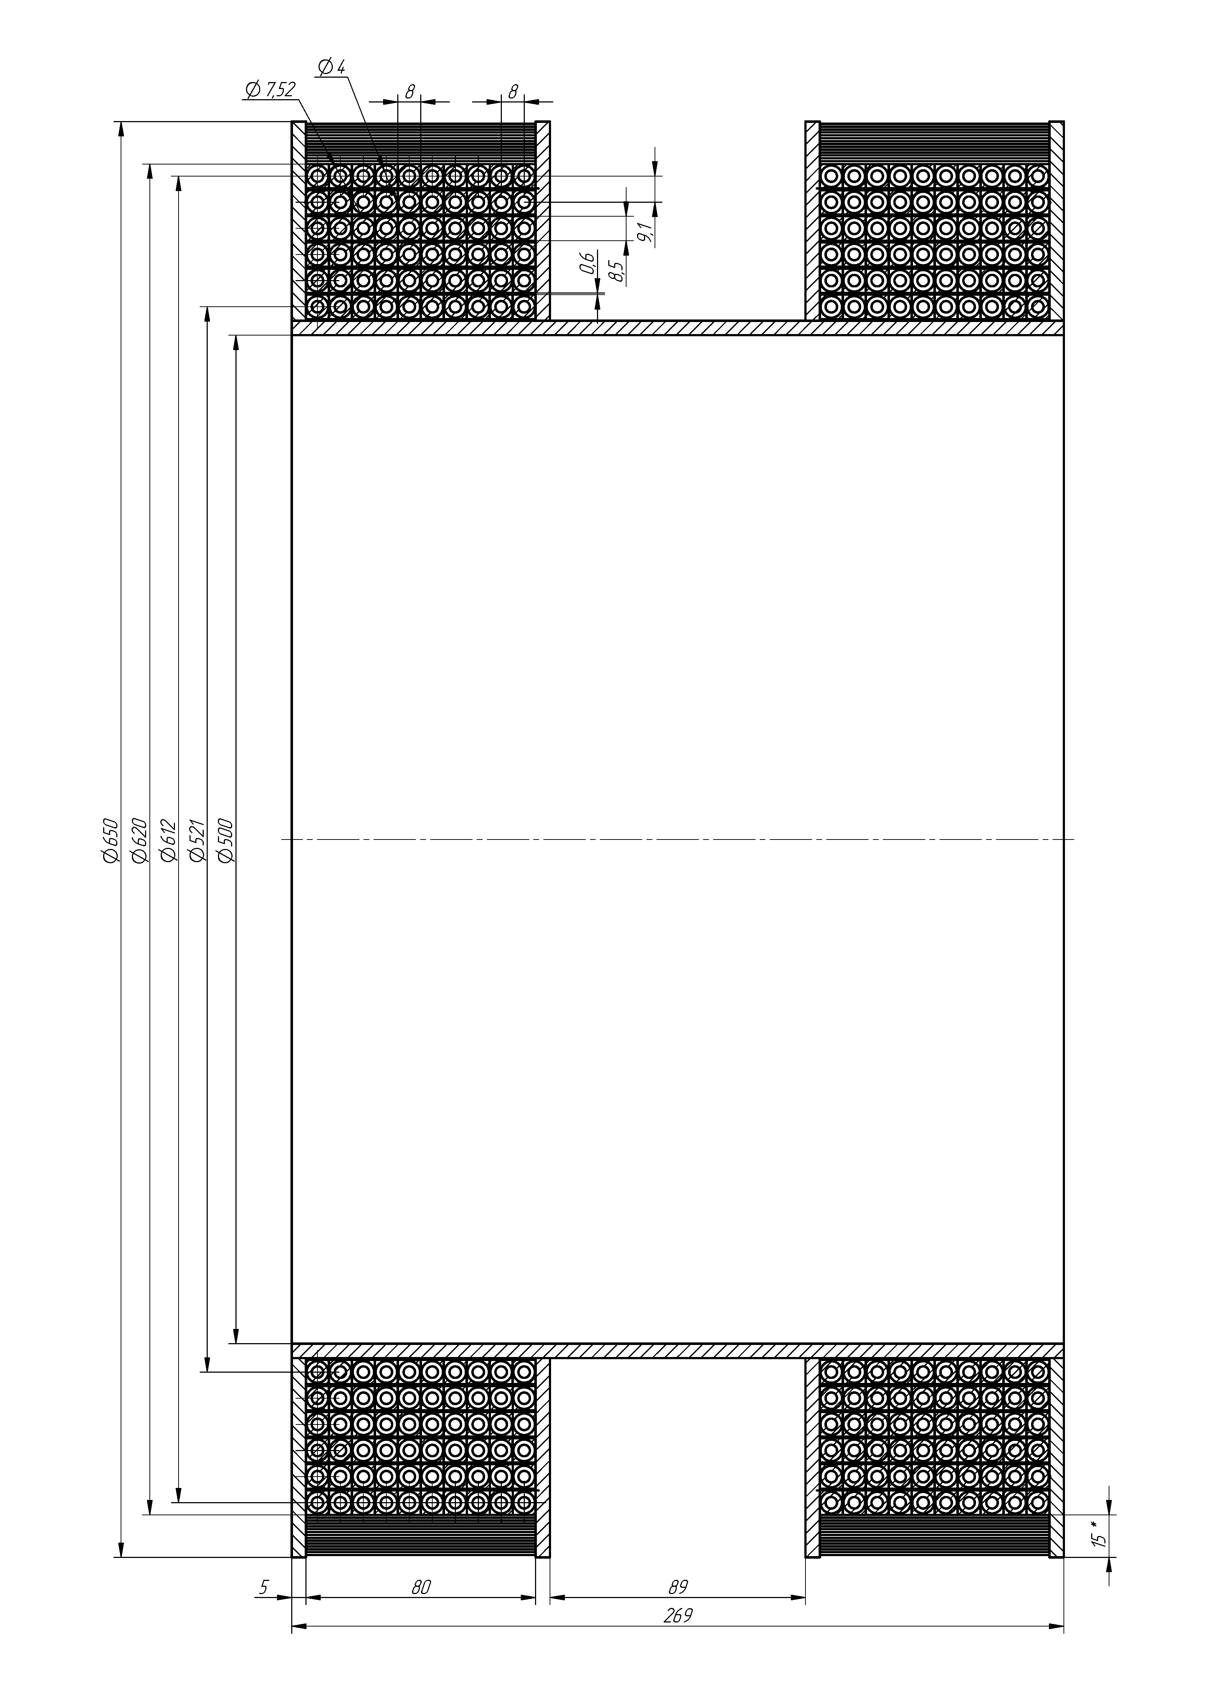
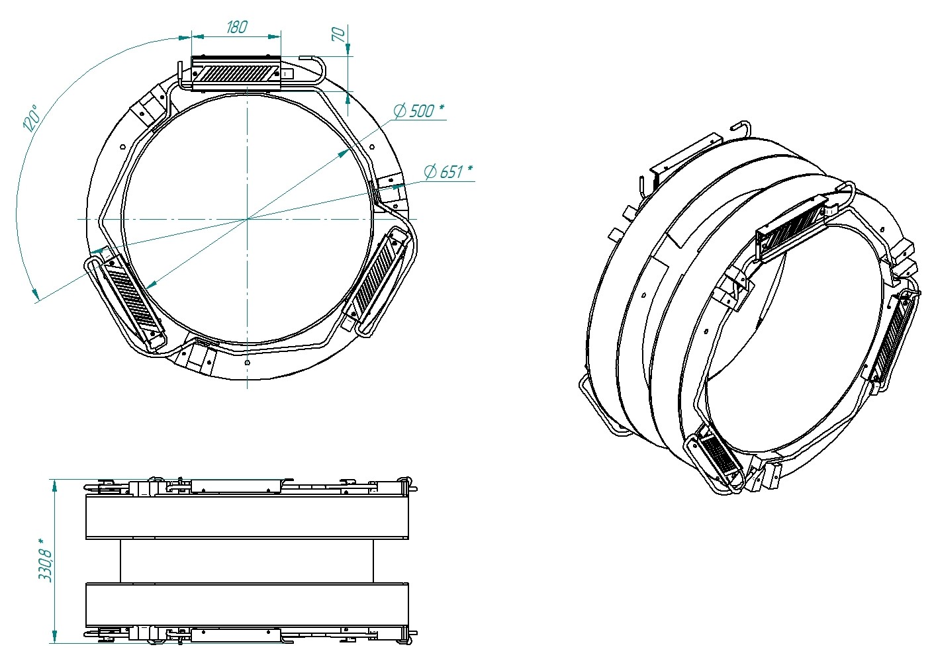
Model coil
Completion of development - 2nd quarter, manufacturing – September 30, cryogenic tests - October 2024.
MSC-230 Design Review Video Meeting, Dubna, March 14, 2024

Slide 6
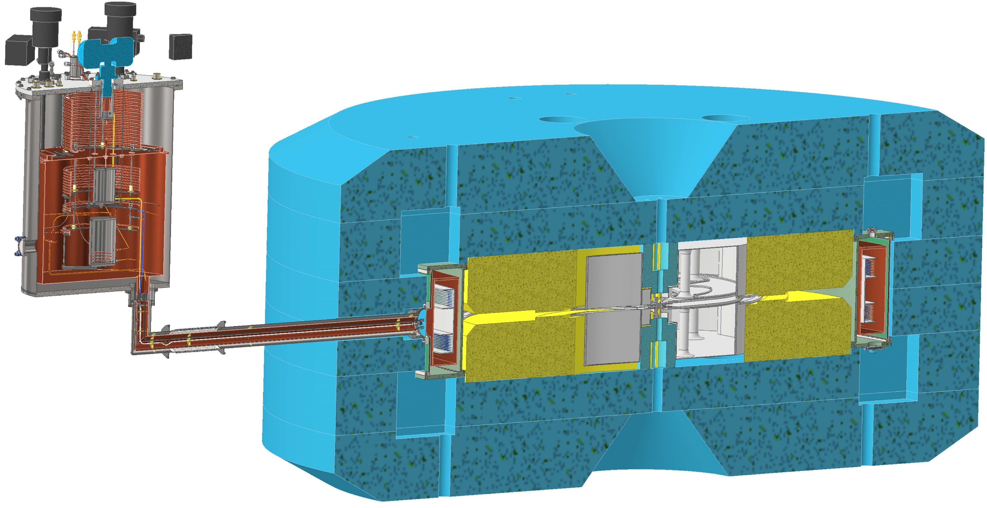
Main coil with own cryostat
Completion of cryostat development - July 15, coil - August 31, 2024, manufacturing - 1 quarter 2025. Cryogenic tests of coil with an iron yoke in Dubna are planned for 2nd quarter 2025.
MSC-230 Design Review Video Meeting, Dubna, March 14, 2024

Slide 7
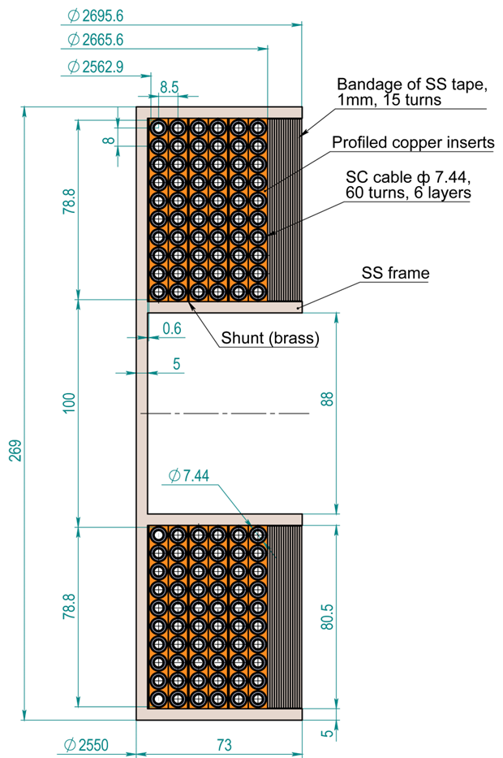
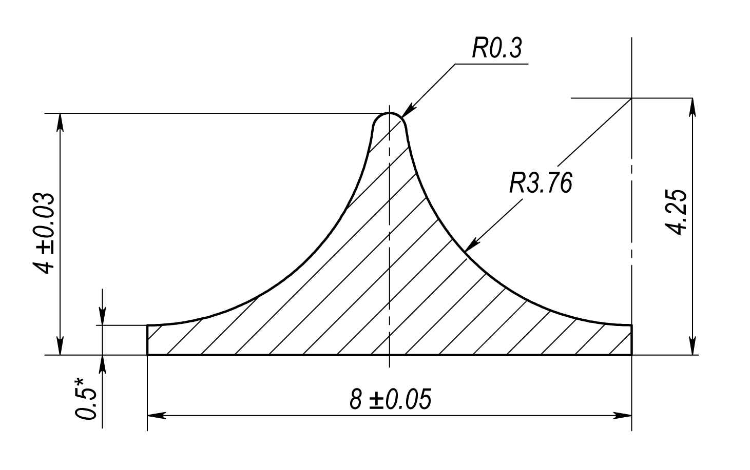
Superconducting coil
Name | Status
Cupro-nickel tube of cable | Received
Superconductor | Manufacturing, March 2024
Profiled copper inserts | Manufacturing, March 2024
Coil devices | Development
Coil mandrel | Development
Coil bandage | Development
MSC-230 Design Review Video Meeting, Dubna, March 14, 2024

Slide 8
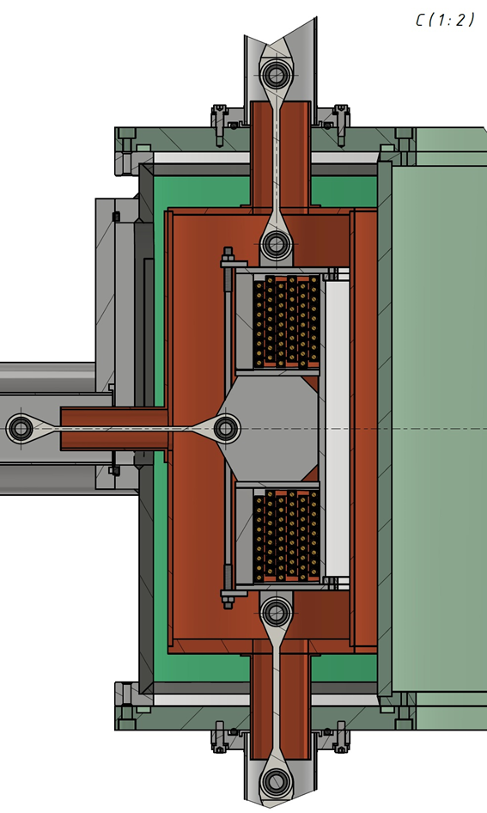
Cryostat
Name | Status
Vacuum shell | Development
Heat shield | Development
Coil support system | Development
Heat shield cooling cryocoolers | Received
Cryocooler for cooling current leads | Received
Cryocoolers for refrigerator | Received
MSC-230 Design Review Video Meeting, Dubna, March 14, 2024

Slide 9
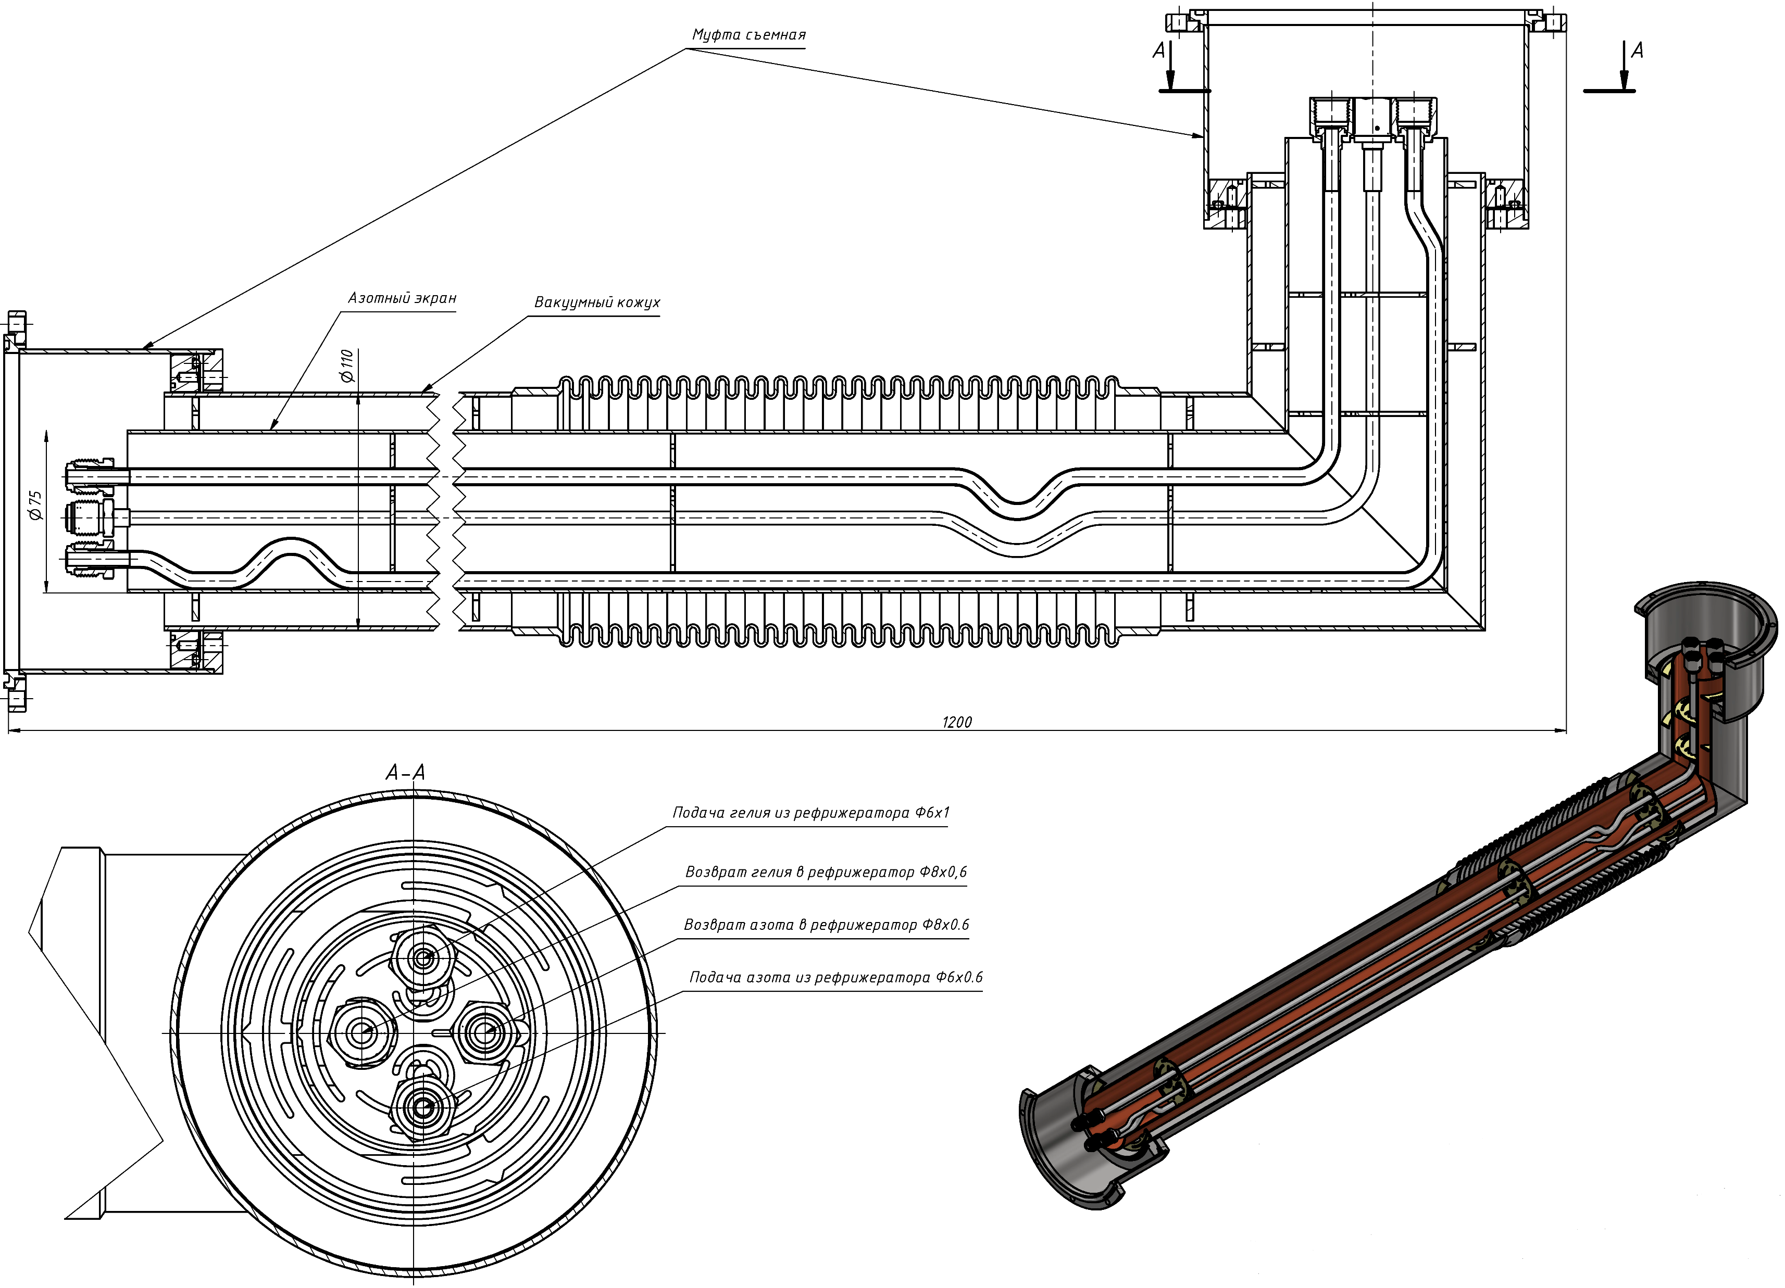
Transfer line for cryogenic liquids
Currently in production stage. Production will be completed in May 2024.
MSC-230 Design Review Video Meeting, Dubna, March 14, 2024

Slide 10
HTS current leads
Under implementation is a contract for the production of two pairs of 500 A HTS current leads with the Institute of Plasma Physics of the Chinese Academy of Sciences in Hefei.
MSC-230 Design Review Video Meeting, Dubna, March 14, 2024

Slide 11
Quench protection system
• The quench protection system consists of a superconductivity failure detection system and a system for evacuation of stored in the magnet energy.
• The quench detection system is based on a sensor for the transition of a magnet from superconducting to the normal state, developed for NICA magnets.
• The energy evacuation system is under development.

Slide 12
Cryogenic parameters control system
- A system for automatic collection and control of cryogenic parameters is under development. It will be based on Siemens controllers and Russian MasterSCADA 4D software. A similar set of software and hardware will be used to create the cyclotron automated control system, which will allow for seamless integration and facilitate further maintenance.
- Cryogenic temperature sensors are selected similar to NICA temperature sensors.

Slide 13
Thank you for your attention

