Slide 1
PARTICIPATION OF JSC NIIEFA IN THE CREATION OF SUPERCONDUCTING CYCLOTRON FOR PROTON THERAPY MSC-230
JSC «NIIEFA», St. Petersburg, Russia
Speaker – Smirnov Kirill

Slide 2
Main goals of JSC «NIIEFA» in this project
Verifications calculations of the magnetic field and beam dynamics using models provided by JINR specialists;
Developing of design documentation for cyclotron components:
Magnetic core;
Resonance system;
Vacuum chamber equipment;
part of supporting system;
Manufacturing of cyclotron components;
Installation of the cyclotron and launch;

Slide 3
Current state of work
3D models of magnetic core and resonance system have been developed (without central region of resonance system);
At the moment, changes are expected in the developed models due to an increase un the distance between the superconducting coils;
After making changes to the calculation models, it will be necessary to new verification calculations and after that make changes to the 3D models of the main components;
Further in the report, models developed for the old cryostat design are shown, a new design in the development.

Slide 4
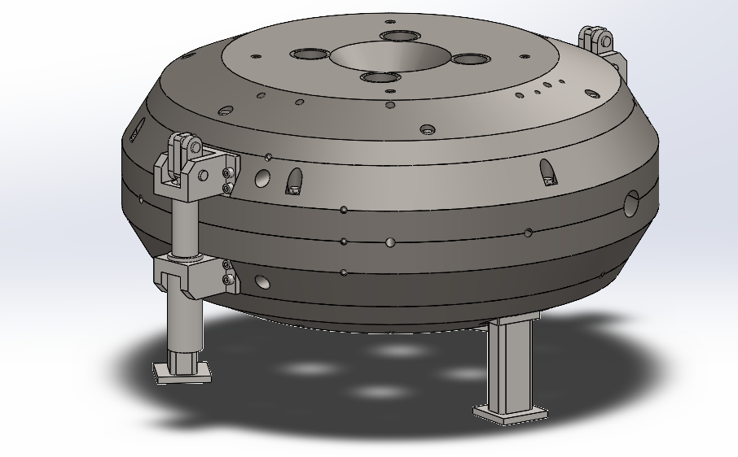
Magnetic core, main parameters and general view
Parameter | Value
Magnetic core dimensions, mm | Ø4 000, height 1 800
Mass, t | 124
Material | Steel 10
Tab.1 Magnetic core main parameters
Fig.1 Magnetic core assembly

Slide 5
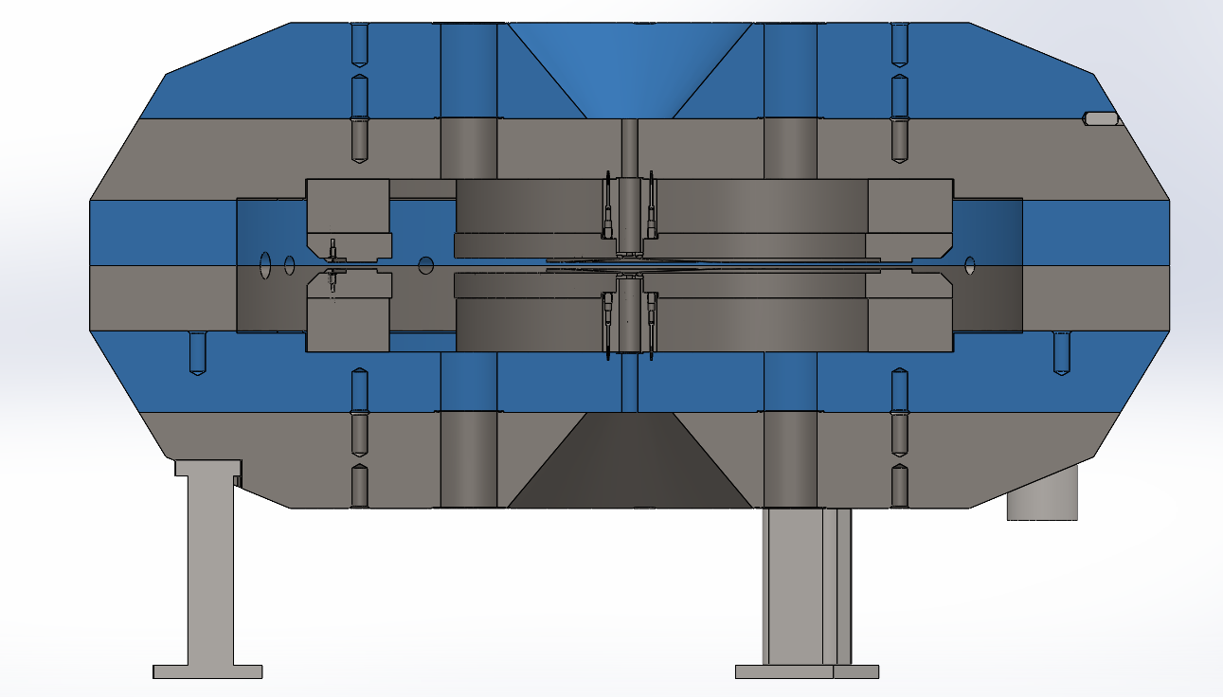
Magnetic core, main parts
Magnetic core is divider into six main parts;
the mass of each part is no more than 28 tons
Fig.2 Main parts of magnetic core

Slide 6
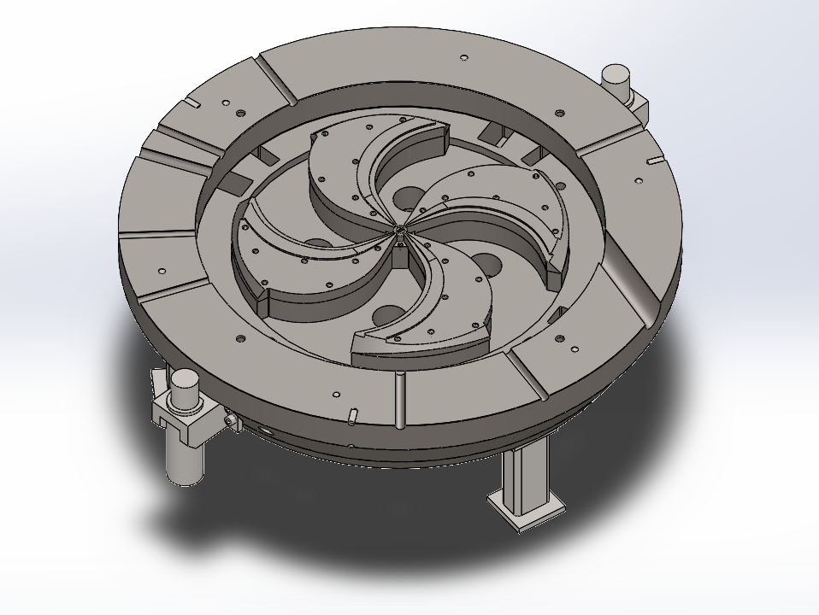
Magnetic core, main parts
Fig.3 median plane cut

Slide 7
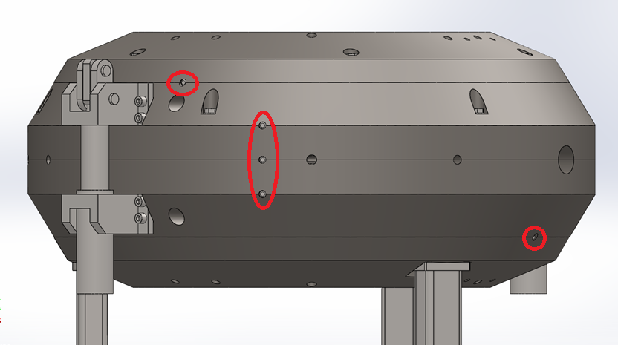
Magnetic core, main parts
all parts of the magnetic core have pins between them
Fig.4 pins between magnetic core parts

Slide 8
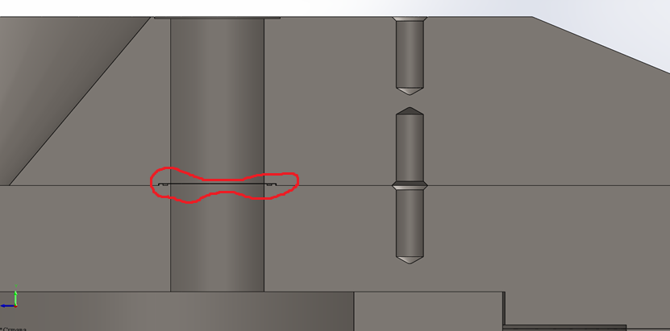
Magnetic core, main parts
The division into parts is design in such a way as to have a minimum number of vacuum seals;
However, in through holes, sealing is necessary. In our case we intend to place in groove a vacuum rubber gasket;
In our experience, such a seal does not require replacement for 15 years or more.
Fig.5 through holes sealing

Slide 9
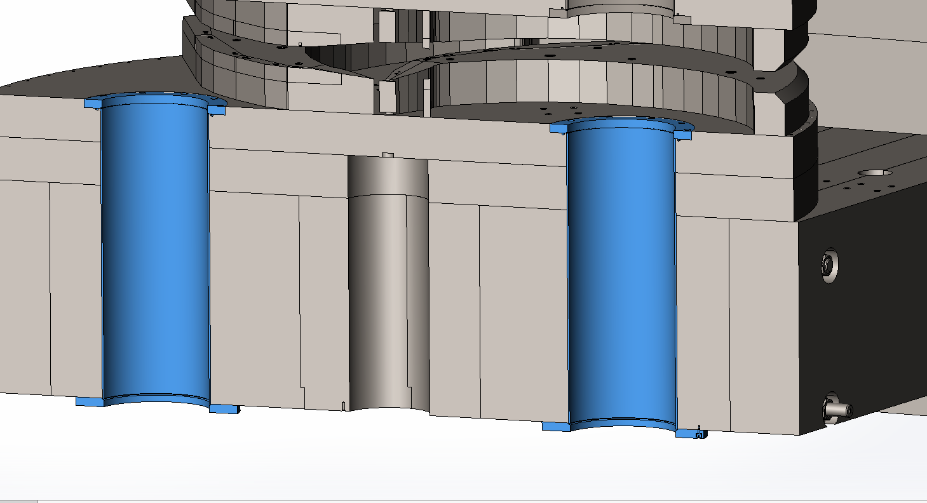
Magnetic core, main parts
The second options for vacuum sealing between the yoke discs can be to make steel «glasses» (cylinders)
Fig.6 example implementation of «glasses» (cycinders)

Slide 10
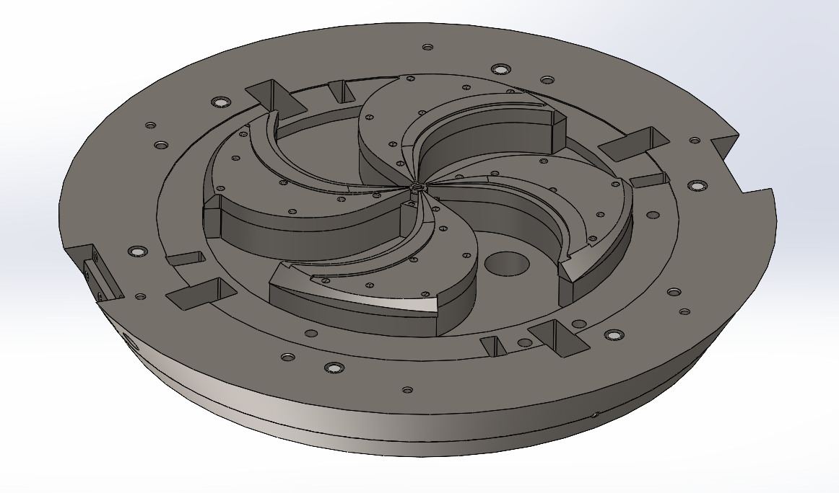
Magnetic core, main parts
Fig.7 sectors

Slide 11
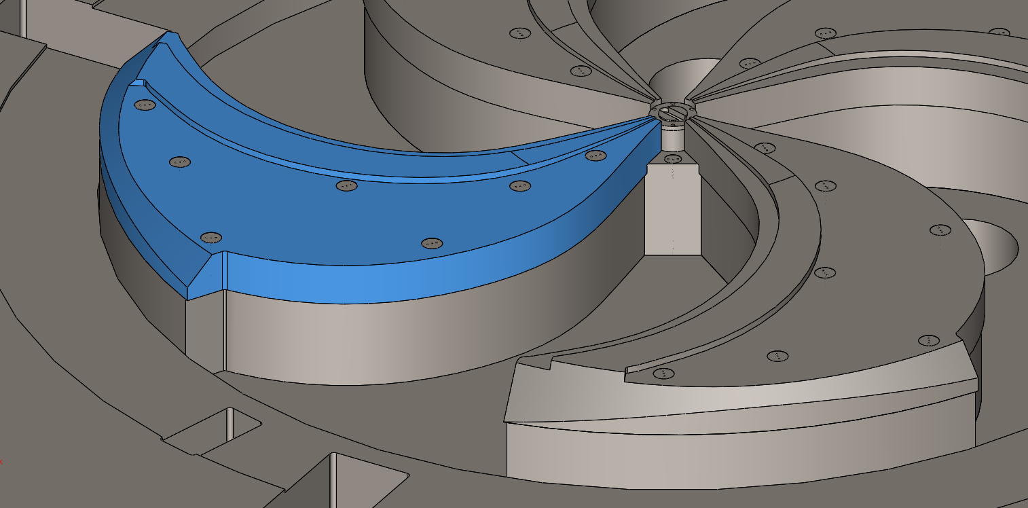
Magnetic core, main parts
On the each sector attached 100 mm solid overlay;
By modifying the shape of overlay, the cyclotron magnetic field will be formed;
All sectors and overlays are also pinned;
All holes for fasteners are closed with plugs made of steel 10.
Fig.8 sector overlay

Slide 12
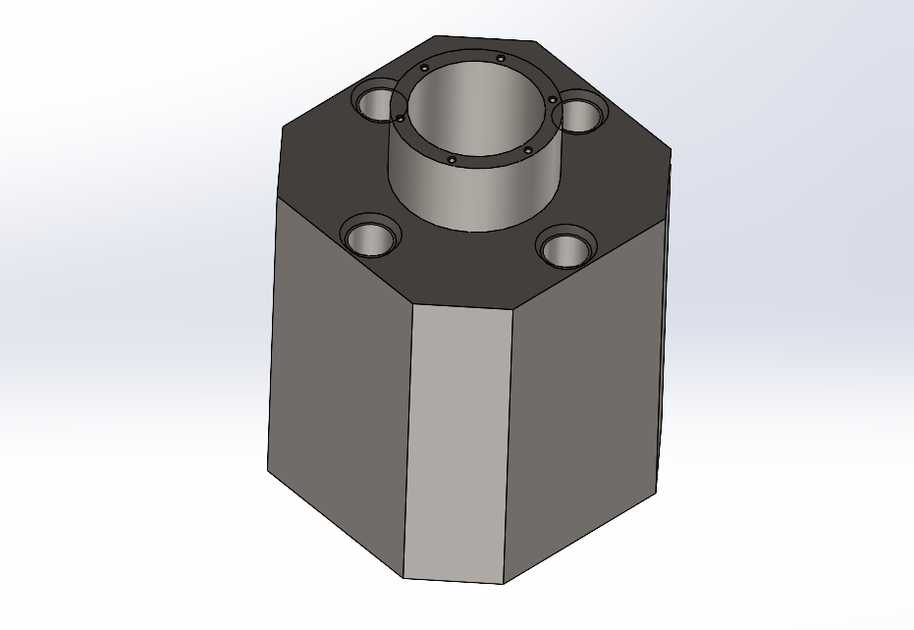
Magnetic core, main parts
In the center between sectors located the central part – rectangular plug with chamfer.
Fig.9 central plug

Slide 13
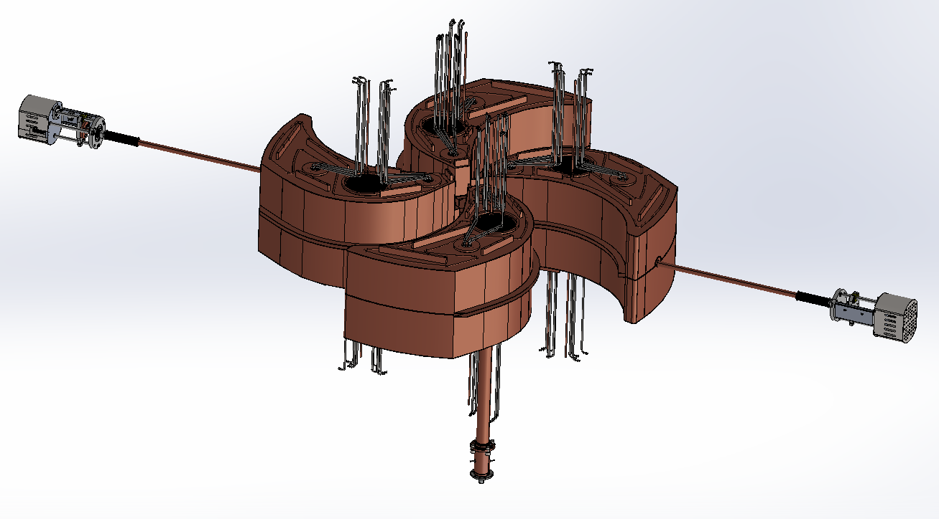
Resonance system
The system consists of four resonators, each of which consists of two halves symmetrical relative to the median plane;
At the moment, two trimmers are designed to frequency adjustment and one RF power input from the bottom of the cyclotron.
Fig.10 General view of resonance system

Slide 14
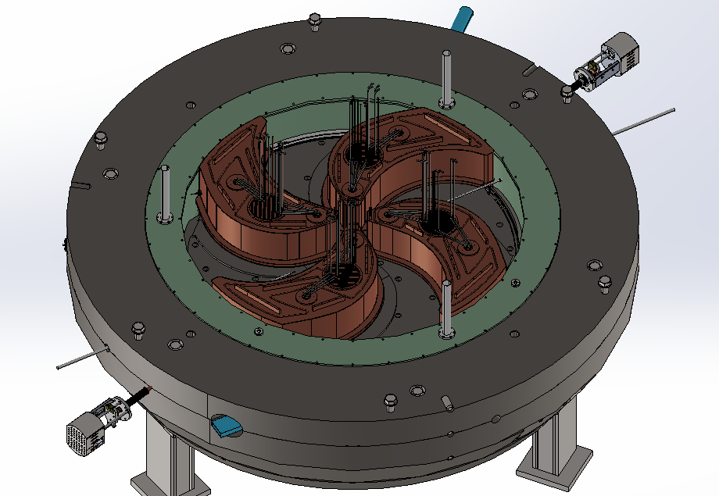
Resonance system
Fig.11 Resonance system in magnetic core and cryostat

Slide 15
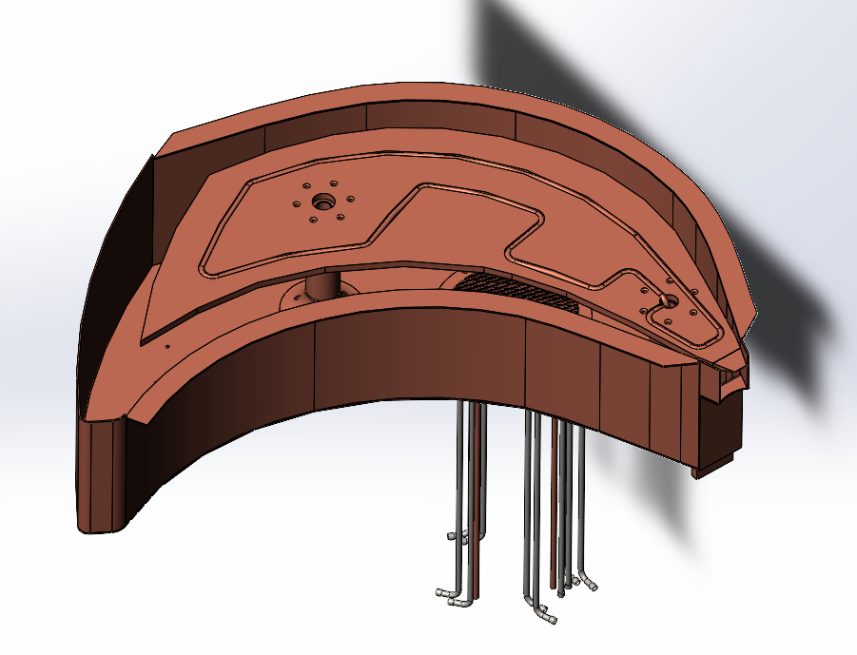
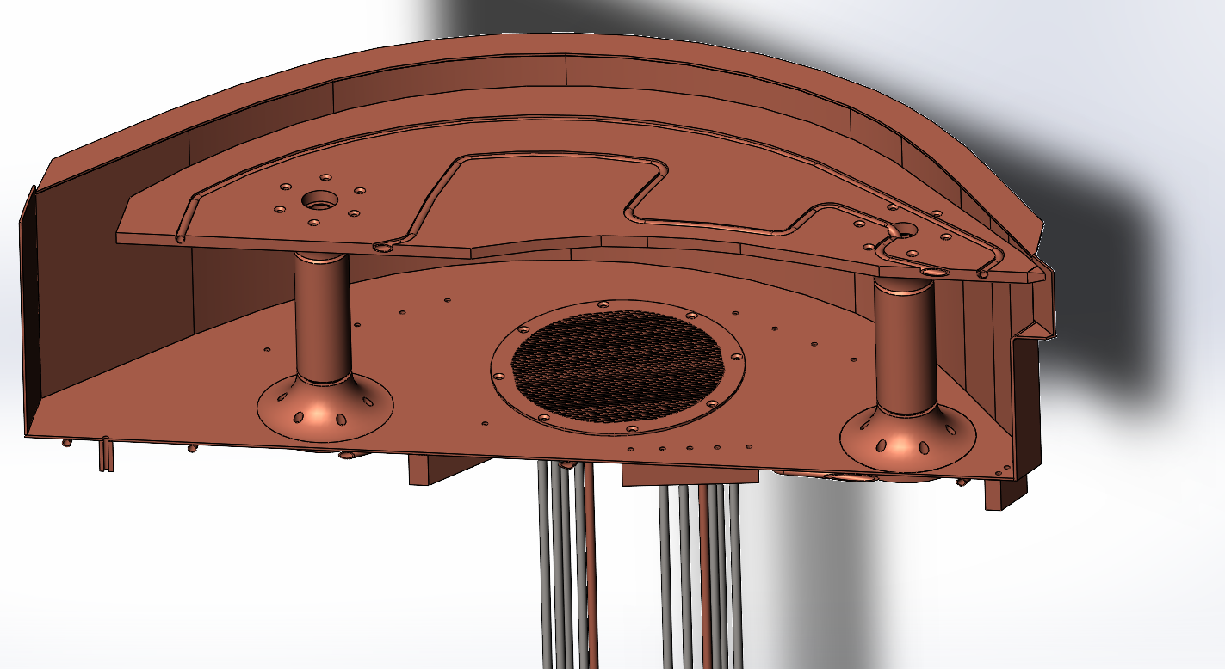
Resonance system
Each half of the resonator consists of plate, half-dee and two rods. Parts of plates and rods are welded for better contact;
Each plate has a mesh opposite the hole in the yoke to vacuum pumping.
Fig.12 half of the resonator

Slide 16
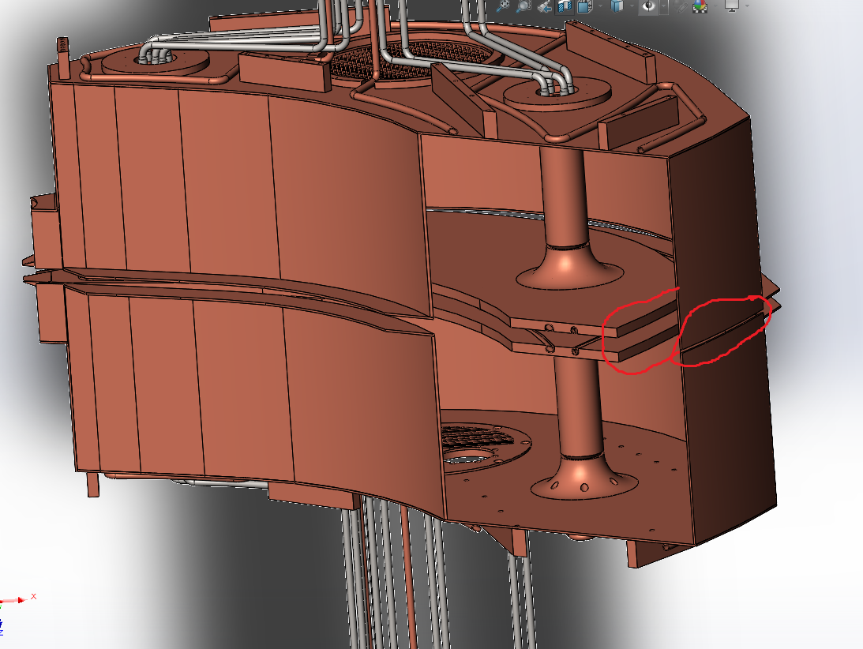
Resonance system
Due to fact that the upper half of the resonator rises along with the upper yoke, we removed the contact between the halves of the dees and plates at the outer radius, leaving the gap there
Fig.12 Resonator, outer radius connection

Slide 17
Issues on which we would like to hear your opinion
Subject | Question | Our opinion
Magnetic core | What is the best way to seal between parts of yoke, gasket or vacuum «glass» | We can implement both options; at the moment, a gasket seal is designed, because in our opinion, the reliability is beyond doubt
Resonance system | We have so far planned to cool the resonator plates only from the main surface; to what extent is it necessary to cool the sidewalls as well? | We decided to evaluate the heat generation on the sidewalls and make a decision after that. We will most likely add tubes on the sides as well.
 | Is contact along the outer radius between the halves of the resonators necessary? | We left a gap there due to concerns that ensuring contact over the entire surface is difficult and sparking may begin in places of poor contact. But we still think it’s right to provide it there.

Slide 18
Thank you for your attention
Smirnov Kirill
Kirill.e.smirnov@gmail.com

