Slide 1
Current Status of the project MSC-230
Sergey Yakovenko
International expertise of the MSC-230 project March, 2024 Yakovenko Sergey

Slide 2
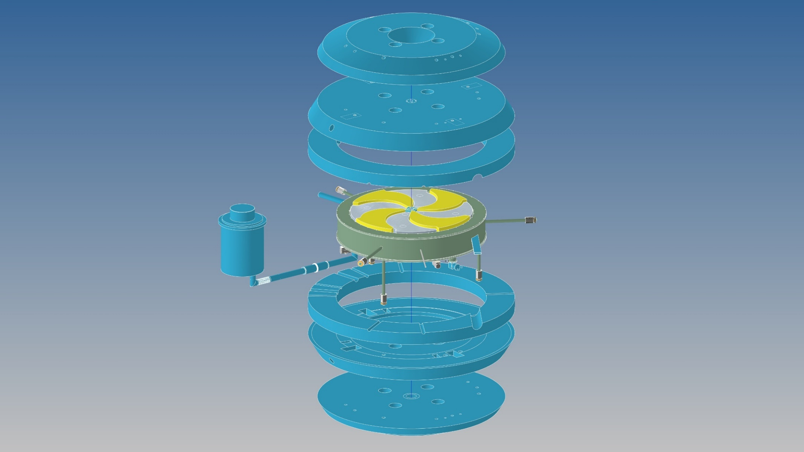
Current status of the project MSC-230
Yoke
RF system
Sectors
Helium refrigerator
Coils tie rods
Cryostat
MSC-230 – 3D conceptual design model
International expertise of the MSC-230 project March, 2024 Yakovenko Sergey

Slide 3
Current status of the project MSC-230
Magnet type | Compat, SC coil, warm yoke
Ion source | PIG
Final energy, MeV | 230
Beam extraction radius, mm | 1070
Мagnetic field (center), T Мagnetic field (extract. radius), T | 1.7 2.15
Dimensions (height×width), mm | 1800 × 4000
Weight, tonnes | 130
Hill/Valley gap, mm | 50/700
A*Turn number | 270 000
RF frequency, MHz | 106.5
Harmonic number | 4
Number of RF cavities | 4
Voltage, center/extraction kV | 40/110
RF power, kW | 60
Number of turns | 500
Beam intensity (Single pulse mode)
I, μA | 10 μA
Pulse duration, ms | 10 ̶ 100
Pulse frequency, Hz | 0.01 ̶ 1
Current stability from pulse to pulse (on the flat part of the pulse) | ± 5%.
Beam intensity (Continuous mode)
I, μA | 10 μA
Current stability | ± 5%
International expertise of the MSC-230 project March 14, 2024 Yakovenko Sergey

Slide 4
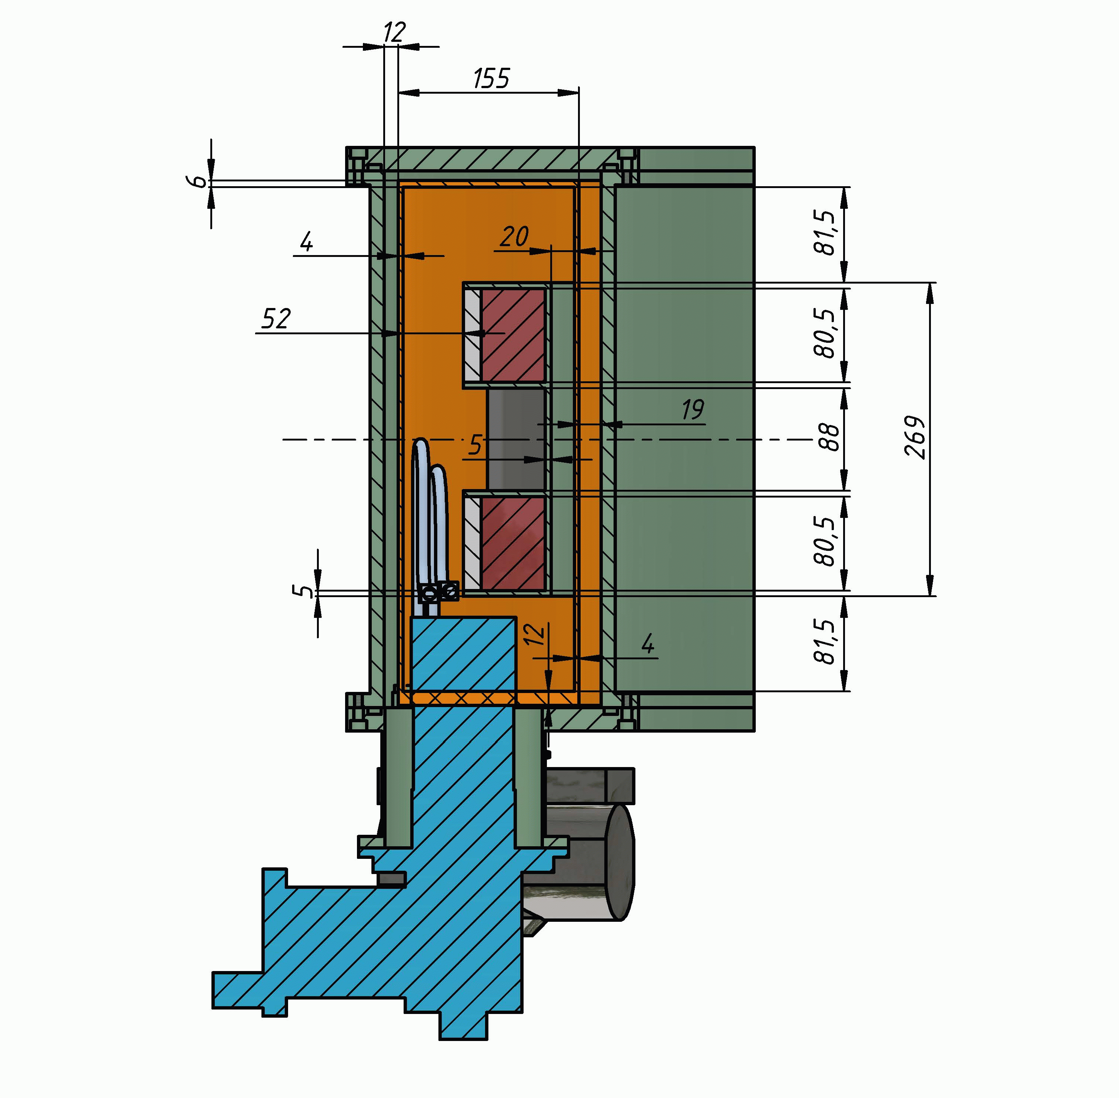
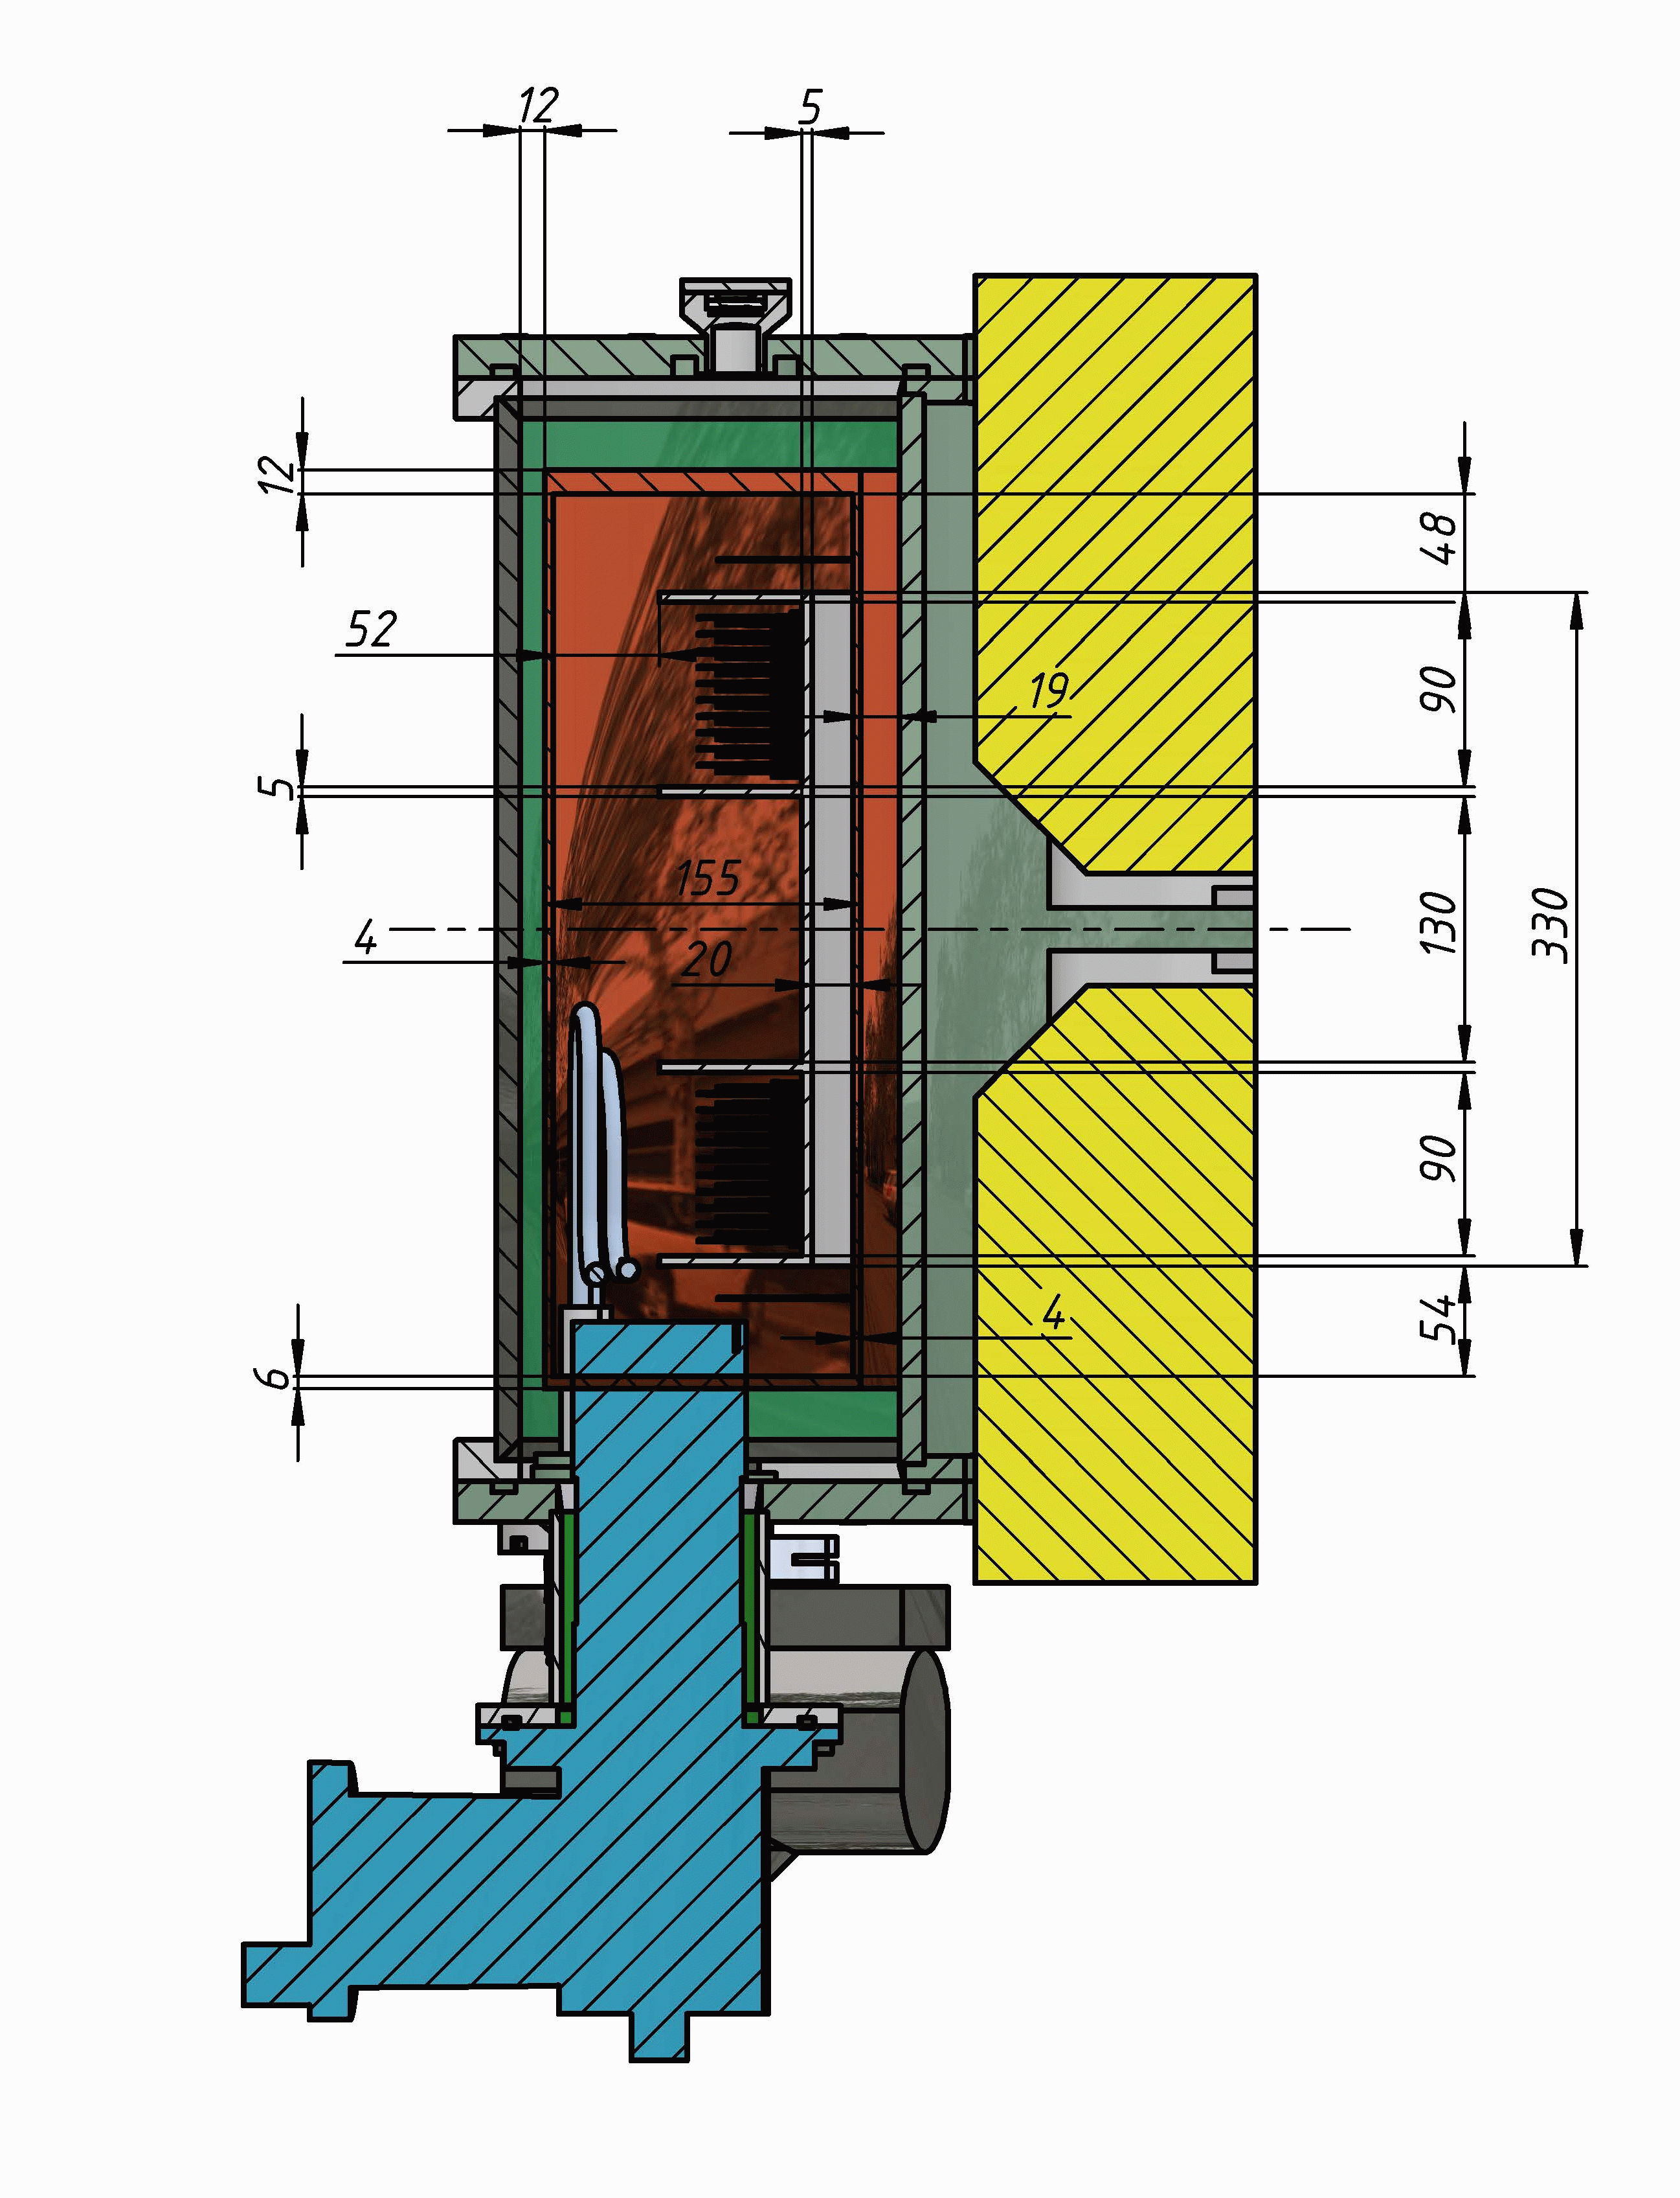
Current status of the project
Design changes
initial version
new version
International expertise of the MSC-230 project March 14, 2024 Yakovenko Sergey

Slide 5
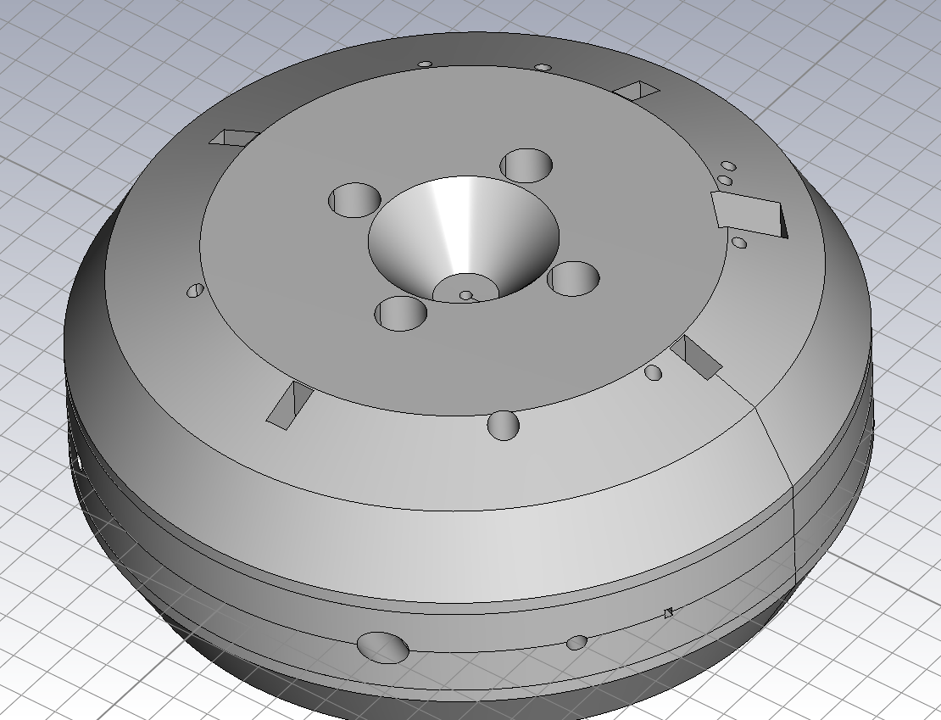
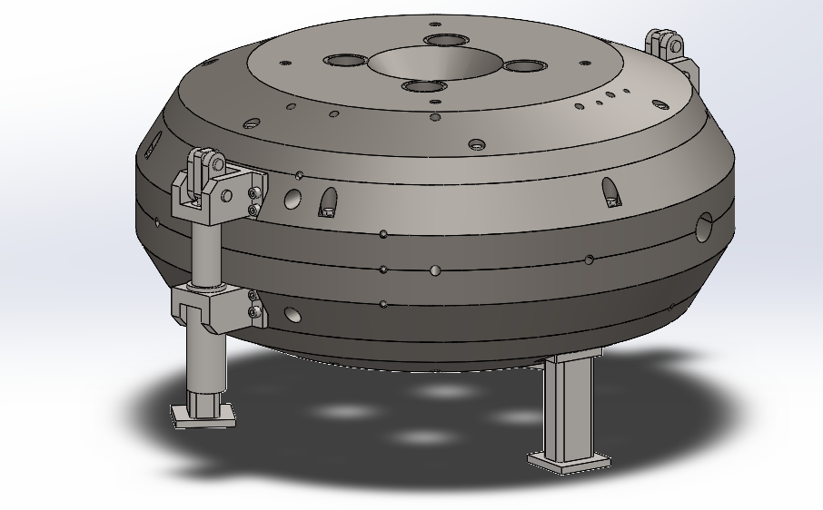
Current status of the Magnet
Complete production February 2025
More details in the report «Integrated design of the MSC230 and manufacturing status»
International expertise of the MSC-230 project March 14, 2024 Yakovenko Sergey

Slide 6
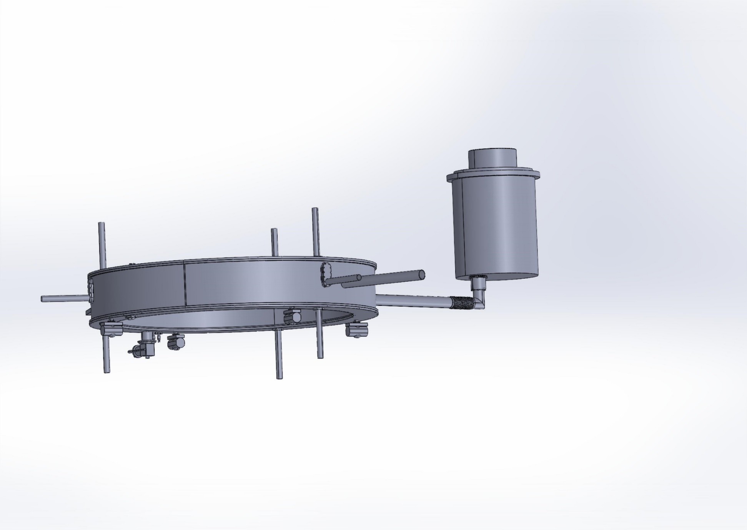
Current status оf cryogenic system
Complete production March 2025
HTS current leads
ТС4188
cryocooler
cryocooler Operation 8
More details in the report «Cold mass design and manufacturing status», Hamlet Khodzhibagiyan
International expertise of the MSC-230 project March 14, 2024 Yakovenko Sergey

Slide 7
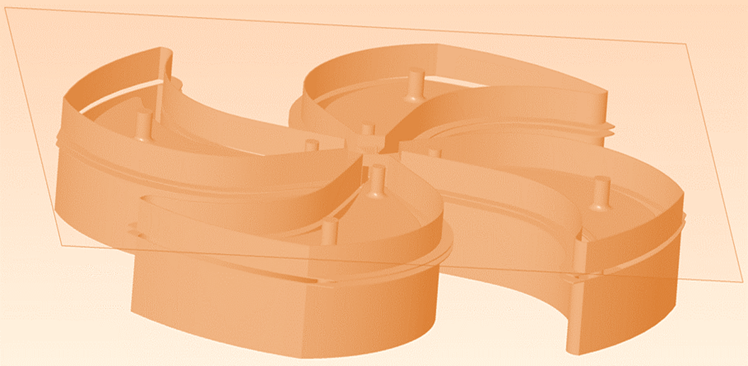
Current status of the RF system
Complete production February 2025
RF Generator | Hefei CAS Ion Medical and Technical Devices Co., Ltd. | January 2025
More details in the report «Integrated design of the MSC230
and manufacturing status»
International expertise of the MSC-230 project March 14, 2024 Yakovenko Sergey

Slide 8
Current status of the vacuum system
Vacuum scheme of the MSC-230
Delivery and testing of vacuum equipment, December 2024
International expertise of the MSC-230 project March 14, 2024 Yakovenko Sergey

Slide 9
Current status of the project
Electrostatic deflector | 1 set | Hefei CAS Ion Medical and Technical Devices Co., Ltd. | October 2024
Magnetic Field Measurement System | 1 set | Hefei CAS Ion Medical and Technical Devices Co., Ltd. | August 2024
Ion source | 1set |  | December 2024
International expertise of the MSC-230 project March 14, 2024 Yakovenko Sergey

Slide 10
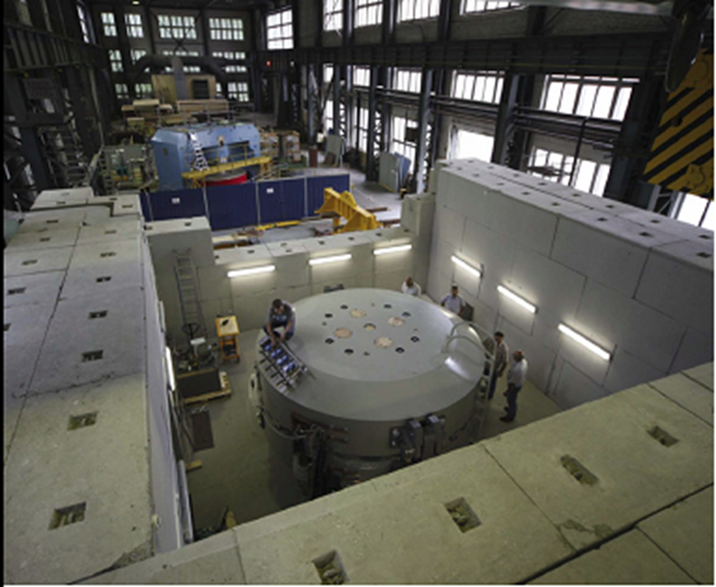
Current status of the infrastructure
International expertise of the MSC-230 project March 14, 2024 Yakovenko Sergey

Slide 11
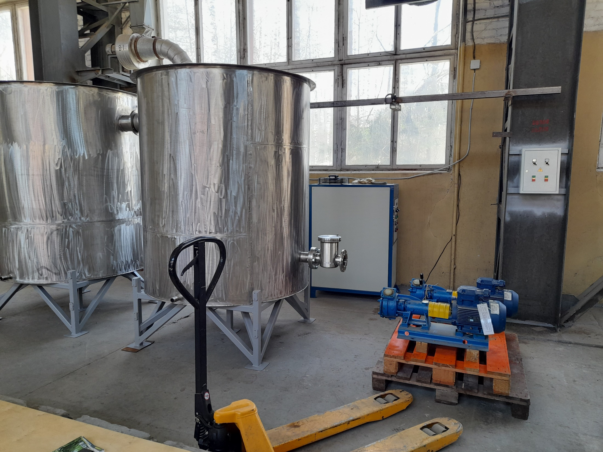
Current status of the infrastructure
International expertise of the MSC-230 project March 14, 2024 Yakovenko Sergey

Slide 12

Timeline of MSC-230 Construction
Major activities
2022
2023
2024
2025
5 | 6 | 7 | 8 | 9 | 10 | 11 | 12 | 1 | 2 | 3 | 4 | 5 | 6 | 7 | 8 | 9 | 10 | 11 | 12 | 1 | 2 | 3 | 4 | 5 | 6 | 7 | 8 | 9 | 10 | 11 | 12 | 1 | 2 | 3 | 4
Kick-off
Final engineering design
Cryogenic system
Magnet System
RF system
Ion Source
Beam extraction
system
Beam diagnostic
system
Vacuum system
Control System
Infrastructure
Integration
Assembly
Beam
Commissioning

