Slide 1

Central region optimization and beam dynamics in the MSC230 cyclotron.
JINR
Karamysheva G.A.
on behalf of New Accelerator Department
DNLP JINR

Slide 2
Virtual prototyping of a cyclotron
Virtual prototyping (VP) is a design method based on computer-aided design (CAD) technologies. Unlike the classical design approach, in which all the components of an object are first developed separately and then put together over several iterations, virtual prototyping involves working with a prototype of the entire product, from the early stages of development until its completion. To introduce the virtual prototyping method into cyclotron development practice, we created a Matlab-based platform that encapsulates distributed VP components and provides a mechanism for their interaction. The main components of the software we use to develop the cyclotron are CAD (Solidworks), various CST Studio modules, as well as analysis and tracing programs that we created in Matlab earlier, optimized and adapted for new tasks now.
MATLAB
Scripts for determining the shape of sectors and cavities
CORD – Closed Orbits Dynamics
Beam tracking
SOLIDWORKS
CAD
Parametrized integrated
model of the cyclotron:
Magnet
RF system
Deflector / Inflector
Simulation results
(2D/3D field maps)
CST studio/ Comsol/ Tosca
Magnetostatic
RF eigenmode
Electrostatic

Slide 3
Beam dynamics programs used for cyclotron development
1. CORD (Closed ORbit Dynamics) - to analyze motion in closed equilibrium orbits
2. Beam tracing (integrating a system of differential equations of motion with 3D maps of electromagnetic fields). Since magnetic field measurements are carried out only in the median plane a subroutine for correct recalculation of the magnetic field outside the median plane was created and verified.

Slide 4
CORD (Closed ORbit Dynamics)- code for analyzing maps of magnetic and accelerating fields in equilibrium closed orbits.
CORD (Closed ORbit Dynamics) allows us to obtain information about the average and isochronous field, lower and multiple harmonics of the magnet structure, the frequency of particle rotation depending on the radius, and the frequencies of betatron oscillations.
Lower number harmonics
Mean magnetic field and flutter
Betatron frequencies along the radius
Difference between average and isochronous field
Frequency of particle rotation
Betatron frequency diagram
Variation in the kinetic energies of the particles at R=10 cm.

Slide 5
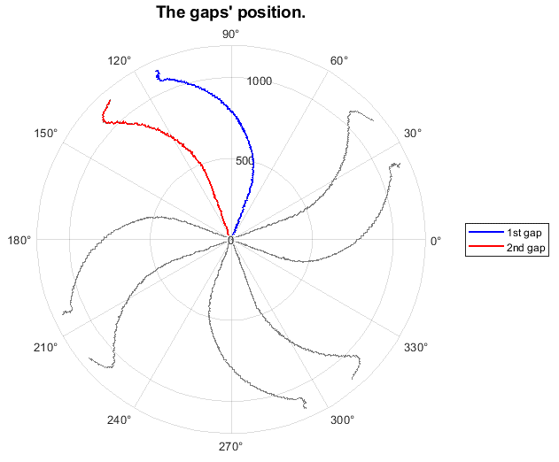
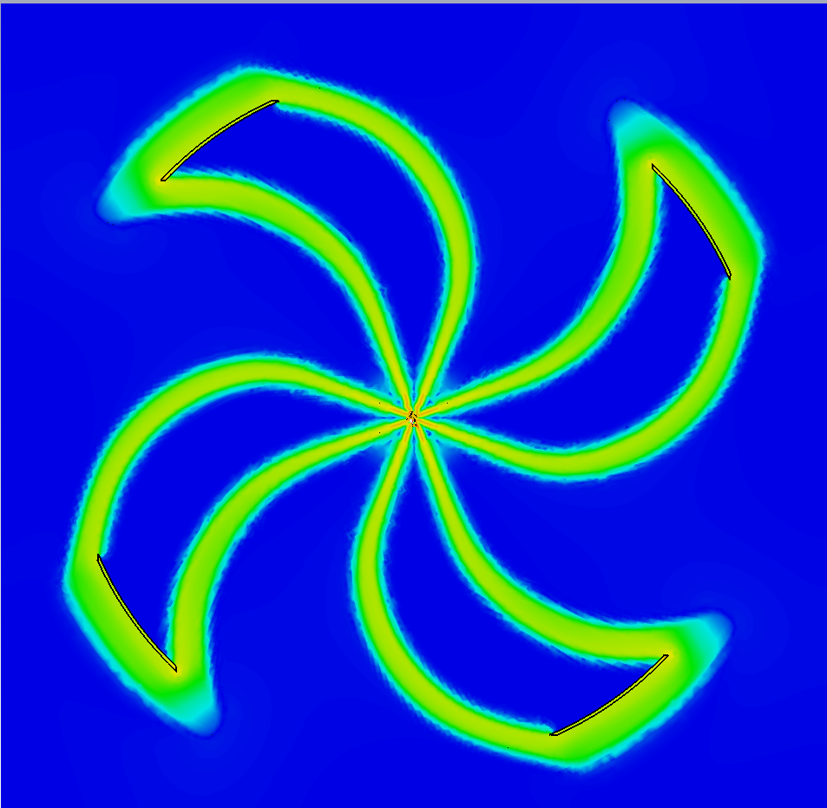
CORD (Closed ORbit Dynamics)
1. Analysis of the accelerating field provides information about the azimuthal extent of the cavities (between maximum/minimum of electric field distribution)
Azimuthal extension of the cavity
Electric field distribution
Maximum/minimum of electric field distribution

Slide 6
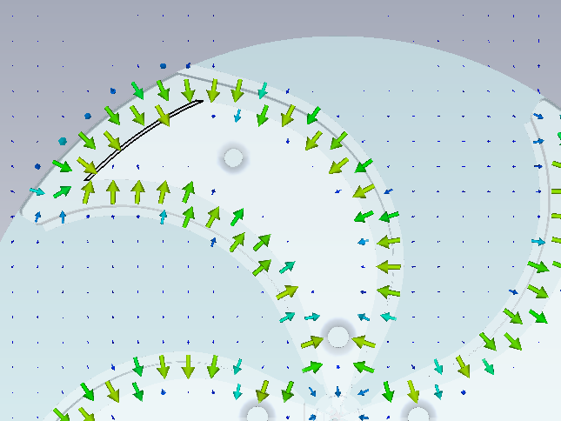
CORD (Closed ORbit Dynamics)
1. Analysis of the accelerating field provides information about the distribution of the accelerating voltage along the radius, the maximum energy gain per turn.
The voltage across the accelerating gaps is the integral of the electric field intensity vector along the circle arc from the middle of the cavity to the middle of the sector in the median plane (red lines)
Variation in the kinetic energies of the particles at R=10 cm.

Slide 7
CORD (Closed ORbit Dynamics)
Code calculates the orbital step and the number of turns along the radius, and calculates the phase motion of the central particle by iterative procedure
phase motion of the
beam (tracking)
central particle (CORD)

Slide 8
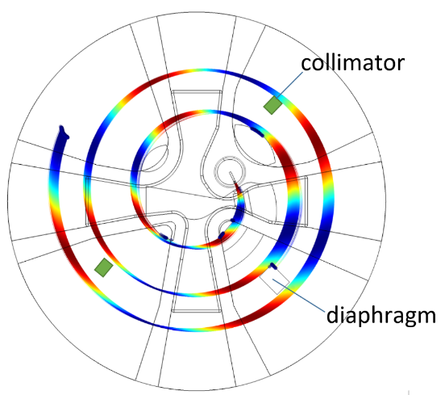
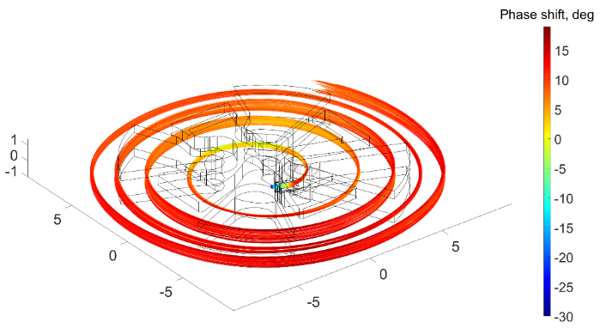
Central region optimization
Betatron oscillation frequencies in the central region. The black solid line is the frequency of vertical betatron oscillations, the blue dots are the frequency of radial oscillations Q _{r} -1.
Average magnetic field along the radius (top) 60-90 Гс
To ensure vertical focusing, we create a bump (radial gradient) of the magnetic field (60-100 Gauss).
Magnetic focusing prompted by the decreasing magnetic field begins after a radius R = 40 mm
For R< 40 mm the accelerating electric field provides vertical focusing of lagging particles.

Slide 9
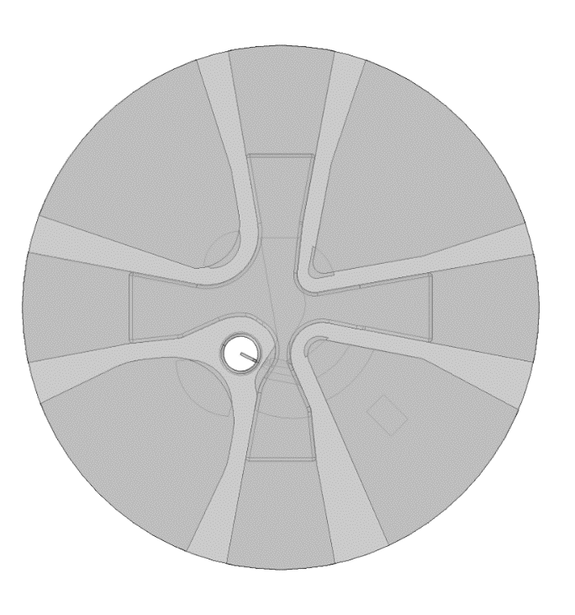
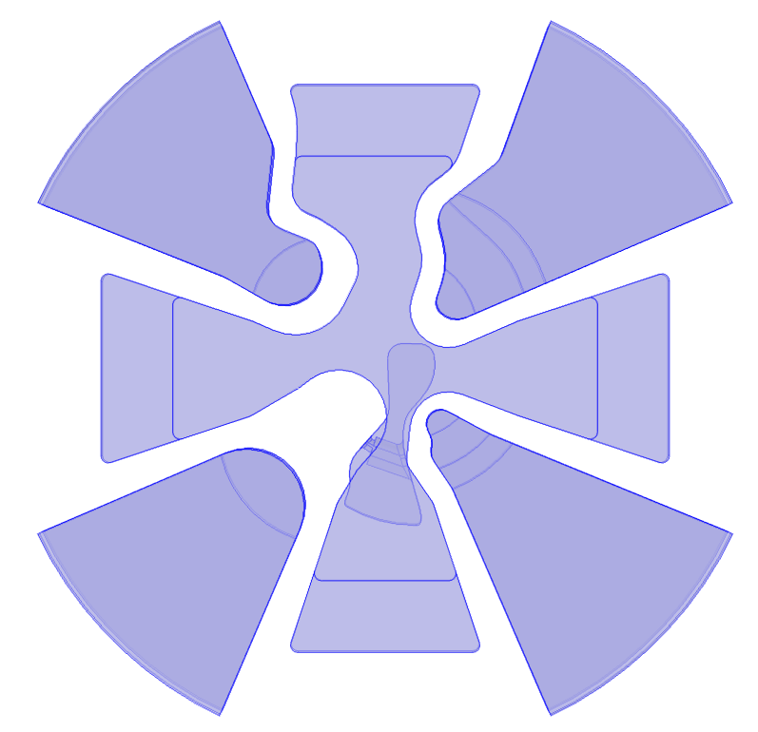
Central region optimization
Accelerating voltage is the central region – 40-50 kV;
Kilpatrick limit Es = 120 kV/cm;
In the direction, perpendicular to the magnetic field lines, the magnetic field prevents electrical break-down -> the electric field strength can be 1.5 higher than the Kilpatrick limit;
Therefore, the first gap width is 2.5-4 mm .
Corner rounding is necessary to reduce the values of local electric fields.
upper cross
dummy dee
dee
Ion source
diaphragm
puller
axially-symmetric
optimized

Slide 10
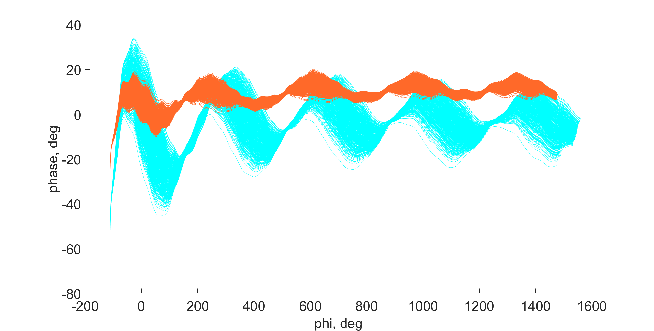
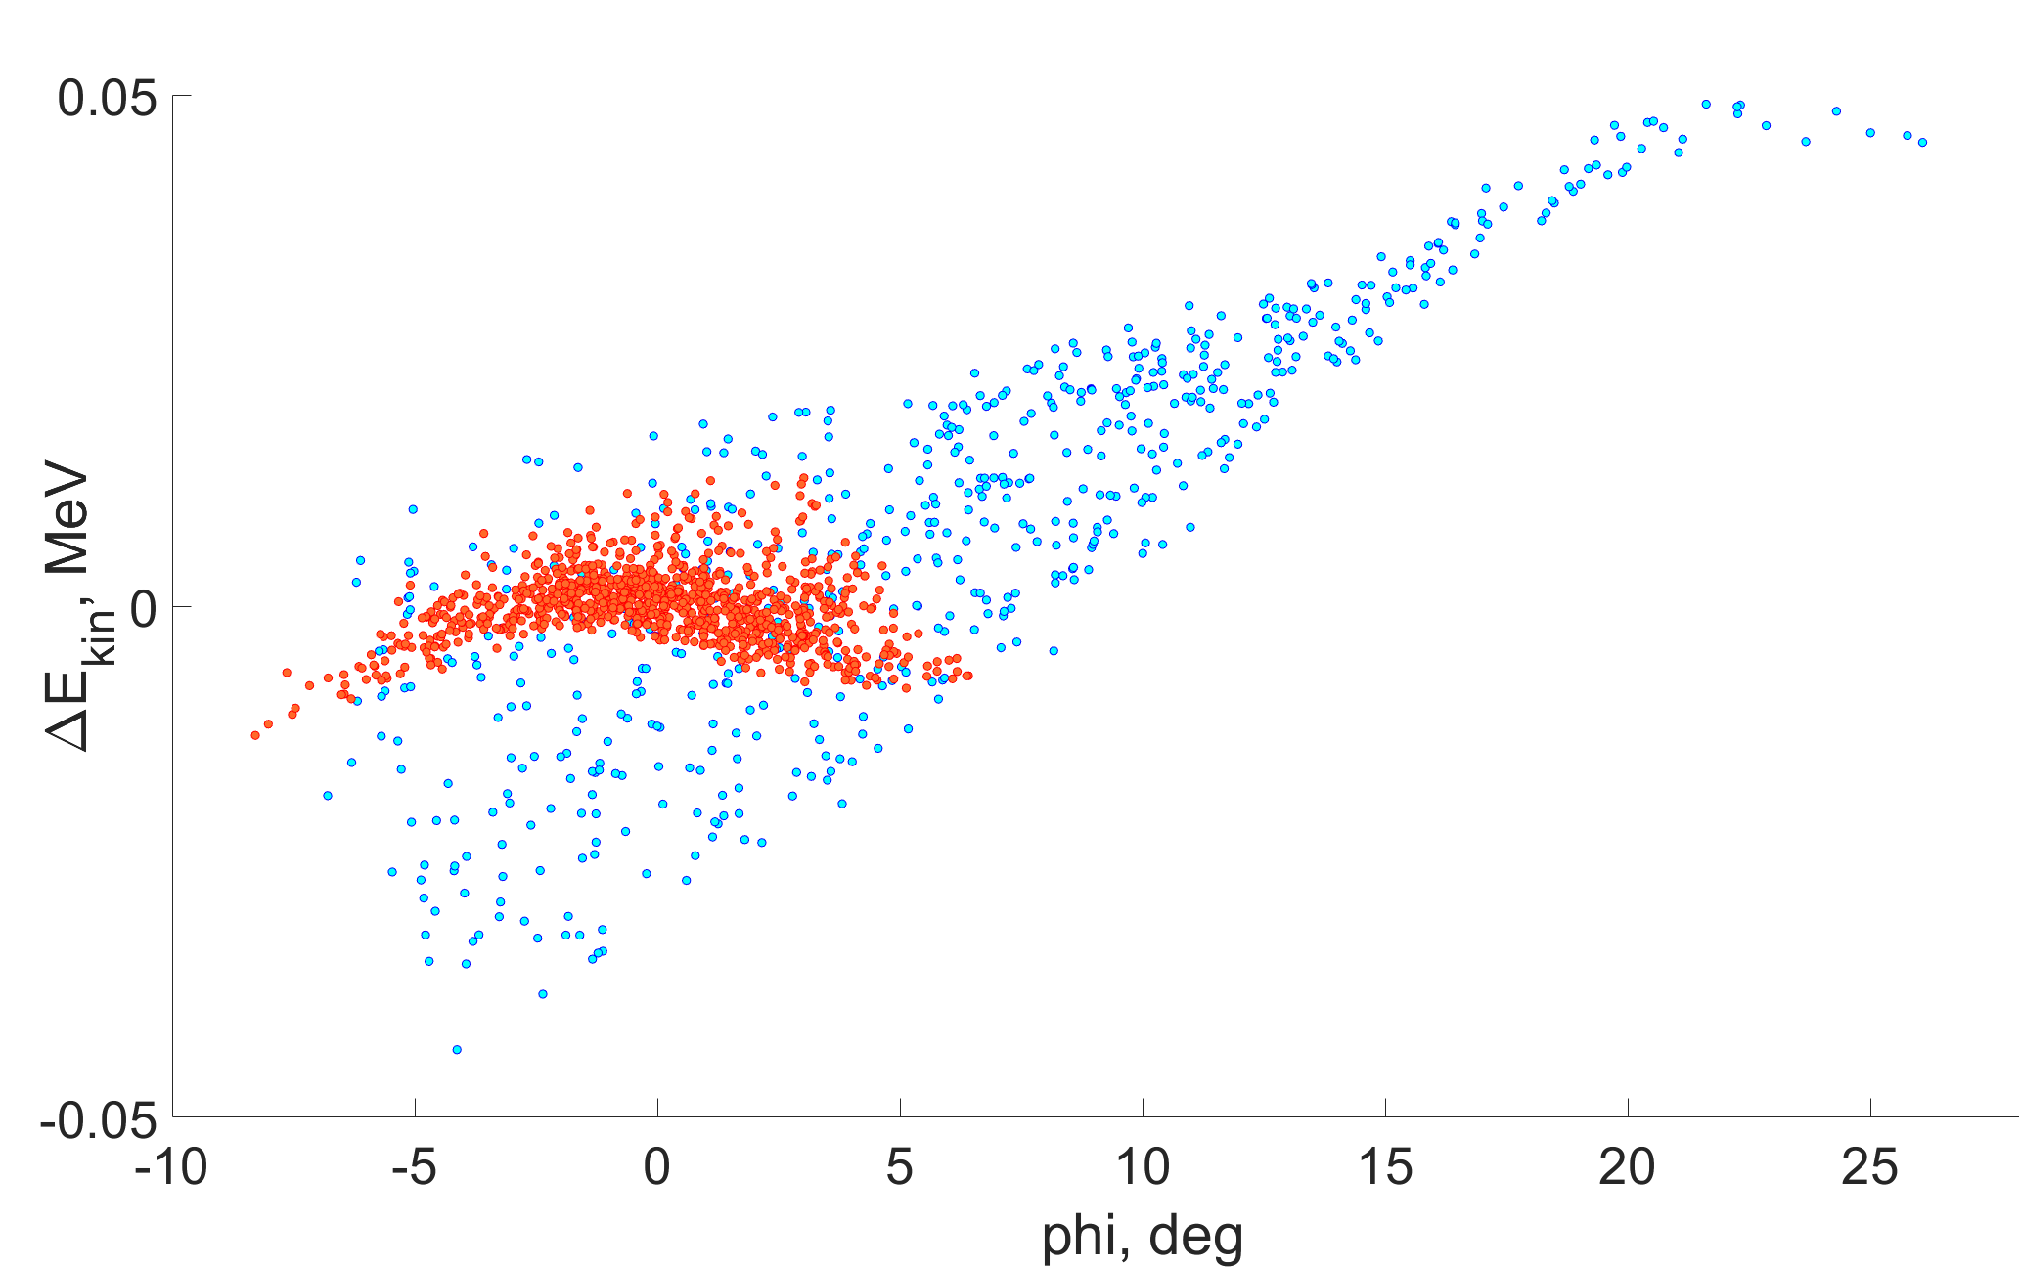
Central region optimization
optimized center
axially-symmetric center
Energy spread versus phase for two options of the center region
Phase motion of the beam. Positive phase corresponds to lagging particles

Slide 11
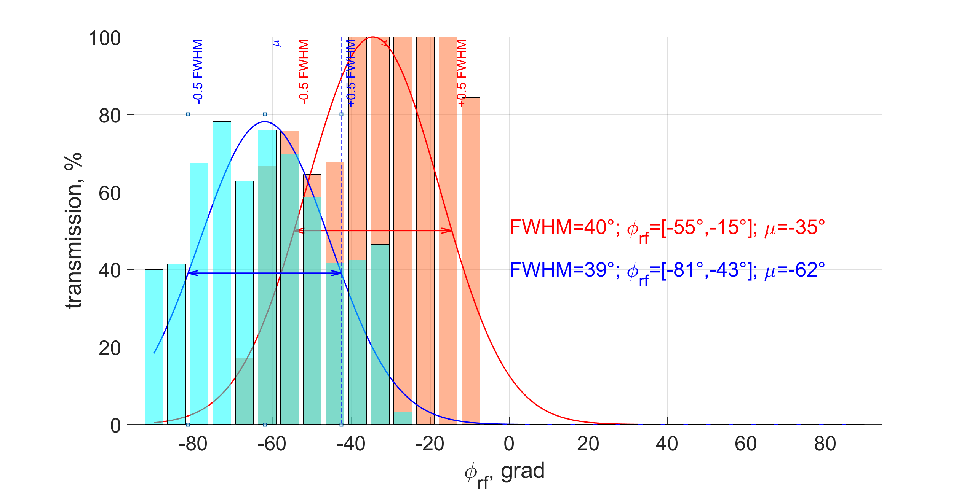
Phаse acceptance of the center
Integral transmission: axially-symmetric - 10% /optimized - 14%

Slide 12
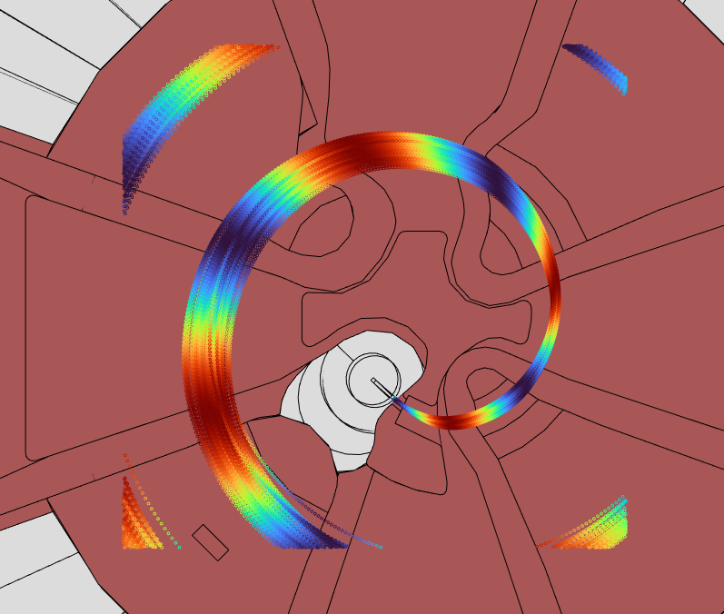
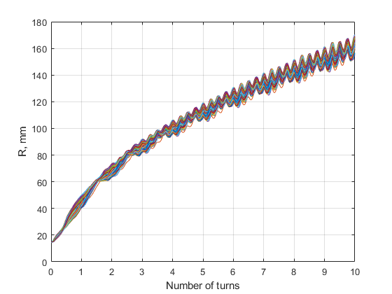
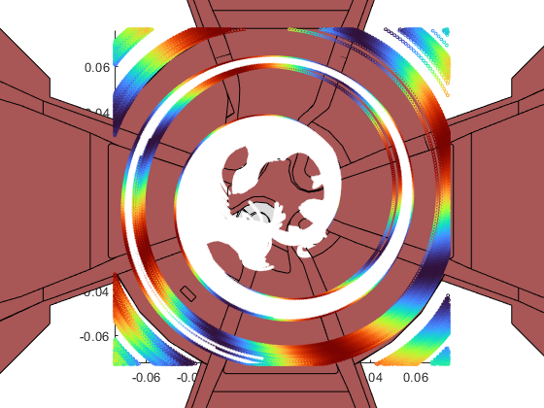
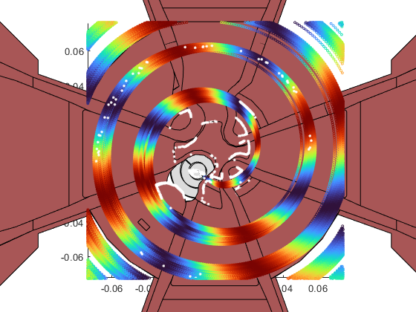
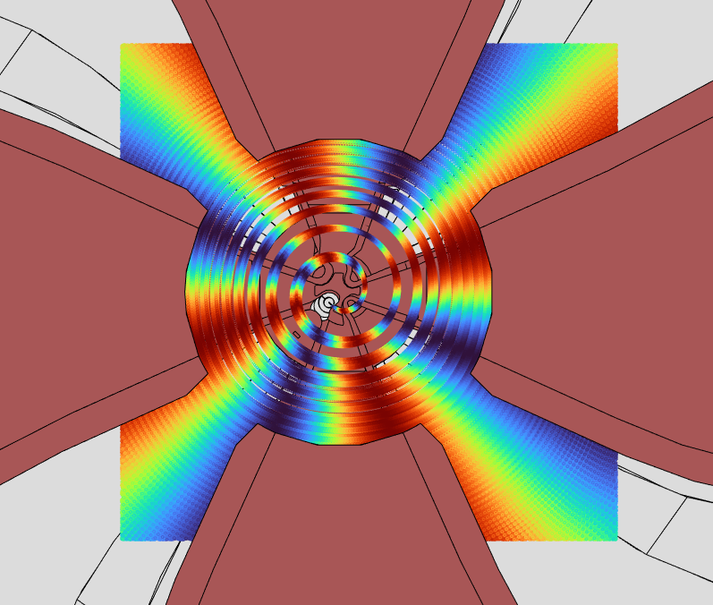
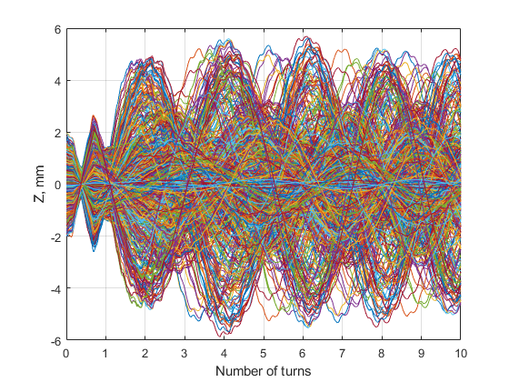
Beam trajectories in the central region. The color of the trajectories reflects the phase of oscillations of the elec-tromagnetic field of the accelerating system.
Transmission -10%

Slide 13
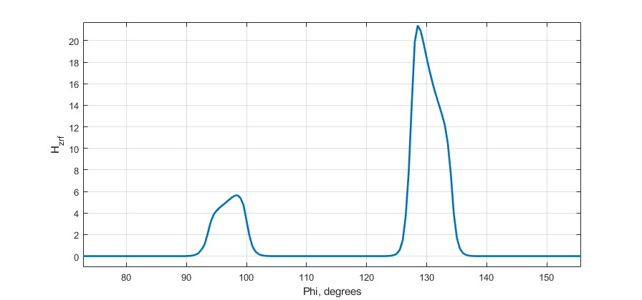
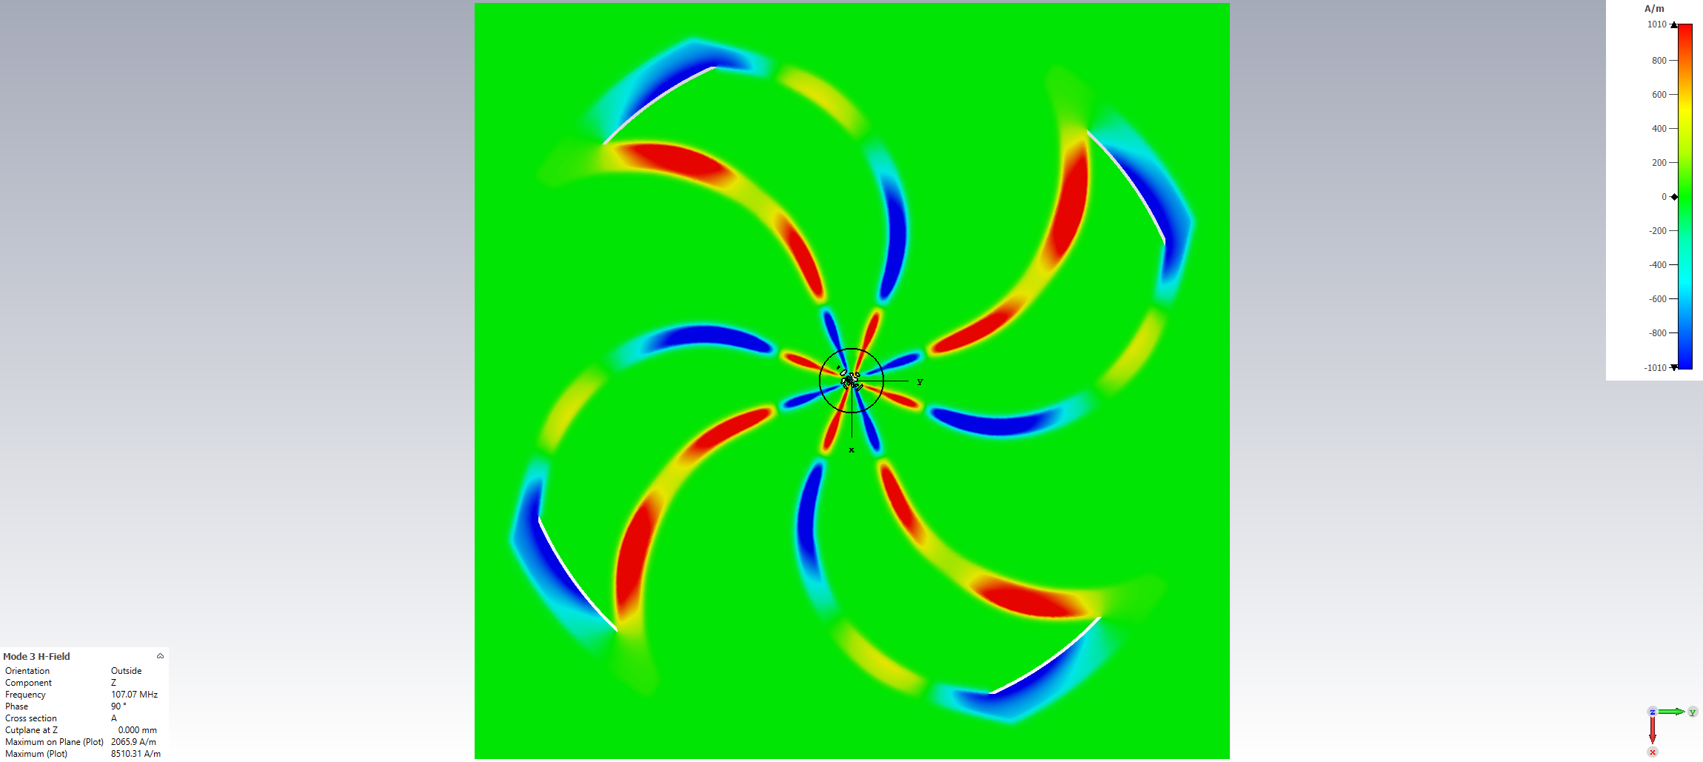
RF Magnetic field of the accelerating system of the cyclotron
The RF magnetic field of the accelerating system is shown in Figures below
Maximum value of the RF magnetic field in the accelerating gaps (R=1000 mm)
Magnetic field distribution of the accelerating system.

Slide 14
RF Magnetic field of the accelerating system of the cyclotron
Therefore, it is important to estimate the magnitude of the possible influence of the magnetic field of the accelerating system on the motion of the beam. To carry out such an assessment, the magnetic field map of the accelerating system was used for beam tracking.
It is known that in cyclotrons with spiral-shaped accelerating resonators, the magnetic field of the accelerating system can influence the beam motion. In the MSC 230 cyclotron, the azimuthal width of the resonators in the output zone is about 27 degrees, which is significantly less than the optimal width for the fourth acceleration harmonic.
Phase motion of the beam during acceleration with (yellow color) and without taking into account the magnetic field of the accelerating system (red color).
Азимутальная протяженность резонатора (между максимумами электрического поля)

Slide 15
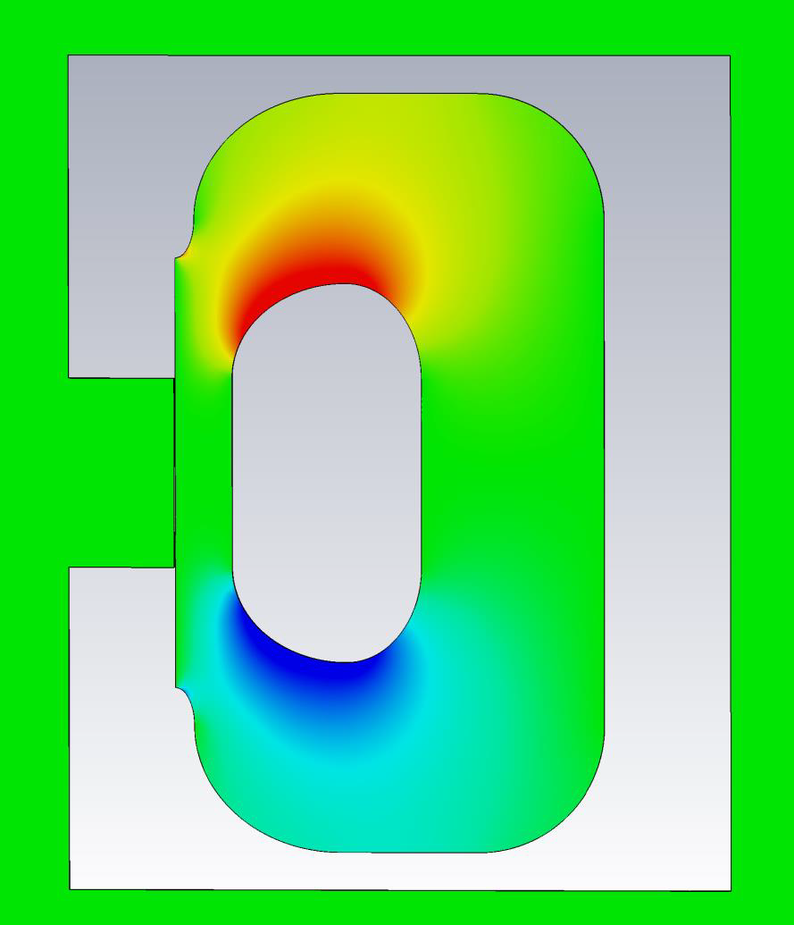
Beam extraction (first harmonic of the magnetic field <5 G)
Beam profile on the entrance to the deflector
Horizontal emittance ε_{x} = 1.4 π mm⋅mrad,
Vertical emittance ε_{z} = 0.8 π mm⋅mrad,
Energy spread δW = ±0.5%.
Losses 20%
Septum (thickness 0.15 mm)

Slide 16
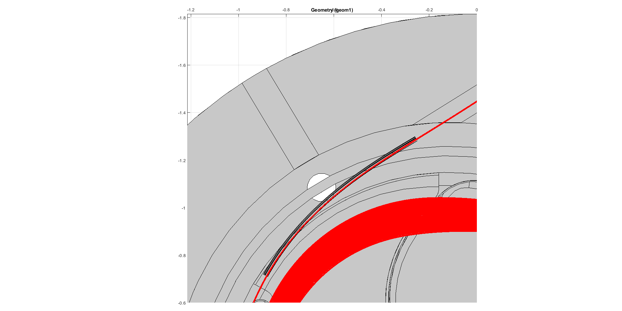
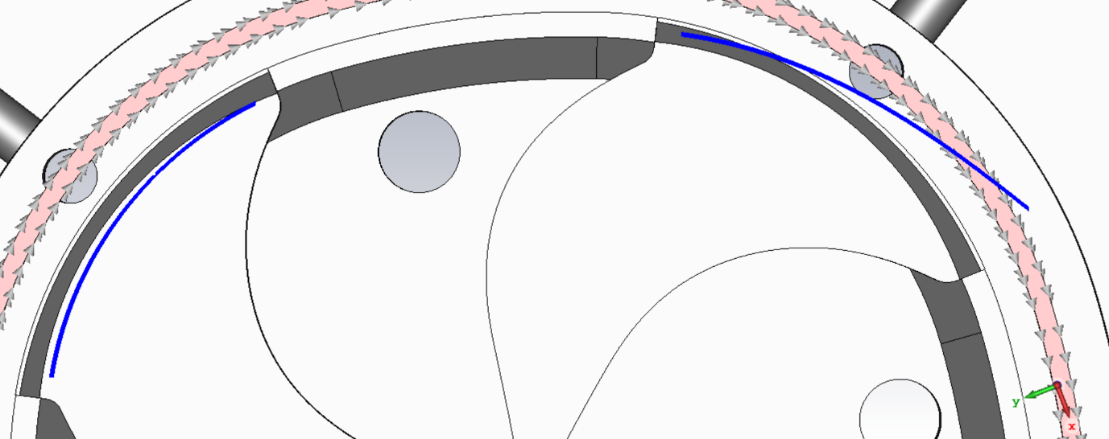
Beam extraction (first harmonic of the magnetic field <5 G)
 | MC1 | MC2
Aperture | 10 mm | 10 mm
Gradient | 100 Gs/mm | 1700Gs/mm
Bz shift | -600 Gs | 0 Gs
Magnet channels’ position is marked by blue color

Slide 17
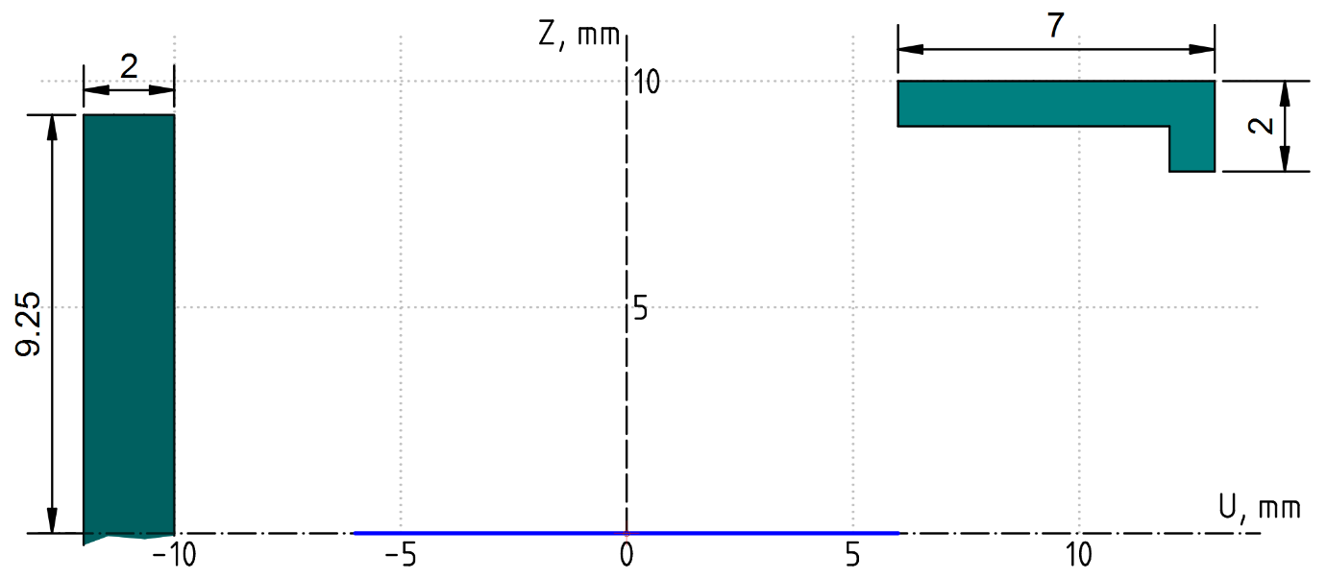
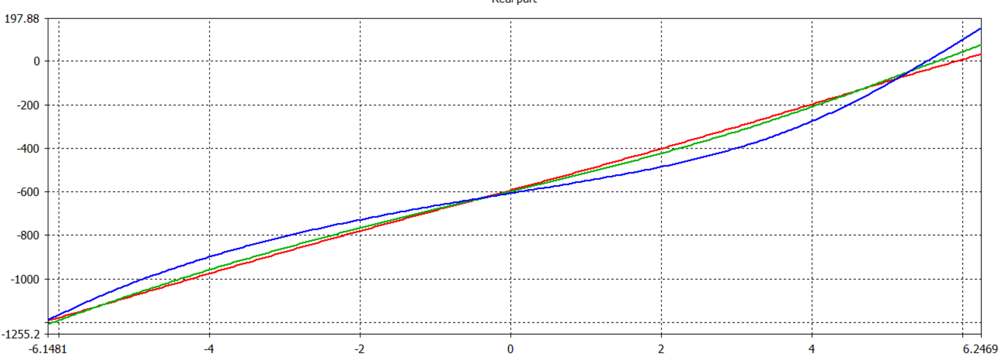
Beam extraction. First magnetic channel.
Cross section of the MC1 corrector (upper half).
Blue line – from -6 to 6 mm,
0 mm is the position of the central particle.
Field change by channel ( in Gauss)
for Z = 0mm (red), 3 mm (green), 5 mm (blue)

Slide 18
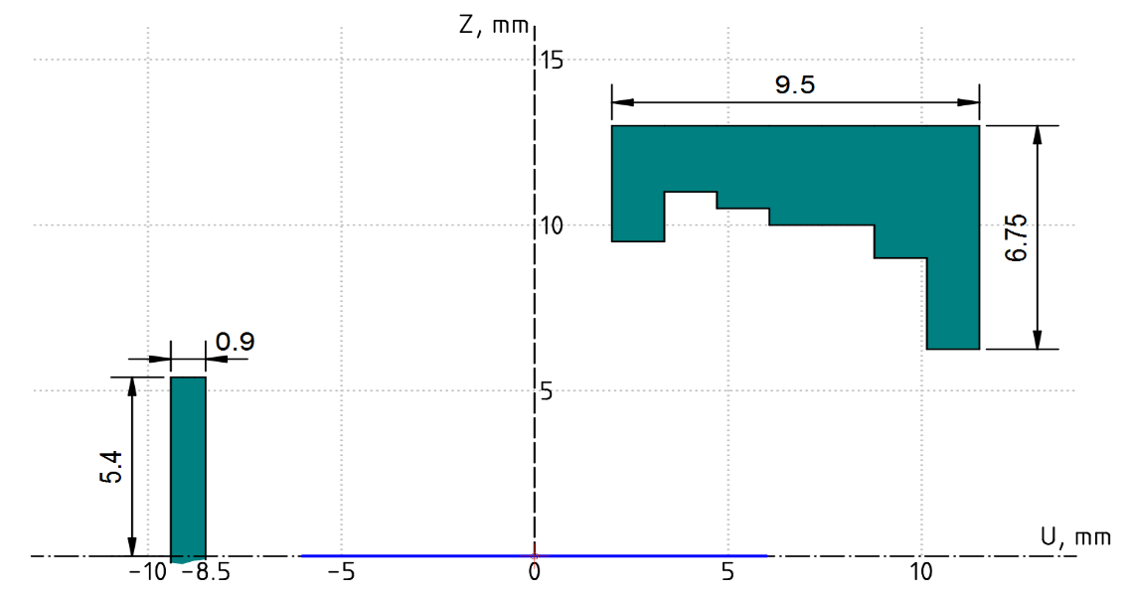
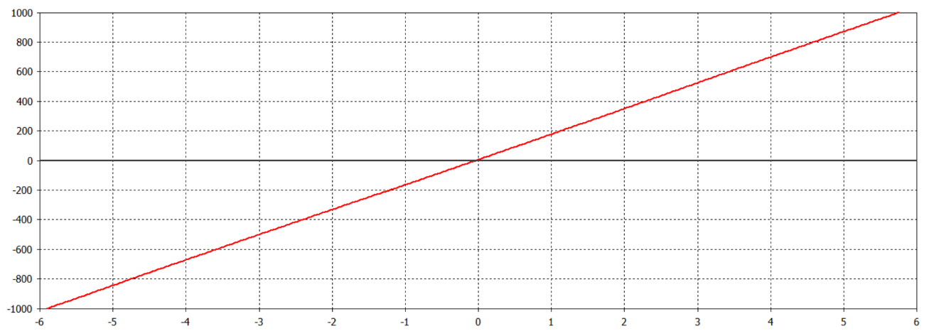
Beam extraction. Second magnetic channel.
Cross section of the MC2 corrector (upper half).
Blue line – from -6 to 6 mm,
0 mm is the position of the central particle.
Contribution of MC2 to the magnetic field.

Slide 19
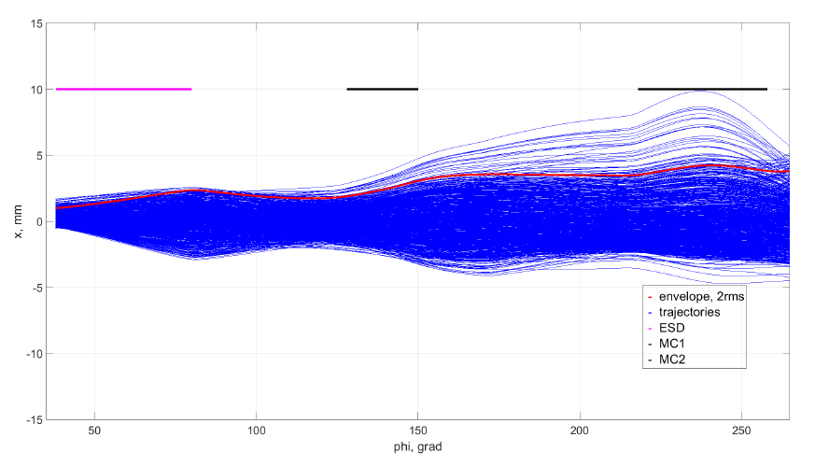
Beam extraction
Extracted beam, horizontally
Horizontal emittance at the exit out of the cyclotron is about ~ 8 π ⋅mm ⋅mrad,
Extracted beam, vertically
Vertical emittance at the exit out of the cyclotron is about ~ 2 π ⋅mm ⋅mrad

Slide 20
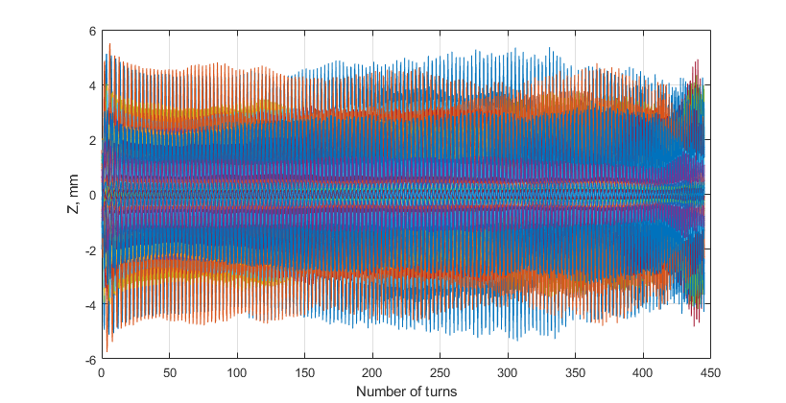
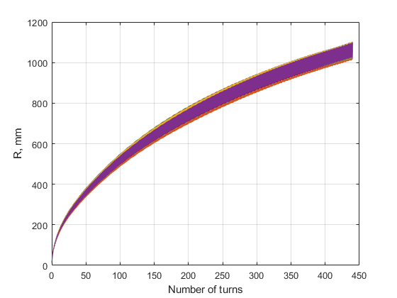
Beam tracing in the acceleration zone
(first harmonic of the magnetic field 30 G)

Slide 21
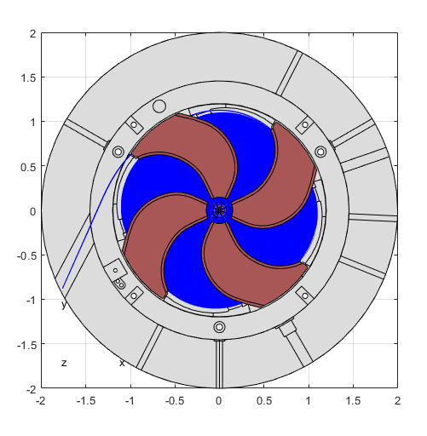
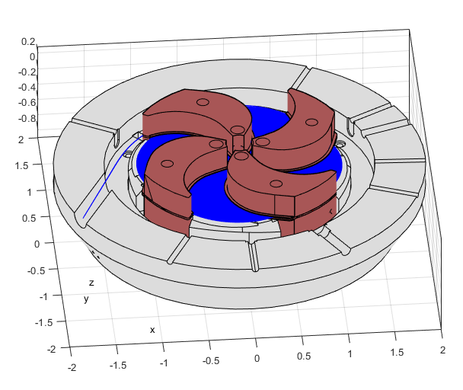
Beam acceleration from ion source to exit
We limited the electric field in the deflector to 100 kV/cm.
The beam, deflected by the deflector, passes through accelerating RF resonators and magnetic channels. Passive magnetic channels are located between the sectors, the first reduces the average magnetic field by 2000 G and provides a gradient of 1000 G/cm, the second provides a gradient of 1700 G/cm.
Tracing the beam from the ion source to the exit from the cyclotron.

Slide 22
Any questions?
Thank you for your attention!

