Slide 1
The CMS Tier1 at JINR: five years of operations
Andrey Baginyan, Anton Balandin, Sergey Belov,
Andrey Dolbilov, Alexey Golunov, Natalia Gromova,
Ivan Kadochnikov, Ivan Kashunin, Vladimir Korenkov, Valery Mitsyn,
Igor Pelevanyuk, Sergei Shmatov, Tatiana Strizh, Vladimir Trofimov,
Nikolay Voytishin, Victor Zhiltsov
JOINT INSTITUTE FOR NUCLEAR RESEARCH

Slide 2
How we started
Main functions
Infrastructure
Network and telecommunication channels
Servers to support the grid-WLCG environment
Resources
Monitoring
How it works

Slide 3
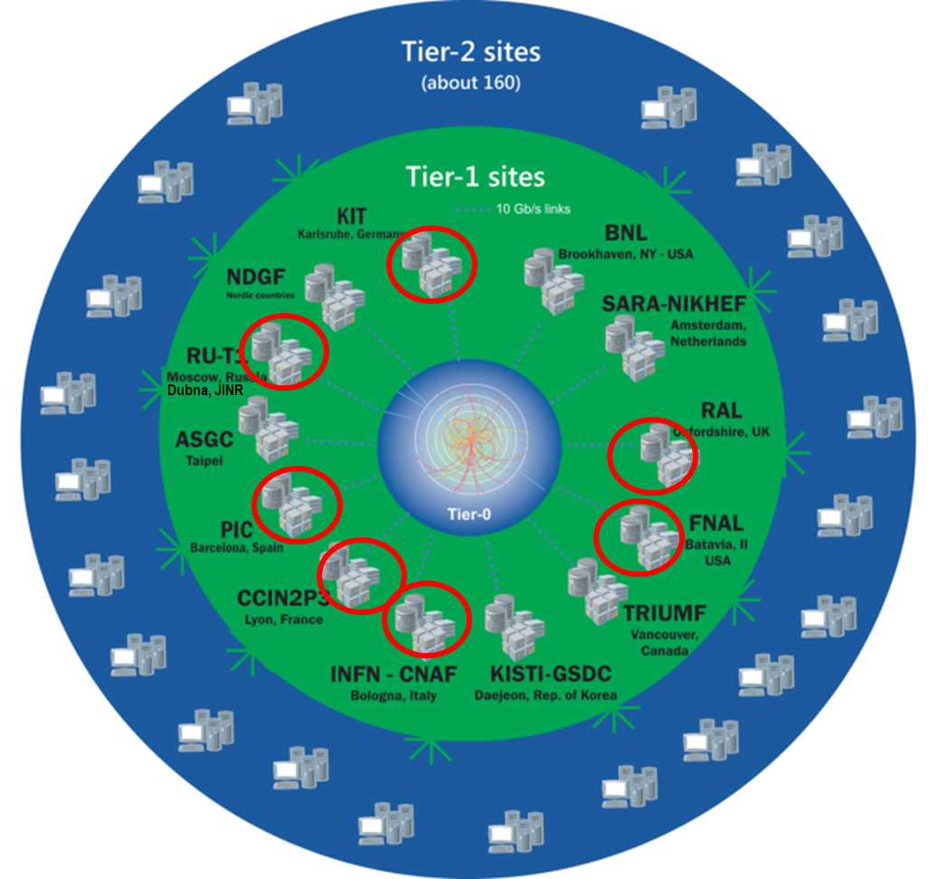
LHC Computing Model + WLCG
WLCG computing enabled physicists to announce the discovery of the Higgs Boson on 4 July 2012
42 countries
170 computing centres
2 million tasks run every day
800,000 computer cores
500 petabytes on disk and
400 petabytes on tape
Tier-0 (CERN):
Data recording
Initial data reconstruction
Data distribution
Tier-1 (14 centres):
Permanent storage
Re-processing
Analysis
Simulation
Tier-2 :
Simulation
End-user analysis

Slide 4
Joint NRC "Kurchatov Institute" – JINR Tier1 Computing Centre
Proposal to create the WLCG Tier1 center in Russia: March 2011, accepted in October 2012
The Federal Target Programme Project: «Creation of the automated system of data processing for experiments at the LHC of Tier1 level and maintenance of Grid services for a distributed analysis of these data»
Duration: 2011 – 2013
Russia Tier1 full scope start-up in WLCG in 2014
NRC “Kurchatov Institute” supports ATLAS, ALICE and LHCb, JINR supports CMS (Compact Muon Solenoid)
Systematic increase of computing capacity and data storage is needed in accordance with the experiment requirements
Notes:
4
The primary Tier-1 tasks can be divided into:
recording raw data from CERN and storing them on tape (critical);
recording processed data from CERN and storing them on disk (less critical);
providing data to other Tier-1 / Tier-2;
reprocessing raw data;
event simulation calculations.

Slide 5
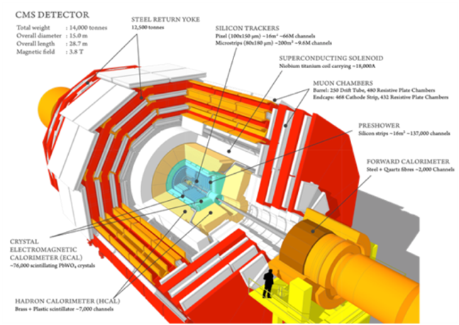
Main functions of the Tier1 site
Receiving of experimental data from a Tier0 site in the volume determined by the WLCG agreement
Archiving and custodial storage of part of experimental RAW data
Consecutive and continuous data processing
Additional processing (skimming) of RAW, RECO (RECOnstructed) and AOD (Analysis Object Data) data
Data reprocessing with the use of new software or new calibration and alignment constants of parts of the CMS setup
Making available AOD data-sets
Serving RECO and AOD datasets to other Tier1/Tier2/Tier3 sites for their duplicated storage (replication) and physical analysis
Running production reprocessing with the use of new software and new calibration and alignment constants of parts of the CMS setup, protected storage of the simulated events
Production of simulated data and data analysis recorded by the CMS experiment

Slide 6
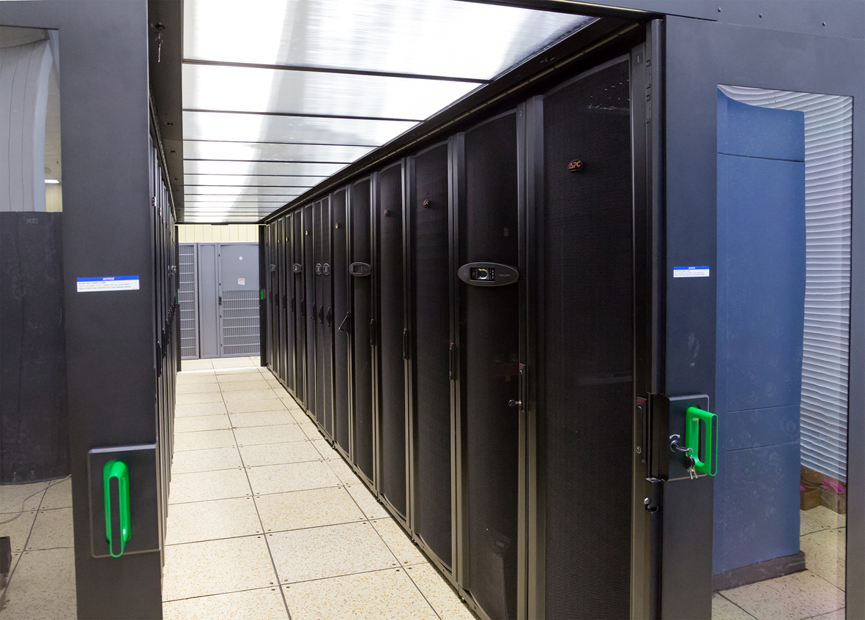
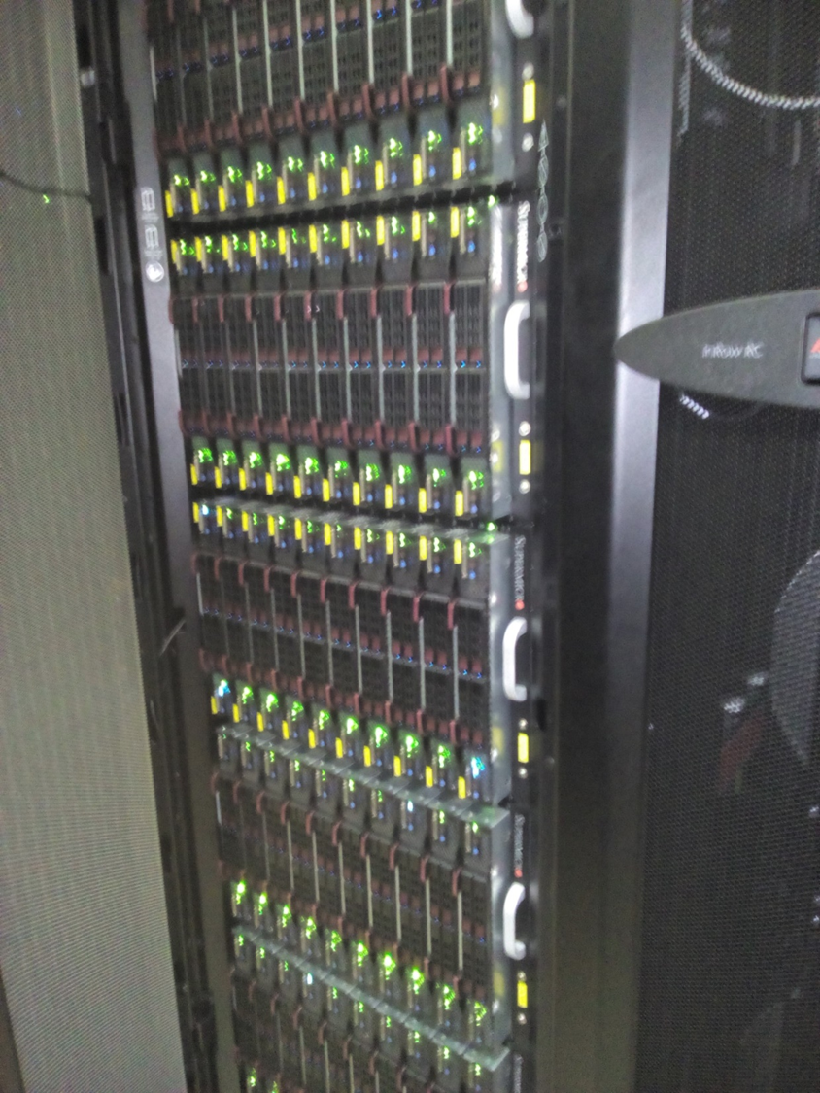
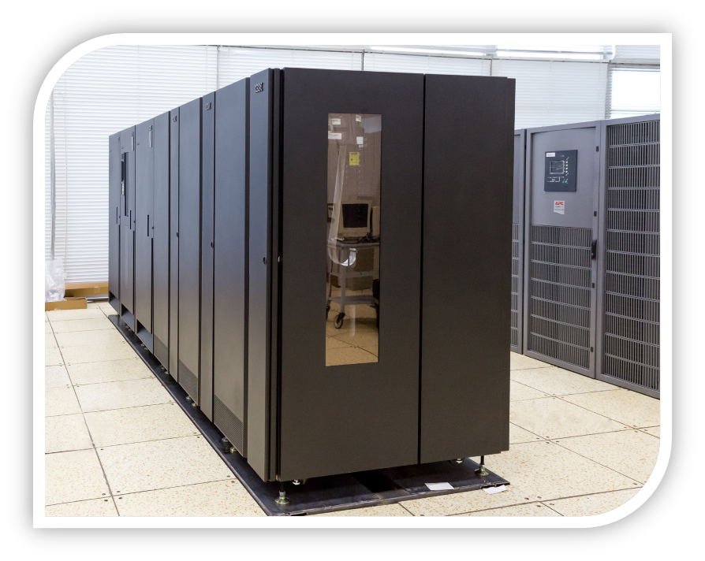
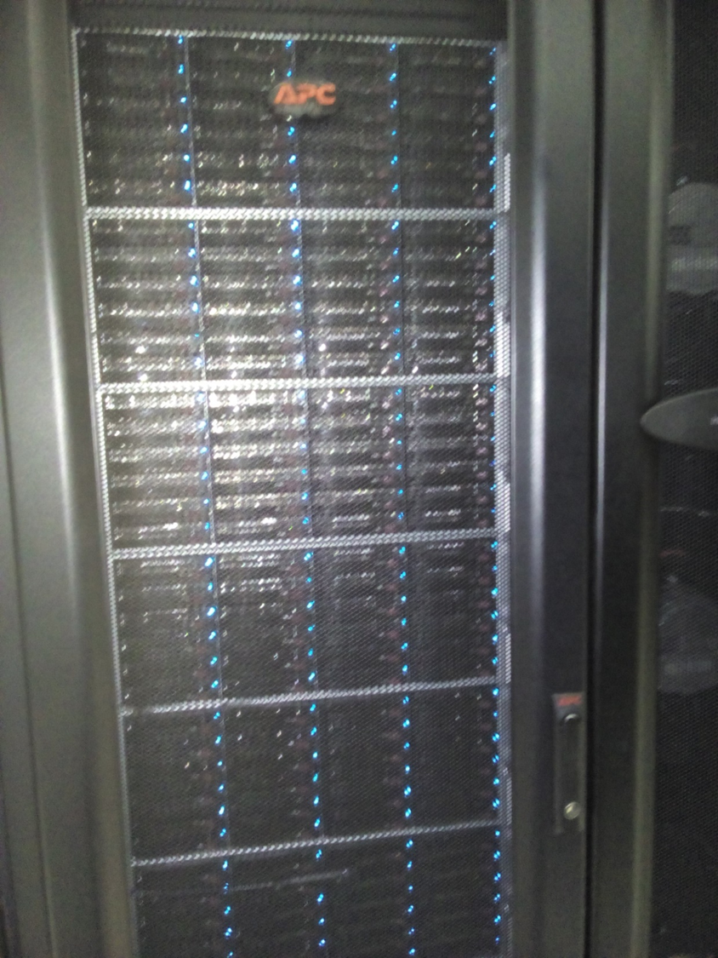
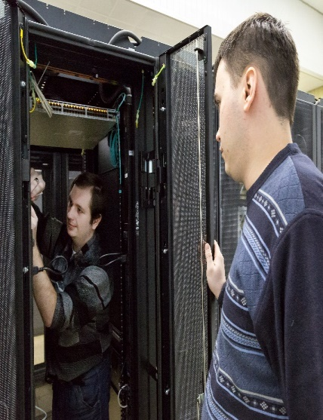
Tier1
JINR participation in Worldwide LHC Computing Grid (WLCG)
Grid Tier1 is one of the 7 centres in the world intended for large-scale processing of experimental and event-modeling data coming from the centres of Tier0 (CERN), as well as Tier1 and Tier2 of the Worldwide Computing Grid WLCG for the CMS experiment. This component is considered as a prototype of the system of processing and storage of the experimental data from the mega-project NICA as a centre of Tier0 and Tier1.

Slide 7
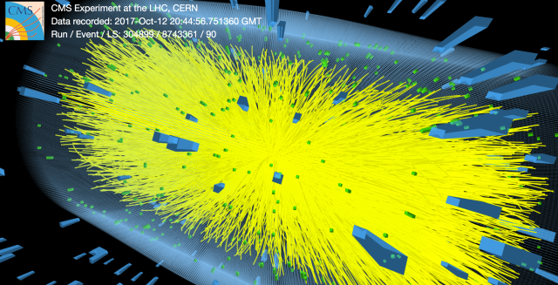
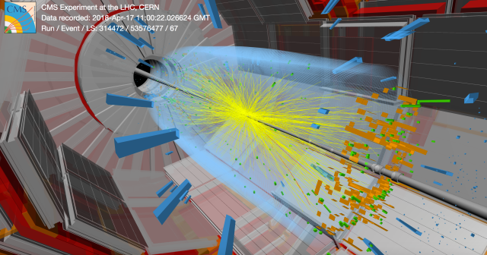
In agreement with the CMS Computing model, the JINR Tier1 site will provide:
acceptance of an agreed share of raw data and Monte Carlo data and provision of access to the stored data by other CMS Tier2/Tier3 sites of the WLCG
will serve FTS-channels for Russian and Dubna Member States Tier2 storage elements including monitoring of data transfers
Tier1 provides
USER-VISIBLE SERVICES
SOME SPECIALIZED SYSTEM-LEVEL SERVICES
Mass storage system
Site security
Prioritization and accounting
Database Services
Data Archiving Service
Disk Storage Services
Data Access Services
Reconstruction Services
Analysis Services
User Services

Slide 8
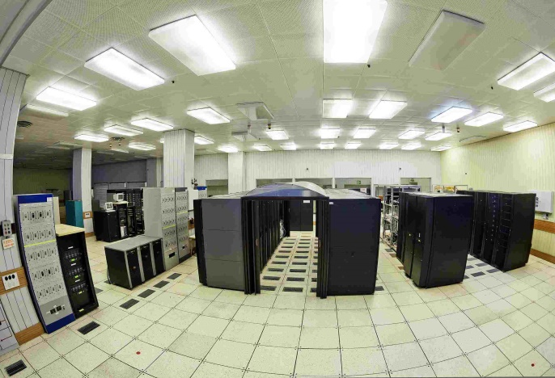
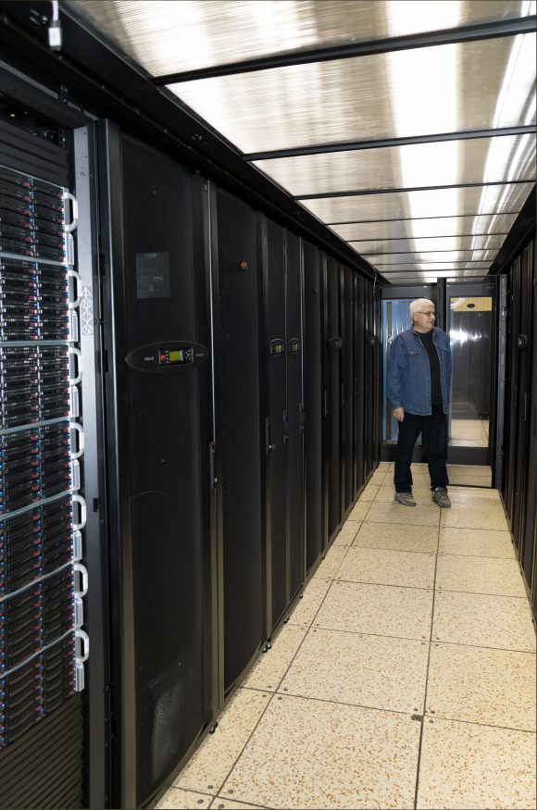
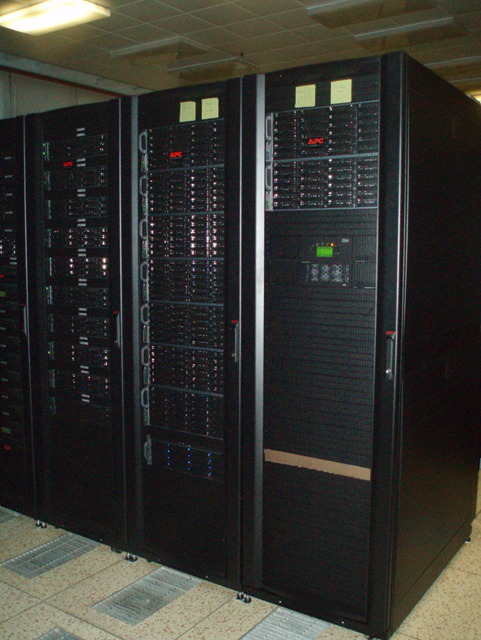
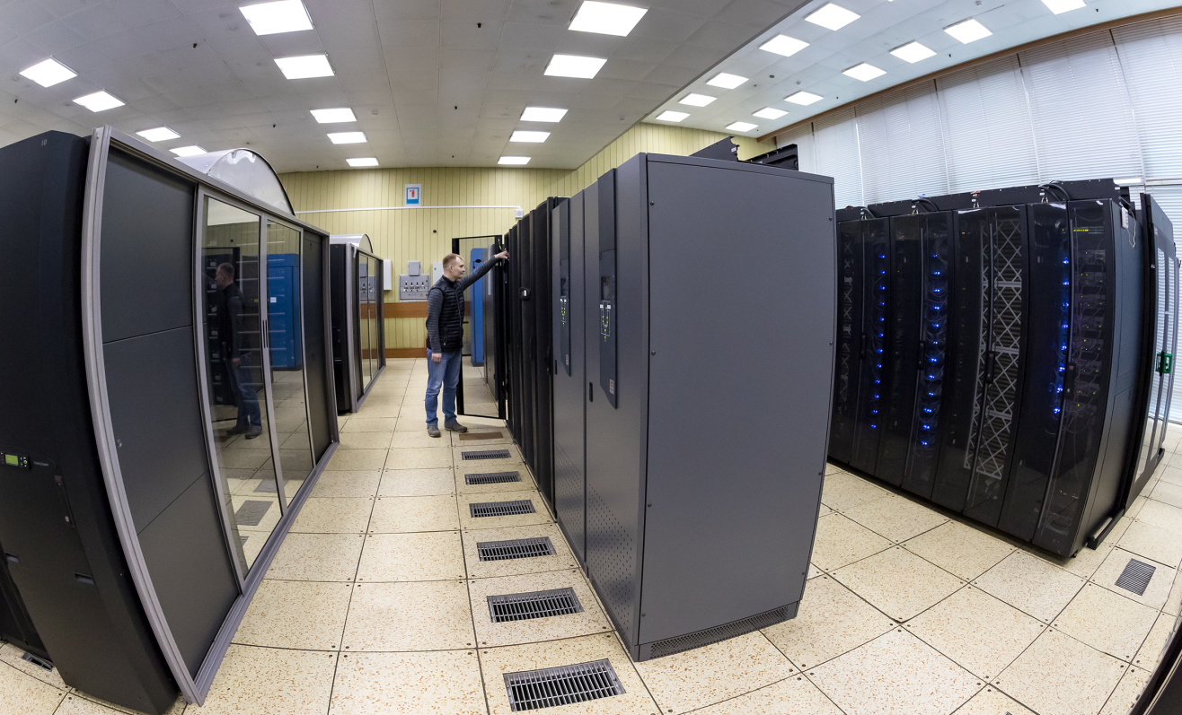
Tier1 prototype
Free space
2014
2018
CPU (HEPSpec06) | 14 400
Disk (Terabytes) | 660
Tape (Terabytes) | 72
CPU (HEPSpec06) | 72 310
Disk (Terabytes) | 8 319
Tape (Terabytes) | 10 825

Slide 9
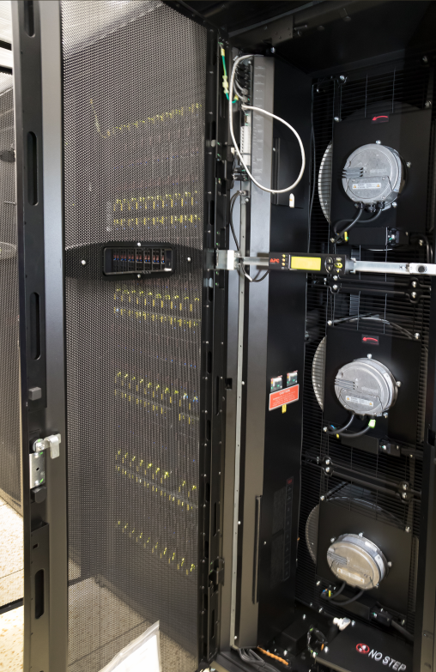
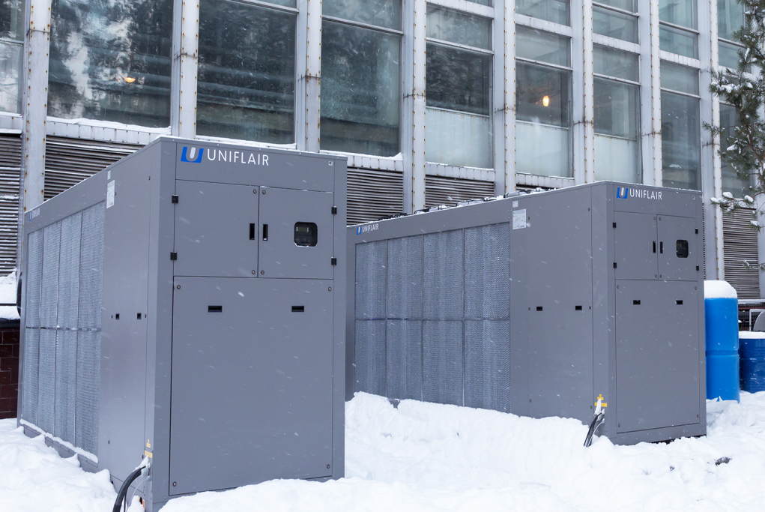
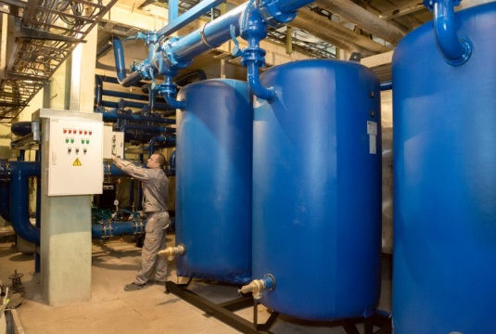
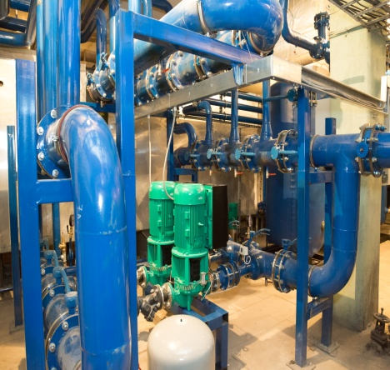
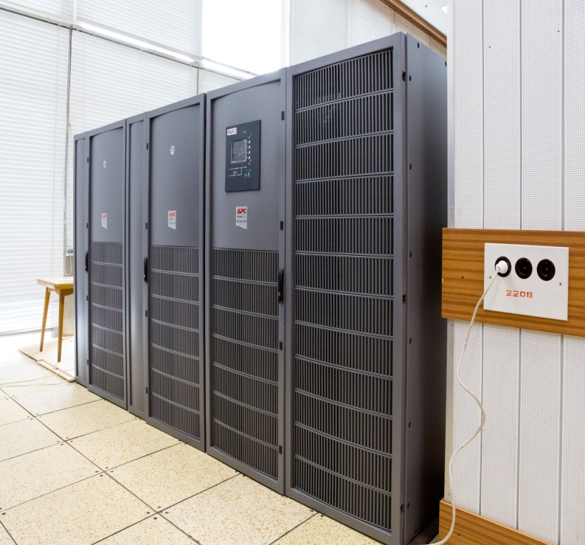
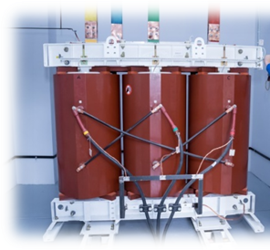
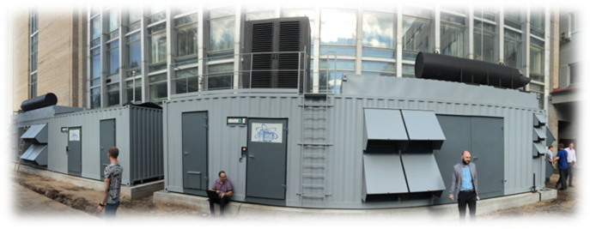
Tier1 Infrastructure
Close-coupled, chilled water cooling InRow
Hot and cold air containment system
MGE Galaxy 7000 – 2x300 kW energy efficient solutions 3Ph power protection with high adaptability
Installation of two new transformers (2.5 MW)
Guaranteed power supply using two diesel generators
Notes:
На базе Центрального информационно-вычислительного комплекса ОИЯИ (ЦИВК ОИЯИ) развивается Многофункциональный центр хранения, обработки и анализа данных, который призван обеспечить широкий спектр возможностей пользователям на основе входящих в него компонент: грид-инфраструктура уровня Tier1 и Tier2 для поддержки экспериментов на LHC (ATLAS, Alice, CMS, LHCB), FAIR (CBM, PANDA) и других масштабных экспериментов; вычислительный кластер общего назначения; инфраструктура «Облачных вычислений»; вычислительный гетерогенный кластер HybriLIT; учебно-исследовательская инфраструктура для распределенных и параллельных вычислений.
В 2014 году проводились интенсивные работы по модернизации инженерной инфраструктуры Многофункционального центра, была введена в эксплуатацию новая система охолождения, установлен новый источник бесперебойного питания, установлен ленточный робот и вычислительные модули.
The existing Central Information and Computing Complex of JINR (CICC JINR) is evolving into a Multifunctional Centre for Data Storage, Processing and Analysis aimed at providing to its users a wide range of possibilities through its main components: a grid-infrastructure at Tier1 and Tier2 levels devoted to the support of the LHC experiments (ATLAS, ALICE, CMS, LHCb), FAIR (CBM, PANDA) and other large-scale experiments; a general purpose computing cluster; a cloud computing infrastructure; the heterogeneous computing cluster HybriLIT; an education and research infrastructure for distributed and parallel computations.
In 2014 works on the modernization of the underlying engineering infrastructure of the Multifunctional Center were done: a new cooling system was brought into operation; there were installed a new uninterruptible power supply unit, a tape robot, and computing modules.
9

Slide 10
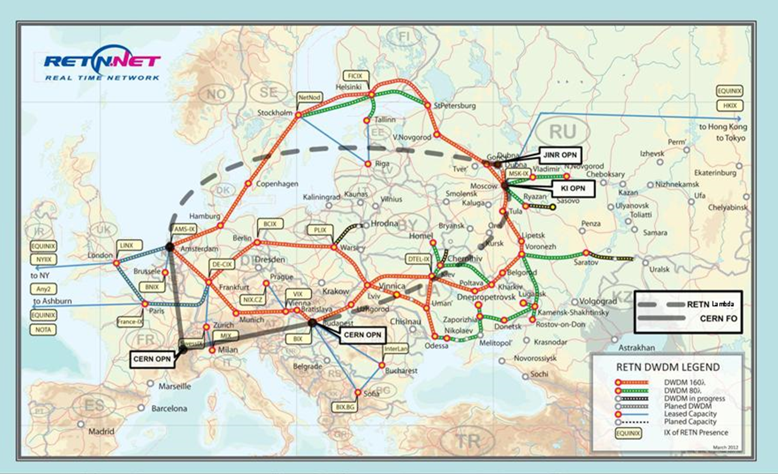
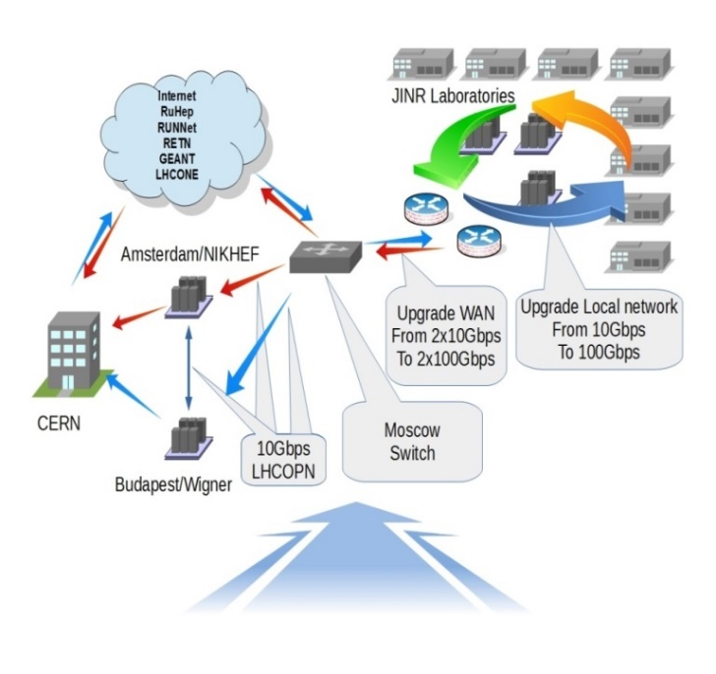
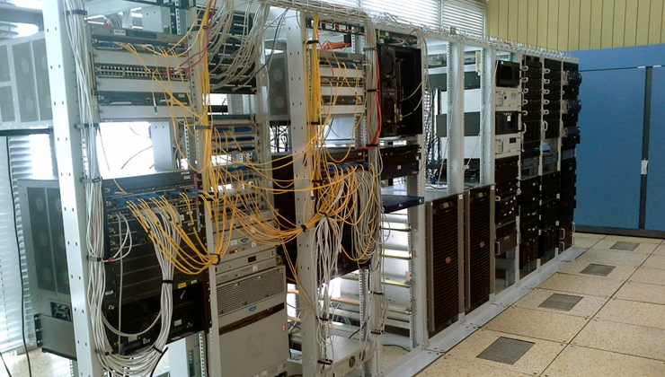
Network and telecommunication channels
One of the most important components of JINR Tier1 providing access to resources and the possibility to work with the big data is a network infrastructure.
Local Area Network – 10 Gbps,
planned upgrade to 100 Gbps
Wide Area Network – 100Gbps,
LHCOPN - 2x10Gbps
LHCONE – 10 Gbps
Upgrade WAN to 2x100Gbps planned
IPv6/IPv4

Slide 11
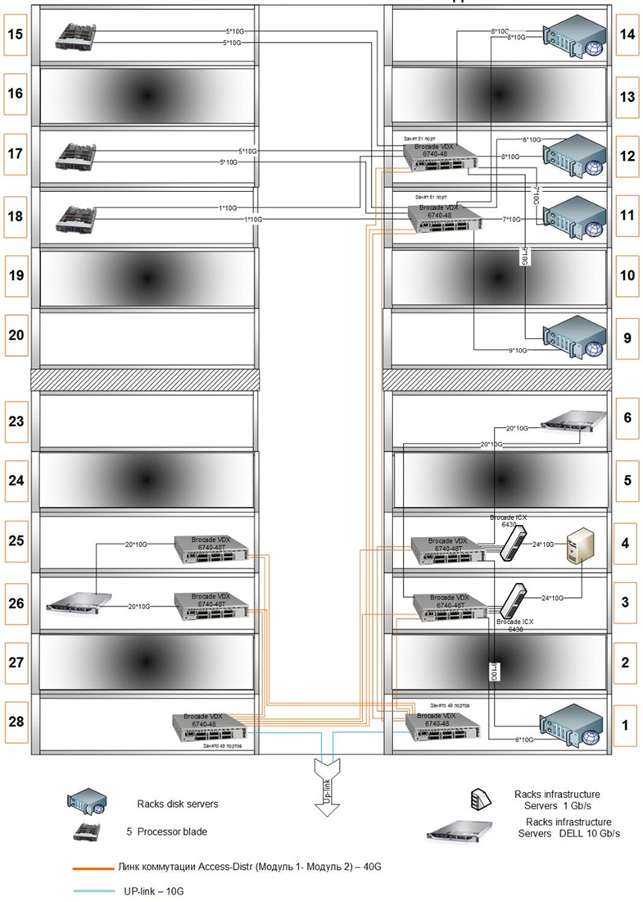
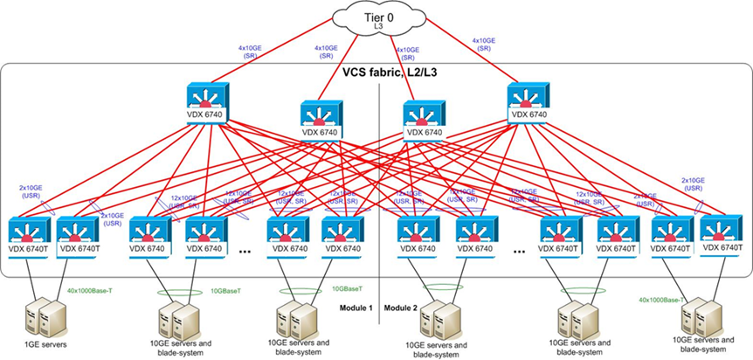
Tier1 network –BROCADE factory
Diagram of a network architecture implemented Tier1 module. The module consists of twenty-four (24) racks, sixteen (16) of which are filled with a server equipment, and eight (8) allocated for the module cooling and to create the desired climate. Ten (10) racks are filled with disk servers. Three (3) racks are allocated by the computing blade servers. Servers that provide Grid infrastructure occupy three (3) racks.

Slide 12
Servers to support the grid-WLCG environment
WLCG services are installed with software EMI-3.
Currently, 21 services WLCG are installed to provide:
user and virtual organizations (VO) authorization;
task run from VO remote services.
the WLCG information system;
different algorithms of remote testing and verification of the service environment on local resources.
Logical structure of the Tier1

Slide 13
Tier1 resources

Slide 14
Storage Elements(SE)
Storage System: dCache
* Hardware
Typically Supermicro and DELL
1st - Disk Only:
31 disk servers: 2 x CPU (Xeon E5-2650 @ 2.00GHz); 128GB RAM; 112TB h/w ZFS (24x6000GB NL SAS); 2x10G.
12 disk servers: 2 x CPU (Xeon E5-2660 @ 2.60GHz); 128GB RAM; 70TB ZFS (16x6000GB NL SAS); 2x10G.
8 disk servers: 2 x CPU (Xeon E5-2650 @ 2.29GHz) 128GB RAM; 150TB ZFS (24x8000GB NLSAS), 2x10G
12 disk servers: 2 x CPU (Xeon E5-2660 @ 2.60GHz) 128GB RAM; 150TB ZFS (24x8000GB NLSAS), 2x10G
Total space: 7.2PB
3 head node machines: 2 x CPU (Xeon E5-2683 @ 2.00GHz); 128GB RAM; 4x1000GB SAS h/w RAID10; 2x10G.
8 KVM for access protocols support.
2nd - support Mass Storage System:
8 disk servers: 2xCPU (Xeon X5650 @2.67GHz); 96GB RAM; 63TB h/w RAID6 (24x3000GB SATAIII); 2x10G; Qlogic Dual 8Gb FC.
8 disk servers: 2 x CPU (E5-2640 v4 @ 2.40GHz); 128GB RAM; 70TB ZFS (16x6000GB NLSAS); 2x10G; Qlogic Dual 16Gb FC.
Total disk buffer space: 1.1 PB.
1 tape robot: IBM TS3500, 10 PB
3440xLTO-6 data cartridges; 12xLTO-6 tape drives FC8.
3 head node machines: 2 x CPU (Xeon E5-2683 v3 @ 2.00GHz); 128GB RAM; 4x1000GB SAS h/w RAID10; 2x10G.
6 KVM machines for access protocols support
* Software
dCache-3.2
Enstore 4.2.2 for tape robot.
Tier1 resources
2018
Computing Elements (CE)
* Worker Node (WN)
Typically SuperMicro Blade
100 64-bit machines: 2 x CPU (Xeon X5675 @ 3.07GHz, 6 cores per processor); 48GB RAM, 2x1000GB SATA-II; 2x1GbE.
175 64-bit machines: 2 x CPU (Xeon E5-2680 v2 @ 2.80GHz, 10 cores per processor), 64GB RAM; 2x1000GB SATA-II; 2x1GbE.
Total: 4720 core/slots for batch.
* Software
OS: Scientific Linux release 6 x86_64.
BATCH : Torque 4.2.10 (home made)
Maui 3.3.2 (home made)
CMS Phedex

Slide 15
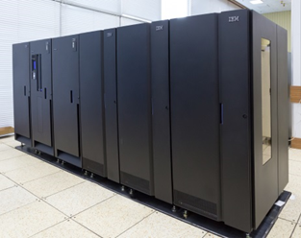
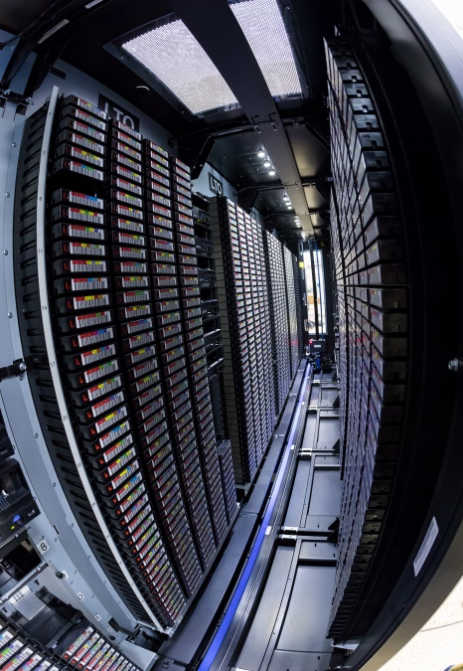
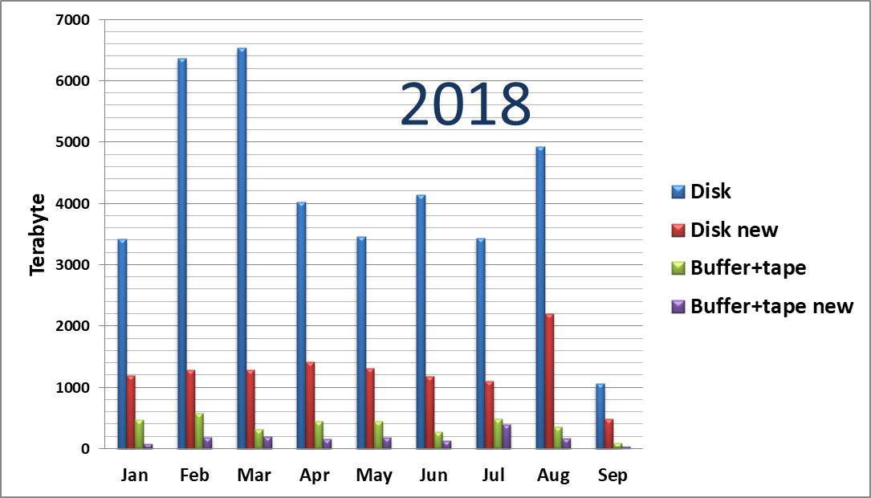
Tier1 data exchange 2017 - 2018
157 sites worldwide reads data from our
SE Buffer+Tape
140 sites writes new file
Leaders are CERN, KIT(Germany), RAL (UK)
316 sites worldwide reads data from our
SE Disk only
150 sites writes new files
SE disk only 2018
Total 36.50 PB
new files 11.19 PB
SE Buffer + Tape 2018
Total 6.78 PB
new files 3.38 PB
SE Buffer + Tape 2017
Total 3.64 PB
new files 1.52 PB

Slide 16
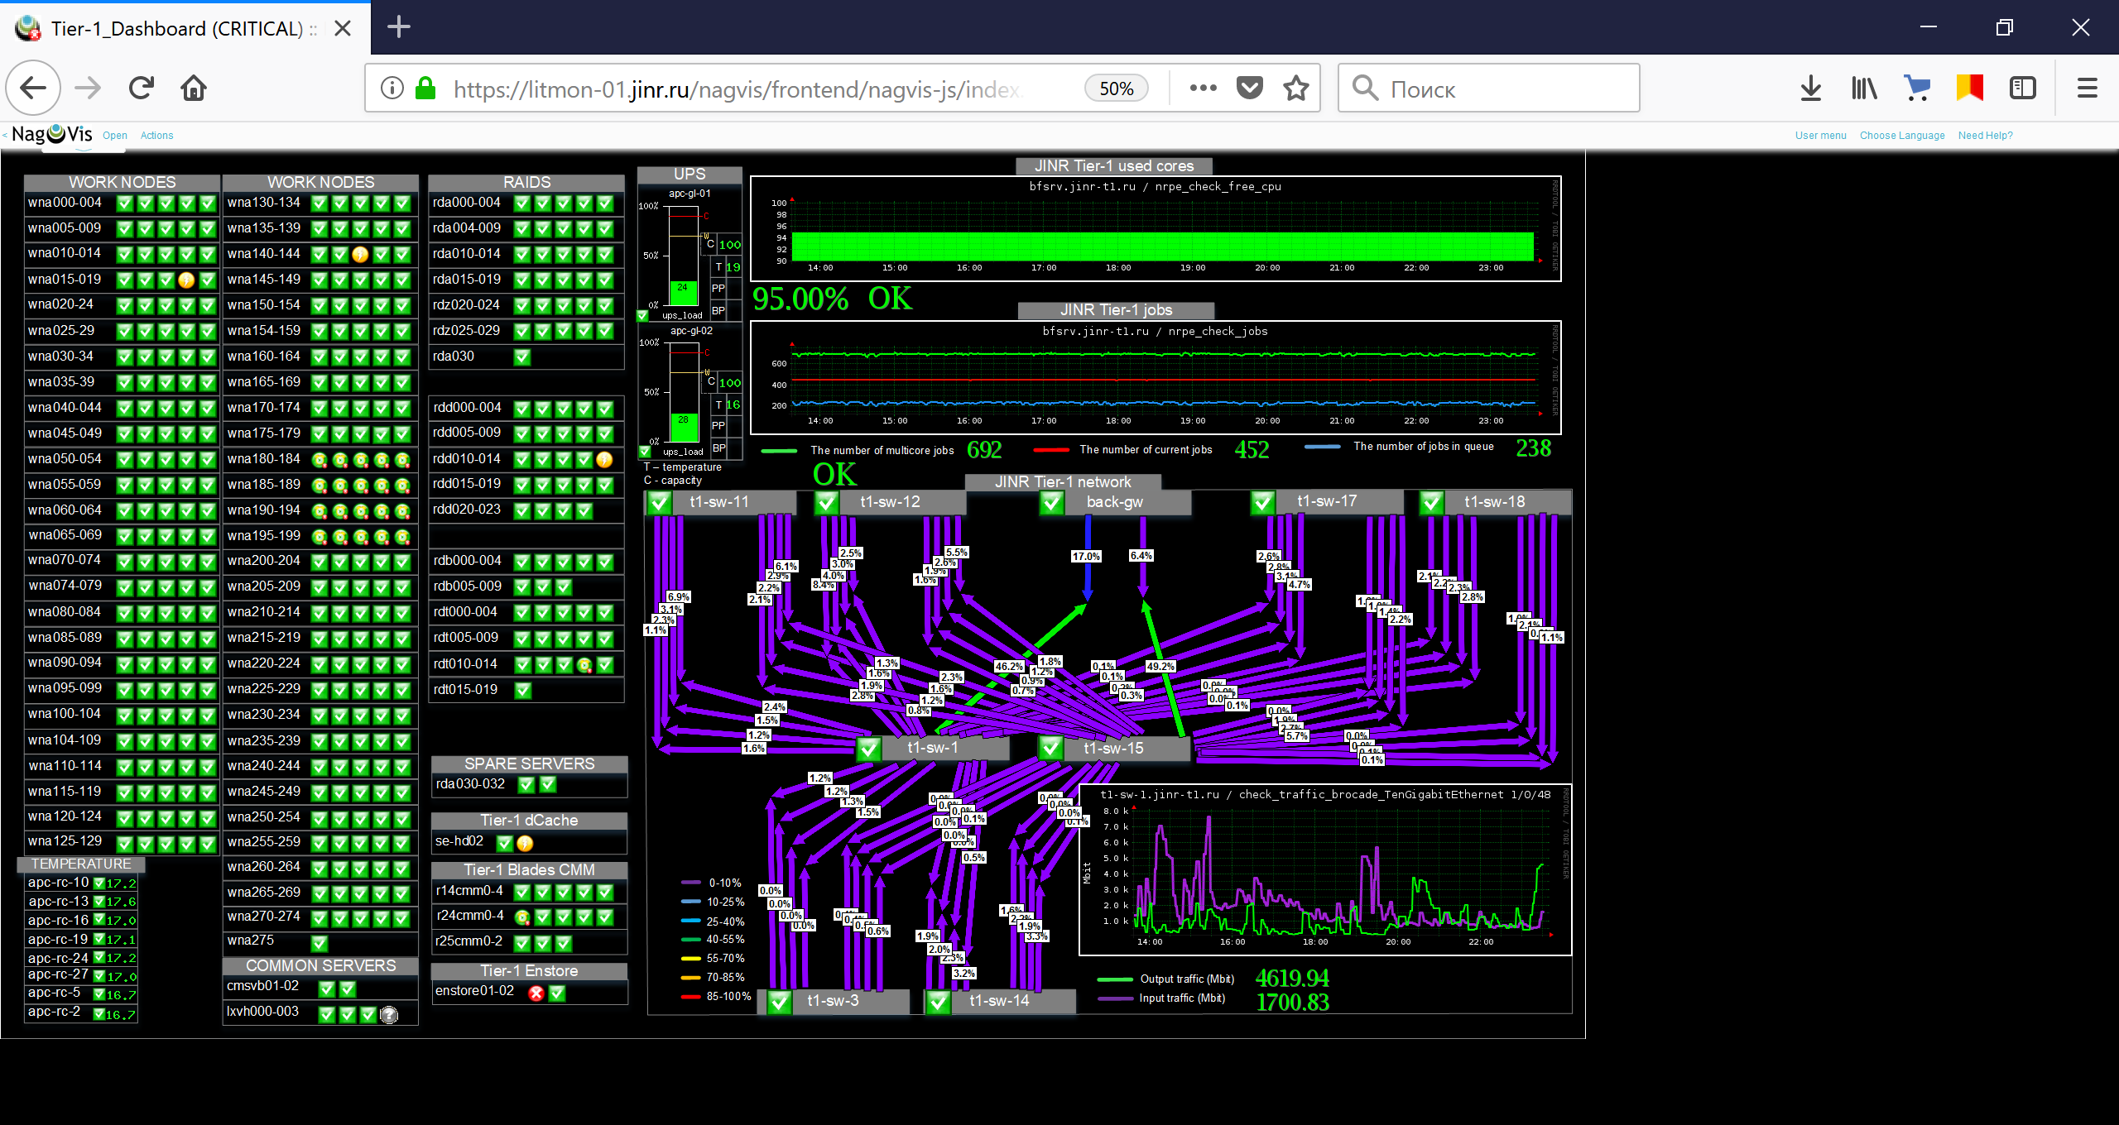
Tier1 hardware monitoring +
For a robust performance of the complex it is necessary to monitor the state of all nodes and services - from the supply system to the robotized tape library.
Monitoring data are
collected from the wide
range of hardware and
software related to Tier1
cooling systems,
temperature sensors,
uninterruptable power
supplies (UPS),
computing servers,
disk arrays,
managing services,
L2 and L3 switches/routers
tape robot.
~ 850 elements are under
observation
~ 8000 checks in real time
~ 100 scripts
The system allows one, in a real time mode, to observe the whole computing complex state and send the system alerts to users via e-mail, sms, etc.

Slide 17
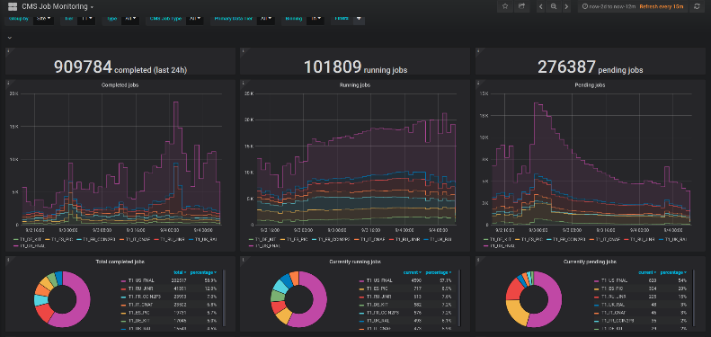
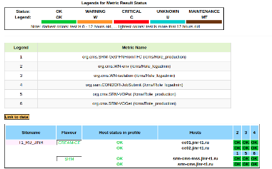
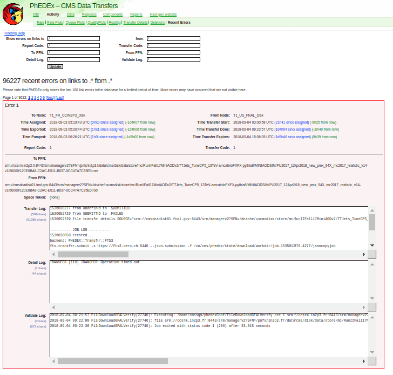
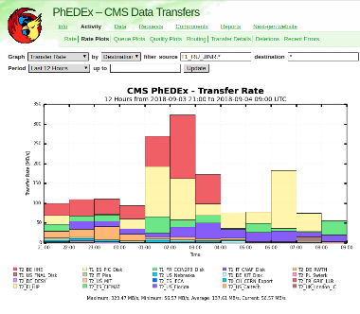
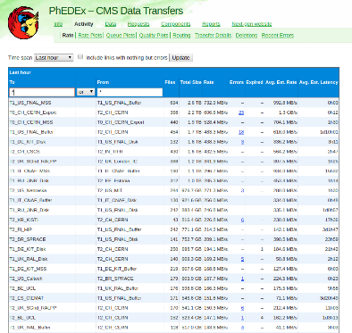
Tier1 services
Apart from hardware metrics, service metrics are scattered among many internal and external systems.
This information relates to
data transfers,
data storage,
data processing.
In order to keep track of the services admin should regularly check several dozens of web pages. Interpretation of data is more complex.
Aim is:
Provide a single source of aggregated monitoring information.
Perform basic analysis of data and provide status of the system.

Slide 18
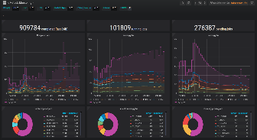
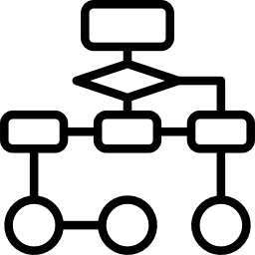
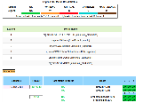
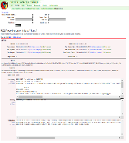
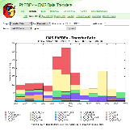
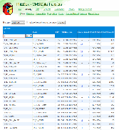
Tier1 services monitoring system (I)
Idea is to collect, aggregate and analyze data from different sources. Then provide in comprehensive form on the web page. In case of critical failures – inform administrators.
Web interface
Data Sources
Filter JINR related
Analyze
Database
Service statuses
Store the data

Slide 19
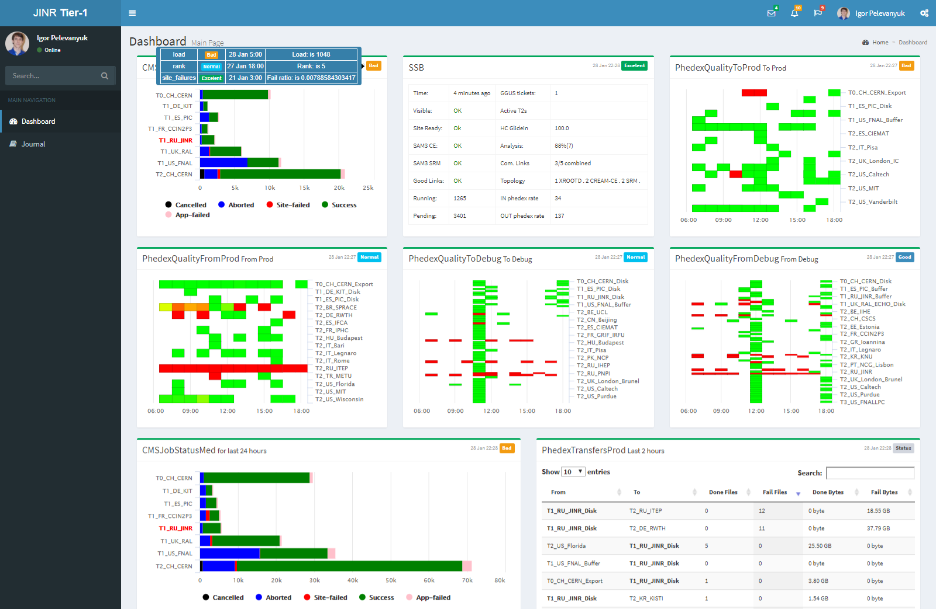
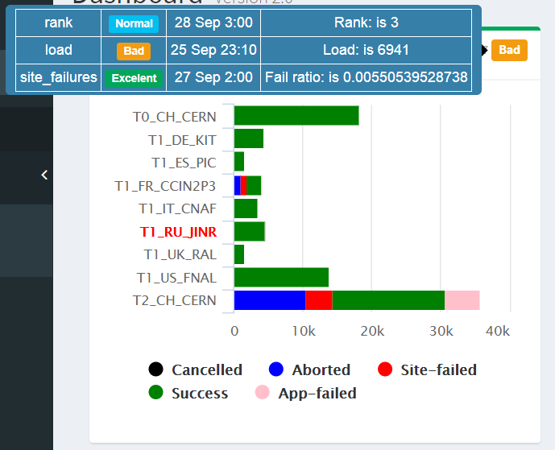
Tier1 services monitoring system (II)

Slide 20
PhEDEx operations: issues
PhEDEx system was designed to operate mostly automatically. But sometimes, due to different reasons it requires intervention to fix errors manually.
Source of information about errors is a corresponding PhEDEx webpage. Every error is a big form with source/destination site, time of assigned/start/done, PFNs to/from, transfer/detail/validate logs.
In order to simplify operation python script was written to list important errors and provide relevant information about them.
PhEDEx
check_phedex_errors.py
Type or errors:
nsf - No such file or directory
csmm - Checksum mismatch
smm - Size mismatch
uto - User timeout over
List of files in error state

Slide 21
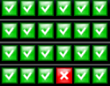
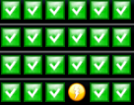
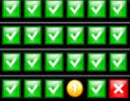
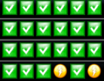
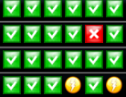
RAID6 -> ZFS RAIDZ2
We’ve experienced several difficulties while using h/w raid6 on FST pools:
Provides only one-way data consistency check (VD health status and PD presence)
No S.M.A.R.T data collection available, no info about physical drive (PD) temp./health.
Pre-fail condition HDD’s may suddenly faults while rebuilding is already in progress
>=3 faulted HDD’s in one pool makes data unavailable
- Segment OK
- Segment rebuilding
- Segment fault, inconsistent or
not present

Slide 22
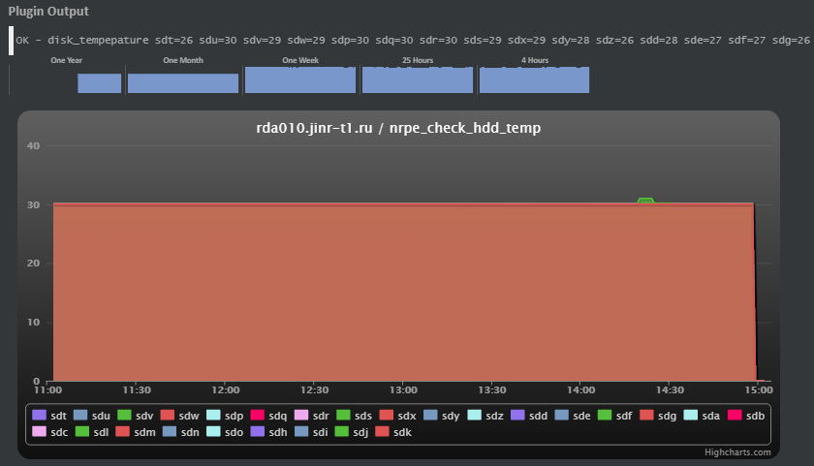
RAID6 -> ZFS RAIDZ2
With ZFS RAIDZ2 we have two-way data consistency check
In HBA mode S.M.A.R.T of each installed HDD available, we are collecting several parameters:
reallocated sectors count
Pending sectors count
HDD temperature
read uncorrected errors count
write uncorrected errors count
ECC correction algorithm invocations count
Overall health status
ZFS provides information about pool and devices:
“State” Indicates the current health of the pool.
“Status” Describes what is wrong with the pool.
“Scrub” Identifies the current status of a scrub operation
“Errors” Identifies known data errors or the absence of them.
We can use both of that information to find faulting PDs and replace them in advance.

Slide 23
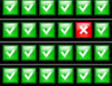
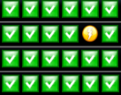
RAID6 -> ZFS RAIDZ2
Rebuild process (resilvering) for 1 or 2 HDD’s in ZFS and is almost the same as for RAID6:
In our configuration we scheduled every week pool-scrub to check data consistency. Resilvering operation also takes about 1 week for 6TB/8TB hdd’s. If ZFS automatically marks another one HDD as fault, while resilvering is incomplete, it will be looks like:
Faulted hdd is usually still present in pool, but in r/o state, so and we can successfully finish previous operation before to start another one, and finally lose only several files instead of tens of TB data.

Slide 24
From: 2014-01-01 to: 2018-08-01
T1_JINR

Slide 25
From: 2014-01-01 to: 2018-08-01

Slide 26
Last Month

Slide 27
Jobs Processing by Activities
Activities | Nevents
Analysis | 281 555 814 018
Reprocessing | 10 042 089 961
Production | 5 569 434 071
Test | 428 136 099
Etc. | …..
Total: 308 560 399 956 events
Average Rate: 2.086/s

Slide 29
Tier1 site reliability and avaiability

Slide 30
Importance of the Tier1 center at JINR
Creation of conditions for JINR physicists, JINR Member States, RDMS-CMS collaboration for a full-scale participation in processing and analysis of data of the CMS experiment on the Large Hadron Collider.
The invaluable experience of launching the Tier1 center will be used for creating a system of storage and data processing of megaproject NICA and other scale projects of the JINR-participating countries.
The studies in the field of Big Data analytics assume significance for the development of the perspective directions of science and economy as well as analysis and forecasting of processes in various fields.

Slide 31
Thank you for your attention!

