Slide 1
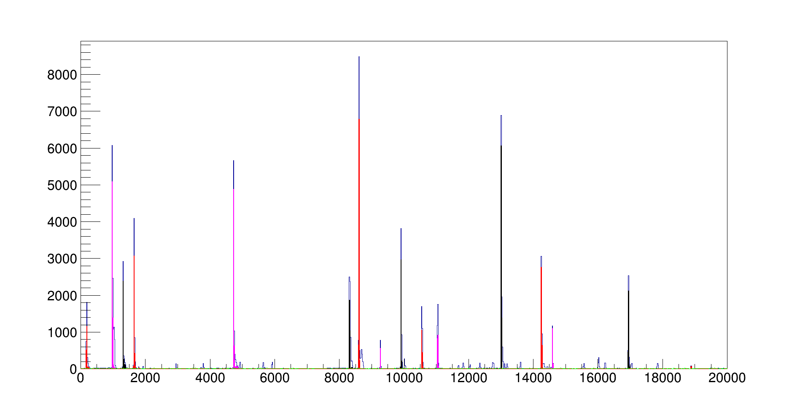
Event building from free streaming data at the CBM
Mikhail Prokudin and Ivan Korolko, ITEP

Slide 2
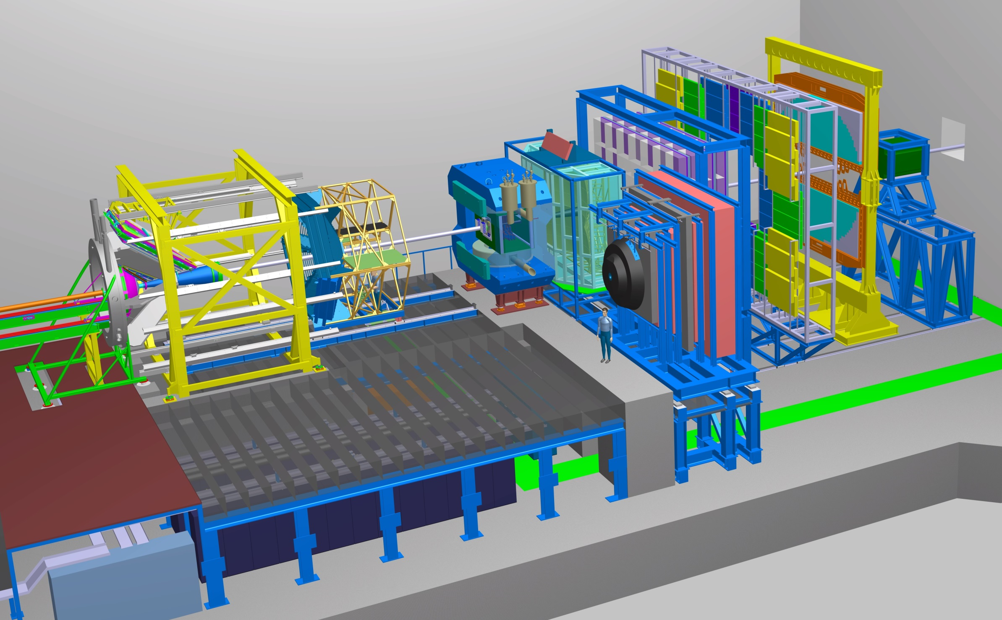
CBM experiment

Slide 3
Physics and interaction rates
Some main physics observables
Charm: D-mesons, J/ψ , ψ’ etc
Multistrange baryons: Ξ⁻(dss),Ξ⁺(dss),Ω⁻(sss),Ω⁺(sss)
Rare QGP probes requiring the high interaction rate
Many of the probes are extremely difficult to trigger on
CBM rate capability is limited by the setup not by the accelerator
10⁵ for MVD if precise vertex reconstruction is required
10⁶ for PSD if precise determination of event plane is needed
10⁷ for all other detectors

Slide 4
CBM readout concept
CBM is the first high interaction rate experiment going to run in a free streaming mode without trigger
Readout electronics will be self-tiriggered and deliver time-stamped data
Timeslice is all data acquired in a given period of time (more than 1 μs)
Timeslices can be threated separately from each other
Full reconstruction of a timeslice should be performed at individual computing unit
Node, processor or core
Interesting data should be saved
Full reconstruction of all acquired data is available = complex cuts (identification quality, event topology, etc.) can be used for data selection
Example: high efficiency for D-mesons
Timeslice should be sectioned into individual collisions (events) during the reconstruction
Event building problem

Slide 5
Event building
Event finding and event construction
Event finding: locate individual events in data stream
Event construction: find all objects belongs to a given found events.
Simple one
Use digi (i.e. individual triggers of readout electronics) dynamics in time
… and some primitive coordinate information.
More complex
Use tracking and vertexing information for event finding and construction

Slide 6
Simple event builder: motivation
For all detectors event based reconstruction exists
But not for time based reconstruction
Time based reconstruction with event based algorithms
Parallelization
Simple = fast
Use one CPU core for event building and several others for more slow reconstruction
Number of tasks (and timeslices) per node?
One task per node: Are our algorithms enough parallel?
One task per core: large RAM requirements and CPU overheads.

Slide 7
Event finding
Can use only one subdetector for event finding
Requirements: good time resolution and acceptance, low noise levels after cuts.
Candidates: STS and BFTC (central TOF region)
No BFTC GEANT model is currently implemented in CBMROOT.
Simple event finder:
Event is found if number of digis in a given time window is more than a threshold
Introduce a dead time to reject delta electrons produced in the detector
STS time resolution =5 ns
Noise of STS electronics is modeled
Delta-electrons born inside the target by passing trough beam particles still not simulated

Slide 8
Event finding
1000 10 AGeV UrQMD mbias AuAu events
1 MHz collision rate
Only STS in game
Fast procedure only: 10 ms per event
Event is reconstructable is it has at least 5 long (5 or more STS hits) reconstructed tracks in event based approach

Slide 9
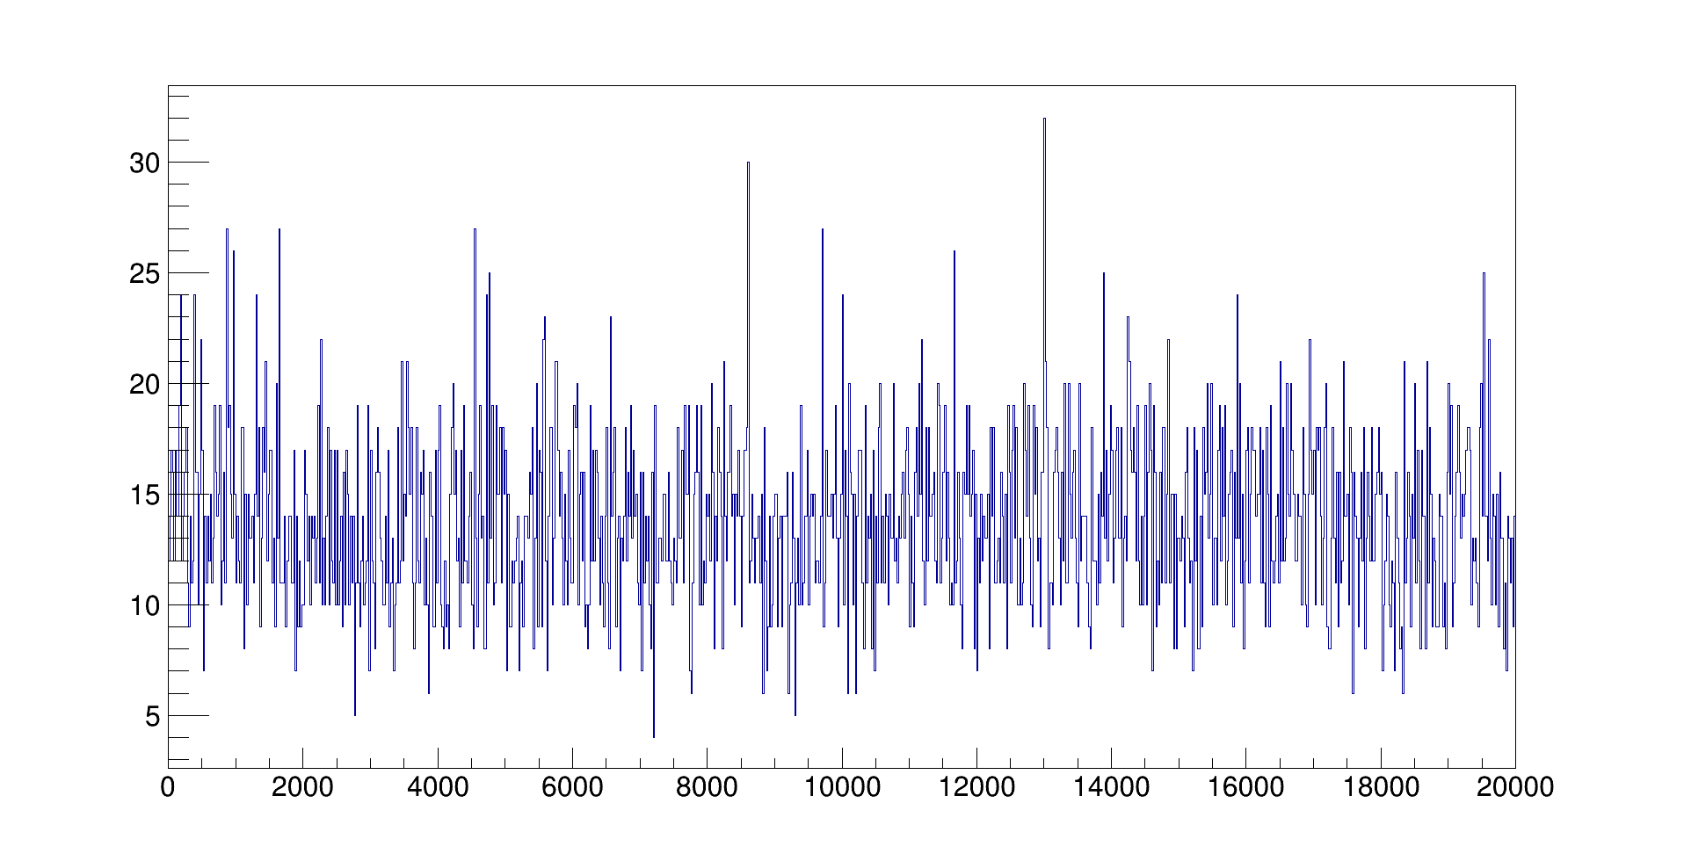
All STS digis
Time, ns
Noise
Time, ns

Slide 10
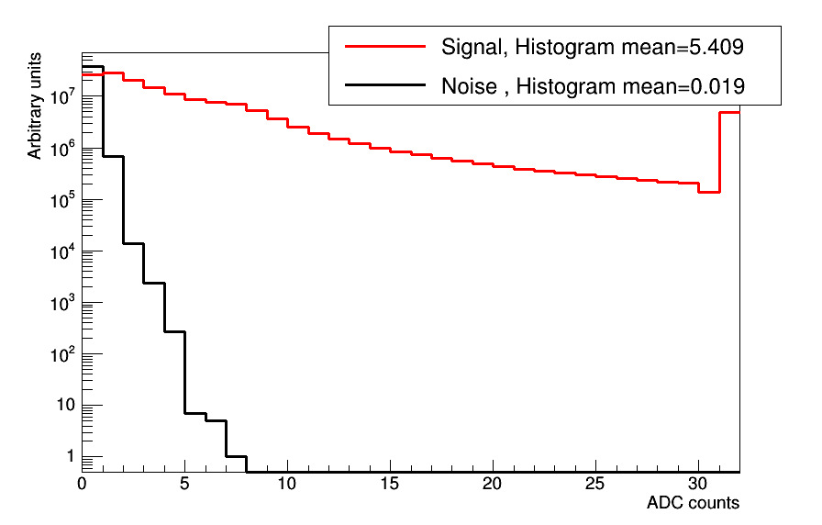
STS charge distributions

Slide 11
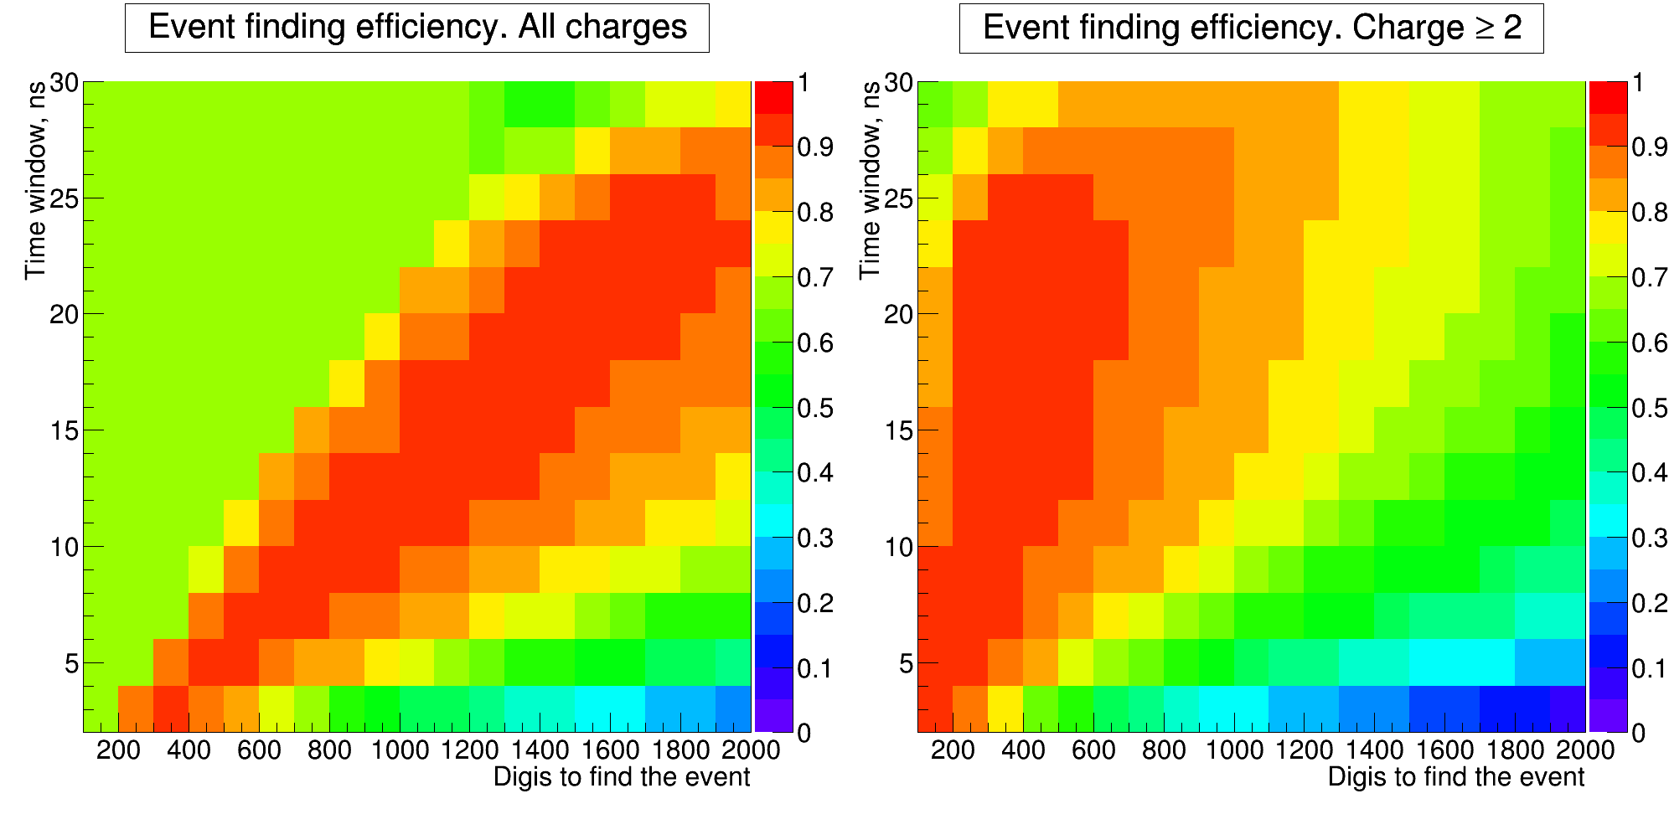
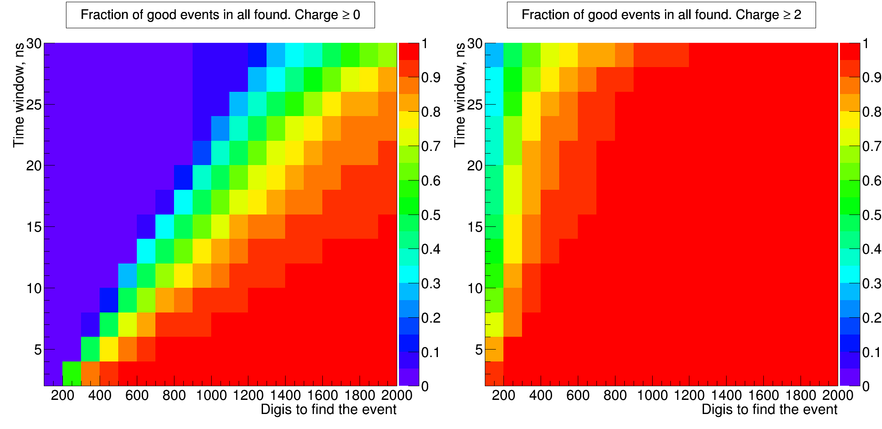

Slide 12
Event finding and event composition
Event finding
Event finding efficiency: 93%
Fraction of correctly found events >85%
Dead time: 50 ns
Event construction
STS: extend found time region by 10 ns from both sides to ensure all STS digis from event included.

Slide 13
Event construction: TOF
Use STS only to find an event
Event construction: all digis in extended time period
STS digis: no time correction required
TOF digis: subtract R_{digi}/c
R_{digi} – distance from (0, 0, 0) to fired channel (i.e. center of the strip or cell)
c – speed of light
10 AGeV AuAu central collisions at 10⁴ events/sec rate
Most easy and pure case

Slide 14
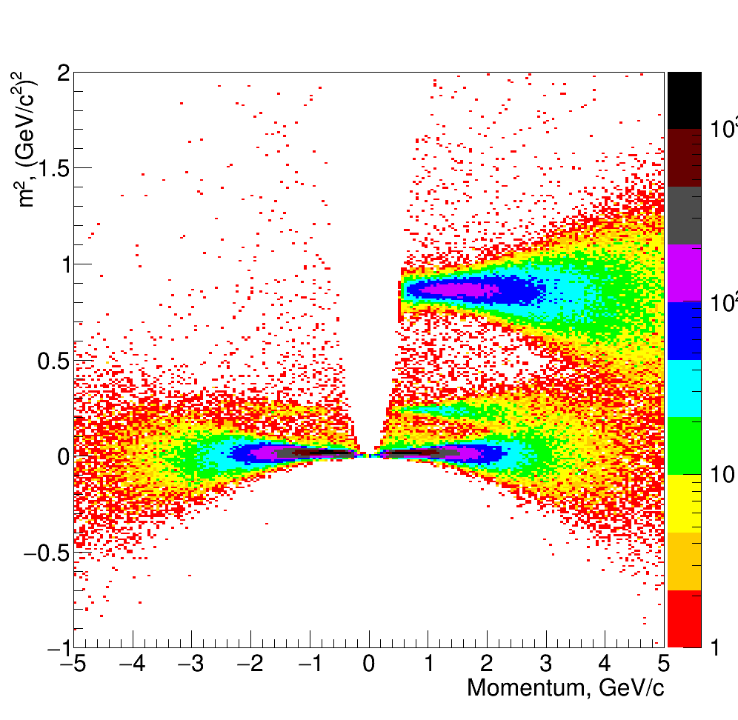
m²/P
Event based
Timeslices
Wide distributions for timeslices: 80 ps TOF ⊕ 105 ps T₀
Low momentum particles (mainly protons) cut away

Slide 15
Event construction: MUCH
Event construction: all digis in extended time period
MUCH digis:
subtract R_{digi}/c (same as for TOF)
increase time window by 50 ns (MUCH time resolution is worse than STS one)
if MUCH time windows for two events intersect digis from intersection added to both events
additional hits shall not be attached to tracks and removed from the analysis
Corrected time
Event 1
Event 2
STS
MUCH
MUCH digis from this region
will be included in both events.

Slide 16
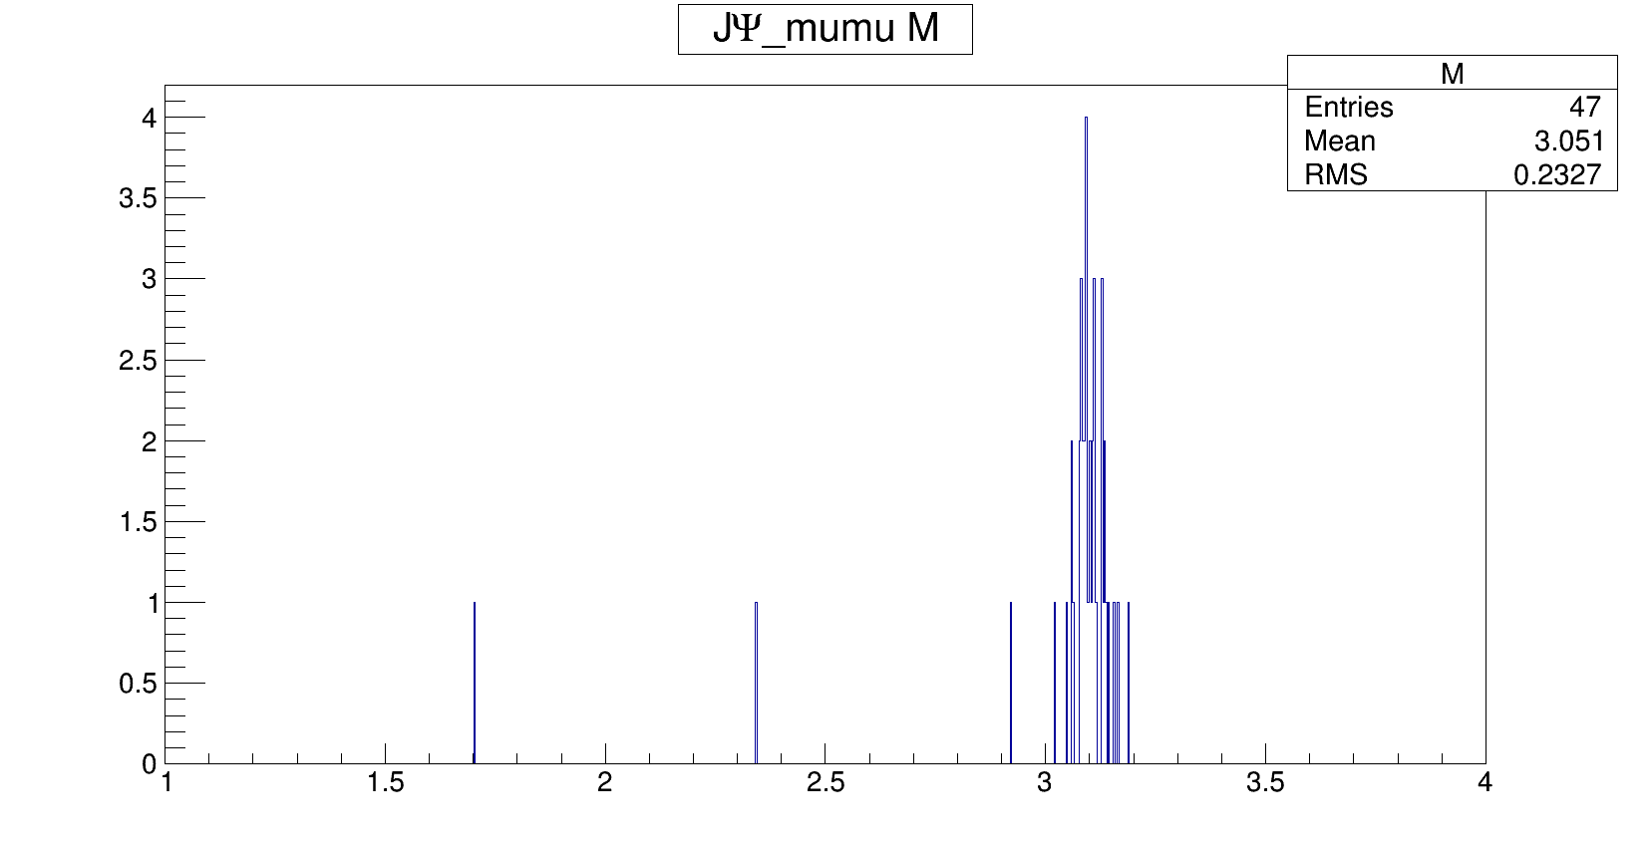
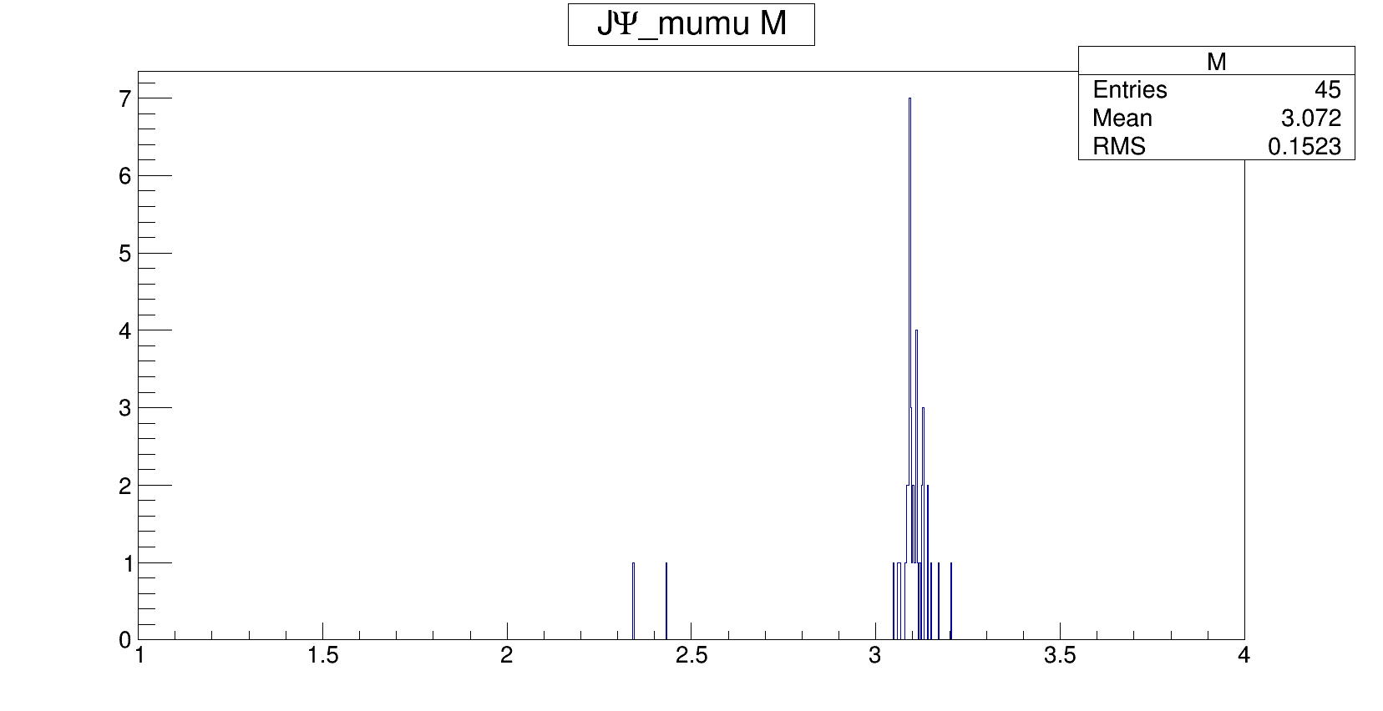
J/ψ
1000 J/ψ mixed with 10 AGeV central UrQMD events
10⁴ events/sec
Event based
Time based

Slide 17
Event construction.
General method
Extended time window is given for found event
Correct digi’s time on R_{digi}/c
Increase time window according to time resolution of the subdetector
If time windows for two events intersect, digis from intersection added to both events
for all subdetectors except calorimeters (energy summation)
Event construction for given subdetector is independent from others
Event construction can run in parallel for several subdetectors

Slide 18
Conclusions
Event building is one of the methods to increase parallelism level.
Run reconstruction for several found events simultaneously.
Simple event building method is presented
Event finding efficiency 93%
General event construction method has been developed
Implemented for TOF and MUCH detectors are used as an example.
Can be parallel for several detectors

