Slide 1
Information-software environment for the GOVORUN Supercomputer
Kirakosyan M., Podgainy D., Streltsova O., Torosyan Sh., Vala M.
Heterogeneous Computations team
LIT JINR

Slide 2
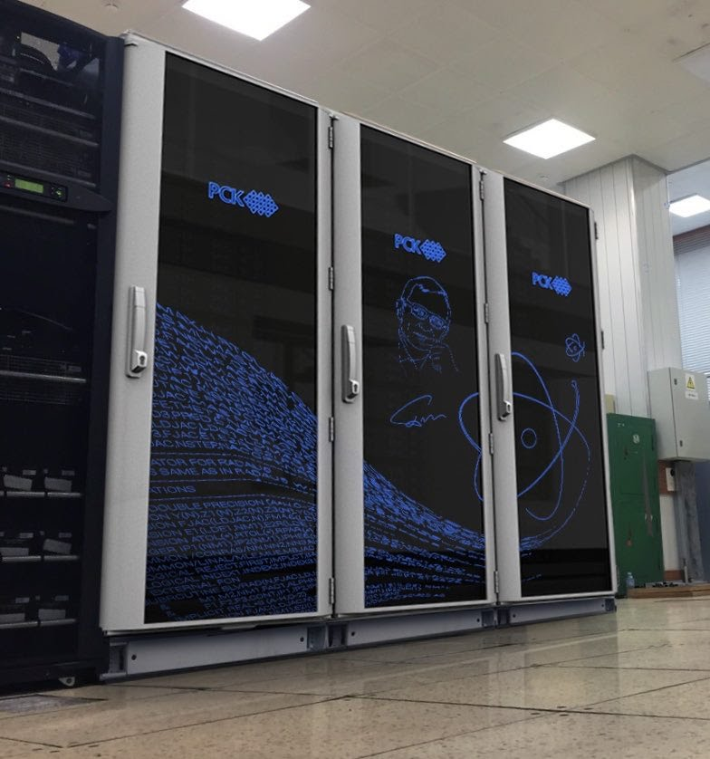
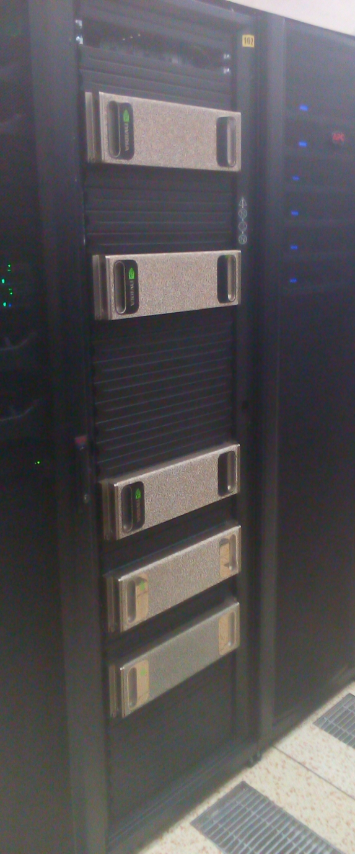
“Govorun” Supercomputer –revolutionary HPC solution

Slide 3
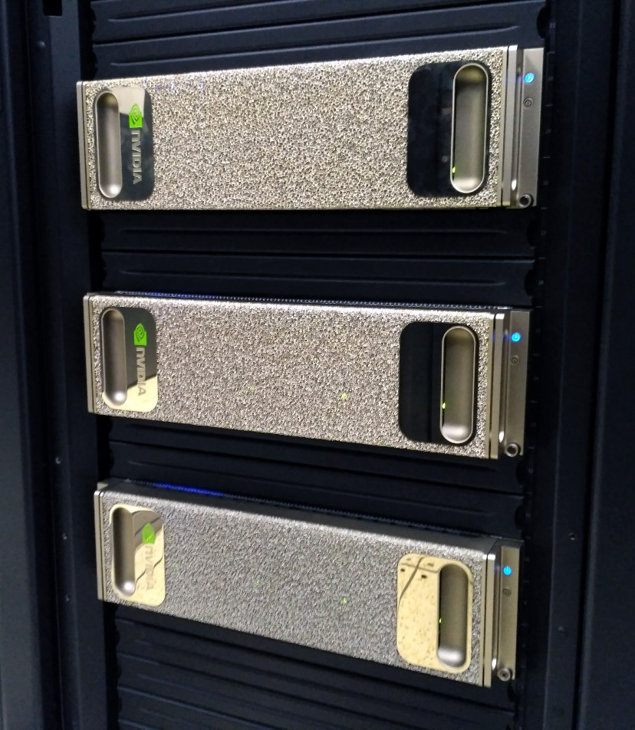
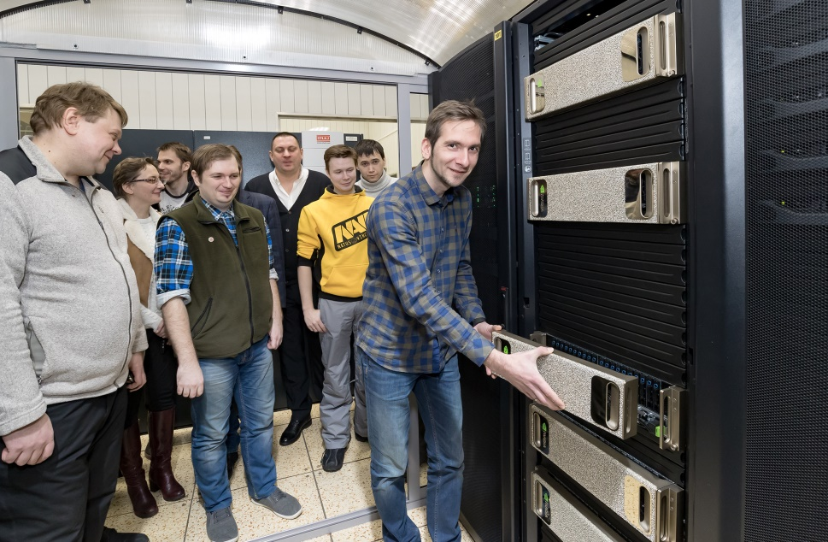
GOVORUN Supercomputer. GPU component.

Slide 4
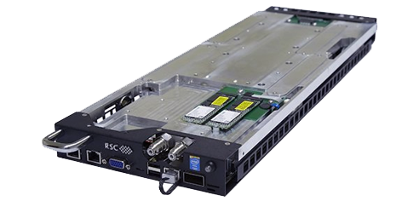
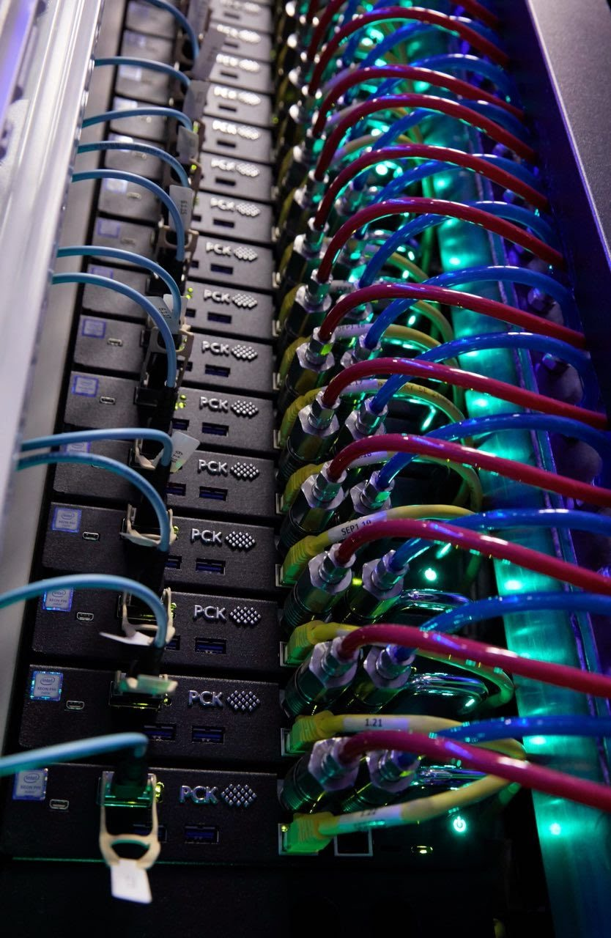
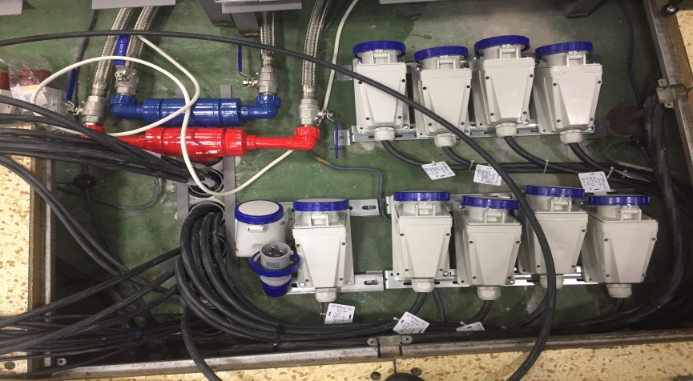
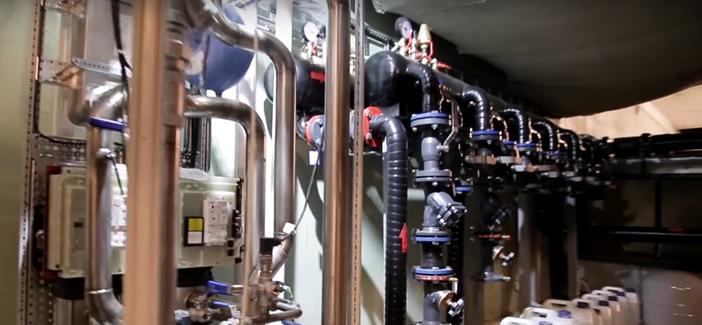
GOVORUN Supercomputer. CPU component

Slide 5
HybriLIT heterogeneous platform
Unified software and information environment
Training and testing polygon “HybriLIT”
“Govorun” Supercomputer
Skylake
1440 cores
KNL
1512 cores
CPU-component
Intel Skylake
Intel
Xeon
Intel
Xeon Phi
40 nodes
CPU-component
Intel Xeon Phi (KNL)
Volta
205 000 CUDA cores
26 000 Tensor cores
K40, K80
78 000 CUDA cores
21 nodes
Nvidia Tesla K20
Nvidia Tesla K40
Nvidia Tesla K80
GPU-component
GPU DGX-1 Volta
(NVIDIA Tesla V100)
5 nodes
10 computation nodes
Peak Performance: 1 PFlops

Slide 6
Heterogeneous computations in JINR
GOVORUN Supercomputer and HybriLIT
CPU component
Intel Skylake
Intel KNL
Clouds & cloud services
Multicore and multi-thread computations
BigPanDA & GRID
Track reconstruction
Physical generators
Monte-Carlo simulation
GPU component
NVIDIA Volta
Quantum chromodynamics
Deep Learning
NVIDIA K40, K80
Big Data Analysis

Slide 7
SLURM
(workload manager)
System level
Software for parallel computing
OpenMPI 1.8.8, 2.1.2;
CUDA 7.0, 8.0, 9.0, 9.1;
OpenCV 2.4.9;
GNU 4.8.5, 4.9.3, 6.2.0;
Intel Parallel Studio 2018;
Licensed math. software
COMSOL 5.3а
MATLAB R2017b
Mathematica 11.2
Maple 2017.3
Scientific
Linux 7.4
xCAT
NFS
(file system)
EOS
(file system)
CernVM-FS
(Virtual Software Appliance)
Haproxy
(VDI server)
Software and Information Environment
FreeIPA
(identity manager solution)
MODULES
HybriLIT web-site
http://hybrilit.jinr.ru/
User level
GitLab
https://gitlab-hybrilit.jinr.ru
Indico
http://indico-hybrilit.jinr.ru
Monitoring (MobiLIT)
http://hybrilit.jinr.ru/mobilit/
Monitoring:
https://stat-hlit.jinr.ru/
HybriLIT user support
https://pm.jinr.ru/projects/hybrilit-user-support

Slide 8
at GOVORUN supercomputer
at HybriLIT platform

Slide 9
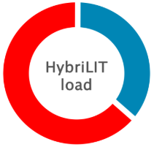
Services

Slide 10
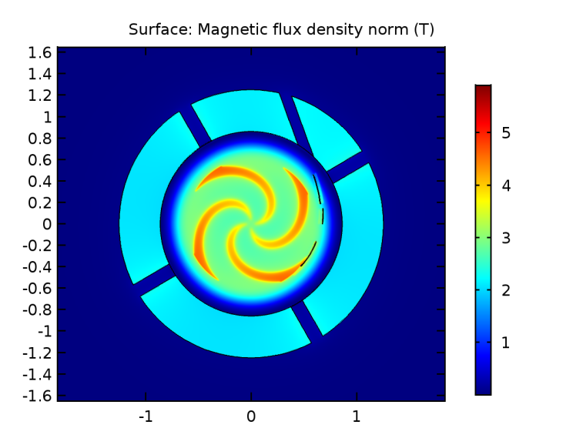
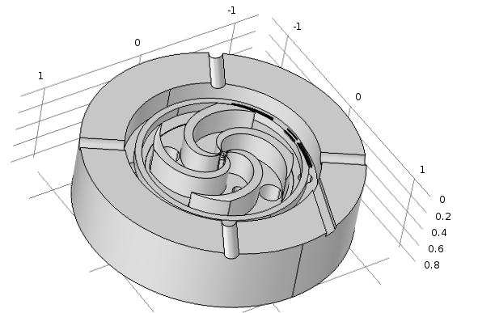
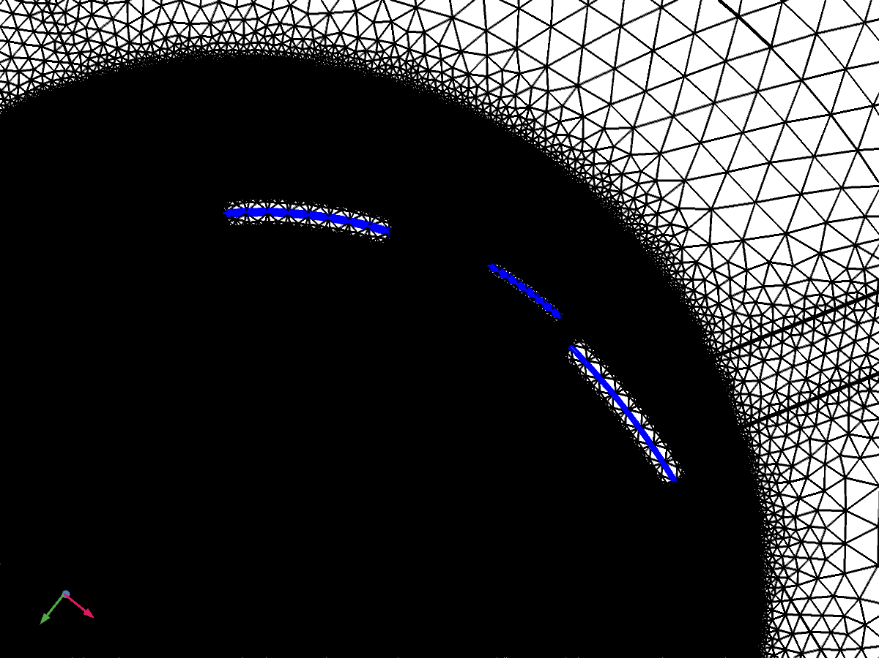
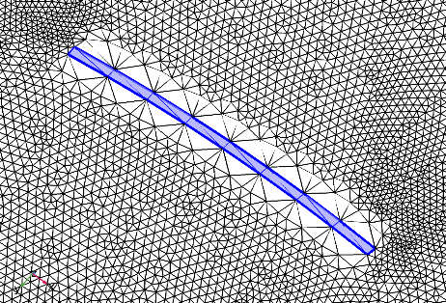
HLIT-VDI – system of virtual desktop interfaces
Superconducting magnet SC200 for medical researches
Distribution of magnetic field
Computation grid
Notes:
Example using of HLIT-VDI service. Modelling and simulation of the magnetic field distribution for design and production of the superconducting magnet SC200 with COMSOL Multiphysics

Slide 11
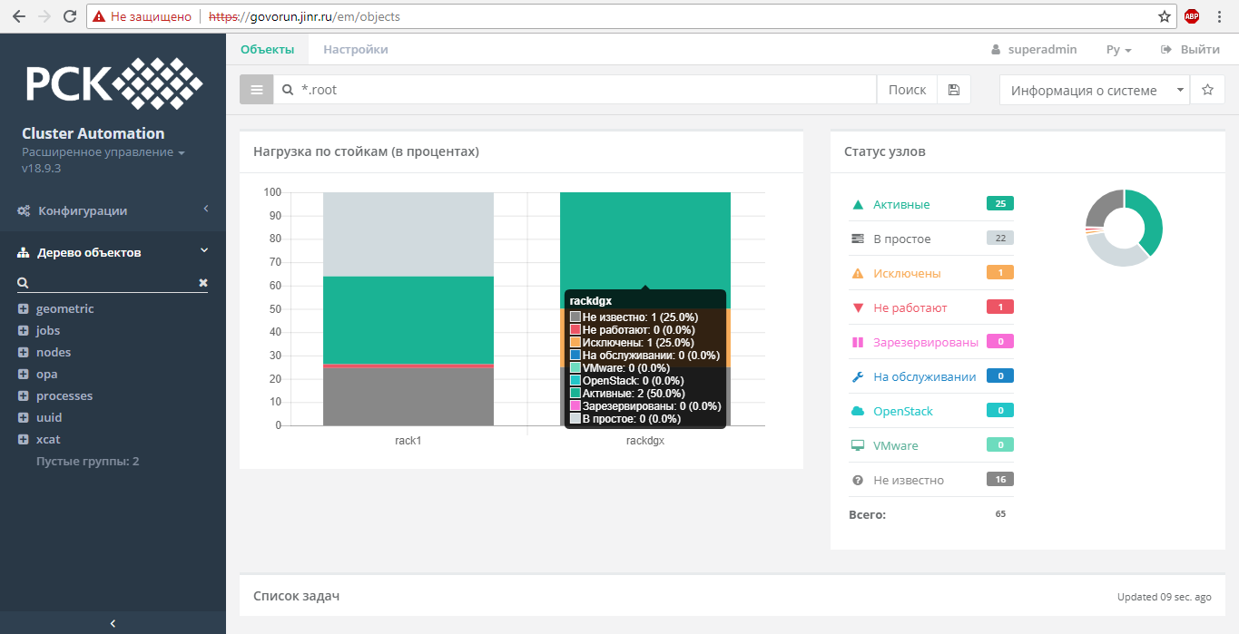
Cluster Automation system

Slide 12
Questions?

