Slide 1


EVOLUTION OF ACCELERATOR BASED
NEUTRON SOURCE VITA
Sergey TASKAEV and BINP BNCT team
Budker Institute of Nuclear Physics, Novosibirsk, Russia Novosibirsk State University, Novosibirsk, Russia
XV Международный cеминар по проблематике ускорителей заряженных частиц

Slide 2
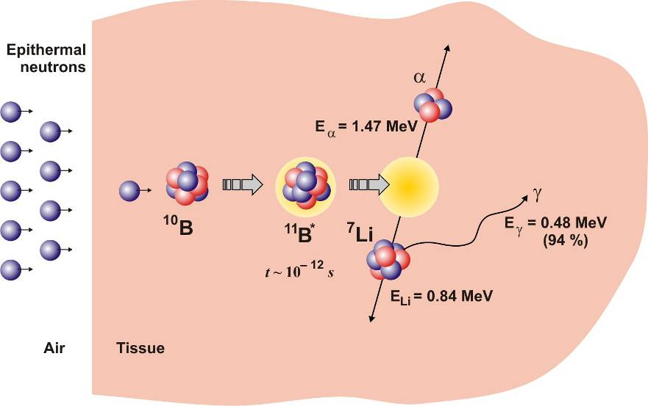
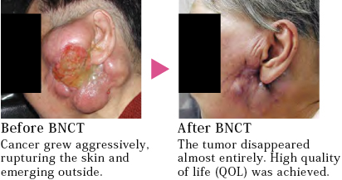
Boron Neutron Capture Therapy
Boron Neutron Capture Therapy (BNCT) is a binary form of radiation therapy using the high propensity of a the nonradioactive boron-10 to capture thermal neutrons (3840 b) resulting in the prompt nuclear reaction ¹⁰B(n,α)⁷Li.
The products of this reaction have high linear energy transfer characteristics, resulting an energy release limited to the diameter of a single cell.
Positive results were obtained in the treatment of the following tumors: malignant glioma, malignant melanoma, head and neck tumors, meningioma, pleural mesothelioma, hepatocellular carcinoma.
Clinical trials of the BNCT technique have begun:
Japan – since 2020
China – since 2022 (VITA)
South Korea – since 2022
Russia – since 2025 (VITA, in the plans)

Slide 3
Why was this neutron source proposed and developed?
Boron neutron capture therapy of malignant tumors requires powerful
sources of epithermal neutrons:
flux density > 5 10⁸ cm⁻² s⁻¹
Energy: 10 keV – for deep seated tumors, 10 eV – for superficial tumors
The best decision: ⁷Li(p,n)⁷Be @ 10 mA 2.3 MeV proton beam
There were no charged particle accelerators for such
parameters – it was necessary to come up with
a new accelerator, called VITA
A lithium target for such parameters was
considered unrealizable - we were lucky
that we did not read these articles in time
As a result, the goal was achieved, but not immediately and only after changing all the units.
Now the input unit to the accelerator is the 5th version, the feedthrough insulator is the 4th version,
the lithium target is the 5th version.
The facility has been actively and effectively used for the 10th year.
σ, b
E, MeV

Slide 4
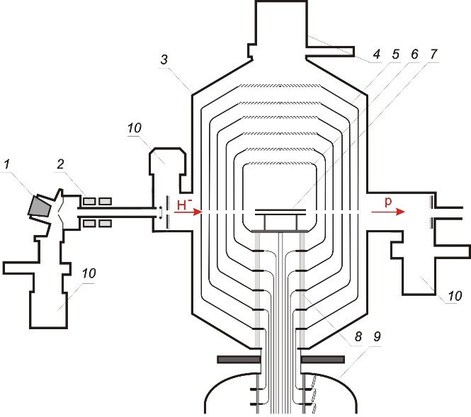

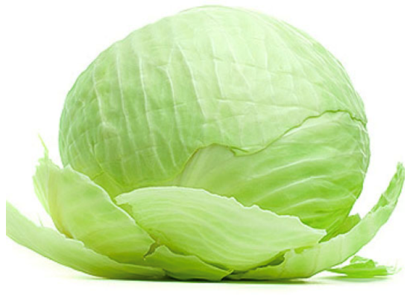
Accelerator
VITA = Vacuum Insulated Tandem Accelerator
VITA is linear electrostatic tandem accelerator of original design.
VITA does not involve accelerating tubes,
unlike conventional tandem accelerators.
Instead of those, the nested intermediate electrodes (5)
fixed at a single feedthrough insulator (8) is used,
as shown in Figure.
The design resembles a cabbage roach or
a Russian nesting doll Matrioshka
VITA: 1 – H– source, 2 – magnetic lenses, 3 – accelerator, 4 – cryogenic pump, 5 – intermediate electrodes, 6 – high-voltage electrode, 7 –gas stripper,
8 – insulator, 9 – high-voltage power supply, 10 – turbomolecular pumps.
Main advantages of the VITA:
compactness
simplicity
reliability
low cost

Slide 5
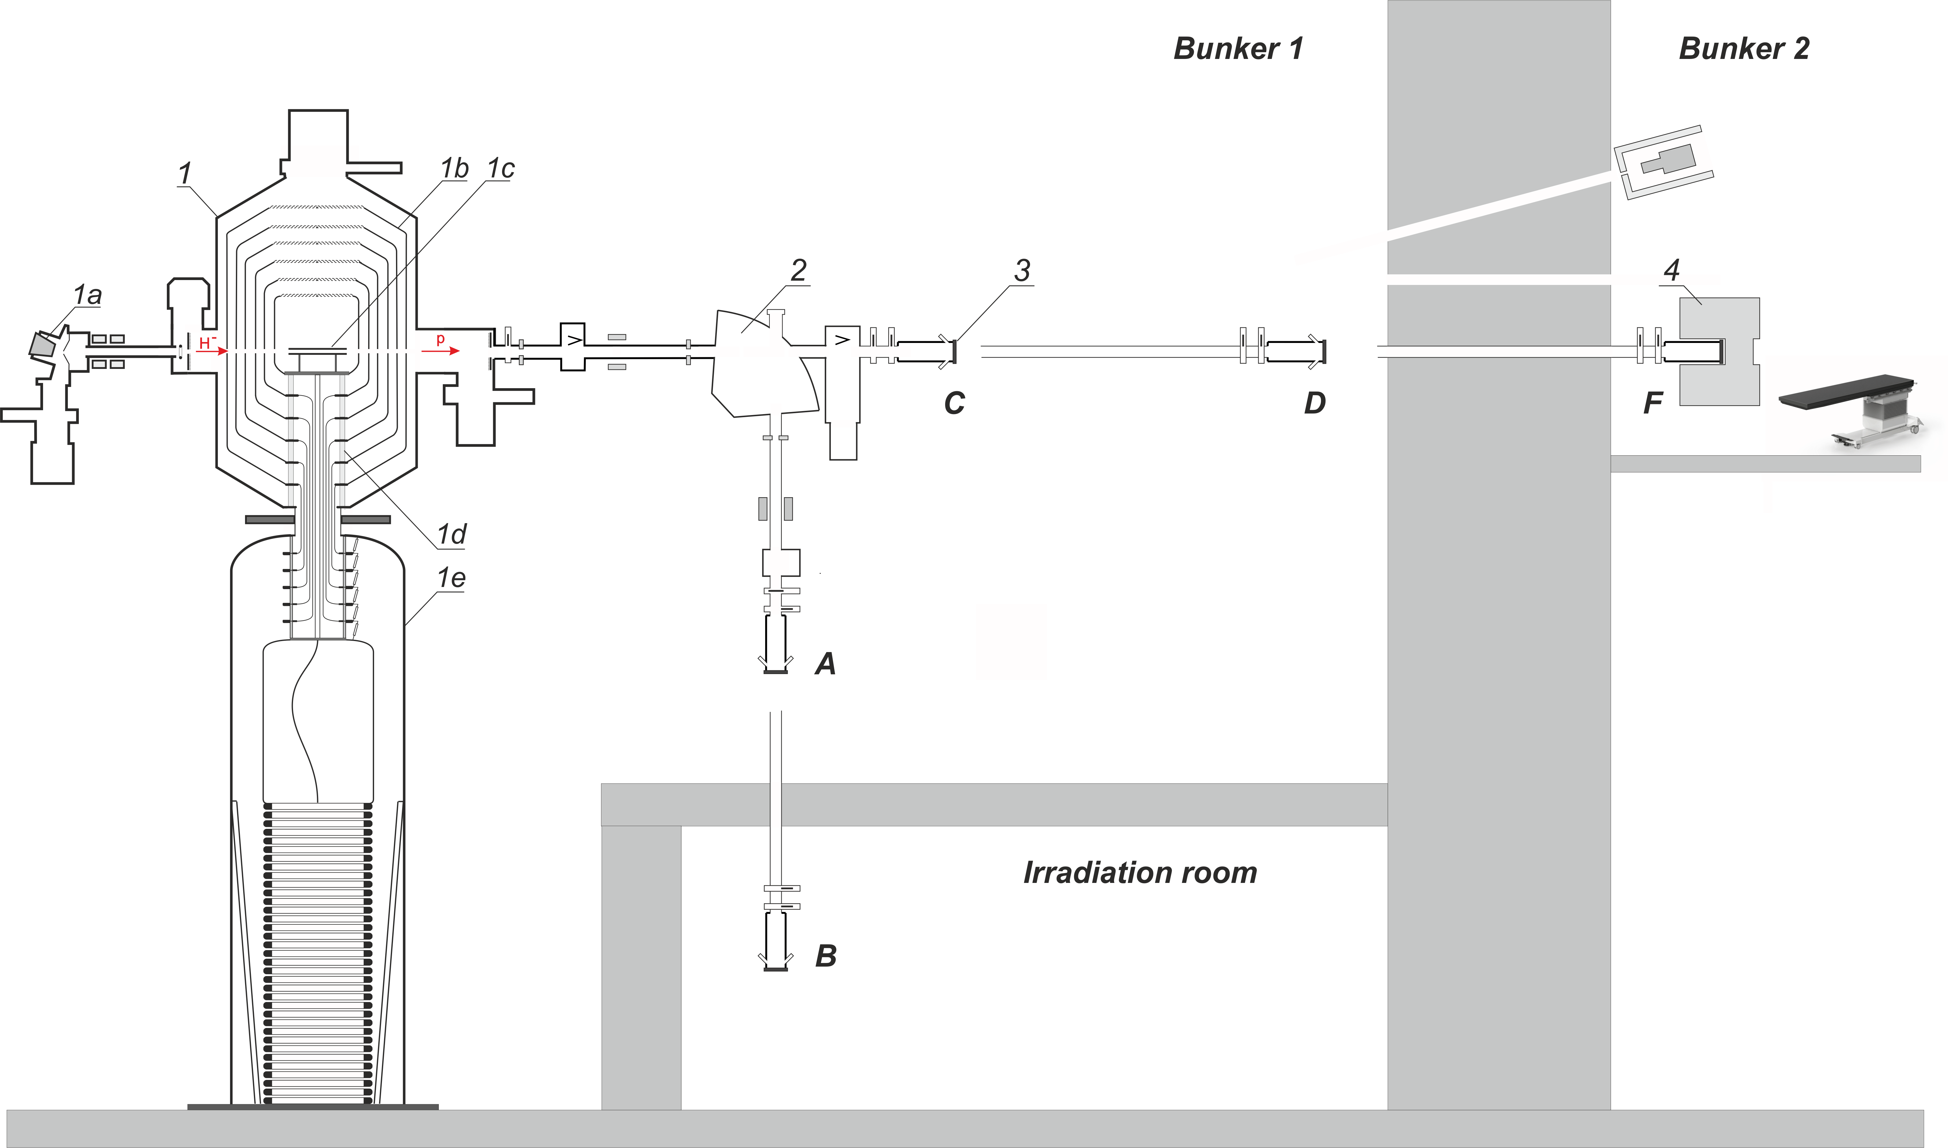
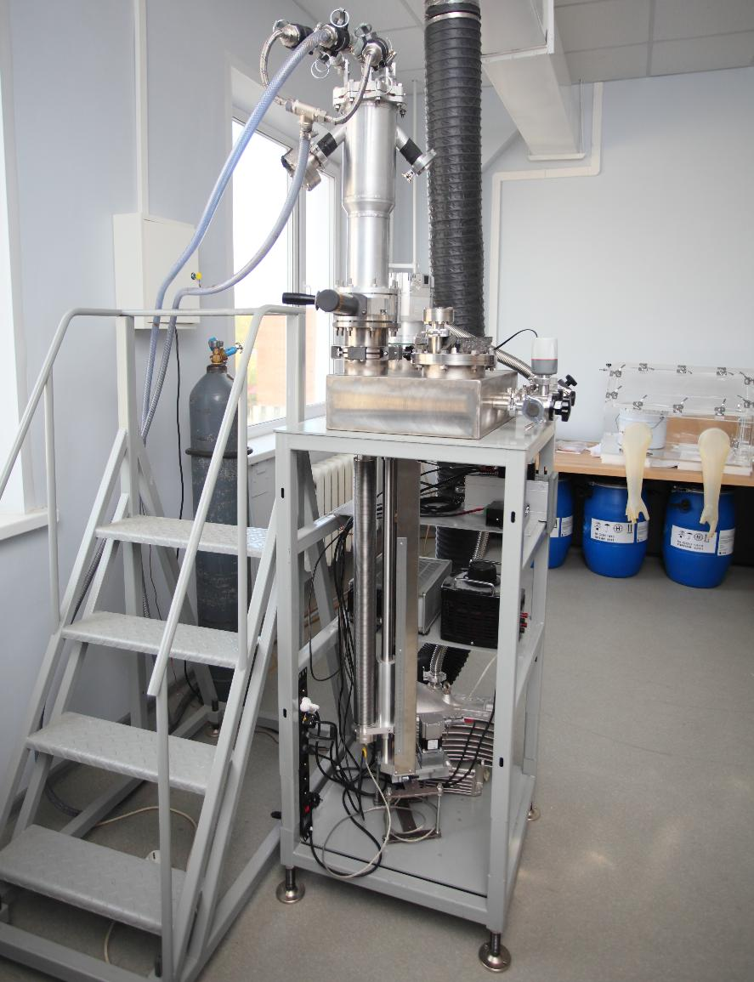
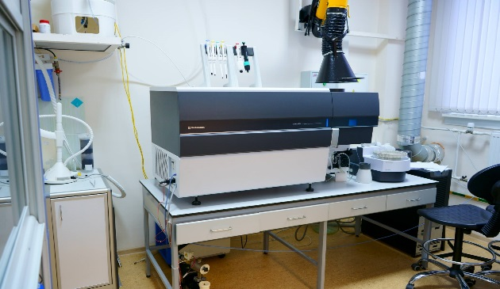
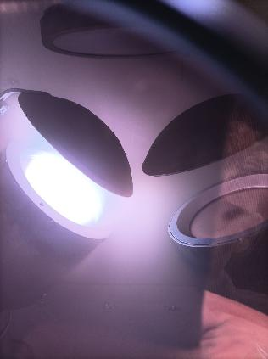
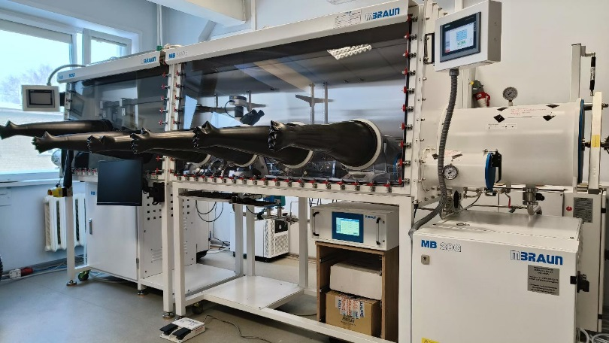
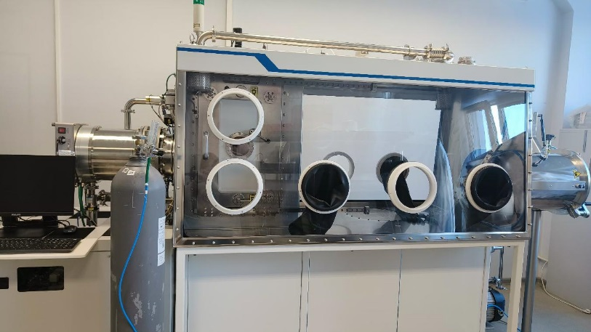

Slide 6
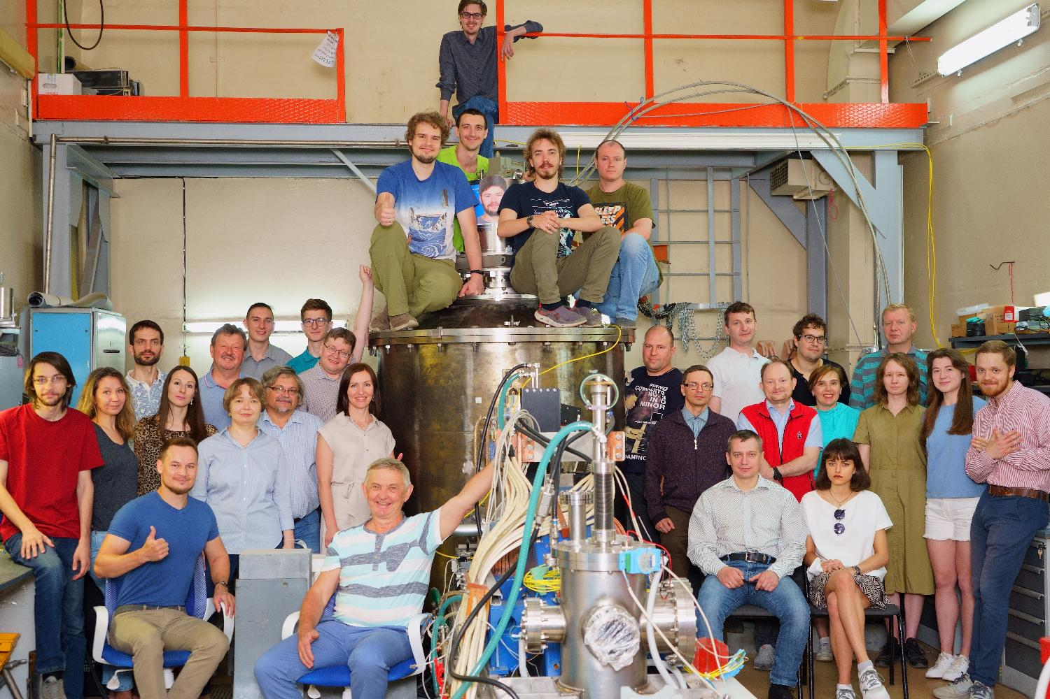
Accelerator based Neutron Source VITA produces:
High power DC proton/deuteron beam (20 kW):
Energy: up to 2.3 MeV
Monochromaticity and stability: 0.1%
Current: up to 10 mA
Current stability: 0.4 %
High flux neutron beam (2 10¹² s⁻¹):
cold (D₂O moderator @ cryo temp.)
thermal (D₂O or Plexiglas moderator)
epithermal (MgF₂ moderator)
exclusively epithermal (no fast and thermal)
over-epithermal
monoenergetic (kinematic collimation)
fast
Bright source of photons – ⁷Li(p,p’γ)⁷Li, ¹⁹F(p, γ e⁺e⁻)¹⁶O
Bright source of α-particles – ⁷Li(p,α)α, ¹¹B(p,α)αα
Bright source of positrons – ¹⁹F(p, γ e⁺e⁻)¹⁶O

Slide 7

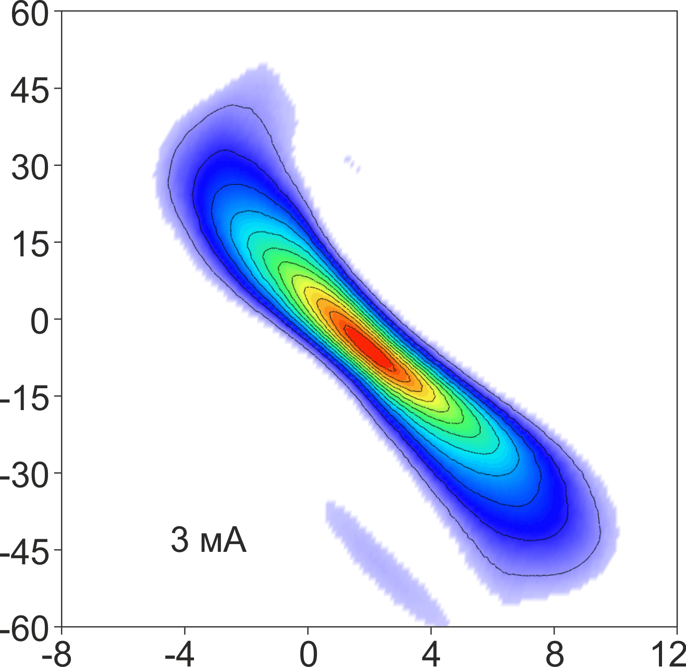
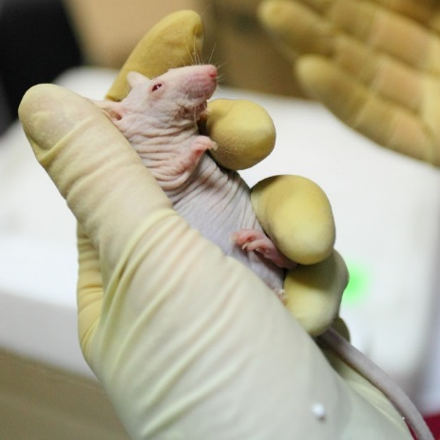


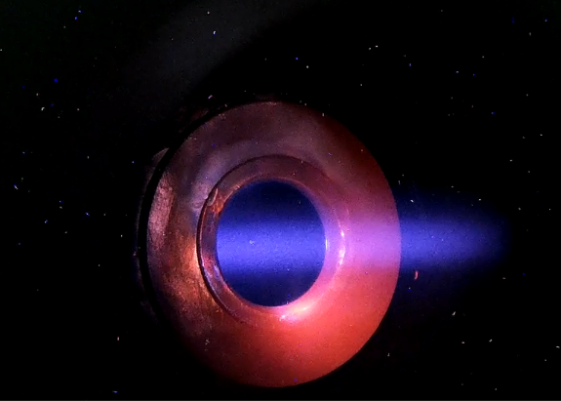
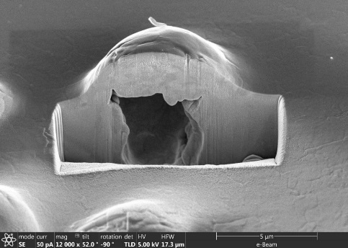
Accelerator based Neutron Source VITA
Budker Institute of Nuclear Physics (Russia) proposed and developed
Accelerator based Neutron Source VITA as the best solution for BNCT
therapeutic epithermal neutron flux = 10⁹ cm⁻² s⁻¹
therapy time = 40 min
VITA in Novosibirsk (Russia) is used for a decade:
to develop dosimetry tools and methods,
to test new boron delivery drugs,
to treat large domestic animals (cats and dogs),
to develop lithium neutron capture therapy,
to test promising materials for ITER and CERN,
to measure the cross-sections of the nuclear reactions,
etc.

Slide 8

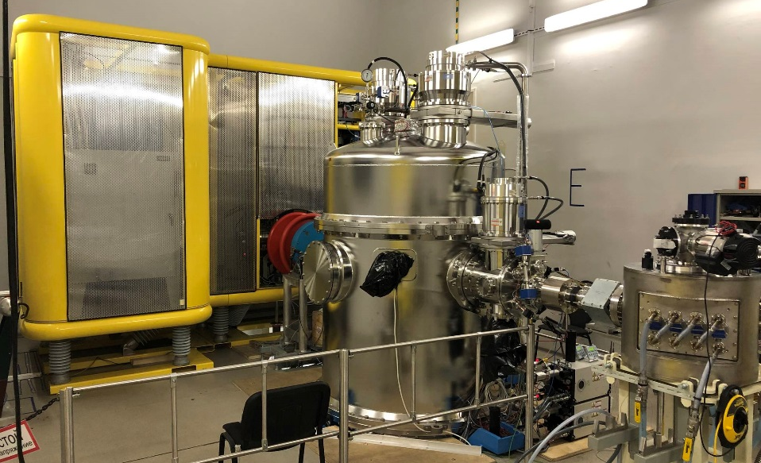

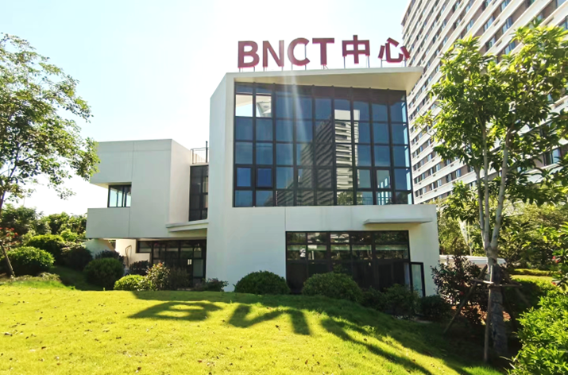
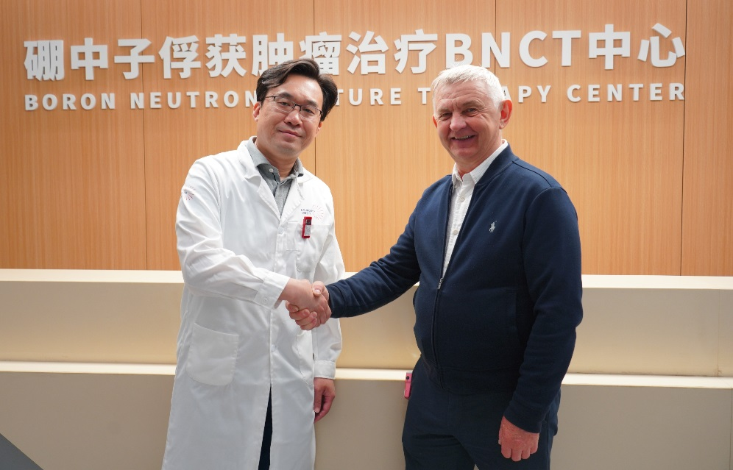
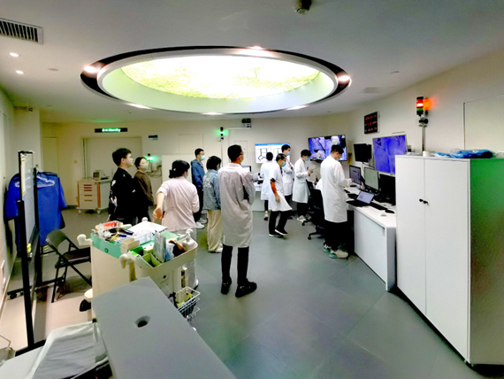
Accelerator based Neutron Source VITA-IIα
VITA-II differs from VITA in the presence of pre-acceleration, reduced height and the use of a volumetric ion source instead of a surface plasma one
VITA-IIα in Xiamen (China) is used for successfully performed investigator-initiated trial on patients at the Xiamen Humanity Hospital BNCT Center in 2022-2023.
In May 22, 2024, the Center began treating patients under the state program (commencement of Phase-I Trial).
China has become the second country in the world to introduce a new cancer treatment technique.

Slide 9

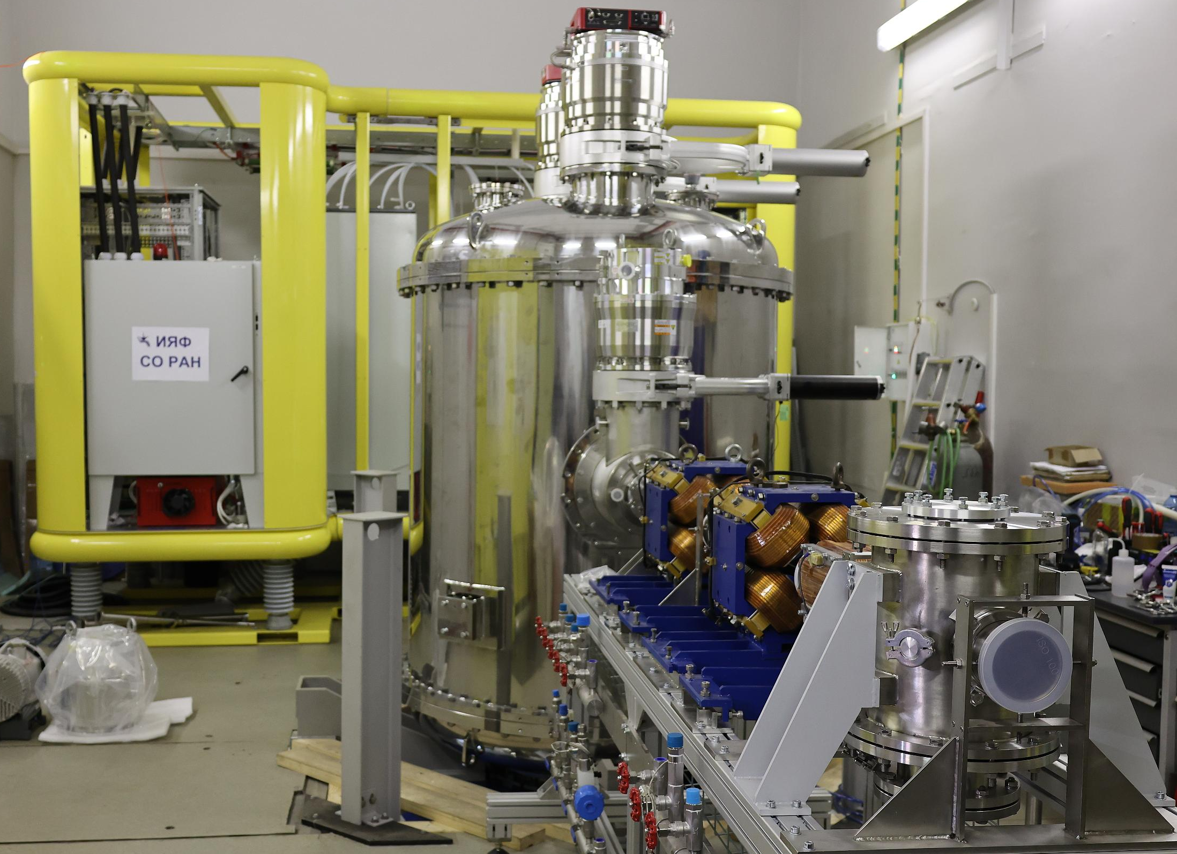

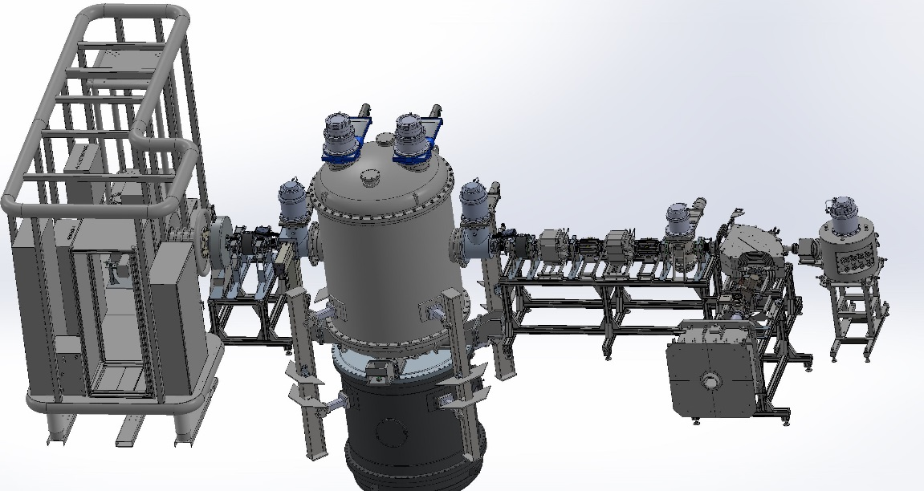
Accelerator based Neutron Sources VITA-IIβ
VITA-IIβ done for Blokhin National Medical Research Center of Oncology.
VITA-IIβ will be put into operation at Blokhin National Medical Research Center of Oncology in Moscow in the spring of 2025 to conduct clinical trials in the Russian Federation.

Slide 10


Accelerator based Neutron Sources VITA-III
BINP has begun developing VITA-III.
VITA-III differs from VITA-II by the absence of pre-acceleration, modified gas stripper, and new volumetric negative hydrogen ion source VITA.
VITA-IIIα will be made for the Burnazyan Federal
Medical Biophysical Center in Moscow.
BINP can equip clinics and Universities
with the Accelerator based Neutron Sources VITA.

Slide 11

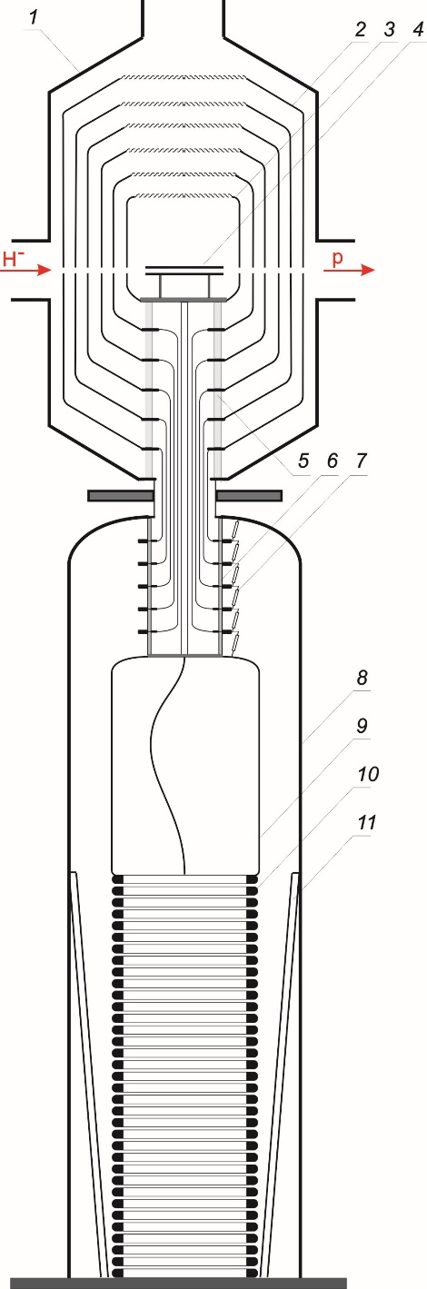
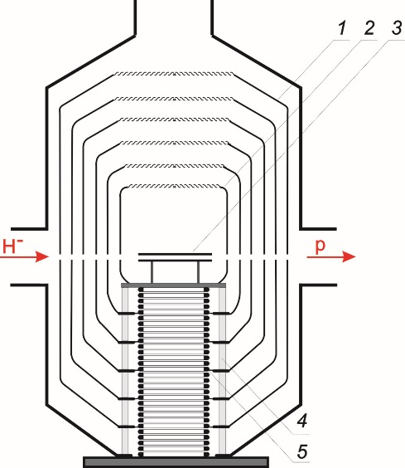
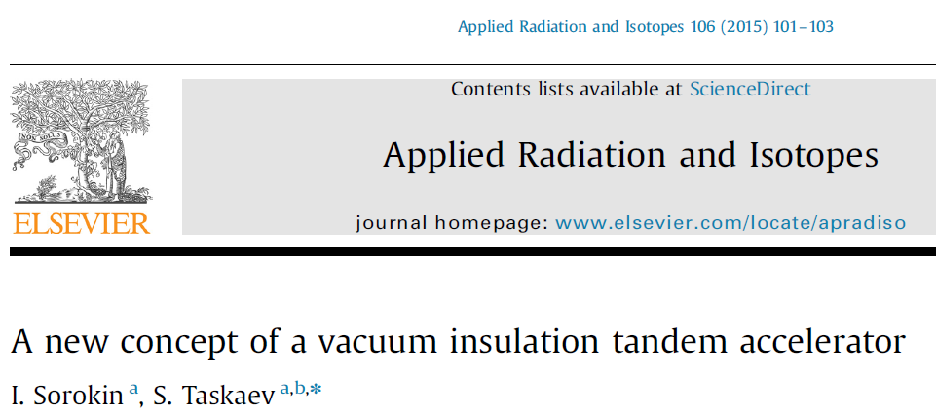
Accelerator based Neutron Sources VITAmin

Slide 12
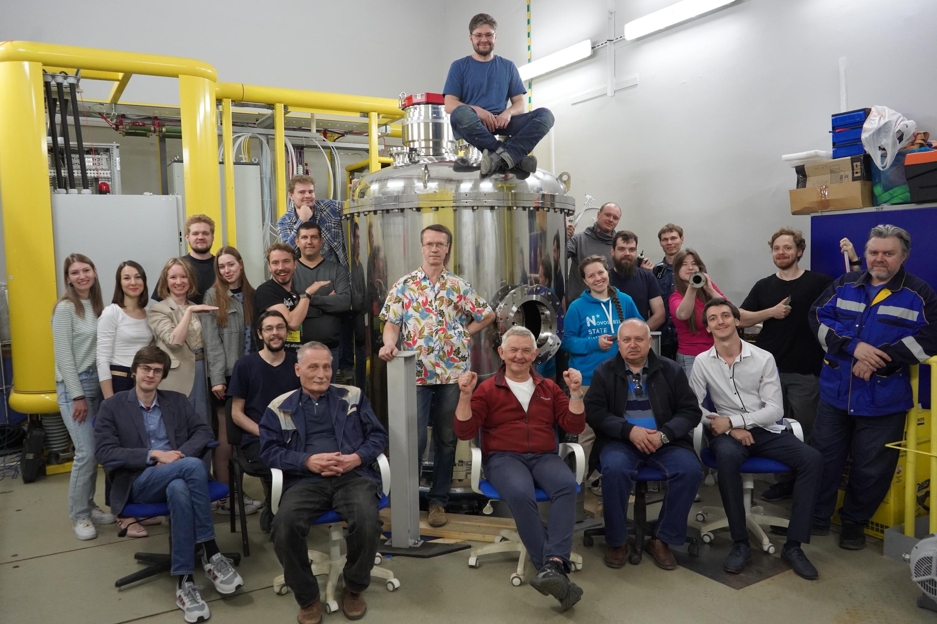

Thank you!

