Slide 1


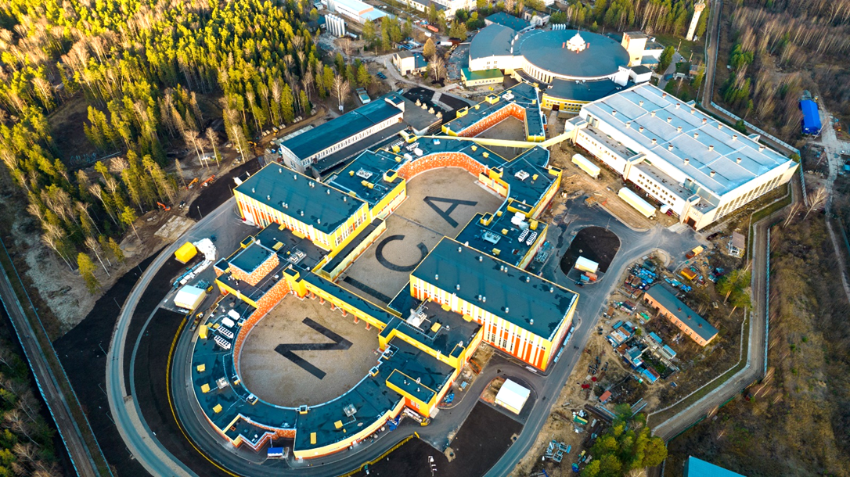
Fundamental Physics Challenges
of the Mission
A. V. Butenko, V. D. Kekelidze, A. S. Sorin, G. V. Trubnikov
XV МЕЖДУНАРОДНЫЙ СЕМИНАР ПО ПРОБЛЕМАТИКЕ УСКОРИТЕЛЕЙ ЗАРЯЖЕННЫХ ЧАСТИЦ
памяти профессора В. П. Саранцева
16 сентября 2024 г.

Slide 2


Slide 3
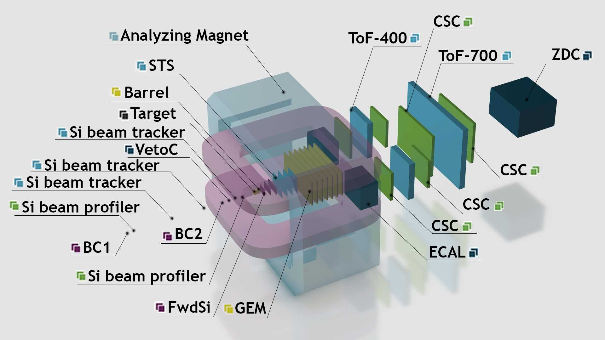

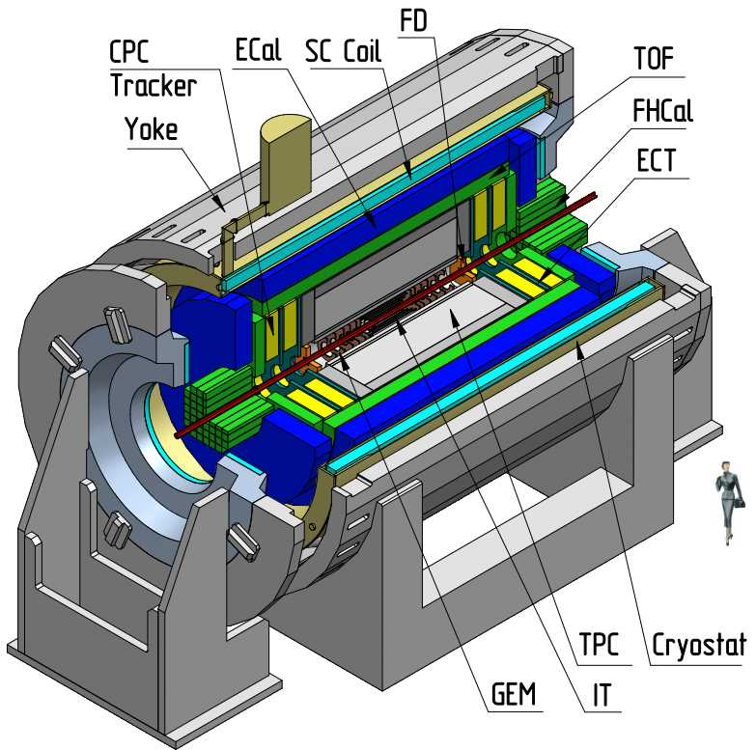

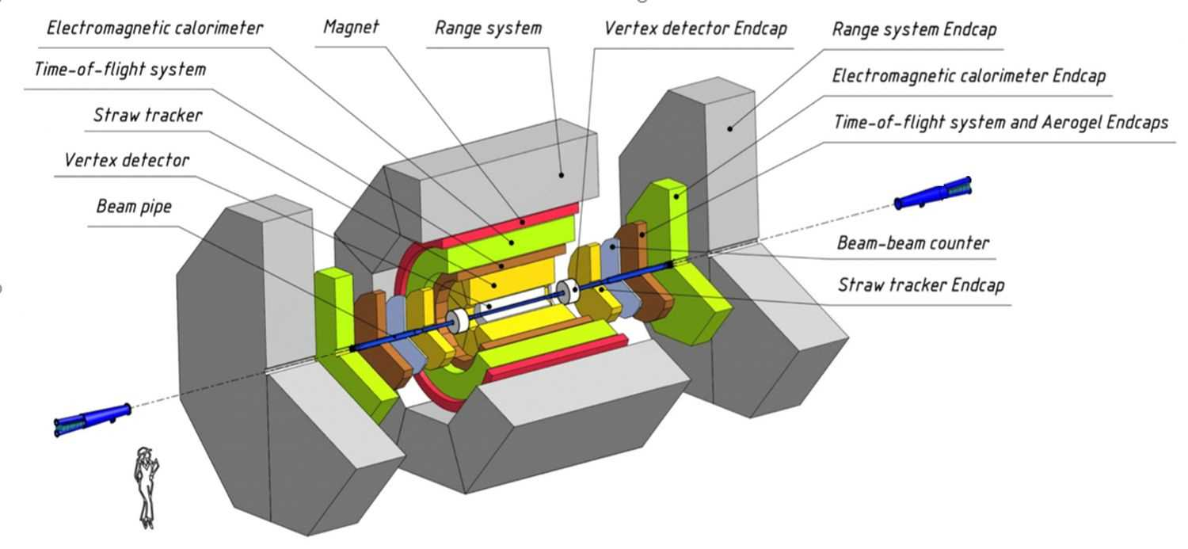


Главные цели исследований
Барионная материя экстремальной барионной плотности
Спиновая структура нуклона
Прикладные исследования
Baryonic Matter at Nuclotron (BM@N) Collaboration:
5 стран +ОИЯИ, 13 центров, >220 участников
Multi Purpose Detector (MPD) Collaboration:
11 стран + ОИЯИ, 38 центров;
> 500 участников
Spin Physics Detector (SPD) Collaboration:
14 стран +ОИЯИ, 32 центра,
~ 300 участников
Коллаборация ARIADNA
для прикладных и инновационных работ:
20 центров, > 150 участников

Slide 4
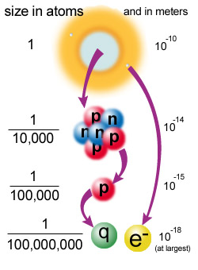
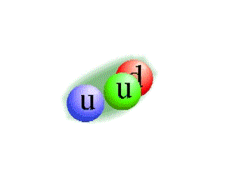


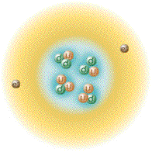
Baryon matter
Nuclear matter
Normal nuclear matter density:
ρ = A / V_{N} V_{N} = 4/3 π R³ R = r₀ A^{1/3} r₀ ~ 1.15 fm
= 0.16 nucleon/fm³
Normal nuclear matter energy density:
ε = A m_{n} / V_{N} m_{n} =0.94 GeV
= 0.15 GeV/fm³
What does this mean in terms of compactness of the nucleus?
Fraction of the nuclear volume occupied by nucleons:
f = A v_{n}/V_{N} v_{n} = 4/3 π r_{n}³ r_{n} ~ 0.84 fm (charge radius of the proton)
~ 0.38
  ~60% of the nuclear volume is empty!
Close packing condition f =1:
ρ ~ 0.4 nucleon/fm³
QGP expected at a density ~10 times larger than the normal nuclear matter density:
ε ~ 2 GeV/fm³

Slide 5
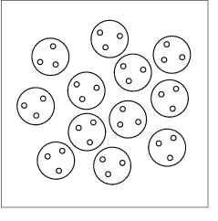

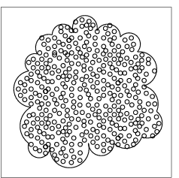
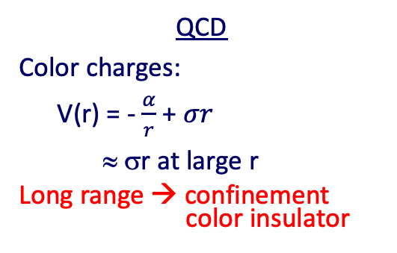
Deconfinement and Chiral Symmetry Restoration
QCD
Color charges:
V(r) = - $\frac{α}{r}$ + $σr$
≈ σr at large r
Long range → confinement
color insulator
QED
Electric charges:
HIGH BARYON DENSITY
V(r) ≈ σ/µ [ 1 - exp (-μr) ]
Screening → Deconfinement
color conductor
µ = 1/ r_{D}
r_{D} Debye screening radius
Partons free to move over a volume >> hadron size.

Slide 6
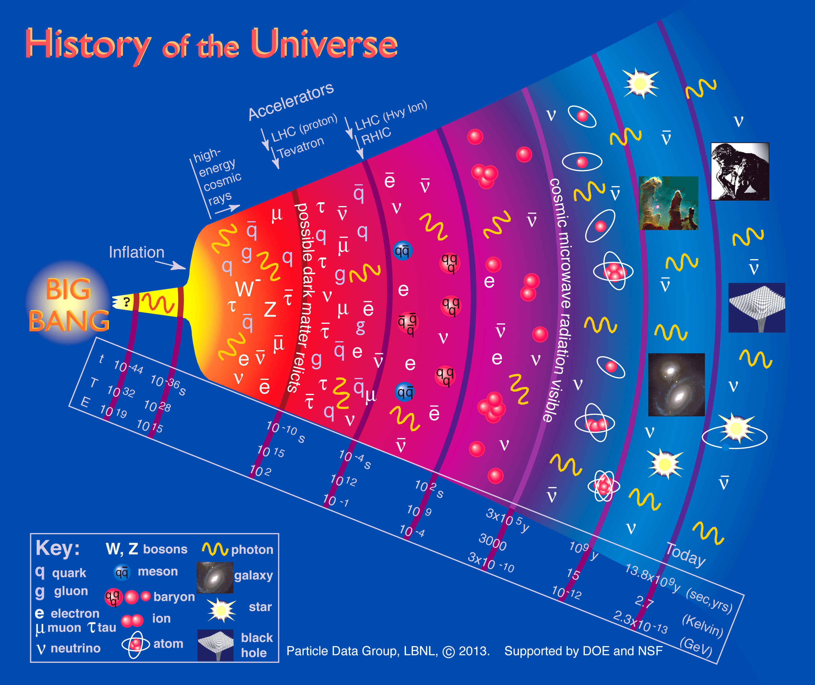
Primordial state of matter of the early Universe
Some ~10 µs after the Big Bang matter characterized by:
Temperature ~170 MeV (2.10¹² K) and density ~1 GeV/fm³ (10¹⁵ g/cm³)

Slide 7
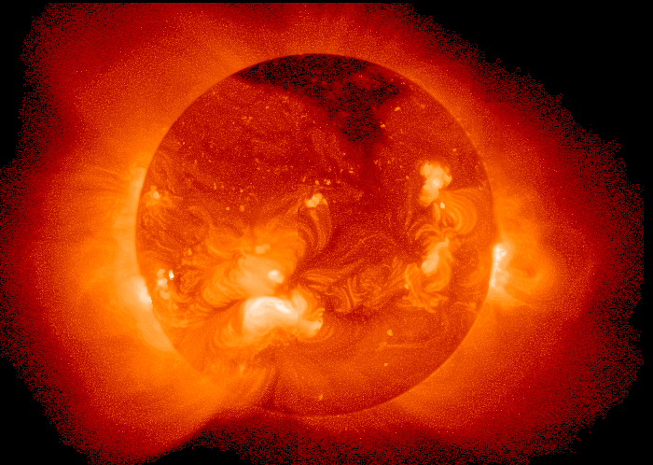
Temperature at the centre of the Sun ~ 15 000 000 K
A medium of 150-170 MeV is more than 100 000 times hotter !!!

Slide 8
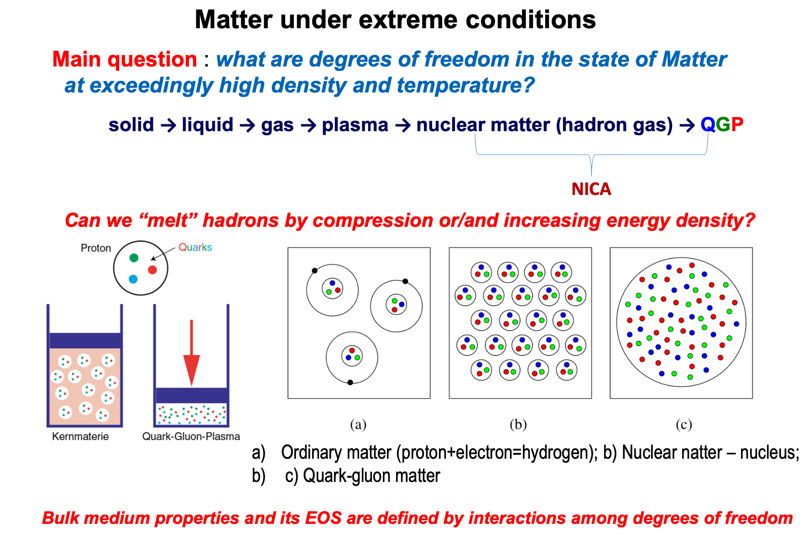

Slide 9
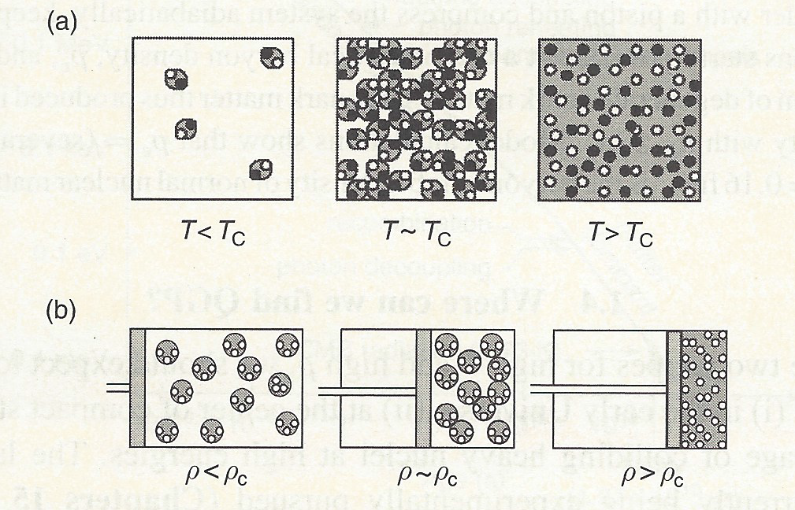
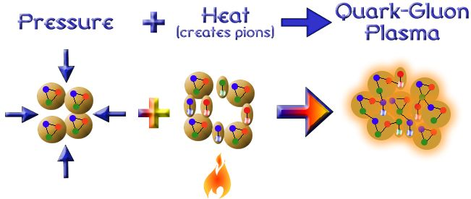
Quark Matter formation
Two recipes:
(a) at high T - Early universe
(b) at high baryon density – Neutron stars
Relativistic heavy ion collisions - A combination of the two recipes
Notes:
).

Slide 10
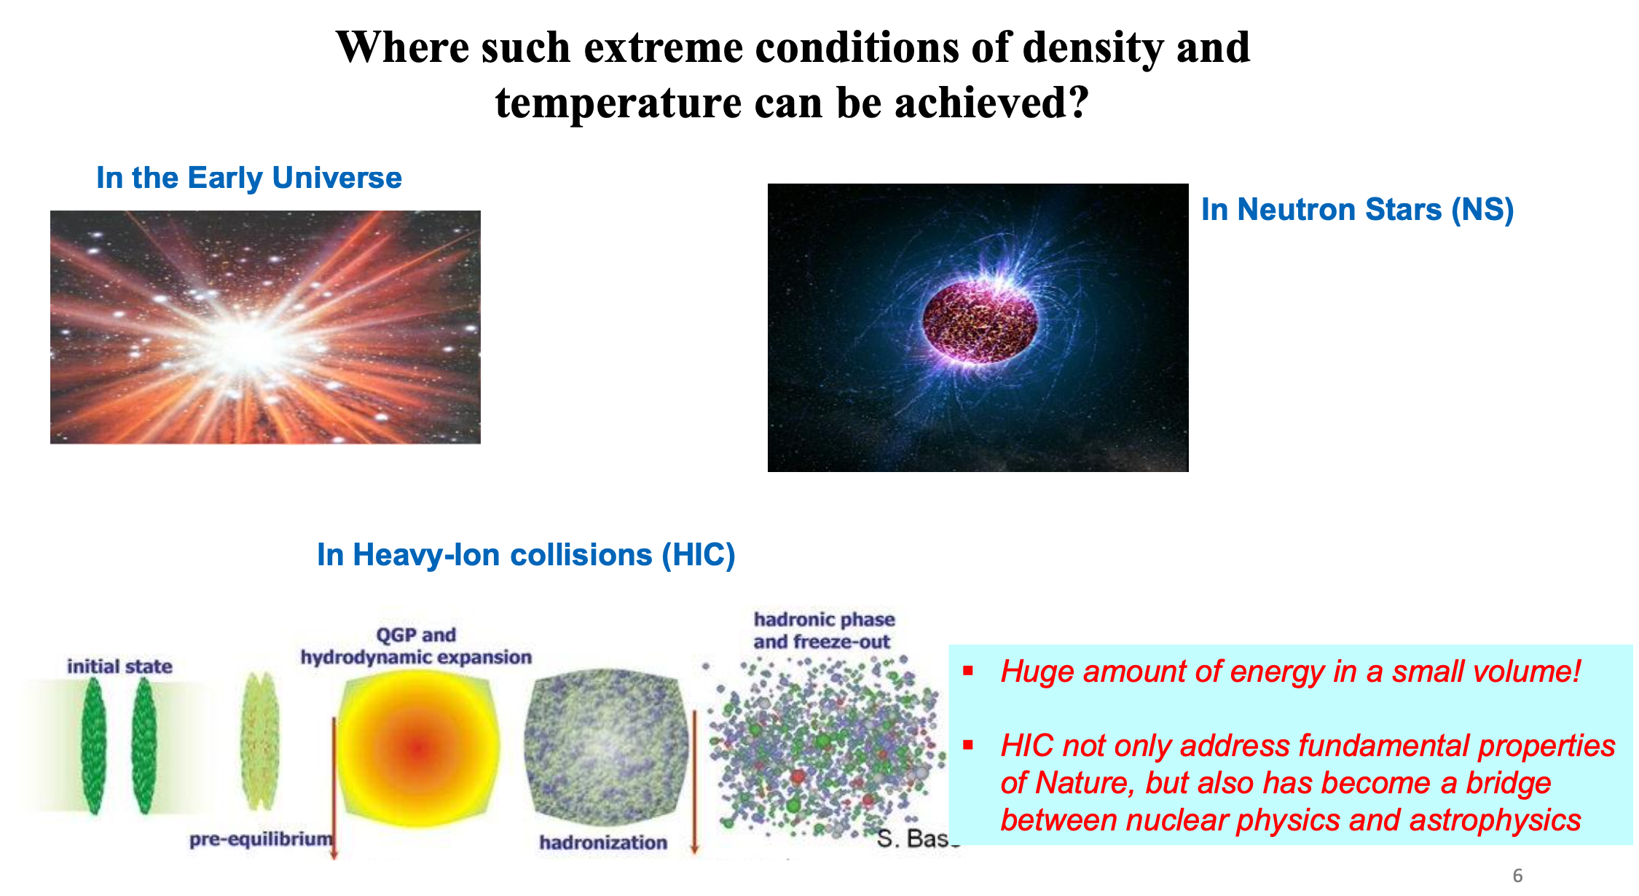

Slide 11
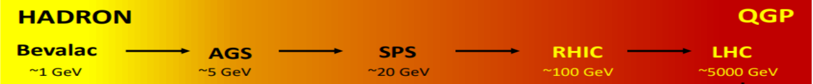
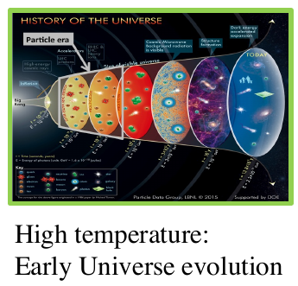
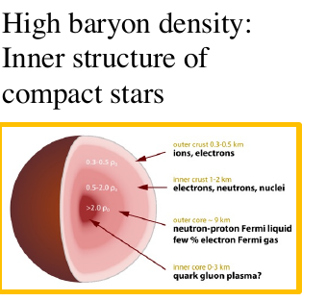
Relativistic Heavy-Ion Collisions and Quark Gluon Plasma (QGP)
It is the primordial form of QCD matter at high temperature and/or baryon density.
It was present during the first few microseconds of the Big Bang.
It provides an example of phase transitions which may occur at a variety of higher temperature scales in the early universe.
It can provide important insights on the origin of mass for matter, and how quarks are confined into hadrons.
Study matter under extreme temperature and baryon density → Explore its phase diagram, search for its new states and study their properties.

Slide 12
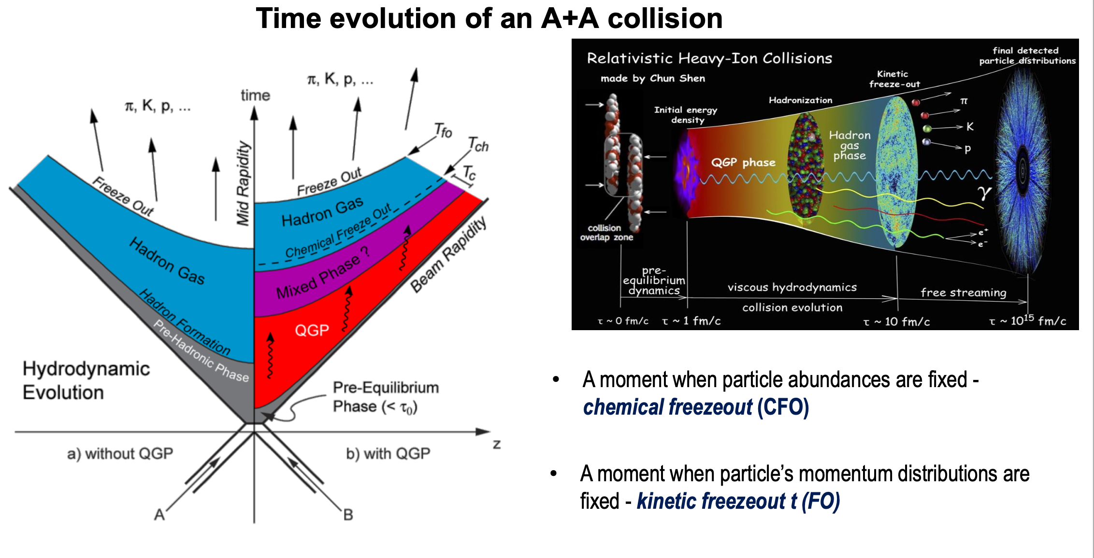
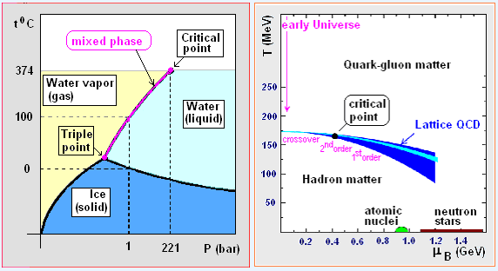
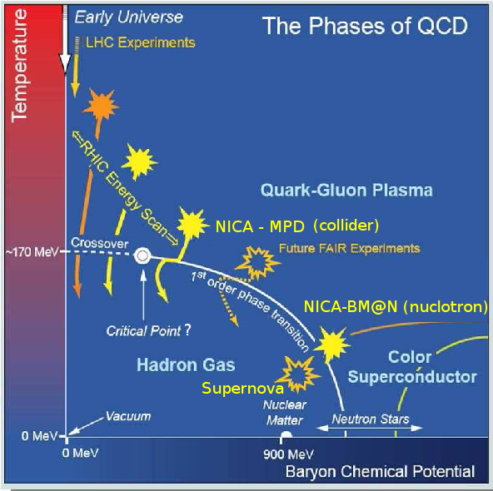
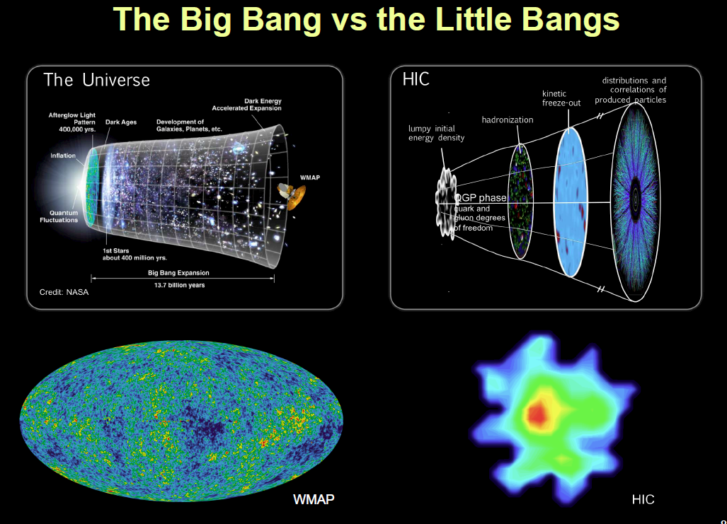

Slide 13
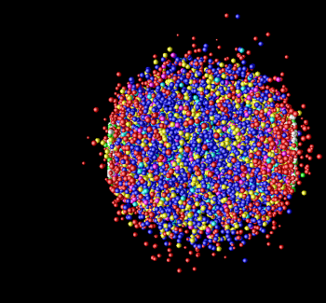
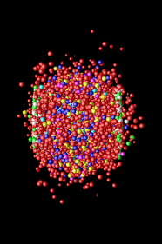
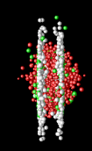
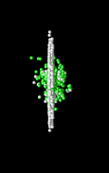

Space-time Evolution of the Collisions
time
e
φ
jet
p
K
π
Λ
γ
μ
γ
e
Freeze-out
(~ 10 fm/c)
(no more elastic collisions)
Hadronization particle composition is fixed (no more inel. Collisions)
→ Expansion →
QGP (~ few fm/c)
Hard Scattering + Thermalization (< 1 fm/c)
space
Au
Au

Slide 14
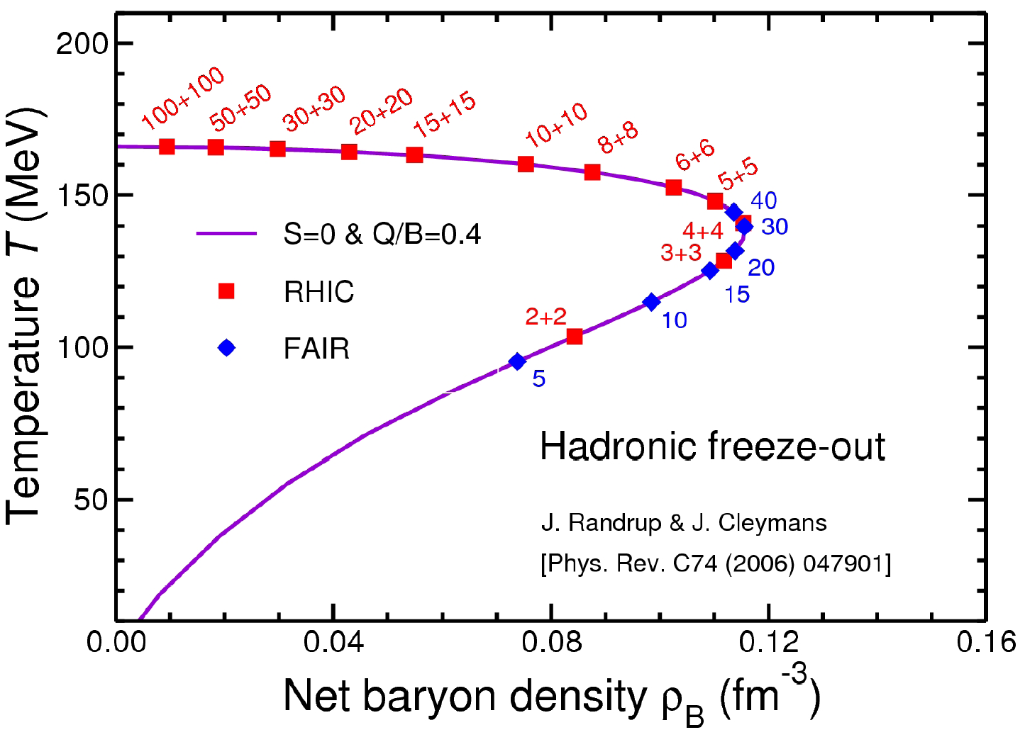
Freeze-out conditions
E1+E2: collider
RHIC
E: FT
SPS
FAIR, NICA

Slide 15
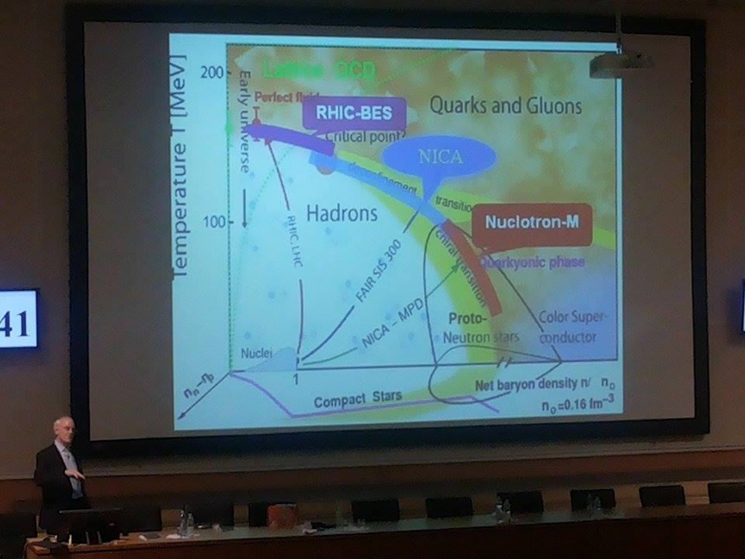
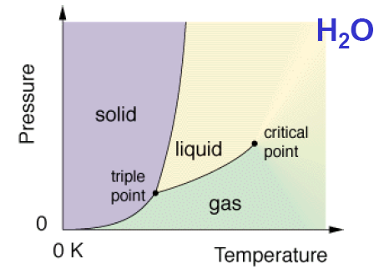
Study of the phase transition from hadronic to quark-gluon matter
Search for the
critical point
Study of in-medium properties of hadrons
at high baryon density and temperature

Slide 16
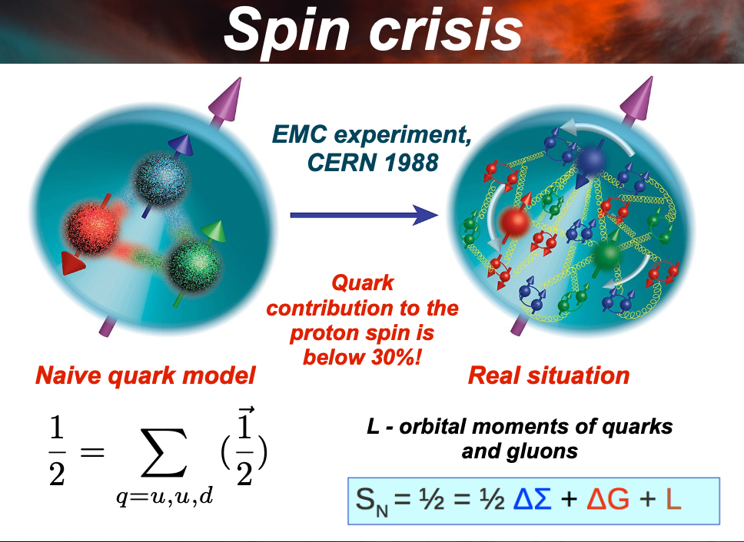

Slide 17
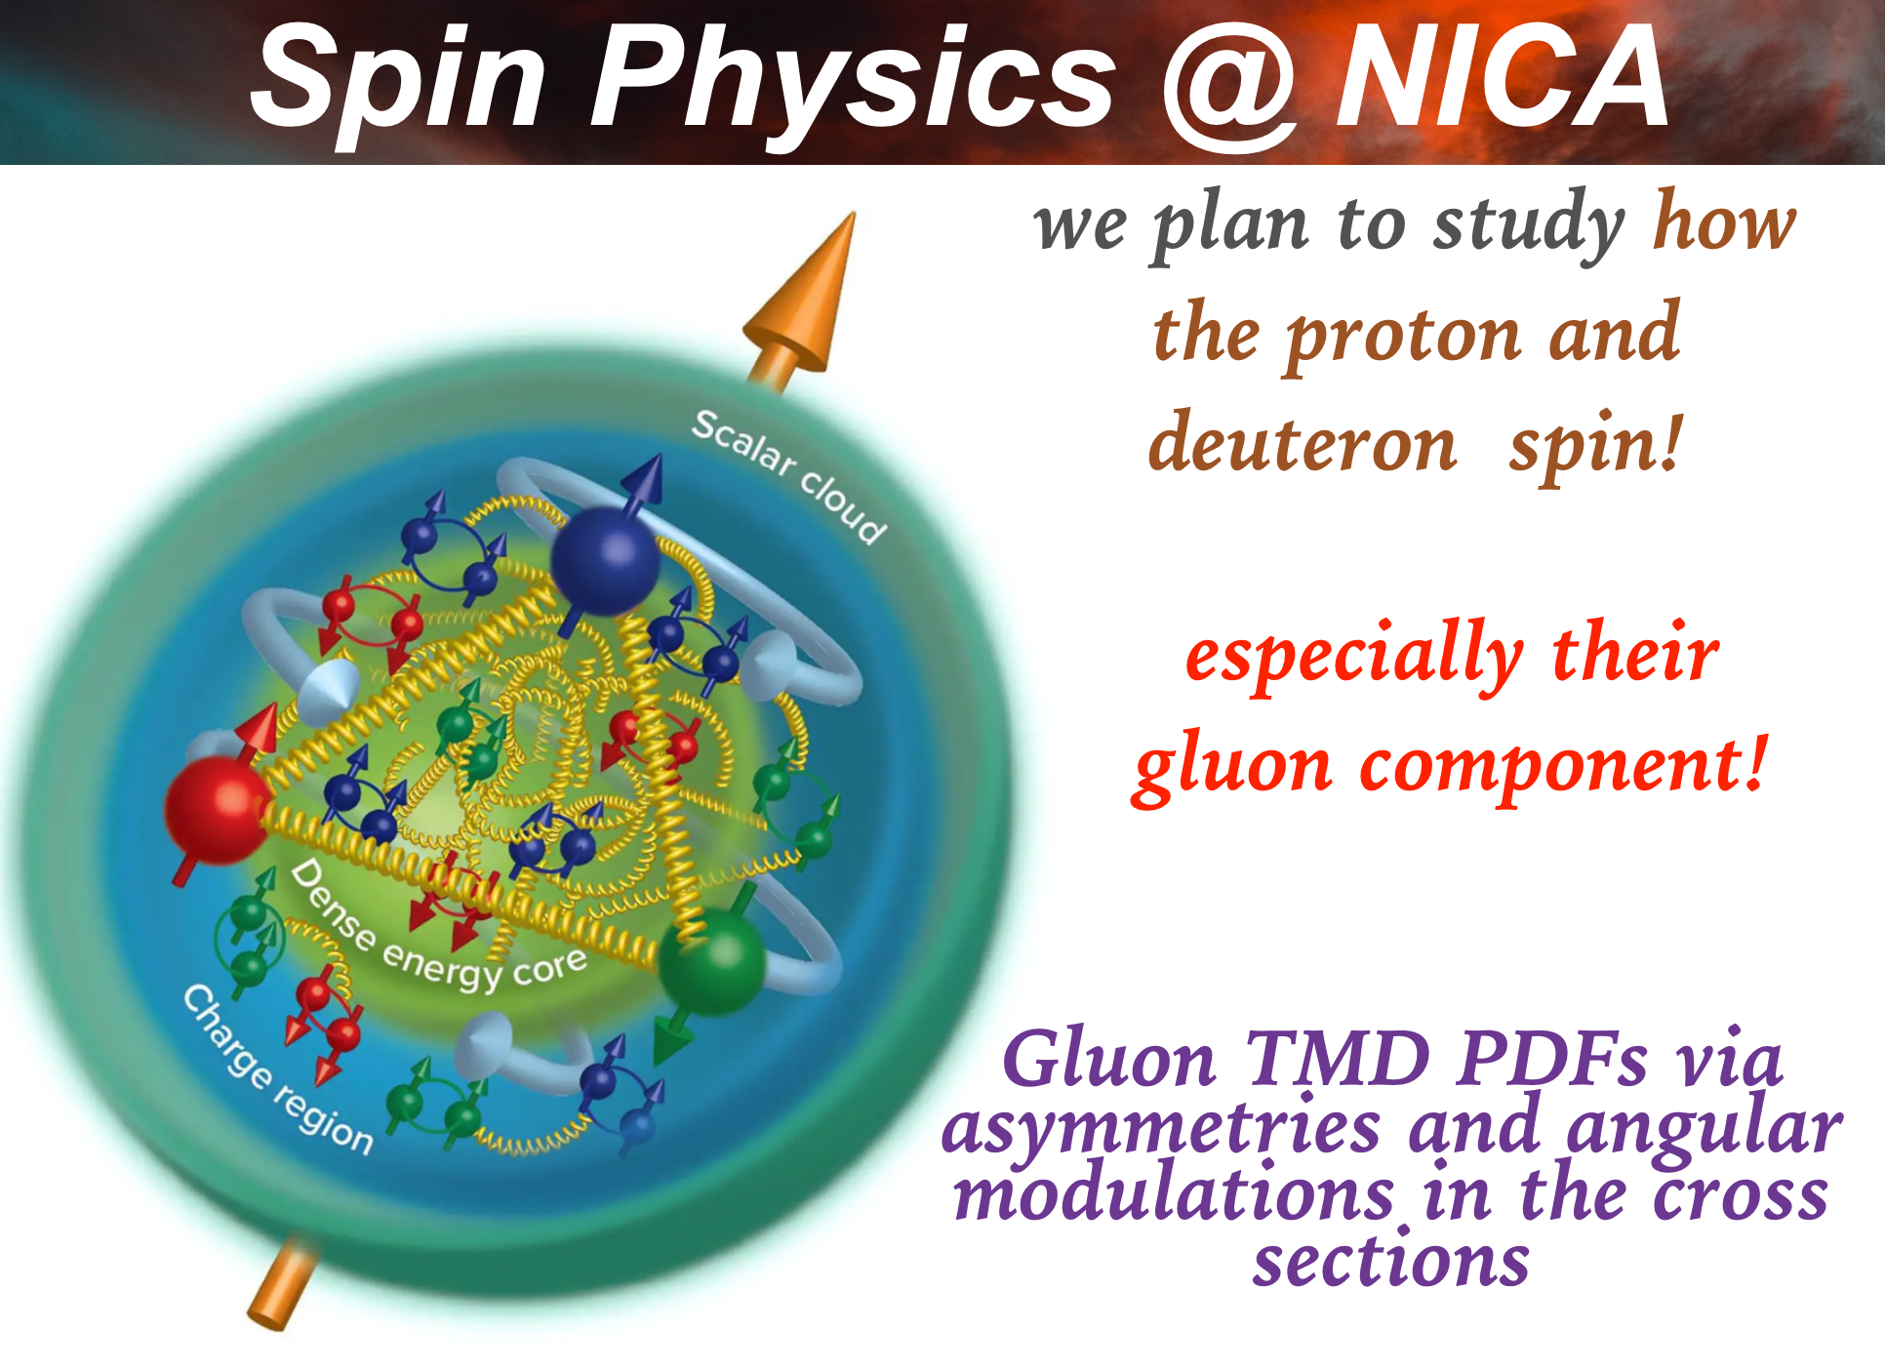

Slide 18
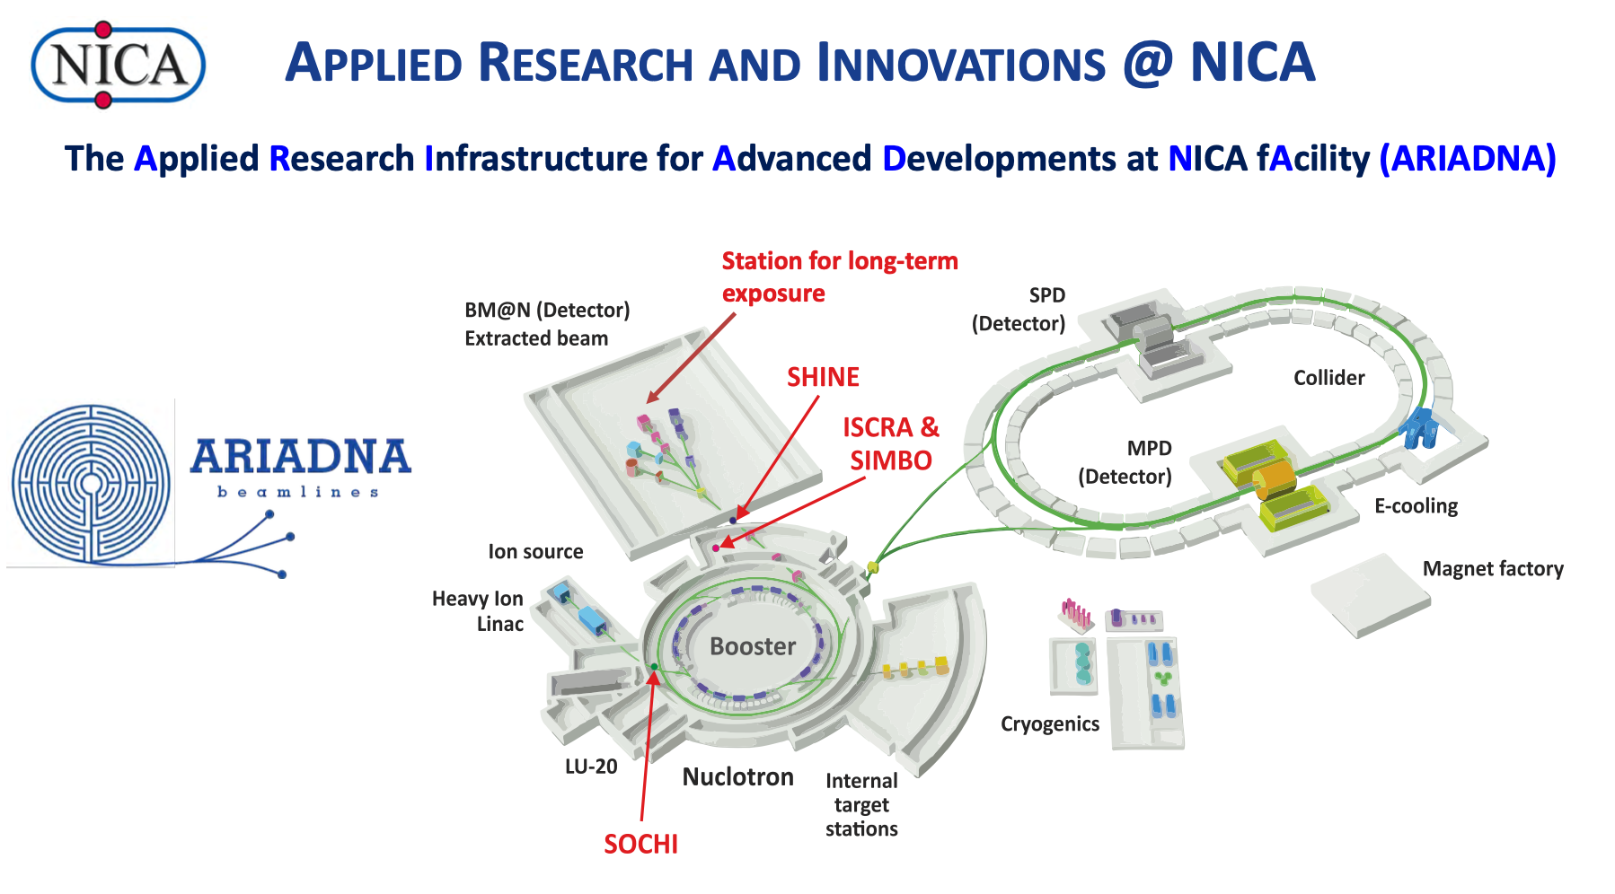
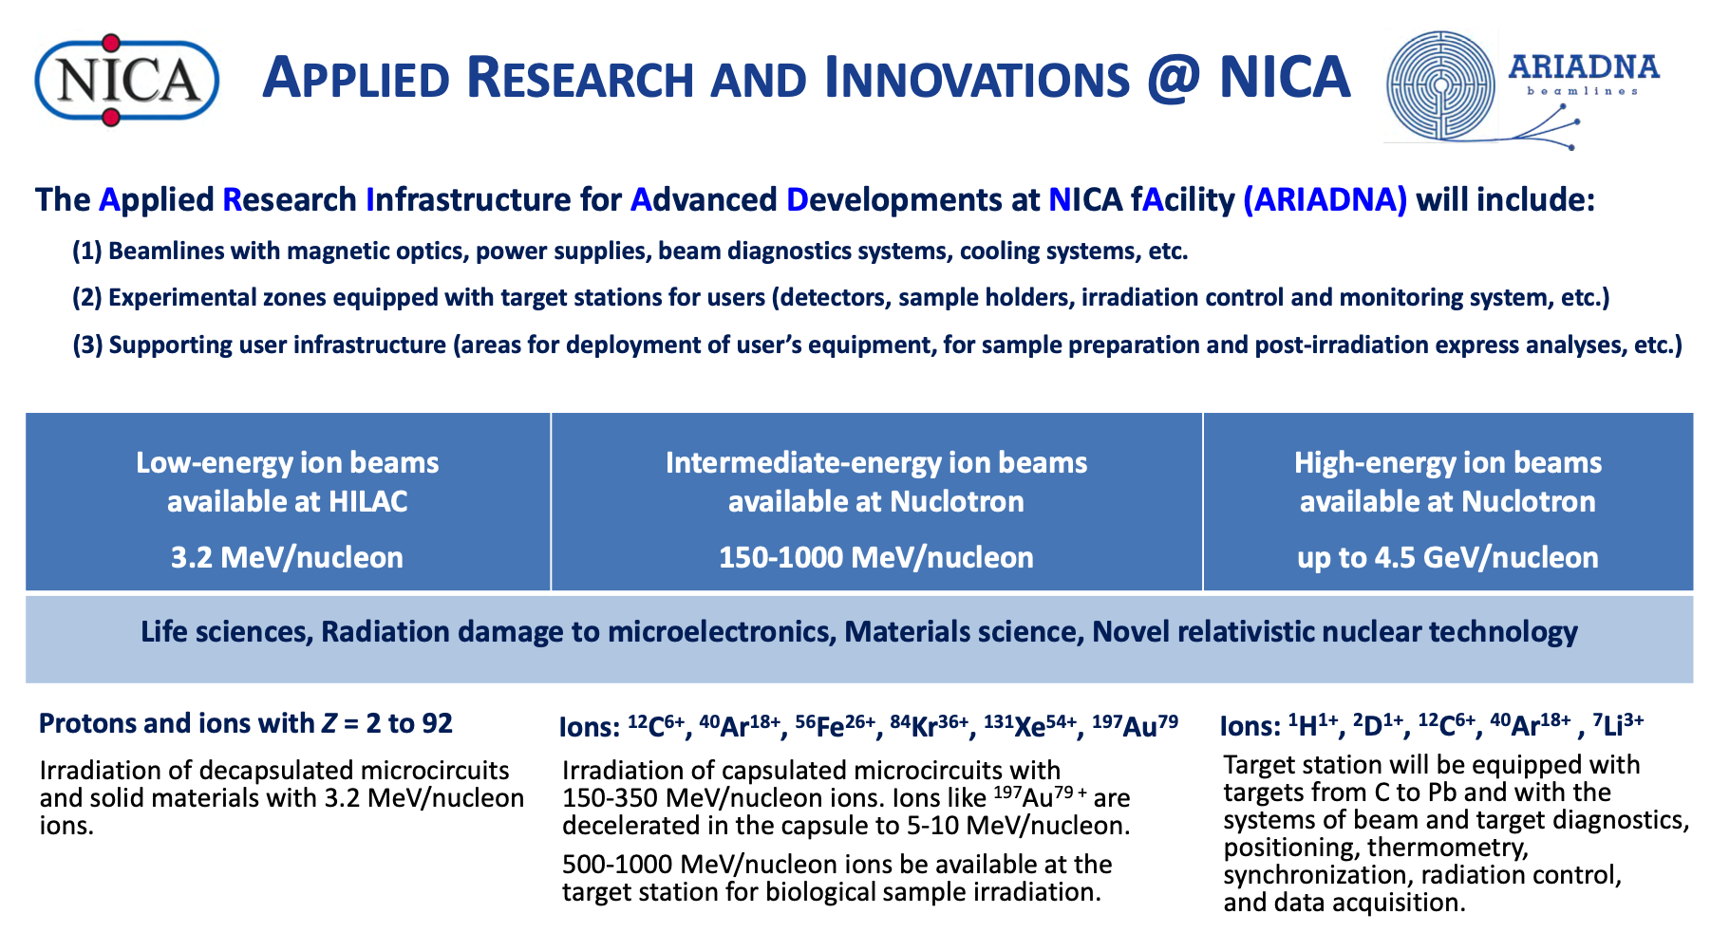

Slide 19
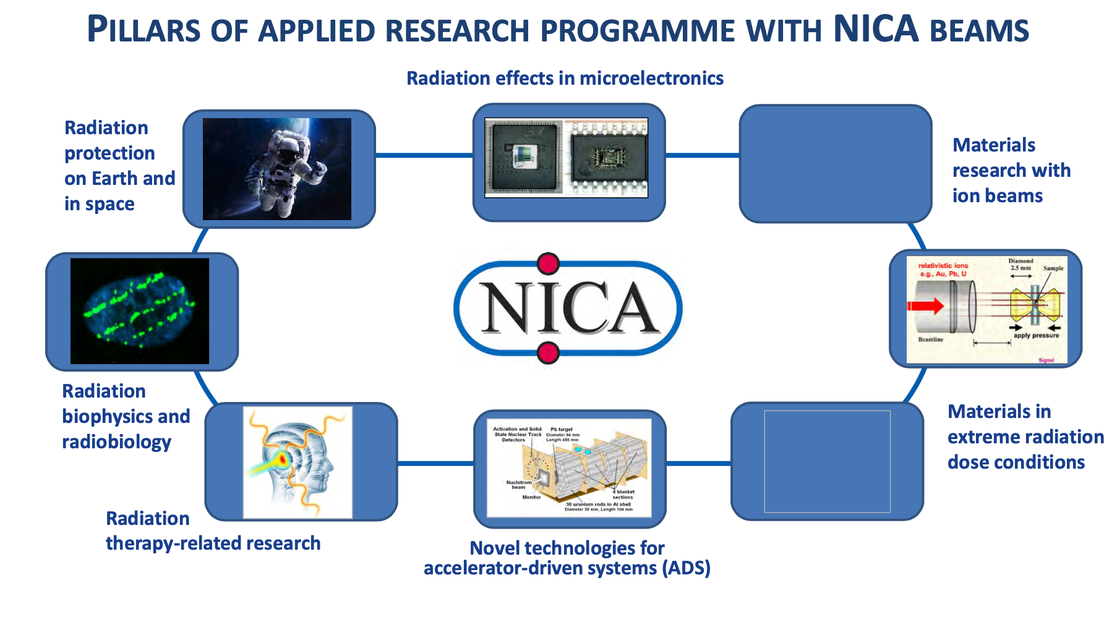

Slide 20
When and where
Short heavy-ion physics history
BEVALAC – LBNL 1972-1984 max. √s_{NN} = 2.2 GeV
SPS – CERN 1986-2000 √s_{NN} = 17.3 GeV
AGS – BNL 1988-1996 √s_{NN} = 4.8 GeV
SIS18 – GSI 1990 → √s_{NN} = 2.4 GeV
RHIC – BNL 2000-2025 √s_{NN} = 200 GeV
LHC – CERN 2010 → √s_{NN} = 5.02 TeV
NA35/49, NA44, NA38/50/51, NA45, NA52, NA57, NA60, WA80/98, WA97 …
Fixed target
E864/941, E802/859/866/917, E814/877, E858/878, E810/891, E896, E910 …
BRAHMS, PHENIX, PHOBOS, STAR
Collider
ALICE, ATLAS, CMS, LHCb
Near future
NICA – JINR 2025 √s_{NN} = 11 GeV
SIS100 – FAIR 2028? √s_{NN} = 5 GeV
Collider &
Fixed target
MPD, BM@N, SPD
CBM, HADES
Fixed target

Slide 21
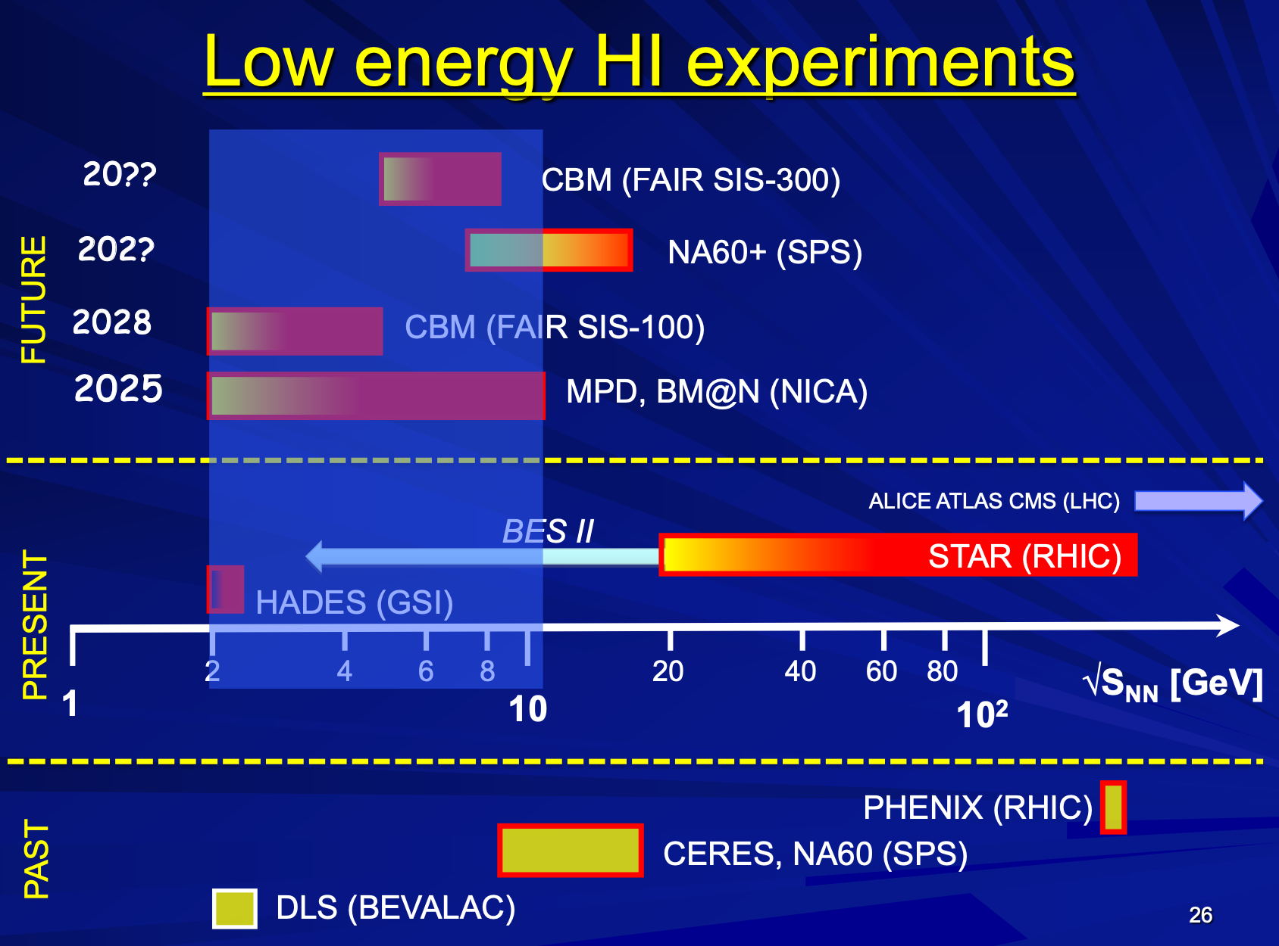

Slide 22
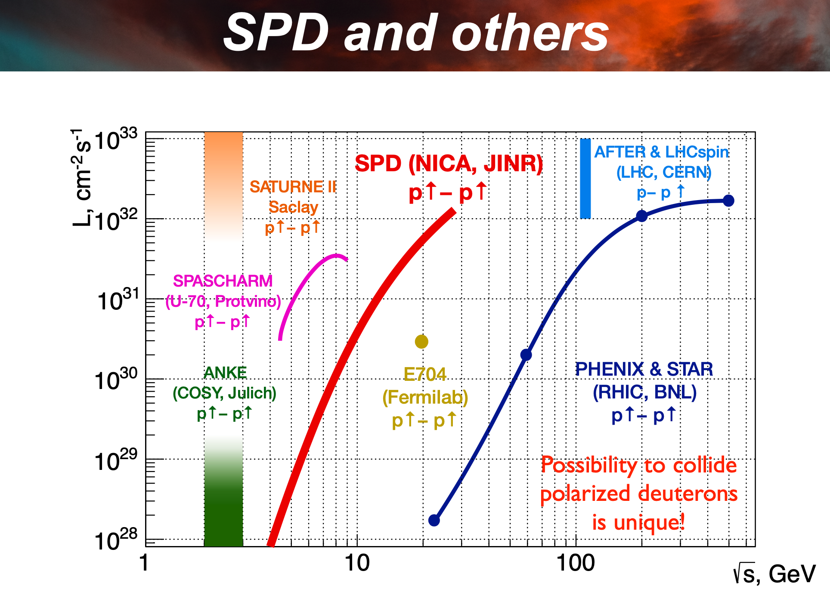

Slide 23
“Hilbert Problems” of
Dense Matter Physics for
- Which phases of QCD matter?
- Which degrees of freedom?
- Nature of the (spin) nucleon?
How hadronization proceeds?
...
Challenging questions:
Character of phase transitions (if any)?
Signals for 1st order phase transition?
Critical Point?
When does the perfect fluid turn on?
Duality of dynamical and thermal descriptions?
Global polarization in HIC?
…

Slide 24


