Slide 1
Interest Wave’10 program
Project “MPD detector performance study at the NICA collider”
Tasks:
1) Study of the MPD phase-space coverage for hadrons and light nuclei in the fixed target mode with different beam-target combinations;
2) Study of MPD identification capability for light hadrons by means of ionization loss (dE/dx) measurements;
3) Estimation of secondary particle contribution in the yields of (anti)protons and deuterons;
4) Study of MPD identification capability for by means of TOF measurements.

Slide 2
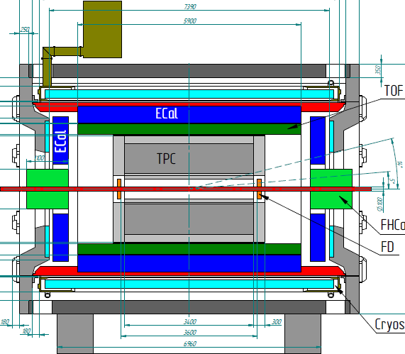
All Tasks : MPD setup and its overall performance
η=1.3
MPD at Stage’1:
TPC tracking: |η|<1.6 (Npoints>15)
TOF & ECAL coverage: |η|<1.3
PID: TOF+dE/dx combined |η|<1.3, pT<3 GeV/c,
limited PID 1.3<|η|<1.6 (dE/dx)
Collider mode: two identical relativistic beams interact in the center of the setup.
Forward/backward regions are also identical, symmetry with respect to the interaction point
Fixed-target mode: one accelerated beam hits the target, displaced to Z = -115 cm from the center. Colliding nuclei are not identical, no symmetry in the phase-space

Slide 3
Task 1 : phase-space, spectra and yields from central Au+Au collisions
MPD in the collider mode: sufficiently large phase-space coverage for identified pions and kaons (> 70% of the full phase-space at 9 GeV)
Hadron spectra can be measured from pT=0.2 to 2.5 GeV/c
Extrapolation to full pT-range and to the full phase space can be performed exploiting
the spectra shapes (see BW fits for pT-spectra and Gaussian for rapidity distributions)
Adrian Lara Tlaxcala
K+
What about the fixed-target mode?
This will be the content of one task

Slide 4
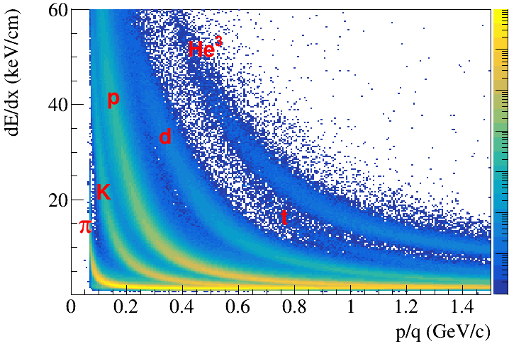
Task 2 : MPD PID performance by means of ionization loss dE/dx
Alejandro San Juan Lopez
Bi+Bi events from the PHQMD model
Simulate A+A collisions
(model and/or box generators)
Optimize track selection criteria
Parametrize dE/dx bands for particle specie
(i.e. positions and width at every p/q)
Define selection regions, calculate purity,
efficiency, and contamination
4

Slide 5
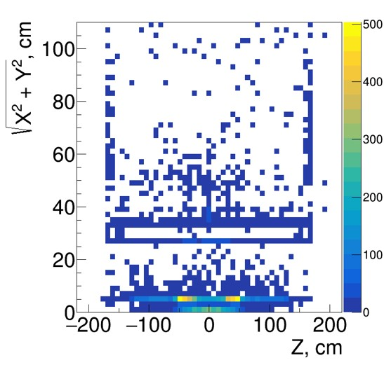
Task 3 : Estimation of secondary particle contribution
in the yields of (anti)protons and deuterons
Juan Carlos Marquez Ramirez
Born in A+A collision primary particles interact
inside MPD detector material producing secondaries
Some of them can be rejected by track selection
criteria, some – cannot!
One must estimate contribution of secondaries
in selected samples of (anti)protons and deuterons
Secondary deuterons from Bi+Bi collsions

Slide 6
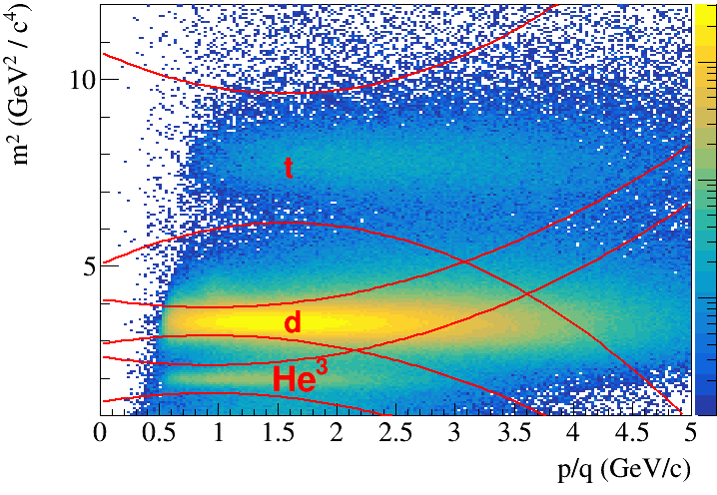
Task 4 (changed): MPD PID performance by TOF measurements
Adolfo Flores
Simulate A+A collisions
(model and/or box generators)
Optimize track selection criteria
Parametrize mass-squared (1/beta) bands
for particle specie (i.e. positions and width
at every p/q)
Define selection regions, calculate purity,
efficiency, and contamination

Slide 7
The full specification for tasks will be completed during several days (# of events, simulation scheme,
requested(expected) results, etc.)
Every task will contain a list of subtasks, such that the completion of several (hopefully, even all)
will be an acceptable result
Using of event generators can be complemented by exploiting of simple phase-space
generators to overcome low multiplicity problem for rare probes (light nuclei and antiprotons)
class MpdHypYPtGenerator : public FairGenerator {
public:
MpdHypYPtGenerator(Int_t pdgid, Int_t mult = 1, Double_t yield = -1.0);
inline void SetPDGType(Int_t pdg) { fPDGType = pdg; };
inline void SetMultiplicity(Int_t mult) { fMult = mult; };
inline void SetDistributionPt (Double_t T=0.154319) {fT=T;};
inline void SetDistributionPt(Double_t T = 0.223) { fT = T; };
inline void SetDistributionY (Double_t y0=1.98604, Double_t sigma=0.617173) {fY0=y0;fSigma=sigma;};
inline void SetDistributionY(Double_t y0 = 0, Double_t sigma = 0.72)
{ fY0 = y0; fSigma = sigma; };
7

