Slide 1
ALICE O2:
By Culicov Alexandru

Slide 2
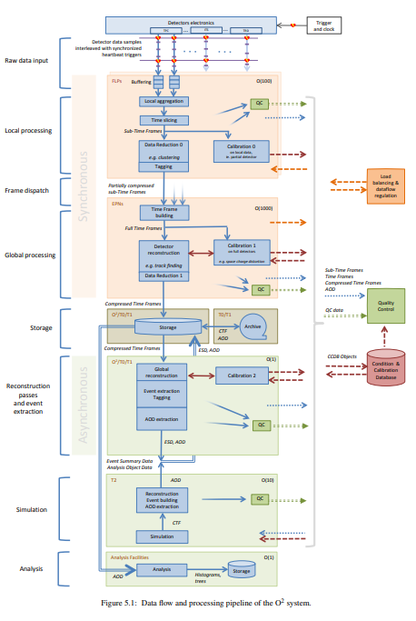
Computational Architecture of ALICE
Distributed Computational Architecture
ALICE O2 is based on a distributed architecture that incorporates 250 FLPs for direct data reading from detectors, each providing a speed of 2 GB/s.
This architecture is supported by 400 EPNs that process these data, executing complex computational tasks including event reconstruction and analysis.
Functionality and Performance
These EPNs collectively handle the processing of full Time Frames generated every 30 seconds, ensuring effective data distribution and analysis throughout the experiment.

Slide 3
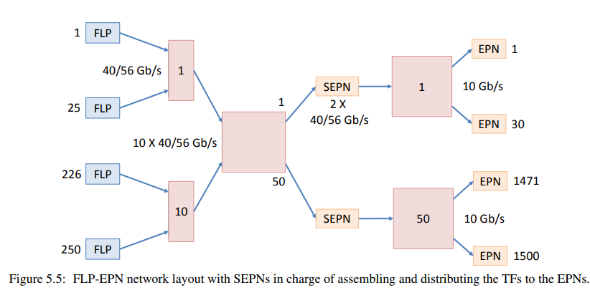
Configuration and Performance of the Network System
Network Infrastructure
400 EPNs are connected through a high-speed network with a bandwidth of 10 Gb/s per node, optimizing data transmission and ensuring high resource availability.
The network architecture is designed to minimize latencies and maximize data processing efficiency, which is crucial for timely processing of Time Frames.

Slide 4
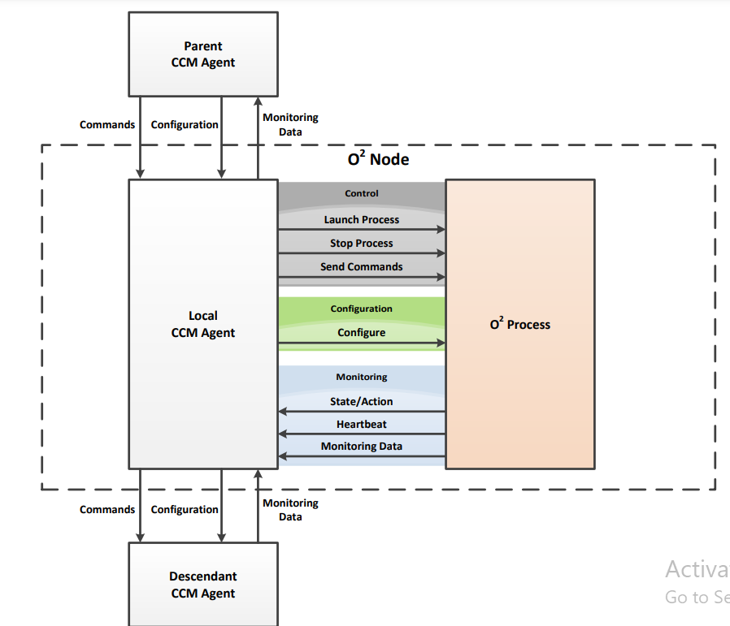
System Monitoring and Management
System Monitoring
The O2 monitoring system allows real-time tracking of all components' performance, gathering metrics such as CPU load, memory usage, and network bandwidth.
The system employs over 1000 sensors to collect data on the status of hardware and software components.
Resource Management
Resource management is conducted through a centralized system that automates task distribution among EPNs and optimizes their load for maximum efficiency.
The system supports dynamic scaling, enabling the addition or removal of computational nodes based on the current computational power requirements.

Slide 5
Data Security and Reliability
Security Measures
ALICE O2 implements a multi-layered security strategy to protect data and infrastructure, including data encryption, user authentication, and regular security audits.
An incident detection and response system provides continuous monitoring of network traffic and user activities to prevent unauthorized access.
Ensuring Reliability
To guarantee high availability and reliability, the O2 system utilizes redundant data storage and automatic failover to backup nodes in case of failures.
Regular backup and data recovery procedures minimize information loss and ensure data integrity under all circumstances.

Slide 6
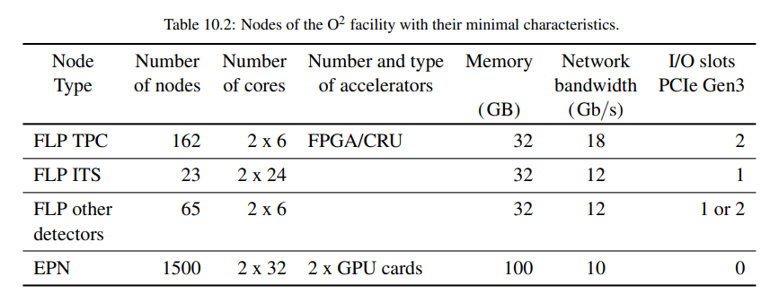
Memory and Computational Resource Requirements
Computational Capabilities
To adequately process data and compress events, each of the 1500 EPNs is equipped with approximately 100 GB of RAM, providing the necessary performance for computational tasks.
Considering the presence of dual-processor systems with 32 cores each, ALICE O2 can effectively distribute and process data streams in real time.

Slide 7
Data Storage System
Volume and Speed The system processes output data at a maximum rate of 500 GB/s from the ALICE detectors, requiring a robust infrastructure for data storage and processing.
Each EPN manages 10 GB of data per Time Frame, necessitating advanced solutions for storage and rapid data access.

