Slide 1
ARCHITECTURE &FUNCTIONAL DECOMPOSITION
ATLAS&ALICE

Slide 2
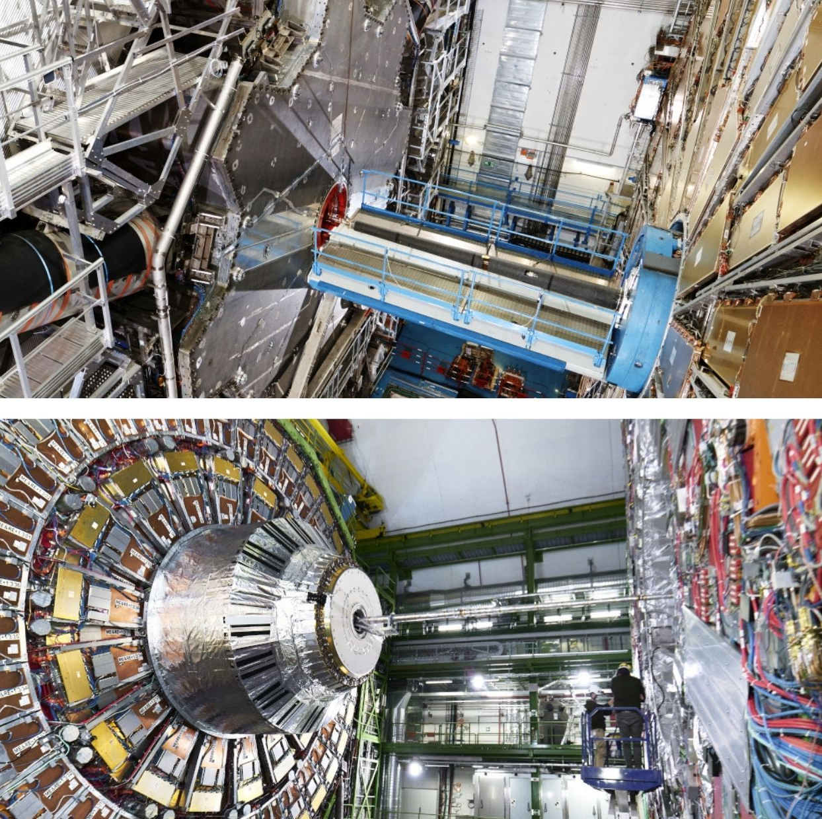
01. ATLAS

Slide 3
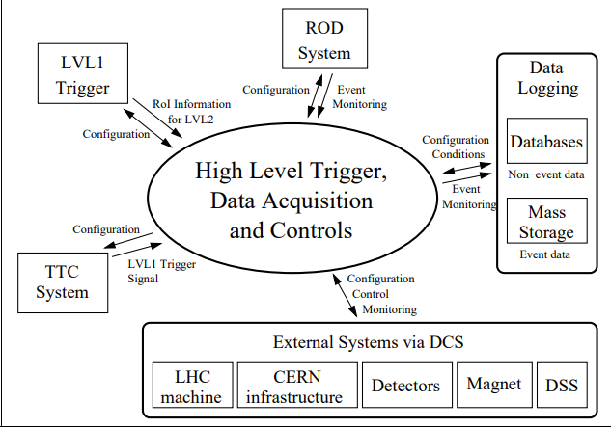
1.1
ARCHITECTURE
-The context diagram of the HLT/DAQ
-It illustrates the inter-relations
between the HLT/DAQ system seen as a whole and elements external to it that are directly related to data acquisition and triggering.
-It also illustrates the type of data which is exchanged in each case

Slide 4
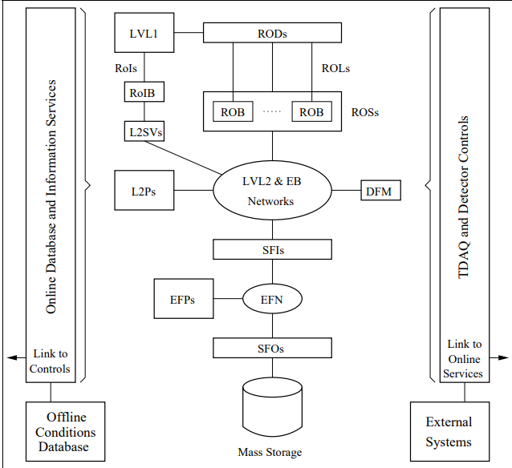
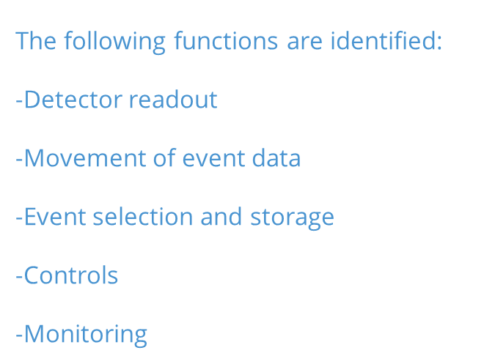
1.2 FUNCTIONAL DECOMPOSITION OF HLT/DAQ
The HLT/DAQ system provides the ATLAS experiment with the capability of moving the detector data, e.g. physics events, from the detector to mass storage; selecting those events that are of
interest for physics studies; and controlling and monitoring the whole experiment

Slide 5
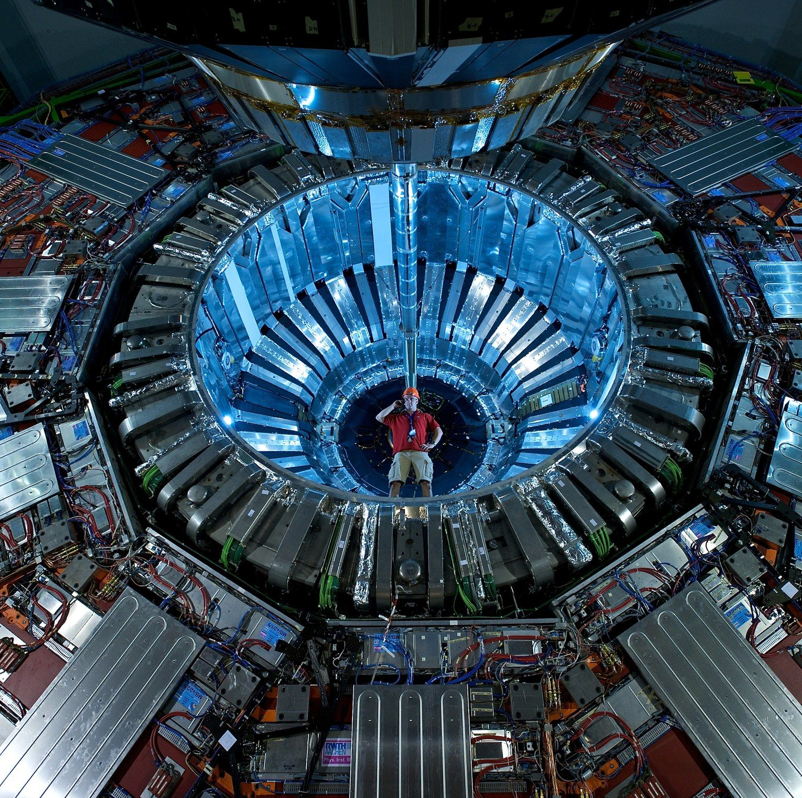
02. ALICE

Slide 6
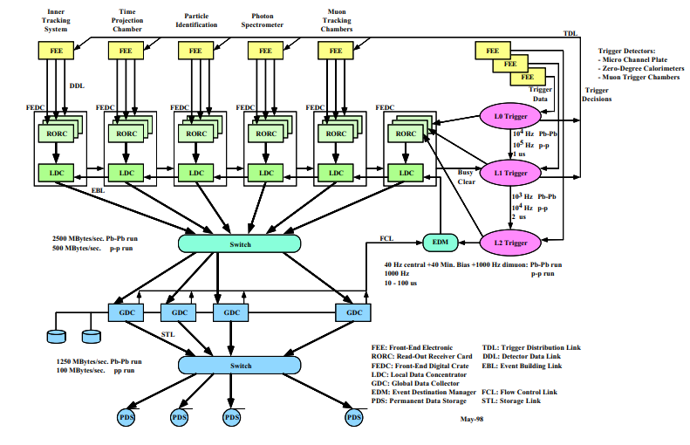
2.1 GENERAL ARCHITECTURE OF DAQ
The DAQ consists of these subsystems:
Detector readout and subevent building
Event buiding and distribution system
Monitoring system to check the quality of data collected
Control and presentation system provides a unified interface to the DAQ

Slide 7
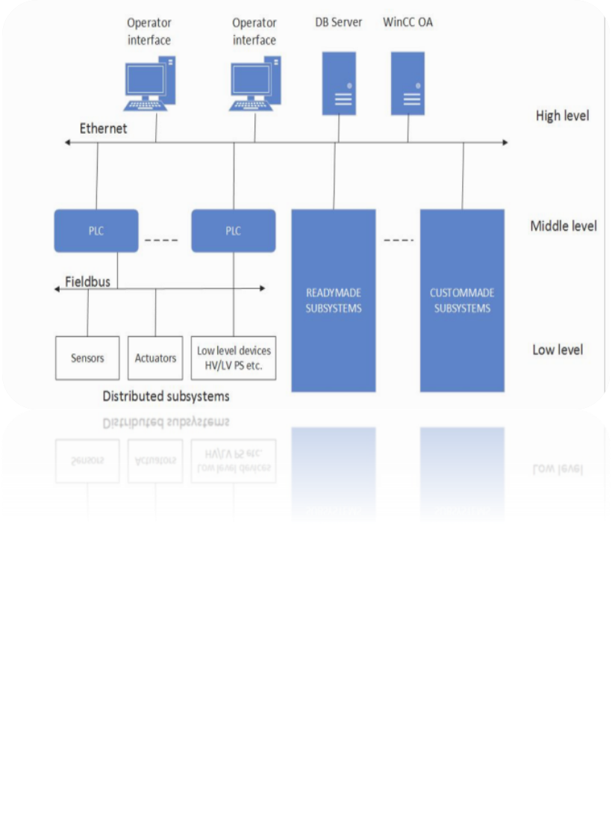
03. SPD
HIGH LEVEL
MIDDLE LEVEL
LOW LEVEL

