Slide 1
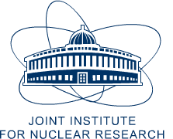
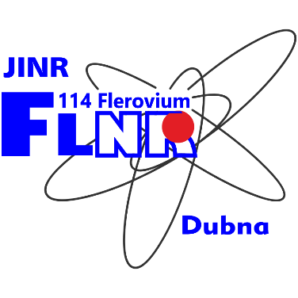
Vachagan Harutyunyan
A. Alikhanian National Science Laboratory (Yerevan Physics Institute)
Head of Applied Physics Researches Division
email: vharut@yerphi.am

Slide 2
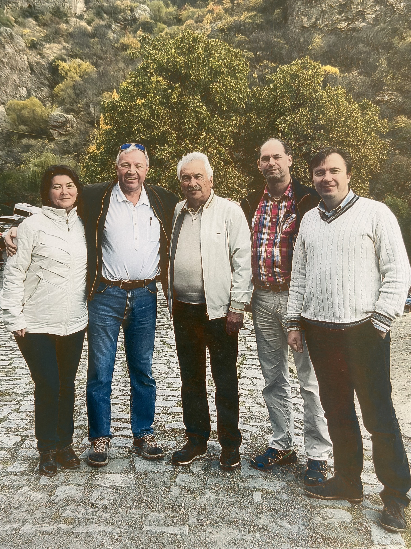
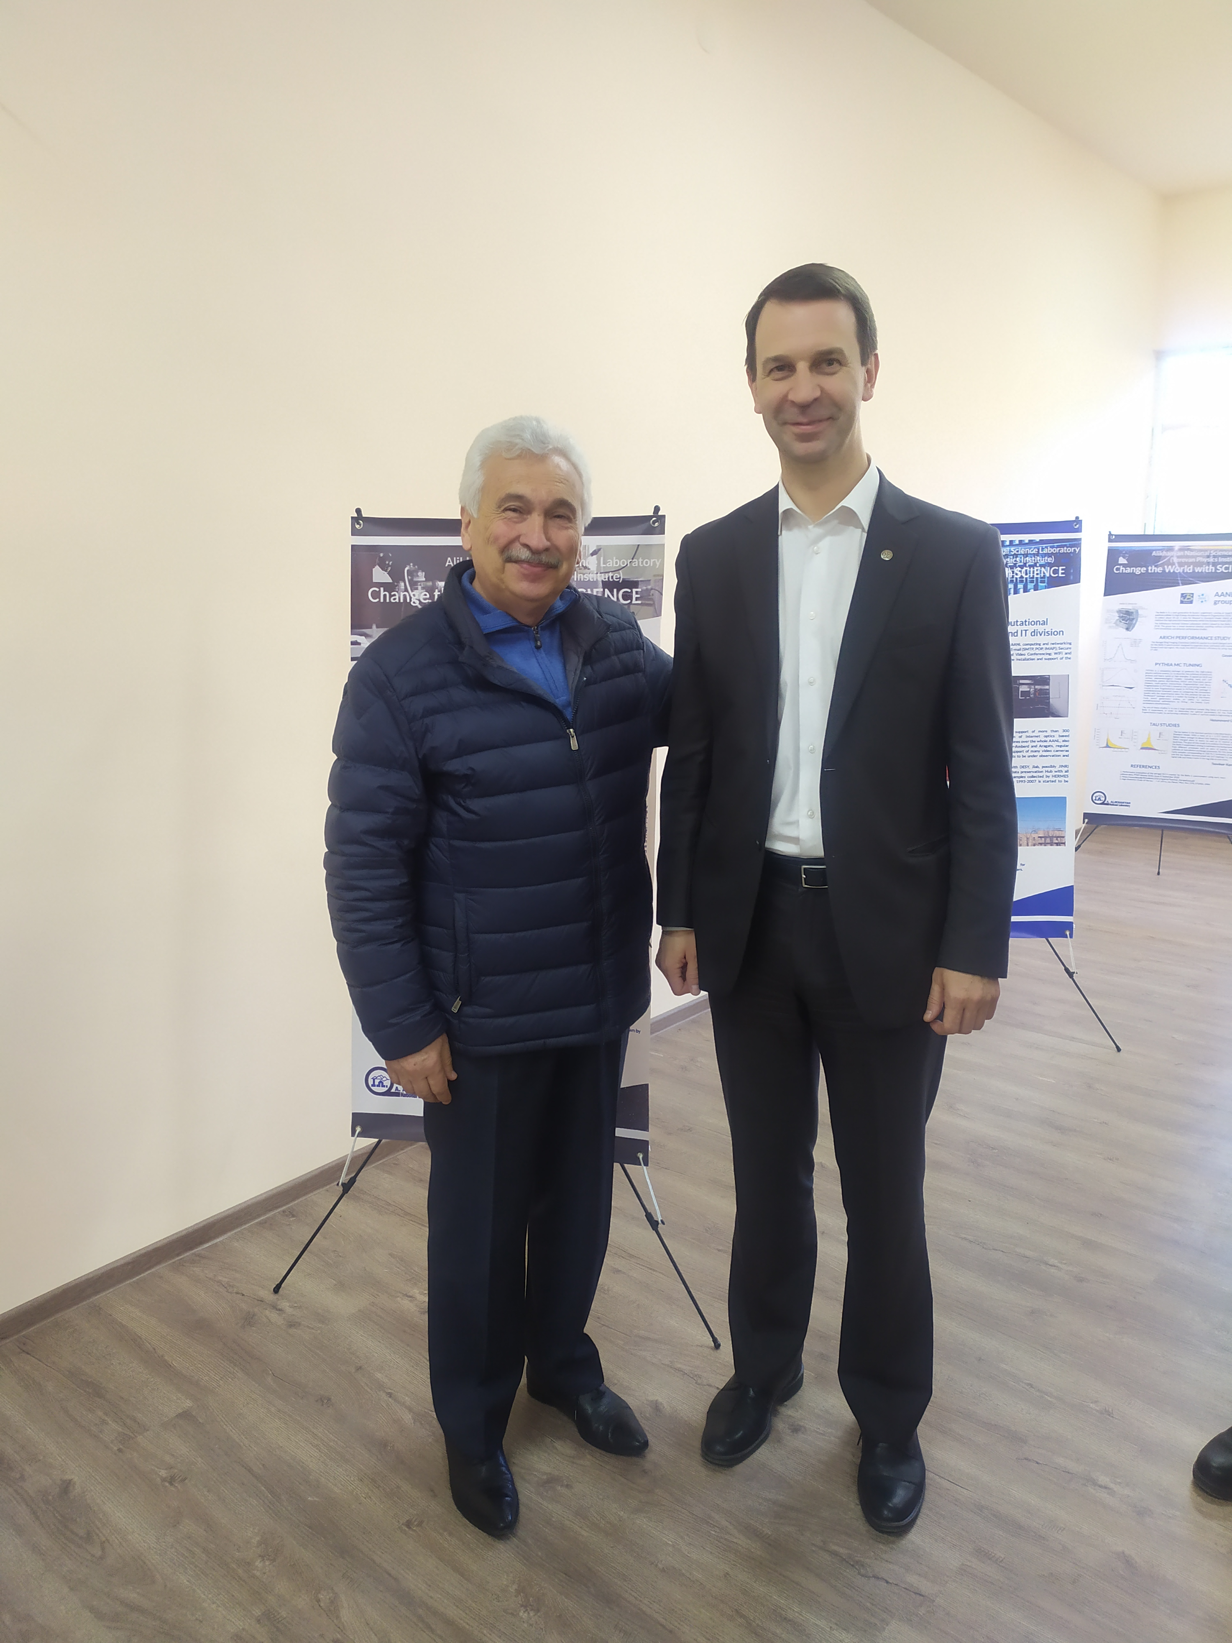
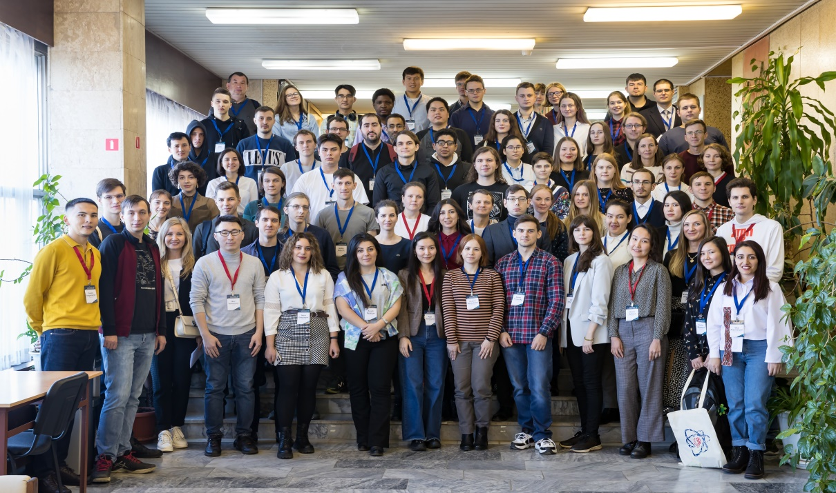
JINR – ANSL collaboration
PROTOCOL of the workshop 21-23 May 2019 on the international scientific and technical cooperation between the Frank Laboratory of Neutron Physics of JINR (FLNP) and A. Alikhanyan National Laboratory (AANL, Yerevan Physics Institute, Yerevan, Armenia).
The visit of the FLNP delegation to AANL in the autumn of 2019 in order to discuss and approve the protocol on cooperation between JINR and AANL, including a work plan for specific scientific tasks.
Protocol with FLNP at JINR DUBNA 2021-2023
No. 5002-4-21/23; Neutron interaction with condensed matter (composite silicate thermal barrier coatings, single crystalline materials, archeological sites of cultural heritage, natural minerals.
No. 4927-4-20/20; Interaction of neutrons with condensed matter (thermoregulating coatings, single-crystal materials, archeological objects.
XXVI International Scientific Conference of Young Scientists and Specialists (AYSS-2022), 24-28 October 2022, Dubna, Russia
A. Badalyan, V. Harutyunyan, E. Aleksanyan, N. Grigoryan, A. Arestakyan, V. Arzumanyan, A. Manukyan, V. Baghramyan, A. Sargsyan, O. Culicov, Investigation of the Radiation Resistance and Optical Properties of New Composite Thermal Barrier Coatings, ISSN 1547-4771, Physics of Particles and Nuclei Letters, 2023, Vol. 20, No. 5, pp. 1236–1239.
V. V. Harutyunyan, A. A. Sahakyan, V. V. Arzumanyan, N. Grigoryan, A. Martirosyan, New Energy Electron and Proton Irradiation Effects in Semiconductor Materials for Space Applications, Physics of Particles and Nuclei Letters, 2023, Vol. 20, No. 5

Slide 3
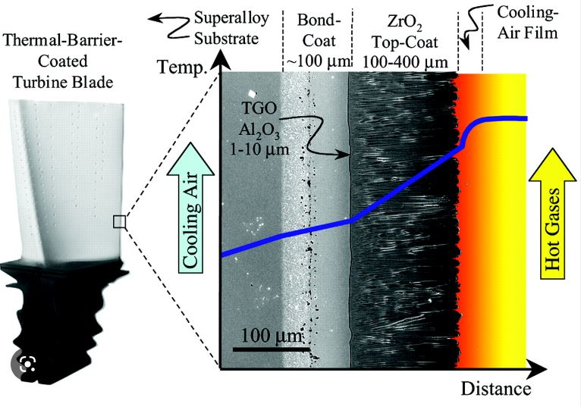
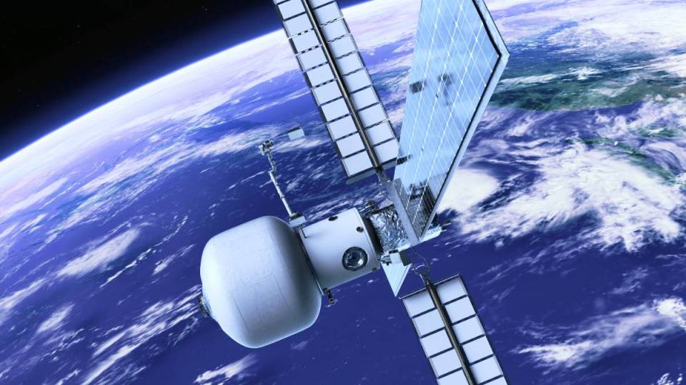
Construction and working
Application of TBCs in turbine engines
Substrate – Ni based
Bond coat - NiCoCrAlY
TGO – thermally grown oxide (α-Al₂O₃)
Top coat – ceramic material, YSZ, …
Space application of thermal control coatings
Higher melting temperatures
Thinner coatings
Compatible thermal expansion coefficient
Phase stability
Low thermal conductivity
Chemical inertness
Corrosion resistance (against CMAS - CaO-MgO-Al₂O₃-SiO₂ particles)
Radiation resistance
High emittance

Slide 4
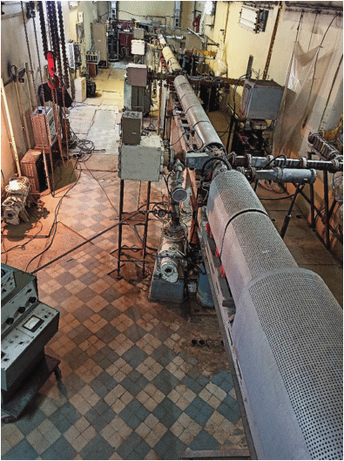
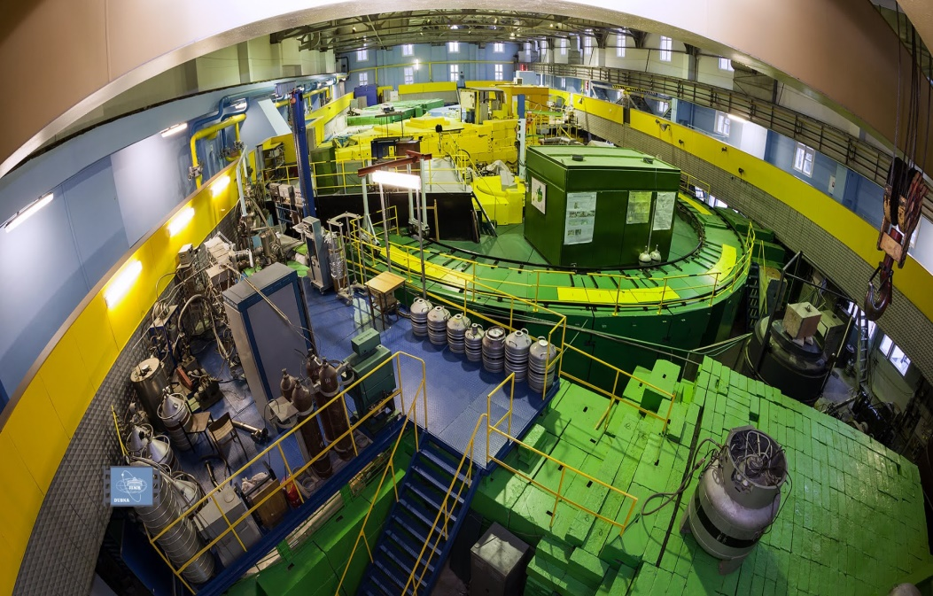
Radiation stimulating effects on TBCs
Electron irradiation with 20 MeV energy and 10¹⁷ e/cm² dose. 75 MeV LUex linear electron accelerator, Yerevan, Armenia
Neutron irradiation with 10¹³, 10¹⁵ n/cm² doses. FLNP IBR-2, Dubna, Russia

Slide 5
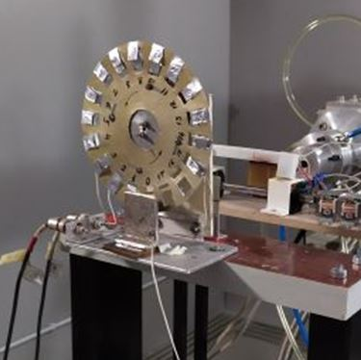
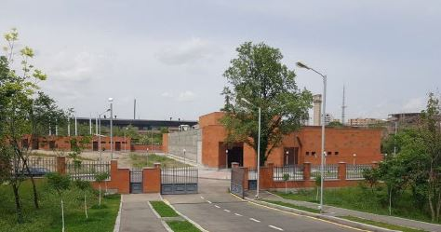
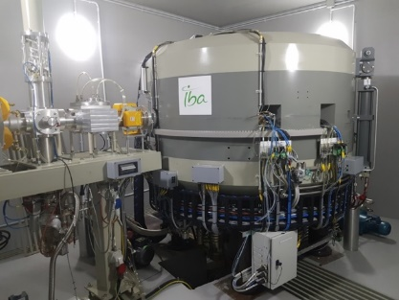
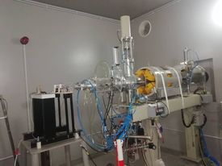
Radiation stimulating effects
Proton irradiation with 18 MeV energy and 10¹³, 10¹⁴, 10¹⁵ p/cm² doses. Cyclotron C18, Yerevan, Armenia
Sample holder – 18 samples
The Isotope Production Center
Cyclone-18 (IBA, Belgium)
External beamline

Slide 6
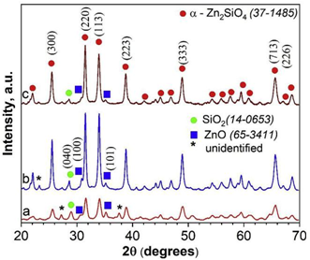
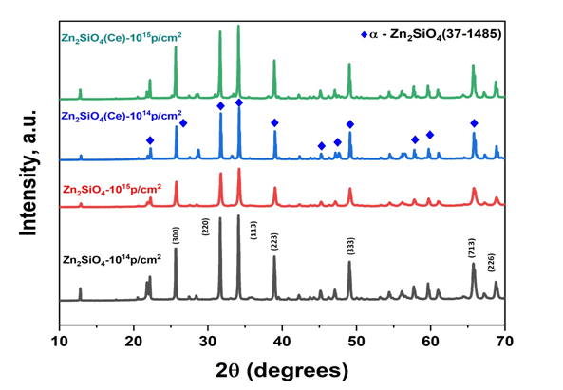
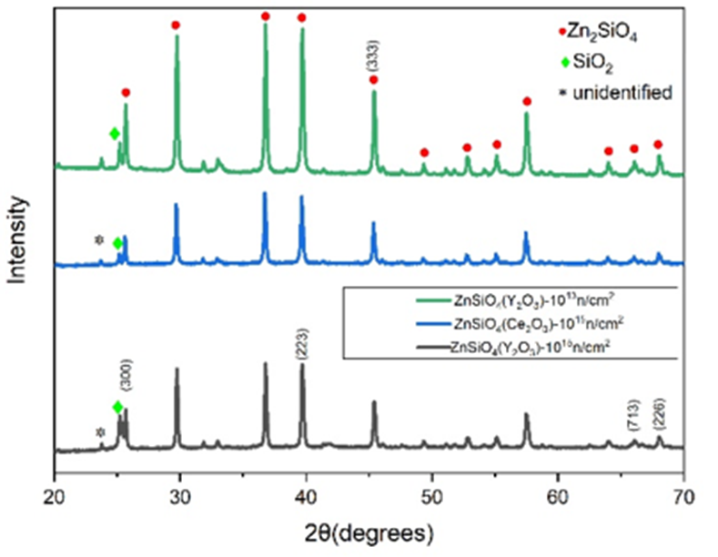
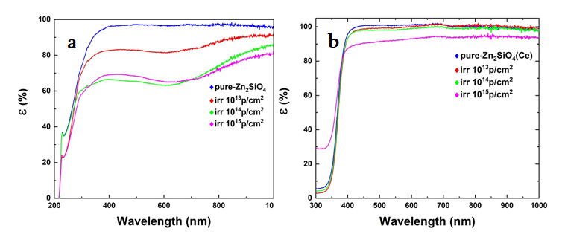
Structural and optical properties
X-ray diffraction analysis Zn₂SiO₄ and Ce-Zn₂SiO₄ samples, after irradiation with electrons, protons and neutrons
List of samples irradiated at the IBR-2 reactor
Zn₂SiO₄ (Ce₂O₃) 10-13n/cm2
Zn₂SiO₃ (Ce₂O₃) 10-15 n/cm2
Zn₂SiO₃ (Y₂O₃) 10-13n/cm2 Zn₂SiO₄ (Y₂O₃) 10-15n/cm2
Diffusion reflectance spectra of Zn₂SiO₄ (a) and Ce–Zn₂SiO₄ samples (b) before and after proton irradiation with 15.5 MeV energy and 10¹³, 10¹⁴, 10¹⁵ p/cm² doses

Slide 7
PROPOSALS FOR SCIENTIFIC AND TECHNICAL COOPERATION BETWEEN JINR AND ANSL
Frank Laboratory of Neutron Physics, JINR
Research and development in the field of interaction of neutron beams from IBR-2, IREN, HFRD with condensed matter
New composite silicate thermal barrier coatings,
Single-crystal laser and semiconductor materials,
Solar perovskite compounds,
Archaeological cultural heritage objects,
Natural minerals - zeolites,
Influence on DNA molecule and microorganisms
Physico-chemical analysis (DSC, FTIR, UV-vis, SEM, etc. methods) Identification of the mechanisms of radiation-induced defects in the studied materials.

Slide 8
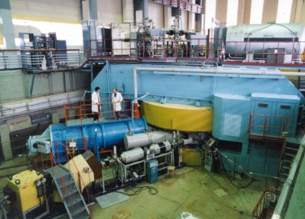
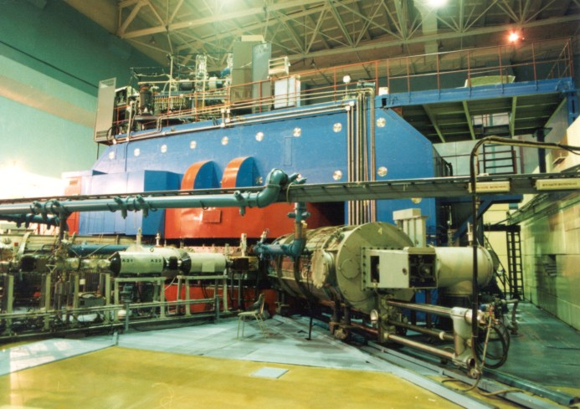
Flerov Laboratory of Nuclear Reactions, JINR
Study of the evolution of radiation-stimulated phenomena and mechanical stresses in wide-gap laser crystals of ruby, sapphire, garnet during irradiation with heavy ions, such as Ne, Ar, 3.5-5 MeV/n 10-11 и MeV/n on U400. On U-400M irradiation with ions, such as ¹¹B, ⁵⁶Fe¹⁵⁺, ¹⁸O with 30-36 MeV/u energy. Study of radiation damage using lazer confocal microscopy (lCM) to study profiles of residual mechanical stresses.
U-400
U-400 M

Slide 9
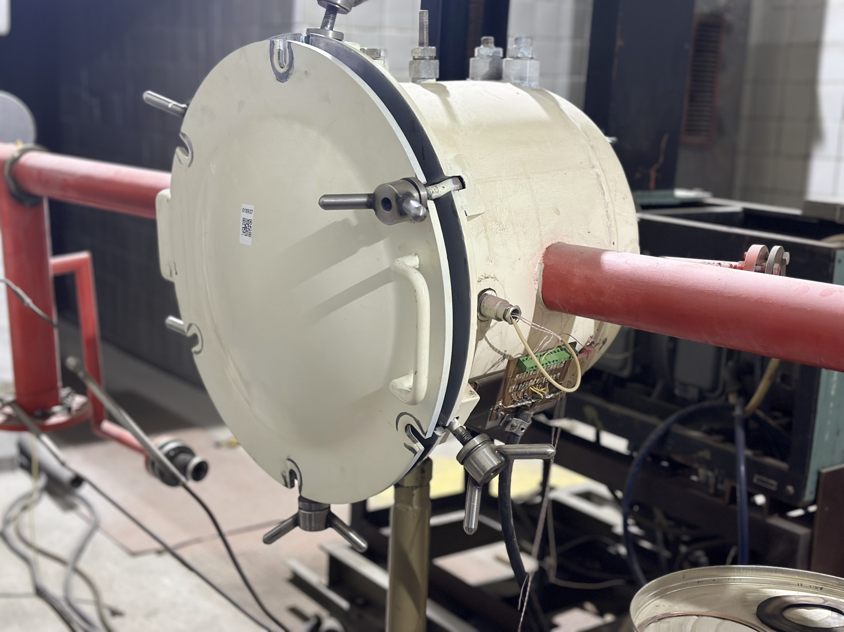
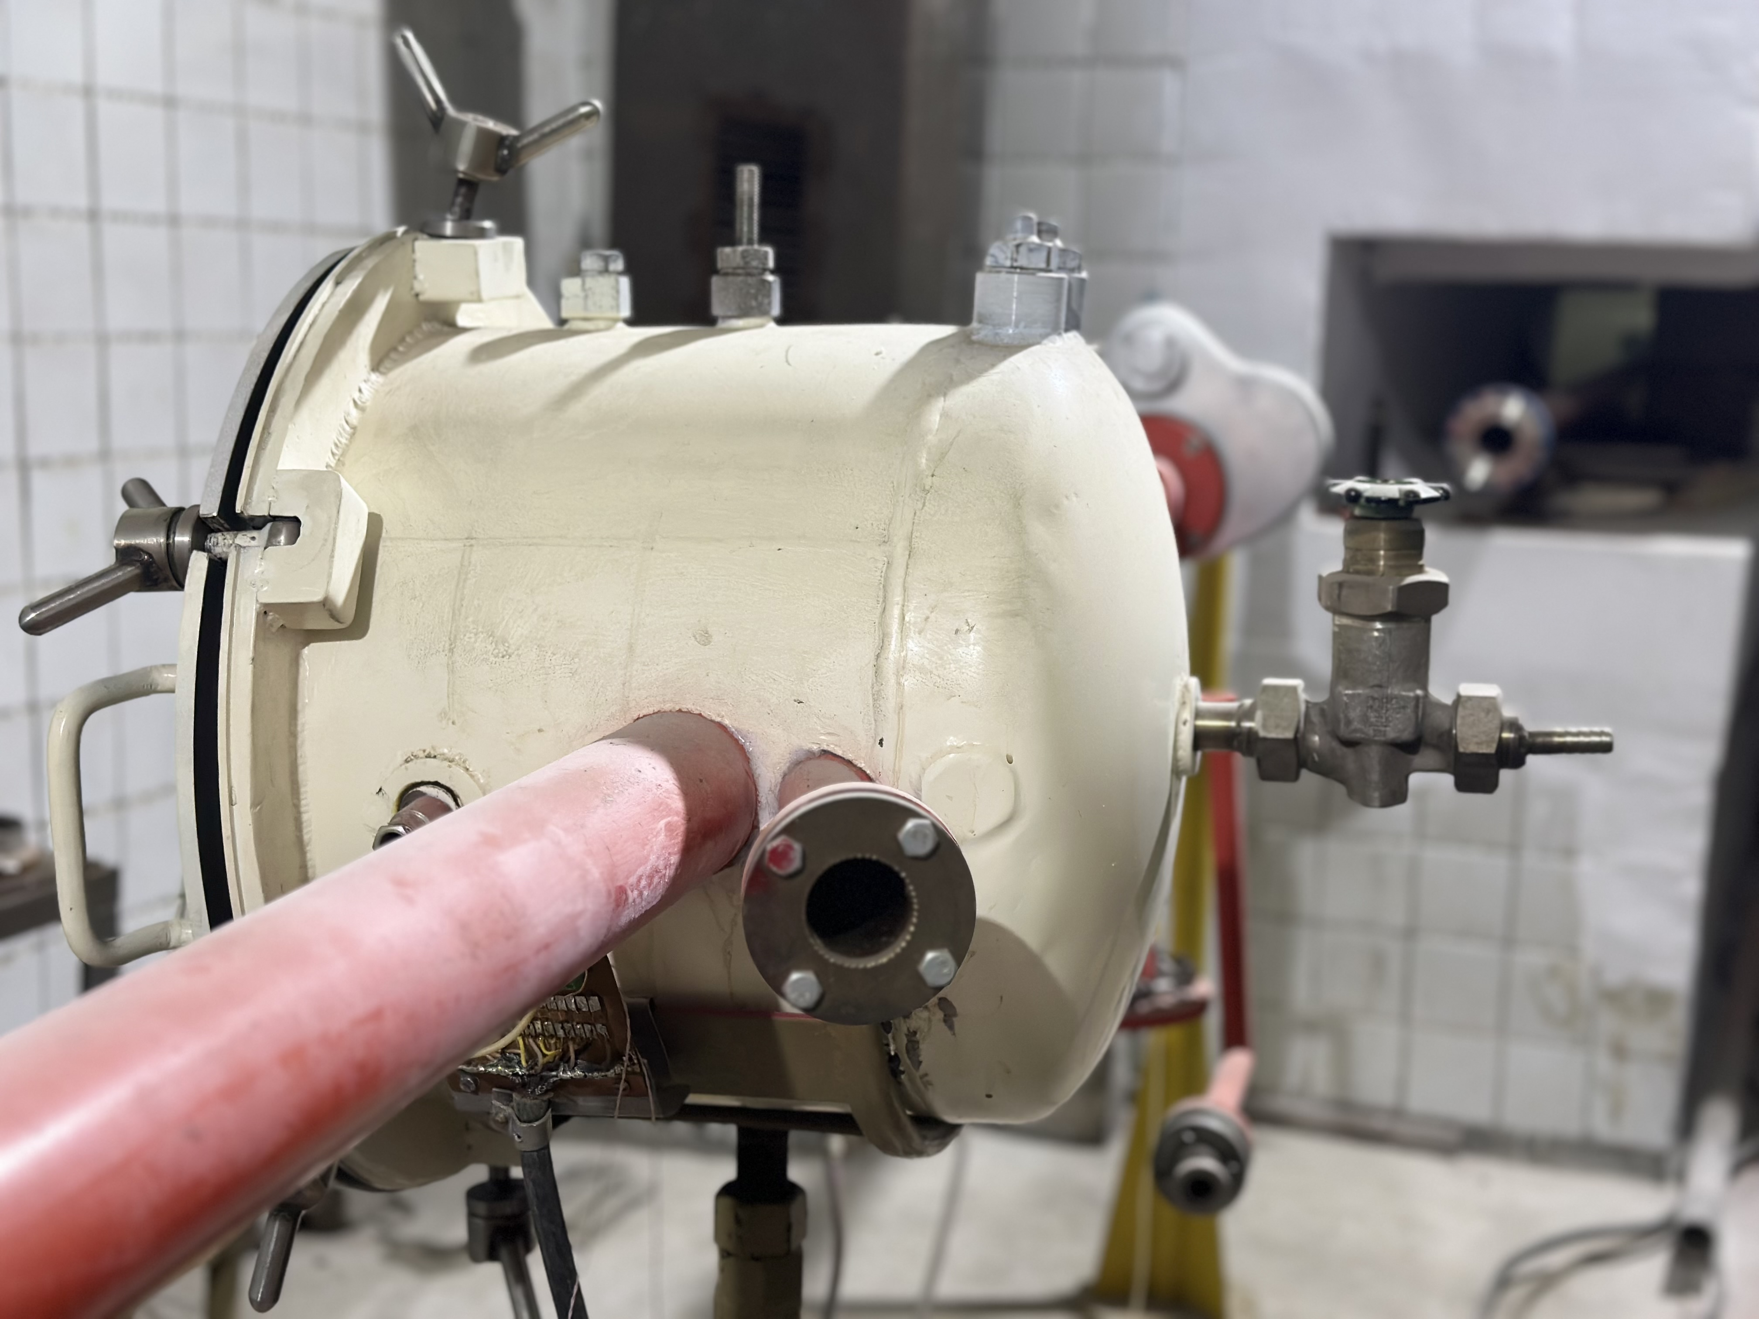
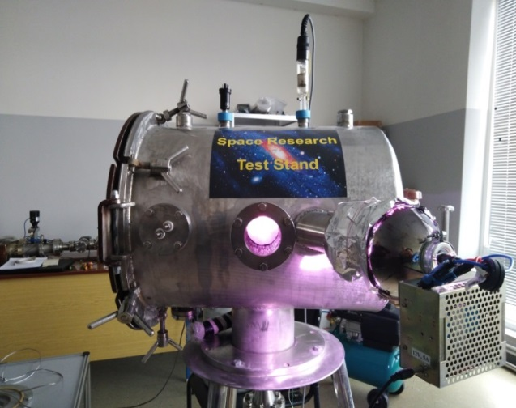
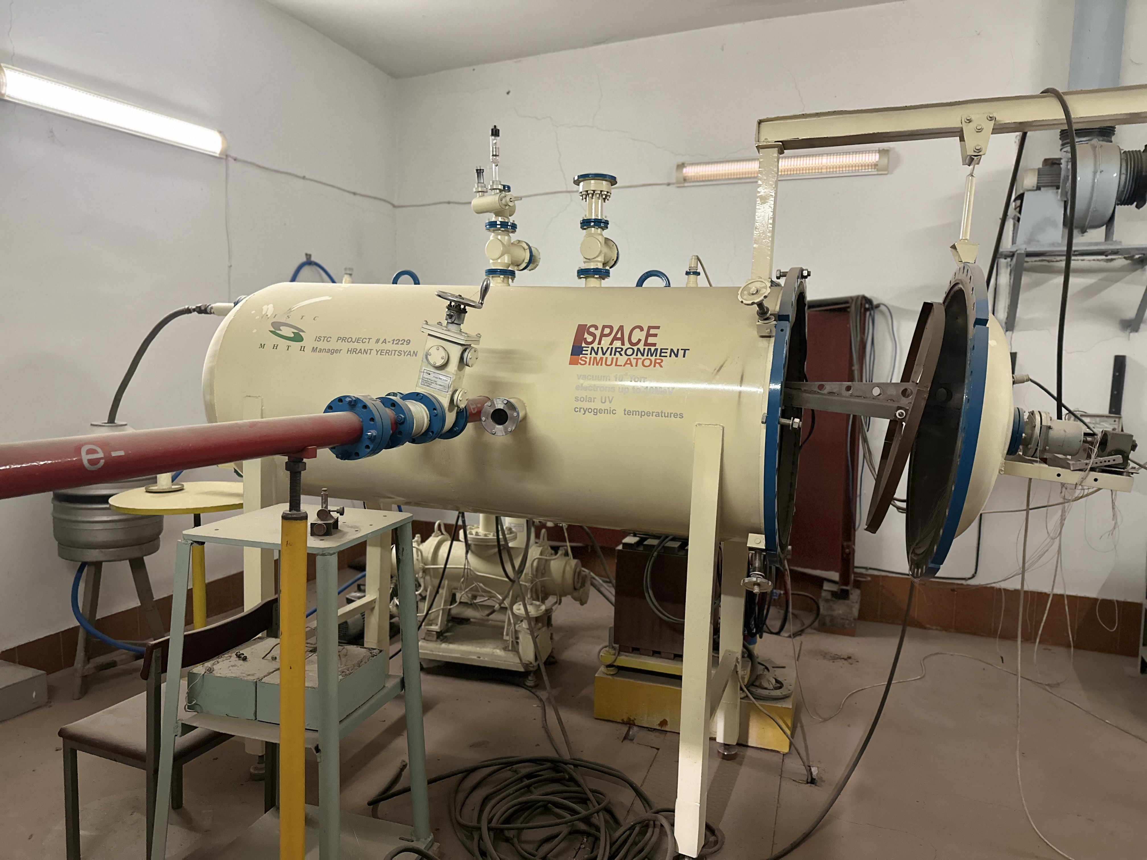
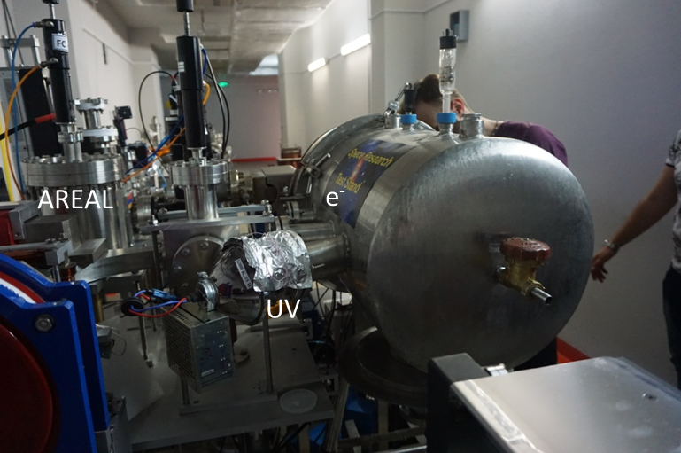
A vacuum station has been developed and manufactured that simulates certain conditions of the Earth’s space environment, simulating the following conditions:
• proton radiation,
• ultraviolet radiation from the Sun,
• vacuum 10-3 Pa.
General view of the space research test station.
Vacuum - 10-5 Torr. (1.33x10-3 Pa),
Electron beam with energy up to 4MeV, pulse duration 4x10-13 sec,
Measurement temperature range from -100 ⁰C to +100 ⁰C,
Solar ultraviolet radiation.

Slide 10
Frank Laboratory of Neutron Physics, JINR – Applied Physics Research Division AANL(YerPhI)
“Radiation Physics of Solid State ” group. Head of the Group Dr. Aram Sahakyan
“Optical Spectroscopy ” group. Head of the Group Eduard Aleksanyan – Candidate of Sciences
THE GOAL OF THE PROJECT is to combine efforts and reduce the joint time frame for achieving scientific and technical results in research and development in the field of interaction of neutrons, protons, electrons, UV radiation with matter and performing tasks using spectroscopic methods.
The importance of joint project requires the creation of a special technical base at AANL, which will complement the missing instruments and electronics, and create conditions for the successful implementation of the planned research at FLNP - AANL.
Research and development of technology for producing complex glass mixture in a new, scientifically based method - the method of hydrothermal-microwave synthesis for the production of heat-resistant, radiation-resistant, high-strength clear and colored glasses for aircraft. Hydrothermal-microwave (HTMV) synthesis of charges of colored and colorless heat-resistant, radiation-resistant high-strength glasses will be carried out on the basis of known systems for each type of glass in order to reduce their melting, production and annealing temperatures. To speed up the glass melting process, a microwave cooking mode will be developed. Synthesis of heat-resistant, radiation-resistant, high-strength
colorless,
red selenium ruby glass,
red copper ruby glass,
green glass,
yellow glass.

Slide 11
From FLNP JINR we assume to have:
1. PL2210-PL2210B series diode pumped picosecond Nd:YAG lasers.
PL2210-2210B models provide pulses with energy up to -2.5mJ at 1kHz frequencies and pulse duration – up to 80ps.
Laser wavelengths – 1064nm, 532nm, 355nm, 266nm with energies 2.5mJ, 1.3mJ, 0.8mJ, 0.5mJ
Application field – Fluorescence, photoluminescence spectroscopy, determination of parameters of nonlinear optical materials.
2. Detector for optical spectroscopy measurements in visible to near IR range – Hamamatsu H10682-01 or equivalent.
Sensitivity range – 230 – 870 nm
Photon counting mode
Power supply - +5V
Among the variety of methods used in materials science, the luminescence spectroscopy using photoexcitation in IR-VUV range play a central role in detailed investigation of scintillating materials. In particular it is a unique tool which allows investigation of energy transfer processes to the luminescence centers at all relaxation stages that is of fundamental as well as of applied interest for the development of new scintillators and X-ray phosphors. To perform such investigations, we use home-built setup for photoluminescence and excitation measurements. To upgrade the current measurements quality a new detector is required.
3. Pfeiffer Hi-Cube Eco Turbo Vacuum Pumping System.
Inlet flange: DN 40 ISO-K
Pumping speed (N2): 35 l/s
Ultimate pressure: < 1 x 10⁻⁷ mbar
UHV vacuum gauge
MVP 015 Diaphragm pump.
Thin film deposition method is used at our lab for preparation of perovskite samples for solar cell application. The quality of thin films strongly depends on deposition conditions, particularly from vacuum in deposition chamber. The suggested vacuum station provides high vacuum levels less than 10⁻⁷ mbar which would guarantee high precision of obtained thin films.

Slide 12
Thank You !!!

