Slide 1
Frank Laboratory of Neutron Physics
(FLNP)
Egor Lychagin
Joint Institute for Nuclear Research

Slide 2
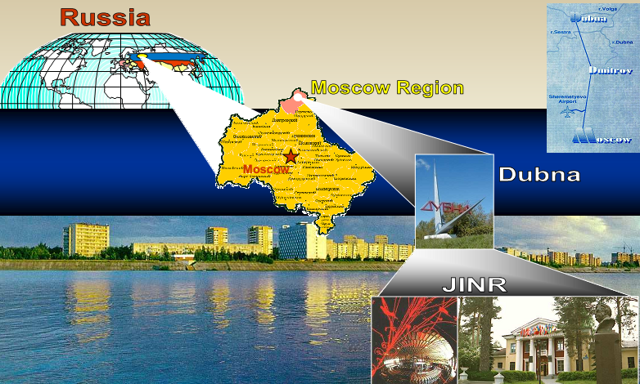

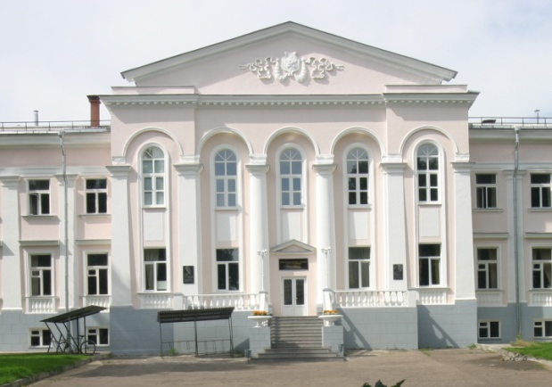
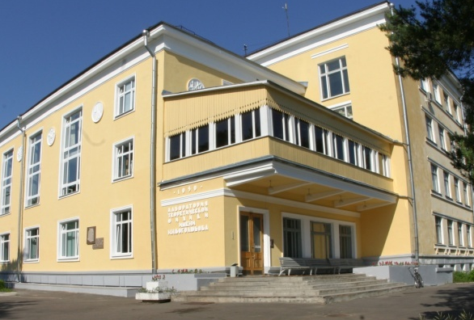
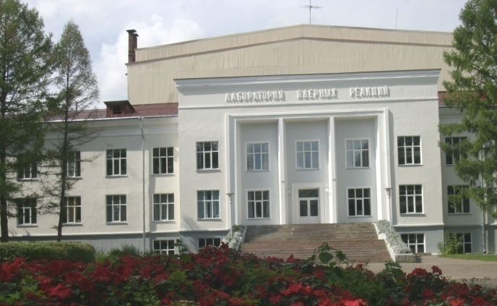
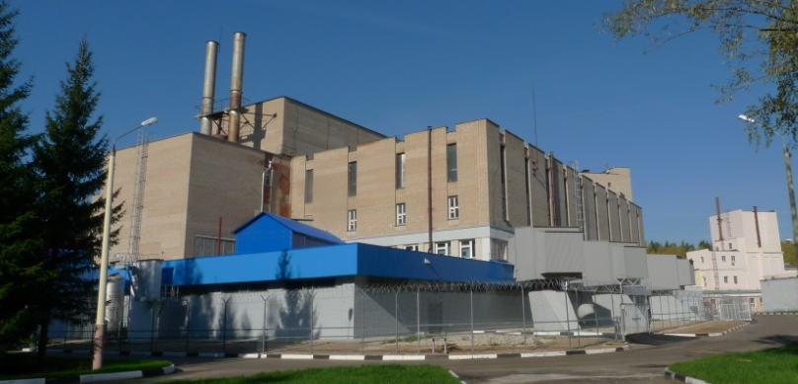
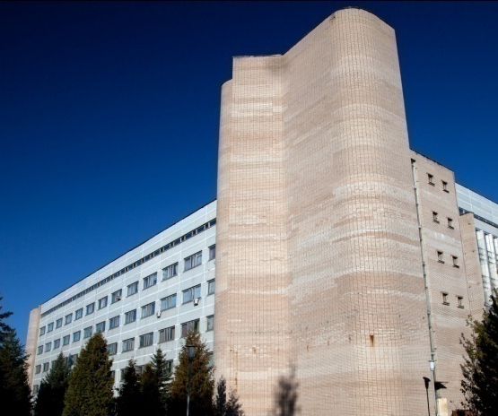
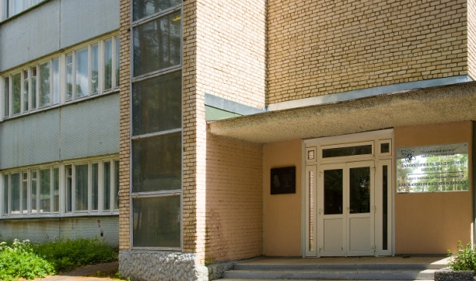
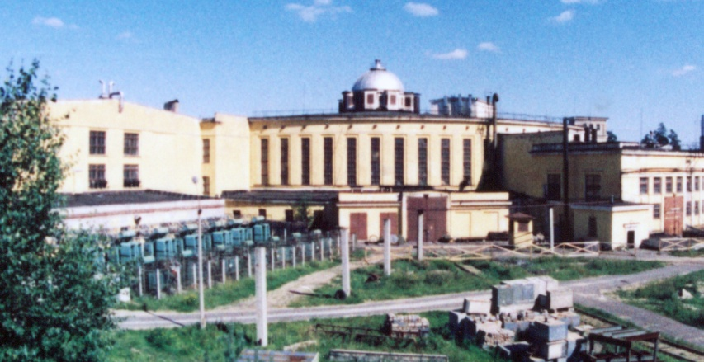
The Joint Institute for Nuclear Research
an international intergovernmental
organization
16 Member States:
Armenia Cuba Kazakhstan Russia
Azerbaijan DPRK Moldova Slovakia
Belarus Egypt Mongolia Uzbekistan
Bulgaria Georgia Romania Vietnam
Associate Members:
Germany, Hungary, Italy, The Republic of South Africa, Serbia
JINR comprises 7 Laboratories, each being comparable with a large institute in the scale and scope of investigations performed
Frank Laboratory of Neutron Physics
prepared by Dr. D. Chudoba

Slide 3
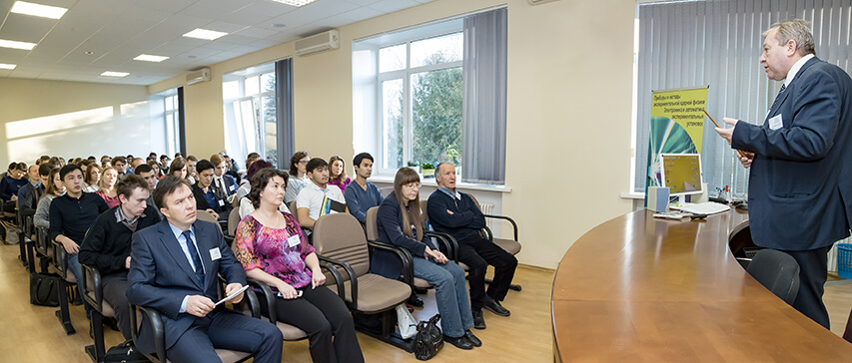
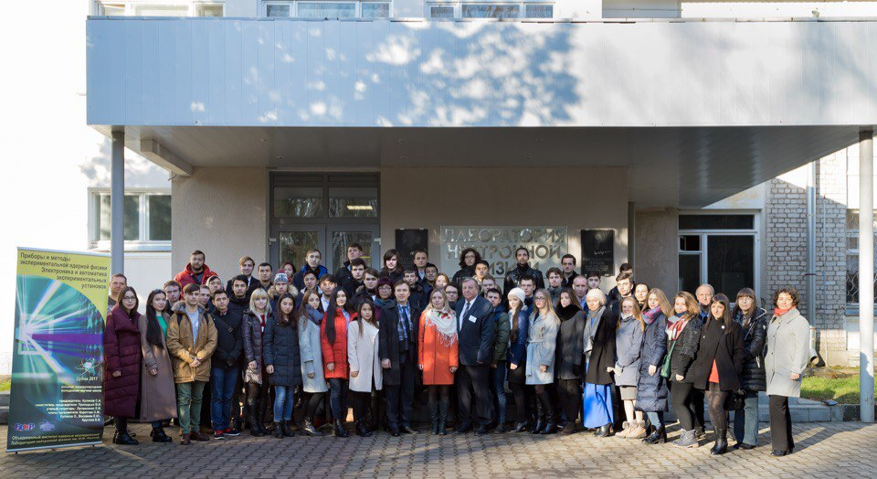
FLNP staff breakdown (2023):
Total | 564
Scientists | 203
Engineers and specialists | 155
Workers | 174
Administrative staff | 32
THREE MAIN SCIENTIFIC DEPARTMENTS of FLNP:
Department of nuclear physics (143 persons)
Department of Neutron Investigations of Condensed Matter (101 persons)
Department of Spectrometers Complex IBR-2 (49 persons+23 persons SNSCM)
+ Raman spectroscopy sector (10 persons)

Slide 4
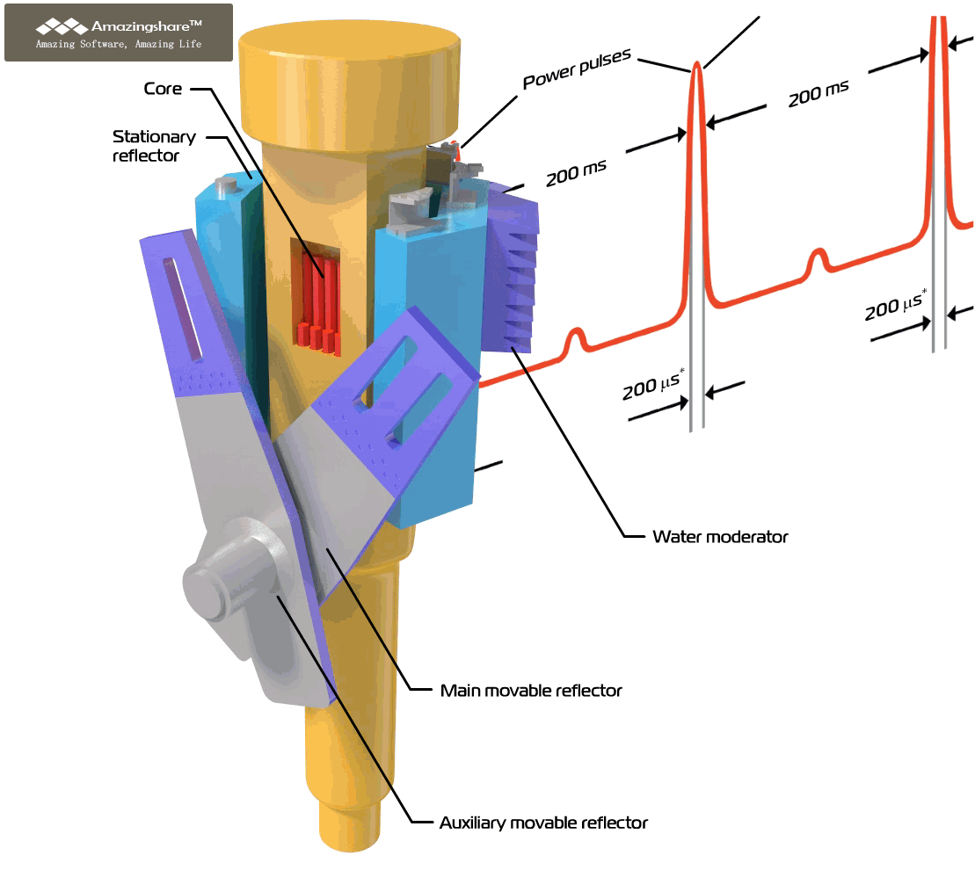
Pulsed Reactor IBR-2
Average power, MW | 2
Fuel | PuO₂
Number of fuel assemblies | 69
Maximum burnup, % | 9
Pulse repetiton rate, Hz | 5
Pulse half-width, µs: fast neutrons thermal neutrons | 200* 340
Rotation rate, rev/min Main reflector Auxiliary reflector | 600 300
MMR and AMR material | Nickel + steel
MR service life, hours | 55 000
Background, % | 7.5
Thermal neutron flux density from the surface of the moderator Time average Burst maximum | ~10¹³ n/cm² s ~10¹⁶ n/cm² s
Operate since 1984
Deep modernization was done at 2006-2010
* at reactor power 2MW
prepared by Dr. D. Chudoba

Slide 5
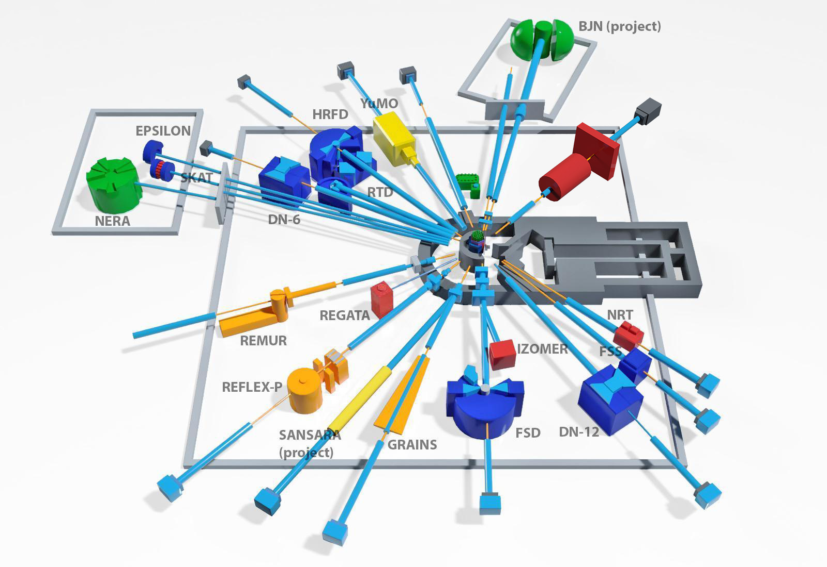
Neutron Instruments
13 INSTRUMENTS INCLUDE IN USER PROGRAMM
Diffraction:
HRFD
RTD
DN-6
EPSILON
SKAT
DN-12
FSD
Small-Aangle
YuMo
Reflectometry:
GRAINS
REMUR
REFLEX
Inelastic scattering:
NERA
NAA:
REGATA
Under construction:
SANSARA – small angle + imaging (2024)
BJN – inelastic scattering (2025)
The Instruments parameters could be found at
https://flnp.jinr.int/en-us/main/facilities/ibr-2

Slide 6
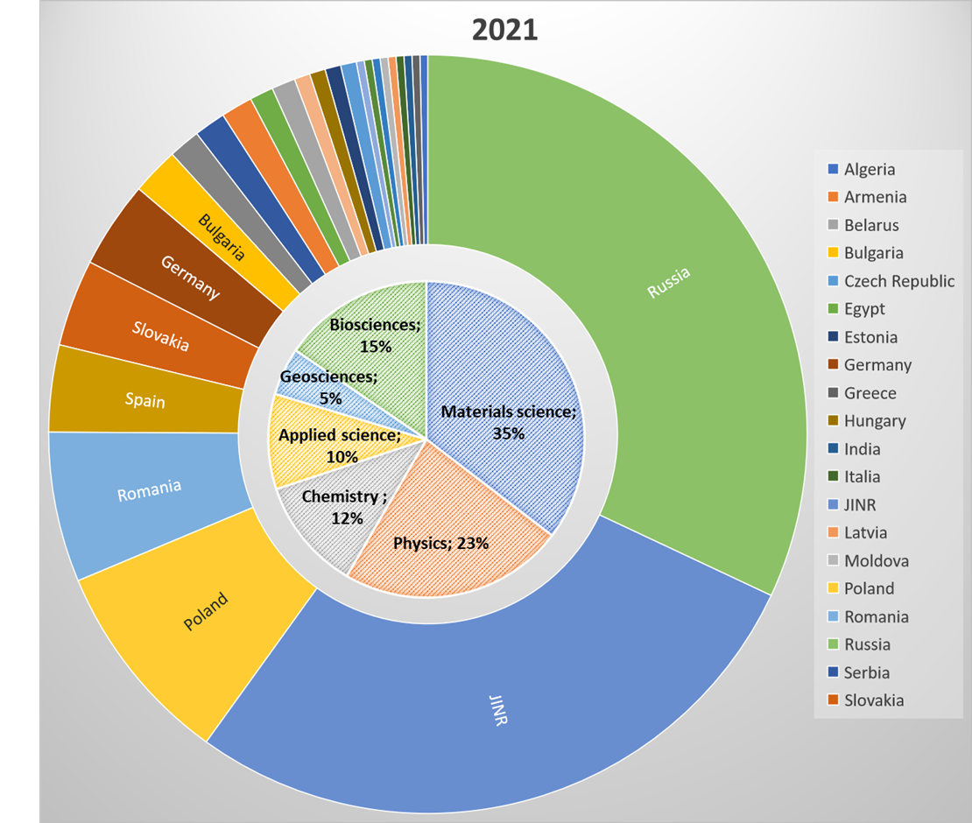
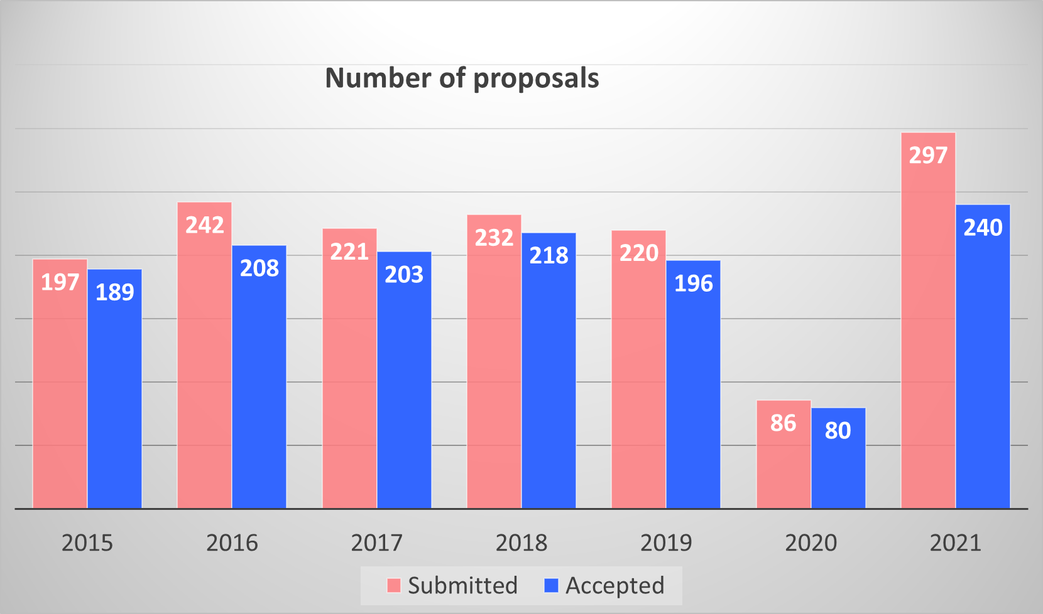
IBR-2 User Club website: https://ibr-2.jinr.ru/
Year | Registered users
2020 | 269
2021 | 147
2022 | 3
2023 | 5
Total: | 424
User meetings are held every two years on the framework of the “Condensed Matter Research at the IBR-2 Reactor” conference traditionally.
The 2024 meeting will be postponed due to a long reactor shutdown.

Slide 7
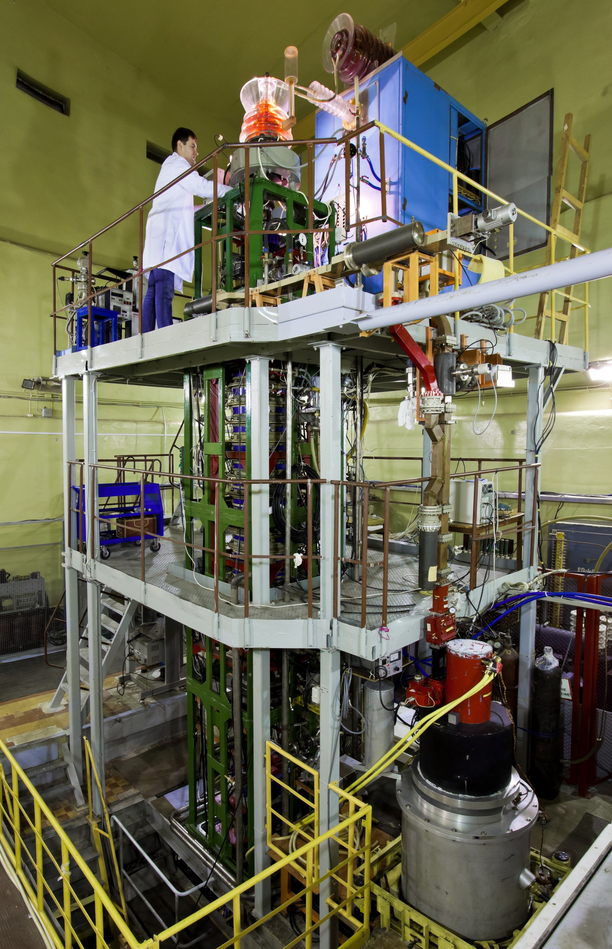
Source of resonance neutrons IREN based at lineal electron accelerator
The linear electron accelerator LUE-200 used as a driver for the intense resonance neutron source IREN. The accelerator is positioned vertically. It consists of a pulsed electron gun, an accelerating system, microwave power sources based on 10-cm klystrons with modulators, a focusing-beam transport system, a diagnostics system with a broadband magnetic spectrometer and a vacuum system.
Peak current (A) | 3
Repetition rate (Hz) | 50
Electron pulse duration (ns) | 100
Electron energy (MeV) | 110
Beam power (kW) | 0.4
Multiplication | 1
Neutron intensity (n/s) | ~3x10¹¹
1200 hours/year
7
7
https://flnp.jinr.int/en-us/main/facilities/iren

Slide 8
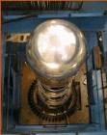
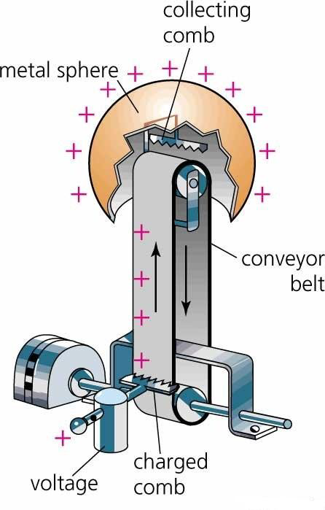
EG-5
Electrostatic Van de Graaff accelerator, as one of basic experimental facilities of Frank Laboratory of Neutron Physics was built in 1965.
The installation remains in demand today.
The characteristics of EG-5 Accelerator:
Energy region: 0.9 – 3.5 MeV
Beam intensity for 𝐻+: 30 μA
Beam intensity for 𝐻𝑒+: 10 μA
Energy spread < 500 eV
Number of beam lines: 6
600 hours/year
Plan of modernization 2023-2025:
Before modernization | After modernization
Terminal voltage - 2,5 MV Beam current – 100nA Ion Energy – 2,5 MeV | Terminal voltage - 4,1 MV Beam current – 50-100mkA Ion Energy – 4,1 MeV

Slide 9
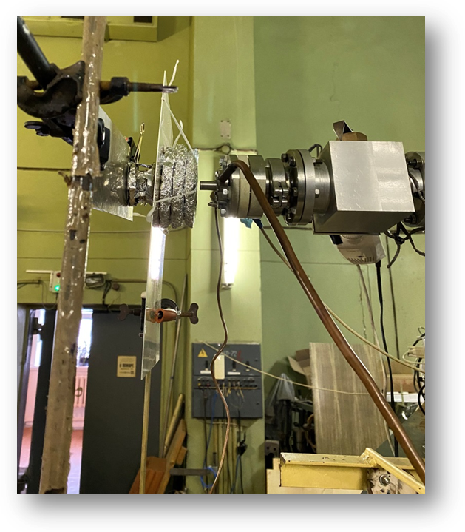
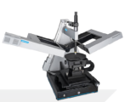
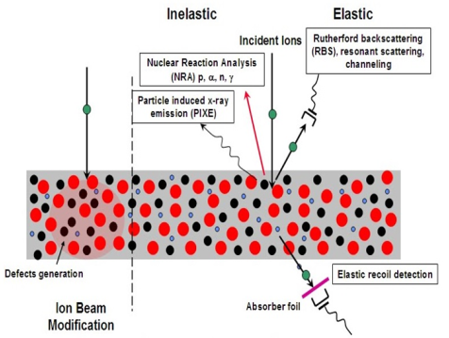

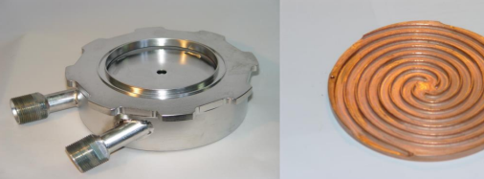
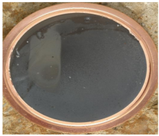

Fast neutron reactions
Ion Beam Analysis & complementary methods
Gas Target D(d,n)³He
        Neutron flux – 5 10⁷ n/s sm²
        - Max. neutrons energy - 5,5 ± 0,1 MeV
Solid-state target
¹H + ⁷Li - ⁷Be + n
⁷Li
        Neutrons flux – 5 10⁷ pat/s sm²
        - Energy region – 20 – 800keV
The elemental composition of multilayer systems, isotopic composition, stoichiometry of films.
- Optical, electronic and electrical properties using complementary methods (ellipsometry voltammetry impedance spectroscopy).
E
20keV
800keV
3.3MeV
5,1 MeV
Quasi-monochromatic neutrons in a wide range of energies

Slide 10
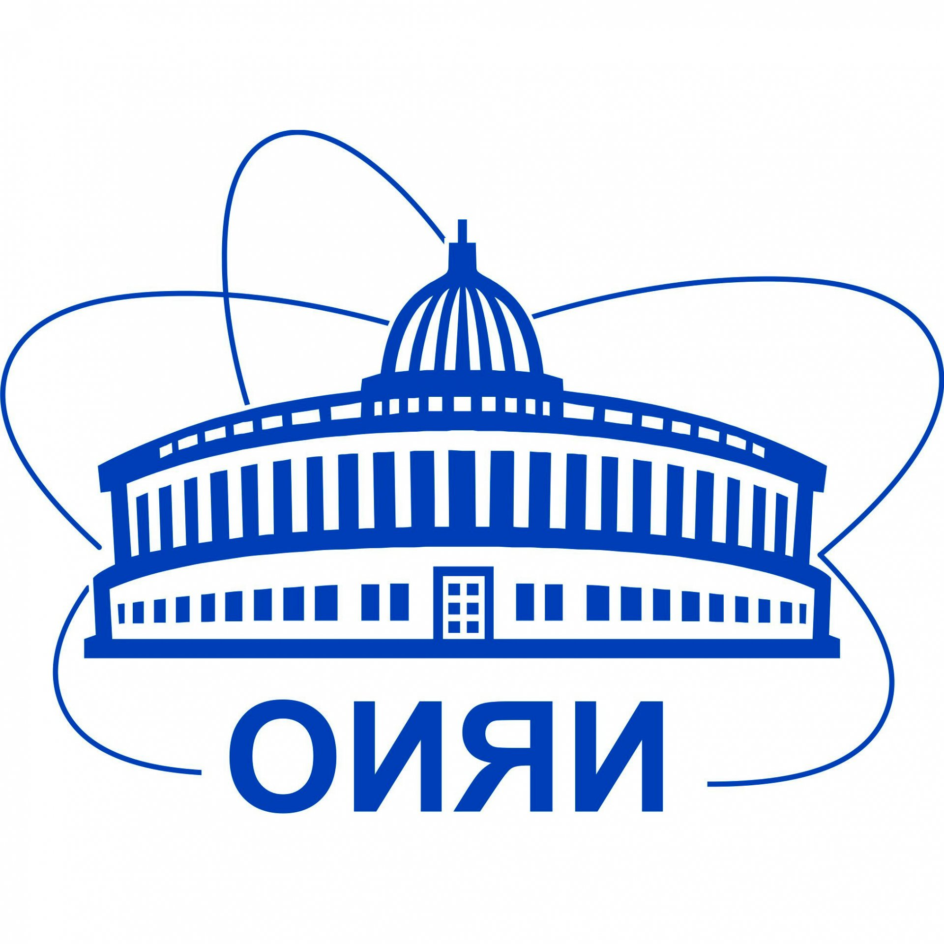




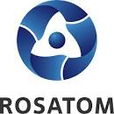









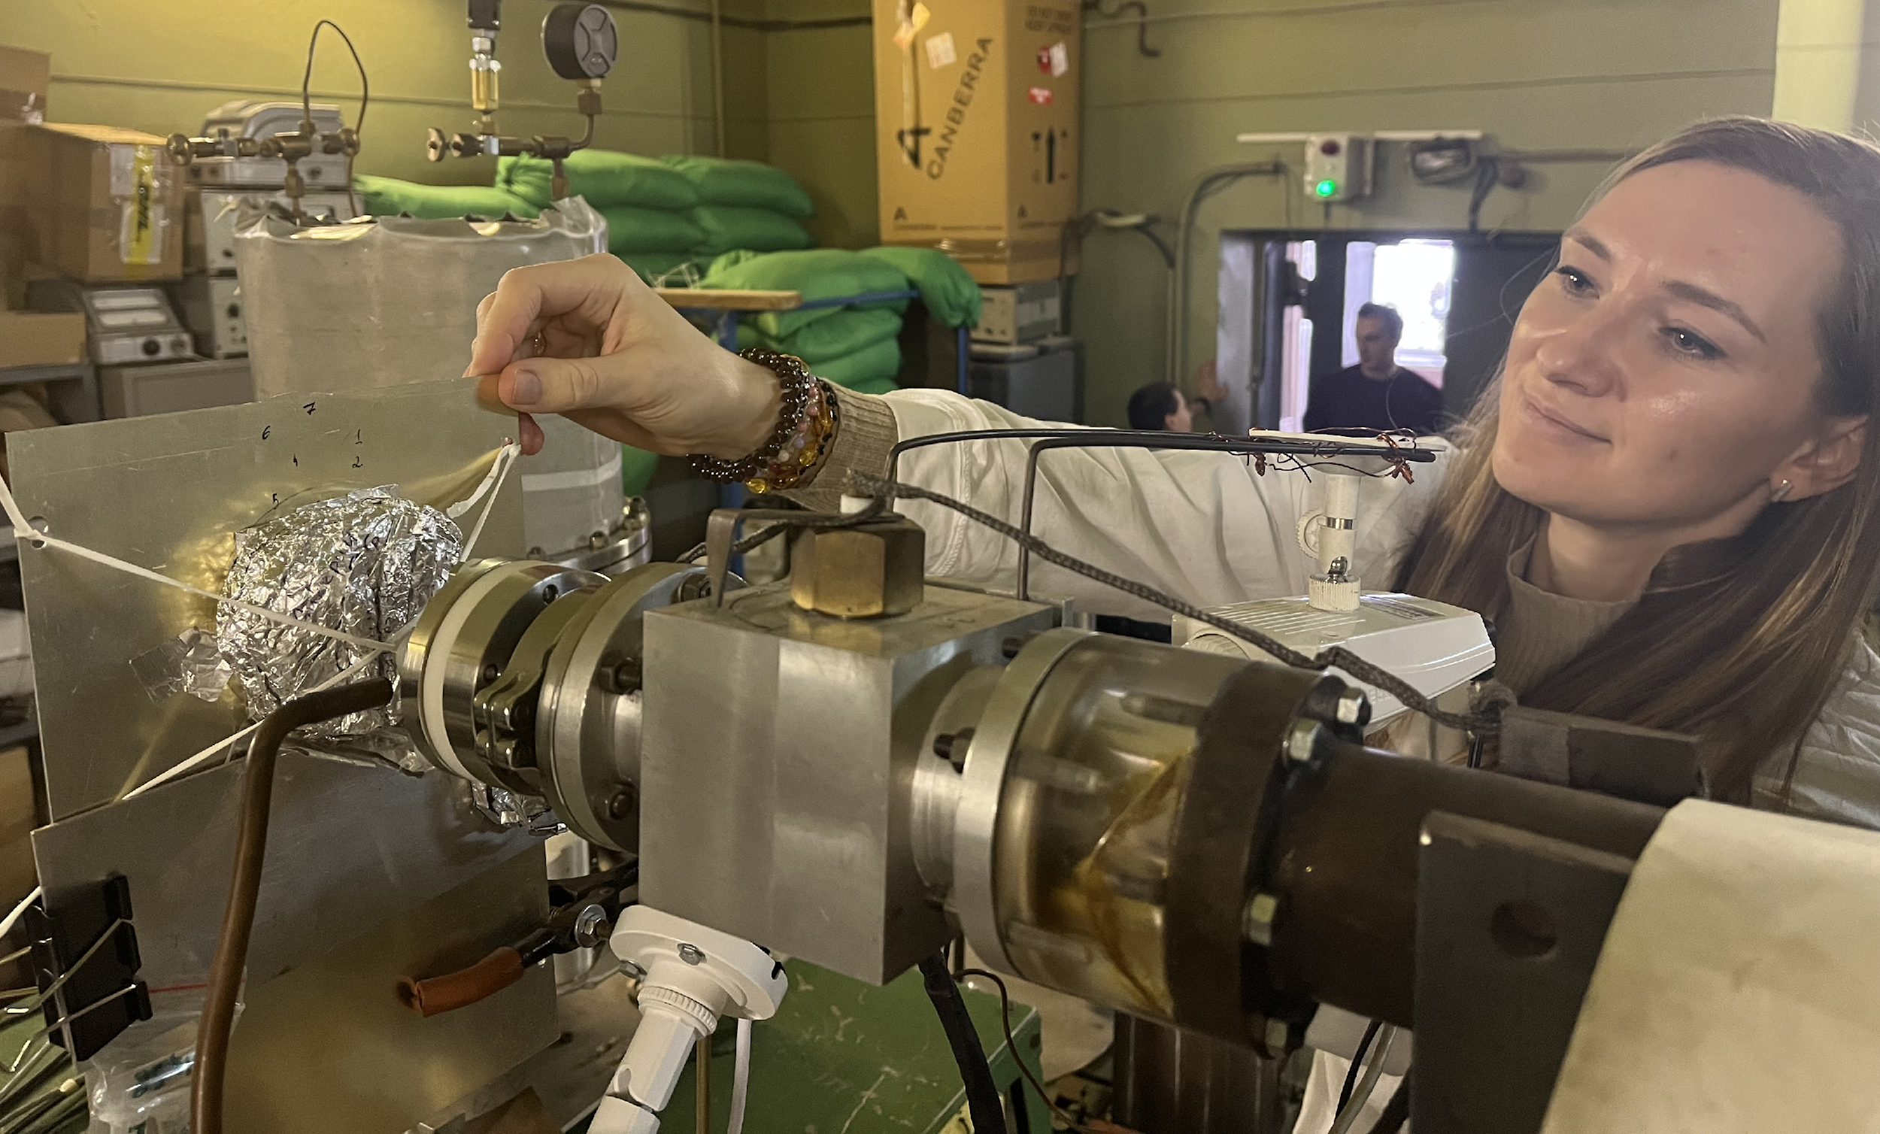

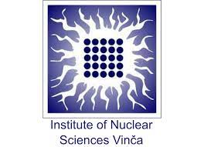

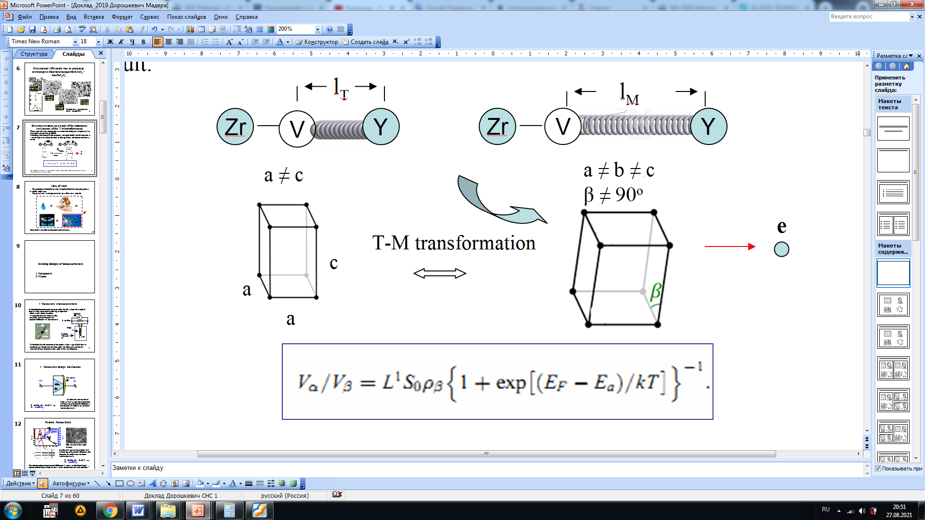

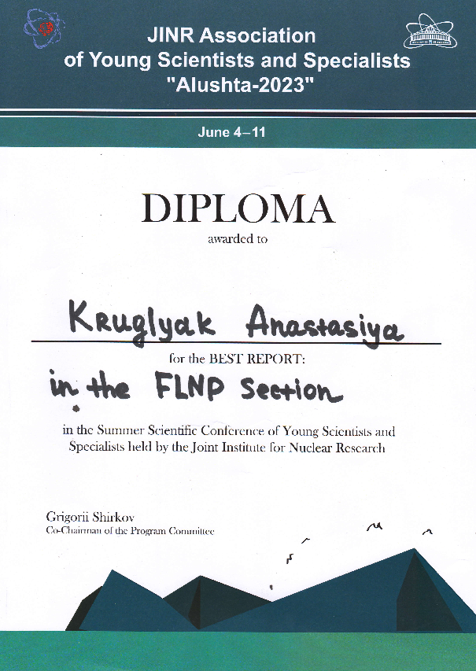
EG-5 activities
1. Scientific collaboration 2023
11 - countries;
23 - institutes;
7 - projects;
23 - cooperation agreements;
3 - industrial partners includingmajor electronics manufacturers (JSC MICRON) and the State Corporation ROSATOM.
2. Industrial Partners 2023
JSC Mikron.
JSC Angstrem
ROSATOM State Corporation
3. Formal performance indicators in 2023
39 publications, including Q1 and Q2;
20 oral presentations.
Project JINR-Serbia №: Order 373 from 22.05.2023, point 4(5).
Kazakhstan Republic project № BR10765056.
ZrO₂ – Y₂O₃ nanoparticle
e
The best report at the
«Alushta 2023» conference

Slide 11
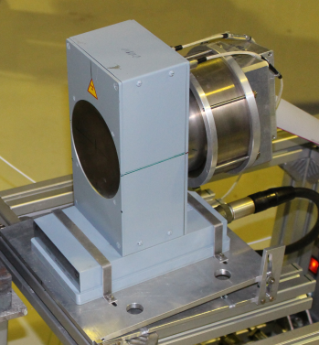
Neutron generators
DT, DD neutron generators of 14, 2.5 MeV neutrons with alfa particle PSD
Neutron yield up to 10⁸ s⁻¹
Special DT neutron generator is the base for "TANGRA" (TAgged Neutrons and Gamma RAys) facility used for implementation the tagged neutron method (TNM). The facility serves as for solving the problem in nuclear physics as for applied research.
https://flnp.jinr.int/en-us/main/facilities/tangra-project-en
Neutron radioisotope sources
²⁵²Cf,
(α,n) ²⁴¹Am, ²³⁹Pu, ²³⁸Pu
Intensity 10⁵ – 10⁷ s⁻¹

Slide 12



Neutron scattering in condensed matter physics
Search for new properties of crystals, liquids, nanosystems.
Study of materials with new properties promising for engineering, energy, biology and pharmacology
Study of the structure and deformations of materials for solving problems of materials science, archeology, geology
Study of dynamics (phase transitions, diffusion, changes in magnetic fields) at the microscopic level in molecular crystals, nanostructured materials, biologically active materials, etc.
Study of cultural heritage sites
https://flnp.jinr.int/images/Books/Main_page/culture_en.pdf
https://flnp.jinr.int/images/Books/Blue_books/LifeSciencesBook.pdf
https://flnp.jinr.int/images/box-slider/MaterialsScienceBook.pdf

Slide 13
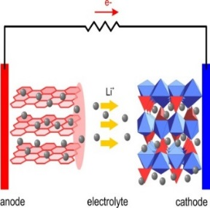
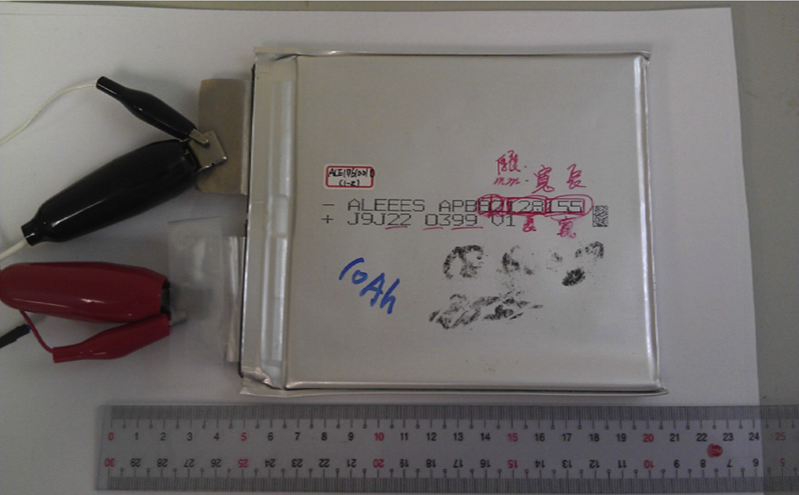
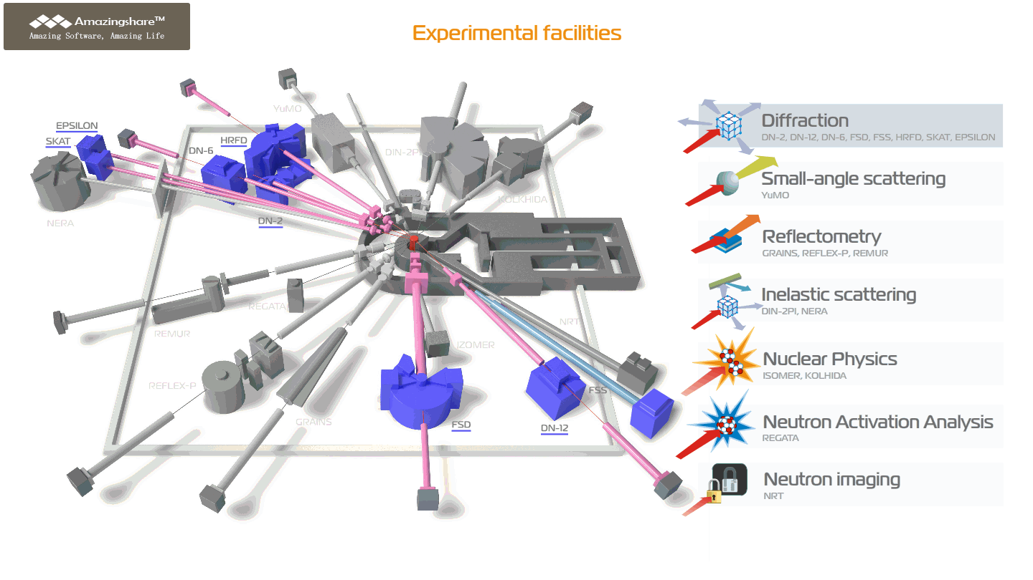
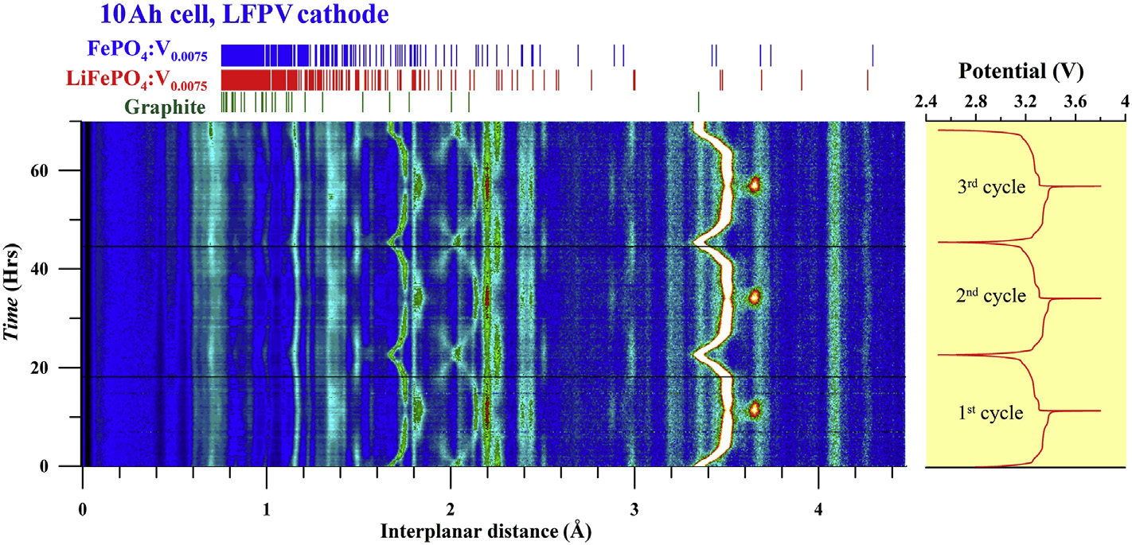
Diffraction
Neutron scattering in condensed matter physics
Crystal and magnetic structure of novel materials at ambient and extreme conditions
Real-time studies of Li-based accumulators
Phase transitions of H-based storage alloys
Crystallographic texture changes in steel
Strain measurements in granite samples

Slide 14
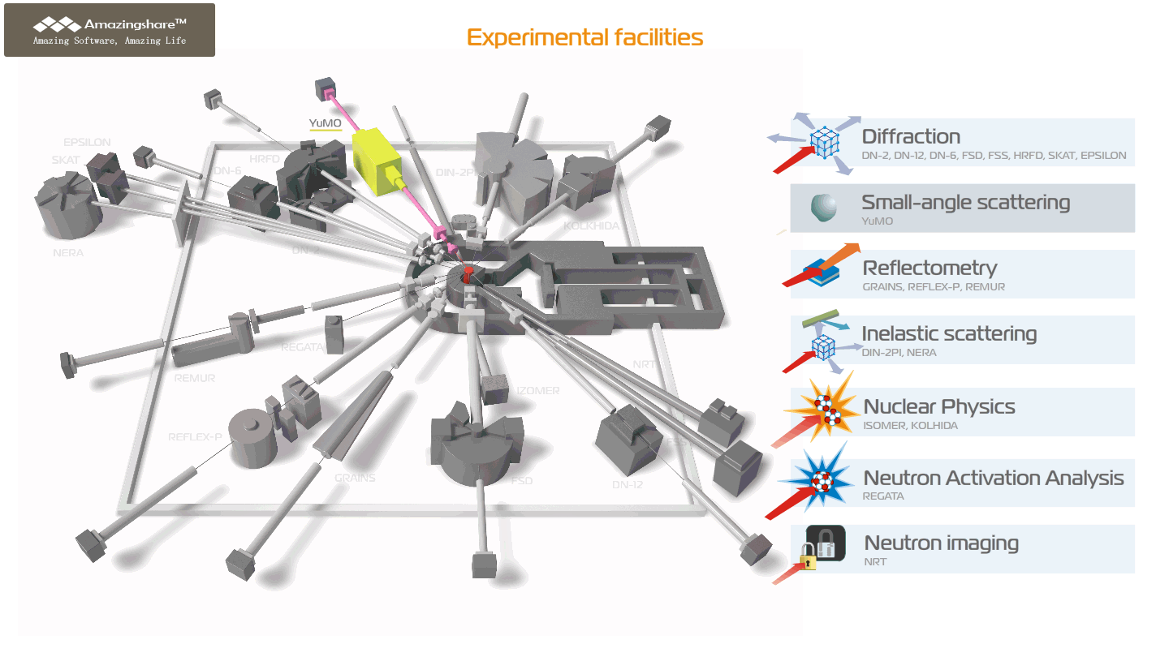
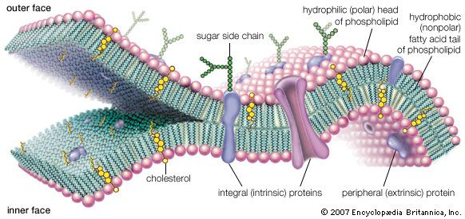
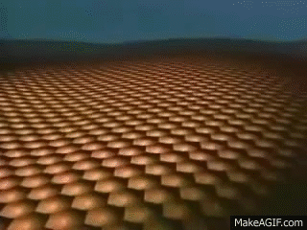
Neutron scattering in condensed matter physics
Small Angle Scattering
BLSs
SULVs
EULVs
Structural organization and aggregation of nanoparticles and composite systems
Interactions of nanoparticles with bio-macromolecules
Nanopores for magnetic and biomedical applications

Slide 15
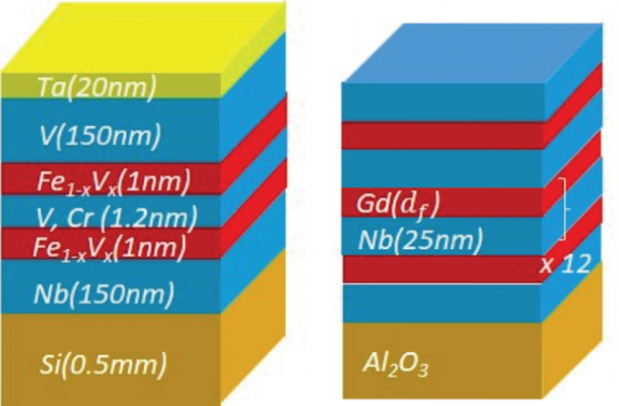
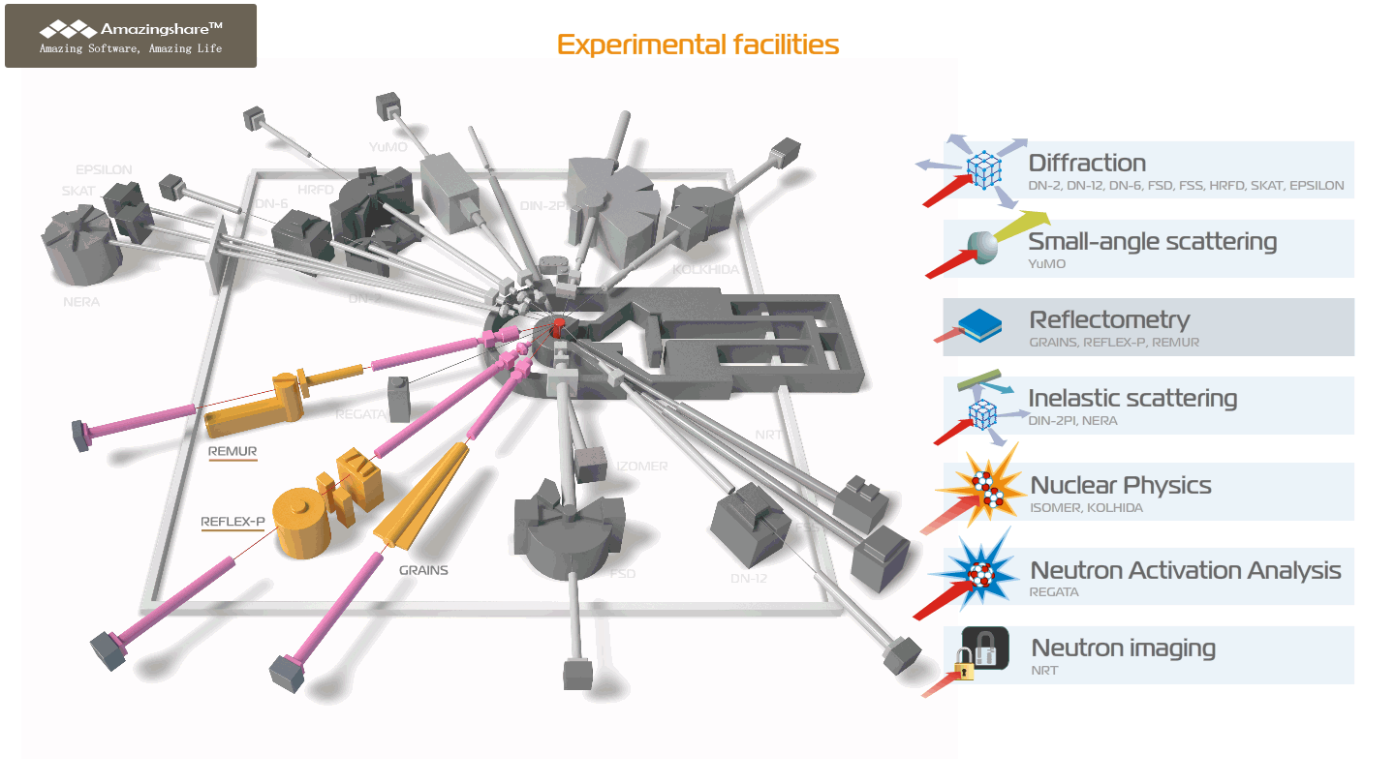
Neutron scattering in condensed matter physics
Reflectometry
Thin films and surfaces
Surface adsorption of magnetic nanoparticles
Superconducting and magnetic properties of the complex layered heterostructures
2D van der Waals magnetic materials

Slide 16
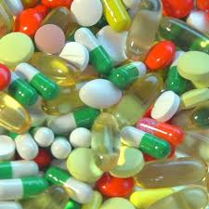
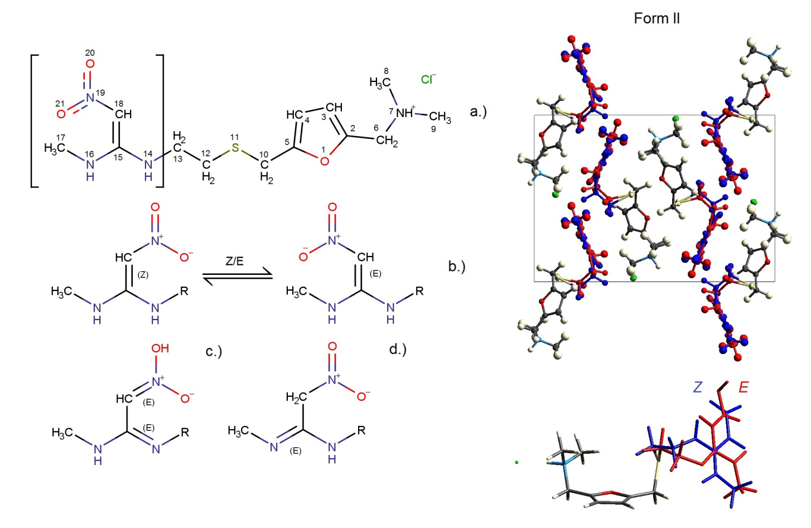
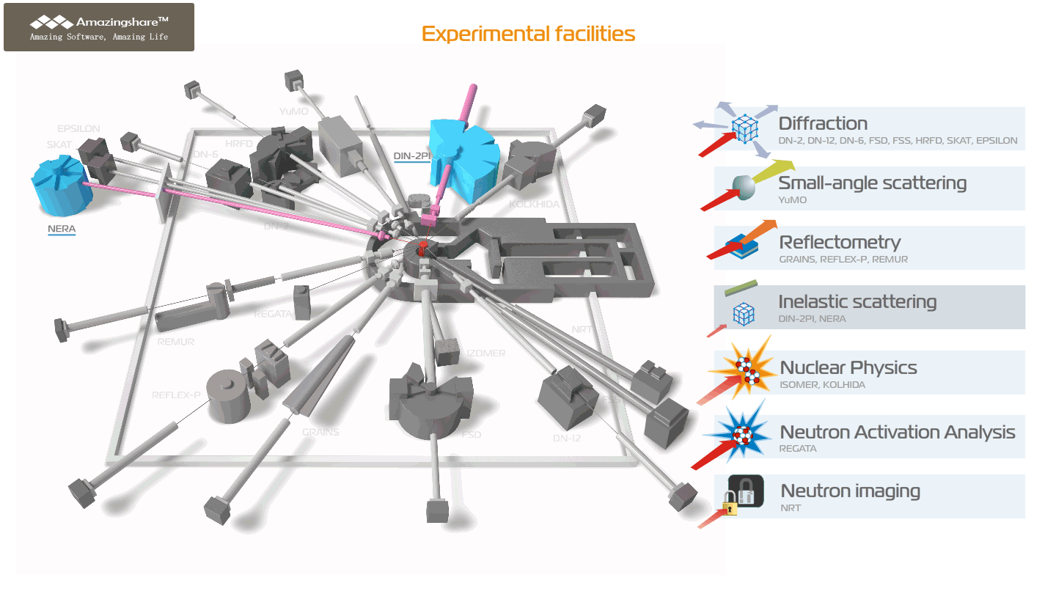
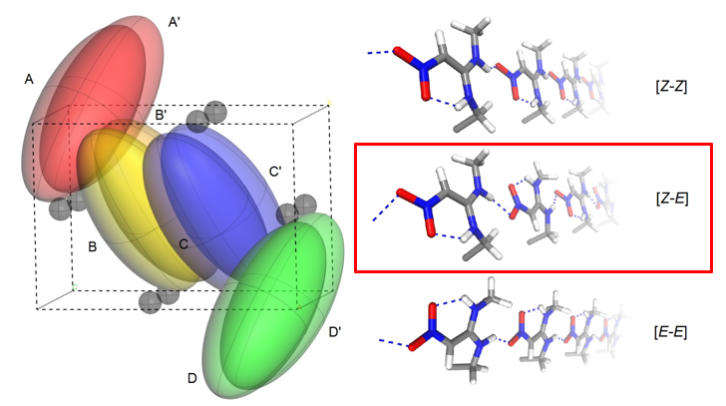
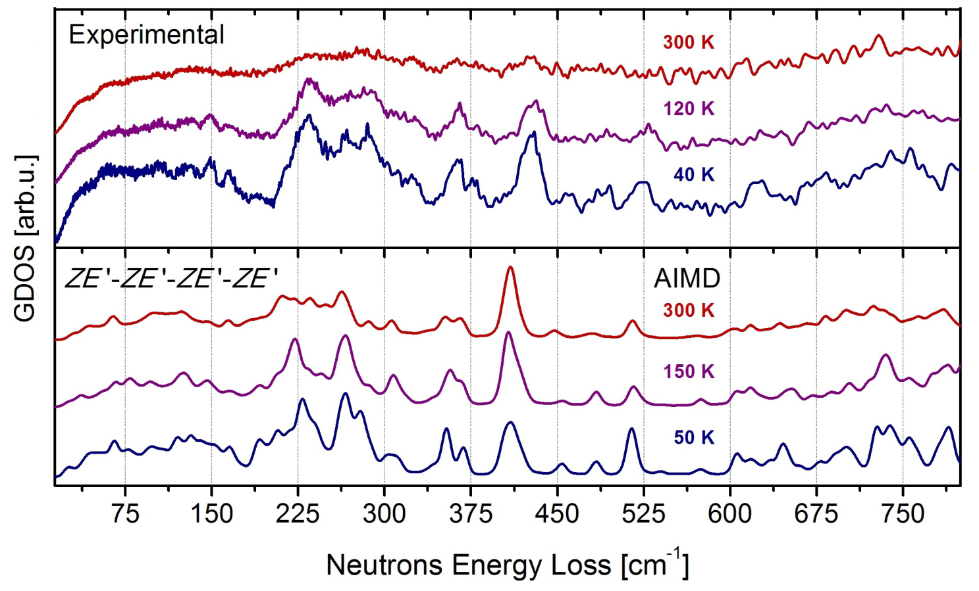
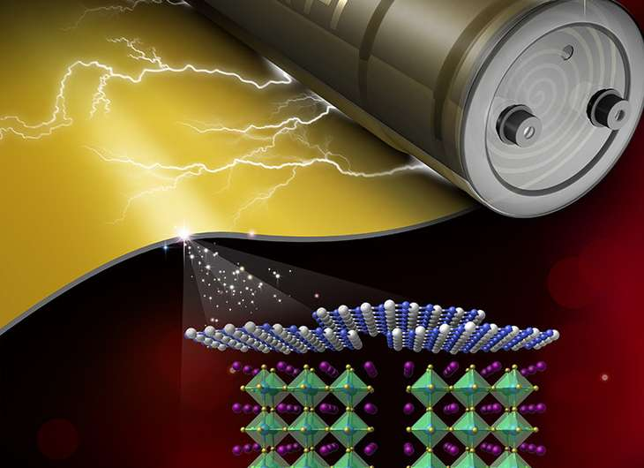
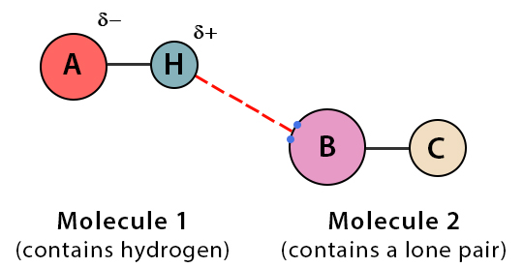
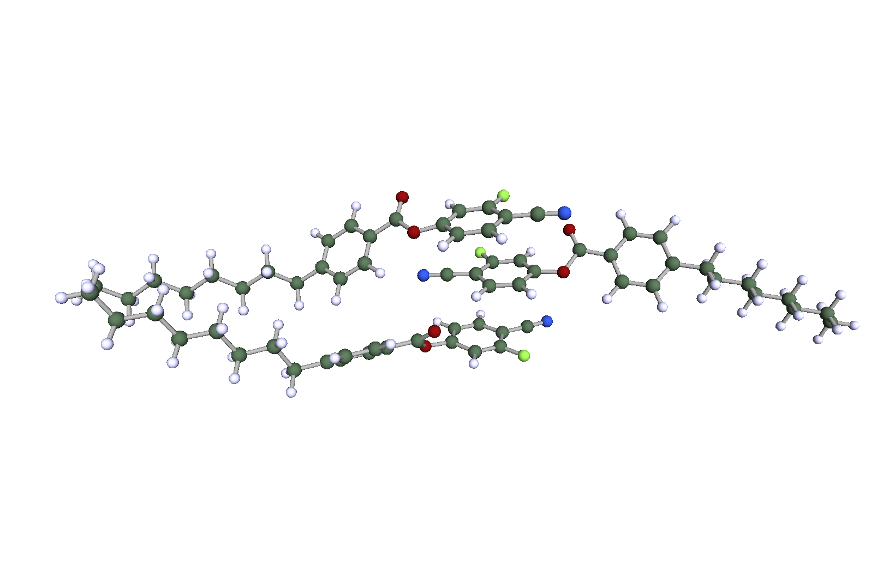
Neutron scattering in condensed matter physics
Inelastic Scattering
Molecular structure and dynamics
Isomeric forms of drugs
Drug delivery systems

Slide 17


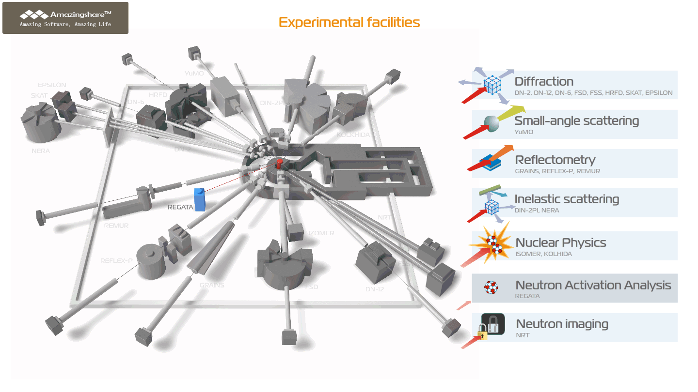
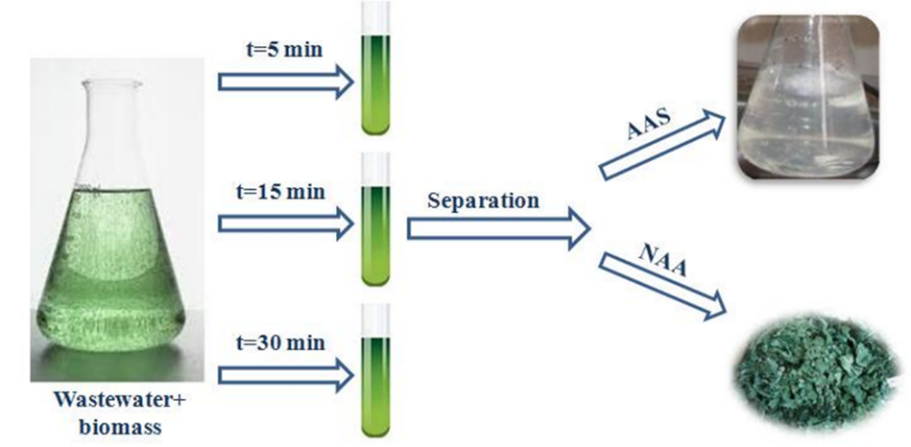
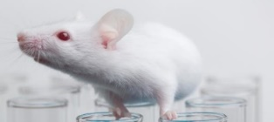

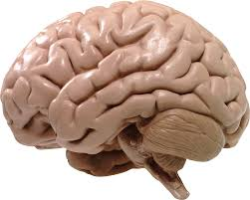



Nuclear analytical method
Neutron Activation Analysis
Elemental composition analysis of air, water, and soil or the objects of cultural heritage
blood
brain
liver
lungs
kidneys

Slide 18




Neutron scattering in condensed matter physics
Neutron Imaging
Non-destructive imaging of the industrial or precious objects

Slide 19

The laboratory has accumulated a large amount of equipment for comprehensive examination of samples by additional methods.
It includes:
Xeuss 3.0 X-ray scattering station;
X-ray Diffractometer EMPYREAN
(PANalytical);
Coherent Anti-Stokes Raman Spectrometer
Raman spectrometers;
IR and UV spectrometers;
RFA;
ICP-MS
Chromatography System
NGC Quest™ 10 Plus
AFMs
…etc
https://flnp.jinr.int/images/box-slider/Laboratory_Equipment_DNICM_FLNP_JINR_2021.pdf

Slide 20
Main activities in the field of nuclear physics with neutrons:
Investigations of the neutron induced nuclear reactions:
fundamental symmetries;
highly excited states of the nuclei;
nuclear fission;
nuclear data.
Investigations of the fundamental properties of the neutron, ultra-cold neutrons:
tests of quantum mechanics;
search for new type of interactions;
neutron lifetime measurement.
Applied and methodical research:
neutron activation analysis and others nuclear technics for isotope analysis;
neutron in space;
Ion beam analysis:
IREN developing.

Slide 21





Investigation of neutron-induced reactions with charge particles emission
Work is planned to measure cross sections for reactions (n,p), (n,α) on various isotopes.
In 2024, it is planned to measure (n,α) reaction cross sections on gas samples Ar, F, O, Ne at EG-5, FLNP JINR (En=3-5 MeV) and at the tandem accelerator HI-13 CIAE (En=8-11 MeV) using specially constructed ionization chamber.
Cross sections will also be measured for ¹⁴⁸Sm(n,α) at EG-5, FLNP JINR.
It is also planned to conduct test measurements of reactions (n,p), (n,α) on ⁶Li and Cl at the IREN facility.
Developing a proposal for experiments at CSNS (China) is undergoing.
Experimental hall EG-5, FLNP JINR
Experimental hall at IREN facility
Yu M Gledenov et.al «63Cu(n, α)60Co cross sections in the MeV region» J. Phys. G: Nucl. Part. Phys., Vol. 50, (2023)
DOI 10.1088/13616471/acb960
New ionization chamber for the IREN faclilty

Slide 22


Setup for measuring γ-ray emission cross sections consisting of two HPGe detectors (4) and four LaBr detectors (5).
In 2024 it is planned to measure γ-ray emission cross sections for light elements: B, C, N, O, F, Na, Mg, Al, Si, P, S, Cl, K, Ca, Ti, V, Cr, Mn, Fe , Co, Ni, Cu, Zn, Sn.

Slide 23


Construction of a pilot mobile setup for determining the carbon content in soil using the Tagged Neutron Method
(in collaboration with LLC “Diamant”).

Slide 24



Frescoes of Moscow Kremlin Cathedral
  Specialist of NAA group of FLNP together with art historians research wall paintings of ancient Russian churches
  Elemental composition analysis by NAA at IREN and IBR-2, X-ray fluorescence, electron microscopy, infrared and Raman spectrometry
  Determining the fresco colours in their original reality by physico-chemical studies to be able to restore them

Slide 25


Slide 26









Pre-amplifiers
Methodical research:
Crate NIM with analog electronics
Neutron spectrometers;
Detectors;
Sample environment;
Hardware & software;
Cryogenics;
Network and computing;
DAN neutron generator
DAN Detectors

Slide 27
Thank you for attention

