Slide 1
Radiobiological Research at JINR

Slide 2
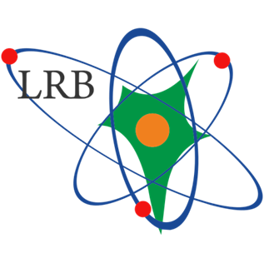
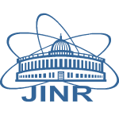
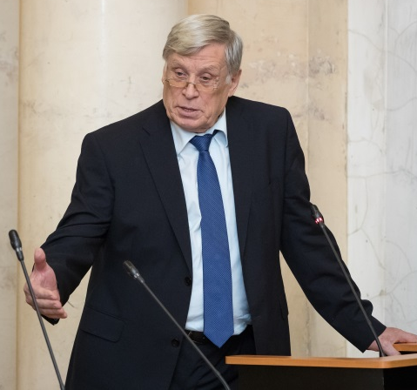
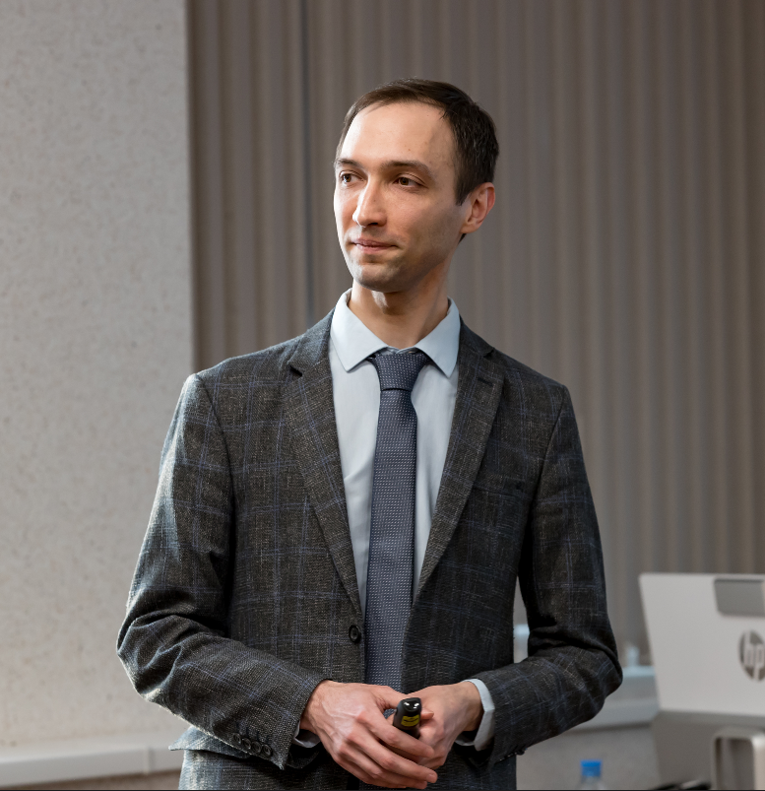
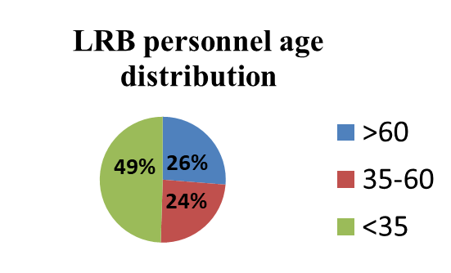
JINR and LRB
lrb.jinr.ru
1959 - first radiobiological experiments (synchrocyclotron, LNP)
1978 - Biological Research Sector
1988 - Biological Division at DLNP
1995 - The Department of Radiation
and Radiobiological Research
2005 - Laboratory of Radiation biology
Founder: Acad. E. A. Krasavin
Director: Prof. A. N. Bugay
krasavin@jinr.ru
bugay@jinr.ru
Education:
Dubna State University,
Department of Biophysics
bachelors
masters
postgraduates
half of scientific staff are young researchers!

Slide 3
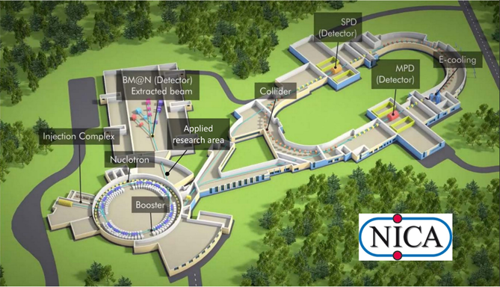
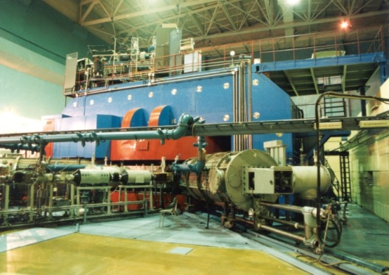
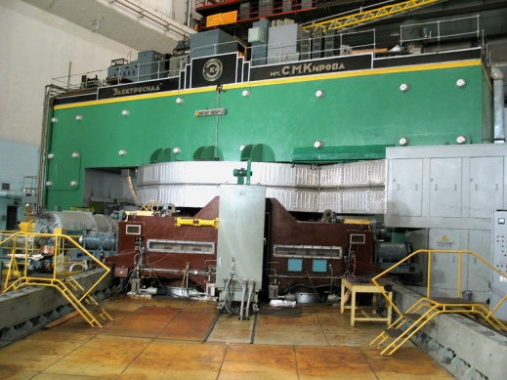
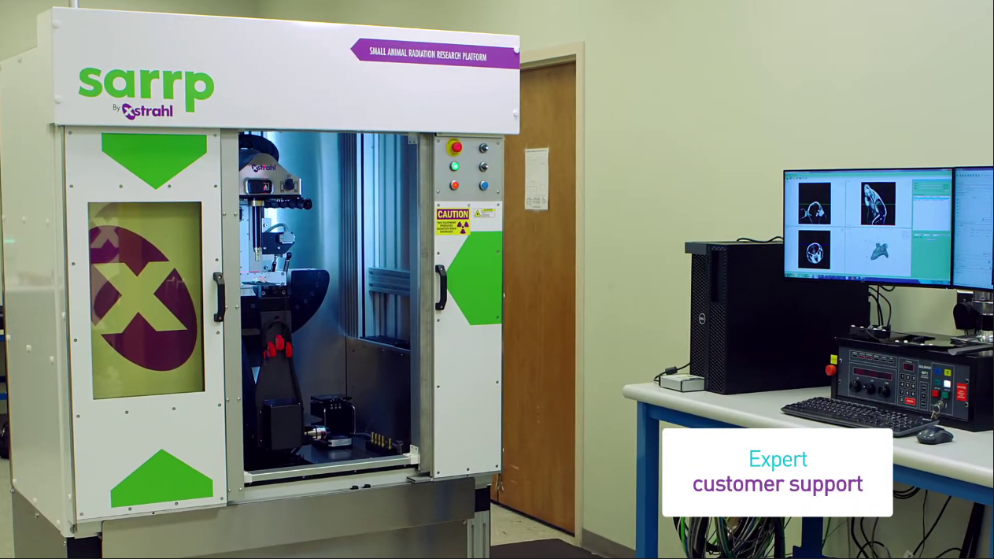
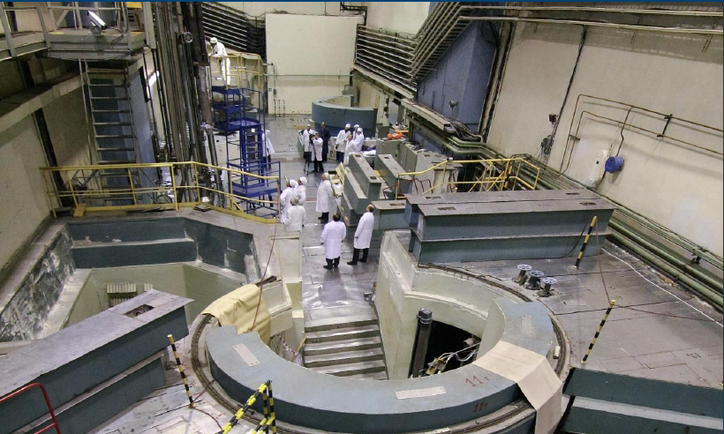
JINR’s radiation sources for radiobiological studies
U-400M cyclotron: heavy ions 50 MeV/u (Li-Ne)
Nuclotron: heavy ions 0.3-1 GeV/u (H – Kr) / ARIADNA
Phasotron: medical proton beam 170 MeV / MSC 230
IBR-2 reactor: neutrons
X-ray animal irradiator

Slide 4
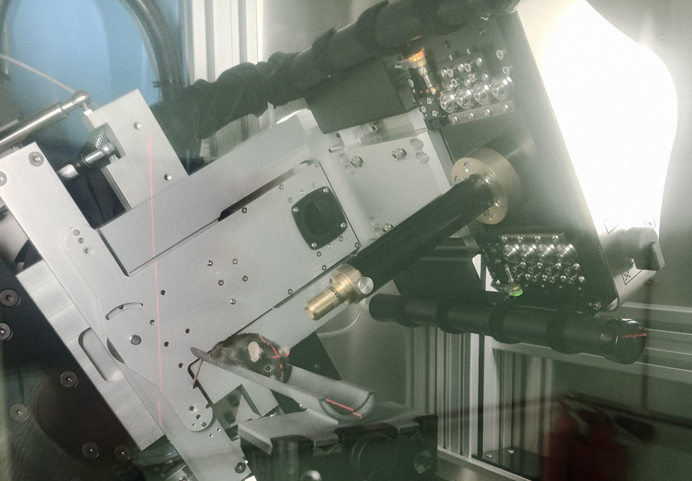
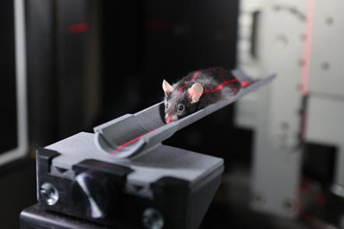
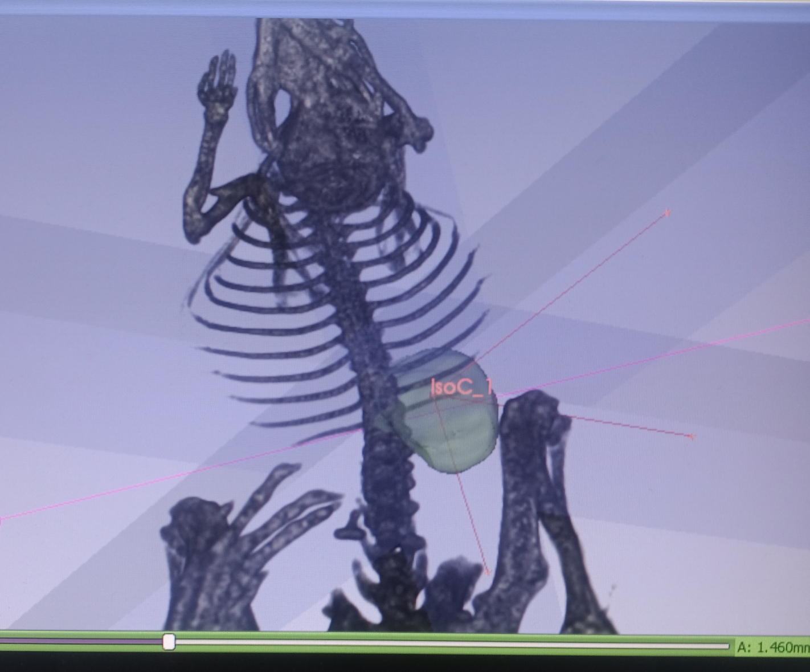
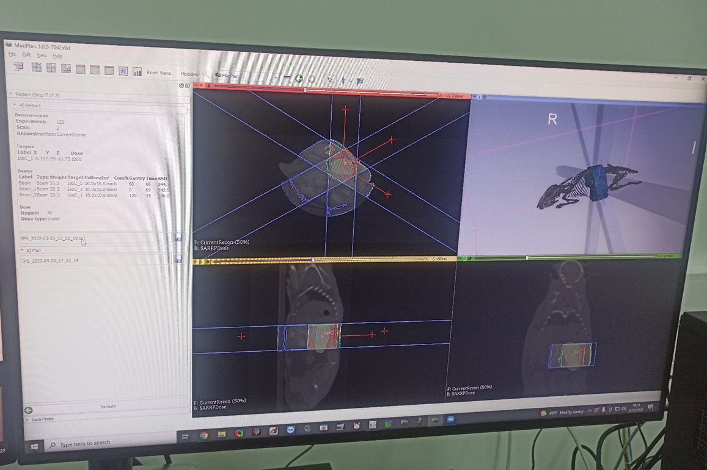
Basic facility of the LRB :
SARRP (Small Animal Radiation Research Platform)
The 360° gantry and motorized stage allow for non-coplanar beam delivery from any angle.
Techniques utilizing planar static beams, parallel opposed beams, continuous arc therapies, multiple isocenter treatments, and non-planar arcs can all be planned, evaluated, and delivered with SARRP
SARRP imitates modern X-ray radiation therapy systems for animal research
First experiments on mice tumor irradiation at SARRP
Notes:
24 марта 2022 г. в Лаборатории радиационной биологии ОИЯИ состоялся торжественный ввод в эксплуатацию облучательной рентгеновской установки SARRP (Small Animal Radiation Research Platform) производства фирмы Xstrahl (Великобритания), предназначенной для радиобиологических исследований на мелких лабораторных животных.
Теперь ученые ЛРБ и стран-участниц ОИЯИ могут проводить уникальные исследования в области радиобиологии и разработке новых методов лучевой терапии на высоком техническом уровне.
On 24 March 2022, the Laboratory of Radiation Biology JINR hosted the ceremonial commissioning of the SARRP (Small Animal Radiation Research Platform) X-ray irradiation facility manufactured by Xstrahl (Great Britain) and designed for radiobiological studies on small laboratory animals.
Now scientists from the LRB and the JINR Member States can conduct unique research in the field of radiobiology and the development of new methods of radiation therapy at a high technical level.
4

Slide 5
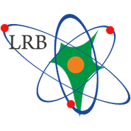
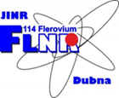
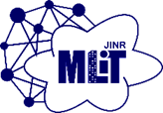
JINR Life Science Program: Basic and Applied Research
Dzhelepov Laboratory of Nuclear Problems
Laboratory of Radiation Biology
Veksler and Baldin Laboratory of HEP
Fundamental Radiobiology
Radiation Neuroscience
Clinical Radiobiology
Mathematical Modeling
Radiation Protection
Astrobiology
Proton therapy of cancer
Genetics
Detectors and Tomography
Heavy ion beamlines for space radiobiology, technologies for beam therapy
Infrastructure for molecular, cellular and animal research
Frank Laboratory of Neutron Physics
Flerov Laboratory of Nuclear Reactions
Mecheryakov Lab. of Information Technologies
Analysis in the structural biology and pharmacology
Ecology
High performance computing
System for biological data storage and processing
Bioinformatics, Machine Learning
Ion beams for cellular research
Radionuclides synthesis for radiation medicine
Notes:
… В ОИЯИ взят курс на активное развитие фундаментальных и прикладных направлений, связанных с Life Science.
На серии институтских семинаров, Ученом Совете, совещаниях и круглых столах сформирована международная программа исследований.
Программа будет реализована на общеинститутском уровне путем тесной межлабораторной кооперации.
Интегрирующим звеном служит специализированная лаборатория – ЛРБ, которая реализует программу по двум трендовым мировым направлениям: науки о мозге (освоение космоса и борьба с нейрозаболеваниями), и радиационная медицина (новые подходы к пучковой и радионуклидной терапии рака).
Для этого используется инфраструктура ключевых институтских проектов: пучки тяжелых ионов сети ARIADNA прикладных каналов NICA, ионного циклотрона ЛЯР (DRIBSIII), нейтронов с реактора ИБР2,
суперкомпьютерной инфраструктуры ЛИТ. В рамках ИЦ планируется разработка нового медицинского протонного циклотрона, технологий производства изотопов, развитие технологий биотомографии.
Биологическая инфраструктура также будет активно развиваться, включая исследования на молекулярном, клеточном и тканевом уровне, задействуя омиксные технологии, а также работу с животными.
5

Slide 6
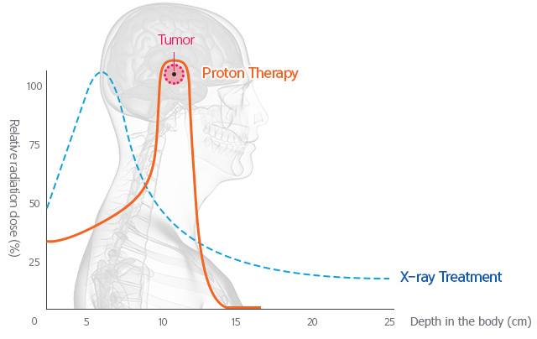
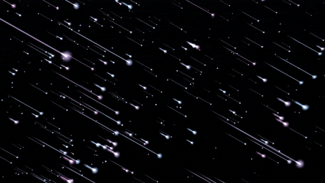
Relative biological effectiveness of charged particles
Radiation-induced mutagenesis
Radiation risk in deep space
Radiation therapy of cancer
¹H to ⁵⁶Fe
100-10000 MeV/n
10⁶ cm⁻² per year

Slide 7
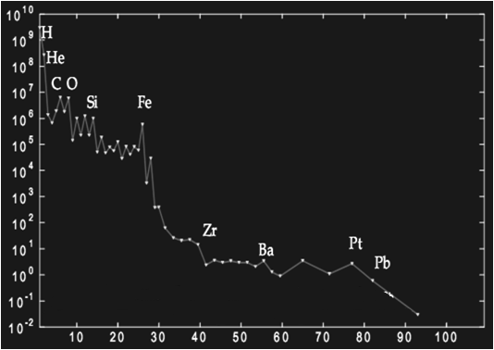
Space Radiobiology
Galactic Cosmic Rays
- Galactic and extragalactic source
- All elements
- Fully ionized nuclei
- Omnidirectional
- 10 ^ 8 - 10 ^ 21 eV
- Solar cycle modulation
(11 years)
Protons ~ 85%
α particles ~ 14%
Heavy nuclei ~ 1%
carbon group
magnesium group
iron group
Flux, arb. units
Z
Charge spectrum of GCR particles

Slide 8
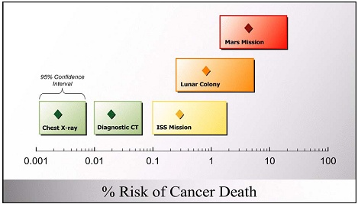
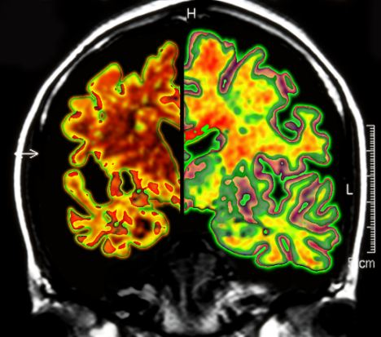
Radiation Neuroscience
Radiation Neuroscience
New concept of radiation risk for deep space flights: Damage to the central nervous system (CNS)
Mars mission
Paradigm shift
Lunar colony
X-ray
CT
Space station
% Risk of cancer death

Slide 9
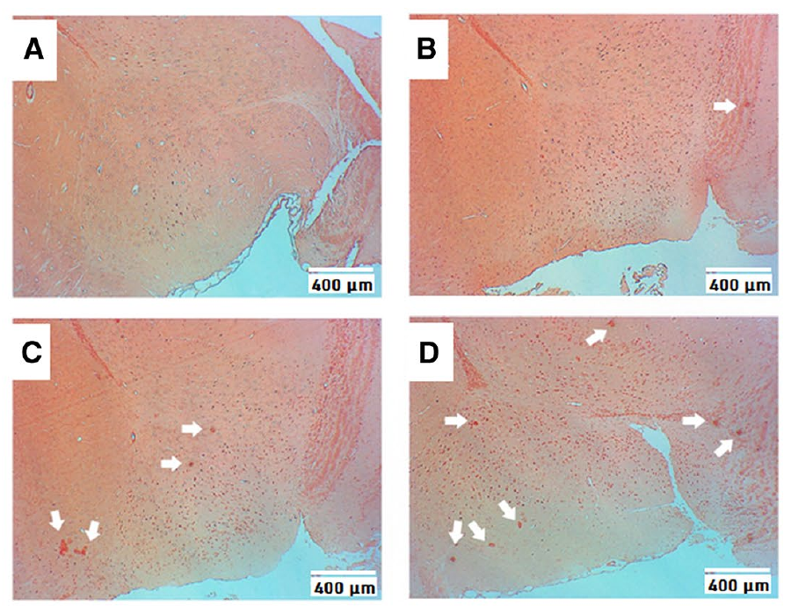
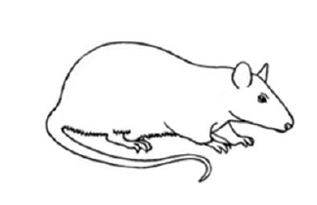
Comparative Analysis of Behavioral Reactions and
Morphological Changes in the Rat Brain after Irradiation
Irradiation Dose: 1 Gy
LET: 0.2 keV/μm (gamma ray)
0.5 keV/μm (170 MeV protons)
1 keV/μm (70 MeV protons)
control
gamma ray
after 1 month
Behavioral reactions:
impaired short-term memory
decrease in overall motor activity
decrease in exploratory behavior
Morphological changes in the brain:
early amyloidosis
autolysis of the ependymal layer
neuronal hypertrophy
increased dystrophic changes
p, 170MeV
p, 70MeV
Amyloid plaques in the forebrain of rats (marked with white arrows)
The neurodegeneration increases with LET of radiation
Yu.S. Severyukhin, et al // Cellular and Molecular Neurobiology 2022
Notes:
Детально изучены поведенческие реакции и морфологические изменения в различных отделах головного мозга крыс после различного облучения.
Через 1 месяц после облучения при одинаковой нелетальной дозе в 1 Гр выявлены ухудшение двигательной и исследовательской активности, кратковременной памяти, дистрофия нейронов, нарушение белкового обмена,
к которому относится амилоидоз – один из признаков болезни Альцгеймера.
Показано, что число наблюдаемых нарушений поведения и нейродегенерации растет с увеличением ЛПЭ излучения.
Behavioral reactions and morphological changes in various parts of the brain of rats after different irradiation were studied in detail
One month after irradiation at the same non-lethal dose of 1 Gy, deterioration in motor and exploratory activity, short-term memory, neuronal dystrophy, and amyloidosis were detected.
Amyloidosis is impaired protein metabolism, which is one of the hallmarks of Alzheimer's disease.
It has been shown that the number of observed behavioral disorders and neurodegeneration increases with increasing LET of radiation.
9

Slide 10
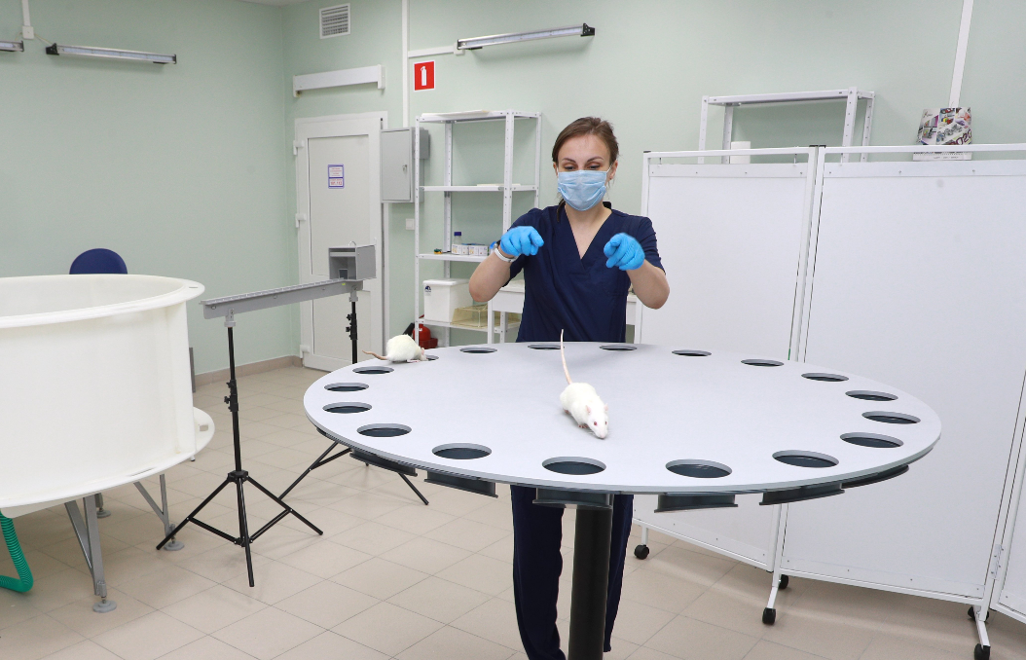
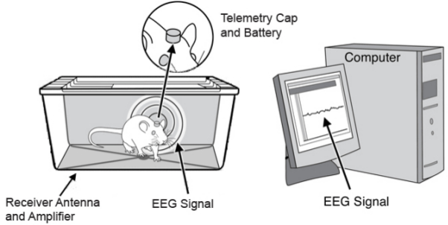
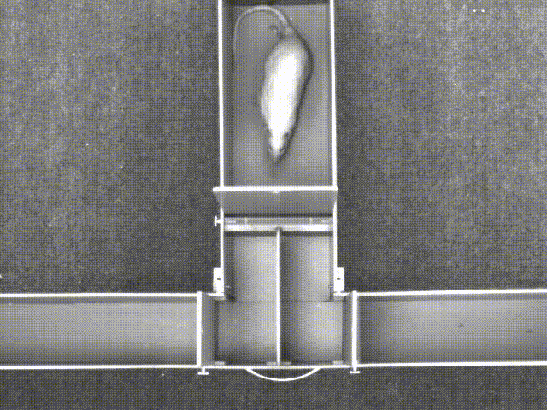
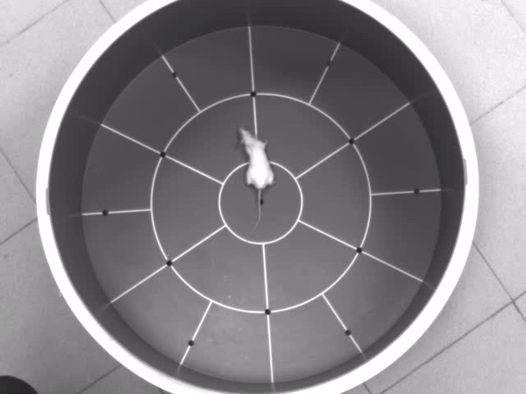
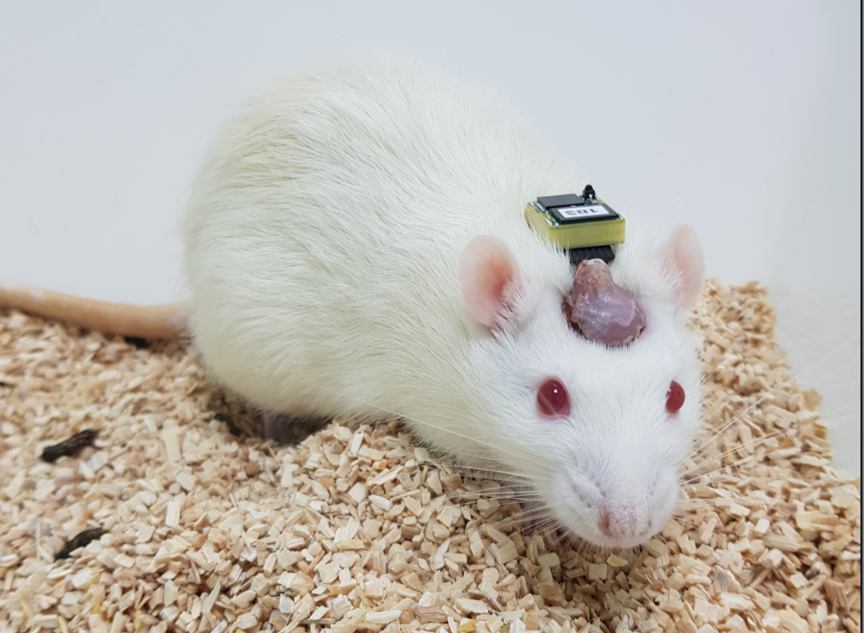
Set of equipment for the study of behavioral reactions and functional disorders of the central nervous system of animals
Behavior test systems
Electrophysiology studies
Open field
Т - maze
Morris water maze
Barnes maze

Slide 11
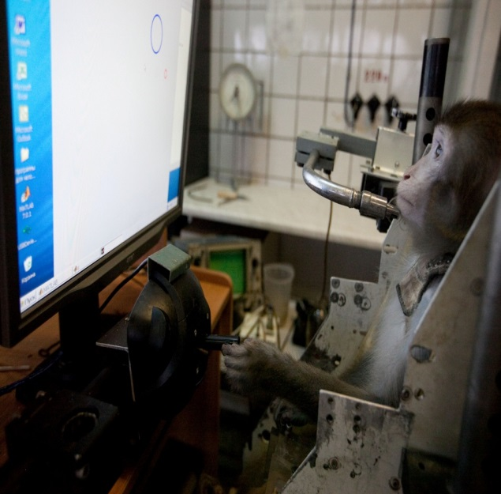
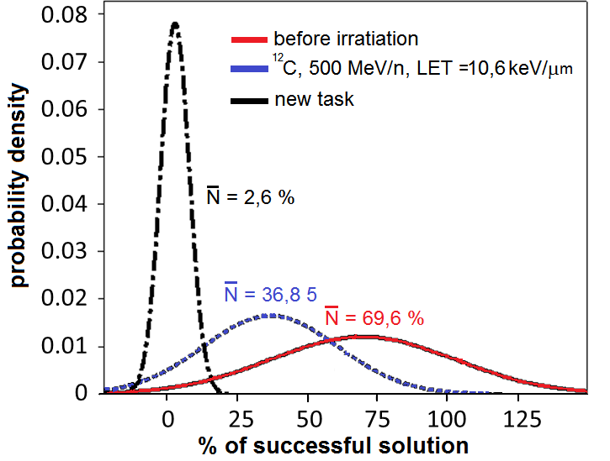
Unique experiments of the LRB with primates at Nuclotron
The monkeys were preliminarily trained to solve logic problems on a computer. The effect of exposure to 1 Gy of carbon ions with energy 500 MeV/u consisted in a significant suppression of the learning ability of monkeys.
Automated computer system for the simulation of operator activity during the flight
1 Gy ¹²C ions:
bad performance
RAS Institute of Biomedical Problems,
RAS Institute of Medical Primatology,
RAS Institute of Higher Nervous Activity and Neurophysiology,
Moscow State University
1Gy protons:
no effect
%

Slide 12
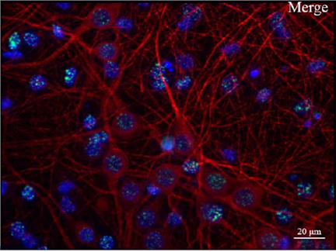
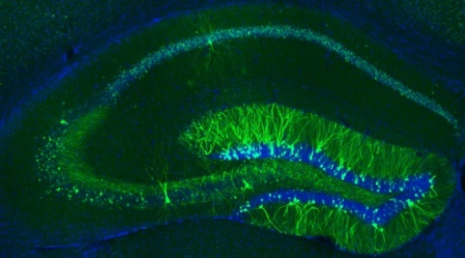
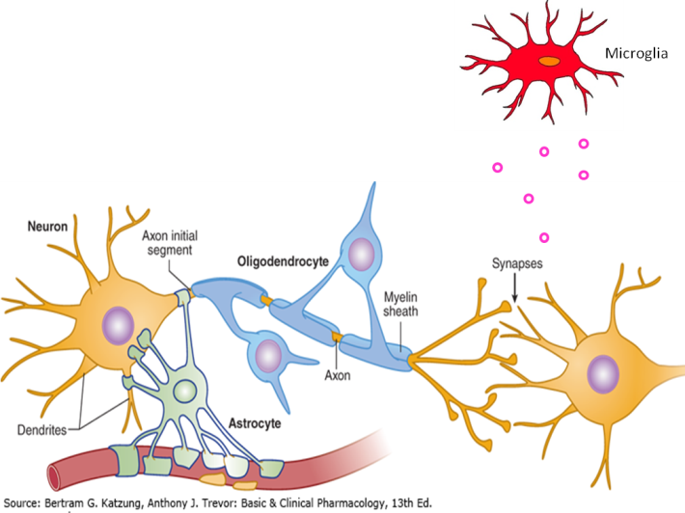
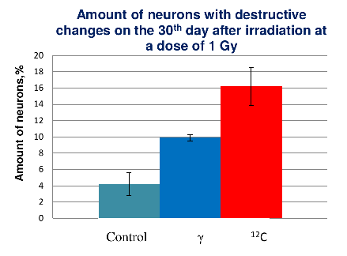
Mechanisms of radiation damage at the molecular, cellular and tissue level
Visualization of different types of nerve cells in rat hippocampal slices
Induction and repair of DNA damage, genomics
- in neural cells (in vitro)
- in brain structures (in vivo)
Suppression of neurogenesis
The role of glial cells:
demyelination
neuroinflammation
visualization of DNA damage in hippocampal cell culture
A link between radiation and neurodegenerative diseases?
Alzheimer, Parkinson, Epilepsy …
The relationship between radiation and aging?

Slide 13
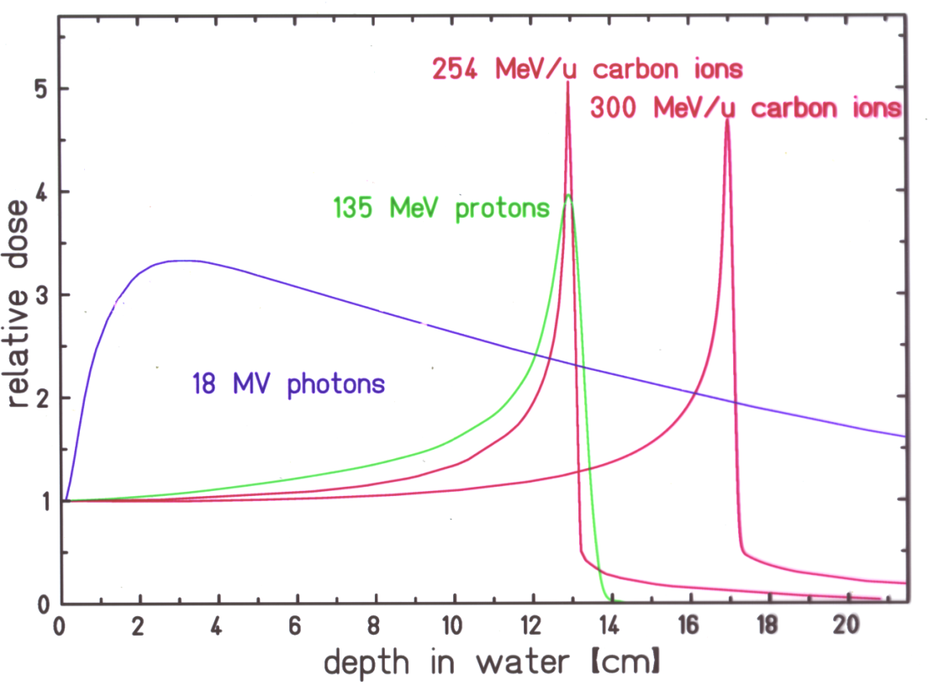
Clinical Radiobiology
Principles of radiation therapy of cancer
Conformal irradiation
Formation of lethal DNA damage (double strand breaks) in tumor cells
Research strategy:
Interference in
genetic regulatory networks of irradiated cells with modifiers

Slide 14
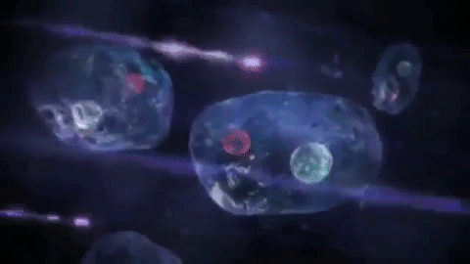
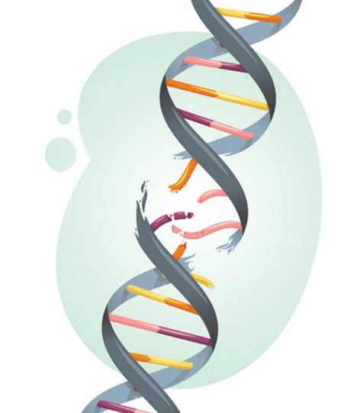
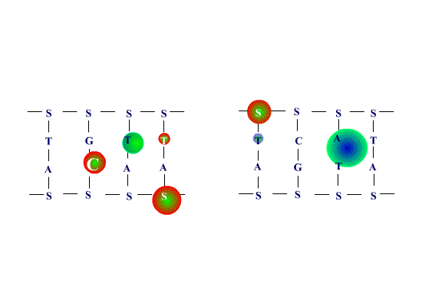
DNA double-strand breaks - the molecular basis of cell death
double-strand break
low - LET
high - LET
ionization
DNA lesion
Clustered double-strand break

Slide 15
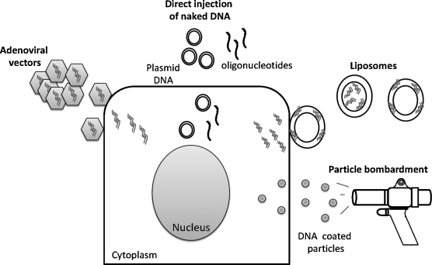
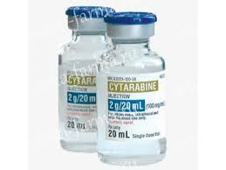
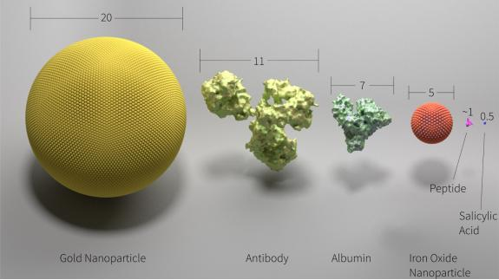
Methods of influence on the biochemical networks of cells
Pharmaceuticals
A big variety!
Registered for clinical use
DNA synthesis inhibitors, repair inhibitors, cell cycle blockers …
Transgene systems
The latest biotechnology,
high selectivity,
targeted delivery is possible, complexity in clinical registration
Artificial compounds
increase energy release when interacting with radiation
Metal nanoparticles, quantum dots, ...

Slide 16
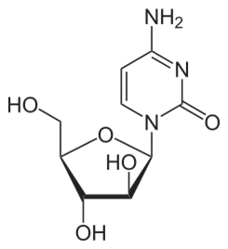
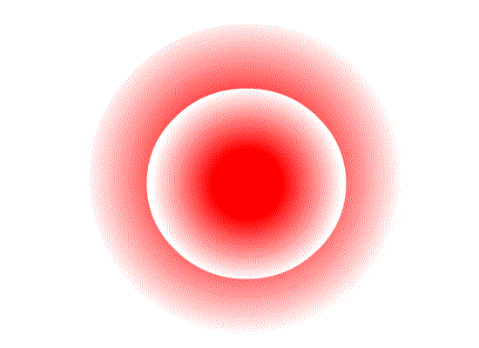
Interference in genetic regulatory networks of irradiated cells with pharmaceuticals
1-β-D-arabinofuranosylcytosine (AraC, cytarabine)
AraC- "The Trojan Horse"
S1 endonuclease
Stopping DNA synthesis and forming a double-strand break

Slide 17
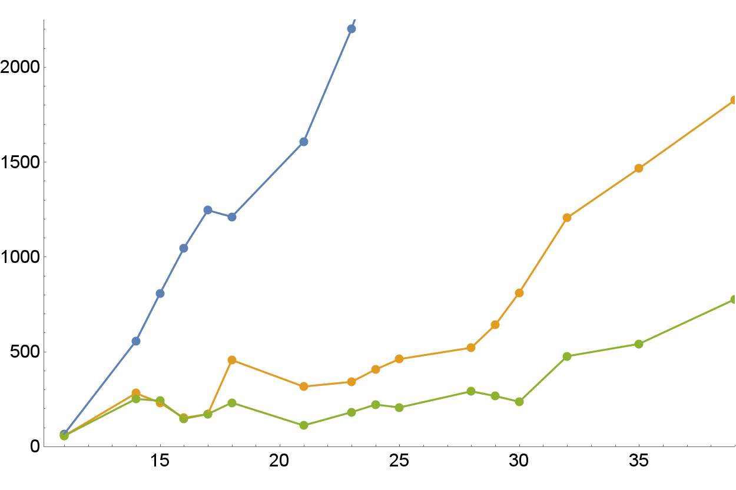
Preclinical animal studies with transplanted melanoma tumor cells in mice (in vivo experiments)
Control: death at day 30
Protons 10 Gy
Irradiation
Survivors
Tumor size, mm³
AraC + Protons 10 Gy
Irradiation
Time after transplantation of tumor cells, day
AraC
Melanoma tumor volume growth rate is 2.5 times lower with modifying agent !
Notes:
On the next slide I would like to draw you attention to the very important outcome of our research: A new promising method for cancer therapy was invented in our Lab. It is based on the increase of the biological effectiveness of gamma and proton radiations by the special modifying agents (drugs). In vitro experiment revealed the sharp increase of DNA damage in the presence of these agents. And in recent experiments on animals with inoculated melanoma tumor the higher effectiveness of medical proton beam was also demonstrated.

Slide 18
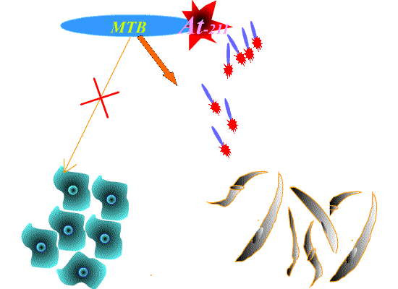
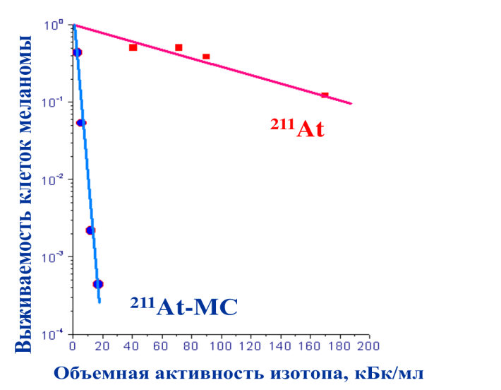
Nuclear medicine:
targeted delivery of radionuclides
Шмакова, Норсеев, Красавин, Кодина и др, 2002
Melanoma tumor cell survival
in vitro
Methylene blue (MTB)

Slide 19
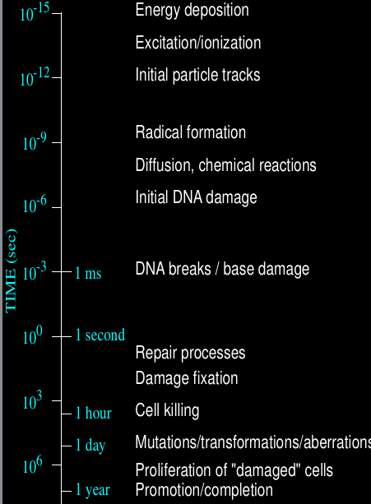
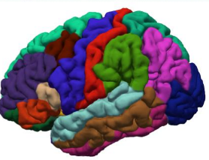
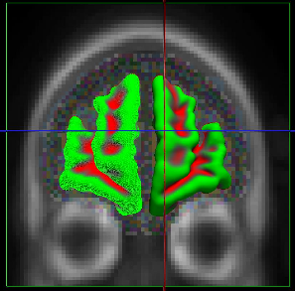
Mathematical Modeling
Energy deposition in tracks,
direct molecular damage
Monte Carlo radiation
transport
Radiation neuroscience:
Brain neural networks
Molecular dynamics
Radiation chemistry,
diffusion,
indirect molecular damage
AMBER
Estimating final effect
Clinical radiobiology:
Dynamical systems:
ODE and PDE
Complex models of tumor growth
Biochemical processes
Wolfram Mathematica
MATLAB
Cell population kinetics

Slide 20
INFORMATION SYSTEM for RADIATION BIOLOGY
The joint project of LIT and LRB is aimed at creating an information system for storing and analyzing changes in the central nervous system of mammals based on molecular, pathomorphological and behavioral changes in the mammalian brain when exposed to ionizing radiation and other factors.
The information system is based on:
computer vision algorithms based on machine and deep learning technologies;
modern IT solutions for storing, processing and visualizing data;
The information system will allow:
to speed up and simplify the work with experimental data for various groups of researchers
to simplify and accelerate the diagnosis of pathologies of the central nervous system, and in a particular case, the development of effective methods of prevention and protection from ionizing radiation.
Notes:
На базе платформы HybriLIT продолжается активная разработка программного обеспечения и сервисов для совместного проекта ЛИТ и ЛРБ по созданию информационной системы (ИС) для анализа поведенческих и патоморфологических изменений в центральной нервной системе (ЦНС) при исследовании воздействия ионизирующего излучения и других факторов на биологические объекты.
Разрабатываемая ИС позволит объединить и структурировать данные различных типов от различных экспериментов и различных экспериментальных групп в единое информационное пространство, способное предоставить как удобство хранения и доступа к данным, так и набор передовых (актуальных) алгоритмических процедур автоматизации анализа данных для решения вопросов, связанных с диагностикой различных заболеваний ЦНС, которые остаются глобально открытыми и недостаточно исследованными, в том числе и на текущем этапе развития медицины.
Разрабатываемая ИС на базе методов машинного и глубокого обучения и нейросетевых подходов позволит обеспечить хранение и доступ к экспериментальным данным в удобной для комплексного статистического анализа форме. Использование в рамках создаваемой ИС нейронных сетей и алгоритмов машинного обучения позволит решить сложные задачи медицинской диагностики и нетривиальные задачи патоморфологов при исследовании гистологических препаратов, снижая временные и энергозатраты и исключая человеческий фактор.
Следствием внедрения этой системы станут систематизация накопленных результатов, выявление скрытых закономерностей, проявляющихся в отклике биологических систем на воздействие поражающих факторов и, как следствие, значительное упрощение и ускорение в постановке диагнозов, особенно на ранних стадиях заболеваний, выработке эффективных методик профилактики и противодействия отрицательным факторам воздействия ионизирующего излучения.

Slide 21
ASTROBIOLOGY
Search for microfossils in the meteorites
The Orgei meteorite is a unique phenomenon in the abundance and diversity of microfossils of prokaryotes and aquatic eukaryotes, including microalgae, protists, and even algae or fungal spores. The microfossils found are indigenous to the meteorite and not terrestrial biocontaminants. The consistency of the theory of panspermia is shown. The capabilities of SEM for the search and analysis of indigenous microfossils in meteorites are demonstrated.

Slide 22
ASTROBIOLOGY
Irradiation with protons with an energy of 170 MeV in the synthesis of formamide and meteoritic substances revealed precursors of nucleic acids, proteins, and metabolic cycles in appreciable amounts. In the absence of irradiation, prebiotic compounds are not formed.
Notes:
Today we have only the preliminary results. You see here the long list of different compounds that was detected in irradiated formamide by the mass-spectroscopy method. Читать!
No doubt, this investigation is very interesting and will be continued.

Slide 23
Education programs
https://uc.jinr.ru
Visits, Trainings, Summer Schools, PhD
Dubna State University
Biophysics Department
bachelor
master
PhD
Moscow State University
branch at Dubna
New Department will appear soon

Slide 24
Life Science Research at the Laboratory of Radiation Biology
Goal: One of the world attractive place for accelerator-based radiation biology, consolidated by Interlab. Research Program
Molecular Radiobiology
Clinical Radiobiology
Mathematical Modeling
Expected in 2030:
New fundamental data on molecular, tissue and organismal effects of radiations with different physical characteristics
Understanding the mechanisms of radiation brain damage and brain diseases
Estimation of radiation risks for astronauts during the interplanetary space travel
Development of new methods to increase the efficiency of particle and radionuclide therapy of cancer
Understanding of prebiotic synthesis pathways, search of life traces in space
New mathematical models and computation approaches for radiobiology, bioinformatics and medicine
Development of new research protocols involving: omics-technologies, super-resolution bio-imaging, new irradiation setups, automated biological data processing with machine learning
Radiation Genetics
Radiation Physiology
Radiation Protection
Radiation Cytogenetics
Radiation Neuroscience
Astrobiology
http://lrb.jinr.ru
Notes:
The Laboratory of Radiation Biology (LRB) was organized in 2005 on the basis of the JINR Division of Radiation and Radiobiological Research. The laboratory structure includes the departments of radiobiology and radiation research and a sector of astrobiology.
For over 20 years LRB’s education programs in Dubna university and JINR Univesity centre contribute to training of young specialists.
Owing to a wide range of radiation sources at JINR, LRB can rightly be regarded as a leader among other scientific organizations of Russia and JINR Member States in the field of radiation biology.
An international research programme is implemented at the laboratory. It includes studies of the action of heavy charged particles on the molecular, cell, tissue, organ and organism levels of biological organization (see research focus).
Modern applied research trends include:
radiation neuroscience and evaluation of space radiation risks
development of innovative methods for radiation medicine
A new trend of fundamental research is developed at the laboratory – astrobiology which studies origin and distribution of life in the universe using nuclear physics methods.
Molecular Radiobiology: DNA damage repair in normal and tumor cells, Mechanisms of clustered DNA double strand break repair, Modification of DNA repair.
Radiation Genetics: Radiation-induced mutagenesis and genetic instability, Study of complex chromosome aberrations, Evaluation of long-term effects of radiation.
Radiation Physiology: Pathomorphology of tissue and organs of rodents, Behavior of rodents and primates after irradiation, Research on new radioprotectors.
Mathematical modeling: Hierarchy of mathematical models at different levels of biological organization, Automatization of biological experiment.
Radiation Research: Simulation of cosmic radiation fields at accelerators, Evaluation of radiation protection at JINR accelerators, Design of irradiator setups for biological experiments.
Astrobiology: Synthesis of prebiotic compounds under irradiation, Search of biofossils in meteorites.
Radiation Neuroscience: Evaluation of radiation risks for CNS of astronauts, Research on new radioprotectors, Development of neurodegenerative diseases after irradiation, Mechanisms of radiation damage of brain, Development of OMICs technologies and bioinformatics.
Clinical Radiobiology: Particle therapy (New methods to increase tumor radiosensitivity by interfering with cells biochemistry, Targeted drug delivery, Development of new treatment planning methods), and Radionuclide therapy (New methods to increase tumor radiosensitivity by interfering with cells biochemistry, Molecular vectors for radioisotope delivery, Research on theranostics).

Slide 25
Thank you for the attention

