Slide 1
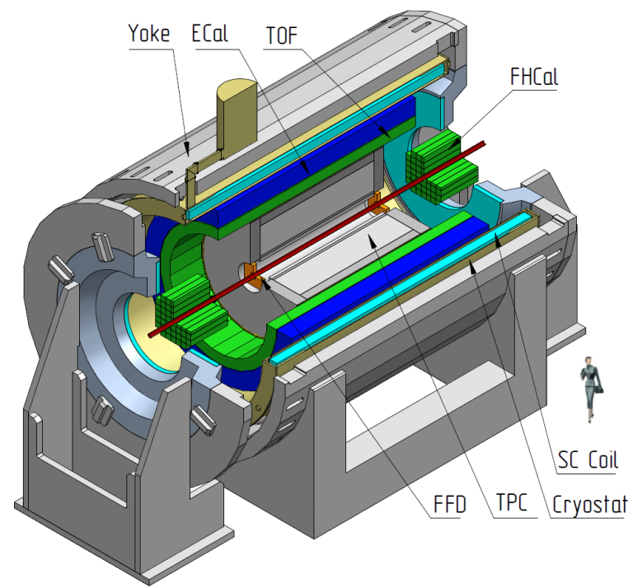
Multi-Purpose Detector (MPD) Collaboration
MPD International Collaboration was established in 2018
to construct, commission and operate the detector
12 Countries, >500 participants, 38 Institutes and JINR
Organization
Acting Spokesperson: Victor Riabov
Deputy Spokespersons: Zebo Tang, Arkadiy Taranenko
Institutional Board Chair: Alejandro Ayala
Project Manager: Slava Golovatyuk
Joint Institute for Nuclear Research, Dubna;
A.Alikhanyan National Lab of Armenia, Yerevan, Armenia;
SSI “Joint Institute for Energy and Nuclear Research – Sosny” of the National Academy of Sciences of Belarus, Minsk, Belarus
University of Plovdiv, Bulgaria;
Tsinghua University, Beijing, China;
University of Science and Technology of China, Hefei, China;
Huzhou University, Huzhou, China;
Institute of Nuclear and Applied Physics, CAS, Shanghai, China;
Central China Normal University, China;
Shandong University, Shandong, China;
University of Chinese Academy of Sciences, Beijing, China;
University of South China, China;
Three Gorges University, China;
Institute of Modern Physics of CAS, Lanzhou, China;
Tbilisi State University, Tbilisi, Georgia;
Institute of Physics and Technology, Almaty, Kazakhstan;
Benemérita Universidad Autónoma de Puebla, Mexico;
Centro de Investigación y de Estudios Avanzados, Mexico;
Instituto de Ciencias Nucleares, UNAM, Mexico;
Universidad Autónoma de Sinaloa, Mexico;
Universidad de Colima, Mexico;
Universidad de Sonora, Mexico;
Universidad Michoacana de San Nicolás de Hidalgo, Mexico
Institute of Applied Physics, Chisinev, Moldova;
Institute of Physics and Technology, Mongolia;
Belgorod National Research University, Russia;
Institute for Nuclear Research of the RAS, Moscow, Russia;
High School of Economics University, Moscow, Russia
National Research Nuclear University MEPhI , Moscow, Russia;
Moscow Institute of Science and Technology, Russia;
North Osetian State University, Russia;
National Research Center "Kurchatov Institute", Russia;
Peter the Great St. Petersburg Polytechnic University Saint Petersburg, Russia;
Plekhanov Russian University of Economics, Moscow, Russia;
St.Petersburg State University, Russia;
Skobeltsyn Institute of Nuclear Physics, Moscow, Russia;
Petersburg Nuclear Physics Institute, Gatchina, Russia;
Vinča Institute of Nuclear Sciences, Serbia;
Pavol Jozef Šafárik University, Košice, Slovakia

Slide 2
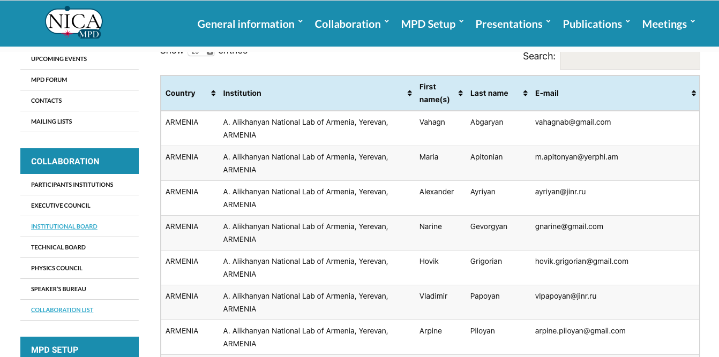

Slide 3
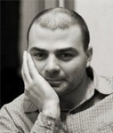
AANL group in MPD Collaboration
Hovik Grigorian (JINR-LIT & YSU & AANL) – lead of group
Alexander Ayriyan (JINR-LIT & AANL)
Vahagn Abgaryan (JINR-LIT & AANL)
Arpine Piloyan (AANL)
Maria Apitonian (AANL & AUA)
Narine Gevorgyan (AANL & RAU)
Vladimir Papoyan (JINR-LIT & AANL)

Slide 4
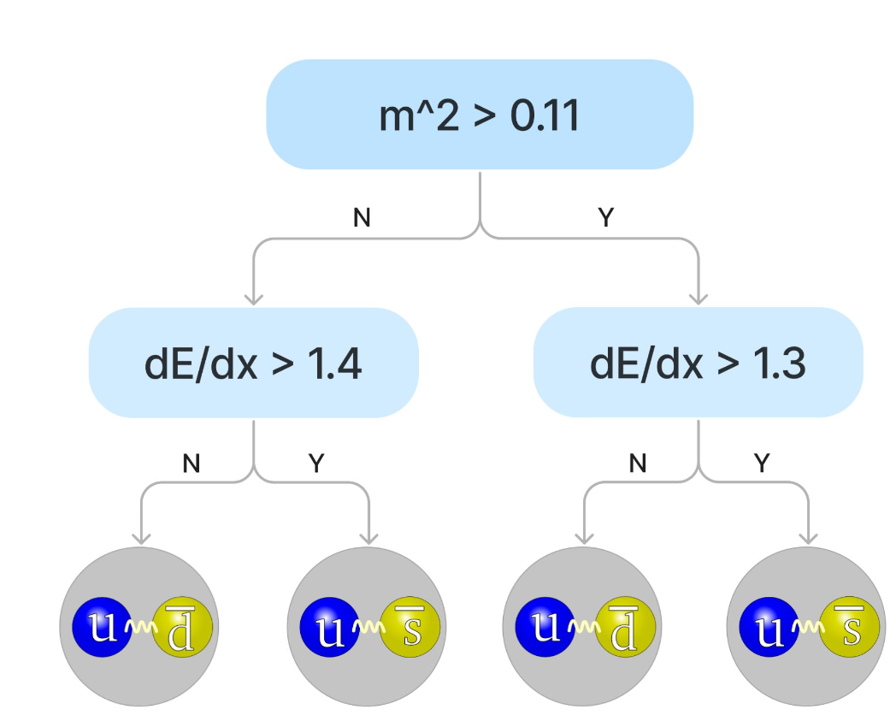
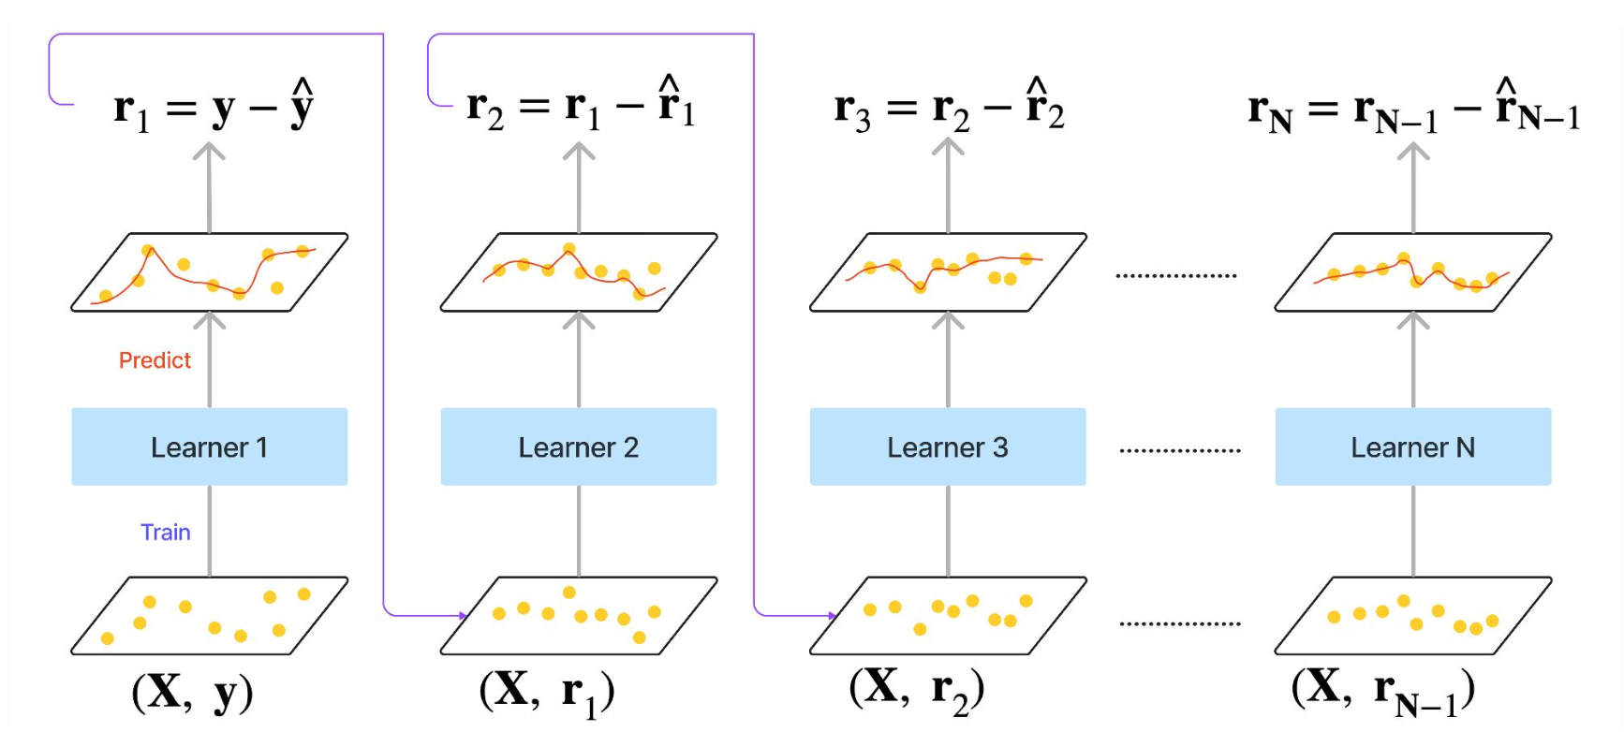
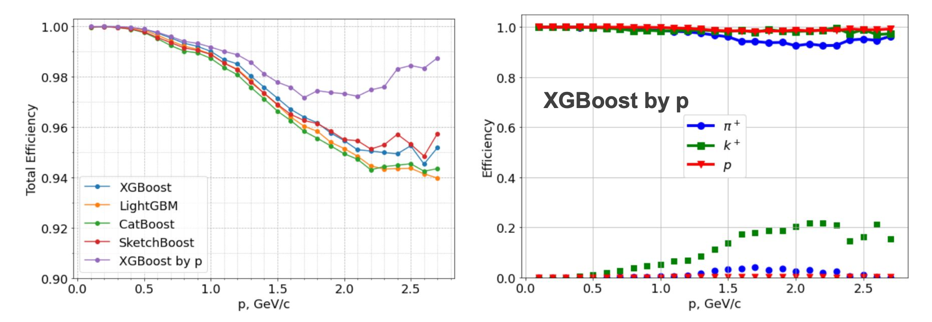
PID with TPC and TOF by Boosted Decision Trees
Efficiency
E=0.9952

Slide 5
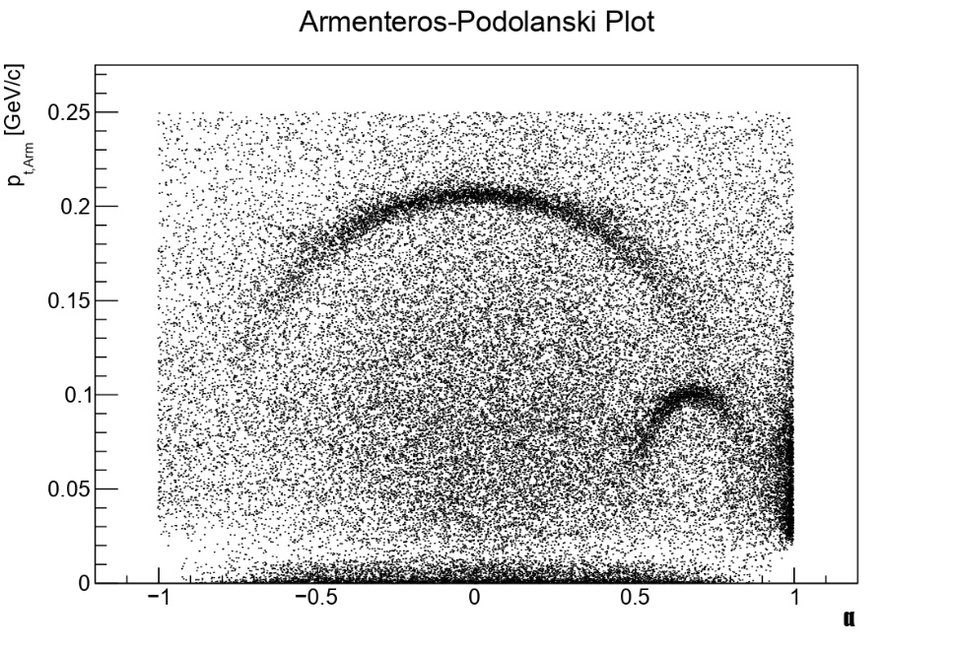
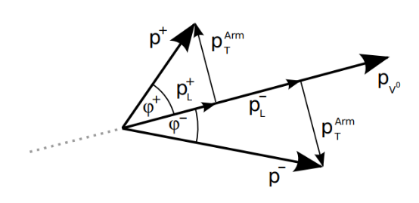
Kaon and Lambda identification (preliminary)
$$K_{S}^{0}→ π^{+}+π^{−}$$
$$K_{S}^{0}→ π^{0}+π^{0}$$
$$Λ^{0}→ p^{+}+π^{−}$$
$$Λ^{0}→n^{0}+π^{0}$$
$$α=\frac{p_{L}^{+}−p_{L}^{−}}{p_{L}^{+}+p_{L}^{−}}$$
Apitonian, Hunanyan, Korobitsin, Aparin

Slide 6
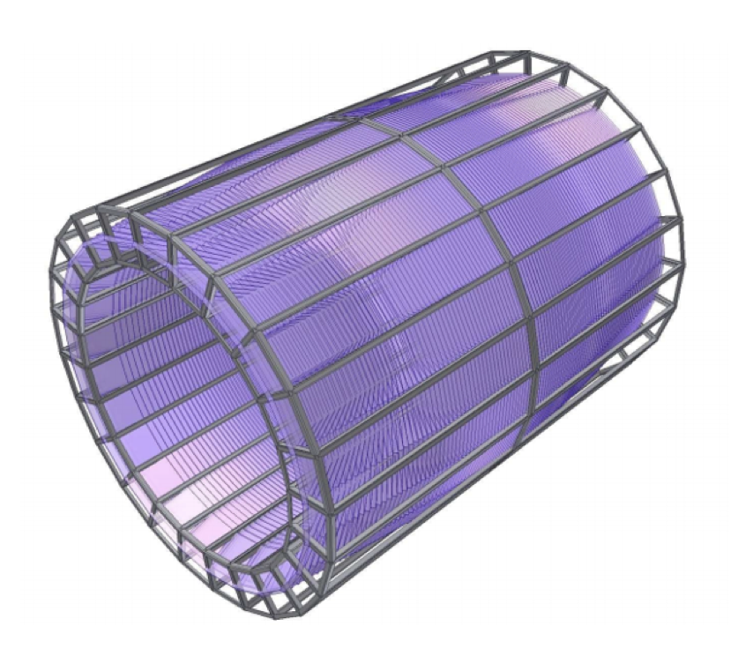
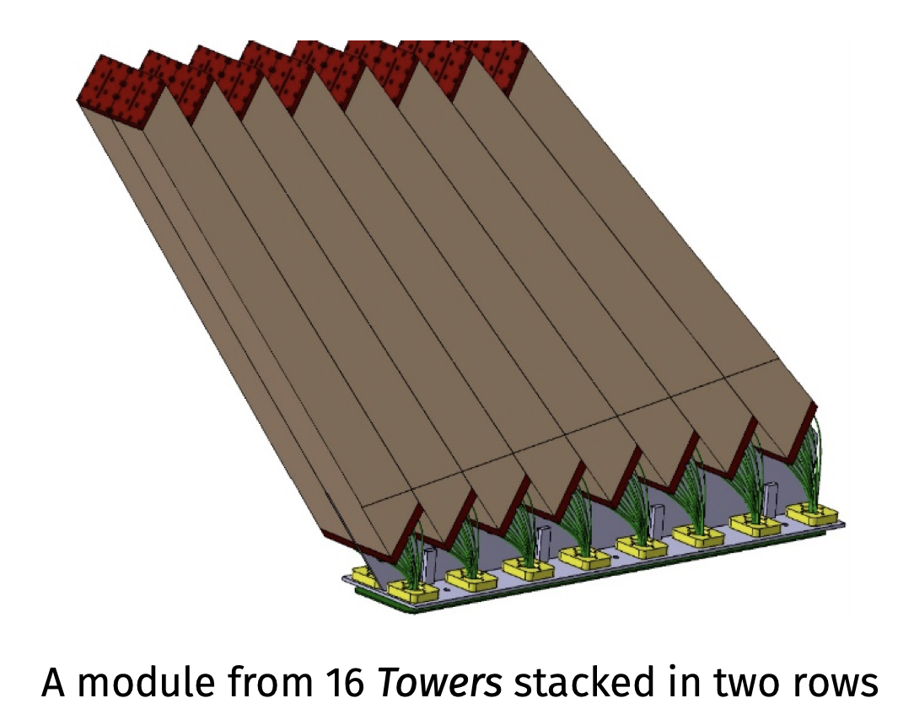
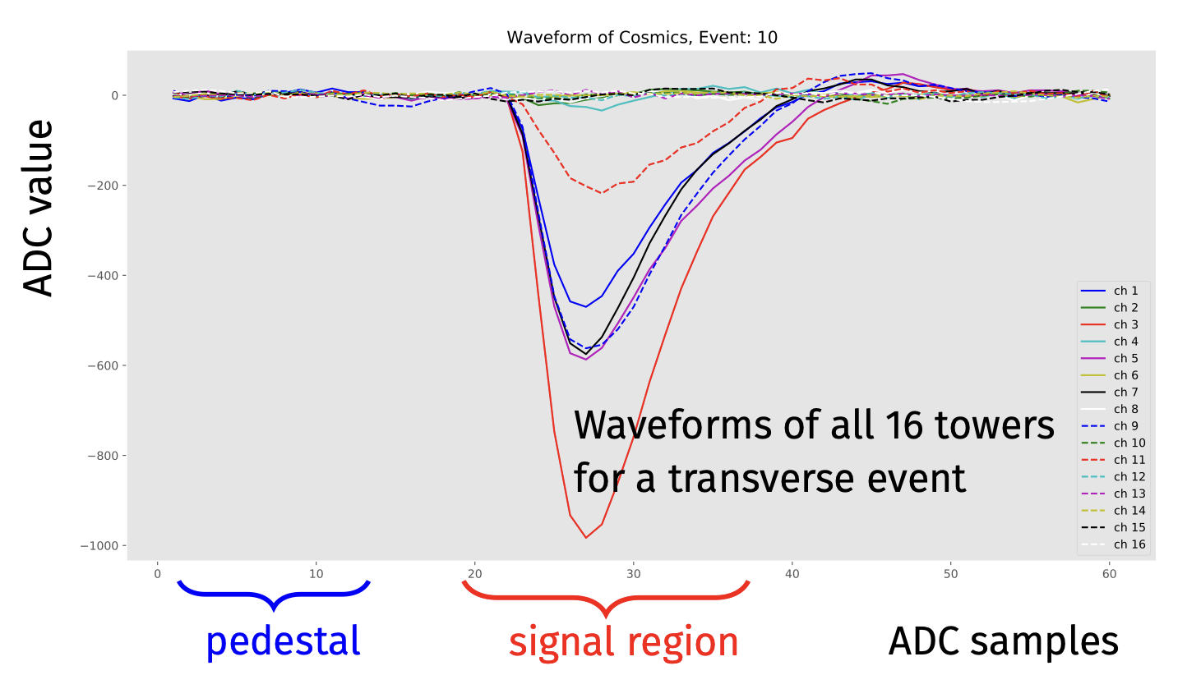
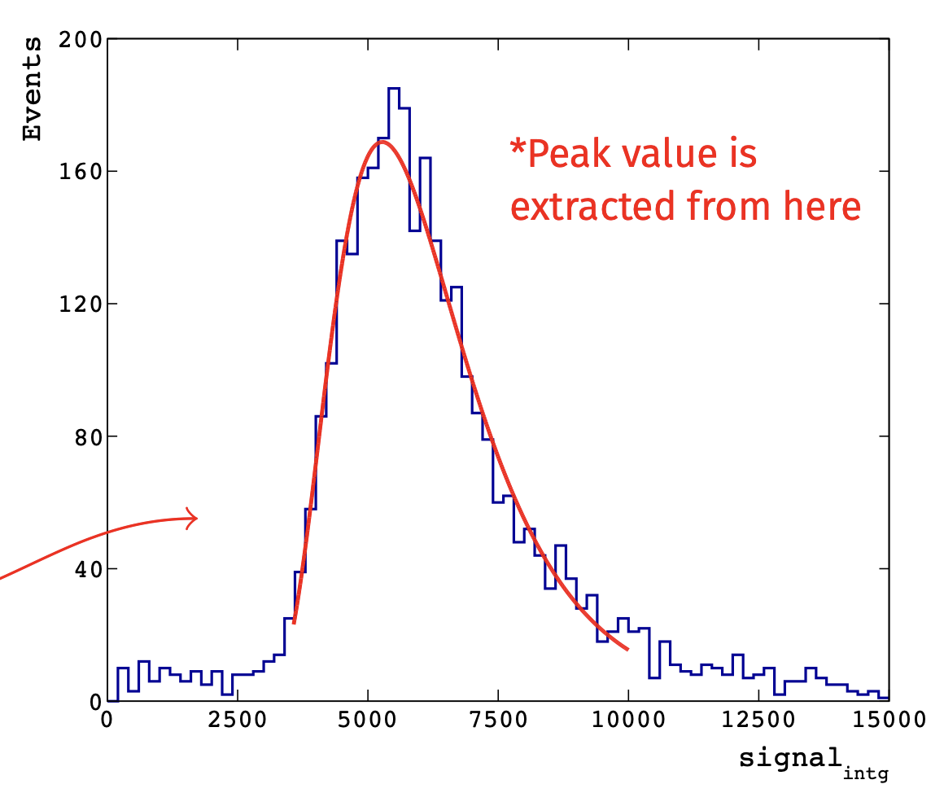
In-kind contribution 2022
Contribution to callibration of MPD ECal modules under supervision of Dr. I. Tyapkin
Maria Apitonian
Asya Hunanyan
Pictures are taken from M. Bhattacharjeea Calibration of NICA-MPD electromagnetic calorimeter modules with cosmic muons

Slide 7
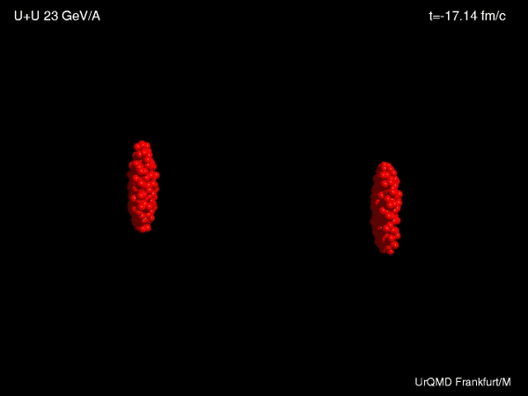
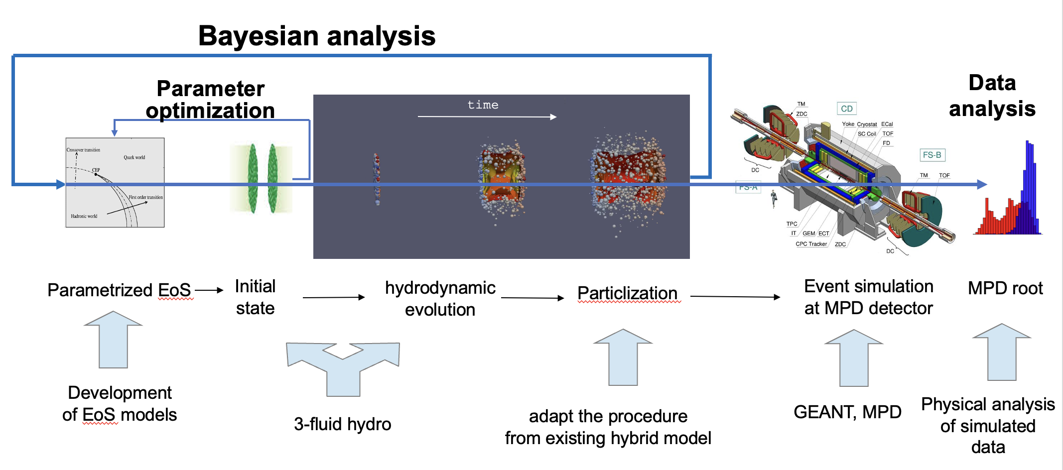
Development Hybrid EoS for HIC modelling
The idea is to study EoS based on HIC simulations in the NICA energy range
Development of constructions of the hybrid EoS with finite densities and temperatures

