Slide 1
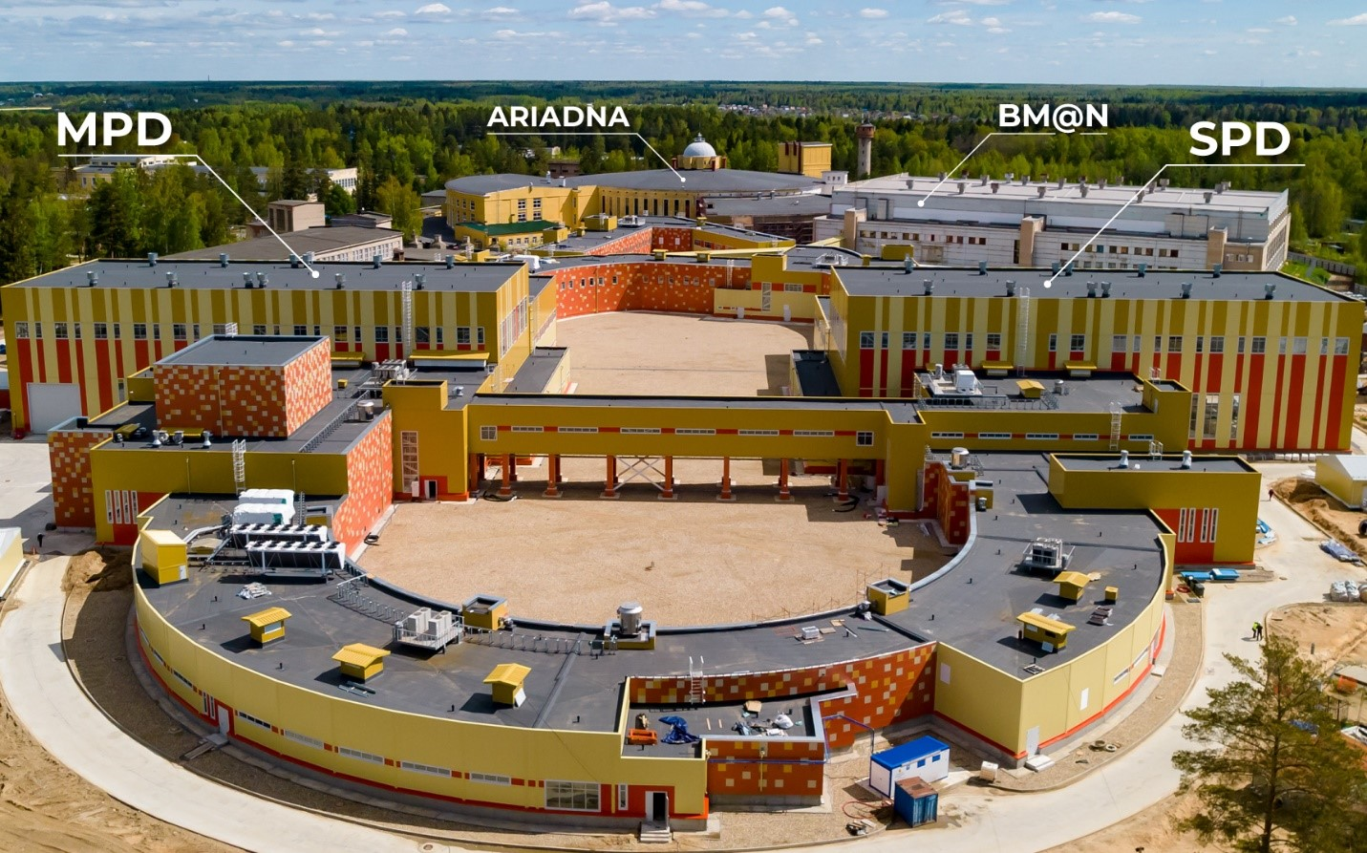
Applied research at VBLHEP
Oleg Belov
Veksler and Baldin Laboratory of High Energy Physics
Joint Institute for Nuclear Research

Slide 2
NICA mega-science project
Notes:
NICA is the (Nuclotron-based Ion Collider fAсility) idesigned at the Joint Institute for Nuclear Research to study properties of dense baryonic matter. Besides the fundamental physics issues, the NICA team is also working under construction of special beamlines for applied research, including biomedical applications, space research, radiation materials science, radiation testing of microelectronics and novel developments for ADS.

Slide 3

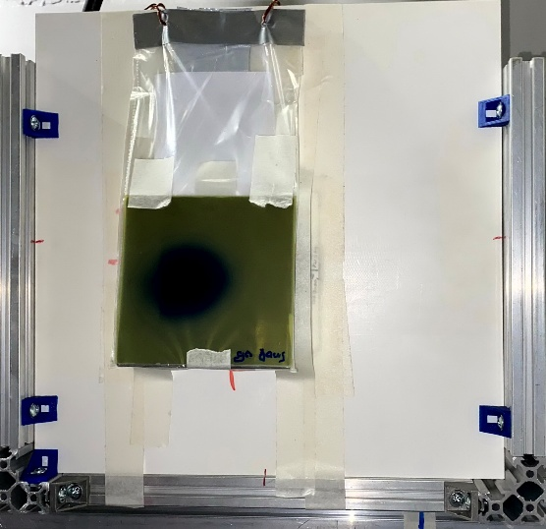
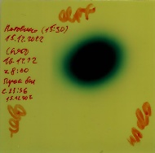
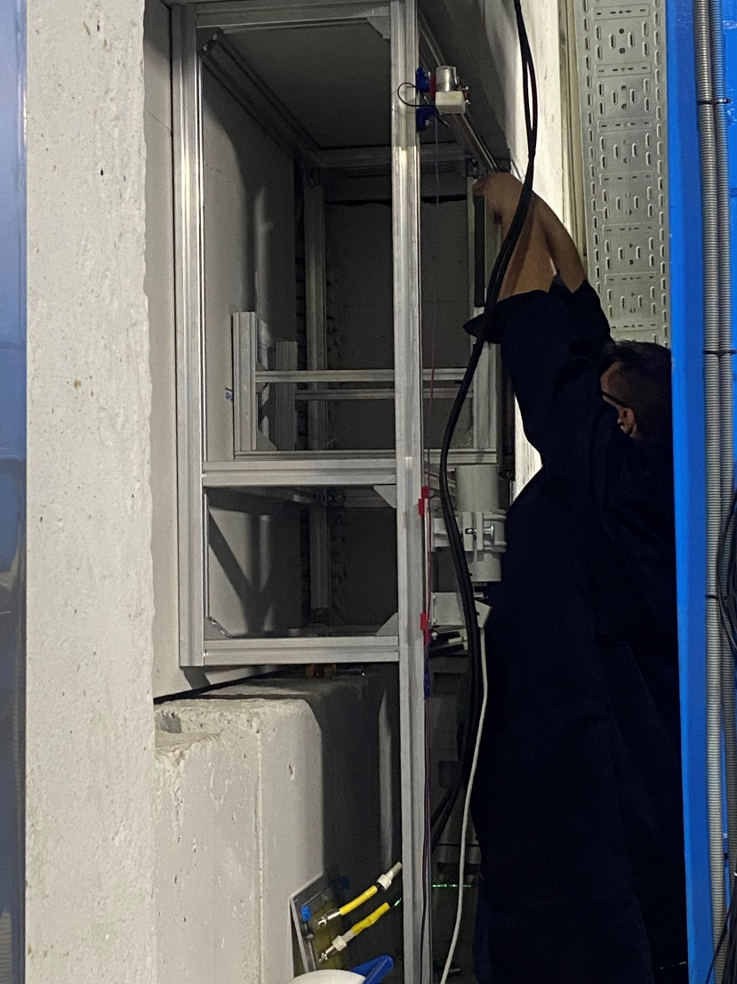
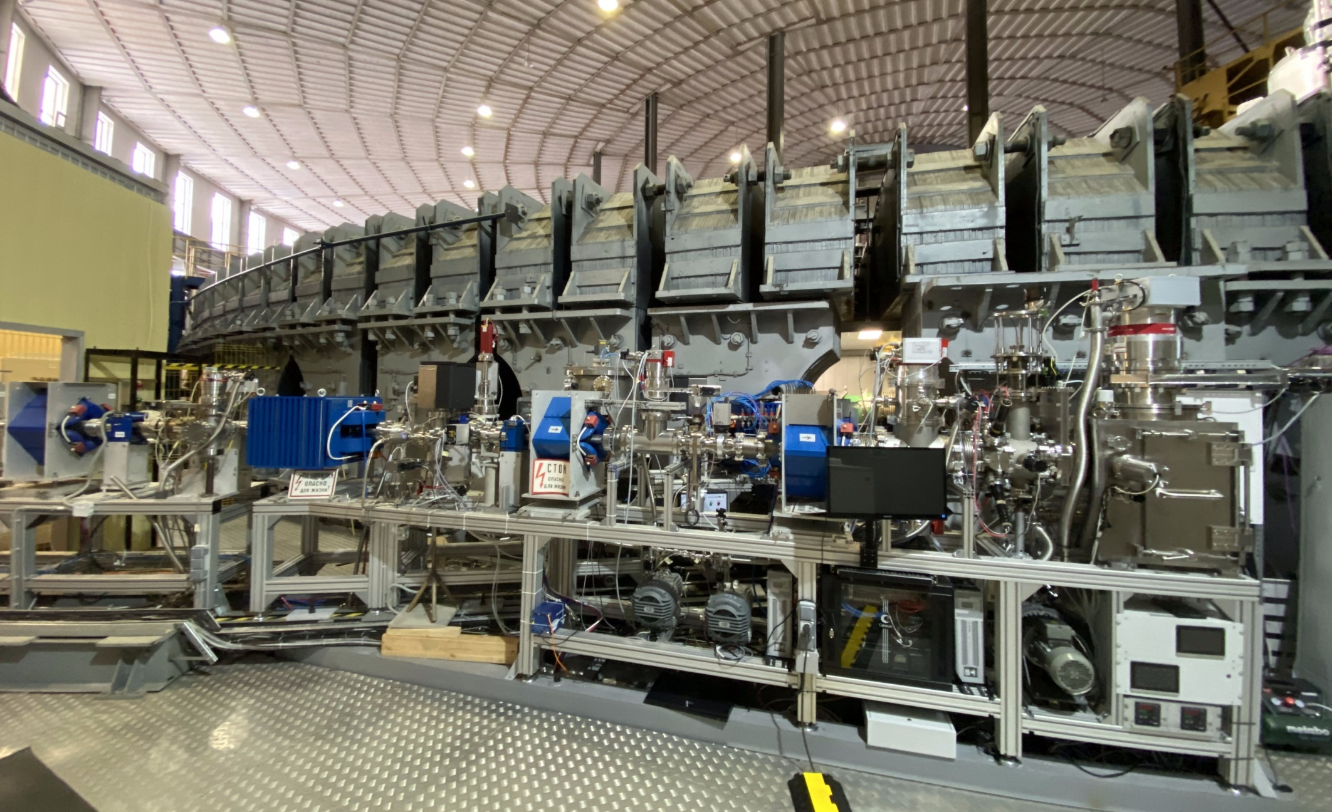
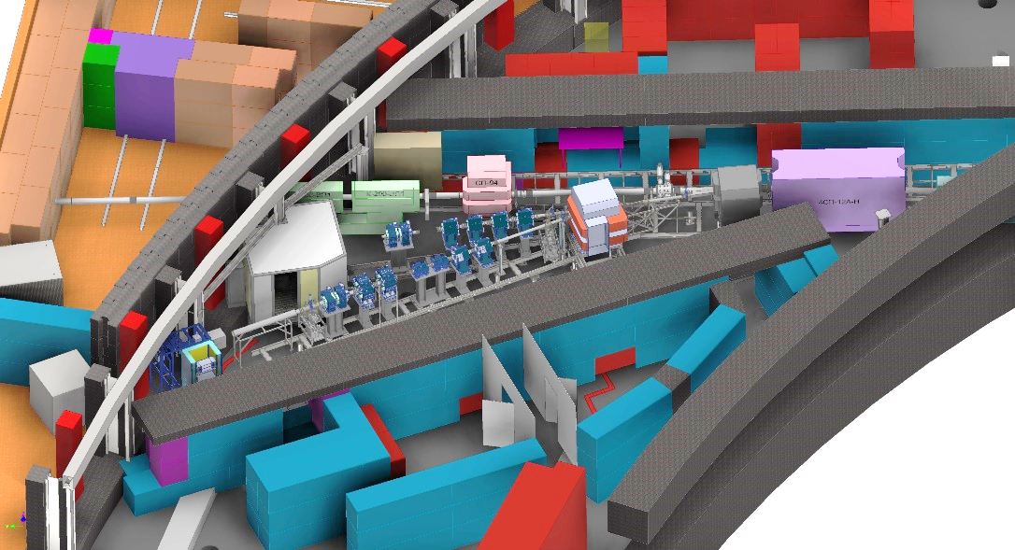
ARIADNA research infrastructure:
Current state and recent developments
Station for LT exposure
The progress was recently made in development of the NICA target stations for applied research.
In December 2021, the beamline and Station Of CHip Irradiation (SOCHI) was completed.
In December 2022, the prototype of the Target station for long-term exposure with high energy ions was assembled at the outgoing beam available behind the BM@N facility. This target station has an advantage to use beams for applied research purposes in parallel with operation of the BM@N setup.
Beam direction
FHCal setup
Target station for long-term exposure
Station Of CHip Irradiation (SOCHI)
SIMBO and ISCRA target stations

Slide 4

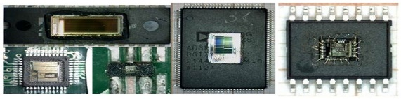
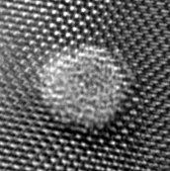
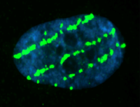

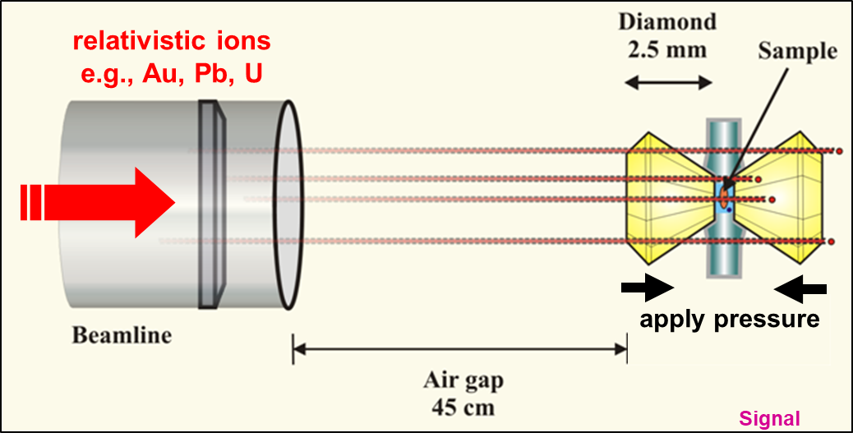
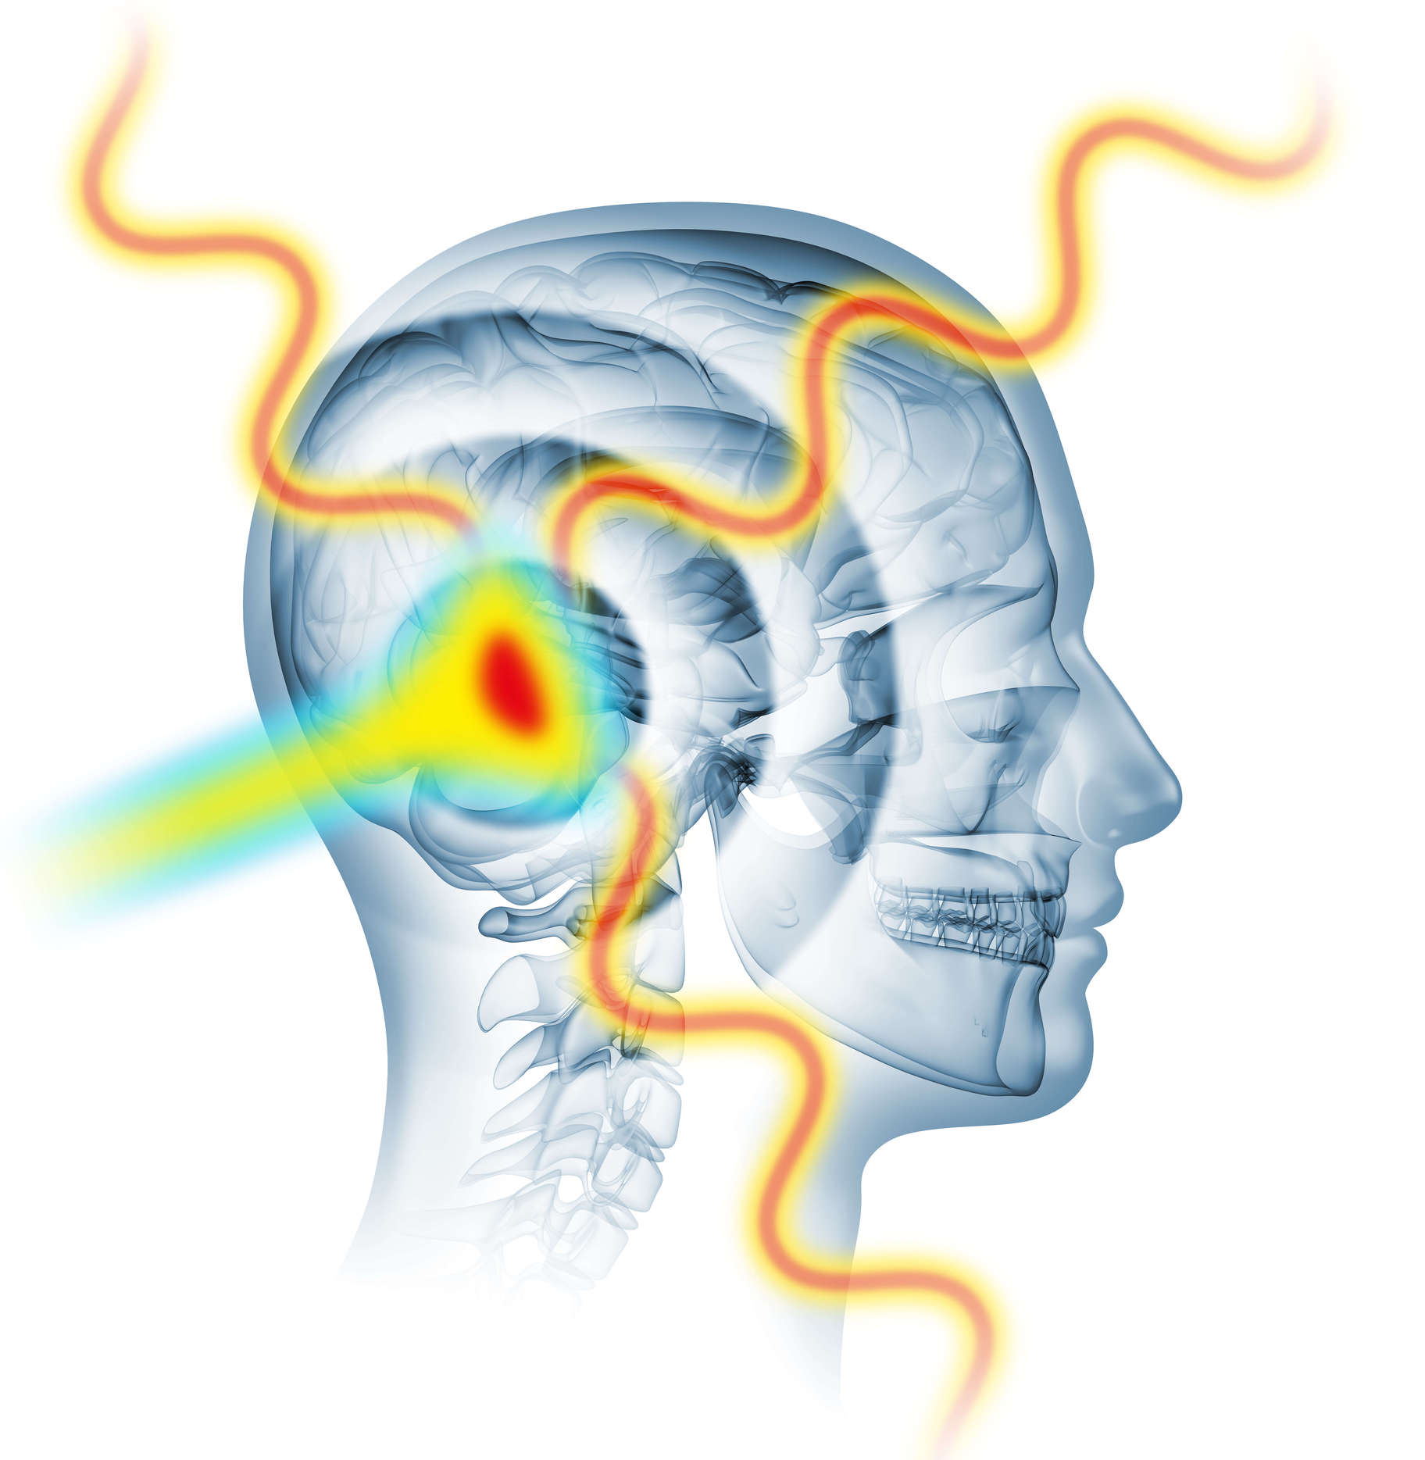
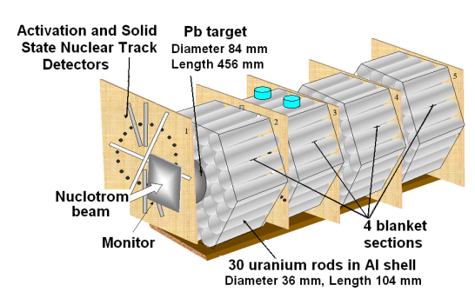
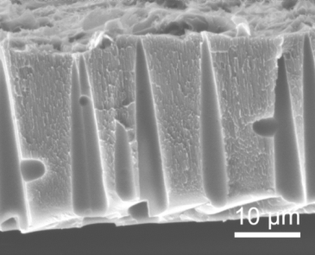
Pillars of the applied research programme at NICA
Radiation effects in microelectronics
Radiation protection
in space
Materials research with ion beams
Radiation biophysics and radiobiology
Materials in extreme radiation dose conditions
Radiation
therapy-related research
Novel technologies for
accelerator-driven systems (ADS)
The entire scope of research is not limited to these directions and open for user proposals
Notes:
Overall scope of applied research be performed using ARIADNA beamlines includes but limited to radiation protection in space, radiation testing of microelectronics, materials research with ion beams and novel technology for radiation waste processing.

Slide 5

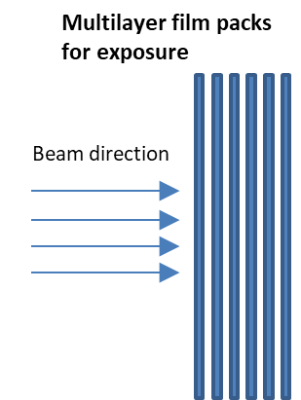
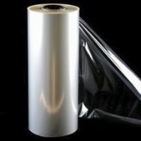
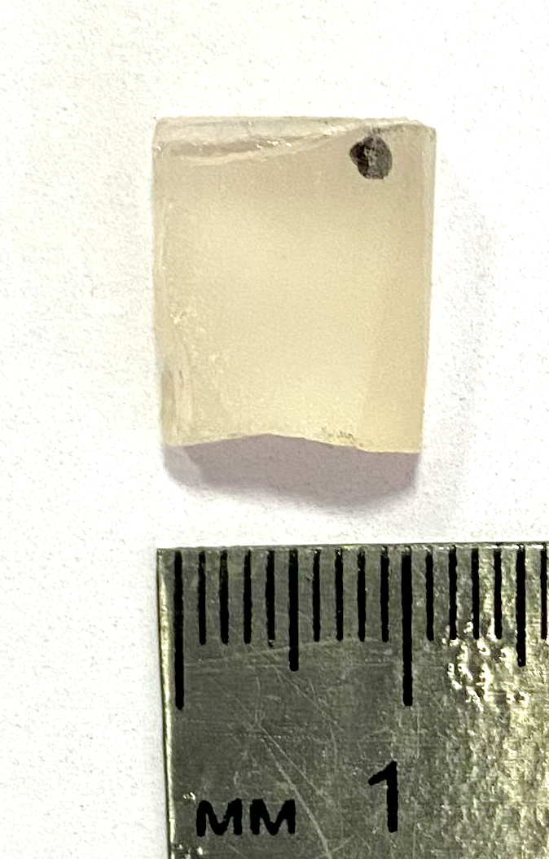
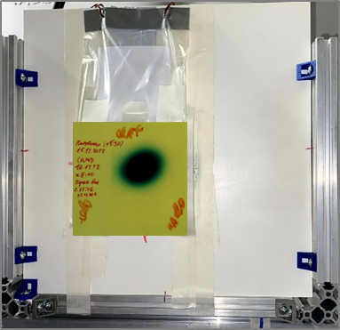

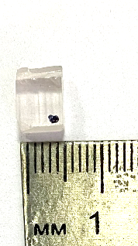
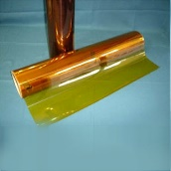
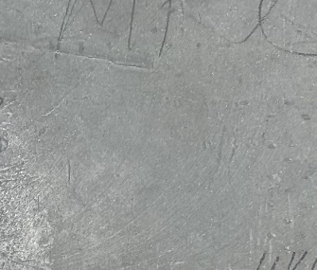
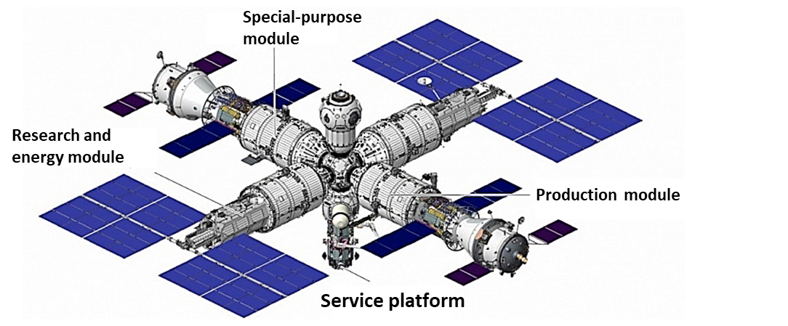
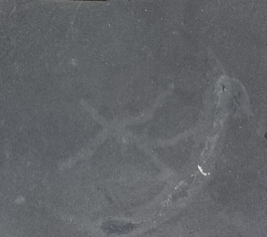

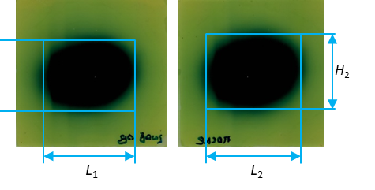
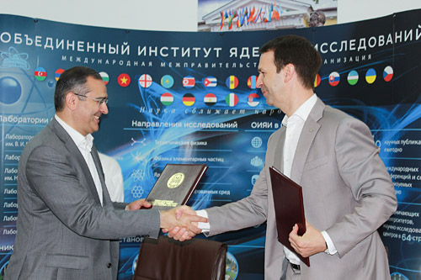
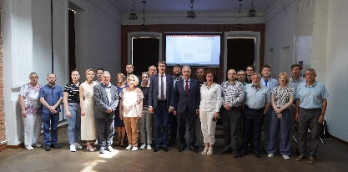
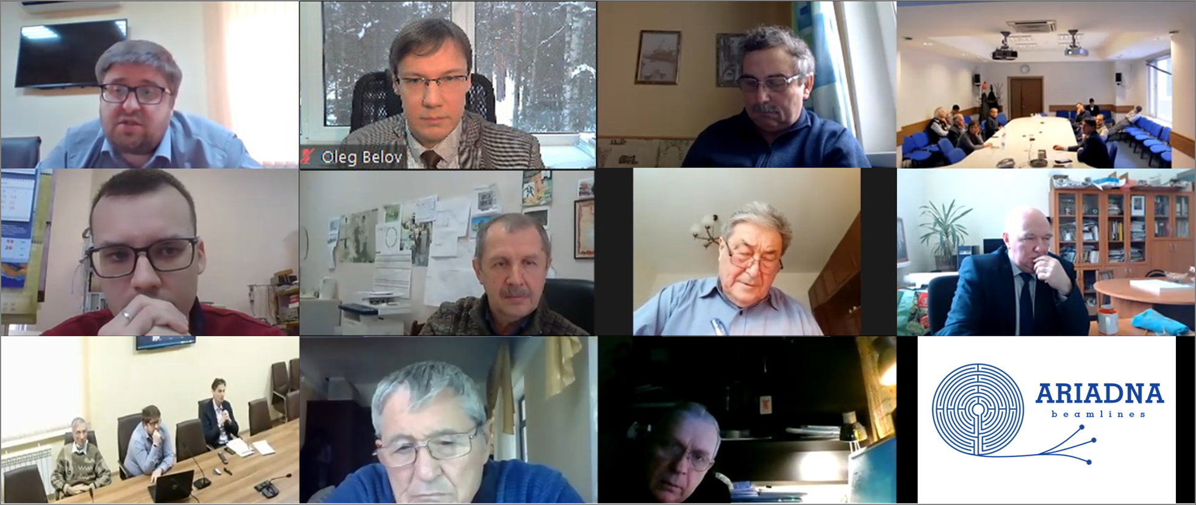
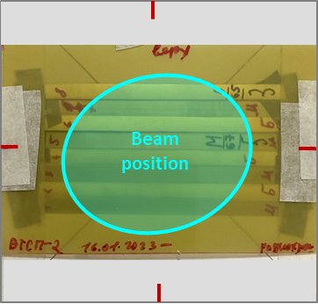
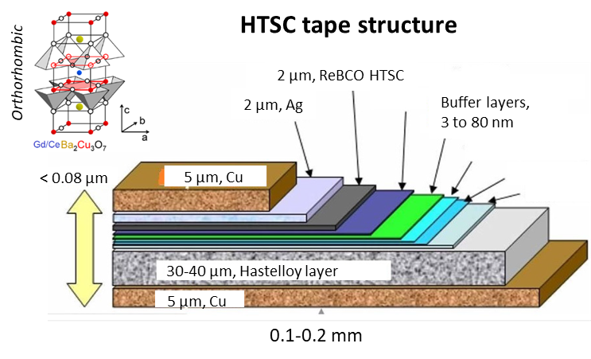
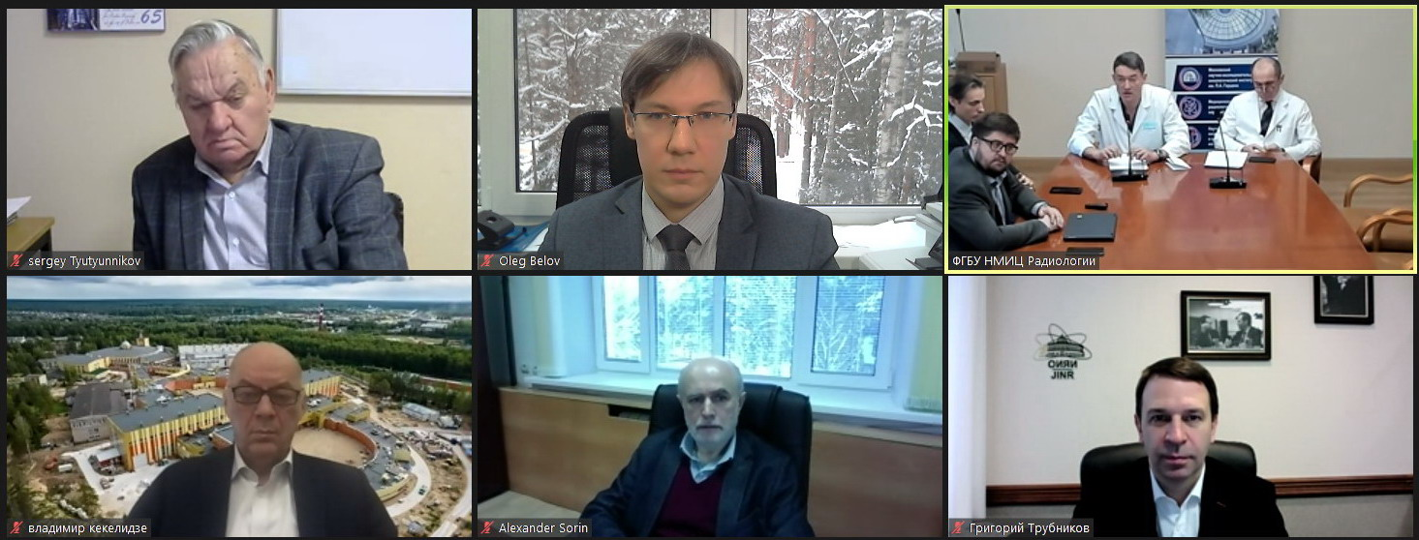
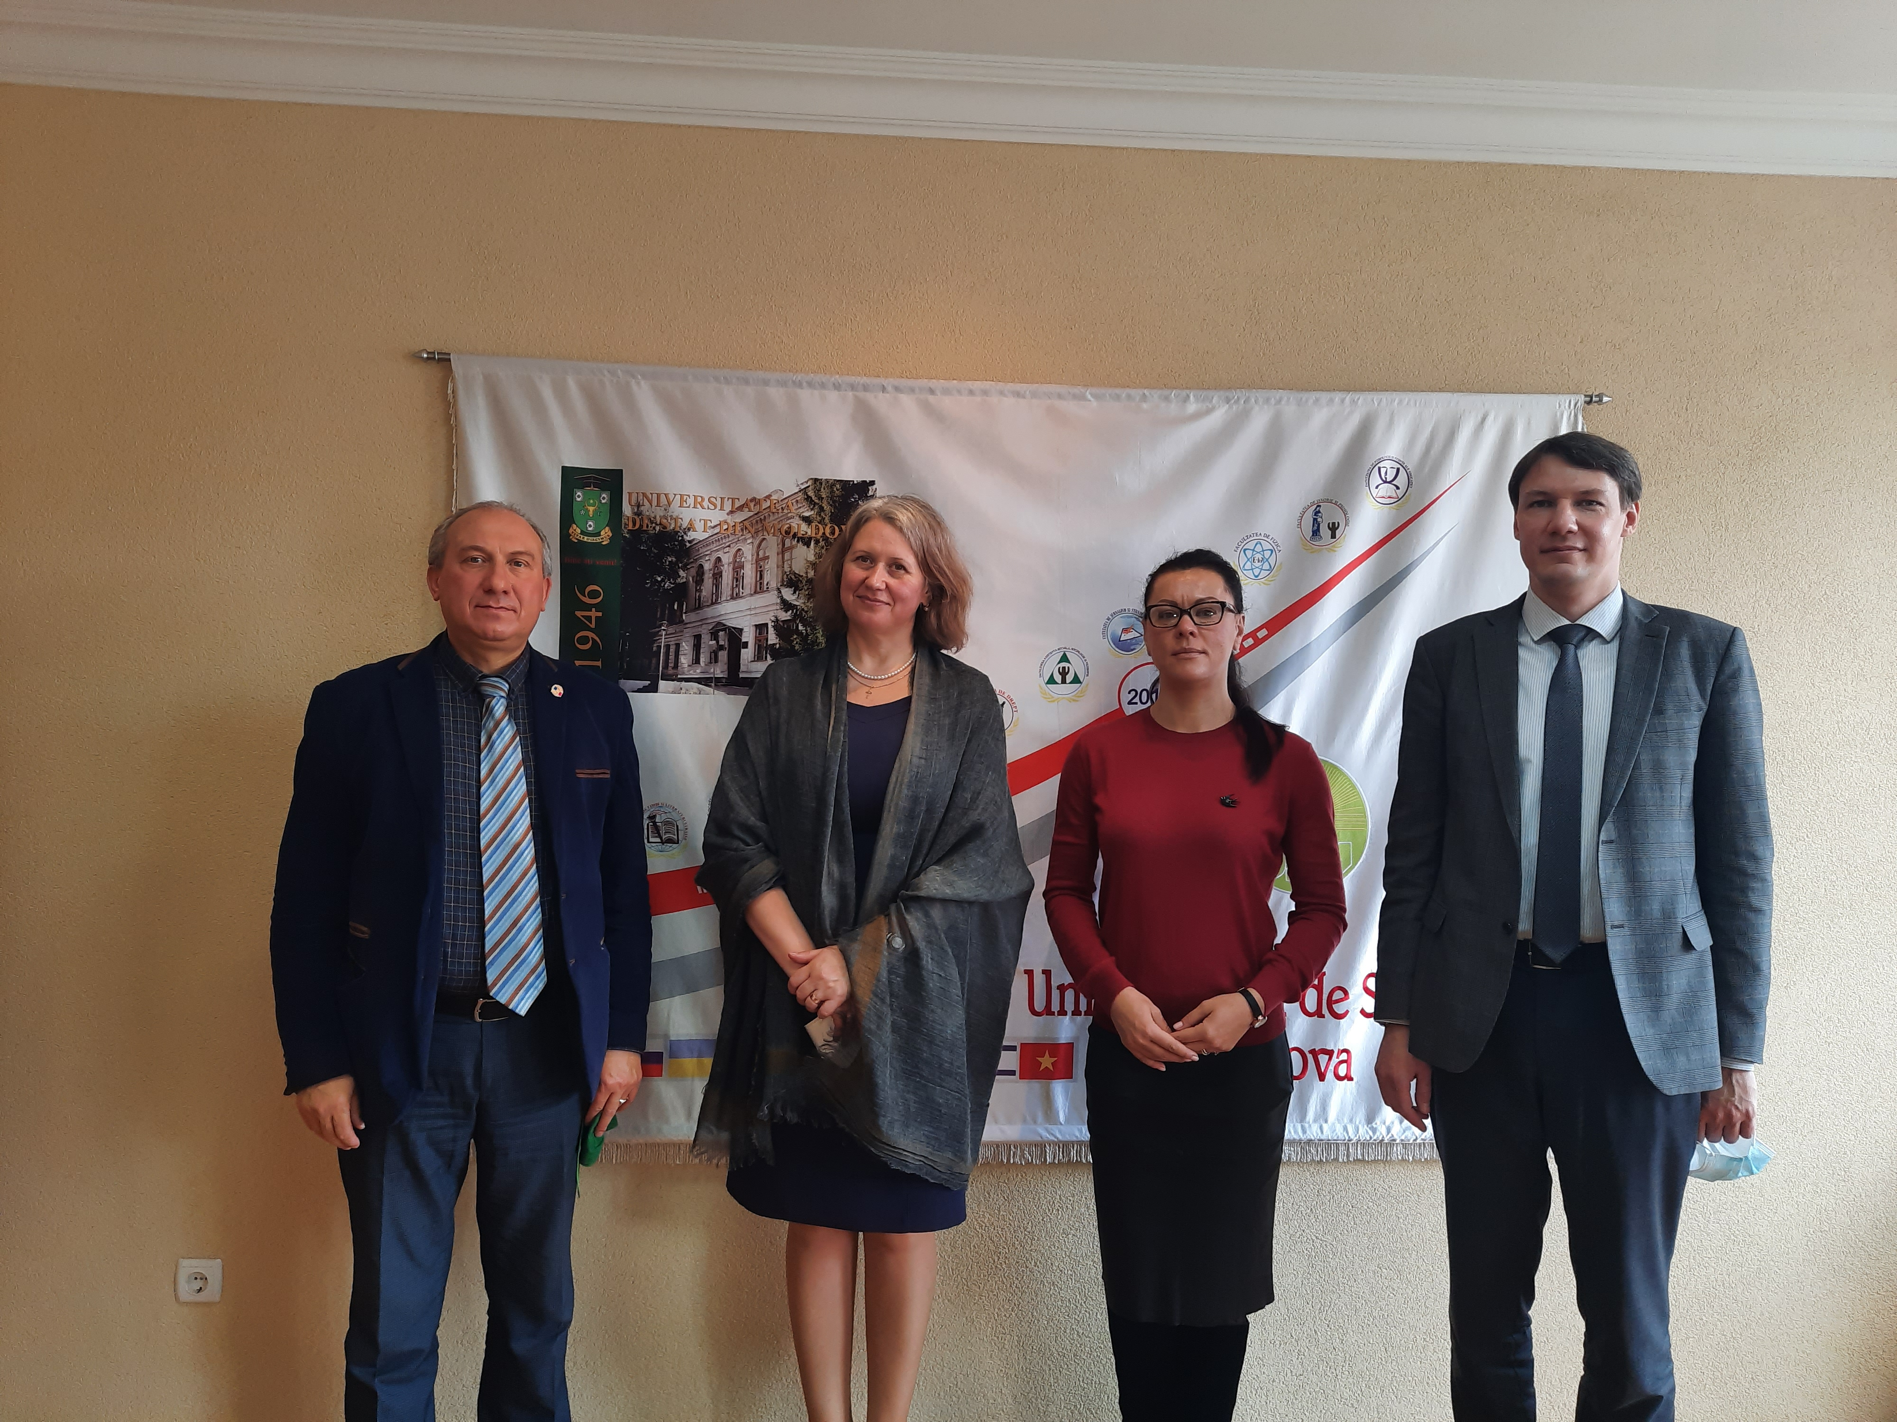
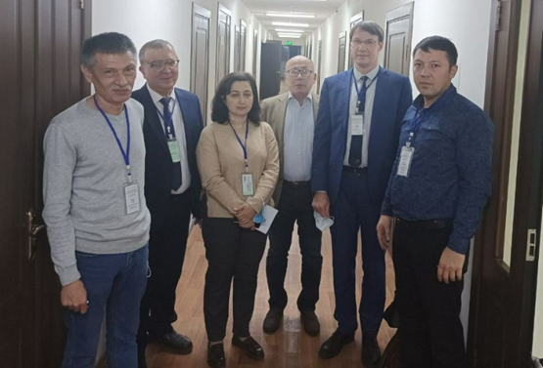
Status of the ARIADNA Research Programme @ NICA
ARIADNA – Applied Research Infrastructure for Advanced Developments at NICA fAcility
First High-energy Beam for Applied Research @ NICA
The Research Programme
is STARTED
Radiation Materials Science
Sapphire samples
¹²⁴Xe⁵⁴⁺
3.8 GeV/nucleon
Beam profile
A = 34.2 mm
B = 29.3 mm
The most uniform area:
a = 12.0 mm
b = 9.0 mm
B
First run: 11 December 2022
– 30 January 2023
A
a
b
Beam trace at the
EBT3 radiochromic film
Composite Materials
Development of ARIADNA Collaborations
Composition of collaboration: 21 institution;
Total number of participants (as of 6 September 2023): 157.
Beam dump
Beam direction
ISS
ROSS
Composite material at ISS
New composite material
for ROSS
FHCal
Radiation Modifications
In High-temperature Superconductors
Installation of dosimetry equipment and samples to ARIADNA target station in BM@N zone

Slide 6
ARIADNA collaborations for applied research at NICA
ARIADNA-LS Collaboration | ARIADNA-MSTE Collaboration | ARIADNA-NPT Collaboration
The Collaboration is being established in order to perform experiments in the field of life sciences at the NICA Complex with the ARIADNA beamlines | The Collaboration is being established in order to perform activities and experiments in radiation materials science and radiation testing of electronics at the NICA Complex with the ARIADNA beamlines | The Collaboration is being established in order to facilitate novel developments for nuclear technology at the NICA Complex with the ARIADNA beamlines
Collaborating organizations
Joint Institute for Nuclear Research (Dubna, Int.)
Institute of Biomedical Problems, RAS (Moscow, Russia)
Burnasyan Federal Medical Biophysical Center of Federal Medical Biological Agency (Moscow, Russia)
Skobeltsyn Research Institute of Nuclear Physics, Moscow State University (Dubna, Russia)
Saint Petersburg State University (Saint Petersburg, Russia)
Tsyb Medical Radiological Research Centre (Obninsk, Russia)
Semenov Research Center of Chemical Physics, RAS (Moscow, Russia)
Institute of Theoretical and Experimental Biophysics, RAS (Moscow, Russia)
Moscow Institute of Physics and Technology (Dolgoprudny, Russia)
Kurnakov Institute of General and Inorganic Chemistry, RAS (Moscow, Russia)
National Research Nuclear University MEPhI (Moscow, Russia)
Joint Institute of High Temperatures, RAS (Moscow, Russia)
North Ossetian State University (Vladikavkaz, Russia)
CANDLE SRI, Yerevan, Armenia
Yerevan State University, Yerevan, Armenia
Institute of Molecular Biology, Yerevan, Armenia
Institute of Nuclear Problems of the Belarusian State University (Minsk, Belarus)
Institute of Nuclear Physics, AS RUz (Tashkent, Uzbekistan)
LLC Research and production company “Kvant-R” (Moscow, Russia)
LLC “S-Innovations” (Moscow, Russia)
LLC “SOL-Instruments” (Minsk, Belarus)
157 participants

Slide 7


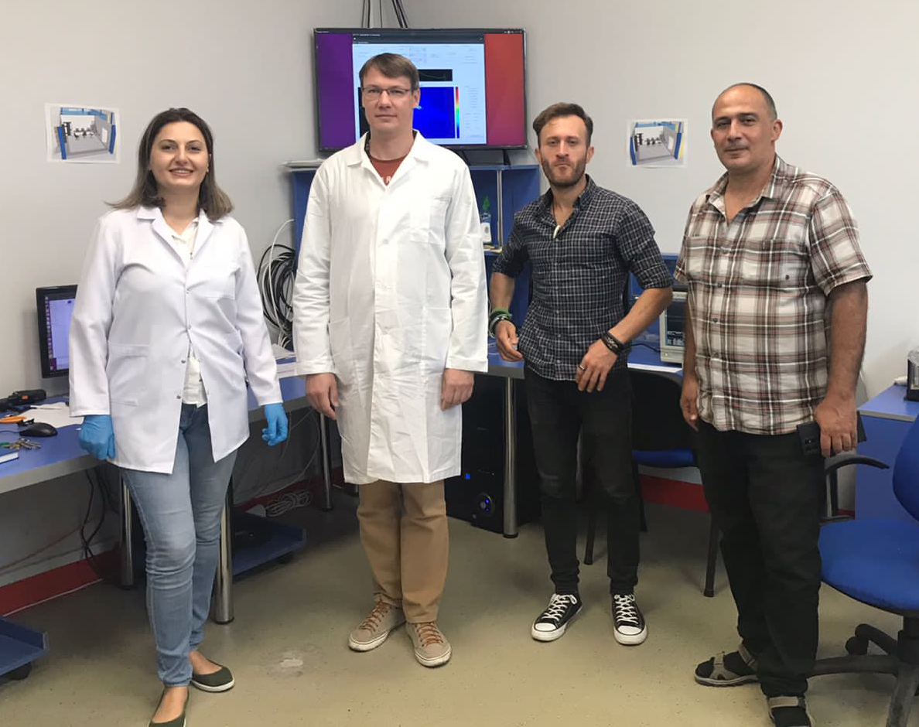
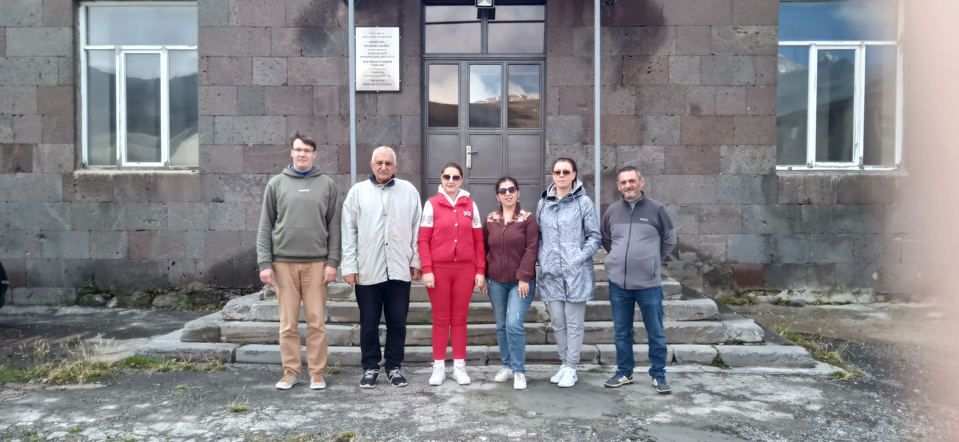
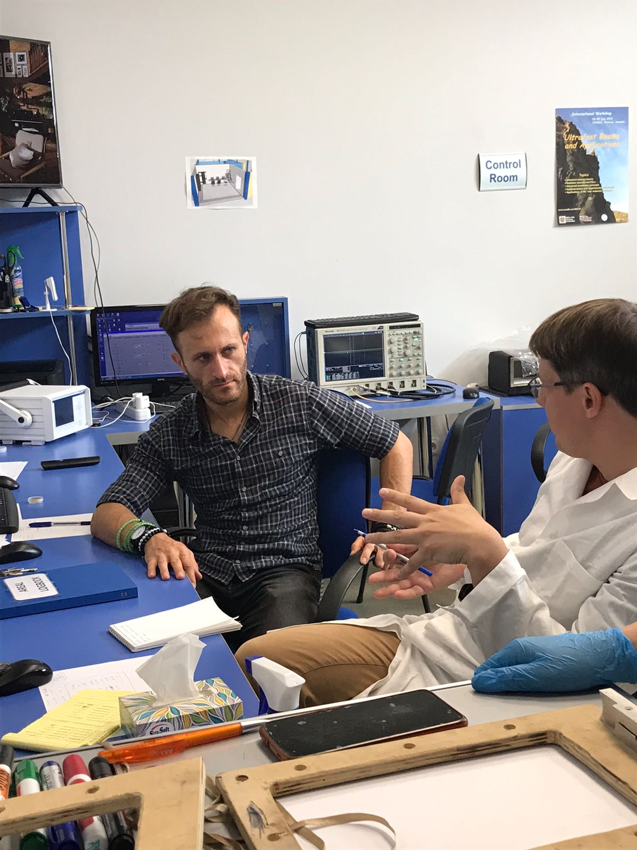
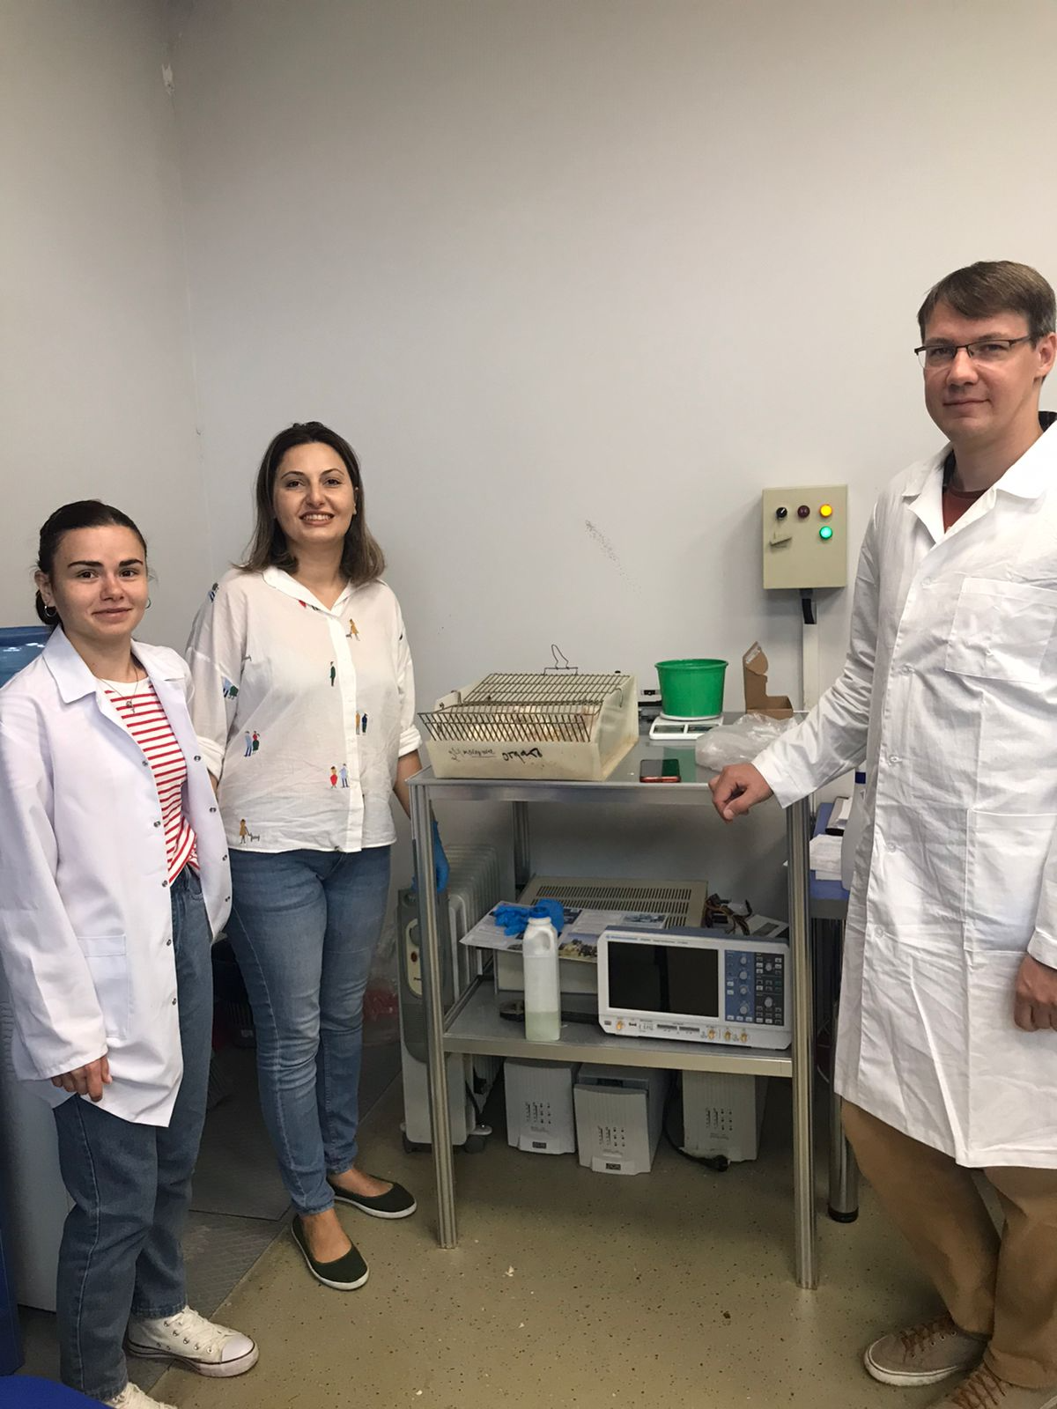
Armenian institutions in joint experiments within
the ARIADNA Collaboration
In April 2023, ARIADNA established contacts with several institutions of Armenia.
Later on, 3 institutions entered a close cooperation with ARIADNA: Yerevan State University, CANDLE SRI and Institute of Molecular Biology.
In September – October 2023, visiting experiments and series of research visits were organized.
Joint experiment between CANDLE SRI, IMB and JINR within the ARIADNA collaboration (October – December 2023)
Visit of delegations of CANDLE SRI and JINR to Aragats Research Station of Yerevan Physics Institute (September 2023)

Slide 8

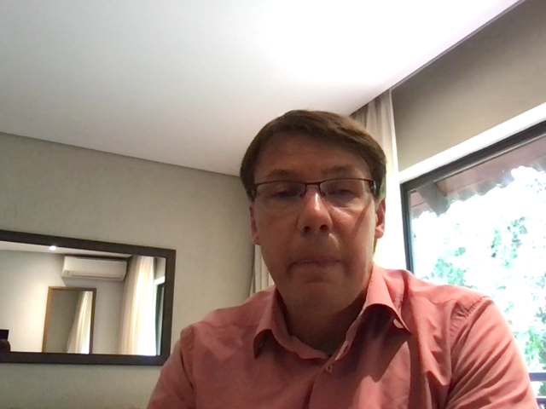
ARIADNA access
Both academic and industrial groups are eligible to access the ARIADNA infrastructure.
A correspondingng user policy at NICA is under development, which includes regulations on equipment use, bioethics, access to beamlines and to supportive user infrastructure, etc.
Funding opportunities can also be provided on the basis of special-purpose grant programs launched for NICA by external funding agencies.
Main counterpart from ARIADNA users: results need to be published!

Slide 9
Ways of getting involved
in ARIADNA
As a member of ARIADNA collaboration: get in touch with us and we will provided instructions on signing an MoU to become a member of the collaboration.
As a user: just prepare and submit you proposal for consideration.
As an ARIADNA partner: let us know how you think you/your research team or company can contribute to ARIADNA and we can prepare a relevant application to be discussed with NICA management.

Slide 10
Thank you for your attention
Thank you for your attention
Contact information:
Oleg Belov
Veksler and Baldin Laboratory of High Energy Physics,
Joint Institute for Nuclear Research
E-mail: oleg.belov@jinr.int

