Slide 1
Work 24-28/03/24

Slide 2
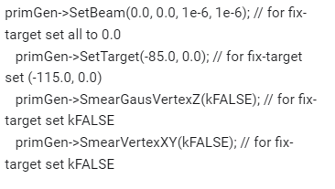
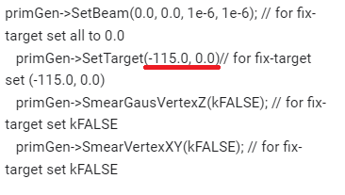
Configuration
runMC.C modification
Transport and Reconstruction
For 10k Steps
UrQMD Config (Fixed Target Mode)
Xe(A=124)+W Collisions at T = 2.5 GeV*A
1k inputfiles with 100 events each. Total 100k events
MPDRoot Config (Fixed Target Mode)
We made 2 configurations to work with fragments/nuclei, modifying GENT 4 Steps
geant4->SetMaxNStep(10000); (10k)
geant4->SetMaxNStep(500000); (500k)
For 500k Steps

Slide 3
Total of files processed with MDPRoot
With Steps = 10k
All files were process. Total events = 100k
With Steps = 500k
Just 81 files were process. Total events = 8.1k

Slide 4
10k Steps

Slide 5
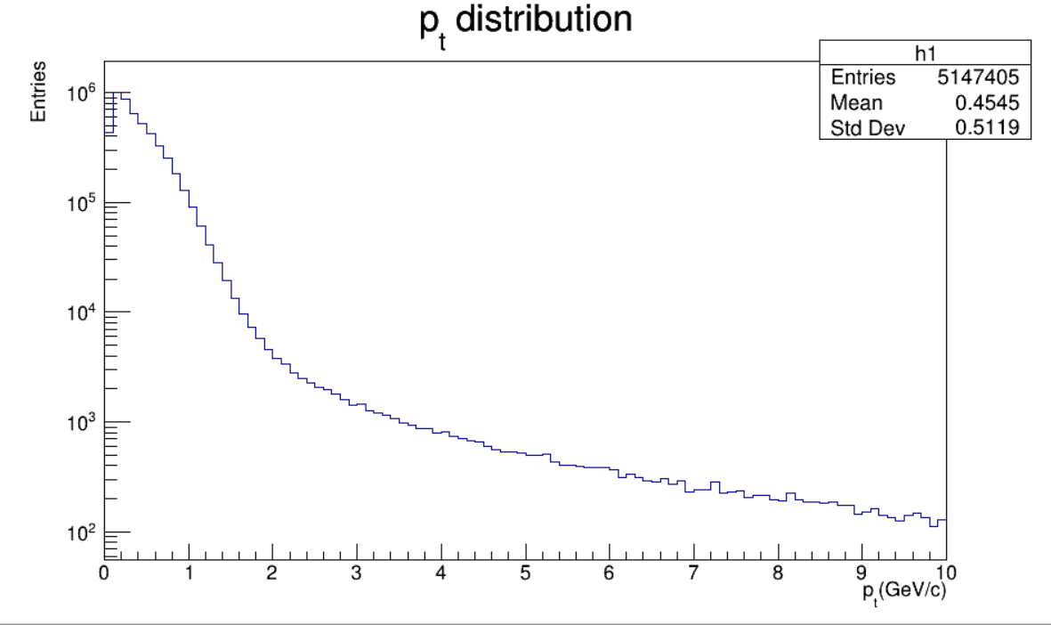
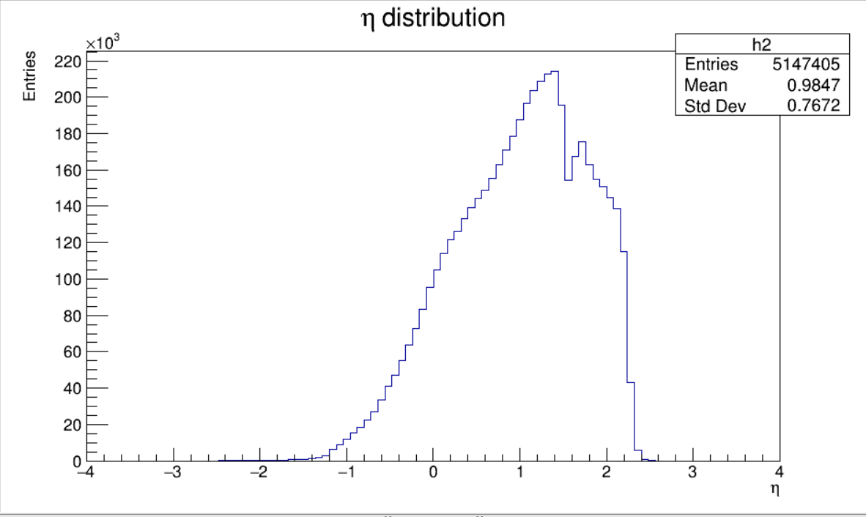
10k steps. Total Events 100k
MpdGlobalTracks
PT Histogram
Eta Histogram

Slide 6
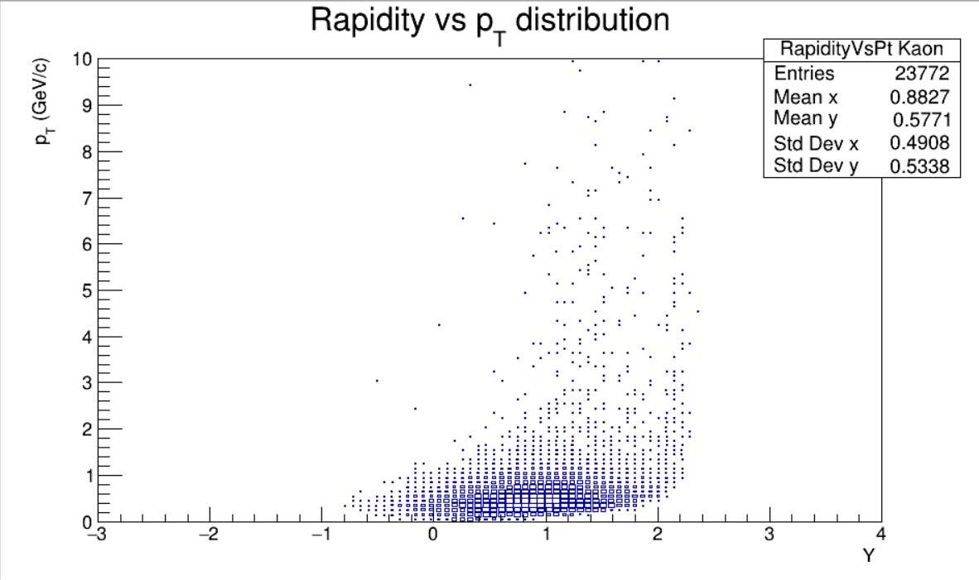
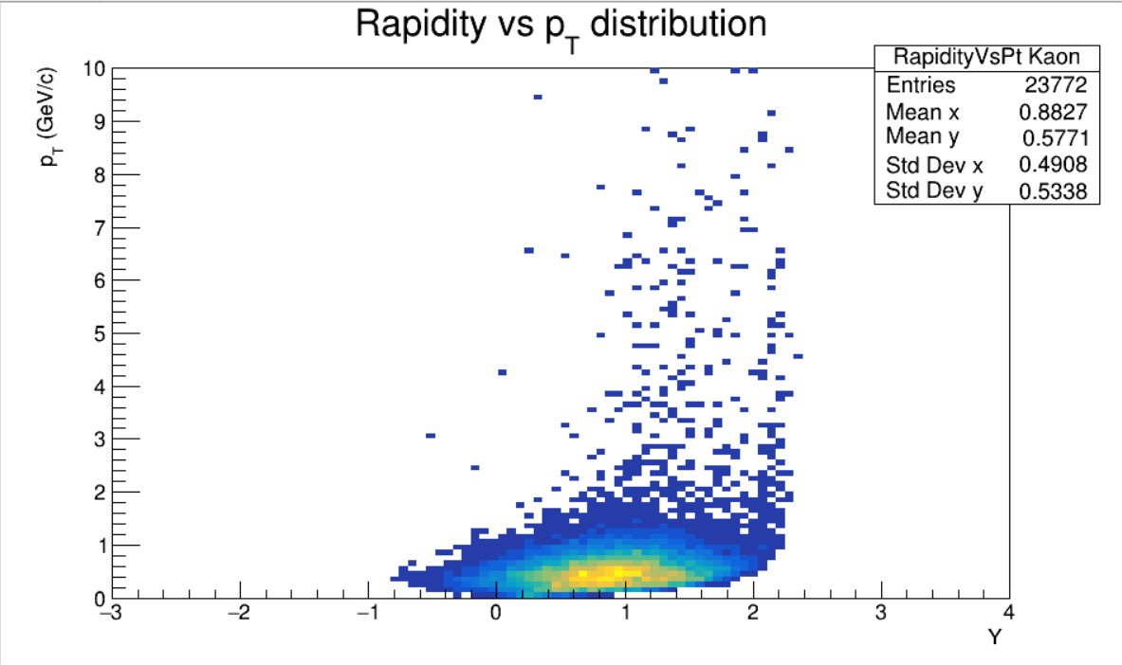
10k steps. Total Events 100k
Kaon Rapidity Vs Pt Histogram
MpdGlobalTracks with MC association
About 0.237 Kaons per event

Slide 7
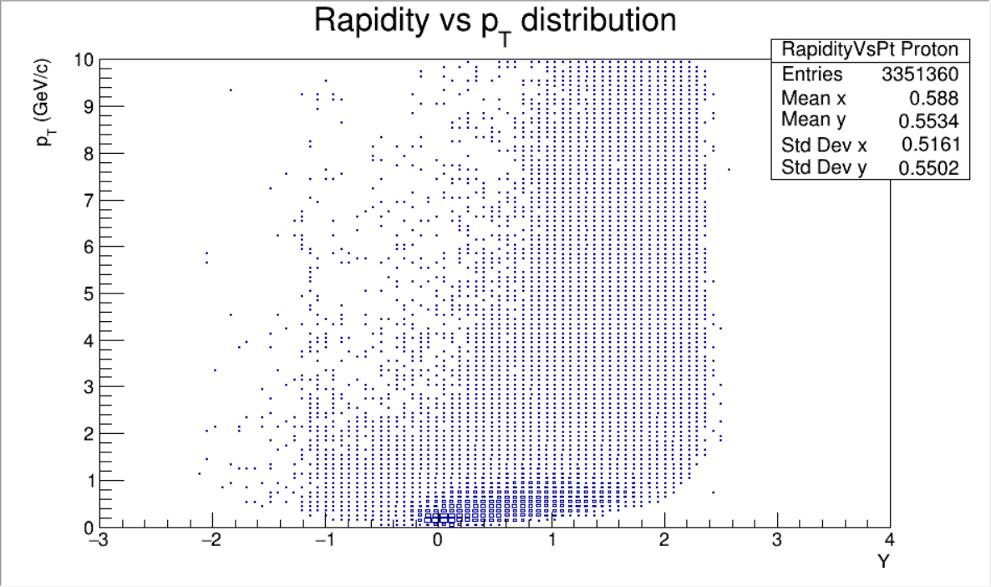
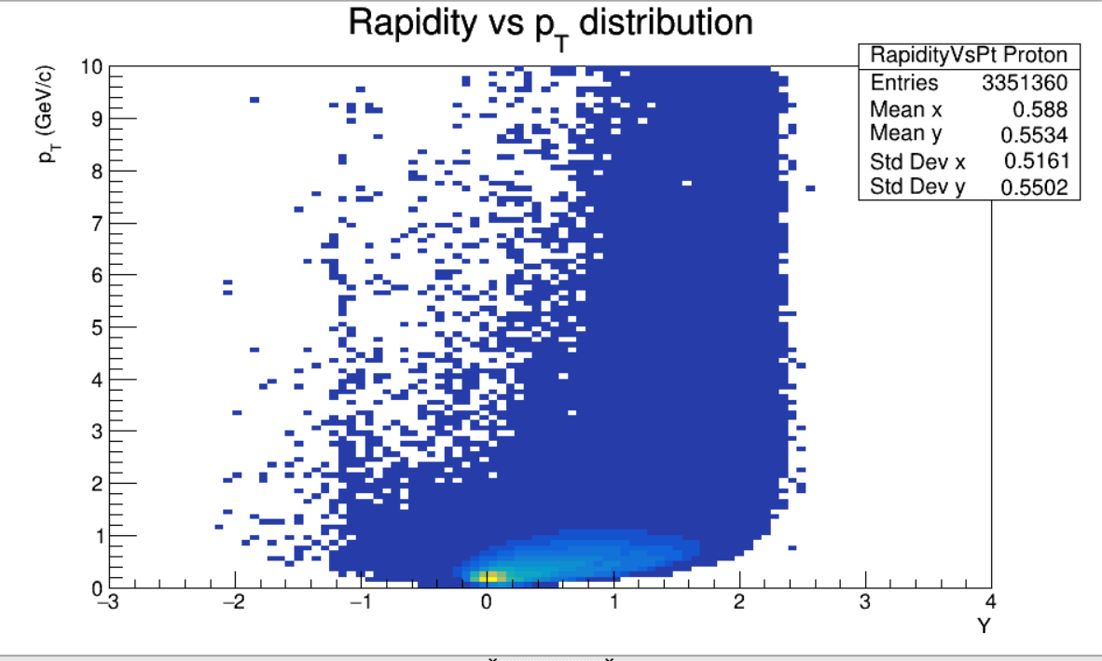
10k steps. Total Events 100k
Proton Rapidity Vs Pt Histogram
MpdGlobalTracks with MC association
About 33.51 Protons per event

Slide 8
500k Steps

Slide 9
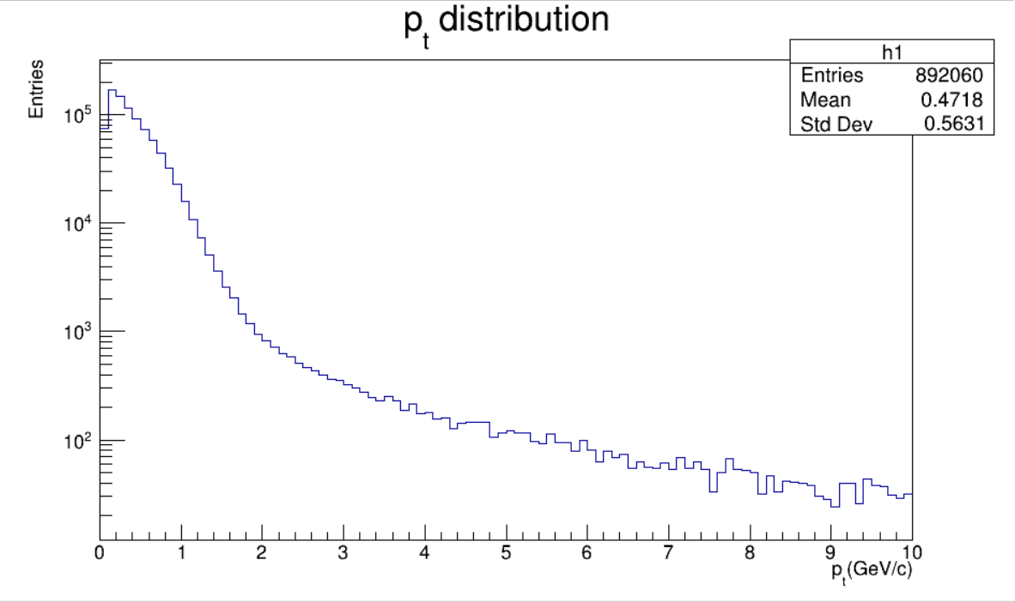
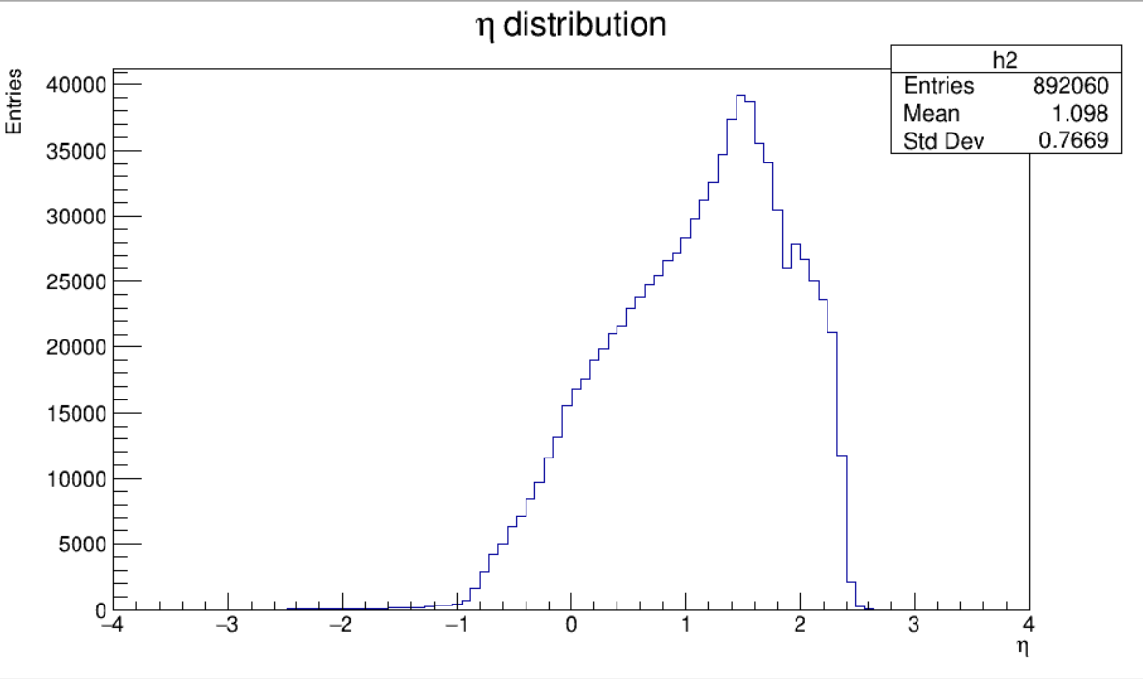
500k steps. Total Events 8.1k
Pt Histogram
Eta Histogram

Slide 10
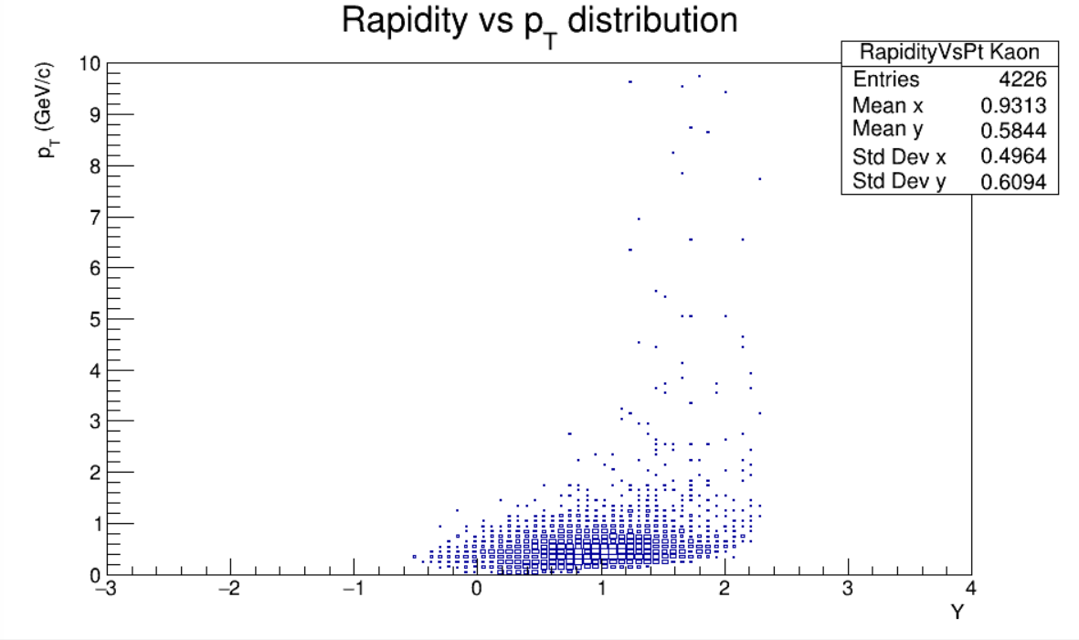
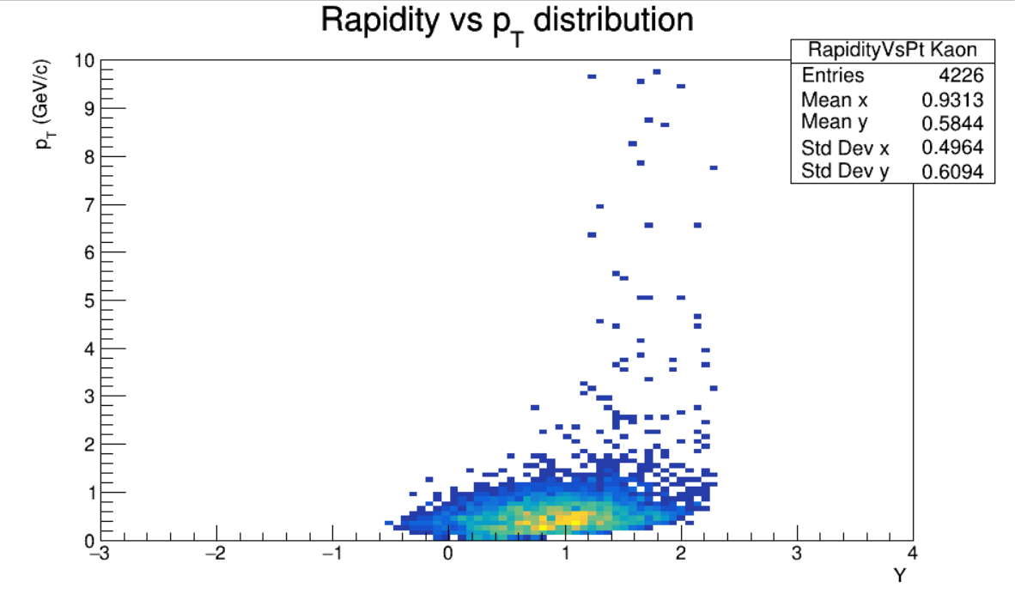
500k steps. Total Events 8.1k
Kaon Rapidity Vs Pt Histogram
MpdGlobalTracks with MC association
About 0.521 Kaons per event

Slide 11
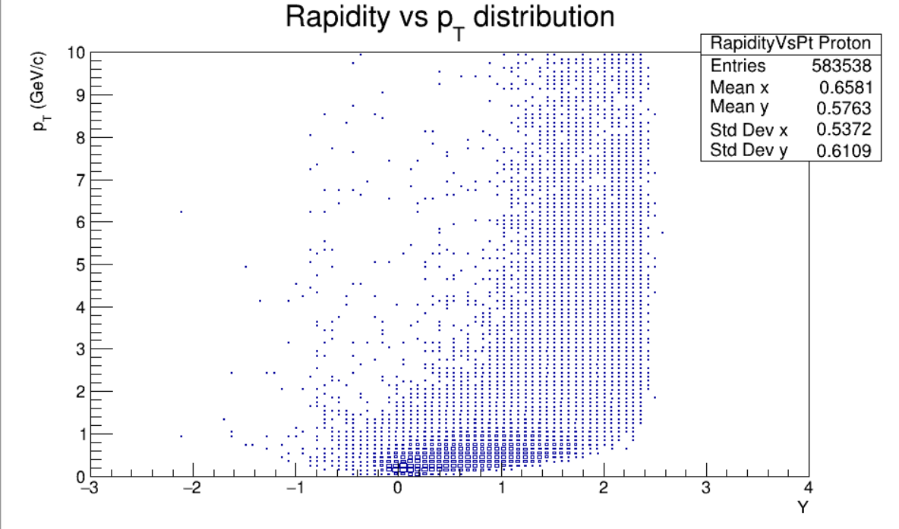
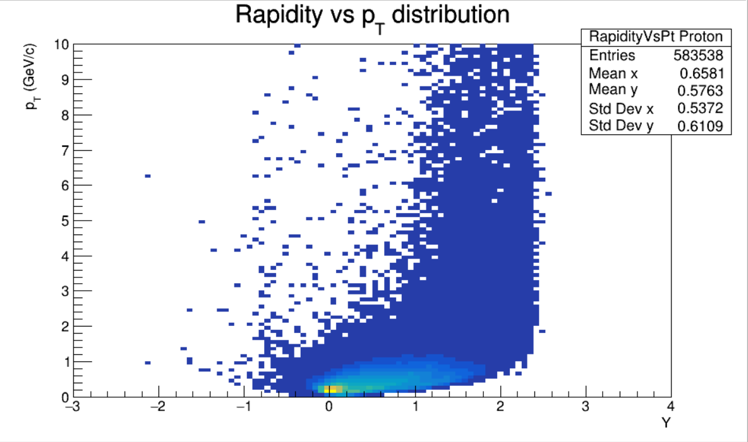
500k steps. Total Events 8.1k
Proton Rapidity Vs Pt Histogram
MpdGlobalTracks with MC association
About 72.04 Protons per event

Slide 12
THANK YOU
Adrián Lara Tlaxcala
adrian_ltz@ciencias.unam.mx

