Slide 1
a₀ baseline
Novel dE/dx particle ID idea
C++ solutions Center “walk”

Slide 2
Contents
Energy loss - dE/dx @ SPD
Trajectory - math problem
Visible deviation, spirality
AI implementation plans
Conclusion

Slide 3
Contents
Energy loss - dE/dx @ SPD
Trajectory - math problem
Visible deviation, spirality
AI implementation plans
Conclusion

Slide 4
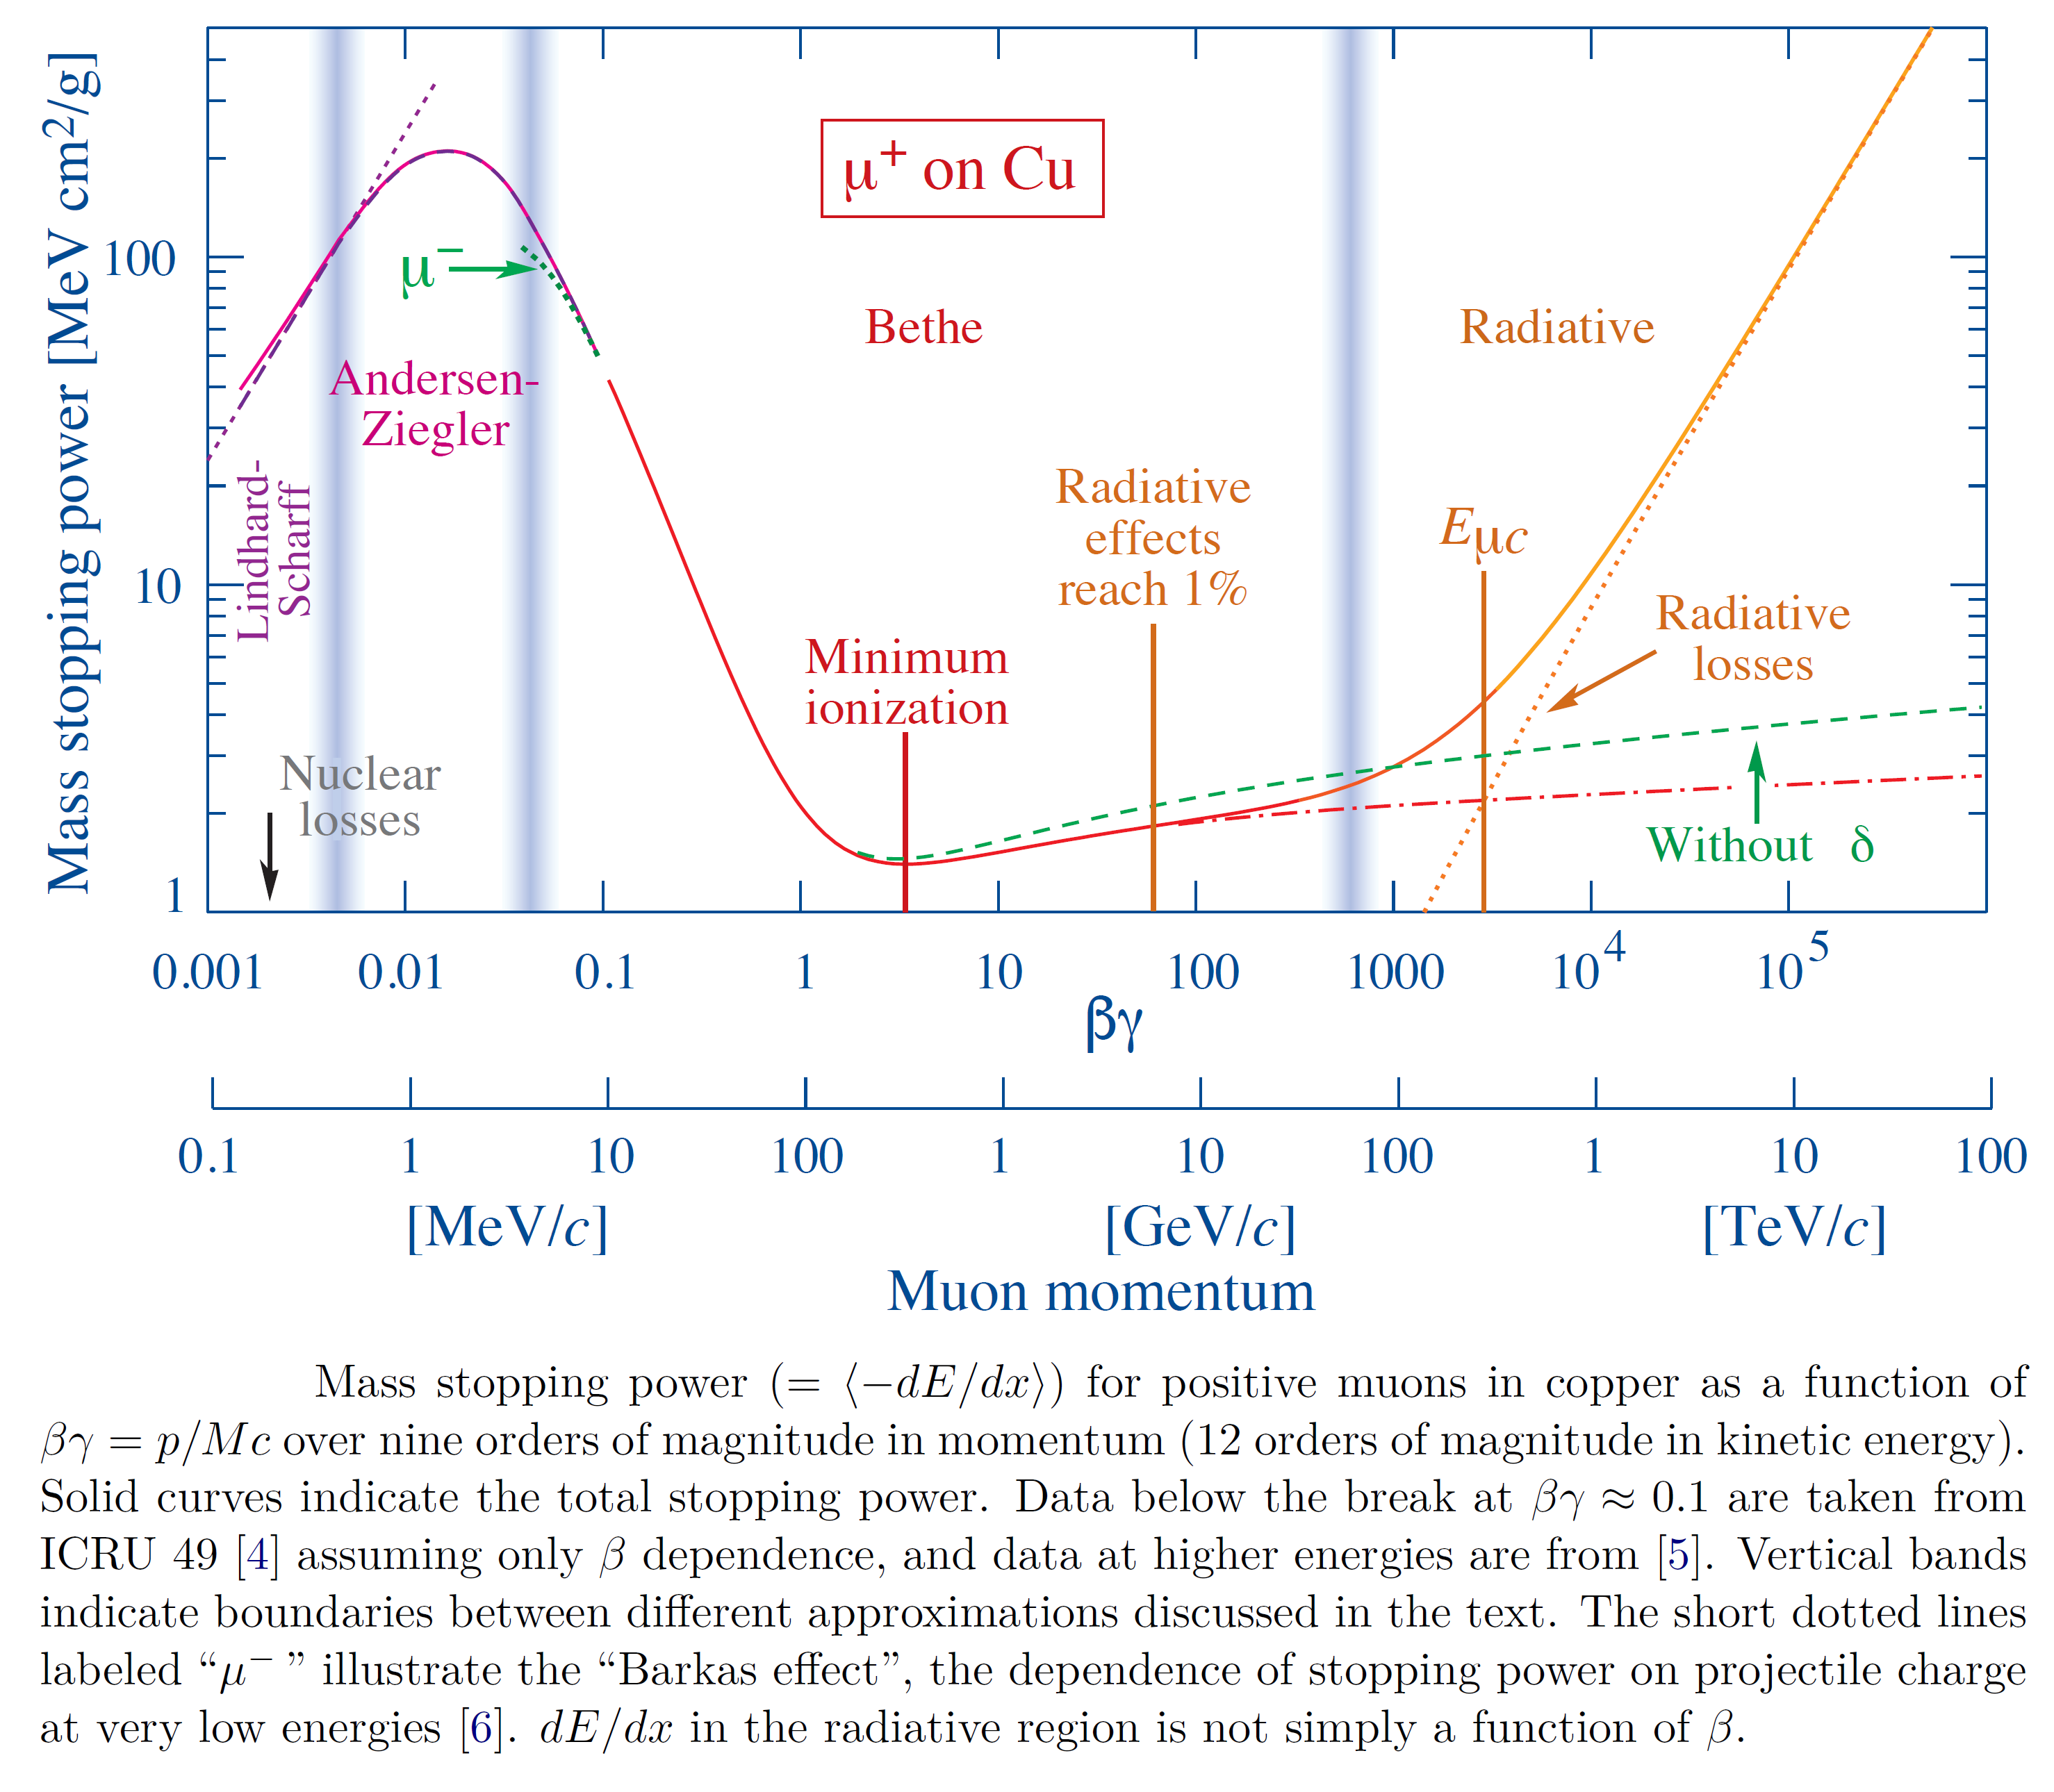
dE/dx @ SPD straw tracker
Bethe-Bloch formula for dE/dx
SPD Straw Tracker
SPD
K = 1.5 … 20 keV/cm

Slide 5
Contents
Energy loss - dE / dx @ SPD
Trajectory - math problem
Visible deviation, spirality
AI implementation plans
Conclusion

Slide 6
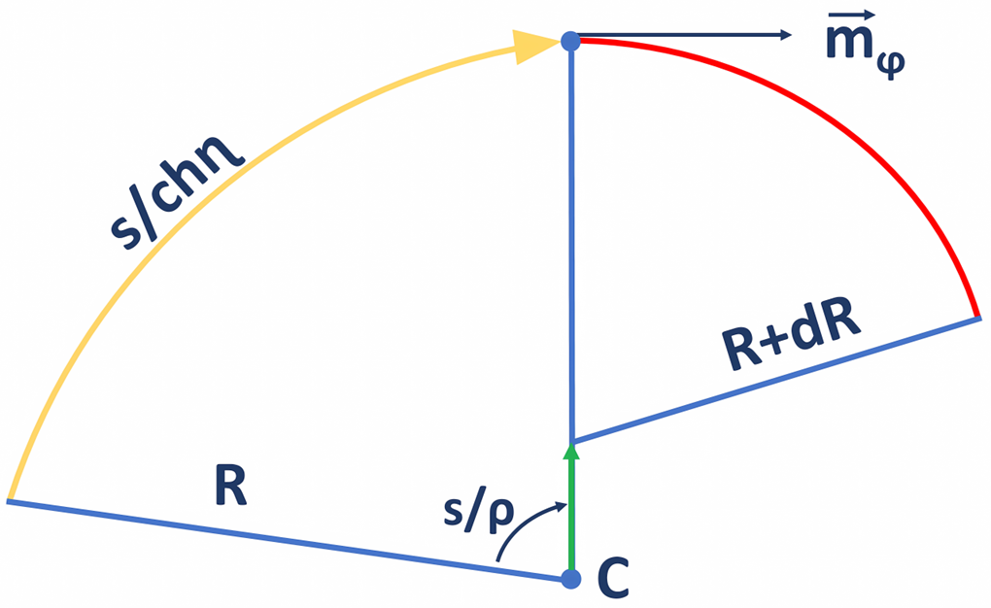
Math problem
Center “walking”

Slide 7
Math problem
Center “walking”
… integrate the center-walk:

Slide 8
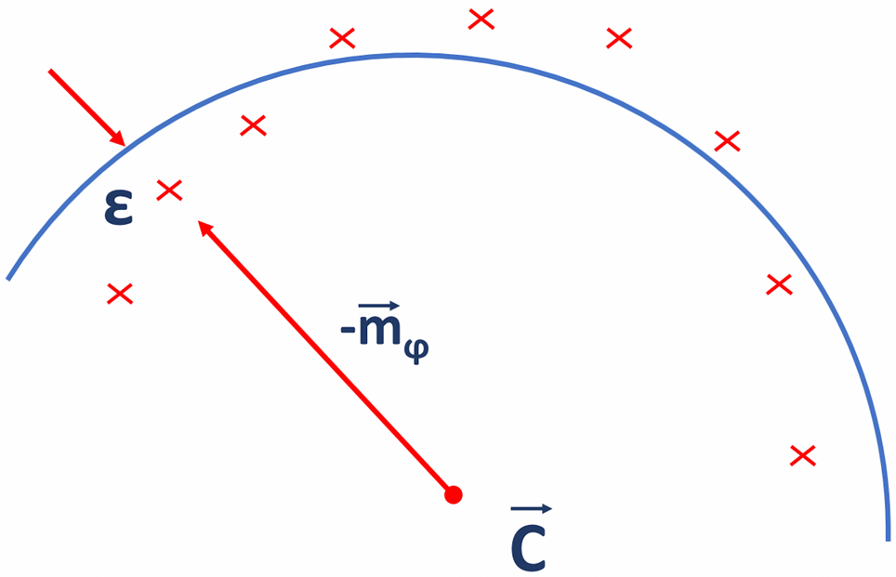
Math problem
“spirality” = dE/dx track – lossless track

Slide 9
Math problem
“spirality” = dE/dx track – lossless track

Slide 10
Contents
Energy loss - dE / dx @ SPD
Trajectory - math problem
Visible deviation, spirality
AI implementation plans
Conclusion

Slide 11
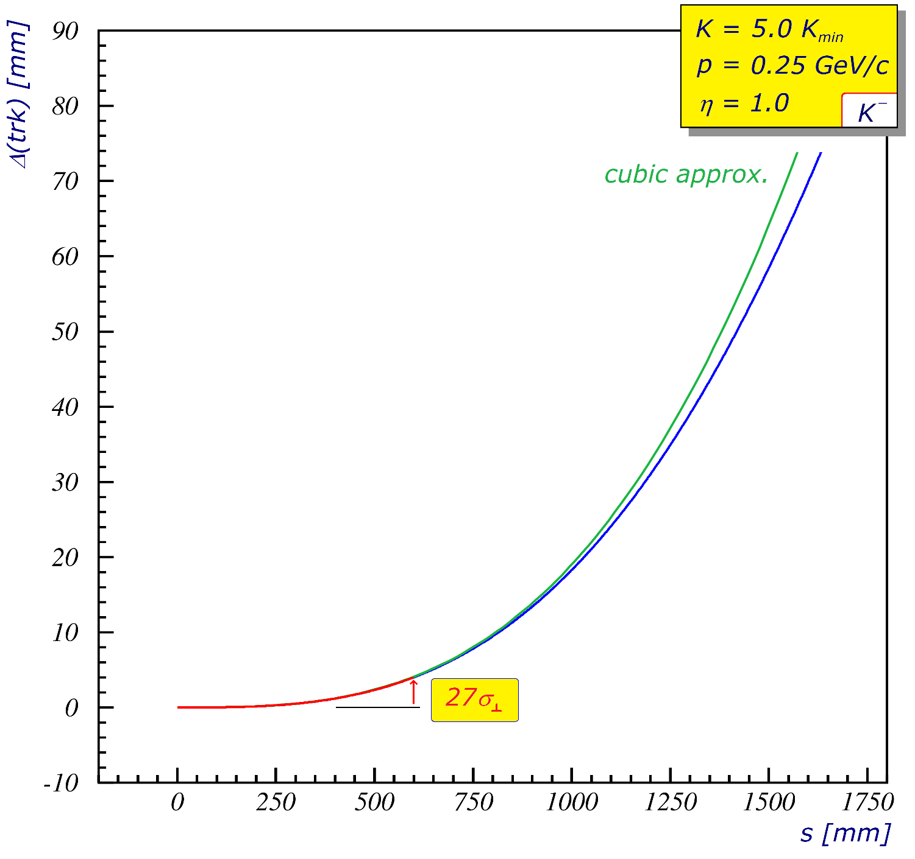
Visible deviation, spirality
deviation from no loss track = visible
within tracker vol. = 0 … 27σ⊥

Slide 12
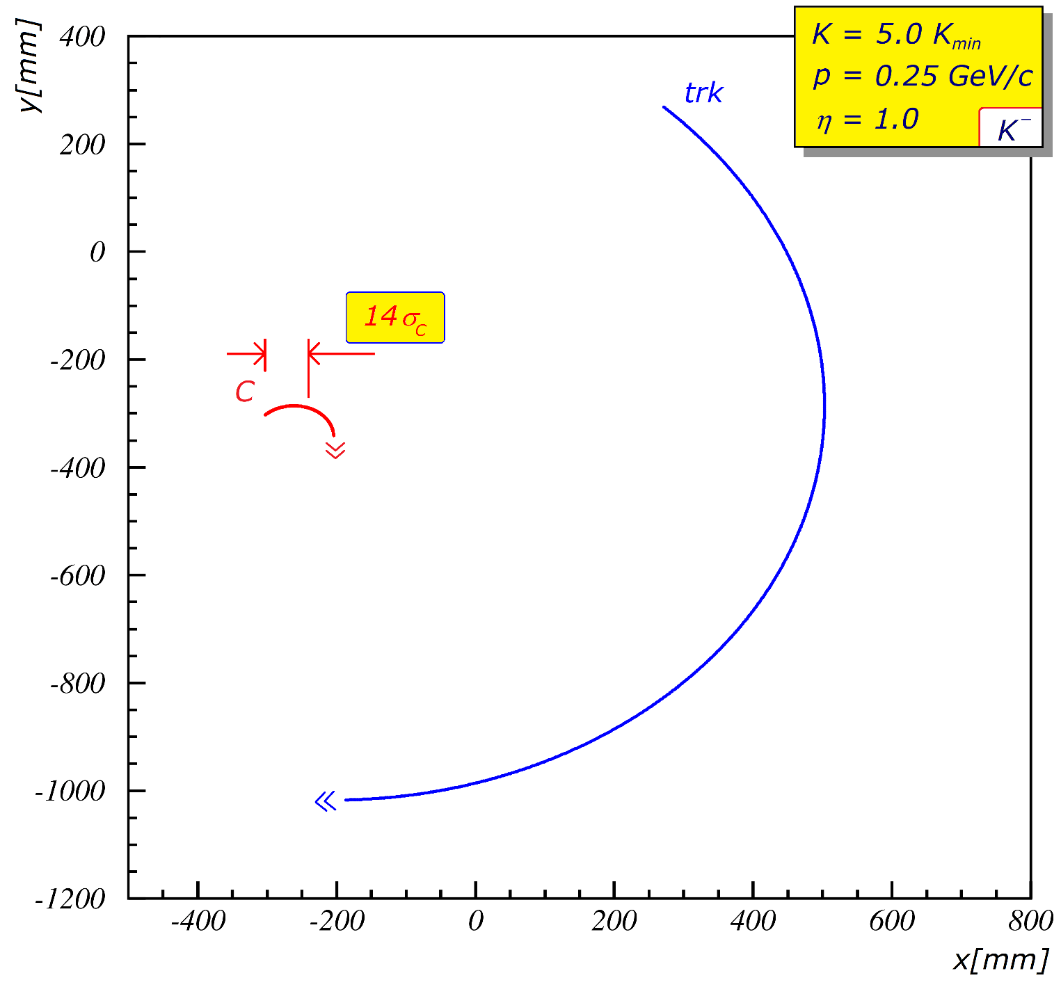
Visible deviation, spirality
center walk = visible
within tracker vol. = 0 … 14σ_{C}

Slide 13
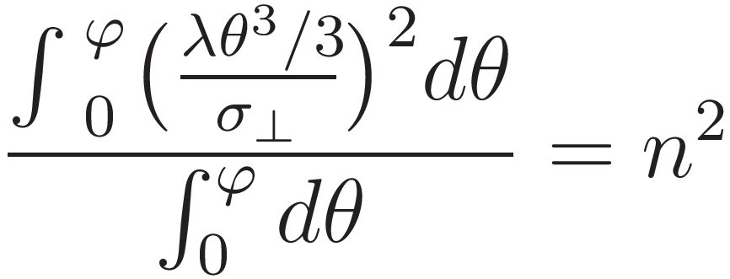
Limits …
… an nσ measurement
intersect functions & find limit

Slide 14
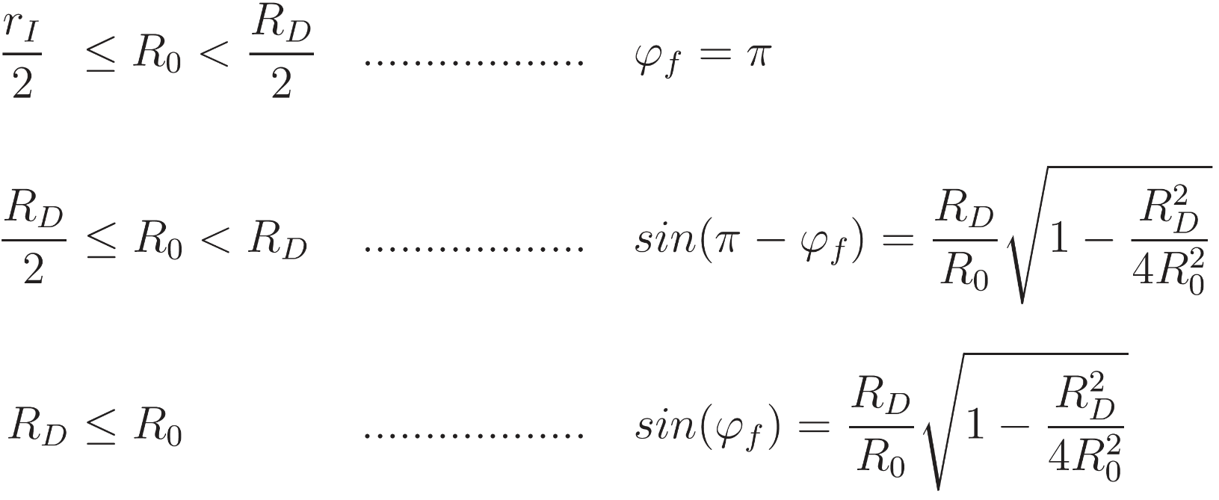
Limits …
… more detailed ϕ estimate

Slide 15
Contents
Energy loss - dE / dx @ SPD
Trajectory - math problem
Visible deviation, spirality
AI implementation plans
Conclusion

Slide 16
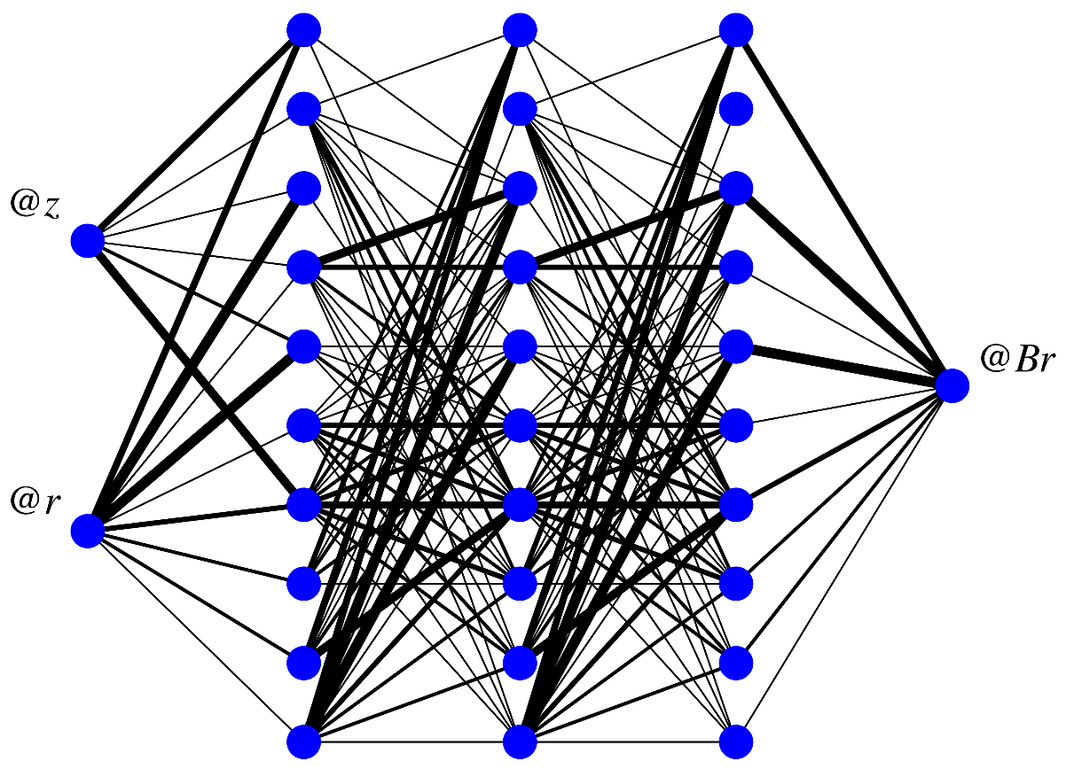
Math problem
Plan
- identify potential features
- spirality
- center walking
- code to obtain them (C++)
- train deep-learning neuro-soft
- test performance

Slide 17
Contents
Energy loss - dE / dx @ SPD
Trajectory - math problem
Visible deviation, spirality
AI implementation plans
Conclusion

Slide 18
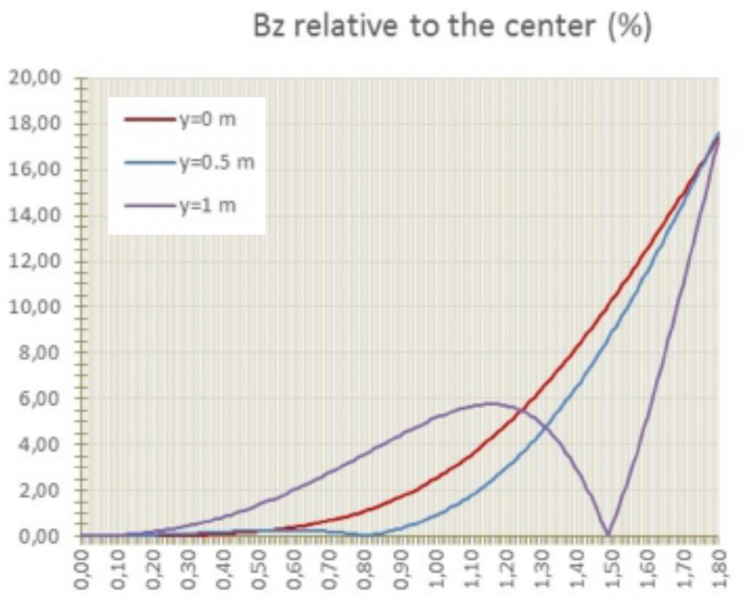
Conclusions
Neuro-soft dE/dx
given estimative resolution: do-able !
relevant features identified:
spirality
center walking
worry about B_{field} non-uniformity
deep-learning neuro-soft trained on those together with relevant contextual info: p, p⊥, χ⊥², χ||²
relevant tests to be performed
Спасибо !

