Slide 1
ALL ALICE subsystems
By Culicov Alexandru

Slide 2
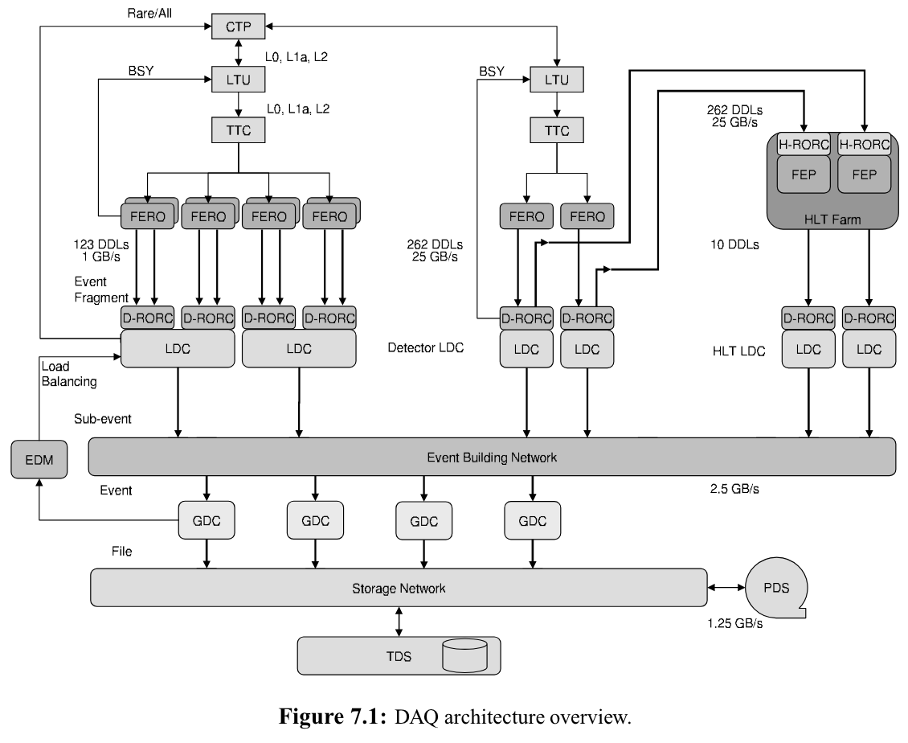
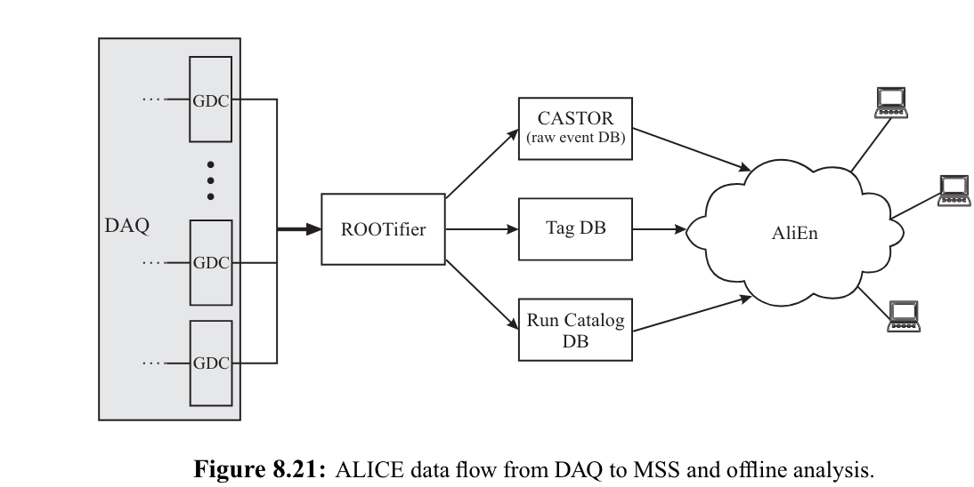
DAQ
The ALICE data storage system comprises the following elements: • The Transient Data Storage (TDS) is made of (arrays of) secondary storage devices (hard disk drives) capable of providing an aggregate sustained data bandwidth of 1.25 GB/s and a total storage capacities of several tens of TB of data. It is used to buffer the data for several hours at the output of the GDC before migration. The TDS is located in the ALICE DAQ counting room. • The Permanent Data Storage (PDS) is made up of (arrays of) tertiary storage devices (magnetic tapes) capable of providing aggregate sustained data bandwidth of 1.25 GB/s and a total storage capacity of several PB of data. It is used for the permanent archiving of raw-physics data migrated from the TDS. The PDS is located in the CERN computing centre. • The Mass Storage System (MSS) is the application interface to the whole storage system. It is a unique file system encompassing the TDS and the PDS and it manages the data flow from the DAQ to the TDS and from the TDS to the PDS.

Slide 3
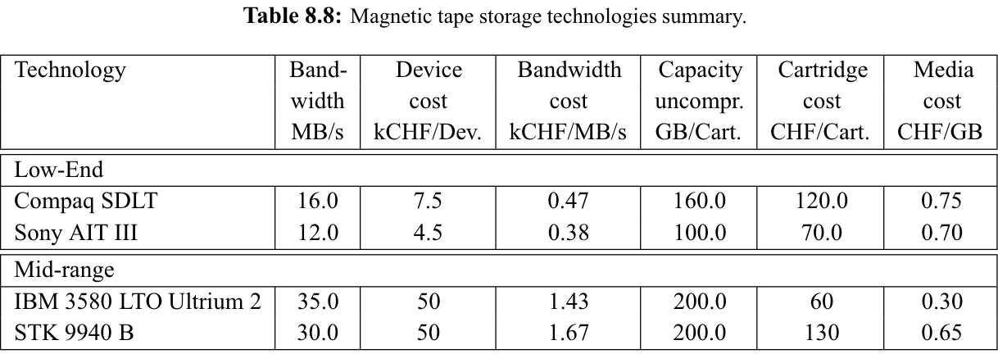
Today, the required bandwidth could be obtained by several dozen mid-range devices. It is expected that a new generation of devices will be available by the time of the LHC heavy-ion run (2008). This new generation will have a performance of the order of 50 MB/s and 500 GB of storage capacity on one media volume. This would lead to a concurrent usage of a few dozen tape drives used in parallel 8.6 Data storage 171 to achieve the required throughput during the ALICE heavy-ion run. This is a realistic and manageable configuration.
Here are presented concrete hardware solutions, like Sony AIT III or IBM 3580

Slide 4
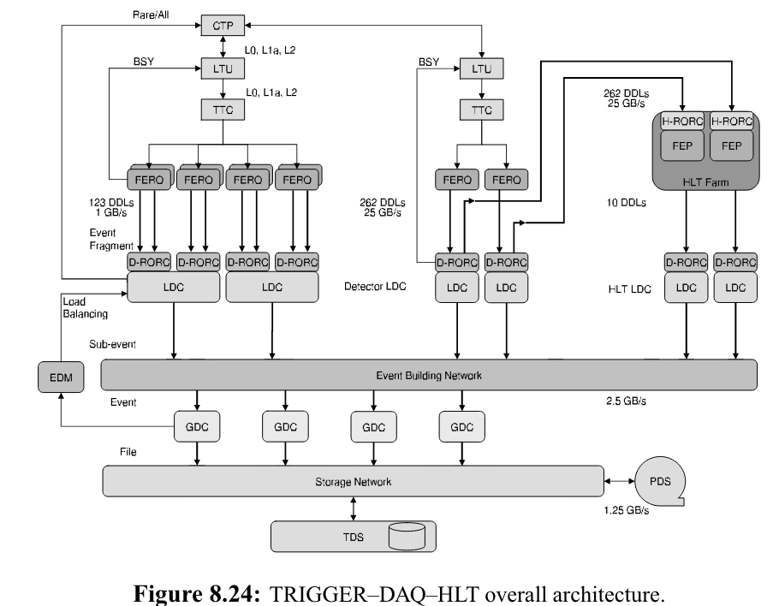
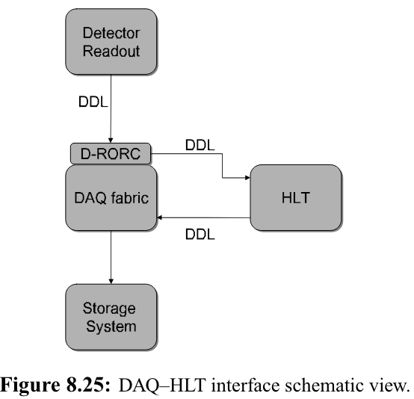
HLT
The task of the HLT system is to select the most relevant data from the large input stream and to reduce the data volume by well over an order of magnitude in order to fit the available storage bandwidth, while preserving the physics information of interest. This is achieved by a combination of event selection (triggering), data compression, or selection of Regions of Interest with partial detector readout. While executing either of these tasks, the HLT may also generate data to be attached to or partially replacing the original event. Care has been taken not to impose any architectural constraints which could compromise the HLT filtering efficiency, knowing that event selection will become more and more elaborated during the experiment lifetime. This way, filtering may be introduced in progressively sophisticated steps without affecting the performance and the stability of the Data-Acquisition system.
DAQ–HLT interface

Slide 5
HLT hardware
HLT Task: Reconstruct ~10000 tracks produced by the charged particles traversing the TPC within ~5 m

Slide 6
DCS
The detector control system (DCS) of ALICE is upgraded to follow the O2 strategy. It is based on the component framework, guidelines, and configurations of a framework named the joint control project (JCOP) [15], which is developed at CERN and provides software tools for DCS development on WinCC Open Architecture (WinCC OA) [16]. The control of FEE employs the GBT slow control adapter (GBT-SCA) [17], which is an application-specific integrated circuit (ASIC), designed for slow control in the framework of the GBT. A
Schematics of the DCS data stream. Control commands are transmitted from WinCC OA to the MFT through the FRED and the FLP. The monitoring data are collected via the same links in the other way, as shown with the blue arrows. A part of DCS data that are temperatures of ALPIDEs share the same packets with the physics data from the MFT to the CRU. The physics data are sent to the O2 farm after splitting from the DCS data at the CRU, while the DCS data come to WinCC OA via Ethernet, as shown with the red arrows.

Slide 7
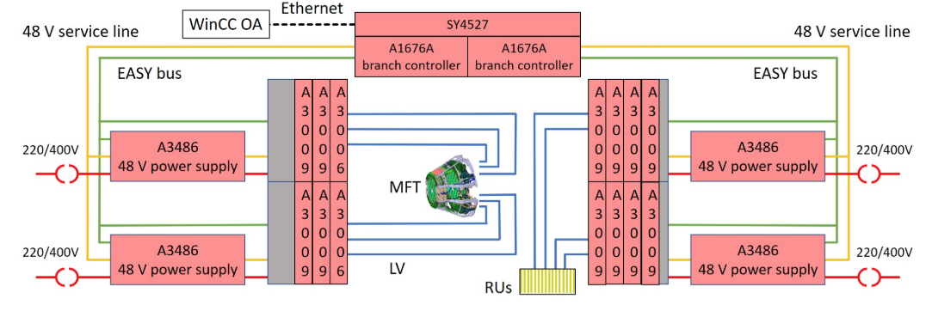
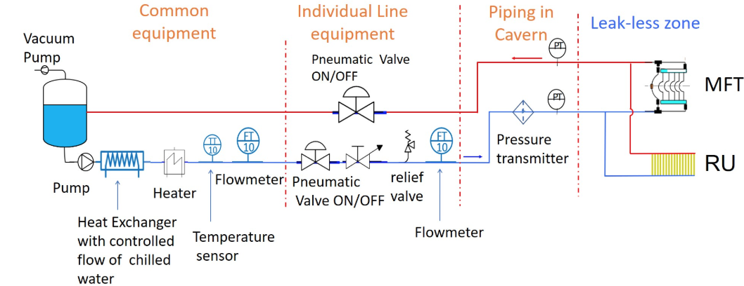
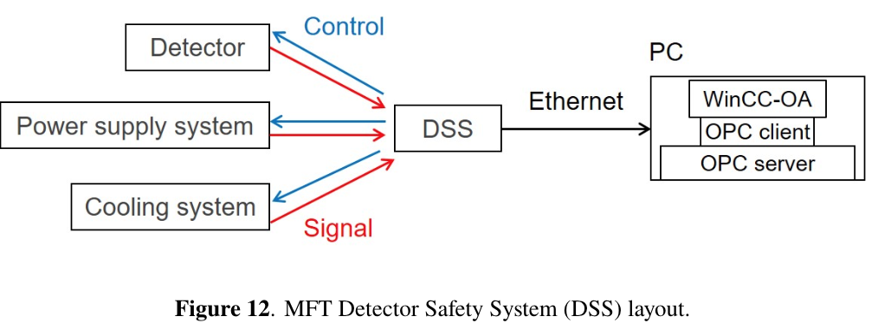
DCS Hardware
Power supply modules manufactured by CAEN [20] are used to supply the low voltage (LV). Figure 6 shows the structure of the LV system of the MFT. WinCC OA connects with an SY4527 mainframe using open platform communications (OPC) via Ethernet. Two branch controllers A1676A in the SY4527 communicate with two power supply systems, one to power the PSUs and the other to power the FEE cards, named the readout units (RUs). These systems are based on the CAEN embedded assembly system (EASY) which is tolerant to radiation and magnetic field. Twelve A3009 power supply boards and two A3006 boards are installed in four EASY3000 crates, which are powered by four A3486 modules to convert 3-phase AC to 48 V DC.
Structure of the power supply system.
Cooling system

Slide 8
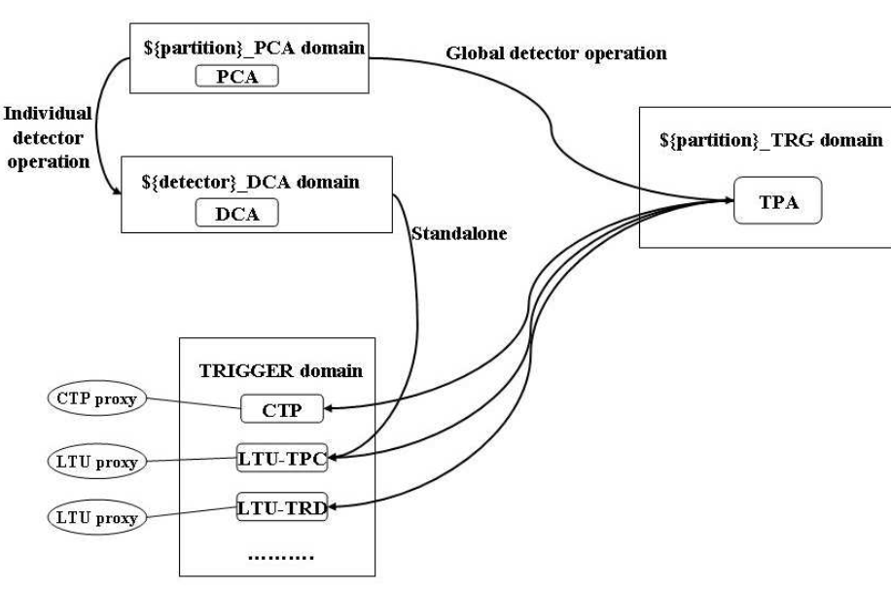
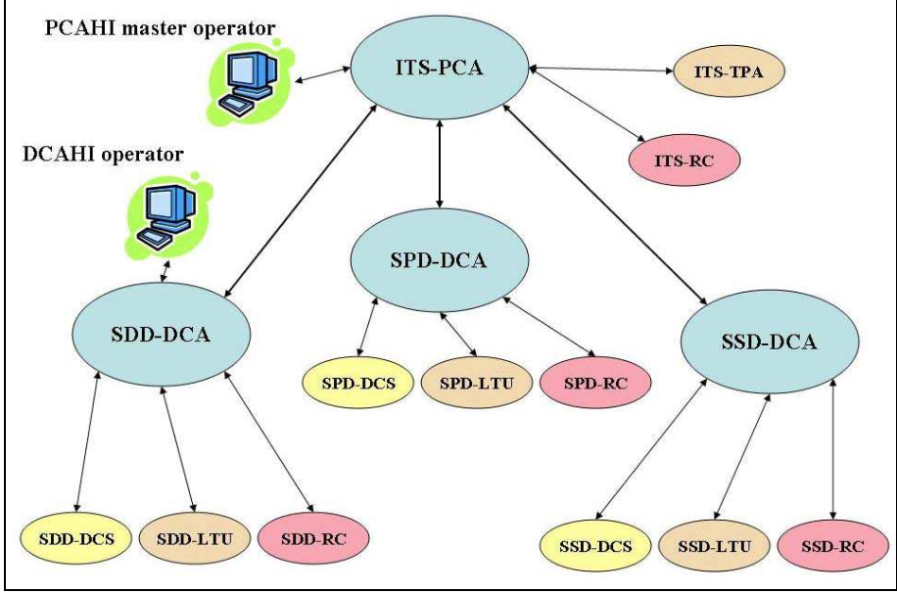
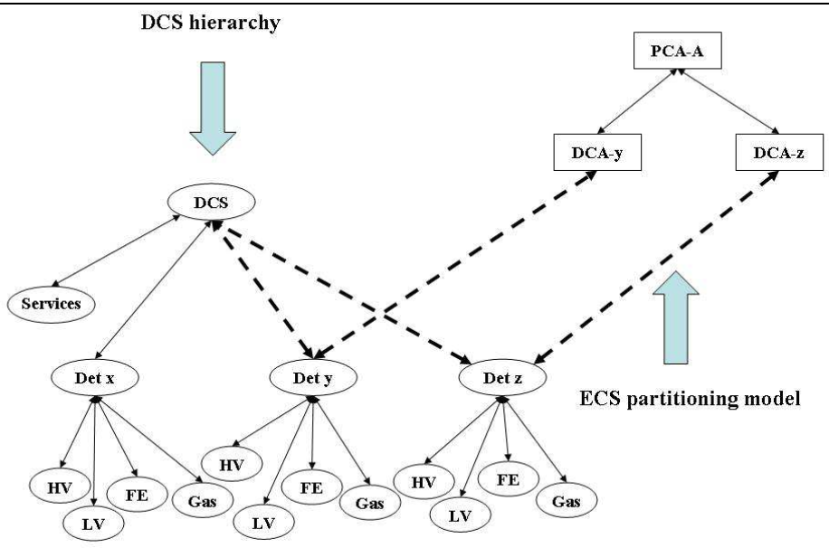
ECS
The control of the ALICE experiment [2] is based on several independent ‘online systems’. Every ‘online system’ controls operations of a different type and belonging to a different domain of activities: Detector Control System (DCS), Data Acquisition (DAQ), Trigger system (TRG), and High Level Trigger (HLT). The ‘online systems’, are independent, may interact with all the particle detectors, and allow partitioning.
Connection between ECS and HLT
ECS architecture
Connection between ECS and DCS

Slide 9
REFERENSES
https://edms.cern.ch/ui/file/456354/1/HLT_Chapters11-15.pdf
https://iopscience.iop.org/article/10.1088/1748-0221/15/10/T10002/pdf
https://accelconf.web.cern.ch/ica05/proceedings/pdf/O1_011.pdf
https://www-conf.kek.jp/acat03/prog/presen/id0027.pdf
Thank you for your attention!

