Slide 1
QUANTITATIVE ANALYSIS –ATLAS SUBSYTEMS
FARAH MAHMOUD

Slide 2
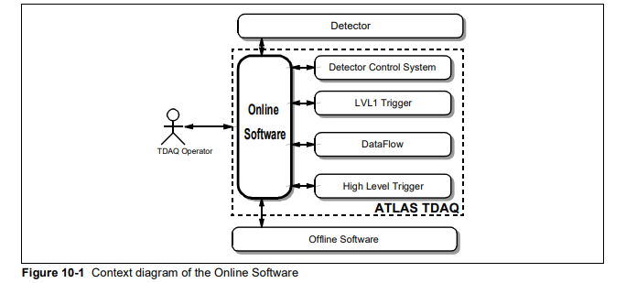
The Online Software encompasses the software to control and monitor the TDAQ system. It is a customizable framework which provides essentially the ‘glue’ that holds the various sub-systems together. It does not contain any elements that are detector specific as it is used by all the various configurations of the TDAQ and detector instrumentation. It co-operates with the other sub-systems and interfaces to the Detector Readout Crates, the Detector Control System, the LVL1 Trigger, the Data Flow, the High-Level Trigger processor farms, the Offline Software. It also provides the interface between the human user and the TDAQ system

Slide 3
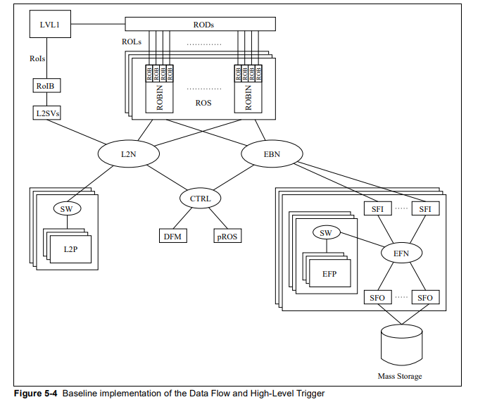
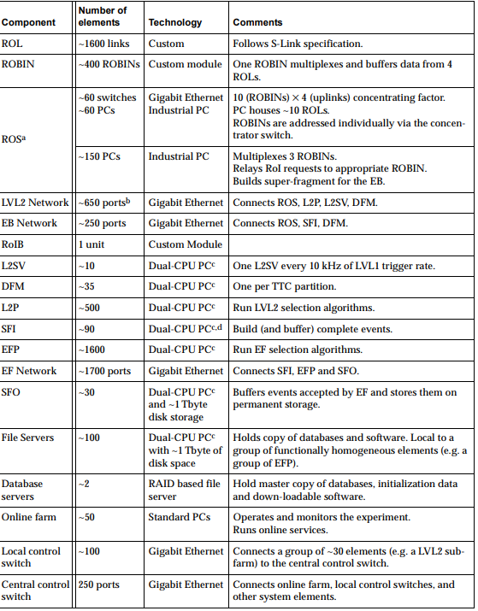
Implementation and size at 1000 KHz LVL 1 rate
Implementation of the data flow and high-level trigger

Slide 4
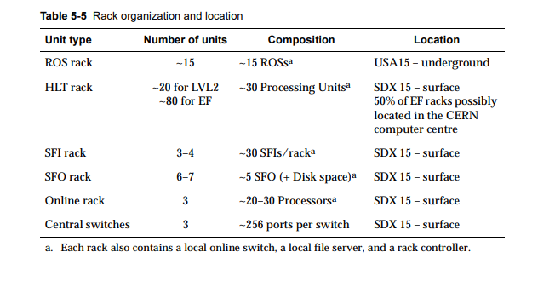
Deployment:
Functionally homogenous components ,e.g. EF processors, are organized in terms of standard ATLAS sub-farm racks. rack contains, in addition to the computing components, a local file server; a local online switch (to connect all the components to the online central switch); a rack controller; and the necessary power and cooling distribution.

Slide 5
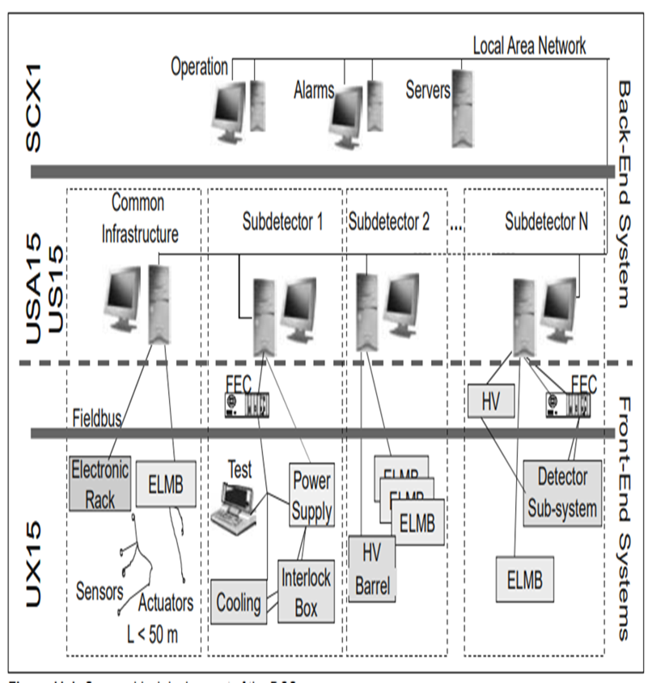
DCS
The experiment comprises nine specialized sub-detectors, each with distinct tasks and operational requirements. These sub-detectors must work seamlessly together

Slide 6
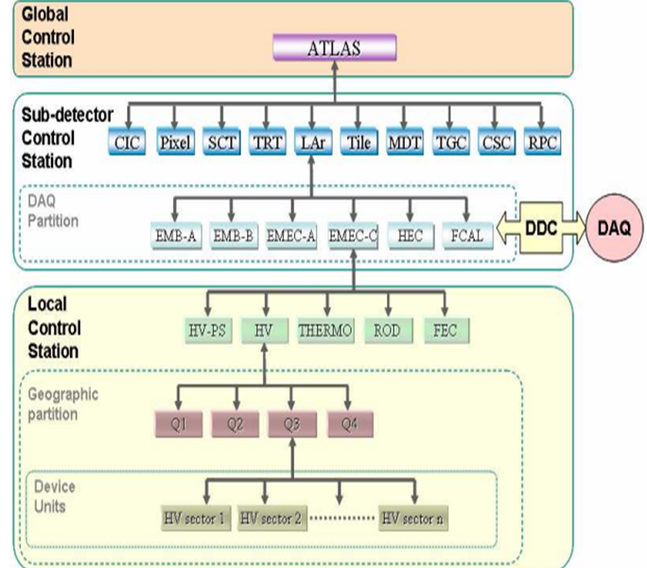
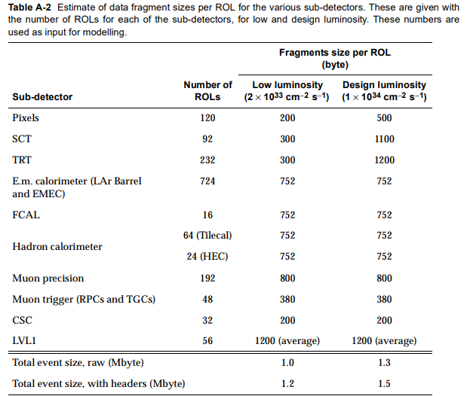
DCS (BE)

Slide 7
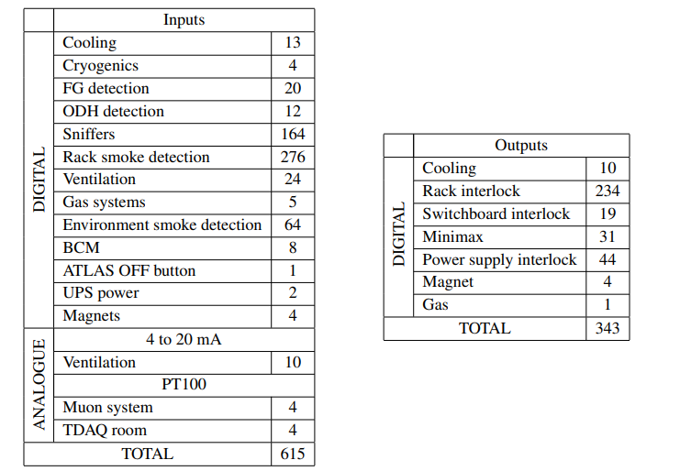
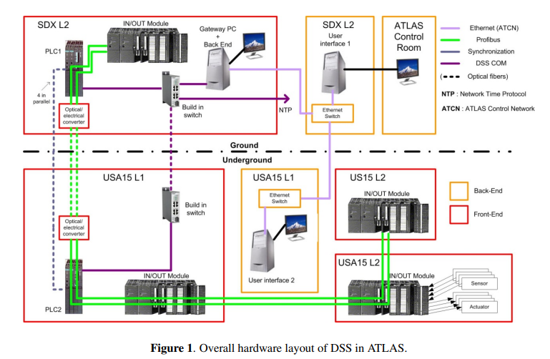
DSS
Digital sensors are implemented as an opto-isolated current loop, which has to be closed to
signal normal conditions. Analogue sensors supply a standard 4 mA–20 mA signal. Most of the
sensors connected to the ATLAS DSS are of the digital type, while a few analogue sensors provide
temperature, flow, and pressure information of critical zones

