Slide 1
STAR group report for STC
STAR experiment (JINR participation)
PROJECT CODE: 02-0-1066-2007/2029-1
G.N. Agakishiev, A. Aitbaev, A.A. Aparin, G.S. Averichev, A.S. Ayriyan, T.G. Dedovich, V.B. Dunin, N.Ya. Kartashov, A.O. Kechechian, K.V. Klygina, V.V. Korenkov, A.A. Korobitsyn, A.Yu. Krayeva, R. Lednický, V.V. Lyuboshitz, V. Luong, J. Miloshevich, E.V. Nedorezov, Yu.A. Panebrattsev, S.S. Panyushkina, S.М. Shmatov, N.E. Sidorov, E. Shakhaliev, A.N. Tawfik, A.A. Timofeev, M.V. Tokarev, S. Vokal, I. Zborovsky
Leaders: Richard Lednický, Yury Panebrattsev
Deputy leader: Alexey Aparin
Dubna, 2024

Slide 2
International cooperation
Organization | Country | City
A. Alikhanyan national scientific laboratory (AANL) | Armenia | Yerevan
IRP ANAS | Azerbaijan | Baku
INRNE BAS | Bulgaria | Sofia
SU | Bulgaria | Sofia
CCNU | China | Wuhan
High Intensity Heavy-ion Accelerator Facility (HIAF) | China | Lanzhou
InSTEC | Cuba | Havana
NPI CAS | Czech Republic | Rez
American University of Cairo | Egypt | Cairo
Niele University | Egypt | Giza
SUBATECH | France | Nantes
University of the Punjab | India | Punjab
University of Jammu | India | Jammu
Indian Institute of Science Education and Research (IISER) Tirupati | India | Tirupati
Institute of Nuclear Physics (INP) | Kazakhstan | Almaty
UNAM | Mexico | Mexico City
Organization | Country | City
MNUE | Mongolia | Ulaanbaatar
ITEP | Russia | Moscow
NNRU “MEPhI” | Russia | Moscow
IHEP | Russia | Protvino
SPbSU | Russia | St. Petersburg
MIPT | Russia | Dolgoprudny
UNS | Serbia | Novi Sad
INS | Serbia | Belgrad
UPJS | Slovakia | Kosice
IP SAS | Slovakia | Bratislava
BNL | USA | Upton
Berkeley Lab | USA | Berkeley
IU | USA | Bloomington
ANL | USA | Lemont
Yale Univ. | USA | New Haven
SUNY | USA | Stony Brook
UIC | USA | Chicago
Penn State | USA | University Park
Dalat Nuclear Research Institute (DNRI) | Vietnam | Dalat
The STAR program is a part the 7-years plan.
US DOE/ BNL have proposed to prolong the existing the BNL – JINR Agreement for the next 5 years.

Slide 3
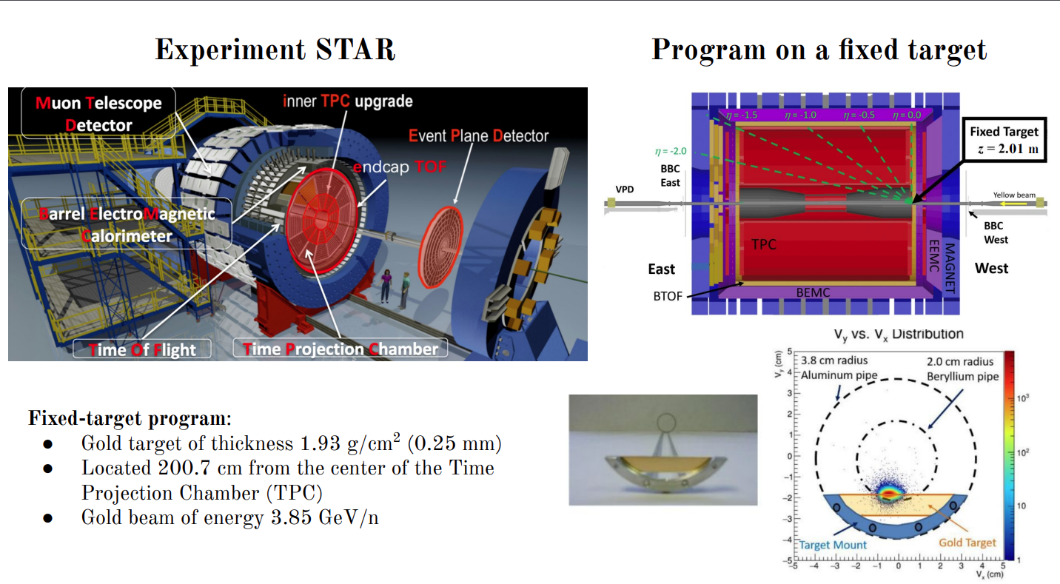
STAR detector for BES-II measurements

Slide 4
Beam Energy Scan to map the QCD phase diagram
Two stages of Beam Energy Scan:
Stage I: 7.7 – 39 GeV 2010 – 2014
First glance at low energy region, rather low statistics
Stage II: 3 – 54.4 GeV 2017 – 2021
Precise measurements at low energies, large statistics

Slide 5
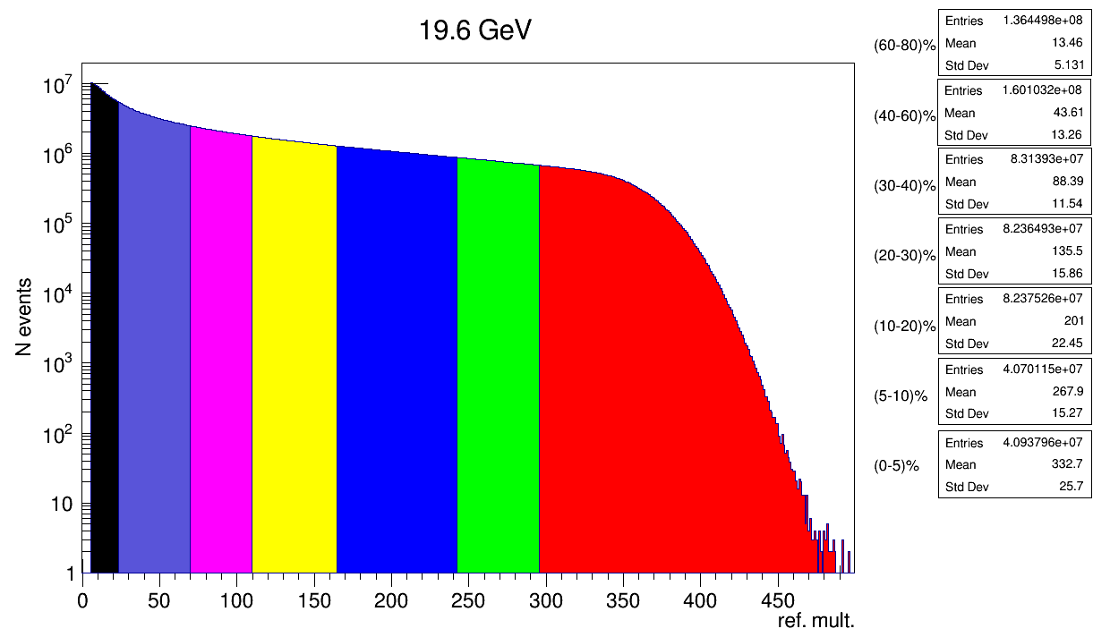
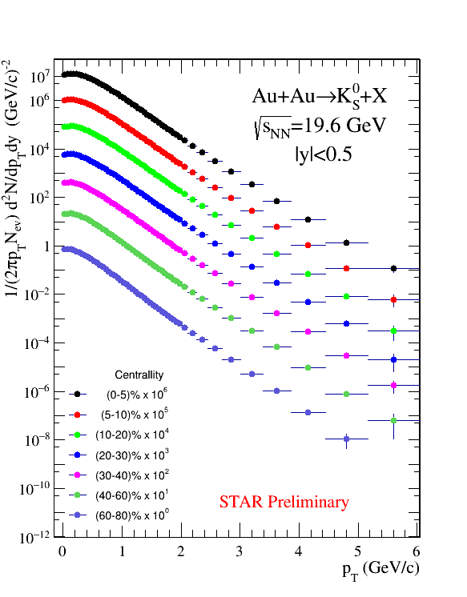
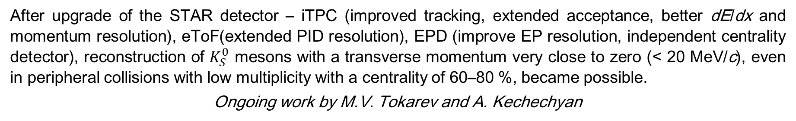
Strange particle production
After upgrade of the STAR detector – iTPC (improved tracking, extended acceptance, better dE/dx and momentum resolution), eToF(extended PID resolution), EPD (improve EP resolution, independent centrality detector), reconstruction of $K_{S}^{0}$ mesons with a transverse momentum very close to zero (< 20 MeV/c), even in peripheral collisions with low multiplicity with a centrality of 60–80 %, became possible.
Ongoing work by M.V. Tokarev and A. Kechechyan

Slide 6
Strange particle production
Momentum spectra for strange particles on full statistics can provide coverage for high p_{T} region where hard production dominates
Example of raw spectra for 27 GeV data sample
Work by MSU students A.Timofeev and N.Kartashov

Slide 7
Thermodynamical properties of the medium
Similar rapidity dependence of the T_{chem} and μ_{B}, μ_{S} over particle multiplicity
Precise study of the QCD phase diagram location of the interaction at different collision energies
Fits by THERMUS
Chemical equilibrium model
Δμ_{B} ≈ 25 MeV for
Δy = 1 at 27 GeV

Slide 8
Parametrization of particle production
number of terms
A. Aparin, E. Nedorezov, A. Parvan. PEPAN, Vol. 55, 4, 2024

Slide 9
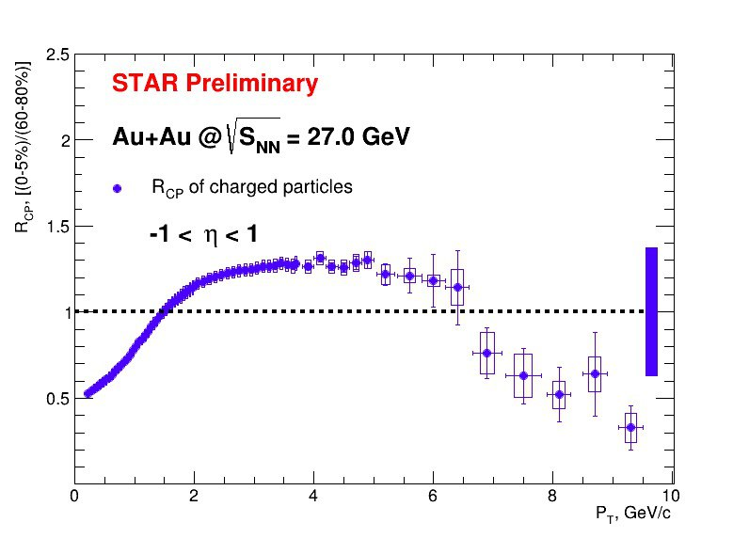
Nuclear modification in the medium
A. Aitbayev on behalf of STAR Collaboration. Universe 2024, 10(3), 139
R_{cp} has two regimes in the behavior depending on the collision energy:
decrease of particle production with high p_{T} in central collisions at high energies
smooth growth of particle production in central collisions at low collision energies.
High statistics of BES-II will allow to measure R_{cp} in high p_{T} region at low collision energies
STAR Phys. Rev. C 102 (2020) 34909
STAR Phys. Rev. Lett. 121 (2018) 32301

Slide 10
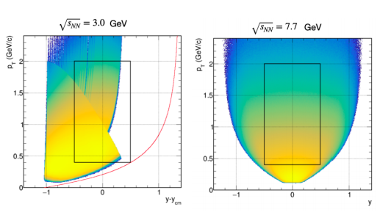
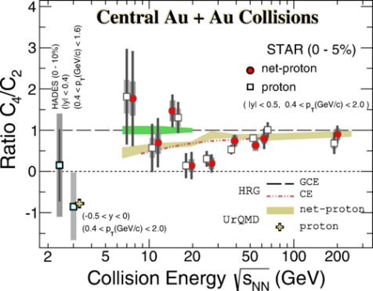
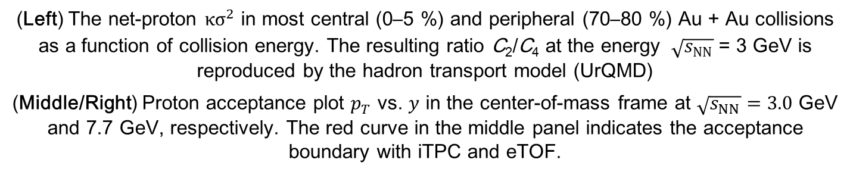
High Moments of Net-Proton Multiplicity Distribution
Phys. Rev. Lett. 128 (2022) 202303
(Left) The net-proton ${κσ}^{2}$ in most central (0–5 %) and peripheral (70–80 %) Au + Au collisions as a function of collision energy. The resulting ratio C₂/C₄ at the energy $\sqrt{s_{NN}}$= 3 GeV is reproduced by the hadron transport model (UrQMD)
(Middle/Right) Proton acceptance plot $p_{T}$ vs. $y$ in the center-of-mass frame at $\sqrt{s_{NN}}=3.0$ GeV and 7.7 GeV, respectively. The red curve in the middle panel indicates the acceptance boundary with iTPC and eTOF.

Slide 11
Elliptic flow at low energies
STAR Phys. Lett. B 827 (2022) 137003
Elliptic flow is negative (squeeze-out) at 3 GeV, as expected from the previous AGS data.
Grows rapidly with energy
The quark number scaling has been used at higher energies as a signature of the QGP. At 3 and 3.2 GeV, the scaling is broken down e.g. hadronic gas (not QGP)
STAR Preliminary

Slide 12
Two pion femtoscopy results from FXT program
A. Krayeva (for STAR Collaboration). Phys. Atom. Nucl. 86, 988-991 (2023)
A. Krayeva., G. Nigmatkulov. Phys. Atom. Nucl. 86, no.5, 854-858 (2023)

Slide 13
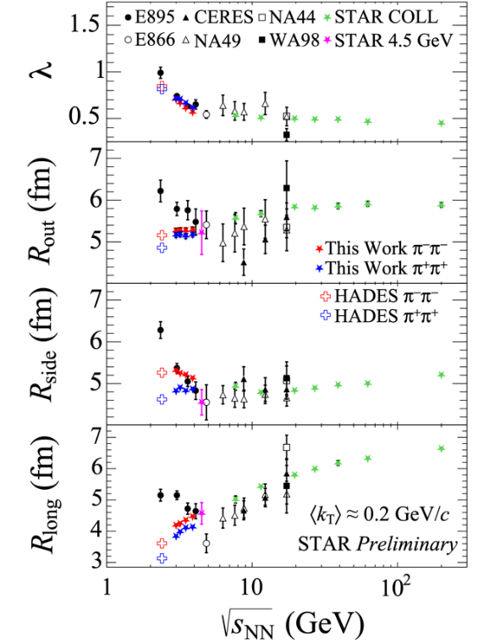
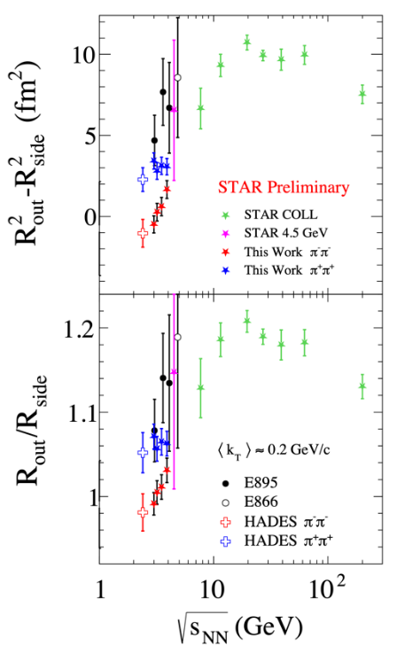
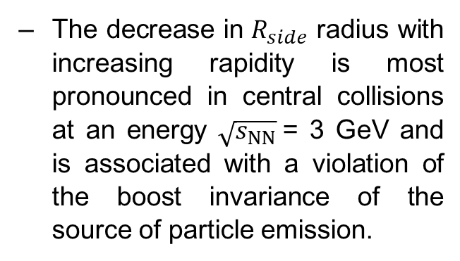
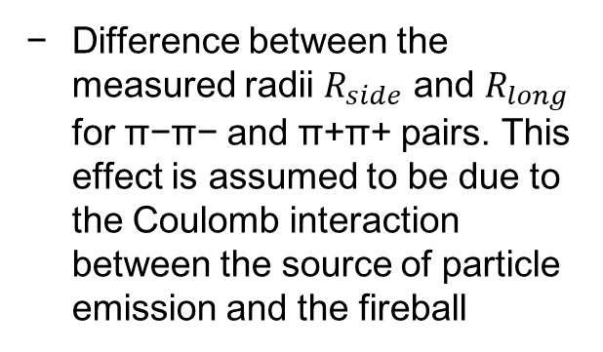
Two pion femtoscopy results from FXT program
V. B. Luong (for the STAR Collaboration). “Recent Flow Results from STAR Experiment at RHIC”, ISMD-2023, Gyöngyös, Hungary, 21–26/08/2023
V.B. Luong. “Femtoscopic measurements of pions in FXT”, STAR collaboration, Upton, New York, USA, September 12–16, 2022
The decrease in $R_{side}$ radius with increasing rapidity is most pronounced in central collisions at an energy $\sqrt{s_{NN}}$= 3 GeV and is associated with a violation of the boost invariance of the source of particle emission.
Difference between the measured radii $R_{side}$ and $R_{long}$ for π−π− and π+π+ pairs. This effect is assumed to be due to the Coulomb interaction between the source of particle emission and the fireball

Slide 14
Machine learning for physics
G. Tolkachev, A. Korobitsin, A. Aparin. Phys.Atom.Nucl. 86 (2023) 5, 845-849
V. Papoyan, A. Aparin… A. Mudrokh. Phys.Atom.Nucl. 86 (2023) 5, 869-873
ML technics demonstrates promising results for particle identification with the same detectors (TPC+TOF)

Slide 15
Machine learning for physics

Slide 16
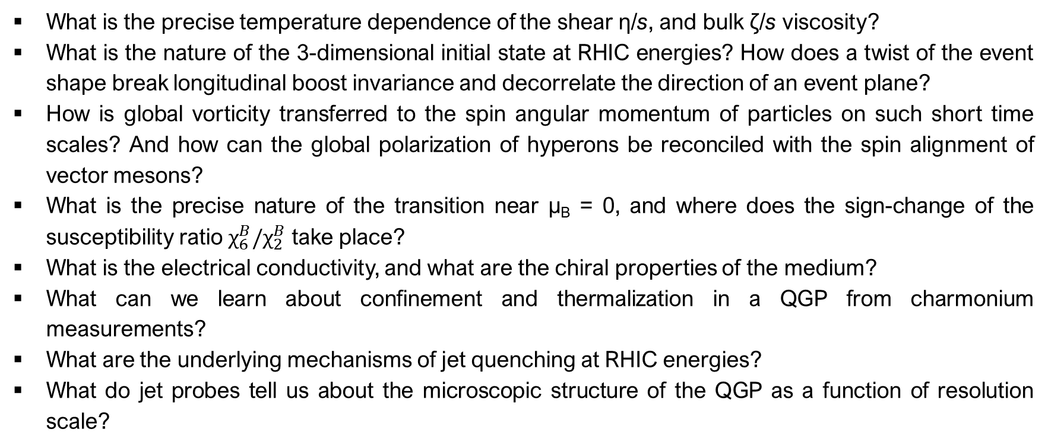
Hot QCD Physics
What is the precise temperature dependence of the shear η/s, and bulk ζ/s viscosity?
What is the nature of the 3-dimensional initial state at RHIC energies? How does a twist of the event shape break longitudinal boost invariance and decorrelate the direction of an event plane?
How is global vorticity transferred to the spin angular momentum of particles on such short time scales? And how can the global polarization of hyperons be reconciled with the spin alignment of vector mesons?
What is the precise nature of the transition near µ_{B} = 0, and where does the sign-change of the susceptibility ratio $χ_{6}^{B}/χ_{2}^{B}$ take place?
What is the electrical conductivity, and what are the chiral properties of the medium?
What can we learn about confinement and thermalization in a QGP from charmonium measurements?
What are the underlying mechanisms of jet quenching at RHIC energies?
What do jet probes tell us about the microscopic structure of the QGP as a function of resolution scale?

Slide 17
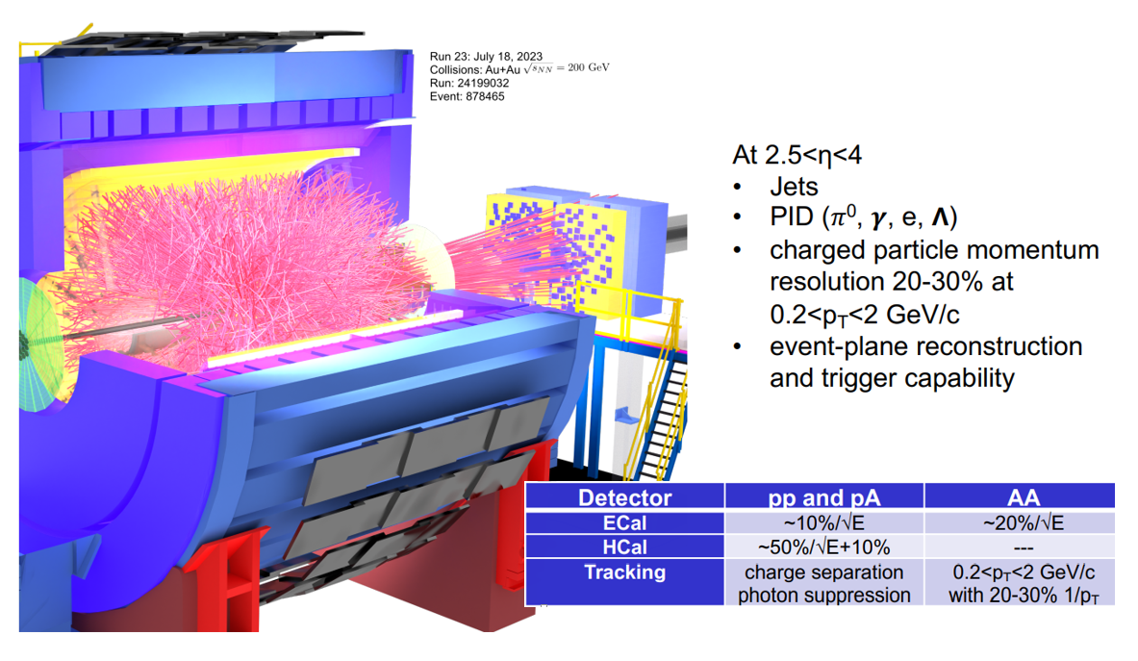
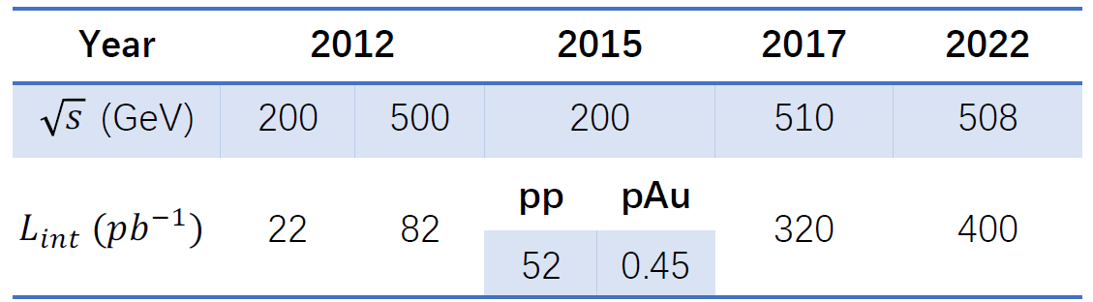
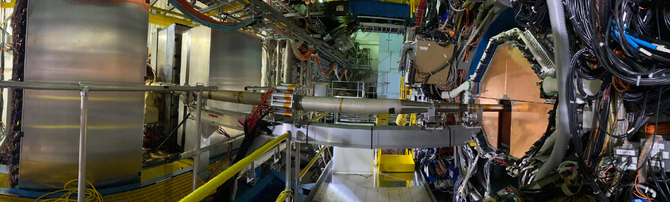
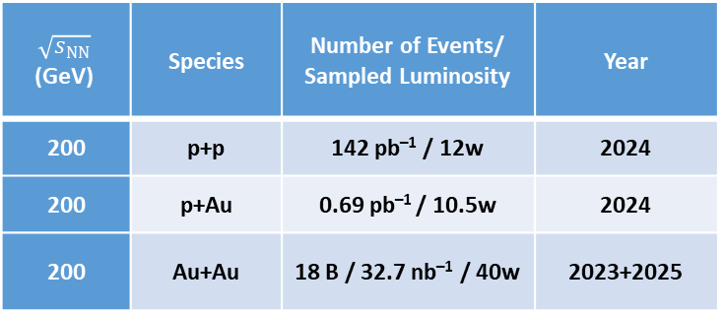
STAR experimental program for 2023–2026
Hot QCD Physics &
Cold QCD Physics
$$\sqrt{s_{NN}}$$ (GeV) | Species | Number of Events/ Sampled Luminosity | Year
200 | p+p | 142 pb^{–1} / 12w | 2024
200 | p+Au | 0.69 pb^{–1} / 10.5w | 2024
200 | Au+Au | 18 B / 32.7 nb^{–1} / 40w | 2023+2025

Slide 18
Cold QCD Physics
Transversely polarized proton beams in p↑ + p↑ collisions at 510 and 200 GeV
Wide η range up to 4.2.
Probe down to x ~ 2·10^{–3} for gluons.
Probe down to x ~ 0.5 for valence quarks.
Cold QCD Physics with p↑ + p↑ Collisions at 510 GeV:
  inclusive transverse spin asymmetries at forward rapidities;
  transversity, Collins function and interference fragmentation function;
  Sivers and Efremov-Teryaev-Qiu-Sterman function.
Polarized p↑ + p and p↑ + A collisions at 200 GeV:
  forward transverse spin asymmetries;
  Sivers effect;
  transversity and related quantities.

Slide 19
Gluon polarization impact on proton spin
The exploration of the fundamental structure of strongly interacting matter has always thrived on the complementarity of lepton scattering and purely hadronic probes. As the community eagerly anticipates the future Electron Ion Collider, an outstanding scientific opportunity remains to complete “must-do” measurements in p+p and p+A physics during the final years of RHIC.
STAR provides a lot of unique data with polarized proton beams. These data can be useful for training young scientists who will work on realization of NICA/SPD polarized program.
DSSV global fit including up-to-date jet, dijet, pion, W data
arXiv:2302.00605

Slide 20


What is the EIC facility
What is the EIC:
A high luminosity (10³³ – 10³⁴ cm⁻²s⁻¹) polarized electron proton / ion collider with √s_{ep} = 28 – 140 GeV
What is special:
EIC is the ONLY new collider in foreseeable future. Allows to remain at frontier of Accelerator S&T.
factor 100 to 1000 higher luminosity as HERA
both electrons and protons / light nuclei polarized,
nuclear beams: d to U
Fixed Target Facilities i.e.:
at minimum > 2 decades increase in kinematic coverage in x and Q²
Science Program:
“An EIC can uniquely address three profound questions
About nucleons—neutrons and protons—and how they
are assembled to form the nuclei of atoms:
• How does the mass of the nucleon arise?
• How does the spin of the nucleon arise?
• What are the emergent properties of dense systems of gluons?”
State of the art general purpose collider detector
Possible
2nd Detector
Location
IR-8
Project
Detector
Location
IR-6

Slide 21
Proton tomography at RHIC and EIC

Slide 22
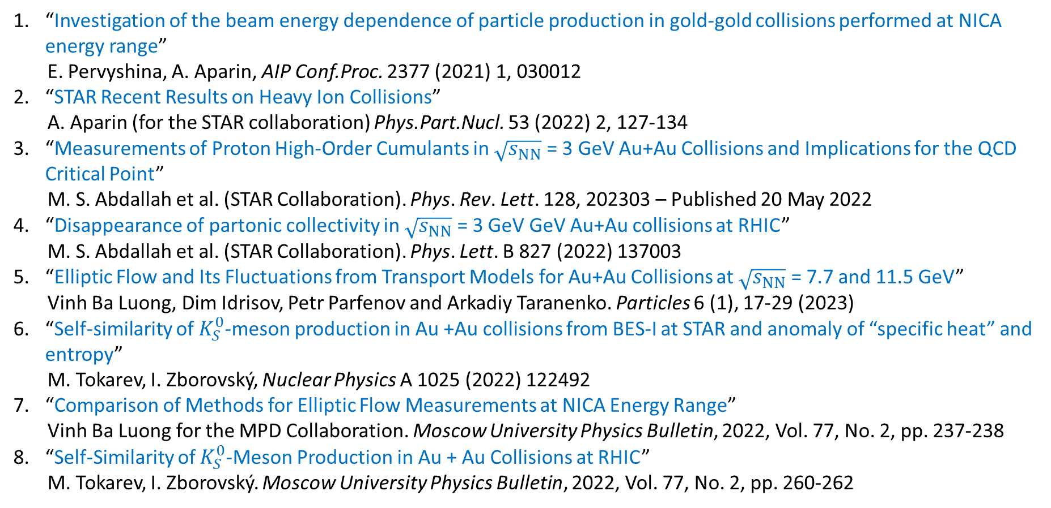
Published papers
“Investigation of the beam energy dependence of particle production in gold-gold collisions performed at NICA energy range”
E. Pervyshina, A. Aparin, AIP Conf.Proc. 2377 (2021) 1, 030012
“STAR Recent Results on Heavy Ion Collisions”
A. Aparin (for the STAR collaboration) Phys.Part.Nucl. 53 (2022) 2, 127-134
“Measurements of Proton High-Order Cumulants in $\sqrt{s_{NN}}$ = 3 GeV Au+Au Collisions and Implications for the QCD Critical Point”
M. S. Abdallah et al. (STAR Collaboration). Phys. Rev. Lett. 128, 202303 – Published 20 May 2022
“Disappearance of partonic collectivity in $\sqrt{s_{NN}}$ = 3 GeV GeV Au+Au collisions at RHIC”
M. S. Abdallah et al. (STAR Collaboration). Phys. Lett. B 827 (2022) 137003
“Elliptic Flow and Its Fluctuations from Transport Models for Au+Au Collisions at $\sqrt{s_{NN}}$ = 7.7 and 11.5 GeV”
Vinh Ba Luong, Dim Idrisov, Petr Parfenov and Arkadiy Taranenko. Particles 6 (1), 17-29 (2023)
“Self-similarity of $K_{S}^{0}$-meson production in Au +Au collisions from BES-I at STAR and anomaly of “specific heat” and entropy”
M. Tokarev, I. Zborovský, Nuclear Physics A 1025 (2022) 122492
“Comparison of Methods for Elliptic Flow Measurements at NICA Energy Range”
Vinh Ba Luong for the MPD Collaboration. Moscow University Physics Bulletin, 2022, Vol. 77, No. 2, pp. 237-238
“Self-Similarity of $K_{S}^{0}$-Meson Production in Au + Au Collisions at RHIC”
M. Tokarev, I. Zborovský. Moscow University Physics Bulletin, 2022, Vol. 77, No. 2, pp. 260-262

Slide 23
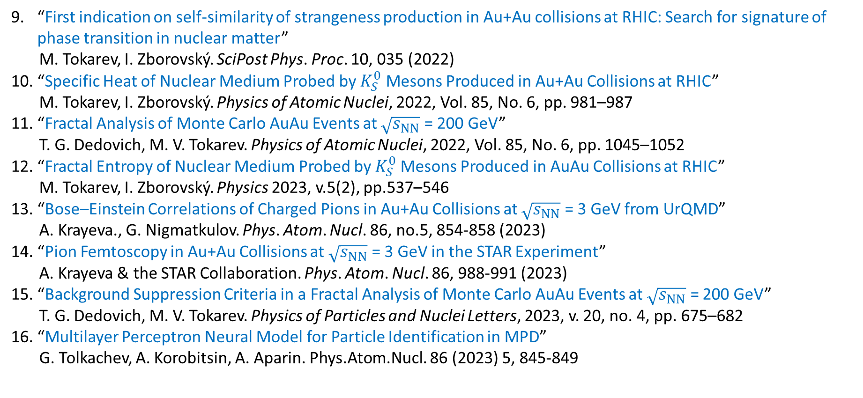
Published papers
“First indication on self-similarity of strangeness production in Au+Au collisions at RHIC: Search for signature of phase transition in nuclear matter”
M. Tokarev, I. Zborovský. SciPost Phys. Proc. 10, 035 (2022)
“Specific Heat of Nuclear Medium Probed by $K_{S}^{0}$ Mesons Produced in Au+Au Collisions at RHIC”
M. Tokarev, I. Zborovský. Physics of Atomic Nuclei, 2022, Vol. 85, No. 6, pp. 981–987
“Fractal Analysis of Monte Carlo AuAu Events at $\sqrt{s_{NN}}$ = 200 GeV”
T. G. Dedovich, M. V. Tokarev. Physics of Atomic Nuclei, 2022, Vol. 85, No. 6, pp. 1045–1052
“Fractal Entropy of Nuclear Medium Probed by $K_{S}^{0}$Mesons Produced in AuAu Collisions at RHIC”
M. Tokarev, I. Zborovský. Physics 2023, v.5(2), pp.537–546
“Bose–Einstein Correlations of Charged Pions in Au+Au Collisions at $\sqrt{s_{NN}}$ = 3 GeV from UrQMD”
A. Krayeva., G. Nigmatkulov. Phys. Atom. Nucl. 86, no.5, 854-858 (2023)
“Pion Femtoscopy in Au+Au Collisions at $\sqrt{s_{NN}}$ = 3 GeV in the STAR Experiment”
A. Krayeva & the STAR Collaboration. Phys. Atom. Nucl. 86, 988-991 (2023)
“Background Suppression Criteria in a Fractal Analysis of Monte Carlo AuAu Events at $\sqrt{s_{NN}}$ = 200 GeV”
T. G. Dedovich, M. V. Tokarev. Physics of Particles and Nuclei Letters, 2023, v. 20, no. 4, pp. 675–682
“Multilayer Perceptron Neural Model for Particle Identification in MPD”
G. Tolkachev, A. Korobitsin, A. Aparin. Phys.Atom.Nucl. 86 (2023) 5, 845-849

Slide 24
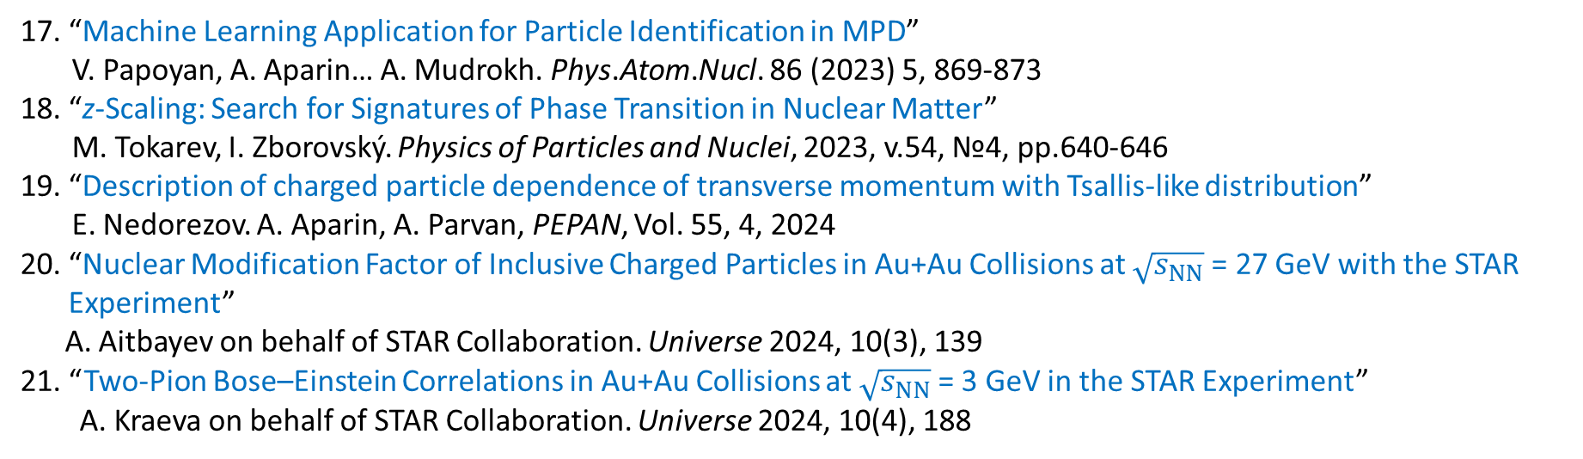
Published papers
“Machine Learning Application for Particle Identification in MPD”
V. Papoyan, A. Aparin… A. Mudrokh. Phys.Atom.Nucl. 86 (2023) 5, 869-873
“z-Scaling: Search for Signatures of Phase Transition in Nuclear Matter”
M. Tokarev, I. Zborovský. Physics of Particles and Nuclei, 2023, v.54, №4, pp.640-646
“Description of charged particle dependence of transverse momentum with Tsallis-like distribution”
E. Nedorezov. A. Aparin, A. Parvan, PEPAN, Vol. 55, 4, 2024
“Nuclear Modification Factor of Inclusive Charged Particles in Au+Au Collisions at $\sqrt{s_{NN}}$= 27 GeV with the STAR Experiment”
A. Aitbayev on behalf of STAR Collaboration. Universe 2024, 10(3), 139
21. “Two-Pion Bose–Einstein Correlations in Au+Au Collisions at $\sqrt{s_{NN}}$= 3 GeV in the STAR Experiment”
A. Kraeva on behalf of STAR Collaboration. Universe 2024, 10(4), 188

Slide 25
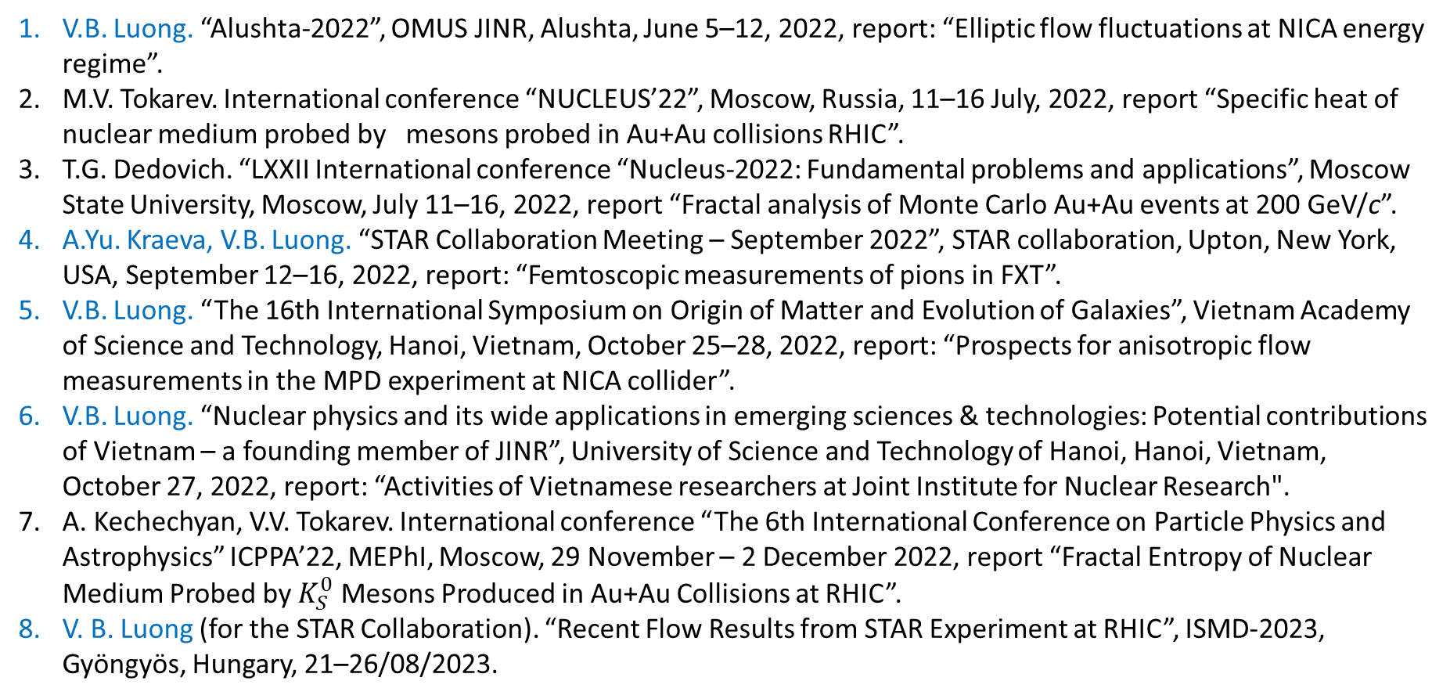
Conference participation
V.B. Luong. “Alushta-2022”, OMUS JINR, Alushta, June 5–12, 2022, report: “Elliptic flow fluctuations at NICA energy regime”.
M.V. Tokarev. International conference “NUCLEUS’22”, Moscow, Russia, 11–16 July, 2022, report “Specific heat of nuclear medium probed by mesons probed in Au+Au collisions RHIC”.
T.G. Dedovich. “LXXII International conference “Nucleus-2022: Fundamental problems and applications”, Moscow State University, Moscow, July 11–16, 2022, report “Fractal analysis of Monte Carlo Au+Au events at 200 GeV/c”.
A.Yu. Kraeva, V.B. Luong. “STAR Collaboration Meeting – September 2022”, STAR collaboration, Upton, New York, USA, September 12–16, 2022, report: “Femtoscopic measurements of pions in FXT”.
V.B. Luong. “The 16th International Symposium on Origin of Matter and Evolution of Galaxies”, Vietnam Academy of Science and Technology, Hanoi, Vietnam, October 25–28, 2022, report: “Prospects for anisotropic flow measurements in the MPD experiment at NICA collider”.
V.B. Luong. “Nuclear physics and its wide applications in emerging sciences & technologies: Potential contributions of Vietnam – a founding member of JINR”, University of Science and Technology of Hanoi, Hanoi, Vietnam, October 27, 2022, report: “Activities of Vietnamese researchers at Joint Institute for Nuclear Research".
A. Kechechyan, V.V. Tokarev. International conference “The 6th International Conference on Particle Physics and Astrophysics” ICPPA’22, MEPhI, Moscow, 29 November – 2 December 2022, report “Fractal Entropy of Nuclear Medium Probed by $K_{S}^{0}$ Mesons Produced in Au+Au Collisions at RHIC”.
V. B. Luong (for the STAR Collaboration). “Recent Flow Results from STAR Experiment at RHIC”, ISMD-2023, Gyöngyös, Hungary, 21–26/08/2023.

Slide 26
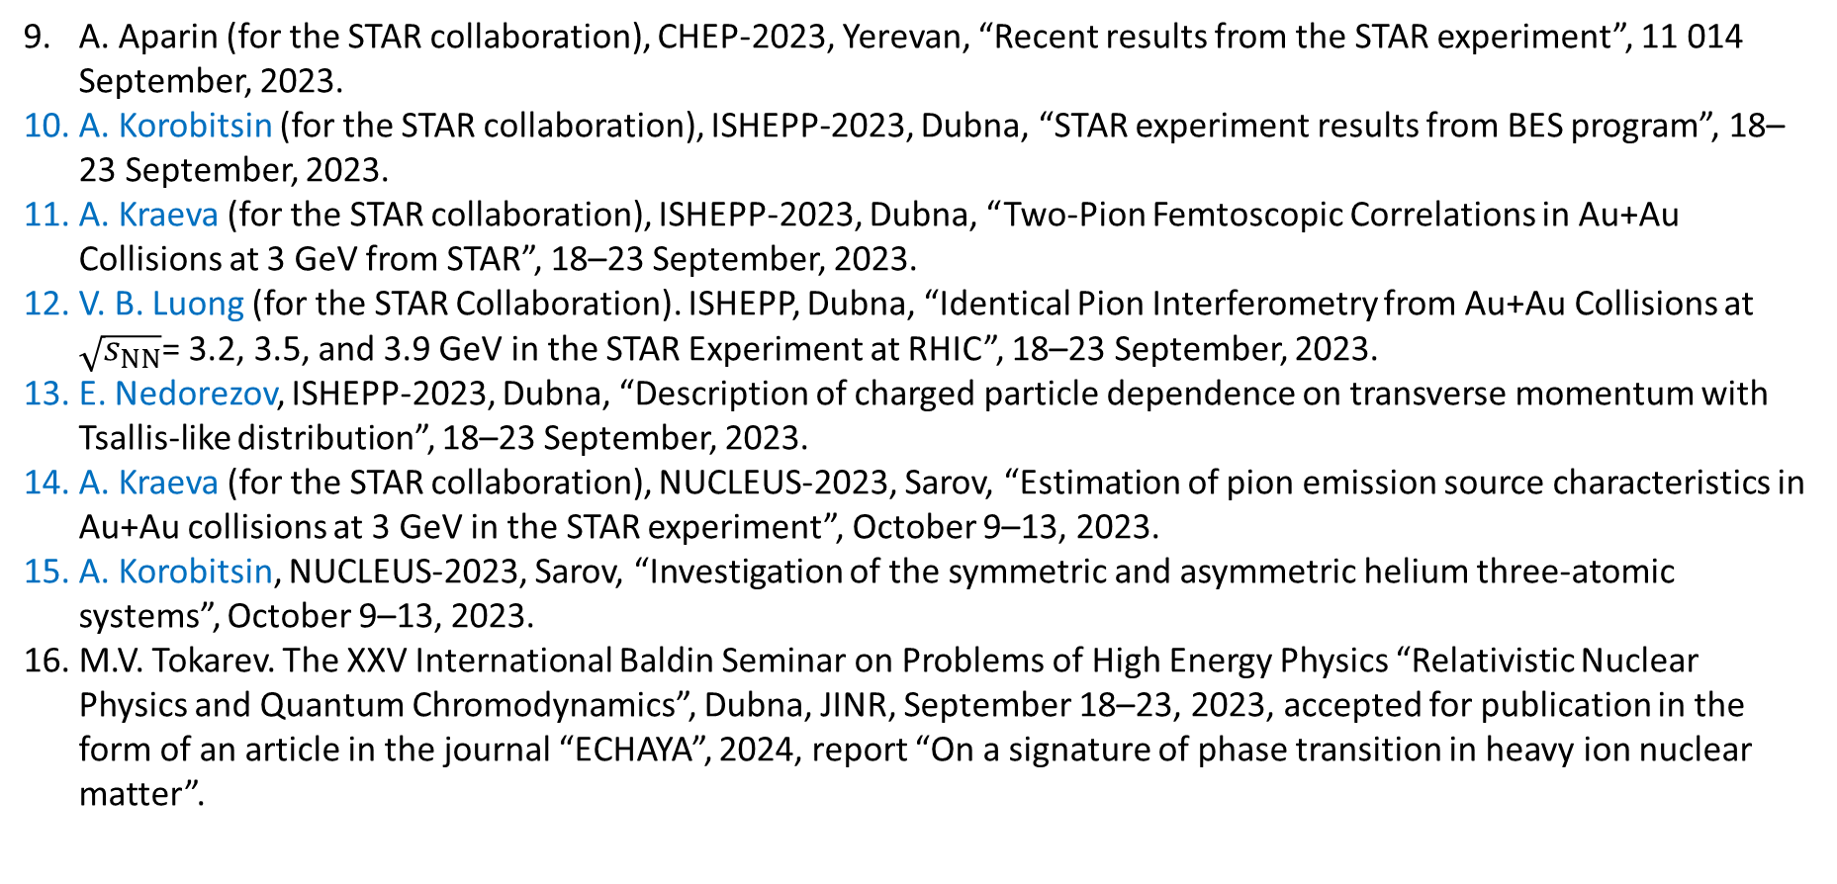
Conference participation
A. Aparin (for the STAR collaboration), CHEP-2023, Yerevan, “Recent results from the STAR experiment”, 11 014 September, 2023.
A. Korobitsin (for the STAR collaboration), ISHEPP-2023, Dubna, “STAR experiment results from BES program”, 18–23 September, 2023.
A. Kraeva (for the STAR collaboration), ISHEPP-2023, Dubna, “Two-Pion Femtoscopic Correlations in Au+Au Collisions at 3 GeV from STAR”, 18–23 September, 2023.
V. B. Luong (for the STAR Collaboration). ISHEPP, Dubna, “Identical Pion Interferometry from Au+Au Collisions at $\sqrt{s_{NN}}$= 3.2, 3.5, and 3.9 GeV in the STAR Experiment at RHIC”, 18–23 September, 2023.
E. Nedorezov, ISHEPP-2023, Dubna, “Description of charged particle dependence on transverse momentum with Tsallis-like distribution”, 18–23 September, 2023.
A. Kraeva (for the STAR collaboration), NUCLEUS-2023, Sarov, “Estimation of pion emission source characteristics in Au+Au collisions at 3 GeV in the STAR experiment”, October 9–13, 2023.
A. Korobitsin, NUCLEUS-2023, Sarov, “Investigation of the symmetric and asymmetric helium three-atomic systems”, October 9–13, 2023.
M.V. Tokarev. The XXV International Baldin Seminar on Problems of High Energy Physics “Relativistic Nuclear Physics and Quantum Chromodynamics”, Dubna, JINR, September 18–23, 2023, accepted for publication in the form of an article in the journal “ECHAYA”, 2024, report “On a signature of phase transition in heavy ion nuclear matter”.

Slide 27
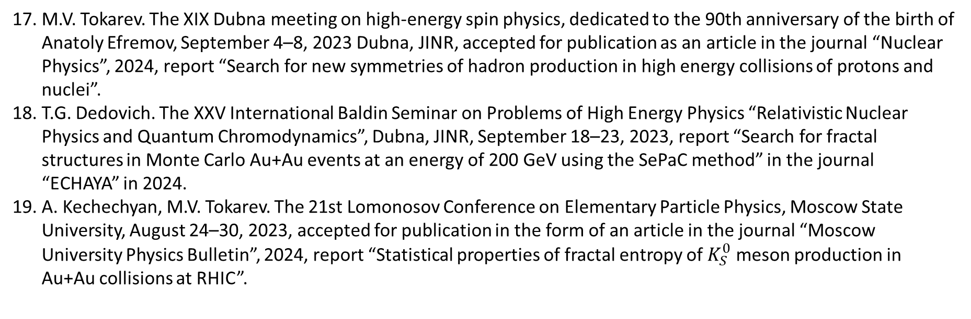
Conference participation
M.V. Tokarev. The XIX Dubna meeting on high-energy spin physics, dedicated to the 90th anniversary of the birth of Anatoly Efremov, September 4–8, 2023 Dubna, JINR, accepted for publication as an article in the journal “Nuclear Physics”, 2024, report “Search for new symmetries of hadron production in high energy collisions of protons and nuclei”.
T.G. Dedovich. The XXV International Baldin Seminar on Problems of High Energy Physics “Relativistic Nuclear Physics and Quantum Chromodynamics”, Dubna, JINR, September 18–23, 2023, report “Search for fractal structures in Monte Carlo Au+Au events at an energy of 200 GeV using the SePaC method” in the journal “ECHAYA” in 2024.
A. Kechechyan, M.V. Tokarev. The 21st Lomonosov Conference on Elementary Particle Physics, Moscow State University, August 24–30, 2023, accepted for publication in the form of an article in the journal “Moscow University Physics Bulletin”, 2024, report “Statistical properties of fractal entropy of $K_{S}^{0}$ meson production in Au+Au collisions at RHIC”.

Slide 28
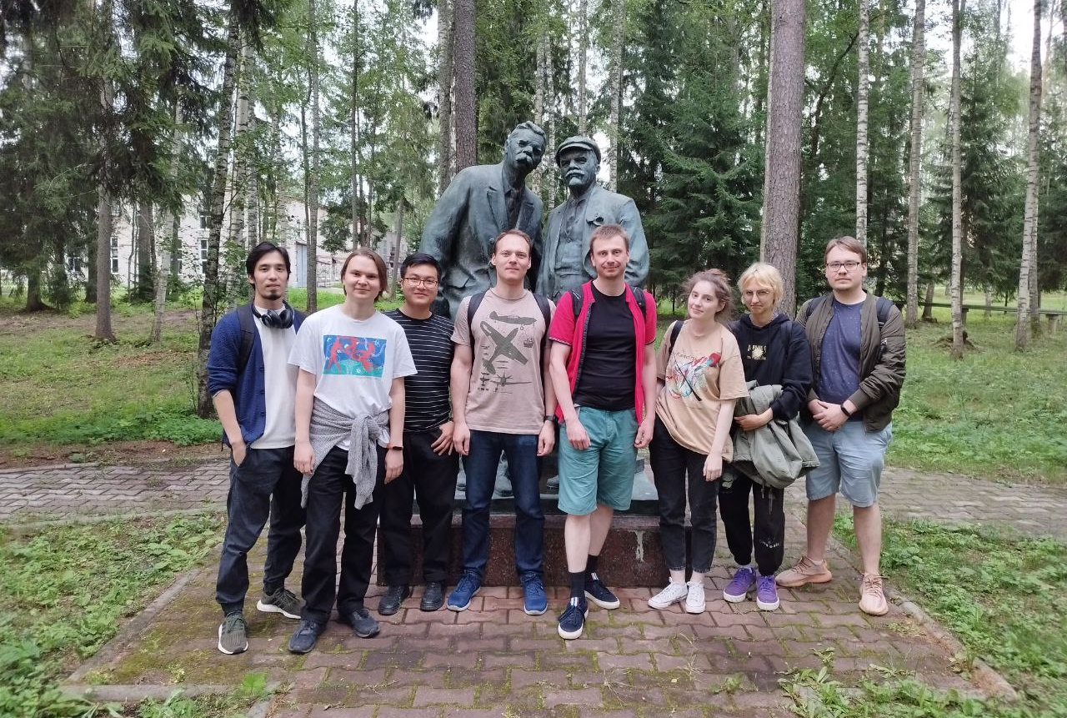
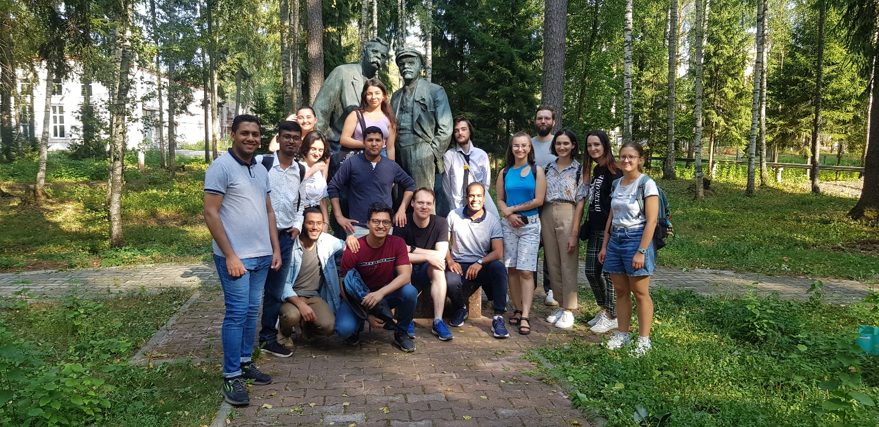
Student participation
Student diplomas since 2021
MSU - 5
Dubna uni – 4
NRNU MEPHI – 1
UrFU – 1
3 PhD currently in preparation
2 PostDoc positions opened in 2024
Short practice at JINR since 2021
From 8 to 12 students each year are hosted at STAR JINR group
Students from Russian institutes and from collaborating countries (Cuba, Mexico, Armenia, India, Egypt)
Active participation of young scientists in internal grant programs: RSF grant 22-72-10028 and Kazakhstan ME grant BR21881941

Slide 29
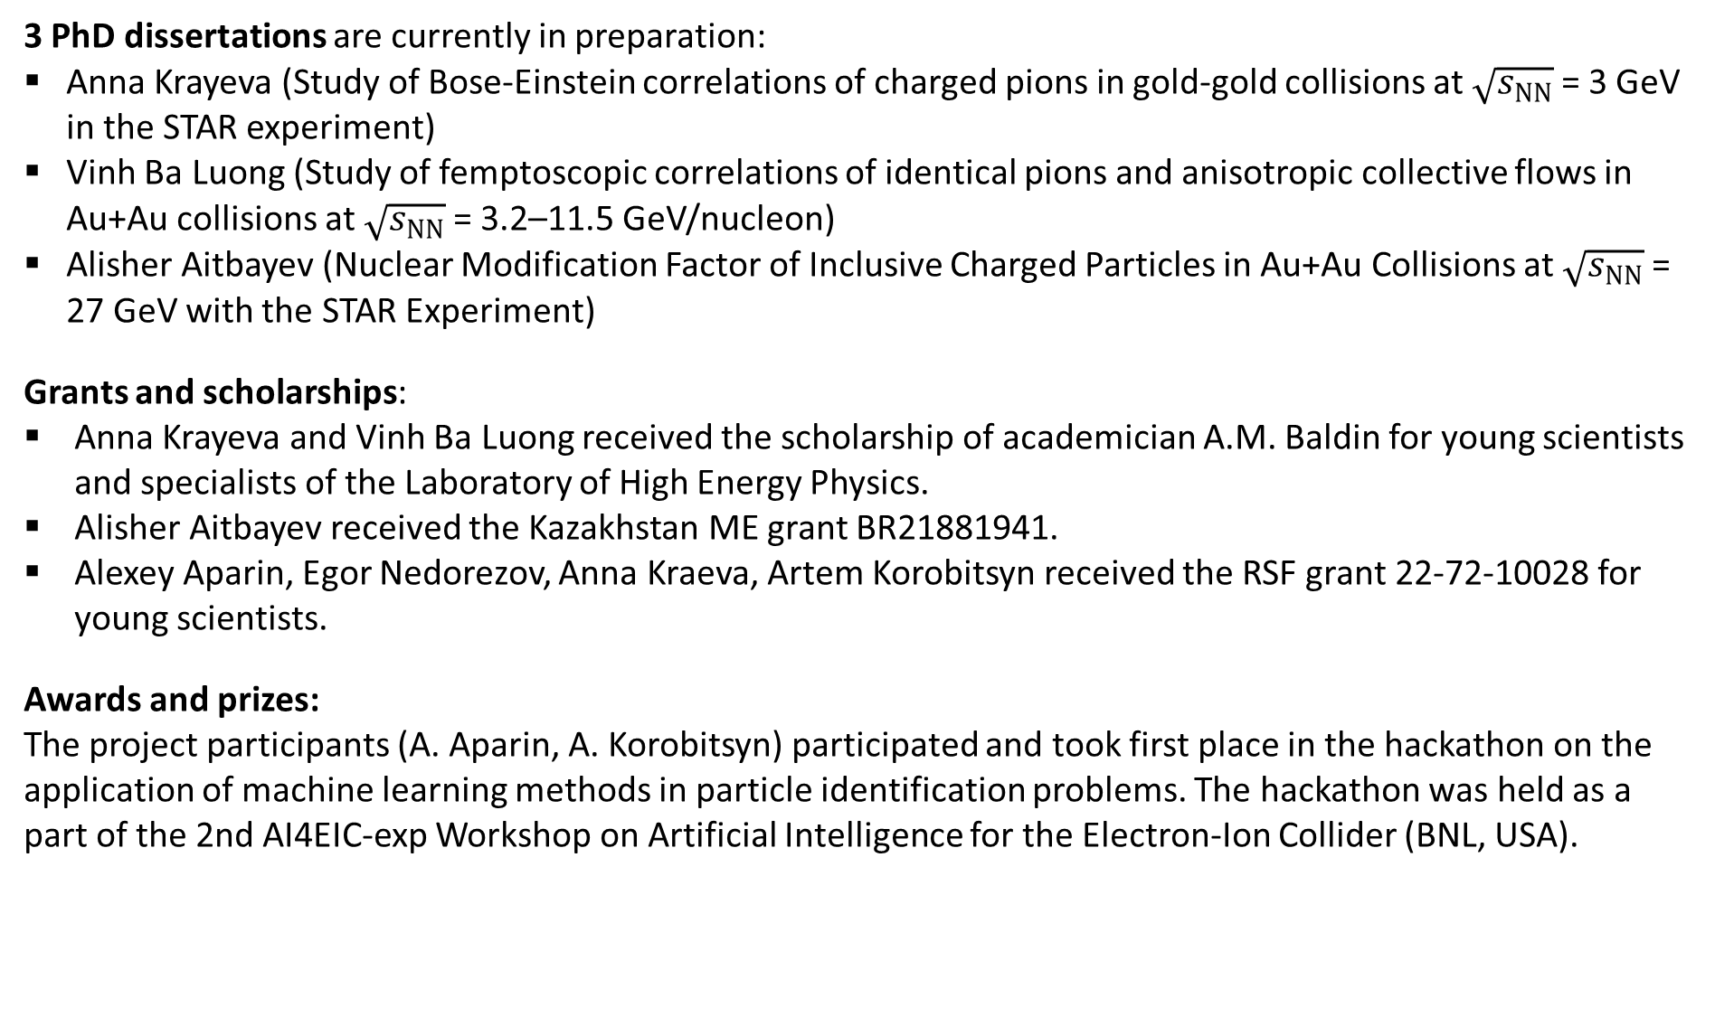
Young scientists participation
3 PhD dissertations are currently in preparation:
Anna Krayeva (Study of Bose-Einstein correlations of charged pions in gold-gold collisions at $\sqrt{s_{NN}}$= 3 GeV in the STAR experiment)
Vinh Ba Luong (Study of femptoscopic correlations of identical pions and anisotropic collective flows in Au+Au collisions at $\sqrt{s_{NN}}$= 3.2–11.5 GeV/nucleon)
Alisher Aitbayev (Nuclear Modification Factor of Inclusive Charged Particles in Au+Au Collisions at $\sqrt{s_{NN}}$= 27 GeV with the STAR Experiment)
Grants and scholarships:
Anna Krayeva and Vinh Ba Luong received the scholarship of academician A.M. Baldin for young scientists and specialists of the Laboratory of High Energy Physics.
Alisher Aitbayev received the Kazakhstan ME grant BR21881941.
Alexey Aparin, Egor Nedorezov, Anna Kraeva, Artem Korobitsyn received the RSF grant 22-72-10028 for young scientists.
Awards and prizes:
The project participants (A. Aparin, A. Korobitsyn) participated and took first place in the hackathon on the application of machine learning methods in particle identification problems. The hackathon was held as a part of the 2nd AI4EIC-exp Workshop on Artificial Intelligence for the Electron-Ion Collider (BNL, USA).

Slide 30
Manpower
No. | Category of personnel | Full name | Division | Position | Amount of FTE
1. | research scientists | Lednický R. | LHEP | Chief research scientist | 1
 |  | Panebratsev Yu.A. | LHEP | Head of Department | 1
 |  | Averichev G.S. | LHEP | Deputy Head of Department | 1
 |  | Agakishiev H. | LHEP | Leading research scientist | 1
 |  | Aparin A.A. | LHEP | Senior research scientist | 1
 |  | Dedovich T.G. | LHEP | Senior research scientist | 0.75
 |  | Dunin V.B. | LHEP | Senior research scientist | 0.5
 |  | Kechechyan A.O. | LHEP | Leading research scientist | 1
 |  | Korobitsyn A.A. | LHEP | Scientist | 1
 |  | Luong Ba Vinh | LHEP | Junior research scientist | 1
 |  | Lyuboshits V.V. | LHEP | Senior research scientist | 0.5
 |  | Tokarev M.V. | LHEP | Head of sector | 1
 |  | Shakhaliyev E. | LHEP | Leading research scientist | 1
2. | engineers | Aitbayev A. | LHEP | Engineer | 1
 |  | Krayeva A.Yu. | LHEP | Engineer | 0.75
 |  | Panyushkina S.I. | LHEP | Engineer | 1
3. | specialists | –
4. | technicians | Nedoresov E.V. | LHEP | Senior assistant | 0.5
 |  | Platonova A.V. | LHEP | Senior inspector | 0.5
 | Total: |  |  |  | 15.00

Slide 31
Financial resources
No. | Items of expenditure | Cost | Expenditure per year (thousands of the US dollars)
 |  |  | 2025 | 2026 | 2027 | 2028 | 2029
1. | International cooperation | 275 | 55 | 55 | 55 | 55 | 55
2. | Materials | 75 | 15 | 15 | 15 | 15 | 15
3. | Equipment, Third-party company services | 125 | 25 | 25 | 25 | 25 | 25
4. | Commissioning | – | – | – | – | – | –
5. | R&D contracts with other research organizations | 125 | 25 | 25 | 25 | 25 | 25
6. | Software purchasing | – | – | – | – | – | –
7. | Design/construction | – | – | – | – | – | –
8. | Service costs (planned in case of direct affiliation) | – | – | – | – | – | –
TOTAL: |  | 600 | 120 | 120 | 120 | 120 | 120

Slide 32
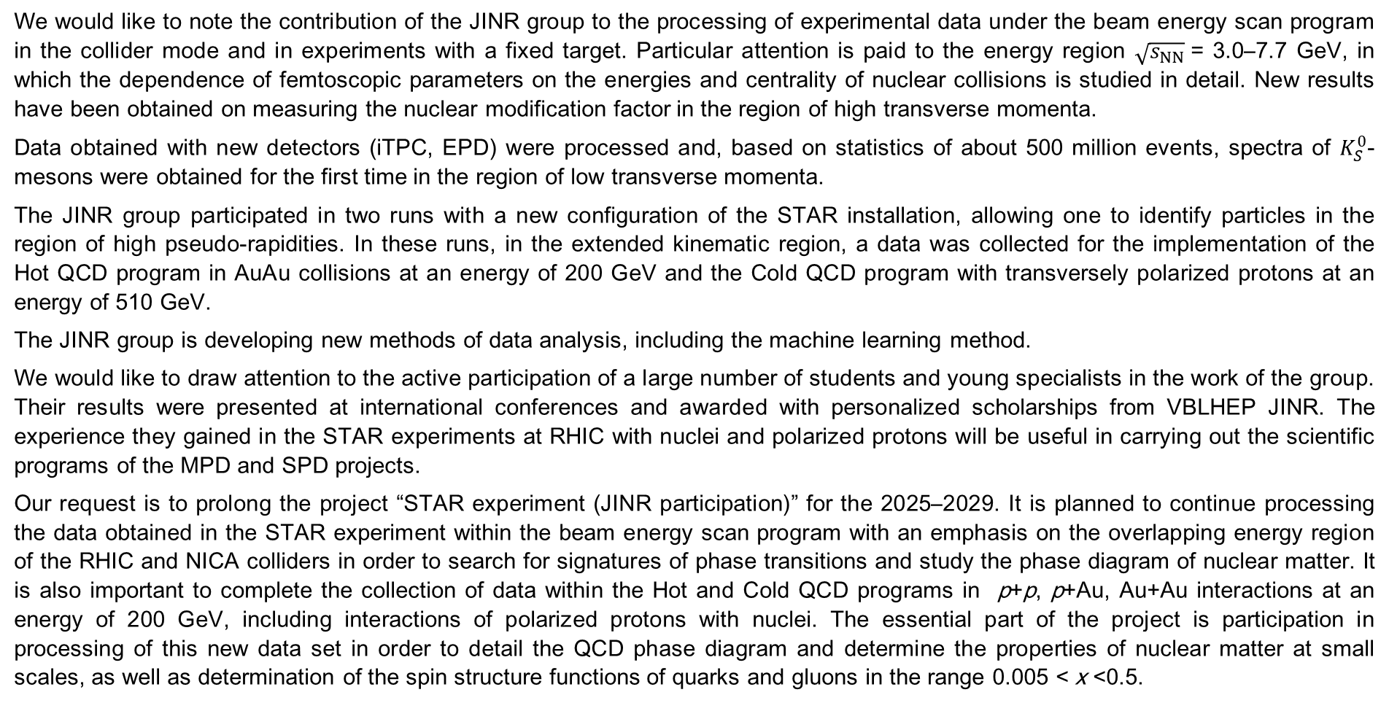
Conclusion
We would like to note the contribution of the JINR group to the processing of experimental data under the beam energy scan program in the collider mode and in experiments with a fixed target. Particular attention is paid to the energy region $\sqrt{s_{NN}}$= 3.0–7.7 GeV, in which the dependence of femtoscopic parameters on the energies and centrality of nuclear collisions is studied in detail. New results have been obtained on measuring the nuclear modification factor in the region of high transverse momenta.
Data obtained with new detectors (iTPC, EPD) were processed and, based on statistics of about 500 million events, spectra of $K_{S}^{0}$-mesons were obtained for the first time in the region of low transverse momenta.
The JINR group participated in two runs with a new configuration of the STAR installation, allowing one to identify particles in the region of high pseudo-rapidities. In these runs, in the extended kinematic region, a data was collected for the implementation of the Hot QCD program in AuAu collisions at an energy of 200 GeV and the Cold QCD program with transversely polarized protons at an energy of 510 GeV.
The JINR group is developing new methods of data analysis, including the machine learning method.
We would like to draw attention to the active participation of a large number of students and young specialists in the work of the group. Their results were presented at international conferences and awarded with personalized scholarships from VBLHEP JINR. The experience they gained in the STAR experiments at RHIC with nuclei and polarized protons will be useful in carrying out the scientific programs of the MPD and SPD projects.
Our request is to prolong the project “STAR experiment (JINR participation)” for the 2025–2029. It is planned to continue processing the data obtained in the STAR experiment within the beam energy scan program with an emphasis on the overlapping energy region of the RHIC and NICA colliders in order to search for signatures of phase transitions and study the phase diagram of nuclear matter. It is also important to complete the collection of data within the Hot and Cold QCD programs in p+p, p+Au, Au+Au interactions at an energy of 200 GeV, including interactions of polarized protons with nuclei. The essential part of the project is participation in processing of this new data set in order to detail the QCD phase diagram and determine the properties of nuclear matter at small scales, as well as determination of the spin structure functions of quarks and gluons in the range 0.005 < x <0.5.

