Slide 1
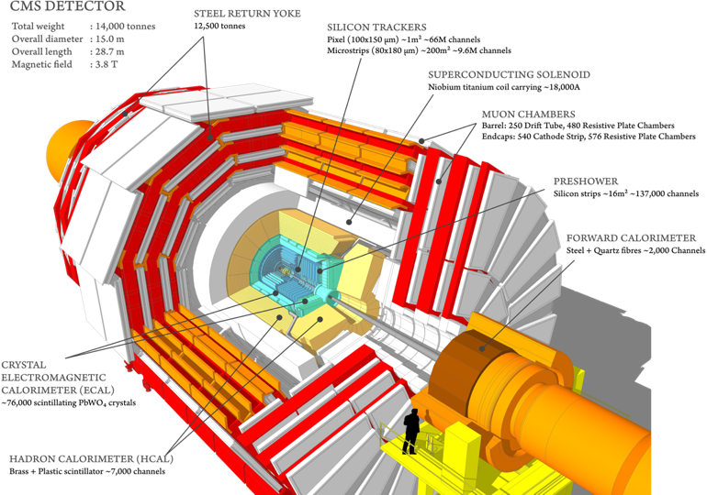
Report on the scientific results obtained
by the JINR group in the CMS experiment
JINR Topic 02-1-1083-2009
CMS Membership
218 | full member institutes
29 | associated institutes
10 | cooperating institutes
5864 | active members
58 | countries
2062 | phd physicists
1171 | physics doctoral students
1293 | non doctoral students
978 | engineers
252 | technicians
108 | administrates
Vladimir Karjavine
for JINR CMS group
60th Meeting of the Programme Advisory Committee. 17.06.2024.

Slide 2
JINR Group Activities in 2024
JINR team responsibility (M&O category B):
- Detectors commissioning after 2023-2024 YETS.
- Detectors maintenance and operation in RUN-3.
- JINR Tier-1 and Tier-2 centers robust operation.
Participation in CMS Phase-2 upgrade:
- Construction of the High Granularity Calorimeter.
- Endcap Muon system upgrade.
Participation in physics analysis and software development.
JINR team composition
Participants from JINR: 70.
JINR authors in CMS: 21
(17 paid and 4 unpaid PhD Students).
DMS authors in CMS: 4
(3 paid by JINR and 1 unpaid PhD Student).
11 young researchers: (6 PhD Students
from JINR, 5 PhD Students from DMS.
JINR team full time equivalent (FTE):
84.27 FTE-months* (work due).
64 central shifts were served by JINR
group in 2024.
CMS duties executed by JINR physicists:
HCAL Technical Coordination.
Muon DQM Coordination.
CMS data managers of Tier-1 and Tier-2 sites.
Participation in Analysis Review Committee (ARC) and Institutional publication review (IR).
Members of institution and collaboration boards.
*) According to Experimental Physics Responsibilities (EPR) each author (paid and unpaid) is required to work on operational, maintenance, upgrade duties, including participation in shifts, at least 4 months
2

Slide 3
Publications
JINR group publication in 2024
The full list of the CMS publications with JINR authors - 61 scientific papers.
JINR physicists made a significant contribution to the preparation: 2 CMS papers and 8 papers in journals and proceedings.
The results of the scientific research were presented in 12 reports at the international conferences.
CMS publication and statistics
Currently at 1296 papers on collision data (RUN-1/RUN-2/RUN3).
7 public results from RUN-3 @ 13.6.
Many new results planned for upcoming summer conferences.
Initiated task force on a time to publications.
3

Slide 4
JINR activity in the CMS physics analysis and SW
Physics beyond the Standard Model and Higgs Physics.
Search for physics beyond the standard model in dilepton mass spectra in pp collision search for new gauge bosons, extra dimensions, new higgs states, dark matter candidates.
Searches for signals of dark matter and new scalar bosons beyond SM (extra Higgs bosons) produced pairs of leptons/b-quarks and missing ET.
Search for a μ+μ-+b-jet event excess at the dimuon mass of 28 GeV in pp collisions at 13 TeV.
Search for physics beyond the standard model in processes with fermion flavor violation (microscopic black holes, dark matter candidates, new higgs states).
Studies of Higgs bosons with bbar-decays in Vector-Boson-Fusion Higgs production process.
Standard Model
Measurement of the differential Drell-Yan cross section in p-p collisions. Drell-Yan Radiative Corrections.
Angular coefficients of Z bosons produced in pp collisions as a function of transverse momentum and rapidity.
Measurements of the multiplicity in quark and gluon jets and fractions of gluon jets.
Algorithms and Software
Development of algorithms for high-momentum muons reconstruction. Muon hit reconstruction and segment builder.
Data Certification (DC) software development with machine learning (ML) algorithms.
4

Slide 5
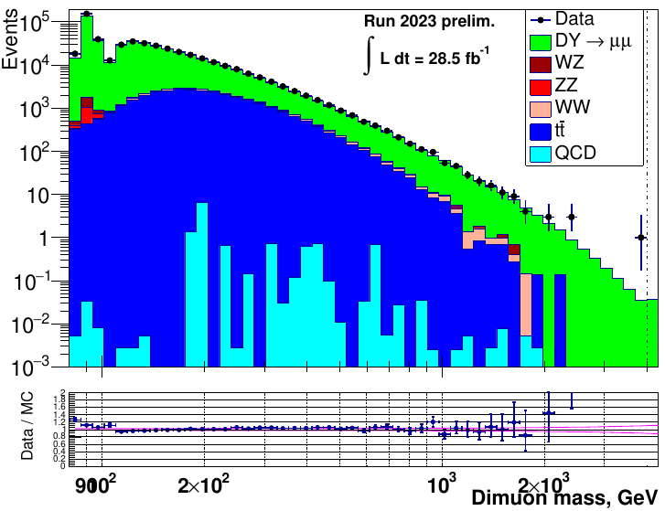
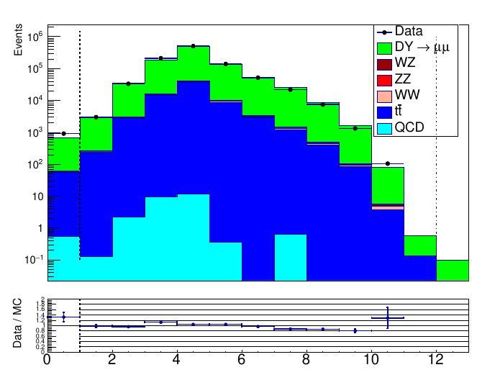
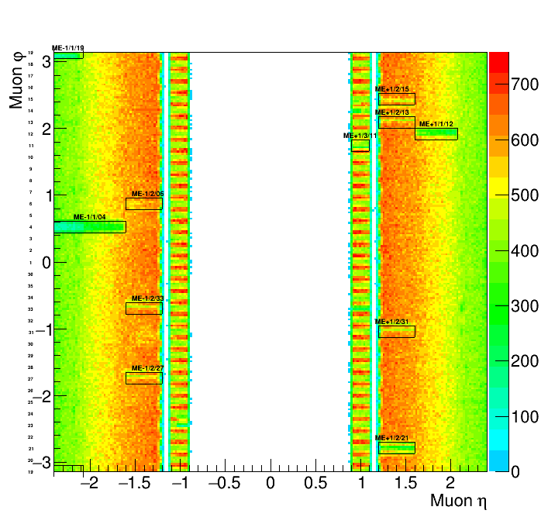
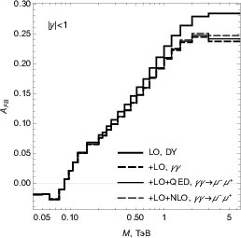
Searches for heavy dimuon resonances with the LHC RUN-3 data
Analysis focused on search for new physics beyond the SM (new gauge bosons, graviton exited states, dark matter mediators).
Preliminary
Scrutiny of events with heavy dimuons is done
Used new MC samples simulated at 13.6 TeV.
Data/MC plots of various kinematical quantities were studied.
Distributions of muon angles from dimuons were used to check the performance of the CSC chambers.
Distributions of eta-phi of reconstructed muon tracks matched to the CSCs in Endcap Muon Station 1.
Rectangles indicate non-effective chambers/channels.
Reconstructed dimuon mass [in GeV].
Distribution of number of pixel hits per muon.
Good agreement with the expected MC @ 13,6 TeV !
Photon-induced background is studied.
Forward-backward asymmetry
One-loop electroweak radiative corrections to dilepton production in hadron collisions via photon fusion are estimated.
Photon-induced background has to be accounted for m > 1 TeV.
5

Slide 6
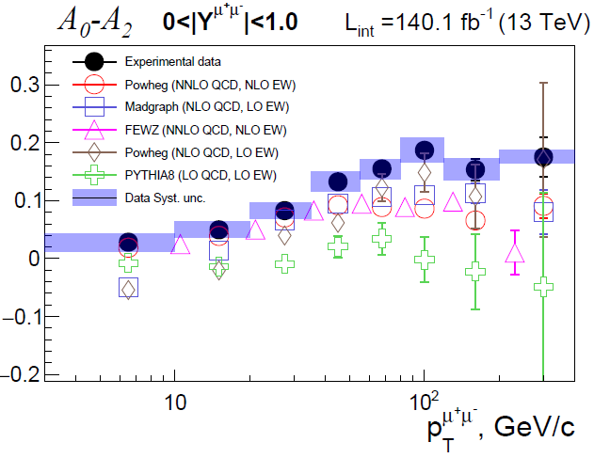
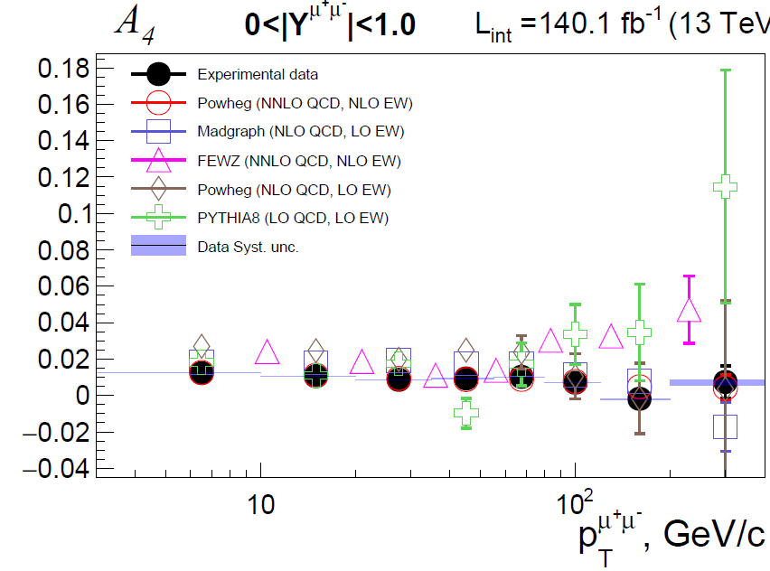
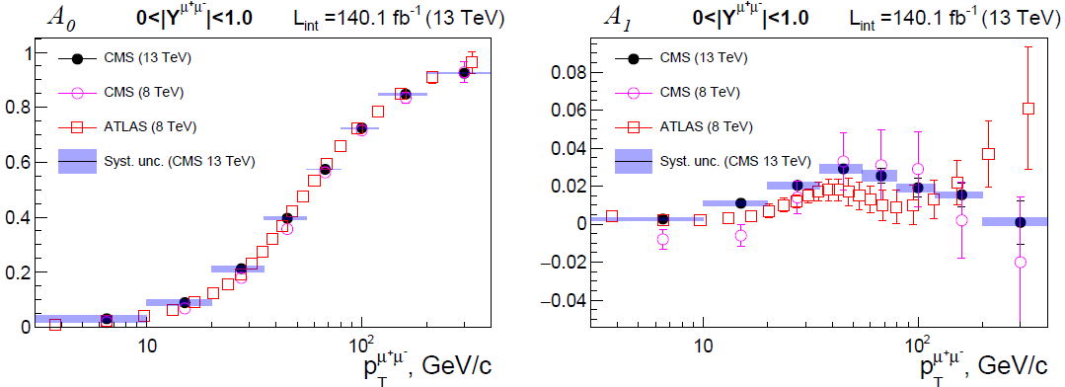
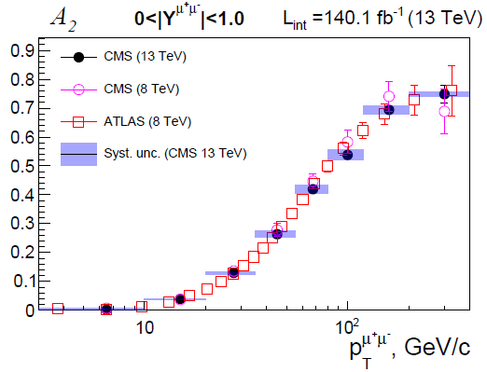
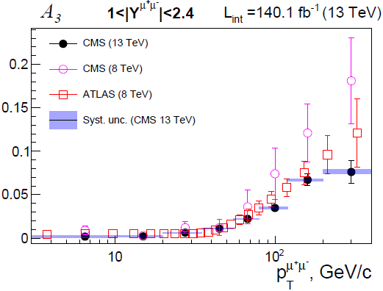
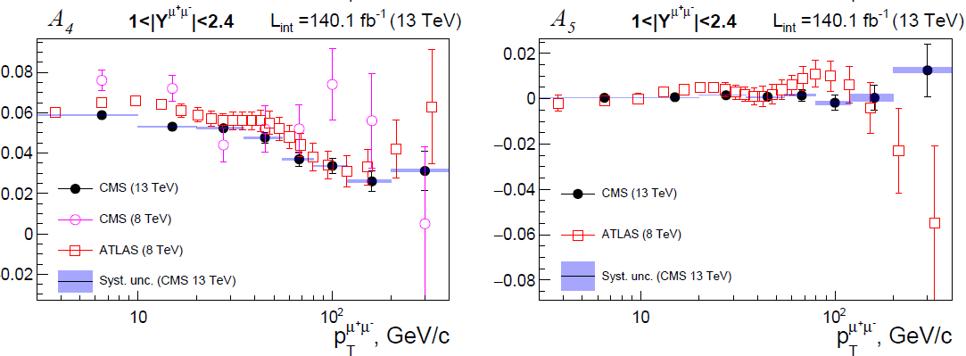
Measurement of Drell-Yan Angular Polarization Coefficients
The full set of angular polarization coefficients and $A_{0}{−A}_{7}$was measured at the first time in the CMS experiment.
Non-conservation of the Lam-Tung relation $A_{0}−A_{2}=0$ was also observed in pp-collisions at $\sqrt{s}=13$ TeV.
Results are compared with calculations in higher orders and previous measurements at $\sqrt{s}=8$ TeV. Good Agreement is observed.
CMS Note was created with a full description of the analysis methodology (Analysis Note 20-220v9).
The analysis has been assigned a CADI number: SMP-23-007.
A prototype of an article in Physical Letters B is under CMS collaboration review.
Results going to CMS Collaboration pre-approval procedure.
PhD thesis based on this analysis going to defence.
6

Slide 7
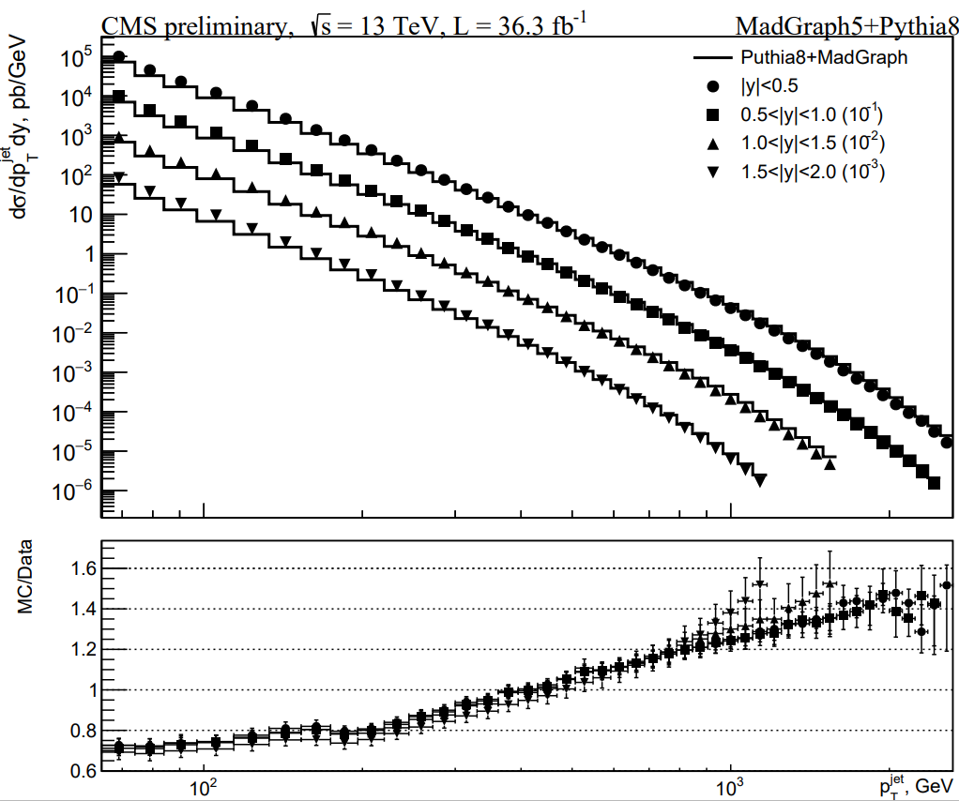
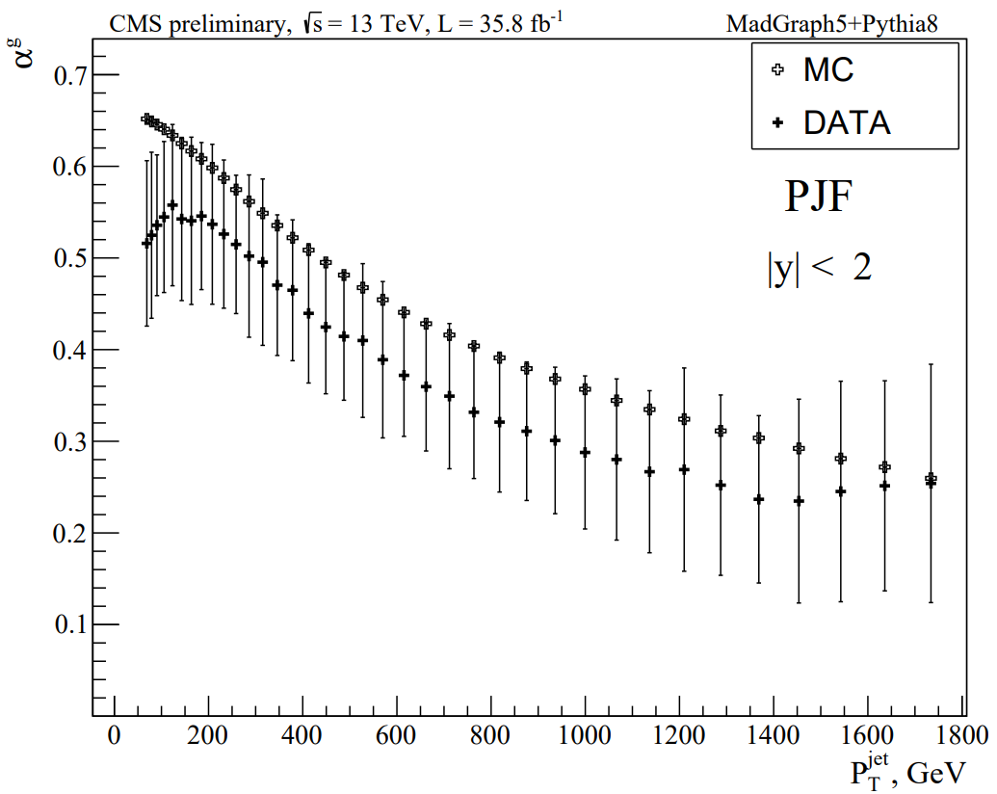
Progress on q/g-jet Fractions Measurement
Status of development of the g-fraction measurement techniques:
The new method of g-fraction measurement in inclusive jets was proposed and implemented (with Run-1 and Run-2 data, Run-3 in progress).
Inclusive jet spectra was obtained on detector level without unfolding and has good agreement with other analysis.
Measurement of g-fractions as a function of $p_{T}^{jet}$ was taken.
It was shown that measurement of g-fractions is a good test for q/g-discriminators.
Concept of “Model Uncertainty of q/g-templates in the measured g-fractions” is introduced:
- Model Uncertainty is estimated for the PYTHIA8 model : $>$ $±$20% .
It means that PYTHIA8 fragmentation model need to be significantly corrected.
Model Uncertainty study with HERWIG fragmentation model is in progress.
CMS analyses note AN-23-153 “Measurement of g-fractions in inclusive jets” at the final stage
of approval.
preliminary
Inclusive jet spectra.
preliminary
g-jet fractions in $p_{T}^{jet}$ bins.
7

Slide 8
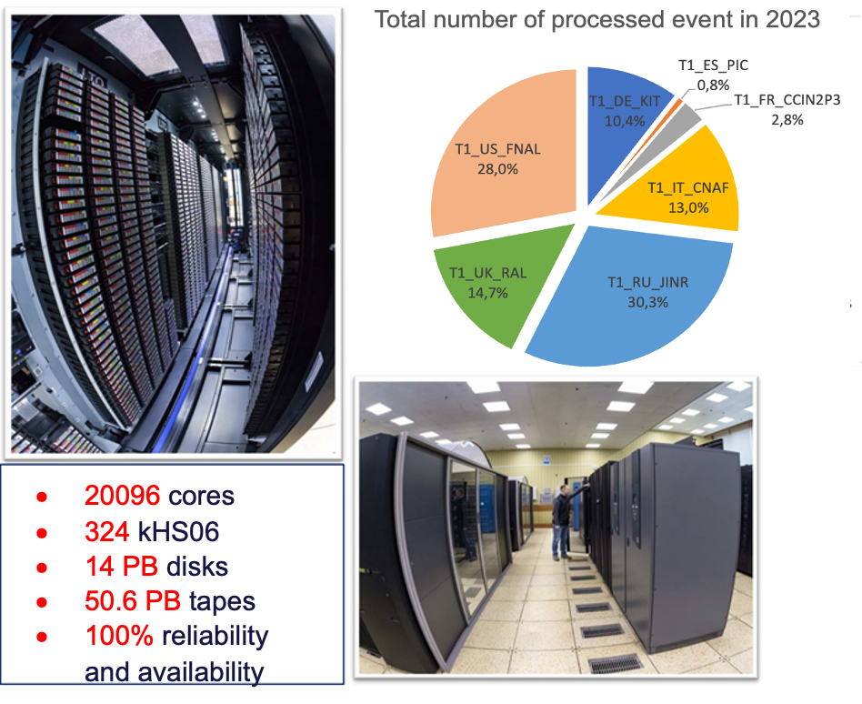
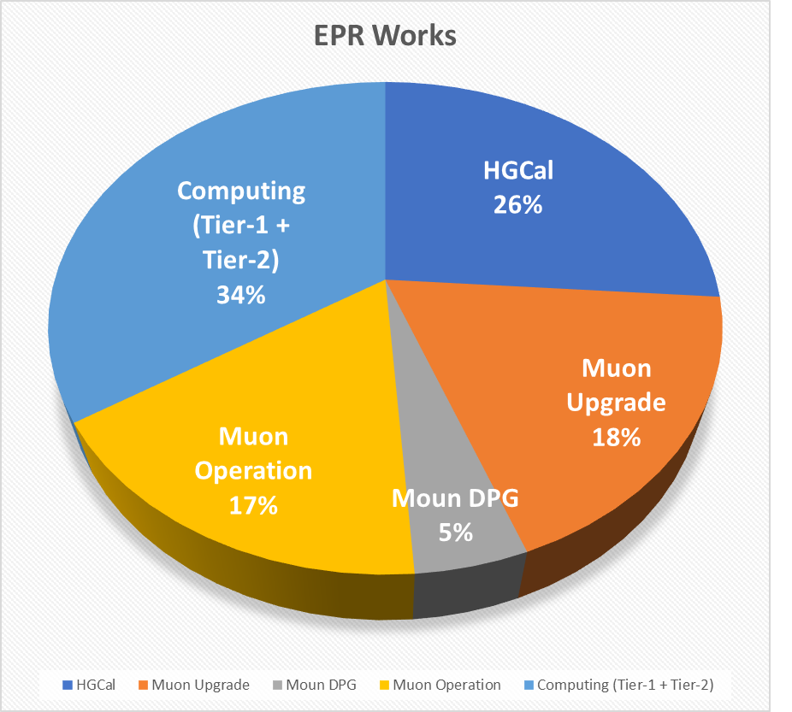
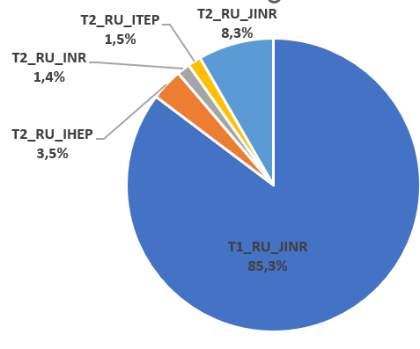
JINR contribution in CMS Computing
In the first half of 2024 JINR grid Tier-1 and Tier-2 centers extensively used for processing and storing CMS data, ensuring 100% availability and reliability of services.
More than 294 million events were successfully processed by JINR Tier-1 in the first half of 2024.
The JINR Tier-1 is ranked the second place among all CMS Tier-1 centers.
JINR Contribution in RDMS
Computing is crucial.
Total number of completed jobs by Russian sites in 2024
JINR Tier2 is the most productive in
the Russian Data Intensive Grid (RDIG).
8

Slide 9
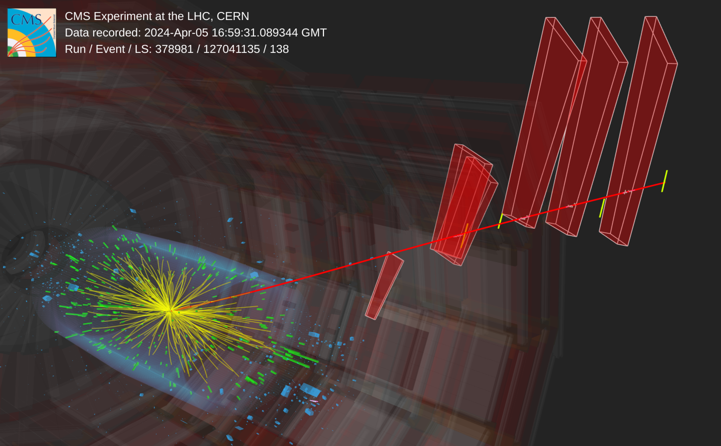
CMS RUN-3 2024 year plan
Year End Technical Stop (YETS) work was completed successfully, and CMS was commissioned for the start of the 2024 Run.
First splashes - 8 March and 13 March.
2024 pp Physics Run is started on April 14.
Stable beams at 13.6 TeV for physics (1200 bunches).
End of 2024 pp run will be on October 17th, 2024.
Pb-Pb ion run to start on November 5th ppref setup
starts on October 24th.
2024-2025 YETS start on Nov 25th.
First stable beam collisions seen in CMS at 13.6 TeV:
muon in the CSCs
9

Slide 10
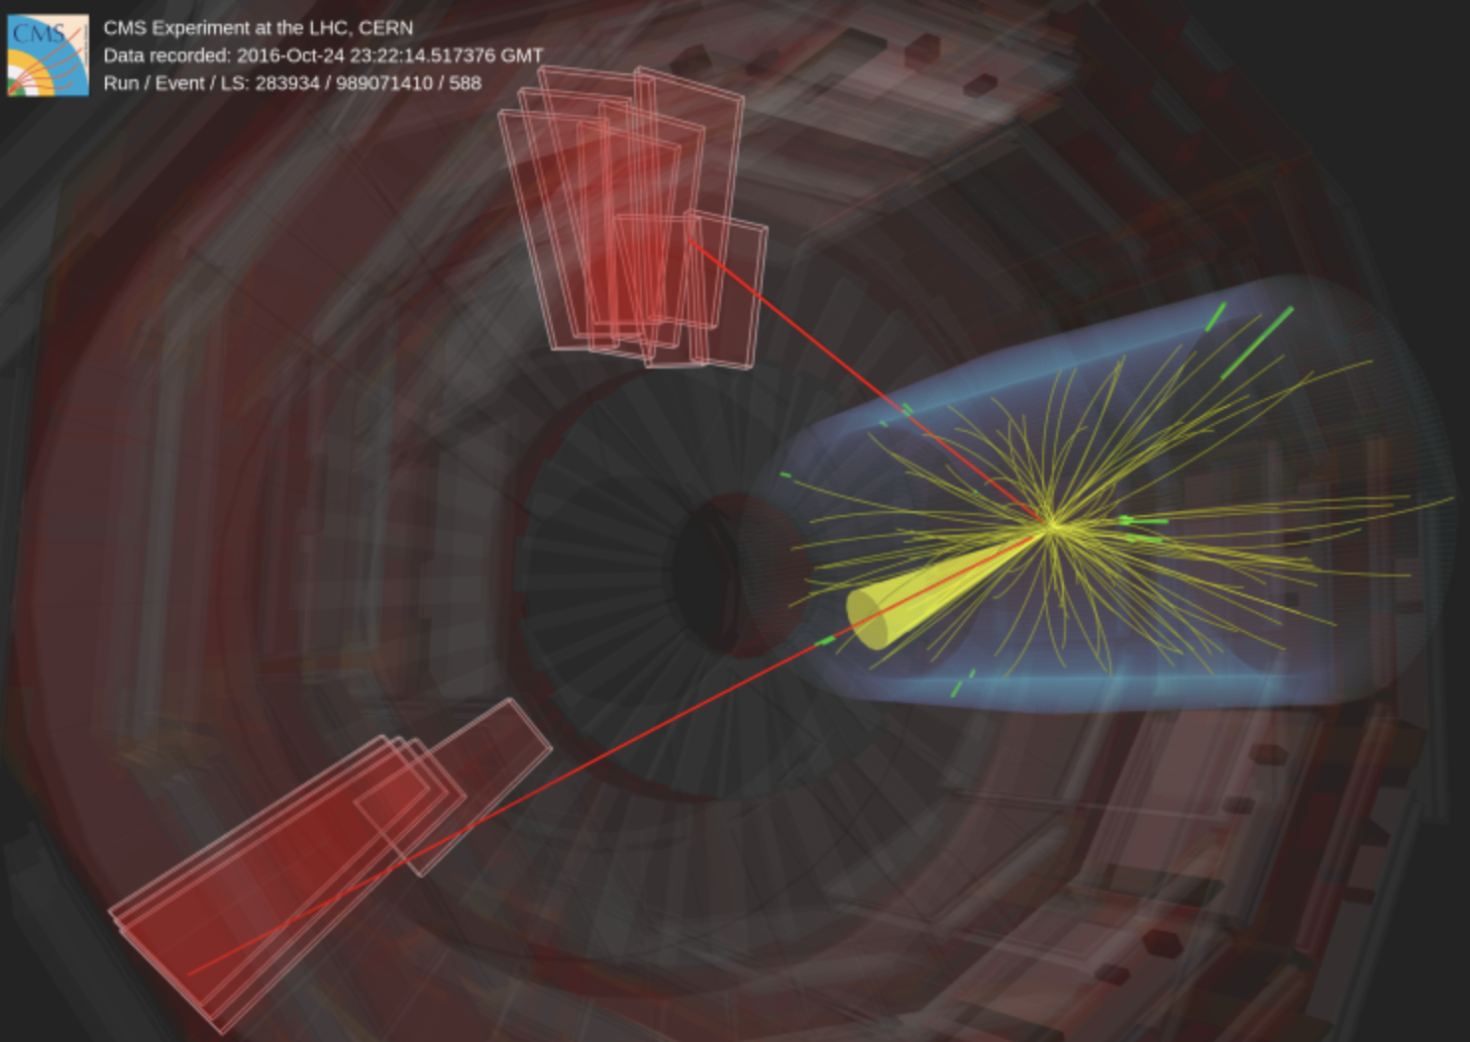
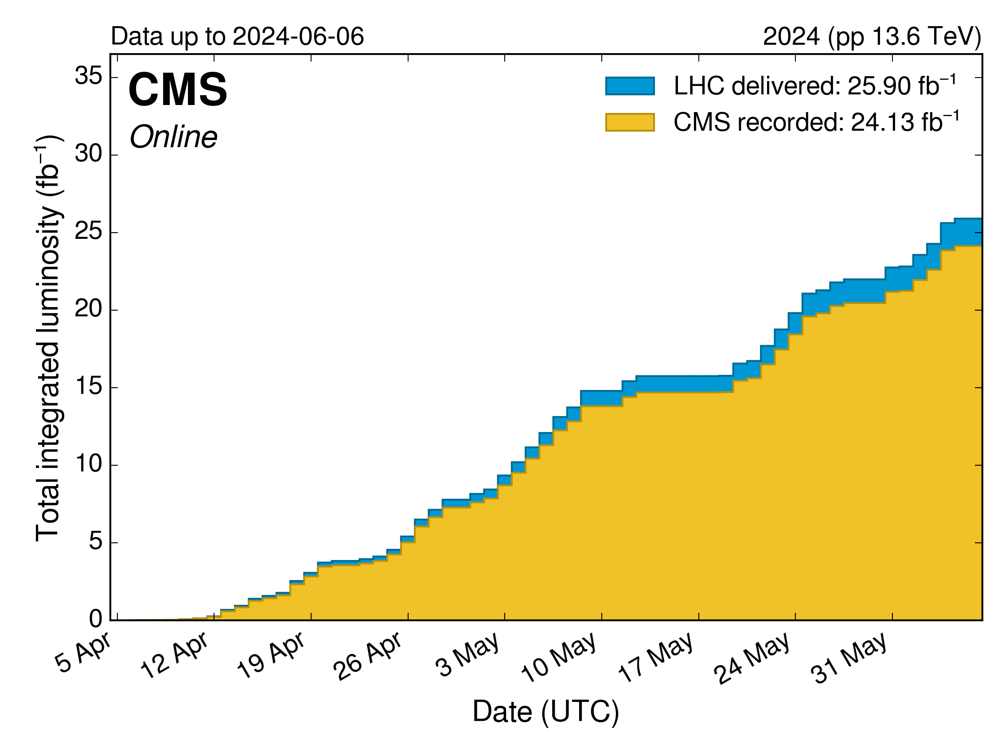
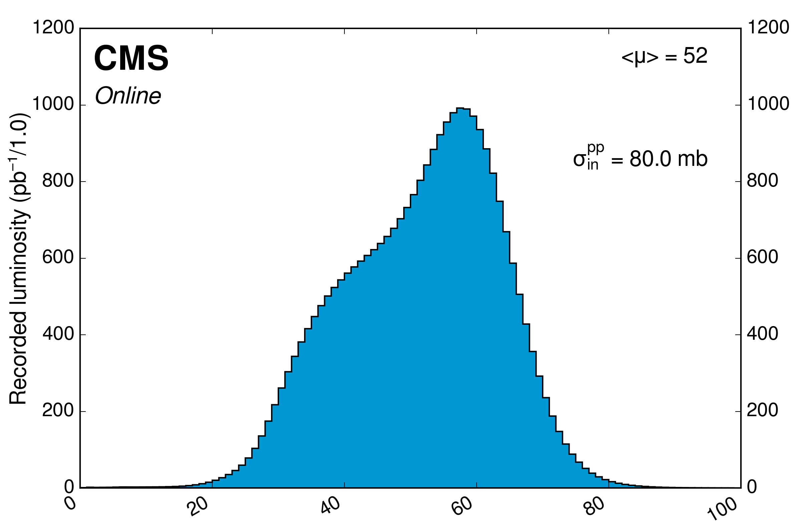
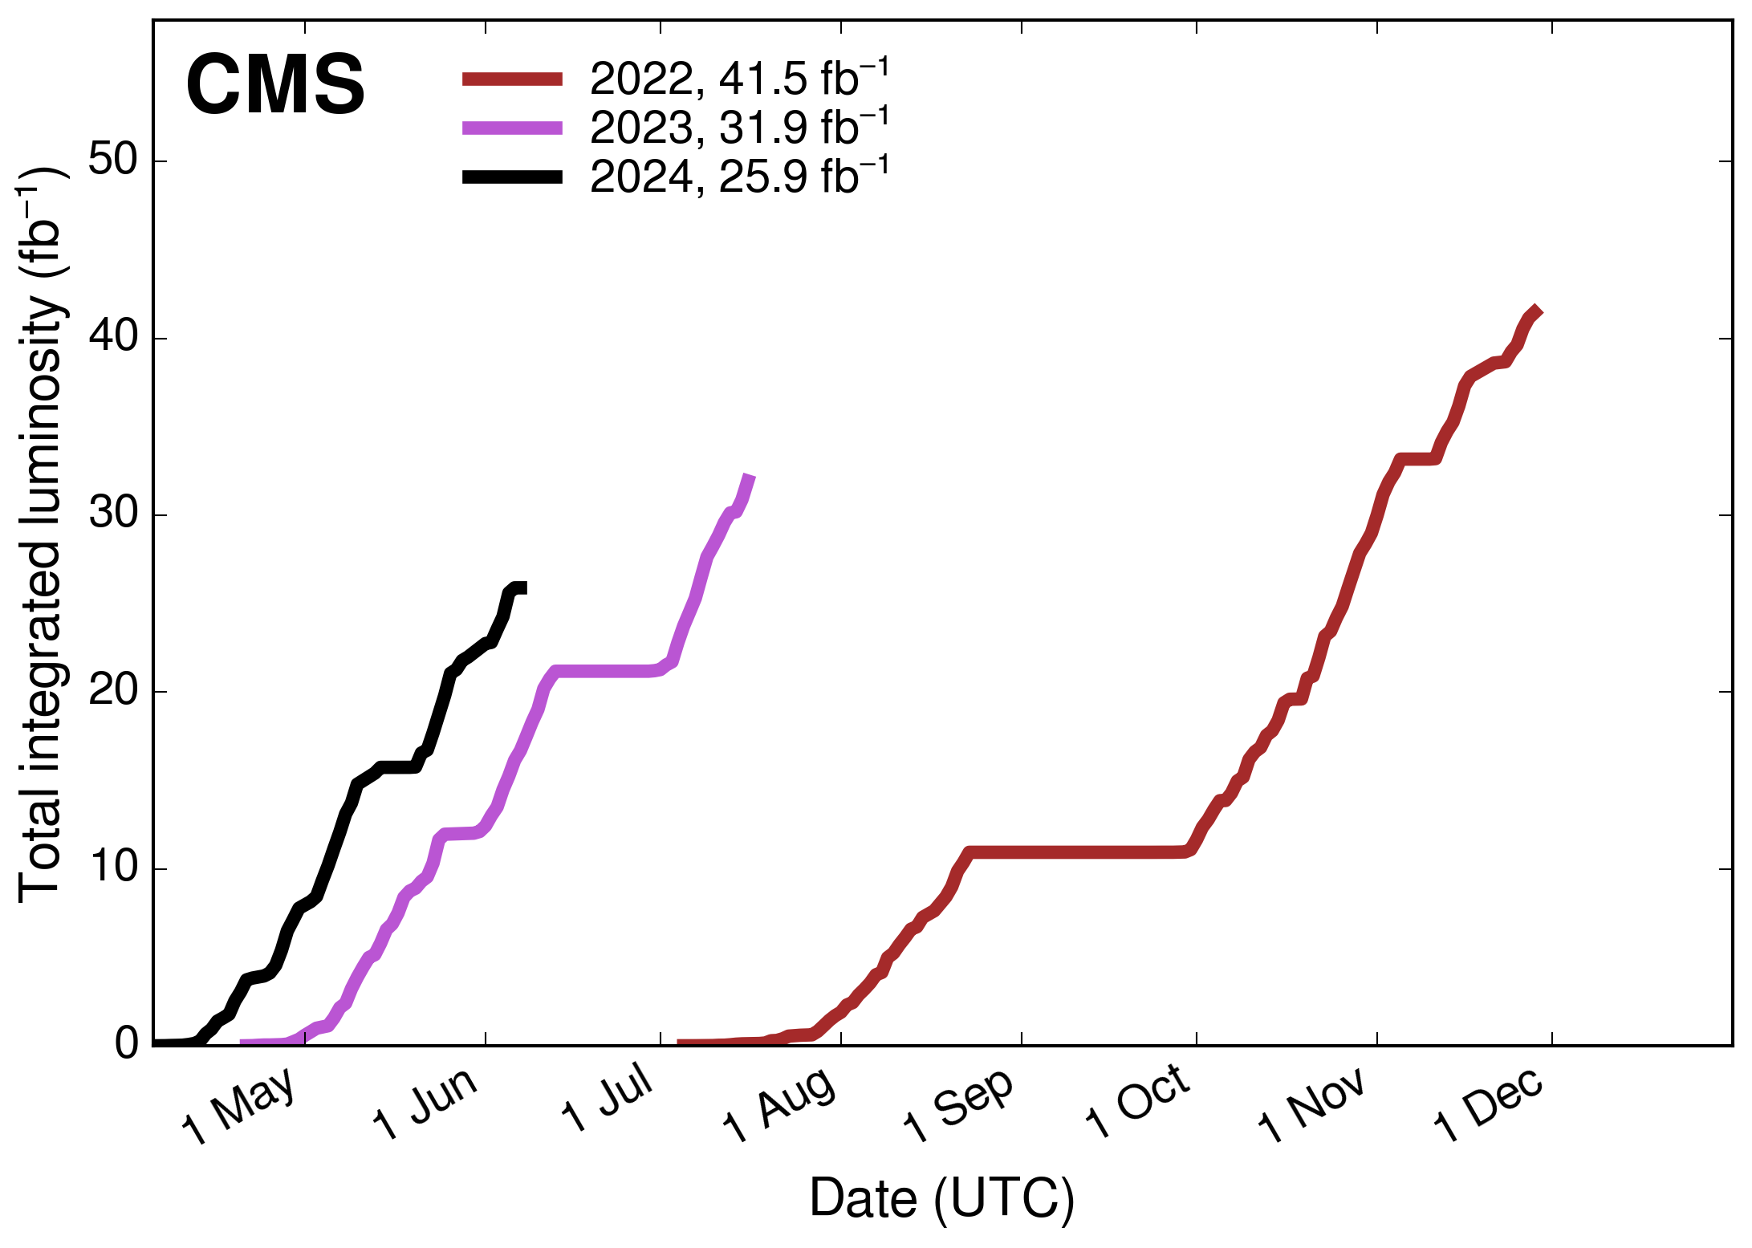
CMS operation in RUN-3 2024
Proton-proton collisions at 13.6 TeV.
CMS data taking efficiency in 2024 (pp): ~ 92%.
Run-3 pp data certification efficiency 94%.
Luminosity summary up to June 2024
Luminosity delivered in 2024: 25.90 fb⁻¹
CMS recorded: ~24.13 fb⁻¹
Data taking efficiency in 2024 (pp): ~ 93.16%.
Luminosity delivered in Run-3 so far: 99.30 fb⁻¹
CMS recorded: 91.50 fb⁻¹
Data taking efficiency in RUN-3 (pp): 92.15%.
Pileup distribution
Mean number of interactions per bunch crossing for the pp Run-3 at 13.6 TeV,
10

Slide 11
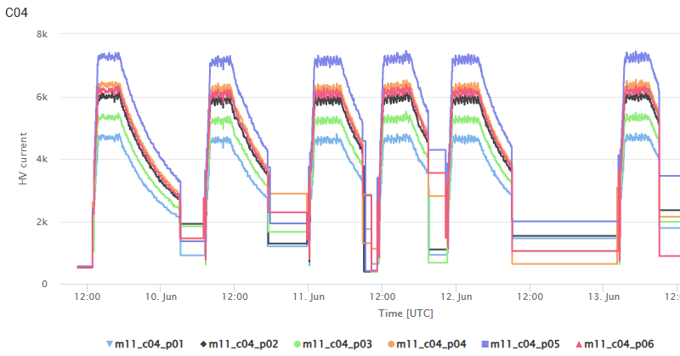
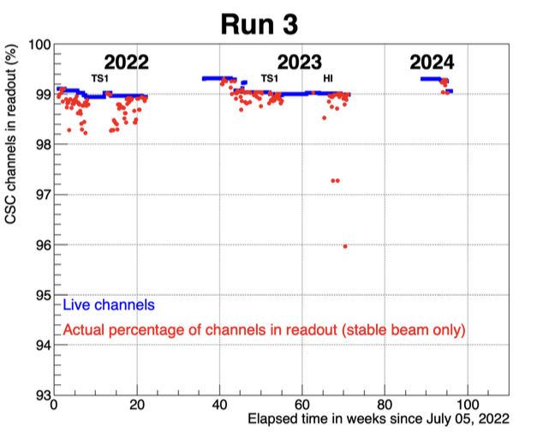
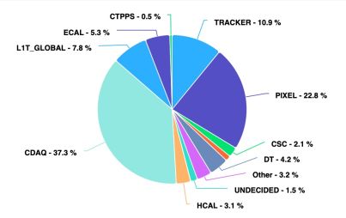
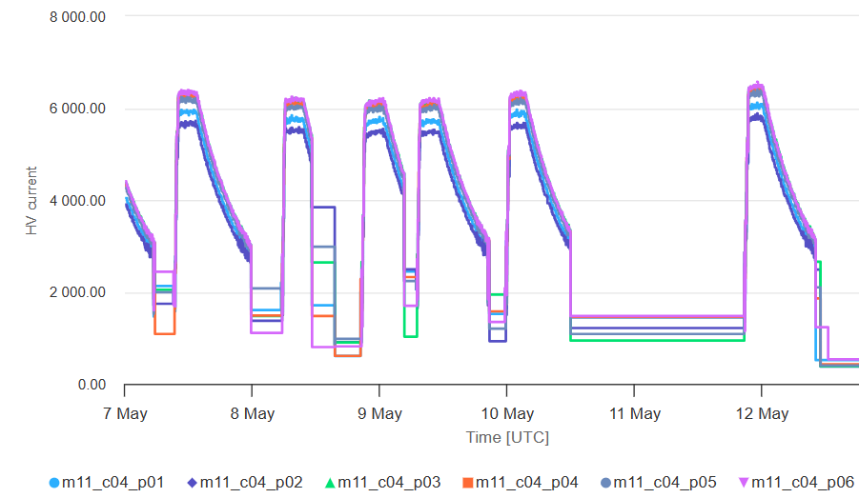
Detectors Operation in RUN-3 2024
Summary of the first stable beam period at 13.6 TeV.
Muon CSC
ME1/1 CSC HV system was replaced by a new.
In 2024 HV correction was performed to equalize the gas gain values in ME1/1 layers.
HCAL
A prefire veto in HCAL successfully commissioned and functionally added to the peak finding algorithm.
Phase scan performed, timing alignments improved
Method of SiPM temperature control (temperature stabilization) improved.
HCAL was running fine without any major issues.
The Muon system shows good performance, comparable to previous years.
CSC operating well: 99.32% active channels.
June 2023
HV current (nA)
Downtime
Time (UTC)
May 2024
HV current (nA)
Time (UTC)
11

Slide 12
JINR contribution to CMS Phase 2 Upgrade
Participation in High Granularity Calorimeter (HGCal) project.
Cooling plate of HGCal cassettes design and production technology reported on collaboration meeting. Preparation of CMS publication in progress.
Design and construction of the HGCAL silicon and scintillator cassettes test facility.
Participation in the Endcap Muon system upgrade.
Cathode Strip Chambers maintenance during LS3 long shutdown period.
CSC longevity study and searches for eco friendly gas mixtures R&D.
Design and construction of the new ME1/1 Patch Panel.
Design and construction of new tooling for ME1/1 CSC assembly and installation.
12

Slide 13
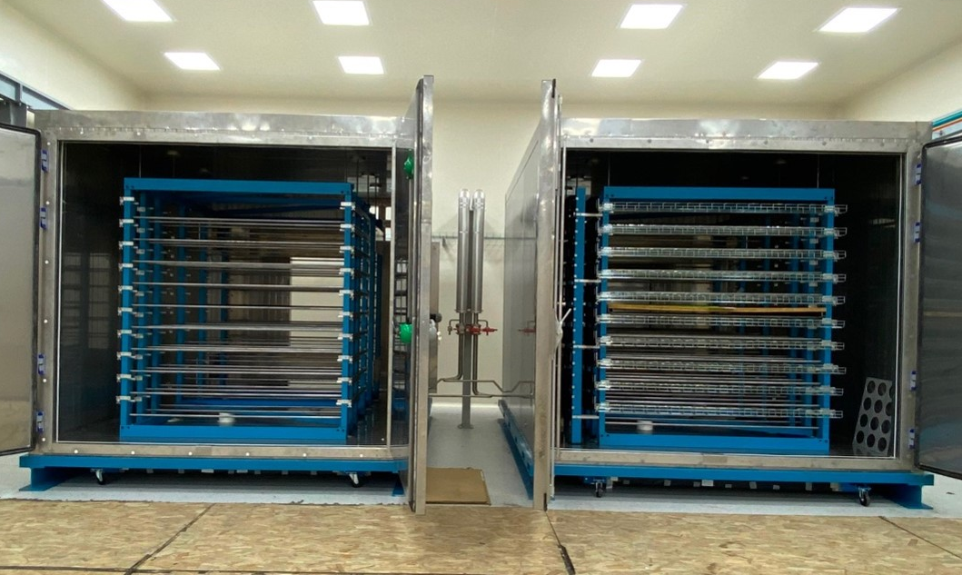
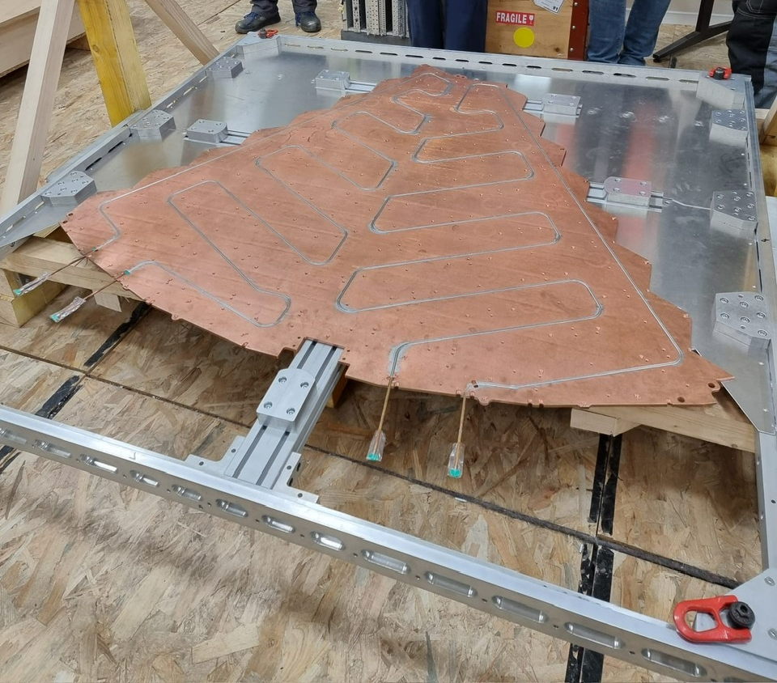
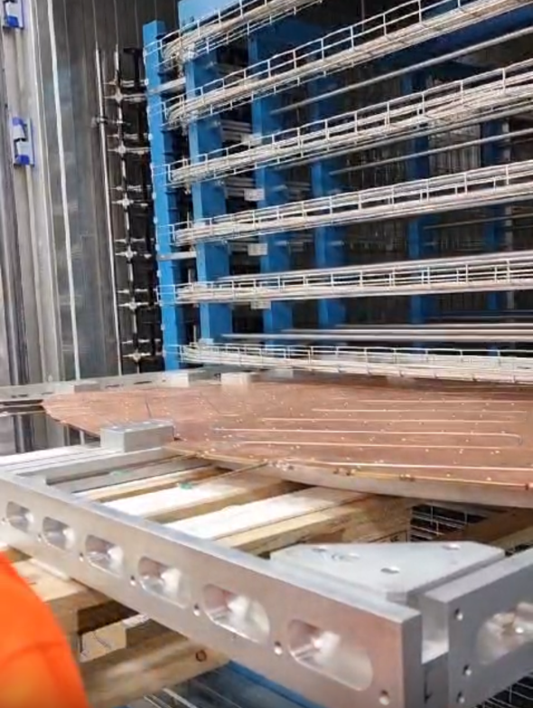
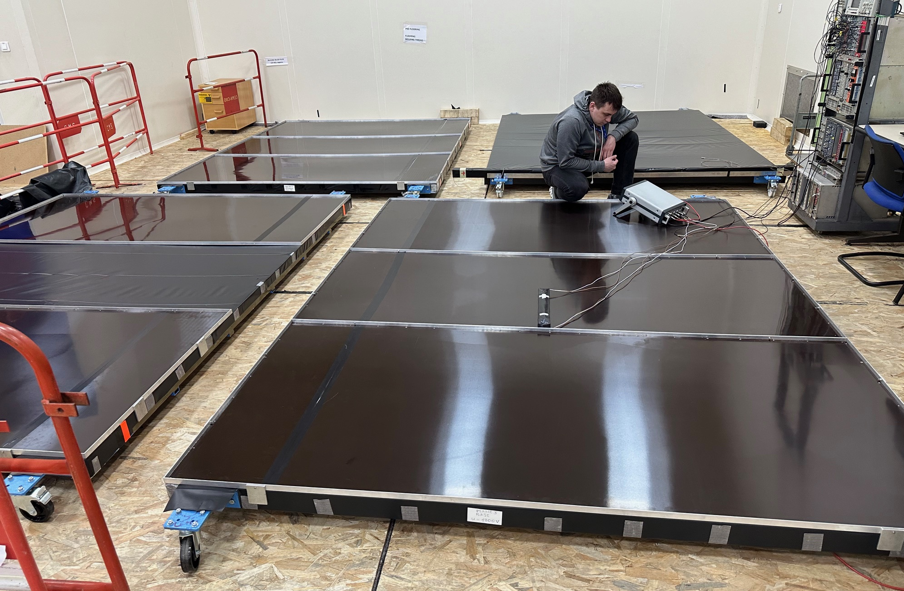
Setup for HGCal Cassettes Testing
2 Cold rooms were assembled at SX5 CERN
Test of the cassette insertion in the rack
Cassette on the supporting frame
Test setup includs:
Racks for cassettes (inside cold rooms).
Supporting frames for cassettes.
Scintillation trigger planes (on top and bottom of cold room)
Readout electronics
Commissioning of the scintillation trigger planes.
Plan to have the test facility is ready for operation by the end of 2024
13

Slide 14
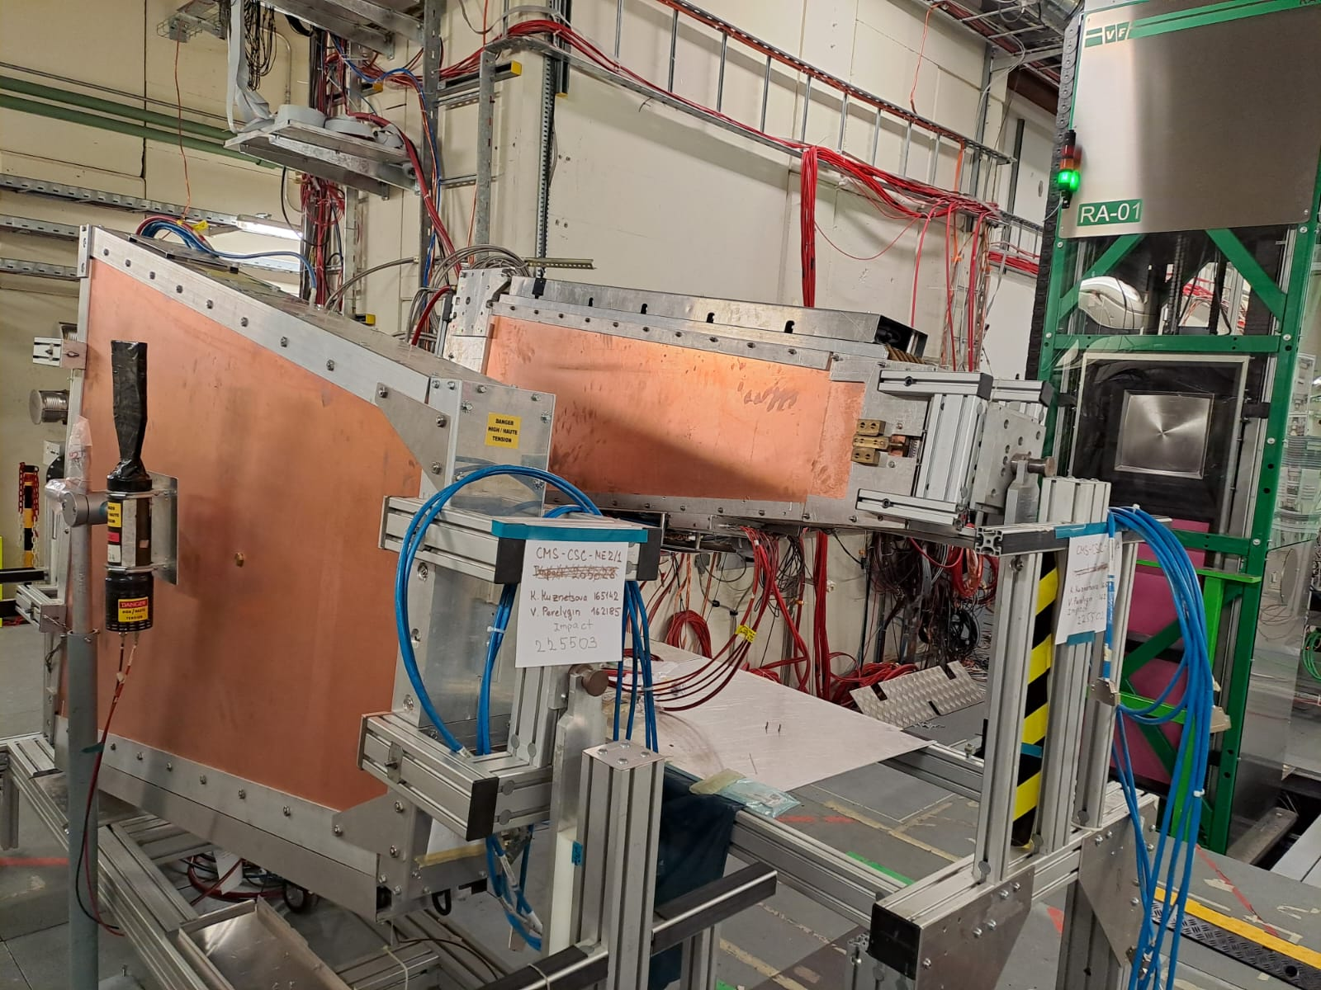
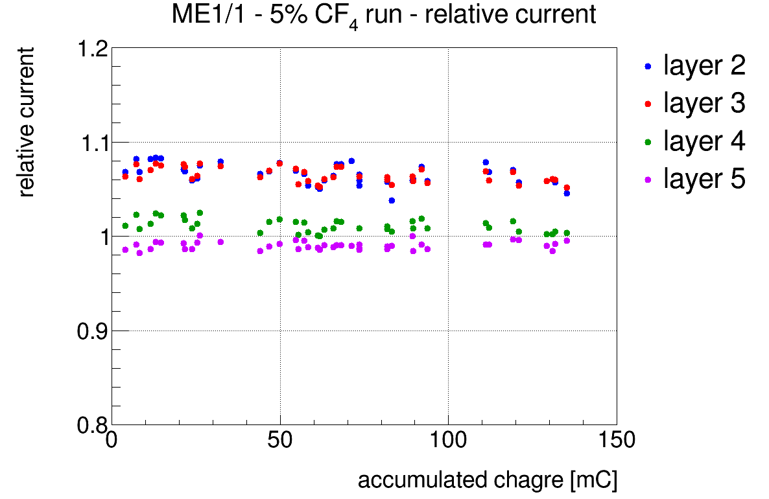
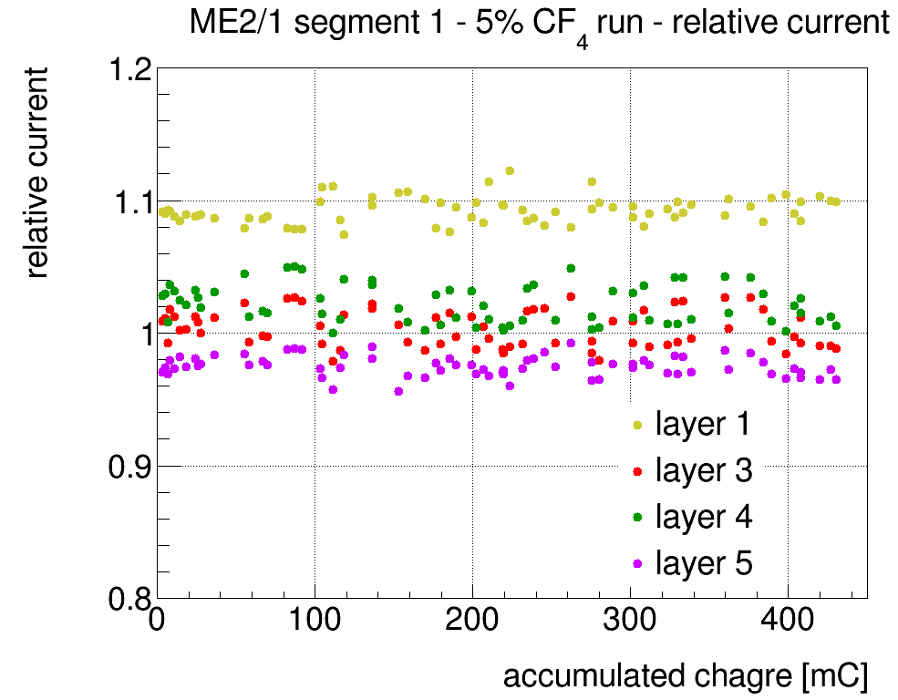
Cathode Strip Chamber Longevity Study @ GIF++
Irradiation setup: ME1/1 and ME2/1 CSCs exposed with the 12 TBq ¹³⁷Cs gamma source
at the GIF++ Facility (HV-ON on 4 layers and HV-OFF on 2 layers kept as reference).
CSC | HL-LHC Expected (3000 fb⁻1) mC/cm | Accumulated charge Q (mC/cm)
 |  | Before 2018 | Nov. 2021 | Oct. 2022 | May 2023 | 19.07.23 | 25.08.23 | 30.04.24
ME1/1 | 200 | 330 (10% CF₄) | 700 (2% CF₄) | 725 (5% CF₄) | 770 | 790 | 800 | 845
ME2/1 | 130 | 310 (10% CF₄) |  | 420 (5% CF₄) | 530 | 570 | 620 | 745
Relative current (I_{Layer}/<I_{referencs Layers}>) vs charge – for mixture with 5% CF4
¹³⁷Cs
ME1/1
ME2/1
2023 Test Beam at GIF++
Relative current is stable → no CSC performance degradation observed so far
14

Slide 15
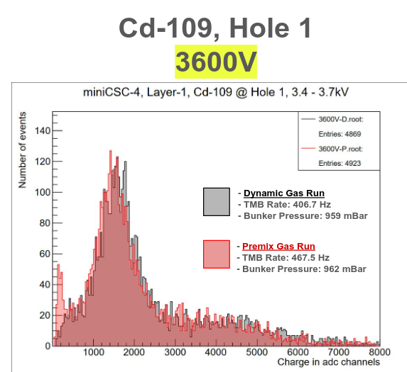
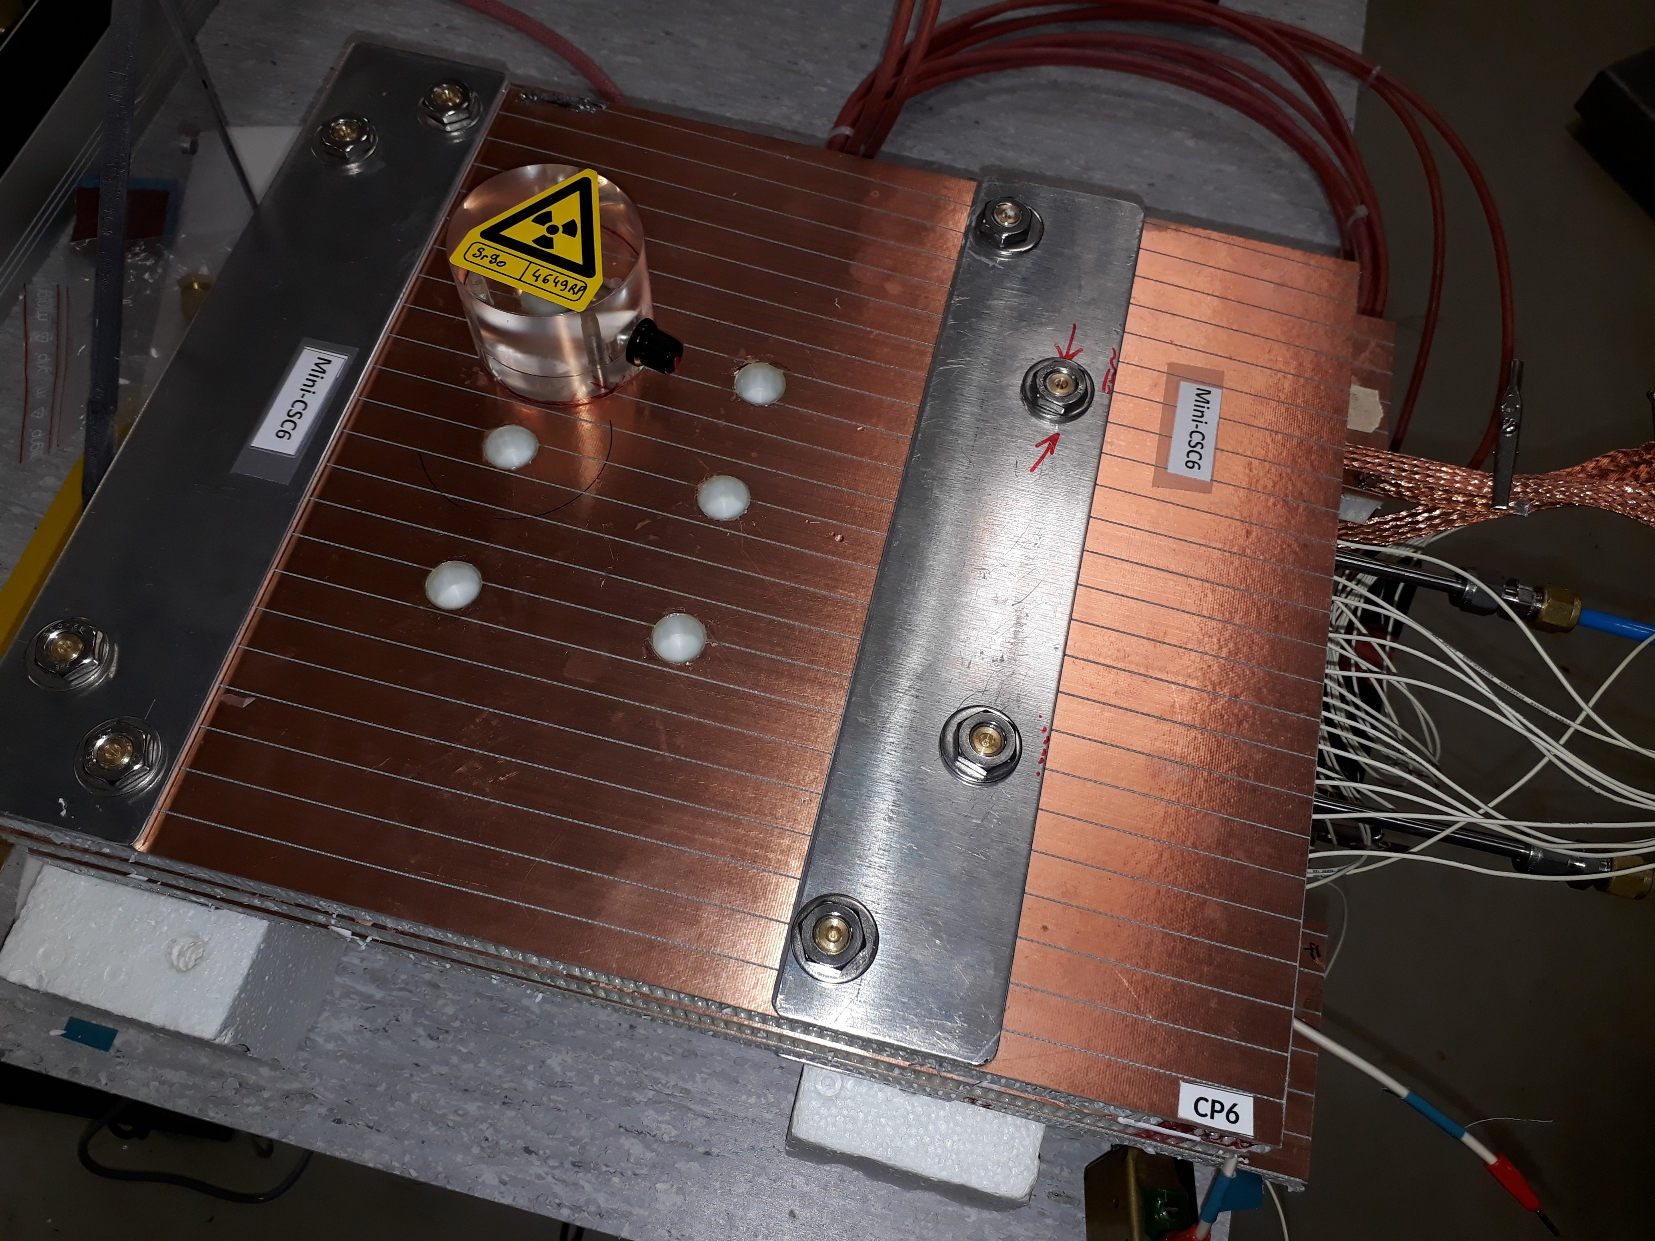
Searches for Eco-friendly Gas Mixtures
Motivation: CSC use CF4 to protect anode wire from Si deposits,
but it’s Global Warning Potential (GWP) is too high: ~ 7000 x CO₂.
Six 2-layer mini-CSCs with sensitive area (30 x 30 cm²) were constructed to study the CSC operation with the new gas mixtures.
Mini-CSC Gas mixer
for four component gas mixtures production has been constructed
Test of the Mini-CSC Gas mixer.
¹⁰⁹Cd spectra measured with mini-CSC with Ar+CO₂ (40/60) gas mixture industrially premixed in cylinder (pink) and produced by the Mini-CSC Gas mixer (grey).
The plot shows a good match of the spectra.
Aging Studies planned:
with recuperated CF₄ , produced at the CMS recuperation factory @ P5:
with HFO1234ze (C₃H₂F₄) as a potential CF₄ alternative (GWP<1).
15

Slide 16
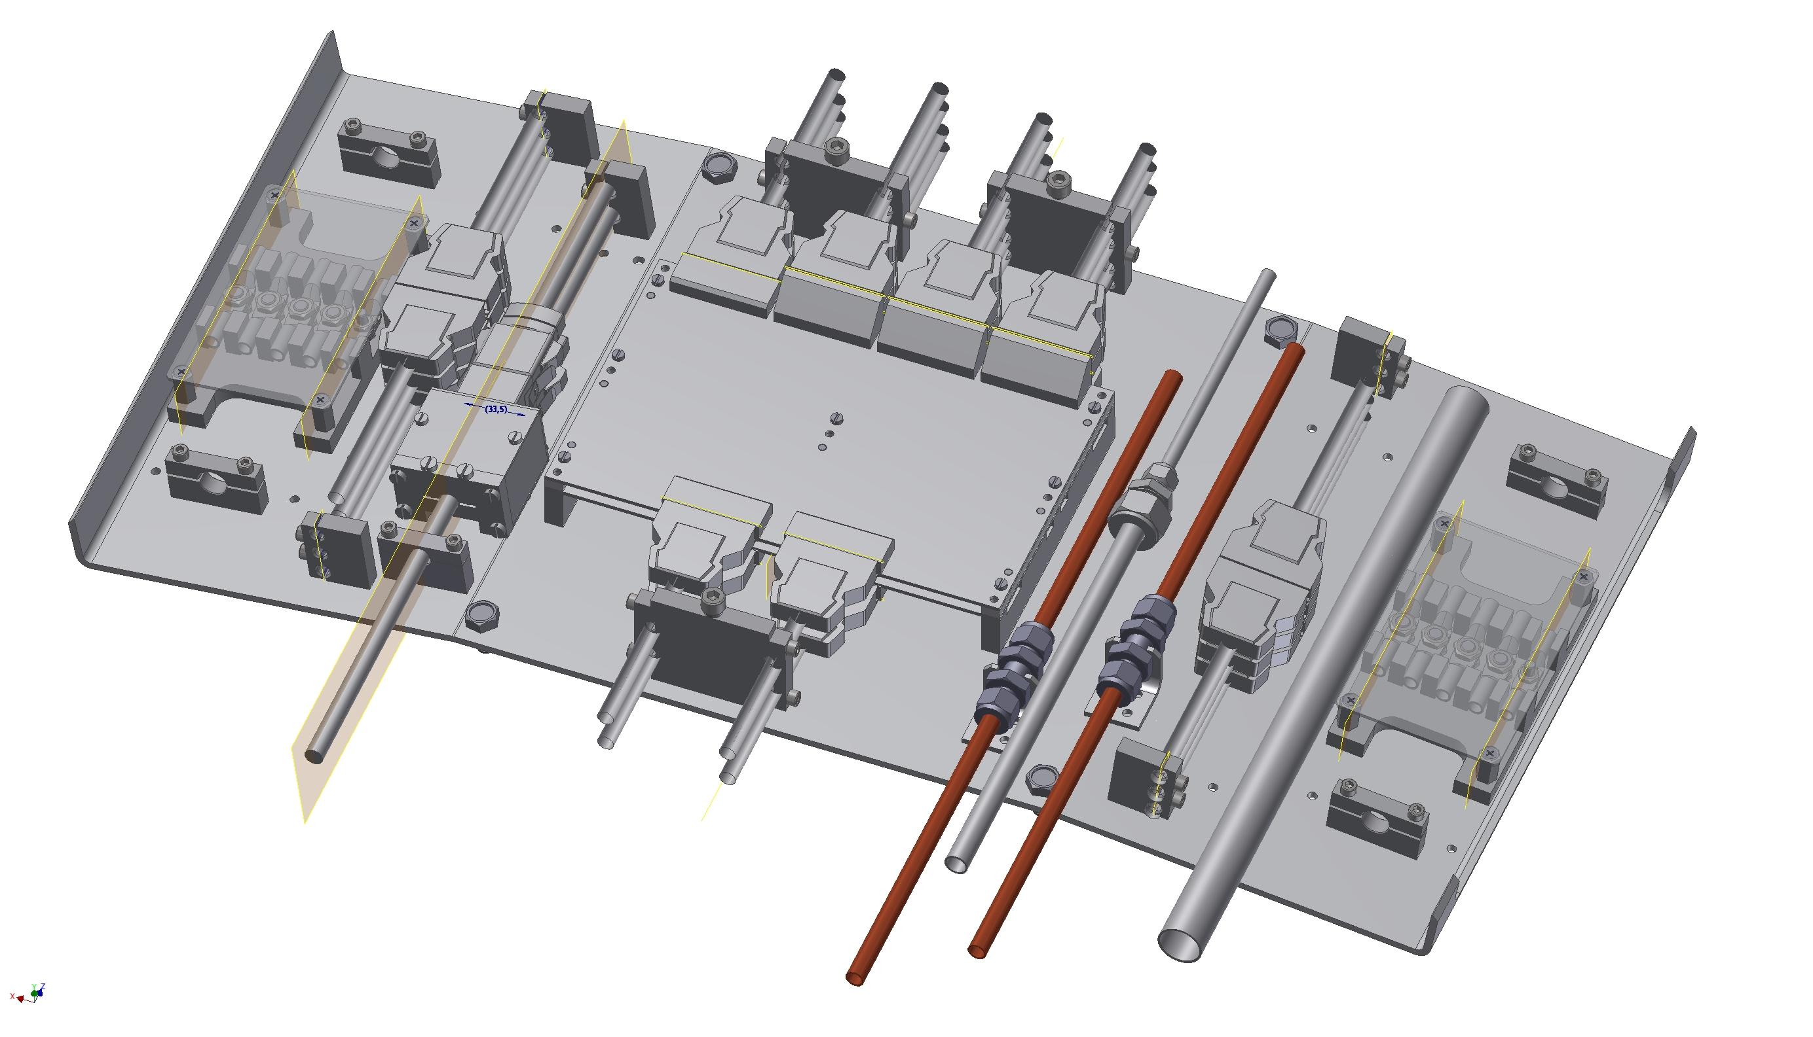
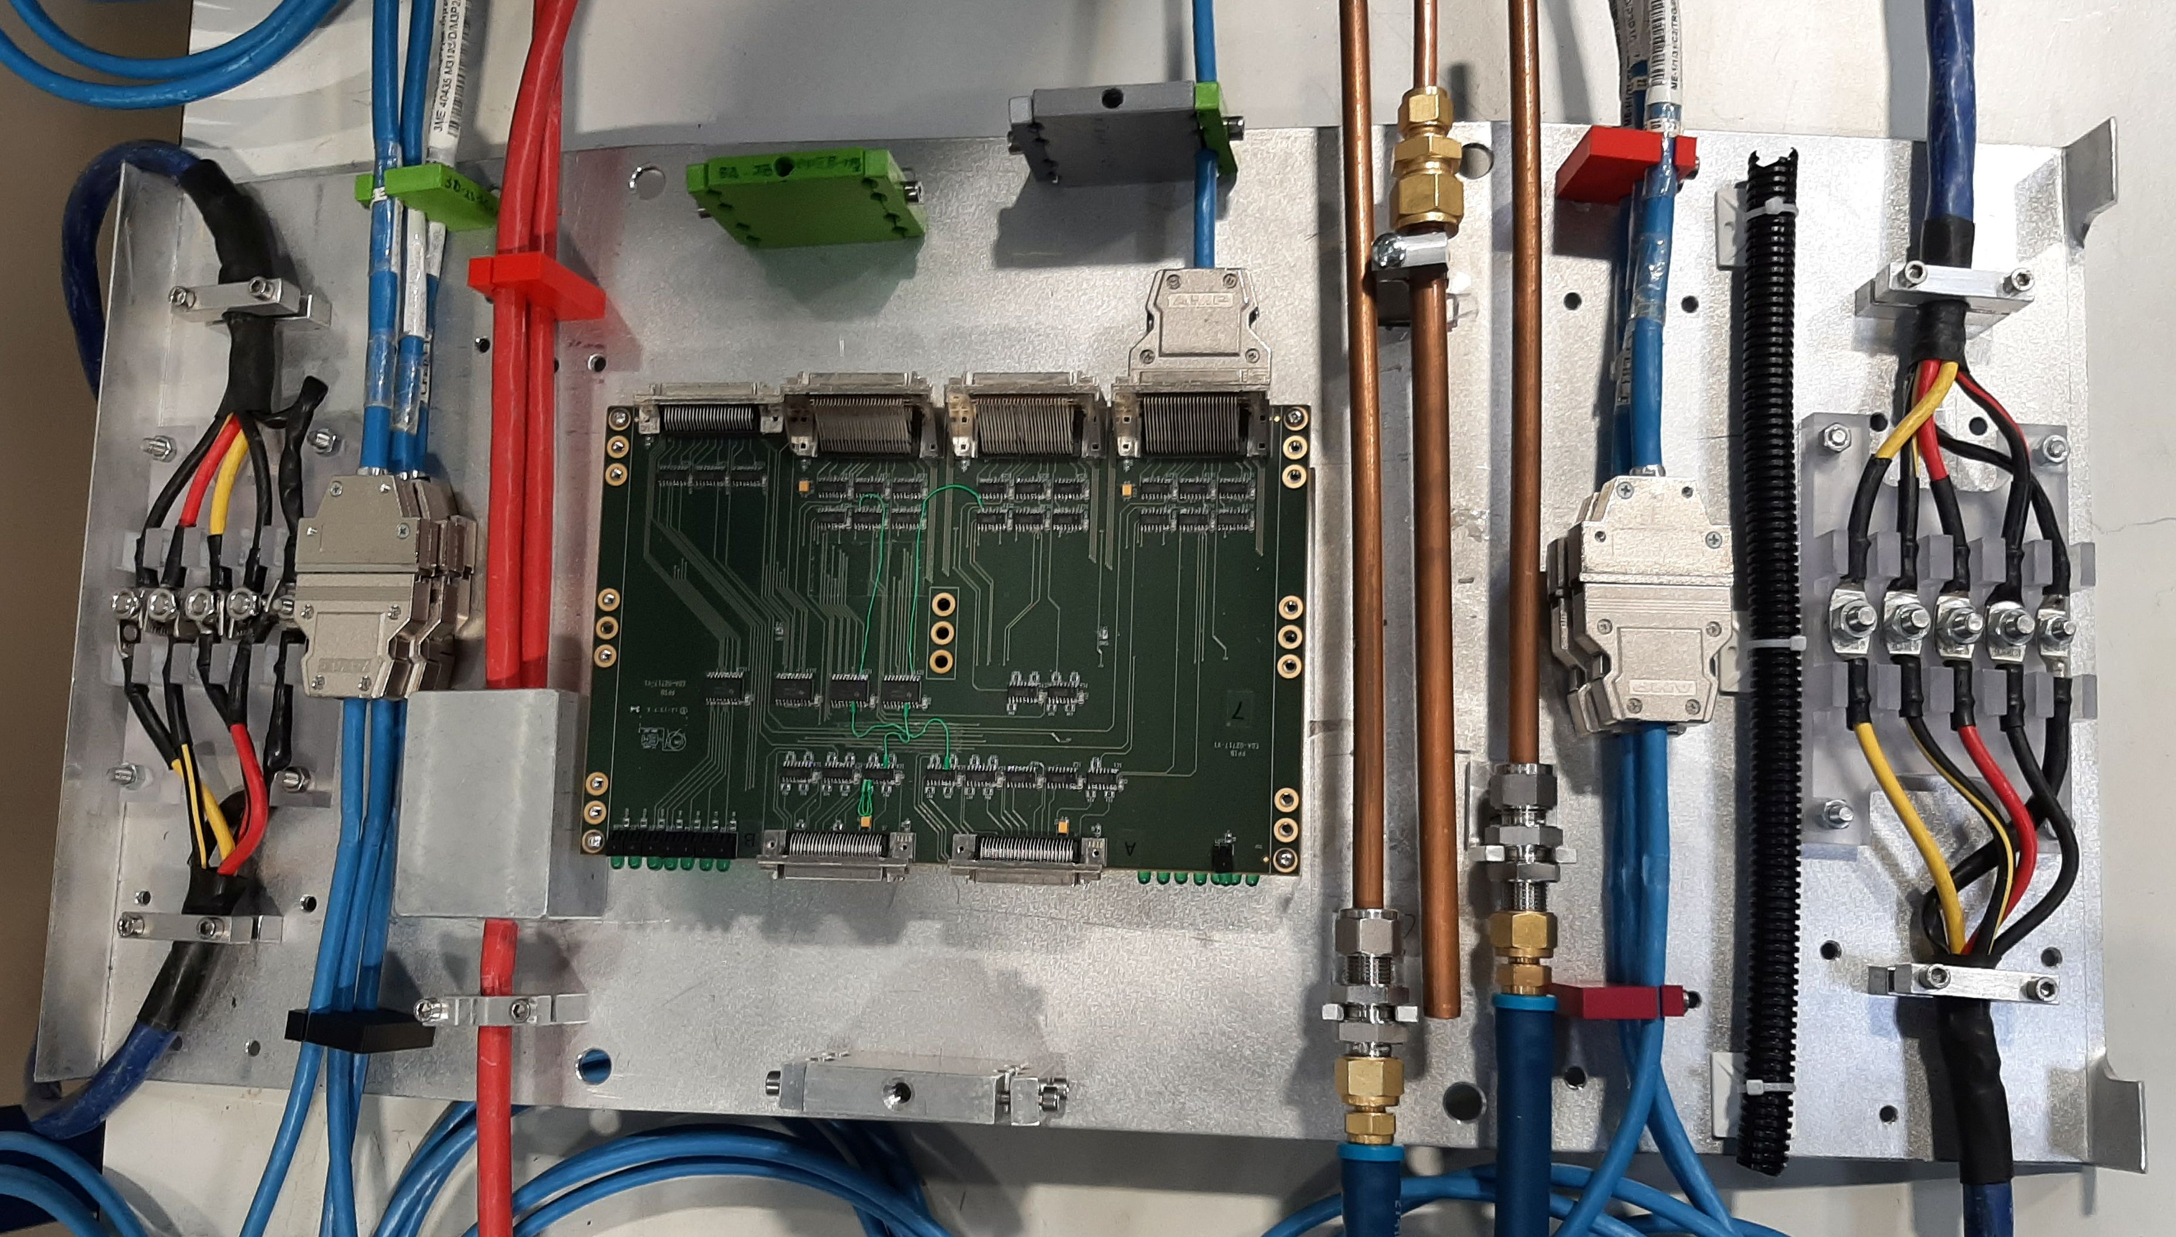
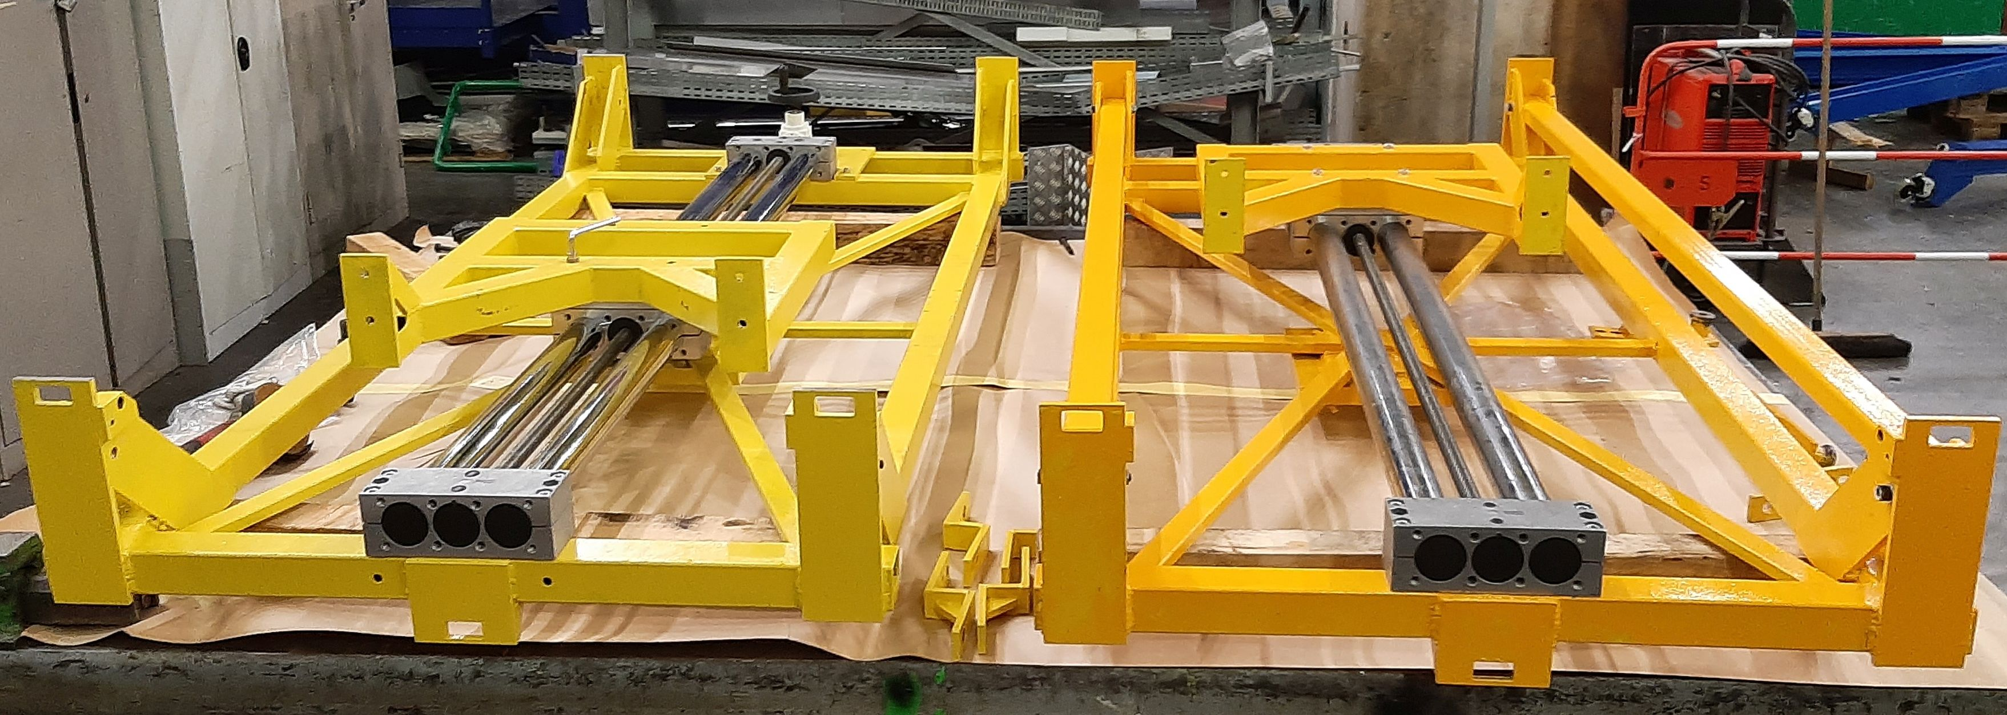
ME1/1 CSC Preparation to the Phase-2 Upgrade
ME1/1 Patch panel
ME1/1 Patch Panel redesigned to fit more rigid envelope for endcap detectors cables and services in the CMS Phase-2 configuration
36 new ME1/1 PP should be constructed before LS3
Production drawings in preparation
3d model
Prototype
Loading machines
ME1/1 two loading machines were constructed for extraction/installation of ME1/1 CSC detectors).
16

Slide 17
Summary
In 2024, the JINR group continue physics analysis based on RUN-2 and RUN-3 data.
In 2024 JINR grid Tier-1 and Tier-2 centers shows stable and robust operation for CMS data processing.
2024 Physics Run is started on April 14 with stable pp beams at 13.6 TeV.
JINR group contribute to maintenance and operation of the CSC Endcap Muon system and Hadron calorimeter. Detectors are performing reasonably well.
CMS Phase-2 Upgrades are making a good progress in 2024. JINR group participating in:
High-Granularity Calorimeter (HGCal) project
Construction of the test setup for HGCAL silicon and scintillator cassettes close to finish (ready for operation by the end of 2024).
CMS Muon Endcap system upgrade.
CSC patch panel - preparation to production.
Two ME1/1 loading machines were constructed and ready for operation in LS3
The CSC longevity and the CSC operation with a new gas mixtures studies in progress
17

Slide 18
Plans for 2024
Continue RUN-2 and RUN-3 data analysis.
Dimuons, dimuons + MET, Z + MET, bbar + MET to search for the new physics and to test the SM.
Continue optimization of the hadronization model for the q/g jet fractions measurement.
Participation in RUN-3 within JINR responsibilities.
- Participation in shifts.
- Detectors operation and maintenance.
- Detectors performance study.
Participation in Phase-2 HGCAL project.
HGCAL cassettes test facility - ready for operation by the end of 2024.
Participation in Phase-2 upgrade of Muon Endcap System.
Preparation to the ME1/1 CSC upgrade during LS3.
Studying the ageing effects and CSC detectors operation in HL-LHC mode at GIF ++ facility.
Continue new gas mixture studies.
Development and test of algorithms for reconstruction of muon track segments.
18

Slide 19
Backup slides
19

Slide 20
Challenging years: 2024 - 2029
from CMS SP Report
CMS is facing an unprecedented situation in the coming 5 years:
• 2024-25 Exploit the delivered luminosity for physics (Run-3 operations)
• 2024-27 Complete the upgrade program construction, including the detectors (and software) but also all the infrastructure and services needed to operate in a safe and reliable way the CMS upgrade
• 2025-26 Decommission the legacy systems that will not be part of the CMS.
Upgrade: detectors, services, infrastructure – ensure legacy systems are
maintained and/or consolidated to guarantee the full HL-LHC exploitation
• 2026-29 Install and commission the CMS Upgrade: starting with infrastructure & services to finish in concert with the detectors and software
2024- 204X Produce and publish world-class physics results
20

Slide 21
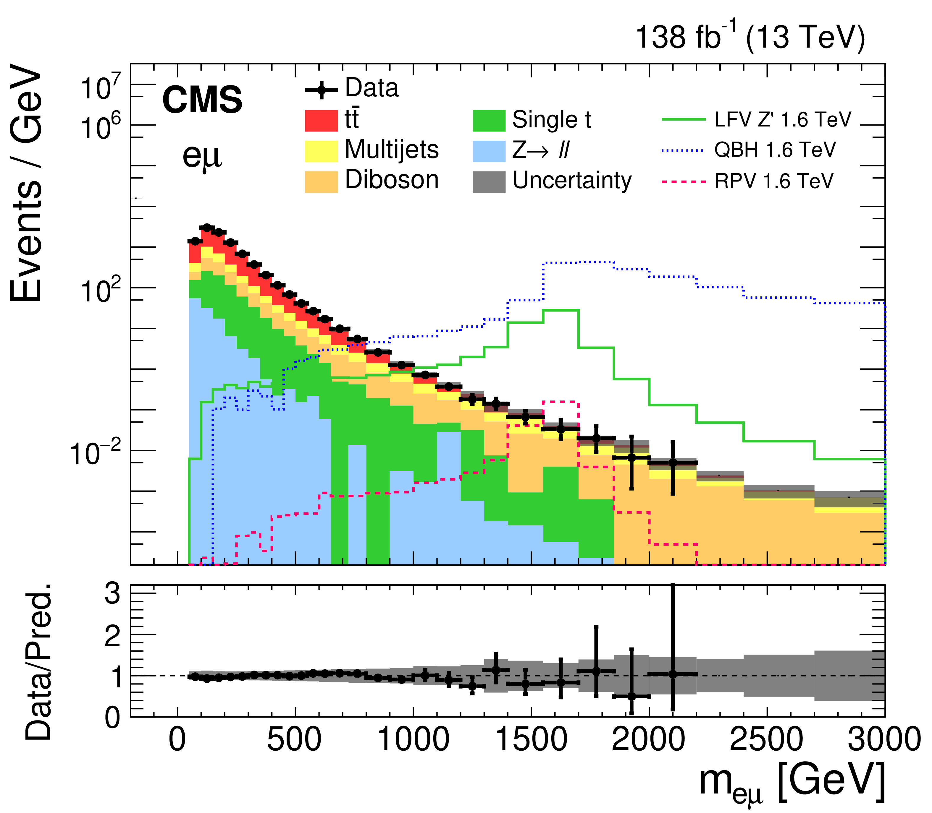
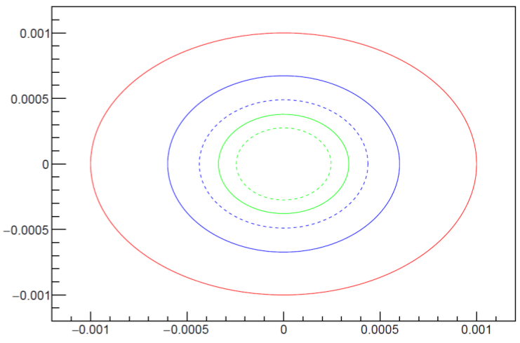
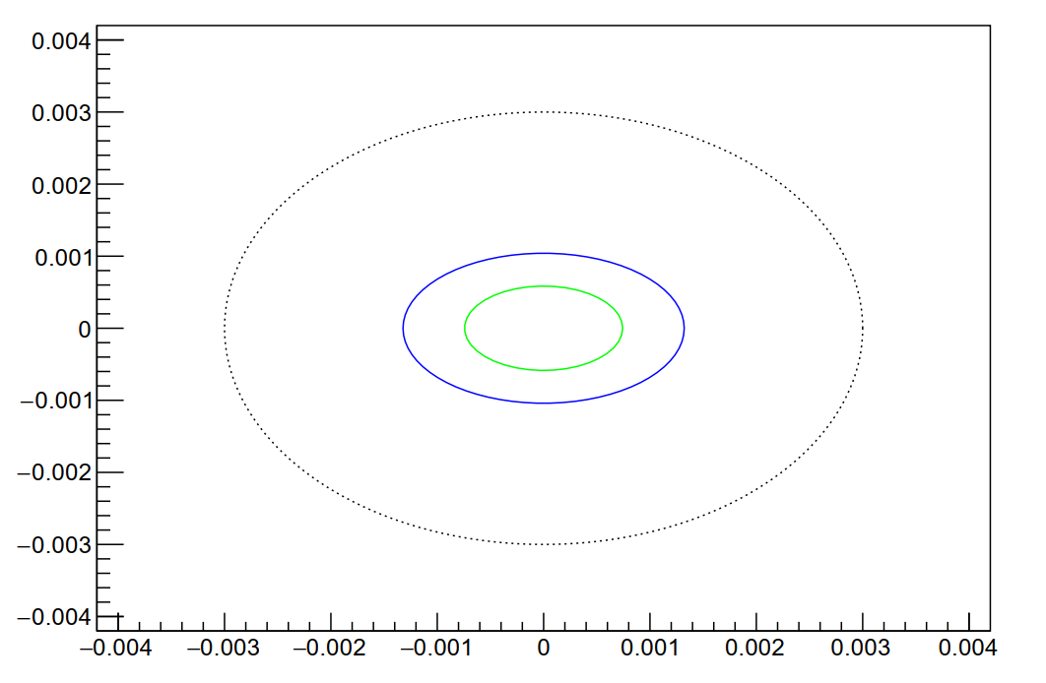
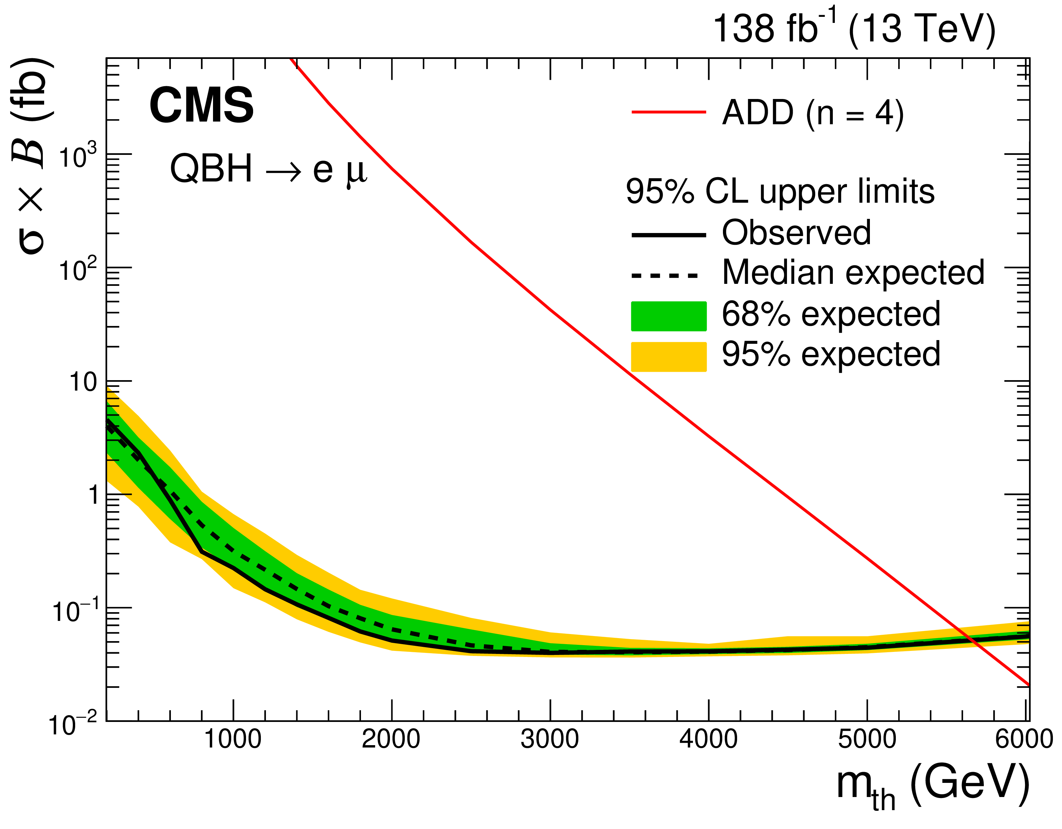
Lepton Flavour Universality with Dileptons
Continued studies with ee, μμ, eμ, eτ, and μτ pair invariant mass spectra.
To test lepton-flavour universality of SM at the TeV scale.
To search for heavy resonances and quantum black holes
(three benchmark signals are studied):
- R parity violating supersymmetric models.
- Heavy Z' gauge bosons with lepton flavor violating decays.
- Quantum black hole production in models with extra spatial dimensions.
To explore LFV effects with the effective field theory (EFT) approach.
RUN-2 (13 TeV, 138 fb⁻¹)
JHEP 05 (2023) 227
(a)
(b)
Upper limits are set at 95% CL on the product of the cross section and branching fraction for lepton flavor violating signals.
The expected limits for the scalar vs. vector LFV constants for eµ (a) and µτ (b) production processes at 300 fb⁻¹ (blue) and 3000 fb⁻¹ (green).
21

Slide 22
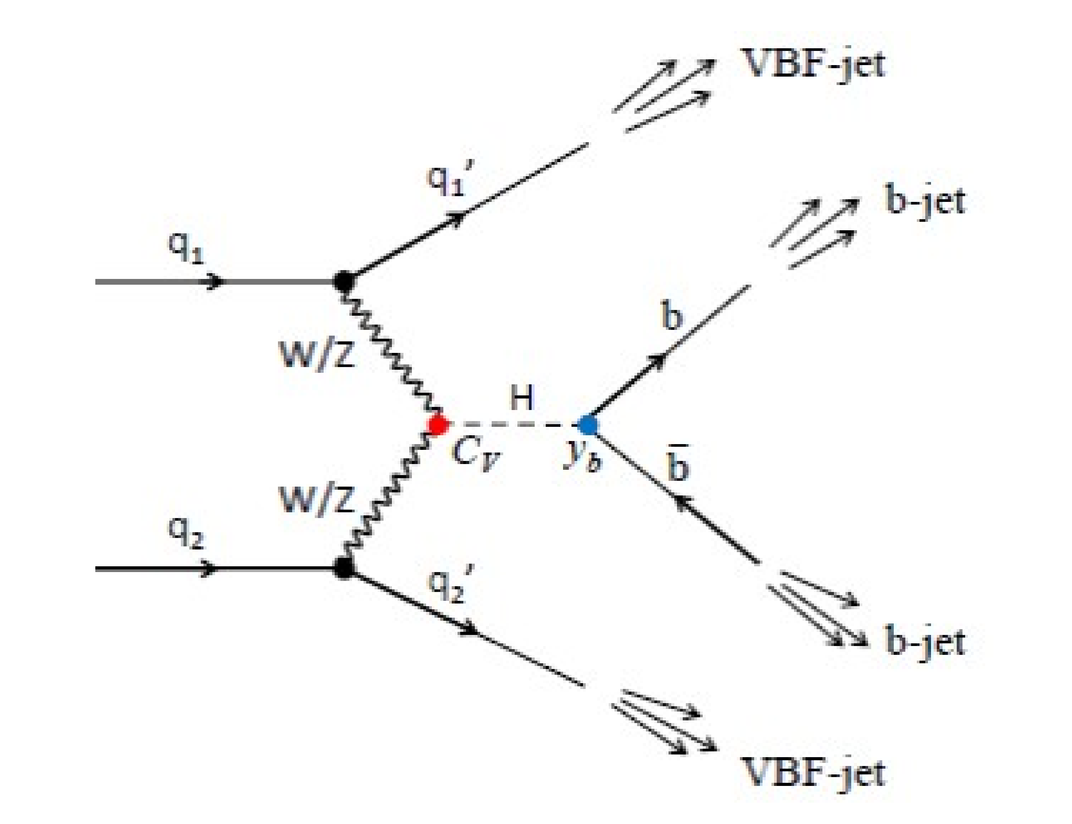
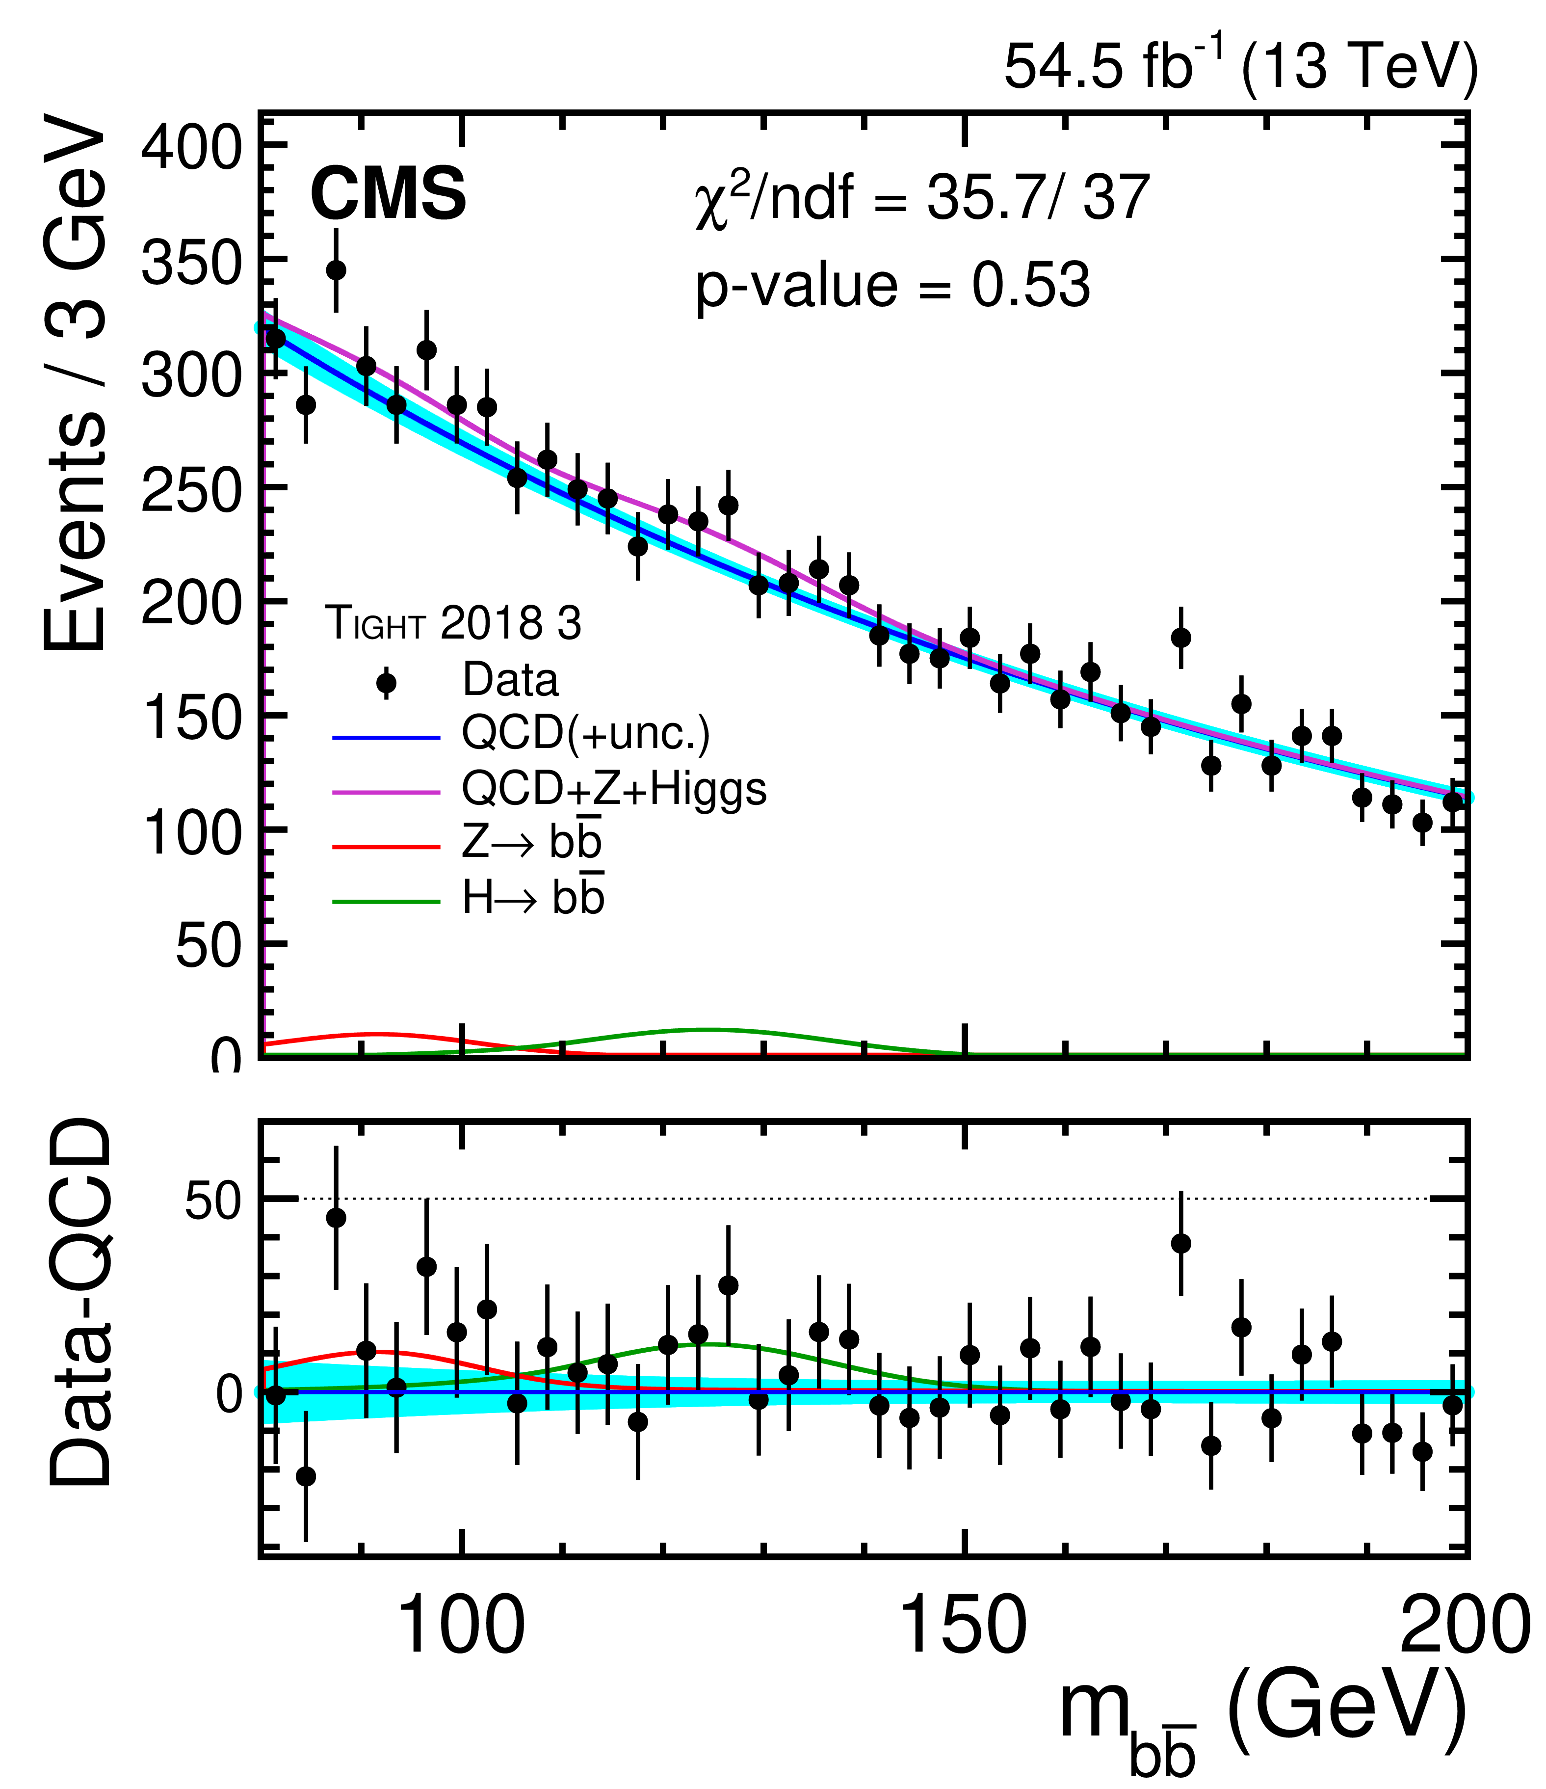
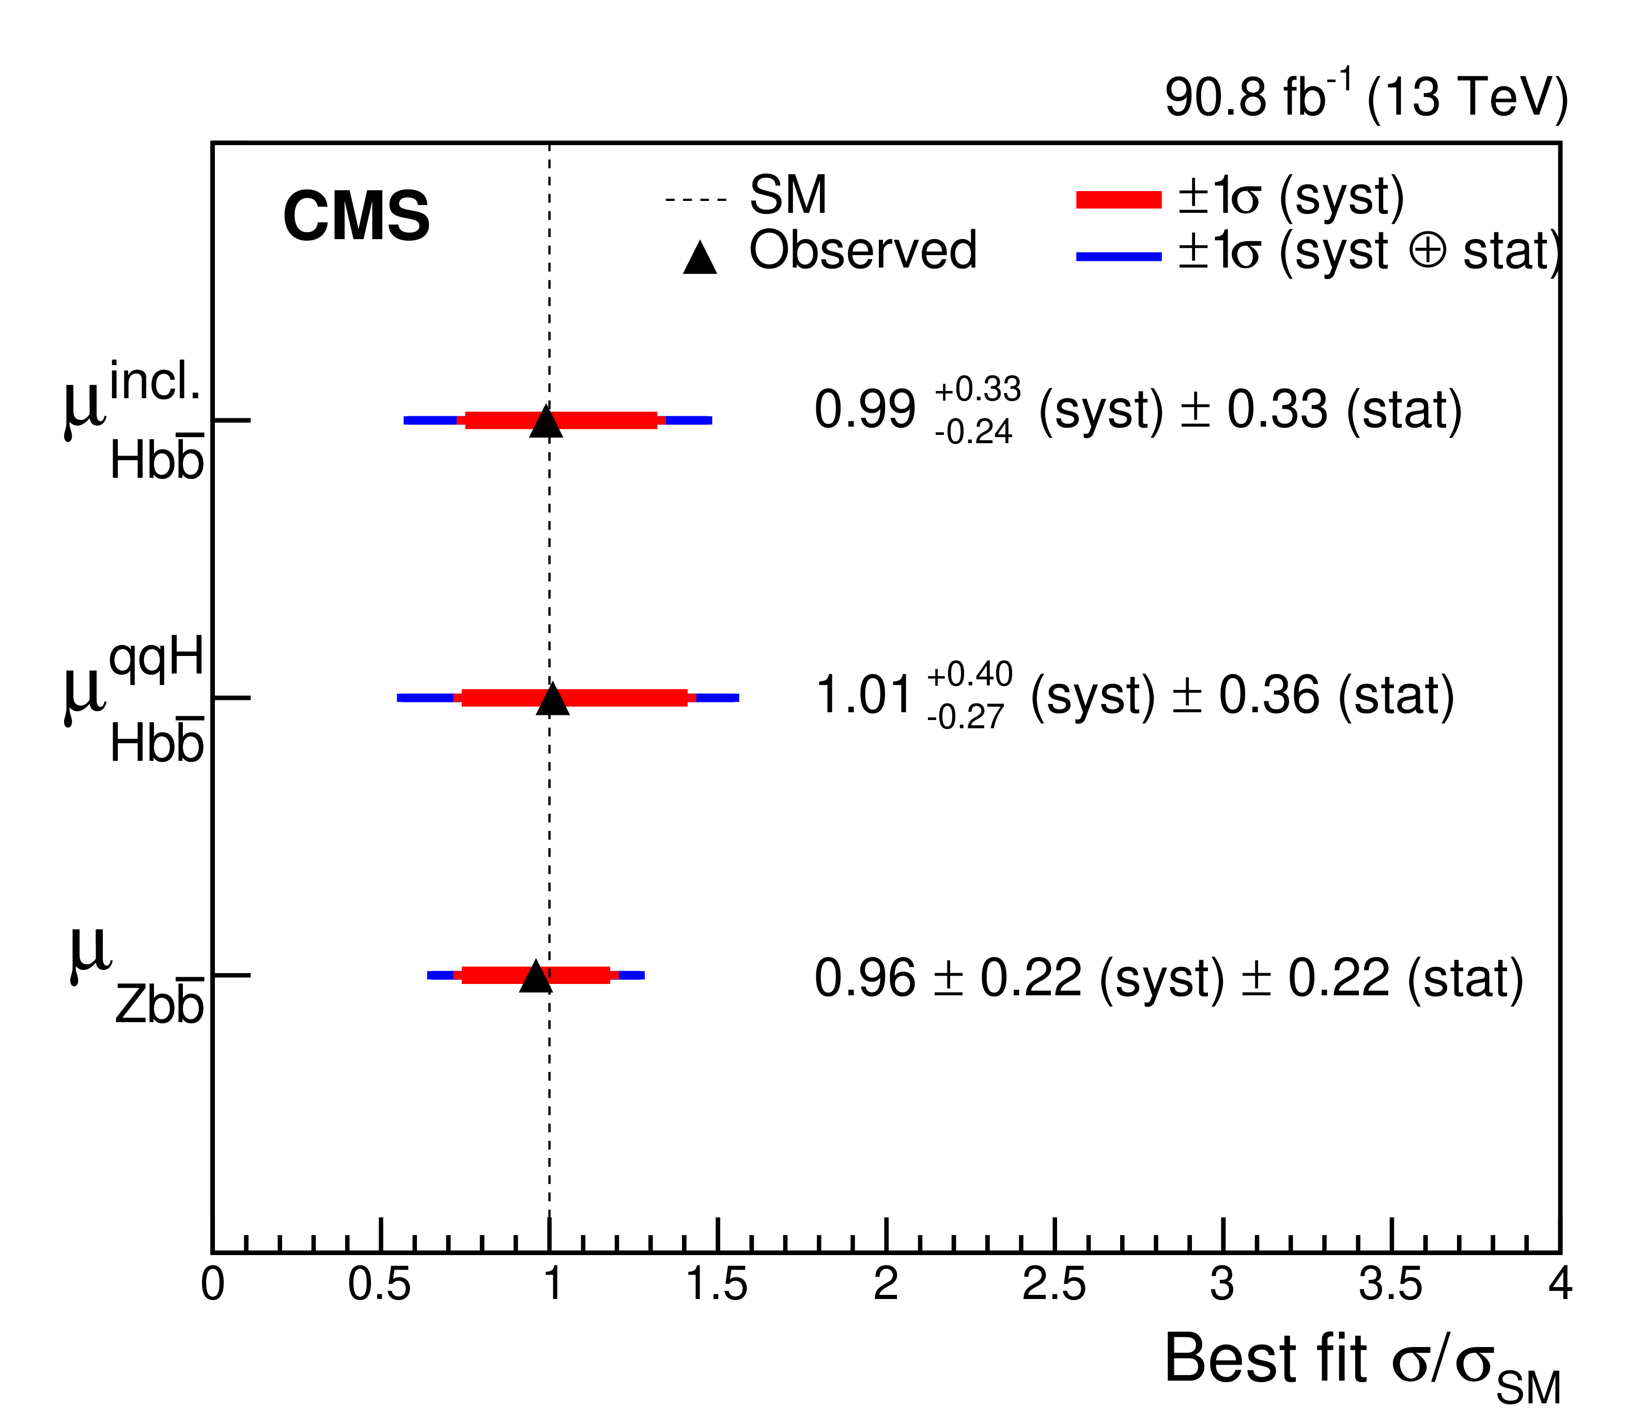
Search for $\text{VBF} H→b\overline{b}$
CMS 2016, 2018 data of pp-collisions at 13 TeV corresponding to ~91 fb⁻¹.
arXiv:2308.01253
ANALYSIS STRATEGY
Inclusive $H→b\overline{b}$(VBF+ggF):
Significance (observed/expected) = 2.6/2.9.
μ_{Hbb} = 0.99±0.33 (stat.)+0.33 (syst.)–0.24 (syst.).
Pure VBF (ggF is constrained within SM-expectation):
Significance (observed/expected) = 2.4/2.7.
μ_{Hbb} = 1.01 ±6 (stat.) +0.40 (syst.) – 0.27 (syst.).
Dedicated online triggers (L1 – HLT).
BDT Signal-Background discrimination.
Separate Zbb analysis category for validation and Zbb constrain.
MC signal and resonant background models.
Data-derived QCD model.
DNN regression to b-jets energy.
Signal extraction using m_{bb} distribution.
22

