Slide 1
Benchmarking the Life Cycle of the ALICE Experimental Setup at CERN in the Context of Automated Systems Composition
By Culicov Alexandru

Slide 2
Abstract
Introduction:
The development of an advanced automated control system for the NICA collider is driven by a necessity to encapsulate precision and control in experimental physics. In this context, the ALICE experiment at CERN stands as a beacon of successful automation integration, serving our analysis with a proven model for system efficacy and evolution. Our study zeroes in on ALICE's automation systems, examining the subsystems like Data Acquisition (DAQ), High-Level Trigger(HLT), Central Trigger System(CTS), Experiment Control System(ECS) and Detector Control Systems (DCS)—their life cycles, design stages and associated requirements.
This focused analysis on ALICE aims to extract actionable insights that address the design complexity and operational efficiency needed for NICA's own systems. By understanding how ALICE sustains high data throughput and accomplishes real-time processing, we can establish a set of guidelines informed by their lifecycle management practices. Such insights are instrumental in sculpting a control system for NICA that encapsulates both reliability and innovation, laying the groundwork for future developments in collider technology.

Slide 3
What was the project?
In this wave of Interest, my main task was to study the subsystems of the Large Ion Collider Experiment (ALICE) and try to structure the information in order to create a starting point for future developers of Control Systems at the NICA experimental facilities.
In this summary, I would like to collect all the information I have obtained together and structure it for easier understanding

Slide 4
ALL ALICE Subsystems:
I'd like to start by showing a diagram of all (almost) subsystems in ALICE. All subsystems, of course, have smaller subsystems. Each subsystem performs its own tasks, but they are all interconnected.
ALICE EXPERIMENT
DAQ
DCS
Trigger system
HLT
Online-offline(O2)
Read-out system
event building
Data storage
Hardware monitoring
Env. monitoring
safety systems
CTP
FIT
LTU
Data filtering
Real-time data processing
Data reduction
Run control
Subsystem control
Interlock systems
Time destribution
Continuos readout
RT data-processing
Offline analysis

Slide 5
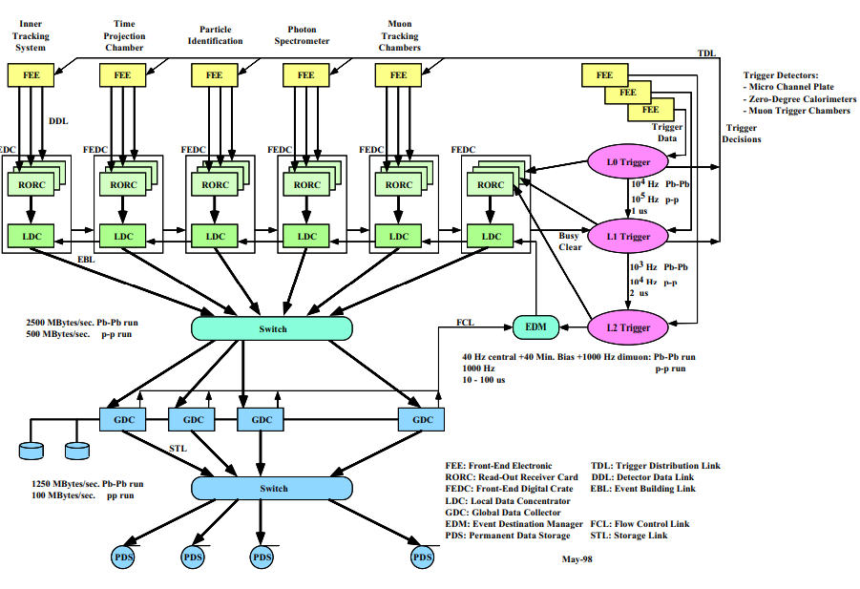
1.ALICE DAQ
Let's start taking a step-by-step look at each ALICE subsystem. First, let's look at DAQ (Data Acquisition System). The ALICE DAQ system is responsible for collecting, processing, and storing data generated by detectors. Here are the key stages of data flow management:
Data Collection: Data from the detectors are received by the system through the front-end electronics (FEE) interface and transmitted via digital communication lines (DDL - Detector Data Link) to data readout systems.
Sub-event Building: The data readout and sub-event building system operates in parallel and independently. Each sub-event building system is controlled by a Local Data Concentrator (LDC), which processes the data and assembles them into sub-events.
Event Building and Distribution: The event building and distribution system accepts sub-events from the LDCs, combines them into complete events, processes, and records them onto permanent data storage. This system needs to be flexible enough to allow easy reconfiguration of computing resources depending on the operational mode.
The ALICE DAQ system includes several key components: front-end electronics, central processing nodes, and data storage systems. The front-end electronics are responsible for the initial processing of signals from detectors, their conversion to digital format, and transmission via high-speed communication channels. Central nodes process and aggregate data, determining which information should be preserved for further analysis. Data storage systems provide safe and long-term preservation of collected data.
During heavy-ion runs, the DAQ must provide rapid processing and data recording due to their large volume. Local Data Concentrators (LDCs) ensure data collection and initial processing, while Global Data Collectors (GDCs) are responsible for merging these data into complete events.
High-bandwidth data transmission is crucial for maintaining system performance, especially in heavy-ion run mode, where throughput can reach 2500 MBytes/sec.
The scheme of ALICE DAQ

Slide 6
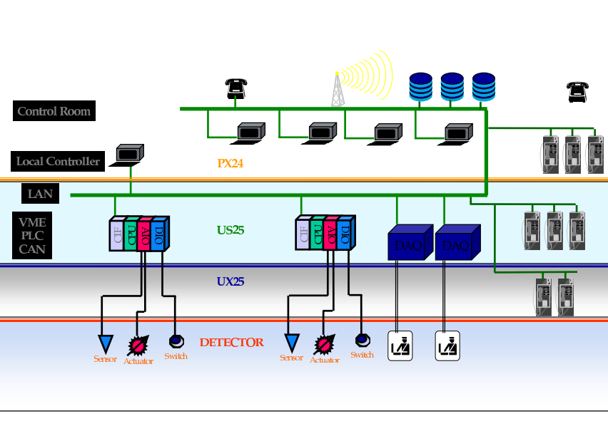
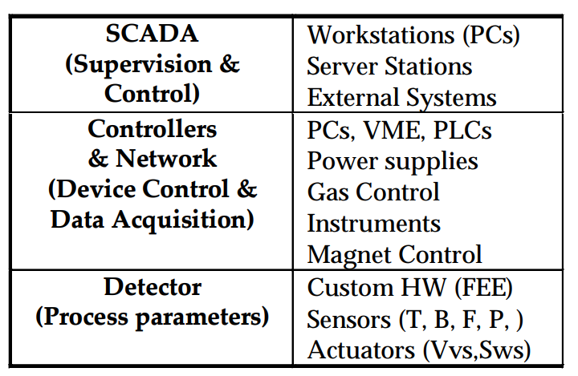
2.ALICE DCS
The next subsystem on the list is DCS (Detector Control System). The DCS provides centralized control over all ALICE detectors, including their power supply, cooling, and diagnostic information gathering. It allows operators to monitor equipment status in real time and quickly respond to any malfunctions. The DCS also plays a crucial role in experiment automation, enabling programmatic control over detector operating modes and adaptation to changing experimental conditions.
what does it work with
Scheme of DCS

Slide 7
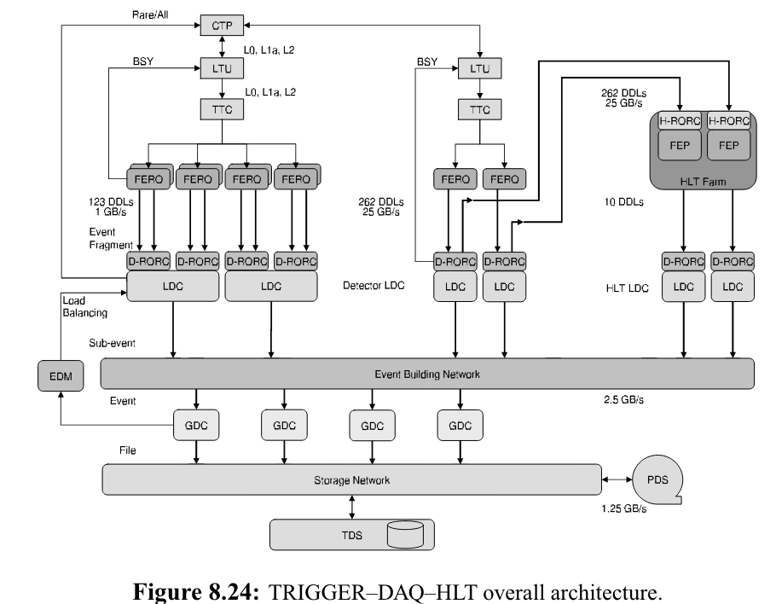
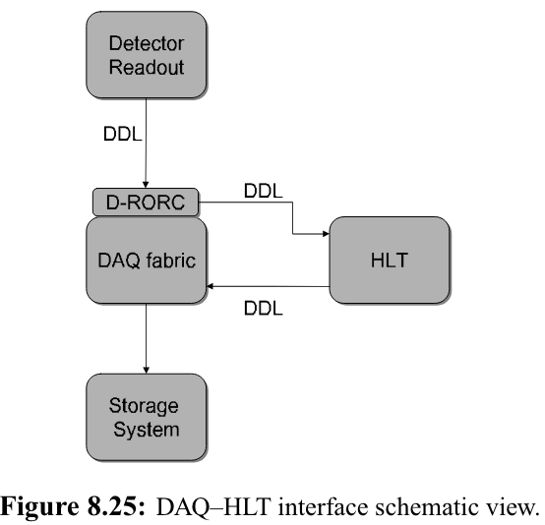
3.HLT
The task of the HLT system is to select the most relevant data from the large input stream and to reduce the data volume by well over an order of magnitude in order to fit the available storage bandwidth, while preserving the physics information of interest. This is achieved by a combination of event selection (triggering), data compression, or selection of Regions of Interest with partial detector readout. While executing either of these tasks, the HLT may also generate data to be attached to or partially replacing the original event. Care has been taken not to impose any architectural constraints which could compromise the HLT filtering efficiency, knowing that event selection will become more and more elaborated during the experiment lifetime. This way, filtering may be introduced in progressively sophisticated steps without affecting the performance and the stability of the Data-Acquisition system.

Slide 8
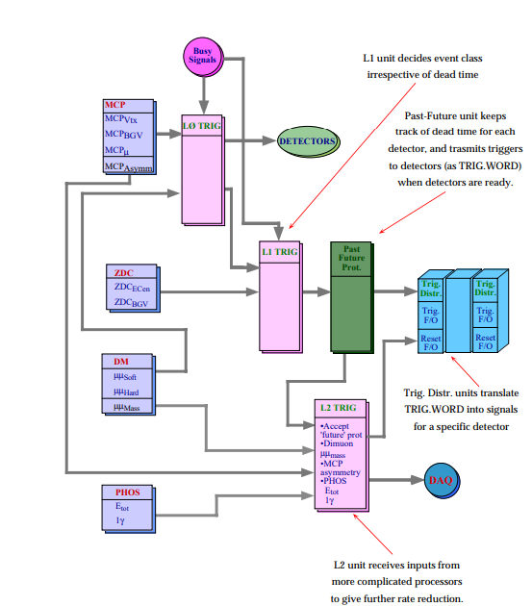
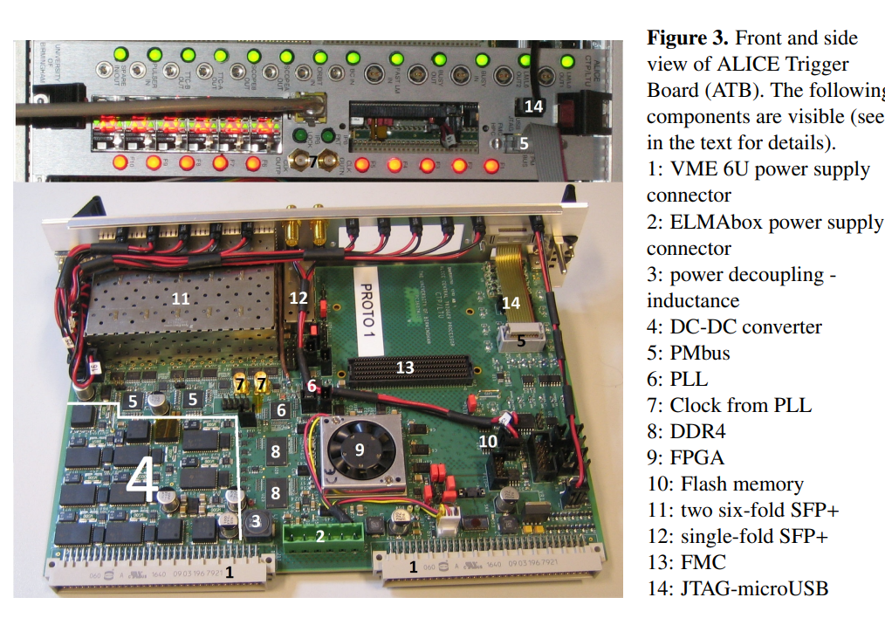
4.ALICE CTS
The fourth one is CTS (Central Trigger System). The CTS ensures that only the most scientifically relevant data is captured, which is crucial given the high rate of collisions and the vast amount of data generated. This selective data capture allows researchers to focus on the most interesting and significant physical events. The trigger architecture of ALICE comprises several levels, each playing a specific role in data filtering and selection. A detailed examination of each level allows understanding how the system minimizes the volume of unnecessary information and focuses on the data required for achieving research objectives.

Slide 9
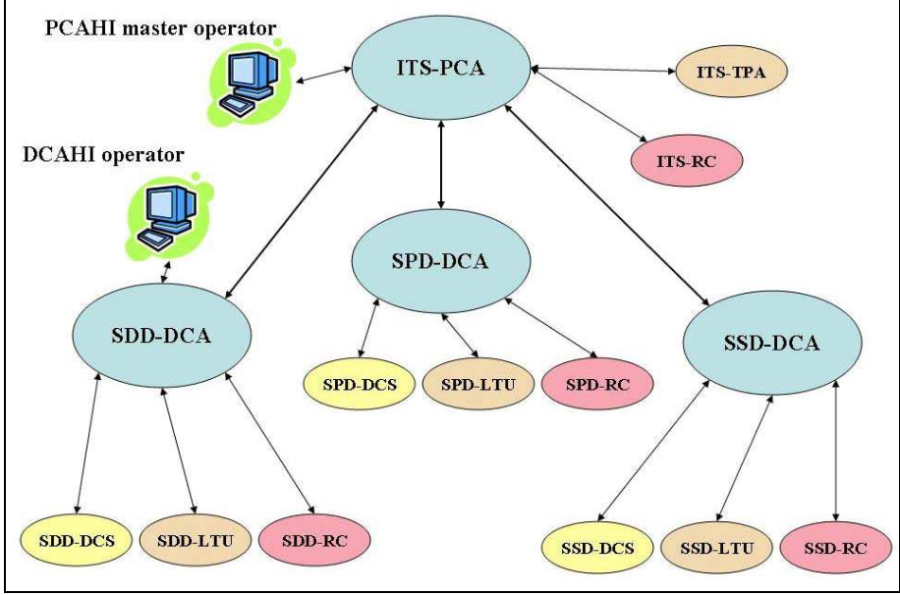
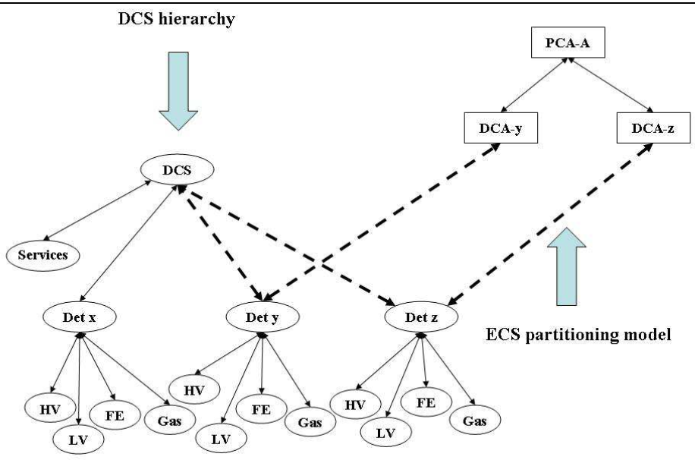
5.ALICE ECS(O2)
Lets talk about ALICE ECS(Experiment Control System). The control of the ALICE experiment is based on several independent ‘online systems’. Every ‘online system’ controls operations of a different type and belonging to a different domain of activities: Detector Control System (DCS), Data Acquisition (DAQ), Trigger system (TRG), and High Level Trigger (HLT). The ‘online systems’, are independent, may interact with all the particle detectors, and allow partitioning. Now O2 online-offline system is the “upgrade” of ECS.
The connection between ECS and DCS
ECS scheme

Slide 10
What do we want?
let's structure our requirements from each subsystem.
DAQ
Category of Requirement | Specific Requirements | Additional Details
Bandwidth | Minimum: 50 GBps Maximum: 100 GBps
Reliability | Fault tolerance: 99.999% uptime Recovery time: ≤ 5 minutes | Includes protocols for rapid recovery and error handling
DCS
Category of Requirement | Specific Requirements | Additional Details
Monitoring Accuracy | Measurement accuracy: ±0.1% | Critical for operational efficiency and safety
Control Interfaces | GUI with remote access and configuration capabilities | Facilitates easy and efficient management
ECS
Category of Requirement | Specific Requirements | Additional Details
Modularity | Integrate up to 10 new systems | Without full system reboot
Data Management | Support for XML and JSON | Ensures compatibility and seamless data exchange
Trigger System
Category of Requirement | Specific Requirements | Additional Details
Reaction Time | Response time: ≤ 10 microseconds | Critical for event accuracy
Data Sampling | Preserve 95% of events meeting criteria | Ensures high-quality data for analysis
HLT
O2 (Online-Offline)
Category of Requirement | Specific Requirements | Additional Details
Processing Performance | Time per event: ≤ 1 ms | Necessary for real-time data processing
Resource Usage | Use no more than 2 GB RAM per process | Maximizes efficiency and resource allocation
Category of Requirement | Specific Requirements | Additional Details
Scalability | Increase power by 50% when data volume increases by 30% | Adjusts to data volume increase automatically
System Integration | Compatible with Hadoop and Spark-based systems | Ensures smooth integration with data analysis platforms

Slide 11
Conclusions
Comprehensive Integration Achieved: I have successfully mapped and analyzed the intricacies of ALICE's subsystems, enhancing my understanding of the Large Ion Collider Experiment. This comprehensive overview paves the way for future developers at the NICA Accelerator Complex, ensuring a robust foundation for the development of control systems.
Subsystems Interconnectivity: My study highlights the seamless interconnectivity between various subsystems such as DAQ, DCS, HLT, and ECS. Each subsystem is designed to handle specific tasks efficiently while maintaining a high degree of synergy with others, which is crucial for the overall functionality of the experiment.
Operational Efficiency and Challenges: Through detailed analysis, I identified key operational efficiencies and potential challenges within subsystems like the DAQ's high data throughput and the DCS's real-time monitoring capabilities. Addressing these challenges will be critical to improving data acquisition, processing, and storage.
Future Enhancements and Adaptability: The project underscores the necessity for future enhancements, especially in terms of scalability and adaptability of the systems to meet evolving experimental conditions and technological advancements.

Slide 12
REFERENCES:
https://ieeexplore.ieee.org/stamp/stamp.jsp?tp=&arnumber=5446521 https://ieeexplore.ieee.org/stamp/stamp.jsp?tp=&arnumber=10274908
https://accelconf.web.cern.ch/ica05/proceedings/pdf/O1_011.pdf
https://arxiv.org/pdf/2106.08353.pdf
https://inspirehep.net/files/dbd6254b24fc39806bcf2ed31a406f67
https://alice-collaboration.web.cern.ch/node/34985
https://edms.cern.ch/ui/file/456354/1/HLT_Chapters11-15.pdf
https://iopscience.iop.org/article/10.1088/1748-0221/15/10/T10002/pdf
https://accelconf.web.cern.ch/ica05/proceedings/pdf/O1_011.pdf
https://www-conf.kek.jp/acat03/prog/presen/id0027.pdf

