Slide 1


Determination of the natural frequencies of ultralight sensor support trusses of silicon tracking systems
Maribel Herrera for et al.^{(*)}
Scientific-Methodological Seminar, LHEP, JINR, Dubna, Russia.
April 25th, 2024
^{(*)} Ligdenova T. (JINR), Ceballos C. (JINR), Dementev D. (JINR), Igolkin S. (SPbSU), Zherebchevsky V. (SPbSU)

Slide 2
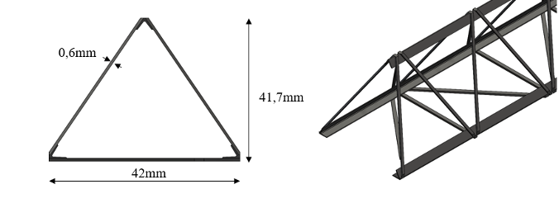
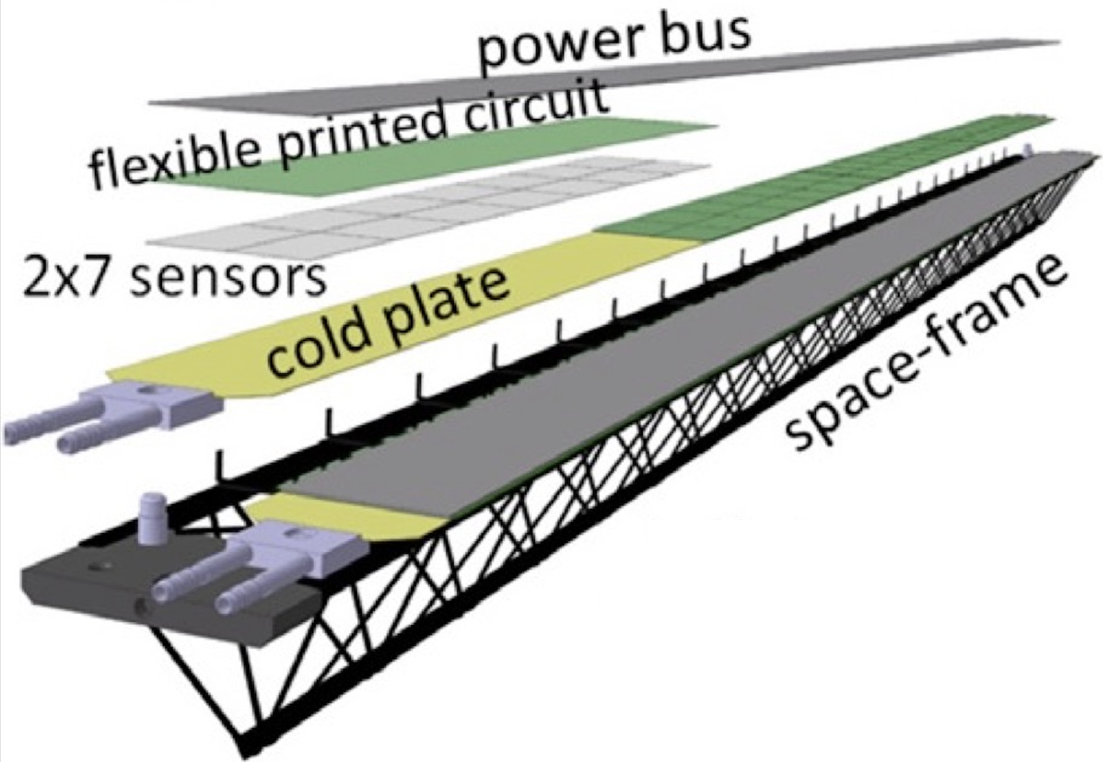

Intro
From SPbSU to tracking systems @ ALICE-ITS2 (CERN), sPhenix (BNL), CBM (FAIR), MPD-ITS (JINR), SPD (JINR), BM@N (JINR)
Usually placed in the zone of highest radiation levels
“Igolking” ultralight supporting trusses: High-Young’s-modulus carbon threads laminated together in epoxies.
(Polymerization of the carbon fibers joins together thousands of individual carbon threads. )
What will happen in the long-run (~10 years) to the supporting trusses of a tracker in high luminosity experiments?
Degradation of the mechanical properties causing:
Systematic displacement of the atteched sensors
Apperance of resonance vibrations of the trusses

Slide 3
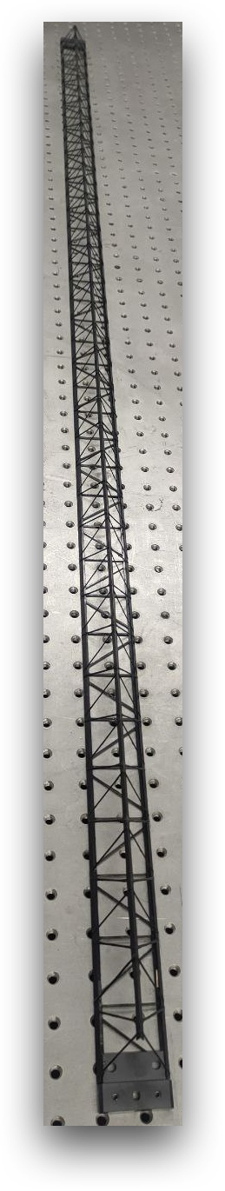
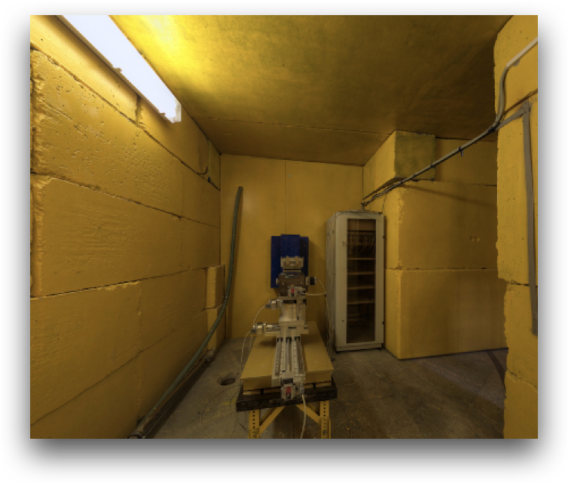
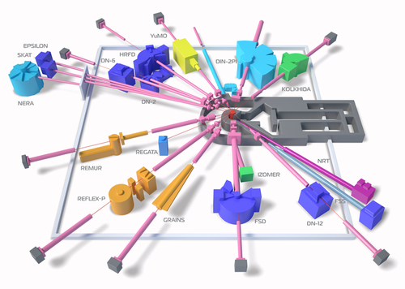
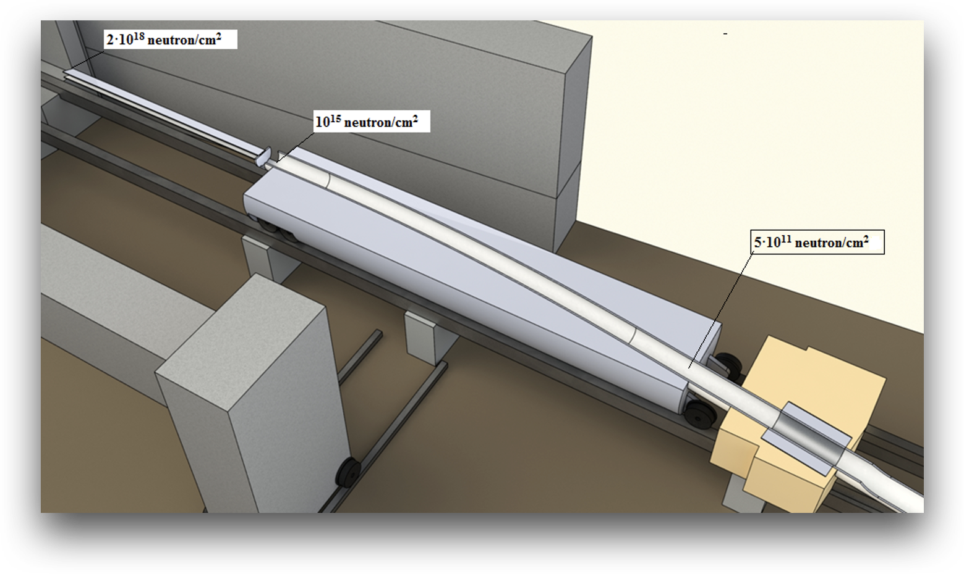
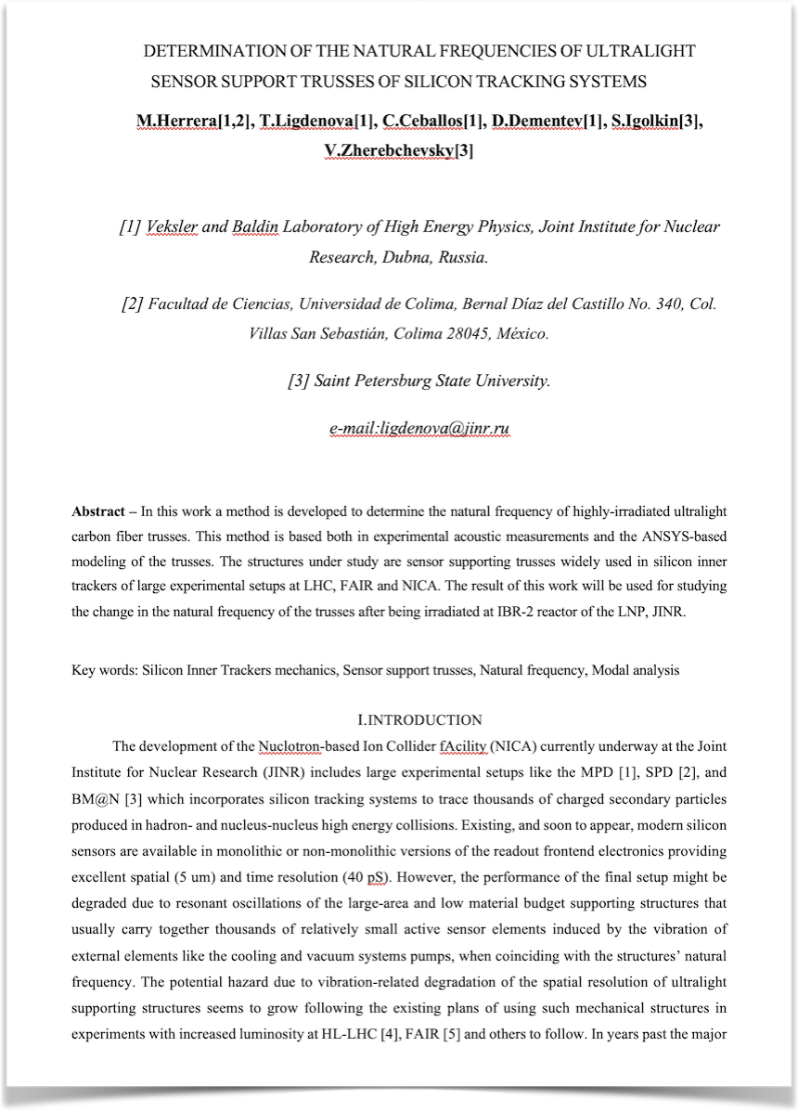
The experiment: Joining the IBR-2 User Club
High Dose Irradiation
Evaluation Criteria: Decrease of the value of the natural frequency of the structure (f_{n}) after irradiation.
What to do?: Determine f_{n} before and after irradiation.
How to?: This work

Slide 4
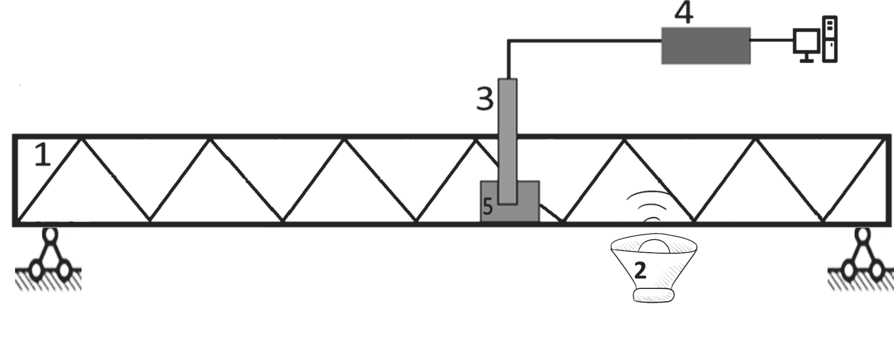
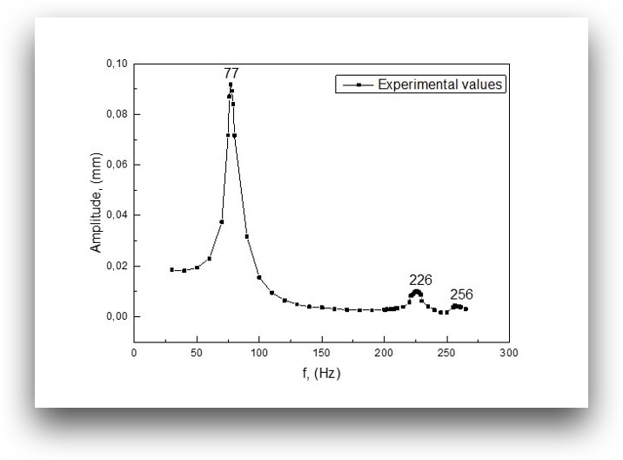
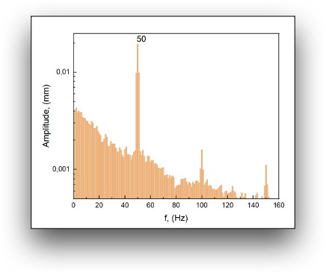
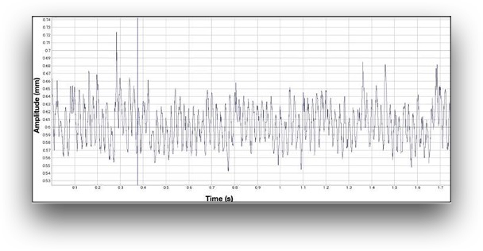
The acoustic experiment
1- Truss under test
2- Truss vibration exciter of variable frequency
3- Vortex sensor probe
4- Driver for connecting the probe to a PC
5- Electric conductive plate
For determining f_{n} :
The exciter’s frequency was varied from 30 Hz to 300 Hz.
At each step the variation of the gap between the vortex sensor and the conductive plate was recorded (S/R 1 kHz).
The obtained signal was converted into a frequency spectrum by means of the Fourier Transform.
The amplitude of the oscillation was determined as a standard deviation of the measured gap values for the recorded time period.
The same process was repeated each frequency step [f-step 30 – 300 / 10Hz, then 1Hz around the peak].
  All oscillation amplitudes were plotted as the function of the exciter’s frequency.
  The natural frequency of the truss (f_{n}) was determined from the resulting peak.
f_{n} = 77 ± 0.55 Hz
FT

Slide 5
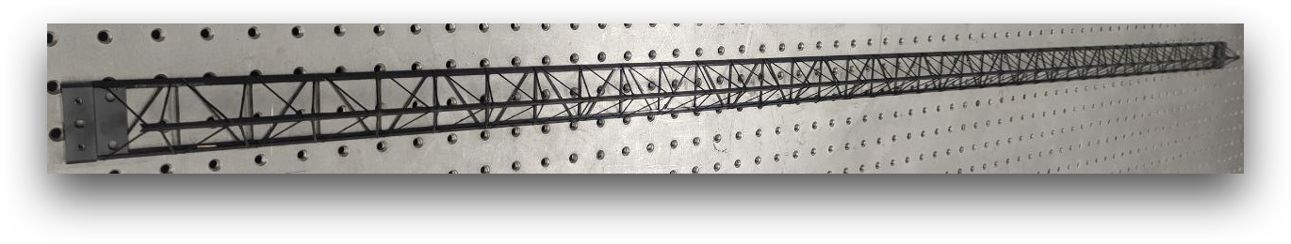

The counter check: Simulations
Idea: To model the truss in ANSYS and calculate the resulting natural frequency (f_{n}).
Required input data:
Geometrical characteristics ✓
Density ✓
Exact material definition X
  Impregnated fiber M55J for the ribs of the frame.
  Prepreg consisting of M55J for the longitudinal beams.
  Not possible to determine the exact characteristics of the carbon fiber-resin composite.
  Datasheet contains information only about the Modulus of Elasticity (ME) in one direction.
Real truss
ANSYS
Material definition?
Idea+: To model the structure as an isotropic material based on M55J that behaves mechanically as the real one.
Required input data:
Geometrical characteristics ✓
Density ✓
Aproximate material definition ✓
Modulus of Elasticity X

Slide 6
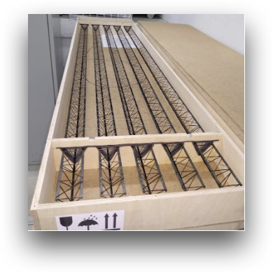
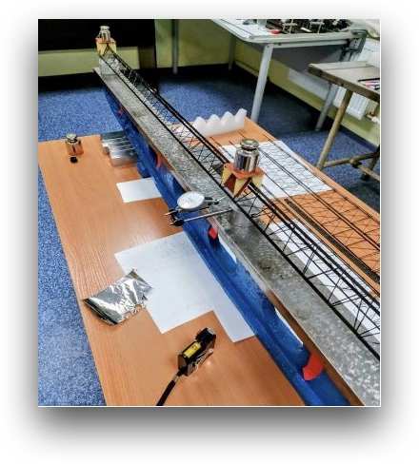
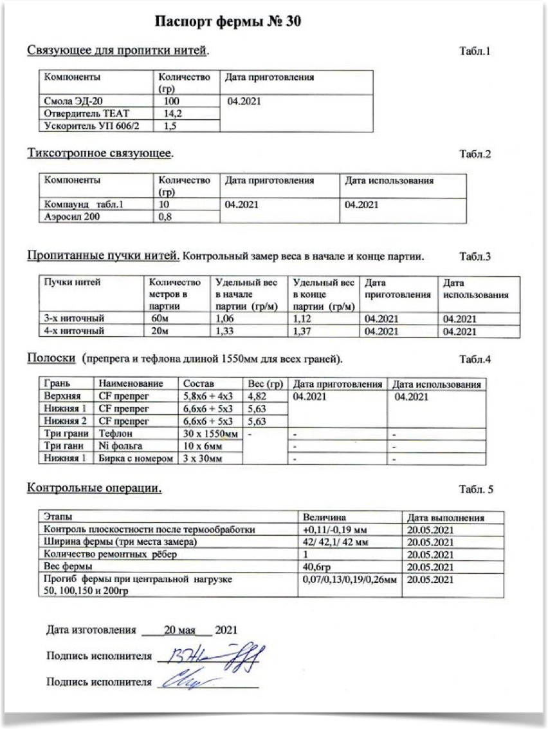


The counter check: Searching for the ME
Total = 30
Sagging measurements from the producer are available
Trusses datasheet
$f_{n,loaded}^{exp}$= F_{exp}
Experimental data
$δ_{t}$(m_{L}); m_{L} = {50 g; 100 g; 150 g; 200 g}
Notes:
sim

Slide 7
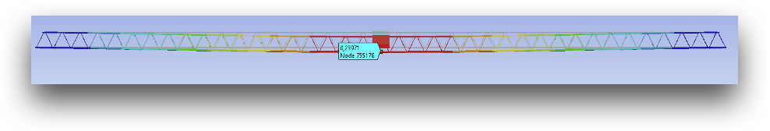

The counter check: Searching for the ME
Total = 30
Sagging measurements from the producer are available
Trusses datasheet
$f_{n,loaded}^{exp}$= F_{exp}
Experimental data
ANSYS model for m_{L}= 200 g
$δ_{t}$(m_{L}); m_{L} = {50 g; 100 g; 150 g; 200 g}
Isotropic M55J
Variable ME
The ME was varied until ${| δt}^{exp}$(200 g) - ${δt}^{sim}$(200 g) | = min
Notes:
sim

Slide 8
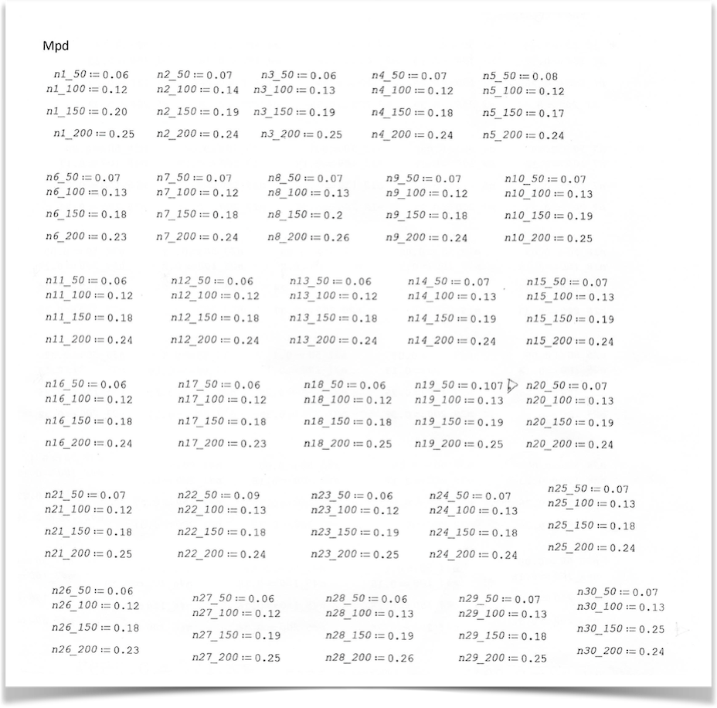


The counter check: Searching for the ME
Total = 30
Sagging measurements from the producer are available
Trusses datasheet
$f_{n,loaded}^{exp}$= F_{exp}
$$∆F^{exp−sim}$$
$f_{n,loaded}^{sim}$= F_{sim}
Experimental data
ANSYS model for m_{L}= 200 g
$δ_{t}$(m_{L}); m_{L} = {50 g; 100 g; 150 g; 200 g}
Isotropic M55J
Variable ME
The ME was varied until ${| δt}^{exp}$(200 g) - ${δt}^{sim}$(200 g) | = min
Notes:
sim

Slide 9
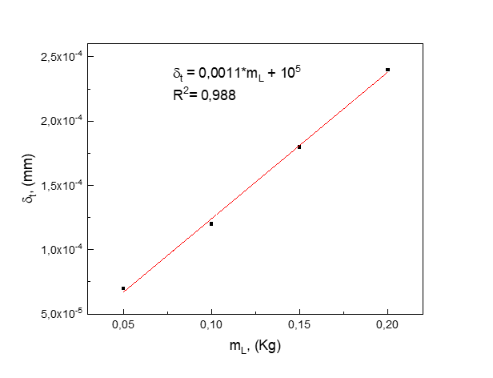
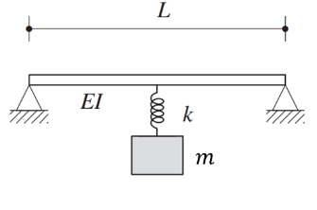
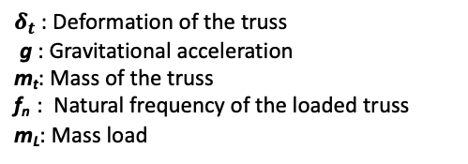


The counter check: Searching for the ME
System approximation
$$δ_{t}=\frac{g}{4π^{2}m_{t}f_{n}^{2}}m_{L}$$
$δ_{t}$: Deformation of the truss
g : Gravitational acceleration
m_{t}: Mass of the truss
f_{n} : Natural frequency of the loaded truss
m_{L}: Mass load
$f_{n,loaded}^{exp}$= F_{exp}
$$∆F^{exp−sim}$$
$f_{n,loaded}^{sim}$= F_{sim}
Experimental data
ANSYS model for m_{L}= 200 g
$δ_{t}$(m_{L}); m_{L} = {50 g; 100 g; 150 g; 200 g}
Isotropic M55J
Variable ME
Average over 30 samples
The ME was varied until ${| δt}^{exp}$(200 g) - ${δt}^{sim}$(200 g) | = min
Load mass (gr) | 50 | 100 | 150 | 200
Deflection (mm) | 0.07±0.01 | 0.12±0.01 | 0.18±0.02 | 0.24±0.01
Notes:
sim

Slide 10

The counter check: Searching for the ME
System approximation
$$δ_{t}=\frac{g}{4π^{2}m_{t}f_{n}^{2}}m_{L}$$
$δ_{t}$: Deformation of the truss
g : Gravitational acceleration
m_{t}: Mass of the truss
f_{n} : Natural frequency of the loaded truss
m_{L}: Mass load
$f_{n,loaded}^{exp}$= 74.41 Hz
$$∆F^{exp−sim}$$
$f_{n,loaded}^{sim}$= F_{sim}
Experimental data
ANSYS model for m_{L}= 200 g
$δ_{t}$(m_{L}); m_{L} = {50 g; 100 g; 150 g; 200 g}
Isotropic M55J
Variable ME
Average over 30 samples
The ME was varied until ${| δt}^{exp}$(200 g) - ${δt}^{sim}$(200 g) | = min
Load mass (gr) | 50 | 100 | 150 | 200
Deflection (mm) | 0.07±0.01 | 0.12±0.01 | 0.18±0.02 | 0.24±0.01
Notes:
sim

Slide 11


The counter check: Searching for the ME
System approximation
$$δ_{t}=\frac{g}{4π^{2}m_{t}f_{n}^{2}}m_{L}$$
$δ_{t}$: Deformation of the truss
g : Gravitational acceleration
m_{t}: Mass of the truss
f_{n} : Natural frequency of the loaded truss
m_{L}: Mass load
$f_{n,loaded}^{exp}$= 74.41 Hz
$∆F^{exp−sim}$ ~ 0.9%
$f_{n,loaded}^{sim}$= 73.7 Hz
Experimental data
ANSYS model for m_{L}= 200 g
$δ_{t}$(m_{L}); m_{L} = {50 g; 100 g; 150 g; 200 g}
Isotropic M55J
Variable ME
Average over 30 samples
The ME was varied until ${| δt}^{exp}$(200 g) - ${δt}^{sim}$(200 g) | = min
Load mass (gr) | 50 | 100 | 150 | 200
Deflection (mm) | 0.07±0.01 | 0.12±0.01 | 0.18±0.02 | 0.24±0.01
ME (GPa) | Deflection (mm) | fn (Hz)
300.0 | 0.099 | 115.14
135.0 | 0.219 | 77.244
133.0 | 0.229 | 76.654
128.9 | 0.239 | 73.669
100.0 | 0.293 | 66.475
ME = 128.9 GPa
Notes:
sim

Slide 12

The counter check: Simulations
$f_{n}^{exp}$= 77.0±0.55 Hz
Real truss
ANSYS
Isotropic M55J
ME = 128.9 GPa
Idea+: To model the structure as an isotropic material based on M55J that behaves mechanically as the real one.
Required input data:
Geometrical characteristics ✓
Density ✓
Aproximate material definition ✓
Modulus of Elasticity ✓

Slide 13
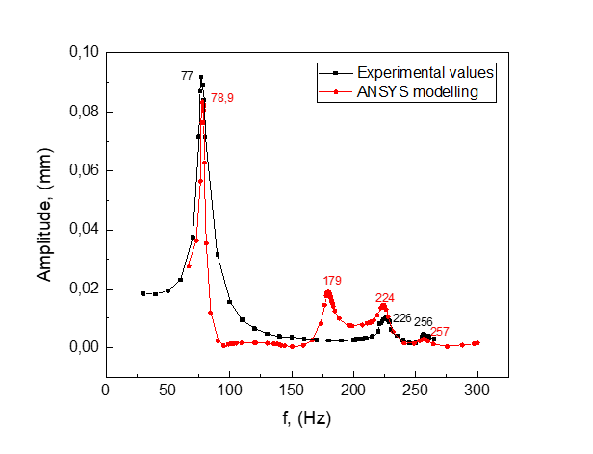


The counter check: Simulations
$∆F^{exp−sim}$ ~ 2.5%
$f_{n}^{exp}$= 77.0±0.55 Hz
$f_{n}^{sim}$= 78.9±1.21 Hz
Real truss
ANSYS
Isotropic M55J
ME = 128.9 GPa
Idea+: To model the structure as an isotropic material based on M55J that behaves mechanically as the real one.
Required input data:
Geometrical characteristics ✓
Density ✓
Aproximate material definition ✓
Modulus of Elasticity ✓

Slide 14
Conclusions
- An acoustic-based experimental setup for measuring the natural frequency of the ultra-light mechanical structures used as support of the tracking sensors in large experimental setups like NICA’s MPD experiment has been assessed.
- A model of the truss was implemented in ANSYS by approximating its composition to an isotropic material with equivalent mechanical characteristics as the real trusses.
- The natural frequency values obtained from the experiment and from the simulations are in good agreement both for loaded and unloaded trusses.

Slide 15
To be published in
Creative Commons Attribution-NonCommercial-NoDerivatives 4.0 International License.
ISSN 0035-001X
Impact Factor = 1.7
Official invitation for publishing

Slide 16
Thank you!

Slide 17
Backup

Slide 18
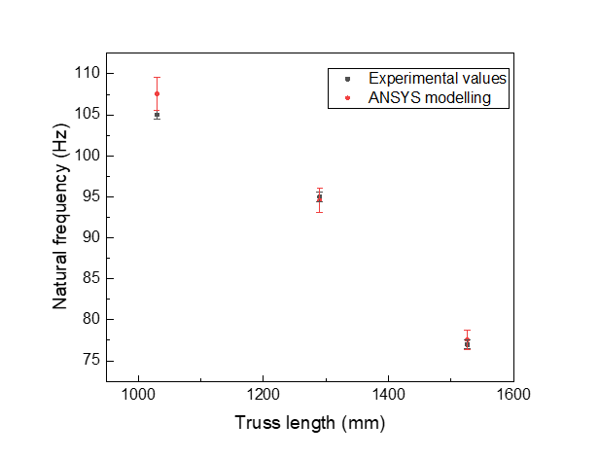
The counter check: Simulations
Real truss
ANSYS
Isotropic M55J
ME = 128.9 GPa
Idea+: To model the structure as an isotropic material based on M55J that behaves mechanically as the real one.
Required input data:
Geometrical characteristics ✓
Density ✓
Aproximate material definition ✓
Modulus of Elasticity ✓

