Slide 1
58
th
Meeting of the
Programme Advisory Committee for Nuclear Physics
29-30 January 2024
Valery V. Nesvizhevsky

Slide 2
Programme Advisory Committee for Nuclear Physics, 58th. meeting, 29 January 2024
1. Opening of the meeting V. Nesvizhevsky
2. Implementation of the recommendations of the 57th PAC meeting V. Nesvizhevsky
3. Information on the Resolution of the 134th session of the JINR Scientific Council (September 2023) and on the decisions S. Dmitriev
of the JINR Committee of Plenipotentiaries (November 2023)
4. Main themes and projects of the Seven-Year Plan for the Development of JINR for 2024–2030 S. Nedelko
5. Work plan on the theme “Neutron Nuclear Physics” and projects within the framework of this theme for 2024 E. Lychagin
6. Work plan on the theme “Synthesis and Properties of Superheavy Elements, the Structure of Nuclei at the Limits S. Sidorchuk
of Nucleon Stability” and projects within the framework of this theme for 2024
7. Work plan on the large research infrastructure (LRI) “Development of the FLNR Accelerator Complex and V. Semin
Experimental Setups (DRIBs-III)” and projects within the framework of this LRI for 2024
8. Review of nuclear physics at the Dzhelepov Laboratory of Nuclear Problems E. Yakushev
9. Scientific reports:
9.1. Verification of T-invariance in the total interaction cross section of neutrons with unpolarized nuclei V. Skoy
using the polarization–asymmetry theorem
9.2. Study of the properties and applications of nanodiamond reflectors of low-energy neutrons A. Nezvanov
Closed session:
10. Meeting of the PAC members with the JINR Directorate
11. Visit to the Flerov Laboratory of Nuclear Reactions

Slide 3
Programme Advisory Committee for Nuclear Physics, 58th. meeting, 30 January 2024
12. Presentations of the new results and proposals by FLNP young scientists in the field of nuclear physics (9 reports)
Closed session:
13. Closed discussion of the young scientists’ presentations
14. Drafting the PAC recommendation
15. Proposals for the agenda of the next PAC meeting
16. Presentation of the PAC recommendations to the directorates of JINR and the laboratories
Closing of the meeting

Slide 4
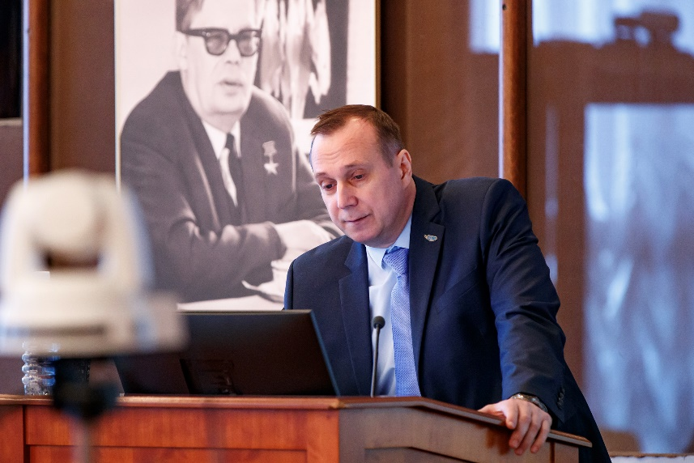
Work plan for the theme “Neutron Nuclear Physics” and projects within the framework of this theme for 2024
Theme: “Neutron Nuclear Physics”
Projects in 2024:
Scientific and technical project:
Modernization of the EG-5 accelerator and its experimental infrastructure
Leader: A.S. Doroshkevich
Scientific projects:
Investigations of neutron nuclear interactions and properties of the neutron
Leaders: V.N Shvetsov, P.V. Sedyshev
Development of the tagged neutron method for measuring the elemental structure of matter and nuclear reactions research (project TANGRA - Tagged Neutrons and Gamma Rays)
Leader: Yu.N. Kopatch
Activity:
Development of the conceptual design of an ultracold neutron source on a pulsed reactor
Leaders: G.V. Kulin , A.I. Frank
Egor
Lychagin

Slide 5
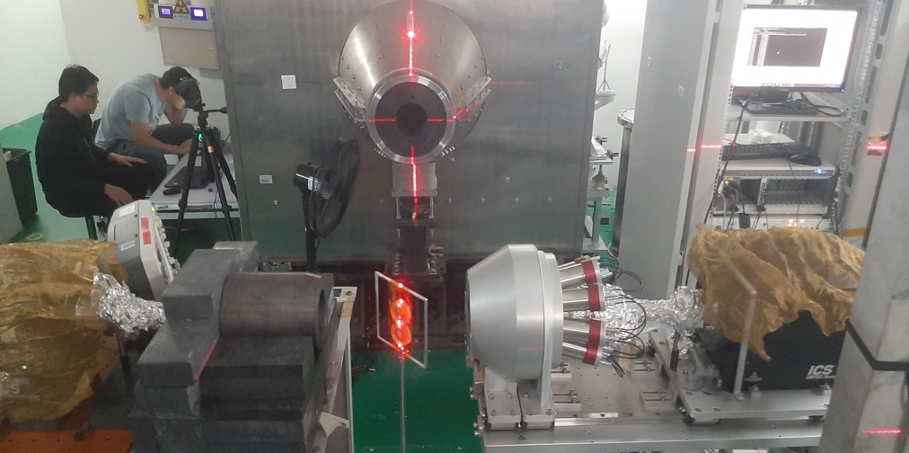
Project “Investigations of neutron nuclear interactions and properties of the neutron”
Experimental investigation of angular asymmetry of γ-quanta emission from the (n,γ)-reaction
10,8 m
Main goal: evaluation of parameters of P-wave resonances, needed for the search for P-odd and T-odd effects in neutron-induced reactions
it is planned to measure angular correlations and γ-ray yields for the already known p-wave resonances in various nuclei, also to search for new p-resonances and new effects promising violation of P- and T-invariance.
The main work is expected to be carried out at the IREN resonance neutron source.
5
1
3
4
2
Scheme of the installation. 1 – the neutron source, 2 – composite shield (polyethylene+ borated polyethylene), 3 – the neutron beam collimator of variable diameter, 4 – vacuum neutron guide, 5 - BGO(Bi₄Ge₃O₁₂) γ-detectors in the shields (lead, ¹⁰В powder and borated polyethylene).
Measurement of γ- decay properties of compound states of ¹⁷⁶Lu and ¹⁷⁷Lu
it is planned to study resonance neutron capture by ¹⁷⁶Lu and ¹⁷⁷Lu in the neutron energy range of 1–300 eV.
The goal of this experiment is to study the effect of Coriolis interaction on the structure of nuclear excited states.
The measurements are planned to be carried out at the IREN resonance neutron source and at the China Spallation Neutron Source (CSNS)
HpGe
HpGe (anti-Compton system)
target
neutron

Slide 6
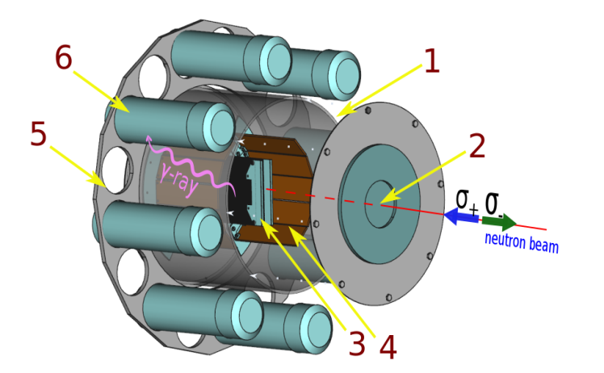
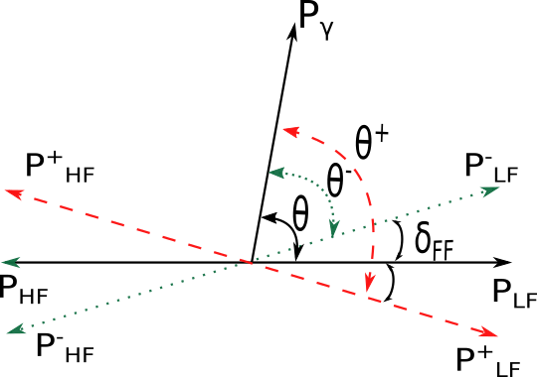
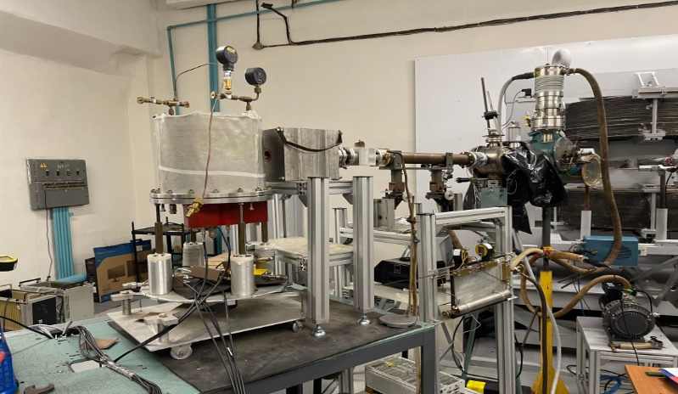
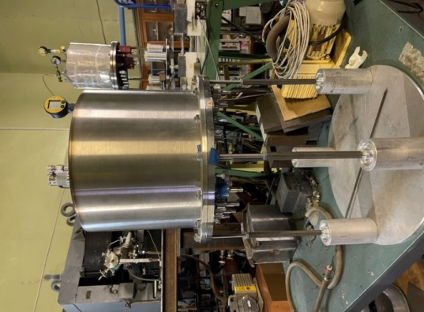
Project “Investigations of neutron nuclear interactions and properties of the neutron”
Measurement of T-odd effects in polarized neutron induced fission
Measurements of TRI and ROT effects for prompt γ-rays and fission neutrons.
Measurements of anisotropy and asymmetry of prompt γ-rays and fission neutrons
Despite the relatively long pulse of the IBR-2 reactor, the resolution of the time-of-flight technique makes it possible to measure low-lying resonances up to several electron-volts at flight paths of the order of 15–30 m.
Investigation of neutron-induced reactions with charged particles emission
In 2024, it is planned to measure reaction cross sections (n, α) on gas samples Ar, F, O, Ne at EG-5 (FLNP, JINR) (En=3–5 MeV) and at the tandem accelerator HI-13 of the China Institute of Atomic Energy (CIAE) (En=8–11 MeV).

Slide 7
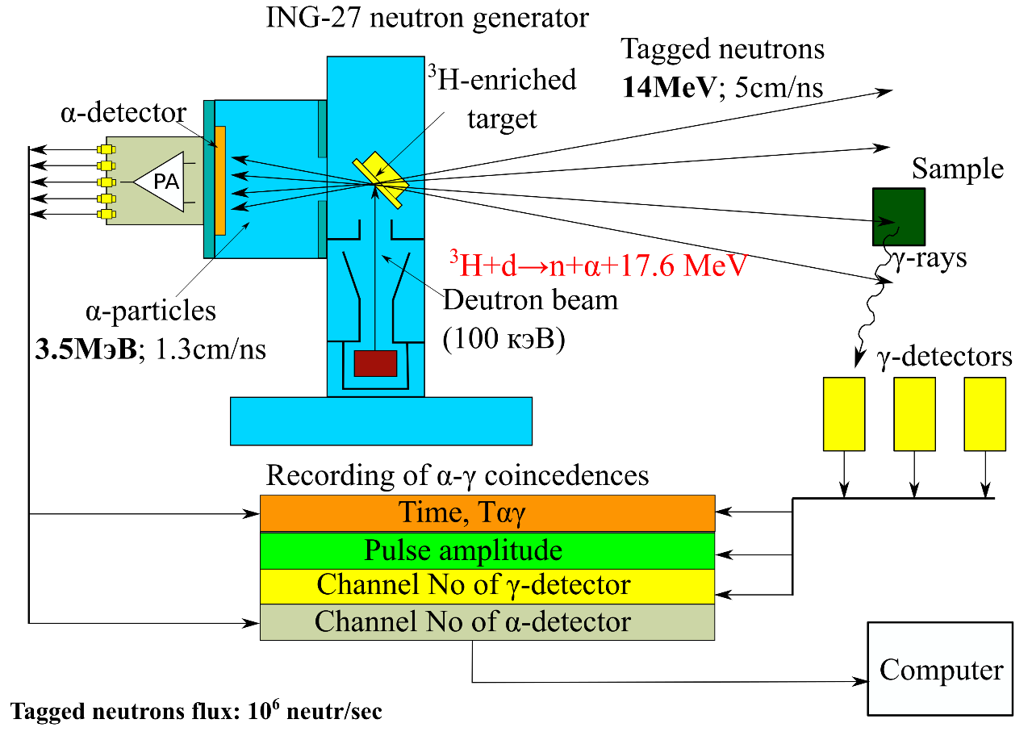
Project TANGRA
The area of interest of the project is nuclear reactions induced by neutrons with an energy of about 14 MeV. The main areas of research in 2024:
it is planned to measure the reaction cross sections (n, xγ) for 22 elements. This information is necessary for elemental analysis, Monte Carlo simulations of nuclear instruments, and verification of theoretical calculations;
it is planned to measure the angular correlations of scattered neutrons and γ-rays in inelastic neutron scattering from carbon. Experiments to study correlations (n, n' γ) are important for understanding the mechanism of reactions (n, n’);
the development of methods for elemental analysis of soils will be continued in collaboration with Diamant LLC. It is planned to assemble and test a prototype of the field setup.

Slide 8
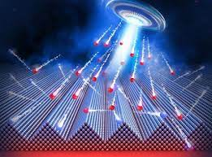
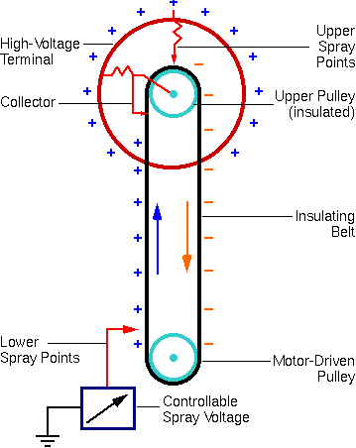
Project “Modernization of the EG-5 accelerator
and its experimental infrastructure”
Areas of use:
Nuclear reactions with fast quasimonoenergetic neutrons;
Ion Beam Spectrometry (Multilayer structures, isotope determination, elemental depth profiling);
Radiation technologies (Science, technology, medicine, etc.).
it is planned to replace the high-voltage system of the EG-5 facility, the main result of which will be an increase in the ion beam current from 2–3 μA to 100–250 μA while maintaining its energy and spatial stability

Slide 9
PAC recommendation:
The PAC noted the good prospects of the proposed scientific programme within the framework of the theme “Neutron Nuclear Physics” and its projects.
The PAC supported the implementation of the scientific programme for 2024 proposed within the framework of the theme “Neutron Nuclear Physics” and the projects “TANGRA”, “Investigations of neutron nuclear interactions and properties of the neutron” and “Modernization of the EG-5 accelerator and its experimental infrastructure”, as well as the activity aimed at developing the concept of a UCN source at the IBR-2 reactor.
SC recommendation
The SC supported the further implementation of the scientific programme for 2024 proposed within the framework of the theme “Neutron Nuclear Physics” and its projects.

Slide 10

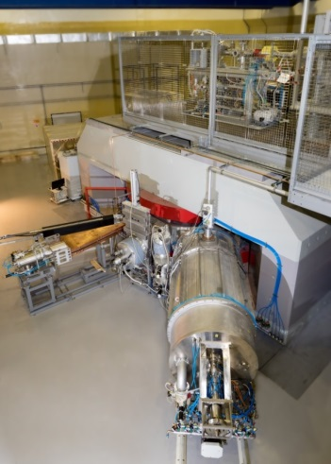
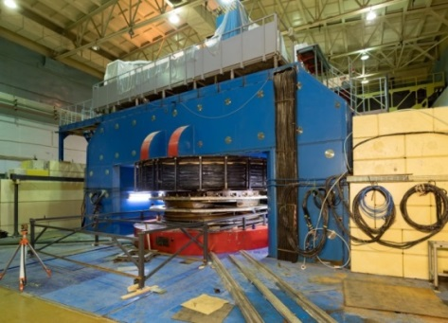
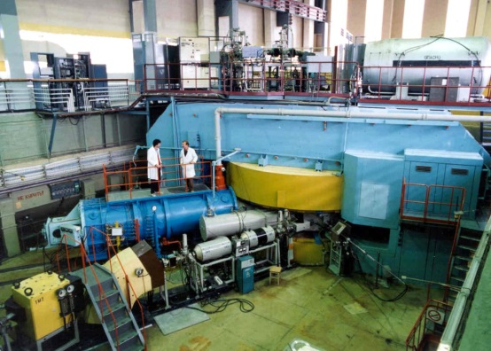
Theme "Synthesis and Properties of Superheavy Elements, the Structure of Nuclei at the Limits of Nucleon Stability"
U400M: commissioning.
Full operation is expected to begin
in the spring 2024
Sergey
Sidorchuk
Radioactive target materials available in 2024
²³²Th, ²³⁸U, ²³⁷Np, ²⁴²Pu;
²⁴³Am. RCL I class is needed to use large amounts of Am;
²⁴⁸Cm. License for the use of Radioactive Materials is expected to be received in 2024.
First half of 2024
January 2024
December 2024
Second half of 2024
U400: start of reconstruction.
Operates until the summer 2024
Beams at the DC280 cyclotron
⁴⁸Ca, ⁵⁰Ti, ⁵⁴Cr etc.

Slide 11
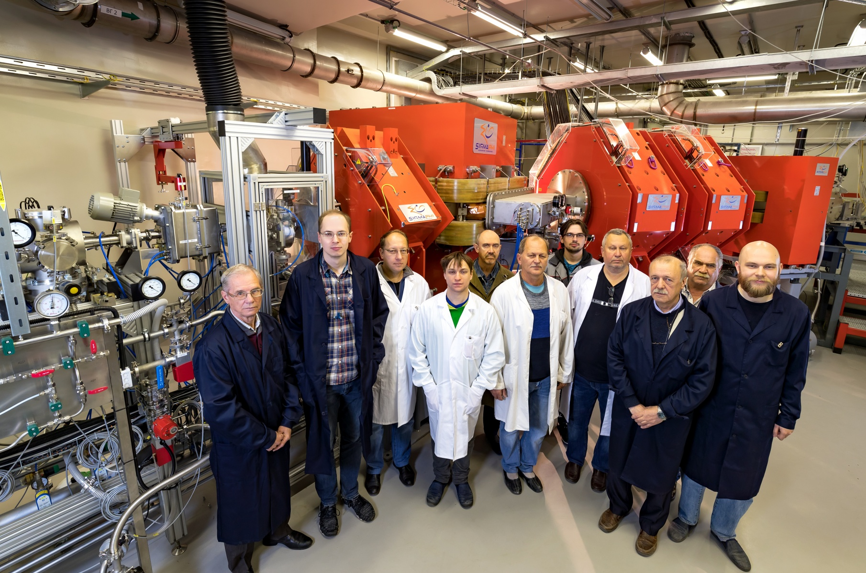
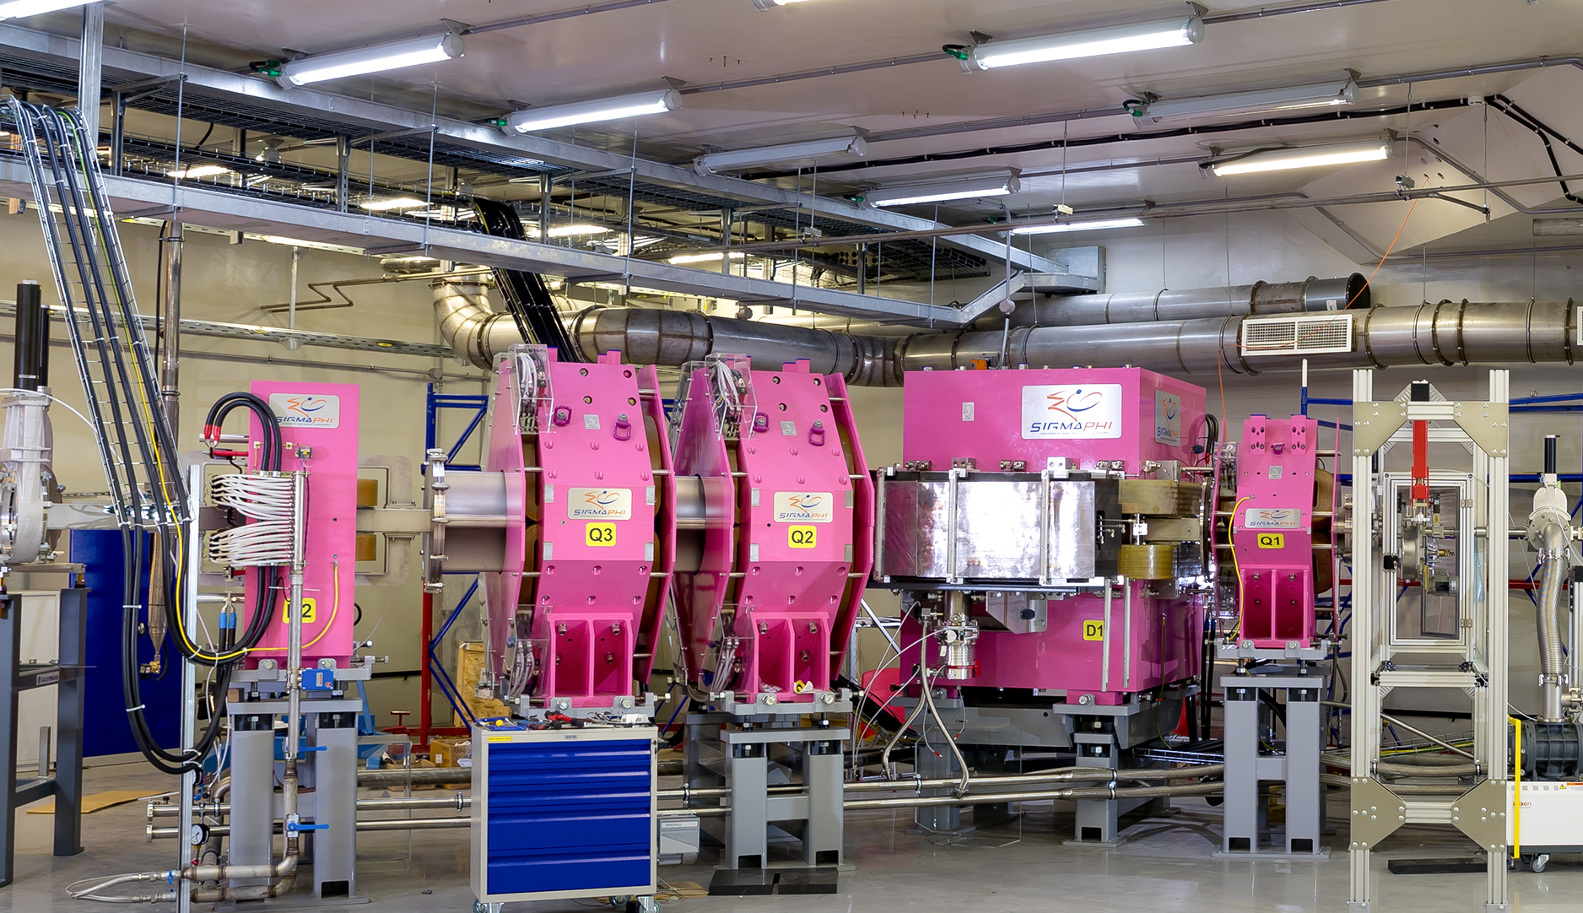
Project “Investigation of heavy and superheavy elements”
DGFRS II (SHE Factory)
Separator GRAND
Chemistry of Fl at the SHE Factory
continuation of the ⁵⁴Cr+²³⁸U experiment, which is extremely important for preparing the synthesis of new superheavy elements 119 and 120.
Previously, in this experiment launched in 2023, two events of the synthesis of the new isotope 288Lv were observed.
First experiments on spectroscopy of superheavy nuclei in the reaction ⁴⁸Ca+²⁴²Pu at the separator GRAND, equipped with the spectrometer GABRIELA-2.
The experiment is aimed at observation of α-decay of even-even nucleus ²⁸⁶Fl to the first excited state of ²⁸²Cn.
Measurement of subsequent γ-emission will allow to estimate deformation of nuclei in vicinity of the stability island.
the continuation of the development and testing of the setup for studying the chemical properties of SHE by thermochromatography.
The main efforts will be focused on increasing the efficiency and speed of extraction of SHE atoms from the stop chamber and transporting them to the detector.
The highest-priority objective of constructing the setup is to conduct experiments on the chemistry of elements Cn and Fl with high statistics

Slide 12
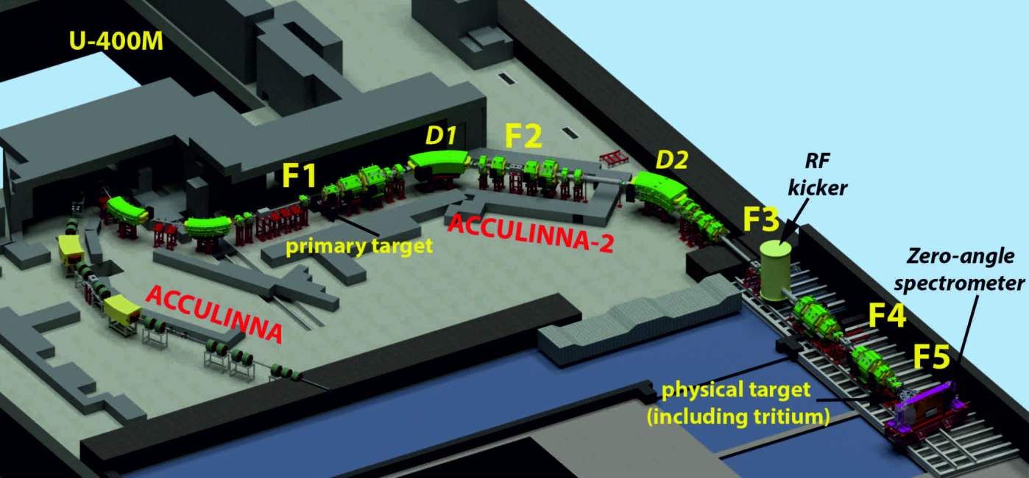
Project “Light exotic nuclei at the borders of nuclear stability”
ACCULINNA and ACCULINNA-2
Structure of heavy helium isotopes – ^{6,8}He
⁶He
⁶He
⁴He
⁴He
⁶He
⁴He
2n
⁴He
⁶He
The main goal:
preparation and conduct of the first experiments aimed at studying the structure of light nuclei near the borders of nucleon stability at the ACCULINNA and ACCULINNA-2 fragment separators of the upgraded U-400M accelerator.
The commissioning of the accelerator is expected in the second quarter of 2024.
In 2024, research will focus on studying the structure of heavy helium isotopes ^{6,7}Не and the reaction mechanisms leading to the formation of unbound exotic systems such as 4n.
In particular, elastic and inelastic scattering of ⁶He on the ⁴He nucleus will be studied over a wide range of center-of-mass angles, including back scattering corresponding to the 2n transfer. This reaction begins a series of investigations of the structure of neutron-rich nuclei and the mechanism of the neutron transfer reaction using secondary beams of helium and beryllium isotopes.

Slide 13
PAC recommendation:
The PAC supported the scientific and technical programmes for 2024 under the theme “Synthesis and Properties of Superheavy Elements, Structure of Nuclei at the Limits of Nucleon Stability”, as they were presented at the current PAC meeting in comparison with the programmes presented 6 months ago, and the continuation of work on the projects “Investigation of heavy and superheavy elements” and “Light exotic nuclei at the borders of nucleon stability”.
The PAC recommended theoretically exploring in detail the pxn reaction channel for the production of SHE nearest to the island of stability, also in the regions of masses below the island of stability and verifying the sensitivity of detecting such channels with the present mass spectrometer and implantation detectors.
SC recommendation
The SC supported the scientific and technical programmes for 2024 under this theme and two projects.

Slide 14
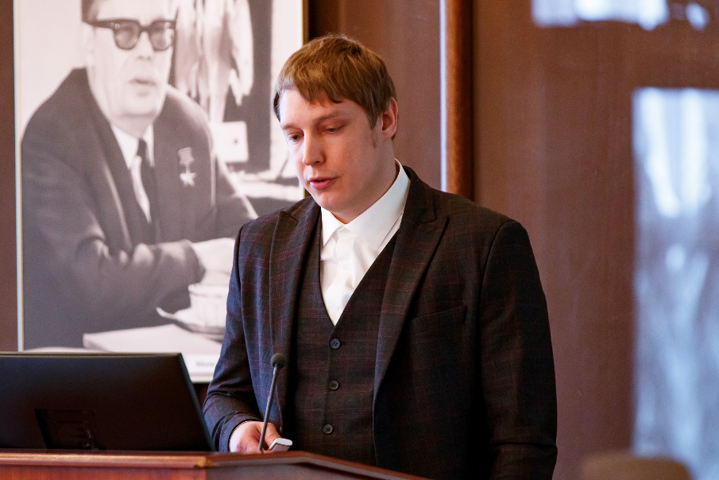
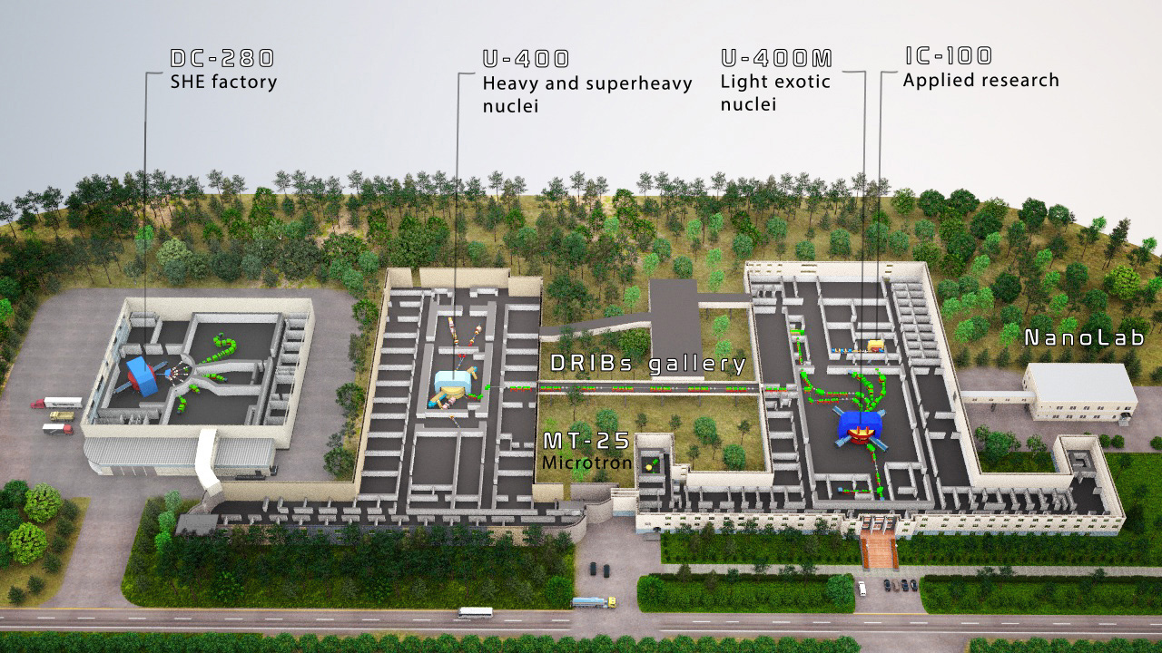
JINR large research infrastructure “Development of the FLNR Accelerator Complex and Experimental Setups (DRIBs-III)”
The main goal:
providing beams with the required characteristics for the implementation of the FLNR’s experimental programme at the existing accelerator complexes DC-280 (SHE Factory) and U-400;
completing the upgrade and commissioning work at the U-400M accelerator, as well as ensuring first experiments with beams of radioactive nuclei;
completing the construction of the DC-140 accelerator complex for applied heavy-ion investigations.
Vasily
Semin
New experimental hall U-400R

Slide 15
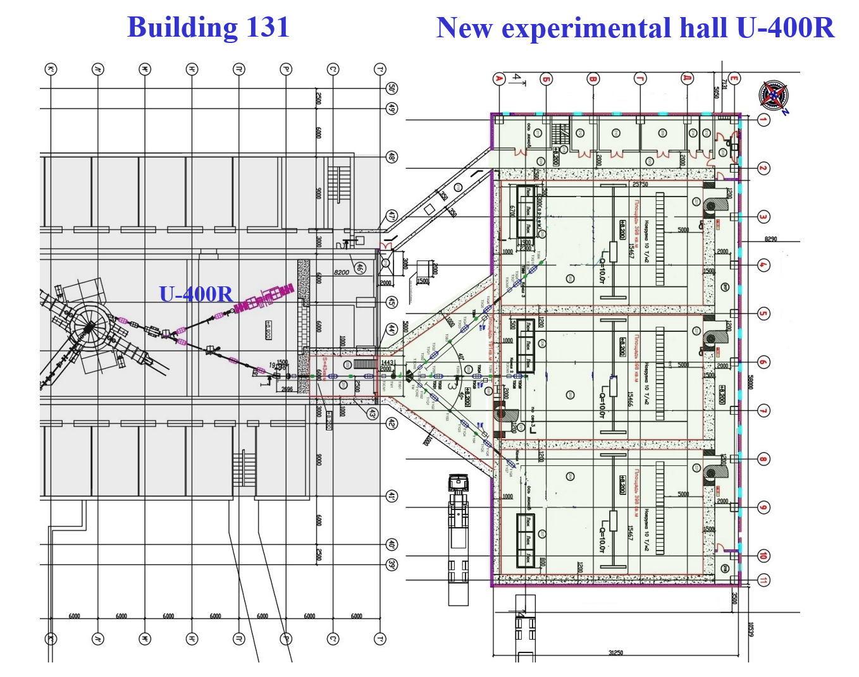
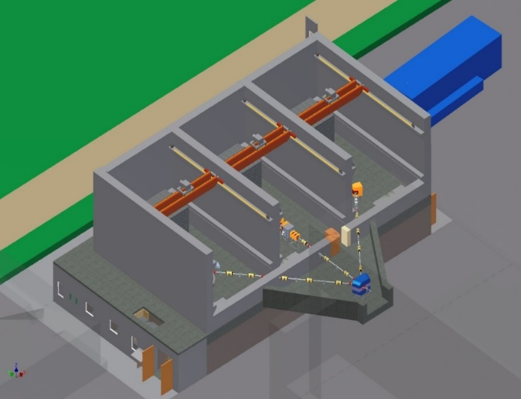
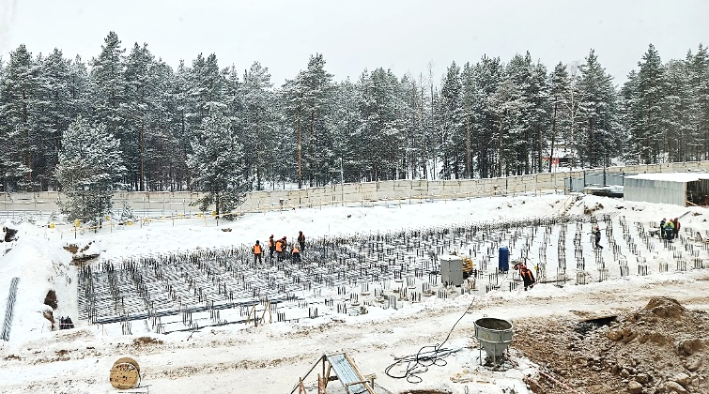
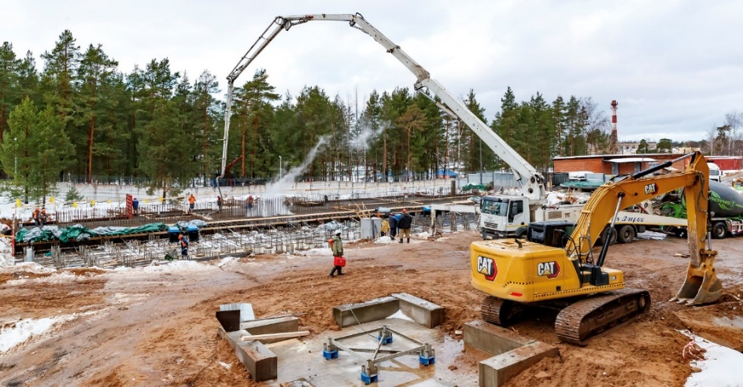
Project “Construction of the U-400R accelerator complex”
U-400 → U-400R
New experimental hall for U-400R
Beginning of pouring the grillage (rostverk) 21.12.23
Increasing the beam intensity for ions with A ≈ 50 from 1.2 pμA to 2.5 pμA;
Smooth variation of energy up to 5 times ;
Decrease of magnetic field from 1.9  2.1 Т to 0.8  1.8 T.
The shutdown of the U-400 facility and the beginning of its upgrade are scheduled for the second half of 2024.
The construction of a new experimental hall, as well as the designing of novel setups for this experimental hall will continue.
The building will have 4 floors:
1st floor: placement of technological systems;
2nd floor: experimental halls, transport gallery and sanitary lock;
3rd floor: measuring and server rooms;
4th floor: power supplies for physical installations.

Slide 16
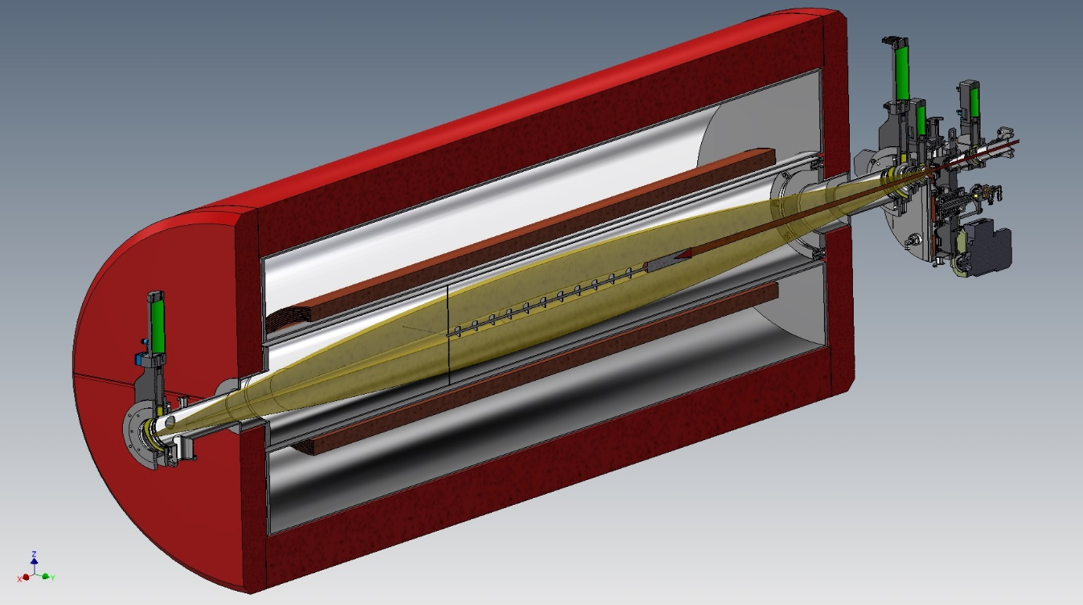

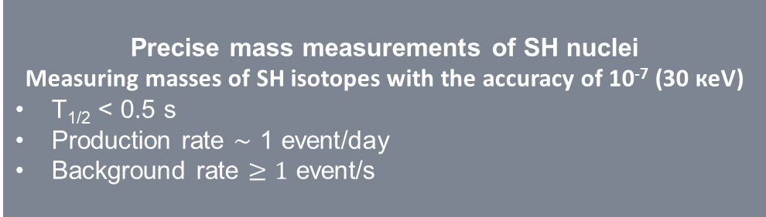
Project “Development of the experimental setups to study the chemical and physical properties of superheavy elements”
GASSOL – Solenoid-based separator
rotating
target
MR TOF spectrometer
axial screens
beam
Diagram of a mass spectrometer:
1 - node of the multi-turn time-of-flight mass analyzer;
2 – node of quadrupole mass filters;
3 - node of the channel for introducing sample ions;
4 - node of the channel for introducing calibrant ions;
5 - node of detectors.
radial
screens
EVRs
beam
axial screens
SC-coils
to He-stop
chamber
beam stopper
3 kW
SC solenoid-based spectrometer for chemical studies of short-lived super-heavy nuclei is expected to be completed and delivered to Dubna by the end of 2024.
Precise mass measurements of SH nuclei
Measuring masses of SH isotopes with the accuracy of 10⁻⁷ (30 кeV)
T_{1/2} < 0.5 s
Production rate $\sim$ 1 event/day
Background rate $≥1$ event/s
In 2024, the construction documentation for the mass spectrometer is expected to be ready, and the GASSOL pre-separator be manufactured and delivered to JINR.

Slide 17
PAC recommendation:
The PAC endorsed the proposed programme for 2024 for the development of FLNR’s accelerator and experimental base under the JINR large research infrastructure project “Development of the FLNR Accelerator Complex and Experimental Setups (DRIBs-III)”.
SC recommendation
The SC supported the JINR large research infrastructure “Development of the FLNR Accelerator Complex and Experimental Setups (DRIBs-III)”.

Slide 18
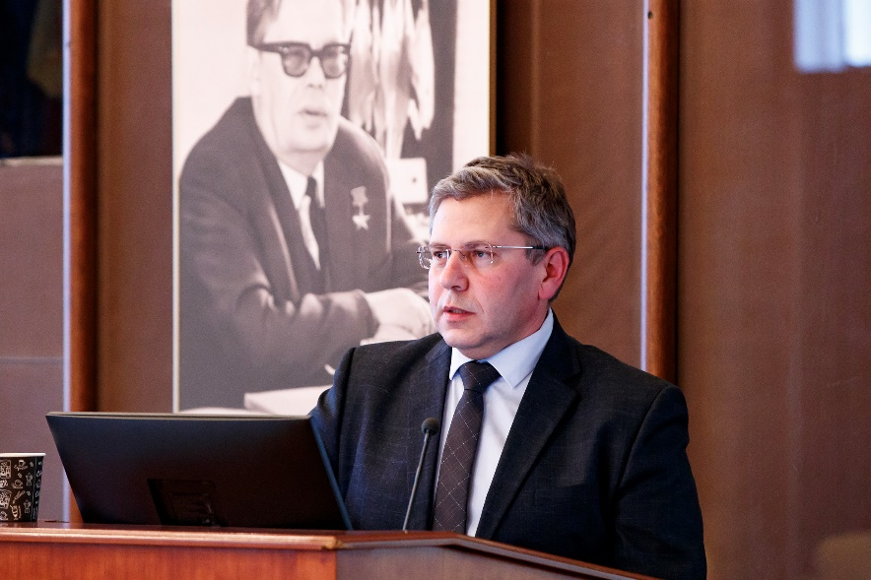
Review of nuclear physics at the Dzhelepov Laboratory of Nuclear Problems
Main scientific directions of the Laboratory now:
Neutrino physics and astrophysics
High energy physics
New detectors, radiochemistry, applied research, biology, medical research
Evgeny
Yakushev
Nuclear physics approaches remain the basis of the DLNP scientific program.
Research directions are:
classical spectrometry of (with) radioactive isotopes
search for evidences of new physics beyond the Standard Model
investigation of double β-decay with different calorimetric and treko-calorimetric methods;
investigation of neutrino properties from different sources;
search for Dark Matter, etc;
significant part of the laboratory scientific program is devoted to the investigation of processes inside nuclear reactor cores using neutrinos.

Slide 19
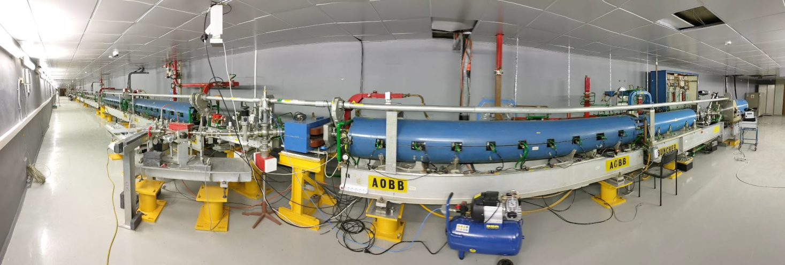
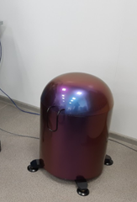
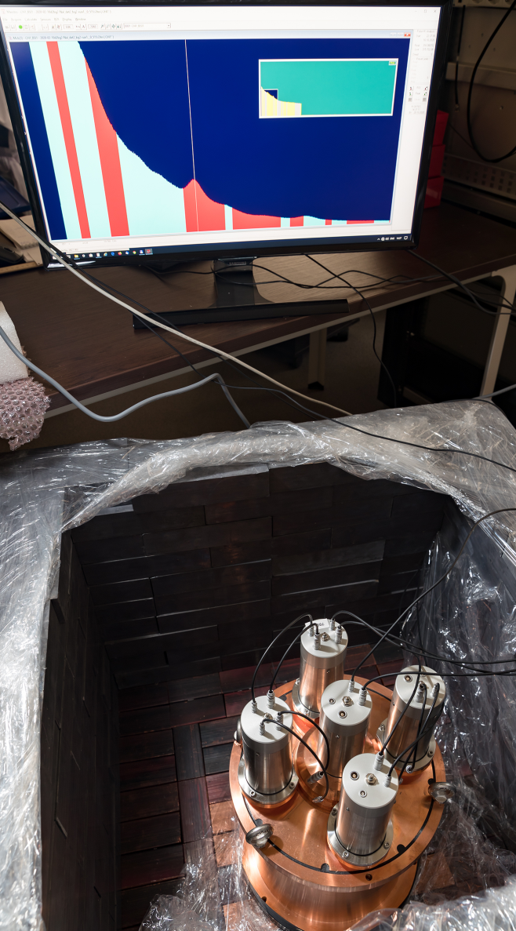
In 2024, the Laboratory plans to commission two new facilities
LINAC-200/800 electron accelerator
Spectrometry cluster
HPGe detector inside of anti-compton veto + shield
The linear accelerator LINAC-200 at JINR is a new facility, constructed to provide electron test beams to carry out particle detectors R&D, to perform studies of advanced methods of electron beam diagnostics, and for applied research.
The cluster will have ~10 different size/shape HPGe detectors, NaI, CsI, organic scintillators, etc: all can be proposed for use in joint measurements (user committee, availability, schedule).

Slide 20
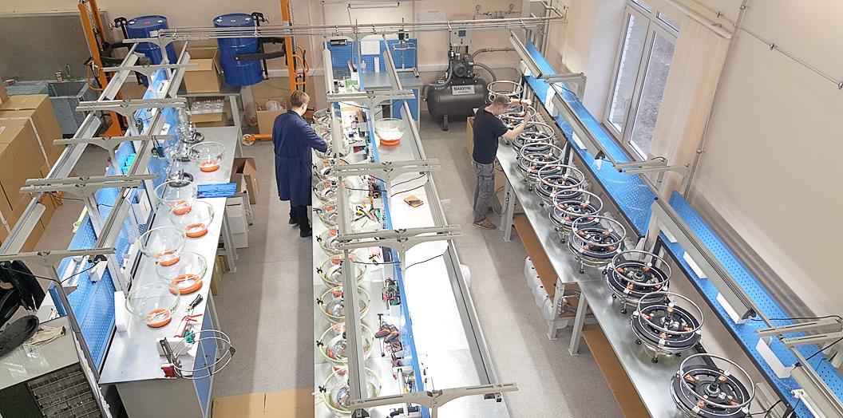
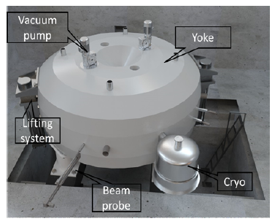
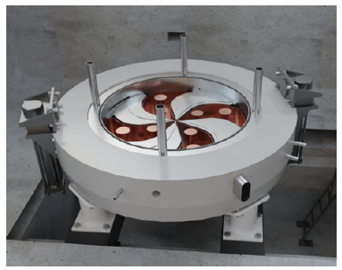
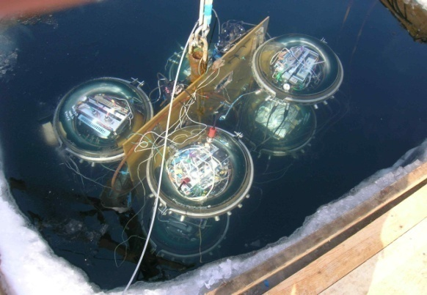
North hemisphere biggest neutrino detector BAIKAL-GVD
MSC-230 cyclotron
A significant part of the Laboratory’s manpower involved in the nuclear physics programme is assigned to the construction and commissioning of the Baikal-GVD gigaton volume neutrino telescope, which is a part of the large research infrastructure of JINR.
MSC230 is intended for basic research in radiobiology, biomedicine, and for beam therapy (proton ~10 mkA, 50msec, > 5Gr/l/s)
TDR is completed.
Superconducting coils are prototyping and scheduled for summer 2024.
Other technical systems are in the process of
procurement and manufacturing.

Slide 21
PAC recommendation:
The PAC noted that DLNP applies a wide range of nuclear physics methods to design and conduct experiments and obtain physics results at the cutting edge of modern science.
The PAC recommended that the support of the experiments conducted in the frame of the DLNP nuclear physics scientific programme be continued.
The PAC emphasized the importance of efforts to further improve the experimental base at JINR and approves the presented plans for 2024 to commission the new basic facilities of the Laboratory.
SC recommendation
The SC approved the presented plans for 2024 and recommends the continued support of the experiments conducted in the frame of the DLNP nuclear physics scientific programme.
General recommendation
The Scientific Council supported the work plan for scientific research and infra-structure development of JINR laboratories in the field of nuclear physics within the framework of themes and projects for 2024.
The SC emphasized the importance of efforts to further improve the experimental base at JINR as well as the interlaboratory links between FLNR, DLNP, and FLNP with BLTP on topics, which are of common interest, to boost research results both experimentally and theoretically.

Slide 22
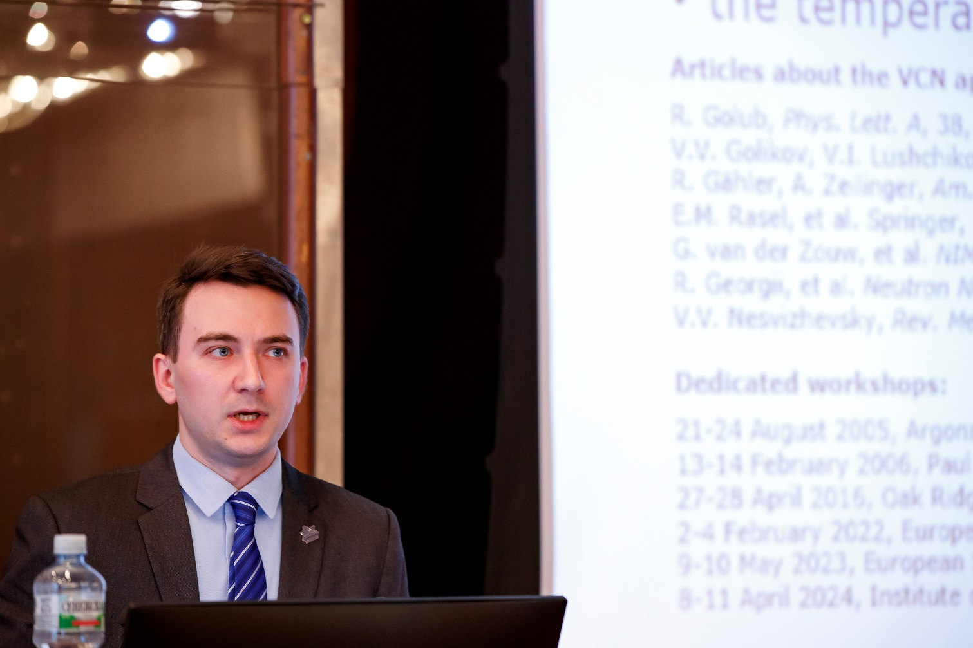

Scientific reports:
Alexander Nezvanov
“Study of the properties and applications of nanodiamond reflectors of low-energy neutrons”
Vadim Skoy
“Verification of T-invariance in the total interaction cross section of neutrons with unpolarized nuclei using the polarization–asymmetry theorem”

Slide 23
Short presentations by young scientists
The PAC reviewed 9 short presentations in the field of nuclear physics research by young scientists from FLNP.
Three best short presentations:
Alexander Nezvanov
“Enhanced directional extraction of very cold neutrons using a diamond nanoparticle powder reflector”
Aleksandra Kravtsova
“Chromium, nickel and zinc accumulation and translocation in root and leafy vegetables irrigated with industrial effluents – a laboratory study”
Constantin Hramco
“Experimental setup for elemental analysis using prompt gamma rays at research reactor IBR-2”

Slide 24
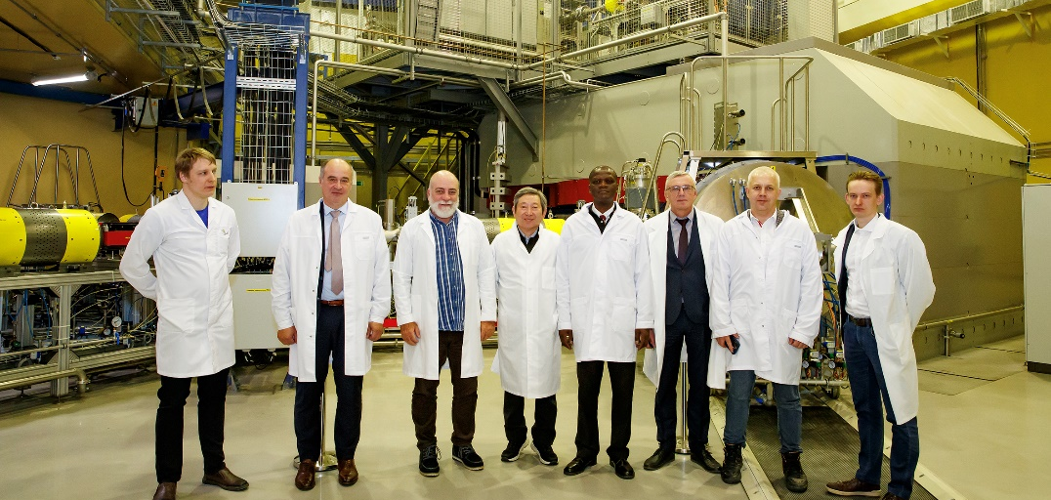
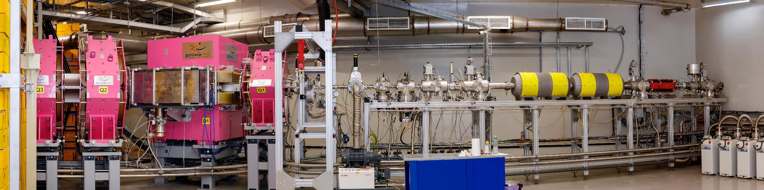
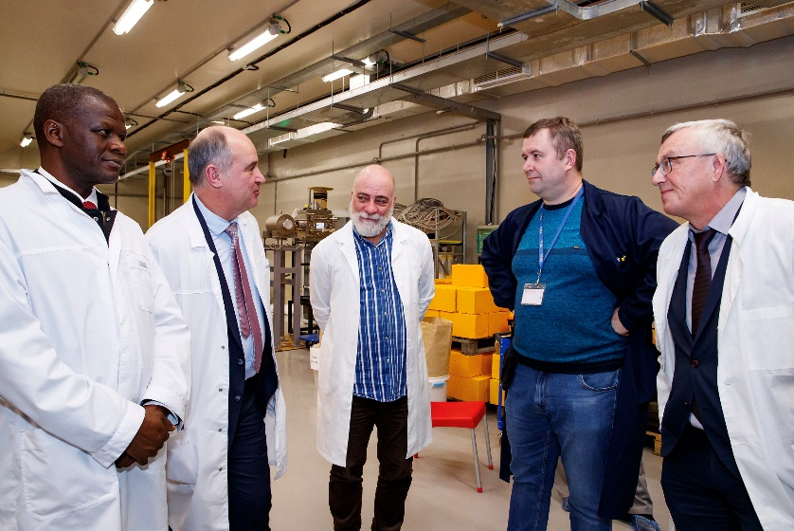
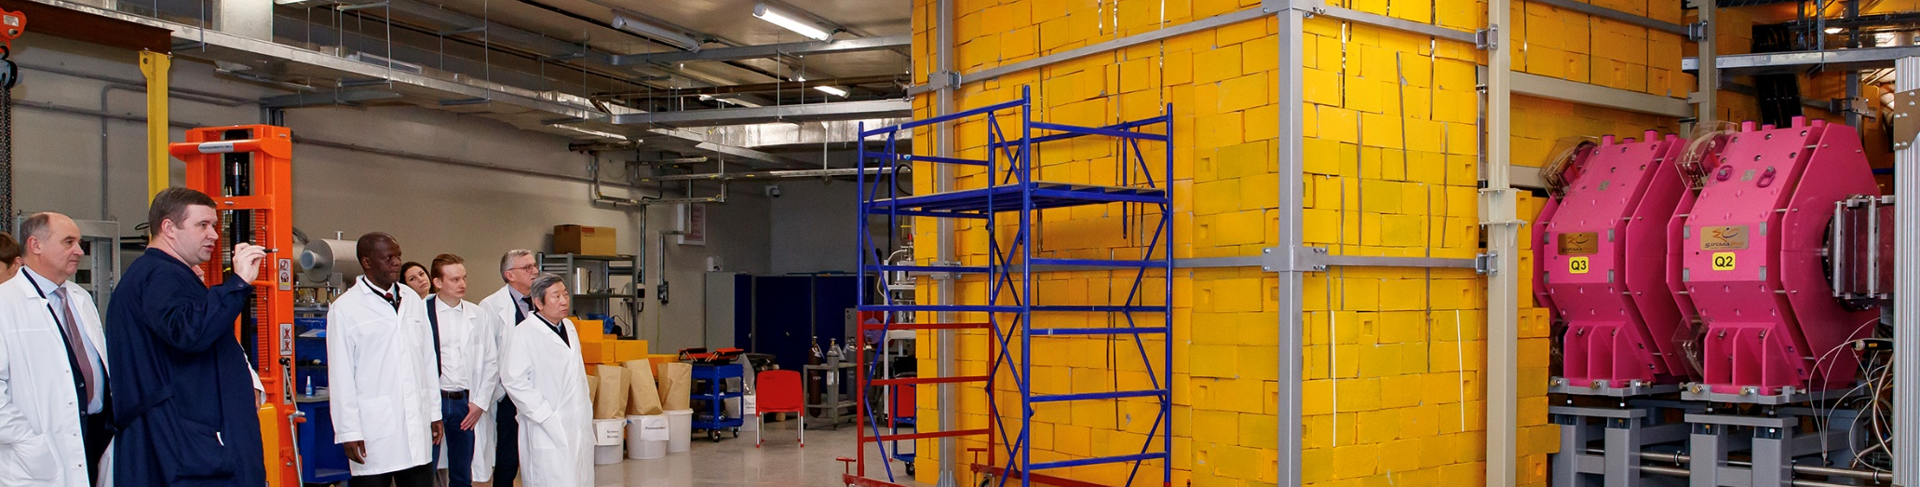
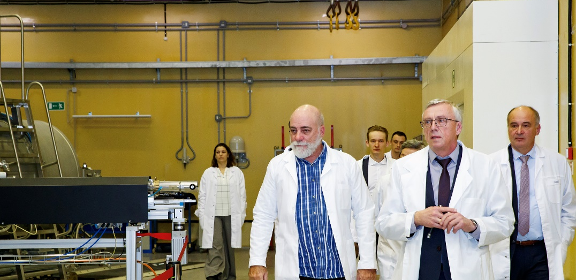
The members of the PAC thank the Directorate of the Flerov Laboratory of Nuclear Reactions for the organization of the visit to this laboratory.

Slide 25
THANK YOU FOR YOUR ATTENTION!

Slide 26
General recommendations:
The PAC recommends an improvement of the interlaboratory links between FLNR, DLNP, FLNP and BLTP on topics, which are of common interest, to boost research results both experimentally and theoretically. The PAC recommends engaging BLTP scientists into research projects of FLNR, DLNP, and FLNP and conducting joint seminars of experimentalists and theoreticians.
The PAC would like to hear scientific reports on developing/applying radiochemical research in JINR laboratories including the production of radioisotopes for ecology and medicine as well as application of nuclear methods and related analytical techniques for the investigation of cultural heritage objects.

