Slide 1

Information on the Resolution of the JINR Scientific Council
135th session, 15–16 February 2024
and
on the decisions of the JINR Committee of Plenipotentiaries
22 March 2024, Dubna
PAC NP, JINR, 13 June 2024

Slide 2
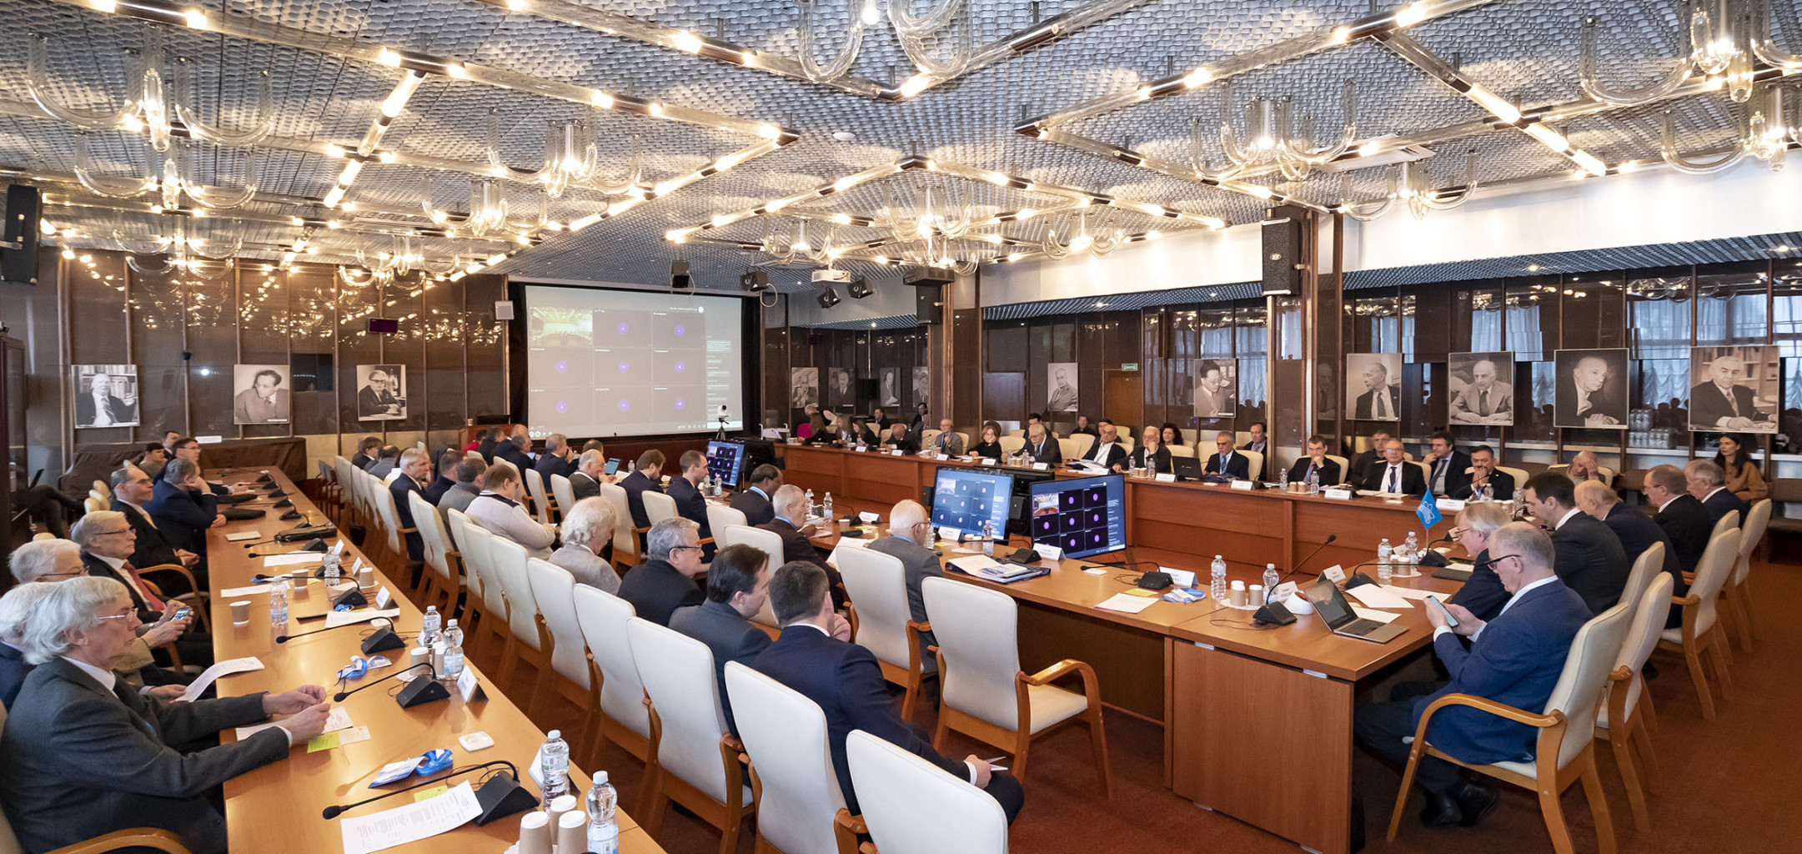
Information on the Resolution of the JINR Scientific Council
135th session, 15–16 February 2024, hybrid mode
Co-chaired by Grigory Trubnikov and by Sergei Kilin

Slide 3
PROGRAMME: 135th session of the JINR Scientific Council 15–16 February 2024
15 February
Report by the JINR Director (G.V. Trubnikov)
- The most notable scientific results and events of 2024
- The results of the implementation of the Seven-Year Plan for the Development of JINR (2017–2023)
Appointment of the Editing Board for drafting the Resolution of the Scientific Council (S. Kilin)
Recommendations of the Programme Advisory Committees taken at the meetings in January 2024:
(I. Tserruya, V. Nesvizhevsky, D. L. Nagy)
Amendments to the Regulation for the election of Directors and for the endorsed appointment of Deputy Directors of JINR Laboratories (S. Nedelko)
Election of Deputy Directors of DLNP and FLNP and announcement of vacancy of the position of Director of FLNR
16 February
Reports by young scientists as recommended by the PACs
Proposals for awarding the title "Honorary Doctor of JINR"
Jury’s recommendations on the award of JINR annual prizes for best papers in the fields of theoretical and experimental research, methodology and technology research, and applied technology research (L. Kostov)
Announcement of vacancies of positions in the directorates of JINR Laboratories (G. Trubnikov)
General discussion. Adoption of the Resolution of the Scientific Council

Slide 4
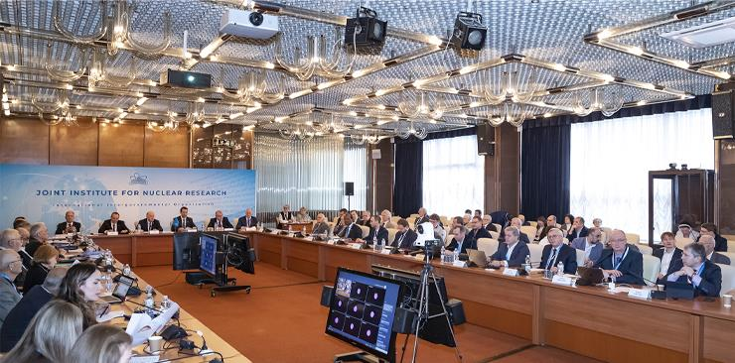
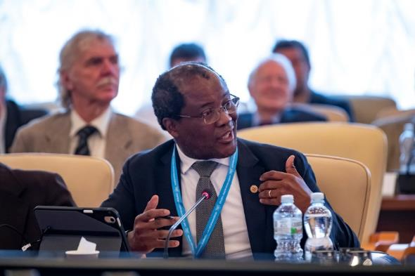
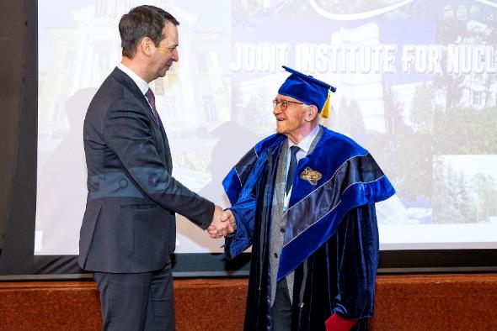
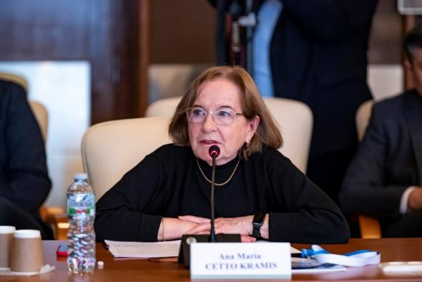
JINR Scientific Council
135th session, 15–16 February 2024
‒ The Scientific Council took note of the comprehensive report by the JINR Director, G. Trubnikov, covering the decisions of the latest session of the Committee of Plenipotentiaries of the Governments of the JINR Member States (9–10 November 2023), the results of the implementation of the Seven-Year Plan for the Development of JINR (2017–2023), the progress in the realization of the projects included in the Topical Plan for 2024 as well as recent events in JINR’s international cooperation.
‒ SC approved the proposal of DG to award the title “Honorary Doctor of JINR” to Prof. Chavdar Stoyanov (Bulgaria).
The Scientific Council appreciated the impressive results in developing JINR’s large research infrastructure, the Institute’s significant contribution to international cooperation, especially at CERN, as well as JINR’s recent achievements.
‒ The Scientific Council took note of the recommendations made by the PACs at their meetings in January 2024.
‒ The Scientific Council endorsed the new edition of the Regulation for the election of Directors and for the endorsement of appointment of Deputy Directors of JINR Laboratories, proposed by the JINR Directorate, and recommended its approval at the next CP session in March 2024.

Slide 5
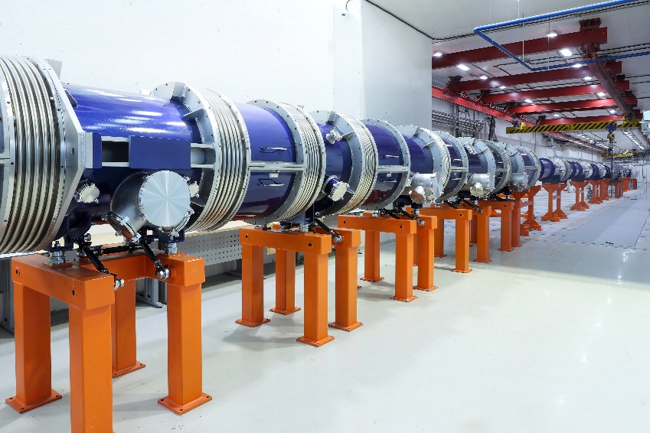
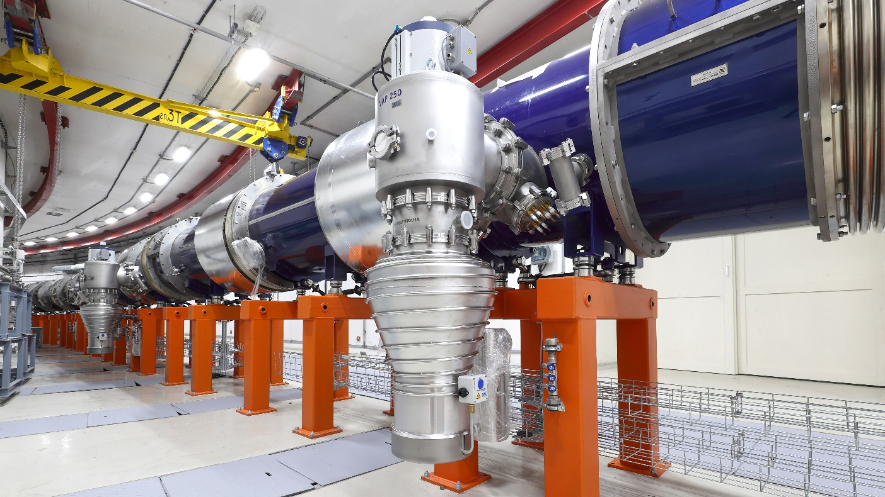
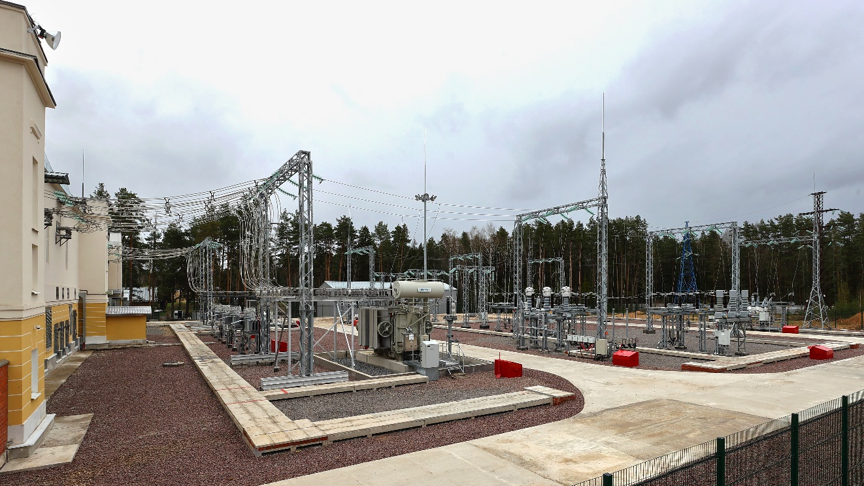
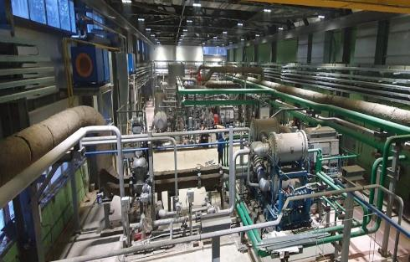
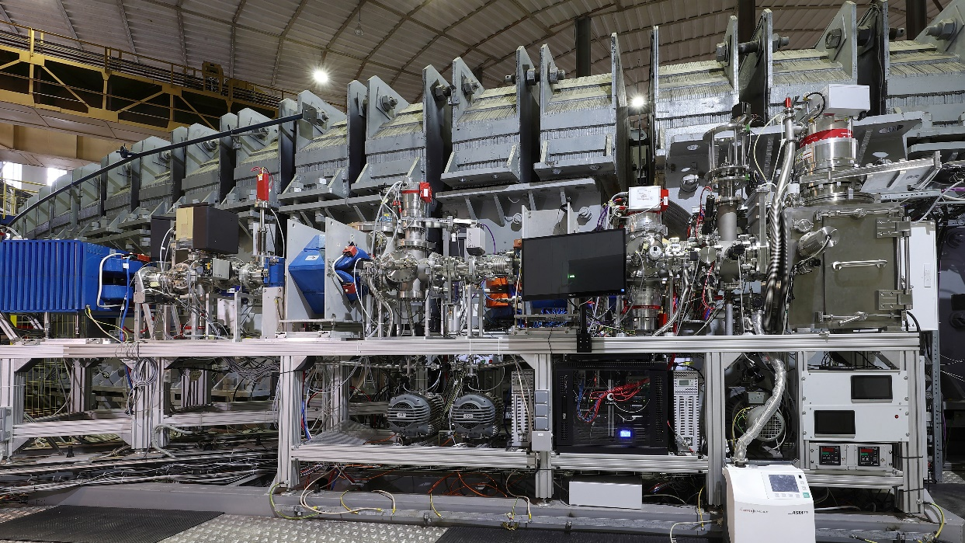
JINR Scientific Council
135th session, 15–16 February 2024
― The Scientific Council appreciated with satisfaction the completion of the production and cryogenic testing of components of the collider’s magnetic system, readiness for commissioning the power supply system for the structural elements of the collider, preparations for the launch of a new cryogenic compressor station, beginning of the implementation of an educational programme to train operators involved in commissioning and operation of the NICA complex;
― progress in the reconstruction of raw experimental data recorded by the BM@N experiment, in particular, the reconstruction of statistically significant signals of Λ- and Ξ-hyperons and K⁰s-mesons for further physics analysis;
― progress in the production of all components of the MPD first-stage detector with minimal delays;
― presentation of the updated SPD Technical Design Report (TDR) at the PAC meeting in January 2024, and the start of a review process of the updated TDR by the new international Detector Advisory Committee (DAC) appointed in December 2023;
― development of the ARIADNA collaboration, whose applied research programme was launched at the NICA complex in the beginning of 2023, testing of the SOCHI station with the Ar beam, and installation of two other stations – SIMBA and ISCRA.
SOCHI station
GPP1 Station (40.8 MW) was modernized and automated, now in operation
New compressor station will be
commissioned in summer 2024

Slide 6
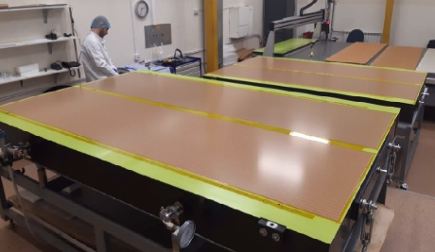
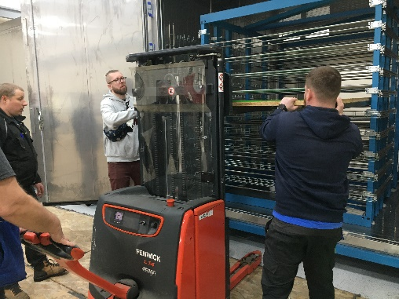
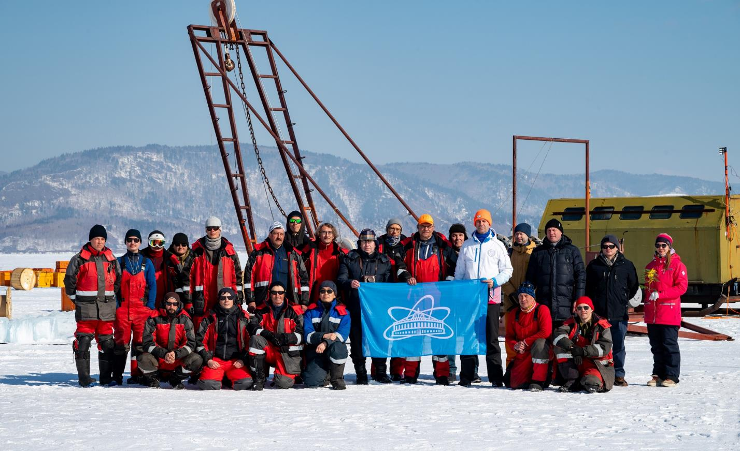
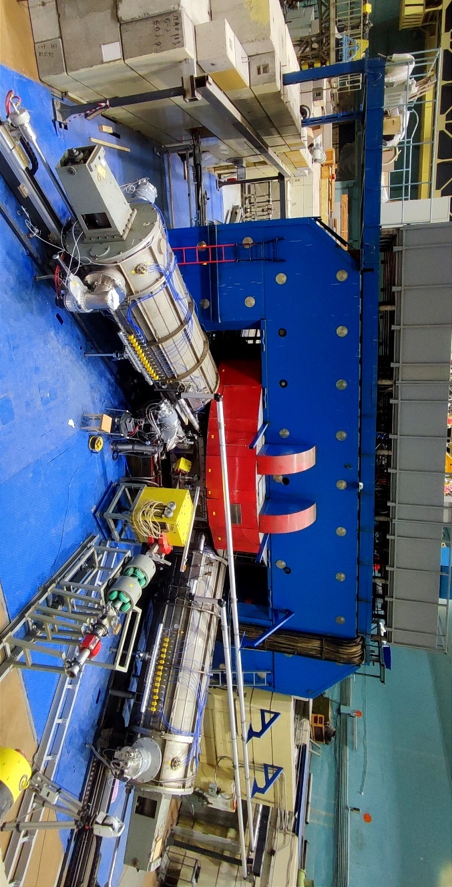
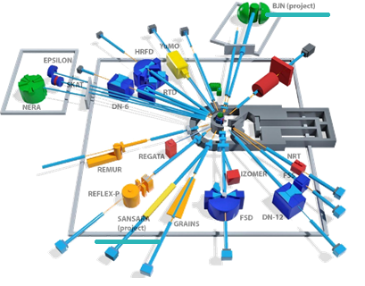
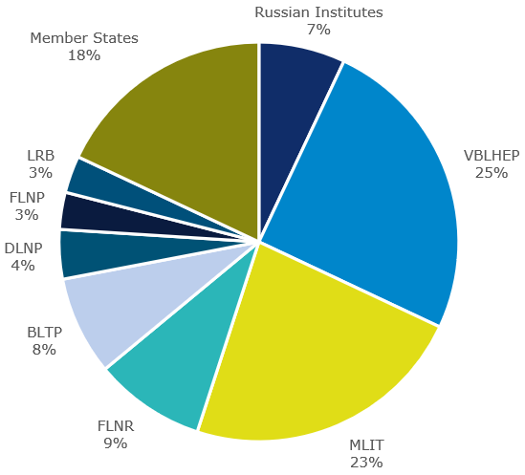
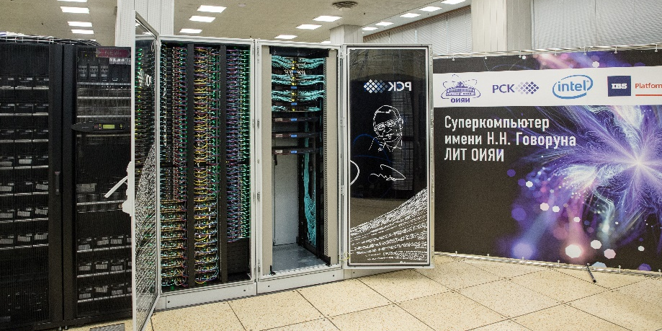
JINR Scientific Council
135th session, 15–16 February 2024
‒ The Scientific Council noted with satisfaction the successful participation of the Institute in the work of collaborations at CERN, as well as the high level of JINR’s activity in the fulfilment of its obligations under the programme for the second phase of upgrade of the ATLAS, CMS, and ALICE detectors;
― progress in developing the Baikal-GVD deep-water neutrino telescope, installation of 576 optical modules and 2 bottom cable lines in 2023, as well as manufacturing 470 optical modules for installation during the 2024 expedition;
― successful continuation of experiments at the Factory of Superheavy Elements, in particular, the observation of 2 events of the new isotope ²⁸⁸Lv in the reaction ⁵⁴Cr+²³⁸U, which is also an important stage in preparation to the synthesis of the new element 120 in the ⁵⁴Cr+²⁴⁸Cm reaction;
― progress in developing the DRIBs-III accelerator complex with the modernization of the U-400M cyclotron with the first beam expected in the spring of 2024, the progress of construction work for DC-140 with commissioning expected at the end of 2024, as well as the planned implementation of the construction work in the new experimental hall of U-400R;
― successful implementation of the working plan to prepare for continuing the regular operation of the IBR-2 reactor, and progress in the development of the spectrometer complex, in particular, the wide-aperture backscattering detector (BSD-A) for the high- resolution Fourier diffractometer, small-angle neutron scattering/neutron radiography detector (SANSARA), and an inelastic neutron scattering spectrometer in inverse geometry (BJN);
― further active development of fundamental and applied areas of research related to life sciences and condensed matter physics due to the development of the interlaboratory research programme at LRB;
― successful work of BLTP and important results in particle, nuclear, condensed matter physics, and advanced mathematical physics, aimed, in particular, at theoretical support of the JINR experimental programme;
― successful development of the MICC JINR, including the expansion of the Govorun supercomputer, the use of the DIRAC distributed platform to support the collaborations of the NICA MPD, BM@N and SPD experiments, as well as the Baikal-GVD neutrino telescope.

Slide 7
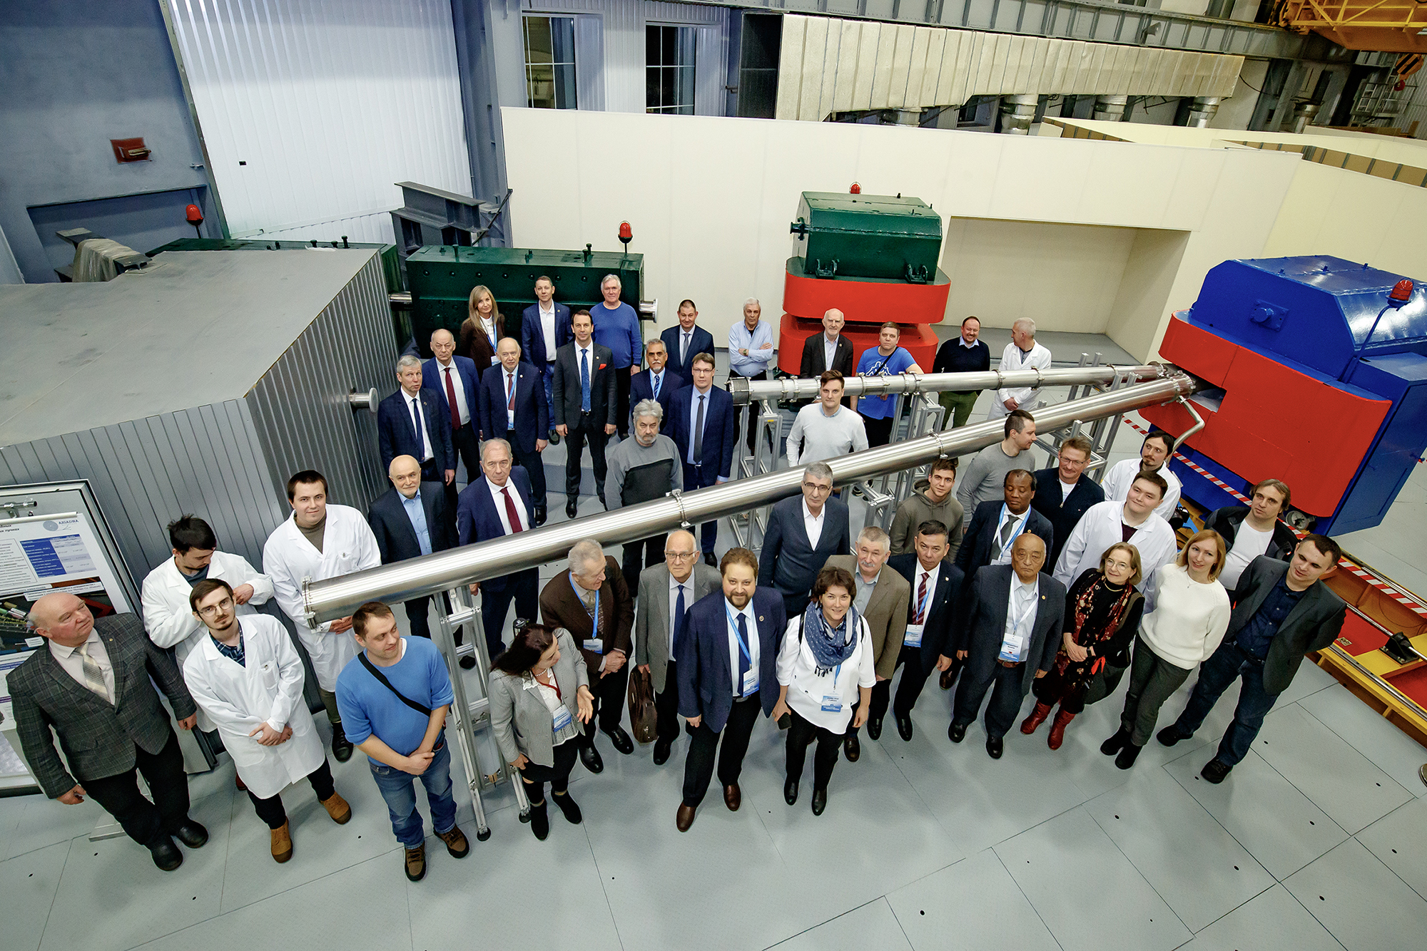
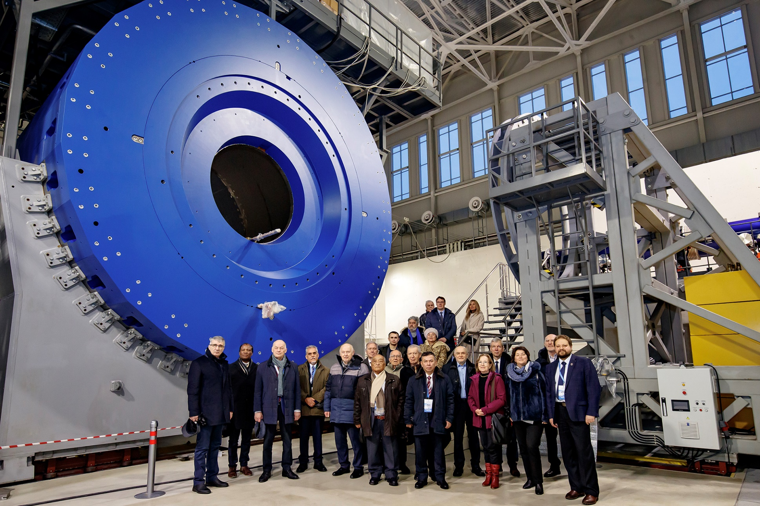
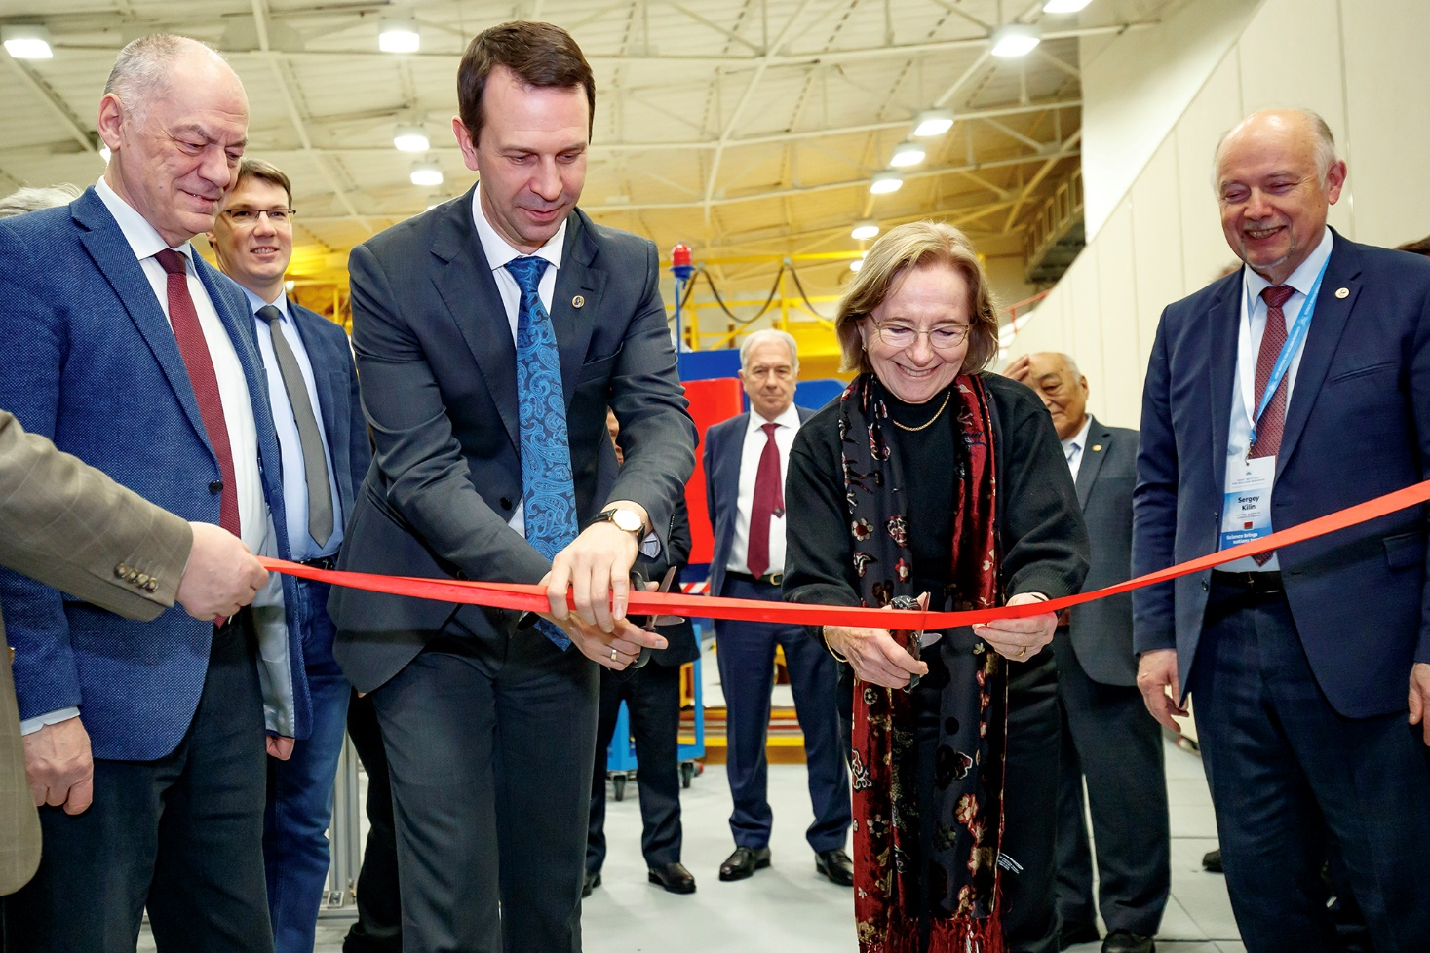
JINR Scientific Council
135th session, 15–16 February 2024
‒ The Scientific Council appreciated with satisfaction the development of the ARIADNA collaboration, whose applied research programme was launched at the NICA complex in the beginning of 2023, testing of the SOCHI station with the Ar beam, and installation of two other stations – SIMBA and ISCRA.
15 February members of the Scientific Council visited the Laboratory of High Energy Physics and inspected the NICA accelerator complex under construction.
In the presence of SC members, the grand opening of two stations for applied research at NICA was held: SIMBO (Station for Investigation of Medical Biological Objects) and ISCRA (Irradiation Station of Components of Radioelectronic Apparatus).
Together with the SOCHI station, they constitute the infrastructure for applied research at ARIADNA.

Slide 8
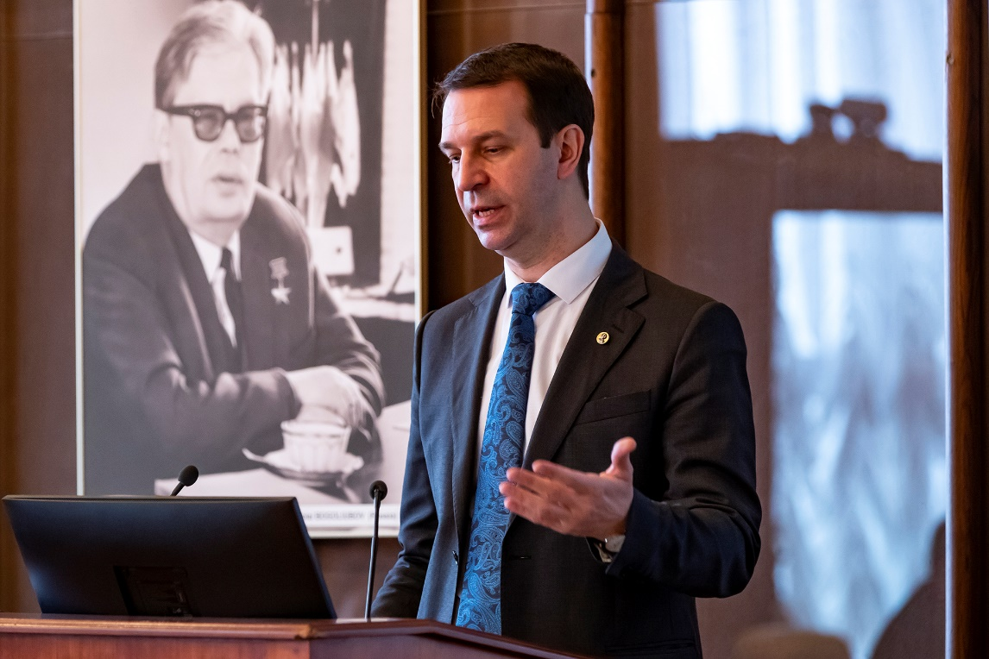
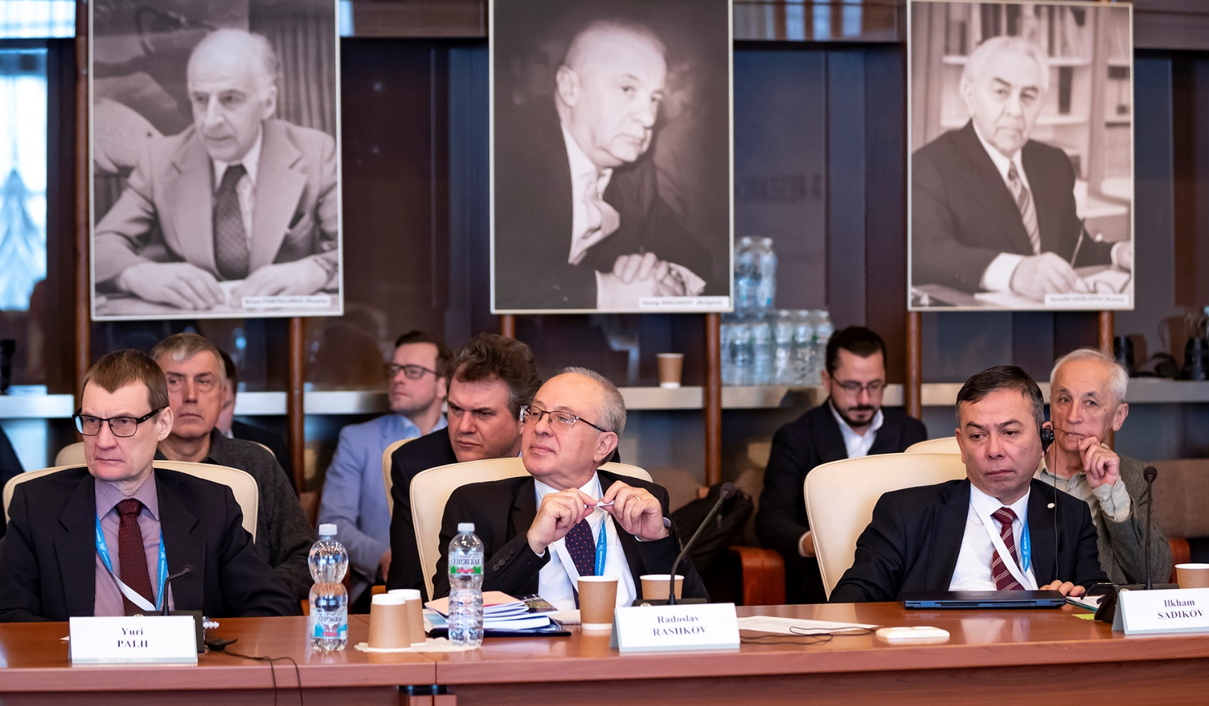
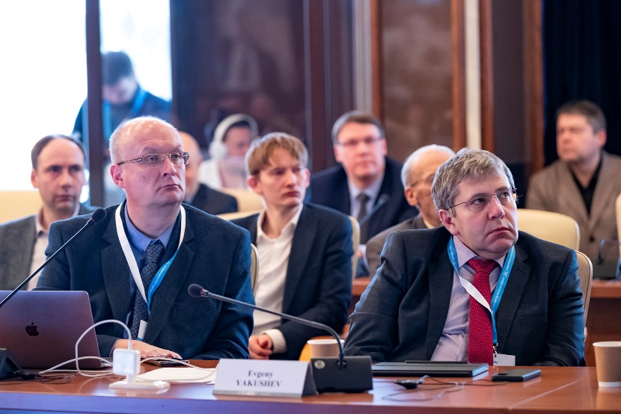
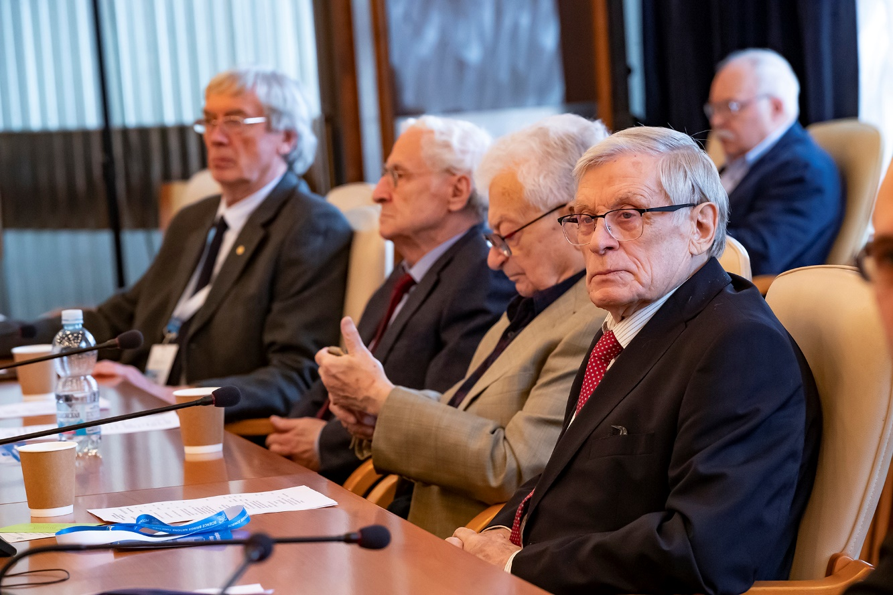
JINR Scientific Council
135th session, 15–16 February 2024
‒ The Scientific Council approved the Jury’s recommendations on awarding the JINR annual prizes for best papers in the fields of theoretical and experimental research, methodology and technology research, and applied technology research.
‒ The Scientific Council endorsed the appointment of A. Guskov as Deputy Director of the Dzhelepov Laboratory of Nuclear Problems (DLNP) until the completion of the term of service of the current DLNP Director, E. Yakushev.
‒ The Scientific Council endorsed the appointment of B. Mukhametuly (Khazakhstan) as Deputy Director of the Frank Laboratory of Neutron Physics until the completion of the term of service of the current FLNP Director, E. Lychagin.
– The Scientific Council announced the vacancy of the position of Director of the Flerov Laboratory of Nuclear Reactions. The election will take place at the 137th session of the Scientific Council in February 2025.
‒ The Scientific Council agreed on the extension of the term of office of all Deputy Directors of VBLHEP until the election of the Director of VBLHEP.
‒ The 136th session of the Scientific Council will be held on 12–13 September 2024.

Slide 9
On the Results of Financial Support for the Seven-Year Plan for the Development of JINR for 2017-2023
Execution of the income part of the financial support of the Seven-Year Plan for the Development of JINR for 2017-2023
М$ | Plan | Actual | Execution
Contributions of the Member States | 1 444.0 | 1 380.5 | 96%
Payment of contribution arrears of Member States | 91.7 | 91.2 | 99%
Funds received under agreements on science and technology cooperation | - | 12.8 | -
Other revenues | 34.5 | 57.6 | 167%
Total | 1 570.2 | 1 542.1 | 98%

Slide 10
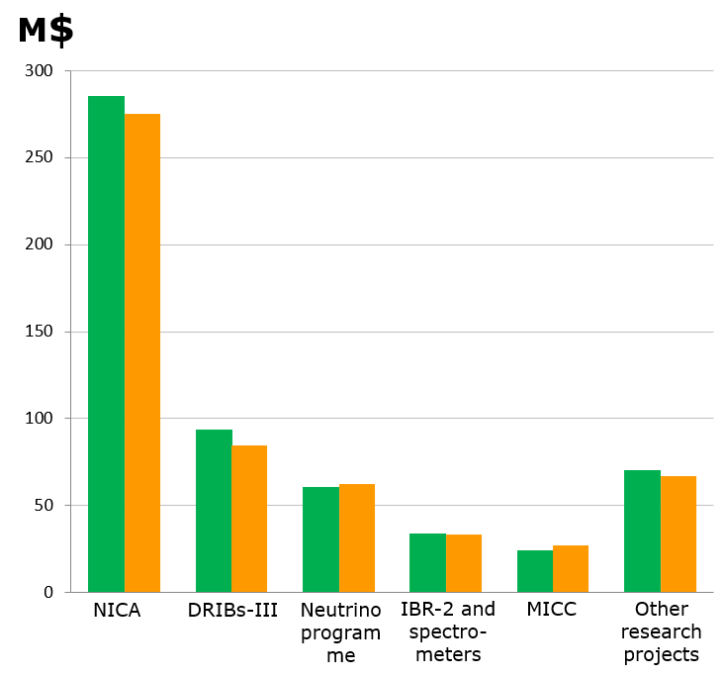
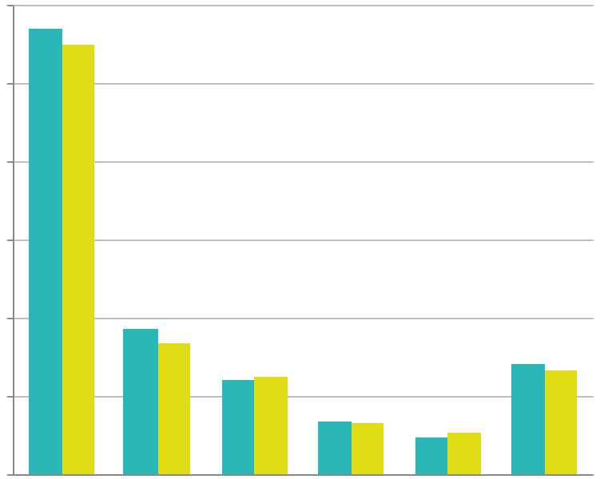


Material costs for the main research projects of the Seven-Year Plan for the Development of JINR for 2017-2023
М$ | Plan | Actual | Execution
NICA | 285.2 | 275.0 | 96%
DRIBs-III | 93.6 | 84.5 | 90%
Neutrino programme | 60.2 | 62.6 | 104%
IBR-2 and spectrometers | 33.9 | 33.1 | 98%
MICC | 24.1 | 27.2 | 113%
Other research projects | 70.3 | 67.4 | 96%
Total | 567.3 | 549.8 | 97%

Slide 11
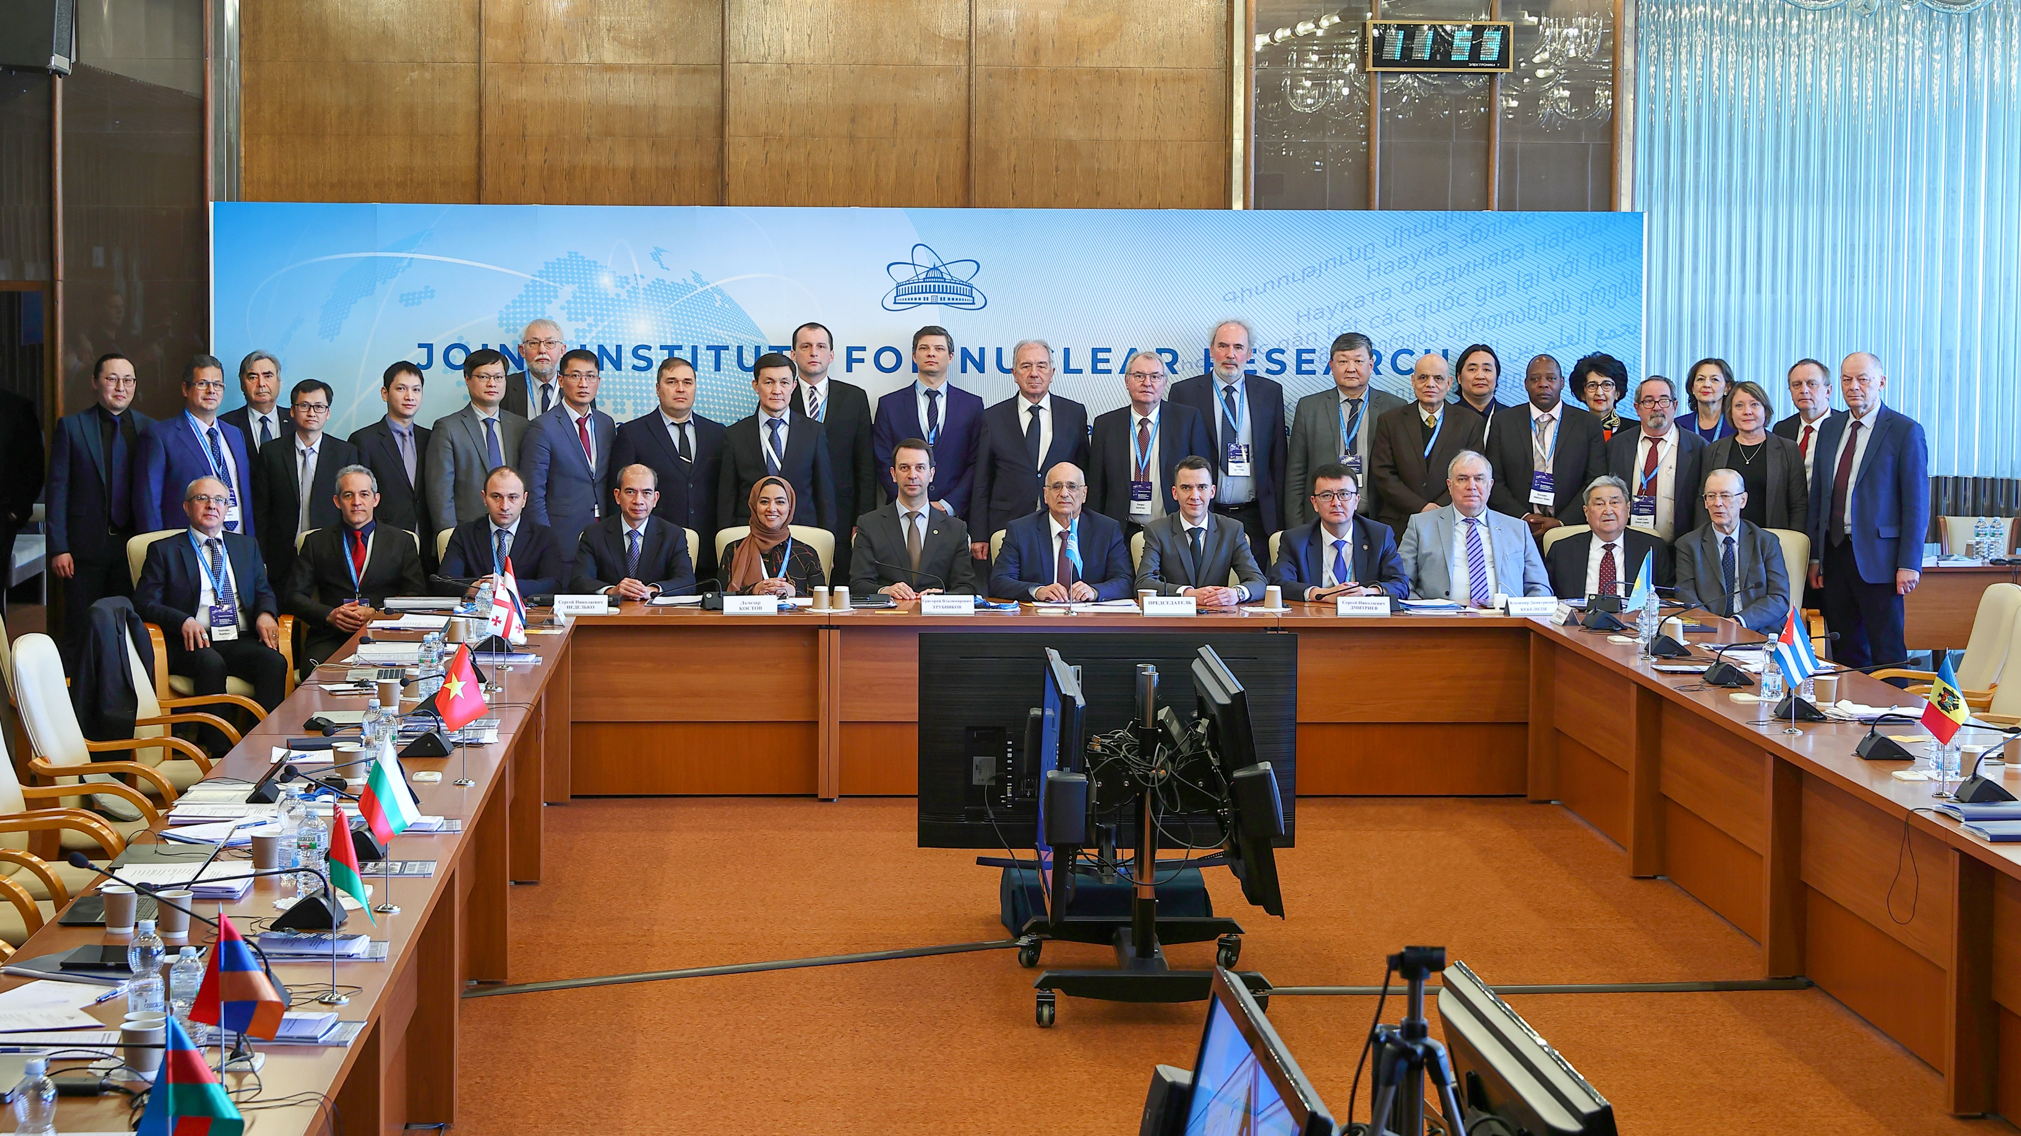
Information on the Resolution of the session of the JINR Committee of Plenipotentiaries
22 March 2024, Dubna
Chair of the Committee of Plenipotentiaries ― representative of Georgia A. Khvedelidze

Slide 12
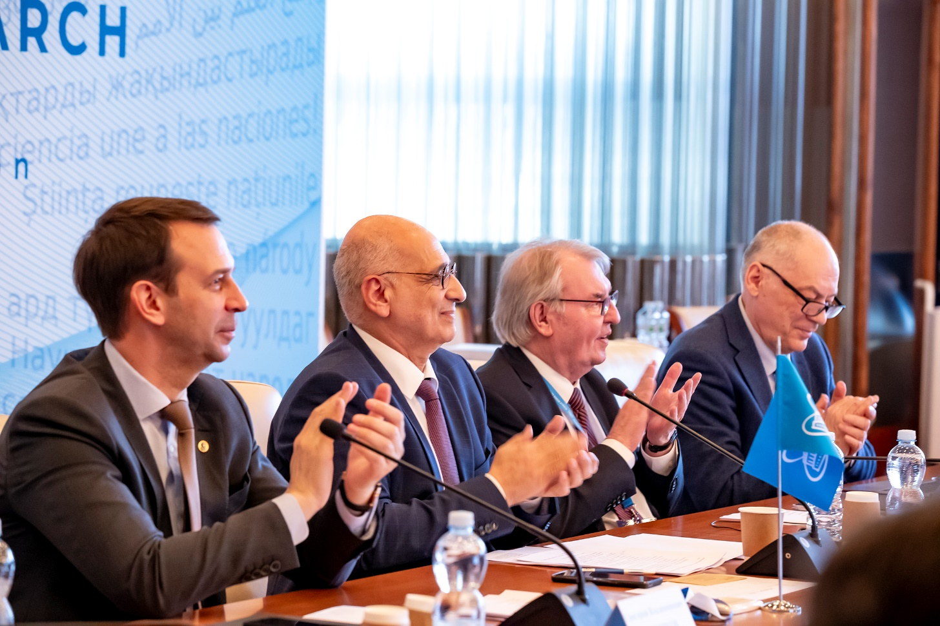
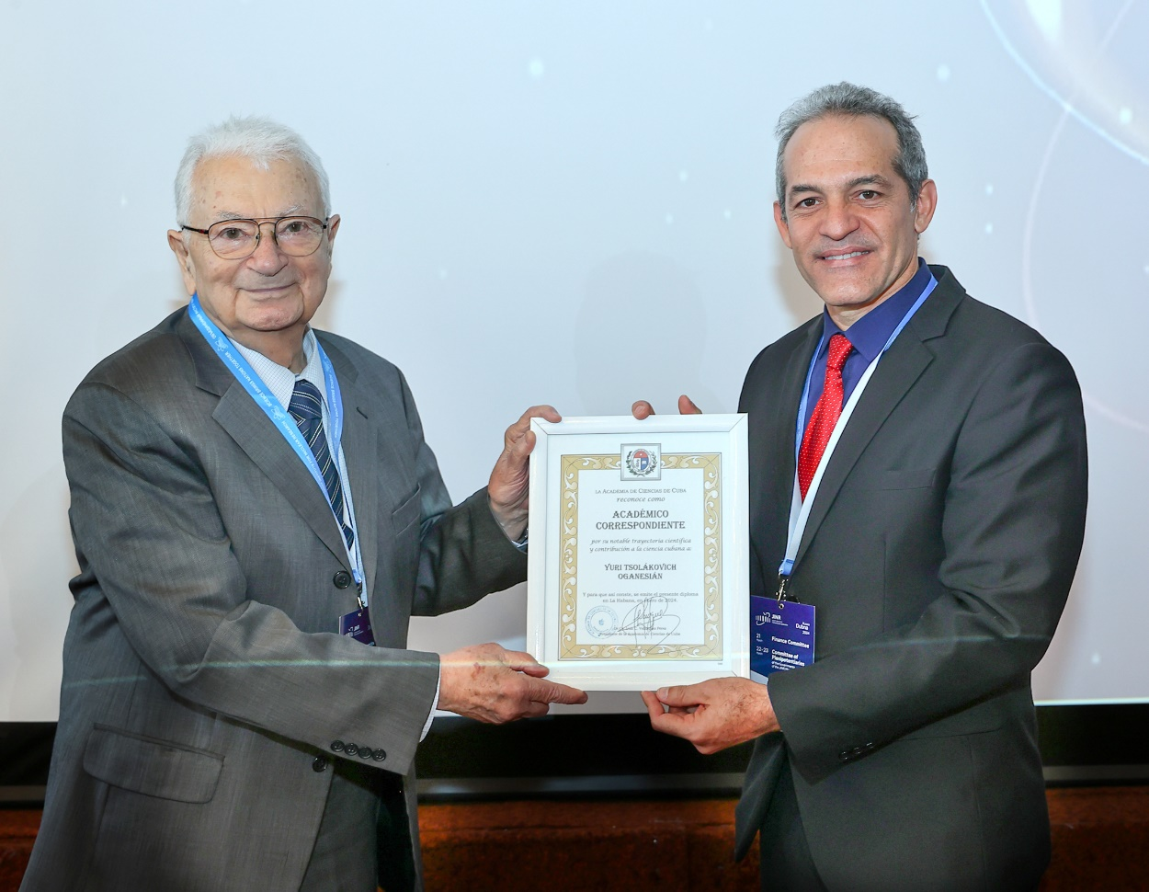
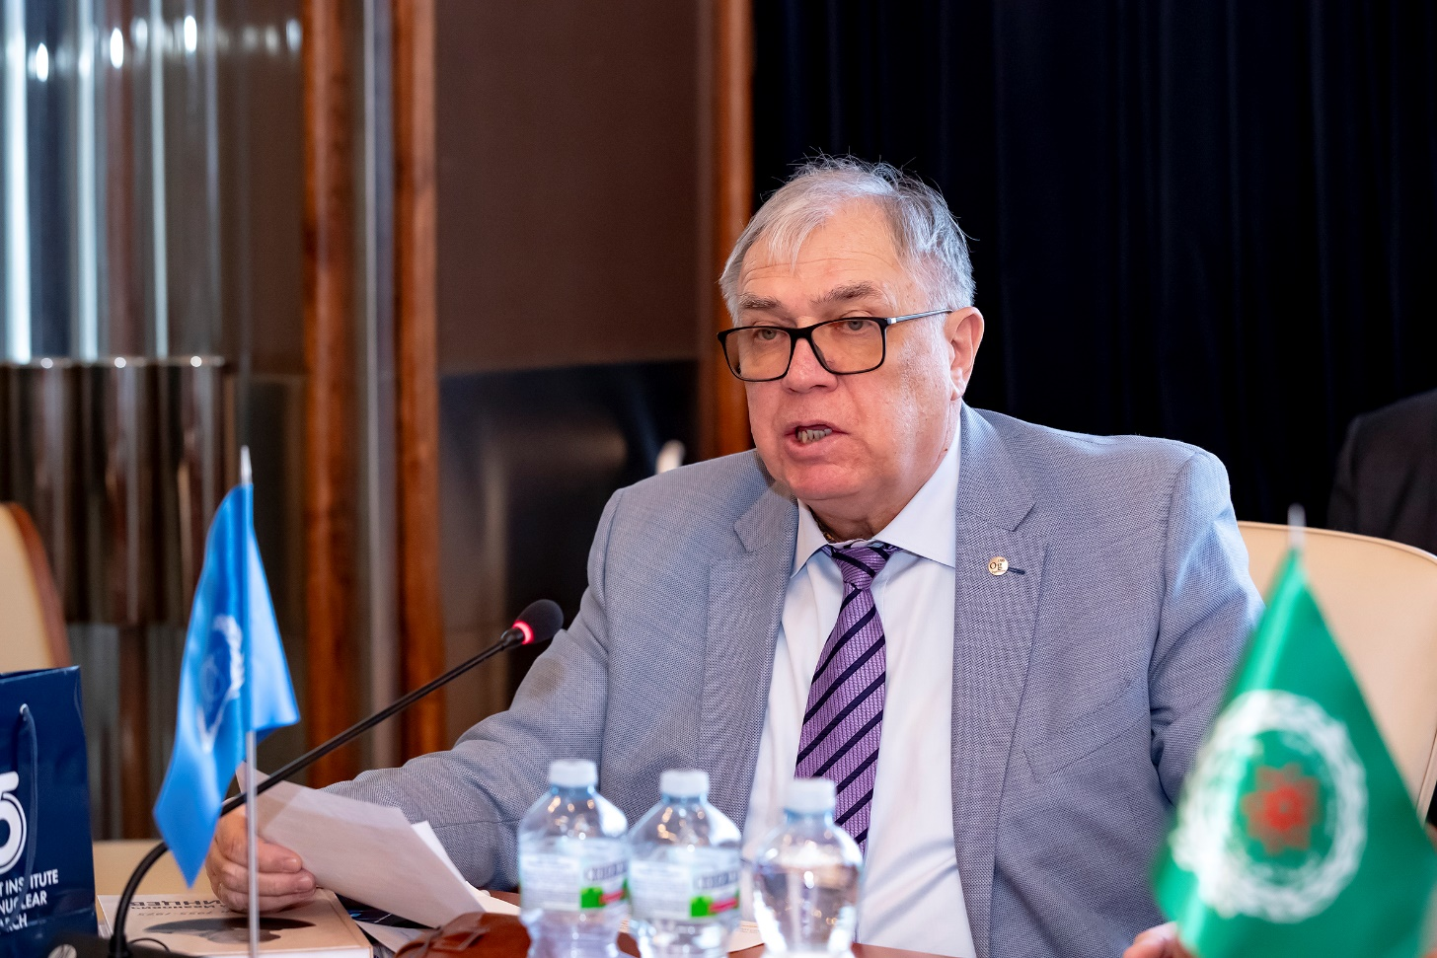
Session of the JINR Committee of Plenipotentiaries
22 March 2024
Plenipotentiary representatives of all JINR Member States attended the meeting of the CP sessions in person. The meeting was attended by representatives of the relevant ministries of Kazakhstan and Cuba, the IAEA and the Arab Atomic Energy Agency, Directorate of the Dubna city district and the Dubna State University.
At the beginning of the session, Deputy Minister of Science, Technology and Environment of the Republic of Cuba Armando Rodriguez Batista announced the awarding of the title of Corresponding Member of the Academy of Sciences of the Republic of Cuba to the Scientific Leader of the Laboratory of Nuclear Reactions at JINR Yuri Oganessian.
Deputy Director General of the IAEA Mikhail Chudakov conveyed greetings from the Agency’s Director General Rafael Mariano Grossi to the members of the CP. He noted the current wide cooperation and expected to expand cooperation and also invited JINR to take part in a number of events held by the agency in 2024.
Minister-Counselor for Science and Technology Affairs of the Chinese Embassy in the Russian Federation Zhou Yu congratulated the Joint Institute on the 68th anniversary of its founding.

Slide 13
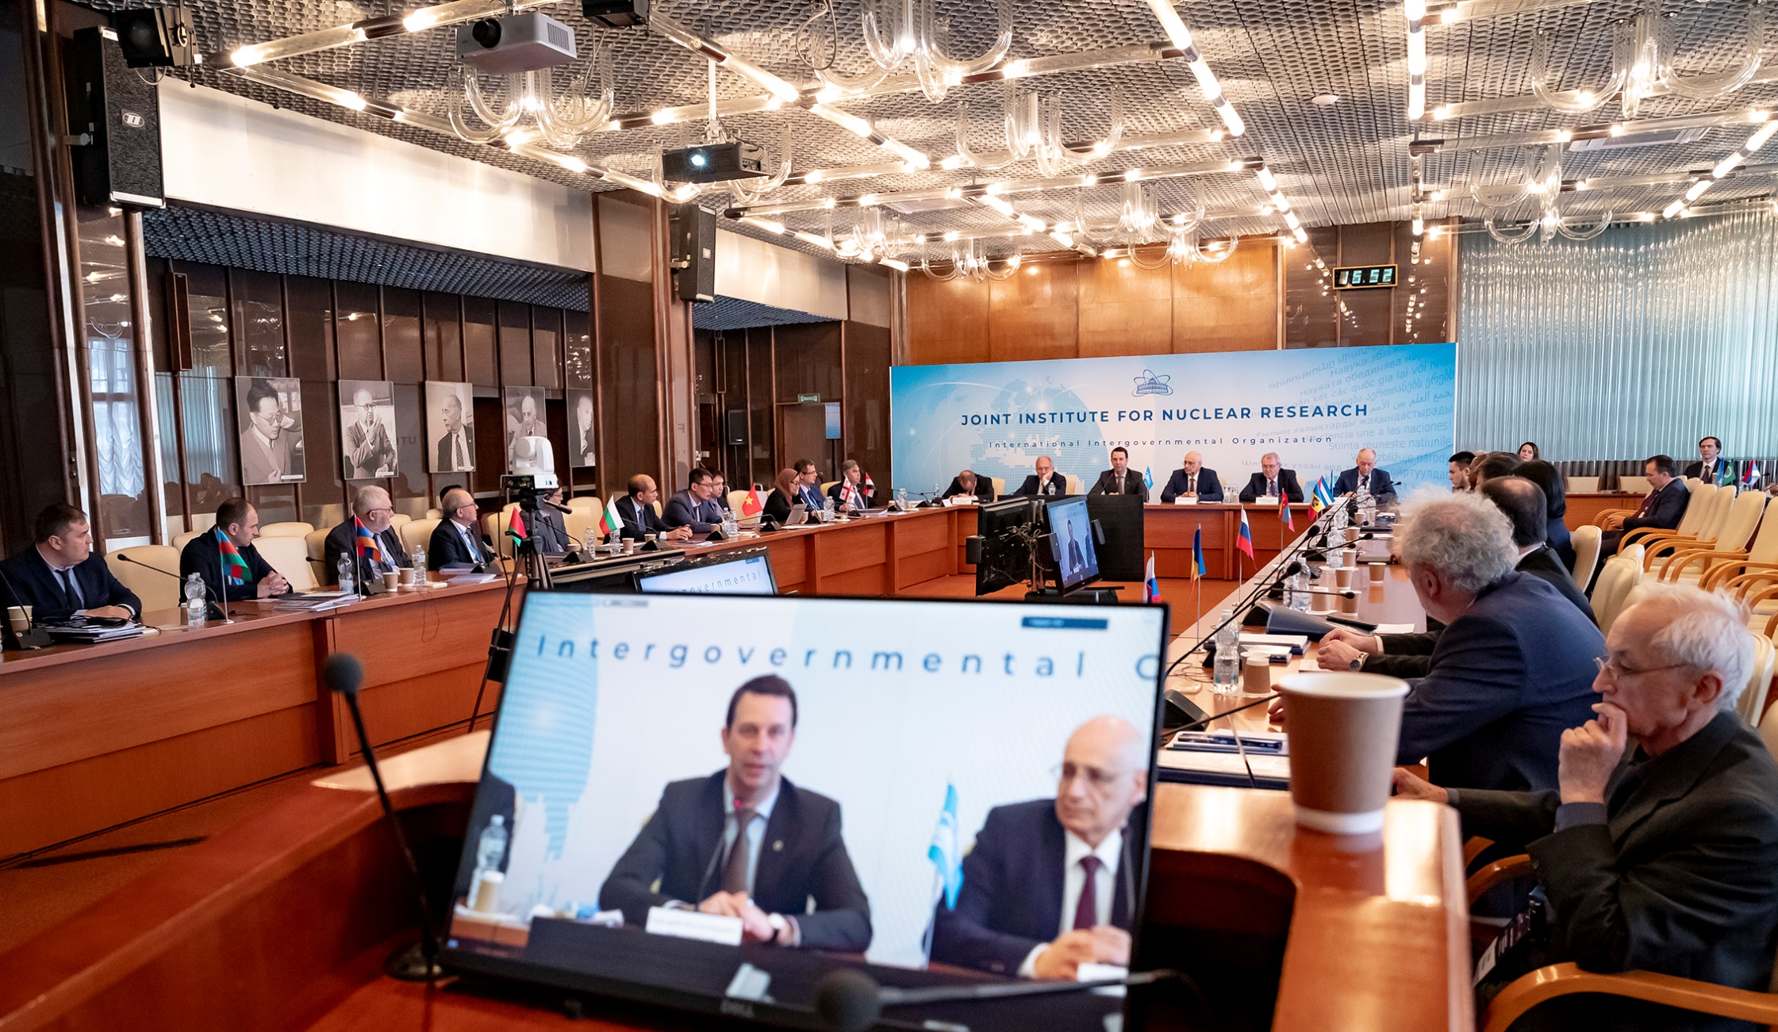
Session of the JINR Committee of Plenipotentiaries
22 March 2024
AGENDA
1. Report by the JINR Director
Speaker — G. Trubnikov
2. Execution of the JINR budget for 2023 and
draft of the revised budget of JINR for 2024
Speaker — N. Kalinin
3. Results of the meeting of the JINR Finance
Committee held on 21 March 2024
Speaker — A. Omelchuk
4. Proposals for amending the Rules
of procedure of the Finance Committee and
the Rules of procedure of the Committee
of Plenipotentiaries of JINR
Speaker — A. Kharevich
5. On the status of preparation and approval of the List of JINR officials
Speaker — A. Kharevich
6. On the decision of the Republic of Moldova to withdraw from JINR
Speaker — A. Khvedelidze
7. Amendments to the Regulation for the election of Directors and for the endorsement of appointment of Deputy Directors of JINR Laboratories
Speaker — S. Nedelko

Slide 14
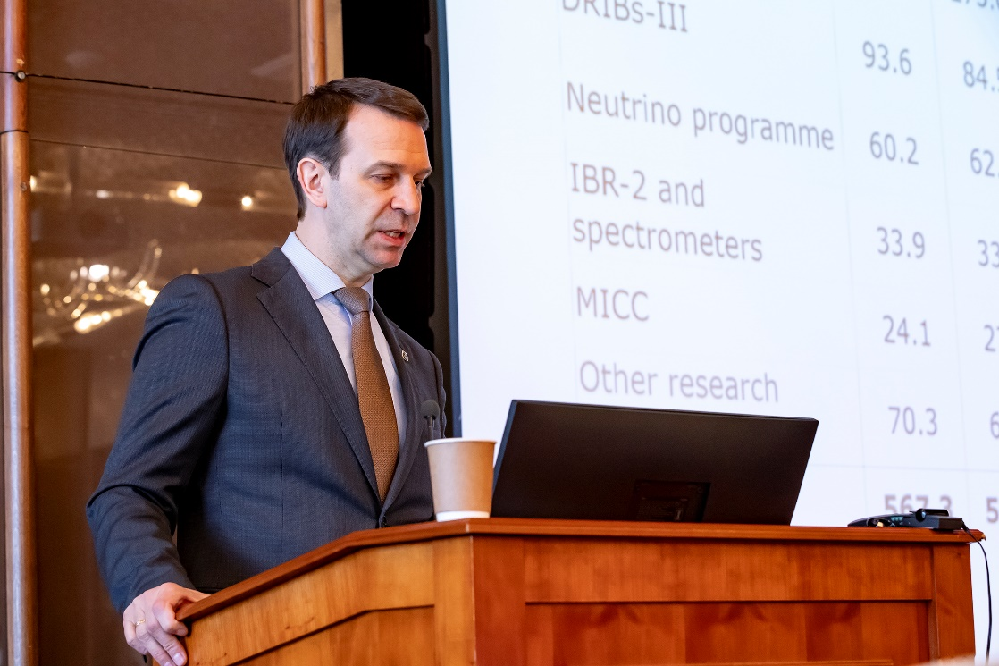
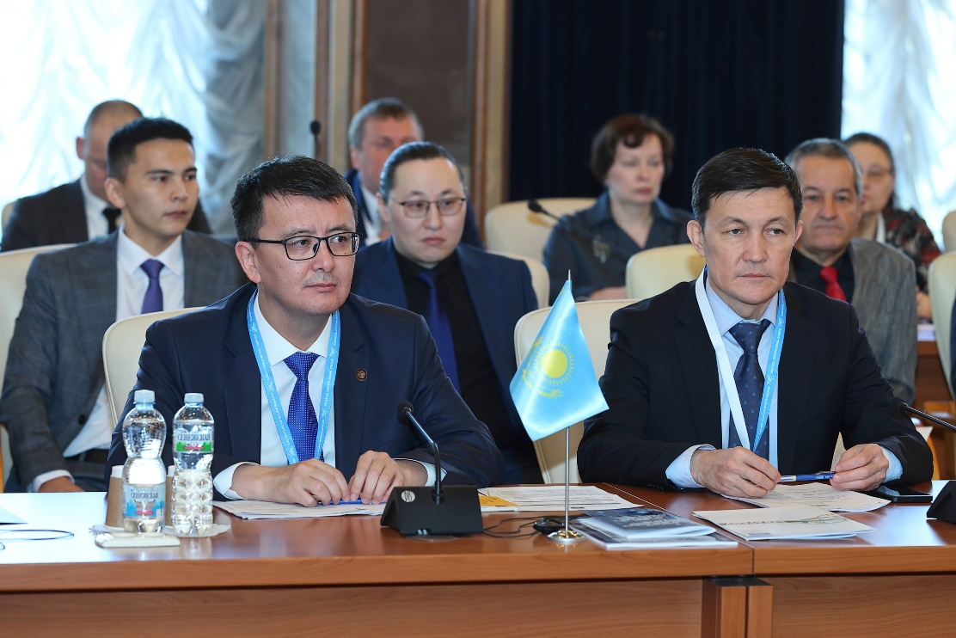
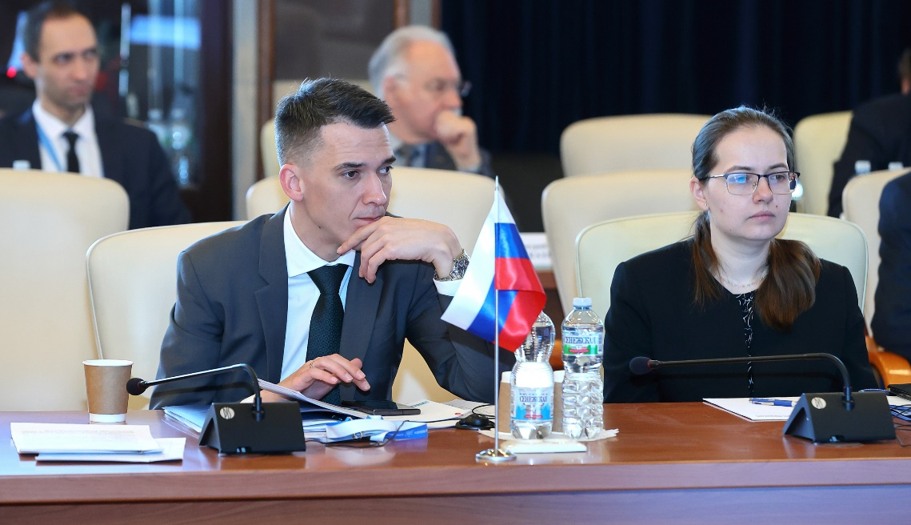
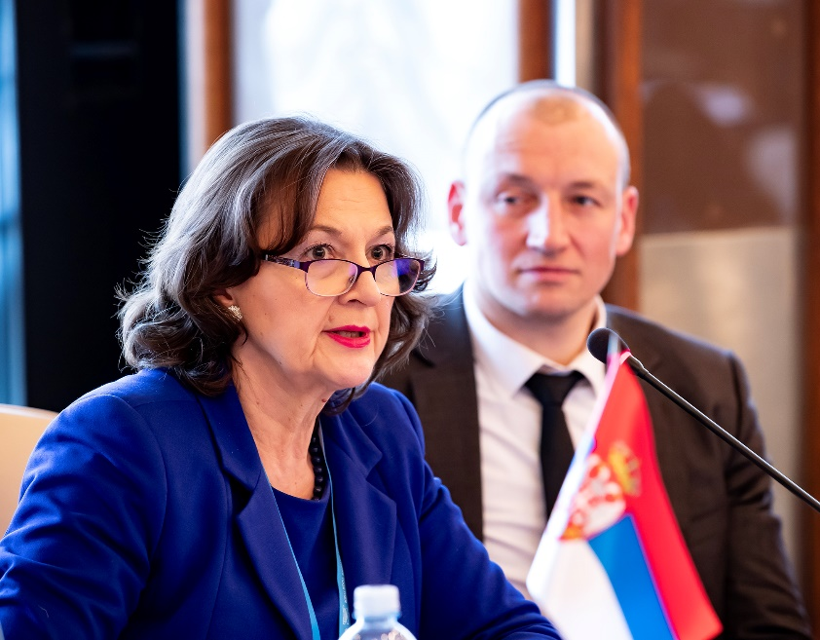
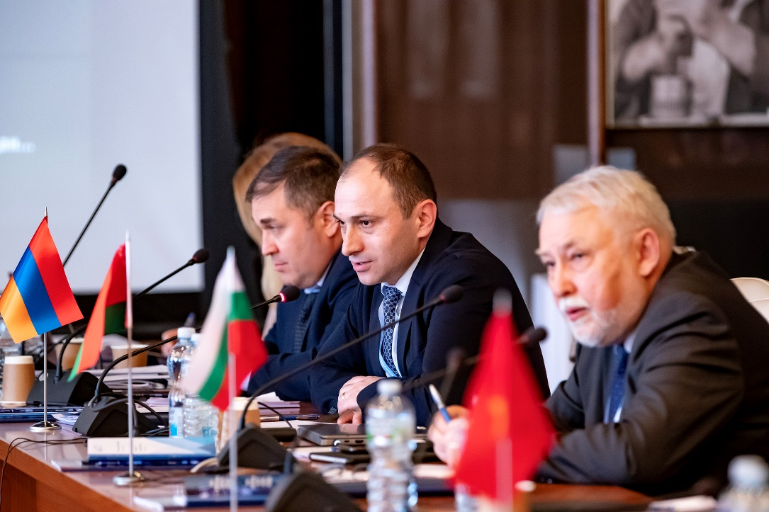
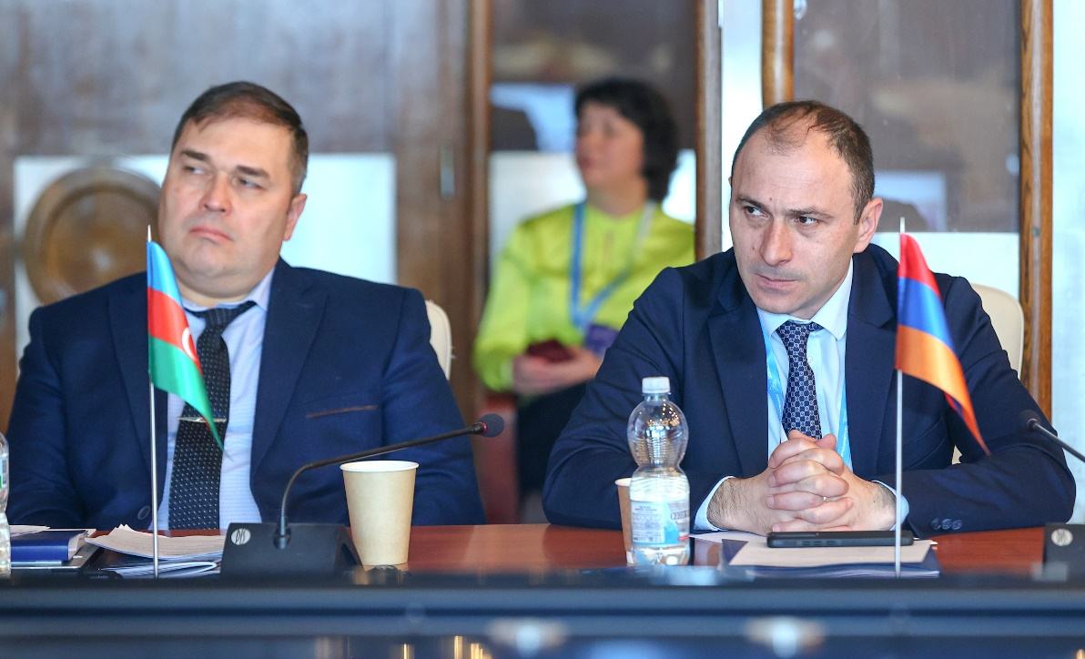
Session of the JINR Committee of Plenipotentiaries
22 March 2024
Having heard the report presented by G. Trubnikov, JINR Director, the Committee of Plenipotentiaries took note of the information from the JINR Directorate about the recommendations of the 135th session of the JINR Scientific Council, the implementation of the current Seven-year plan for the development of JINR, the efforts of the Member States towards realization of JINR’s large projects, the new scientific and technological results obtained, and about the most important events related to JINR’s scientific research and educational activities and international cooperation.
The CP noted the high efficiency of the Institute’s activities in intensifying and expanding scientific cooperation with partner organizations of JINR Member States and Associate Members, increasing the level of interaction with the People’s Republic of China, the United Mexican States, the Federative Republic of Brazil, and the Republic of India.
The CP appreciated with satisfaction the progress in implementing the current plan for research and development of the scientific infrastructure of JINR, the successful participation of the Institute in international collaborations, and achievements in strengthening international cooperation.

Slide 15
Session of the JINR Committee of Plenipotentiaries
22 March 2024
The Committee of Plenipotentiaries took note the information on the transfer of the rights and obligations of the general contractor under the general construction contract “Installation of the heavy ion collider NICA at the site of VBLHEP JINR in Dubna with a partial reconstruction of the building #1” of 18 September 2015 to TES LLC from 1 March 2024.
The CP supported the efforts of the JINR Directorate to renew and develop the social infrastructure of JINR (the restaurant of the H&R Complex “Dubna”, the complex of buildings on the territory of the Resort Hotel “Ratmino”, the International Conference Centre) for the infrastructure support of the programme for the development of human resources of the Institute in accordance with the current Seven-Year Plan for the Development of JINR.
The CP supported the initiative of the JINR Directorate to create an international innovation park of science and technology in Dubna, including, in particular, the construction of a modern university campus and comprehensive development of the surrounding areas, together with technologically advanced partners from JINR Participating Countries and partner countries, the SEZ “Dubna”, regional and federal executive authorities, Dubna State University.
The CP expressed gratitude to the IAEA and the JINR Directorate for supporting the initiative to hold a two-week internship at JINR within the framework of the IAEA Lise Meitner Programme in agreement with the IAEA.
The CP endorsed JINR’s intensified participation in the International Decade of Basic Sciences for Sustainable Development (IDBSSD) under the auspices of UNESCO through JINR’s accession to the Earth Charter.
The CP supported the efforts of the JINR Directorate in the development of international scientific and technical cooperation and the creation of an integrated scientific and technological space in the field of neutron research at the unique neutron sources, including research infrastructure of the “megascience” class.
The CP endorsed the accession of the Joint Institute for Nuclear Research to the Consortium for the project to develop an International Research Center based on the Multipurpose Fast Research Reactor (MBIR) and to the International Association “Interdisciplinary Center for Neutron Research PIK” on conditions taking into account the special status of the Institute and the Seven-Year Plan for the Development of JINR for 2024–2030, as well as the interests of the JINR Member States.
The CP supported the initiative of the JINR Directorate to establish a new scientific journal published by JINR.
The CP congratulated the staff of the Institute on the 40th anniversary of the commissioning of the IBR-2 pulsed neutron source, support the initiative of the JINR Directorate and the Frank Laboratory of Neutron Physics on naming the square near the IBR-2 reactor building at the JINR DLNP Site after V. D. Ananyev.

Slide 16

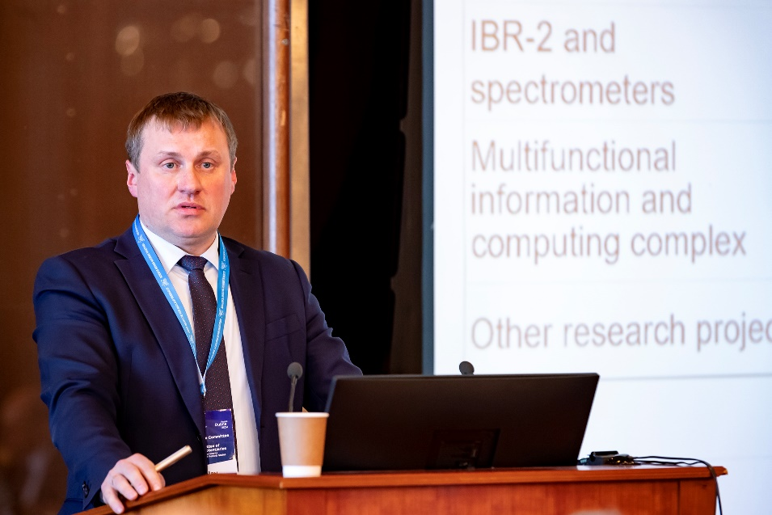
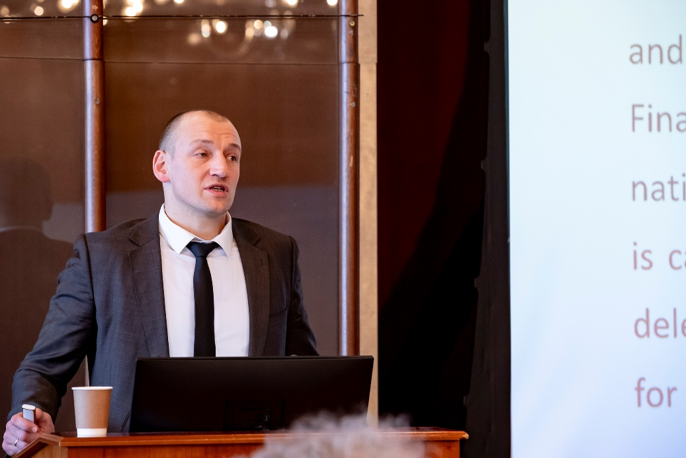
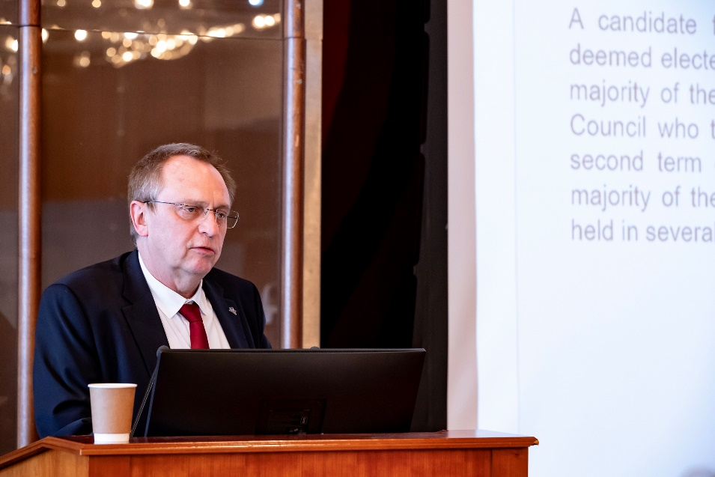
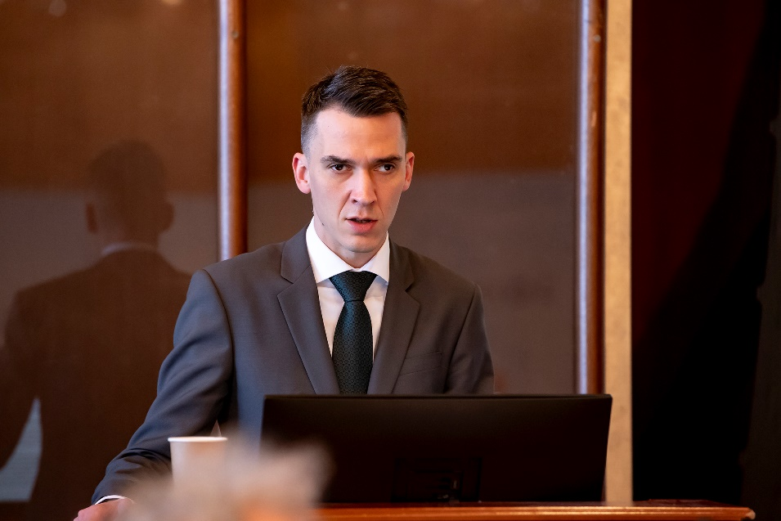
Session of the JINR Committee of Plenipotentiaries
22 March 2024
The CP approved the revised budget of JINR for 2024 with the income amounting to US$ 214 124.5 thousand and the expenditure amounting to US$ 286 818.2 thousand, taking into account the positive opening balance amounting to US$ 56 749.0 thousand, as well as the new forms of reports on the execution of the JINR budget.
The CP took note of the information about the contribution arrears to the JINR budget of the states that left the JINR membership in 2022.
The CP instructed the JINR Directorate and the Working Group under the CP Chair for JINR Financial Issues to develop an approach to determining the annual contributions of the Member States, taking into account the annual increase in the JINR budget by 5% during the Seven-Year Plan for the Development of JINR for 2024–2030 and the issue of abolishing the Rule for the lower
limits of contributions starting from 2025, and submit their proposals for consideration at the meeting of the Finance Committee and the CP session in November 2024.
The CP took note of the notification of the Republic of Moldova on its withdrawal from the Joint Institute for Nuclear Research and instructed the CP Chair to notify the Republic of Moldova about maintaining its full membership in the Joint Institute for Nuclear Research during 2024 and the entry into force of its withdrawal from JINR from 1 January 2025.
Having heard and discussed the report “Amendments to the Regulation for the election of Directors and for the endorsement of appointment of Deputy Directors of JINR Laboratories” presented by S. Nedelko, JINR Chief Scientific Secretary, the CP approved the new edition of the Regulation.

Slide 17
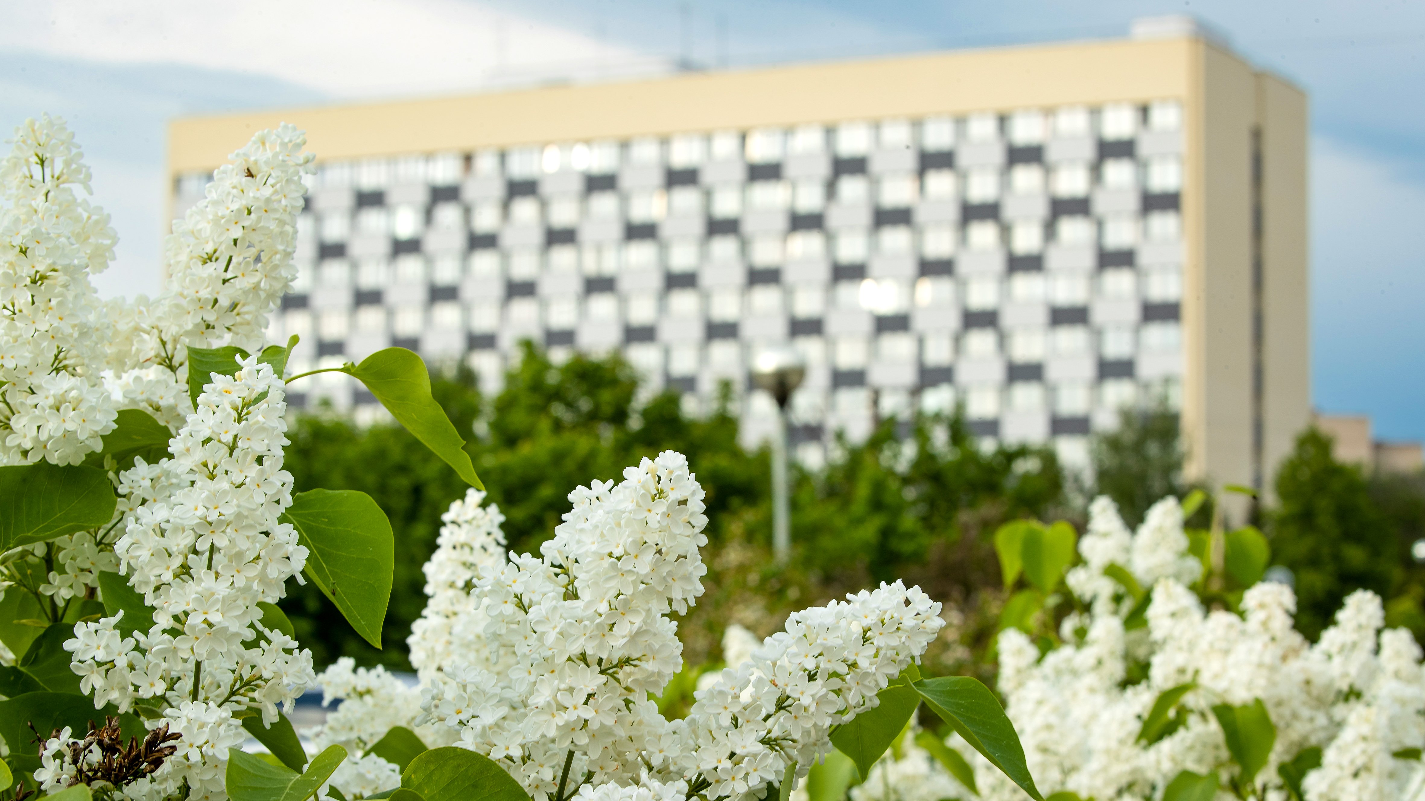
Thank you for your attention!

