Slide 1
SATURN project and Nuclear BOLOMETER subproject to measure electromagnetic characteristics of neutrino with tritium source and low-temperature bolometers
V.Trofimov
Dzhelepov Laboratory of Nuclear Problems
Dubna
2024

Slide 2
Subproject “Development of low-temperature detection systems for the study of coherent elastic scattering of neutrinos on atoms, nuclei and electrons and measurement of electromagnetic characteristics of neutrinos (subproject Nuclear BOLOMETER)
Project “Study of coherent elastic neutrino scattering on atoms, nuclei and electrons and measurement of electromagnetic characteristics of neutrinos using an intense tritium antineutrino source” (Project SATURN: Sarov-Tritium-Neutrino) funded by federal budget and Rosatom.
Collaboration SATURN
-Russian Federal Nuclear Center (Sarov)
-Joint Institute for Nuclear Research (Dubna)
-Nighegorodskii Technical State University (Nighnii Novgorod)
-Moscow State University (Moscow)
- The Institute for Physics of Microstructures of RAS (Nizhniy Novgorod)
-Institute for Nuclear Research of RAS (Troitsk)
-Ioffe Institute (St. Petersberg)
-Corporation MAYAK (Ozersk)

Slide 3
 | GGe
Registration of rare events involving neutrinos in the low and ultra-low energy regions
 | Helium detector | Silicon detector
Recording environment | Superfluid helium | Single-crystal high resistivity Si
Volume (mass) | 1000l. | 5kg.
Operating temperature | (20-40)mk | (20-40)mk
Bolometer type | TES + SQUID | TES + SQUID
Product of interaction with neutrinos | The Recoil Atom of He4 | Recoil Electron
Energy interval | (0-200)meV | (0-1.2) keV
Elementary excitations for registering an event | rotons | Electron-hole pairs→ phonons
Neutrino source, activity | Tritium 10MKi | Tritium 10MKi
Prototypes | no | exist
Goal | Observation of coherent scattering on an atom, setting limits on the magnetic moment and charge radius of neutrinos | Reducing the threshold for the magnetic moment of neutrinos to 2 * 10^{­-12} μ_{B}

Slide 4
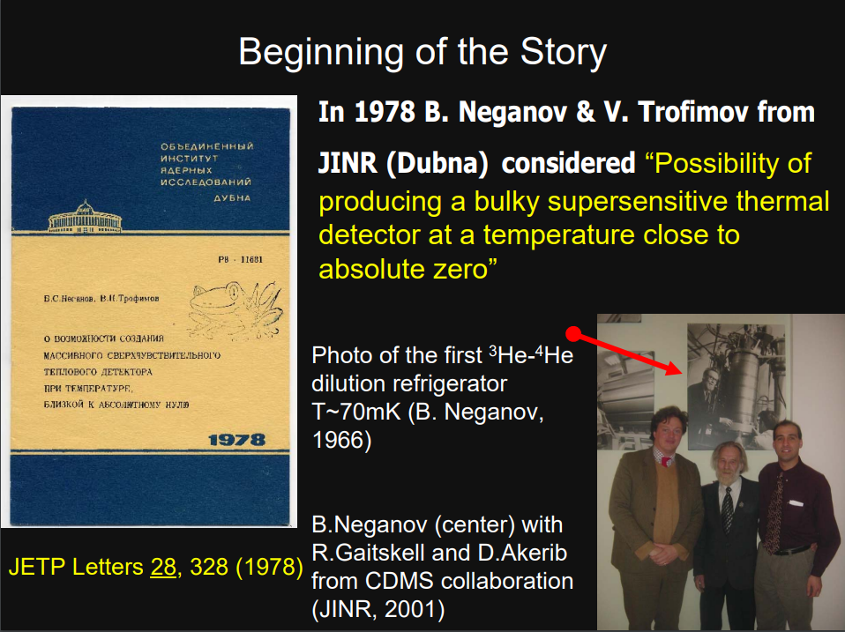
Ultra-low temperature in nuclear physics
Both types of detectors are based on observation of thermal effects of interaction and therefore require cooling to ultra-low temperature. The only method of obtaining ultra-low stationary temperature is the method of dissolution of He3 in He4, proposed in the early 50's of the last century by G. London and first in the world successfully realized in the mid 60's in the Laboratory of Nuclear Problems (LNP) by a group led by B. Neganov. The first application of the method in nuclear physics - polarized nuclear targets of "frozen" type was also successfully carried out at the LNP. The second application - registration of particles by low-temperature bolometers was proposed independently at JINR and CERN in the late 70s. Now it has become a rapidly developing direction in nuclear physics, first of all in the field of registration of rare events involving neutrinos and dark matter. Thus, our laboratory has good experience in obtaining and using ultra-low temperatures.
©L.Bogdanova

Slide 5
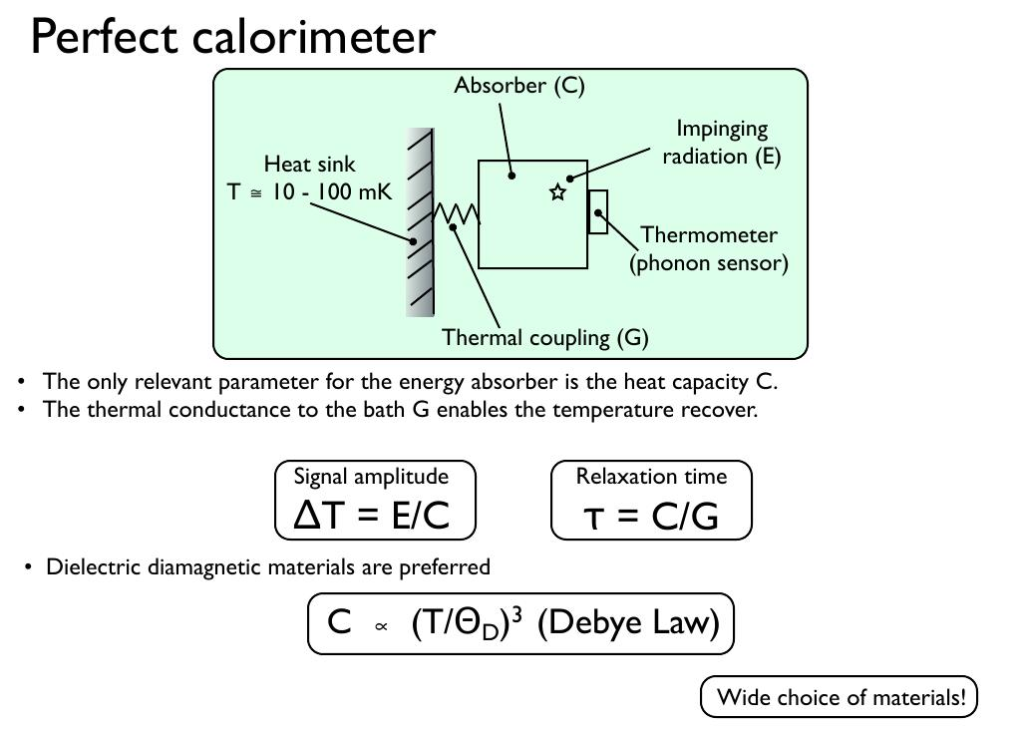
The principle of a low-temperature bolometer
©P.Gorla

Slide 6
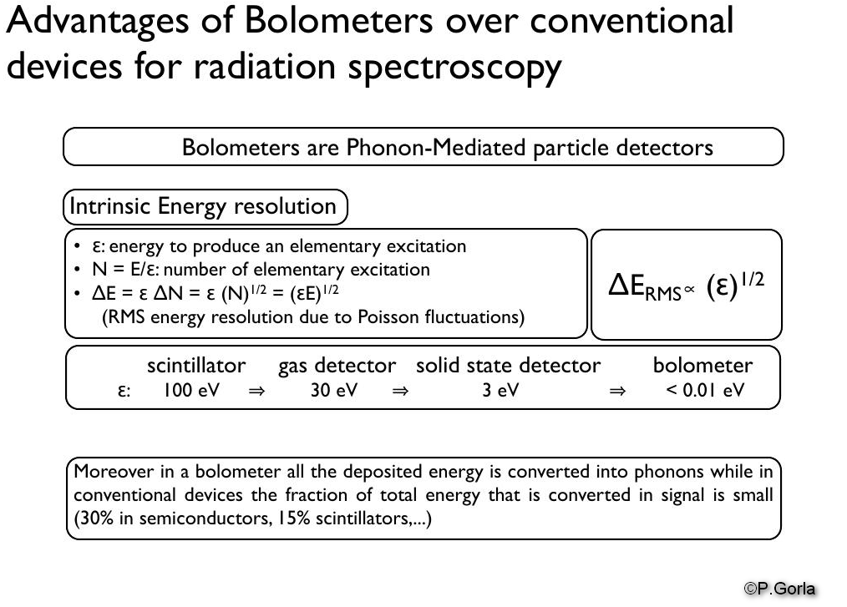

Slide 7
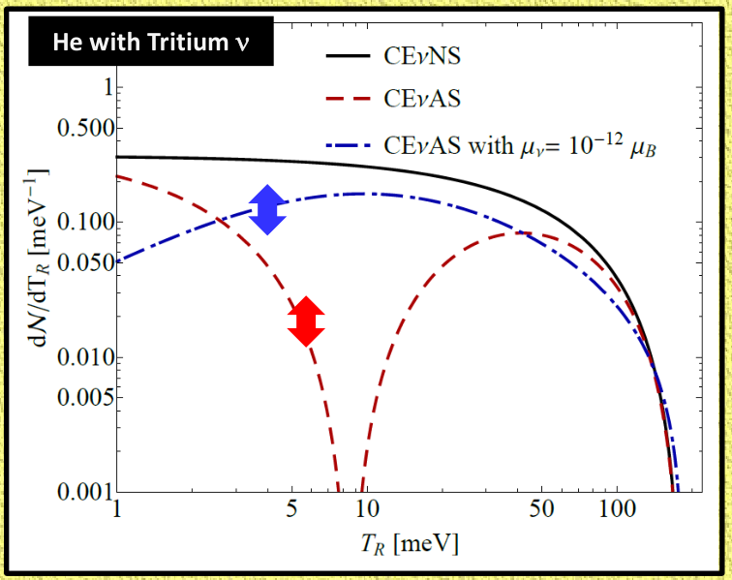
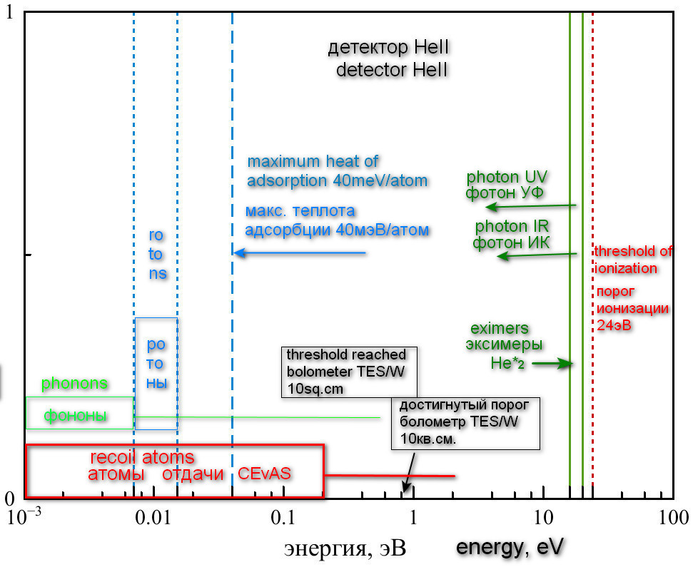
Superfluid helium detector
Superfluid helium is the purest substance ever created by man
Current projects: HeRALD (USA, dark matter), Saturn (Russia, coherent scattering)
Exitations in HeII below ionization threshold which can be used for particles detection
Coherent scattering of tritium neutrino on He4 atom
M. Cadeddu, F. Dordei, C. Giunti , K. A. Kouzakov , E. Picciau , and A. I. Studenikin, PHYSICAL REVIEW D 100, 073014 (2019)

Slide 8
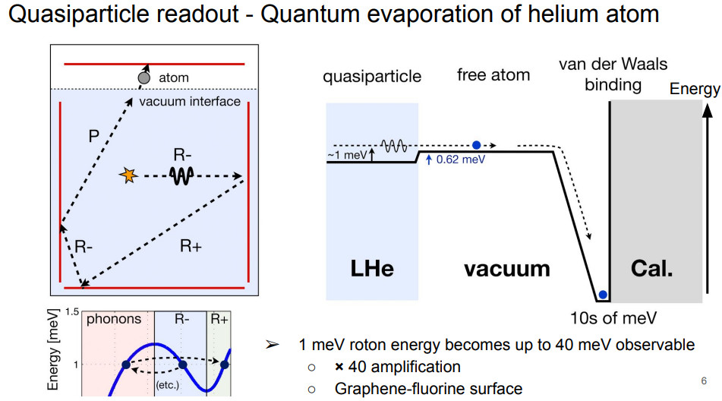

Slide 9
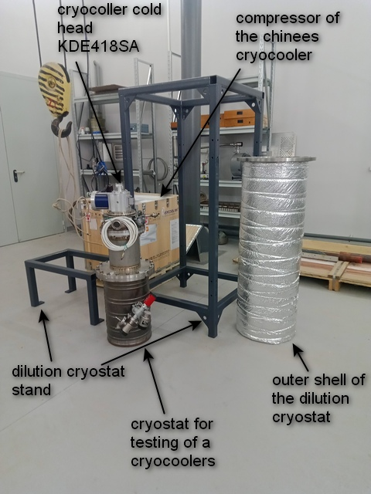
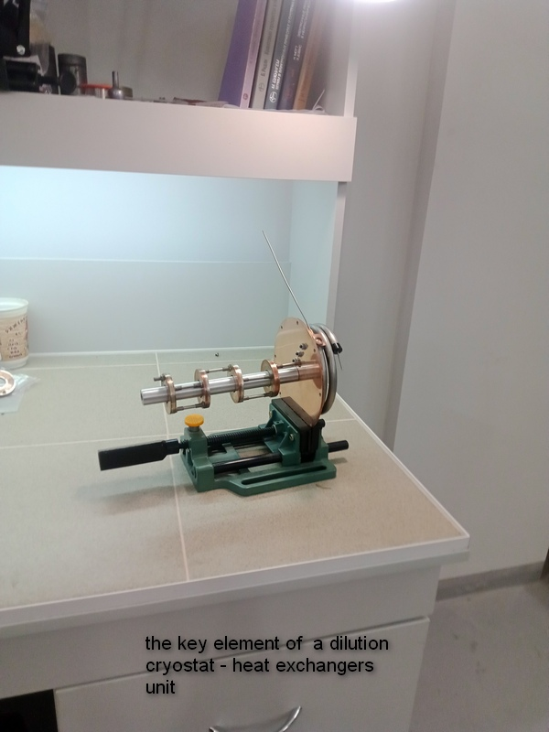
The implementation of the Nuclear BOLOMETER subproject began in LNP with the support of the laboratory directorate and the immediate goal is to manufacture a laboratory dilution refrigerator by the end of 2024 to begin testing a prototype small-volume helium detector. If this plan is implemented, it will be Russia's first "home made" dilution refrigerator of the "dry" type.

Slide 10
Summary
Based on the experience of the LNP in the development and application of ultra-low temperatures, we have begun to develop new detection methods in the field of low and ultra-low energies
Near-term plans include the launch of a dry-type laboratory dilution refrigerator at the end of 2024 and the start of testing prototypes of helium and silicon detectors in 2025

