Slide 1


Status and Prospects of Radiochemical Research
at the Dzhelepov Laboratory of Nuclear Problems of JINR
AYAGOZ Baimukhanova
PhD, research scientist
DLNP Department of Nuclear Spectroscopy and Radiochemistry
59th Meeting of the PAC for Nuclear Physics
June 13, 2024

Slide 2






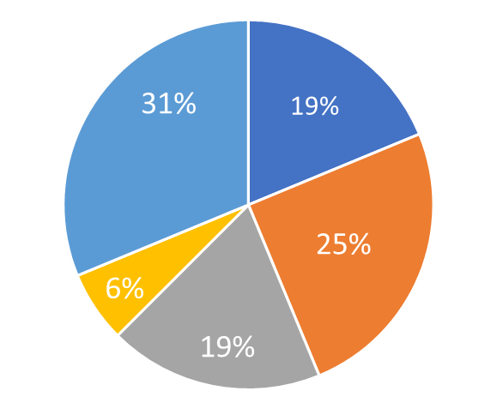
Section of Radiochemistry
Azerbaijan 1 Bulgaria 2
Jordan 1
Kazakhstan 2
South Africa 1
Uzbekistan 3
Experience in high-precision nuclear spectroscopy using semiconductors, scintillators and other types of detectors;
experience in studying rare processes in different underground environments;
experience in production of radionuclides and in synthesis of radiopharmaceuticals;
experience in nuclear hyperfine interaction spectroscopy.
All the personnel: 17 (avg. age 41 yr)
Scientific personnel: 12 (avg. age 41 yr)
PhD: 7 (58%)
Senior researchers
Junior researchers
Research
scientists
Assistant researchers
Engineers, lab assistants
Notes:
2

Slide 3
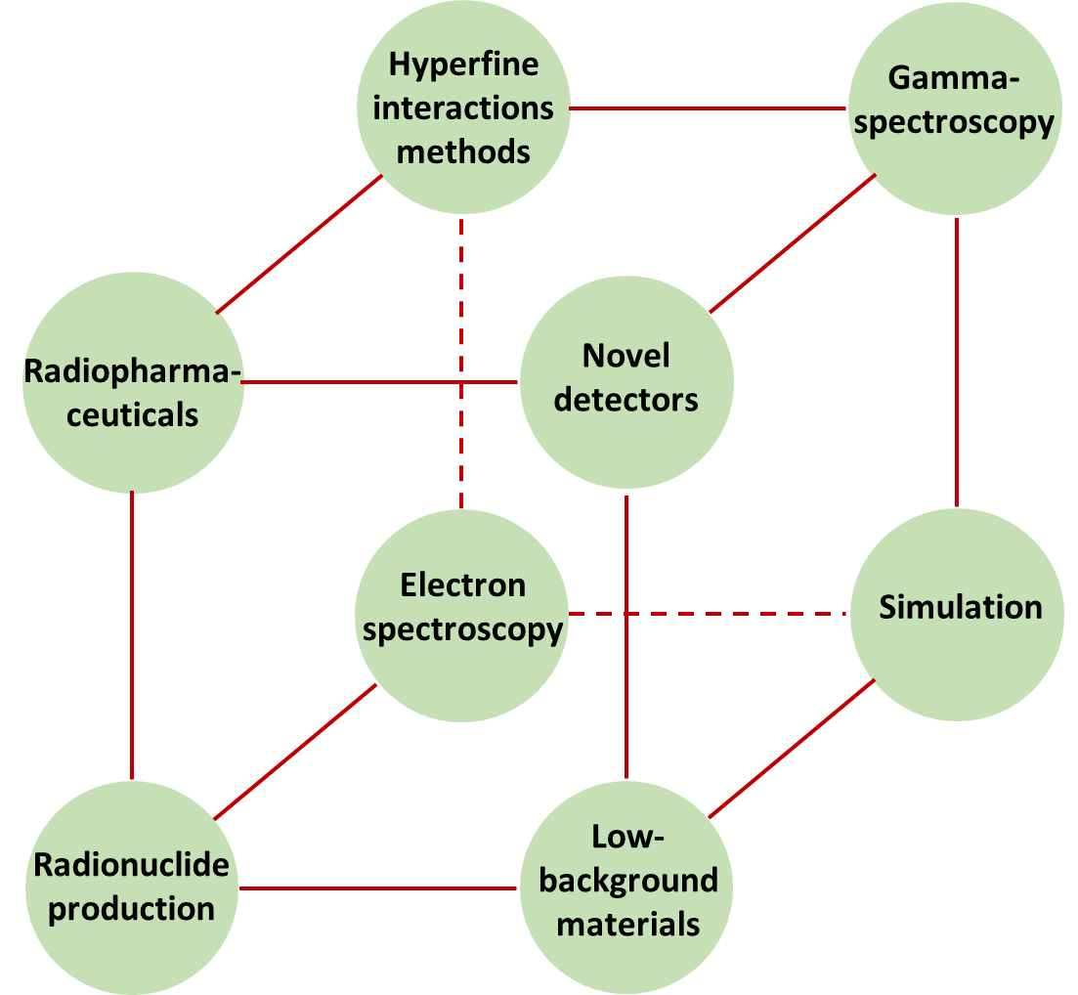
Radiochemistry and Spectroscopy in Astrophysics and Nuclear Medicine
Scientific directions

Slide 4
Producing Preparations and Sources of Radionuclides
Applications
I. Nuclear medicine
- Synthesis of radiopharmaceuticals
- Studying kinetic properties of complexes with metal ions
- Development of radiolabelling based on chelators with "slow" kinetics
III. Radioactive tracers
- Studying sorption in various solution-sorbent systems
- Studying local environment of nuclei via methods of hyperfine interactions
- Development of isolation and separation methods
High specific activity
Radionuclide purity
Radiochemical purity
Chemical purity
II. Nuclear spectroscopy
and neutrino physics
- Obtaining experimental data
- Manufacturing calibration sources

Slide 5
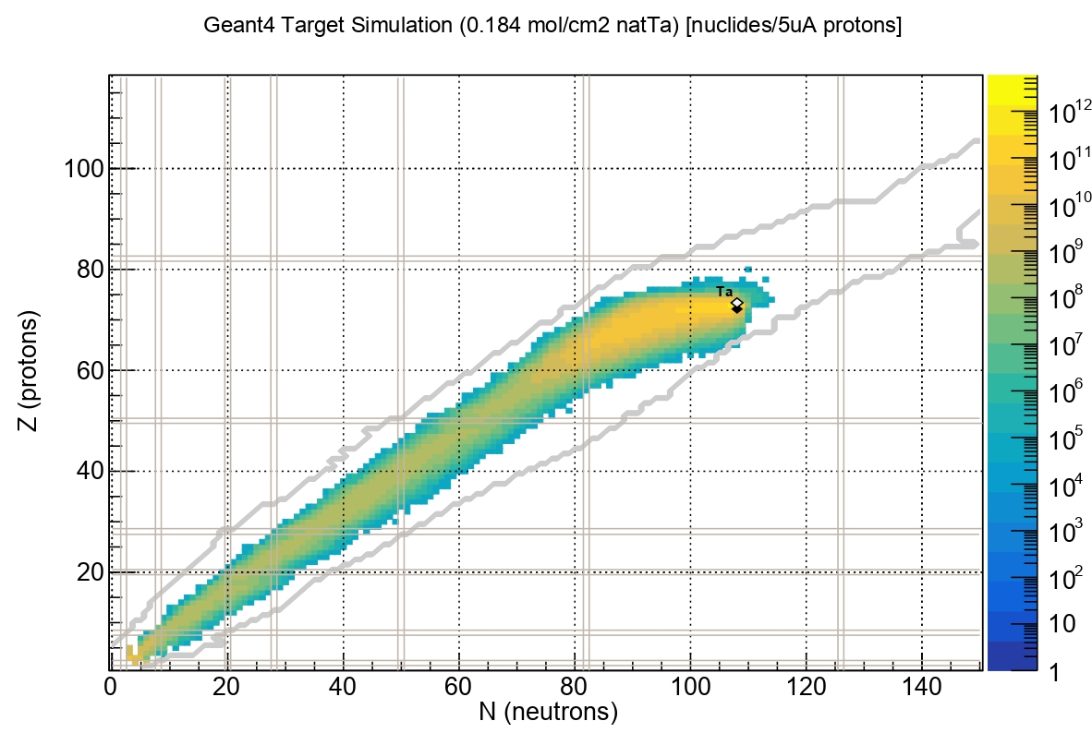
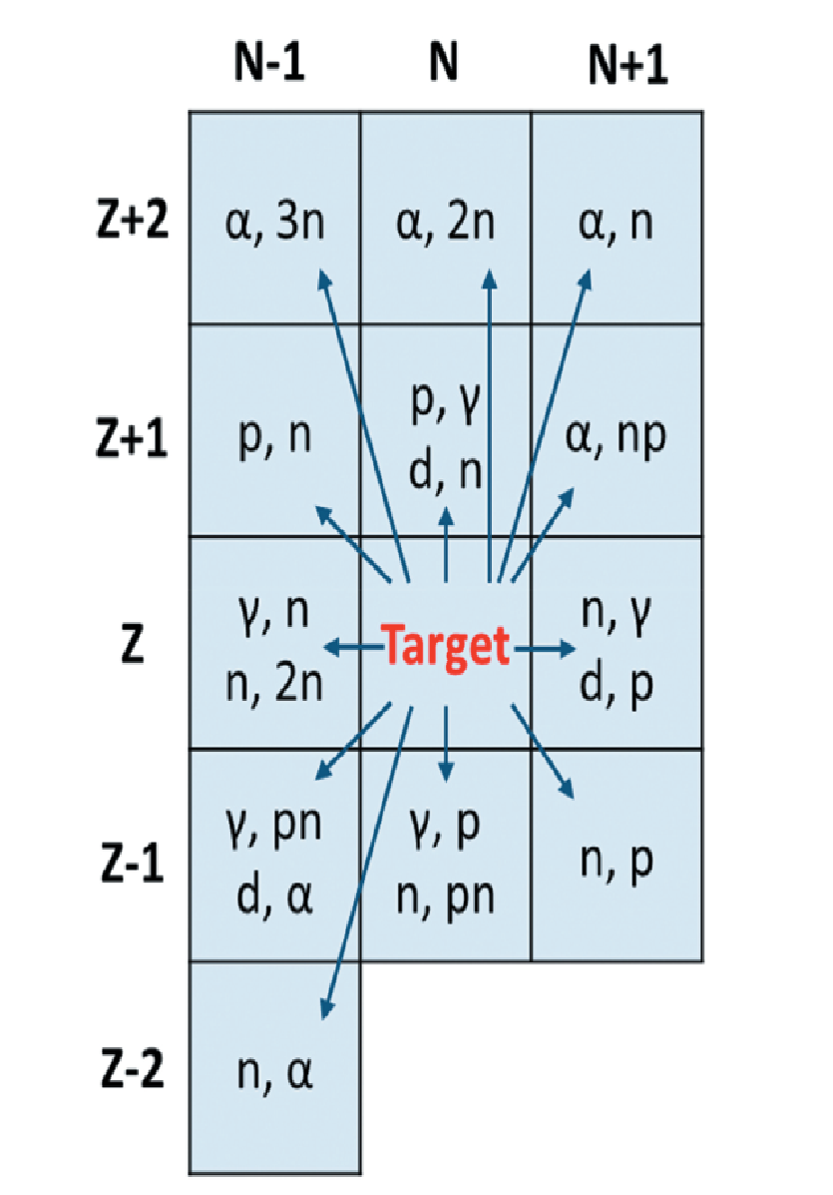
Producing Preparations and Sources of Radionuclides
Production of radionuclides:
1. At JINR facilities
2. By commercial suppliers
3. In cooperation with INP UZ, INP KZ and others
Theoretical calculation of radionuclide yields upon irradiation of a tantalum target (target thickness is 0.184 mol/cm²) with 660-MeV protons, current is 5 μA (Geant4)

Slide 6
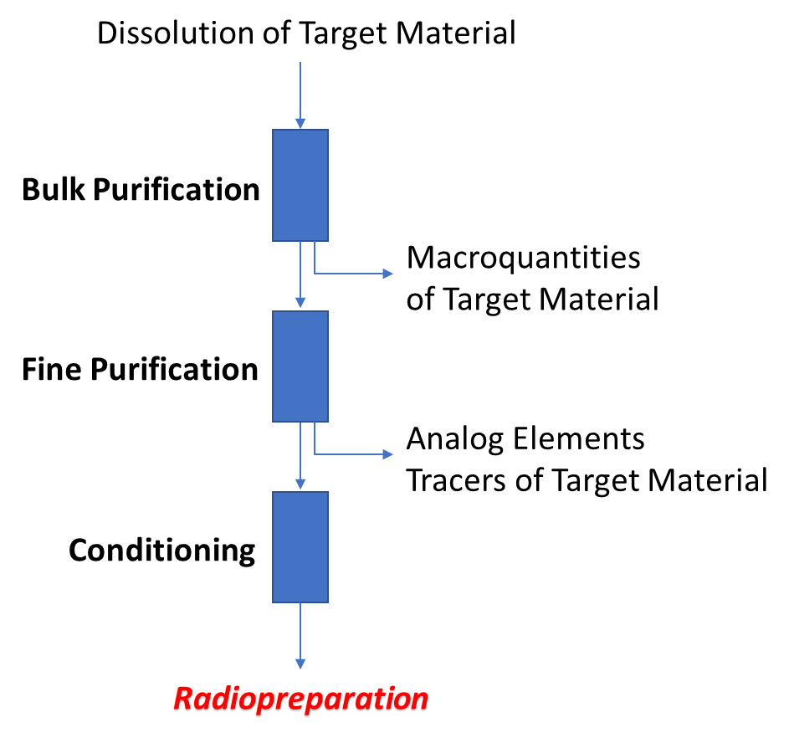
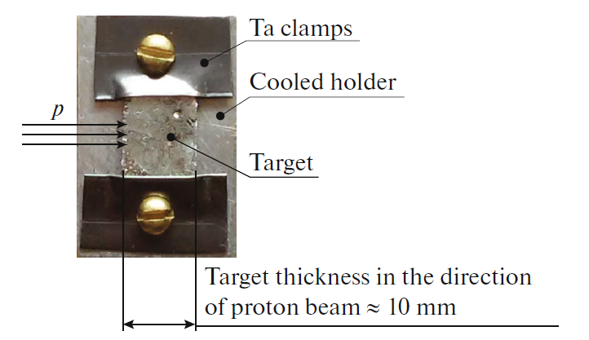
Producing Preparations and Sources of Radionuclides
Radiochemical methods for isolation and separation of radionuclides
Typical metal target
Chromatogram of separation of radiolanthanides
with ammonium α–hydroxyisobutyrarate

Slide 7
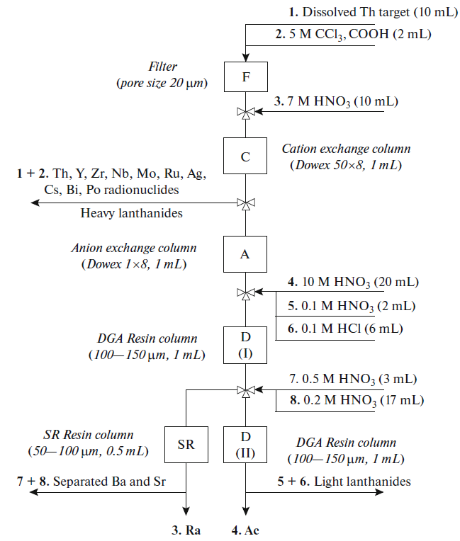
Producing Preparations and Sources of Radionuclides
Radiochemical methods for isolation and separation of radionuclides
Production of radionuclides at accelerators:
¹⁷⁷Lu from Yb target
²²⁵Ac from Th target
⁴⁴Sc from Ca target
⁸⁶Zr from Y target
⁹⁰Nb from Mo, Zr targets
¹¹¹In from Ag, Sb targets
Lanthanides from Ta target
Radionuclides from Th target

Slide 8

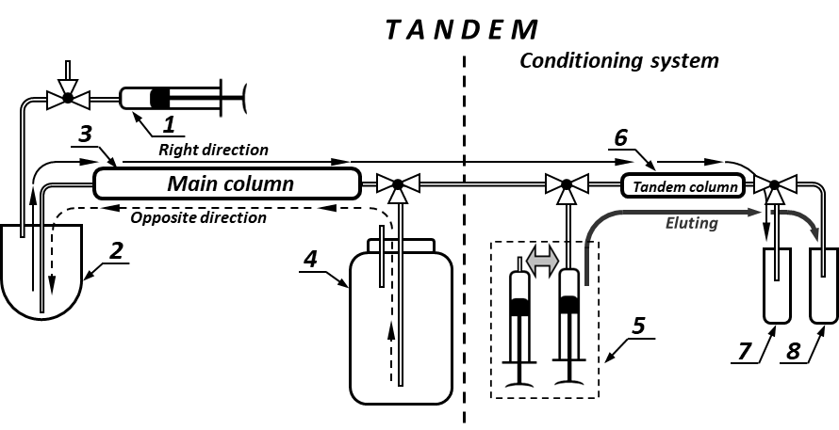
Producing Preparations and Sources of Radionuclides
Radionuclide generators
⁴⁴Ti → ⁴⁴Sc
⁶⁸Ge → ⁶⁸Ga
⁷²Se → ⁷²As
⁸⁶Zr → ⁸⁶Y
⁹⁰Sr → ⁹⁰Y
¹¹¹In → ^{111m}Cd
¹⁷²Hf → ¹⁷²Lu
²²⁹Th → ²²⁵Ra → ²²⁵Ac, etc.
Reverse-tandem scheme of the generator
(1) – syringe for maintaining pressure/underpressure, (2) – reverse storage vessel, (3) – main column , (4) – vial, (5) – solutions with eluents, (6) – tandem column, (7) – waste vial, (8) – vial with radiopreparation
Classic generator scheme

Slide 9
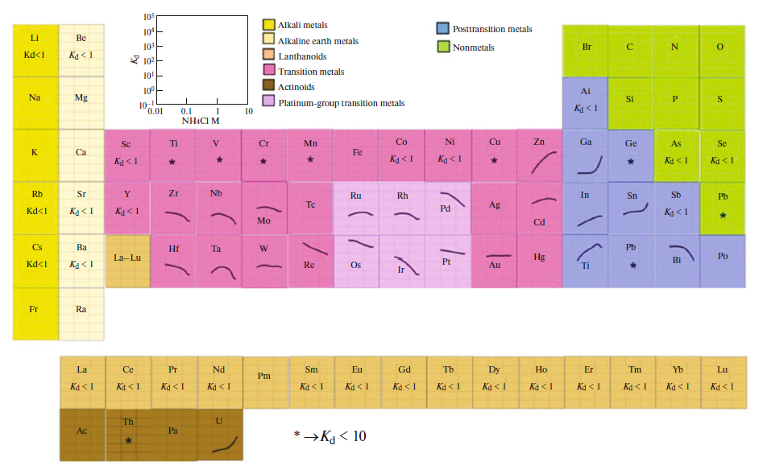

Studying Sorption Properties of Metal Ions
Using radioactive tracers
(1) Studying the sorption of several elements in unstudied systems regularly
(2) Developing generator schemes
(3) Isolating microquantities of radionuclides
from macroquantities of the target material
(4) Purifying substances for low-background
experiments
(5) Predicting the behavior of superheavy elements

Slide 10
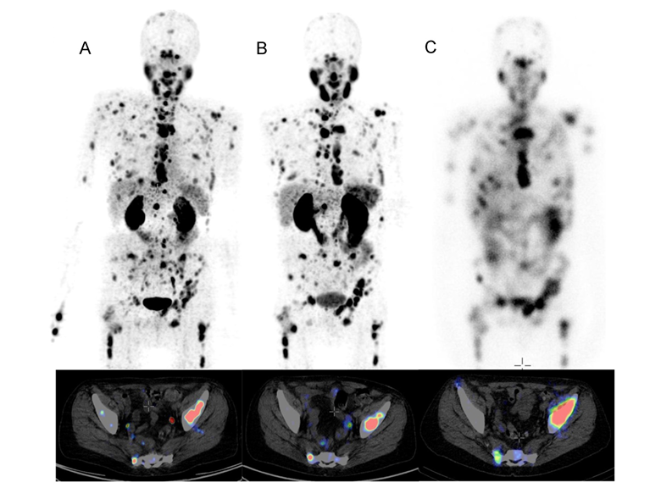
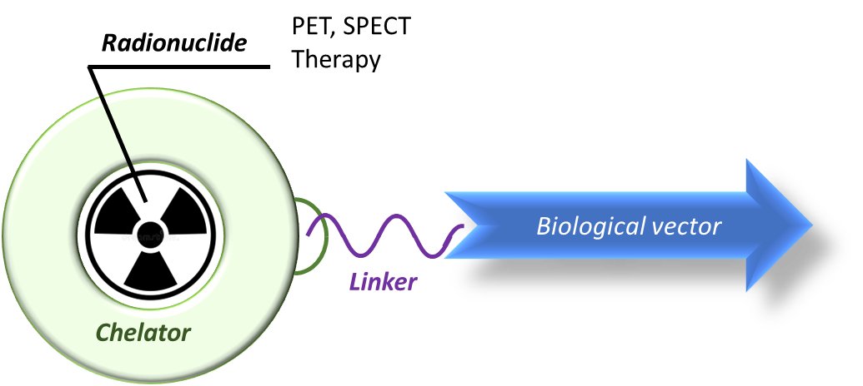
Synthesis and Analysis of Radiopharmaceuticals
Complex requirements:
thermodynamic stability
kinetic insertion
high kinetic of complexation
radiation resistance
Structure of a modern radiopharmaceutical
Radiopharmaceuticals based on:
²¹¹At with DTPA
⁶⁸Ga with DOTATOC
⁴⁴Sc with DOTA/DOTATOC
⁹⁰Nb with rituximab/bevacizumab
Maximal intensity projection (top) and representative slice (bottom) of PET/CT examination of a 77-year-old patient suffering of mCRPC with high tumor load using (A) [⁴⁴Sc]Sc-PSMA-617 (50 MBq, 60 min p.i.), and (B) [⁶⁸Ga]Ga-PSMA-11 (120 MBq, 60 min p.i.). (C) On the right hand side the planar scintigraphy is shown (top) and a representative slice of the post therapy SPECT/CT scan, about 24 h after application of 6700 MBq of [¹⁷⁷Lu]Lu-PSMA-617.

Slide 11
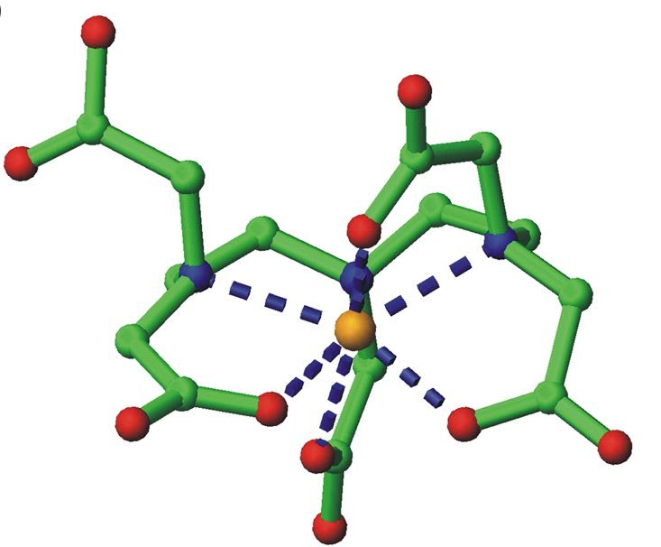
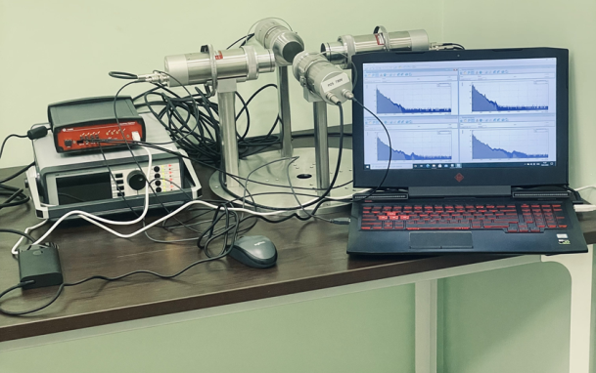
Method of Hyperfine Interactions
Using radioactive tracers
¹¹¹In (EC)
^{111m}Cd (IT)
DTPA
¹¹¹In, ^{111m}Cd, ¹⁵²Eu, ¹⁵⁴Eu
with DOTA, DTPA
¹⁵²Eu (EC)
¹⁵⁴Eu (β⁻)
L₂ – PAC parameter

Slide 12
Recent Results in Nuclear Physics and Research Proposals Presented by DLNP Young Scientists
Production of Trivalent Radionuclides for Nuclear Medicine and Analysis via Nuclear-Spectrometric Methods
Elena Kurakina
Tellurium-Loaded Organic Scintillators for the Search of Neutrinoless Double Beta Decay
Ivan Suslov

Slide 13
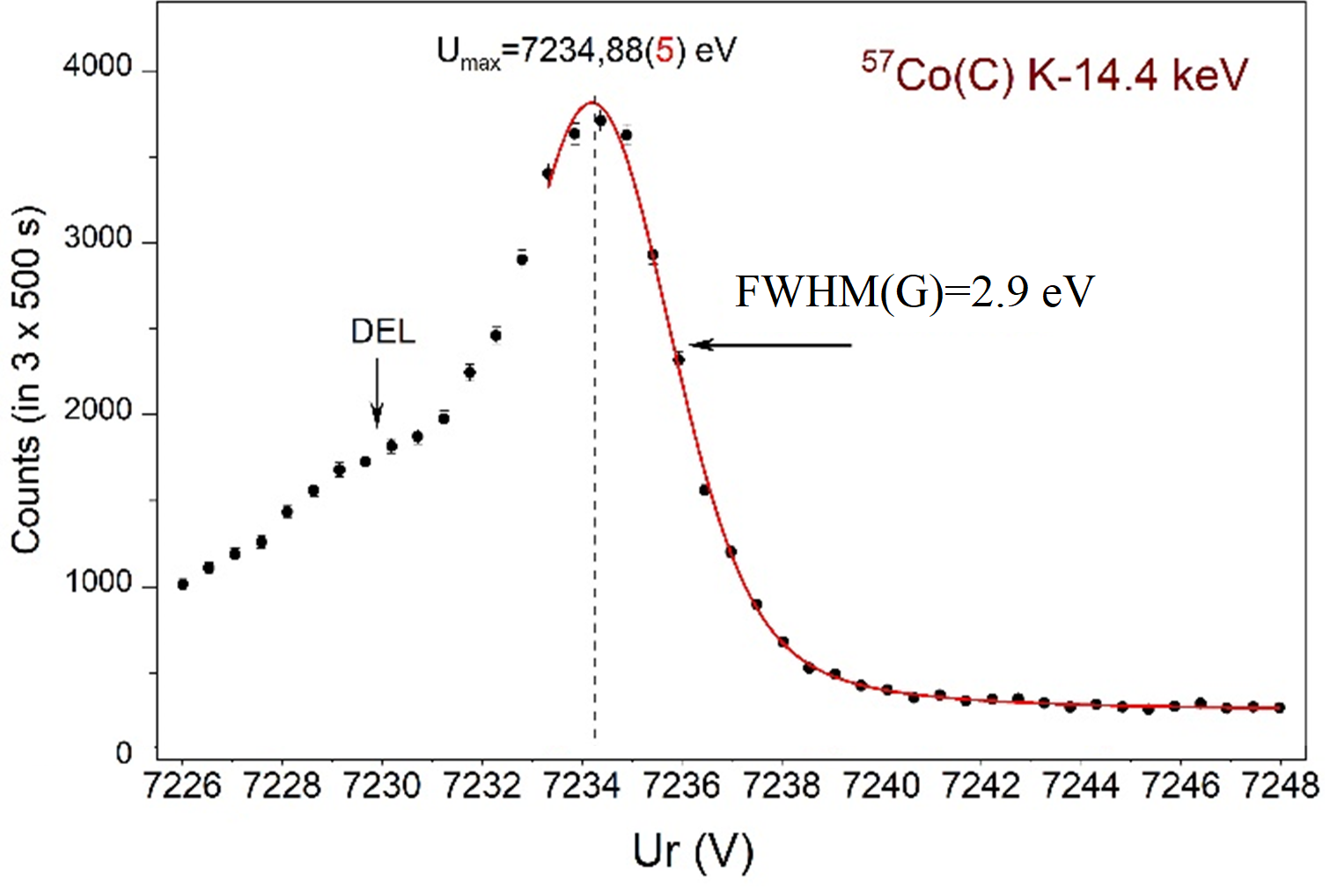
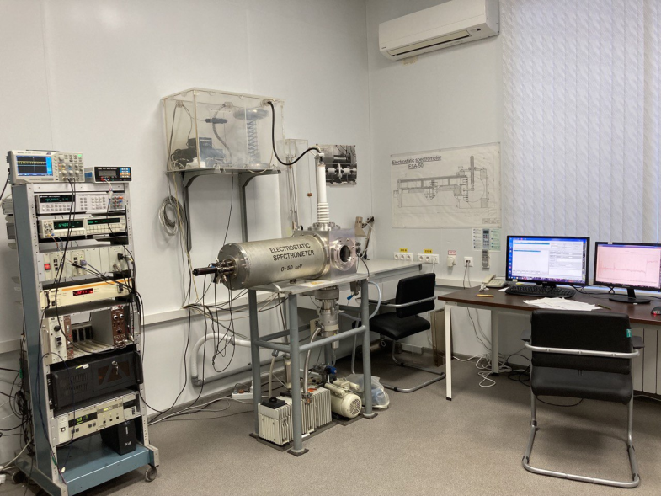
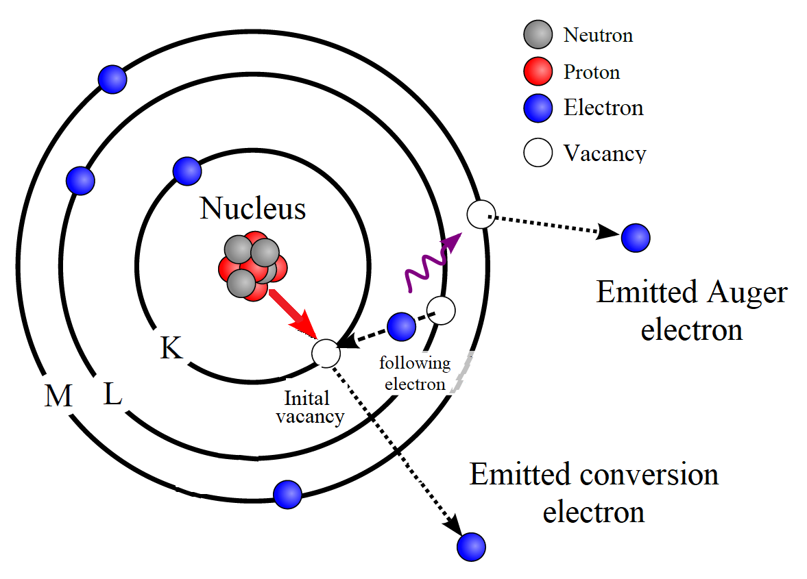
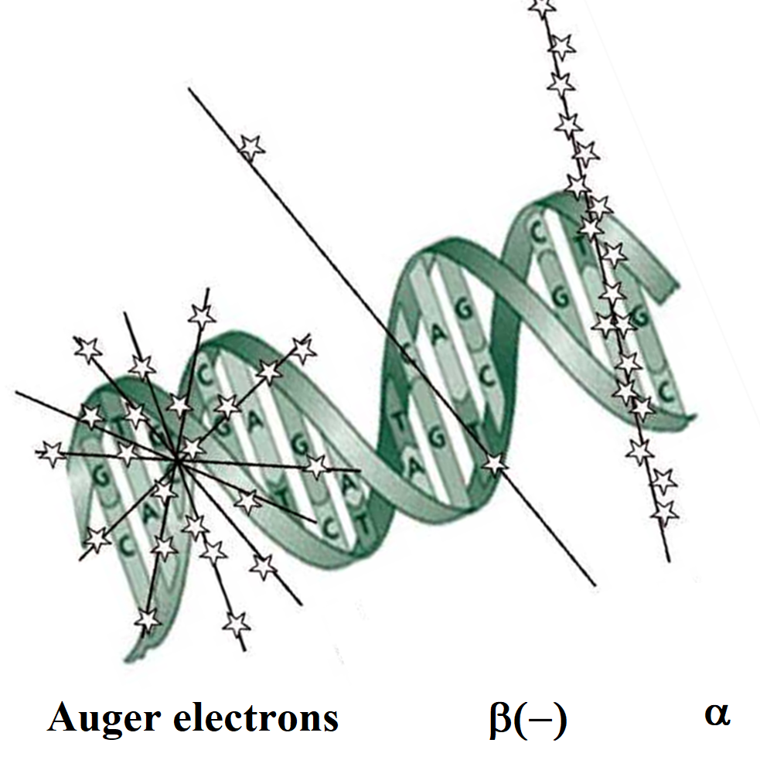
Electron Spectroscopy
Using radioactive tracers
Internal conversion and Auger electron emission from radioactive decay of nucleus
ESA-50 Spectrometer
Obtaining experimental data for evaluation of applications of Auger electrons to nuclear medicine

Slide 14
High-Purity Materials
Applications
I. Low-background materials
- Production of materials with ultralow impurities
- Reduction of radioactive impurities in detector materials, in measured samples and in structural materials of experimental facilities and laboratories
III. Analysis
- ICP-MS, ICP-AES with chemical preparation
- Neutron activation analysis
- Gamma-ray screening, etc.
High specific activity
Radionuclide purity
Radiochemical purity
Chemical purity
II. Reagents
- Low-background electronics: solder and fluxes
- Media for synthesis of radiopharmaceuticals

Slide 15
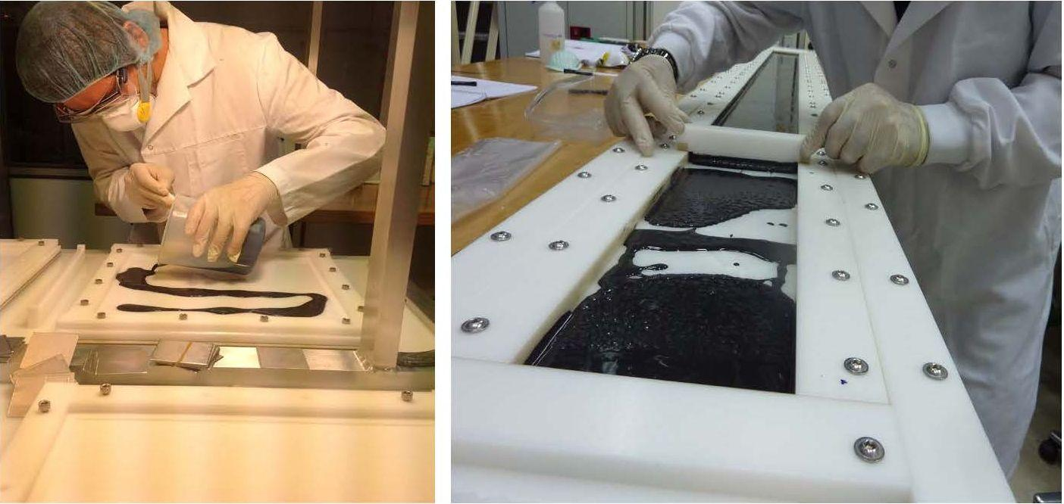
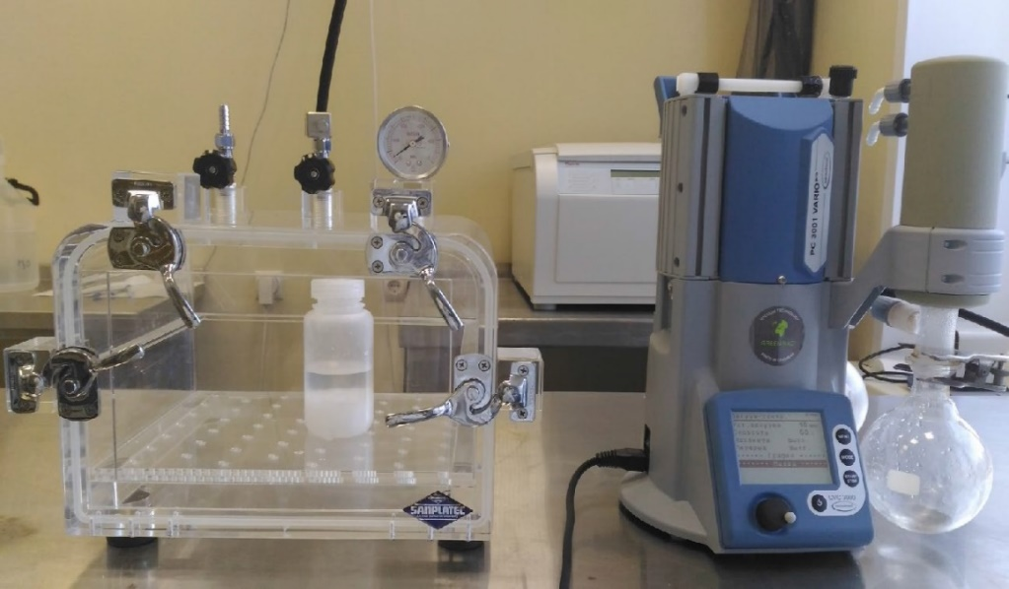
Materials and Methods Developed at DLNP
Samples for measurement
⁴⁸Ca
⁸²Se
⁹⁶Zr
¹⁰⁶Cd
Solders and fluxes
Archaeological Pb+Sn
NH₄Cl, CH₃COONH₄
Detector, protection and construction materials
Etching methods for copper surface
Surface cleaning protocols

Slide 16
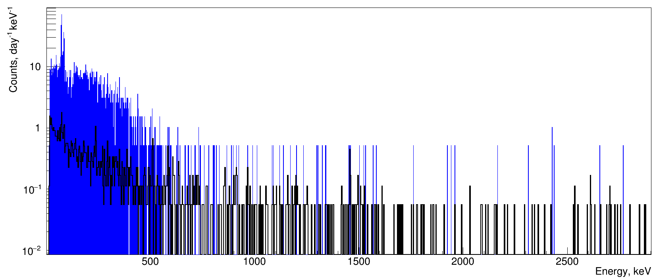
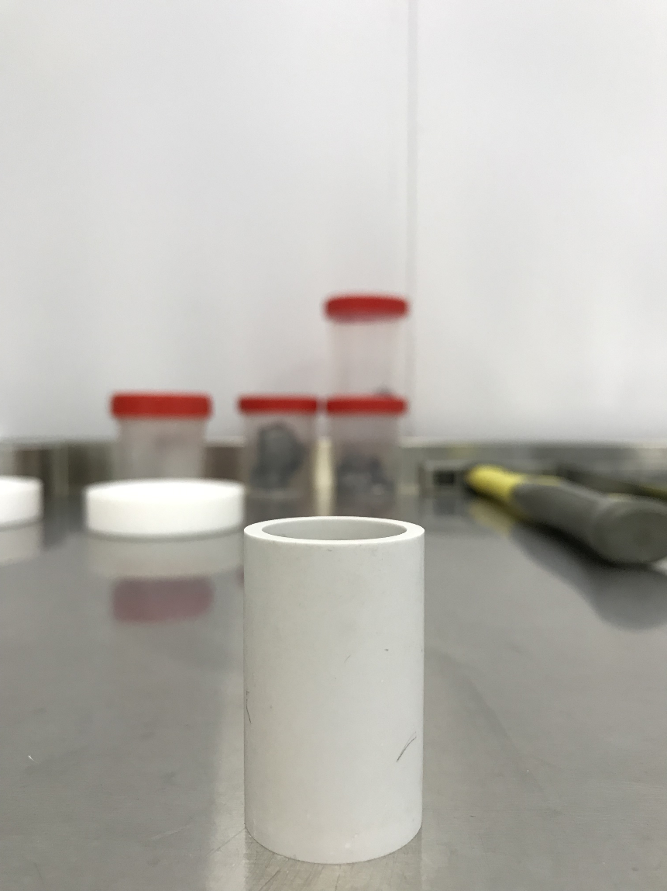
Preparing Solder Made of Archaeological Pb and Sn. Part 1
 | > 30 keV | > 500 keV
Pb (99.9999%), GOST 22861-77 m = 100,8 g | 3161 ± 70 per day | 857 ± 37 per day
Background | 243 ± 6 per day | 112 ± 5 per day
²³²Th decay chain |  | ²³⁸U decay chain
Radionuclide | Activity, mBq/kg | Radionuclide | Activity, mBq/kg
²⁰⁸Tl | < 18 | ²¹⁴Pb | < 17
²⁰⁸Tl | < 27 | ²¹⁴Bi | < 13
²¹²Bi | < 144 | ²¹⁰Pb | < 78
²¹²Pb | < 34 | Radionuclide | Activity, mBq/kg
²²⁸Ac | < 79 | ⁴⁰K | < 94
BeO

Slide 17
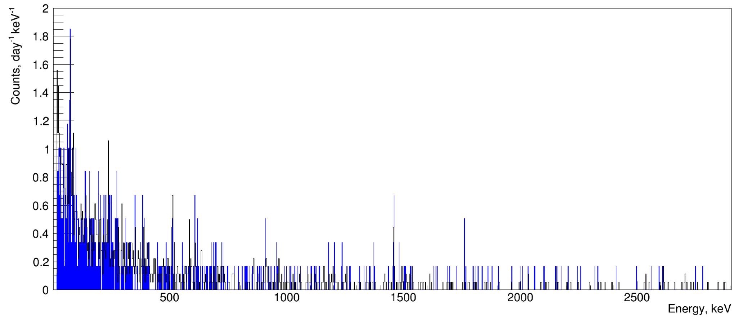
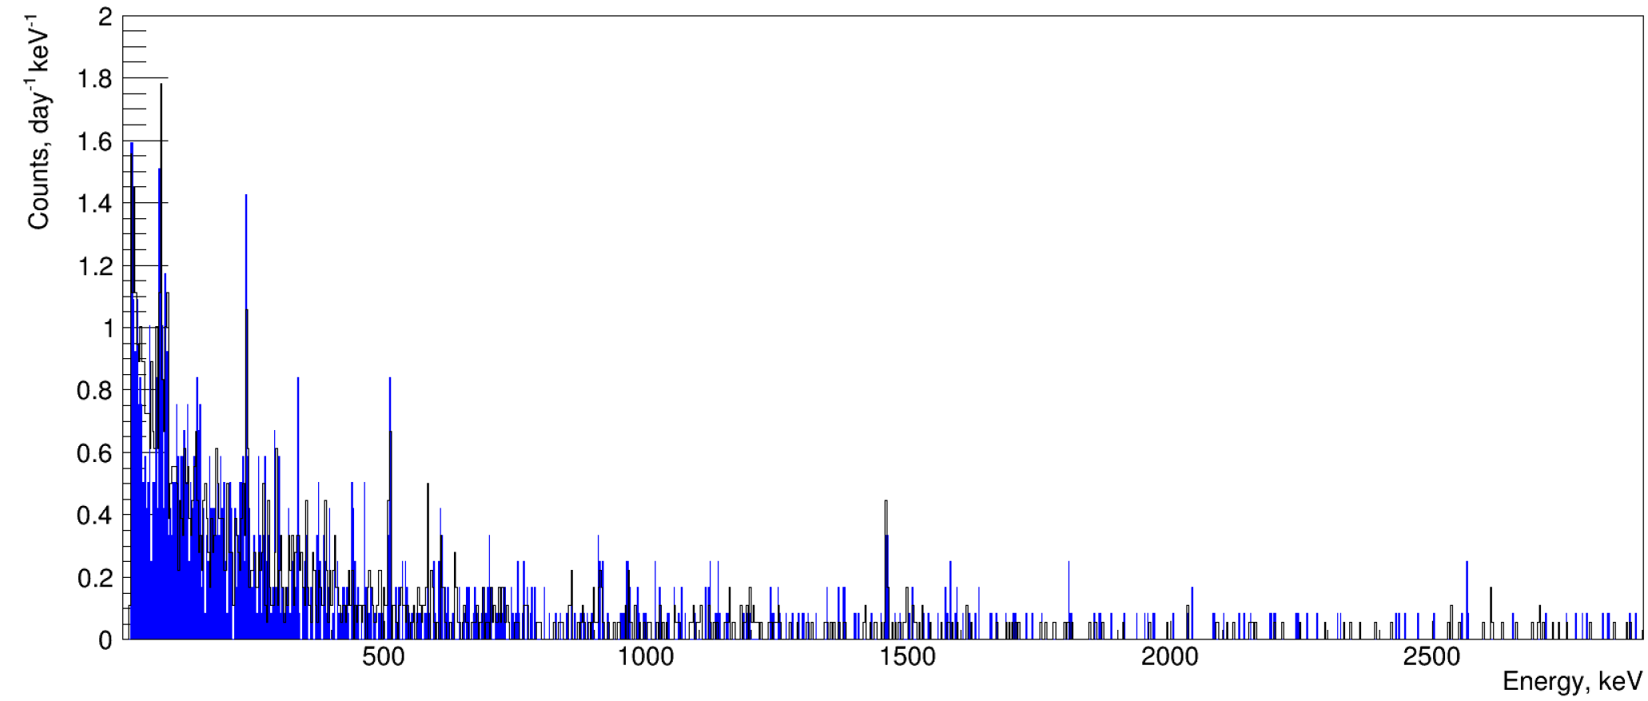
Preparing Solder Made of Archaeological Pb and Sn. Part 2
 | > 30 keV | > 500 keV
Tin (99.9999%), GOST 860-75 m = 75,1 g | 269 ± 12 per day | 139 ± 9 per day
Background | 243 ± 6 per day | 112 ± 5 per day
 | > 30 keV | > 500 keV
Arch. Lead m = 114 g | 243 ± 7 per day | 112 ± 5 per day
Background | 243 ± 6 per day | 112 ± 5 per day

Slide 18
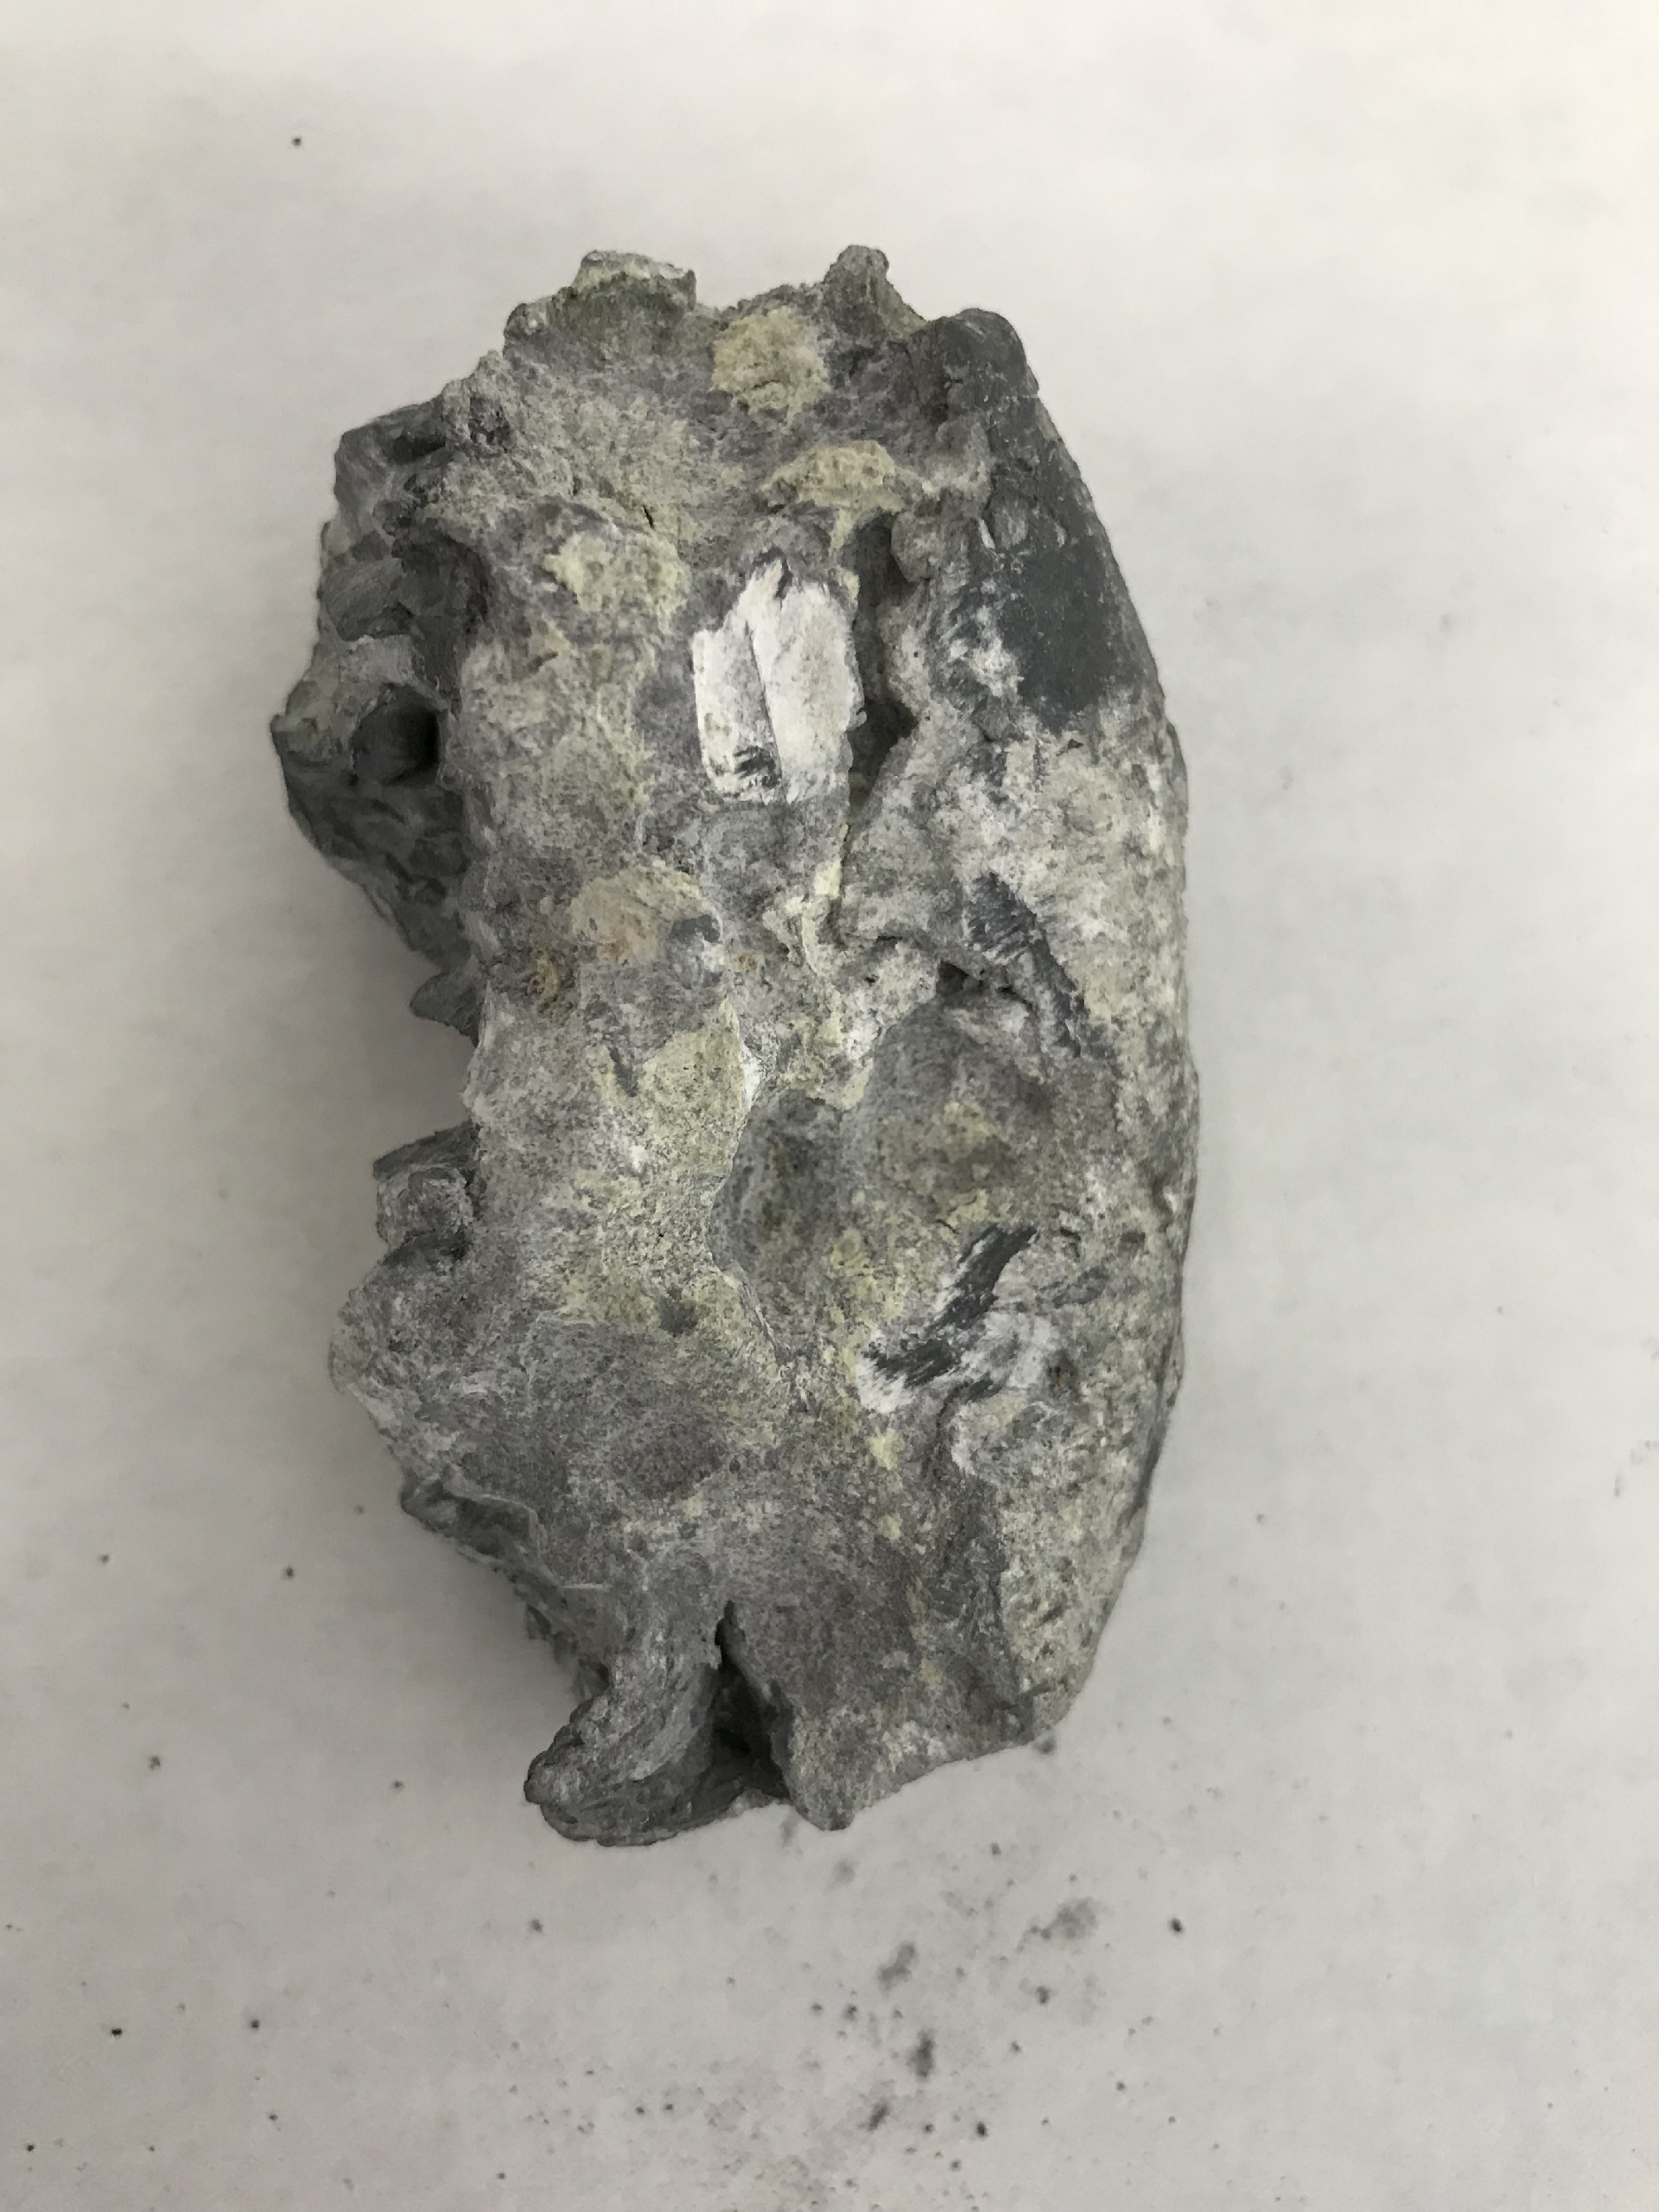
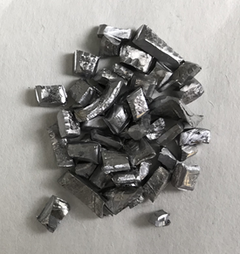
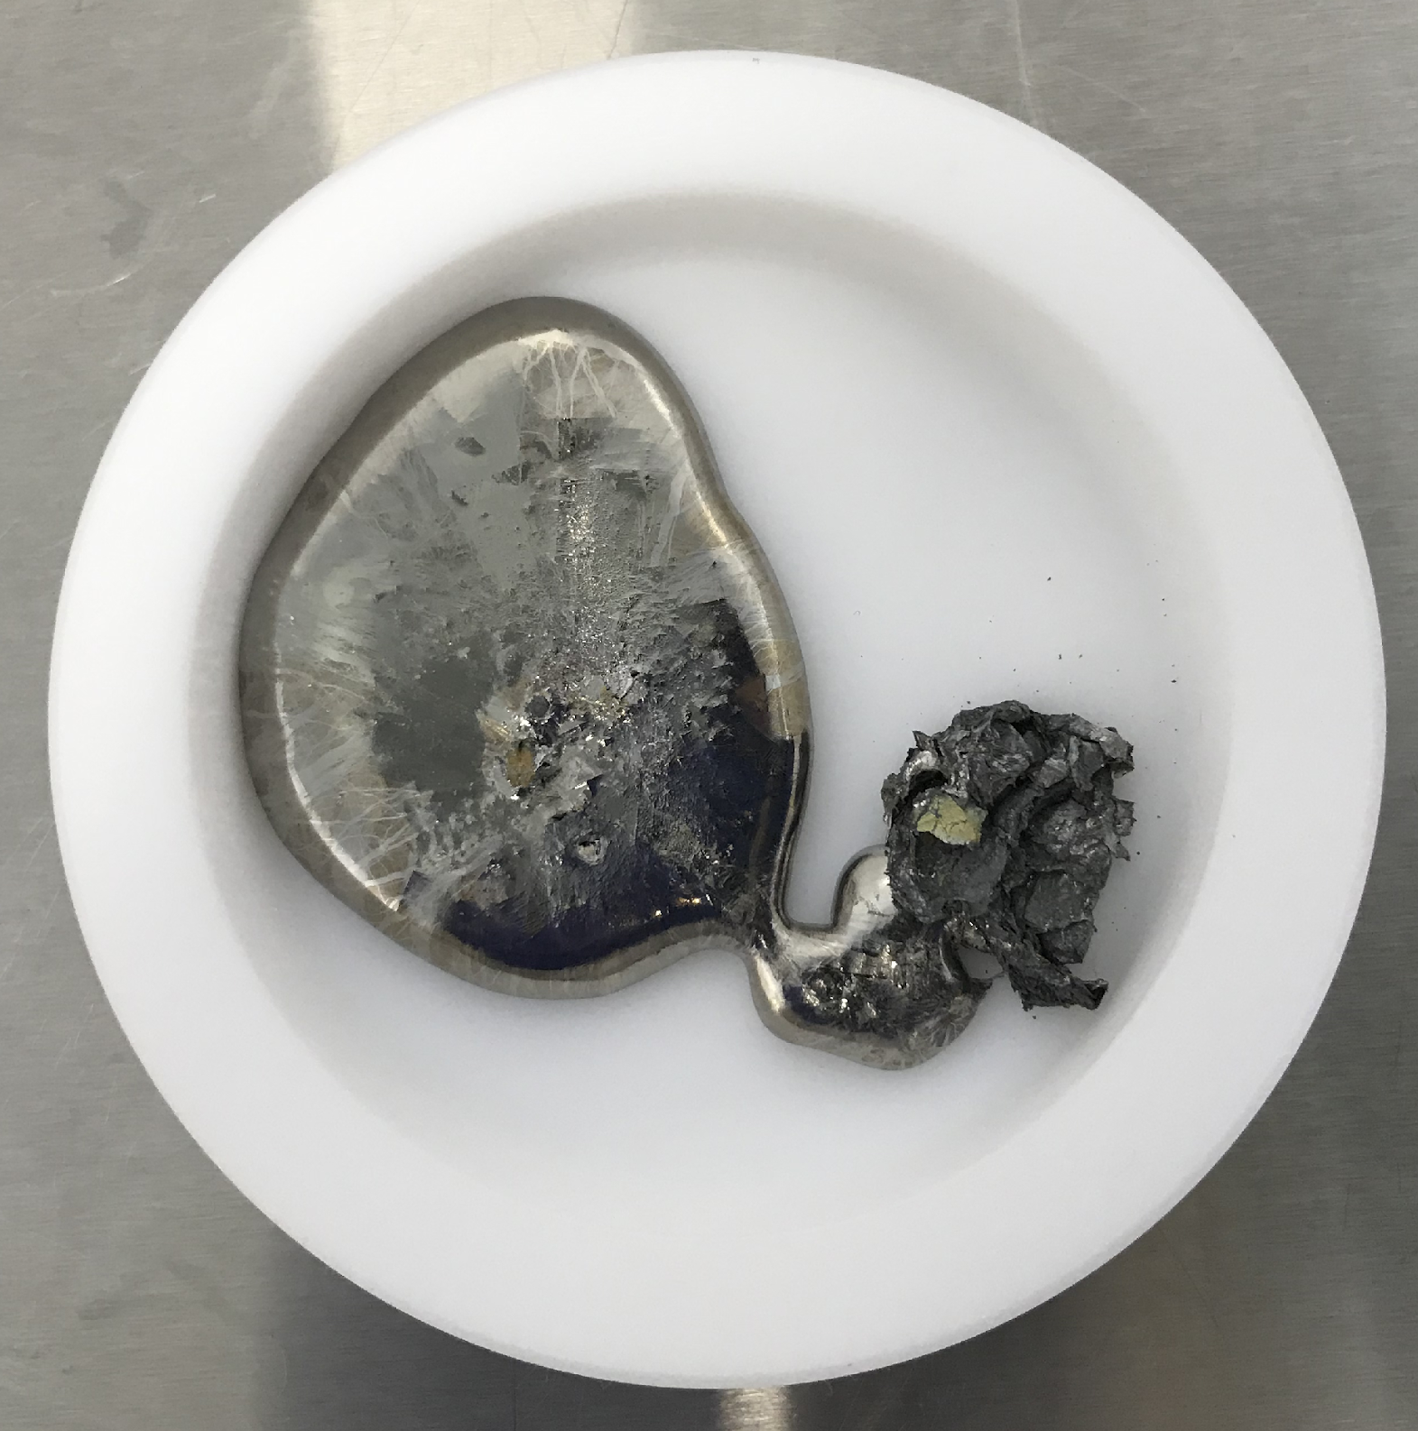
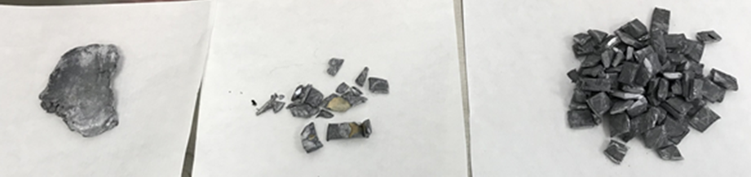
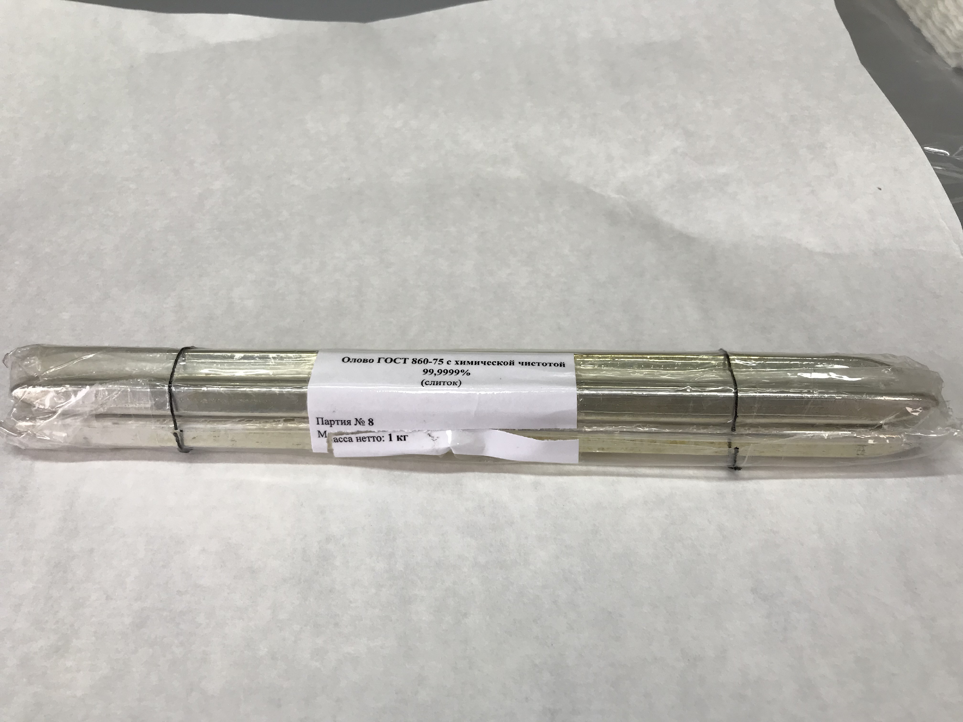
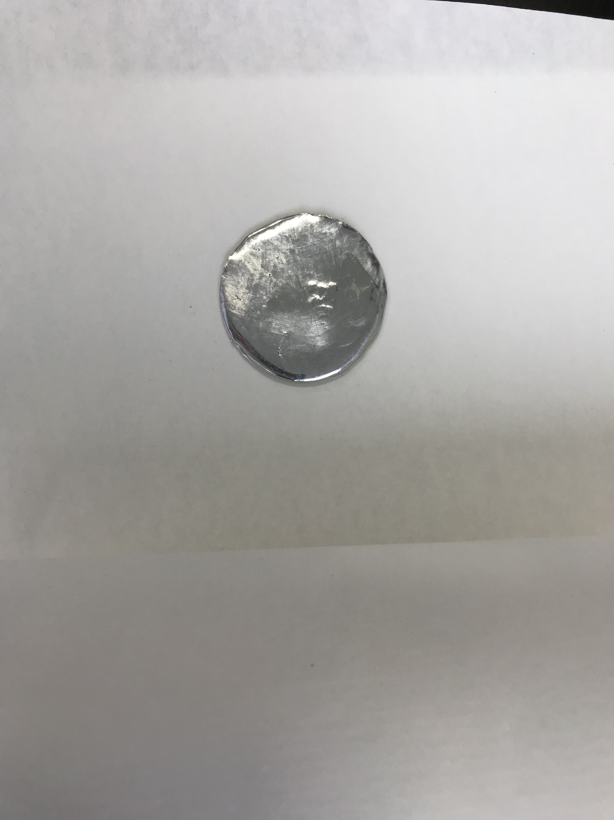
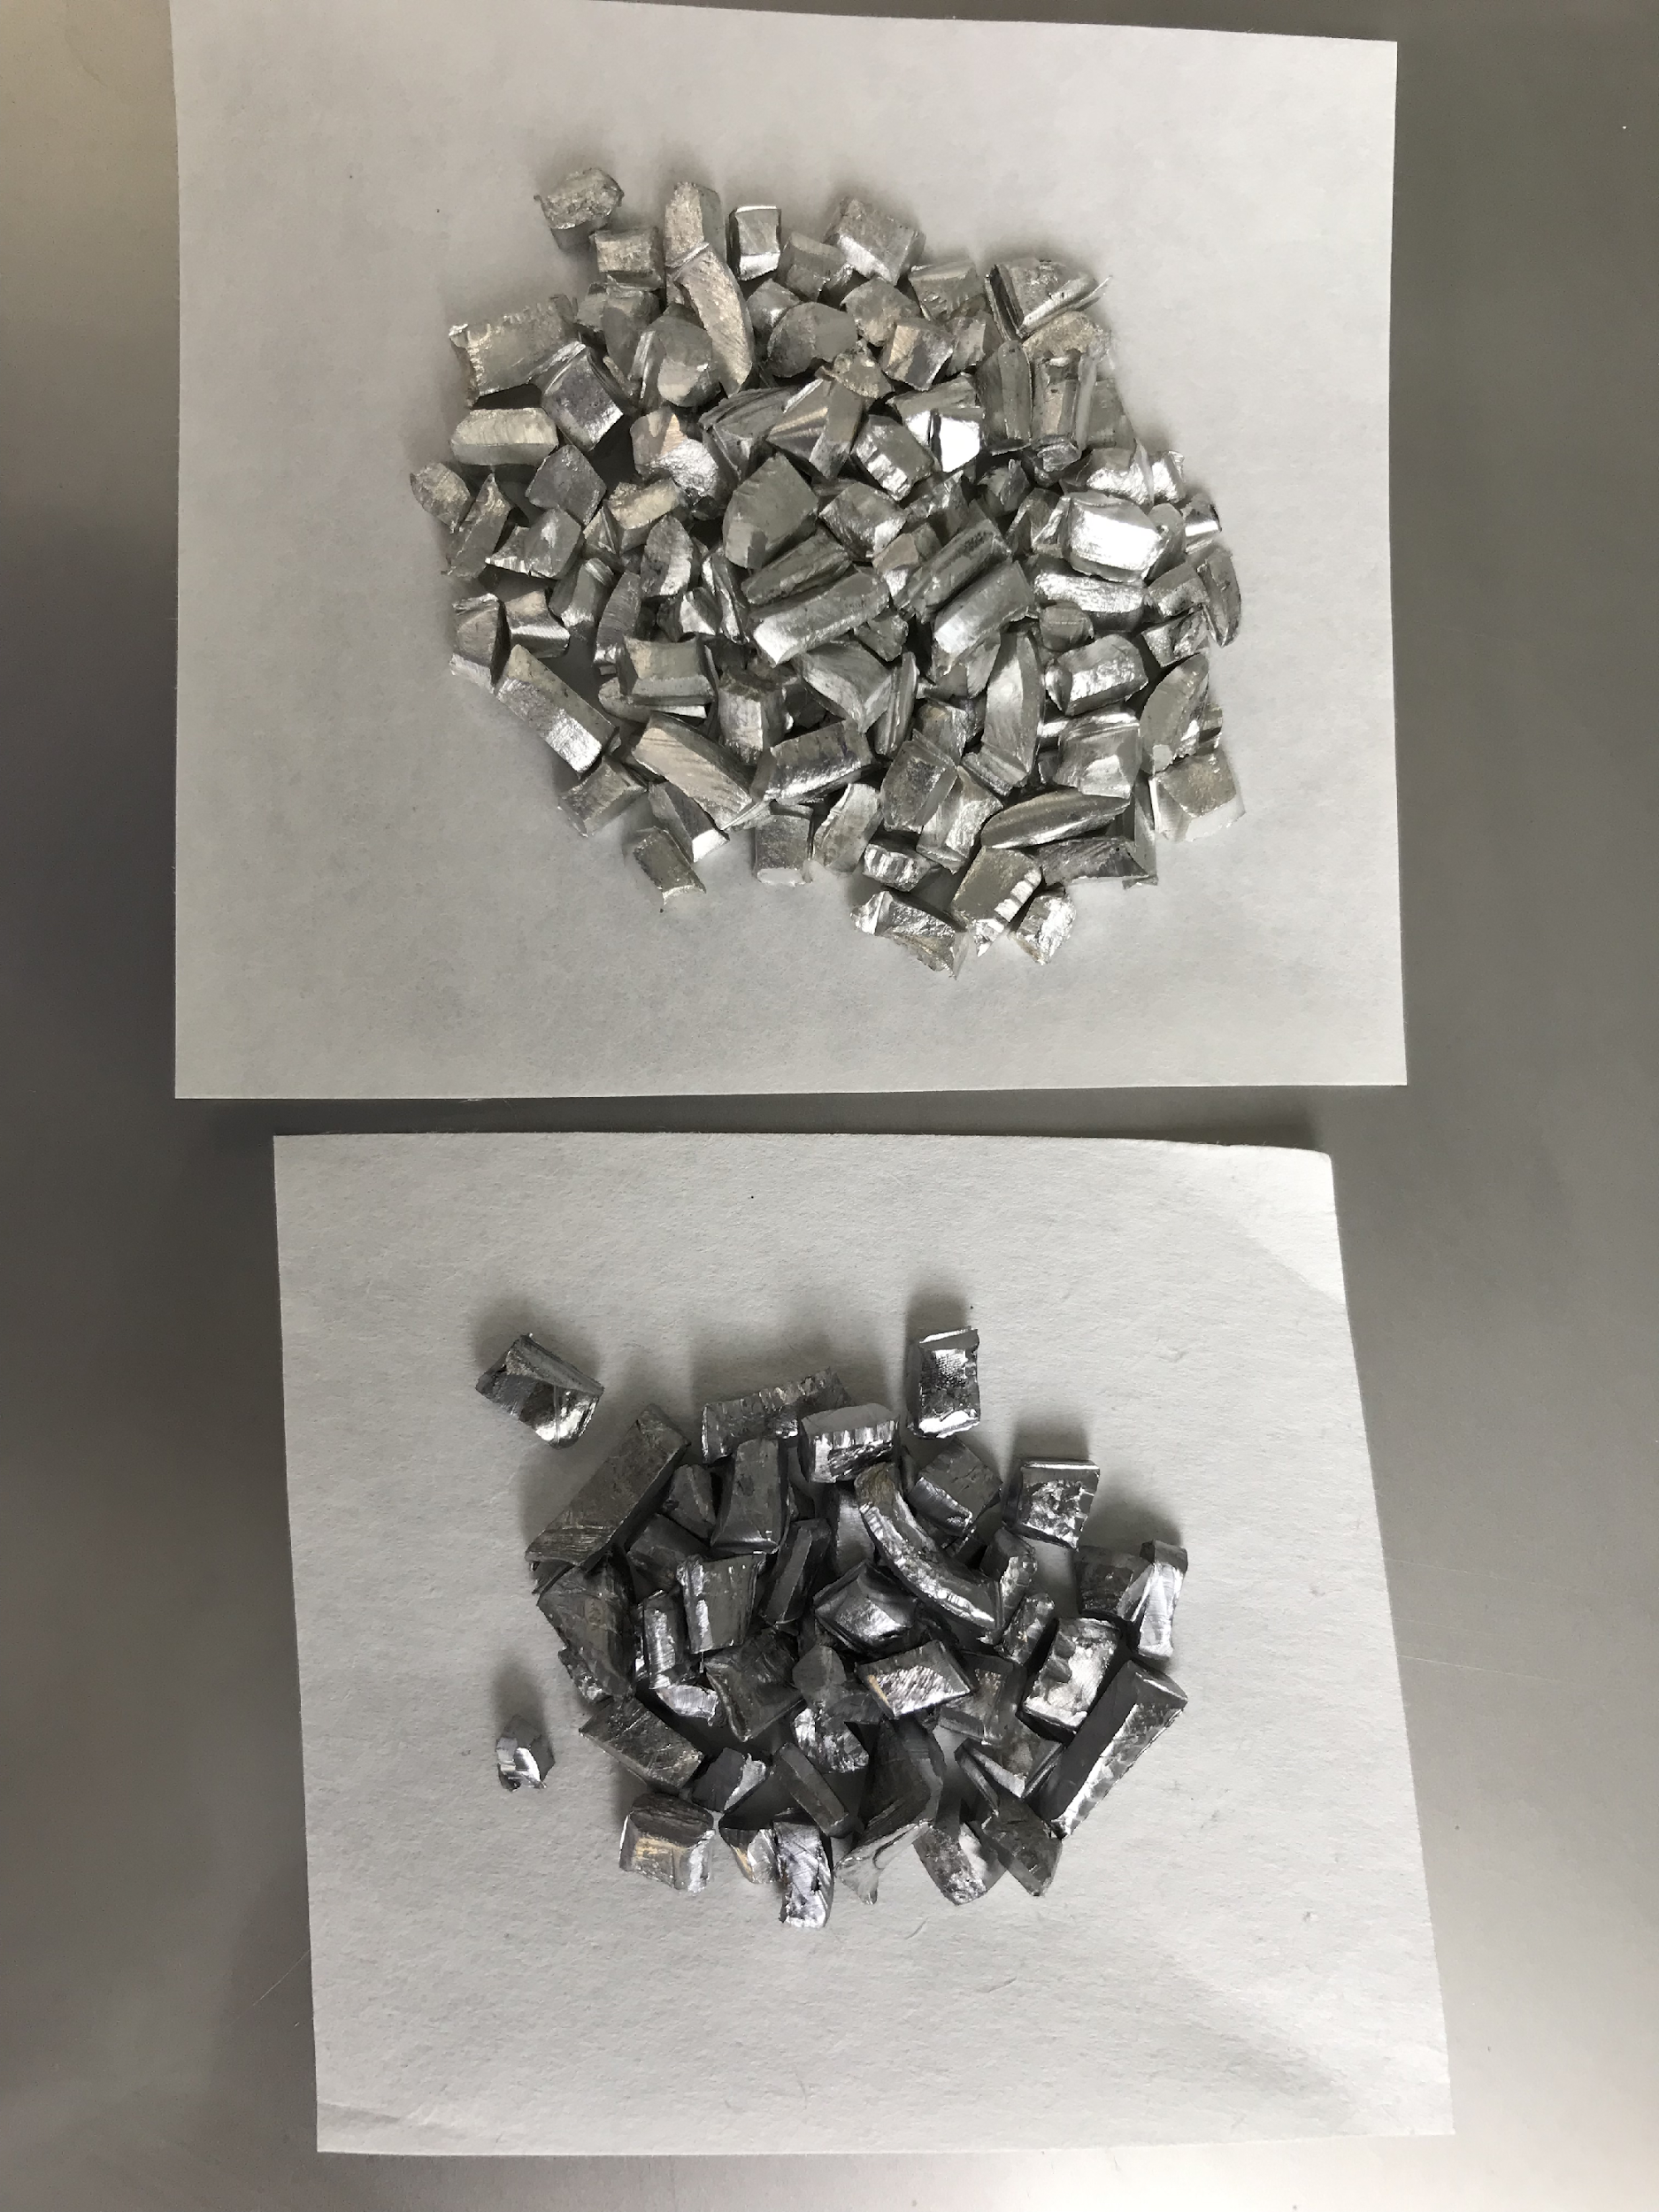
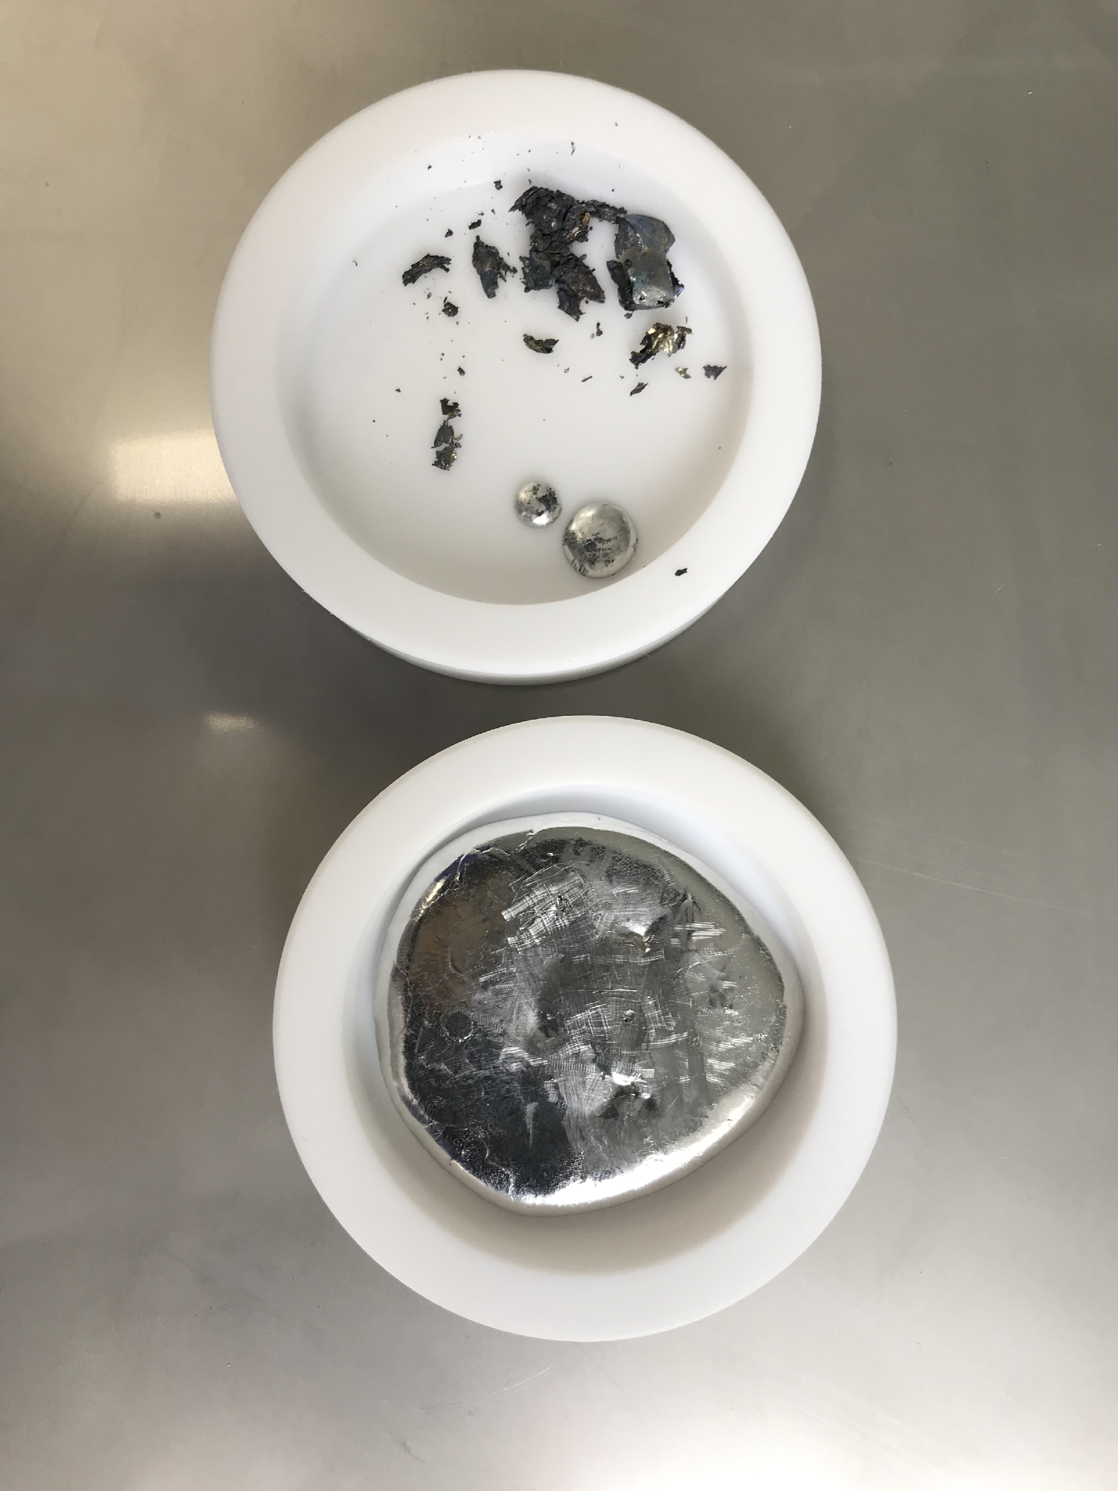
Preparing Solder Made of Archaeological Pb and Sn. Part 3
slag
I.
The original piece of archaeological lead
The molten lead
III.
Pb, 60%
Sn, 40%
II.
metal cutting and weighing
Tin with chemical purity 99.9999%
melting at Т=400 °С
pouring into a Teflon cup

Slide 19
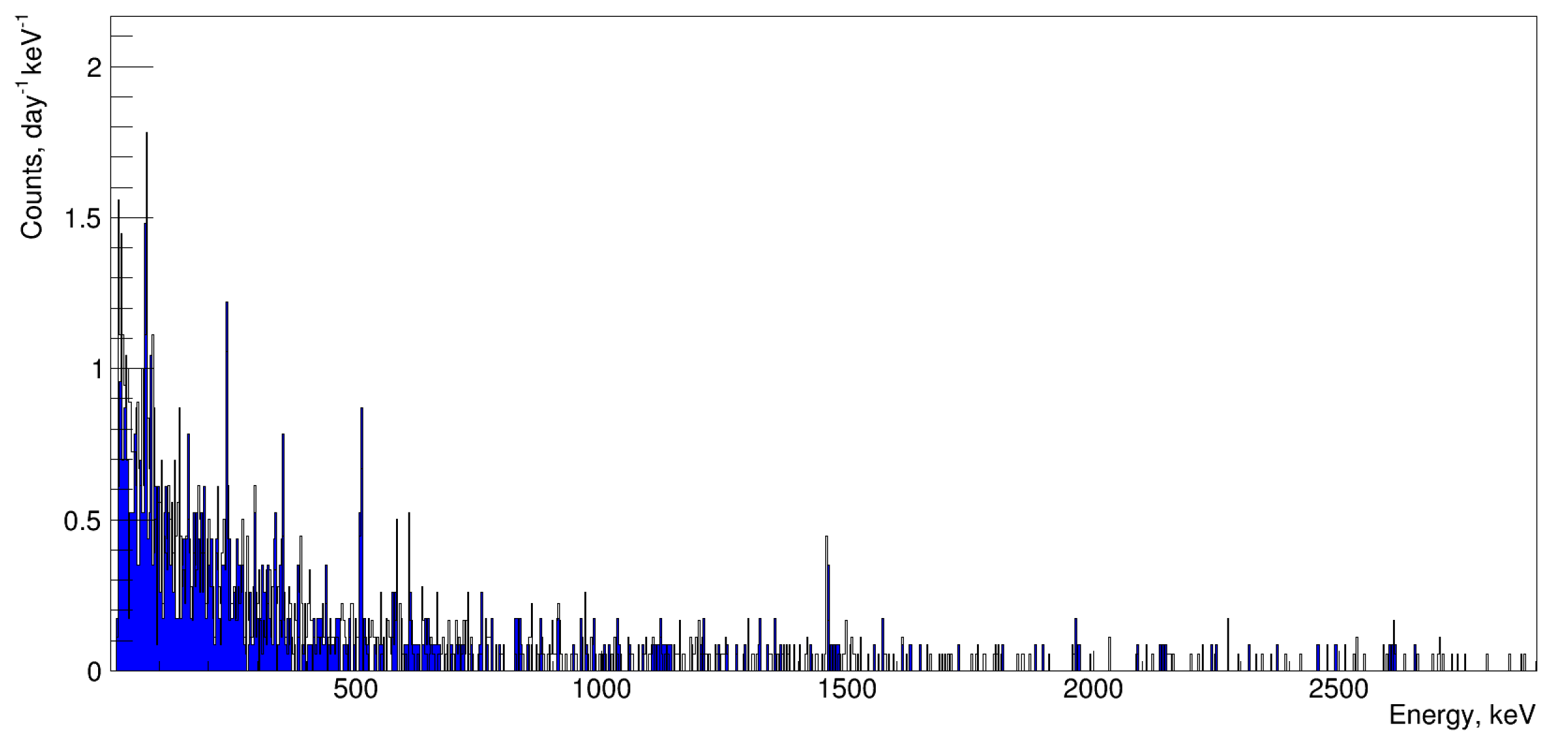
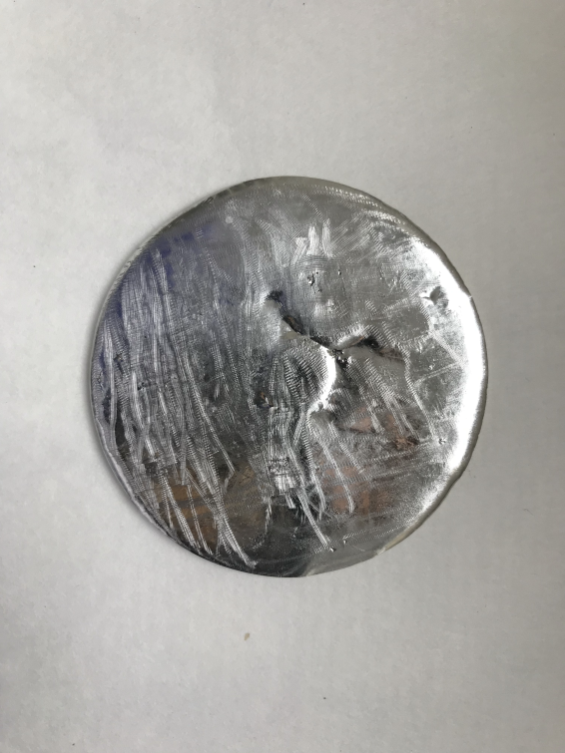
Preparing Solder Made of Archaeological Pb and Sn. Part 4
Solder (60% Sn and 40% archPb)
 | > 30 keV | > 500 keV
Solder Sn(60%)Pb(40%) m = 154.5 g | 222 ± 8 per day | 105 ± 6 per day
Background | 243 ± 6 per day | 112 ± 5 per day

Slide 20
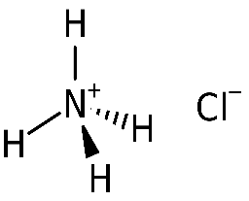
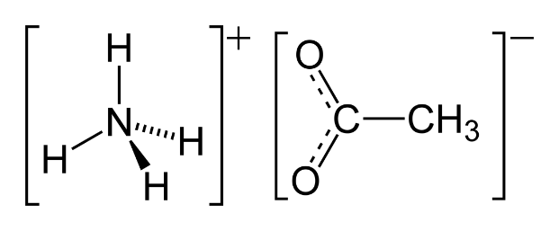
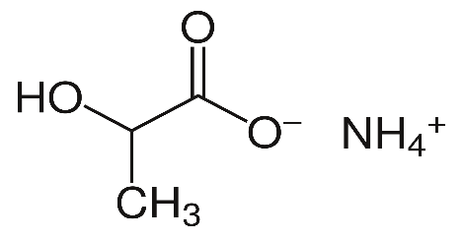
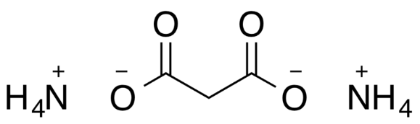
High-Purity Ammonium Salts for Fluxes and Radiolabelling. Part 1
Samples | Purity, % | ²³⁸U |  | ²³²Th |  | ⁴⁰K
 |  | 10⁻⁹ g/g | mBq/kg | 10⁻⁹ g/g | mBq/kg | 10⁻⁹ g/g | mBq/kg
ZnCl₂ | 99.999 | 55 ± 15 | 679 ± 185 | < 200 | < 812 | < 64 | < 2.0
NH₄Cl | 99.999 | 60 ± 20 | 741 ± 247 | 330 ± 140 | 1340 ± 568 | < 72 | < 2.2
H₃PO₄ | 99.998 | 27±12 | 333 ± 148 | < 74 | < 300 | < 66 | < 2.1
C₉H₈O₄ | 99.9 | 160 ± 30 | 1970 ± 370 | 170 ± 90 | 690 ± 365 | < 44 | < 1.4
D.S, Akerib, А. D. Silva, D.L. Herli [et al]. Production of solder and flux with low radioactivity / Nucl Instrum Meth -1997. V. 400, I. 1, P. 181-183

Slide 21
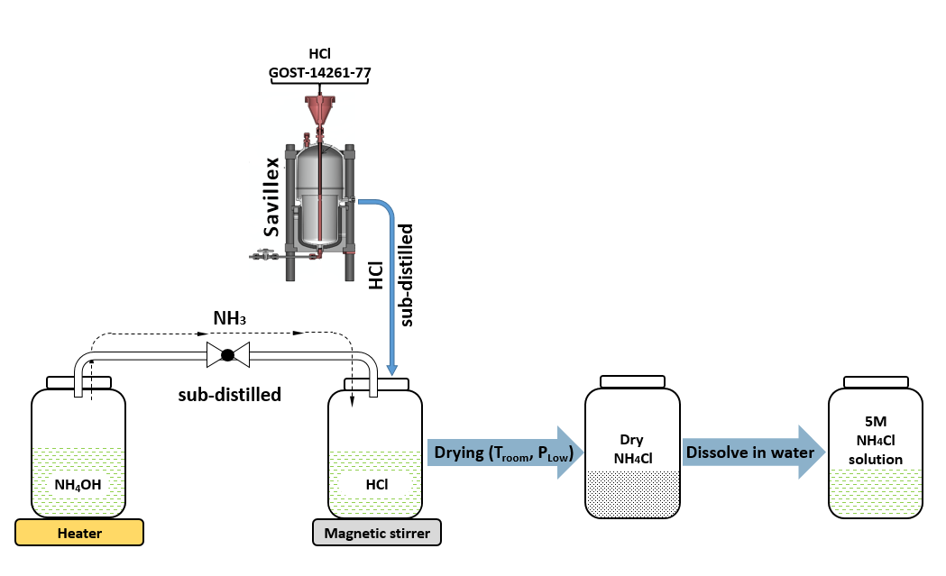
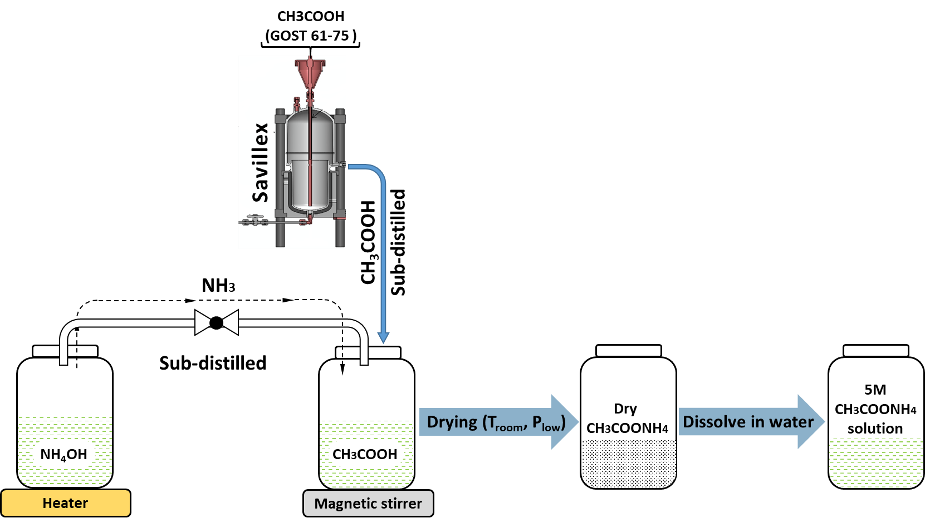
Synthesis of High-Purity Ammonium Salts. Part 2
I. Ammonium chloride
II. Ammonium acetate
NH₃ + HCl → NH₄Cl
Purification of HCl;
synthesis of ammonium chloride solution (transfer of gas phase ammonia to acid);
obtaining NH₄Cl in a solid state by vacuum drying at room temperature.
NH₃ + CH₃COOH → CH₃COONH₄
Purification of the 16 M CH₃COOH acid;
synthesis of ammonium acetate solution (transfer of gas-phase ammonia to acid);
obtaining CH₃COONH₄ in a solid state by vacuum drying at room temperature.

Slide 22
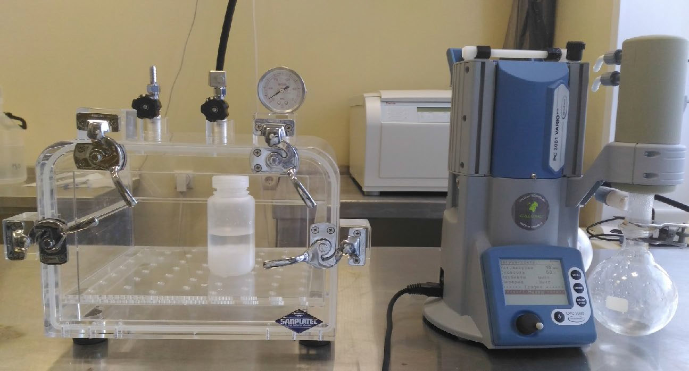
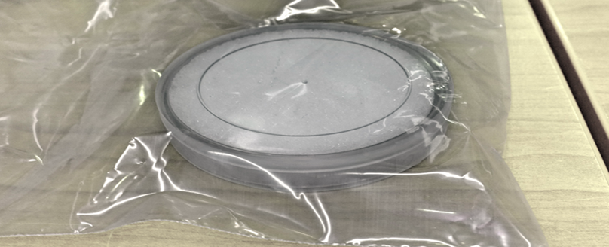
Analysis of High-Purity Ammonium Salts. Part 3
Measurement results of the synthesized NH₄Cl (low-background HPGe)
Impurities of ²³²Th, ²³⁸U and ⁴⁰K in the synthesized ammonium salts (ICP-MS, ICP-AES)
Radionuclide | E_{γ}, keV | Activity, mBq/kg
⁴⁰K | 1461 | < 77
²⁰⁸Tl | 2614 | < 5
²¹⁰Pb | 46 | < 91
²¹²Pb | 239 | < 2
²¹⁴Pb | 242 | < 10
²¹⁴Pb | 352 | < 5
²¹⁴Bi | 609 | < 10
²¹⁴Bi | 1765 | < 5
²²⁸Ac | 911 | < 5
Samples | ²³²Th, mBq/kg | ²³⁸U, mBq/kg | ⁴⁰K, mBq/kg
NH₄Cl | < 0.1 | < 0.1 | < 0.7
CH₃COONH₄ | < 0.1 | < 0.1 | < 0.7

Slide 23
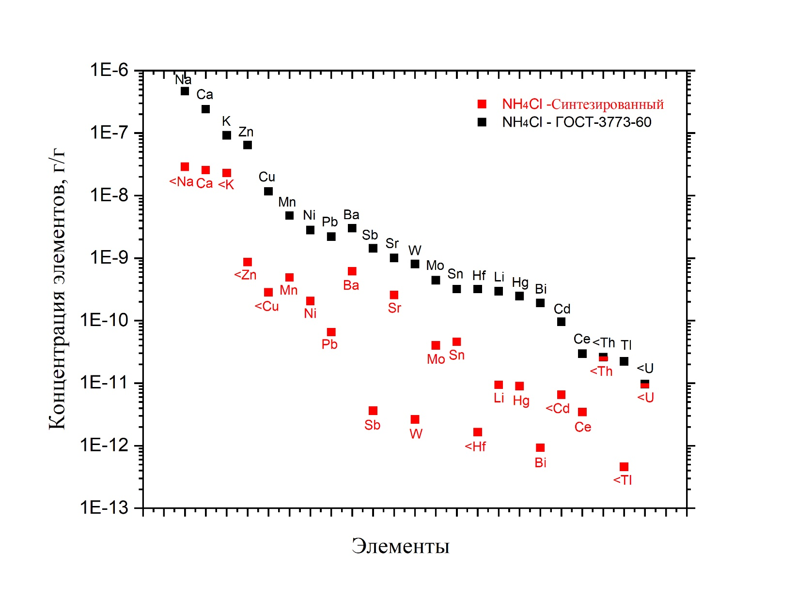
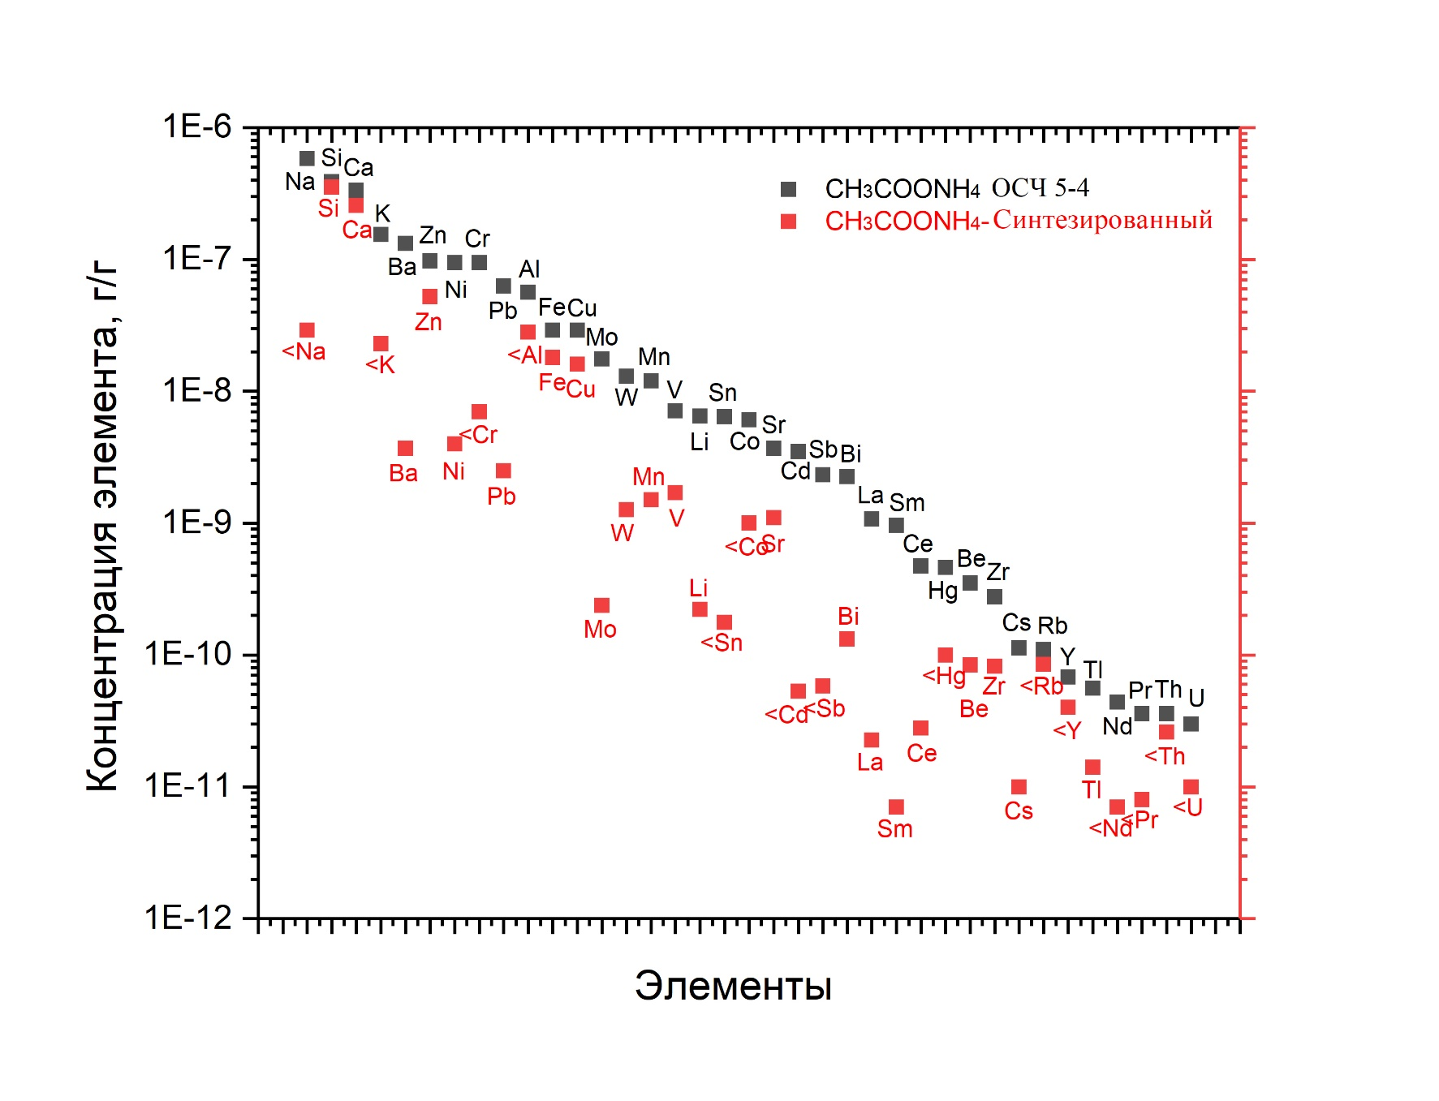
ICP-MS and ICP-AES results of analysis of the commercial NH₄Cl (GOST 3773-60) and the synthesized one
Analysis of High-Purity Ammonium Salts. Part 4
NH₄Cl – Synthesized
NH₄Cl – GOST-3773-60
CH₃COONH₄ – Synthesized CH₃COONH₄ – OSCH 5-4
Element concentration, g/g
Element concentration, g/g
Elements
Elements
ICP-MS and ICP-AES results of the commercial CH₃COONH₄ (OSCh 5-4) and the synthesized one

Slide 24
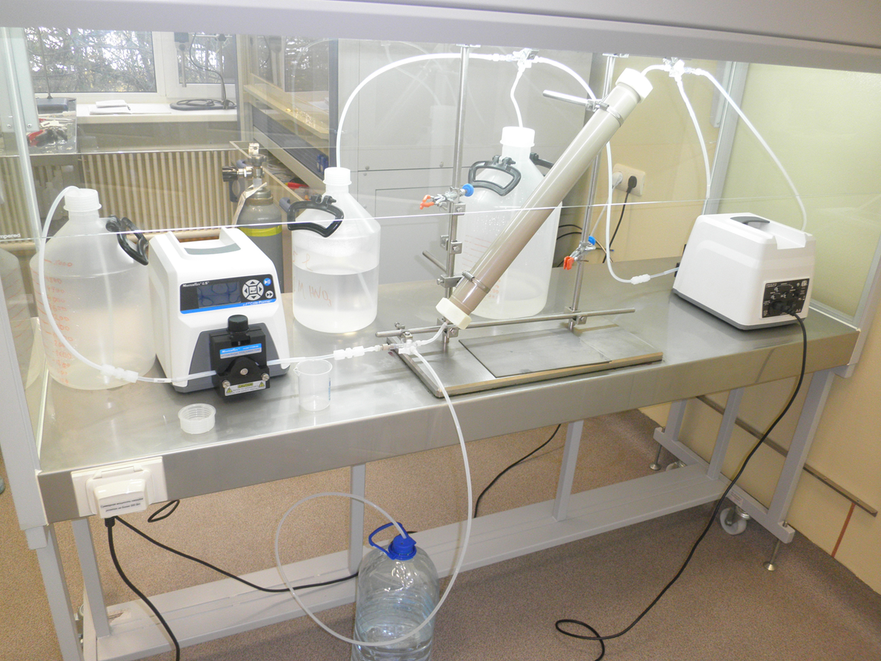
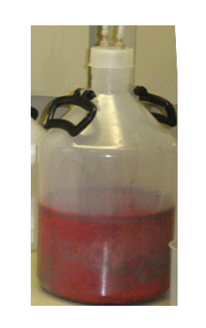
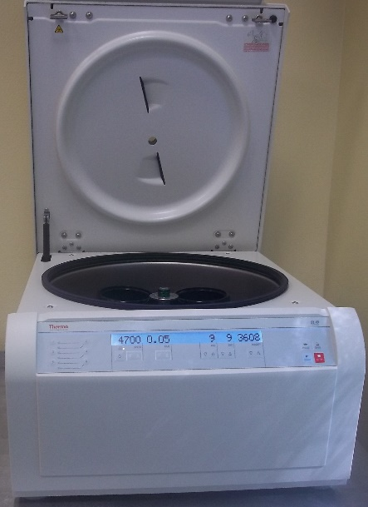
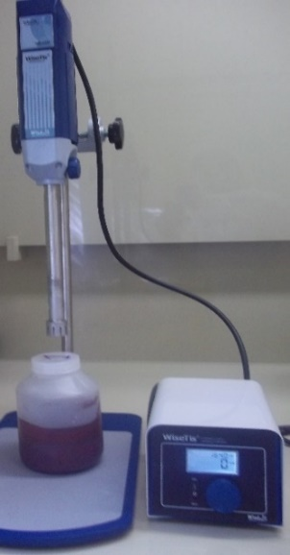
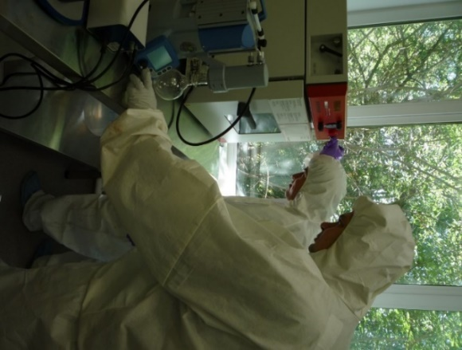
Method for Purification and Conditioning of Selenium. Part 1
I. Dissolving
Se+4HNO₃ →H₂SeO₃+4NO₂↑+Н₂О
SeO₂+Н₂О ↔ H₂SeO₃
II. Chromatographic purification
Conditioning
II.
III. Reduction to elemental Se with SO₂
At room
temperature
IV. Centrifugation
(washing with alcohol, water)
III.
V. Homogenization of selenium (in alcohol)
IV.
V.
VI. Vacuum drying
VI.

Slide 25
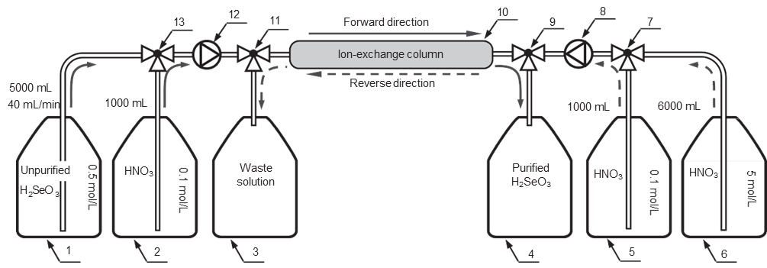
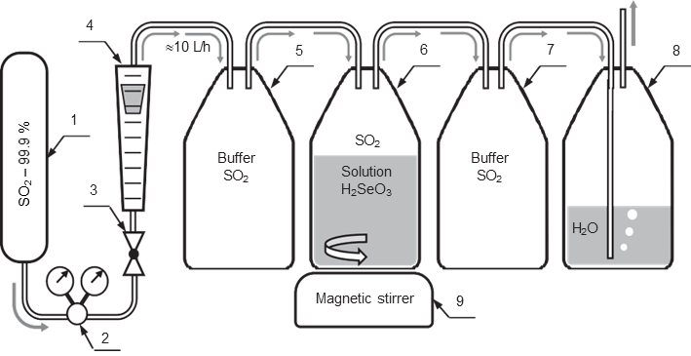
Method for Purification and Conditioning of Selenium. Part 2
1 ÷ 6 – solutions; 7, 9, 11, 13 – triple valves; 8, 12 – pumps;
10 – ion-exchange column
1 - SO₂; 2 - reducer; 3 – valve; 4 – rotameter;
5 ÷ 8 vessels (10 L); 9 - magnetic stirrer
Dowex 50W×8, h=500 mm
For m=100 g of selenium → d=10 мм
For m>100 g → d=28 мм.
H₂SeO₃+2SO₂+H₂O→Se+2H₂SO₄
Reverse chromatography scheme of H₂SeO₃ purification
Scheme of reduction of selenous acid to elemental state

Slide 26

Method for Purification and Conditioning of Selenium. Part 1
Samples | Specific activities of radionuclide impurities, µBq/kg
 | ⁴⁰K | ^{234m}Pa | ²⁰⁸Tl | ²¹⁴Bi
⁸²Se | 58700 ± 100 | 17300 ± 100 | 390 ± 10 | 1500 ± 40
Samples | Specific activities of radionuclide impurities, µBq/kg
 | ⁴⁰K | ²³⁸U (^{234m}Pa) | ²³²Th (²⁰⁸Tl) | ²²⁶Ra (²¹⁴Bi)
Purified ⁸²Se | < 9300* | < 2500* | 22 - 150 (8 - 54) | < 600
Improvement factor of purified ⁸²Se | > 6 | > 7 | 7 - 50 | > 2.5
* ICP-MS results. Element content converts from g/g to µBq/kg
< - detection limit

Slide 27

Methods and Techniques for Production and Analysis of
Low-Background Materials
With a low content of radioactive impurities
Development of sample production methods (⁸²Se; ⁹⁶Zr;
shielding materials – Pb, Cu, Zn; solder; etc.) with impurity content of μBq/kg
Development of sample analysis methods at an ultralow-sensitivity level using Inductively Coupled Plasma Mass Spectrometry (ICP-MS) and other analytical and nuclear spectroscopic methods

Slide 28
PLANS
To support physical, chemical and radiopharmaceutical studies of radionuclides: to develop methods for production of preparations and sources of radionuclides.
To put into operation two new basic facilities: the LINAC-200/800 Electron Accelerator and a Spectrometric Cluster functioning in tandem.
To complete the reconstruction of radiochemical laboratories at the DLNP Experimental Department of Nuclear Spectroscopy and Radiochemistry.
To expand radiochemical research through new areas: ICP-MS for determining ultra-low concentrations of substances, primarily radioactive Th, U and K; the emission mode of Mössbauer spectroscopy for studying post-effects of the radioactive decay in solids and autoradiolysis of radiopharmaceuticals (¹¹⁹Sb, ¹⁶¹Tb, ⁵⁷Co, ^{119m}Sn, etc.); the improved PAC method for studying the behavior of radiopharmaceuticals (¹¹¹In, ¹⁵²Eu, ¹⁵⁴Eu, ¹⁷²Lu, etc.) and solids with isomers (^{111m}Cd, ^{199m}Hg, ^{204m}Pb) in samples irradiated at the LINAC-200/800.
To produce low-background materials for experiments in neutrino physics and astrophysics, and also to analyse these materials at a level of μBq/kg and below.
To manufacture a wide range of radionuclide generators ³²Si→³²P, ⁴⁴Ti→⁴⁴Sc, ⁶⁸Ge→⁶⁸Ga, ⁹⁰Sr→⁹⁰Y, ¹⁹⁴Hg→¹⁹⁴Au, ²⁰²Pb→²⁰²Tl, ²²⁷Ac→²²⁷Th→²²³Ra, ²²⁹Th→²²⁵Ra→²²⁵Ac, ²³⁷Np→²³³Pa, ²³⁸U→²³⁴Th, etc. (up to 40-50)

Slide 29
Thank you for attention!

