Slide 1

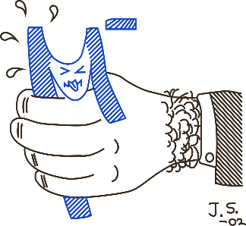
59th meeting of the PAC for Nuclear Physics
JINR
Muon trigger system for the MONUMENT experiment
S. Kazartsev
13/06/2024

Slide 2











L. Baudis², V. Belov¹, T. Comellato³, T. Cocolios⁴, H. Ejiri⁵,
M. Fomina¹, I.H. Hashim⁶, K.Gusev^{1,3}, L. Jokiniemi⁷, S. Kazartsev^{1,8}, A. Knecht⁹,
F. Othman⁶, I. Ostrovskiy¹⁰, N.Rumyantseva¹,
M. Schwarz³, S. Schönert ³, M. Shirchenko¹, E. Shevchik¹, Yu. Shitov¹,J. Suhonen⁷,
S.M. Vogiatzi^{9,11}, C. Wiesinger³, I. Zhitnikov¹, and D. Zinatulina¹
¹Joint Institute for Nuclear Research, Dubna, Russia.
²Physik-Institut, University of Zurich, Zurich, Switzerland
³Technische Universität München, Garching, Germany.
⁴KU Leuven, Institute for Nuclear and Radiation Physics, Leuven, Belgium
⁵Research Center on Nuclear Physics, Osaka University, Ibaraki, Osaka, Japan
⁶Department of Physics, Universiti Teknologi Malaysia, Johor Bahru, Malaysia.
⁷Department of Physics, University of Jyväskylä, Jyväskylä, Finland.
⁸Voronezh State University, Voronezh, Russia.
⁹Paul Scherrer Institut, Villigen, Switzerland.
¹⁰Department of Physics and Astronomy, University of Alabama, Tuscaloosa, AL, USA
¹¹ETH Zurich, Switzerland
MONUMENT (Muon Ordinary capture for the Nuclear Matrix elemENTs in ββ decays) collaboration

Slide 3
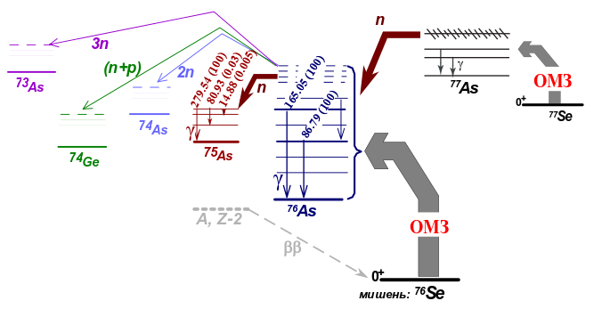
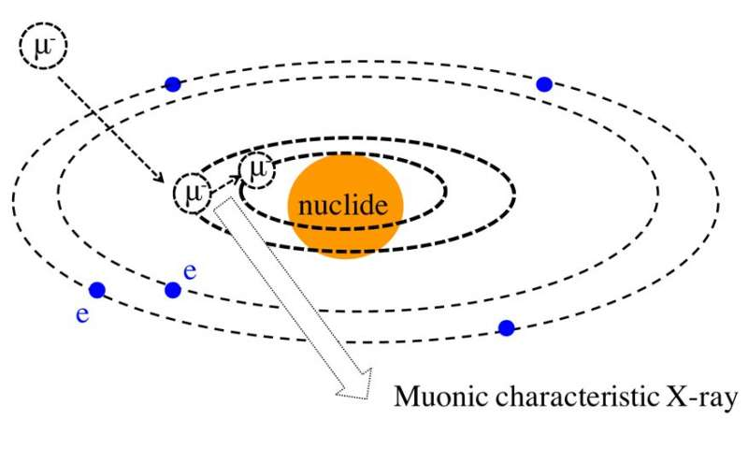






MONUMENT
nucleus
OMC
m_{μ} = 105,7 MeV
Capture
$$\left(A, Z\right)+μ^{−}→{\left(A, Z−1\right)}^{∗}+ν_{μ}$$
Decay
$$→\left(A, Z−1\right)+γ$$
$μ^{−}→e^{−}+ν_{μ}+{\tilde{ν}}_{e}$,
$$→\left(A−1, Z−1\right)+n+γ$$
$$τ_{μ}=2,197 мкс$$
$$→\left(A−1, Z−2\right)+p+γ$$
Notes:
The process of muon capture is similar to electron capture, the main difference is that a muon is approximately 200 times heavier than an electron, and the muon's interaction with matter is therefore more intense.
After the stop in the target material, the muon enters its Rydberg state, and then successively descends to the K-shell, emitting a cascade of muonic X-ray photons (𝑋). This entire process takes place in about 10-13 so for our purposes it could be considered as instant.
After a muon descends to the K-shell, it has two possibilities: either to decay, or be captured by the nucleus through the weak interaction.
When and if the muon is captured, daughter nuclei with different excited states appears. The figure schematically shows possible reaction channels after the muon capture. By measuring the change of intensity of the recorded gamma lines with time, one can determine the total rate of muon capture in this exact nuclei.

Slide 4
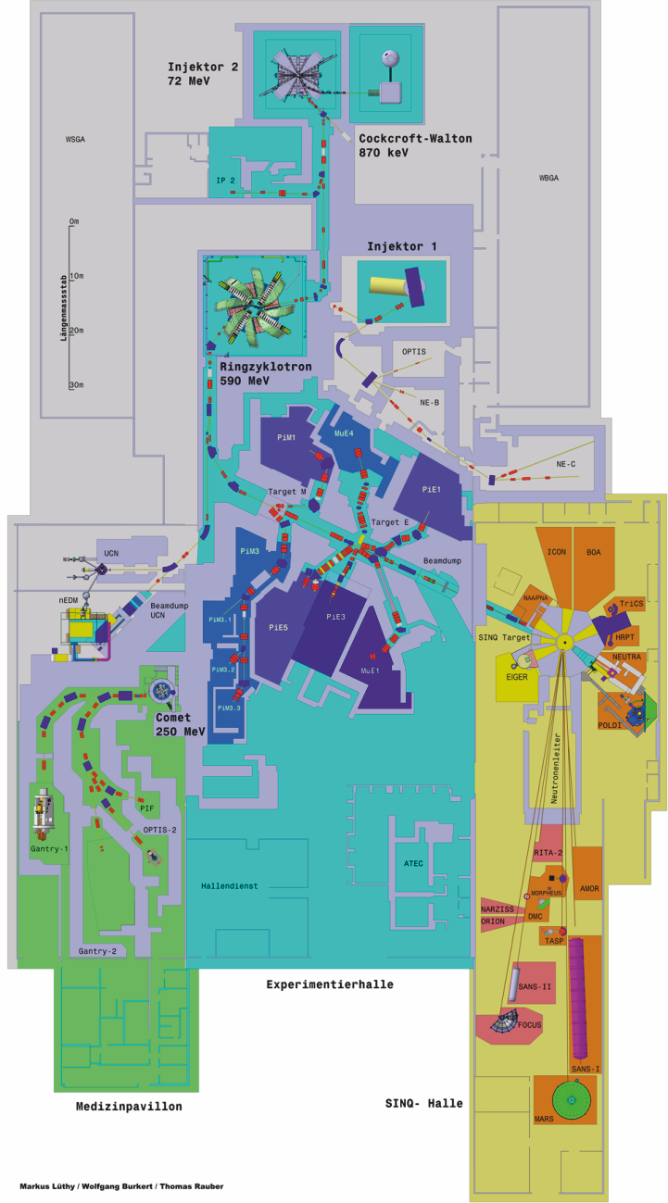
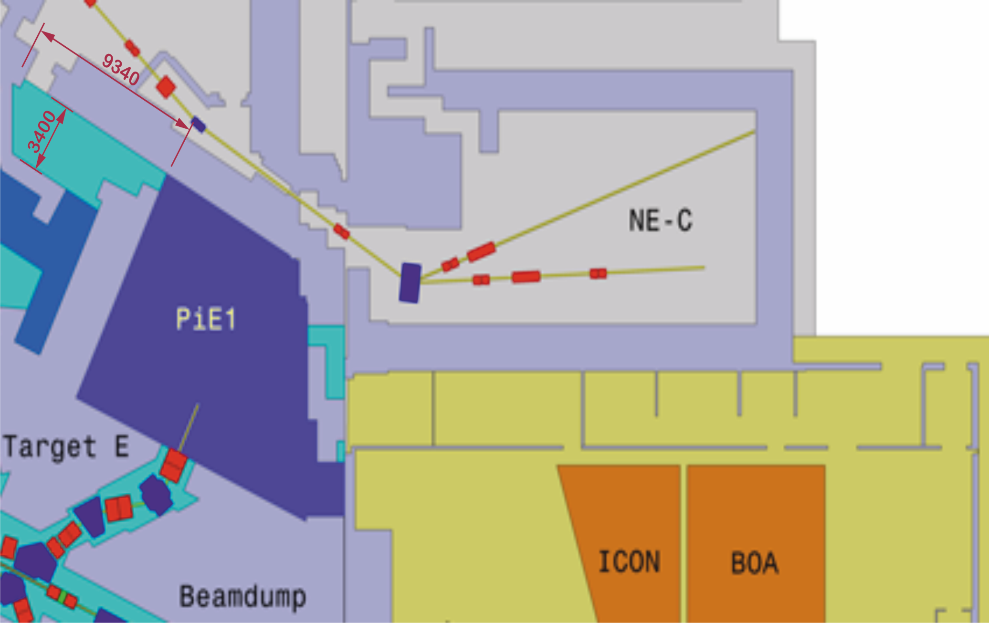
Experimental Hall
OMC4DBD setup
Control rooms
Notes:
The MONUMENT experiment is carried out in Switzerland, on a beam of negative muons. There is a plan of the accelerator facility. The experimental area, where the installation is located, as well as rooms for data and setup monitoring are shown

Slide 5
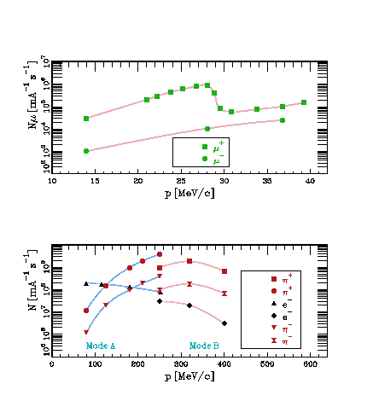
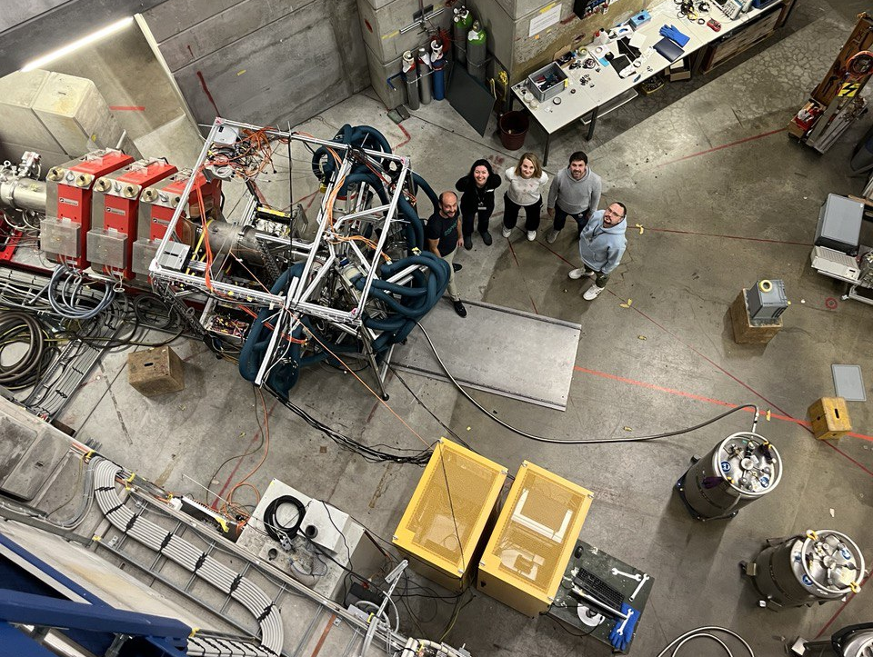
Paul Scherrer Institute, πE-1 beam
Campaign 2023
Beamline
MONUMENT collab
Our setup
Dewars
Electronic Racks
Impulse – 15 - 40 MeV/C
Intensity – 2x10³ – 6x10⁴ c⁻¹
Notes:
We are assembling the installation on the PIE1 beam. The slide shows a top view of the experimental hall. Photo is taken from 2023, this was our third trip to PSI. In the photo you can see the channel output. Installation of our experimental setup, dewars for filling germanium detectors. The slide also shows the characteristics of the muon beam and the dependence of the number of muons on their momentum.

Slide 6
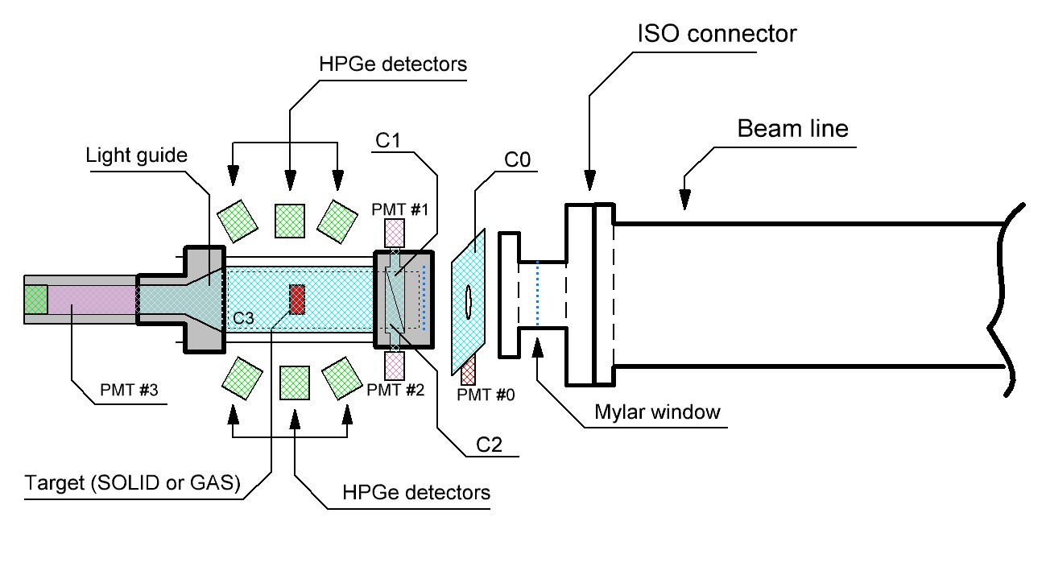

Simplified scheme of the experimental setup
PMT0, PMT1, PMT2 – H10720
PMT3 – R6233
Target: Solid or Gaseous isotopes
$\overline{C0}$& C1 & C2 & $\overline{C3} →EVENT$
Notes:
This slide schematically shows our setup. In addition to germanium detectors, we use 4 fly-through scintillation counters to tune and focus the beam. Counter C0, C1-C2, measured isotope, counter C3.

Slide 7
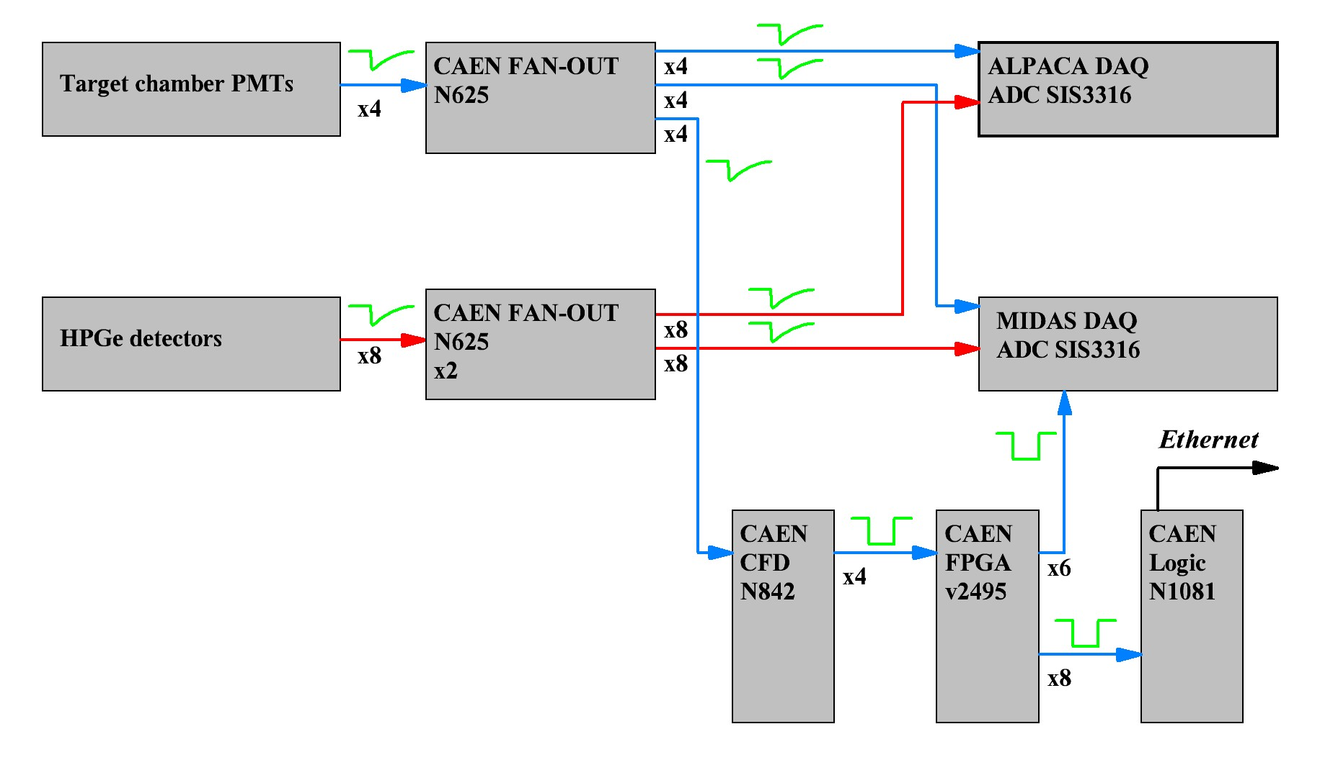
Scheme of the signal connection
Both DAQ use FADC SIS3316 with freq 250 MHz.
MIDAS DAQ – PSI
ALPACA DAQ – TUM
In campaign of 2021 и 2022 was used two independent DAQ (MIDAS and ALPACA).
In 2023 MIDAS only
Notes:
The slide shows a simplified diagram of the electronics for our experiment. For the 2021 and 2022 campaigns, we used two independent data collection systems. The MIDAS system is a Swiss made DAQ, and the ALPACA system made by our colleagues from the Technical University of Munich. To digitize signals, both systems use digitizers designed by STRÜK, model SIS3316 with a sampling rate 250 MHz each.

Slide 8
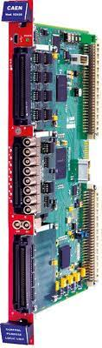
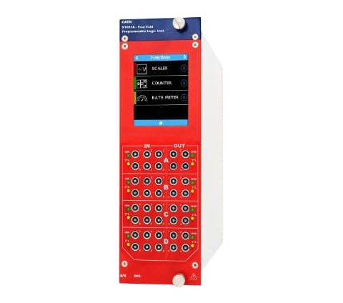

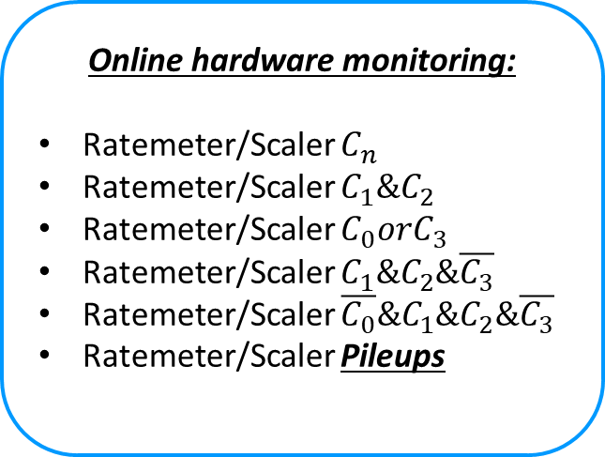
Beam tuning
Online hardware monitoring:
Ratemeter/Scaler $C_{n}$
Ratemeter/Scaler $C_{1}\&C_{2}$
Ratemeter/Scaler $C_{0}orC_{3}$
Ratemeter/Scaler $C_{1}\&C_{2}\&\overline{C_{3}}$
Ratemeter/Scaler $\overline{C_{0}}\&C_{1}\&C_{2}\&\overline{C_{3}}$
Ratemeter/Scaler Pileups
4 logic signals from PMTs
CAEN v2495
Logic module with programmable FPGA
CAEN N1081
ONLINE DATA monitoring via Ethernet connections
MONUMENT Collaboration
Notes:
When the gate is open on the beam channel, it is prohibited to be in the experimental room, and therefore fine tuning of the flight counters seems possible only remotely. To focus the beam, we need to organize several logical circuits at the hardware level that show us exactly what manipulations we need to perform with the beam. Move it to the side, increase the momentum, shut it from one side, etc. For this we use the CAEN electronic model 2495, which is logically programmable unit. It can also be programmed remotely. So, 4 logical signals from scintillation counters are input to the module 2495, where these signals are connected to various logical circuits. And then, the signals from the logic are transferred to the module 1081, which allows you to transmit information from its inputs via Ethernet to the local network. Various combinations of output signals are shown as examples

Slide 9
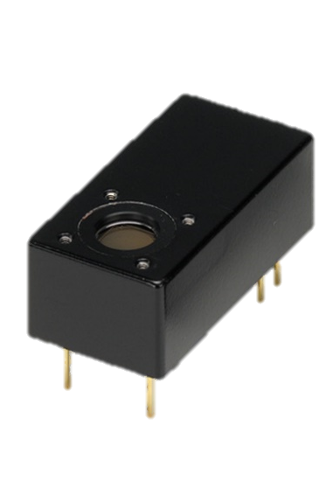
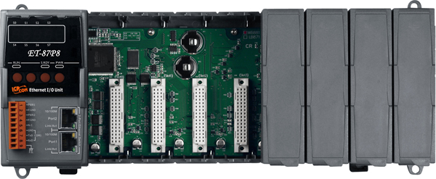

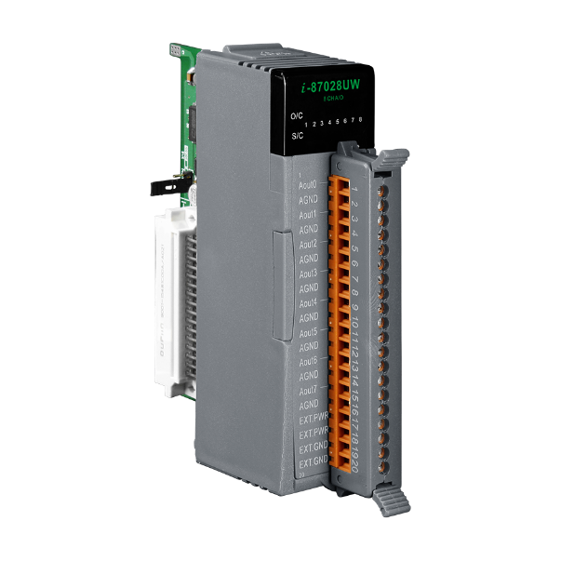
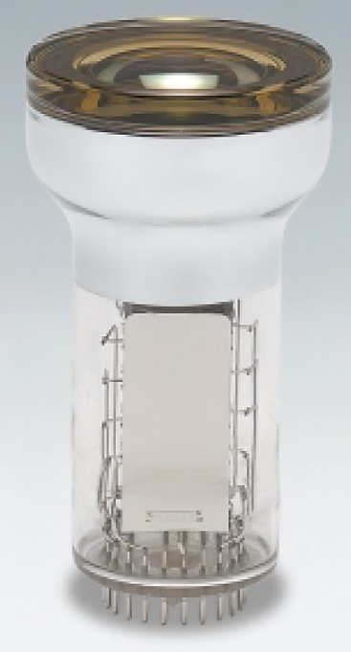
PMTs HV remote control
Remote control with
Crate ICPDAS ET-878P
C0 counter
PMT H10720 x2
Built-in HV power supply
0.5 – 1.1 VDC adjustable
C1, C2 counters
PMT H6780
Built-in HV power supply
0.5 – 1.1 VDC adjustable
Digital to Analog converter
ICPDAS I-87028UW-G
C3 Counter
3” PMT R6091
With Traco DC-DC for HV
0-4 VDC adjustable
Notes:
In order to increase or decrease the amplitude of the analog signal from each PMT, we also use a remotely controlled digital-to-analog converter. PMTs for counters C0-C1-C2 are modular, and already have an embedded high-voltage supply unit, and for PMTs of counter C3, a unit is assembled on a DC-DC converter.

Slide 10
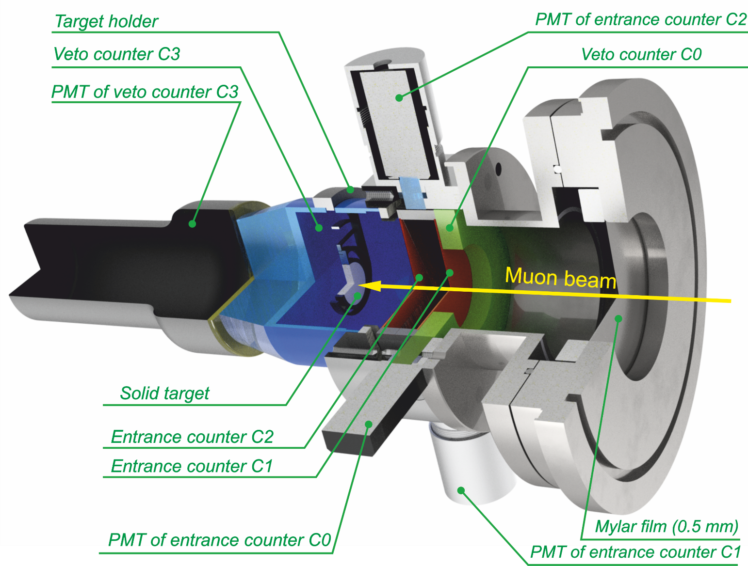
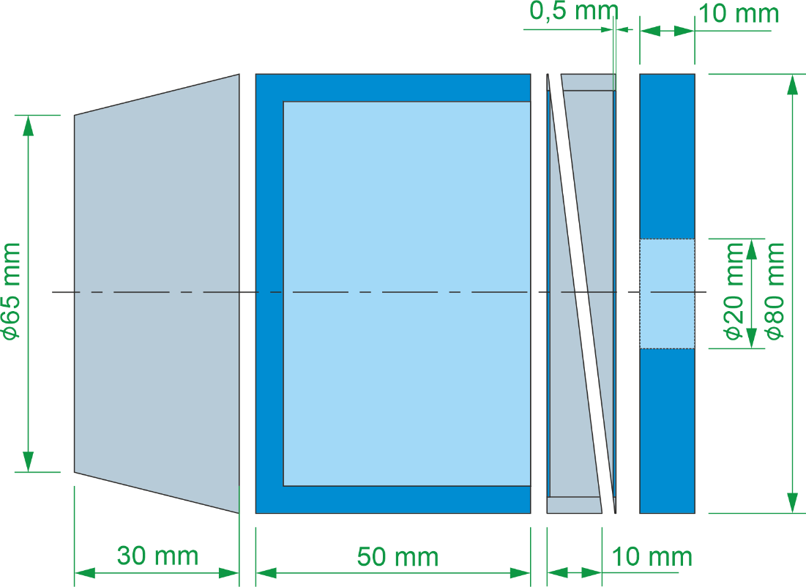
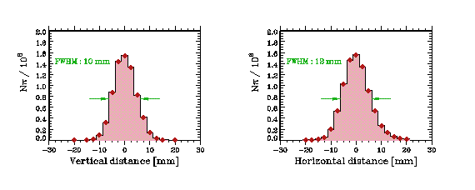
Model of the target (trigger system)
Notes:
Let's move on to a detailed look at the target itself. The slide shows the render in the development environment. Here is the counter C0, and the counters C1 and C2. Next is the cup-shaped counter C3, it contains the isotope under study. PMTs are connected to the corresponding scintillation counter via light guides.

Slide 11
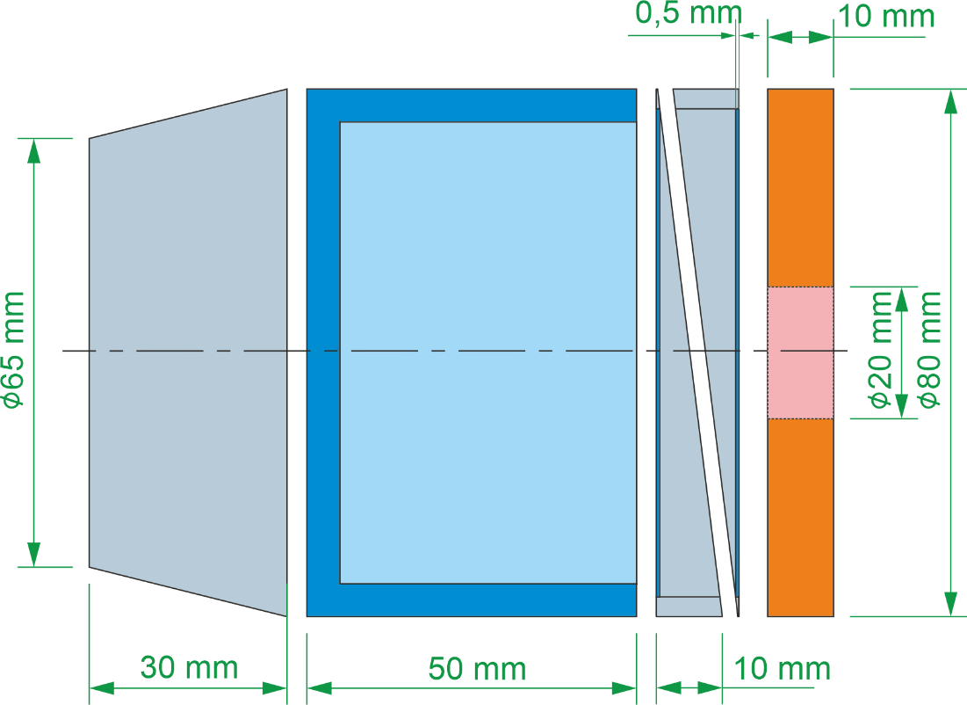
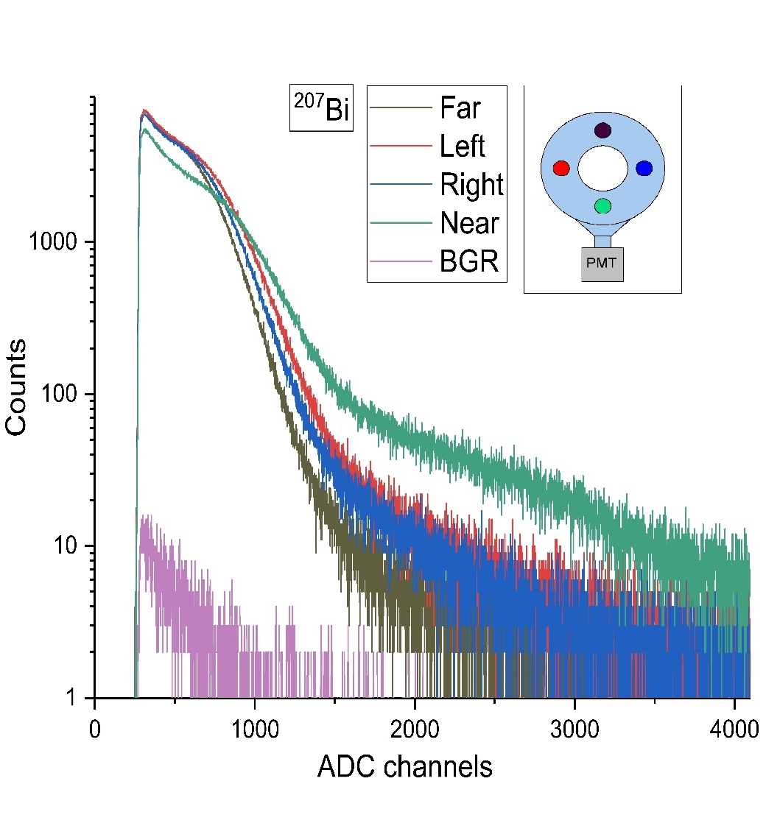
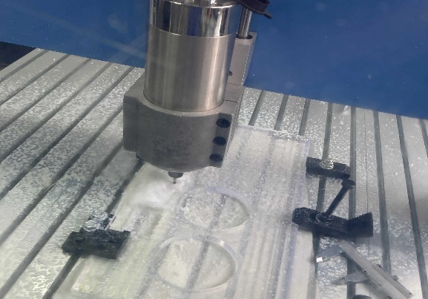
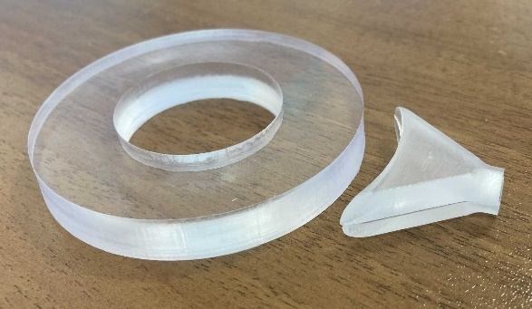

Aperture counter $С_{0}$
C0
D = 80 mm
Dhole=20 mm
HScint = 10 mm
10 mm ring made of plastic scintillator and wrapped into 5 um mylar film.
The counter is attached to modular PMT by “fishtail” lightguide.
Density of lightcollection in different positions less then 30%
Notes:
Before sending all the equipment to Switzerland, we carried out many tests with all elements of the target, including each of the counters. The slide shows the manufacturing process of the C0 counter. This is a plastic scintillator based on polystyrene. We made it on a CNC milling machine, the process is shown. The counter has the shape of a washer, with the following dimensions: Diameter 80 mm, the diameter of the internal hole is 20 mm, and this is made based on the dimensions of the isotope being studied. The thickness of the counter is 10 mm. To improve light collection, it is wrapped with aluminized lavsan. It is viewed by a Hamamatsu H10720 modular photomultiplier. It may seem that the light from the interacting muon at the farthest point may not reach the PMT. We checked this using a collimated 207Bi source. The results are shown on the slide.

Slide 12
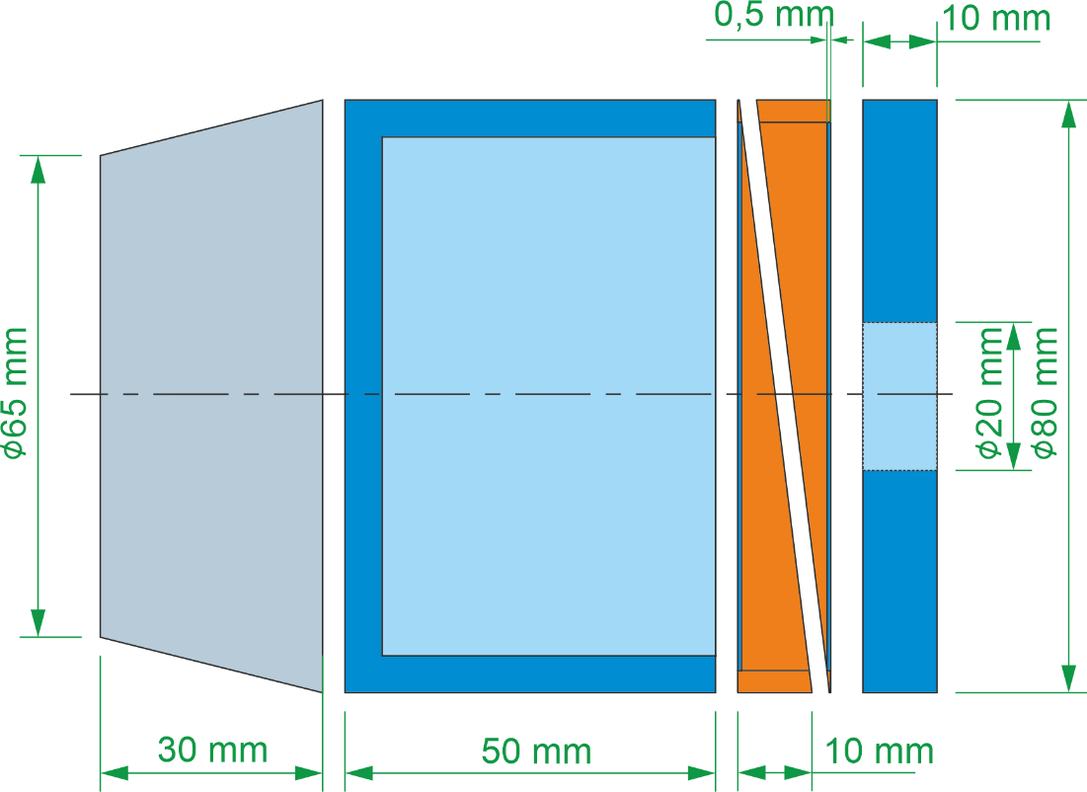
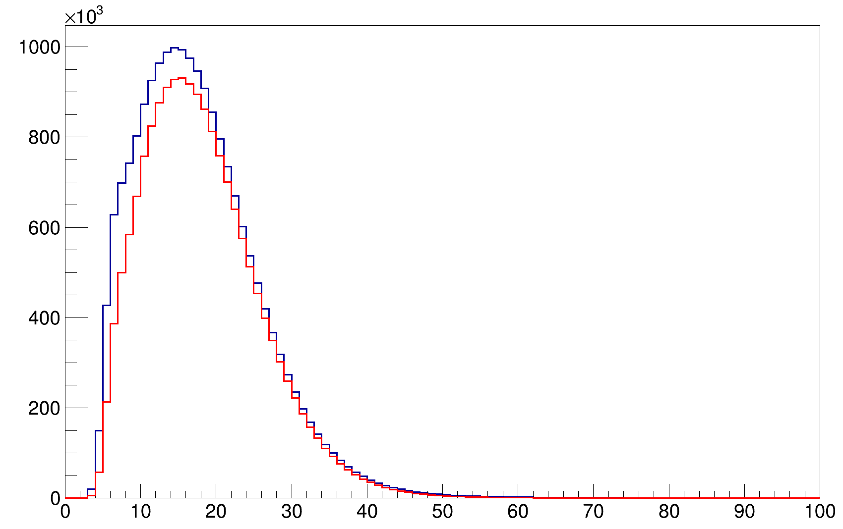
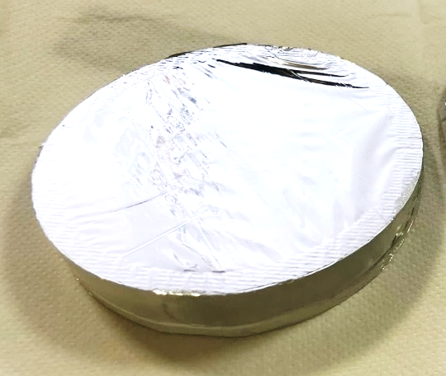
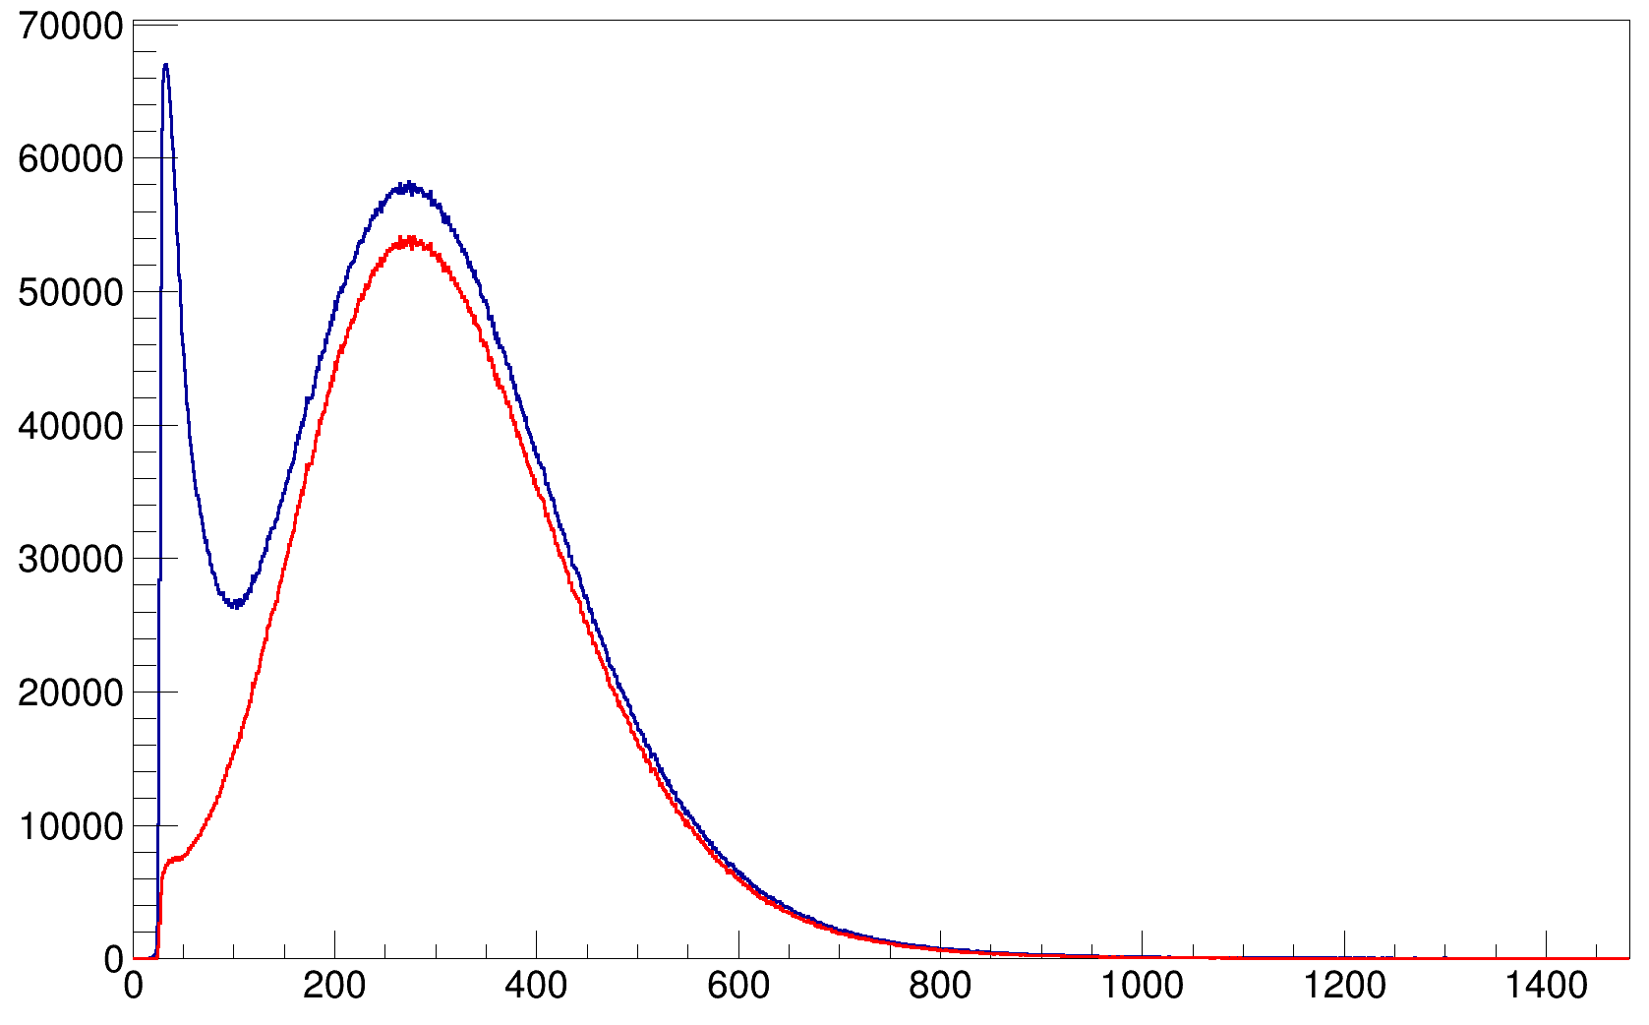
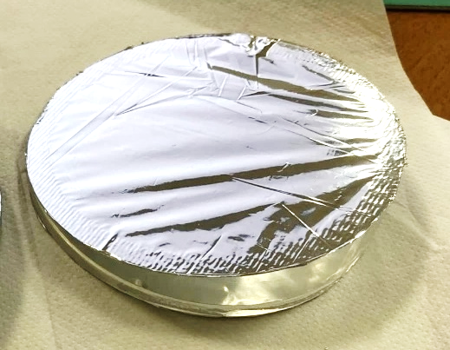

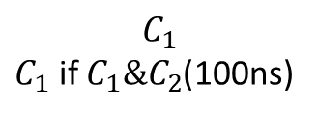
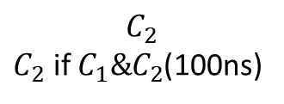
Entrance counters $С_{1}$ и $С_{2}$
$$C_{1}$$
$C_{1}$ if $C_{1}\&C_{2}$(100ns)
Counts
С1 & С2
D = 80 mm
HScint = 0.5 mm
ADC channels
$$C_{2}$$
$C_{2}$ if $C_{1}\&C_{2}$(100ns)
Thin 0.5 mm plastic scintillator circle glued into acrylic lightguide.
The lightguide has ring shape with wedge profile.
The counters are covered with 5 um mylar films and separated by the same thickness from each other.
The counters are readout by modular PMTs individually.
Counts
ADC channels
Notes:
Next come flythrough counters C1 and C2. These are thin disks, 80 mm in diameter and 500 microns thick. The scintillators are glued into wedge-shaped acrylic light guides. Each meter is also wrapped with aluminized mylar to improve light collection and prevent cross-talk between meters. They are also viewed by modular photomultipliers made by Hamamatsu H10721. The slide shows these counters. We performed tests on the efficiency using cosmic muons with these counters. They were placed in a muon telescope with a small solid angle. The registration efficiency was above 95 percent. The energy resolution of these counters, of course, leaves much to be desired, but the task of this detector is different. It needs to work in trigger mode, and there is no talk of any spectroscopy here.

Slide 13
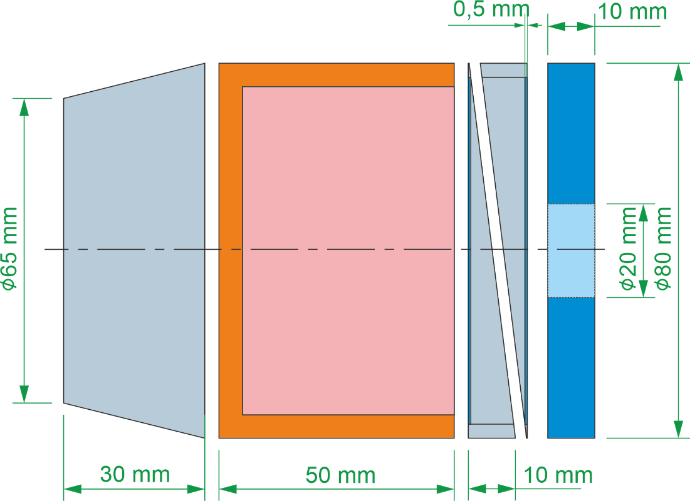
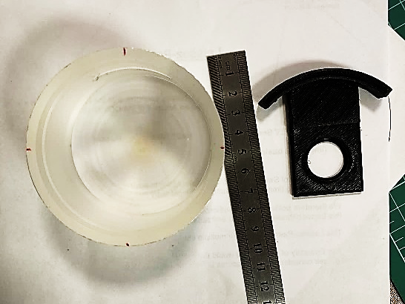
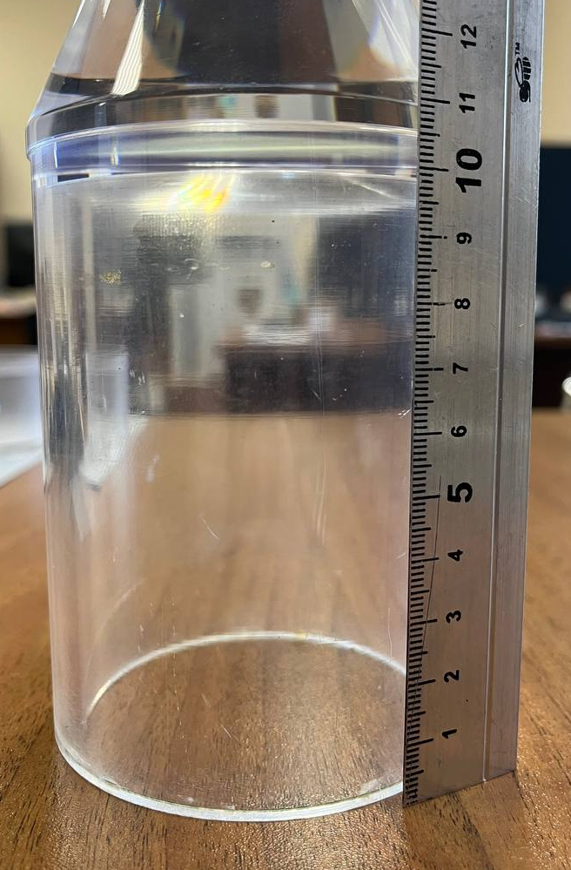
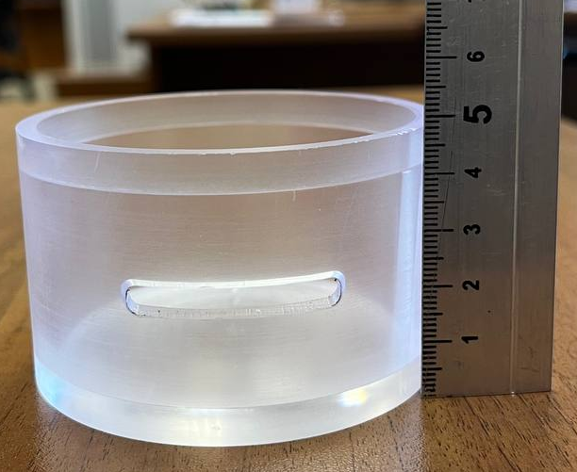

$С_{3}$ counter
Cup-like scintillator surrounding a target holder
Thickness of the C3 counter walls is 5 mm.
A target holder can be inserted through the cut in the wall of С3. The same way for calibration sources.
The counter is attached to R6233 PMT through a light guide made of acrylic
С3 SOLID
D = 80 mm
h = 50 mm
HScint = 5 mm
С3 GAS
D = 80 mm
h = 110 mm
HScint = 5 mm
Notes:
The C3 counter is also made of a plastic scintillator based on polystyrene and has a cup shape. The wall thickness is 5 mm and the diameter is 80. The isotope under study is placed in the center of this counter through a window on the side surface. Also, for calibration measurements of germanium detectors while maintaining geometry, a calibration radioactive source can be placed instead of the isotope under study. The counter is viewed by a classic Hamamatsu R6233 photomultiplier through a light guide. In the case of gases, the geometry of the meter changes slightly, instead of 50 mm, it becomes larger, and there is no more window for introducing calibration sources.

Slide 14
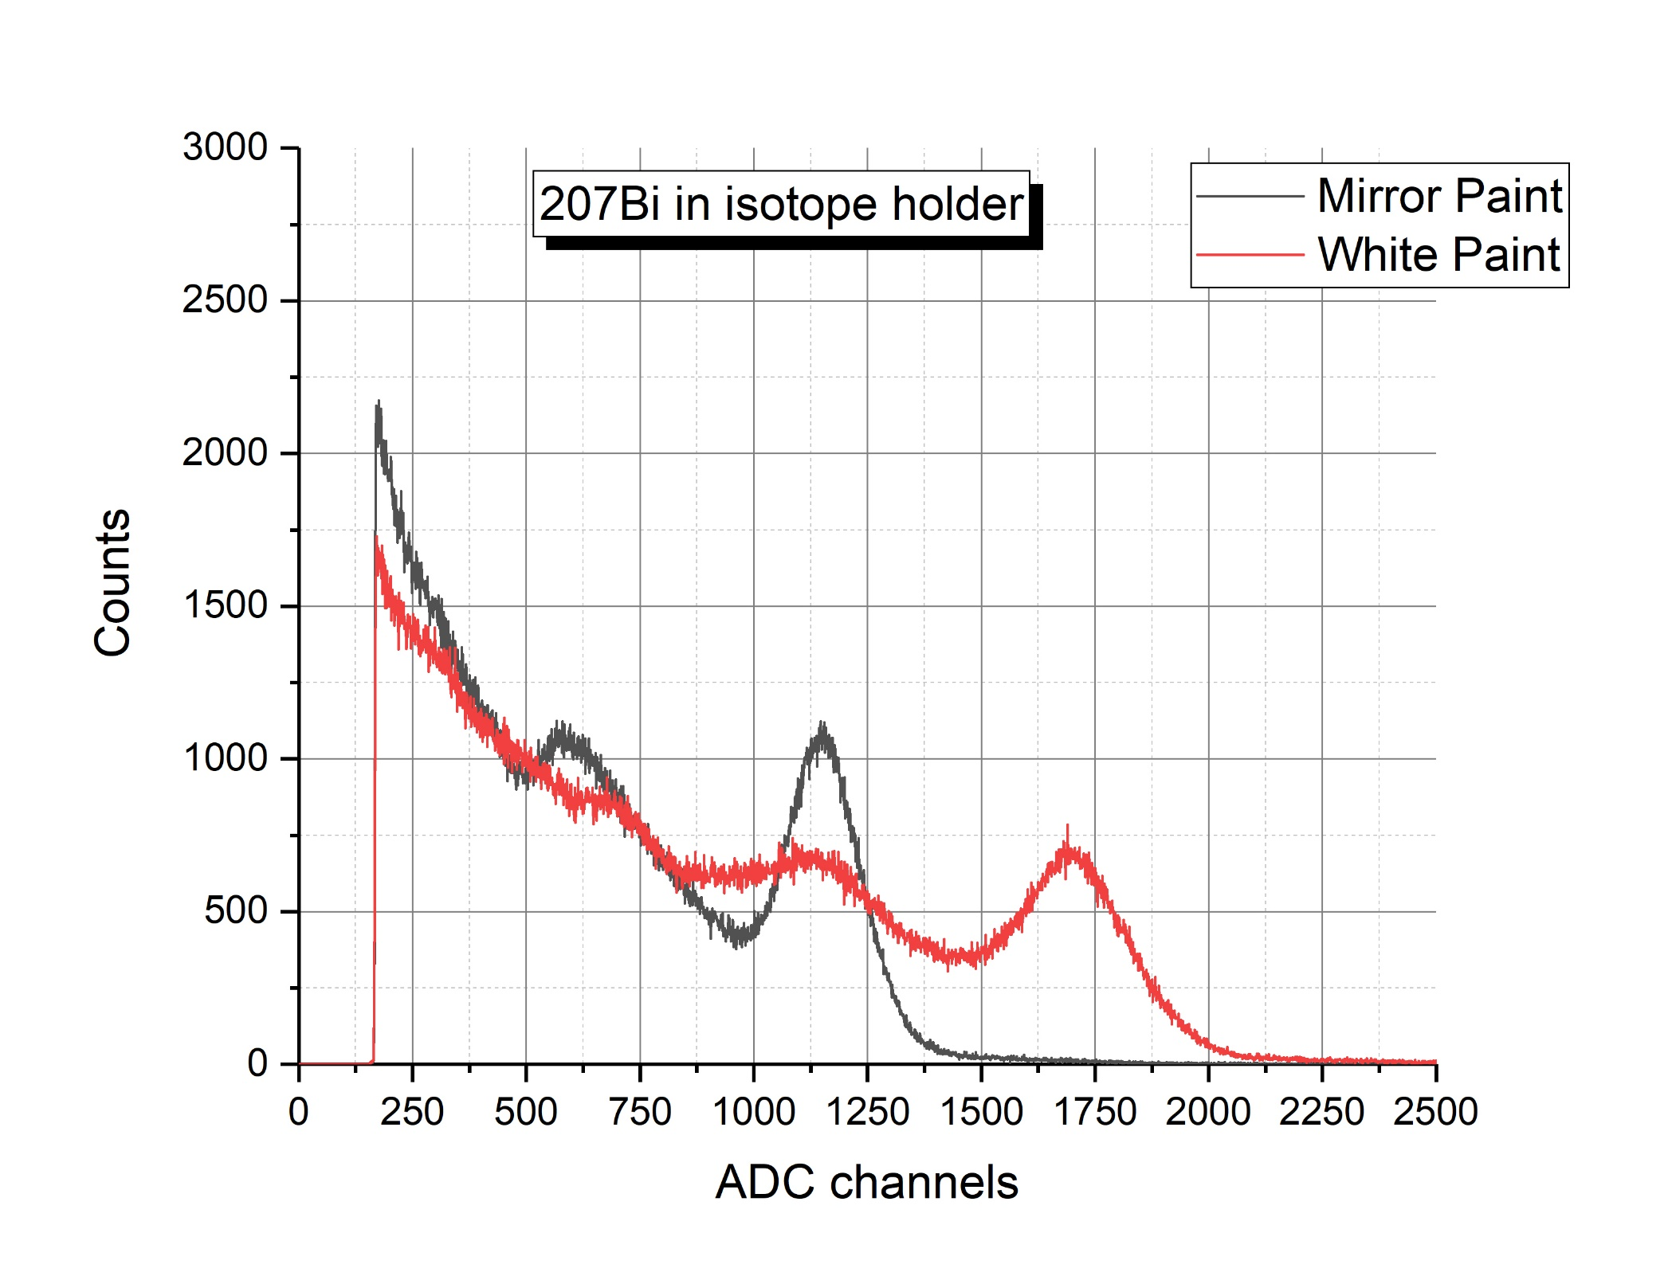
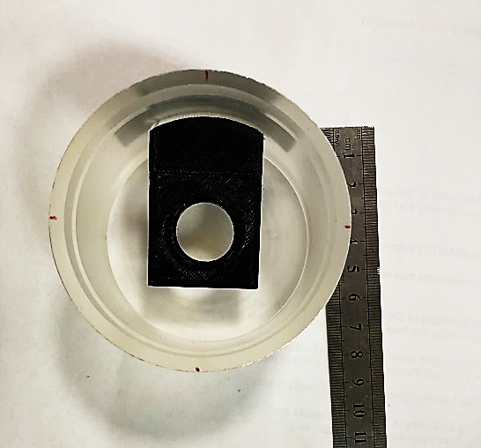
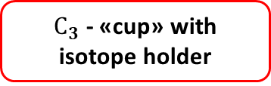


$С_{3}$ counter tests
Place for calibration source or isotop-target
$${}_{}^{207}{Bi}$$
$С_{3}$ - «cup» with isotope holder
Source has been placed on 15 mm from bottom

Slide 15
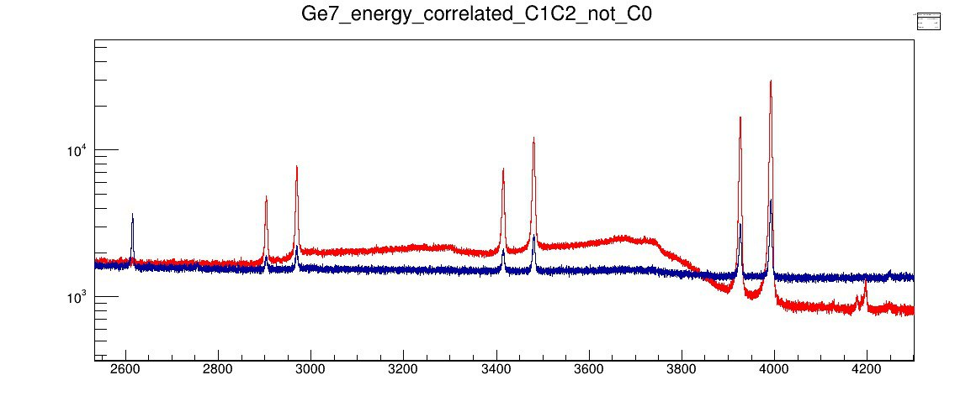
Summary
The muon trigger veto system has been developed and constructed
The system has been used in the experimental campaigns from 2021 to 2023 and performed very well
The results of the analysis show a good separation of the good events form background (as shown in the picture)
The muon trigger system fits well for solid and gaseous materials.
Energy spectra ¹³³Ba
Correlated
Uncorrelated
keV

Slide 16
Thank you for attention!

Slide 17
Back slides

Slide 18
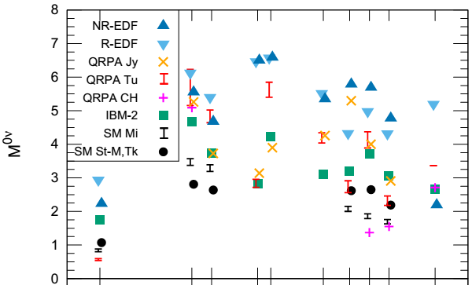

Main idea for research OMC
OMC
target
Notes:
In modern physics, one of the most pressing problems is the problem of determining the nature of neutrinos. The most sensitive process to determining the nature of neutrinos is the process of double neutrinoless beta decay; it is prohibited by the standard model, since it violates the law of conservation of lepton charge. The probability of this hypothetical process can be determined by the formula. From this formula it can be noted that the probability depends not only on the effective Majorana mass of the neutrino and the phase volume factor, but also on the size of the nuclear matrix element. There are several models for calculating NME. The figure shows the value of NME depending on the atomic mass of the nucleus for various models. So, for example, for an atomic mass equal to 136, the NME values ​​differ by a factor of 3 depending on the model. Due to this discrepancy, it is difficult to determine which model is correct, and experimental data is needed to understand this.
When determining the probability of neutrinoless double beta decay, matrix elements are calculated in two stages: through the probabilities of virtual transitions - from the mother nucleus to the intermediate one and from the intermediate nucleus to the daughter nucleus (Fig. 2, and then summation occurs over all excited states of the intermediate nucleus. If a charge-exchange (p,n) reaction can be used to study transitions on the left, then checking transitions on the right using a (n, p) reaction is difficult to achieve. Therefore, it was proposed to use muon capture to study these transitions.

Slide 19
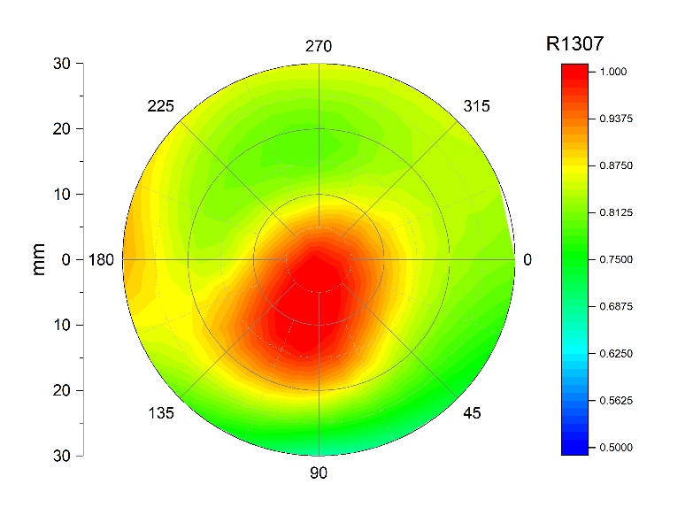
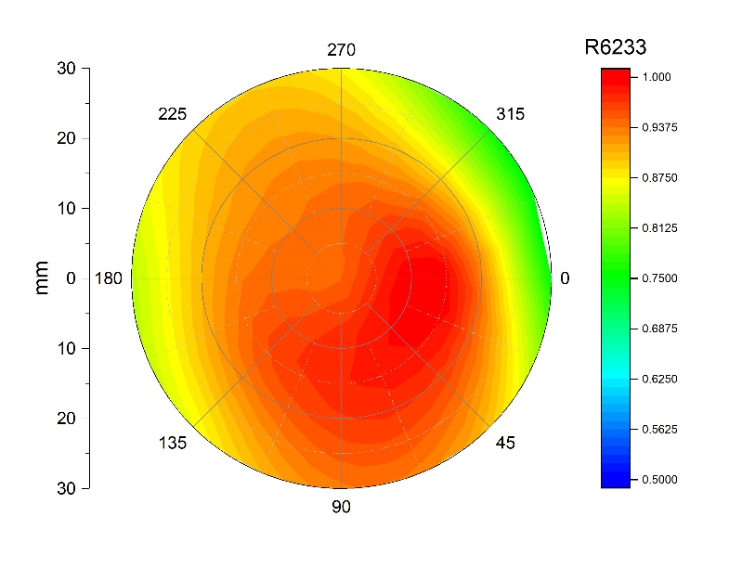
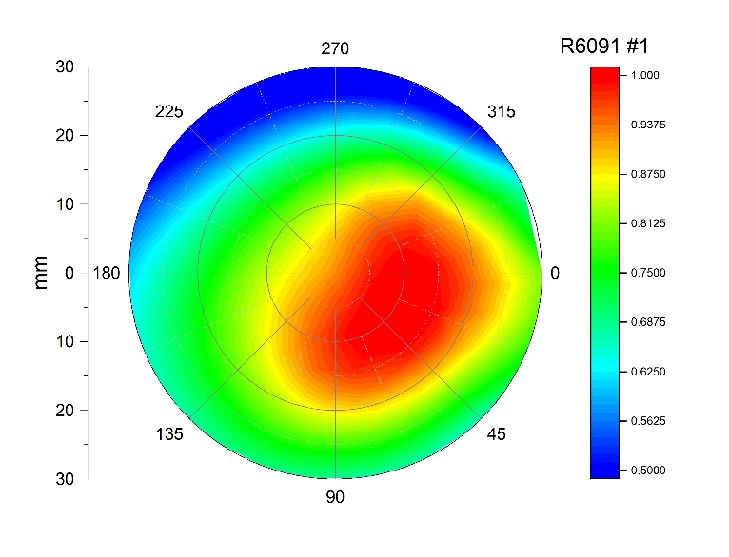
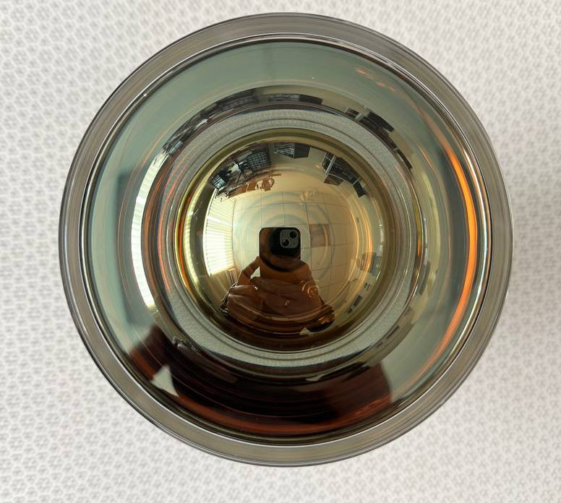
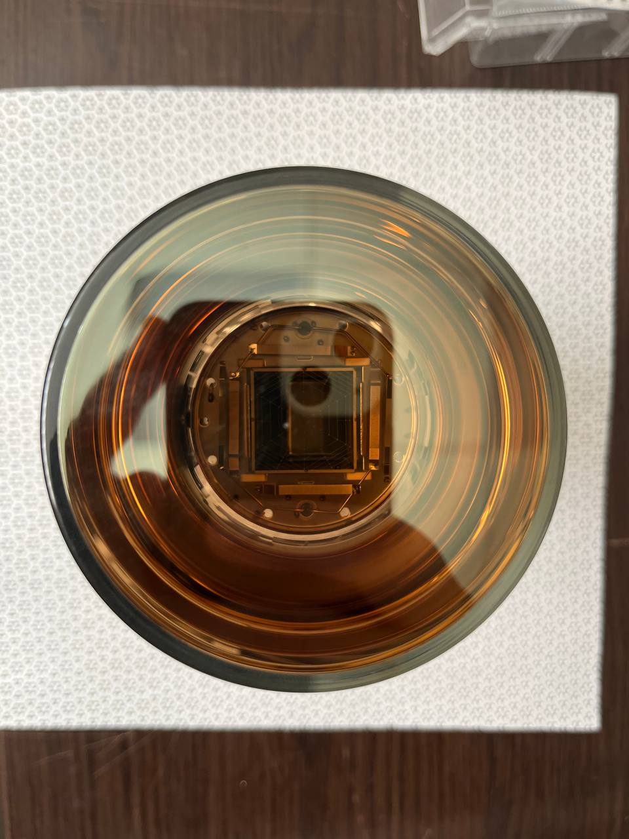
Sensitivities any different PMTs
R6091, max >50%
R1307, max <30%
R6233, max <25%
Х4
Х1
Х1
Notes:
A total of 6 photomultipliers were tested, 4 photomultipliers of the same model that was used in the measurement campaigns and 2 photomultipliers of another model, but with the same photocathode dimensions. And after carrying out a series of measurements, we obtained the following results. On PMT R6091 the maximum heterogeneity exceeds 50 percent, on PMT 1307 the heterogeneity is less than 30%, and PMT6233 turned out to be the most homogeneous. All photomultipliers were placed in the same position for measurements. This may be due to the optical lens that is located in the internal part of the FEU6091.

Slide 20
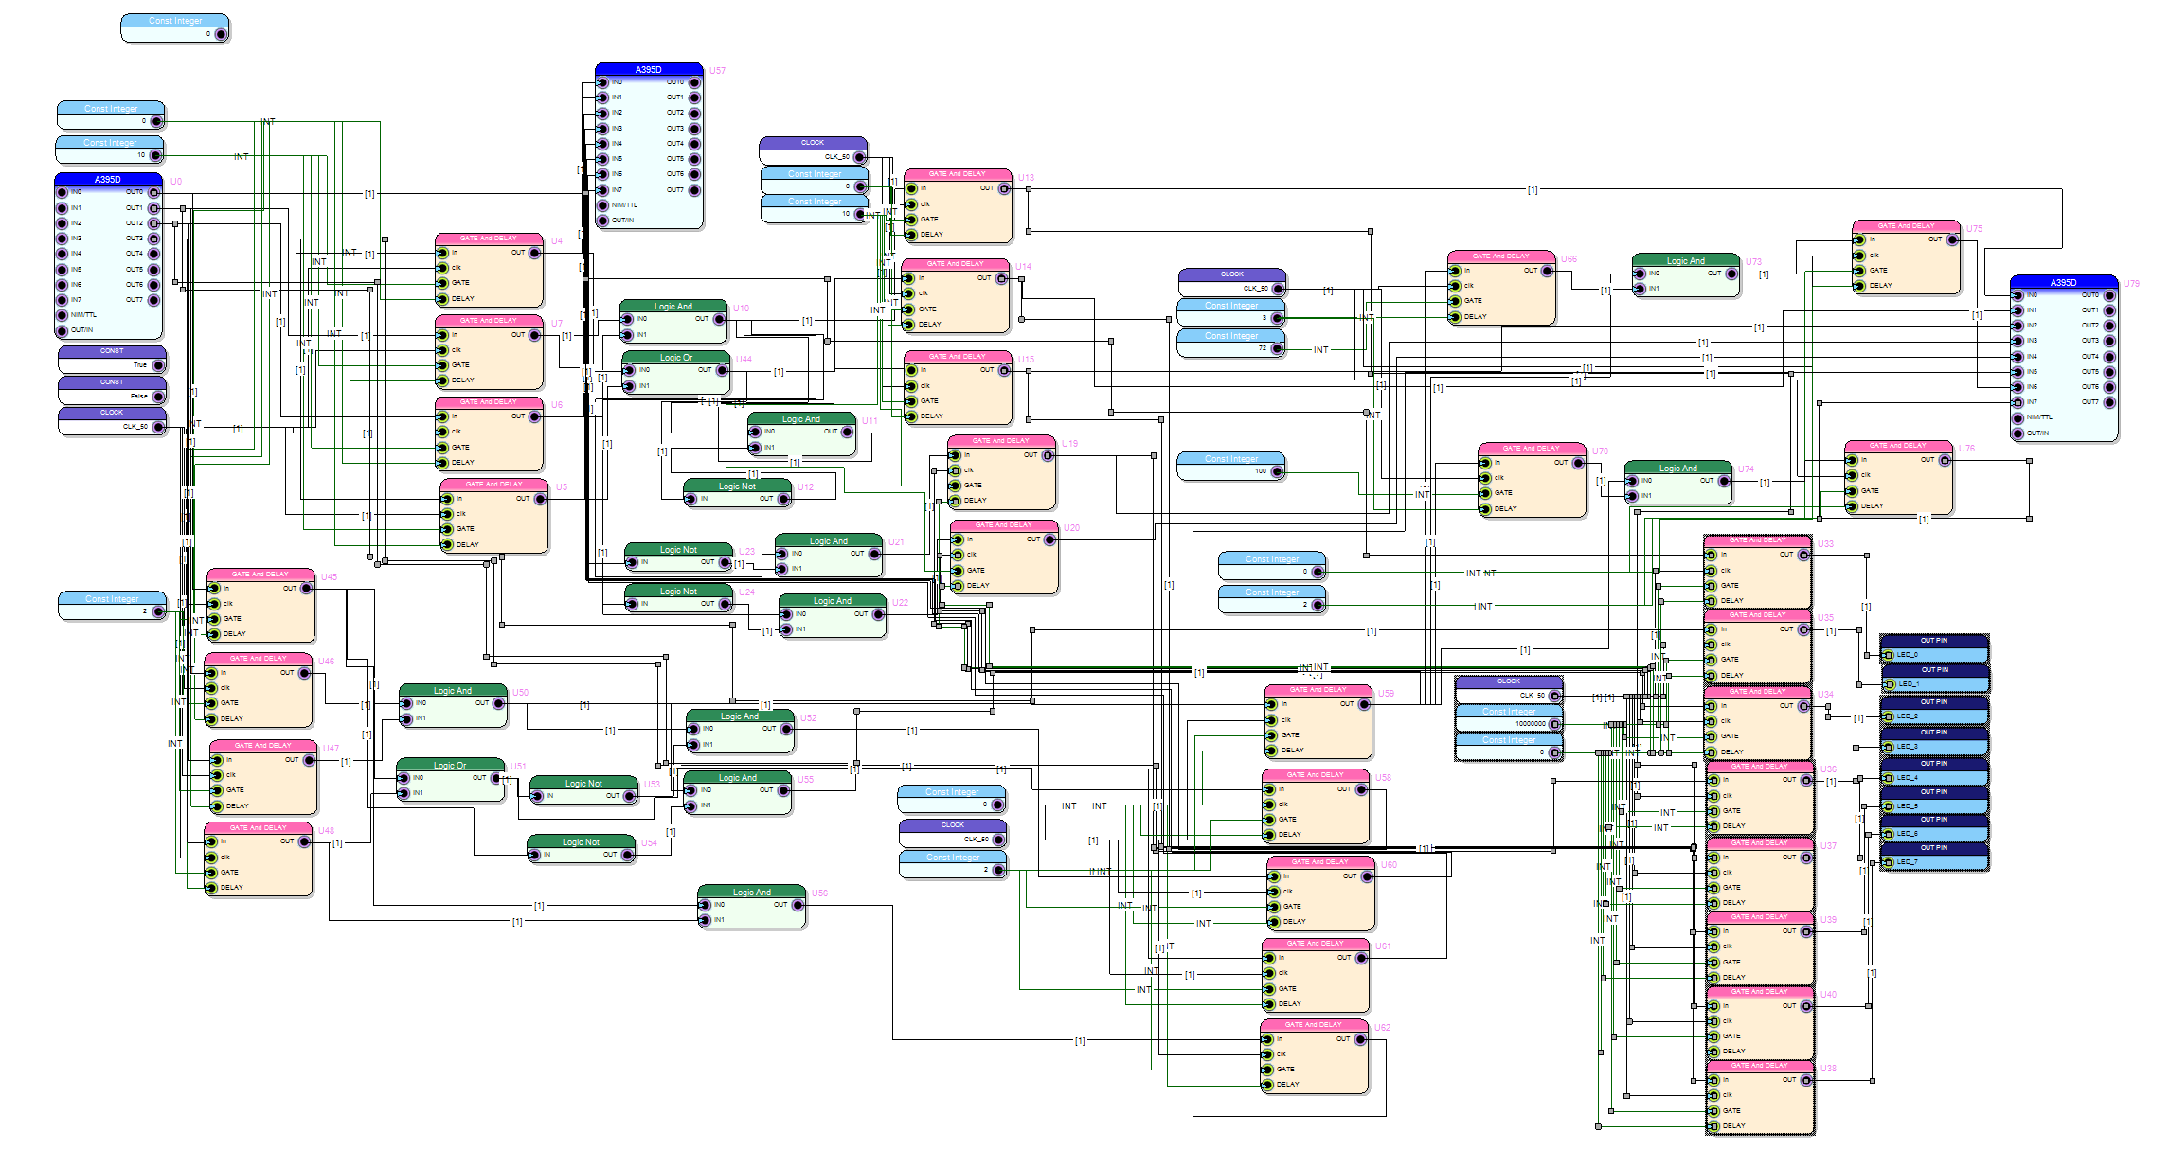
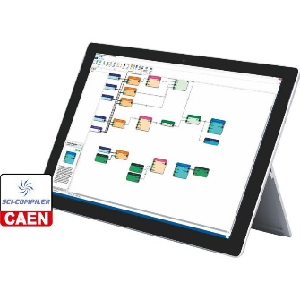
Full logic scheme in FPGA v2495 module
Notes:
The previous slide does not reflect the complexity of the logic circuit, but the current one shows a circuit that is programmed in 2495. Almost every block in this circuit corresponds to an electronic module.

Slide 21
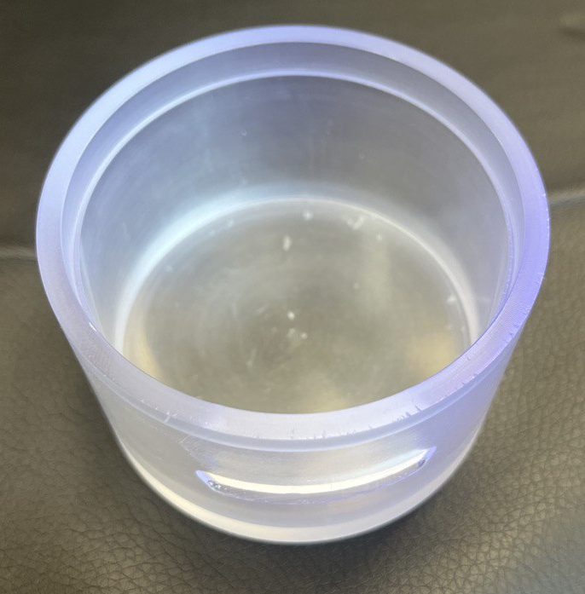
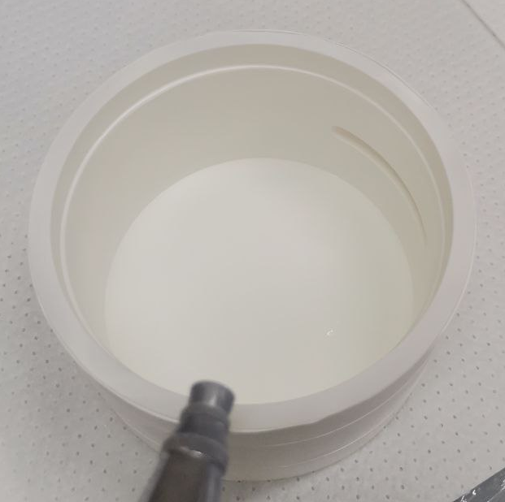
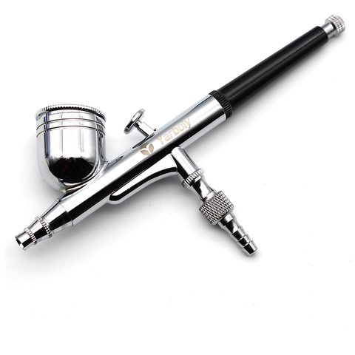



Covering $С_{3}$ mirror/white paint
White – Zinc paint (ZnSO4)
Mirror – Manoukian silver shine M415001K
Notes:
We first tested various coatings on the internal surface of the C3 meter. We made several cups and covered them with two different reflectors. For diffuse reflections we used zinc white and mirror paint. Using a spray gun, we coated the inner surface and conducted tests during a collaboration meeting at TUM.

Slide 22

Software for control HV counters
C2 Counter
Lightguide
C3 CUP
C1 Counter
C0 Counter
Notes:
To control voltages, we also wrote software that does not allow DACs to exceed the maximum permissible values, and voltage logs are also stored. The slide shows a screenshot of the high voltage control program.

