Slide 1
Tellurium-Loaded Organic Scintillators
to Search for
Neutrinoless Double Beta Decay
I. Suslov, I. Nemchenok, A. Klimenko, A. Bystryakov, I. Kamnev
59th Meeting of the PAC for Particle Physics
13 June 2024, Dubna, Russia

Slide 2
Neutrinoless double β-decay
Observation of 0vββ-decay would imply:
lepton number violation;
presence of the Majorana term for neutrino mass;
сonstraints on neutrino mass hierarchy and scale;
hints at origin of matter/antimatter asymmetry.
1. Šimkovic F., et al., Physical Review C 77.4 (2008): 045503.
2. Meija J., et al., Pure and Applied Chemistry 88.3 (2016): 293-306.
2

Slide 3
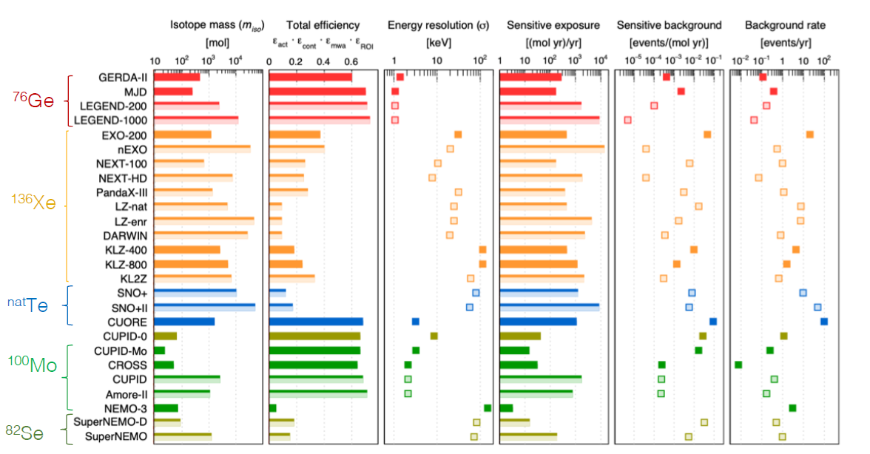
Experiments searching for 0νββ
Fundamental parameters drive the sensitive background and exposure and consequently the sensitivity of recent and future phases of existing experiments [3]
3. Agostini M., et al., Rev. Mod. Phys. 95, 025002
3

Slide 4
Element-loaded organic scintillators in 0νββ search
Element/isotope, concentration | Scintillation base | Element-containing additive | Light yield⁶
Nd, up to 6.5 g/l | PC¹ | 2-Methylvalerate | 80%
¹⁵⁰Nd, up to 20 g/l up to 2 g/l | PC¹ PC¹ | Tris(trimethylhexanoate) Complexes with fluorinated β-diketonates | 90% 62%
Nd, 0.32% | LAB² | 4-Methyloctanoate | 64%
Nd, 1 – 3% | PMMA³ | Complex of Nd(NO₃)₃ with HMPA⁵ | 58 – 25%
Mo, 0.027 – 0.43% | Toluene | Nanoparticles of AMoO₄ (A= Ca, Sr, Ba) | –
Sn, 32.6%, | PC | Tetramethyltin | 57%
Sn, 0.5 – 10% | LAB | Tetrabutyltin | 96% – 55%
Sn, 3 – 15% | Polystyrene | Tetraphenyltin, tributyltin methacrylate | 83 – 37%
Cd, 1.5% | LAB + TBP⁴ | Chloride | 47%
Cd, 0.5 – 2% | PMMA | Complex of CdCl₂ with HMPA | 84 – 67%
Zr, 1.4% | Anisole | Tetrakisisopropylacetoacetate | 30 – 40%
Zr, up to 2.5 g/l | PC¹ | Dipivaloylmethanate | 63%
Zr, 0.33% | Toluene | Nanoparticles of ZrO₂ | -
¹³⁶Xe, ≤ 3% | Decane + PC¹ | Gaseous ¹³⁶Хе | -
Te, 0.5% | LAB | Complex of telluric acid with butanediol hexanediol | 71% 67%
¹ Pseudocumene; ²Linear alkylbenzene; ³Polymethylmethacrylate; ⁴Tributylphosphate;
⁵Hexamethylphosporoamide; ⁶ Relative to unloaded scintillator
4

Slide 5
Why tellurium?
Recent estimations show that almost the only available technique for future mega-projects to search for 0𝜈𝛽𝛽-decay with sources of several hundred tons and more is using liquid scintillators loaded with natural tellurium [4].
High natural abundance (34%) allows using natural tellurium in experiments without expensive enrichment.
The longest half-life of ordinary SM-allowed double beta decay (T_{1∕2} 2𝜈𝛽𝛽 = 8.2 × 10²⁰) among all 𝛽𝛽-candidates minimizes an unavoidable background contribution from the 2𝜈𝛽𝛽 mode in the ROI of 0𝜈𝛽𝛽-decay.
4. Biller S.D. // Physical Review D - 2013. Vol. 87, № 7. P. 071301.
5

Slide 6
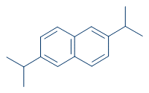
Composition of TeOS. Scintillation base
Scintillation base:
high boiling point;
explosion and fire safety, high flash point;
non-toxicity;
low corrosive activity in relation to the materials of the detector;
availability and low cost.
Linear alkylbenzene [5 – 8]:
Polystyrene [9, 10]:
Diisopropylnapthalene [7]:
5. V. Albanese, et al., JINST. 16 (2021) P08059.
6. W. Beriguete, et al., NIMA. 763 (2014) 82–88
7. C. Buck, et al., JINST. 14 (2019) P01027–P01027.
8. S.J. Haselschwardt, et al., NIMA. 937 (2019) 148–163.
9. Alekseev I. et al., NIMA. (2016) Т. 11, № 11, С. P11011.
10. Arnold R. et al., NIMA. (2005) Т. 536, № 1-2, С. 79-122.
6

Slide 7
Composition of TeOS. Tellurium-containing additives
Requirements for tellurium-containing additives:
solubility in scintillation base;
absence of absorption bands in the visible region of the spectrum;
stability to hydrolysis, atmospheric oxygen and other environmental factors;
compatibility of different detector materials;
feasibility of large-scale production;
non-toxicity, explosion and fire safety.
(a) Hexanoate
(c) Te(But)₂
R = -CH(C₂H₅)(CH₂)₃CH₃
(b) Complex
7

Slide 8
Scintillation characteristics.
Comparison with other TeLS
TeLS sample | Scintillation composition | Light yield¹, rel. units
Hexanote [11] | 0.5% Te, 1% PPO, 0.04%POPOP, 30% DIPN | 0.72±0,03
 | 1% Te, 2% PPO, 0.04%POPOP, 30% DIPN | 0.58±0,03
Complex [12] | 0,5% Te, 0.5% PPO, 0.0025%POPOP | 0.73±0,04
 | 1% Te, 0.5% PPO, 0.0025% POPOP, 30% DIPN | 0.71±0,03
Te(But)₂ | 0,5% Te, 0.5% PPO, 0.0025% POPOP, 1% octylamine | 0.63±0,03
 | 1% Te, 1.5% PPO, 0.0025% POPOP, 2% octylamine | 0.54±0,03
IHEP CAS² [13] | 0.6% Te, 2,5 g/l PPO, 3 mg/l bis-MSB | ~0,65
SNO+³ [14] | 1% Te, 6 g/l PPO | ~0,65
¹Relative to unloaded LS
² Tellurium in form of complex telluric acid with hexanediol-1,2 and N,N-dimethyldodecylamine
³ Tellurium in form of complex telluric acid with butanediol-1,2 and N,N-dimethyldodecylamine
11. I. Suslov, et al., NIMA 1040 (2022): 167131.
12. I. Suslov, et al., PEPAN Letters, 250 (2023): 1187-1190
13. Ding Ya-Yun, et al., NIMA 1049 (2023): 168111.
14. Auty, D. J., et al., NIMA 1051 (2023): 168204.

Slide 9
Scintillation characteristics.
Stability of TeLS
(a)
(b)
Stability of the light yield (a) and the transparency (b) for TeLS samples with a 1%-Te content of different tellurium-containing additives
9

Slide 10
TePS with complex of diphenyltellurium oxide and D2EHPA.
Scintillation characteristics
0
0,1
0,25
0,5
0,75
1
1,25
1,5
Tellurium concentration, %
Te, % | T_{λ=430 нм} ±1, %
0 | 87.5
0.1 | 81.3
0.25 | 79.6
0.5 | 79.2
0.75 | 79.3
1.0 | 75.9
1.25 | 75.9
1.5 | 73.5
Light yield as a function of tellurium concentration (relative unloaded plastic scintillator) and transparency at λ=430 nm (optical path – 1 cm, relative to air) of TePS with complex and constant concentration PPO, POPOP (1.5%, 0.015%, respectively)
10

Slide 11
Conclusion
— For the first time, diphenyltellurium dicarboxylates, a complex compound of diphenyltellurium oxide with di-(2-ethylhexyl)phosphoric acid and tellurium dibutanediol-1,2-ate have been proposed for the use as tellurium-containing additives.
— A series of new TeLSs with a tellurium concentration of up to 3% has been developed, with good scintillation and optical properties.
— A several-month-lasting stability of liquid scintillator properties has been proven.
— For the first time in the world, plastic tellurium-loaded scintillators have been obtained. Scintillation and optical properties of the materials developed allow us to recommend them for the use in large-scale detectors to search for neutrinoless double β-decay.
11

Slide 12
Backup
12

Slide 13
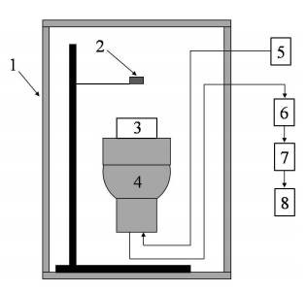
Measurement technique
Light yield:
Experimental conditions:
Teflon cuvette with uviol glass;
volume – 40 ml, height – 2 cm;
²⁰⁷Bi;
subtractive measurement method.
Block diagram of the installation for measuring the LS light yield and energy resolution: 1 – light-tight box; 2 – radioactive source; 3 – cell with LS; 4 – PMT; 5 – high-voltage source; 6 – preamplifier; 7 – amplifier; 8 – signal converter
UV-VIS spectra: UNICO UV 2804 in a 10-cm cuvette relative to air at a wavelength of 390 to 600 nm.
Tellurium-containing additives: UV-VIS, IR, Raman spectroscopy, elemental analysis (C, H, Te), Differential Scanning Calorimetry (melting point), ICP-AES (MS) (in plans)
13

Slide 14
Scintillation characteristics.
Absolute light yield
LS sample | Scintillation composition | Absolute LY, photons/MeV | Evaluation method
unloaded LS | 0.5% PPO, 0.0025%POPOP | 8646±400 | Relative to EJ-309²
TeLS | 0.5% Te¹, 1% PPO, 0.04% POPOP, 30% DIPN | 6399±320 | Relative to EJ-309
TeLS | 1% Te¹, 2% PPO, 0.04% POPOP, 30% DIPN | 5128±256 | Relative to EJ-309
RENO | 0.3% PPO, 0.0030% bis-MSB | ~8000 | Relative to anthracene
Daya Bay | 0.3% PPO, 0.0015% bis-MSB | 8700 | Relative to anthracene
Stereo | 0.3% PPO, 0.0020% bis-MSB | 8400 | Quantum efficiency of PMT
¹di-2-ethylhexanoate diphenyltellurium
²LS based on diisopropylnapthalene with light yield of 12.300 photons/ 1 MeV e⁻
14

Slide 15
Synthesis of tellurium-containing additives
15

