Slide 1
Status of the Ricochet experiment
Dmitrii Ponomarev

Slide 2
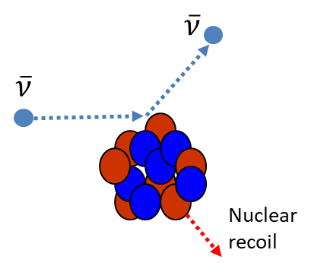
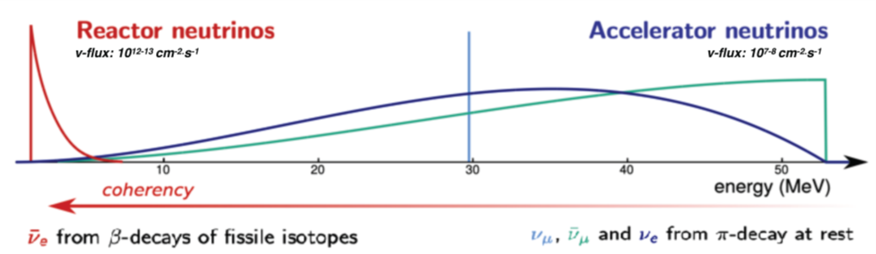
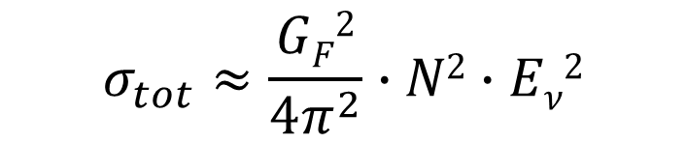
$$σ_{tot}≈\frac{GF2}{4π^{2}}∙N2∙Eν2$$
²
₌ 2𝐸 (1−𝑐𝑜𝑠𝜃)
𝐸
_{𝐴}
2𝑀𝐴
A gateway to new physics
Non-Standard Interaction
Existence of new massive bosons
Neutrino Magnetic Moment

Slide 3
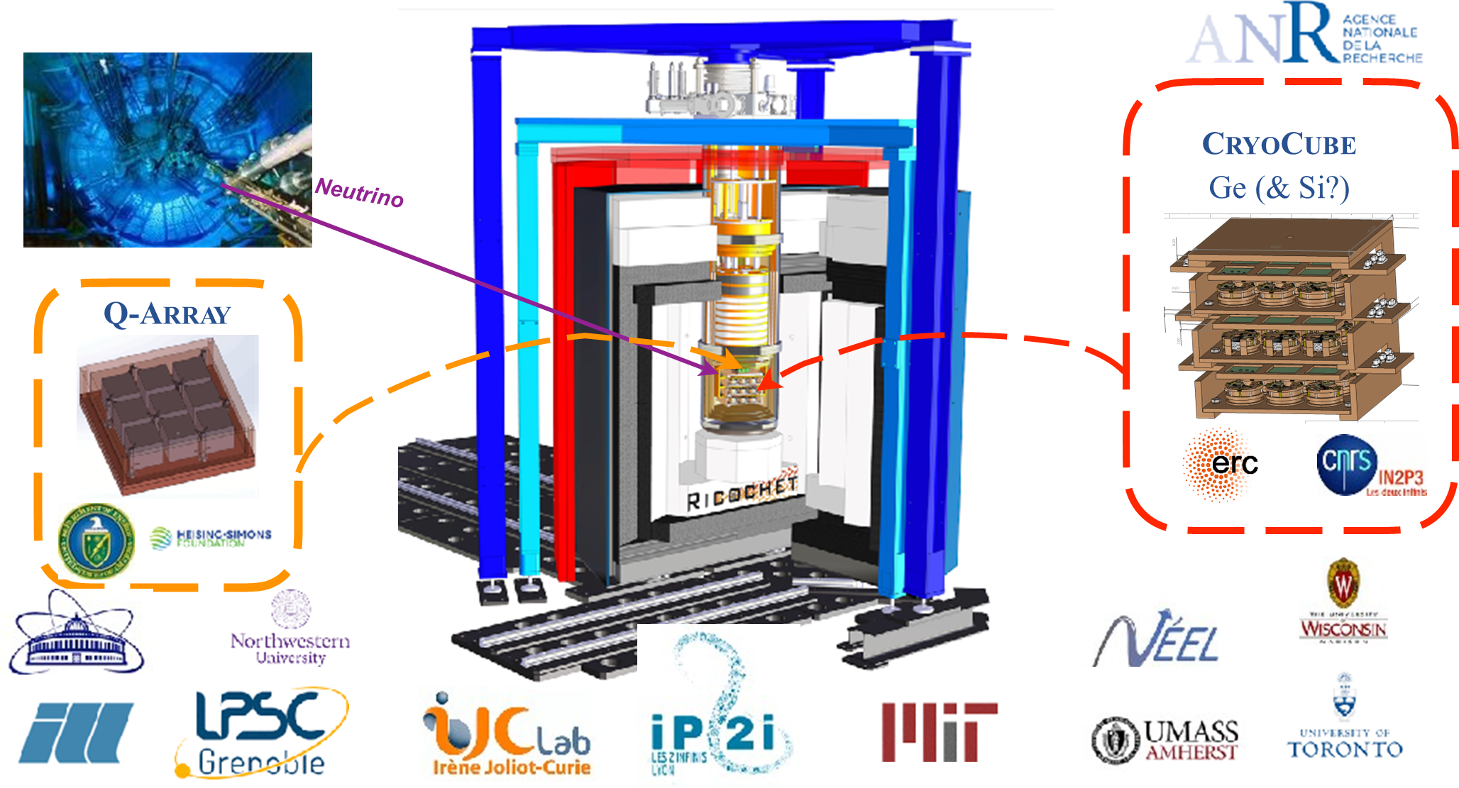

Slide 4
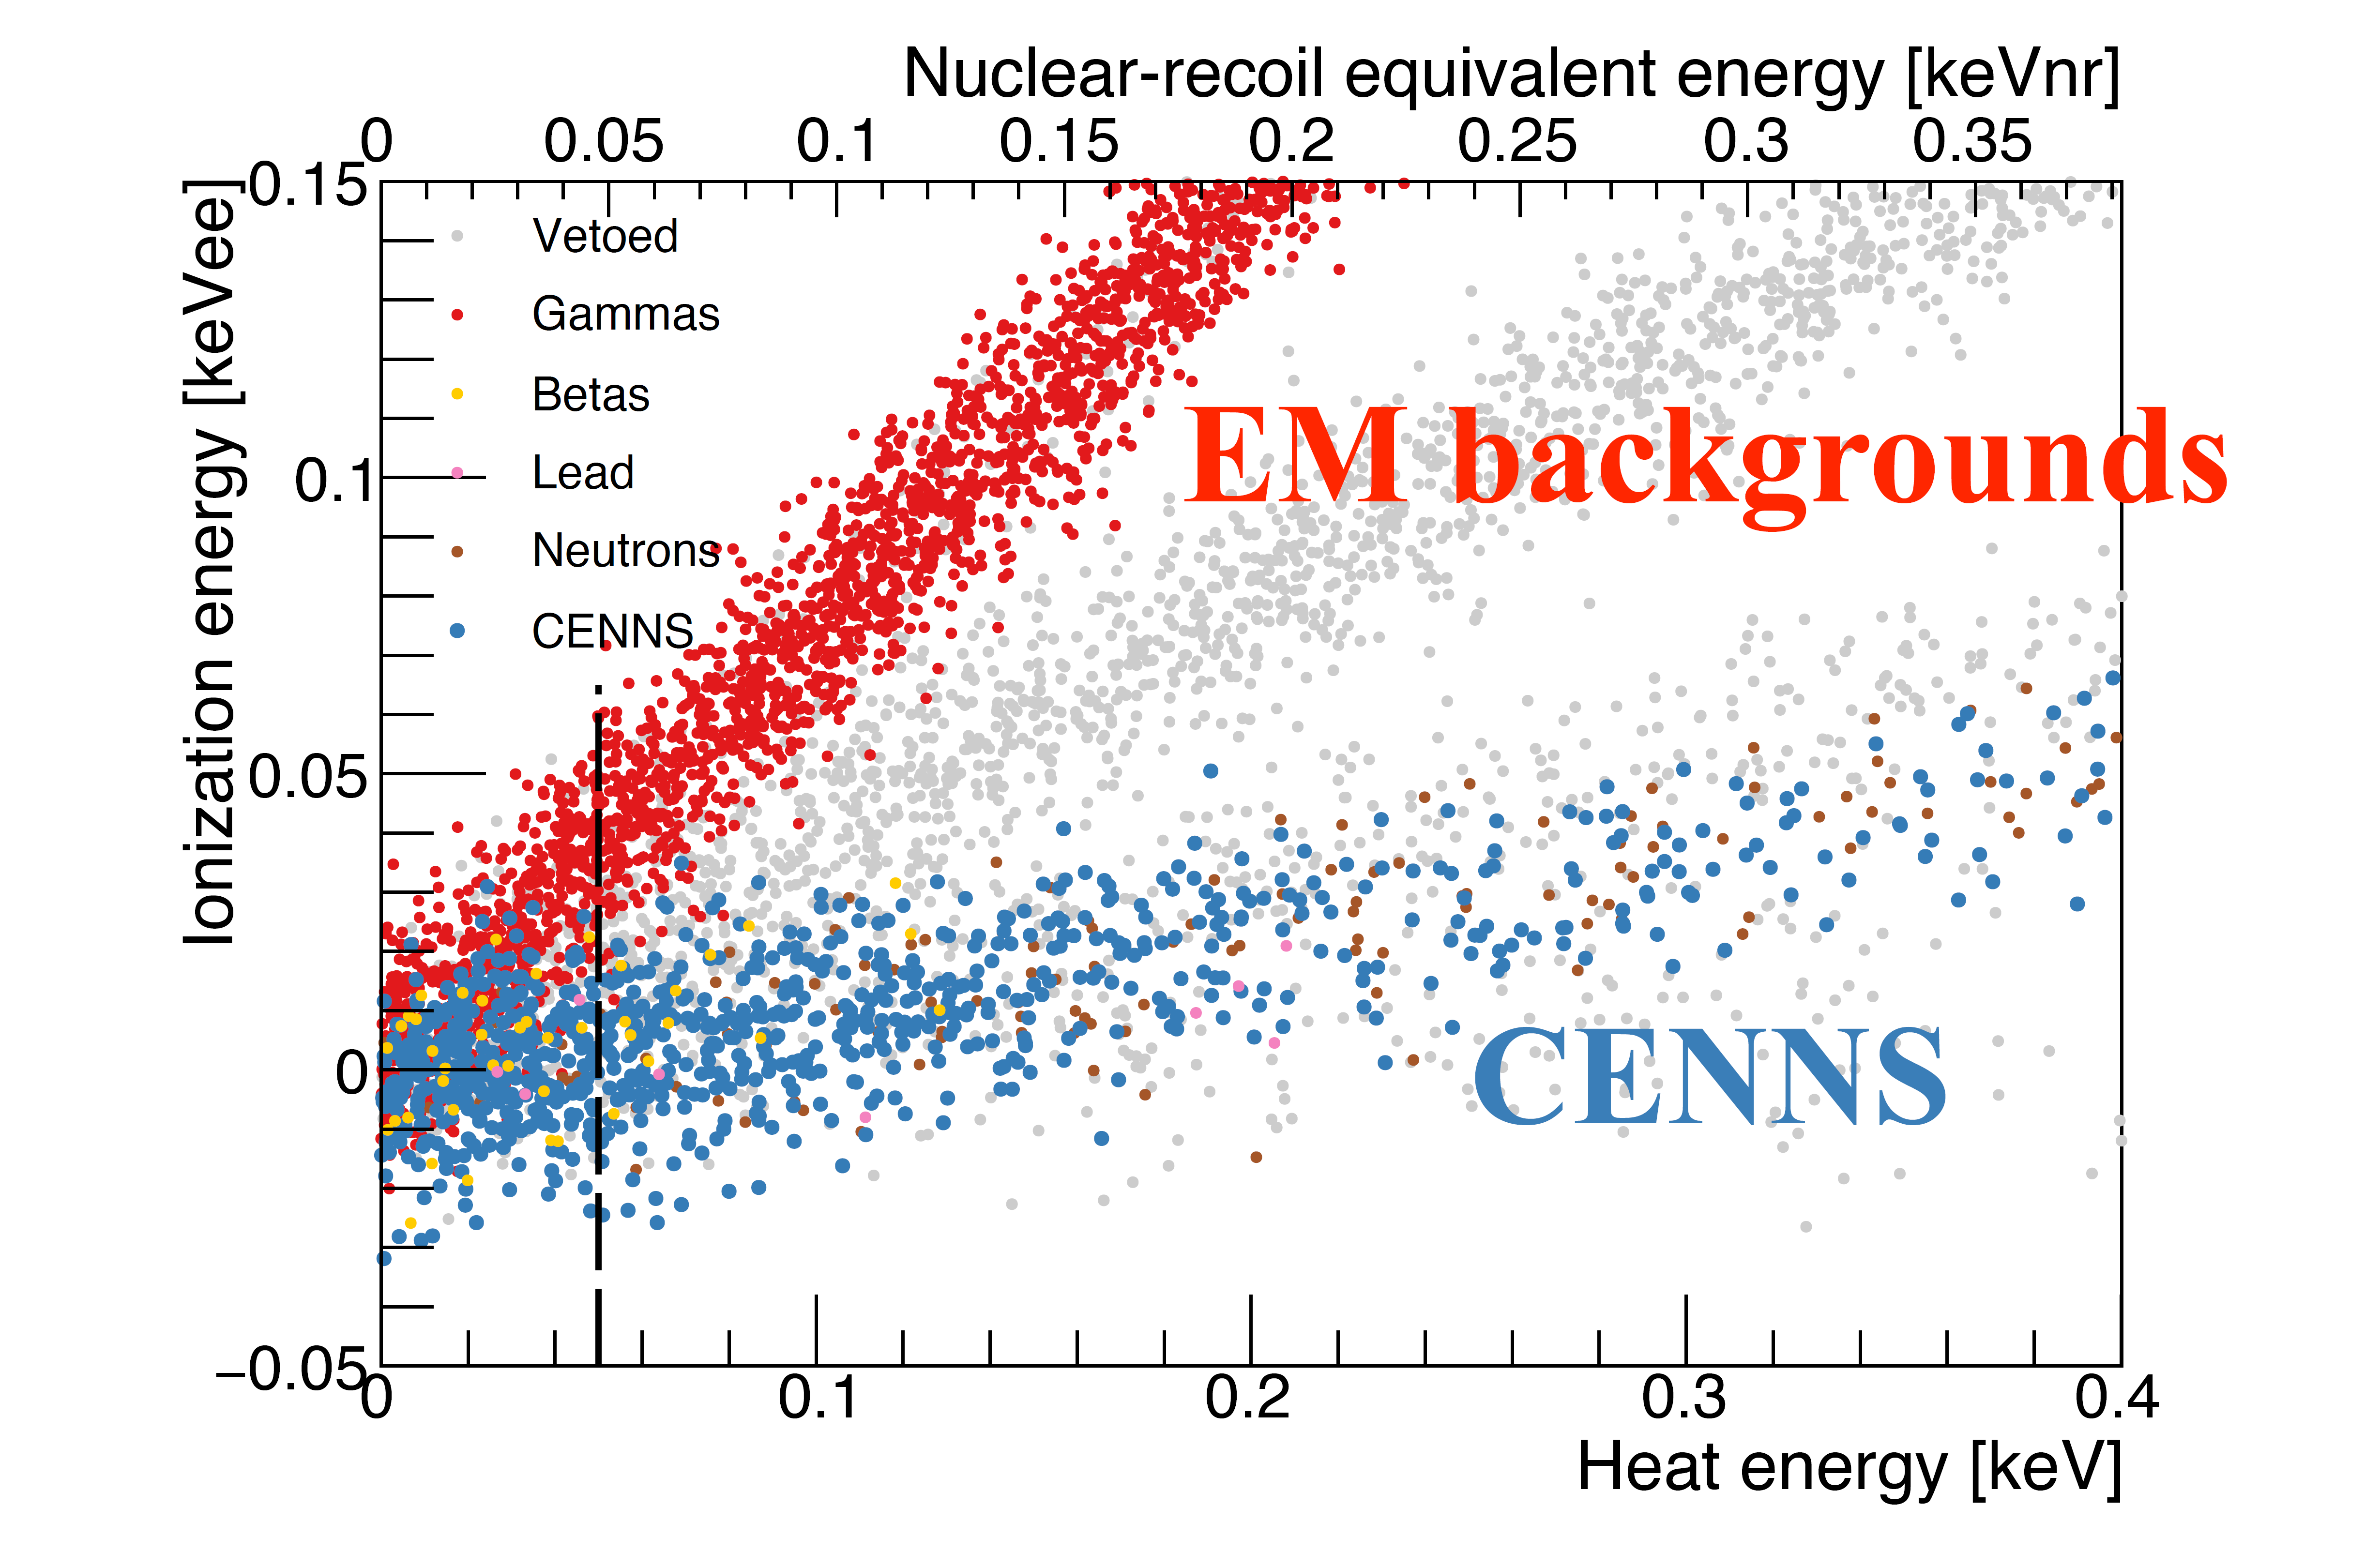
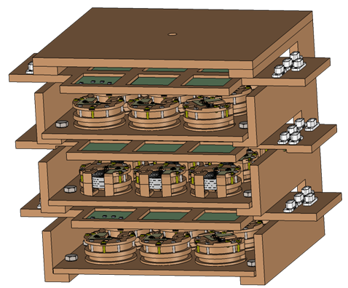
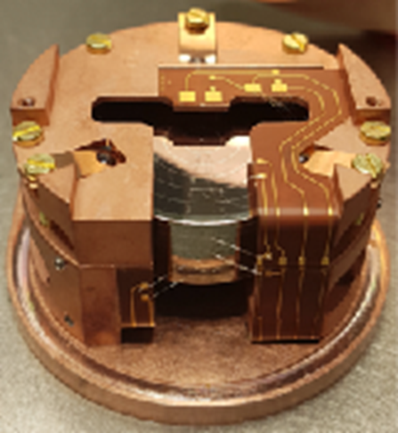
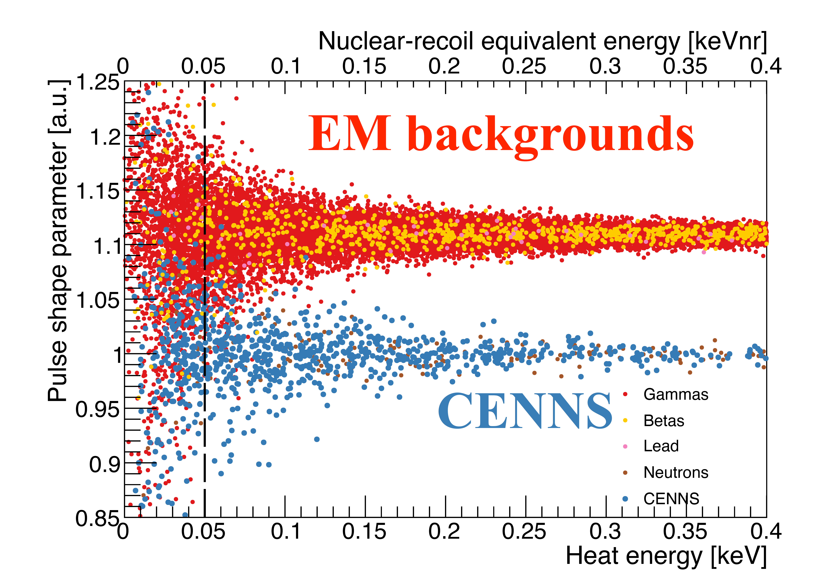
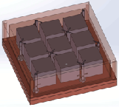
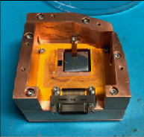
Detector technology
Key features of RICOCHET: Particle Identification down to sub-100 eV
Germanium semiconductor
CryoCube:
Array of 18 38-g Ge detectors (~700 g)
Particle ID based on Ionization / Heat ratio
CEνNS
Zinc superconducting metal
Q-Array:
Array of 9 32-g Zn detectors (300 g)
Particle ID based on
Prompt / delayed heat signals
CEνNS

Slide 5
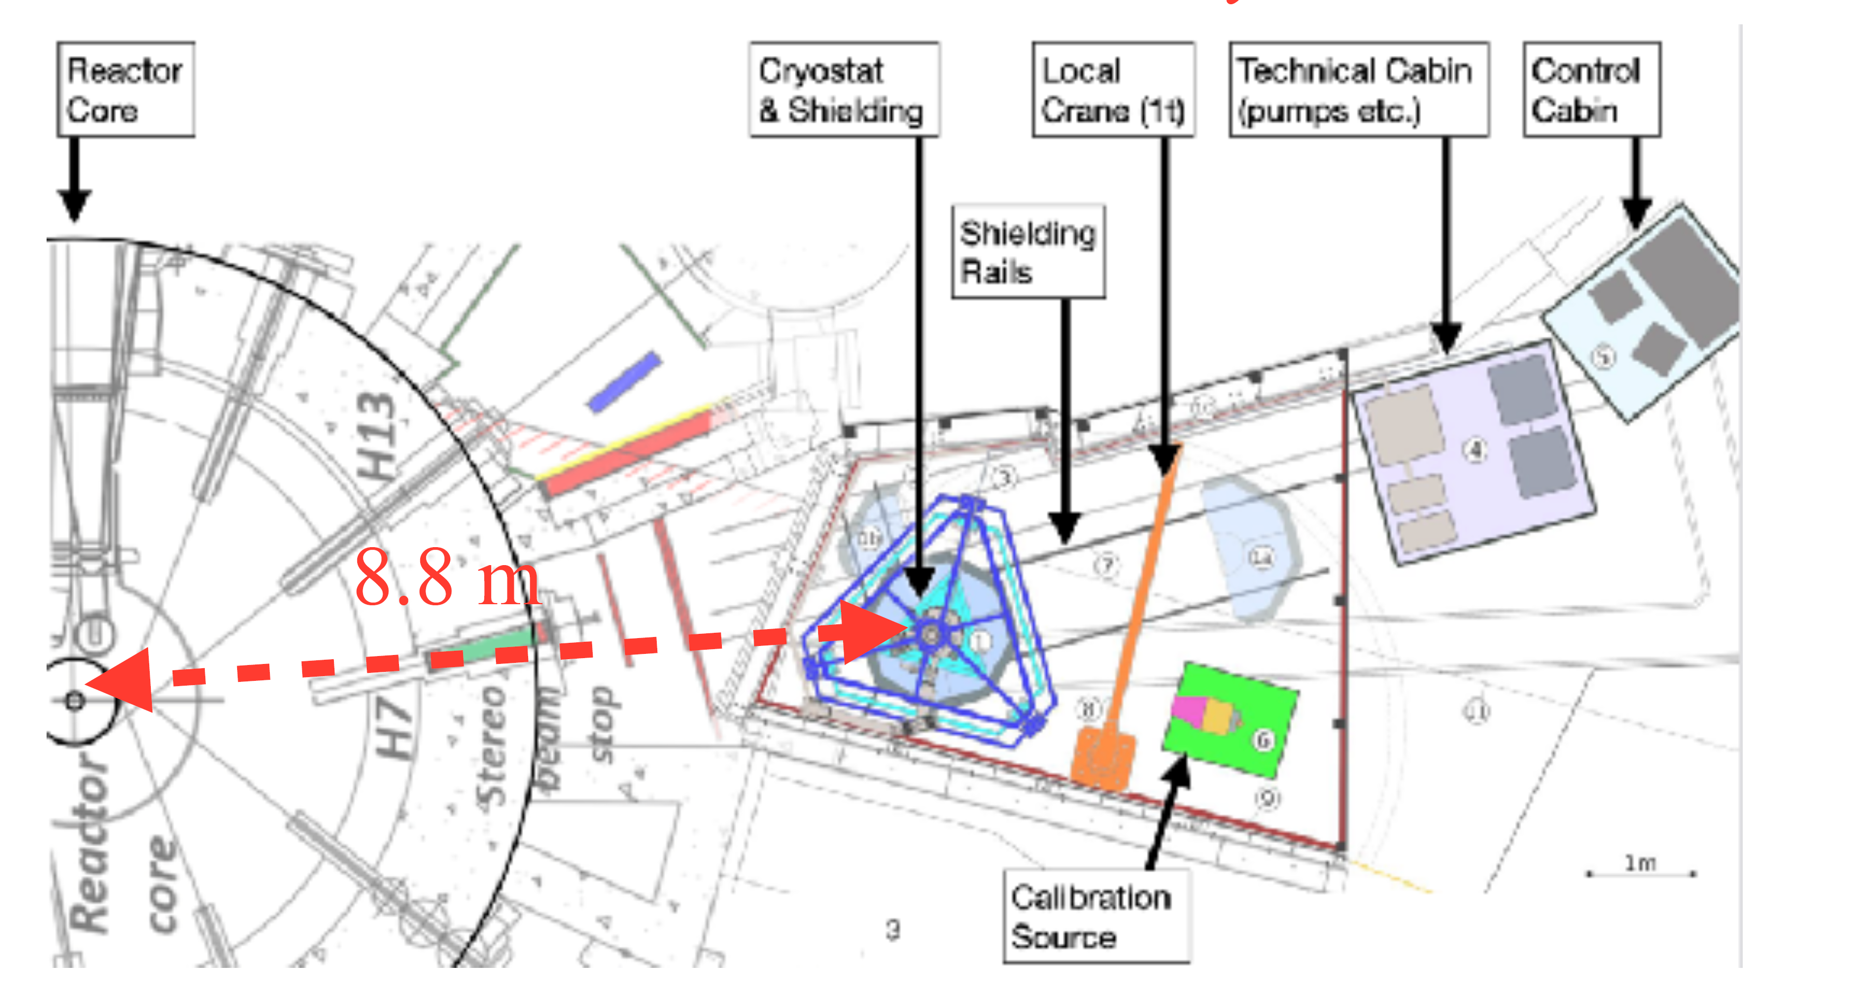
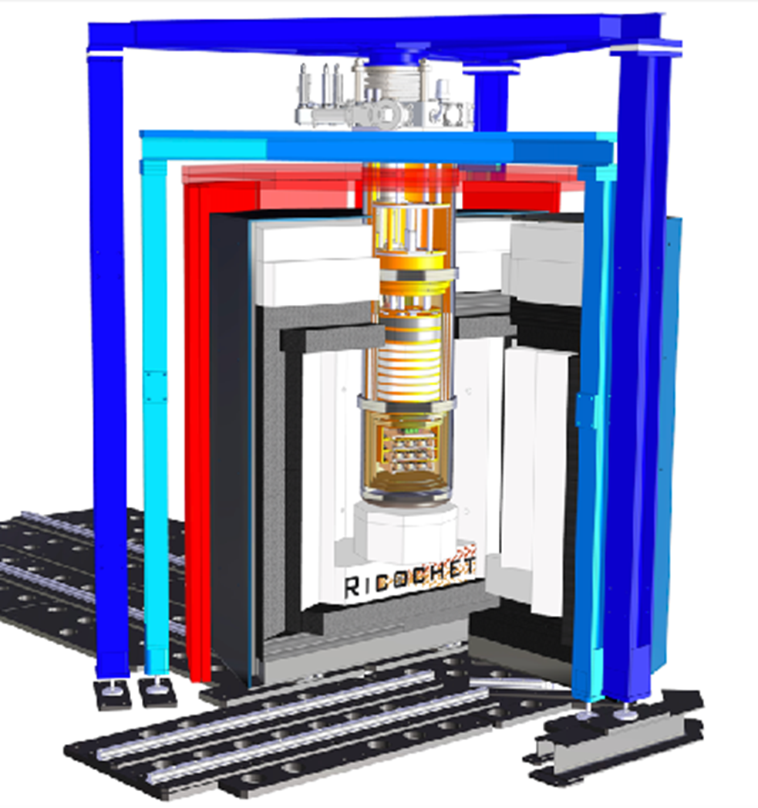
Location
Inner shielding:
PE/Cu: 30 cm
Pb/Cu: 15 cm Cryogenic Muon Veto Mu-Metal
Outer shielding:
PE: 35 cm
Pb: 20 cm Muon veto Soft iron
58 MW nominal thermal power
~13 evts/day/kg (50 eV threshold)
3 to 4 cycles per year: excellent ON/OFF modulation to subtract uncorrelated backgrounds
Significant overburden (~15 m.w.e) to reduce cosmics

Slide 6
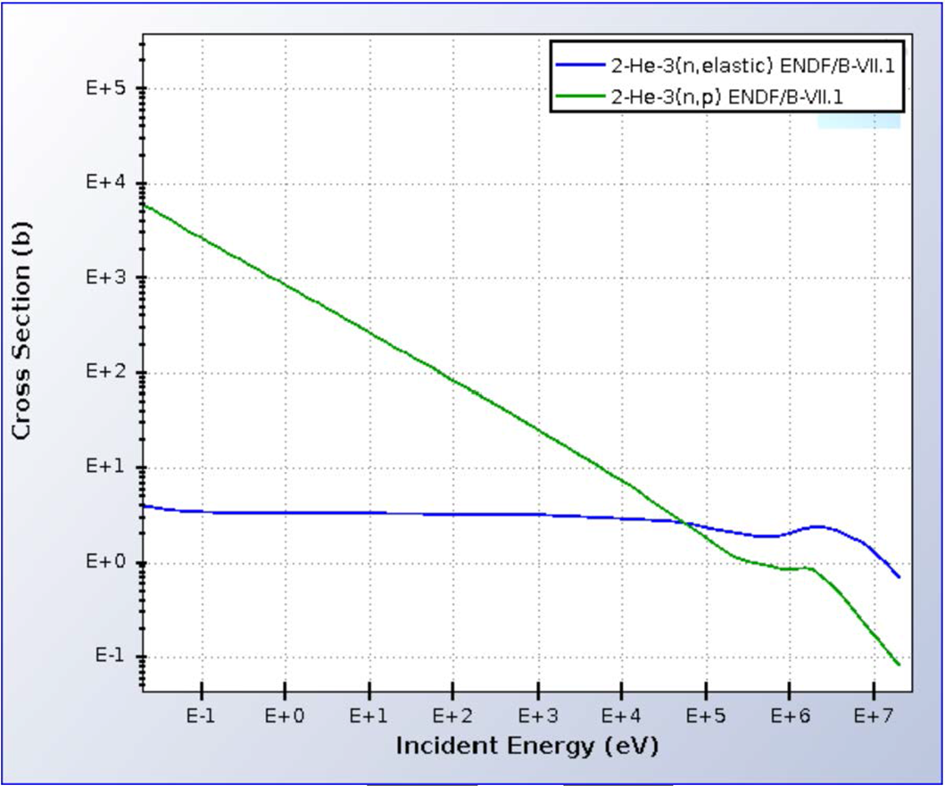
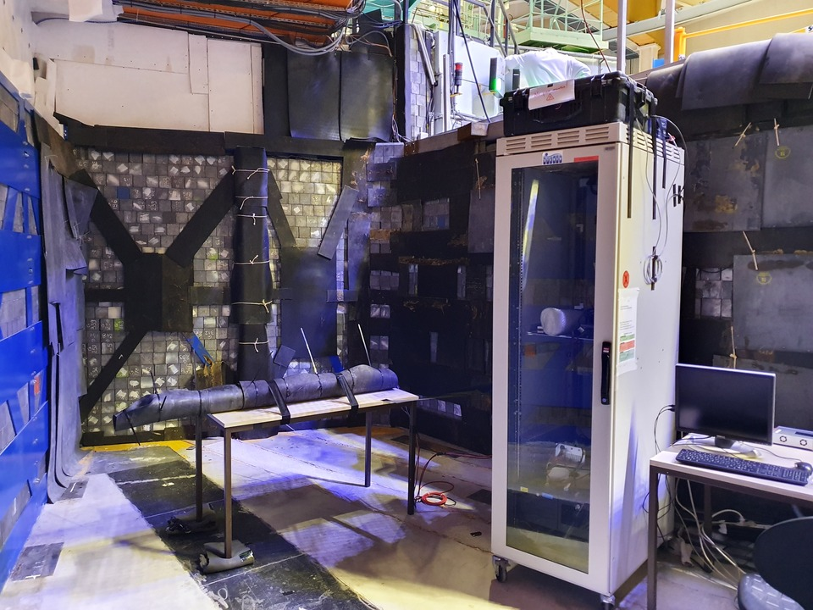
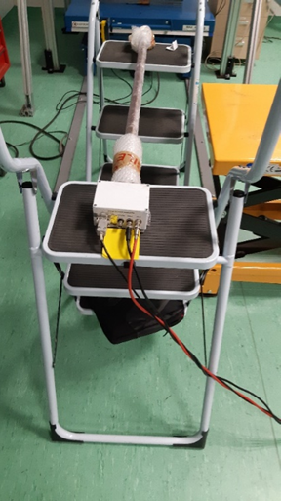
Fast neutron background measurements with ³He counter
Cross sections of neutron capture and elastic scattering of ³He
³He counter in ILL
³He counter
n + ³He → t + p + (764 keV + E_{n})
The ³He(n,p) cross section for the neutrons with energies 100 keV to 10 MeV is ∼1 barn.
The ability to detect fast neutrons with a ³He counter whose intrinsic background close to 0.

Slide 7
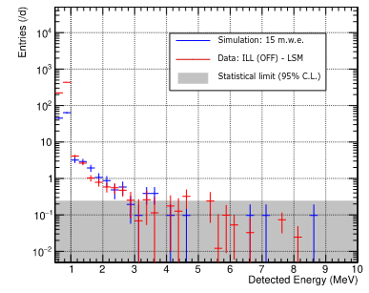
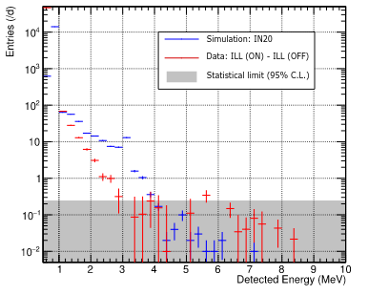
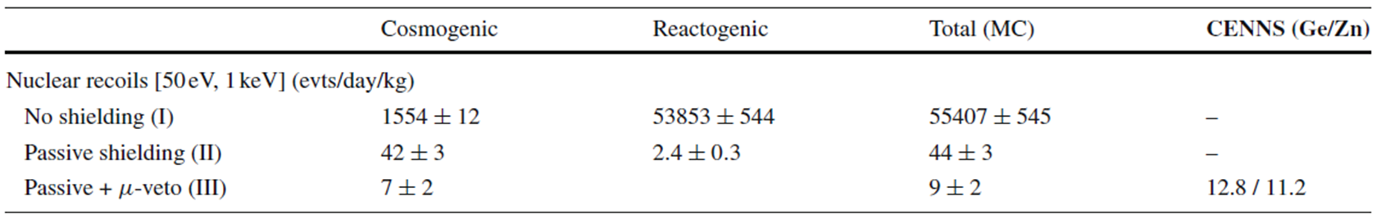
Fast neutron background measurements with ³He counter
Simulated energy spectra
OFF
cosm. + react. gamma
ON-OFF
~20 sigma CEνNS detection after one reactor cycle !!!

Slide 8
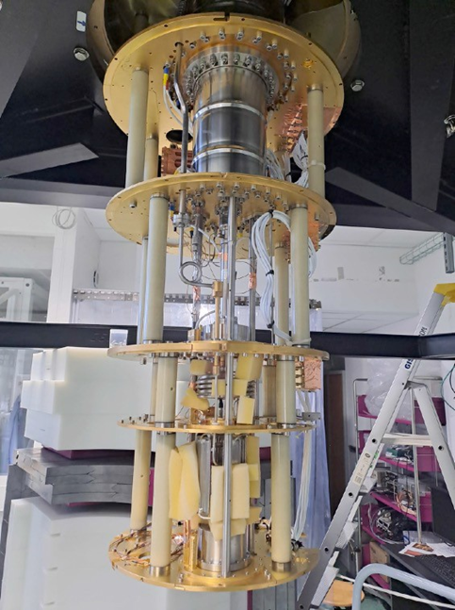
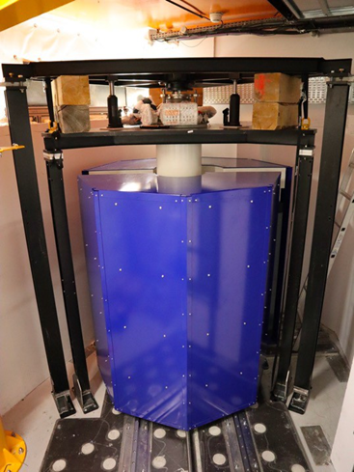
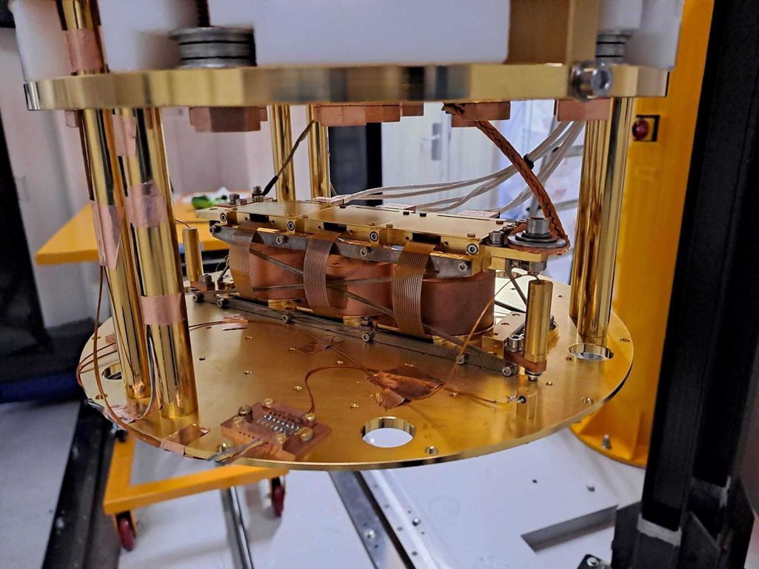
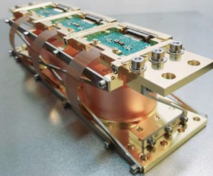
Status of the Ricochet experiment
January 2024
February 2024

Slide 9
Status of the Ricochet experiment & Conclusion
Ricochet at ILL design finalized;
The background from fast neutrons characterized;
The cryostat is deployed at ILL;
3 of 18 germanium bolometers installed in the Ricochet cryostat;
First test measurements have been started;
Full configuration of CryoCube (germanium bolometers) expected in the end of 2024.
The goal is to deliver a low-energy and high precision CEνNS measurement at the percentage level by the end of 2024 to:
Measure the Weinberg angle with a %-precision from 1 to 10 MeV in momentum transfer;
Search for new bosons with a sensitivity up to two orders of magnitude better than current limits;
Further constrain the existence of NSI by two orders of magnitude;
Reach a world-leading CEνNS-based NMM limit;
…
Articles:
« Fast neutron background characterization of the future Ricochet experiment at the ILL research nuclear reactor », Eur. Phys. J. C 83 (2023) 1, 20
« Results from a Prototype TES Detector for the Ricochet Experiment », Nucl. Instrum. Meth. A 1057 (2023) 168765
« First demonstration of 30 eVee ionization energy resolution with Ricochet germanium cryogenic bolometers », Eur. Phys. J. C 84 (2024) 2, 186

Slide 10
Dubna team participates and make commitments to the following parts of the RICOCHET project:
    The Ricochet cryosystem (together with IP2I);
    Development of methods for low background measurements;
    New supplementary detectors;
    Muon veto systems: partly some plastic panels development and building;
    Data taking (this includes daily routine procedures, as well as regular and special calibration runs);
    Low background study and development of methods of neutron and radon detection;
    Selection and production of less radioactive materials;
    Detector simulations and data analysis;
    Publication of results.

Slide 11
Thank you for your attention!

