Slide 1


«Production of trivalent radionuclides for nuclear medicine and analysis via nuclear-spectrometric methods»
Presenter: E.S. Kurakina
59th meeting of the PAC on Nuclear Physics
Dubna, 2024

Slide 2
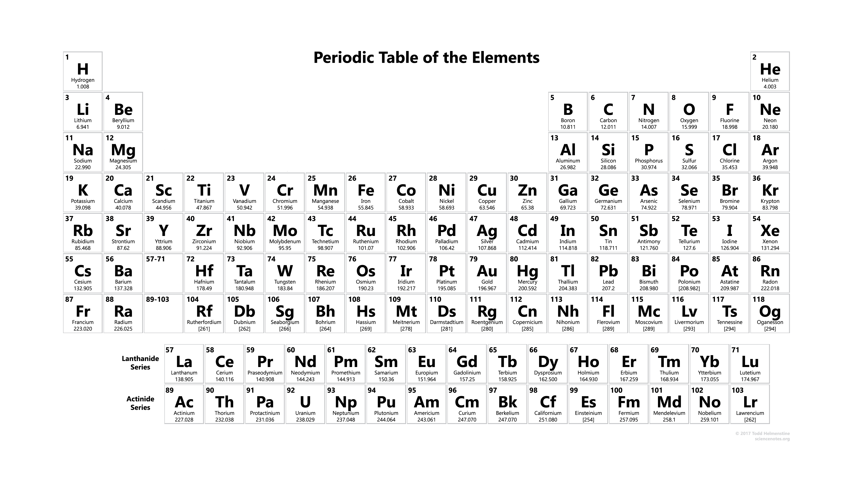
Trivalent radionuclides for nuclear medicine
Diagnostics:
Therapy:
PET
α therapy
SPECT
β‒ therapy
Auger therapy

Slide 3
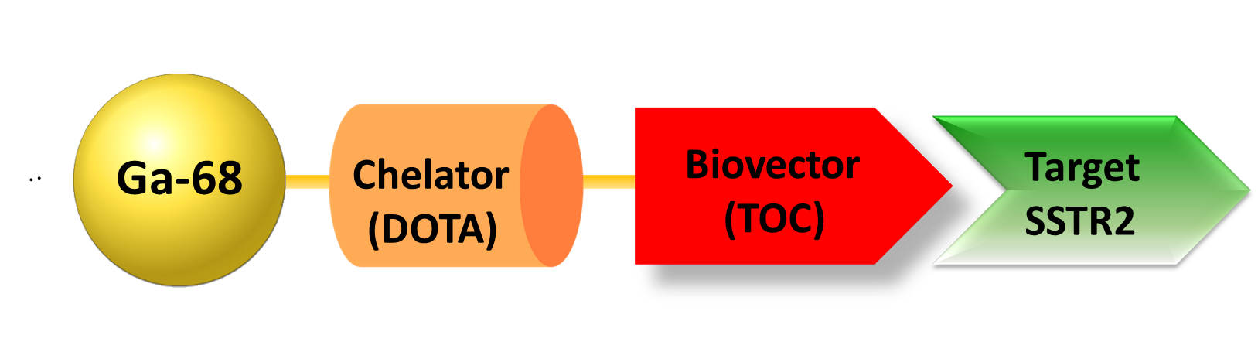
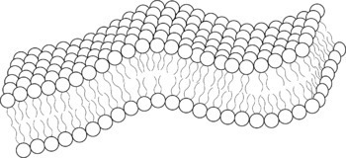

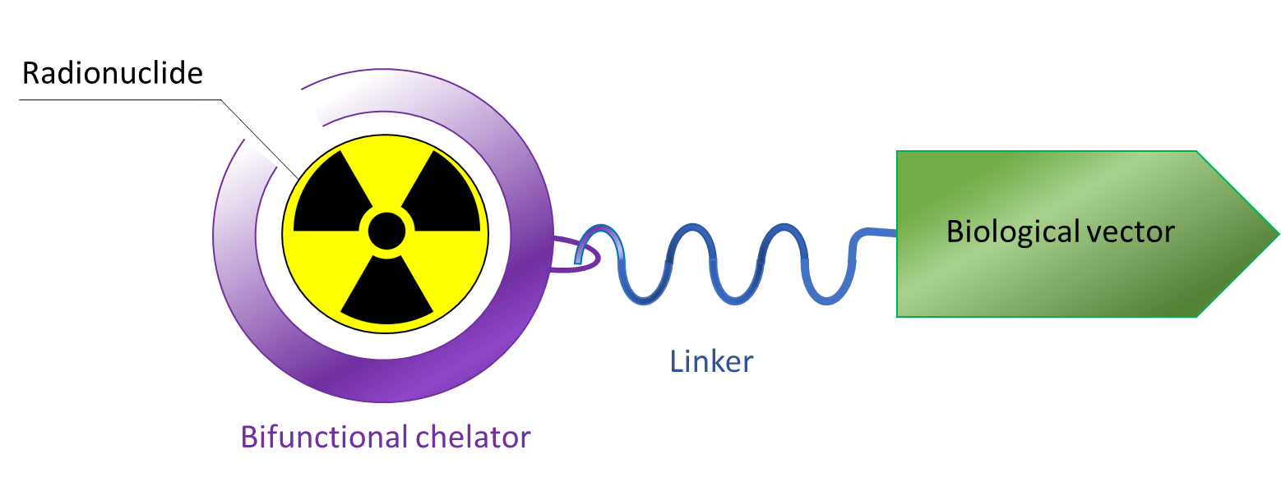
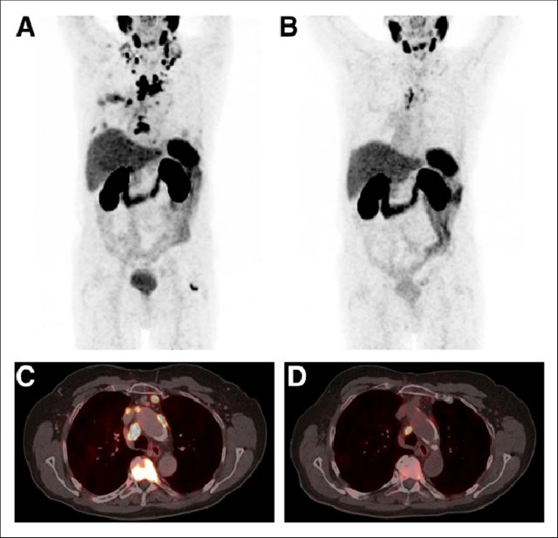
Modern radiopharmaceuticals and theranostics
Diagnostic
Therapeutic
Theranostic
Tumour cell membrane
177Lu-PSMA Radioligand Therapy for Prostate Cancer
Wolfgang P. Fendler et al. Journal of Nuclear Medicine 2017, Vol. 58 (8), P. 1196-1200;
Filosofov D.V. et al. Radiochemical Investigations for Radiopharmaceutical Nuclear Medicine at JINR Laboratory of Nuclear Problems// Phys. Part. Nuclei, 2023, Vol. 54, P. 321–363

Slide 4
Motivation
⁴⁴Sc has favourable nuclear decay characteristics (T_{1/2} = 3.927 h, 94.3% β⁺, E_{max} = 1474 keV) for PET imaging;
Well established chelation chemistry;
has a matched pair - low-energy β⁻ emitter ⁴⁷Sc (T_{1/2} = 3.35 d, E_{β−avg} = 162 keV, 100%) suitable for theranostics.
⁴⁴Sc
¹³⁵La (T_{1/2} = 19.93 h, EC) is a promising candidate for Auger therapy. ^{132,135}La can be used as a theranostic pair for simultaneous diagnostics and therapy of small tumours;
Well established chelation chemistry;
Both ^{132,135}La can be produced via irradiation of ^{nat}Ba targets with protons (up to 20 MeV).
¹³⁵La
¹¹¹In
¹¹¹In (T_{1/2}= 2.8 d) is used as a diagnostic radionuclide for SPECT imaging for a number of neuroendocrine tumours;
One of the most suitable radionuclides for Perturbed angular correlation (PAC).

Slide 5

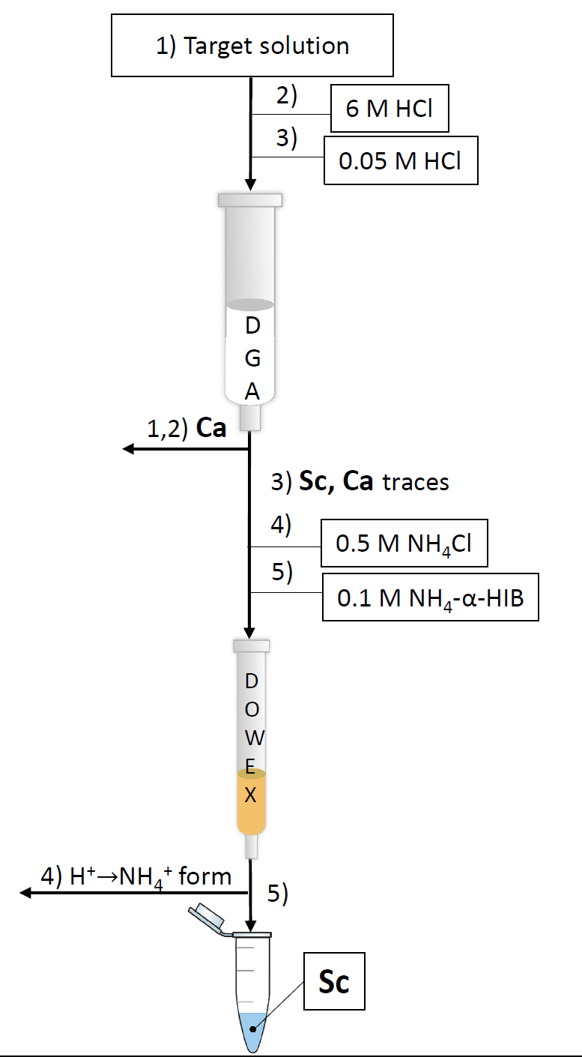
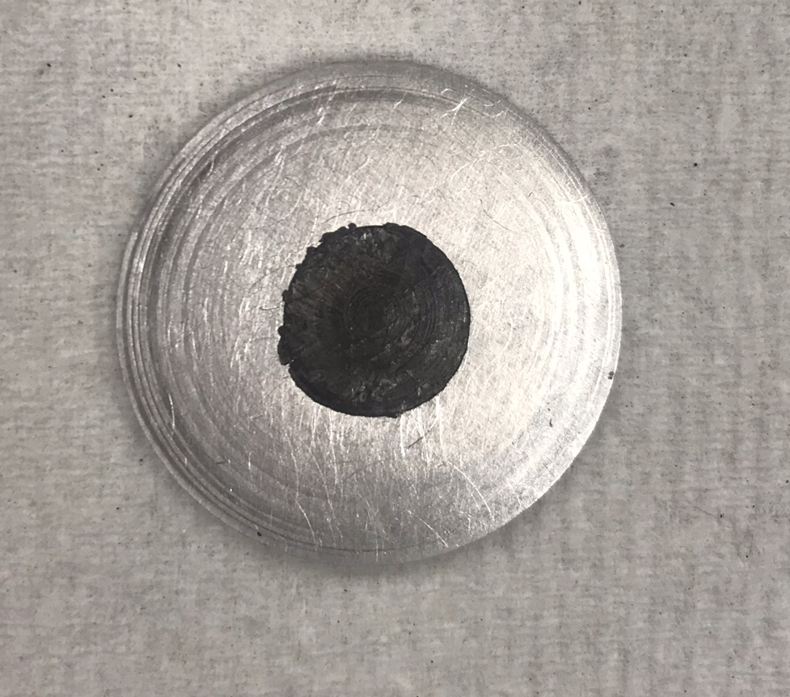
⁴⁴Sc production
Target: metallic ^{nat}Ca
Reaction: ⁴⁴Ca(p,n)⁴⁴Sc
Irradiation: E_{p}= 12.8 MeV, 10 μA, 1 h
Advantages:
Radionuclide | EOB, MBq
⁴³Sc | 2.63±0.44
^{44g}Sc | 100±7
^{44m}Sc | 0.61±0.07
⁴⁷Sc | 0.38±0.04
⁴⁸Sc | 0.73±0.12
Two-step separation scheme;
High radiochemical yield (RCY) 95±3%
High chemical purity
Suitable final fraction medium (NH₄-α-HIB)
for further radiolabeling
Separation time ≈ 15 mins
^{nat}Ca target

Slide 6
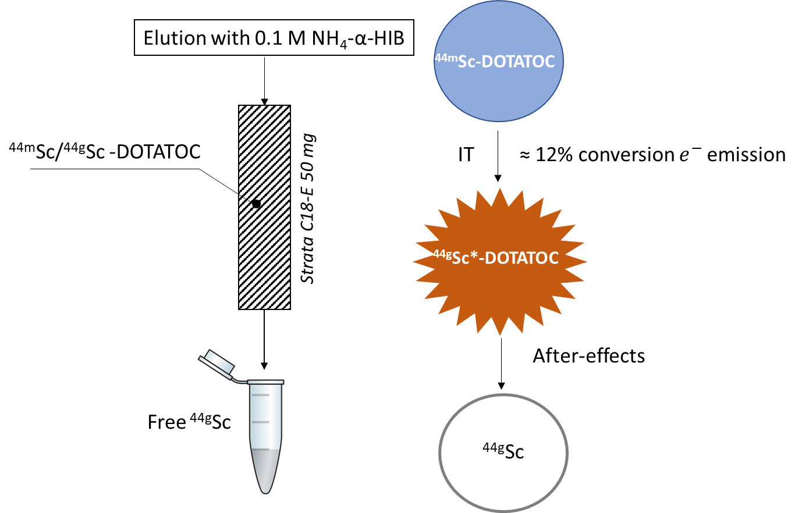
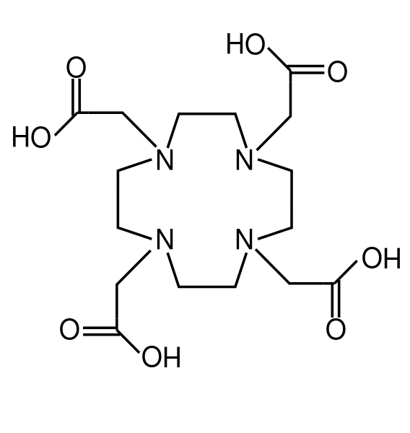
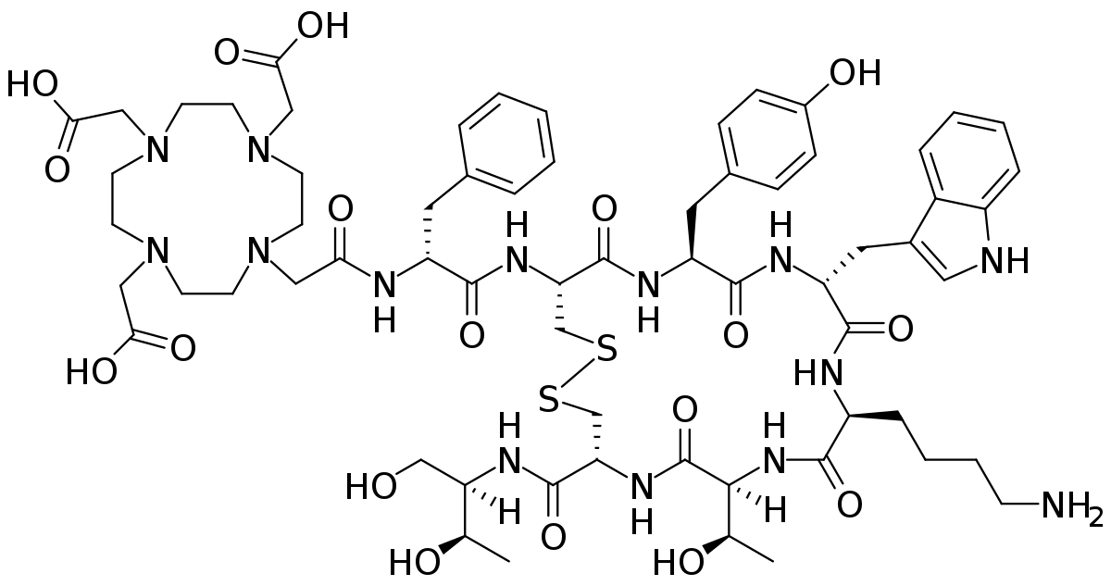
^{44m}Sc/^{44g}Sc generator
DOTA
Elution | ^{44g}Sc yield (%) | ^{44m}Sc breakthrough (%)
1 | 10.5 | 3.0
2 | 10.5 | 0.5
3 | 9.7 | 0.15
4 | 9.3 | 0.2
5 | 8.8 | 0.03
DOTATOC

Slide 7
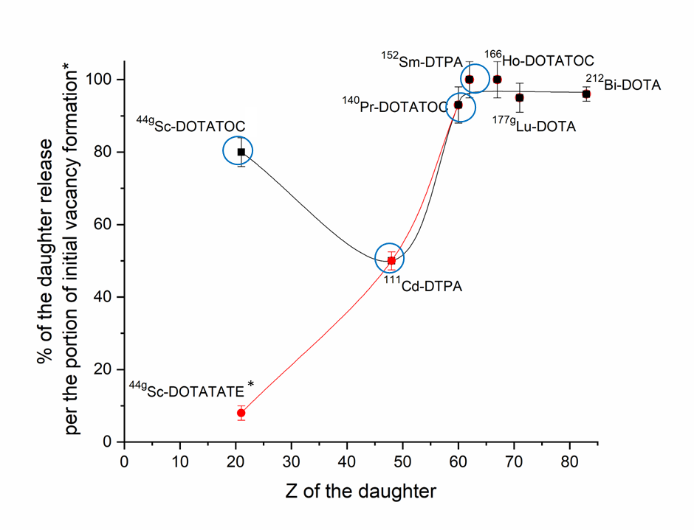
^{44m}Sc/^{44g}Sc generator
* - Huclier-Markai, S.; Kerdjoudj, R.; Alliot, C.; Bonraisin, A. C.; Michel, N.; Haddad, F.; Barbet, J. Optimization of Reaction Conditions for the Radiolabeling of DOTA and DOTA-Peptide with 44m/44Sc and Experimental Evidence of the Feasibility of an in Vivo PET Generator. Nucl Med Biol 2014, 41 (S), e36–e43. https://doi.org/10.1016/j.nucmedbio.2013.11.004.
1) Mirzadeh, B. S.; Kumar, K.; Gansow, O. A. The Chemical Fate of 212 Bi-DOTA Formed by / Γ Decay of 212 Pb ( DOTA )2-. Radiochim. Acta 1993, 60 1–10.
2) Bhardwaj, R.; Van Der Meer, A.; Das, S. K.; De Bruin, M.; Gascon, J.; Wolterbeek, H. T.; Denkova, A. G.; Serra-Crespo, P. Separation of Nuclear Isomers for Cancer Therapeutic Radionuclides Based on Nuclear Decay After-Effects. Sci Rep 2017, 7.
3) Zeevaart, J. R.; Szücs, Z.; Takács, S.; Jarvi, N.; Jansen, D. Recoil and Conversion Electron Considerations of the 166Dy/ 166Ho in Vivo Generator. Radiochim Acta 2012, 100 (2), 109–113.
4) Zhernosekov, K. P.; Filosofov, D. V.; Qaim, S. M.; Rosch, F. A 140Nd/140Pr Radionuclide Generator Based on Physico-Chemical Transitions in 140Pr Complexes after Electron Capture Decay of 140Nd-DOTA. Radiochim Acta 2007, 95 (6), 319–327.
5) Kurakina, E. S.; Radchenko, V.; Belozub, A. N.; Bonchev, G.; Bozhikov, G. A.; Velichkov, A. I.; Stachura, M.; Karaivanov, D. V.; Magomedbekov, E. P.; Filosofov, D. V. Perturbed Angular Correlation as a Tool to Study Precursors for Radiopharmaceuticals. Inorg Chem 2020, 59 (17), 12209–12217.

Slide 8
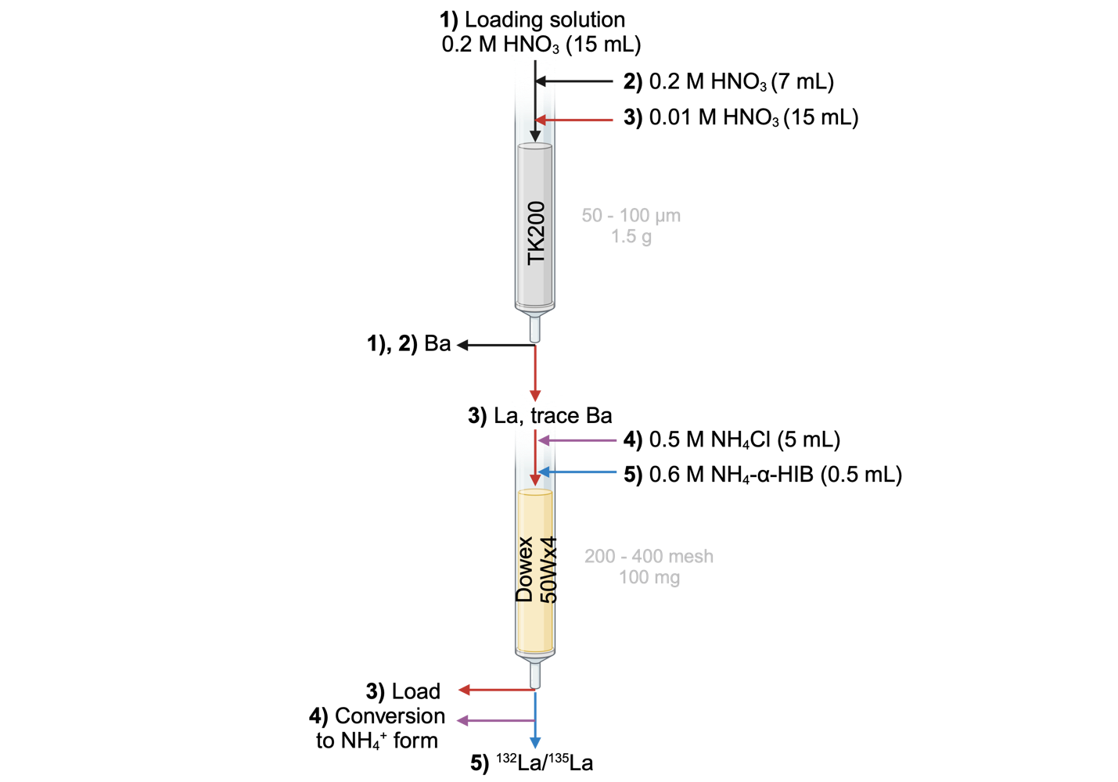
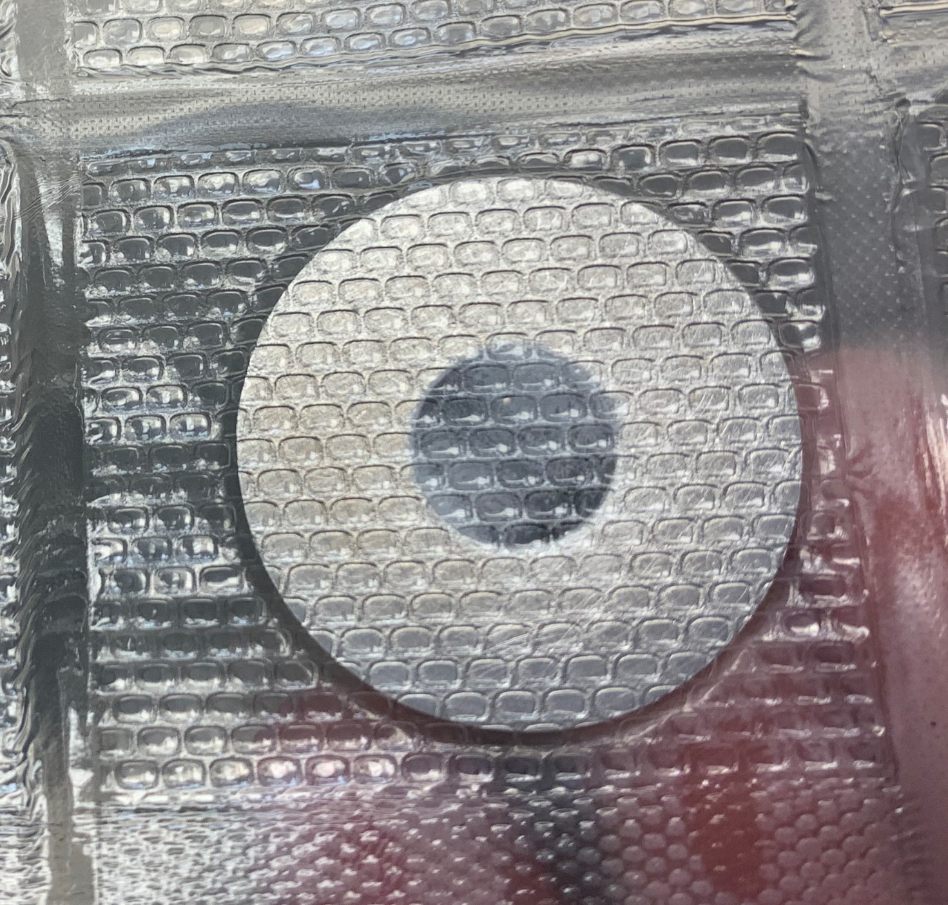
^{135,132}La production
Target: metallic ^{nat}Ba
Reaction: ¹³²Ba(p,n)¹³²La, ¹³⁵Ba(p,n)¹³⁵La
Irradiation: E_{p}= 12.8 MeV, 10 μA, 1-4 h
Radionuclide | MBq/μA∙h
¹³²La | 0.23±0.09
¹³⁵La | 6.37±0.94
^{135m}Ba | 0.04±0.007
^{nat}Ba target

Slide 9
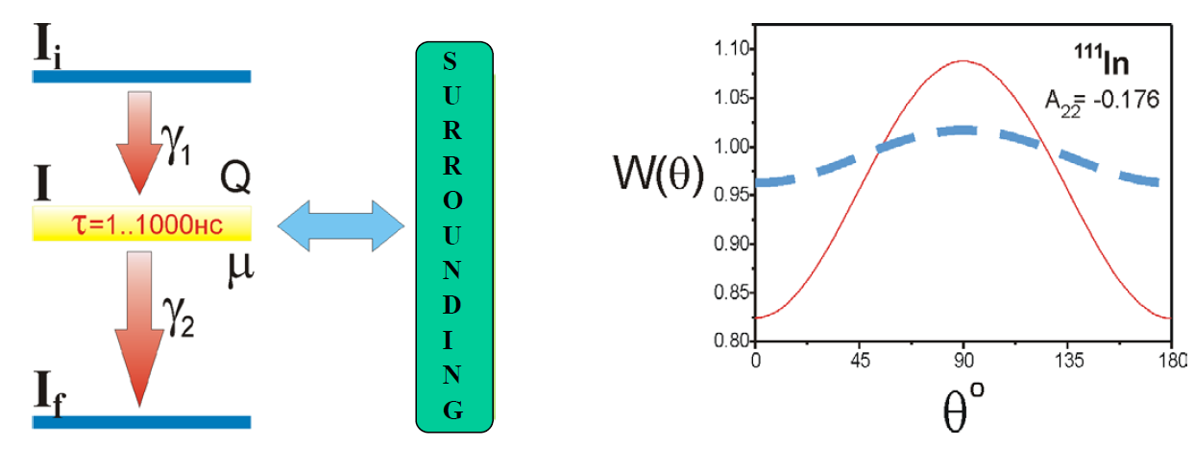
Perturbed angular correlation (PAC)
V.B. Brudanin et al. // Nuclear Instruments and Methods in Physics Research A 547 (2005) 389-399

Slide 10
Perturbed angular correlation (PAC)
¹¹¹In/^{111m}Cd decay mode
¹⁵²Eu/¹⁵⁴Eu decay mode

Slide 11
Perturbed angular correlation (PAC) to study complexes
pH = 0.3
Ме
pH = 0.3
¹¹¹In-DTPA
DTPA
^{111m}Cd-DTPA
pH = 1.85
I = 0.5 (HClO₄, NaClO₄, NaOH)
pH = 2.0

Slide 12
Perturbed angular correlation (PAC) to study complexes
¹¹¹In-DTPA
^{111m}Cd-DTPA

Slide 13
Perturbed angular correlation (PAC) to study complexes
pH = 1.0
Ме
pH = 0.9
¹⁵⁴Eu-DTPA
DTPA
¹⁵²Eu-DTPA
I = 0.5 (HClO₄, NaClO₄, NaOH)
pH = 1.92
pH = 1.72

Slide 14
Perturbed angular correlation (PAC) to study complexes
¹⁵⁴Eu-DTPA
¹⁵²Eu-DTPA
pH

Slide 15
List of publications:
Kurakina E. S., Wharton L., Khushvaktov J., Magomedbekov E. P., Radchenko V., Filosofov D. V. Separation of 44mSc/44gSc Nuclear Isomers Based on After-Effects// Inorg. Chem. 2023, Vol. 62, № 50, P. 20646–20654. Filosofov D.V., Baimukhanova A.E., Kurakina, E.S. et al. Radiochemical Investigations for Radiopharmaceutical Nuclear Medicine at JINR Laboratory of Nuclear Problems// Phys. Part. Nuclei, 2023, Vol. 54, P. 321–363. Filosofov D., Kurakina E., Radchenko V. Potent candidates for Targeted Auger Therapy: Production and radiochemical considerations// Nucl. Med. Biol. Elsevier Inc., 2021. Vol. 94–95. P. 1–19. Wharton L., Kurakina E., Radchenko V. et al. Chemical Promiscuity of Non-Macrocyclic Multidentate Chelating Ligands for Radiometal Ions: H4neunpa-NH2vs H4noneunpa// Inorg. Chem. 2021. Vol. 60, № 6. P. 4076–4092. Kurakina E., Wharton E., Hoehr C., et al. An improved separation scheme for 44Sc purification produced by irradiation of natCa targets with 12.8 MeV protons // Nucl. Med. Biol. Vol. 104–105, 2022. P. 22-27. Kurakina E.S., Radchenko V., Belozub A.N. et al. Perturbed Angular Correlation as a Tool to Study Precursors for Radiopharmaceuticals// Inorg. Chem. 2020. Vol. 59, № 17. P. 12209–12217. Kurakina, E.S., Velichkov, A.I., Karaivanov, D.V. et al. Production of 111In and Radioisotopes of Te and Sn from an Antimony Target Irradiated with High-Energy Protons// Radiochemistry 2020, Vol. 62, P. 393–399.

Slide 16
Plans for the future
Parent isotope and decay mode | Generator | Parent half-life | Daughter half-life | Production
⁶²Zn (EC) | ⁶²Zn/⁶²Cu | 9.186 h | 9.673 min | Accelerator
⁵⁶Ni (EC) | ⁵⁶Ni/⁵⁶Co | 6.075 d | 77.236 d | Accelerator
⁴⁴Ti (EC) | ⁴⁴Ti/⁴⁴Sc | 60.0 y | 3.97 h | Accelerator, Commercial
⁴⁸Cr (EC) | ⁴⁸Cr/⁴⁸V | 21.56 h | 15.974 d | Accelerator
⁵²Fe (EC) | ⁵²Fe/⁵²Mn | 5.591 d | 45.9 s | Accelerator
^{69m}Zn (IT) | ^{69m}Zn/^{69g}Zn | 13.756 h | 56.4 min | Accelerator Reactor*
⁸⁷Y (EC) | ⁸⁷Y/^{87m}Sr | 79.8 h | 2.8 h | Accelerator
^{87m}Y (IT) | ^{87m}Y/^{87g}Y | 13.37 h | 79.8 h | Accelerator
⁸⁸Zr (EC) | ⁸⁸Zr/⁸⁸Y | 83.4 d | 106.62 d | Accelerator, Commercial
¹⁰³Pd (EC) | ¹⁰³Pd/^{103m}Rh | 16.991 d | 56.114 min | Reactor*, accelerator
¹⁰⁷Cd (EC) | ¹⁰⁷Cd/^{107m}Ag | 6.5 h | 44.3 s | Reactor*, accelerator
¹⁰⁹Cd (EC) | ¹⁰⁹Cd/^{109m}Ag | 461.4 d | 39.8 s | Reactor**, accelerator
^{114m}In (IT) | ^{114m}In/ ¹¹⁴In | 49.51 d | 71.9 s | Reactor**, accelerator
¹¹³Sn (EC) | ¹¹³Sn/^{113m}In | 115.09 d | 99.476 min | Reactor**, accelerator
¹³⁴Ce (EC) | ¹³⁴Ce/¹³⁴La | 3.16 d | 6.45 min | Accelerator

Slide 17
Conclusions:
A successful isolation of ⁴⁴Sc and ¹³⁵La from irradiated ^{nat}Ca and ^{nat}Ba targets, respectively, were achieved using a direct-flow two-step separation scheme. This allows for the quick and radiolabeling-ready final product for further application in preclinical studies.
A ^{44m}Sc/^{44g}Sc radionuclide generator was designed using Strata C18-E and DOTATOC (10⁻⁴ M). Firstly, this may make possible a generator source of the diagnostic ⁴⁴Sc for on-site use at medical facility. Secondly, this demonstrates the influence of after-effects on the initial chelate complex at low Z (Z=21), which completely changes the overall trend.
The PAC technique is proved to be a useful tool in studying the complexes of ¹¹¹In, ^{111m}Cd, ¹⁵²Eu and ¹⁵⁴Eu as well as after-effects in nanosecond range. Novel chelators and radiolabeling might be investigated by PAC in future work.

Slide 18
Thanks for your attention!

