Slide 1
CURRENT STATUS AND LATEST FINDINGS FROM THE NUGEN EXPERIMENT AT KALININ NUCLEAR POWER PLANT
K.V. Shakhov^{1,} for the nuGeN collaboration^{1,2,3}
¹JINR, Dubna, Russia
²LPI, Moscow, Russia
³IEAP CTU, Prague, Czech
PAC 2024

Slide 2
Tasks of the νGeN experiment
The purpose of νGeN is to study the properties of neutrinos using germanium detectors located near a power reactor.
Aims of the νGeN experiment:
Search for coherent elastic scattering of neutrinos on the nuclei of matter (CEvNS) from reactor neutrinos
Search for the magnetic moment of neutrino
Search for New physics, non-standard neutrino interactions, determination of the Weinberg angle at low energies, sterile neutrino
Monitoring of nuclear reactor, non-proliferation of nuclear weapons

Slide 3
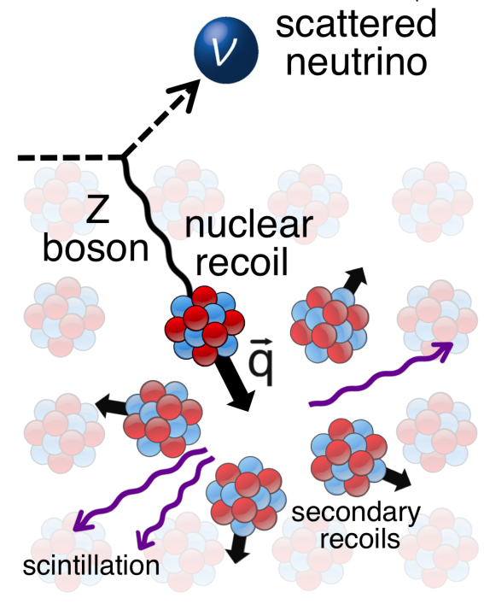
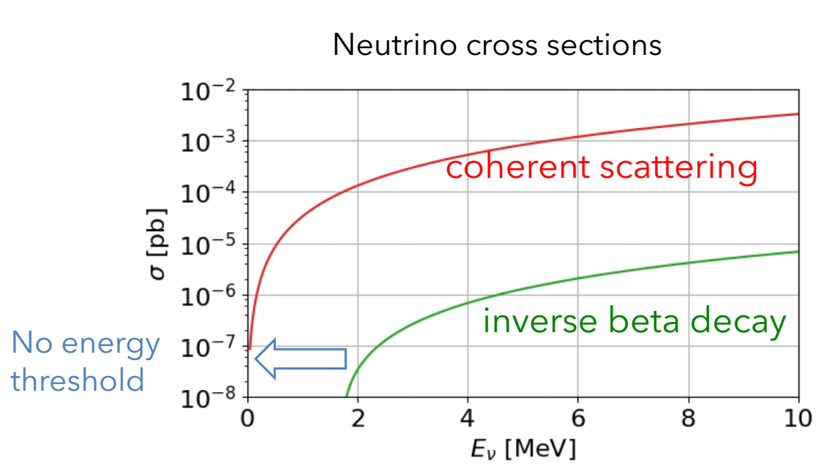
CEvNS
Coherent neutrino scattering is a process predicted by the Standard Model [1]
It has never been observed for reactor antineutrinos
It dominates at neutrino energies below 50 MeV (the region of full coherence is below ~30 MeV)
The cross section is several orders of magnitude higher than for ordinary scattering:
Proportional to the square of the number of neutrons N²
Small recoil energy - less than a few keV
Moreover, only part of the energy can be detected due to quenching (part of the ionization losses)
CEvNS
$$σ_{tot}≈\frac{GF2}{4π^{2}}∙N2∙Eν2$$
R. Strauss at Magnificent CEvNS
[1] D. Freedman, Phys.Rev. D 9 1389 (1974)

Slide 4
The location of the experiment
KNPP, Power Unit No. 3
The νGeN spectrometer is located under the power unit No. 3 of the KNPP (thermal power – 3.1 GW) at a distance of ~ 11 m from the center of the core
The antineutrino flux passing through the detector >4*10¹³ν/(s*cm²) is one of the highest
Reactors, concrete structures of the building and technological equipment provide protection from cosmic radiation ~50 m.w.e.
νGeN

Slide 5
Comparison of reactor experiments
Experiment | Location | Neutrinos flux ν/(cm² s) | Shield [m.w.e.]
νGeN | KNPP, Russia | ∼(3.6-4.4)×10¹³ | ∼50
CONUS | Brokdorf, Germany | 2.4×10¹³ | 10-45
TEXONO | Kuo-Sheng NPP, Taiwan | 6.4×10¹² | ∼30
RED-100 | KNPP, Russia | 1.7×10¹³ | >50
CONNIE | Angra 2, Brazil | 7.8×10¹² | 0
RICOCHET | ILL, France | 2×10¹² | ∼15
MINER | Texas A&M, USA | 2×10¹² | ∼5
NUCLEUS | Chooz, France | 2×10¹² | ∼3
NCC-1701 | Dresden-II, USA | 4.8×10¹³ | -
NEON | Hanbit 6, Korea | 7.1×10¹² | ∼8
SBS | Laguna Verde, Mexico | 3×10¹²? | ?

Slide 6
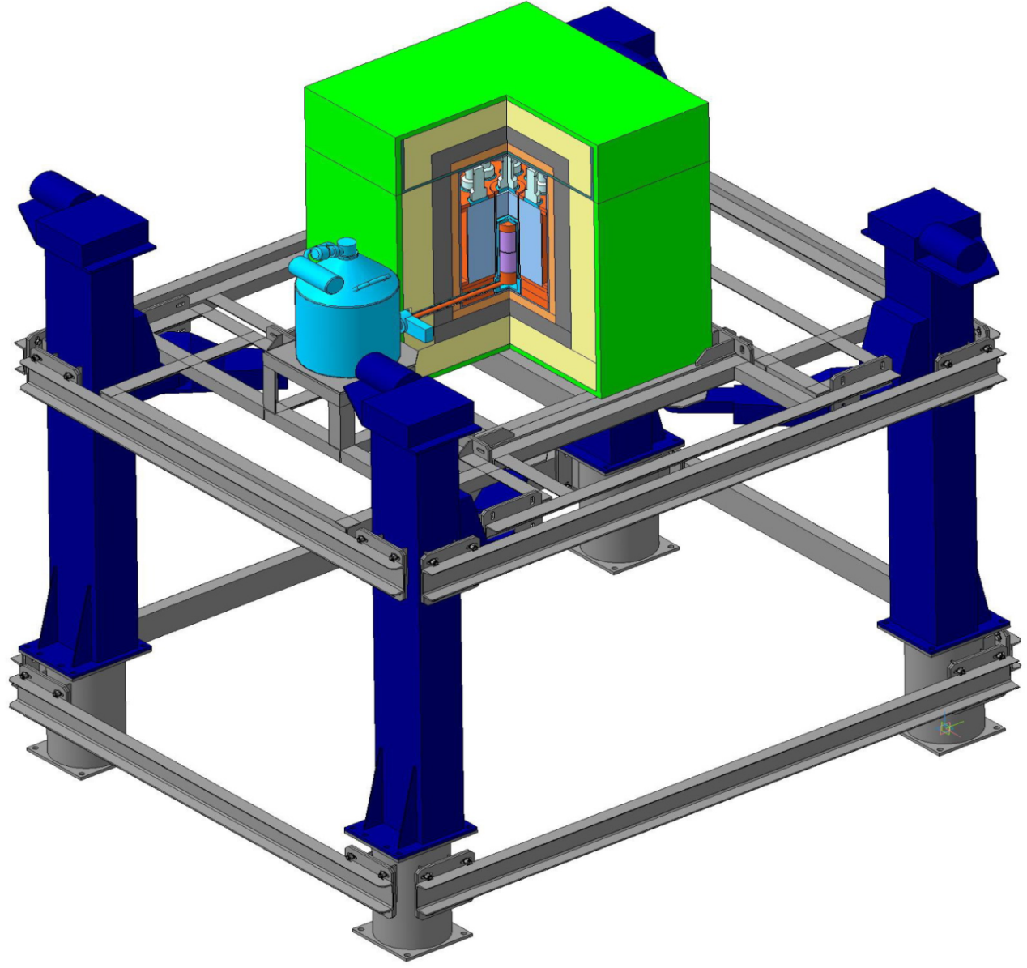
νGeN at KNPP
Lifting mechanism was built in order to change the distance to the reactor core from 11.1 m to 12.2 m, thereby changing the value of the antineutrino flux (3.6 to 4.4) × 10¹³ ν/(cm²s), and it helps to take into account the systematic error in determining the uncertainty background
There are backup power supplies and an electrical protection circuit for stable operation of the installation
General cooling of the installation by three air conditioners and constant temperature control of several areas near the installation
The general scheme of the facility on the lifting mech.

Slide 7
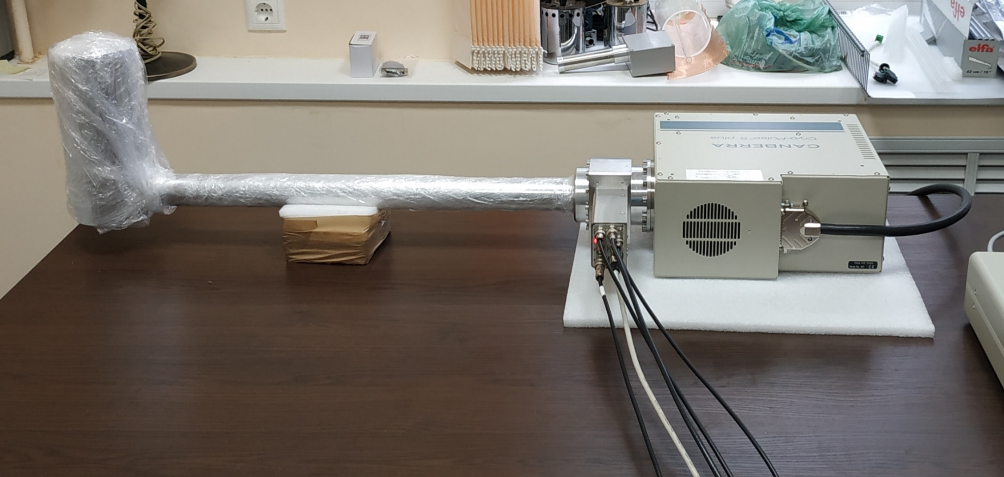
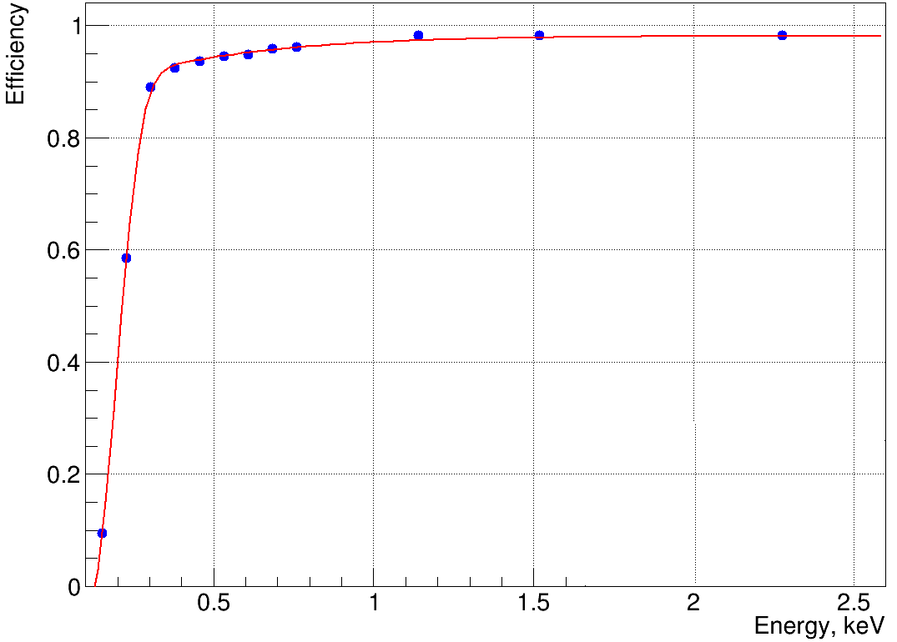
HPGe detector νGeN
A special low-threshold, low-background HPGe detector with a mass of 1.4 kg, equipped with electronic cooling CP5+ is used to detect signal from neutrino scattering.
Data taking is organized using the real-time ADC of CAEN electronics. Different shaping times is used to reduce noise.
The energy resolution at the KNPP conditions is 101.6(5) eV (FWHM) (measured with a pulse generator).
Efficiency ~45% for threshold 200 eV and ~85% for threshold 300 eV after trigger + graphical cuts.

Slide 8
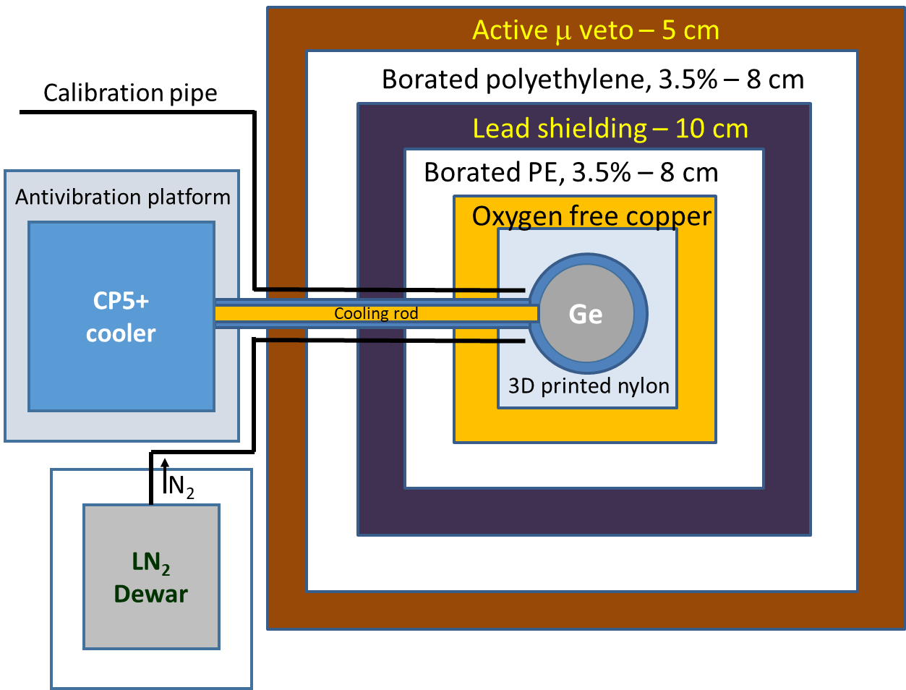
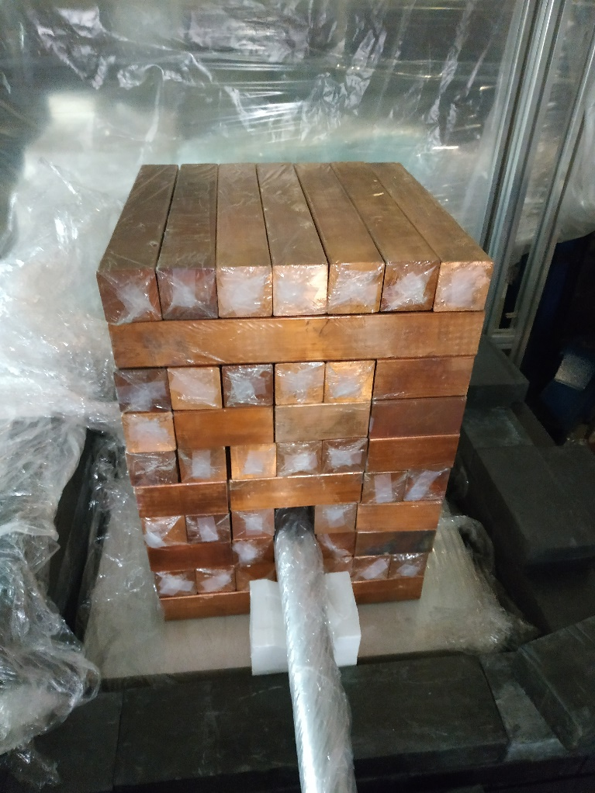
νGeN shielding
Scheme of the νGeN shielding
Active and passive shielding is used to protect against external radiation.
Photo of the assembly process at the KNPP

Slide 9
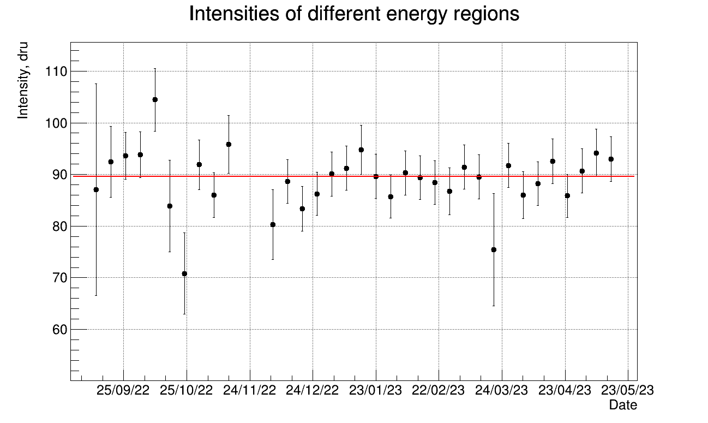
Monitoring of measurement conditions
Stable measurement conditions are very important because instabilities can shift the energy scale and change the noise level.
The temperature regime of the air near the installation is stabilized by three air conditioners.
Temperature and humidity are constantly monitored.
The neutron background outside the shielding (fast and thermal) is measured by a special low-background He³ counter and a NaI detector.
The decay of cosmogenic isotopes in the detector is taken into account in the analysis.
Neutron detectors: He³ at the top, NaI at the bottom
Stability measurement νGeN at KNPP

Slide 10
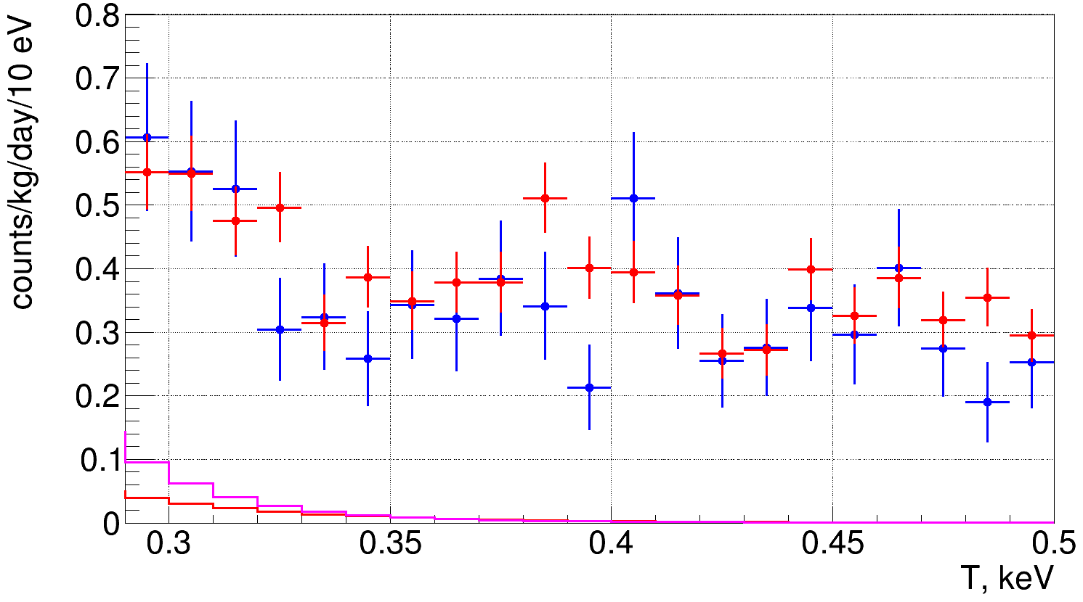
Analysis
• - reactor ON
• - reactor OFF
Collected October 2022 — May 2023 at 11.1 m from the reactor core
Prediction the CEvNS with use model: CONUS quenching factor [2] and Dresden ll quenching factor [3]
Neutrino spectrum was calculating with help (SM2018 spectra) model
: CONUS quenching factor (k=0.162)
: Dresden II quenching factor (k=0.157)
[2] Eur. Phys. J. C (2022) 82:815
[3] Phys. Rev. D 103, 122003 (2021)

Slide 11
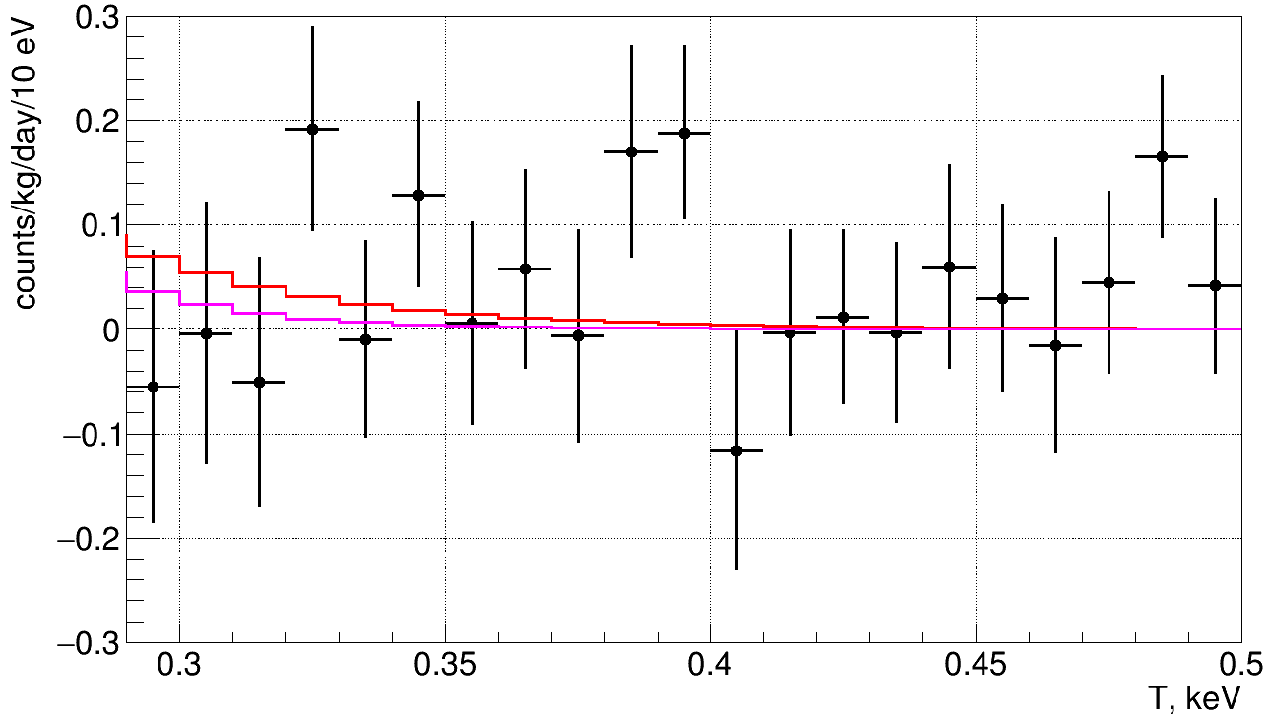
New results
Direct comparison of the data with reactor ON (137 days) and OFF (38 days) do not show a significant difference in the background level.
Use two different model quenching parameter for best fits: CONUS QF (Lindhard k=0.162), Dresden QF (Ff, mod. k=0.157).
Set the 90% C.L. limit on the CEvNS rate: 5.0/2.0 ×SM depending on QF
: Best Fit for CONUS QF model (k=0.162)
: Best Fit for Dresden II QF model (k=0.157)
QF | Prediction, ev./kg/day | Sensitivity, ×SM | 68% expectation for a 90% C.L. limit, ×SM | Best fit, ×SM | 90% C.L. limit
CONUS | 0.159 | 4.1 | 2.3-6.0 | 1.80 | 5.0
Dresden | 0.278 | 2.6 | 1.6-3.6 | 0.38 | 2.0

Slide 12
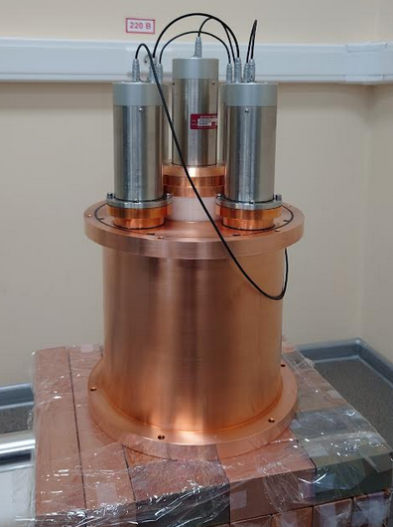
Conclusion
Stable measurements with the νGeN spectrometer have been performed since 2022. Good background level, stable measurement condition and efficiency ~45% for threshold 200eV and ~85% for threshold 300 eV allows to search for CEvNS.
Set the 90% C.L. limit on the CEvNS rate: 5.0/2.0 ×SM depending on QF.
Currently, more than 1600 kg*days of data have been collected.
New results with optimized analysis are expected.
Further improvements to the nuGeN installation are planned:
A new acquisition system is developing (waveform signal)
The internal veto system is planned to install to improve background level
Improvement of the detector cooling system to reduce noise
Improved analysis of background events

Slide 13
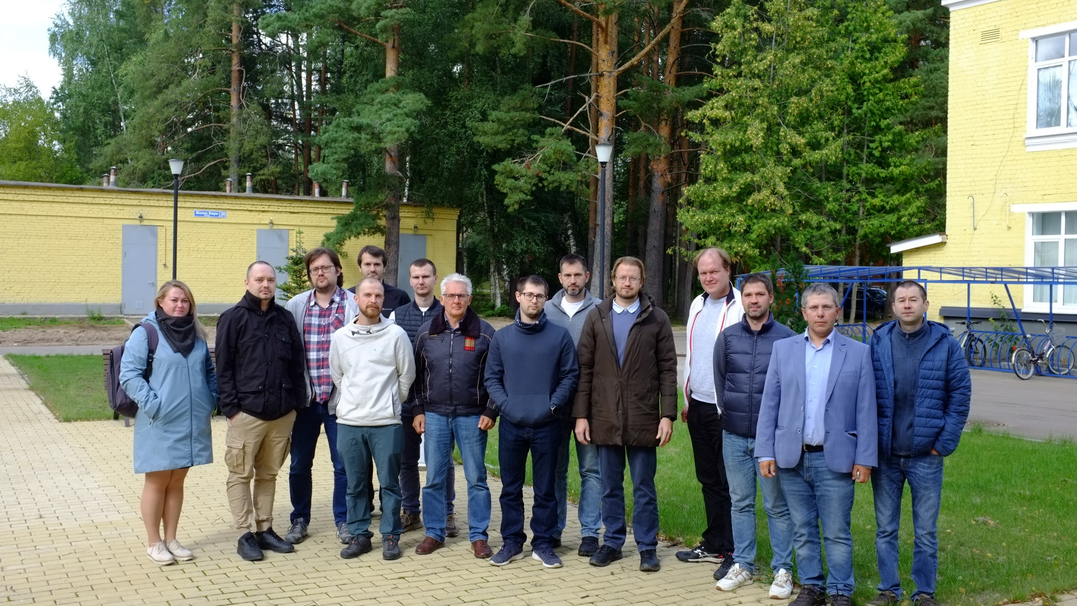
nuGeN Collaboration: thanks for your attention

Slide 14
Backup

Slide 15
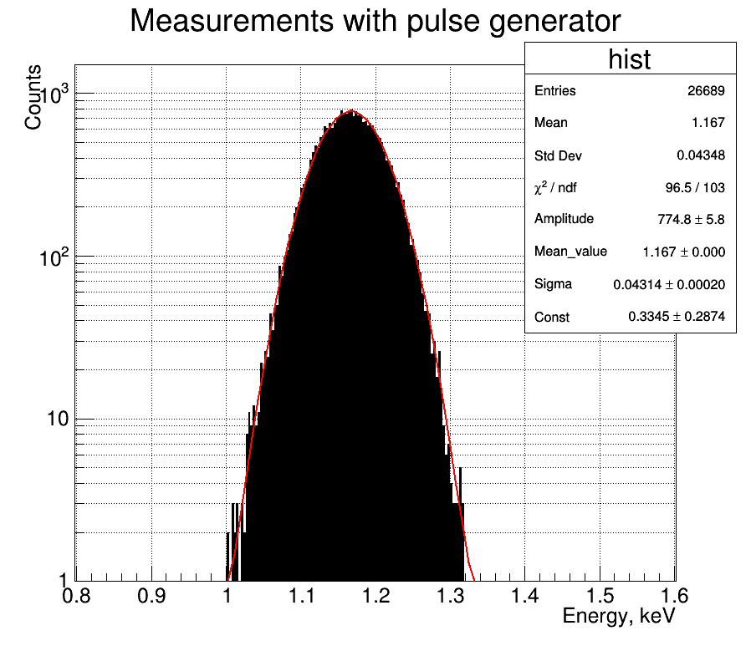
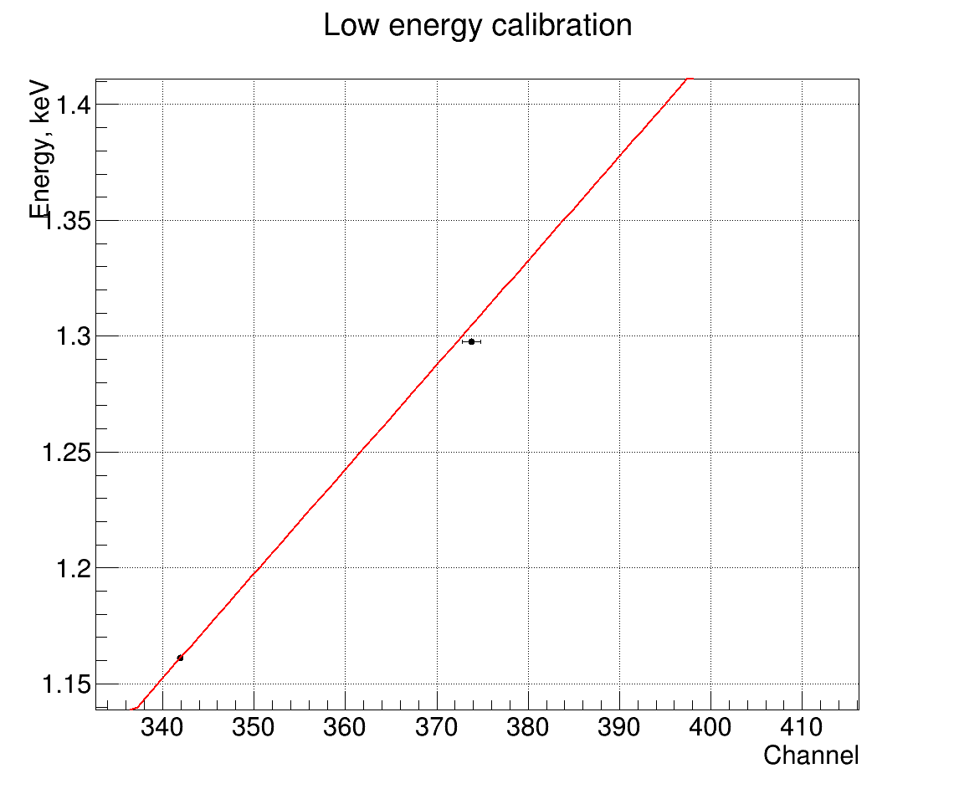
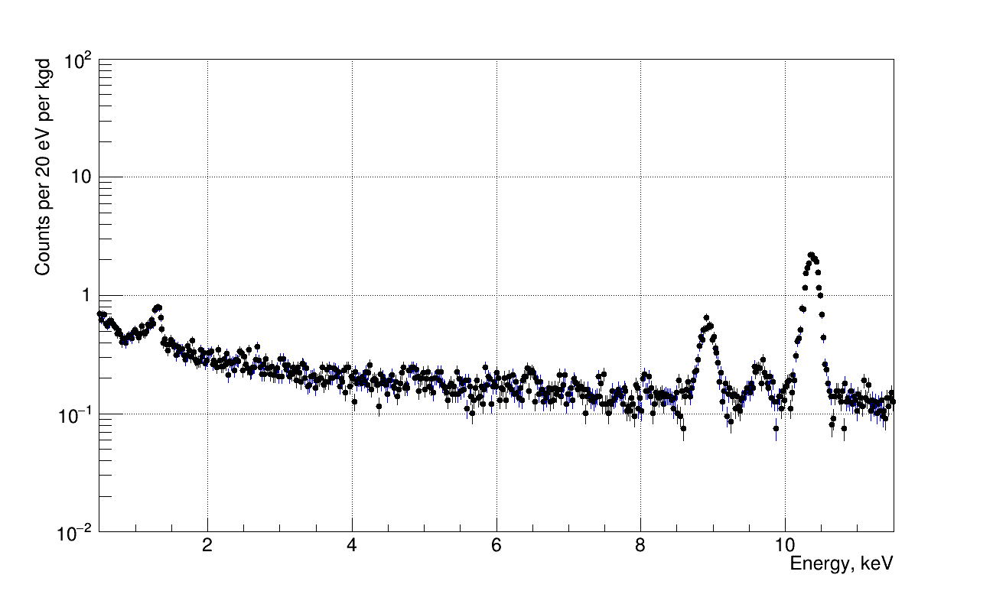
Calibration
Energy calibration at low energy is performed by means of 10.37 keV cosmogenic line and pulse generator.
Calibration check with 1.3 keV line
Data taking shows very good stability of peak position during all measurement time.
Energy resolution of 1.4 kg detector at KNPP is 101.6(5) eV (FWHM).
^{68,71}Ge (K)
10.367 keV
^{68,71}Ge (L)
1.3 keV
^{68,71}Ge (L)
1.2977 keV
Peak from pulse generator

Slide 16
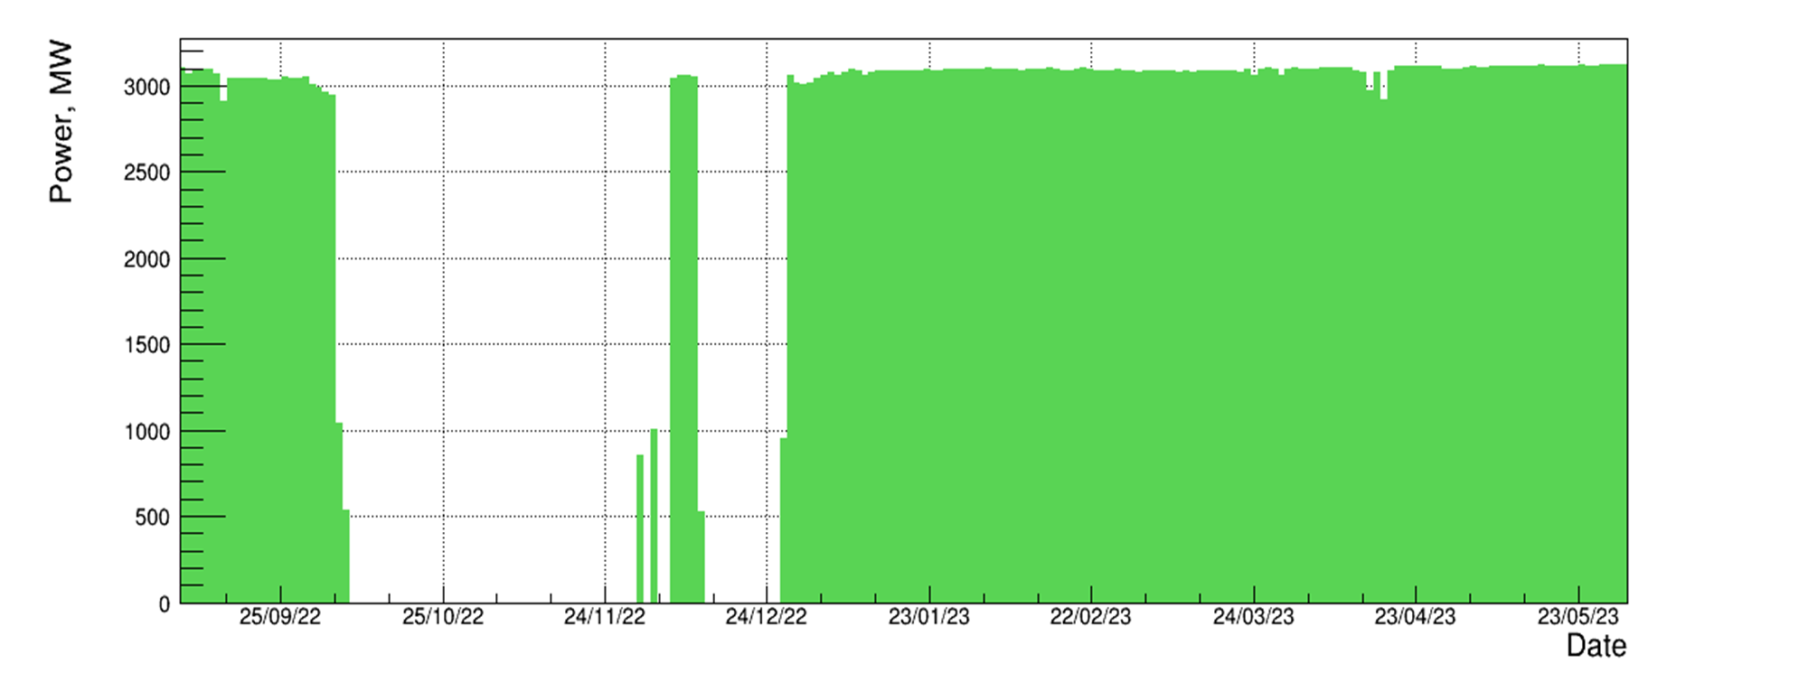
Stability measurement νGeN at KNPP
Chi2/NDf = 29.3/33

Slide 17
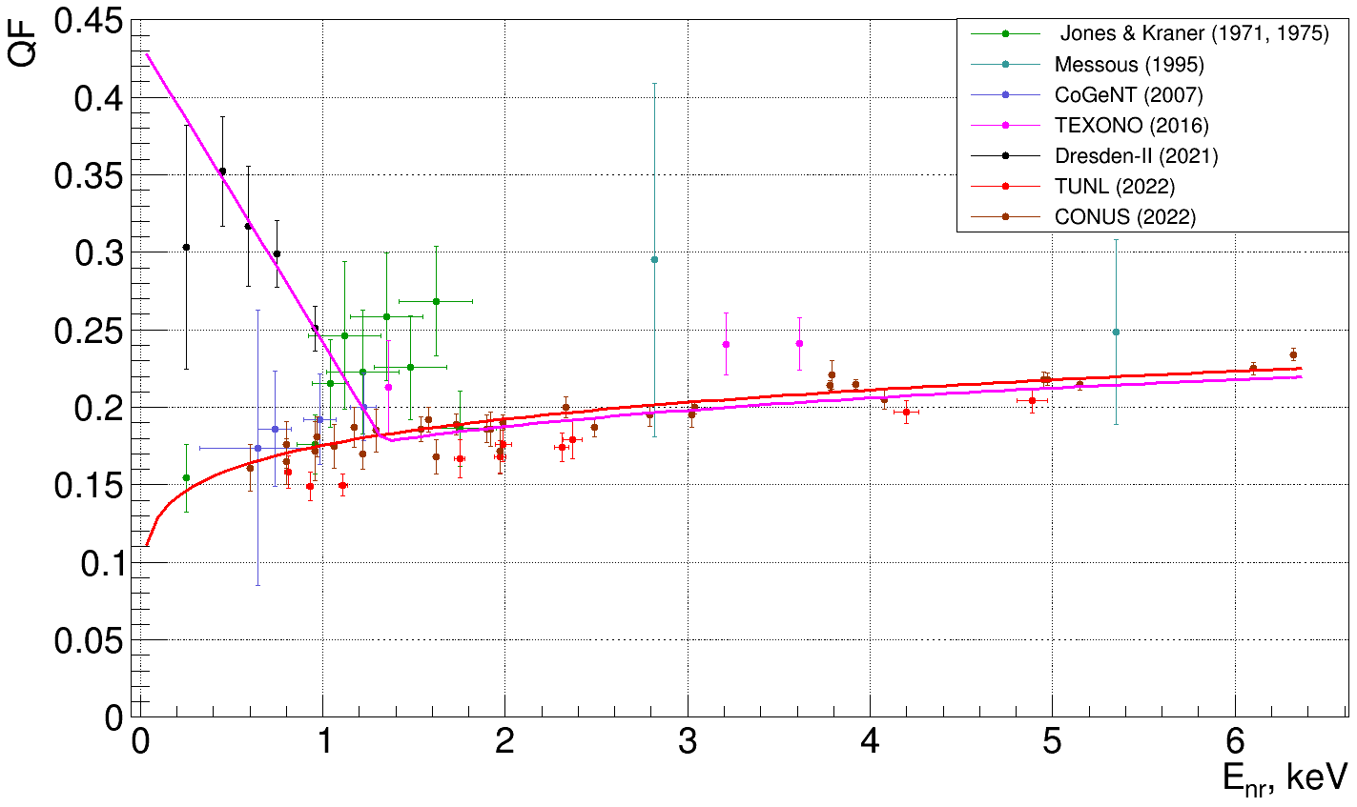
Approach to the quenching problem
We consider two cases: CONUS QF (Lindhard k=0.162), Dresden QF (FeF, mod. k=0.157)

Slide 18
The Lindhard quenching parameter

Slide 19
Sensitivity CEvNS in upper position
Hypotheses about the sensitivity to CEvNS are obtained from comparing the background spectrum (55 kg days) and the generated spectrum of CEvNS + background (with statistics equivalent to 217 kg days).

Slide 20
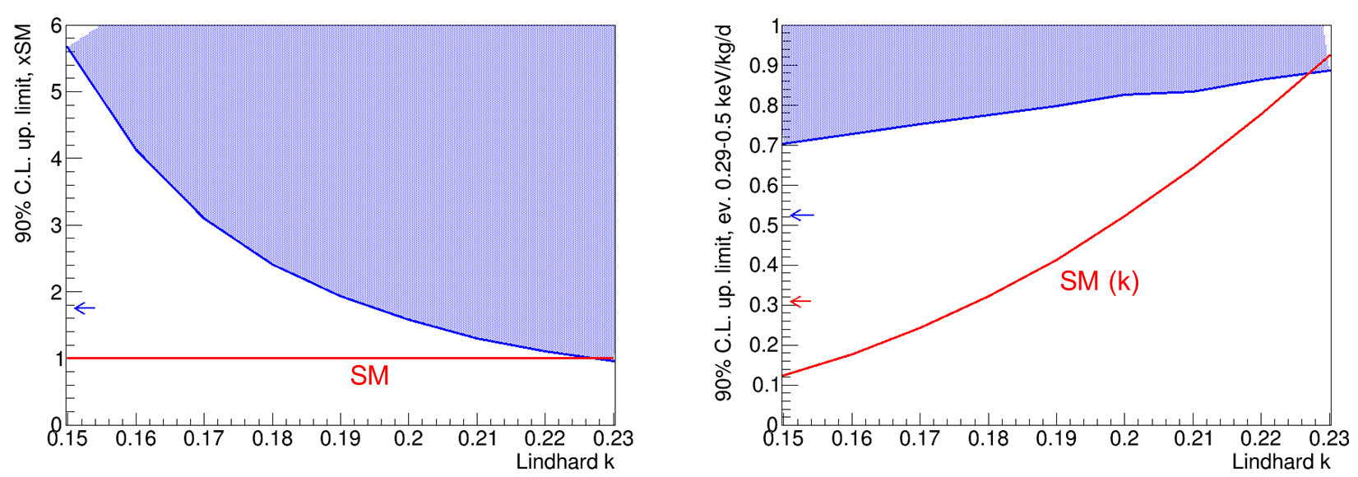
Quenching results
The upper limit on a quenching parameter k < 0.23, 90% CL.

Slide 21
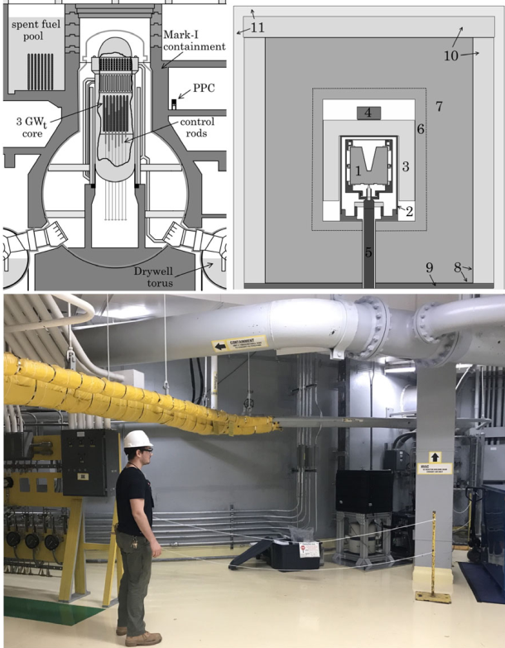
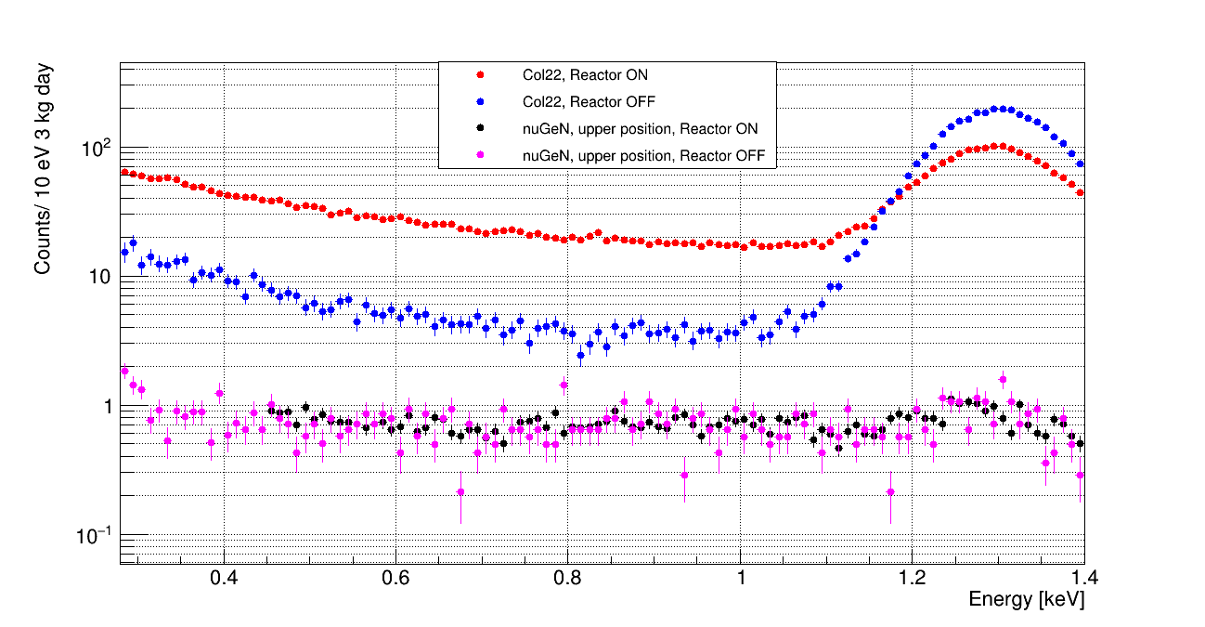
J. Colaresi, J. I. Collar,* T. W. Hossbach , C. M. Lewis , and K. M. Yocum, «Measurement of Coherent Elastic Neutrino-Nucleus Scattering from Reactor Antineutrinos», PHYSICAL REVIEW LETTERS 129, 211802 (2022)
Claimed about strong preference (p<1.2⋅10⁻³) for the presence of CEνNS.
Similar to νGeN antineutrino flux from reactor (4.8 10¹³ v/cm2/sec)
Sideway location gives almost no overburden (cosmogenic background).
Almost no shielding against fast neutrons.
Different shielding during reactor ON and OFF
Big difference in background levels during reactor ON and OFF
Moderate energy resolution > 160 eV (FWHM) (in nuGeN – 101.6(5) eV)

Slide 22
Upgrade νGeN to 2022 year
The new power supply line of the facility, grounding and improved anti-radon nitrogen purge have reduced background and noise levels.

Slide 23
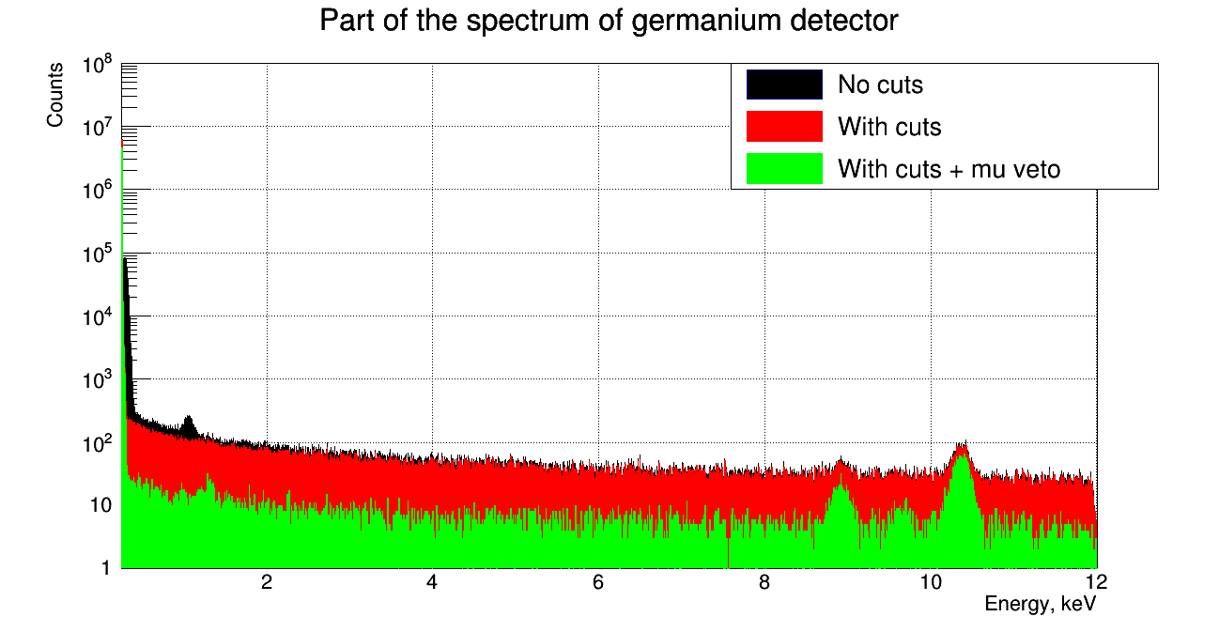
µVeto and others cuts
Matches with the muon veto can reduce the background associated with muons
The efficiency after all cuts was 85.3(19)% (according to the intensity of 10.37 keV peak)

Slide 24
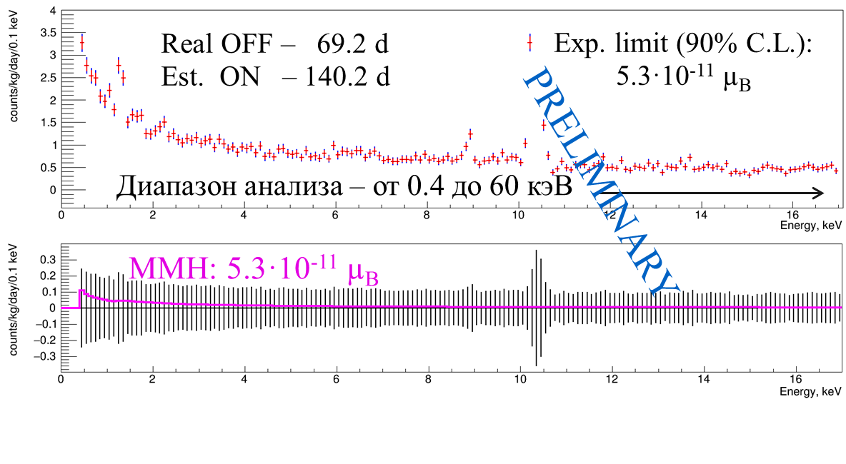
Sensitivity to neutrino magnetic moment
Sensitivity assessment with the background measured at the KNPP (reactor: off)
Changing the measured background to a model :
-> 4.0·10⁻¹¹ µ_{B}, [2.8,5.1]·10⁻¹¹ µ_{B}
Increasing the statistics with the reactor turned on to 900 days:
-> 2.5·10⁻¹¹ µ_{B}, [1.8,3.3]·10⁻¹¹ µ_{B}
Sensitivity GEMMA:
3.4·10⁻¹¹ µ_{B}, [2.8,4.1]·10⁻¹¹ µ_{B}

Slide 25
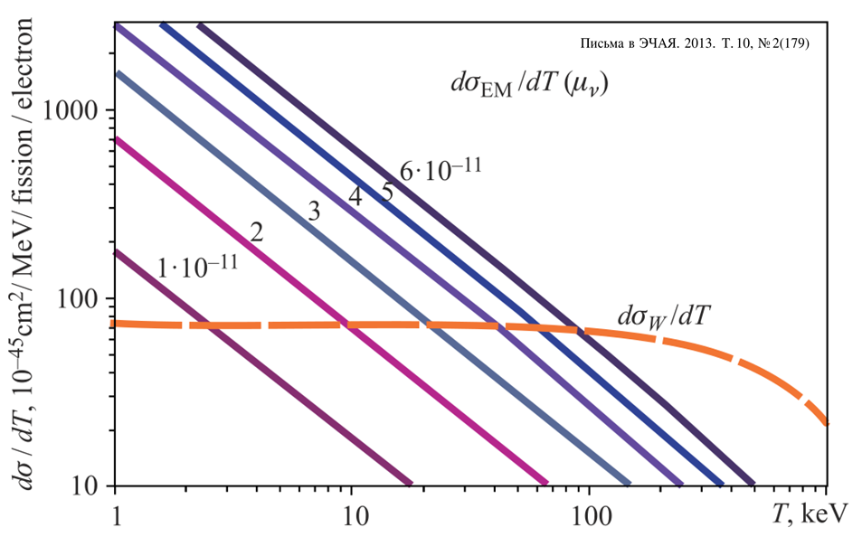
The neutrino magnetic moment (NMM)
In SM augmented by right neutrinos:
The minimally Extended Standard Model predicts a very small value of the magnetic moment for massive neutrinos (μ_{ν} < 10^{–19}μB), which cannot be measured in modern experiments. However, physics outside the Standard Model can lead to an abnormal NMM value higher than 10^{–14} μB.
Method: search for e/m scattering by electrons
Aim: for a tougher limit compared to GEMMA: <2.9·10⁻¹¹ µ_{В}, 90% C.L.
The cross section is ~1/T, best from a low threshold

