Slide 1
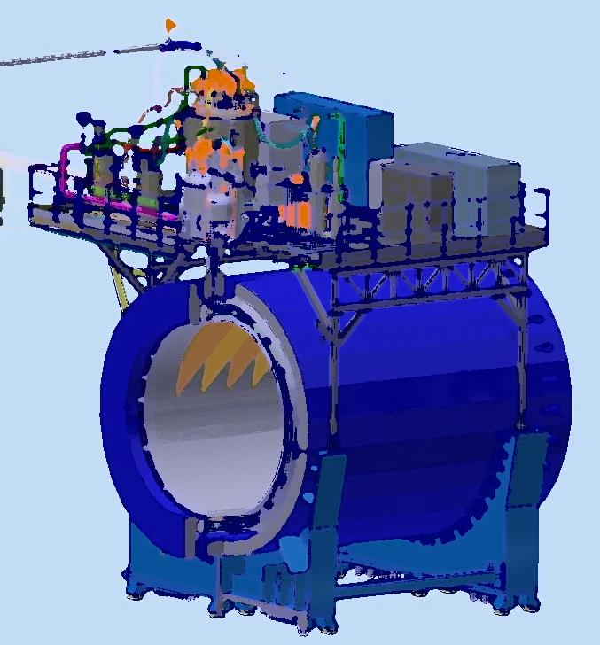
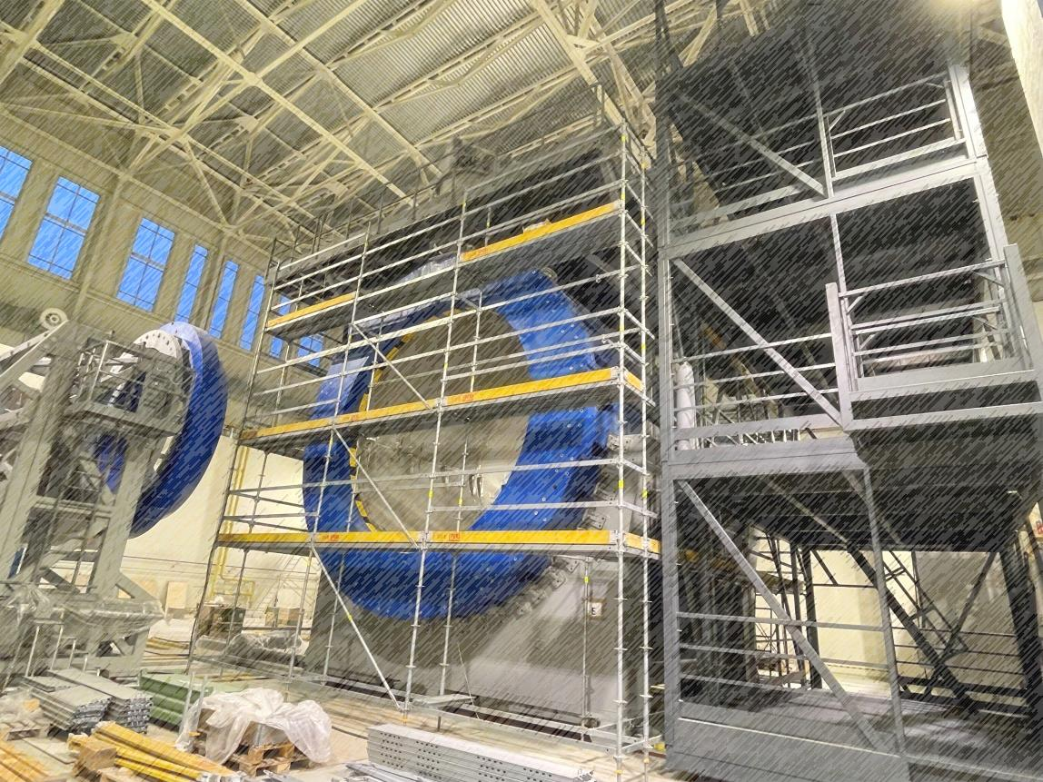
Status of the solenoid assembling
The 2nd China – Russian Joint Workshop
09-14/09/2024, Qingdao
From drawing
to facility
Speaker: K. Mukhin

Slide 2
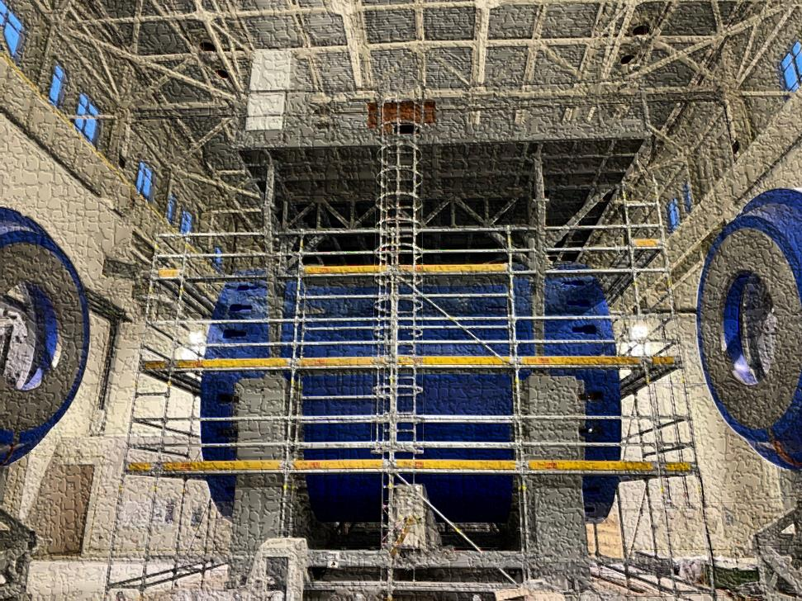
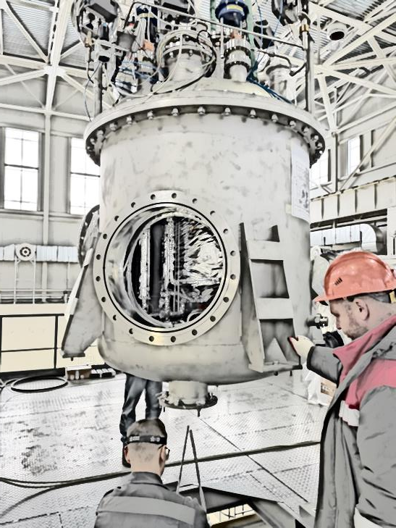
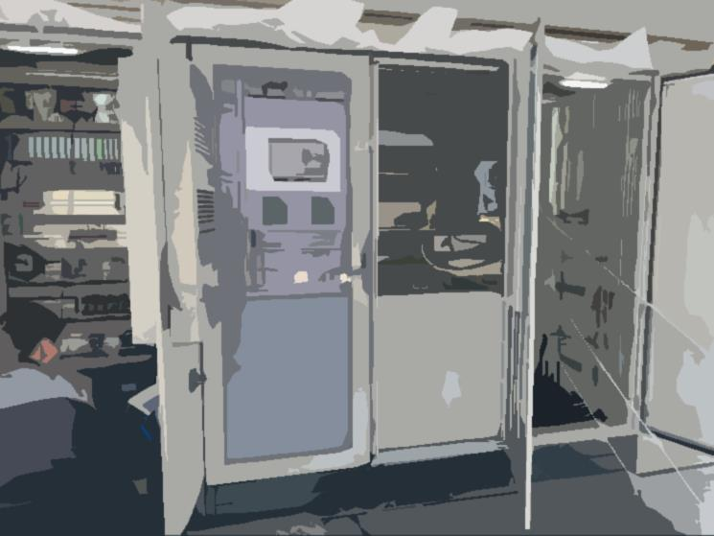
Plan of talk
Magnet construction and some parameters
Cryogenic infrastructure
Conclusion of the first cooling by 72K
Control and protection system
Timeline

Slide 3
Chapter 1 Magnet construction and parameters

Slide 4
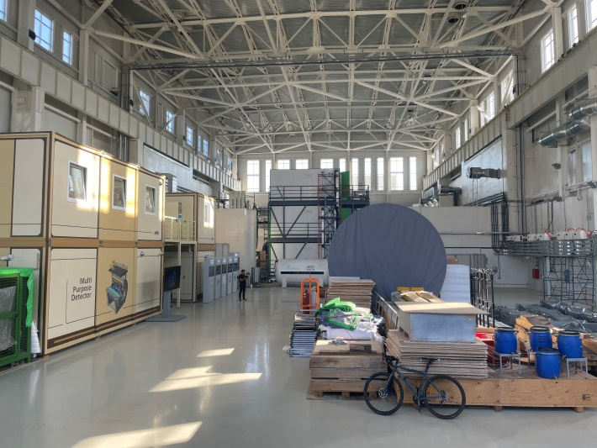
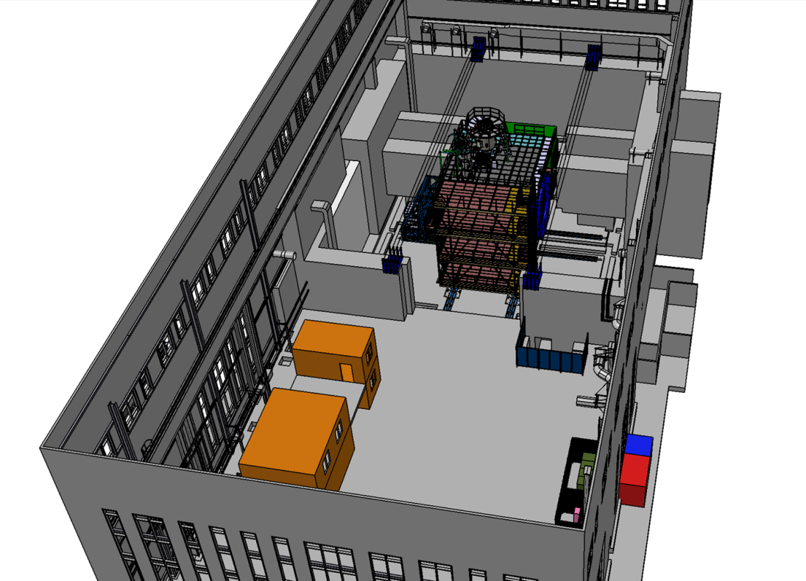
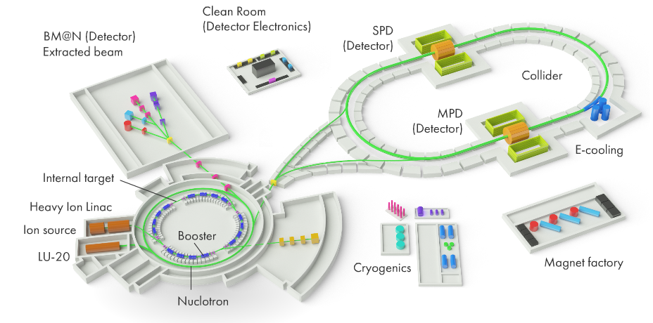
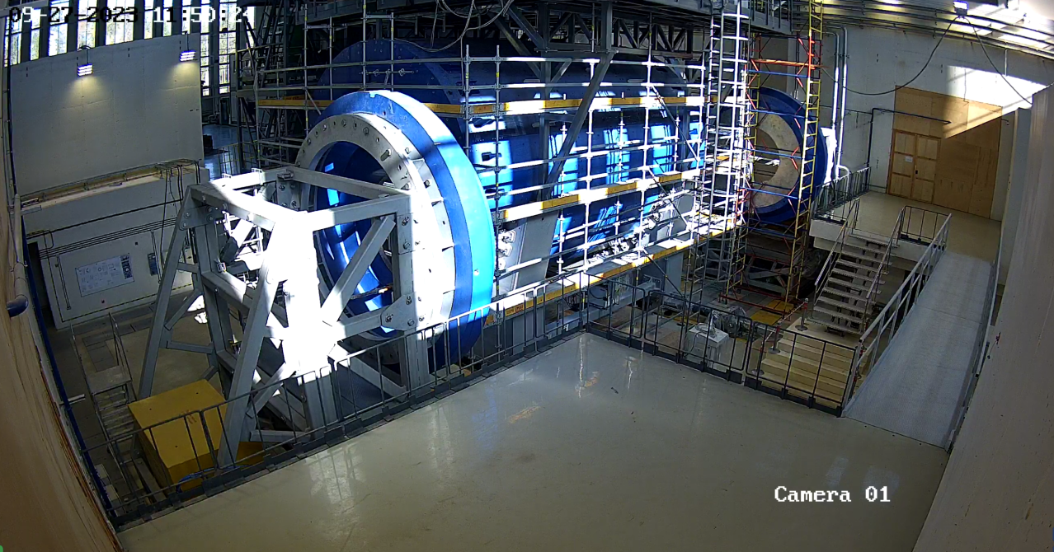
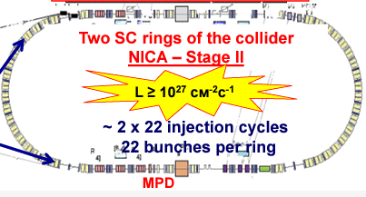
MPD in NICA complex
NICA parameters

Slide 5
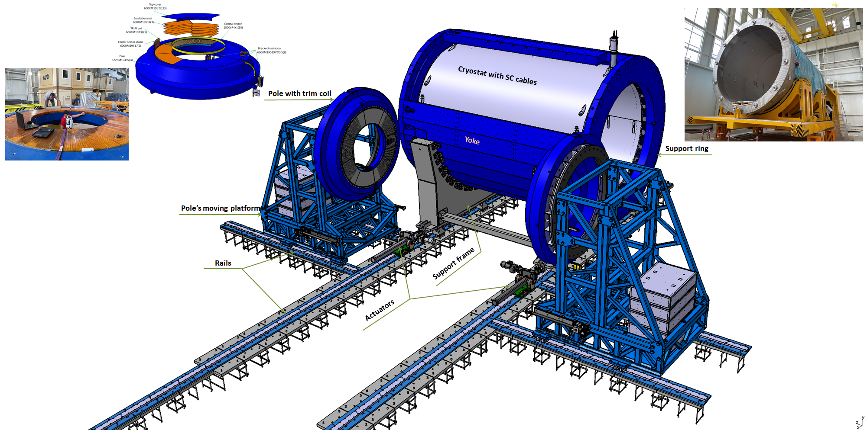
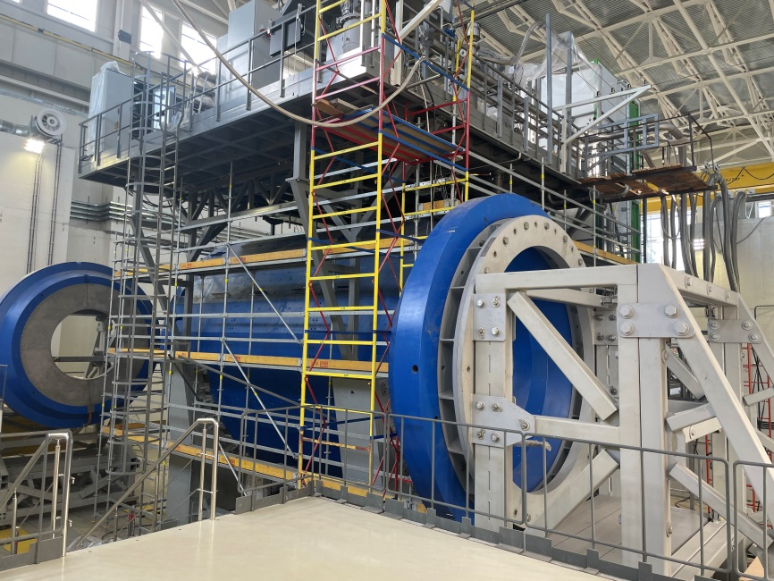
MPD magnet construction
Parameters of the magnet
Magnetic field | 0,57 T
Cryostat weight and size (diameter/length) mm | 66 tons 5443/7910
Yoke weight and size (diameter/length) mm | 630 tons 6583/8970
Current Voltage | 1790 A 10V
Each pole weight | 45 tons
Total weight with support equipment | 800 tons

Slide 6
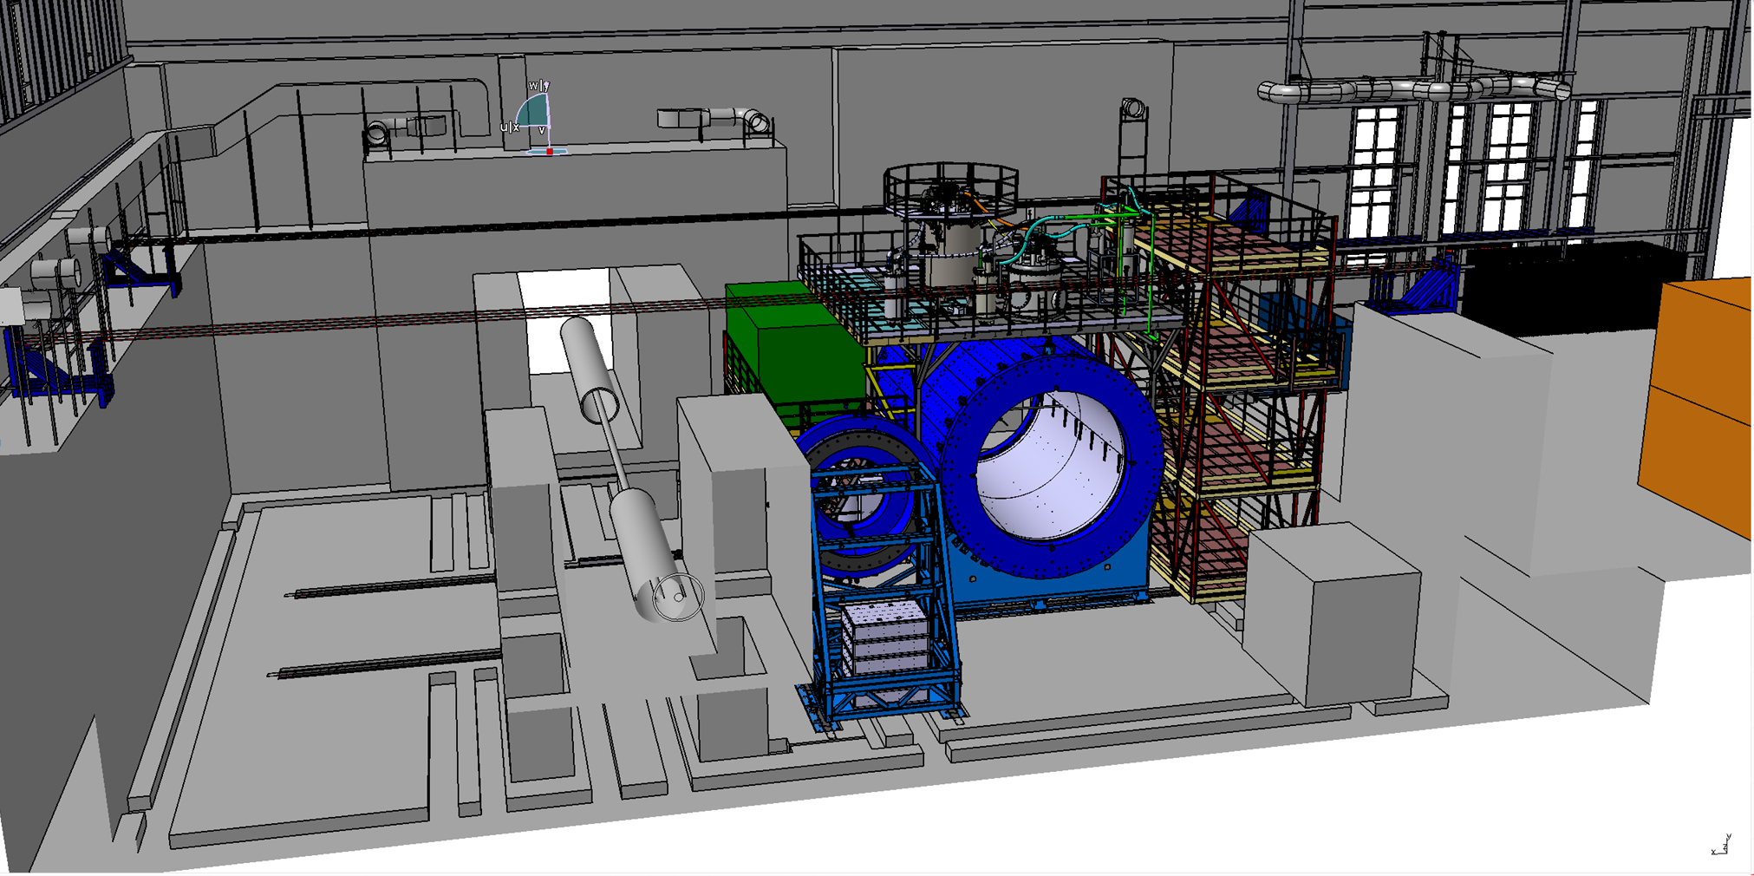
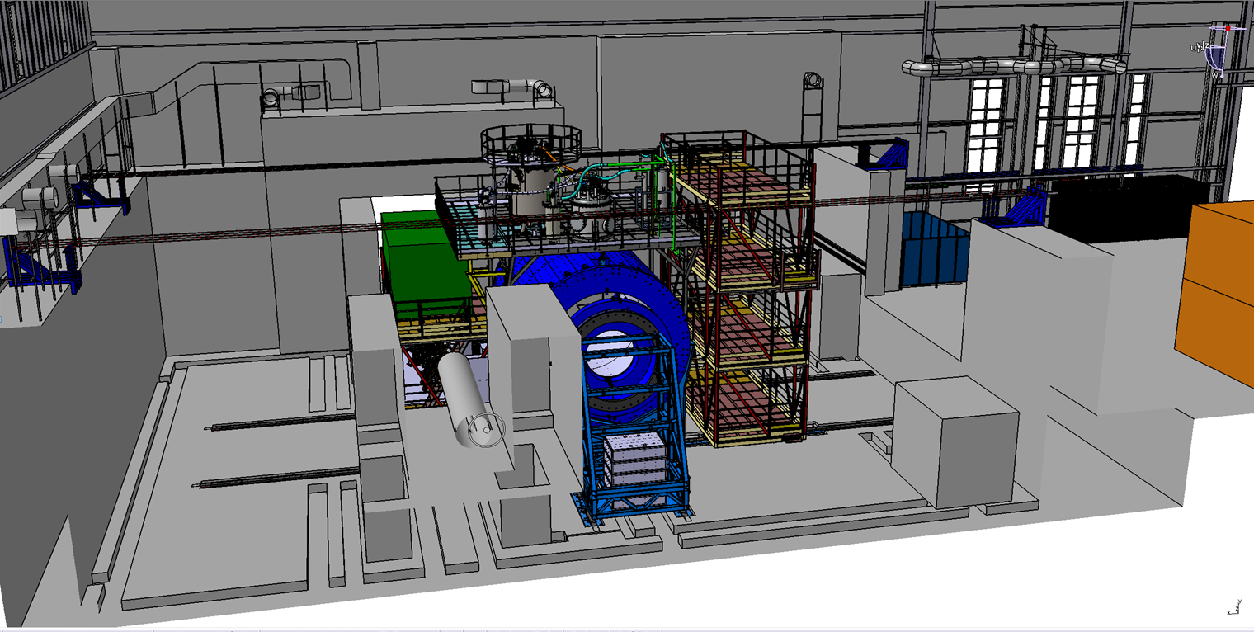
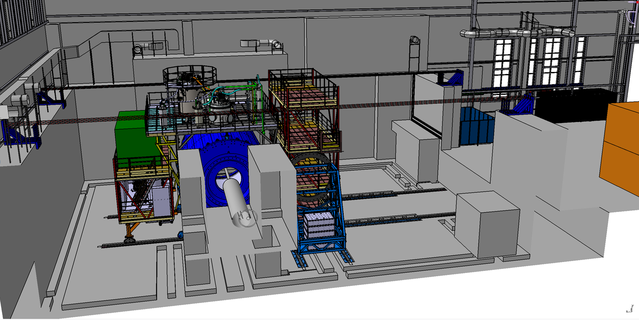
Possibility of magnet moving
Three main position
Assembling position
Trim coils installation position
Beam position
Distance – 12 m
Moving time about 5 hours
Speed 2 – 3 mm/s (for the final step 0,4-0,5 mm/s)

Slide 7
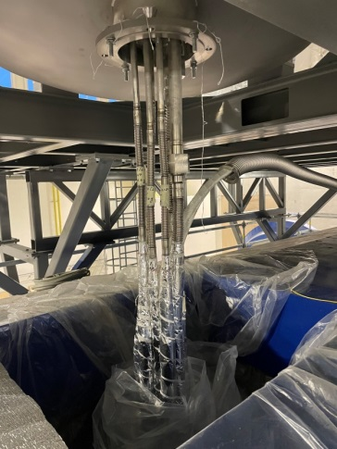
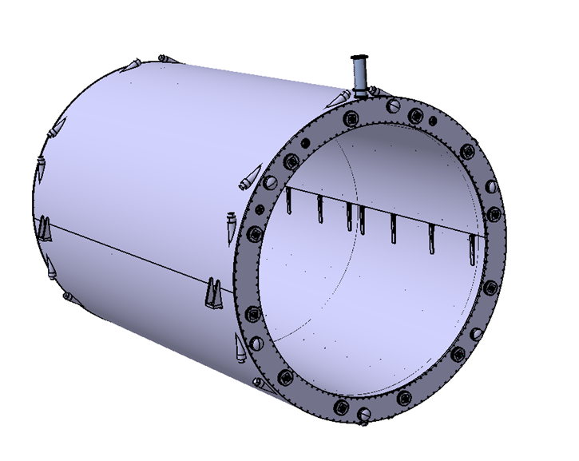
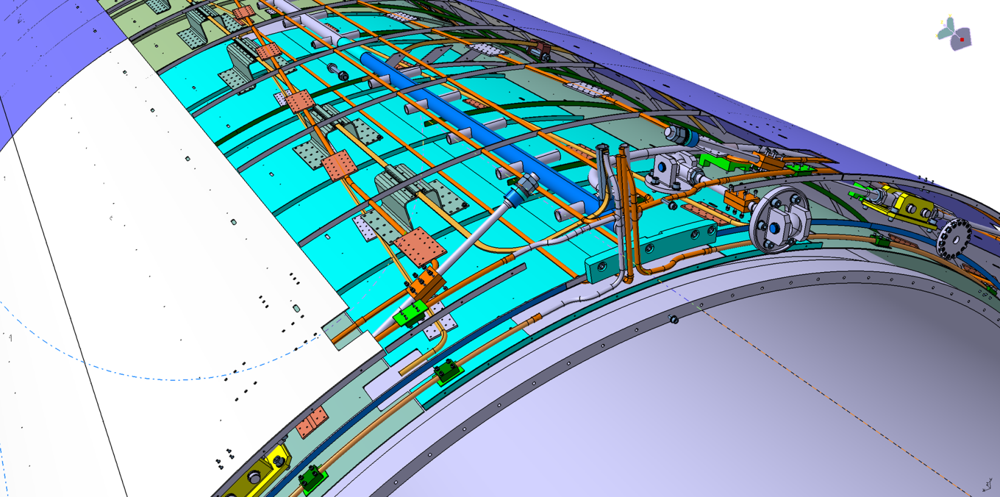
Solenoid construction
Solenoid with vacuum jacket
Solenoid without vacuum jacket
LN2 shield
4, 5
9
3
Vacuum jacket
Parameters of solenoid
Vacuum jacket (10-5 Torr in warm mode)
LN2 thermal shield (80K)
Cold mass (support cylinder for SC cables)
Superconductor cables (3 parts) total length 27 km, NbTi in pure aluminum matrix.
Cooling LN2 and LH pipes (cimmny area)
6. Number of turns – 1674
7. Operation temperature 4,5 – 5,5 K
8. Operation current / Rated induction – 1,79 A / 0,5 T.
9. 12 Radial and 6 axis cold mass suspensions
10. Total heat gain – 1056 W
Inner diameter is 4656 mm
Outer diameter is 5443 mm
Length is 7910 mm

Slide 8
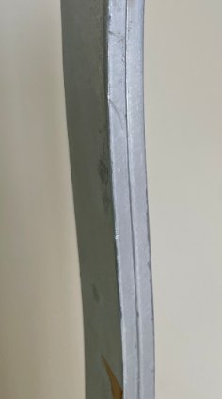
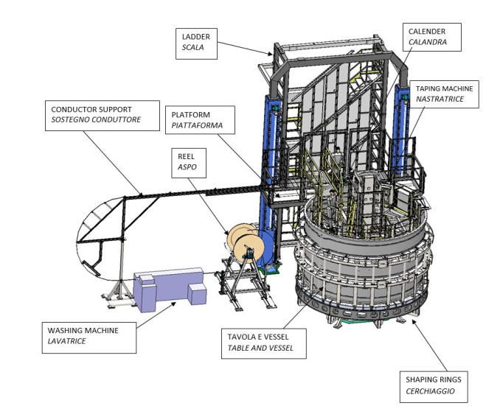
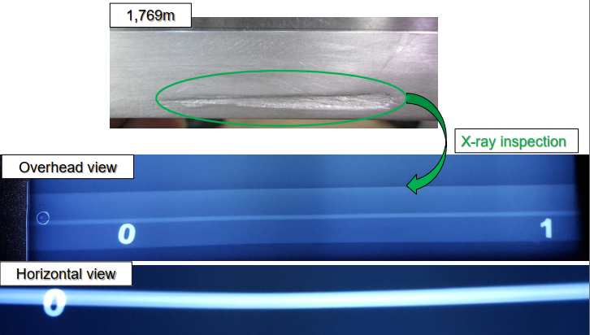
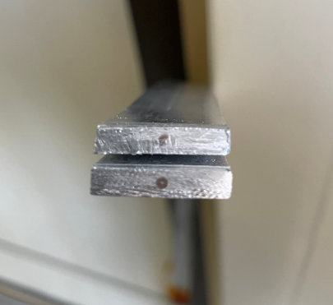
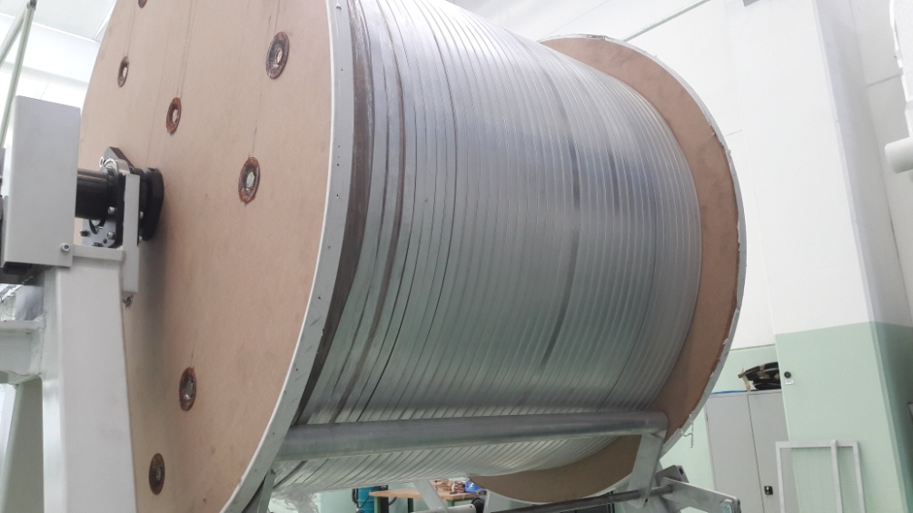
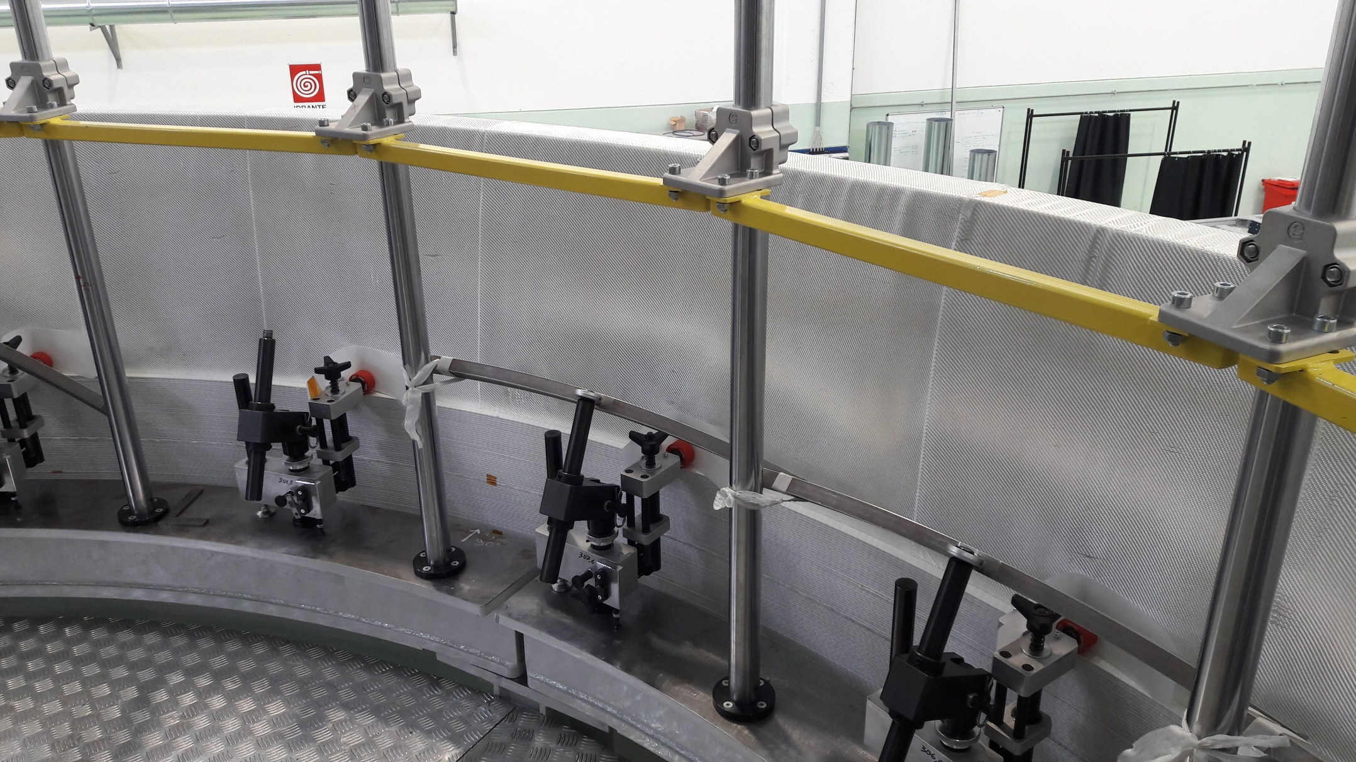
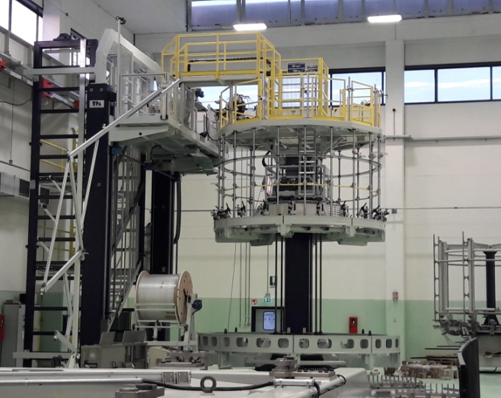
Superconductor cable
Original SC cables for MPD
Winding and tests of SC cable in ASG
SC cables parameters
SC Materials – NbTi/Cu.
Cable composition is pure aluminum matrix (4,1 x 20 mm) and inside string of Cu/SC ratio 0,9/1 (d – 1,5 mm).
Insulation – kapton tape, glass tape and epoxy resin.
Critical current (1,2 T, 4,5 K) – 6,9 kA
Cable length - 27 km.
Cable weight – 6,3 tons

Slide 9
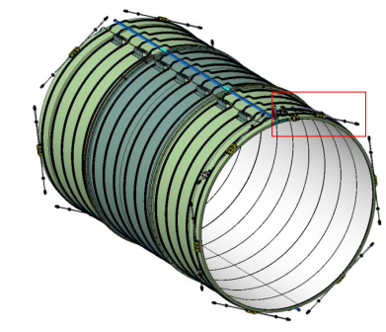
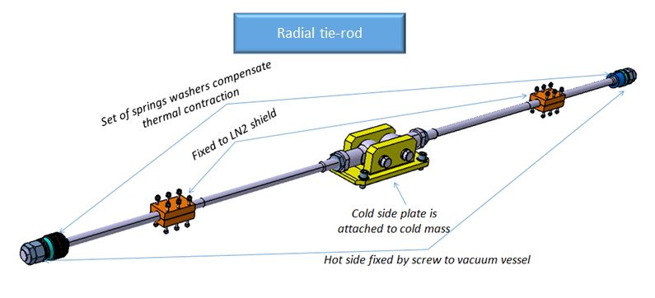
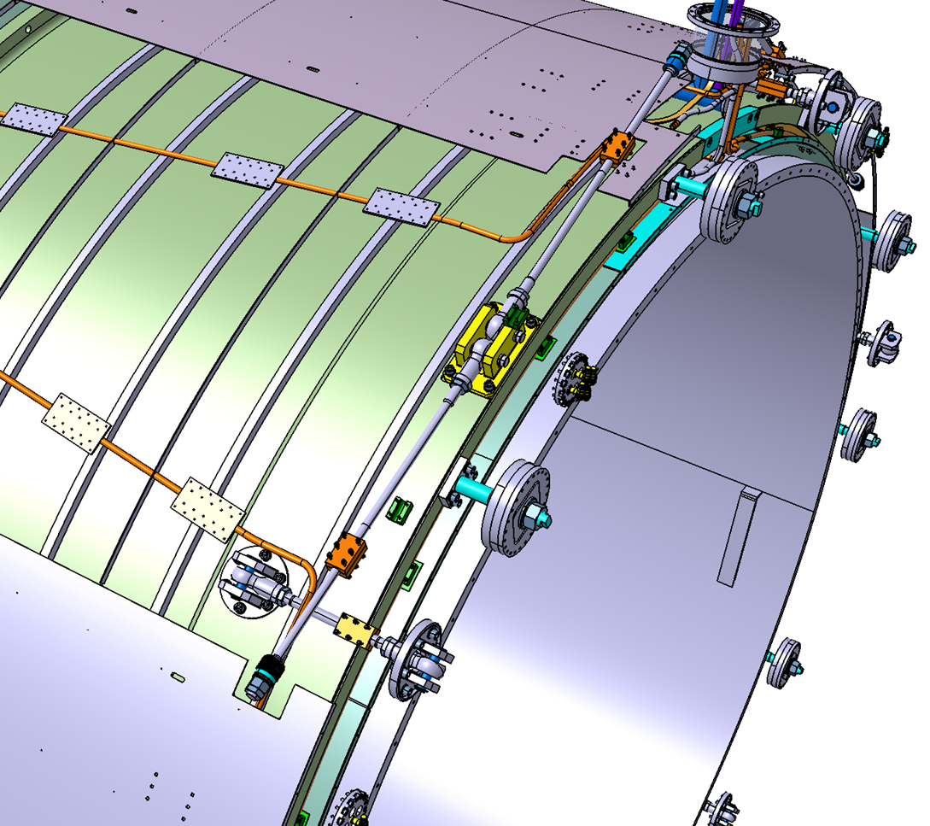
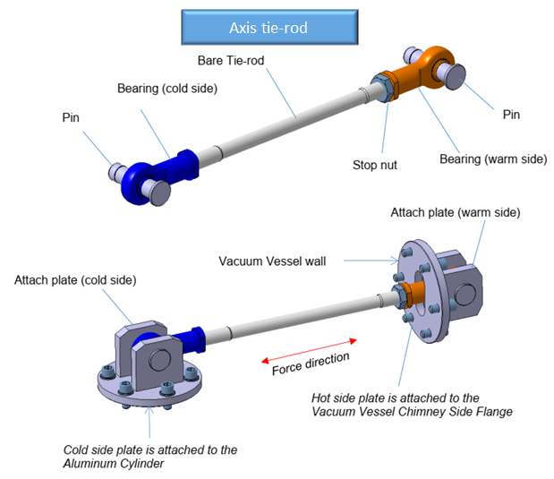
Suspension system of cold mass
Suspension system consist of 6 axils and 12 radial tie-rods.
Axis tie-rods – fixed cold mass from moving in axis direction
Maximum force of tensile/compressive is 240/89 kN. Safety factor is 4,3.
Radial tie-rods – supporting a cold mass inside vacuum vessel.
Safe against shear + bending with the sizing load of 50 kN. Safety factor 1,8.

Slide 10
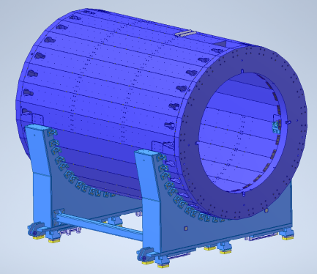
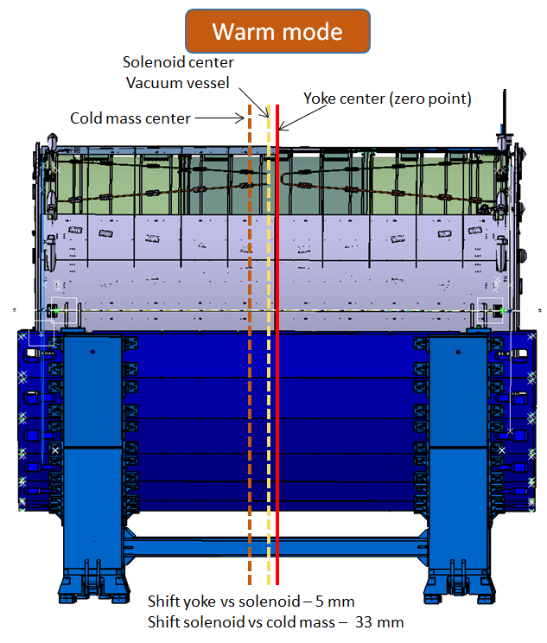
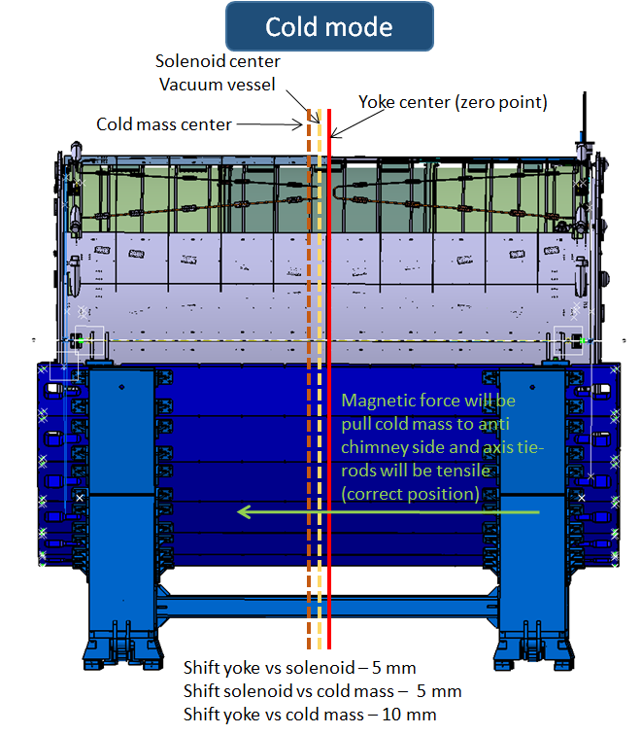
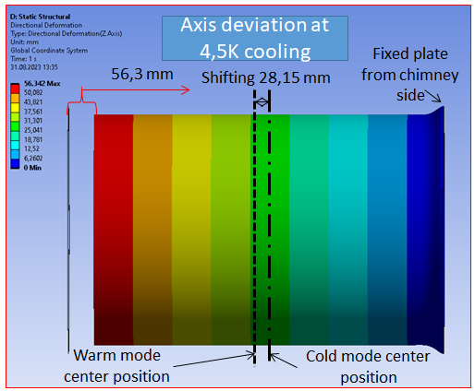
Vertical axis position and verification
Yoke
Solenoid (vacuum vessel)
Cold mass with SC cables
Computing simulation

Slide 11
Chapter 2 Cryogenic infrastructure. Conclusion of the first cooling by 72K .

Slide 12
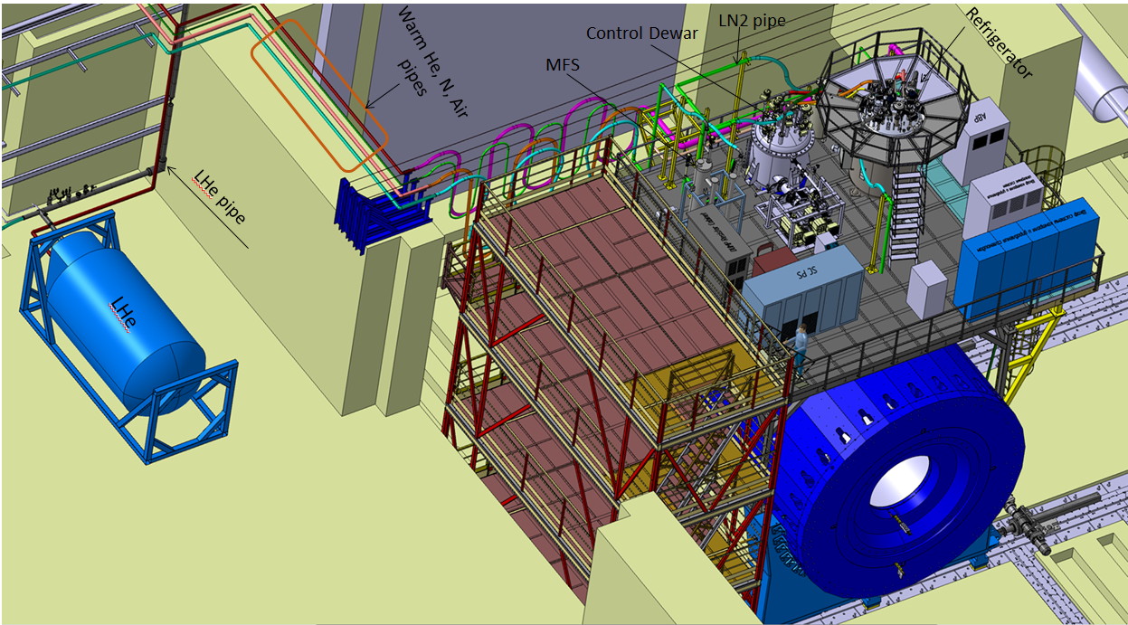
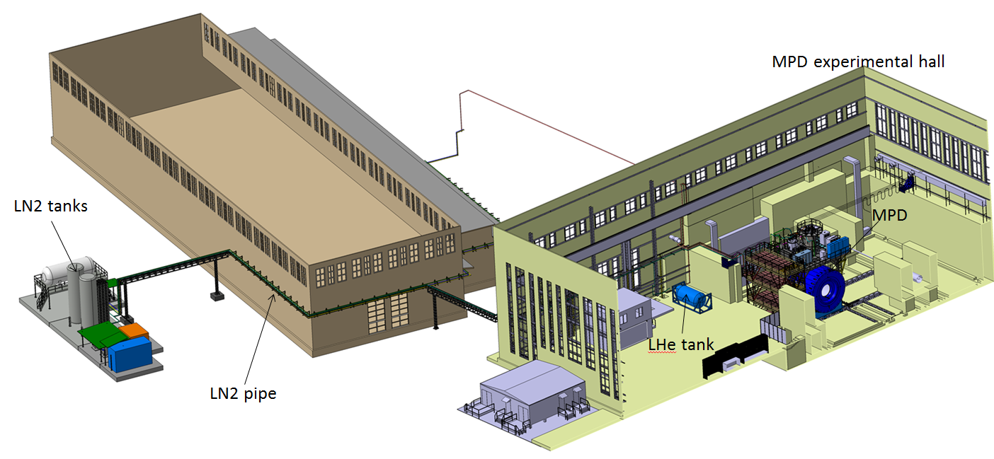
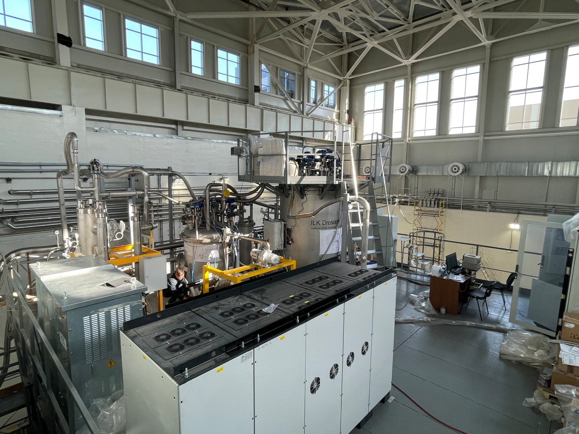
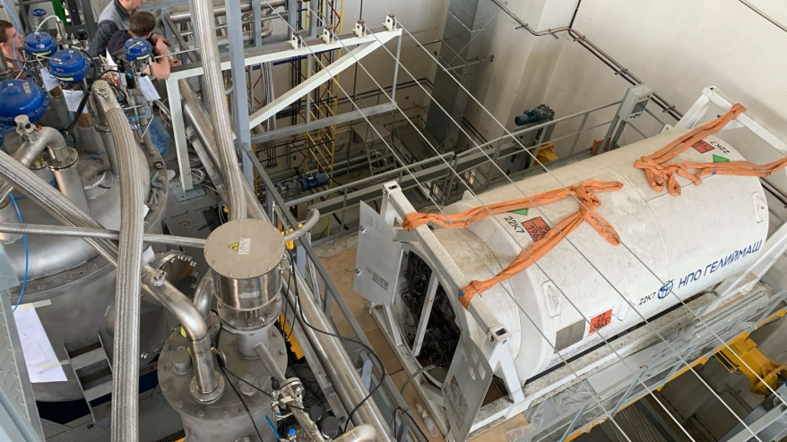
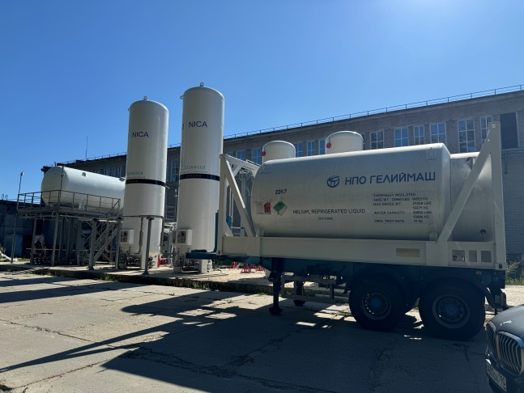
Cryogenic infrastructure
Control Dewar
Refrigerator
NTCS (Nitrogen temperature correction system)
LN2 and LHe heaters
LHe pipe
Cryogenic flexible connection pipes
LN2 Tanks (2 pc)
LHe Tanks (2 pc)
LN2 transfer pipe 120 m
Warm pipes for He, N2 and instrumentation Air
Flexible warm pipes
Support system for flexible pipes
Temporary pipes for cooling by temporary scheme

Slide 13
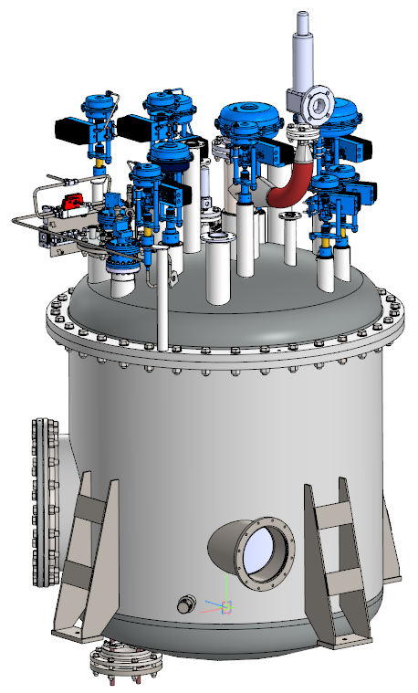
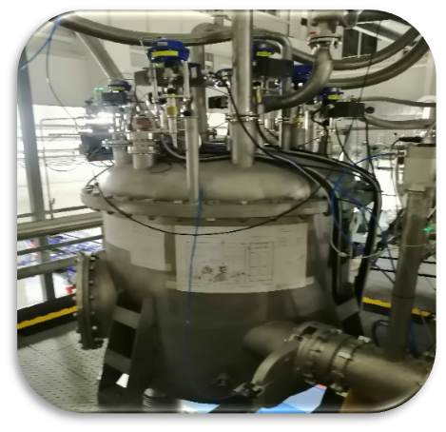
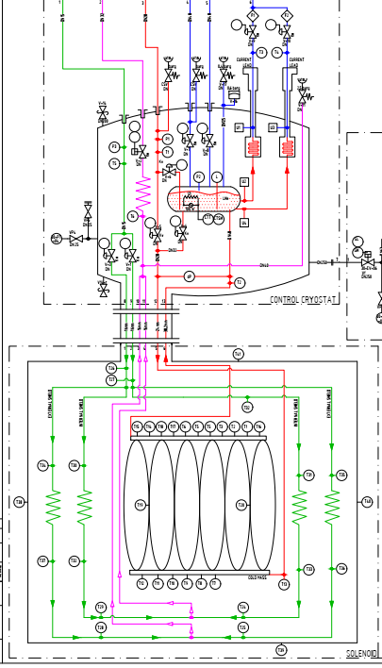
Control Dewar
The control Dewar is a functional block of the MPD magnetic cryogenic system. Control Dewar regulates the supply of cryogenic liquids to the magnet under appropriate thermodynamic conditions in accordance with operating modes, as well as the stable maintenance of helium cooling of the electrical input of low-temperature current leads.
Cooling power (helium mass flow rate 5g/s depends on the satellite helium refrigerator | 100 W at 4.5 K (liquid helium)
Forward pressure | Max 16 bar(abs)
Output of the He line from the control Dewar to the heater and the recovery line in the SGR | 1.4 bar(a)
Peripherals LN2 – thermal shield | 2.5 bar(a)
Maximum pressure in the helium reservoir | 1.4 bar(a) valve 1.5 bar membrane
Low pressure line from current conductors | 1.5 bar(a)
Useful volume of helium reservoir | 250 l

Slide 14
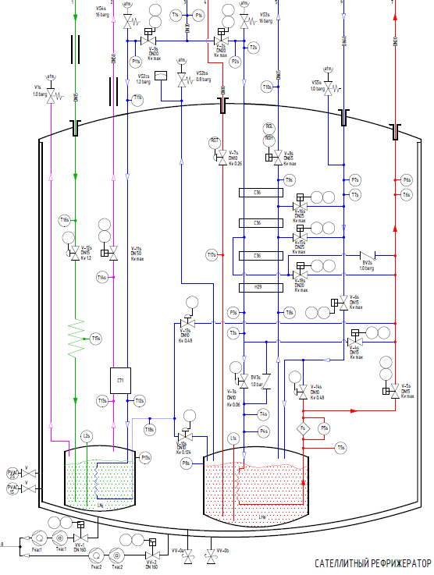
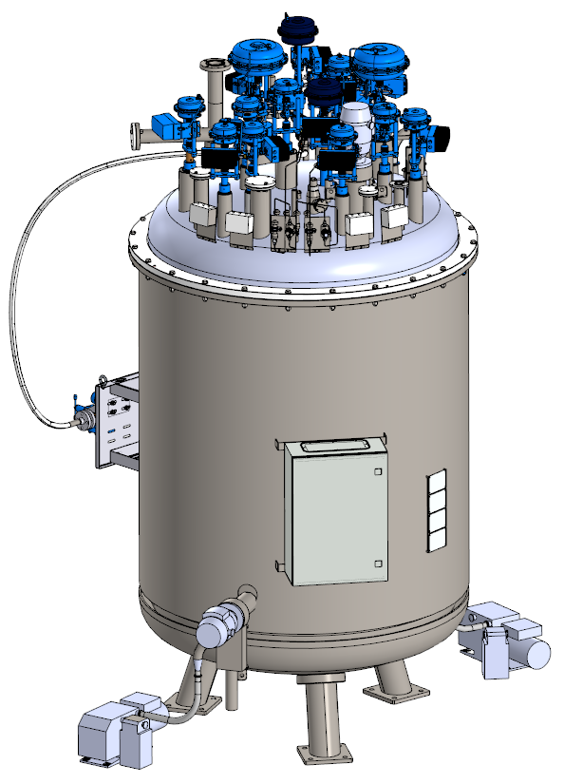
Satellite helium refrigerator
One of the main elements of the magnetic cryogenic system is the satellite helium refrigerator (SHR). The satellite helium refrigerator is designed to supply gaseous and liquid helium to the control Dewar, and then to the superconducting solenoid coil of the MPD detector.
The satellite helium refrigerator has a cooling capacity of 100 W at 4.5 K. The normal operating pressure of compressed helium at the inlet, depending on the operating mode, is 13 bar(g) (max 16 bar(a)). The satellite helium refrigerator has optimal cooling stages, ensuring the most stable cooling of the superconducting detector coils to a temperature of 4.5 K.
Cooling power (helium mass flow 5 g/s, normal operation) | 100 W at 4.5 K (liquid helium)
Forward pressure | Max 16 bar(abs)
Useful volume of helium reservoir | 160 l
Useful volume of nitrogen reservoir | 125 l

Slide 15
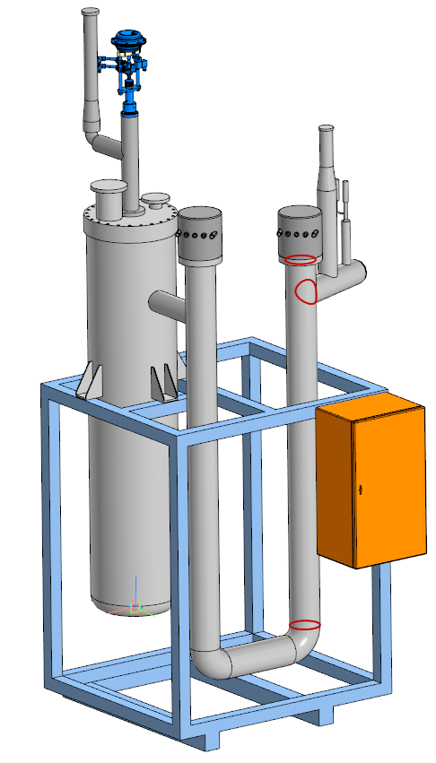
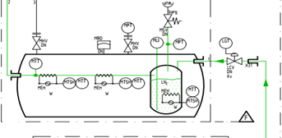
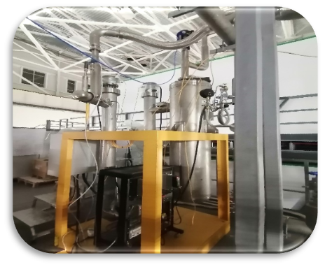
Nitrogen Temperature Correction System (NTCS)
The Nitrogen temperature correction system (NTCS) is designed to supply liquid or gaseous nitrogen at a controlled temperature to the nitrogen screens of the MPD detector solenoid. NTCS is necessary to control the required maximum temperature gradient in the solenoid during both cooling and warming.
Temperature operating conditions | 300-78К
Operating mode | Cooling/Heating
Heating element power | 5кW
The cooling/warming system of the thermal screens of the MPD multi-purpose detector is carried out using an automated control system. All sensors and actuators are connected through the control rack to a programmable logic controller (PLC).
The automatic process consists of 4 phases with subphases:
1) standby mode;
2) the beginning of filling of the MFS and evaporation;
3) pumping LN2;
4) emptying and warming the cryostat.
PID control is used to operate the heaters of the installation

Slide 16
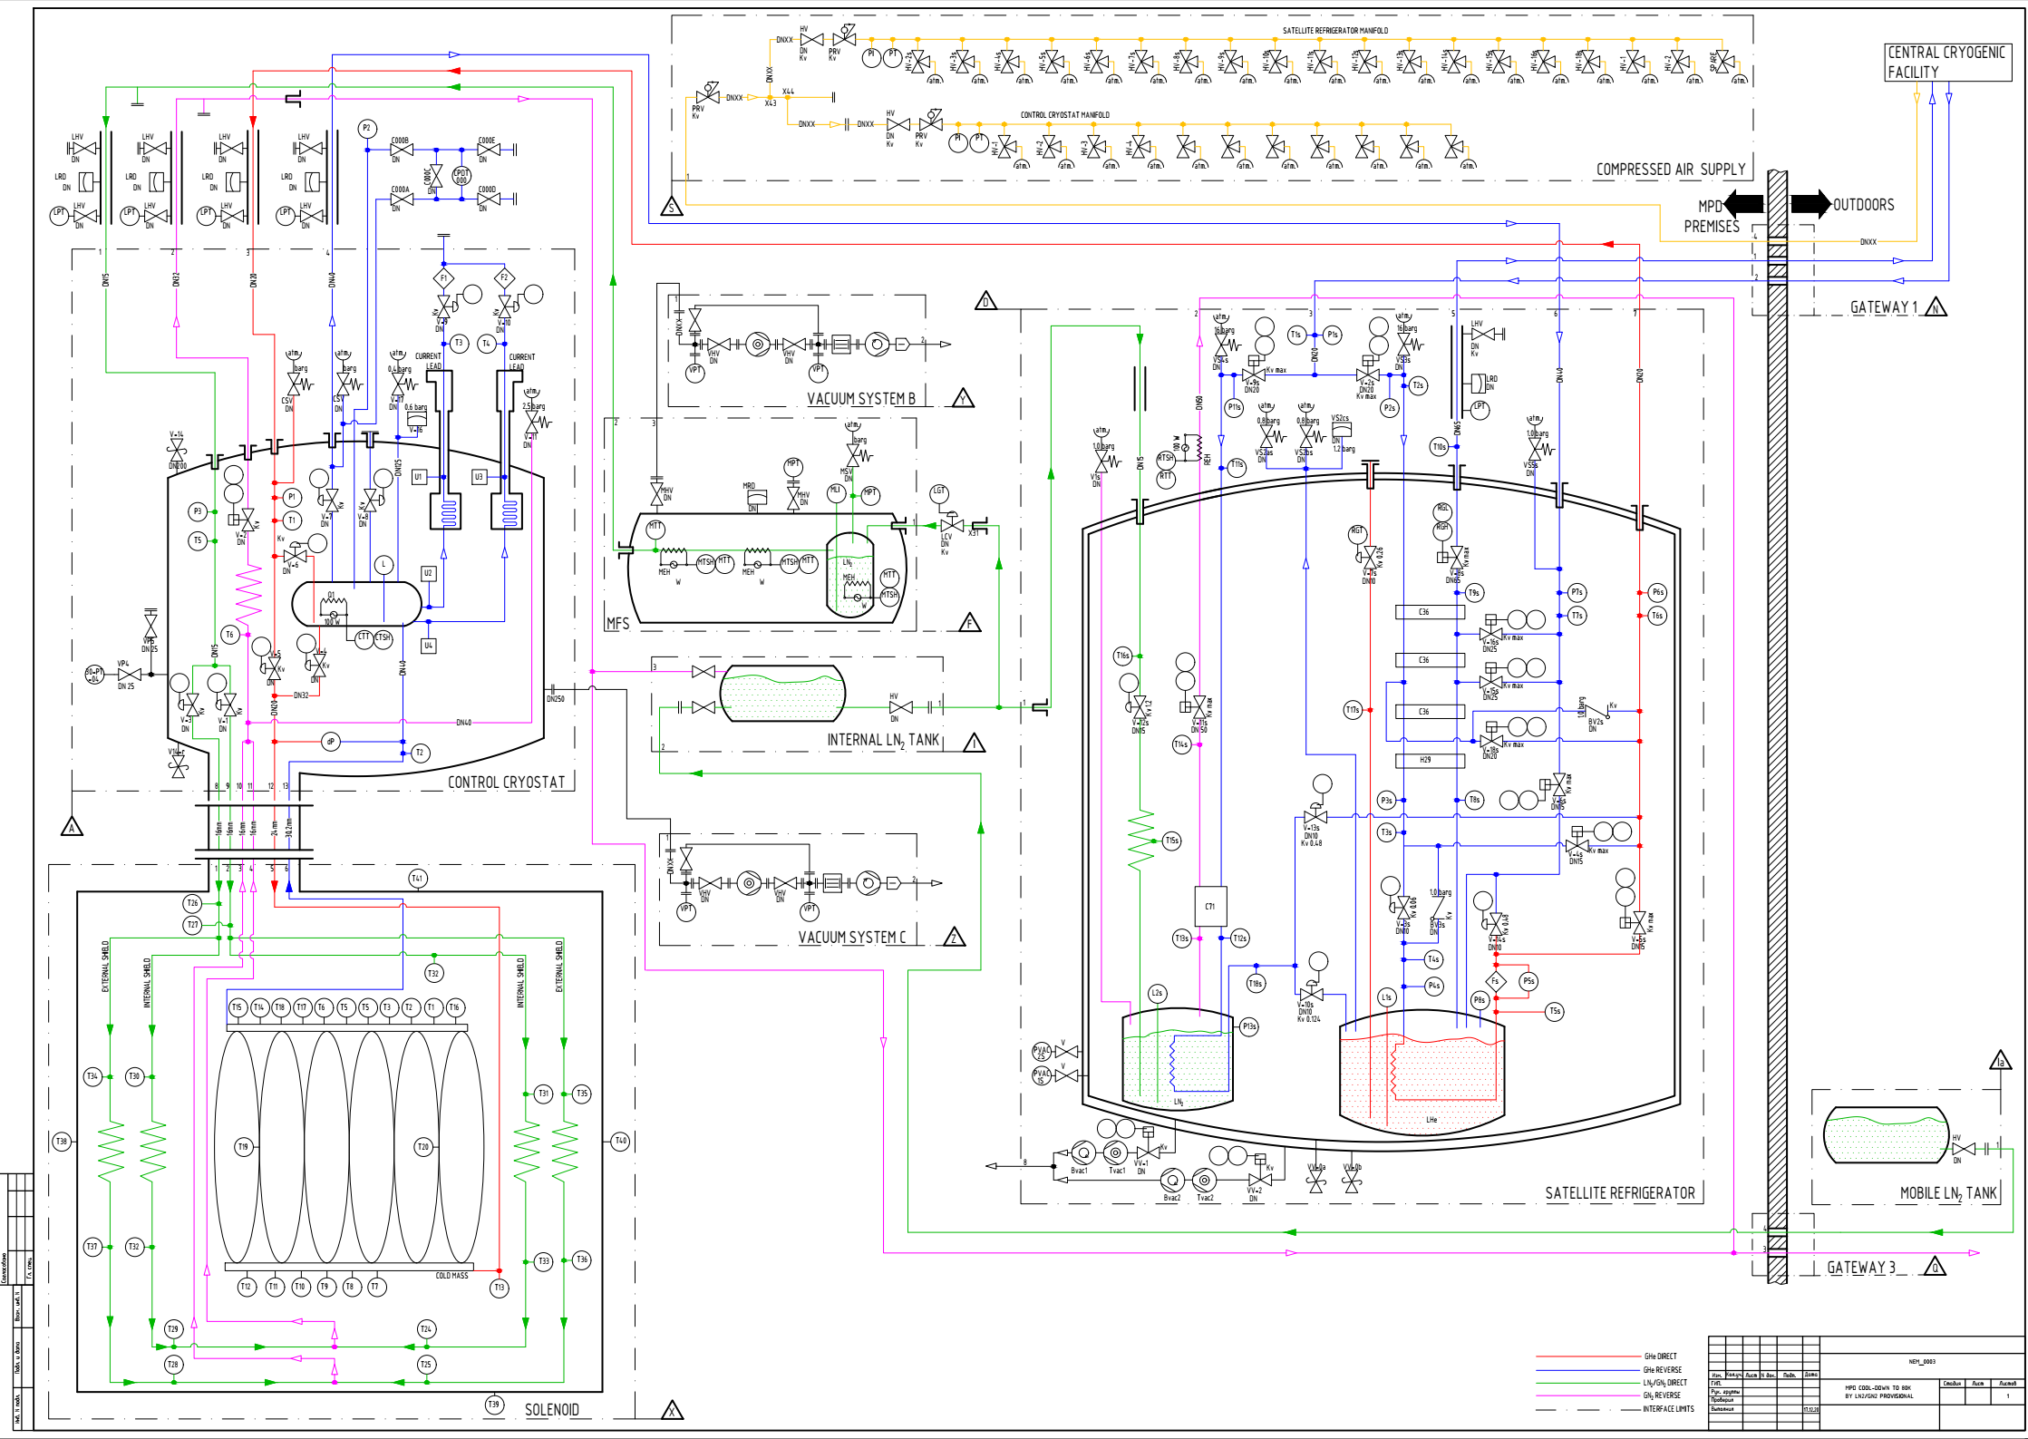
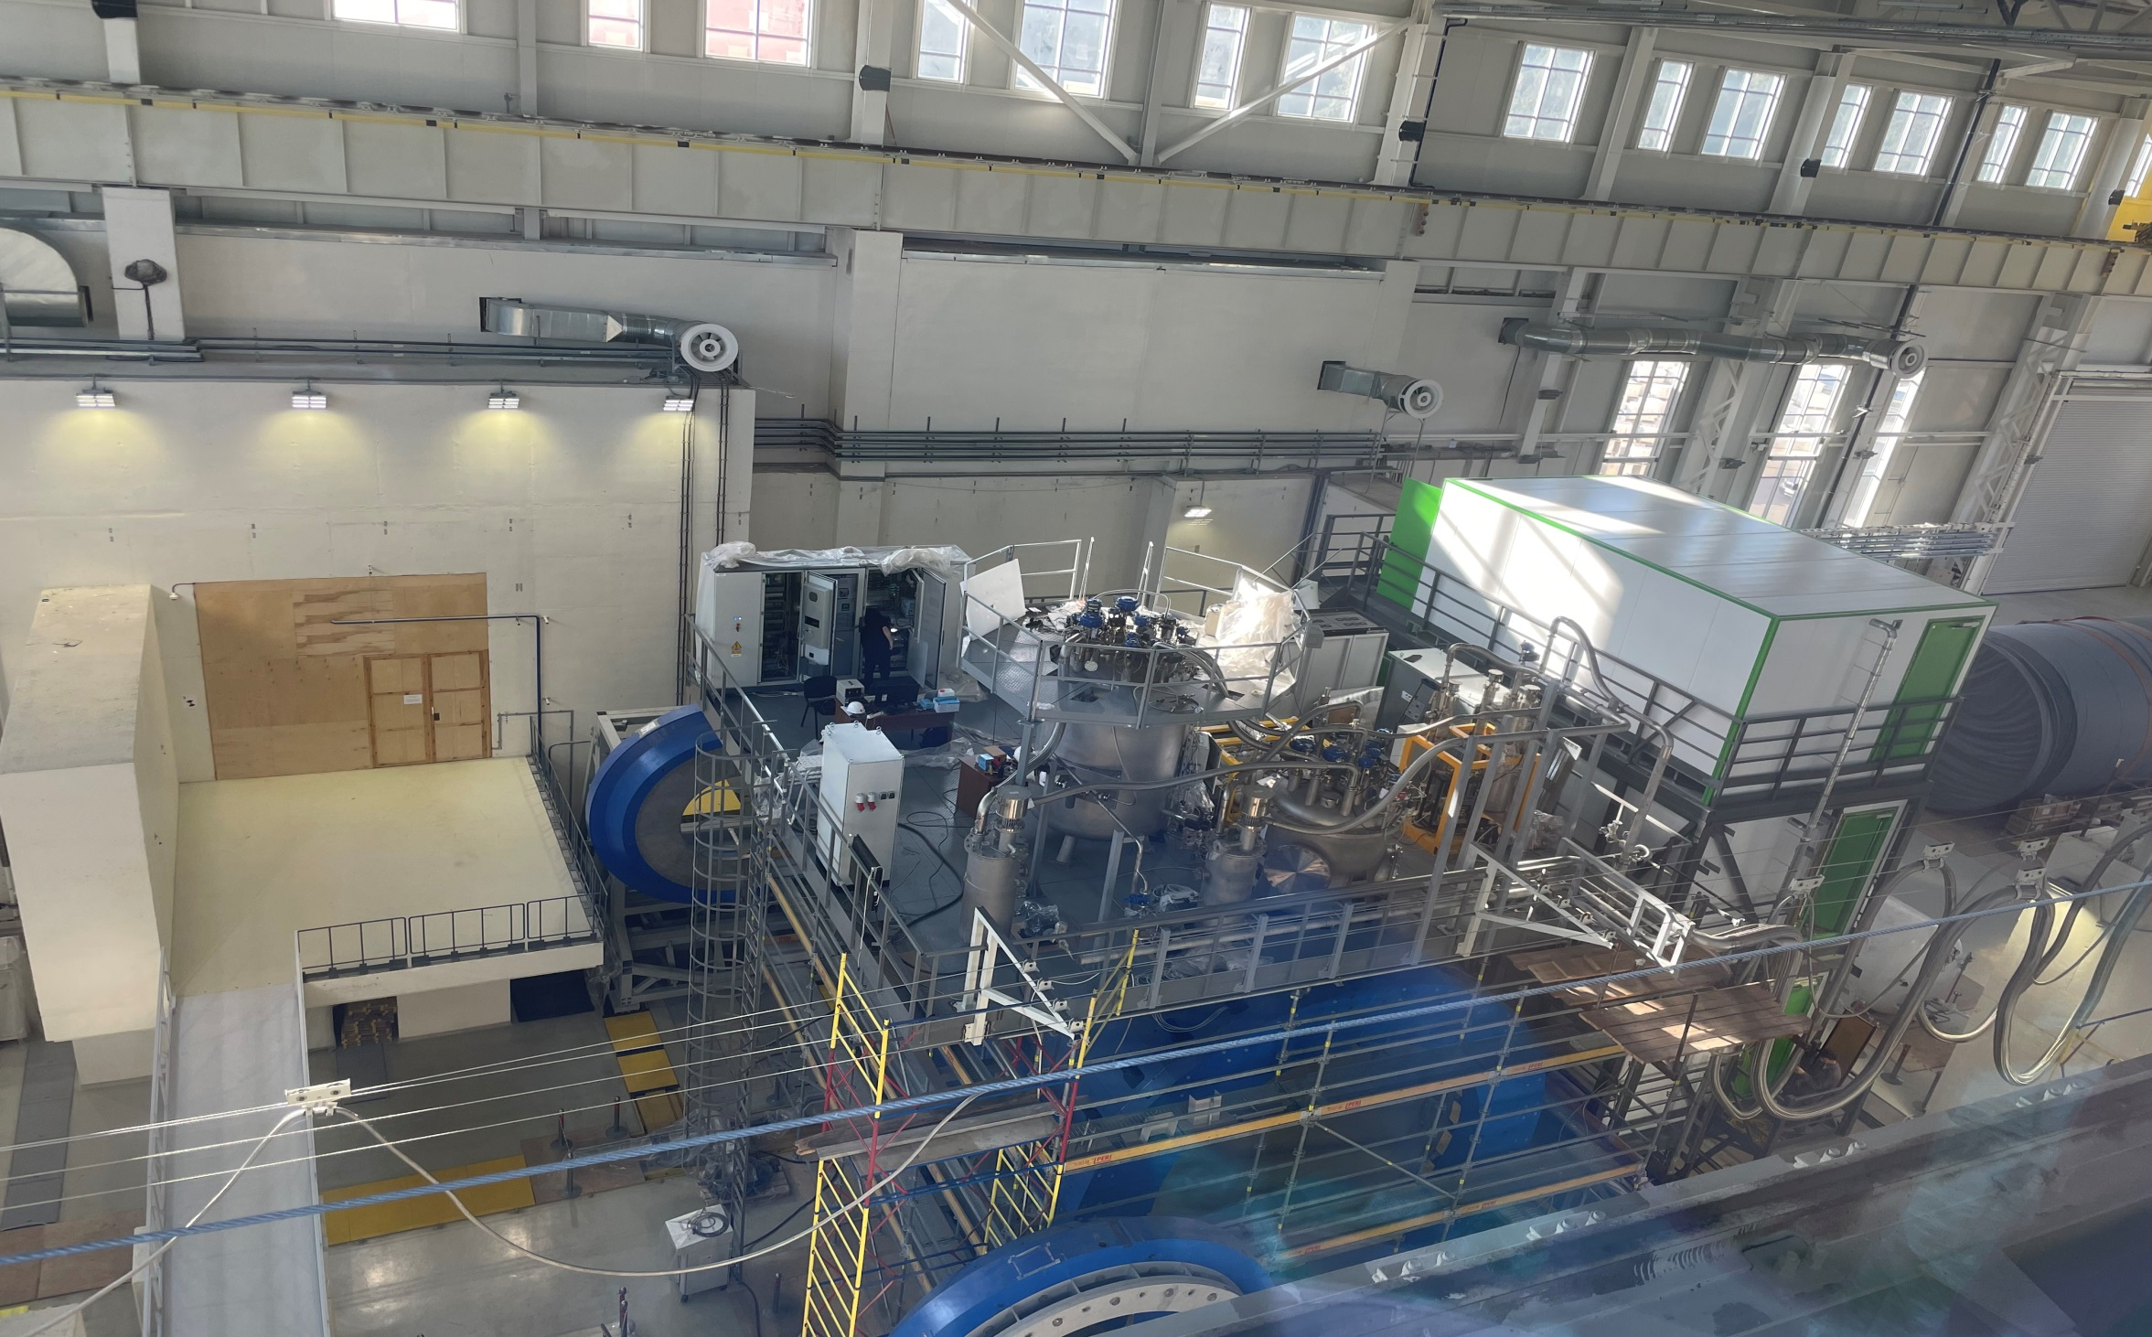
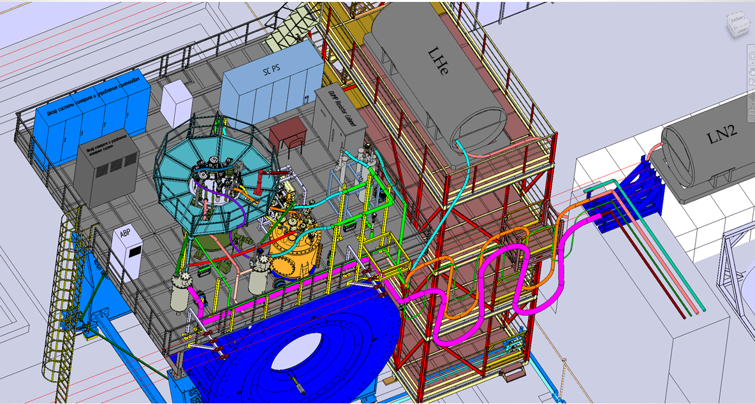
Temporary scheme of cooling at 80 K

Slide 17
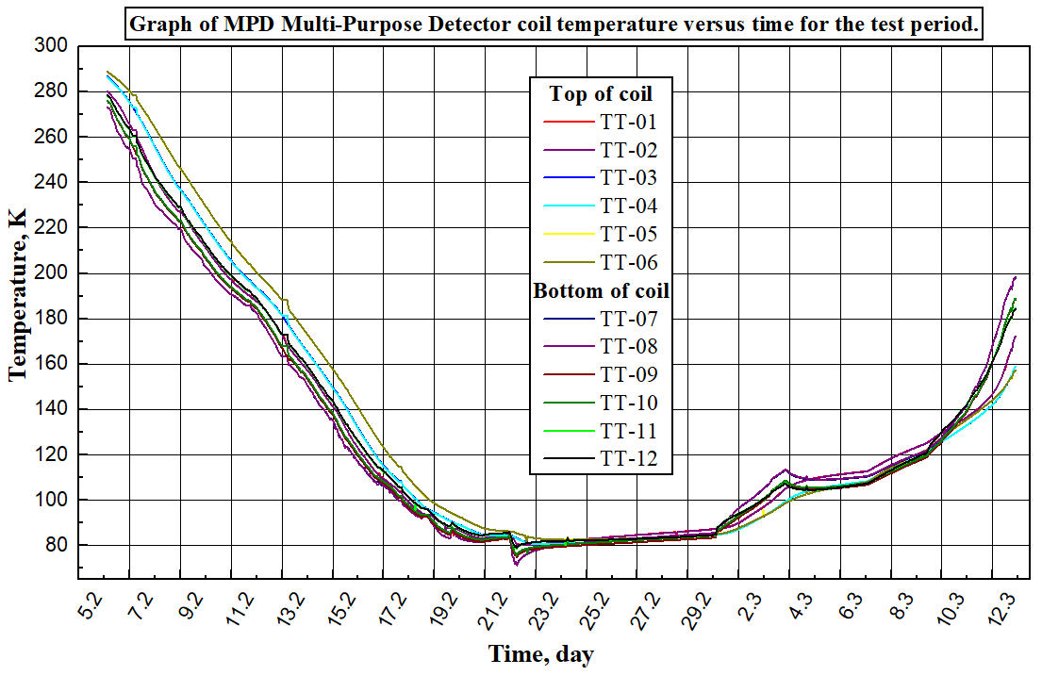
The first cooling by 72K
Tasks of the first cooling
Cooling the superconducting coil to nitrogen temperatures (78 K).
Check leak by cold model.
Test of maintaining a multi-purpose detector cooling rate of 1 Kelvin per hour.
Cooling of heat shields in automation mode.
Investigation of heat loads at the cooling stage and at 78K mode (stationary).
Cooling the superconducting coil with liquid helium.
Determination of heat inflow when vacuum deteriorates (heating mode).
Test cooling by nitrogen shield without helium circulation.
Maintaining a multi-purpose detector warming rate of 1 Kelvin per hour by warm mode.

Slide 19
Dependence of the temperature of the coil (MPD detector) when cooling the thermal screens and switching off by helium circulation
Uniform temperature rise 0.5 K by 11 hours

Slide 20
Conclusions of first cooling
Successful cooling solenoid by 72 K.
No cold leak in thermal shield and LHe circle.
Obtained cooling parameters of cryogenic equipment can be accept and are consistent with a manual (1 - 1,5K/h).
Heat load into solenoid are consistent by passport and low then 100 W.
Cooling time from room temperature to 80 K take’s about 13 days (need optimization, temperature difference need less then 30 K).
Successful test of hold 80 K temperature solenoid by LN2 shield without helium circulation (not actuators, no risks let us hold solenoid by 80 K all time It is extend a life time of solenoid).
Successful a warm mode test

Slide 21
Chapter 3 Control and protection system.

Slide 22
Control system
All signals from solenoid engineering system connect to control system
Valves position in different operation and alarm modes
Failure list and feedback on CS
Main control parameters
Temperature of CS cables (we add 6 sensors to chimney area and current leads)
Temperature of thermal shield
Volume of LHe in control Dewar vessel
Voltage taps (drop current at CS, current leads)
Pressure inside vacuum vessel
Tie rods (stress sensors, position of cold mass)
Water flow and temperature
Refrigerator failure (by LHe level)

Slide 23
Test of solenoid protection system (voltage taps)
Nominal current - 1790 A
Nominal volts - 10 V
Induction – 0,5 T
For the safety of SC cables and previously shout down power system, provide QD and voltage taps.
Voltage taps located in to welding points of SC cables, warm and cold part of current leads.
Signals from voltage taps transfer to Yokogawa, converted and gives a control signal to QD.
Safety parameters is +/- 1 V.
Test parameters 1,2A, 10V

Slide 24
Timeline
September – October 2024 – start cooling at 4 K
October – November 2024 – cooling water engineering system preparation and technical and heat tests
October – November 2024 – prepare a program and test for Power supply system, quench detection system and energy evacuation system.
November – December 2024 – beginning of current supply.
November 2024 – January 2025– assembling and measurement of magnetic field in MPD magnet.
January… - automatization of engineering system of solenoid (propose to take part in this tasks)
Purpose to take part of cooling of solenoid, test of power supply system (meet with an equipment and training, formation of algorithms preparing an automatization software).

Slide 25
Thank you for attention

