Slide 1
STAR detector upgrade: inner TPC & at forward rapidity
Qian Yang ( 杨 钱 )
Shandong University
2024/09/10
Qian Yang @ , Sep. 10^{td} - Sep. 13th 2024

Slide 2
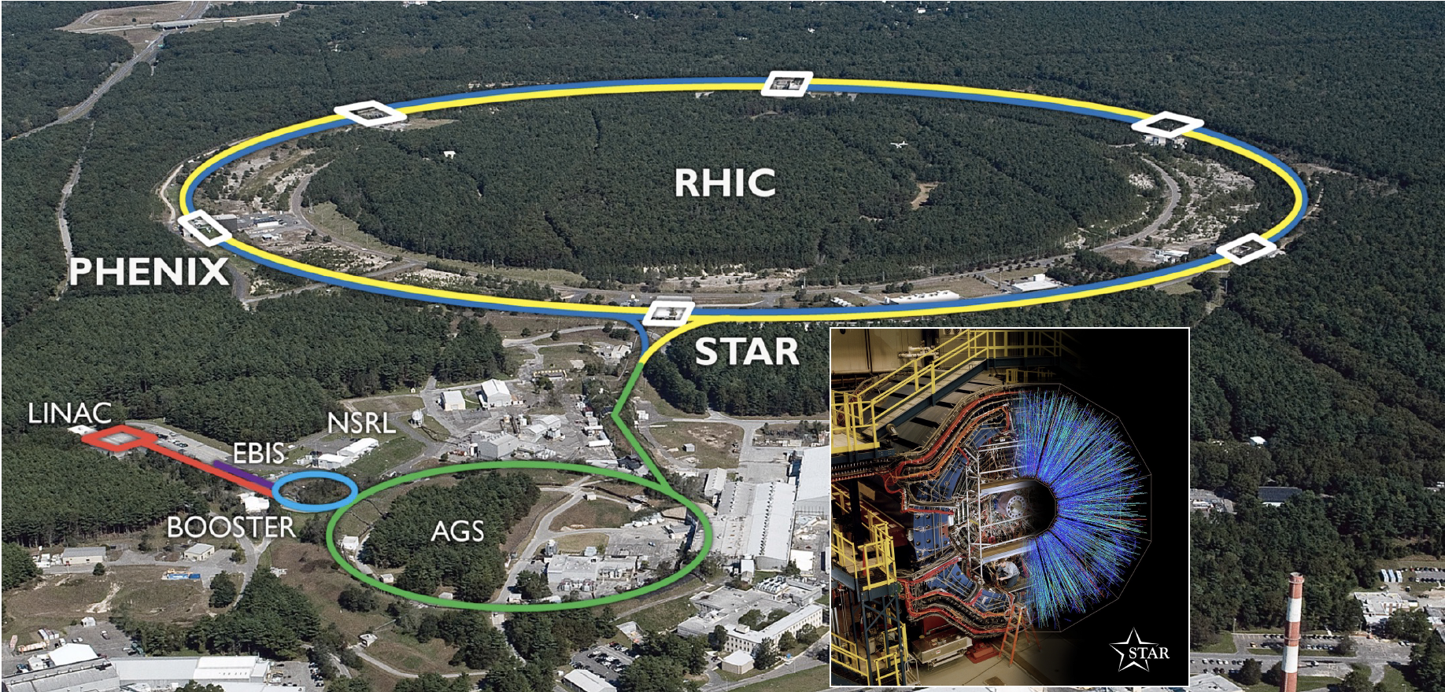
RHIC-STAR experiment
2024/09/10
Qian Yang @ , Sep. 10^{td} - Sep. 13th 2024

Slide 3
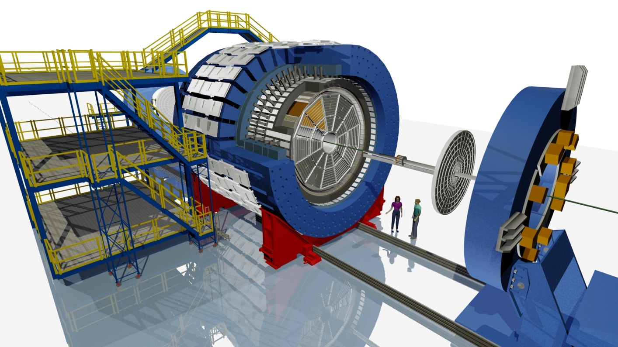
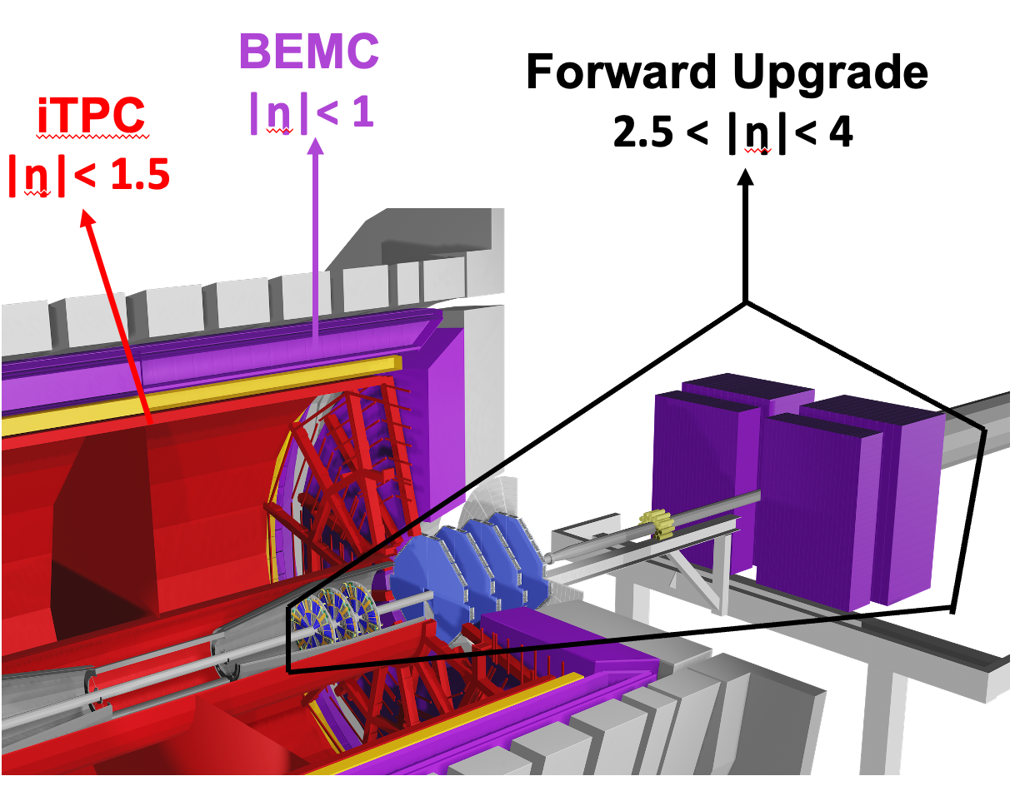
Physics Programs at RHIC
Beam Energy Scan Phase II program:
RHIC run 2019-2021
QCD phase diagram
Such as CEP, Chiral phase transition …
Cold and hot QCD plans:
RHIC run 2022-2025
Properties of QCD matter
Such as precise imaging of gluons and sea quarks inside protons …
Inner TPC
Forward Tracking System
2024/09/10
Qian Yang @ , Sep. 10^{td} - Sep. 13th 2024

Slide 4
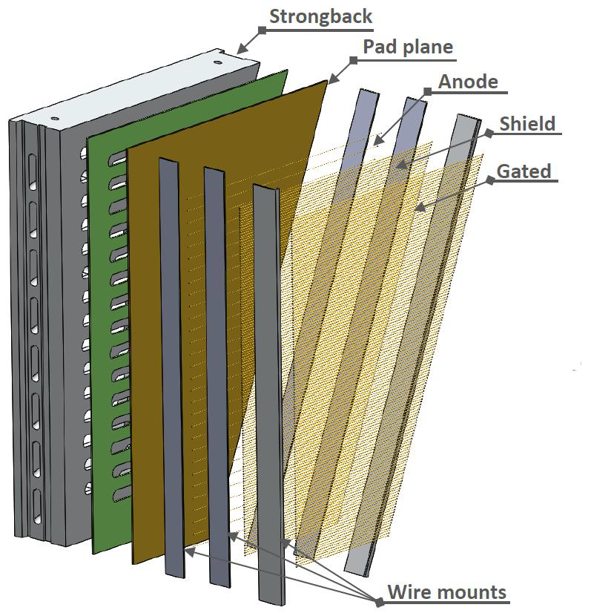
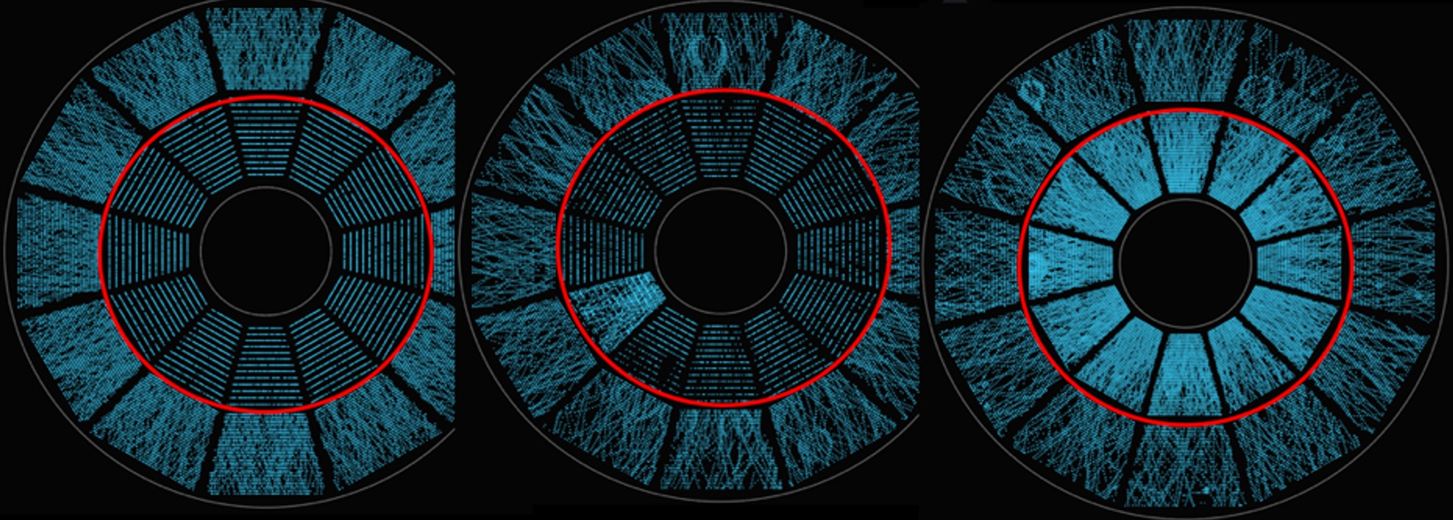
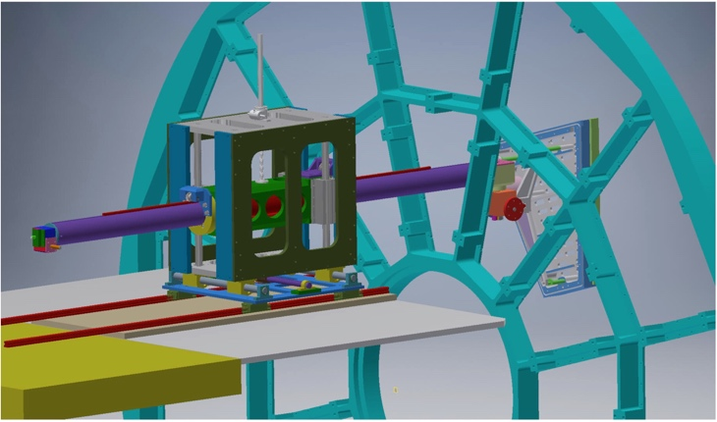
The inner TPC upgrade
Inner Sectors
New designed strongback
New wire frames
-- Replace ageing wires,
MWPC building in Shandong University
Increases readout pad rows (13 to 40)
-- 20% coverage -> ~100% coverage
New electronics for inner sectors
-- Double # of readout channels per FEE,
use ALICE SAMPA chip
New designed insertion tools
-- Install and replace sectors, STAR operations
2024/09/10
Qian Yang @ , Sep. 10^{td} - Sep. 13th 2024

Slide 5
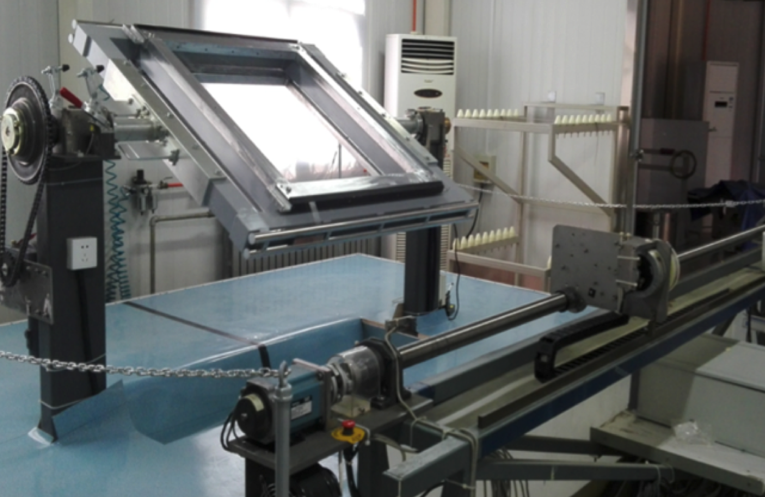
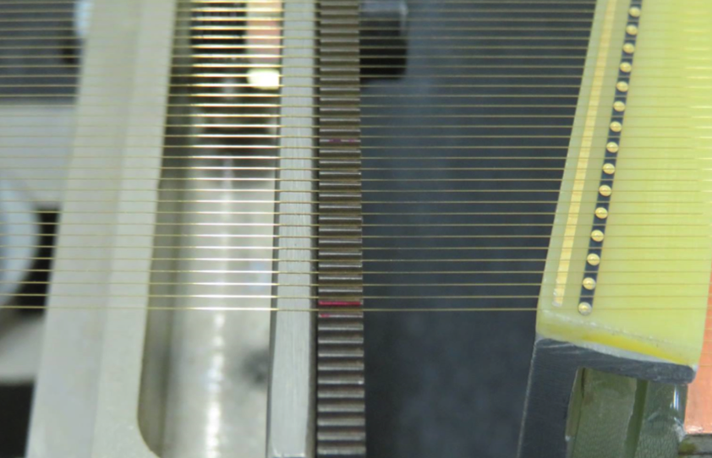
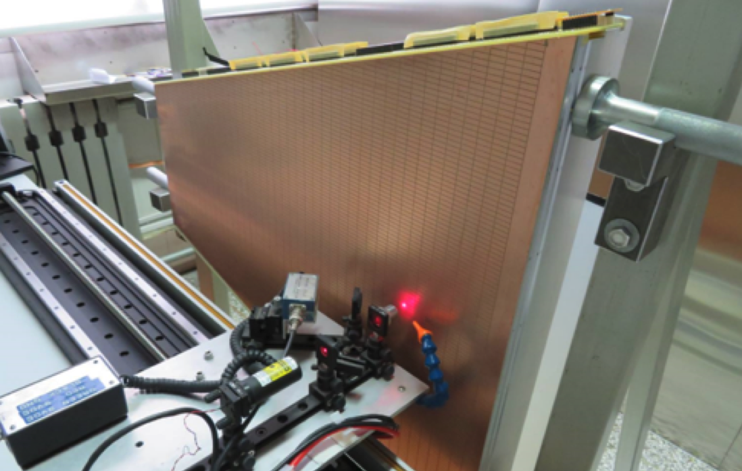
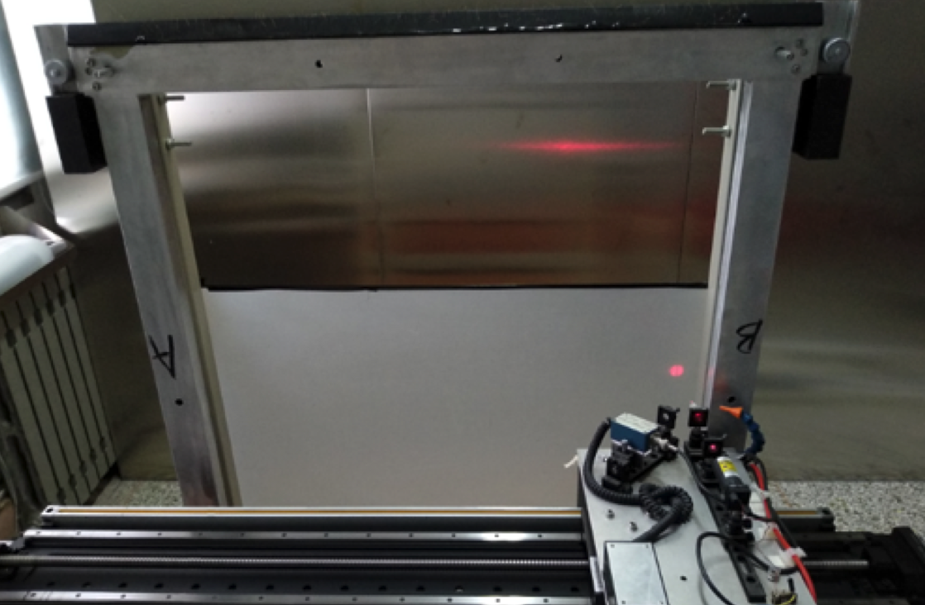
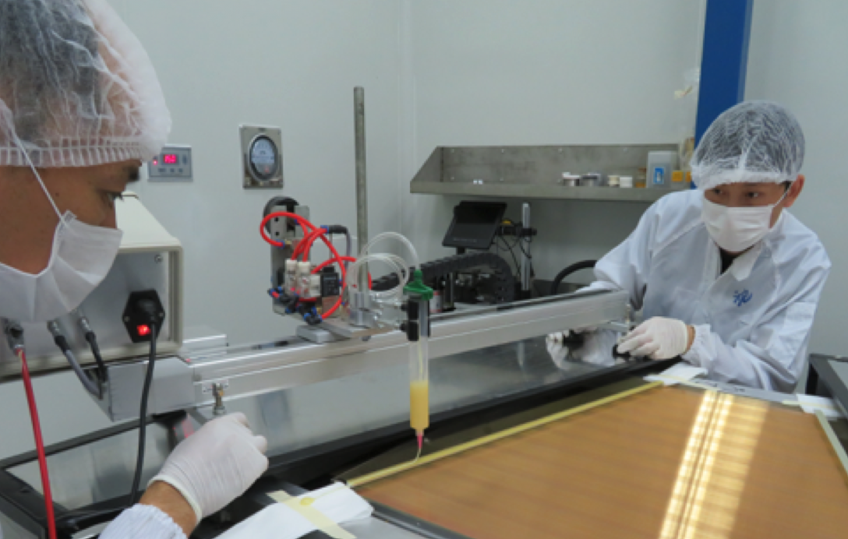
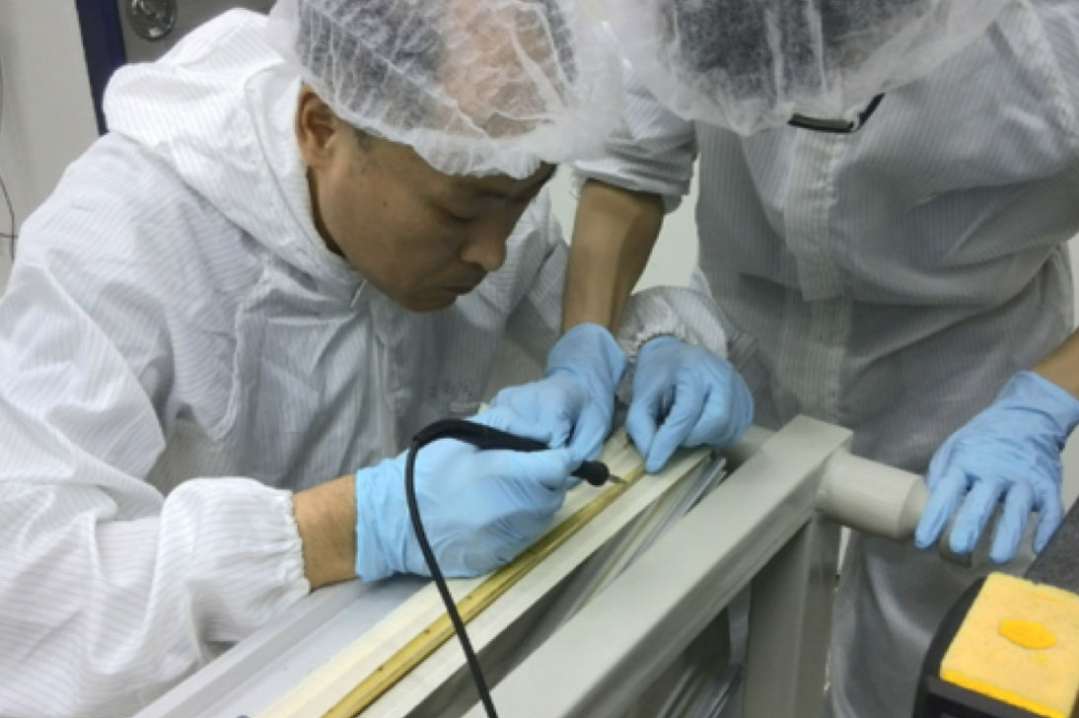
WMPC prototype production at SDU
Wire winding
Wire mounting system
Wire tension meas.
Wire tension meas.
Epoxy
Soldering
2024/09/10
Qian Yang @ , Sep. 10^{td} - Sep. 13th 2024

Slide 6
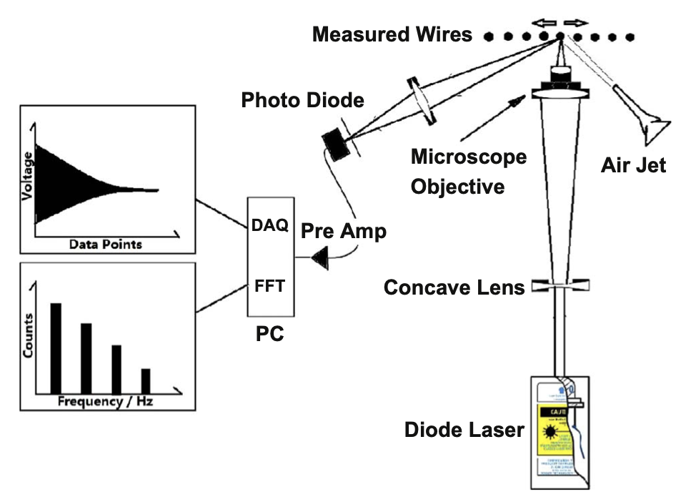
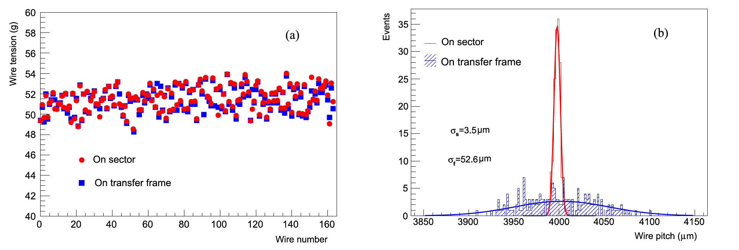
Wire pitch and tension for MWPC
Wire tension control system
Wire tension meas. system
$$T=4μf_{0}^{2}L^{2}$$
KPP ：Anode wire tension $51∓3 g$
2024/09/10
Qian Yang @ , Sep. 10^{td} - Sep. 13th 2024

Slide 7
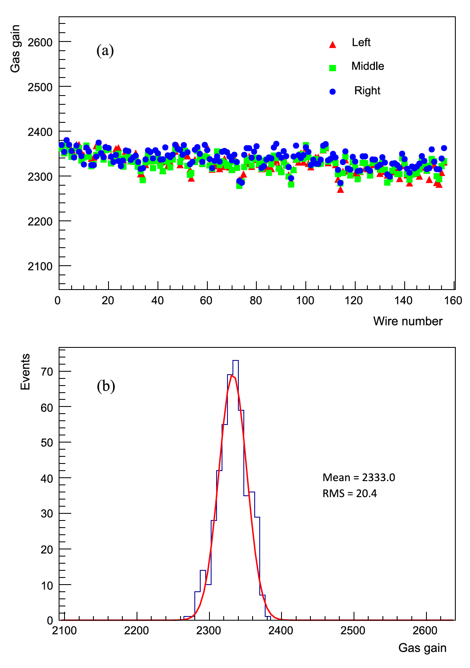
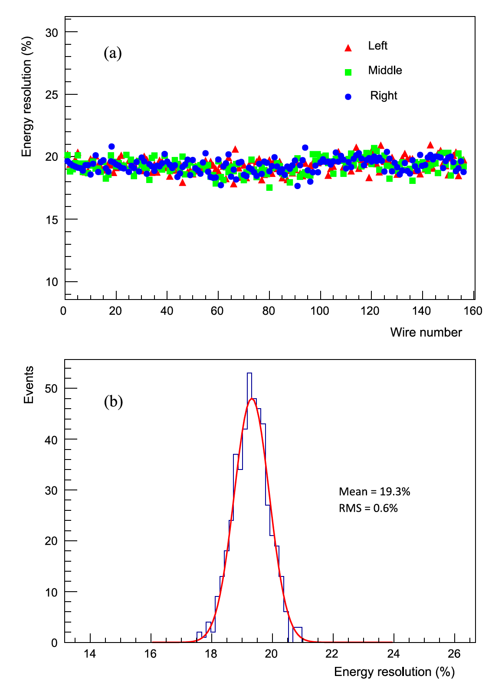
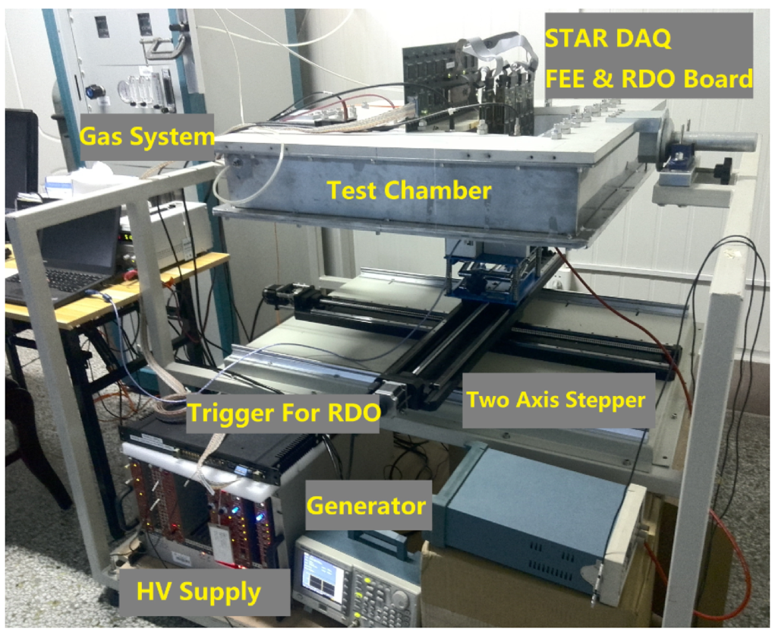
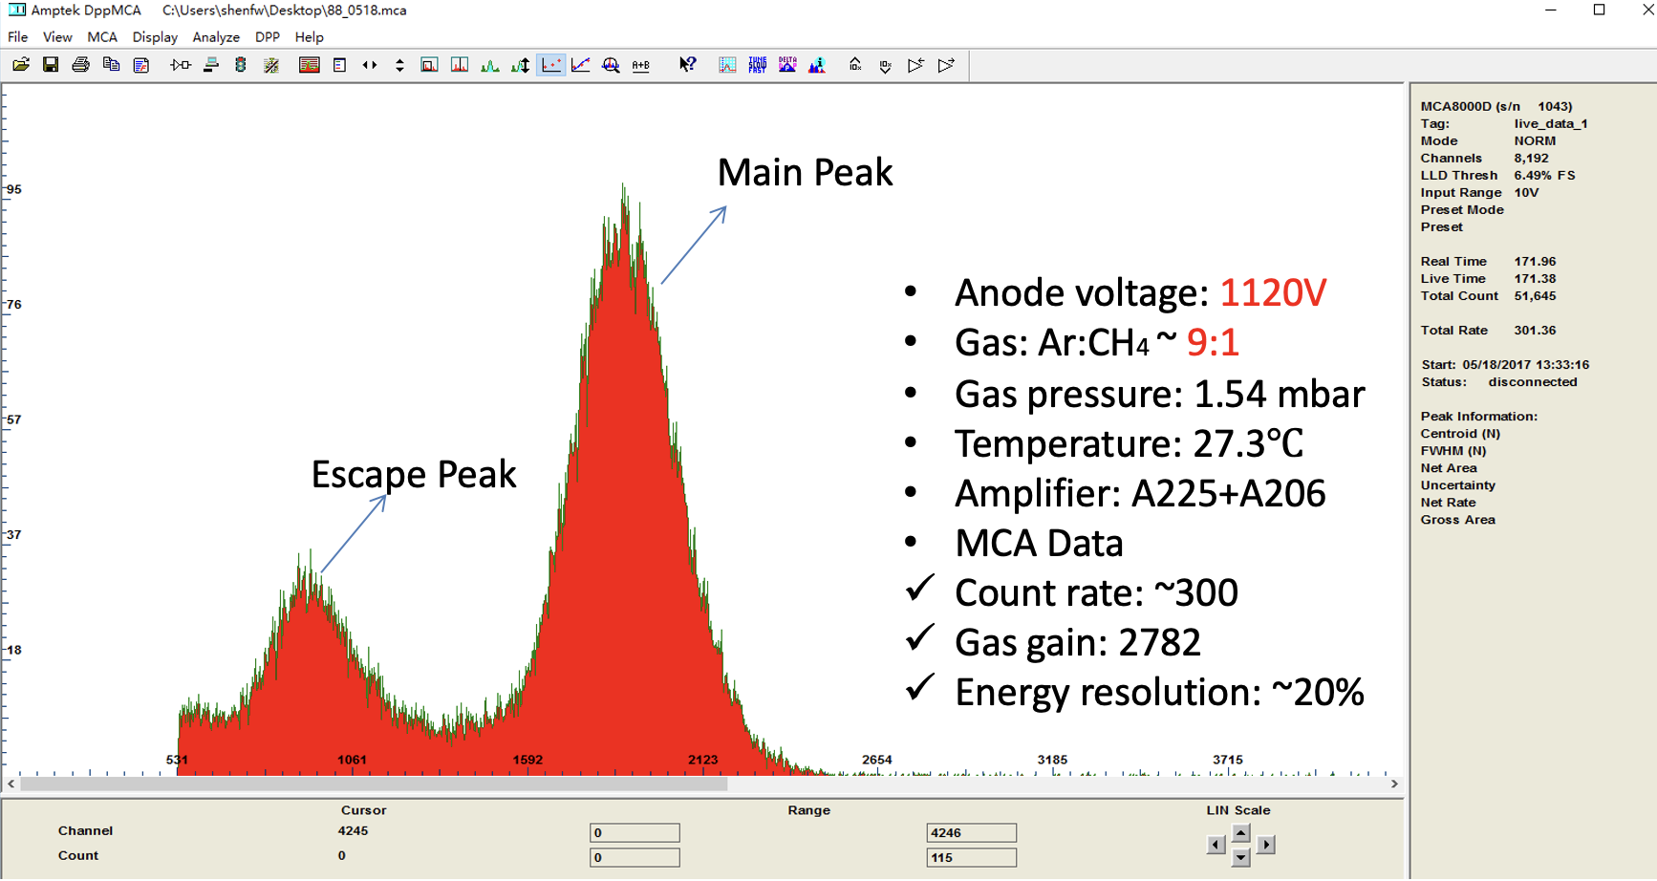
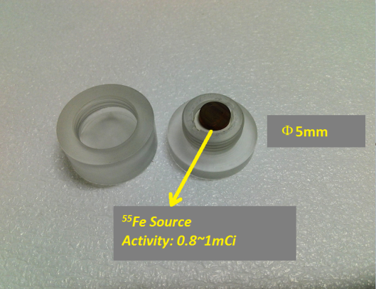
MWPC bench test at SDU
Gas gain uniformity
Energy resolution uniformity
MWPC testing system
Amplifier + MCA
2024/09/10
Qian Yang @ , Sep. 10^{td} - Sep. 13th 2024

Slide 8
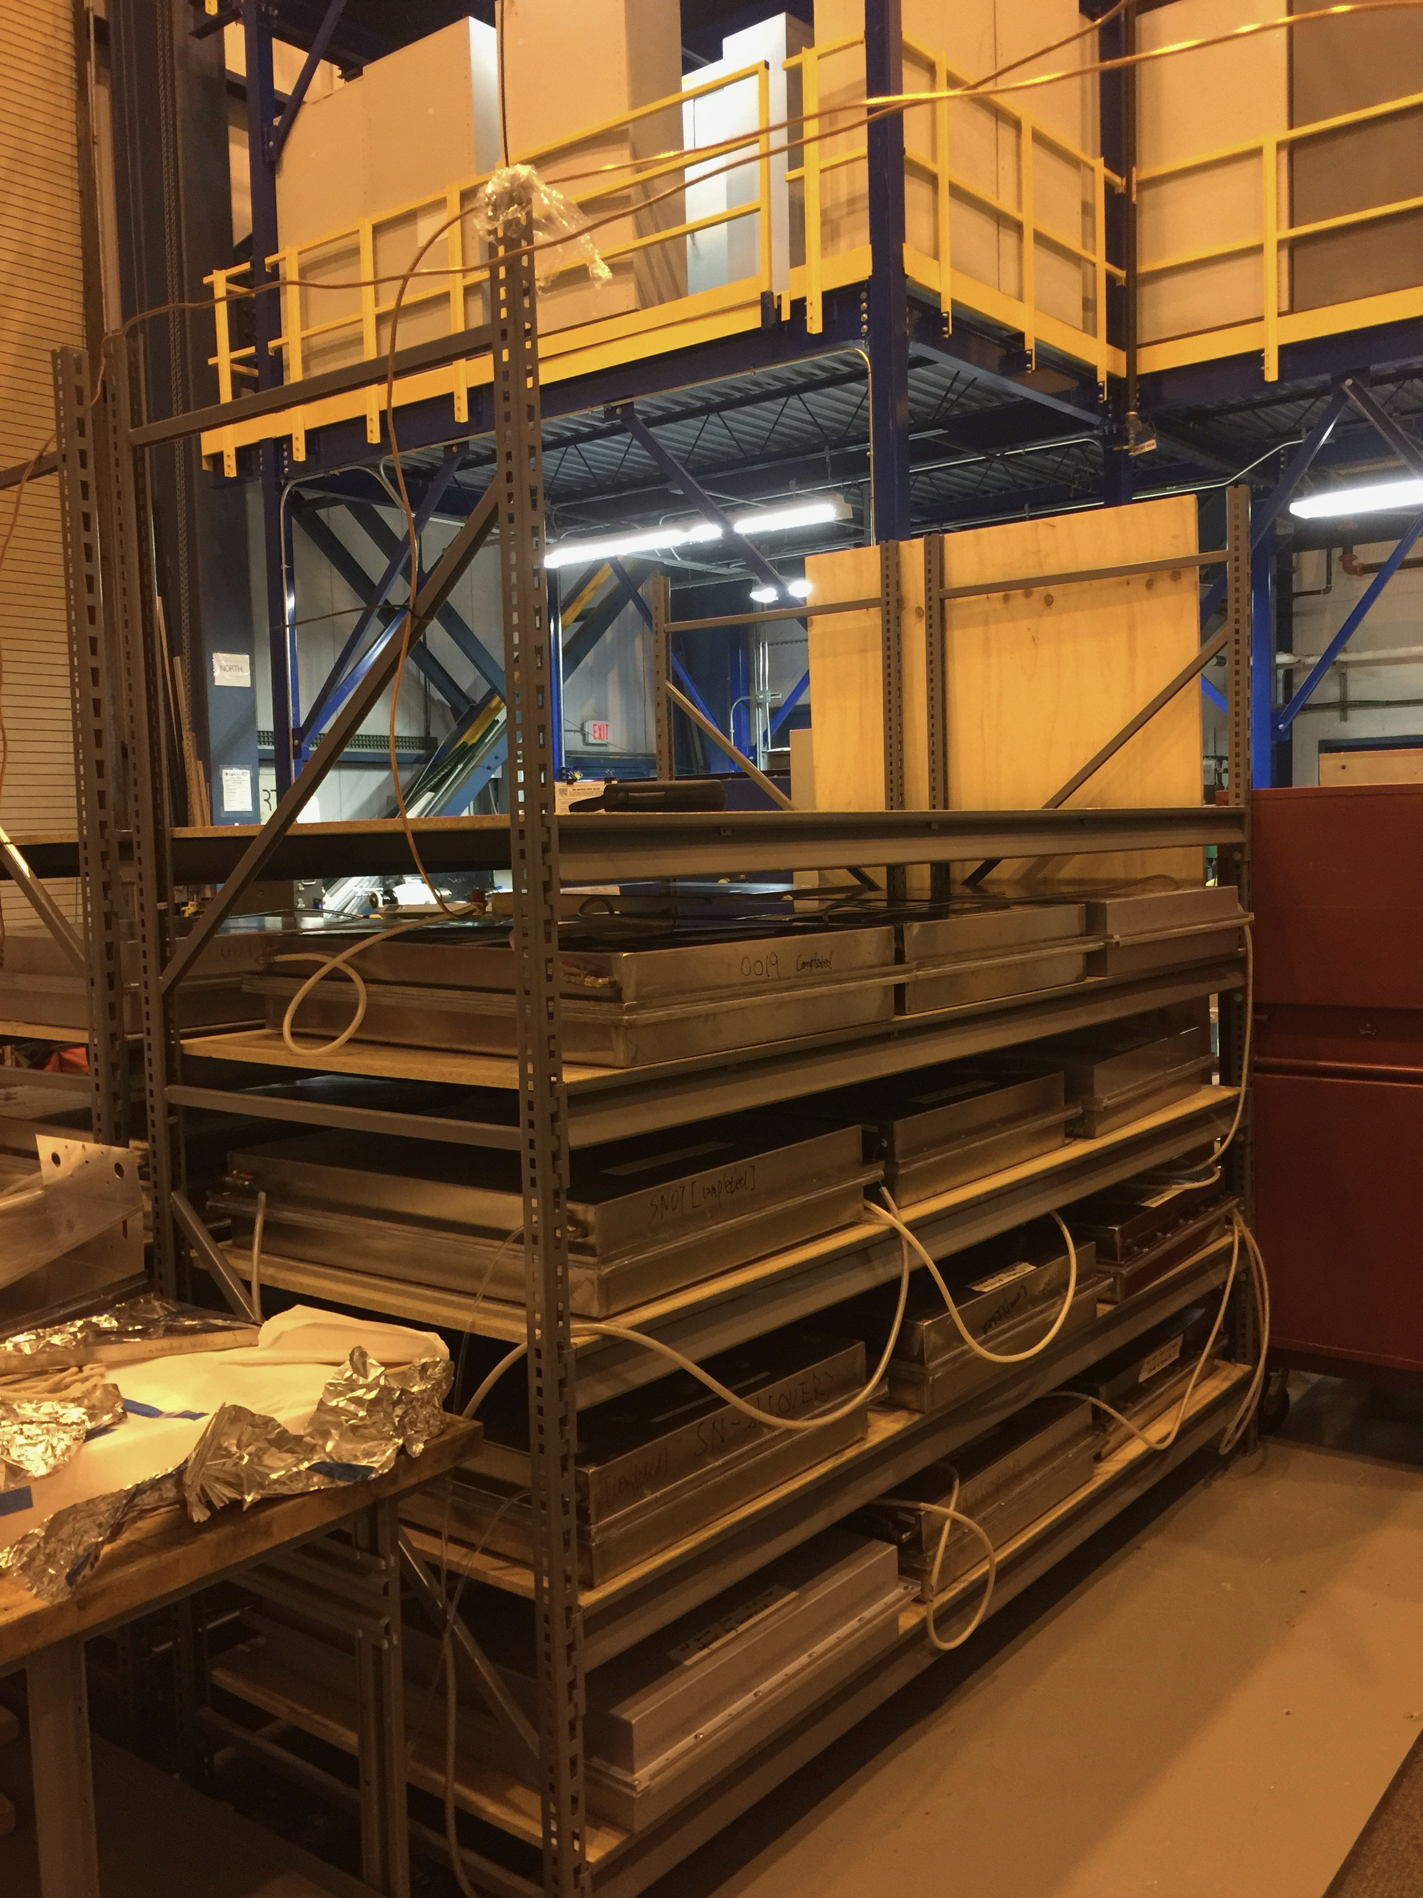
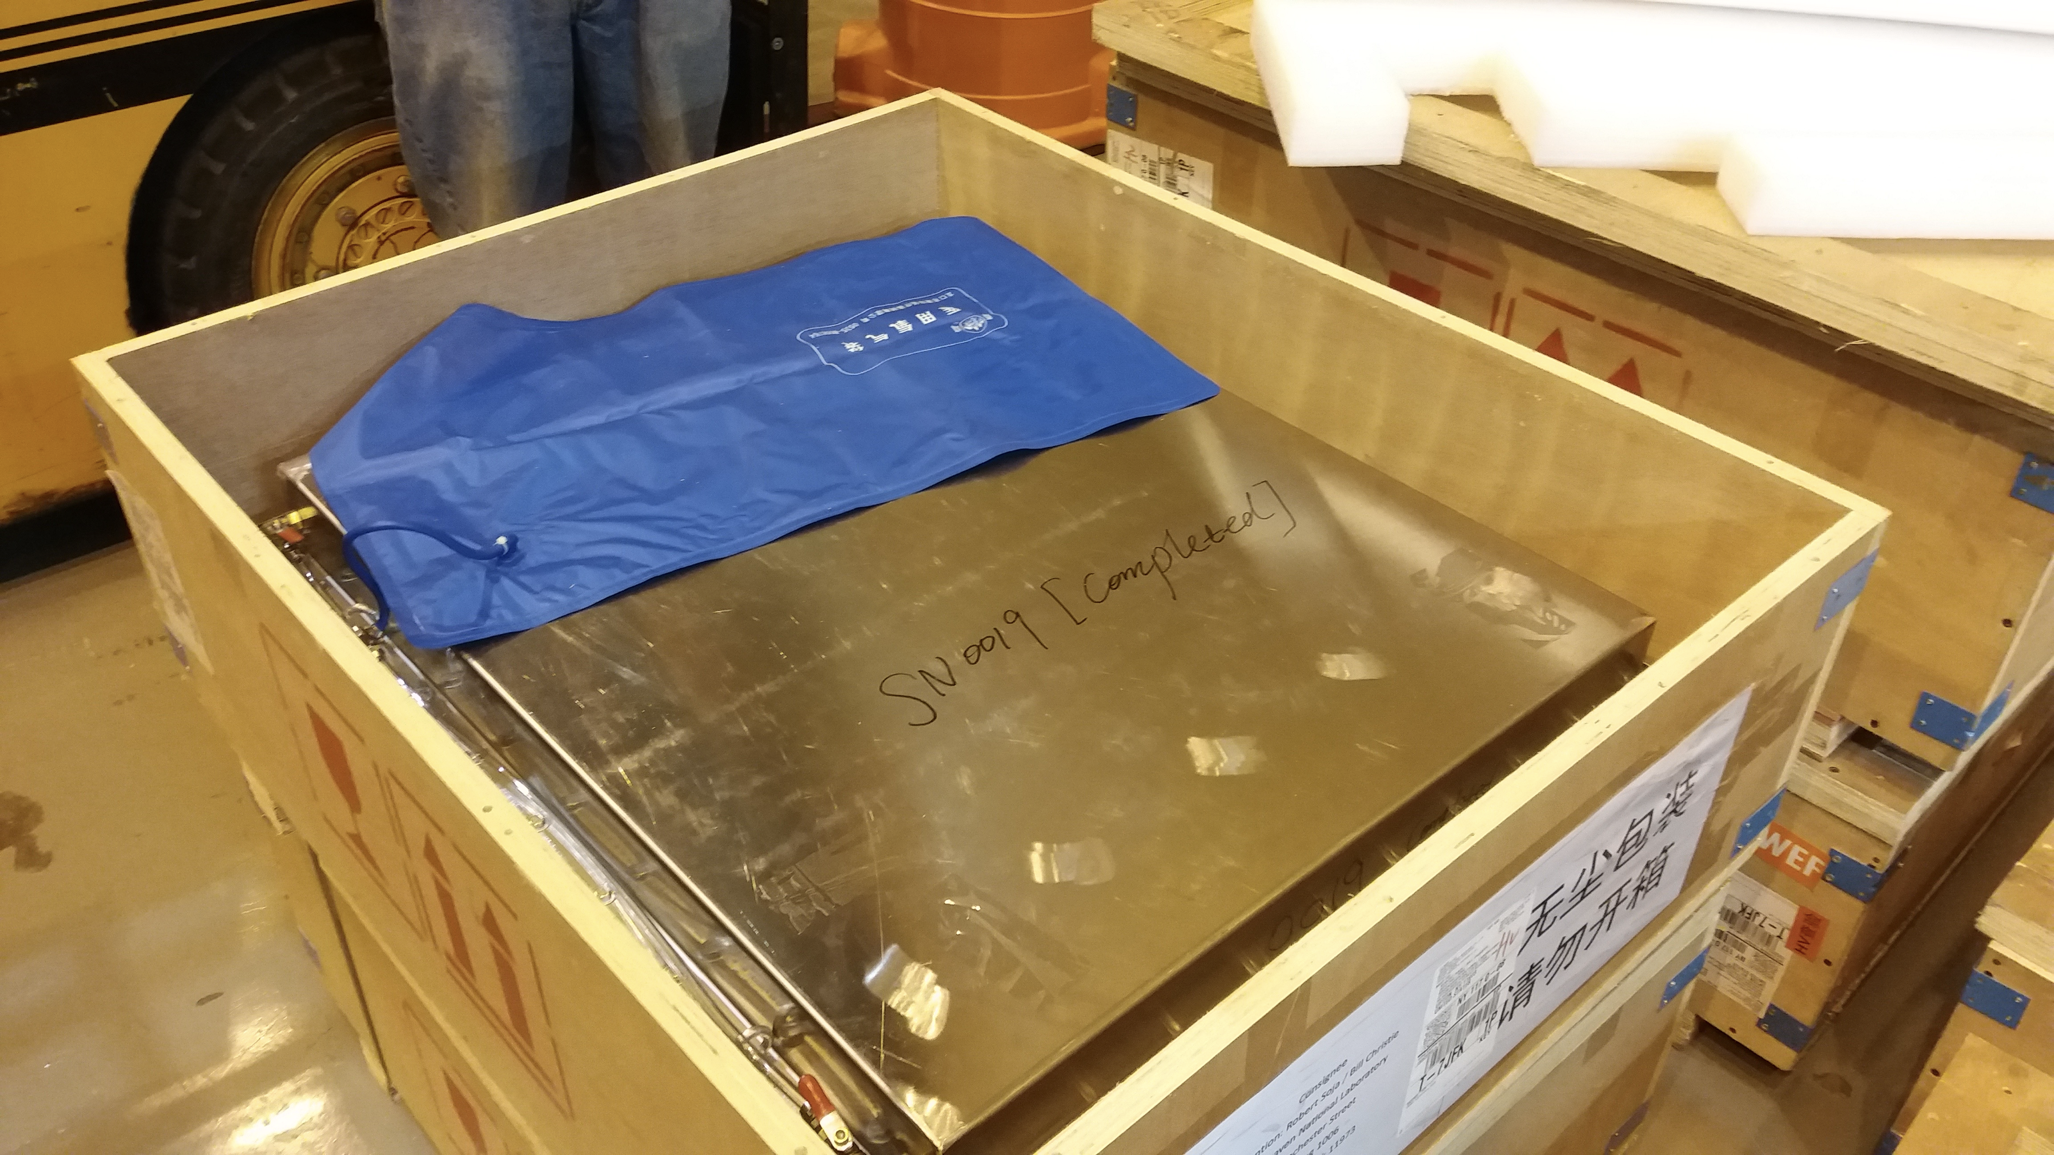
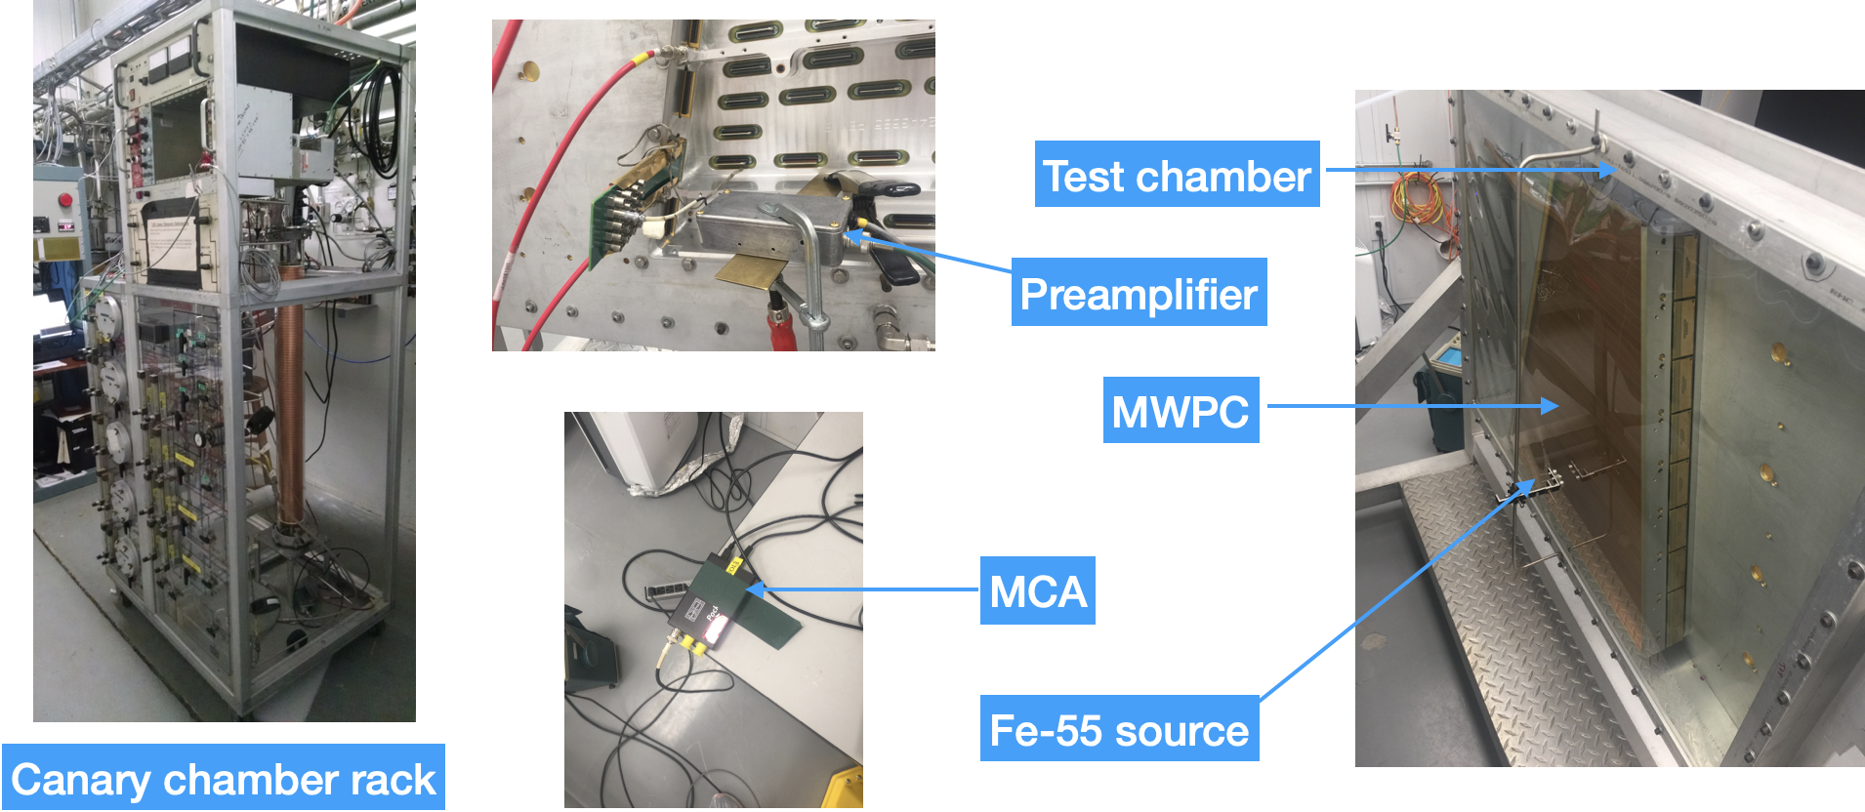
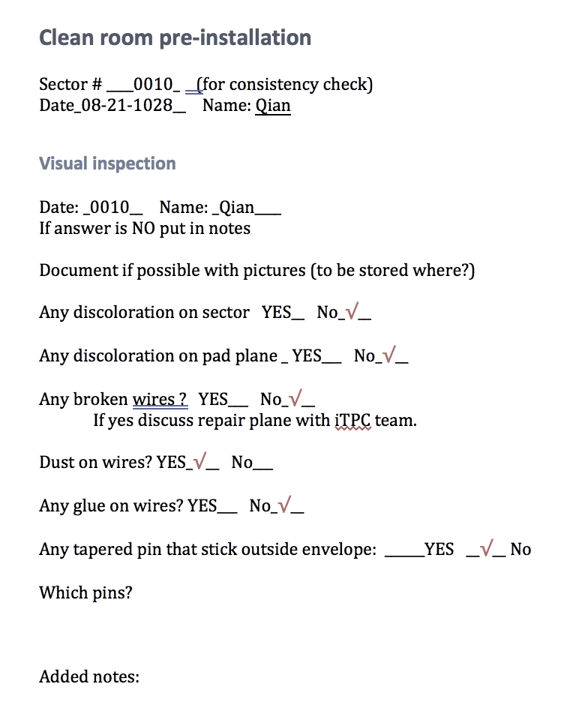
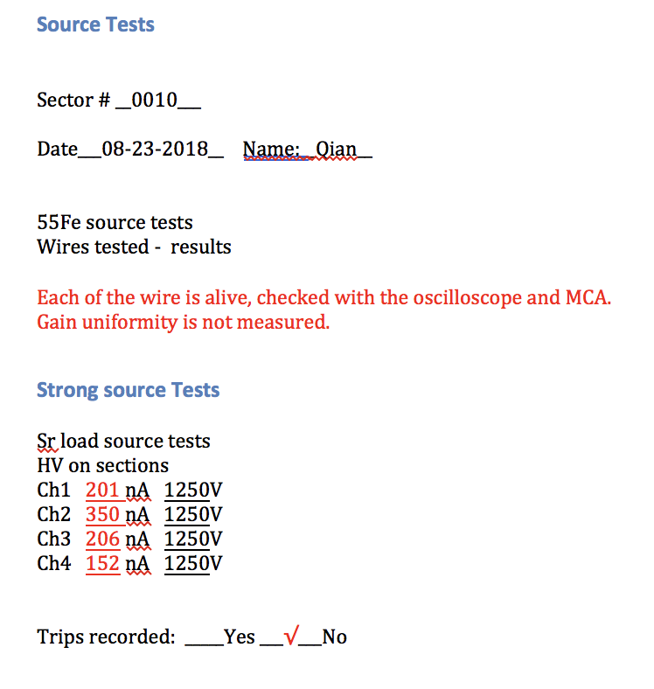
MWPC bench test at BNL
Connectivity check
HV tests (N2 and P10 gas)
Material canary check
Radiation source test (⁵⁵Fe and Sr source)
Connectivity before installation
Documented in traveller
2024/09/10
Qian Yang @ , Sep. 10^{td} - Sep. 13th 2024

Slide 9
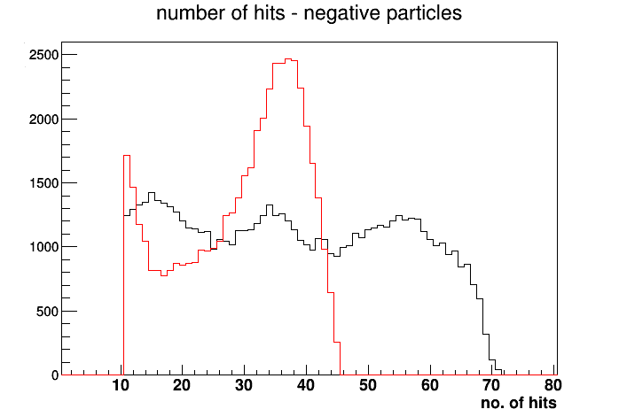
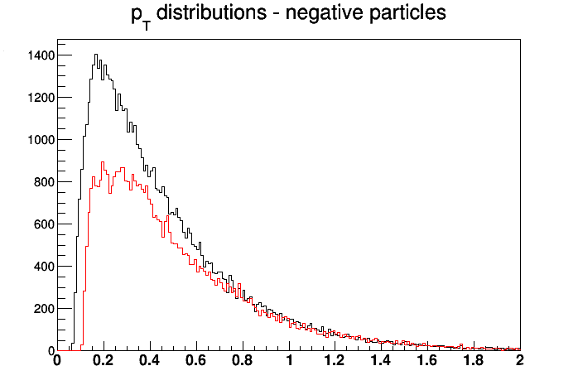
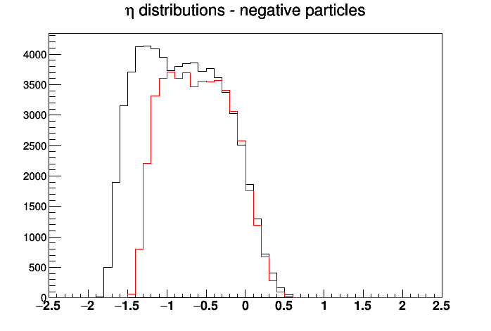
iTPC operation at STAR
iTPC performance in isobar data collisions at 2018
Maximum hits per tracks: 45 → 72
Lower transverse momentum threshold of 60 MeV/c
$η$ coverage extended by 0.4 units
2024/09/10
Qian Yang @ , Sep. 10^{td} - Sep. 13th 2024

Slide 10
STAR Forward Upgrade
2024/09/10
Qian Yang @ , Sep. 10^{td} - Sep. 13th 2024

Slide 11
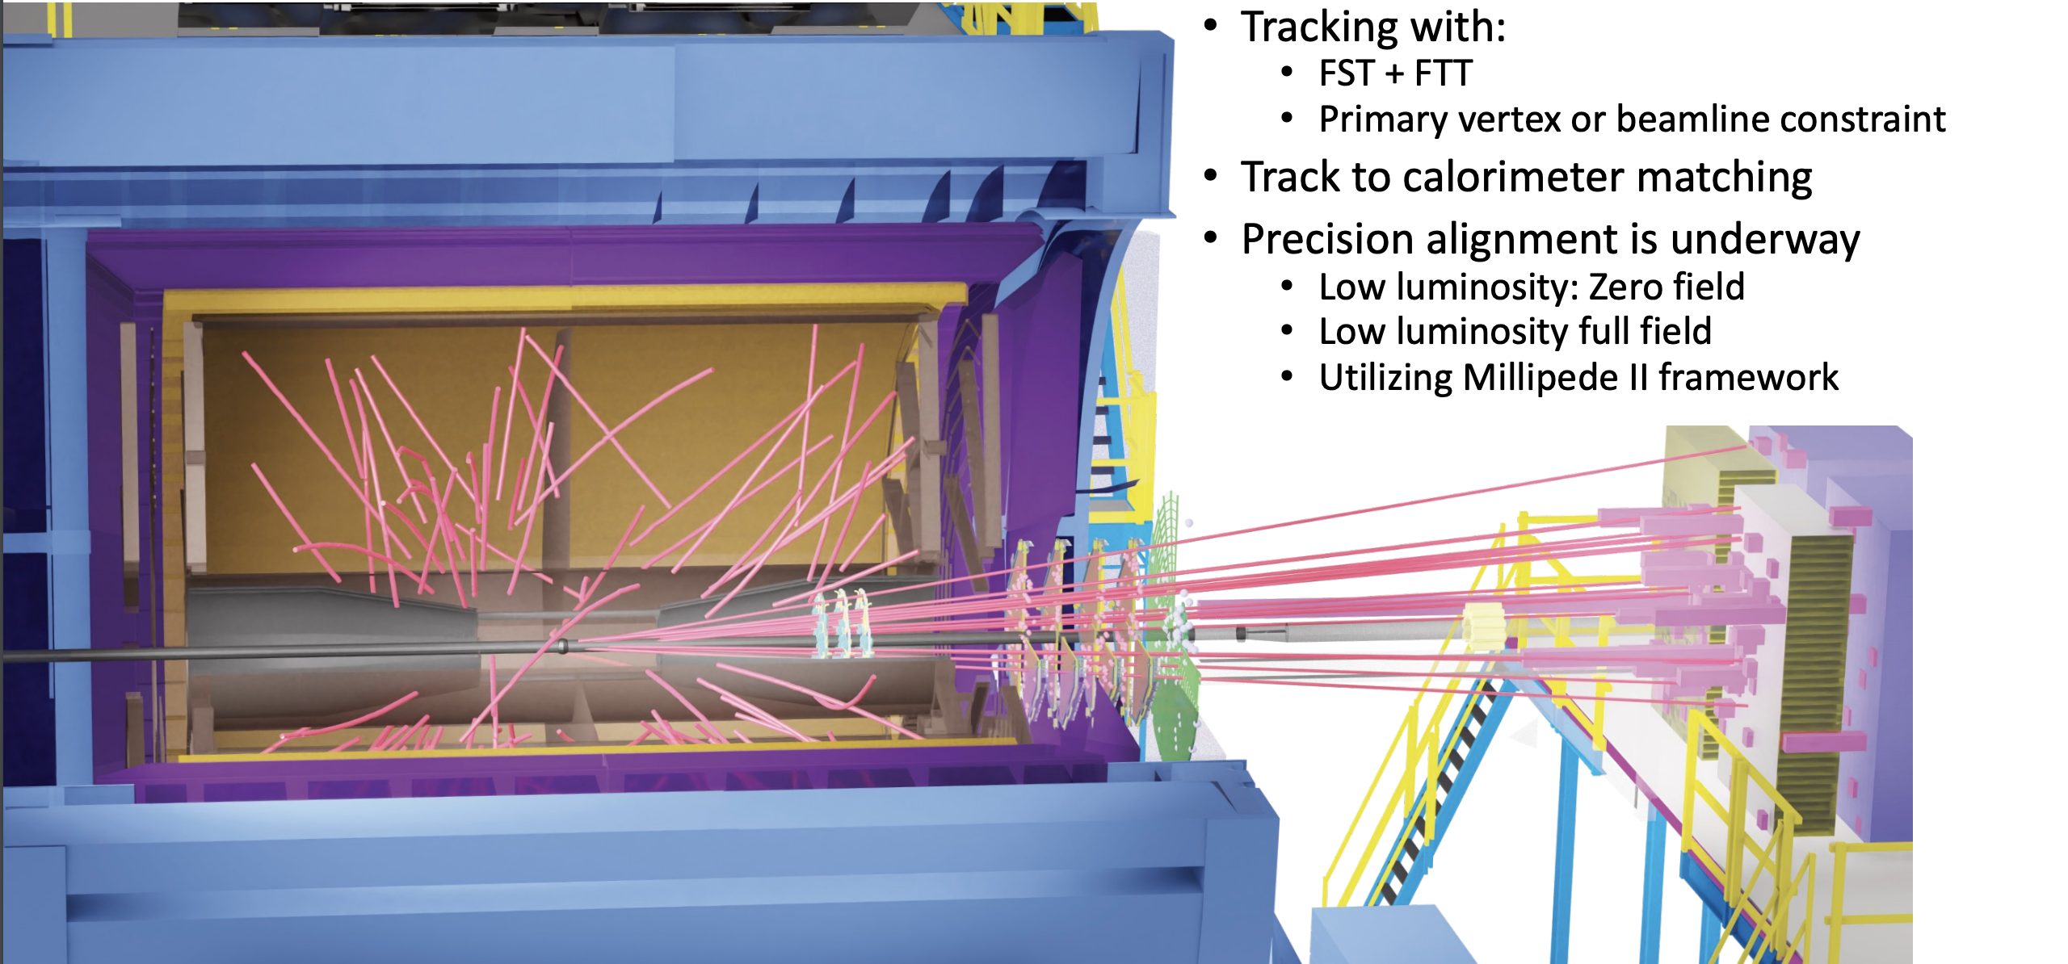
STAR Forward Upgrade
Real event display
2024/09/10
Qian Yang @ , Sep. 10^{td} - Sep. 13th 2024

Slide 12
STAR Forward Upgrade: Overview
Installed at STAR successfully in 2021, and started taking data from 2022 (Run 22)
Forward Tracking System:
Forward Silicon Tracker (FST)
Forward small-strip Thin Gap Chamber Tracker (FTT)
Charge separation
$δp_{T}/p_{T}$ ~ 20-30% for 0.2 < p_{T} < 2 GeV/c
Forward Calorimeter System:
Forward Electromagnetic Calorimeter (ECal)
Forward Hadronic Calorimeter (HCal)
Good e/h separation
Photon, $π^{0}$ identification
ECal: $\sim 10\%/\sqrt{E}$ for pp and pA, $\sim 20\%/\sqrt{E}$ for AA
HCal: $\sim 50\%/\sqrt{E}$ for pp and pA
Locate at STAR west side, 2.5 < $η$ < 4
Similar coverage as the EIC detector’s hadron endcap
2024/09/10
Qian Yang @ , Sep. 10^{td} - Sep. 13th 2024

Slide 13
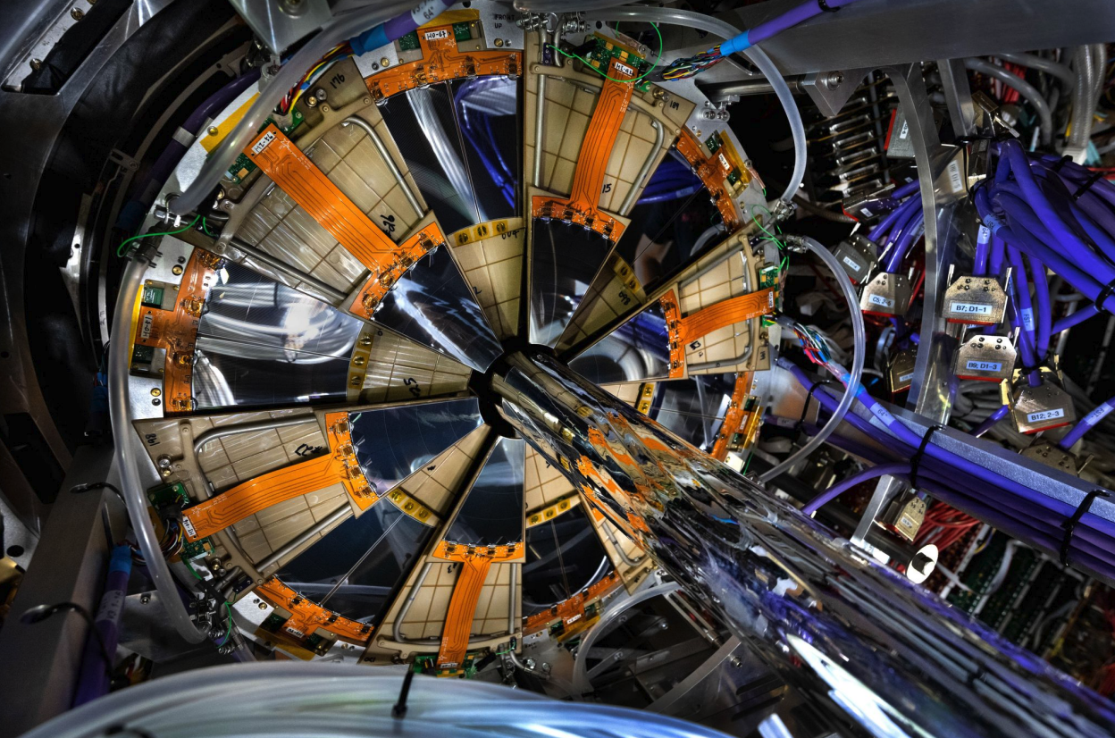
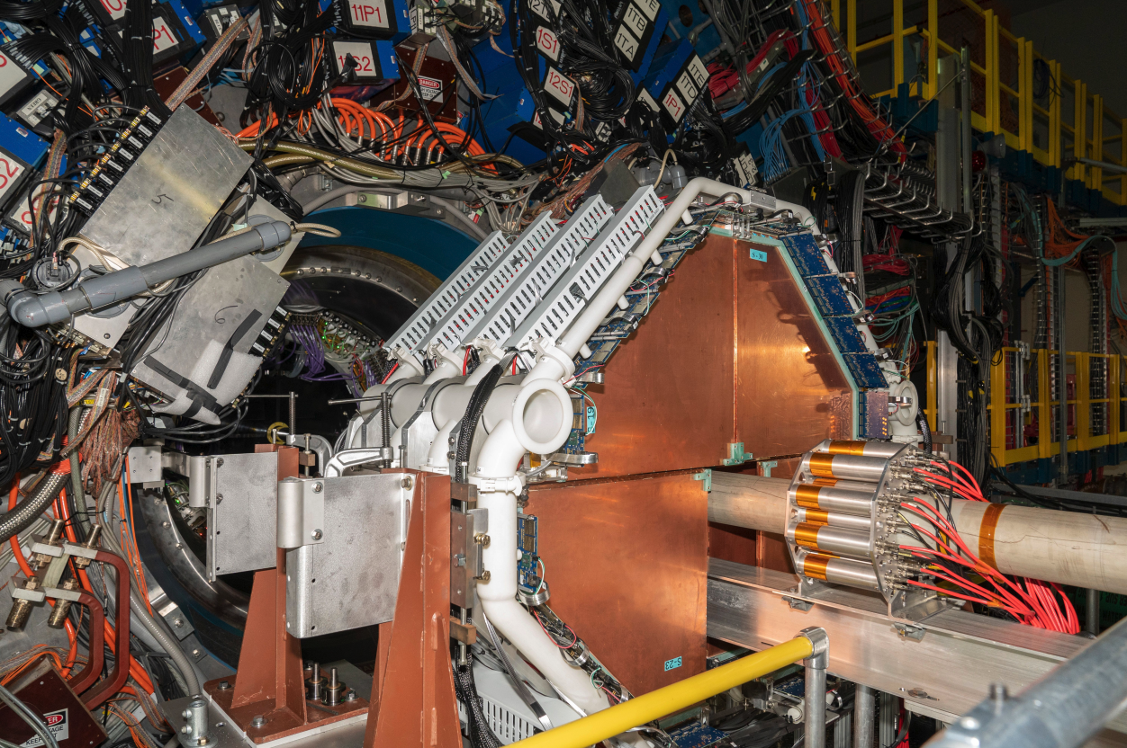
Forward Tracking System
Forward Silicon Tracker:
3 disks, at 152, 165, and 179 cm from IP
Locate inside STAR TPC cone
Forward small-strip Thin Gap Chamber Tracker:
4 disks, at 307, 325, 343 and 361 cm from IP
Locate inside STAR magnet pole tip opening
FTT
FST
2.5 < $η$ < 4
2024/09/10
Qian Yang @ , Sep. 10^{td} - Sep. 13th 2024

Slide 14
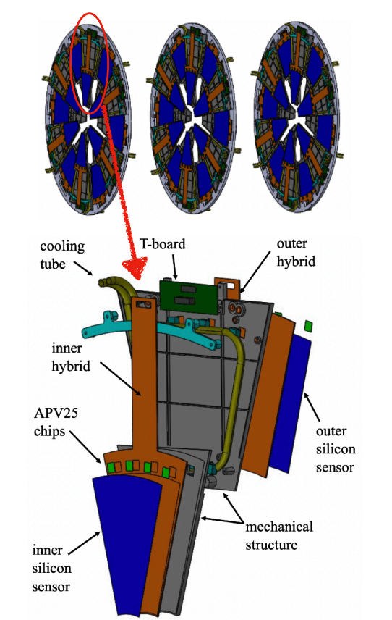
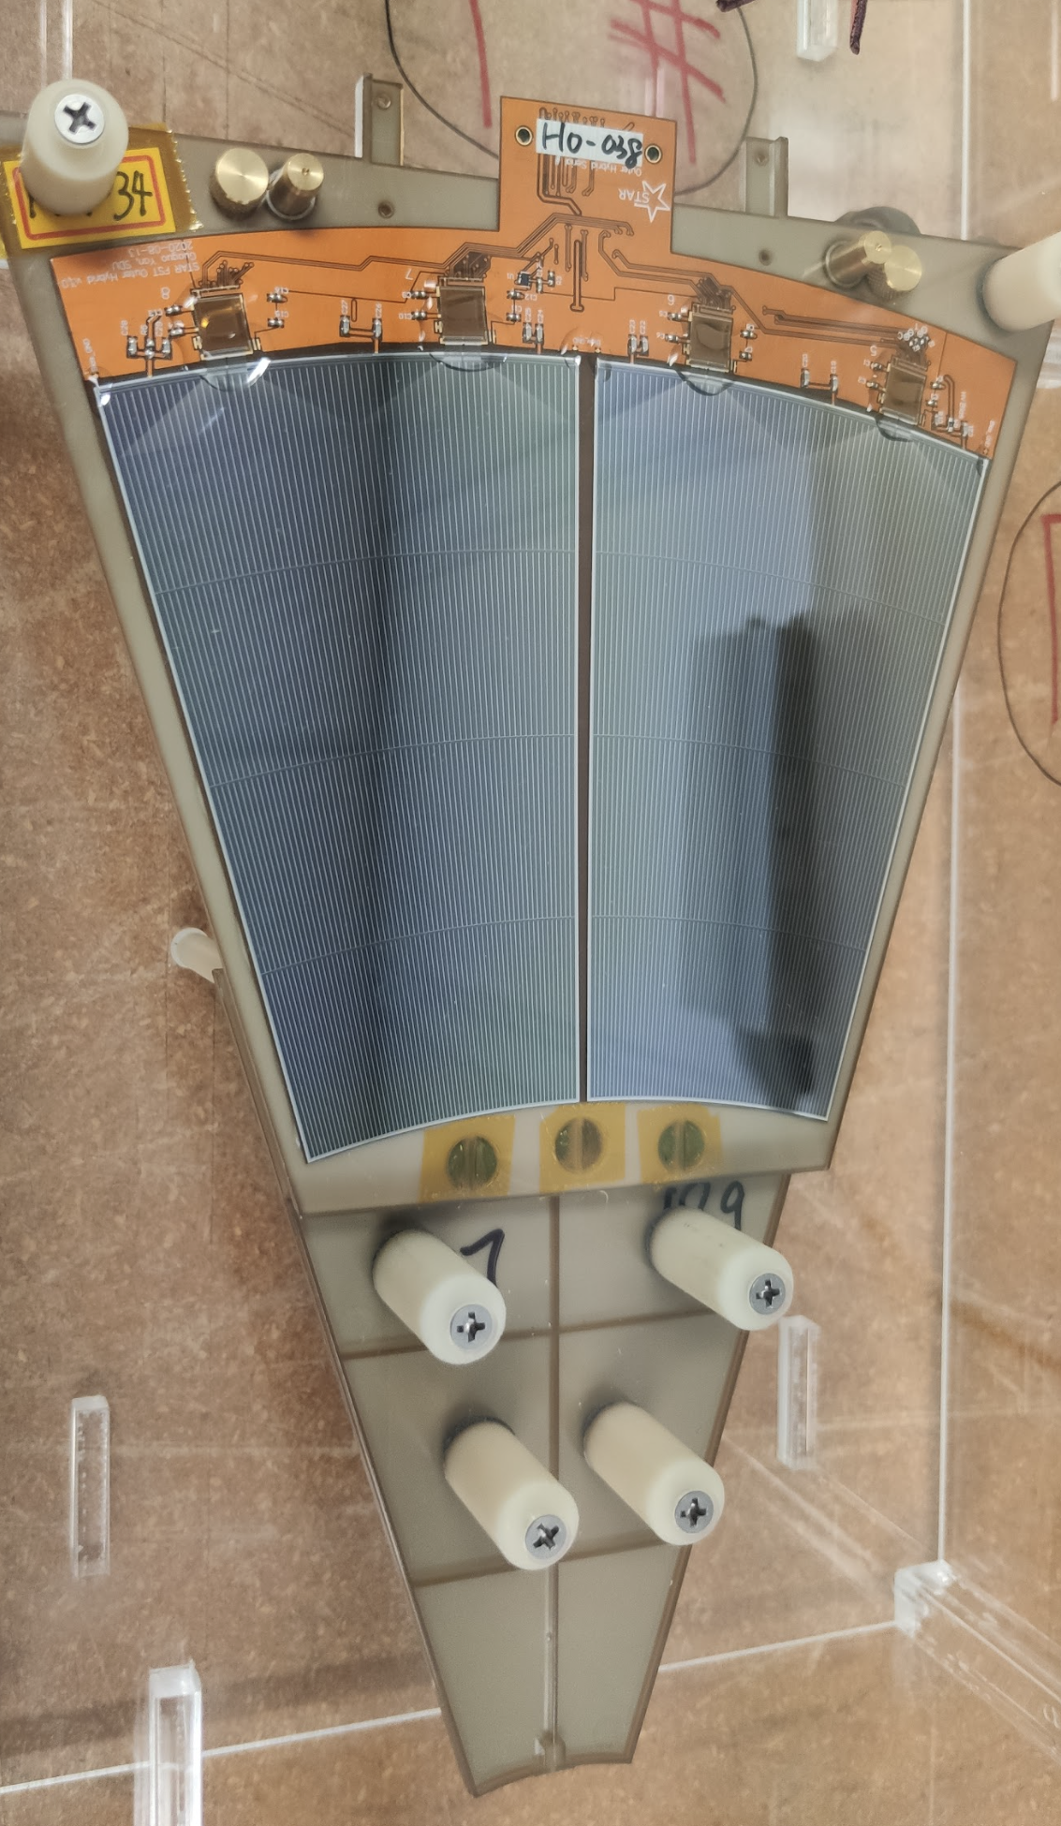
Forward Silicon Tracker
3 Silicon disks:
152, 165, and 179 cm from IP
Locate inside STAR TPC cone
12 modules per disk
Si from Hamamatsu
Granularity:
fine in $ϕ$ and coarse in R
Front-end chips:
APV25
Material budget:
~1% per disk
Reuse:
IST DAQ system & IST cooling system
Outer silicon sensor
2024/09/10
Qian Yang @ , Sep. 10^{td} - Sep. 13th 2024

Slide 15
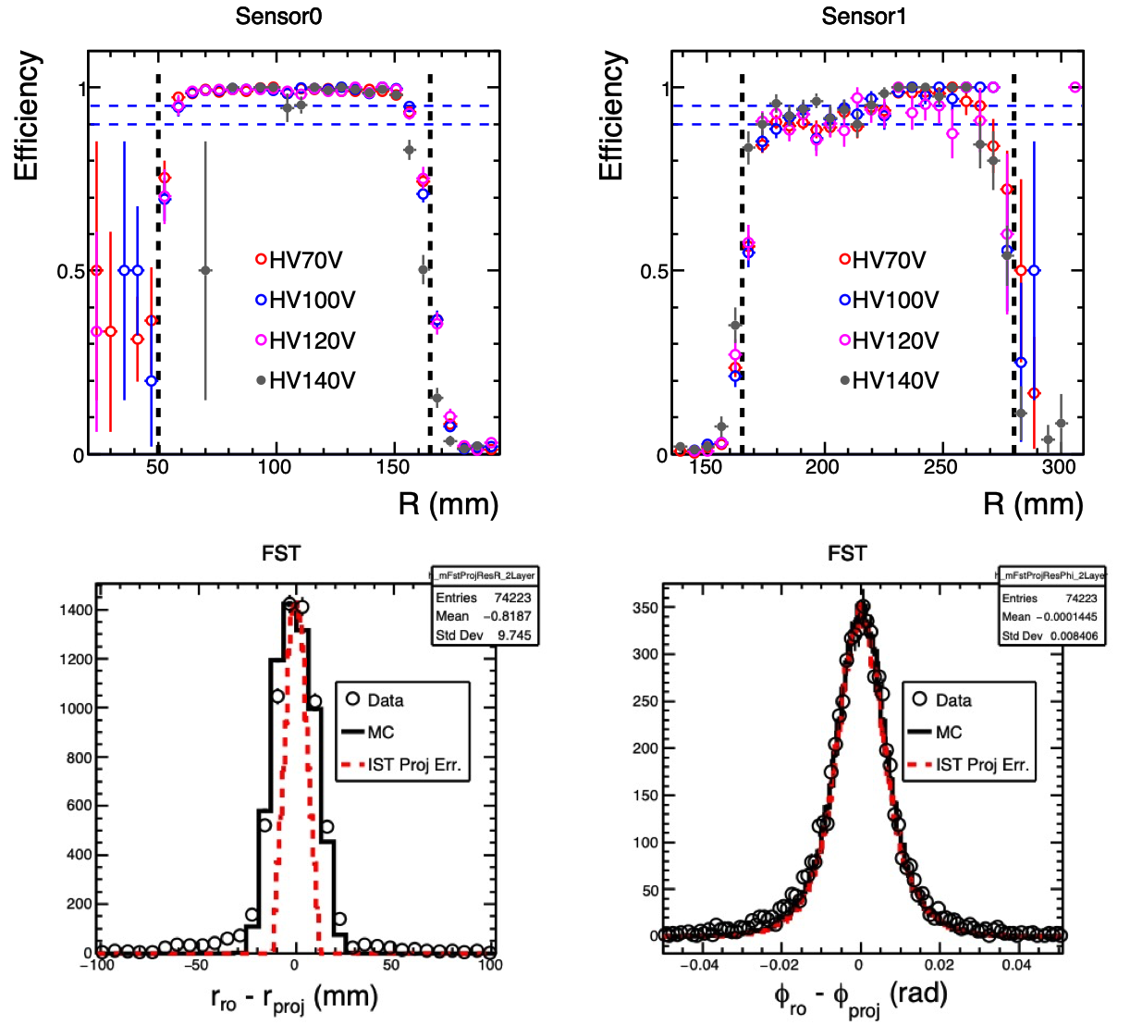
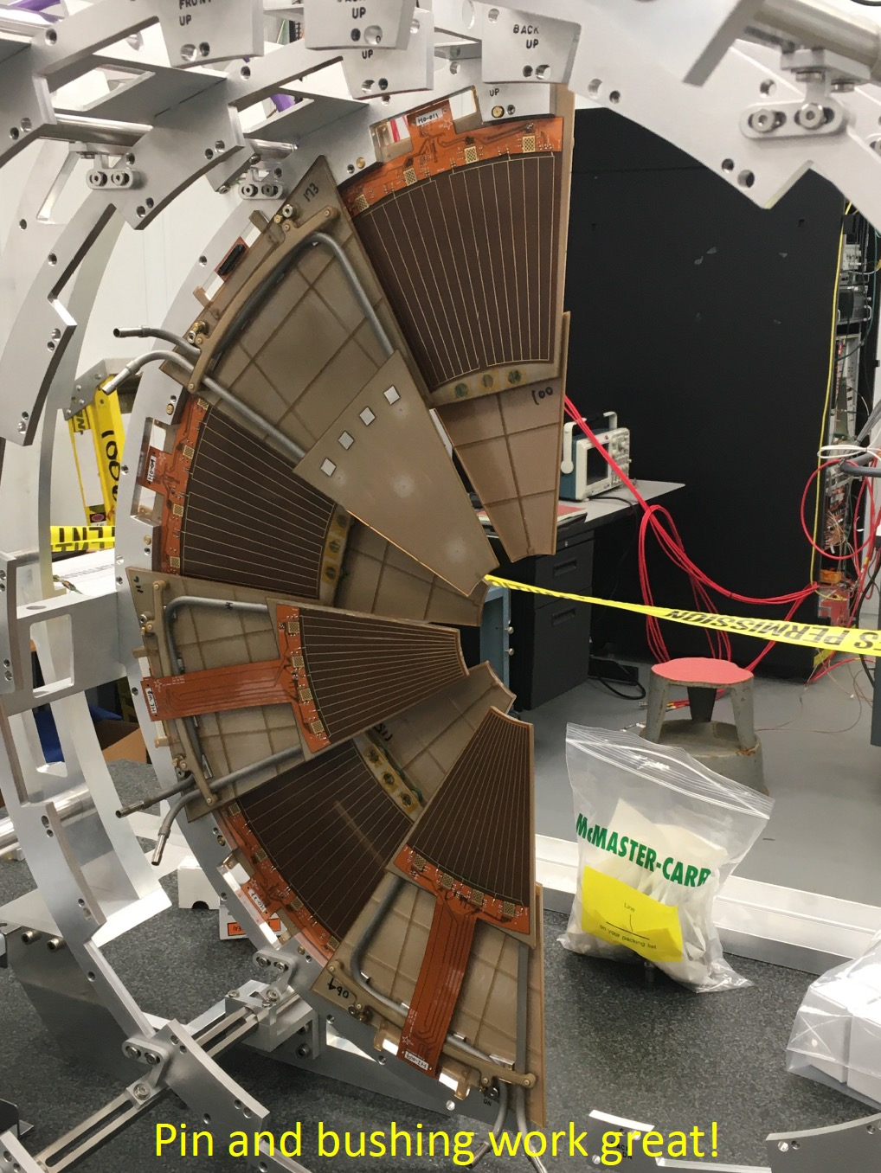
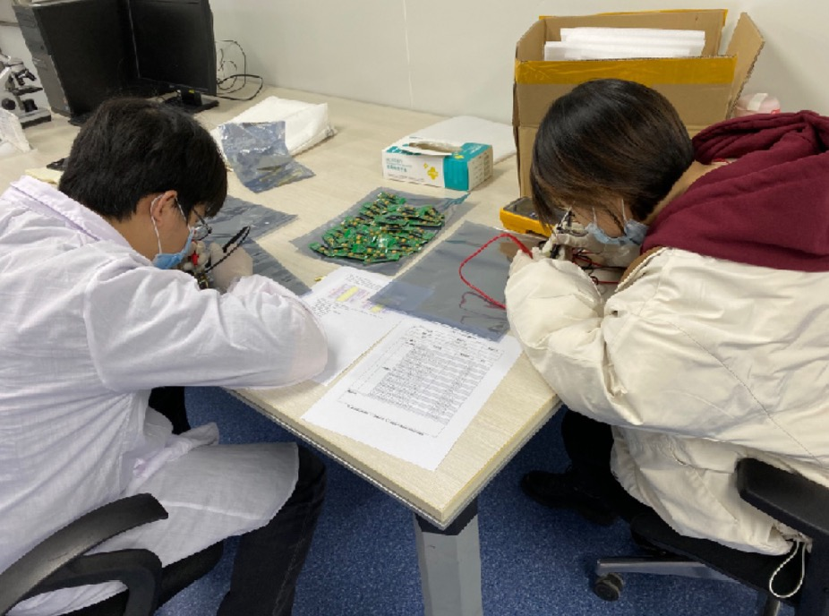
Forward Silicon Tracker – Prototype Module Performance
T-Board production at SDU
Performance of two fully asembled prototype modules evaluated with cosmis ray
All channels can be read out (KPP:>85%)
Efficiency higher than 90% (KPP:>90%)
Pre-Installation at BNL
2024/09/10
Qian Yang @ , Sep. 10^{td} - Sep. 13th 2024

Slide 16
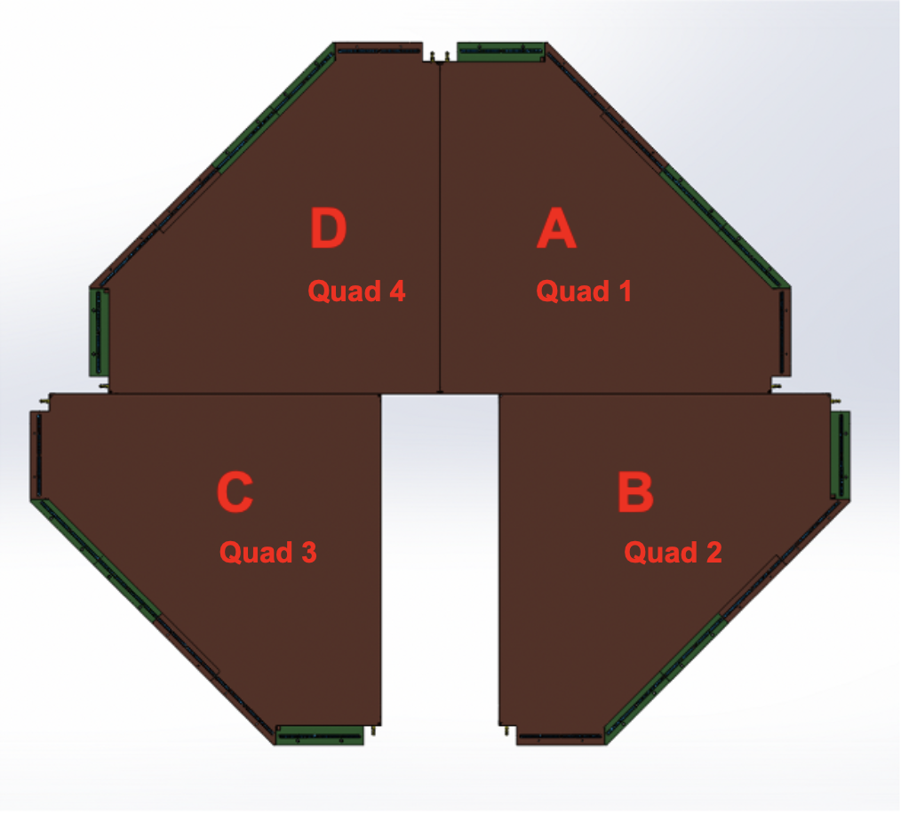
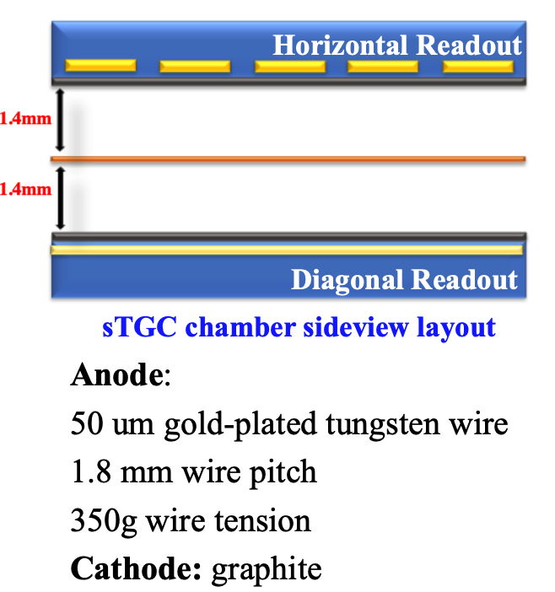
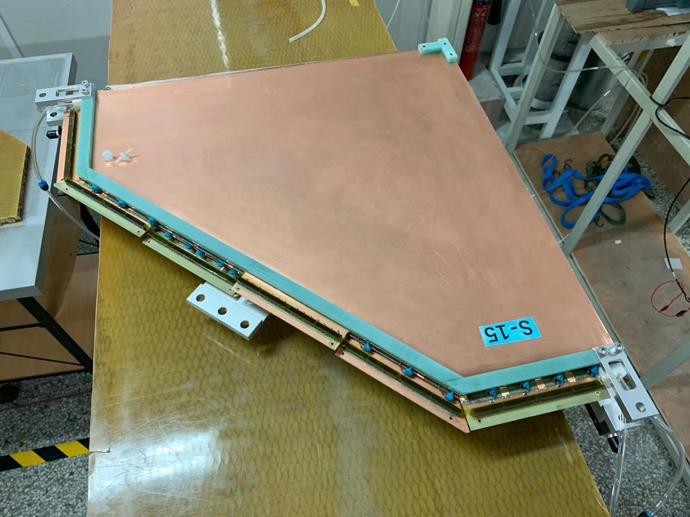
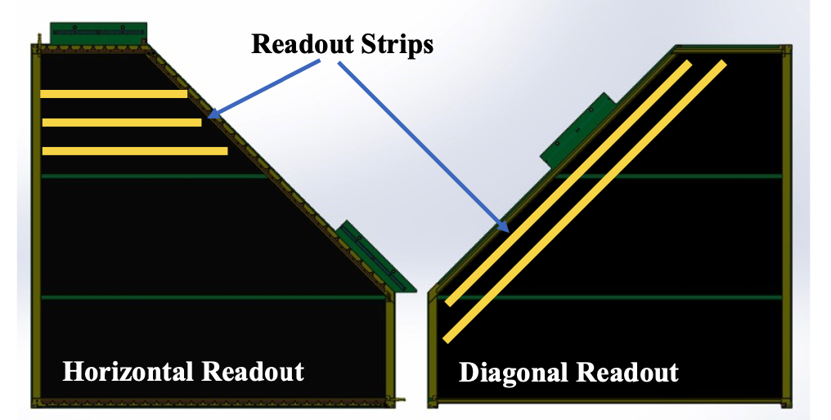
Forward sTGC Tracker
4 sTGC disks:
307, 325, 343 and 361 cm from IP
4 pentagon module per disk
sTGC technique developed by ATLAS
Working gas:
45% n-pentane + 55% CO₂
Position resolution:
< 200 um
Material budget:
~0.5% per layer
Readout:
VMM chips
2024/09/10
Qian Yang @ , Sep. 10^{td} - Sep. 13th 2024

Slide 17
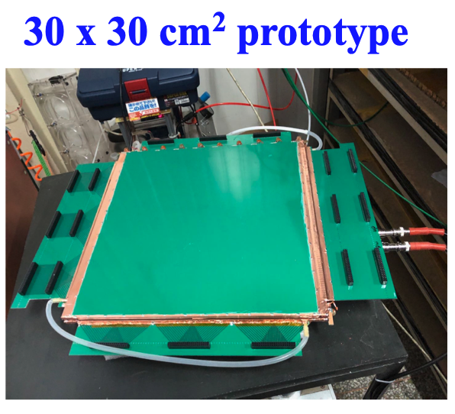
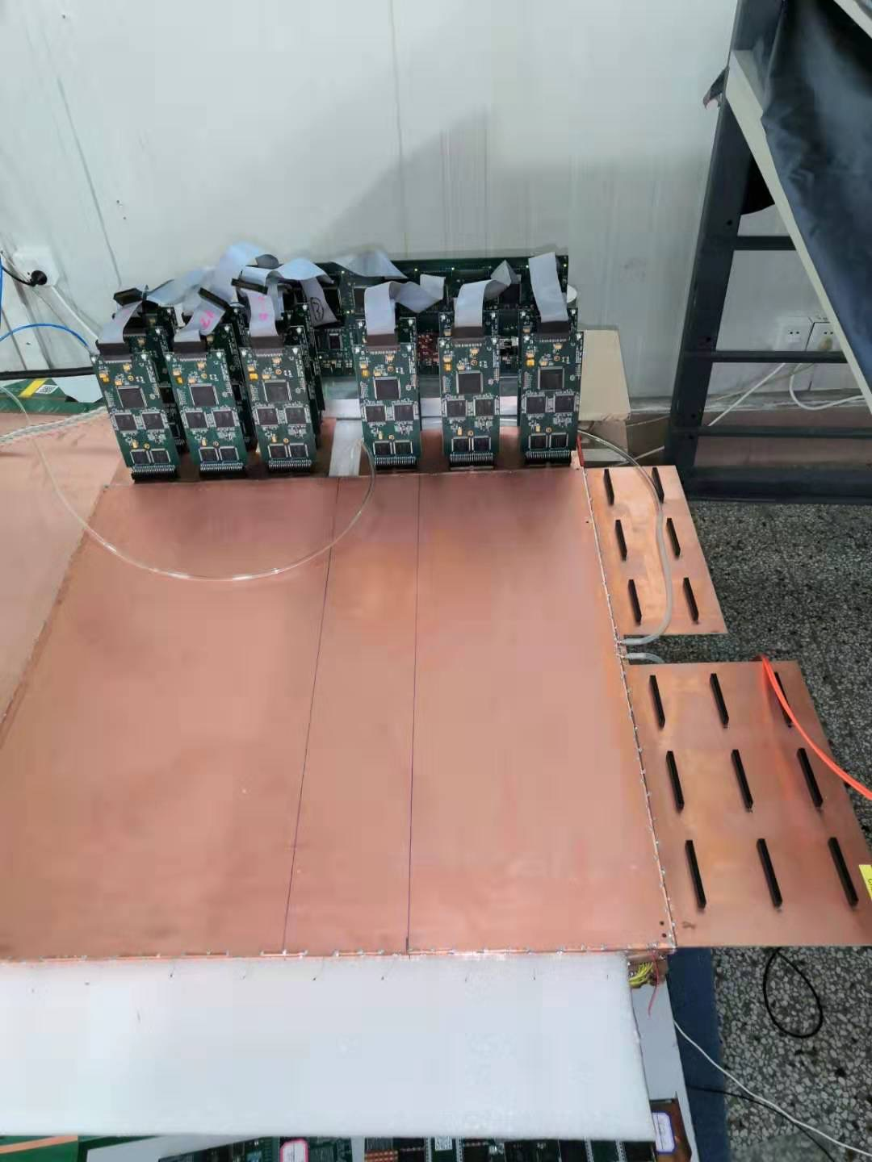
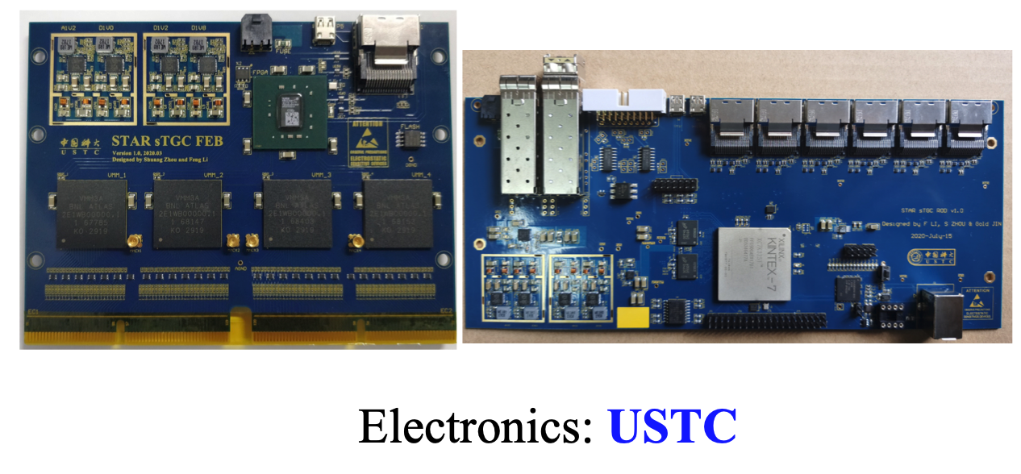
Forward sTGC Tracker
sTGC module since 2018:
Three versions of module protoypes
Integrations & DQA: BNL
Commissioning & software: BNL, SDU
Detector | Produced | Shipped | Installed
1st prototype | Oct. 2018 | Jan. 2019 | Jun. 2019
2nd prototype | Jan. 2019 | Jul. 2020 | May. 2019
3rd prototype | Oct. 2020 | Jun. 2021 | Sep. 2021
2024/09/10
Qian Yang @ , Sep. 10^{td} - Sep. 13th 2024

Slide 18
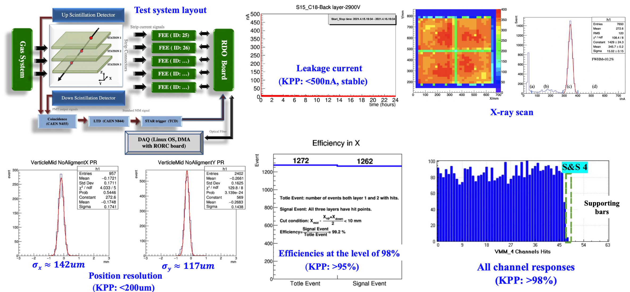
Forward sTGC Tracker – Prototype Module Performance
2024/09/10
Qian Yang @ , Sep. 10^{td} - Sep. 13th 2024

Slide 19
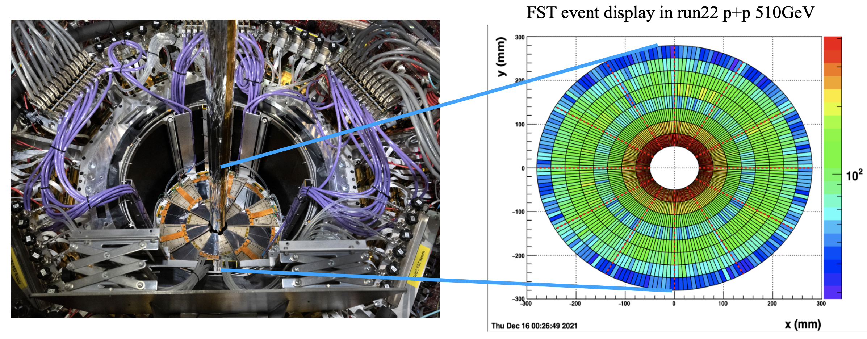
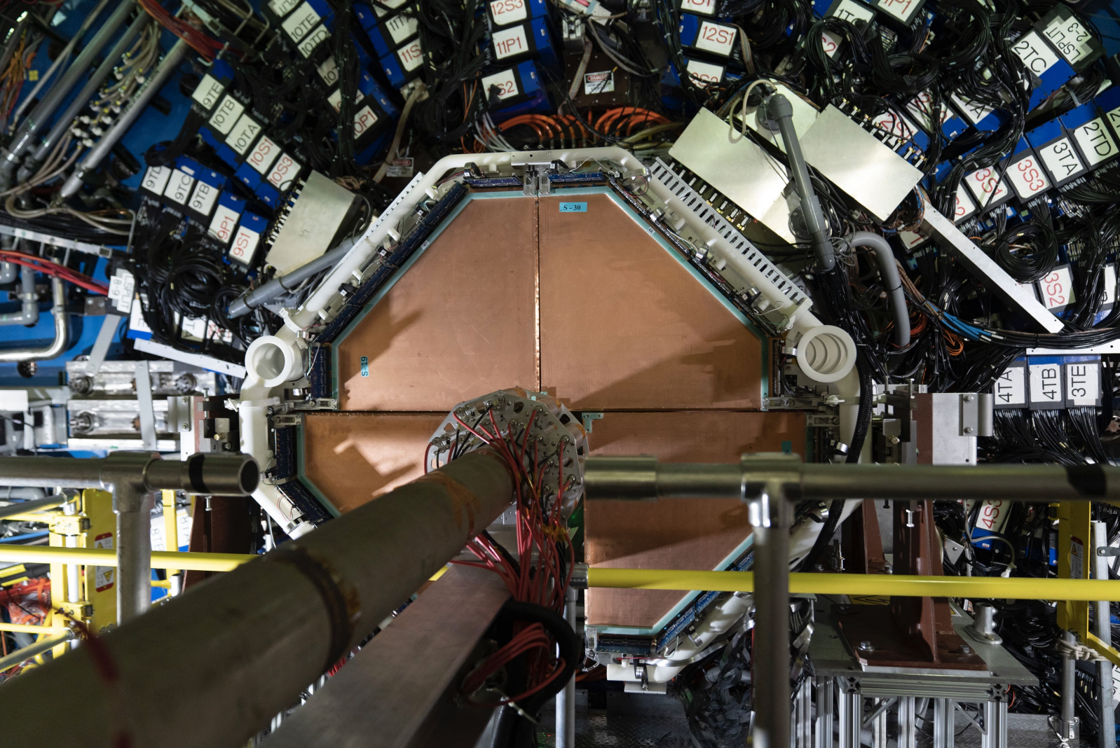
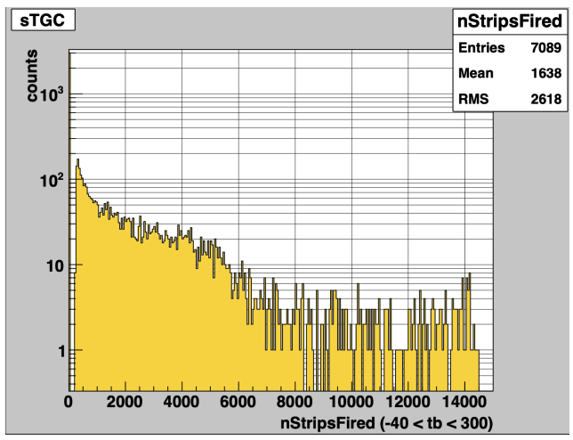
Operation
FST :
HV:
140V for inner module
160V for outer module
Hit map:
Match expectations given known missing APVs and lower bias voltages on a few of the sensors
FTT :
HV:
2900V for data taking
Hit multiplicity:
Consisting of predominately minimum bias triggered events
2024/09/10
Qian Yang @ , Sep. 10^{td} - Sep. 13th 2024

Slide 20
Charge track multiplicity & Match to FCS
Charged track multiplicity:
Reasonable result
Match to FCS:
Matched(narrow peak) + Random background(wide peak)
Good alignment between FTS and FCS
More analysis is ongoing
2024/09/10
Qian Yang @ , Sep. 10^{td} - Sep. 13th 2024

Slide 21
Summary
STAR detector has a new inner core
“High-quality, fully tested MWPC modules that met or exceeded the required performance specifications"
Forward detector data taking since 2022
2024/09/10
Qian Yang @ , Sep. 10^{td} - Sep. 13th 2024

