Slide 1
MPD performance in the fixed-target mode
P. Parfenov, M. Mamaev and A. Taranenko
(JINR, NRNU MEPhI)
The 2-nd China-Russia Joint Workshop on NICA Facility
10-13 September 2024
The work has been supported by the Ministry of Science and Higher Education of the Russian Federation, Project "Fundamental and applied research at the NICA megascience experimental complex" № FSWU-2024-0024

Slide 2
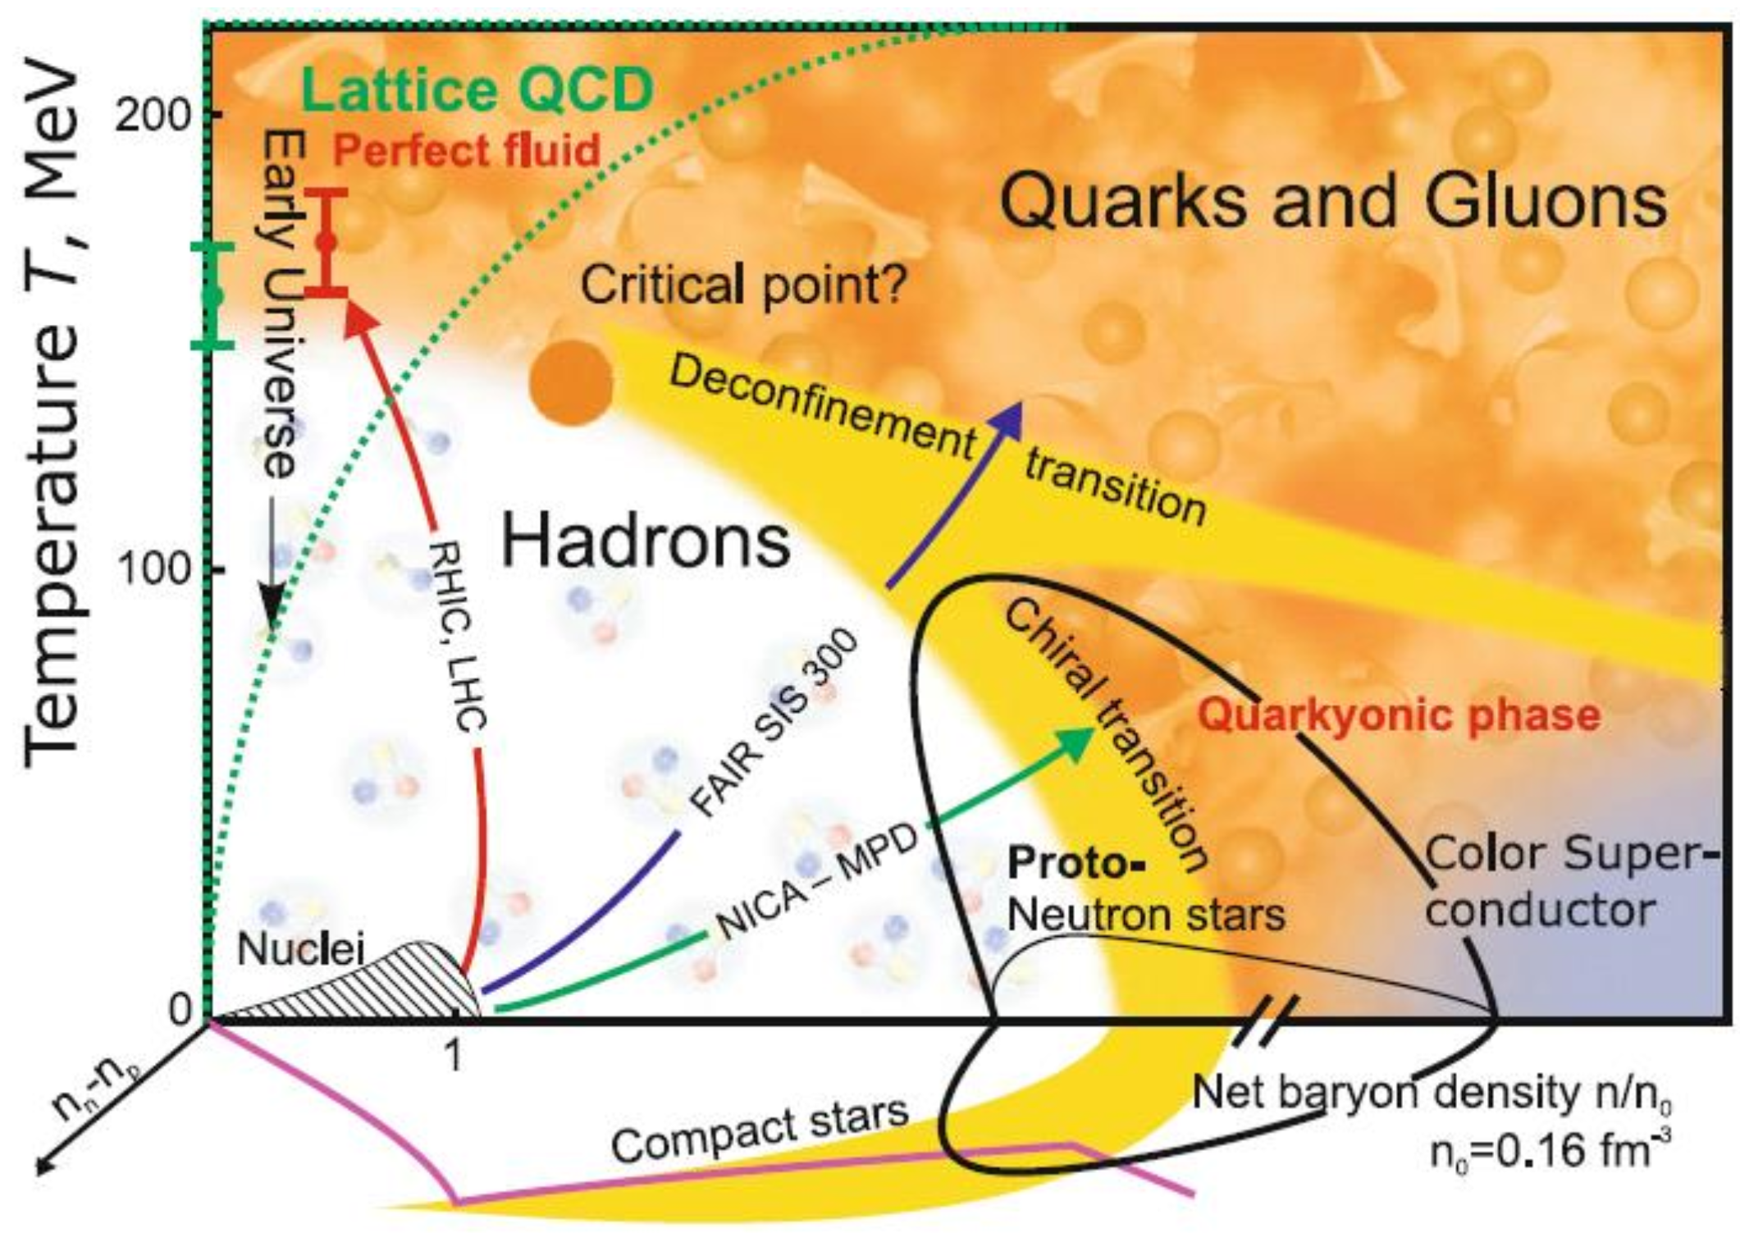
Relativistic heavy-ion collisions

Slide 3
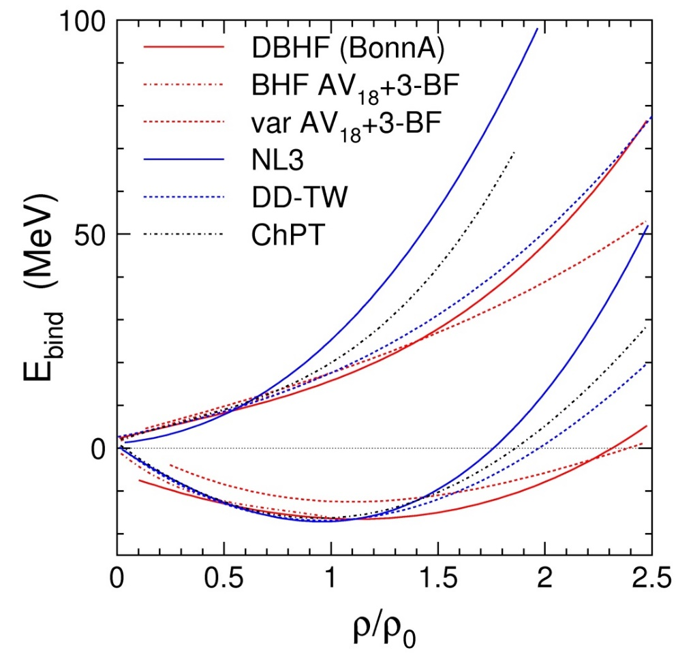
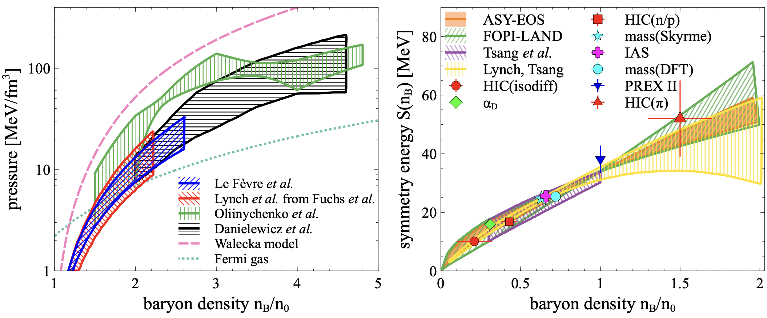
EOS for high baryon density matter
The binding energy per nucleon:
Isospin asymmetry:
Symmetric matter
Symmetry energy
Neutron matter
E/A
E_{sym}
Symmetric matter
Ch. Fuchs and H.H. Wolter, EPJA 30 (2006) 5
A. Sorensen et. al., Prog.Part.Nucl.Phys. 134 (2024) 104080
New data is needed to further constrain transport models with hadronic d.o.f.

Slide 4
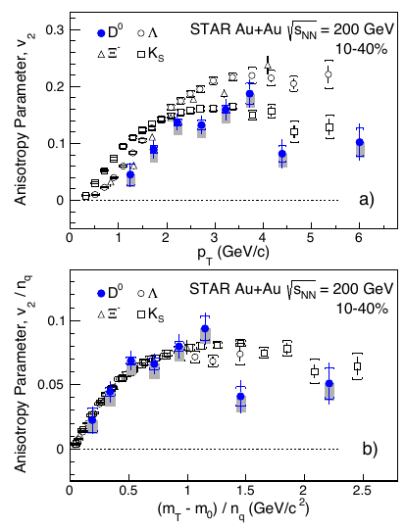
Anisotropic flow at LHC/RHIC
Gale, Jeon, et al., Phys. Rev. Lett. 110, 012302
STAR PRL118 (2017) 212301
v₁ – directed flow, v₂ – elliptic flow

Slide 5
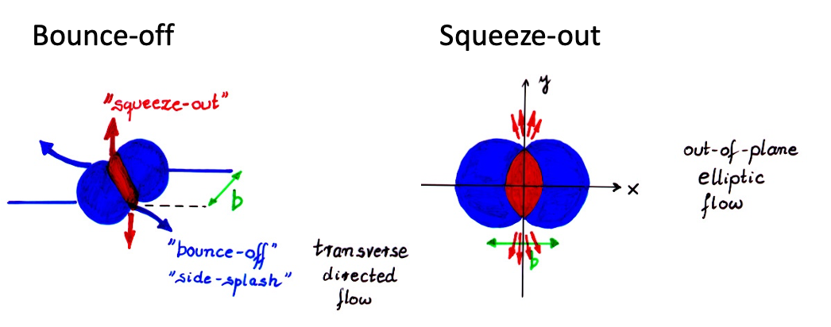
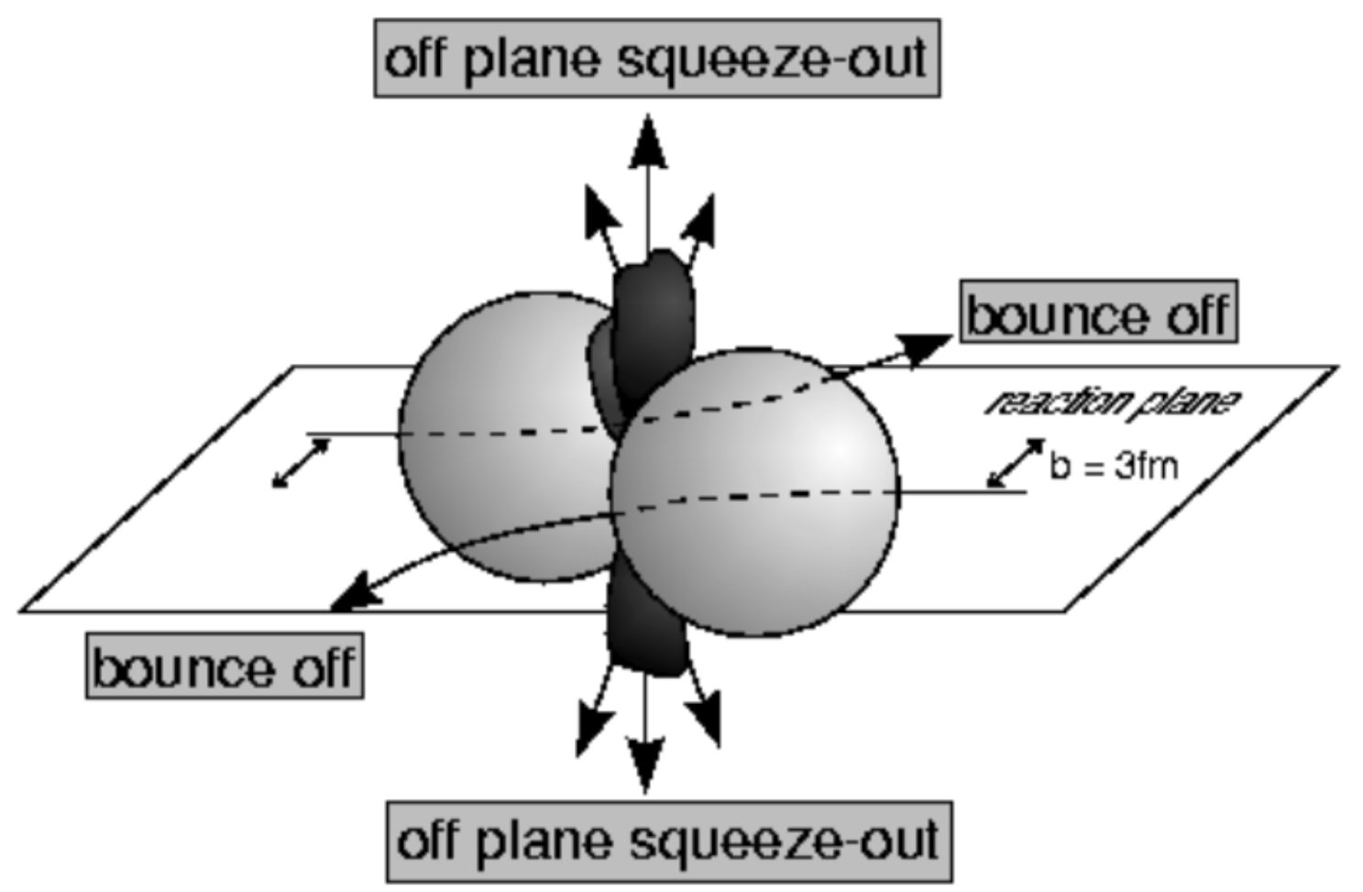
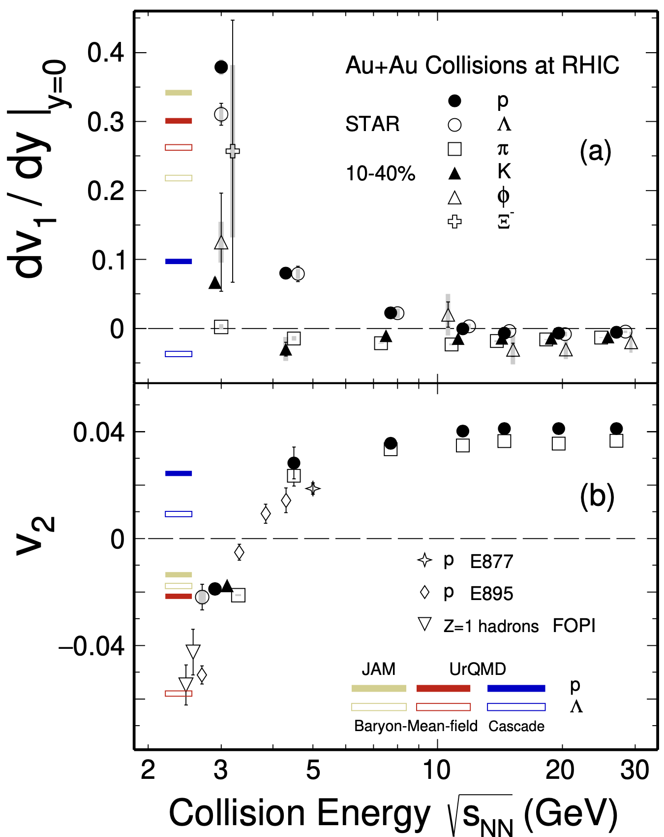
Anisotropic flow at Nuclotron-NICA energies
STAR, Phys.Lett.B 827 (2022) 137003
BM@N
MPD
MPD-FXT
12.09.2024
2nd China-Russia NICA
Notes:
One more way to study the properties of the matter created in the collision is through the lens of collective motion of created in the collision particles.
We can decompose the azimuthal distribution of produced particles with respect to RP in a FS
Coefficients …
The main mechanisms driving the direced and elliptic flow are
Bounce off for directed flow — when two nuclei collide, the remnants are deflected out from the overlap region and pull the matter created in the collision apart
Squeeze out for elliptic flow — when the remnants of colliding nuclei are pushing the matter within the overlap region and squeeze the produced particles out of reaction plane
Collective flow is sensitive to …

Slide 6
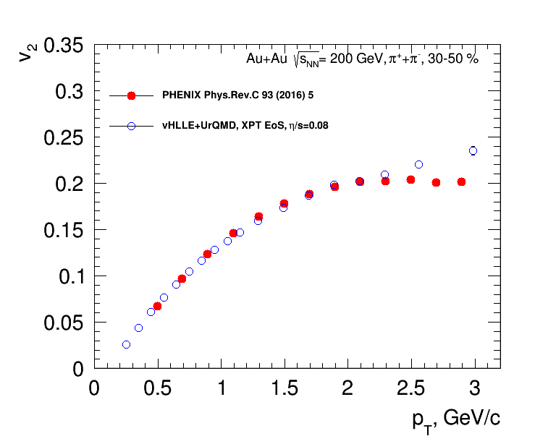
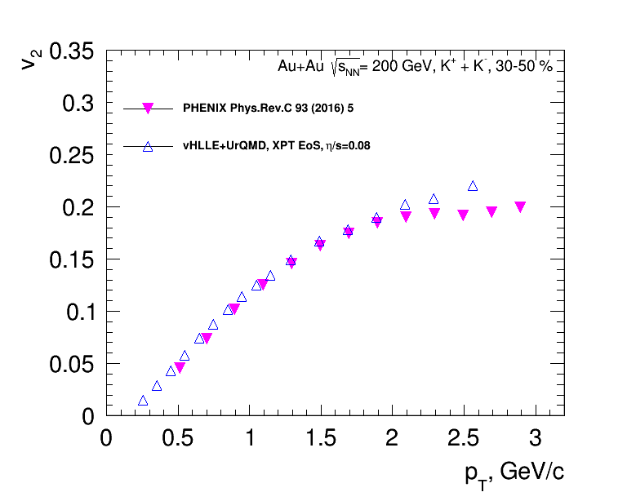
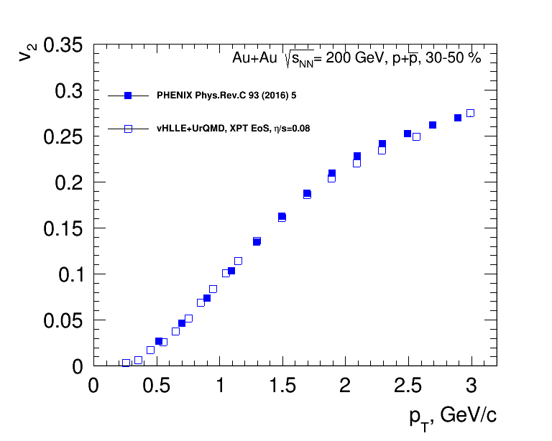
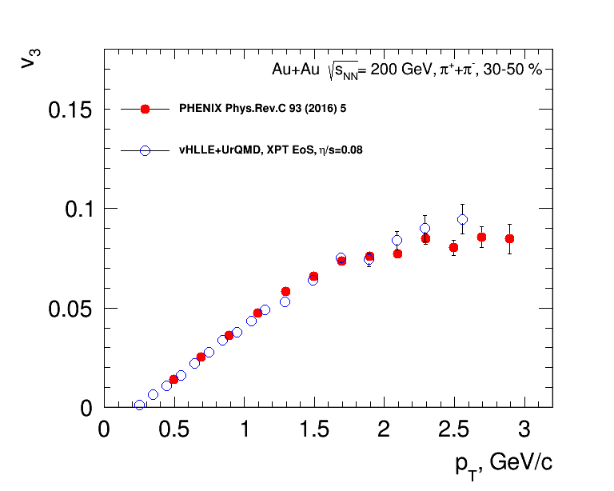
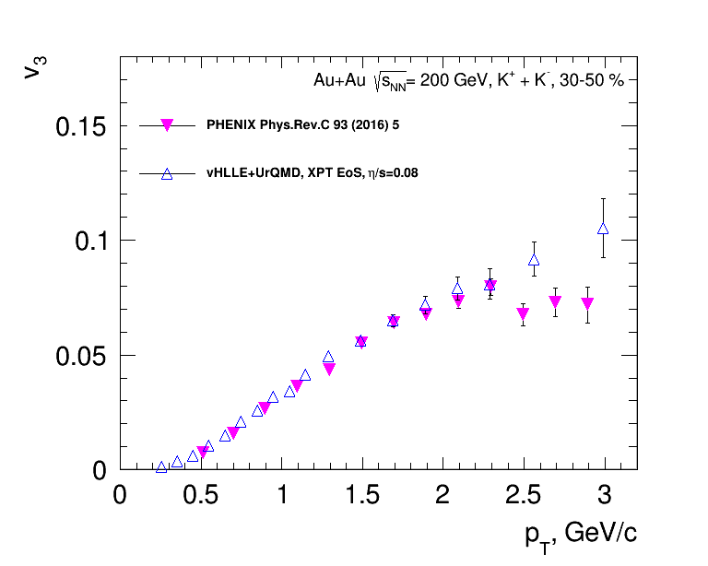
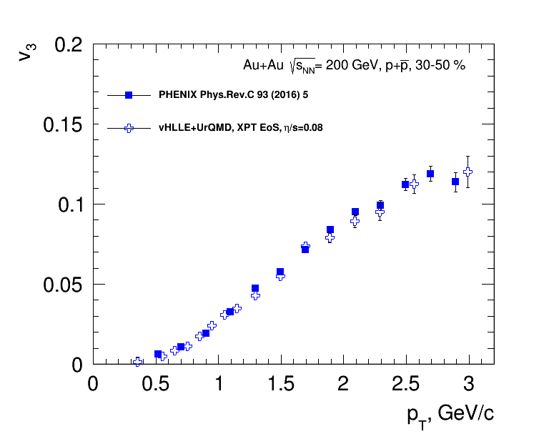
vHLLE+UrQMD: Elliptic and triangular flow in Au+Au collisions at 200 GeV
3D hydro model vHHLE + UrQMD (XPT EOS), η/s= 0.08 + param from Iu.A. Karpenko, P. Huovinen, H. Petersen, M. Bleicher , Phys.Rev. C91 (2015) no.6, 064901
Reasonable agreement between results of vHLLE+UrQMD model and published PHENIX data

Slide 7
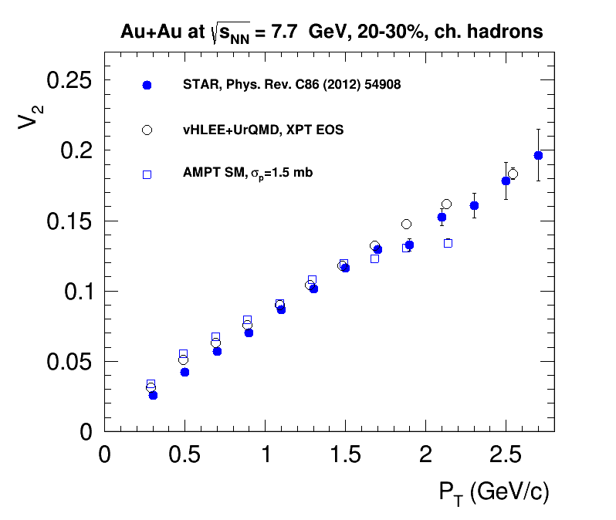
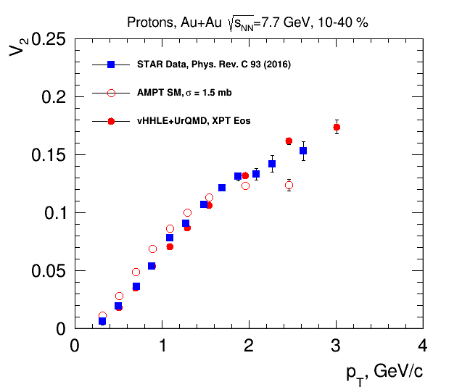
Elliptic flow at NICA energies: Models vs. Data comparison

Slide 8
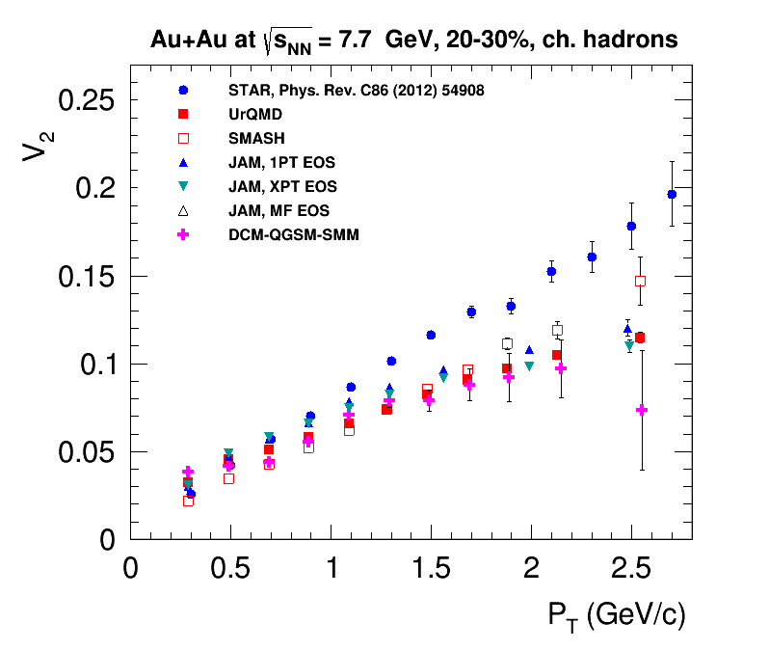
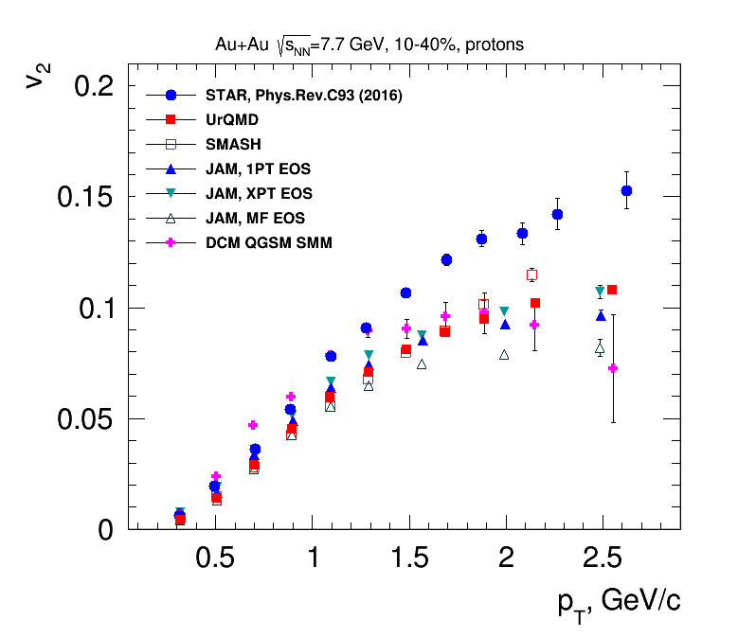
Elliptic flow at NICA energies: Models vs. Data comparison

Slide 9
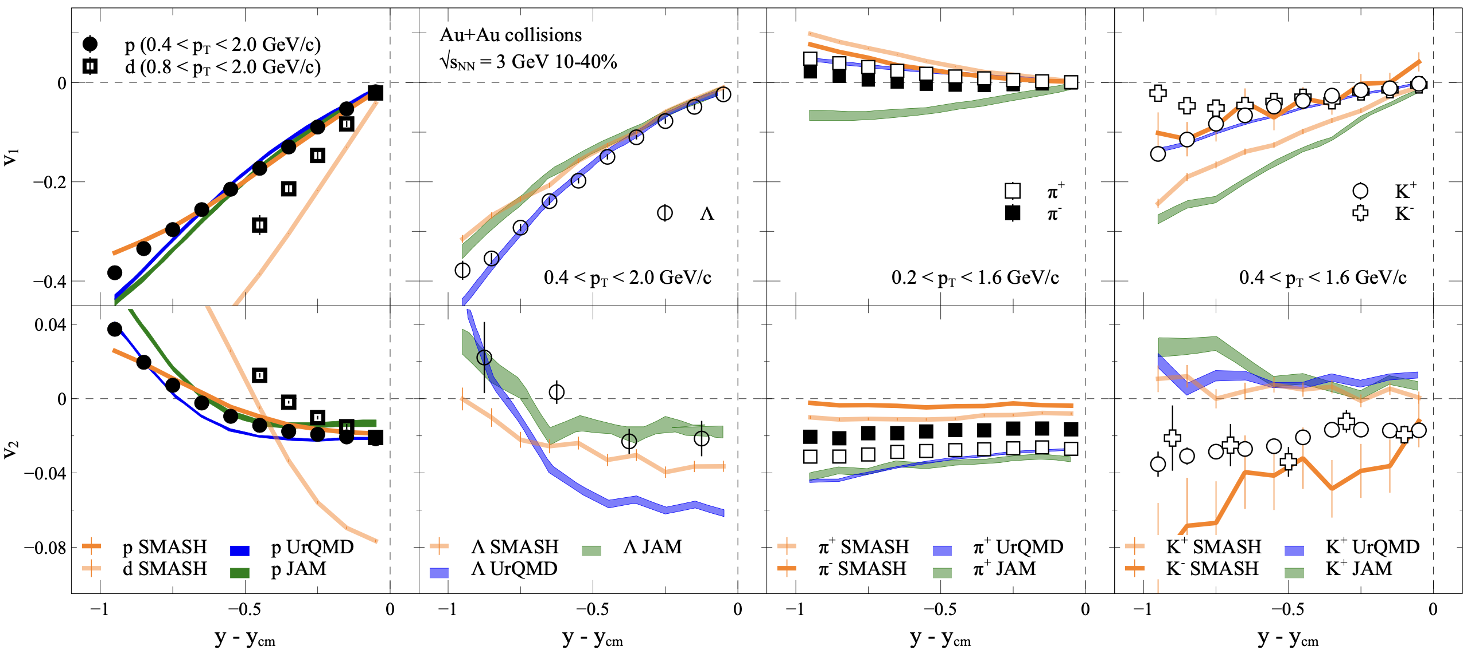
A. Sorensen et. al., Prog.Part.Nucl.Phys. 134 (2024) 104080

Slide 10
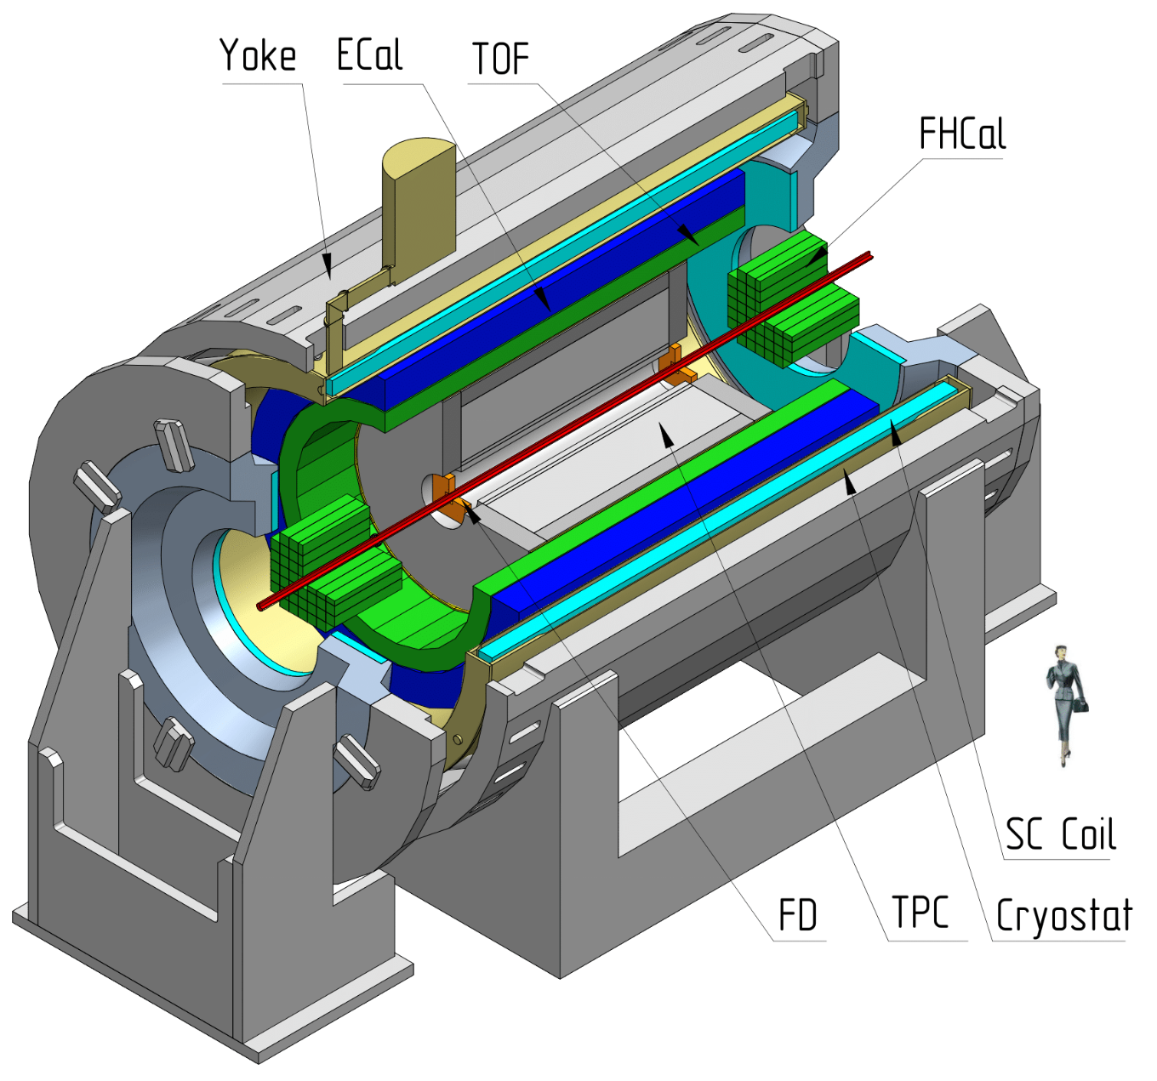
MPD Experiment at NICA
Bi+Bi: 50M at √s_{NN} = 9.2 GeV (UrQMD, vHLLE+UrQMD, …)
Centrality determination: Bayesian inversion method and MC-Glauber
Event plane determination: TPC, FHCal
Track selection:
Primary tracks
N_{TPC hits} ≥ 16
0.2 < p_{T} < 3.0 GeV/c
|η| < 1.5
PID – ToF + dE/dx
Multi-Purpose Detector in collider mode (MPD-CLD)

Slide 11
Anisotropic flow in MPD-CLD
Good performance for flow measurements for all methods used (EP, SP, Q-cumulants)

Slide 12
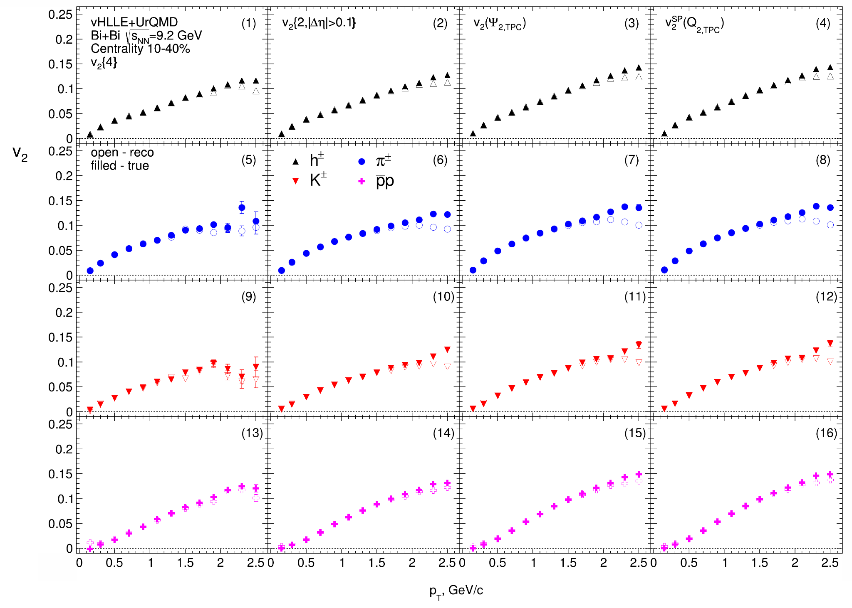
Elliptic flow in MPD-CLD
Cuts:
Charged particles only
Primary
|η|<1.5
Δ η = 0,1
p_{T} >0.2 GeV/c
|DCA|<3σ
nTPC hits ≥ 16
PID: PDG code
good agreement of the v_{2,mc} with v_{2,reco} data
The difference at large p_{T} between v_{2,mc} and v_{2,reco} (non-flow)

Slide 13
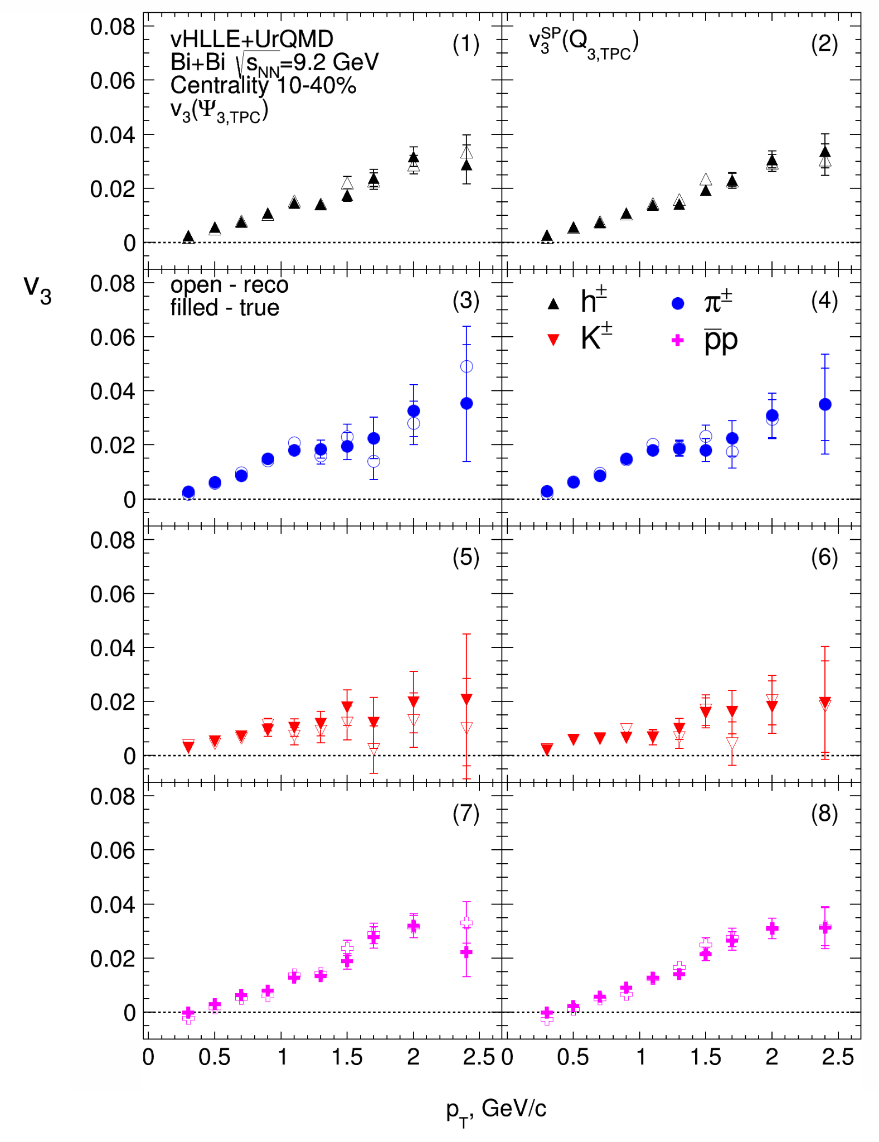
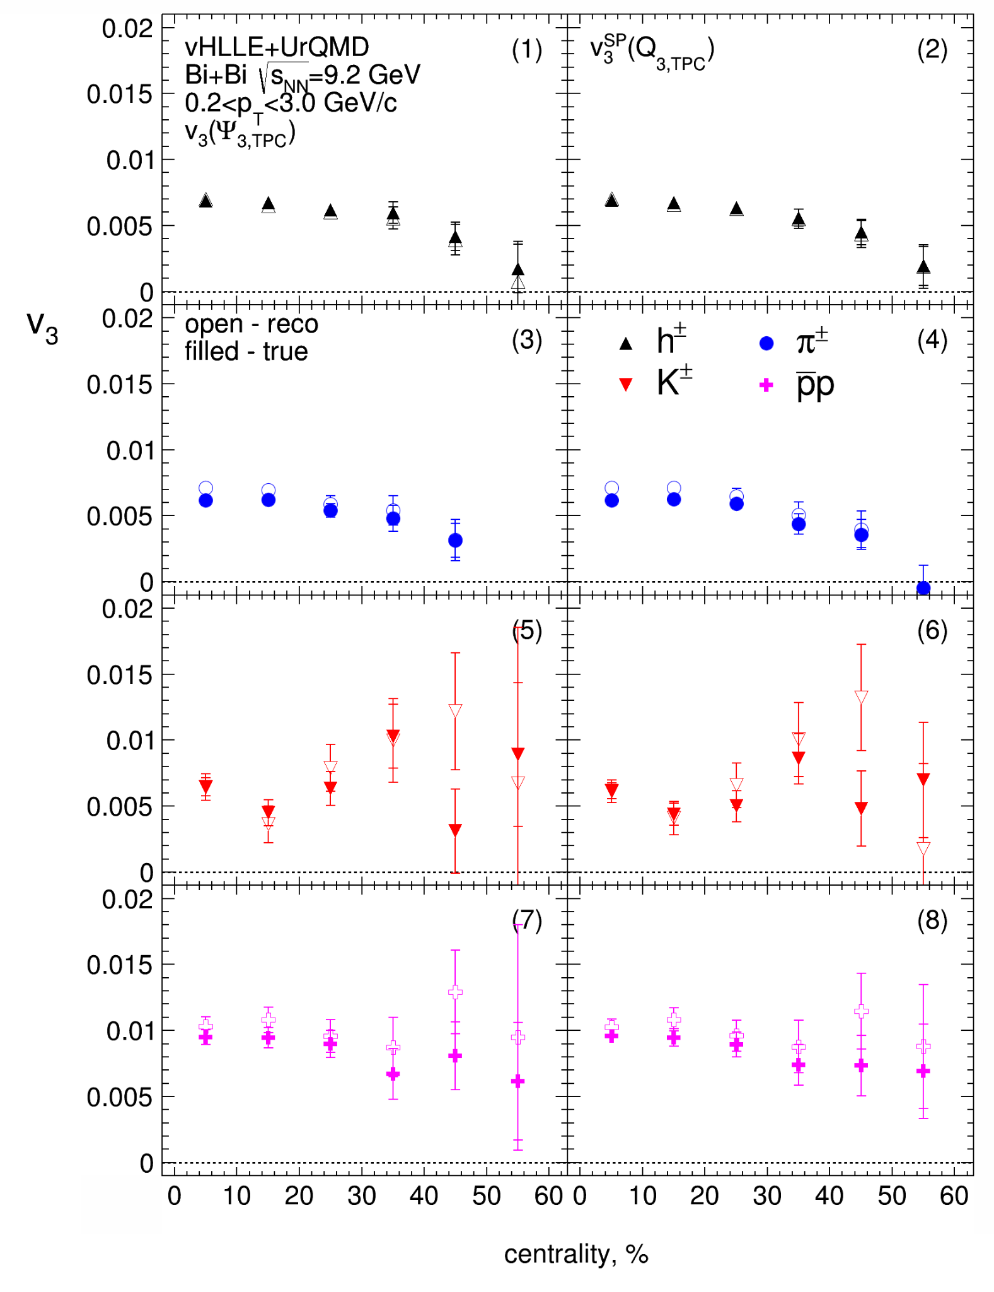
Triangular flow in MPD-CLD
Cuts:
Charged particles only
Primary
|η|<1.5
Δ η = 0,1
p_{T} >0.2 GeV/c
|DCA|<3σ
nTPC hits ≥ 16
PID: PDG code

Slide 14
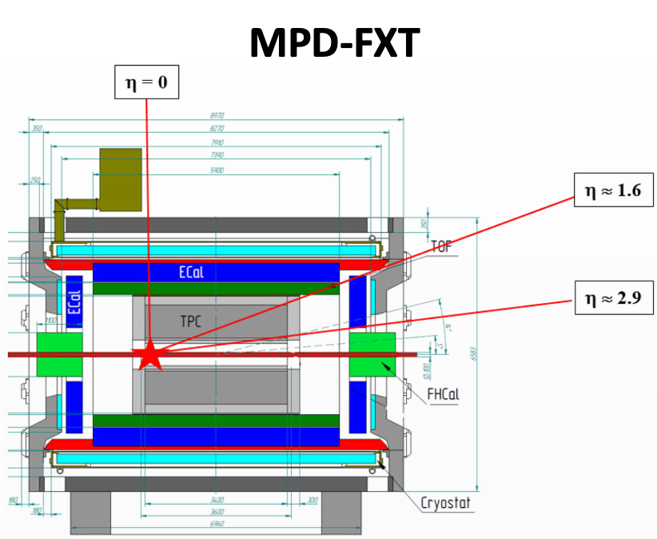
MPD in Fixed-Target Mode (FXT)
Model used: UrQMD mean-field
Bi+Bi, E_{kin}=1.45 AGeV (√s_{NN} =2.5 GeV)
Bi+Bi, E_{kin}=2.92 AGeV (√s_{NN} =3.0 GeV)
Bi+Bi, E_{kin}=4.65 AGeV (√s_{NN}=3.5 GeV)
Point-like target at z = -115 cm
GEANT4 transport
Multiplicity-based centrality determination
PID using information from TPC and TOF
Primary track selection: DCA<1 cm
Track selection:
N_{hits}>27 (protons), N_{hits}>22 (pions)
12.09.2024
2nd China-Russia NICA

Slide 15
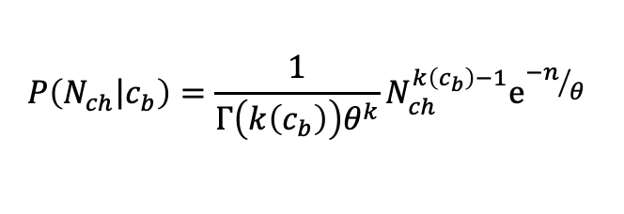
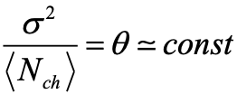
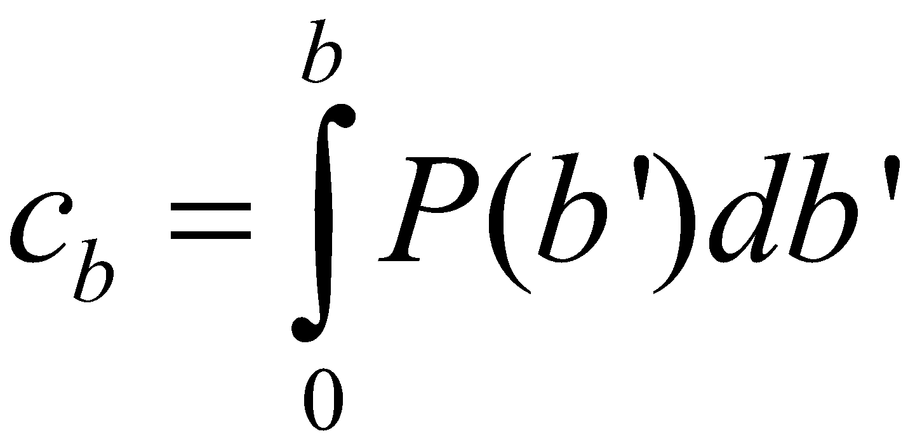
The Bayesian inversion method (Γ-fit)
Relation between multiplicity N_{ch} and impact parameter b is defined by the fluctuation kernel:
2 main steps of the method:
Fit experimental (model) distribution with P(N)
– centrality based on impact parameter
Mean multiplicity as a function of c_{b} can be defined as follows:
Construct P(b|E) using Bayes’ theorem:
P(b|N) = P(b)P(N|b)/P(N)
- 5 parameters
Fit function for N_{ch} distribution:
b-distribution for a given N_{ch} range:
Notes:
the ratio of the fluctuation to the average value is equal to a constant
In the ehd

Slide 16
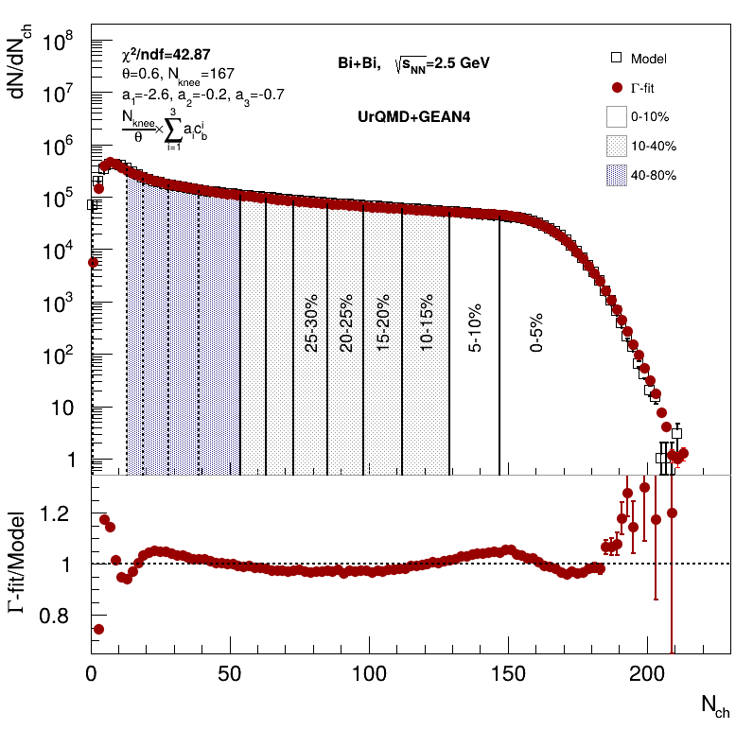
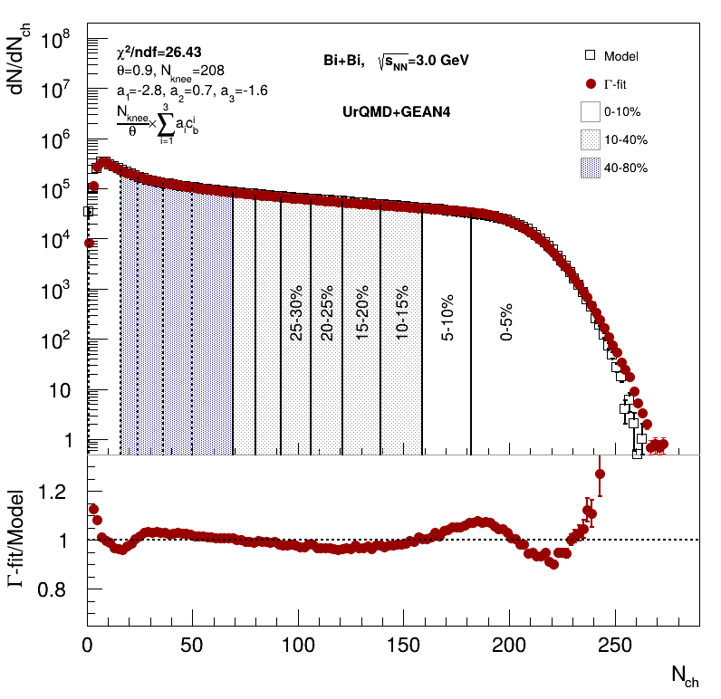
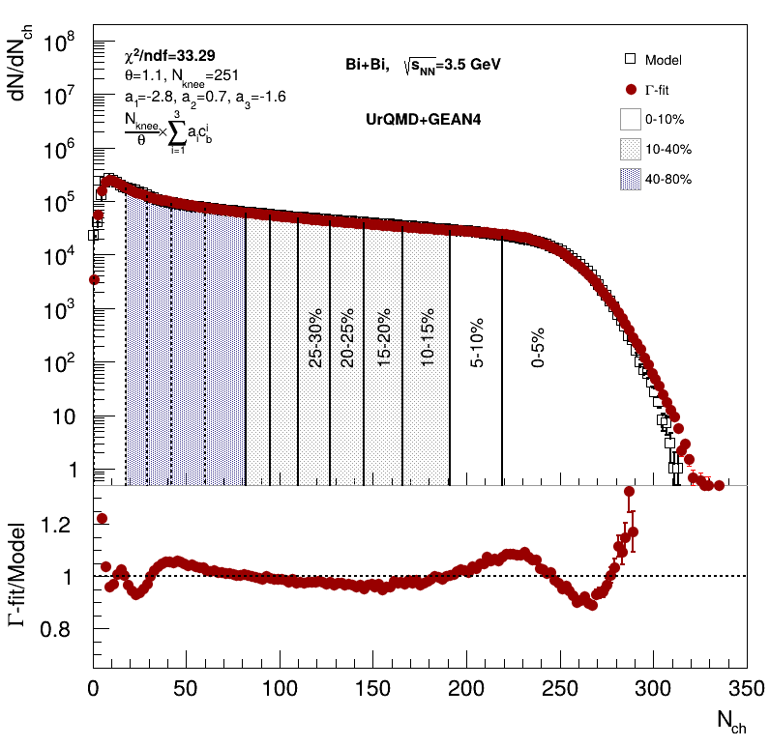
Centrality determination: multiplicity fit
Cuts on tracks:
Nhits>16
0 < η < 2
Multiplicity-based centrality determination (Г-fit) was used
Good agreement between fit and data
12.09.2024
2nd China-Russia NICA

Slide 17
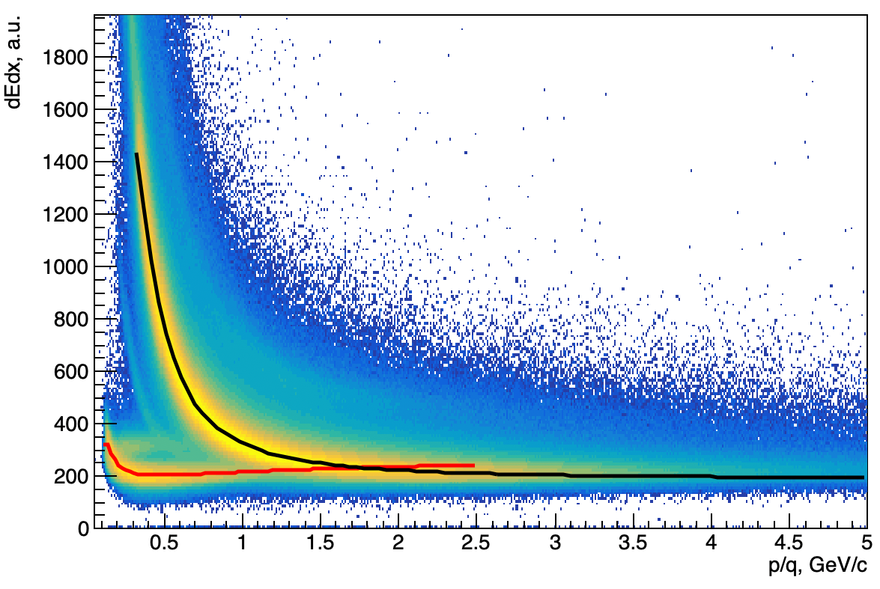
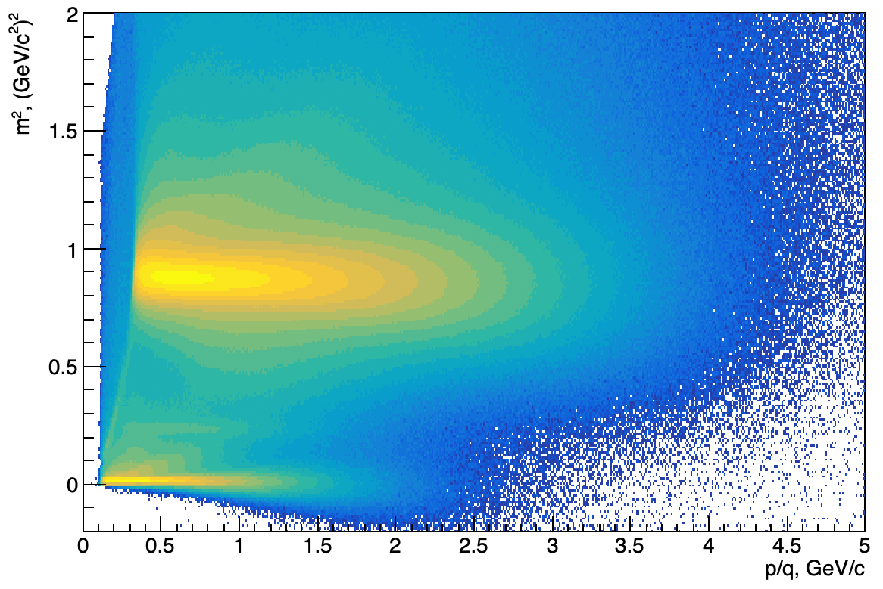
PID procedure
W. Blum, W. Riegler, L. Rolandi, Particle Detection with Drift Chambers (2nd ed.), Springer, Verlag (2008)
Fit dE/dx distributions with Bethe-Bloch parametrization:
p_{i} - fit parameters
Fit (dE/dx - f(βɣ))/f(βɣ) with gaus in the slices of p/q and get σ_{p}(dE/dx)
p
𝝿⁺
Fit m² with gaus in the slices of p/q and get σ_{p}(m²)
p
(dE/dx,m)→(x,y) coordinates for PID:
𝝿⁺

Slide 18
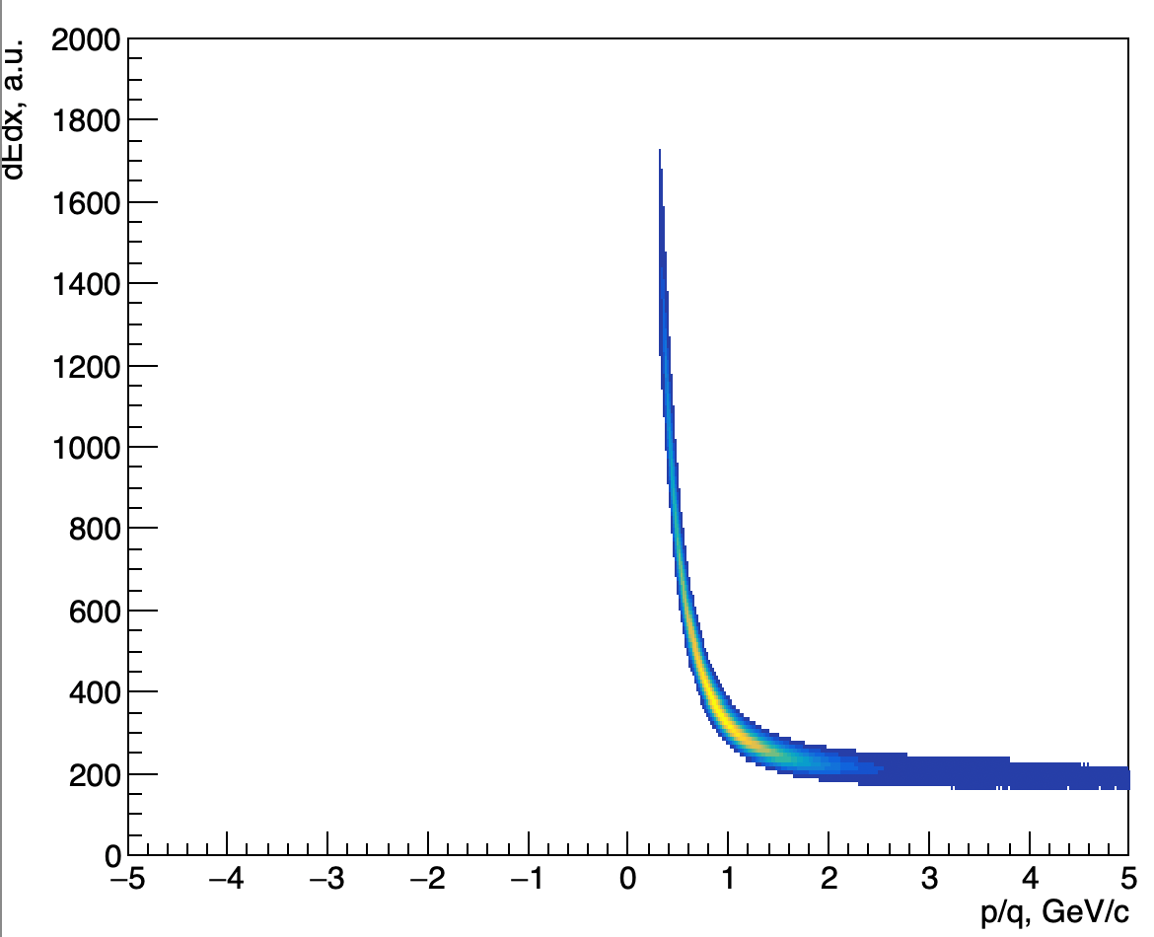
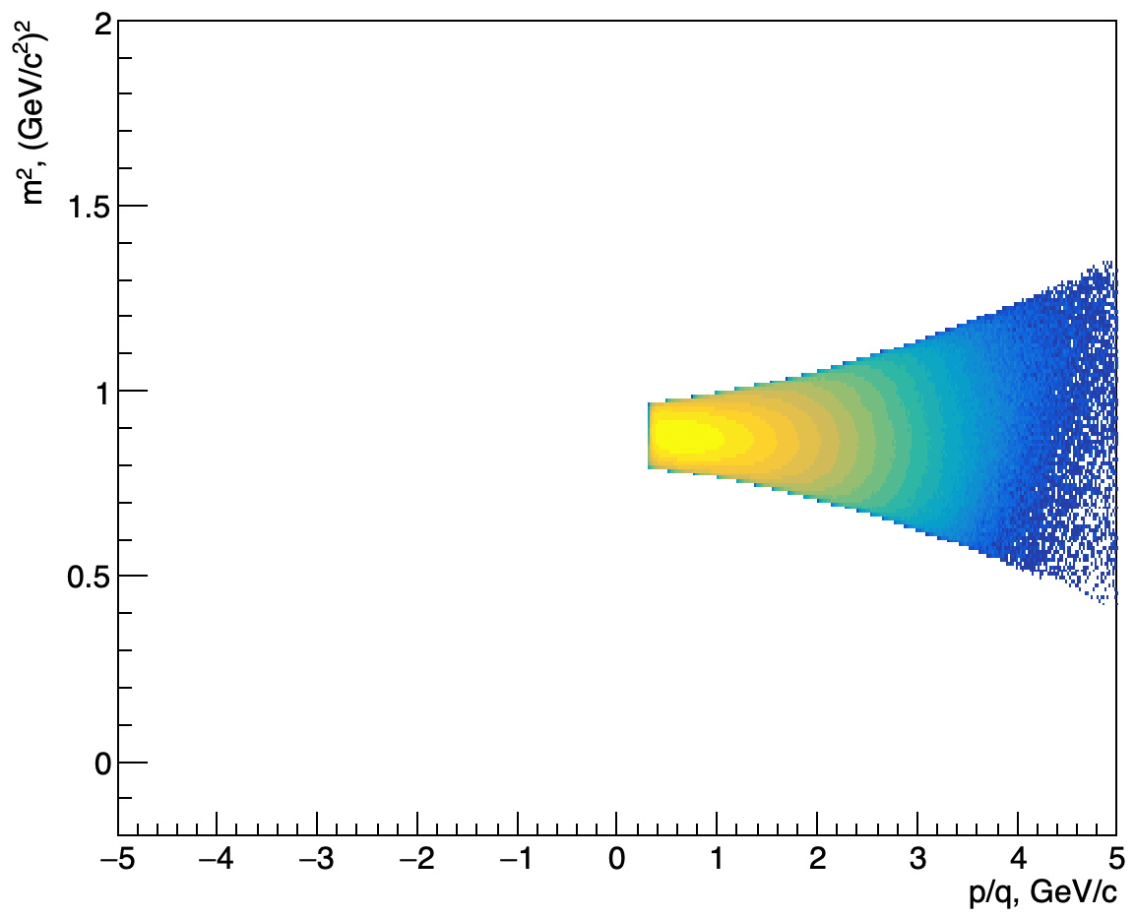
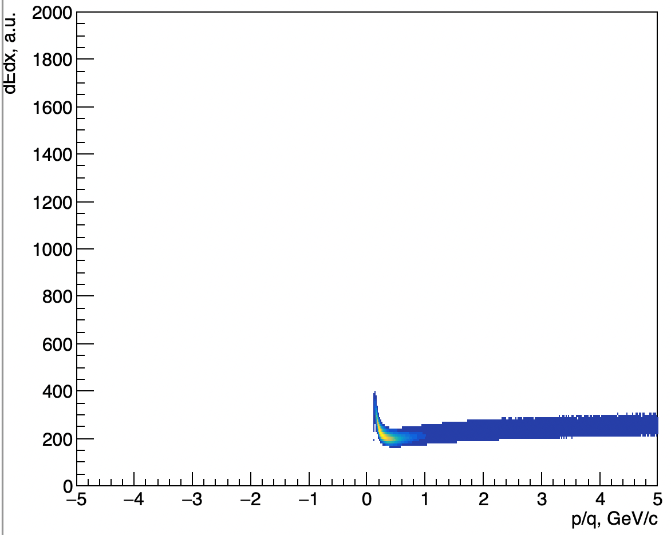
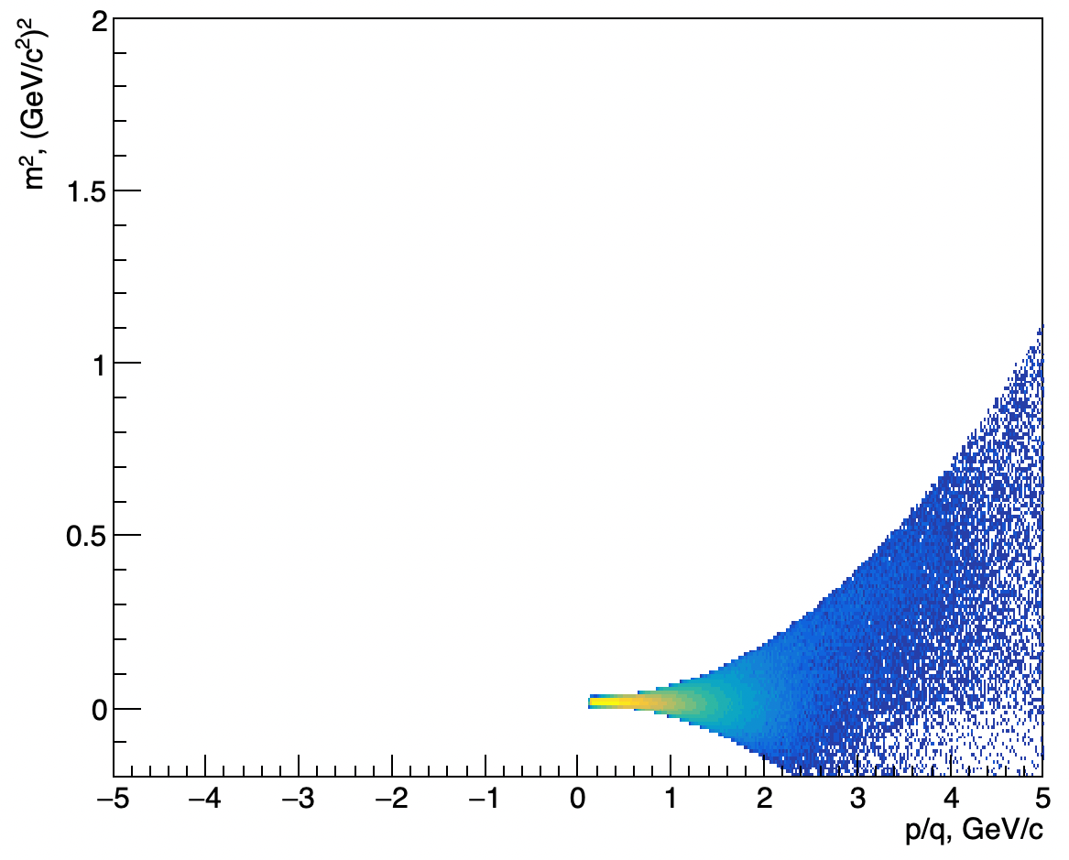
PID procedure: Results
Protons:
Pions (𝛑⁺):
Pions (𝛑⁻):
charge<0

Slide 19
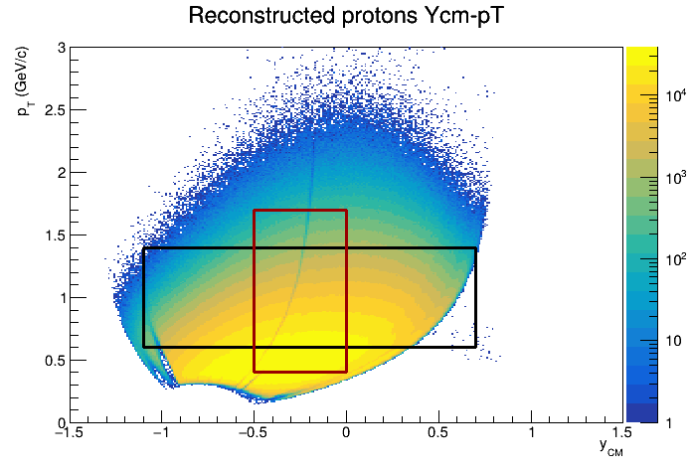
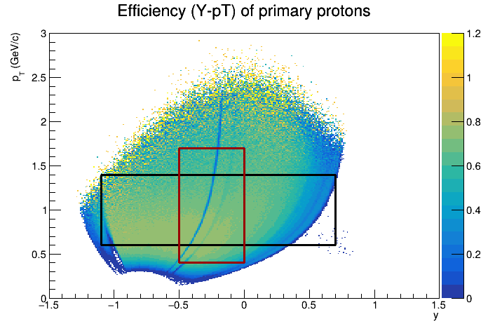
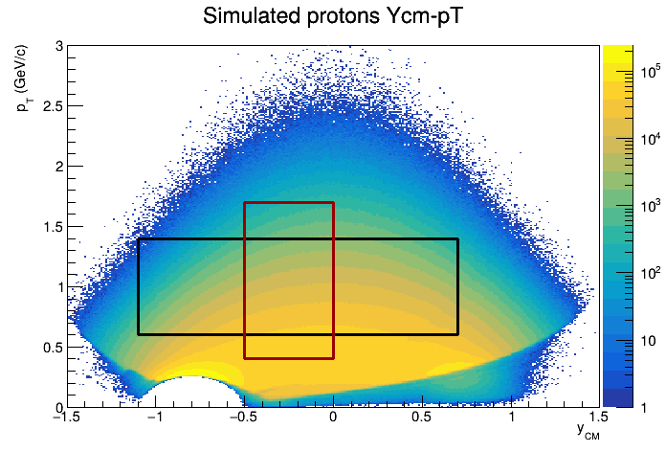
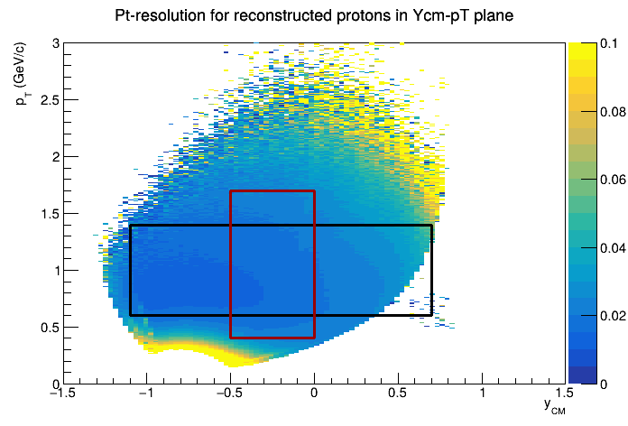
(y-pt) distribution, efficiency and δpt (protons)
Bi+Bi √s_{NN}=2.5 GeV
Cuts for reco tracks:
Nhits>27
DCA< 1 cm
PID (TPC+TOF)
Primary (DCA<1 cm)
Cuts for sim particles:
PID (pdg code)
Primary (motherId)
Black box: acceptance window for v_{n}(y)
Red box: acceptance window for v_{n}(p_{T})

Slide 20
Flow vectors
F3
Q{F2}
F2
Modules of FHCal divided into 3 groups
F1
From momentum of each measured particle define a u_{n}-vector in transverse plane:
Q{F1}
Q{F3}
where φ is the azimuthal angle
Sum over a group of u_{n}-vectors in one event forms Q_{n}-vector:
Tp
Additional subevents from tracks not pointing at FHCal:
Tp: p; -1.0<y<-0.6;
Ψ_{n}^{EP} is the event plane angle
Notes:
Let’s introduce flow vectors. Every particle in event represent as un vector in transverse plane, where phi is azimuthal angle of particle’s momentum. Summation over this un-vectors results with Qn vector, which is directed to symmetry plane of the event. This plane is called Event plane, and the transverse angle of this plane is called event plane angle relatively.

Slide 21
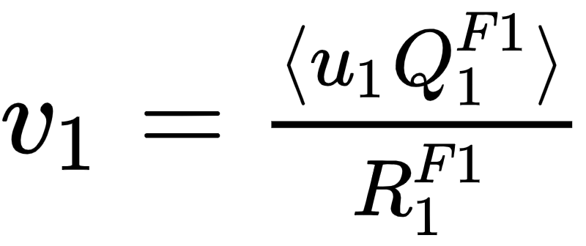
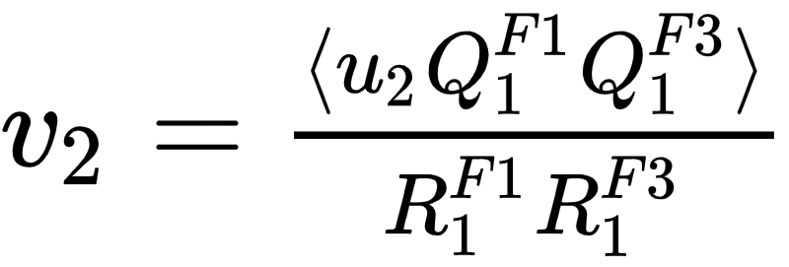
Flow methods for v_{n} calculation
Tested in HADES:
M Mamaev et al 2020 PPNuclei 53, 277–281
M Mamaev et al 2020 J. Phys.: Conf. Ser. 1690 012122
Scalar product (SP) method:
Where R₁ is the resolution correction factor
F3
F2
F1
Symbol “F2(F1,F3)” means R₁ calculated via (3S resolution):
Symbol “F2{Tp}(F1,F3)” means R₁ calculated via (4S resolution):
12.09.2024
2nd China-Russia NICA
Notes:
In this work two methods of flow calculation are used: Event plane for cross-checks and scalar product for the analysis. In the first method, one estimates event plane angle and measures mean cosine of particles azimuthal angle. Then, resolution of event plane estimation is applied. Resolution is calculated with random sub event method. In the scalar product the correlation between flow vectors are calculated and then, the resolution correction is applied estimated with 3-sub event method.

Slide 22
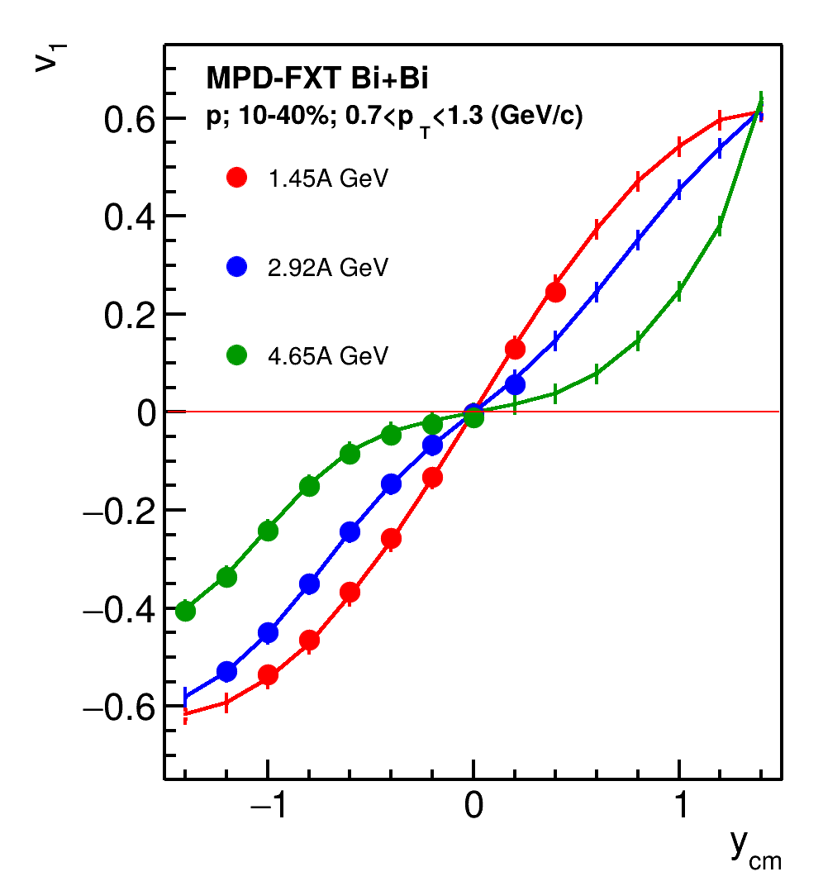
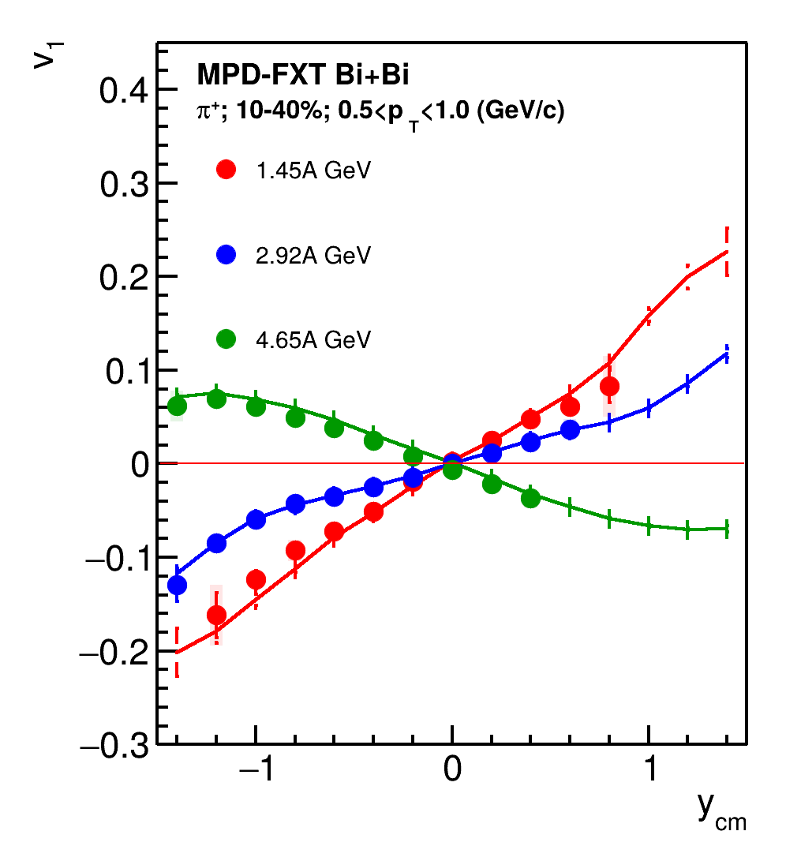
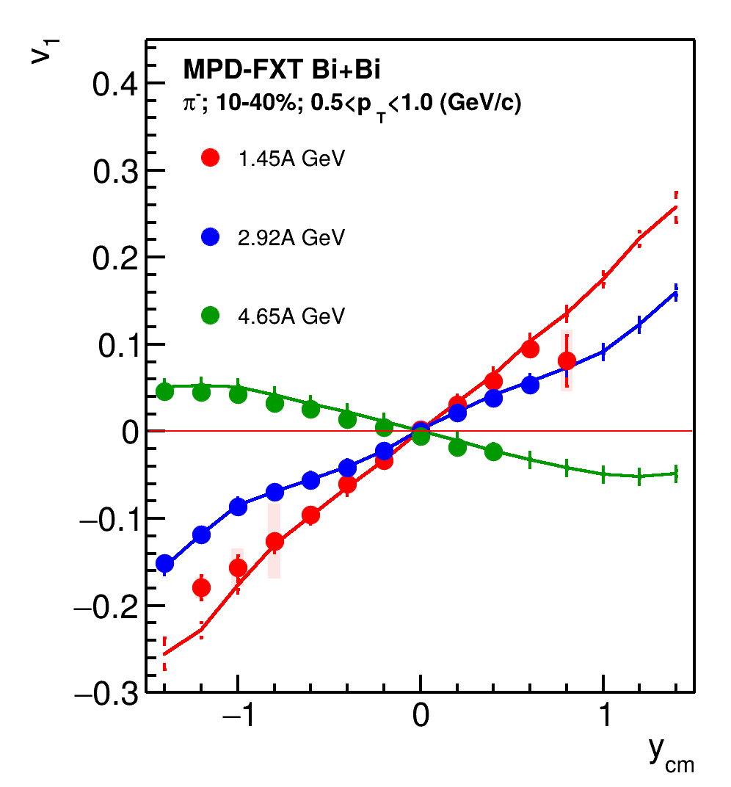
Results: v₁(y)
Systematics: xx, yy, F1, F2, F3
p
𝝿⁺
𝝿⁻
Good agreement with MC data
12.09.2024
2nd China-Russia NICA

Slide 23
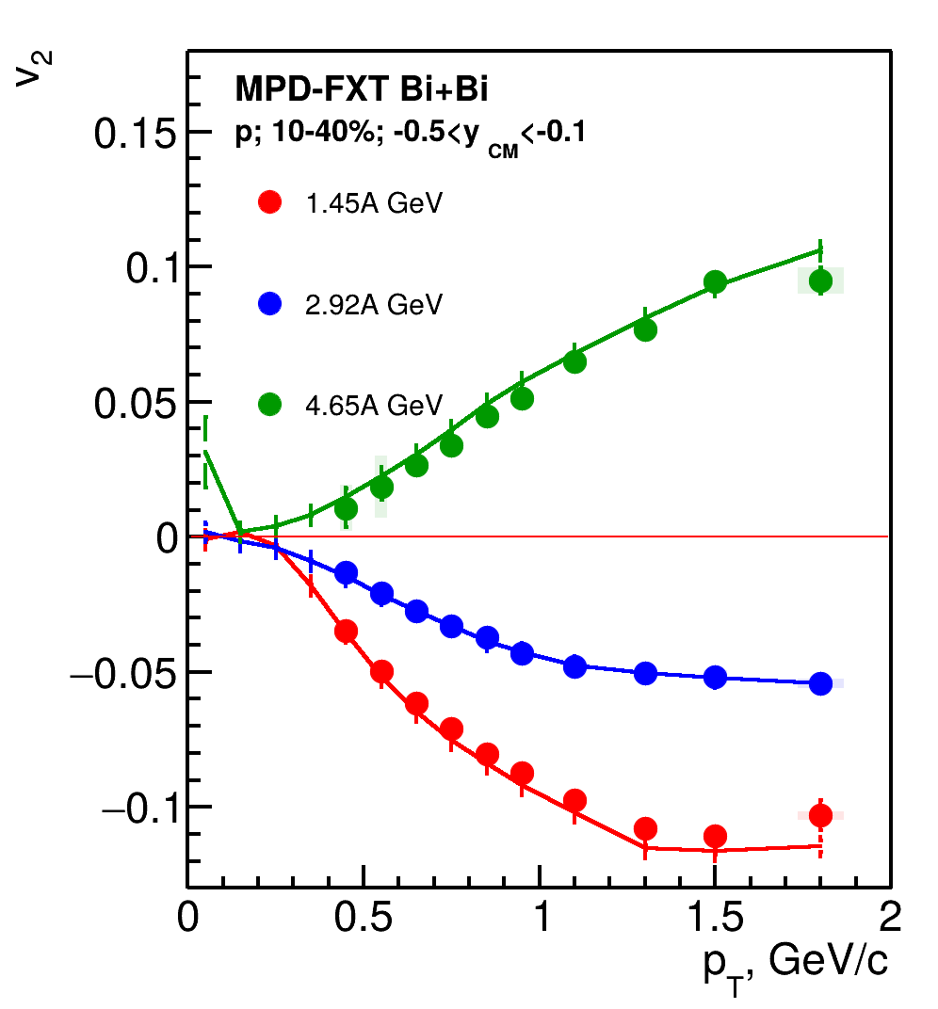
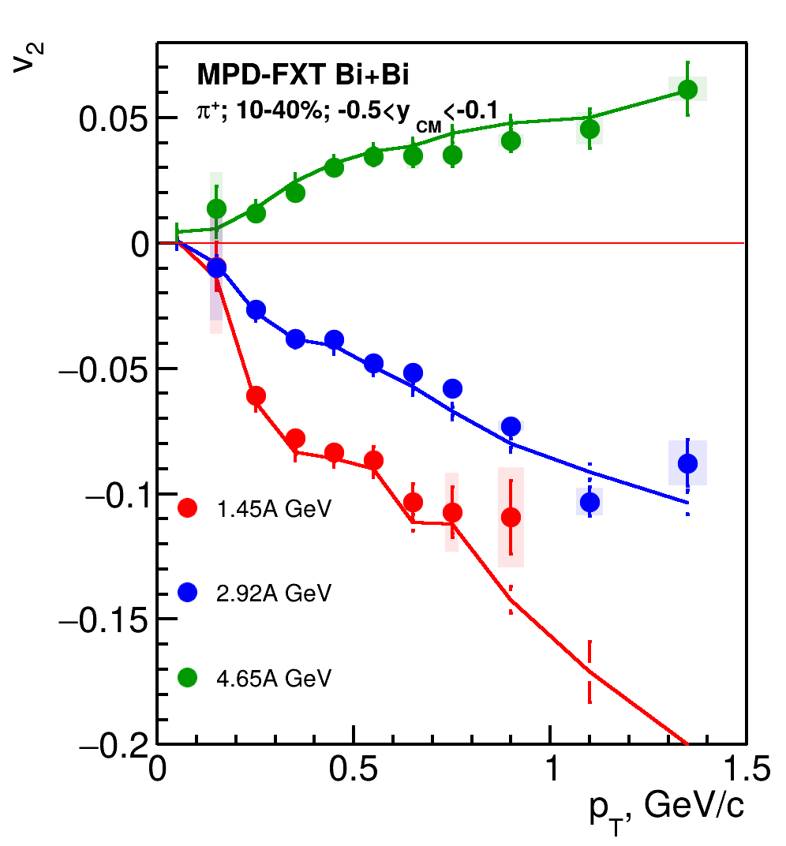
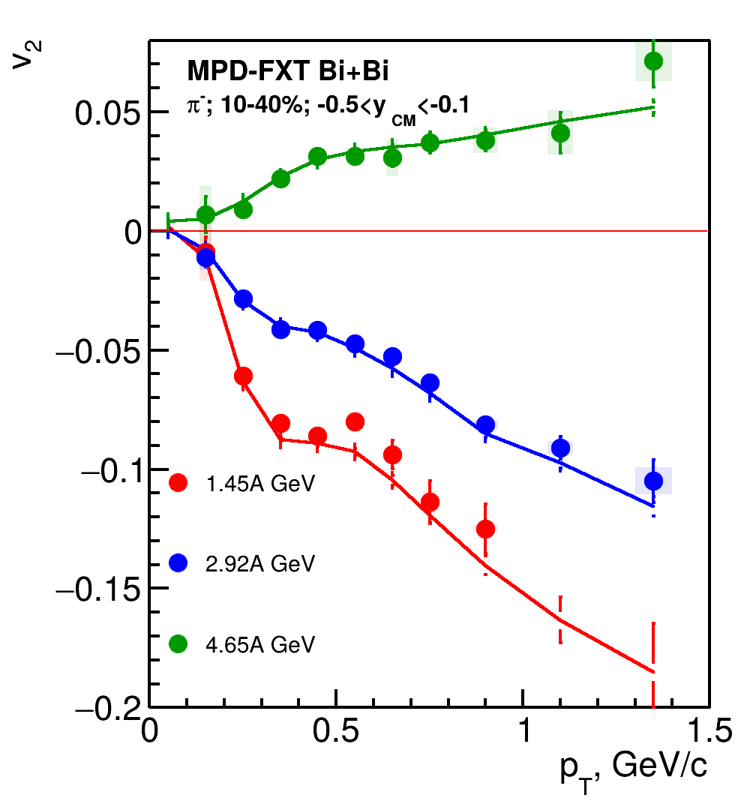
Results: v₂(p_{T})
Systematics: xxx, xyy
p
𝝿⁺
𝝿⁻
Good agreement with MC data
12.09.2024
2nd China-Russia NICA

Slide 24
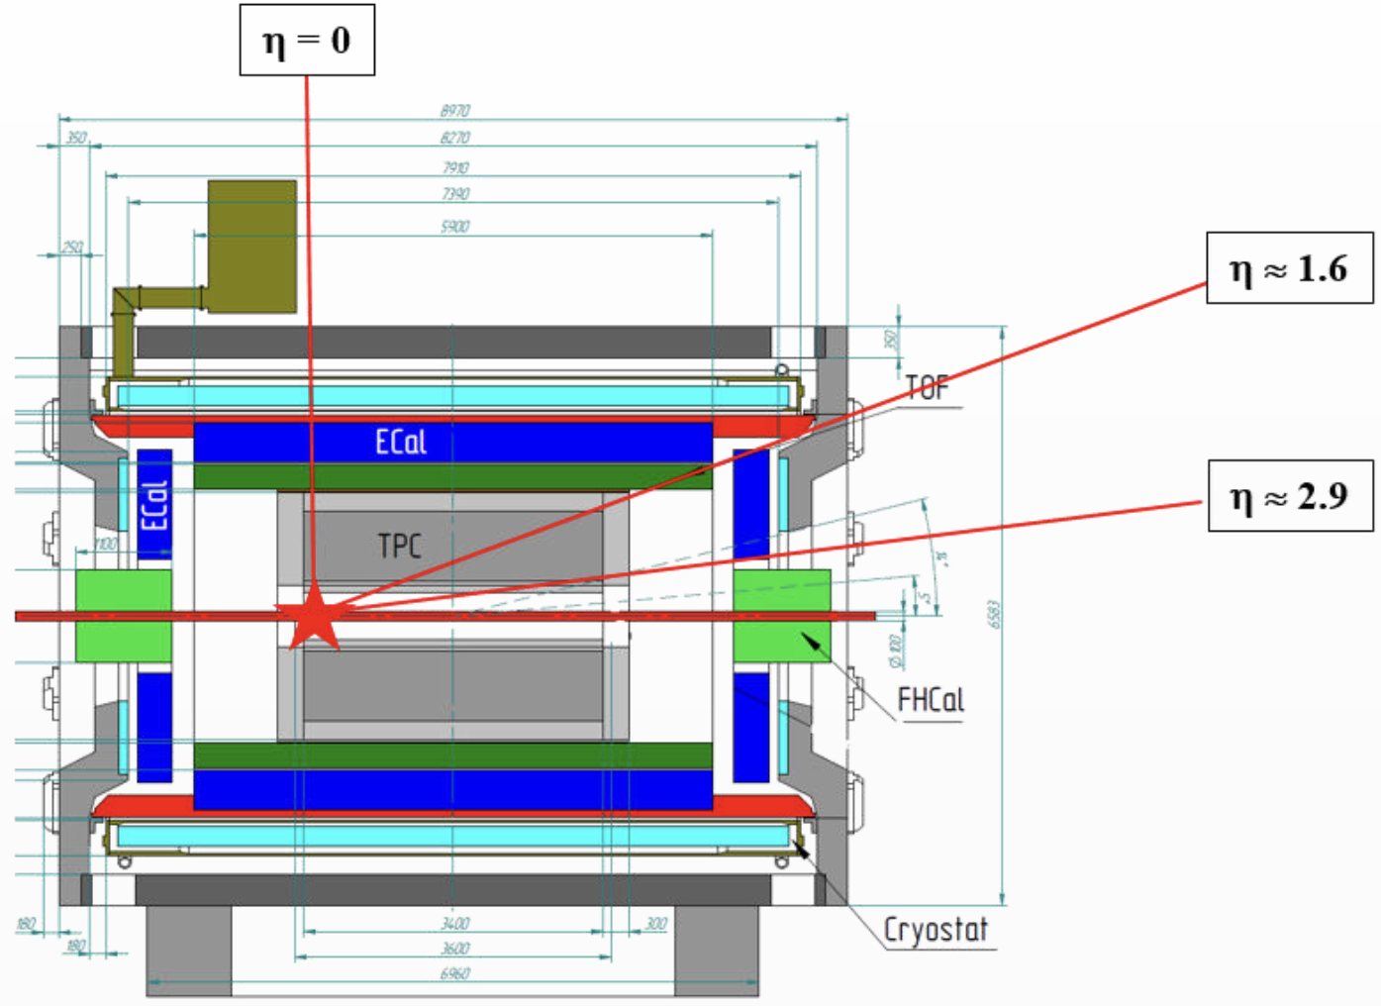
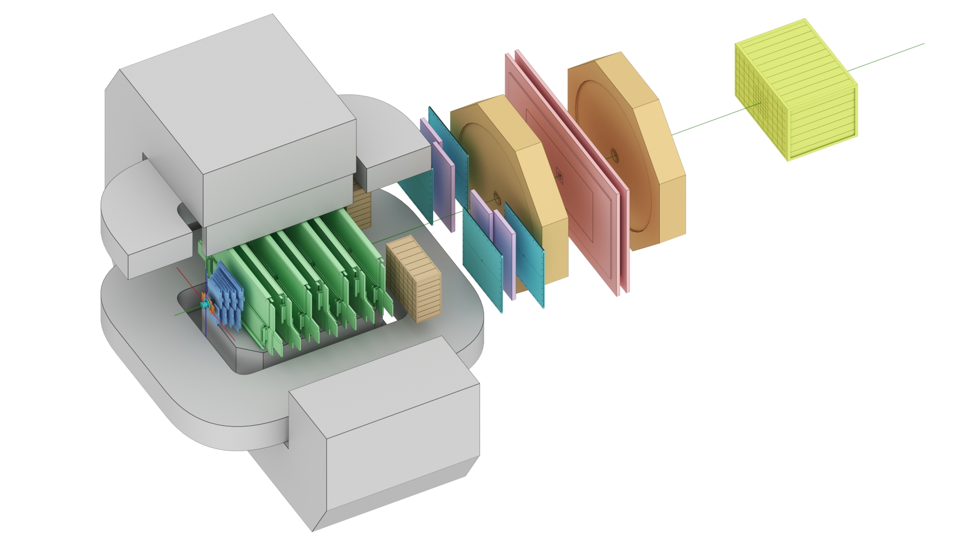
The BM@N and MPD-FXT experiments
BM@N
MPD-FXT
FHCal
Silicon + GEM
TOF-700
TOF-400
Detectors used for anisotropic flow measurements:
Tracking system: FSD+GEM (BM@N); TPC (MPD-FXT)
PID: TOF-400, TOF-700 (BM@N); TPC, TOF (MPD-FXT)
EP measurements: FHCal (BM@N), FHCal (MPD-FXT)
Notes:
Схема эксперимента хадес на слайде.
Траектории рожденных частиц регистристрируются трекинговой системой, состоящей из …
Импульс восстанавливается по отклонению частиц в магнитном поле
Идентификация производится при помощи детекторов времени пролета … которые регистрируют время пролета. Зная длину траектории можно вычислить массу частицы.
Спектаторы регистрируются детектором FW. Поскольку они отклоняются в плоскости реакции материей в области перекрытия, спектаторы используются для оценки угла плоскости реакции.
Всего столько статистики ...

Slide 25
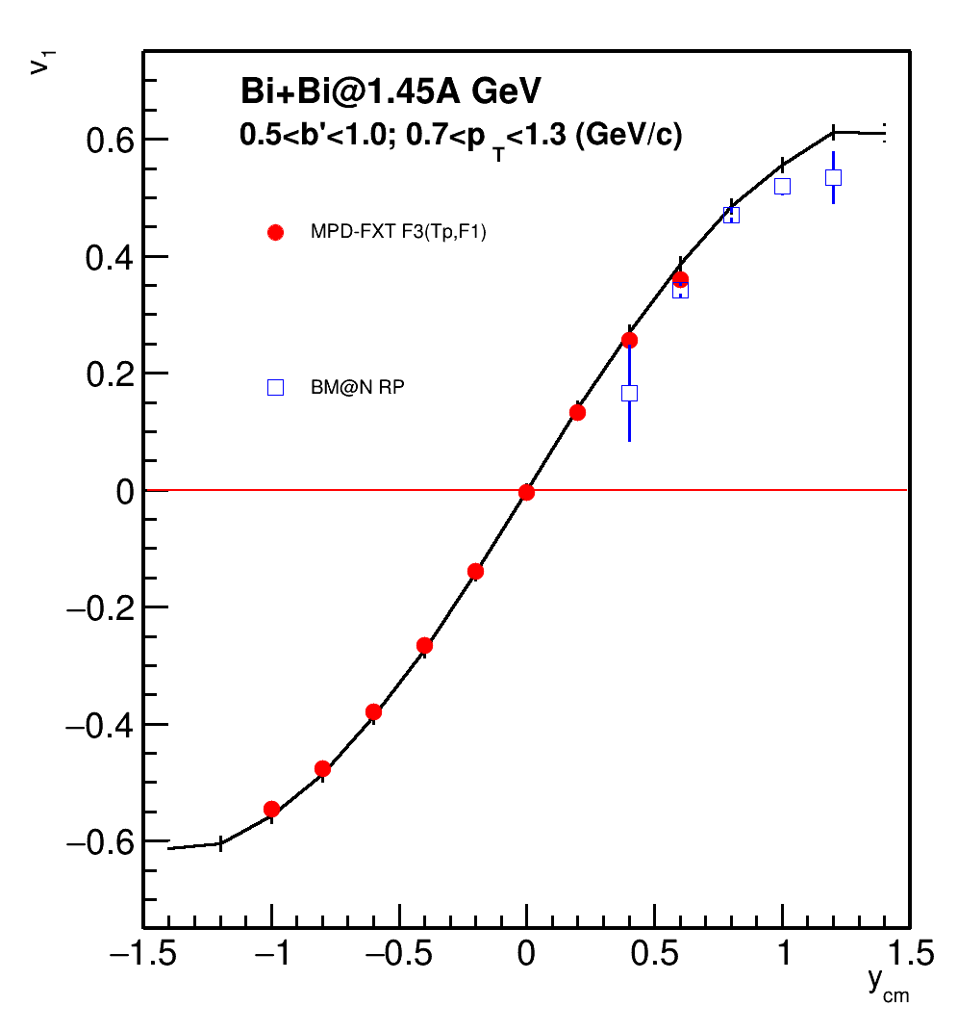
Comparison with BM@N performance
BM@N TOF system (TOF-400 and TOF-700) has poor midrapidity coverage at √s_{NN} = 2.5 GeV
One needs to check higher energies (√s_{NN} = 3, 3.5 GeV)
More statistics are required due to the effects of magnetic field in BM@N:
Only “yy” component of <uQ> and <QQ> correlation can be used
Despite the challenges, both MPD-FXT and BM@N can be used in v_{n} measurements:
To widen rapidity coverage
To perform a cross-check in the future

Slide 26
Summary
Strong energy dependence of v_{n} at Nuclotron-NICA energy range
Big passing times → spectators influences flow formation
v_{n} at √s_{NN}>7.7 GeV: models with QGP
v_{n} at √s_{NN}<7.7 GeV: models without QGP (cascade or mean-field models)
Performance study for the anisotropic flow measurements was shown for the MPD-FXT using realistic procedures for centrality determination, primary track selection and PID:
Multiplicity-based centrality determination using Г-fit shows good agreement between fit and data
Overall good agreement between the estimated fit and impact parameter with the corresponding values taken directly from the model
Basic PID was performed using dE/dx from TPC and m² from TOF
Directed and elliptic flow of protons and pions were measured for √s_{NN} = 2.5, 3, 3.5 GeV:
Good agreement between reconstructed and model data within corresponding acceptance windows for all particle species
Both MPD-FXT and BM@N can complement each other in terms of v_{n}:
Cross-checks can be performed to test the implemented flow measurement techniques
Using results from both experiments can widen the rapidity coverage - no single fixed target experiment can achieve that!
New data from the BM@N and MPD (MPD-FXT) is required to address existing discrepancies in the experimental data and provide further constraints for the EoS in the models
12.09.2024
2nd China-Russia NICA

Slide 27
Backup

Slide 28
Hybrid models for anisotropic flow at RHIC/LHC
Z.W. Lin, C. M. Ko, B.A. Li, B. Zhang and S. Pal:
Physical Review C 72, 064901 (2005).

Slide 29
Sensitivity of the collective flow to the EOS
A. Sorensen et. al., Prog.Part.Nucl.Phys. 134 (2024) 104080
A. Sorensen et. al., Prog.Part.Nucl.Phys. 134 (2024) 104080
MPD
MPD-FXT
BM@N
12.09.2024
2nd China-Russia NICA
Notes:
One more way to study the properties of the matter created in the collision is through the lens of collective motion of created in the collision particles.
We can decompose the azimuthal distribution of produced particles with respect to RP in a FS
Coefficients …
The main mechanisms driving the direced and elliptic flow are
Bounce off for directed flow — when two nuclei collide, the remnants are deflected out from the overlap region and pull the matter created in the collision apart
Squeeze out for elliptic flow — when the remnants of colliding nuclei are pushing the matter within the overlap region and squeeze the produced particles out of reaction plane
Collective flow is sensitive to …

Slide 30
Selecting the model
P.Parfenov Particles 5 (2022) 4, 561-579
Cascade models fail to reproduce v_{n} at low-energy heavy-ion collision
Mean field models reproduce the v_{n} rather well
12.09.2024
2nd China-Russia NICA

Slide 31
Why do we need new measurements at BM@N and MPD?

Slide 32
v_{n} at Nuclotron-NICA energies
P. DANIELEWICZ, R. LACEY, W. LYNCH
10.1126/science.1078070
v₁ suggests soft EoS
v₂ suggests hard EoS
v_{n} results from the E895 experiment are ambiguous:
v₁ suggests EoS and v₂ suggests hard EoS
Additional experimental data are required to address this discrepancy

Slide 33
V0 selection: PFSimple
motherId cut applied
motherId cut applied

Slide 34
HADES, Eur. Phys. J. A 59 (2023) 4, 80
Overall trend reasonably well described, but no model works everywhere

Slide 35
P. Parfenov, Particles 5, no.4, 561-579 (2022)

Slide 36
A. Sorensen et. al., Prog.Part.Nucl.Phys. 134 (2024) 104080

Slide 37
New STAR results from BES-II
Results from QM 2023

Slide 38
Anisotropic flow & spectators
The azimuthal angle distribution is decomposed in a Fourier series relative to reaction plane angle:
Anisotropic flow:
v₁ - directed flow, v₂ - elliptic flow
Anisotropic flow is sensitive to:
Compressibility of the created matter
Time of the interaction between overlap region and spectators
Notes:
At the first moment of the collision there’s the spatial anisotropy, of energy distribution inside the overlapping region. By means of the interaction of matter this asymmetry into anisotropic emission of produced particles
Reaction plane, it is a plane laying on vectors of beam direction and impact parameter. Expanding dense matter in the overlap region bounces off spectator fragments in the plane, that they can be used for symmetry plane estimation.
Decomposing the azimuthal angle distribution of produced particles in a Fourier series, one gets such an equation. The coefficients of this decomposition, “vn” are called the flow on n-th harmonic. First harmonic coefficient has specific name directed flow

Slide 39
Sensitivity of the collective flow to the EOS
P. Danielewicz, R. Lacey, W.G. Lynch, Science 298 (2002) 1592
MPD-FXT
BM@N
MPD
MPD-FXT
BM@N
MPD
Soft EOS
Hard EOS
Additional measurements are essential to clarify the previous results
12.09.2024
2nd China-Russia NICA

Slide 40
Centrality determination: <b> vs Centrality
Good agreement between fit and data
Cuts on tracks:
Nhits>16
0 < η < 2
Multiplicity-based centrality determination using inverse Bayes was used

Slide 41
Results: v₁(p_{T})
Systematics: xx, yy, F1, F2, F3
p
𝝿⁺
𝝿⁻
Good agreement with MC data

Slide 42
Results: v₂(y)
Systematics: xxx, xyy
p
𝝿⁺
𝝿⁻
Good agreement with MC data

Slide 43
Elliptic flow at NICA energies: Models vs. Data comparison
Experimental data is taken from: Phys.Rev.C 103 (2021) 3, 034908

Slide 44
The BM@N experiment (GEANT4 simulation for RUN8)
FHCal
Silicon + GEM
TOF-700
TOF-400
neutron
x=0
ion
proton
Square-like tracking system within the magnetic field deflecting particles along X-axis
Charge splitting on the surface of the FHCal is observed due to magnetic field

Slide 45
Sensitivity of the collective flow to the EOS
A. Sorensen et. al., Prog.Part.Nucl.Phys. 134 (2024) 104080

Slide 46
Performance of v_{1,2} of 𝚲 hyperons in MPD
V. Troshin
Good performance for v₁, v₂ using invariant mass fit and event plane methods

Slide 47
Motivation of elliptic flow fluctuation study
Indicate a dominated initial state driven uctuations σ_{ε2}
Provide constraints for IS models and shear viscosity η(T/s)
How about v2 fluctuations at NICA energies?

Slide 48
Relative v₂ fluctuations of identified hadrons
For more details see A.Demanov’s talk on ISHEP-2023
Weak dependence between v₂{4}/v₂{2} of protons and pions at 11.5 GeV
The difference between v₂{4}/v₂{2} of protons and pions increases with decreasing energy

Slide 49
Anisotropic flow at Nuclotron-NICA energies
Flow at >7.7 GeV, flow at 4.5 GeV, flow at <3 GeV
Our works so far with the collider mode
FXT allows to widen the energy coverage of MPD
12.09.2024
2nd China-Russia NICA
Notes:
One more way to study the properties of the matter created in the collision is through the lens of collective motion of created in the collision particles.
We can decompose the azimuthal distribution of produced particles with respect to RP in a FS
Coefficients …
The main mechanisms driving the direced and elliptic flow are
Bounce off for directed flow — when two nuclei collide, the remnants are deflected out from the overlap region and pull the matter created in the collision apart
Squeeze out for elliptic flow — when the remnants of colliding nuclei are pushing the matter within the overlap region and squeeze the produced particles out of reaction plane
Collective flow is sensitive to …

