Slide 1

Forward TOF
--MRPC and LGAD
Yongjie Sun
State Key Laboratory of Particle Detection and Electronics
Department of Modern Physics
University of Science and Technology of China

Slide 2
Outline
Introduction
MRPC based sub-system contributed by USTC
  MRPC for STAR TOF
  MRPC for STAR MTD
  MRPC for BES-III e-TOF
  MRPC for CBM TOF (pre-production for STAR e-TOF)
  MRPC for CEE
LGAD status in USTC
Summary and outlook

Slide 3
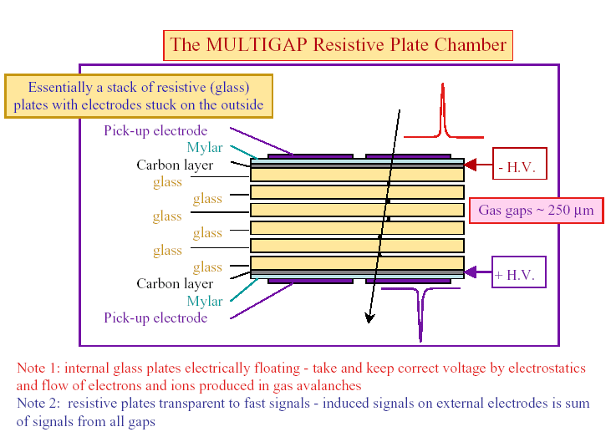
Introduction
MRPC is good for timing
First suggested by C. Williams et al for ALICE TOF
Uniform High Electric Field
~11 kV/mm
high drift velocity ~200 μm/ns
high Townsend coefficient.
Operate in Avalanche mode
Gas: Freon (electron affinity )
iso-butane (UV photon absorption)
SF₆ (streamer suppressing)
Heavy gas: 9-10 clusters/mm for MIP
Small gap: 0.2-0.3 mm, high resolution
Multi-gaps: high efficiency
Simple structure & cost-effective for large area coverage
E. Gorini et al. Nucl. Instr. Meth. A 396(1997), 93

Slide 4
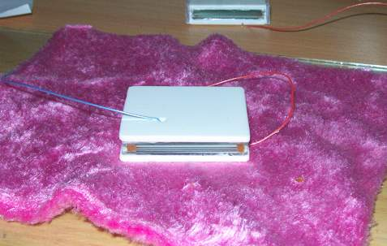
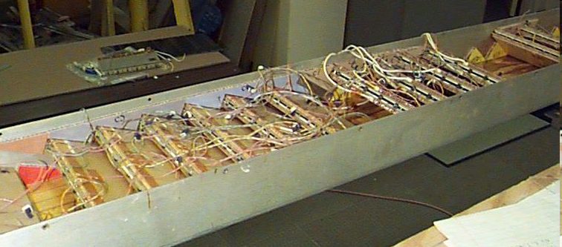
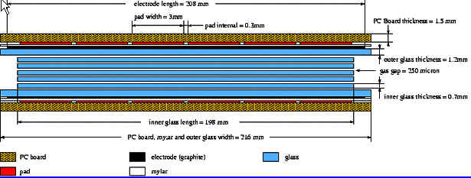
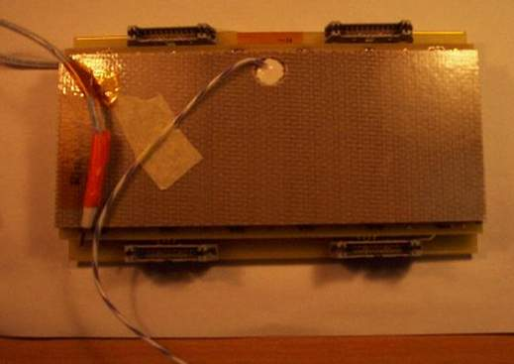
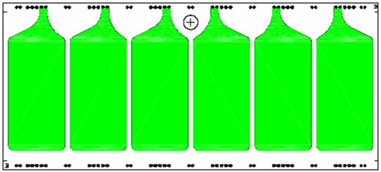
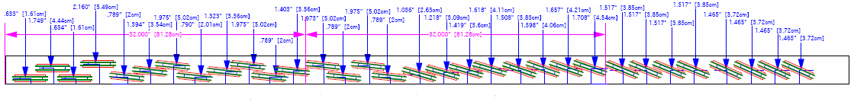
MRPC for STAR TOF
First single-cell MRPC with 5×0.22mm gaps
R&D Started in 2000.
Prototypes tested in 2001
MRPC final design in 2002
First TOFr tray installed (2002-2004)
Efficiency >~ 95%
Timing resolution ~70 ps
Good uniformity
TOFr tray at STAR
Prototypes with single- and double-stack
Final design
Module: 20×6 cm
Gap: 6×0.22 mm
Pad: 3.15cm×6.1cm
Gas: 95% C2H2F4
+5% Iso-C4H10

Slide 5
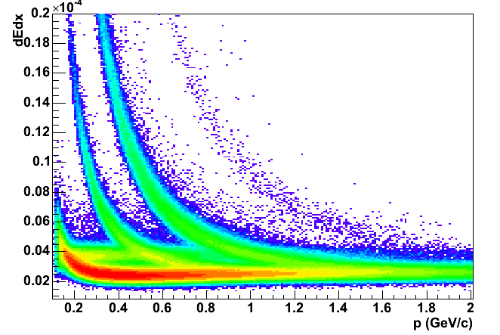
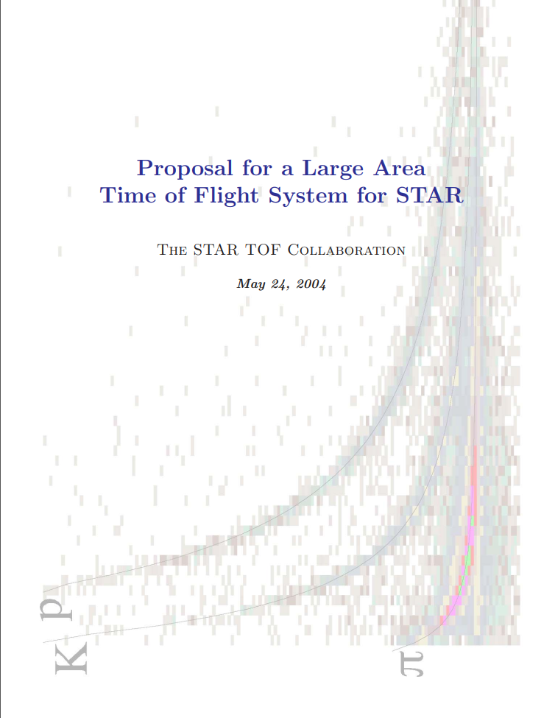
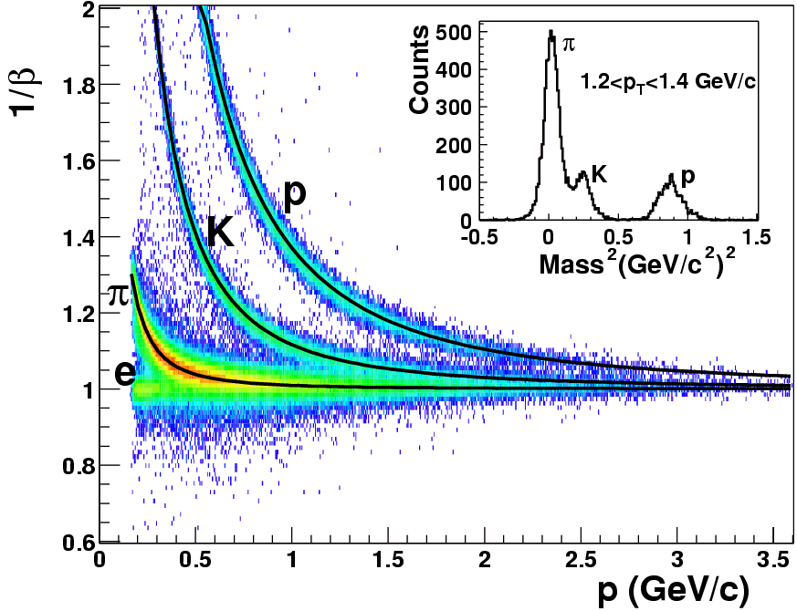
Good performance facilitates the TOFr proposal
TPC alone:
π/K ~0.7 GeV/c
(π, K)/p ~1.1 GeV/c
STAR officially adopted MRPC for TOF
TOF alone:
π/K ~1.6 GeV/c
(π, K)/p ~ 3.0 GeV/c

Slide 6
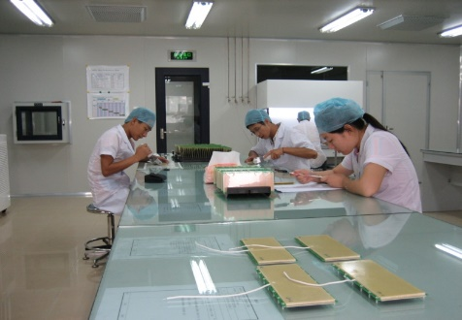
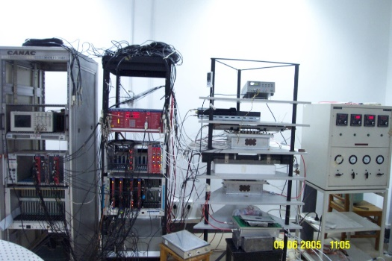
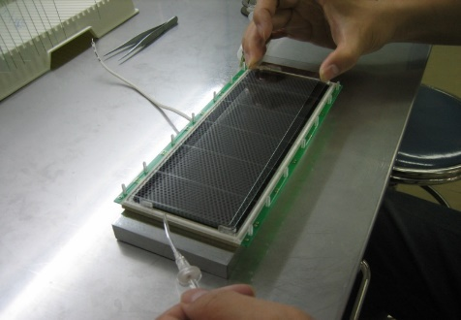
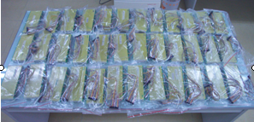
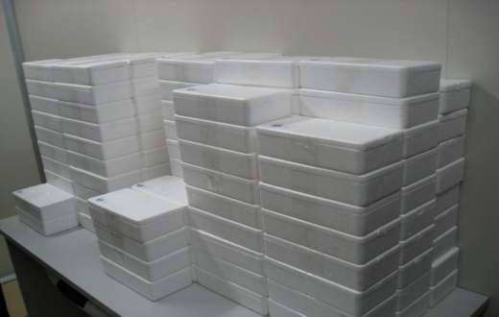
Mass production for STAR TOF
Mass production started in April 2006 and finished in Nov. 2007.
1283 MRPCs produced and qualified in USTC (30% of total STAR-TOF MRPCs).
Over 95% of MRPCs tested with good quality.
Operating in STAR smoothly from 2008 till now.
  Clean room (100K) with temperature and humidity control
  Detailed documents of assembly and test for tracking
  Database for the mass production
  Cosmic ray test system
 | TOFr
2000 | R&D started, 1st beam test at CERN
2001 | 2nd beam test at CERN
2002 | 1st prototype in physics run
2003 | 2nd prototype in physics run
2004 | Proposal
2005 | 3rd prototype will NINO-based FEE
2006 | Mass production started
2007 | Mass production continued
2008 | 5 trays (4%) installed
2009 | 86 trays (72%) installed
2010 | 120 trays (100%) installed

Slide 7
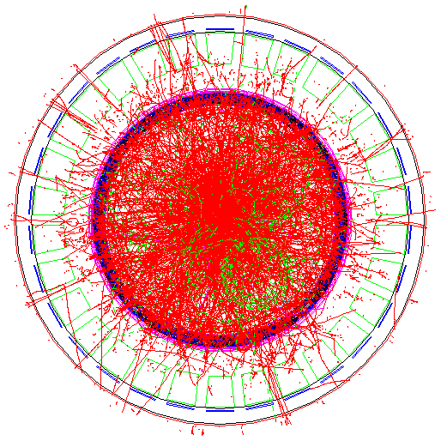
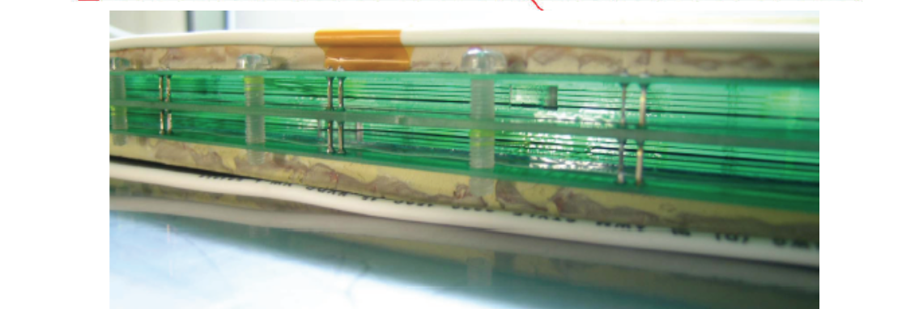
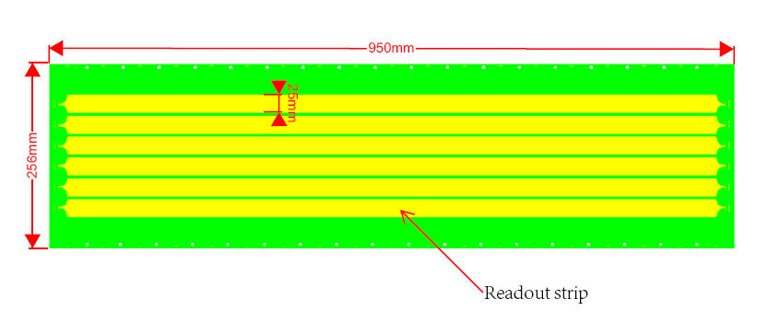
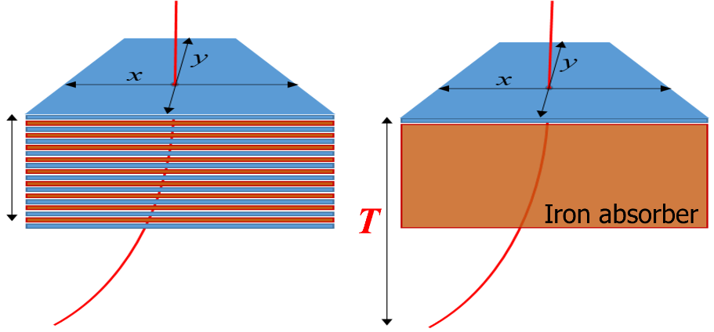
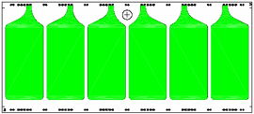
Long strip MRPC for STAR Muon Telescope Detector
Motivated by the muon trigger requirement of STAR
High time resolution and good spatial resolution for muon trigger and identification
Finally Realized by a single layer of LMRPC installed behind the magnet yoke
  Suitable for large area coverage
  Mean time independent of incident position
  Time difference for positioning
5m
First prototype in 2006 by USTC
8m
Performance of prototype:
Time resolution: ~70 ps
Efficiency: >97%
Spatial resolution: ~ 1 cm
MTD MRPC
TOF MRPC

Slide 8
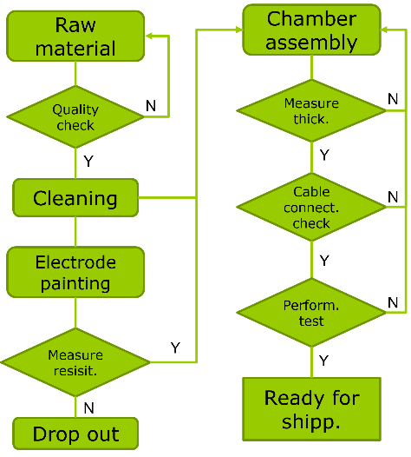
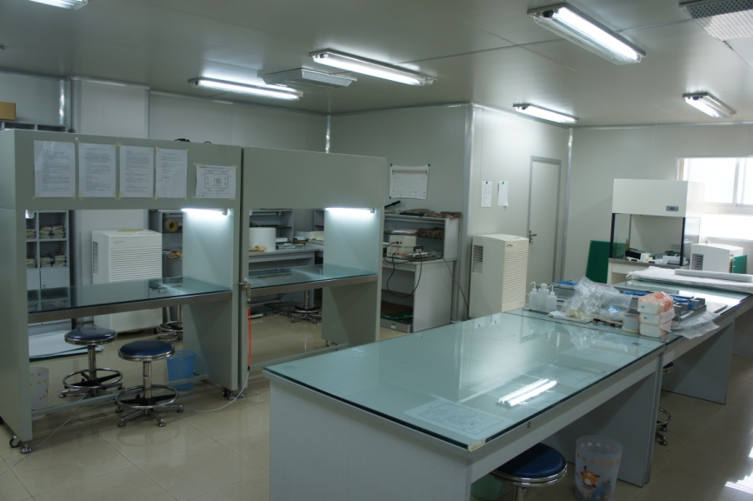
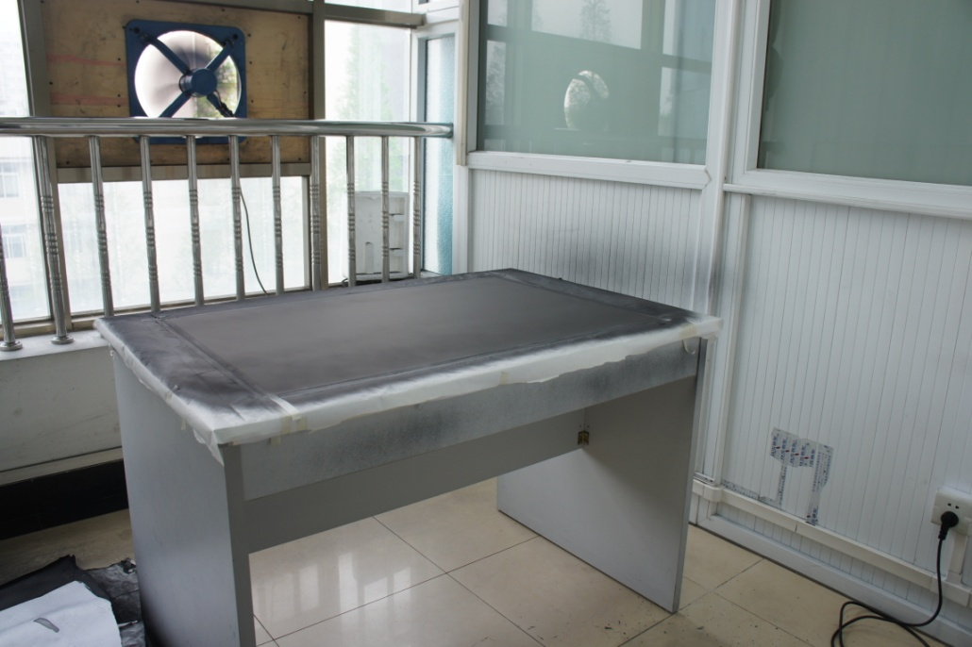
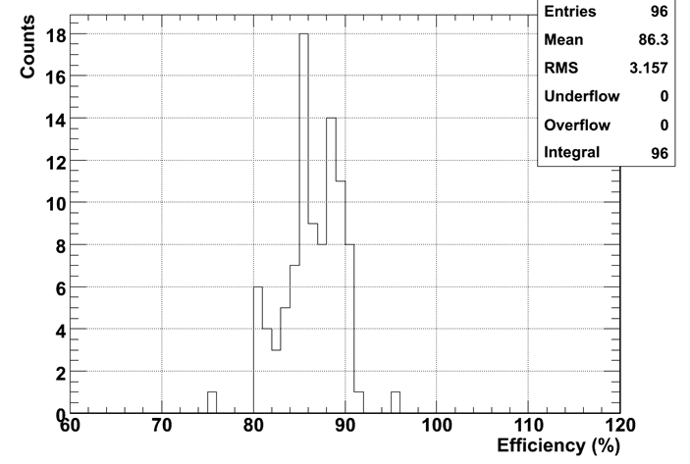
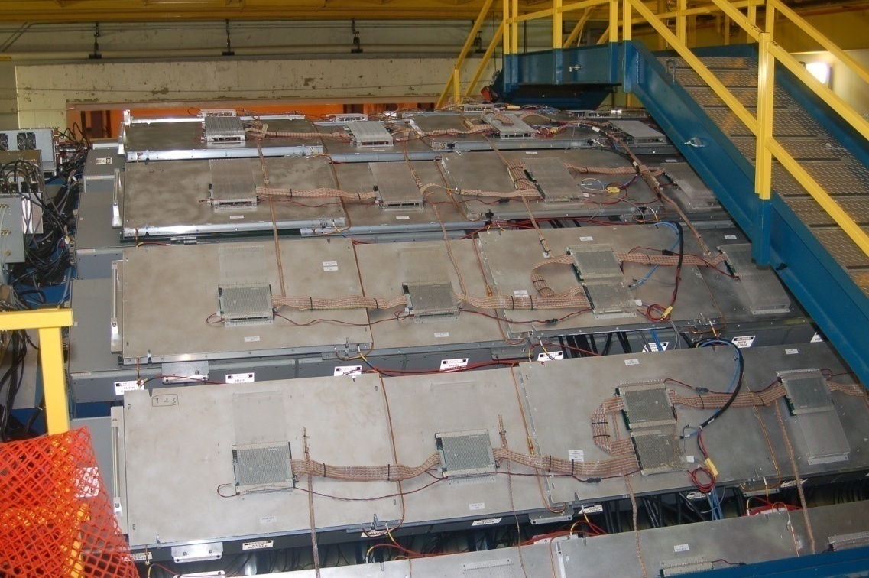
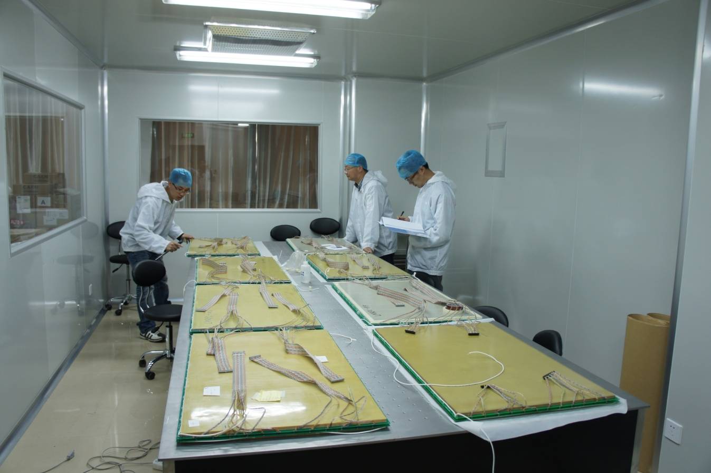
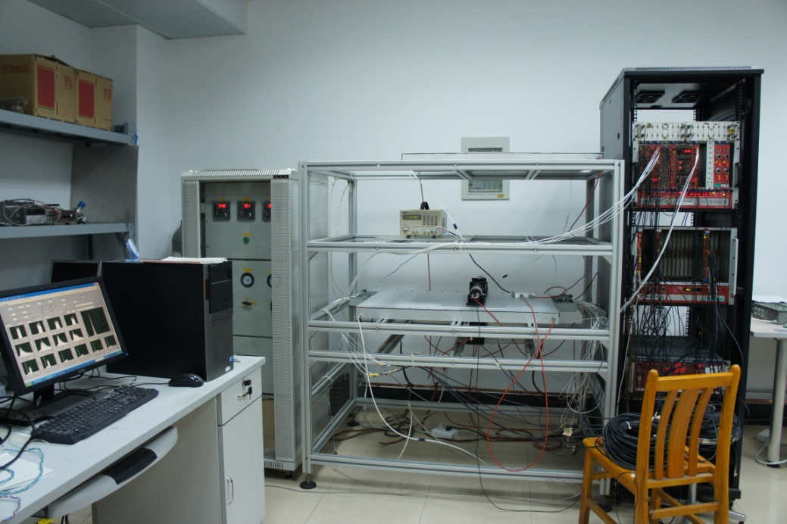
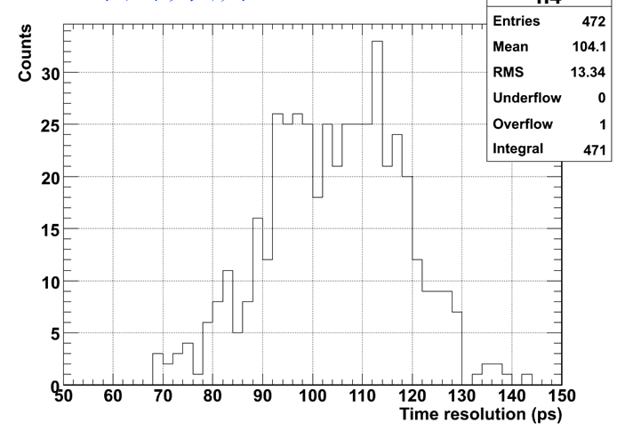
Mass production of LMRPC for STAR MTD
Final design in 2009:
  Size: 58×91.5 cm, strip: 3.8×87 cm
  Gap: 5×0.25 mm
  Readout: double-end
LMRPC mass production: May. 2011 - Jan. 2013
57 LMRPC produced and qualified in USTC (50% of total)
 | Timeline of STAR MTD
2005 | R&D started
2006 | Beam test at Fermi-Lab T963 beam
2007 | 2 modules with trigger elec. installed
2008 | 3 modules with TOF elec. installed
2009 | Design finalized
2010 | 1 module of final design installed
2011 | Mass production started
2012 | 10% installed
2013 | 63% installed
2014 | 100% installed

Slide 9
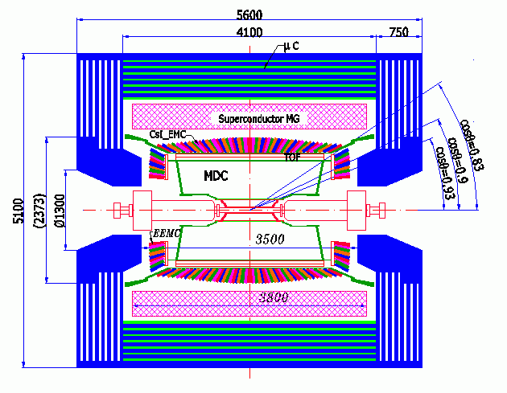
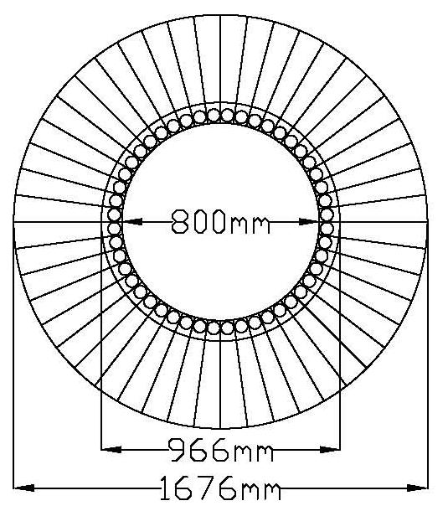
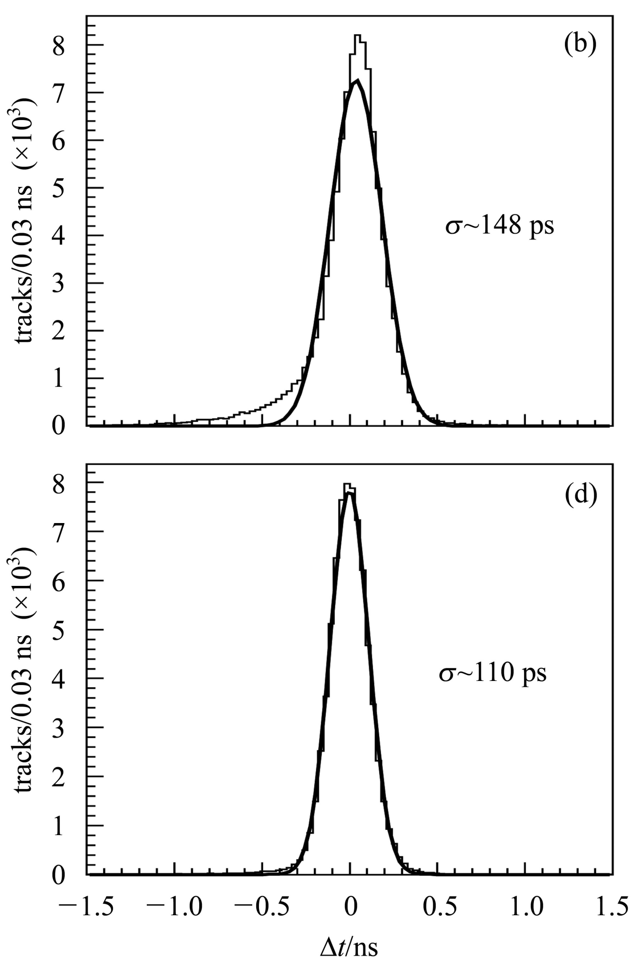
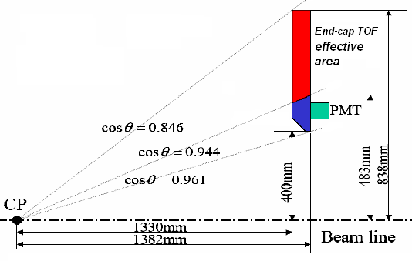
BES-III endcap Time-of-Flight
Electron
Muon
Built with 48 scintillators on each side
  Plastic scintillator: EJ204
  Fine-mesh PMT: R5924
Good performance achieved through 2002-2007

Slide 10
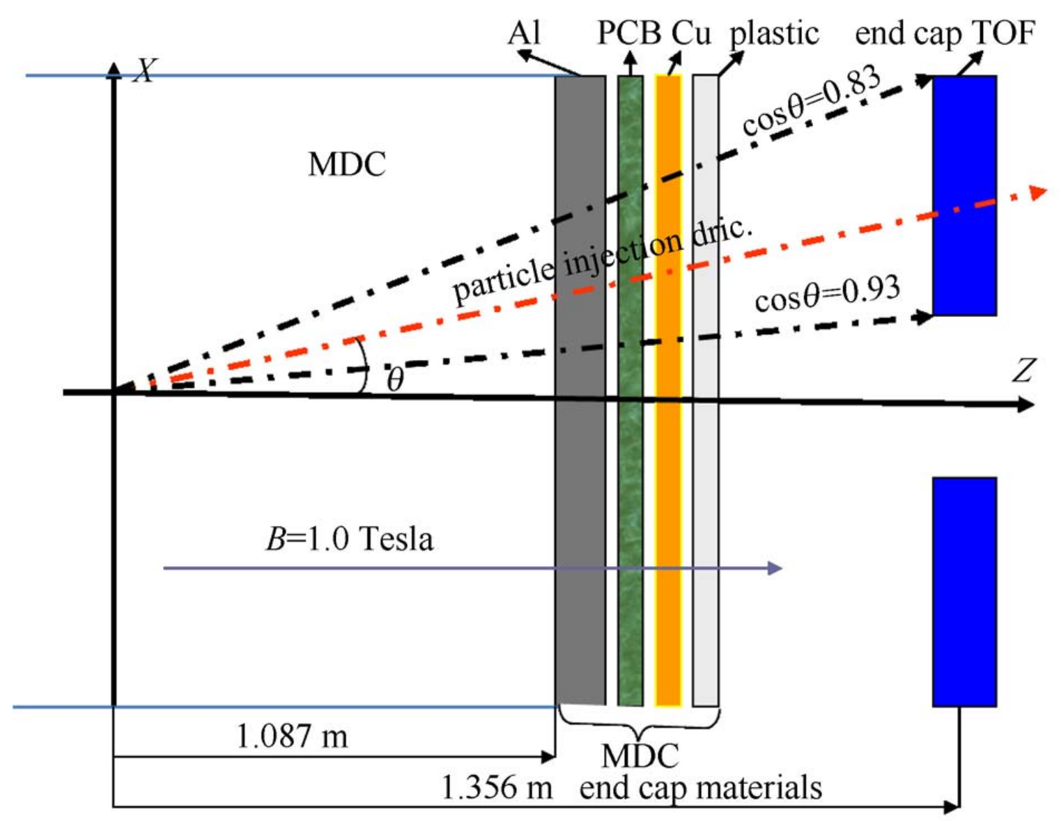
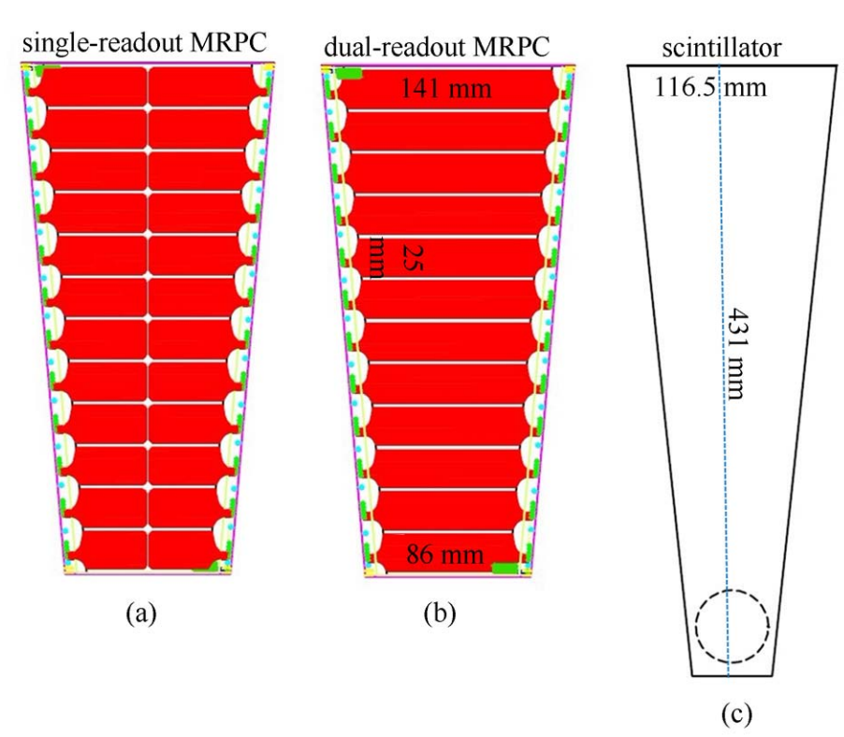
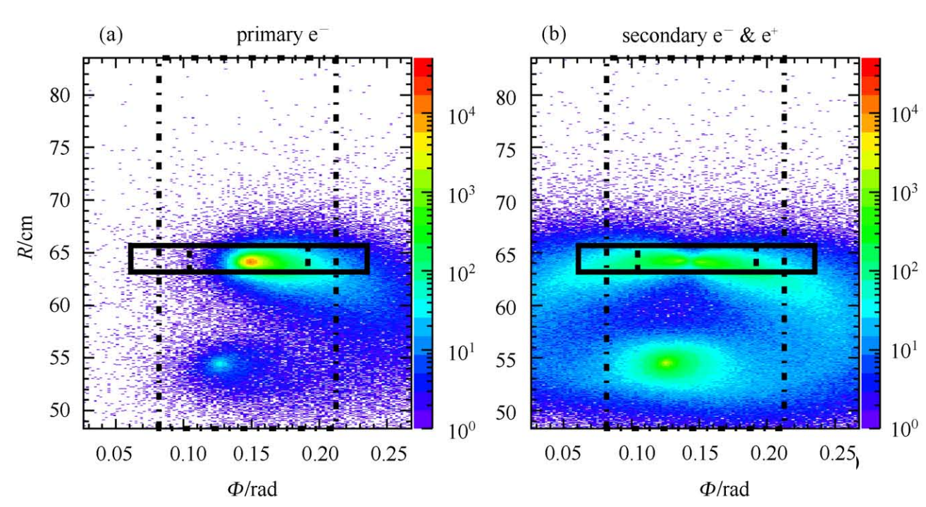
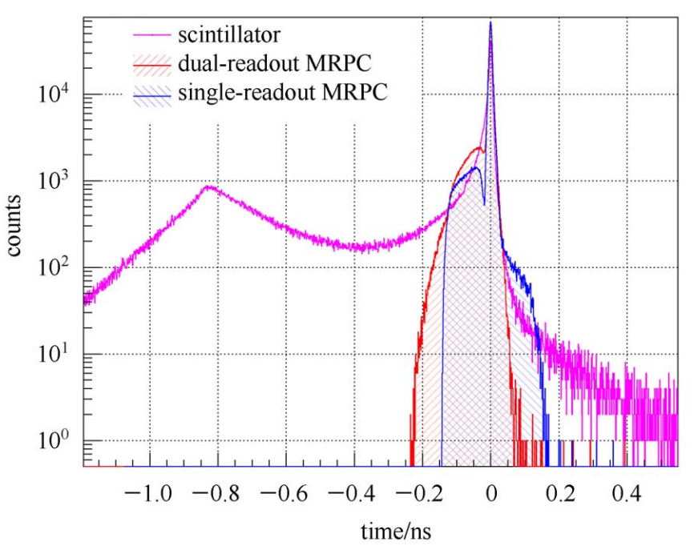
BESIII e-TOF upgrade
By GEANT4 based simulation
multiple scattering effects, mainly from the materials at the MDC endcap
multi-hit on the “large” ETOF cell
significantly influence the timing property of ETOF.
MRPC with better time resolution and smaller cell size is a good solution.
Hui Zhang et al., CPC37, 096002 (2013)

Slide 11
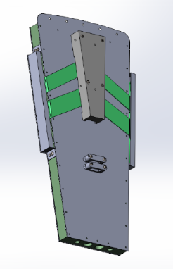
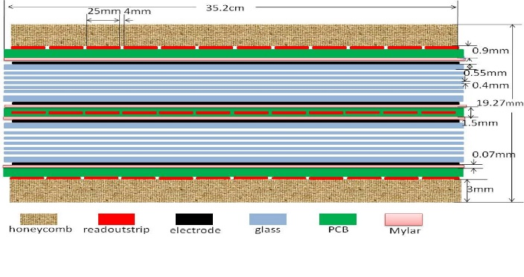
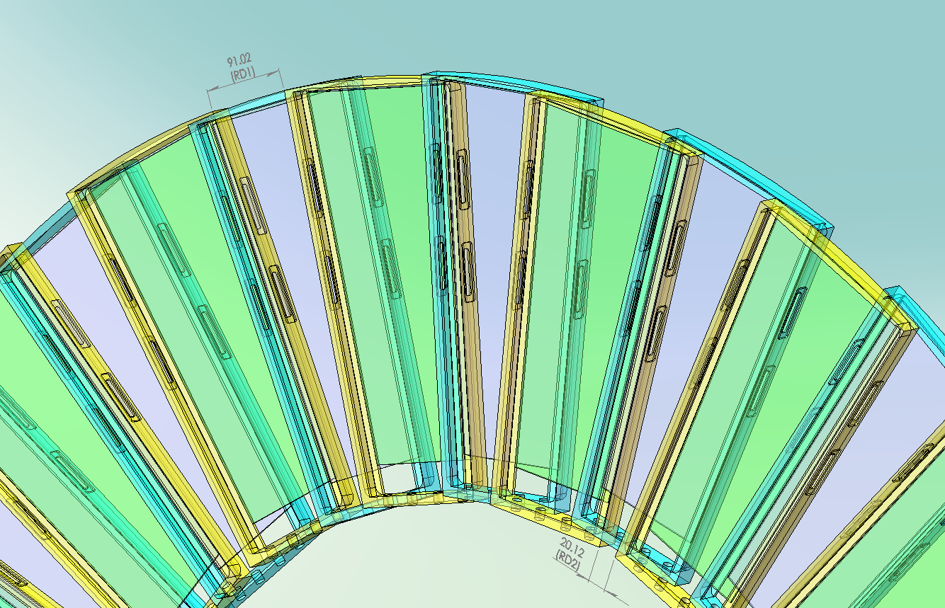
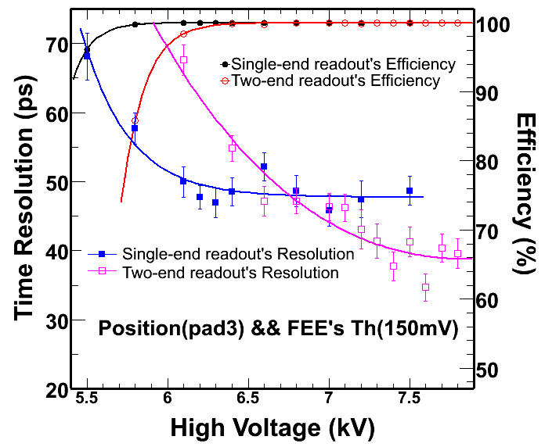
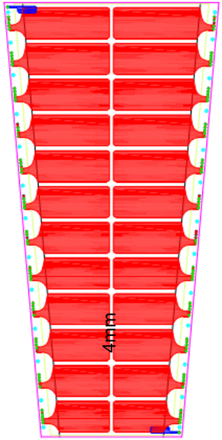
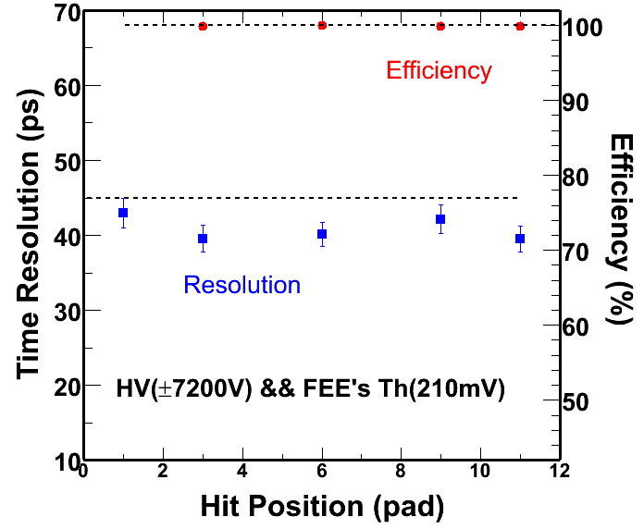
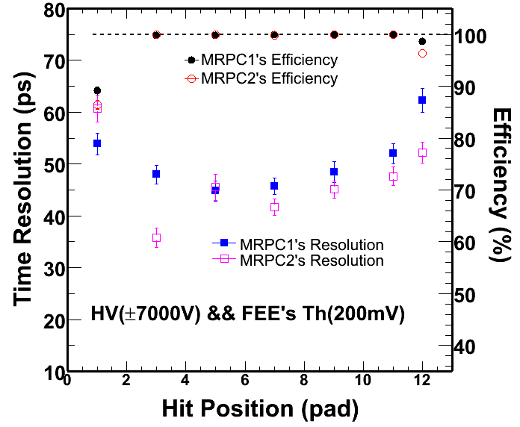
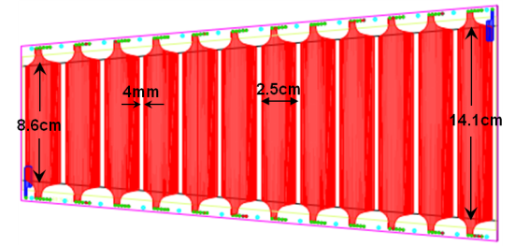
BES-III@BEPC e-TOF upgrade
Main challenges
  Very limited space: 4 cm for two layers
  Trapezoid MRPC shape
Prototypes tested in 2011 and 2013@BEPC E3 line
  Same gap structure: 2×6×0.22 mm
  Different readout pattern: single- vs. double-end
Double-end shows better time resolution without position correction
Double-end time resolution independent of strip length
Single-end time resolution varies between strips
19.27mm
Double-end readout
single-end readout

Slide 12
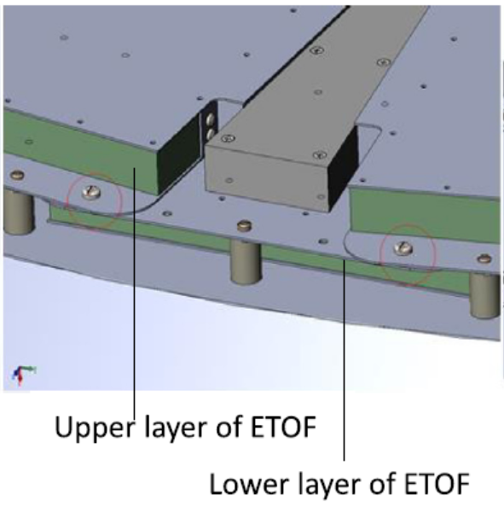
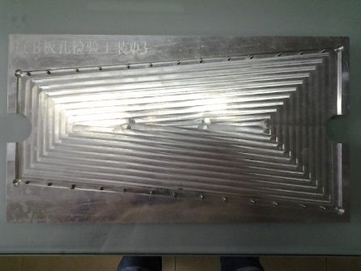
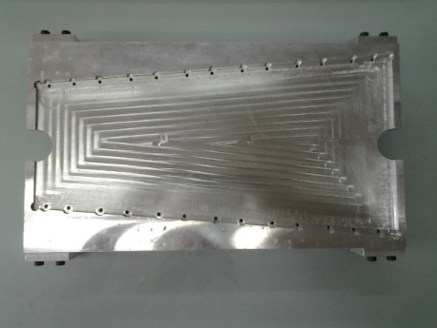
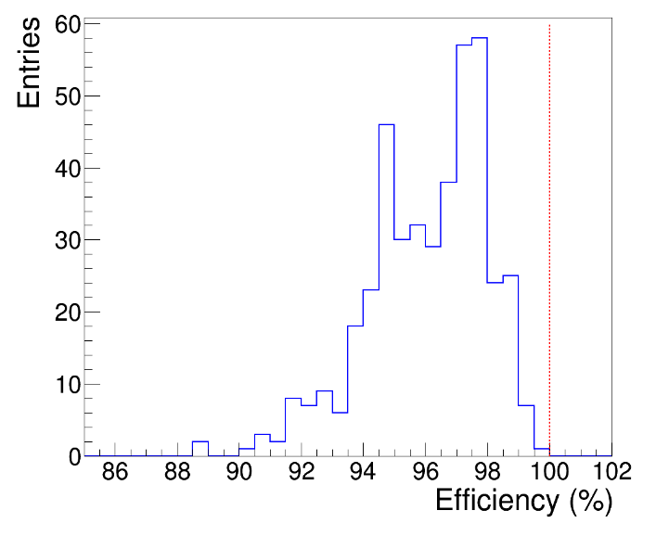
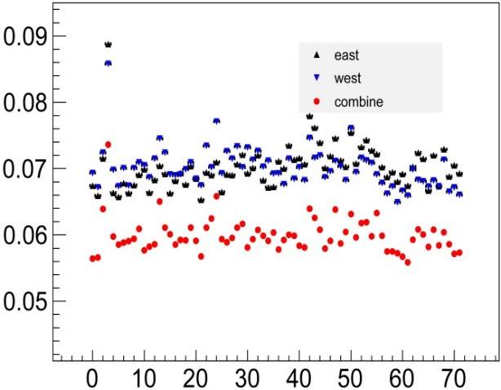
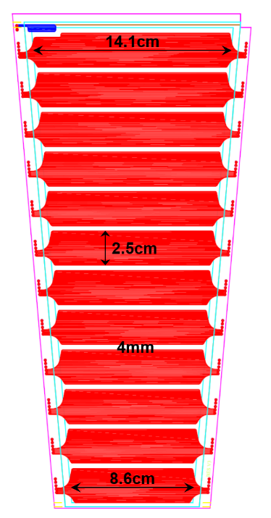




Mass production of BES-III e-TOF MRPC
Final design in 2014
Production: 2014-2016
Totally, 80 MRPC were produced and qualified
Physical run
NIM. A 953 (2020) 163053

Slide 13





MRPC for CBM TOF
High rate @CBM TOF as a fixed target heavy iron experiment
  Coverage: ~ 120 m²
  Rate: 1-25 kHz/cm²
Thin float glass MRPC is a cost-effective solution for the TOF wall outer region (rate ~ 1 kHz/cm²)
R&D started as early as 2009
The first prototype to check the cross-talk effect with a long-strip structure
Beam test Aug. 2009 @ GSI
Effective size: 50 x 18 cm²
Strip: 50 cm x 2.5 cm
Gaps: 2×5×0.25 mm

Slide 14









Thin float glass MRPC3/4 for CBM TOF
Final design
  Glass: 0.23 mm
  Rate capability: 2 kHz/cm²
  Strip: 1 cm pitch, 50 Ω differential impedance
80 MRPC3 produced and installed for STAR e-TOF as pre-production
STAR e-TOF

Slide 15






Aging effect
Aging effect observed under high beam intensity
  Increased overall current
  Increased noise rate along fishing line
  fluorine element deposit on glass around fishing line
SEM scan
 | wt%
C | 1.77
O | 27.14
F | 21.28
Na | 12.48
Si | 26.92
Simulated with the electromechanical coupling physics module in COMSOL
  More than 4 times higher field around the fishing line
  Uniform field around the cylindrical spacer
Aged MRPC
fishline
Aged MRPC
Aged glass
Electrode
Electrode
Electric field around the fishline is much higher
Cylindrical
spacer
Fishline
MRPC with cylindrical spacers may decrease aging effect!
electrode

Slide 16





Mechanical simulation
Structural design of a fishline MRPC for CBM-TOF
Fishline: 0.23 mm diameter, 19 mm interval
fishline spacer
Max deformation ~ 2 µm
Replace fishline with pad
Z. Zhang et. al JINST. 9 (2014) C10028
Thermal bonding film
polyester
Thermal bonding film
Pad: 2 mm diameter, 0.24 mm thickness, 19 mm interval
pad spacer
Max deformation ~ 2 µm

Slide 17











MRPC with pad spacers
Similar performance as the fishing line spacer
Have a better anti-aging effect under high flux.
①Setting Kapton and graphite electrode
②Setting glass with spacers
③Bottom stack with 5 layers spacers
④Fixed with pins
$$∆I$$
⑤Upper stack with 5 layers spacers
⑥Placing detectors inside box for testing
Fishline spacer MRPC

Slide 18







MRPC for iTOF on CEE@HIRFL-CSR
An ultra-high time resolution MRPC
4 stacks of gaps: 0.16mm x 6
NINO based FEE
43/$\sqrt{2}$=30.4 ps

Slide 19


LGAD (Low-Gain Avalanche Diodes)
Signal formation
LGAD technology
Pioneered by CNM (Centro Nacional de Microelectronica, Barcelona, Spain) and supported by RD50
Producers today: CNM, FBK, HPK, BNL, NDL, IHEP-IME, USTC-IME …

Slide 20



USTC LGAD design and fabrication
2019.7 first design completed
2019.9 discussions with IME (Institute of Microelectronics)
2020.7 USTC-IME-1.0 (W1-W6) delivered
2020.11 USTC-IME-1.1 (W7-W11)
2020.12 - 2021.2 Neutron irradiation at JSI
2021.5 - 2021.10 USTC-IME-2.0 production(W12-W16)
2021.11 - 2021.12 USTC-IME-2.1 production (W17-W21)
At the same time, small-scale fabrication at USTC-NRFC for fast verifications
2022 source, laser, beam tests at USTC/JSI/CERN/DESY
2023.1 passed the ATLAS Design Review
2023.2 ATLAS sign-off the pre-production
2023.10 pre-production completed
2024.7 passed production readiness review
Notes:
USTC center for Micro- and Nanoscale research and fabrication

Slide 21




Acceptor removal effect
Gain layer doping density drops exponentially with fluence, so is VGL
USTC-IME-1.1
$$V_{GL}(Φ)=V_{GL}(0)exp(−cΦ)$$
c-factor quantifies the radiation-hardness.

Slide 22

Charge collection and time resolution
NIM. A 1039(2022)167008

Slide 23






Results from test beams
JINST 18(2023)P05005
DESY
CERN SPS
DESY
120 GeV Pion

Slide 24




AC-LGAD
CST simulation models well the charge sharing
AC-LGAD
USTC prototype
Preliminary
Pad size/pitch = 100/150 um, preliminary test result with laser:
position resolution w/ largest charge sharing: better than 2 um
Notes:
TCT, Transient Current Techniq

Slide 25
Summary
USTC has a long-term experience in MRPC production.
  Several projects completed successfully.
  All built MRPC systems operated smoothly.
  For each project, we started from the R&D according to the requirements.
  Proposals submitted successfully with abundant R&D efforts.
LGAD is developing quickly following the state-of-the-art idea and technic.
  potentially a good candidate for further TOF system / 4D-tracking.
Thanks for your attention!

