Slide 1
L. Kostov
Information on the Resolution of the JINR Scientific Council 135th session, 15–16 February 2024 and on the decisions of the JINR Committee of Plenipotentiaries
22 March 2024, Dubna

Slide 2
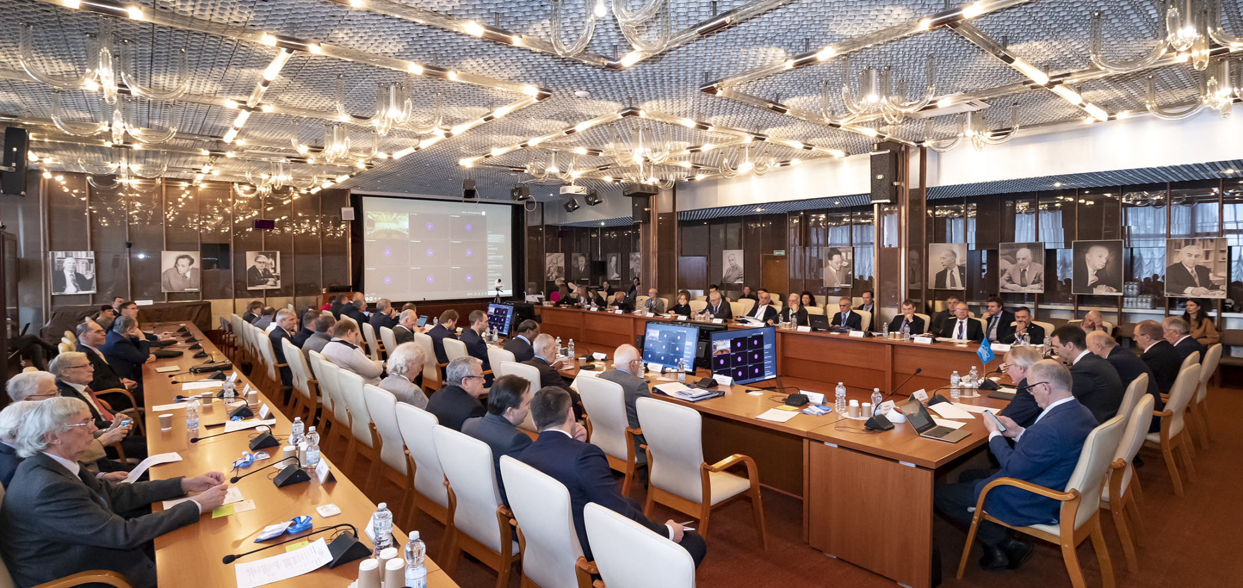
Information on the Resolution of the JINR Scientific Council
135th session, 15–16 February 2024, hybrid mode
Co-chaired by Grigory Trubnikov and by Sergei Kilin

Slide 3
PROGRAMME: 135th session of the JINR Scientific Council 15–16 February 2024
15 February
Report by the JINR Director (G.V. Trubnikov)
- The most notable scientific results and events of 2024
- The results of the implementation of the 7-Y Plan for the Development of JINR (2017–2023)
Appointment of the Editing Board for drafting the Resolution of the Scientific Council (S. Kilin)
Recommendations of the Programme Advisory Committees
taken at the meetings in January 2024 (I. Tserruya, V. Nesvizhevsky, D. L. Nagy)
Amendments to the Regulation for the election of Directors and
Deputy Directors of JINR Laboratories (S. Nedelko)
Election of Deputy Directors of DLNP and FLNP
and announcement of vacancy of the position of Director of FLNR

Slide 4
PROGRAMME: 135th session of the JINR Scientific Council 15–16 February 2024
16 February
Reports by young scientists as recommended by the PACs
Proposals for awarding the title "Honorary Doctor of JINR"
Jury’s recommendations on the award of JINR annual prizes for best papers in the fields of
- theoretical and experimental research,
- methodology and technology research,
- applied research (L. Kostov)
Announcement of vacancies of positions in the Directorates of JINR Laboratories (G. Trubnikov)
General discussion. Adoption of the Resolution of the Scientific Council

Slide 5
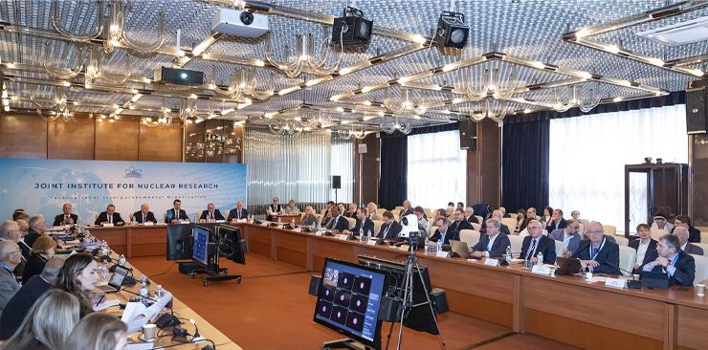
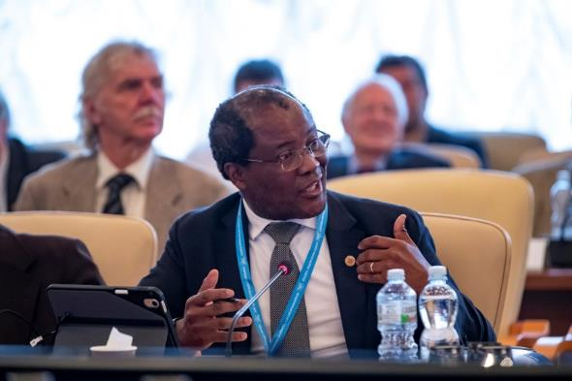
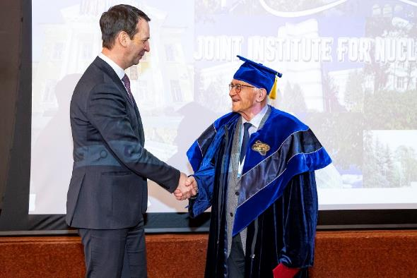
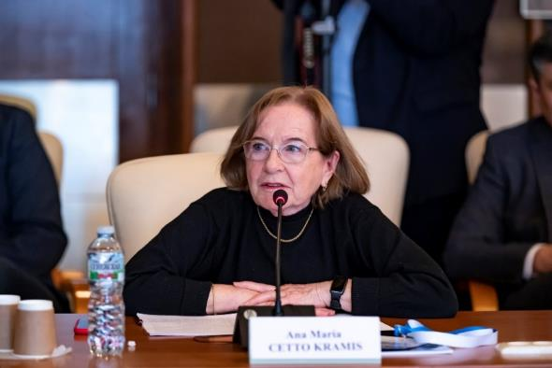
JINR Scientific Council
‒ SC took note of the comprehensive report by the JINR Director, G. Trubnikov, covering the latest session of the CP (9–10 November 2023), the results of the implementation of the 7-Y Plan (2017–2023), the progress in the projects realization (Topical Plan 2024), and the international cooperation.
- SC appreciated the impressive results in developing the large research infrastructure, significant contribution to international cooperation, especially at CERN,
and recent achievements.
SC approved to award the title “Honorary Doctor of JINR” to Prof. Chavdar Stoyanov (Bulgaria).
- SC endorsed the new Regulation for the election of Directors & Deputy Directors of the Laboratories, proposed by the JINR Directorate, and recommended its approval at the next CP session in March 2024.

Slide 6
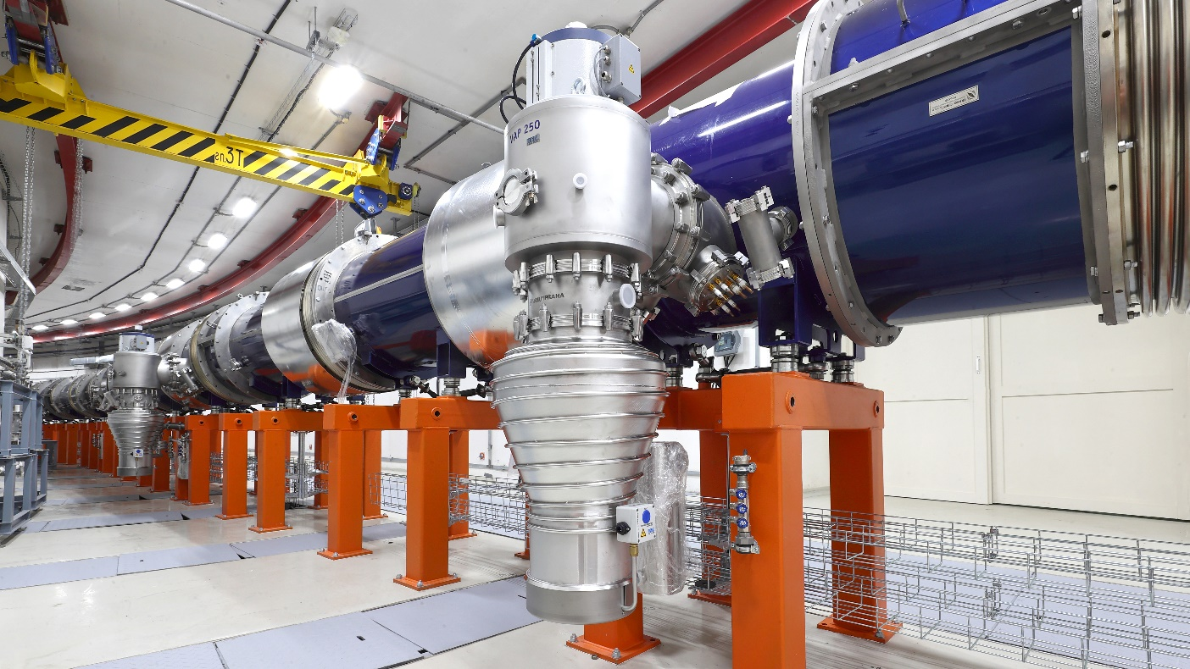
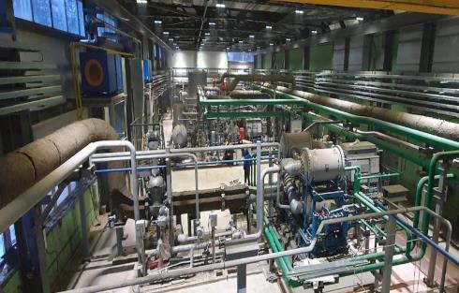
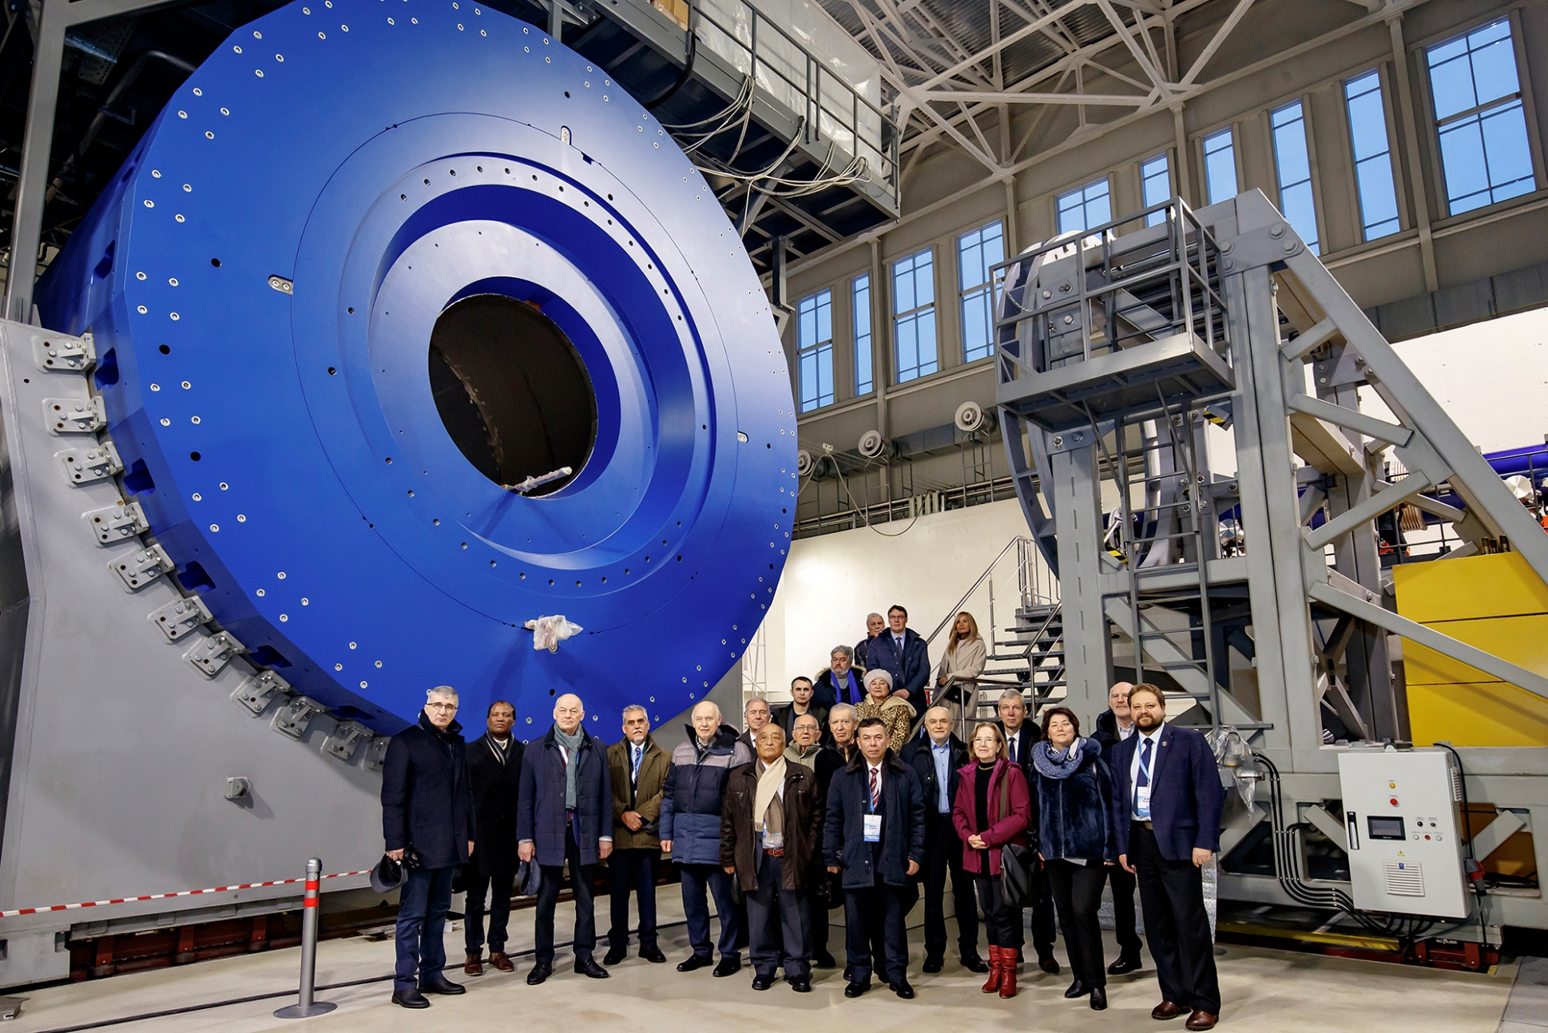
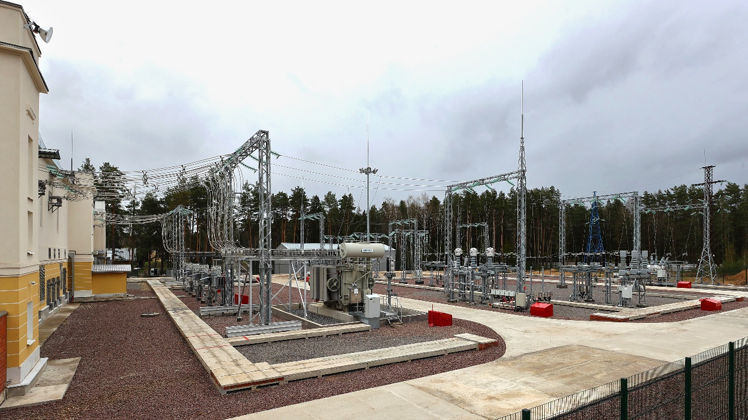
JINR Scientific Council
SC appreciated with satisfaction:
- the completion of the production & cryogenic testing of the collider’s magnetic system, readiness for commissioning the power supply system for the collider’s elements, preparations for the launch of a new cryogenic compressor station, beginning of educational program to train operators for commissioning & operation of the NICA complex;
- progress in the reconstruction of data recorded by the BM@N experiment;
Collider magnetic system
- progress in the production of all components of the MPD first-stage detector with minimal delays;
new compressor station
15 February the SC members
visited the VBLHEP & inspected
the NICA accelerator complex under construction.
modernized and automated
GPP1 Station (40.8 MW)

Slide 7
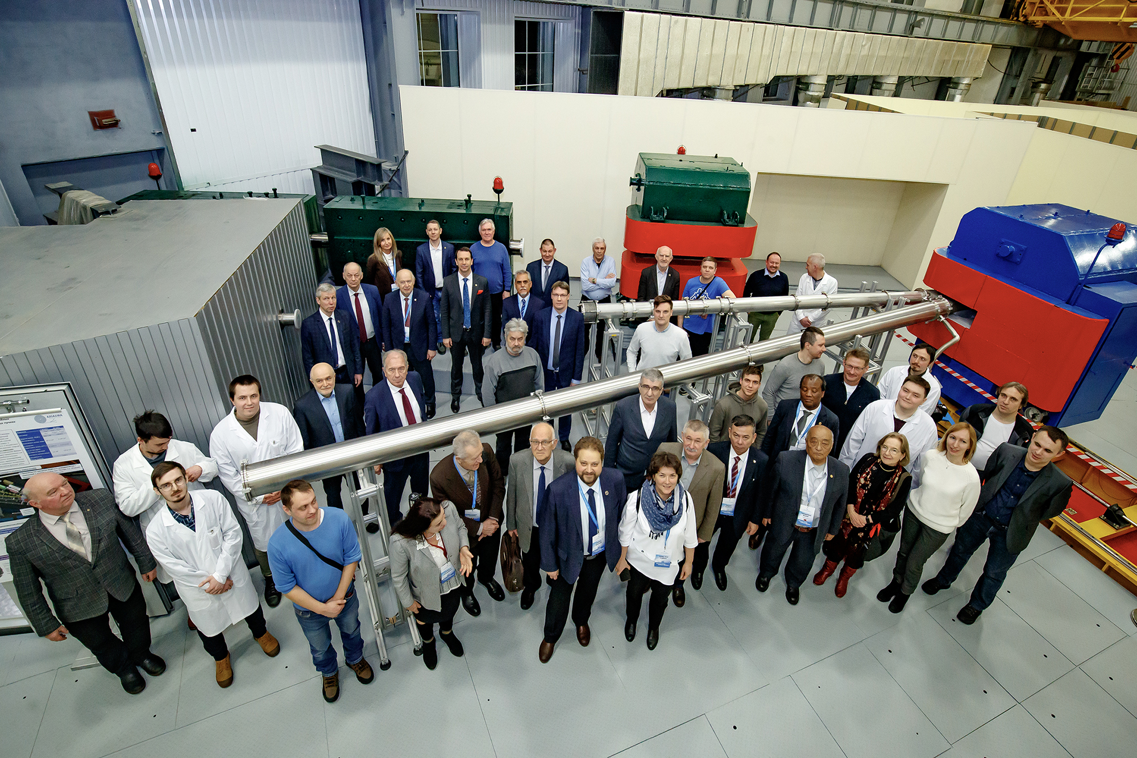
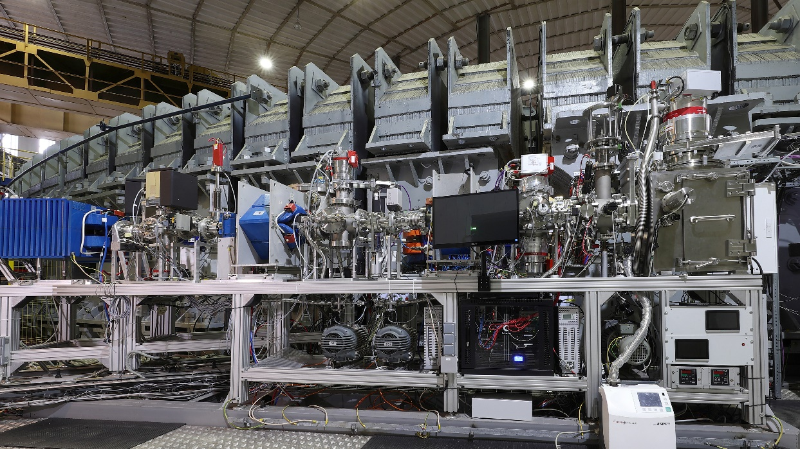
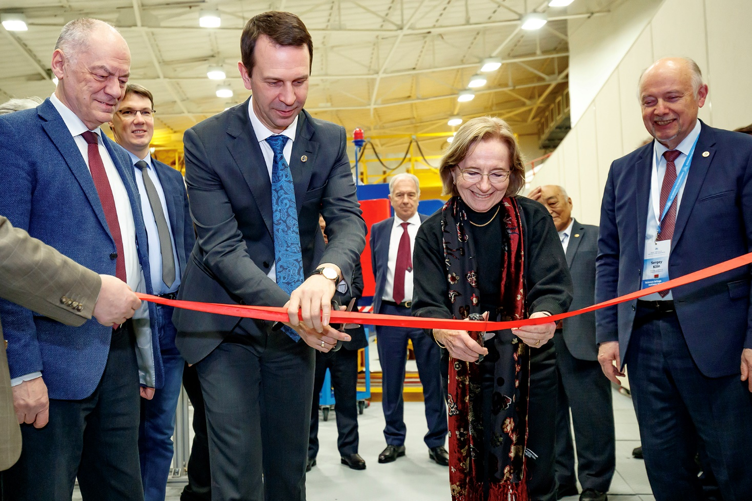
JINR Scientific Council
‒ SC appreciated with satisfaction the development of the ARIADNA collaboration, whose applied research program was launched at the NICA complex in the beginning of 2023, testing of the SOCHI station with the Ar beam, & installation of two other stations
– SIMBA & ISCRA.
In the presence of SC members,
the grand opening of 2 stations
for applied research was held:
Station for Investigation of Medical
Biological Objects (SIMBO) and Irradiation Station of Components
of Radioelectronic Apparatus (ISCRA).
SOCHI station
together with the SOCHI station,
they constitute the infrastructure for applied research at ARIADNA.

Slide 8
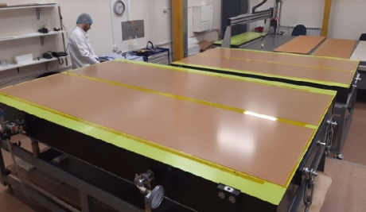
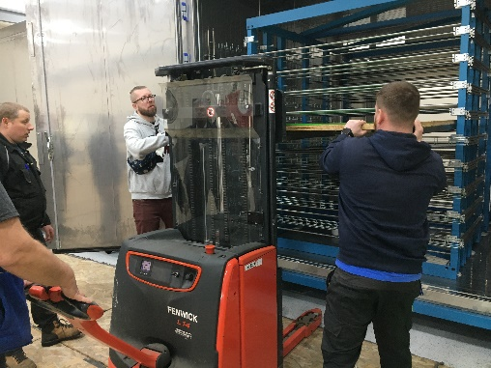
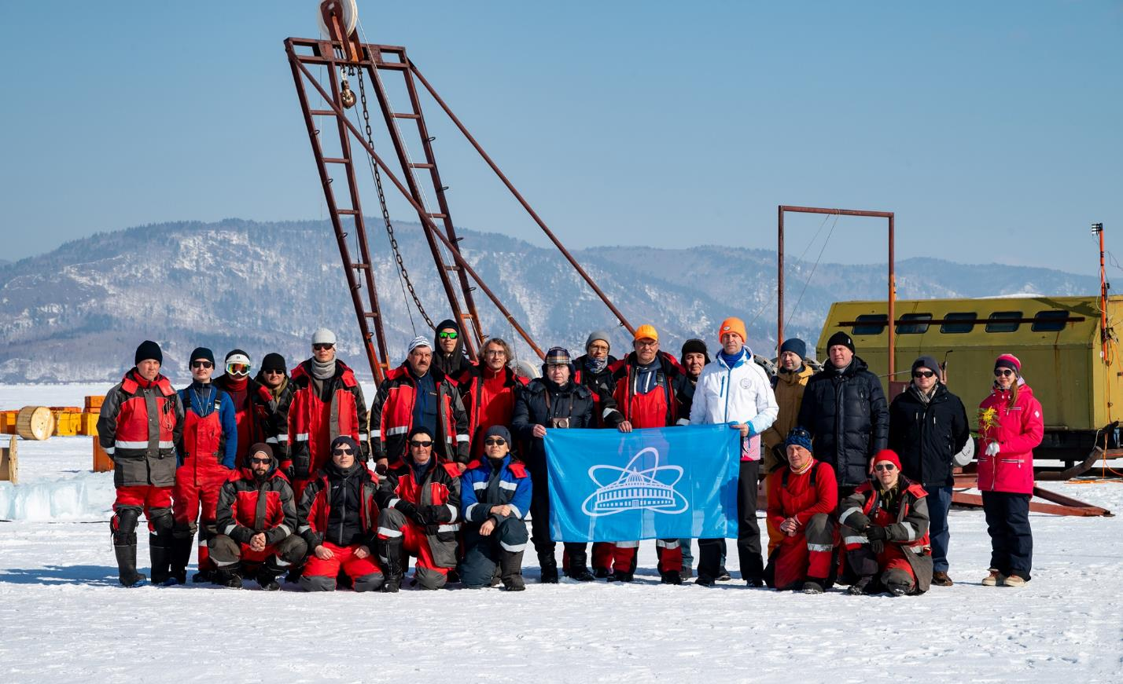
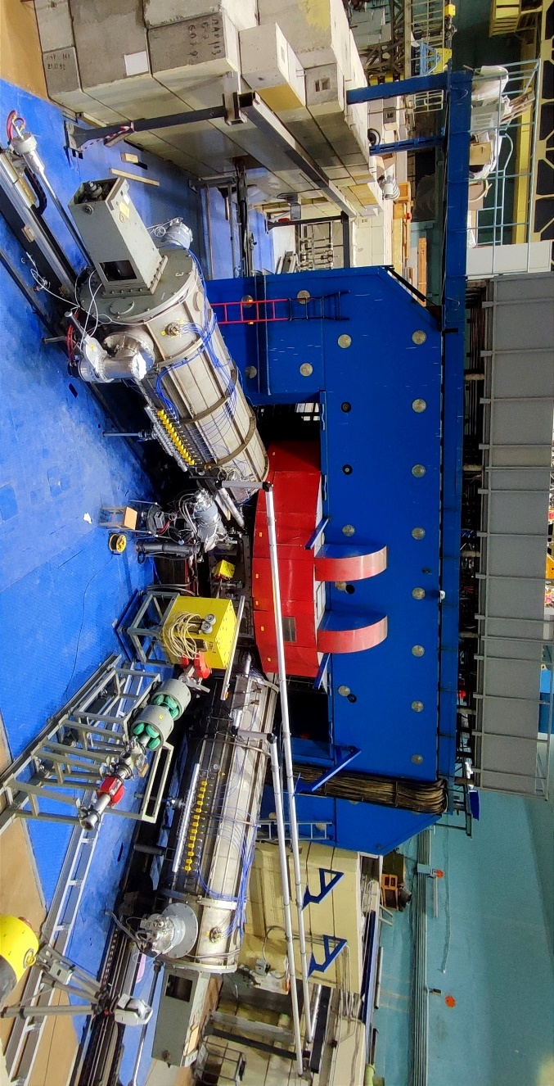
JINR Scientific Council
SC noted with satisfaction:
‒ the successful participation of the Institute in the work of collaborations at CERN, as well as the high level of activity in the fulfilment of its obligations for the 2-nd phase of upgrade of the ATLAS, CMS, and ALICE;
- progress in developing the Baikal-GVD deep-water neutrino telescope, installation of 576 OM & 2 bottom cable lines in 2023, as well as manufacturing 470 OM for installation during the 2024 expedition;
- successful continuation of experiments at the Superheavy Elements Factory, the observation of 2 events of the new isotope ²⁸⁸Lv in the reaction ⁵⁴Cr+²³⁸U, - important stage in preparation to the synthesis of the new element 120 in the ⁵⁴Cr+²⁴⁸Cm reaction;
― progress in developing the DRIBs-III complex with the modernization of the U-400M cyclotron with the first beam expected in the spring '24, the progress of construction work for DC-140 with commissioning expected at the end ‘24, implementation of the construction work in the new experimental hall of U-400R;

Slide 9
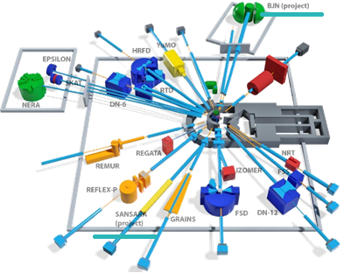
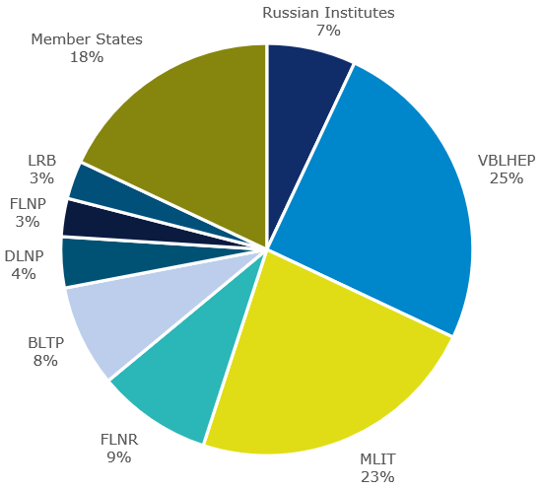
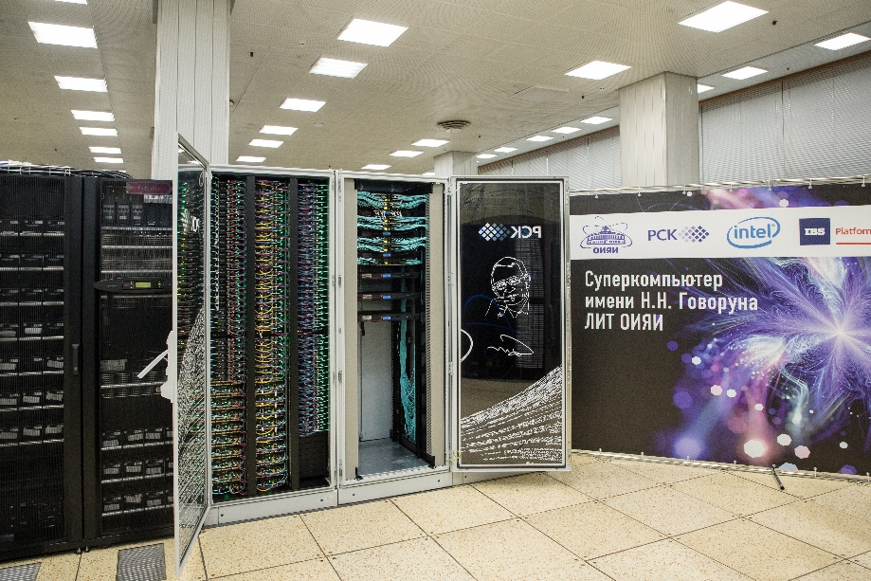
JINR Scientific Council
SC noted with satisfaction:
― successful implementation of the plan to prepare for continuing the regular operation of the IBR-2 reactor, & progress in the development of the spectrometer complex, in particular, the wide-aperture backscattering detector (BSD-A) for the high- resolution Fourier diffractometer, small-angle neutron scattering/neutron radiography detector (SANSARA), and an inelastic neutron scattering spectrometer in inverse geometry (BJN);
― further active development of fundamental & applied research related to life sciences & condensed matter physics due to the development of
the interlaboratory research program at LRB;
― successful work of the BLTP & important results in particle, nuclear, condensed matter physics, & advanced mathematical physics, aimed, in particular, at theoretical support of the JINR experimental program;
― successful development of the MICC JINR, including the expansion of the Govorun supercomputer, the use of the DIRAC distributed platform to support the collaborations of the NICA MPD, BM@N and SPD experiments, as well as the Baikal-GVD neutrino telescope.

Slide 10
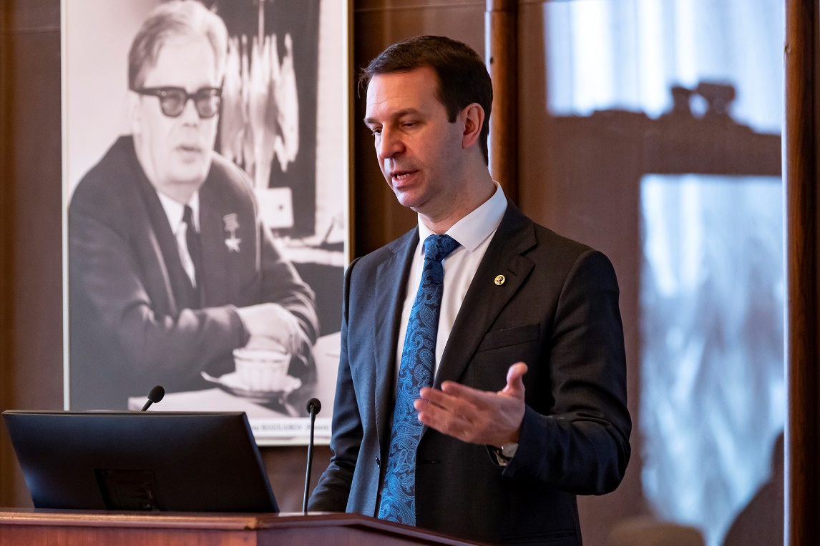
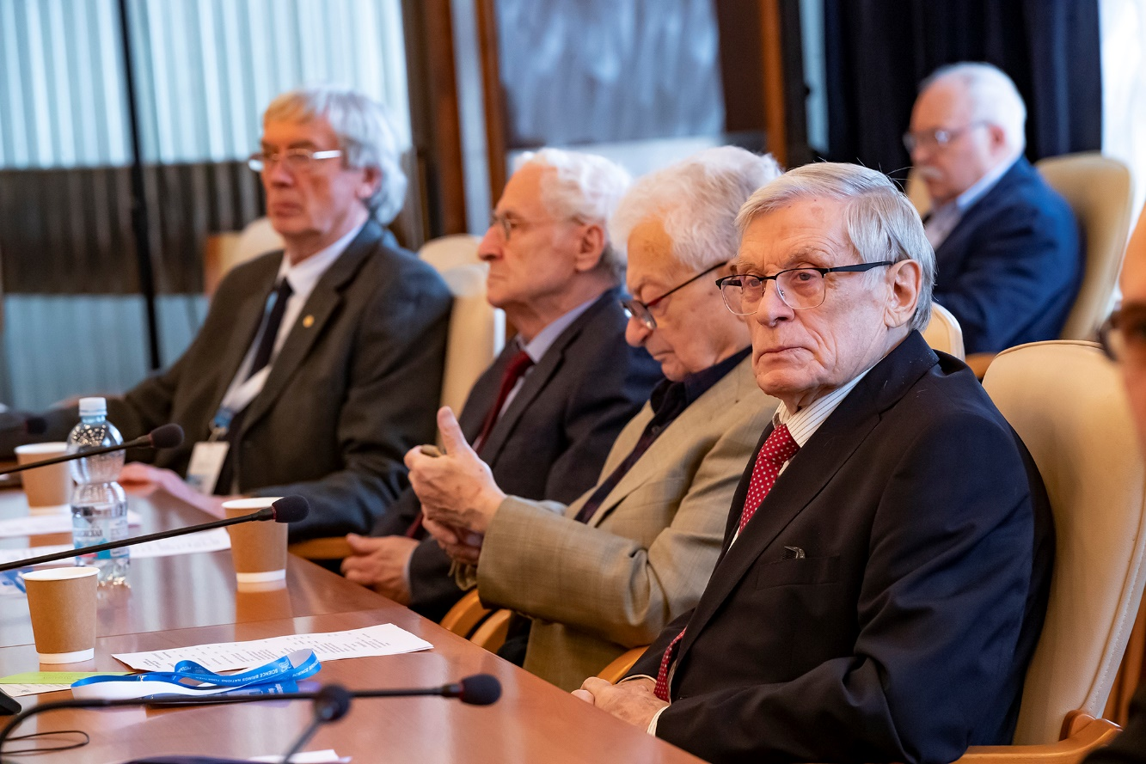
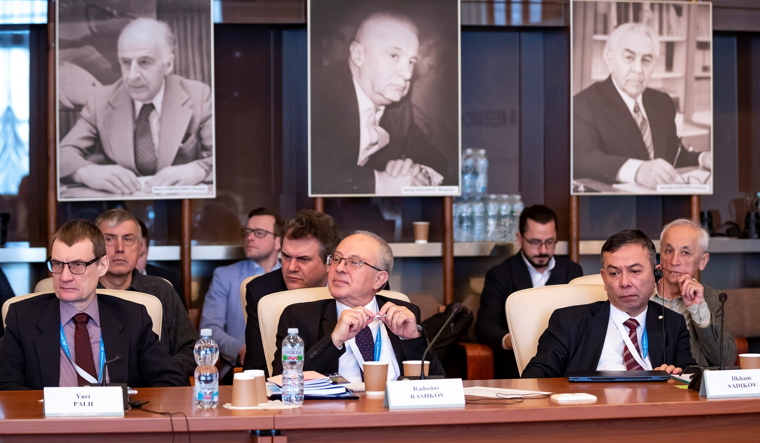
‒ SC approved the Jury’s recommendations on awarding the JINR annual prizes for best papers in the theoretical & experimental research, methodology & technology research, & applied technology research.
JINR Scientific Council
‒ SC elected A. Guskov as Deputy Director of the Dzhelepov Laboratory of Nuclear Problems (DLNP) until the completion of the term of service of the current DLNP Director.
‒ SC elected B. Mukhametuly (Khazakhstan) as Deputy Director of the Frank Laboratory of Neutron Physics until the completion of the term of service of the current FLNP Director.
- SC announced the vacancy of the Director’s position at the Flerov Laboratory of Nuclear Reactions; the election will take place at the 137th session of the Scientific Council in February 2025.
‒ SC agreed on the extension of the term of office of all Deputy Directors of VBLHEP until the election of
the Director of VBLHEP.
‒ The 136th session of the Scientific Council will be held on 12–13 September 2024.

Slide 11
On the Results of Financial Support for the Seven-Year Plan for the Development of JINR for 2017-2023
Execution of the income part of the financial support of the Seven-Year Plan
М$ | Plan | Actual | Execution
Contributions of the Member States (MS) | 1 444.0 | 1 380.5 | 96%
Payment of contribution arrears of MS | 91.7 | 91.2 | 99%
Funds received under agreements on science and technology cooperation | - | 12.8 | -
Other revenues | 34.5 | 57.6 | 167%
Total | 1 570.2 | 1 542.1 | 98%

Slide 12
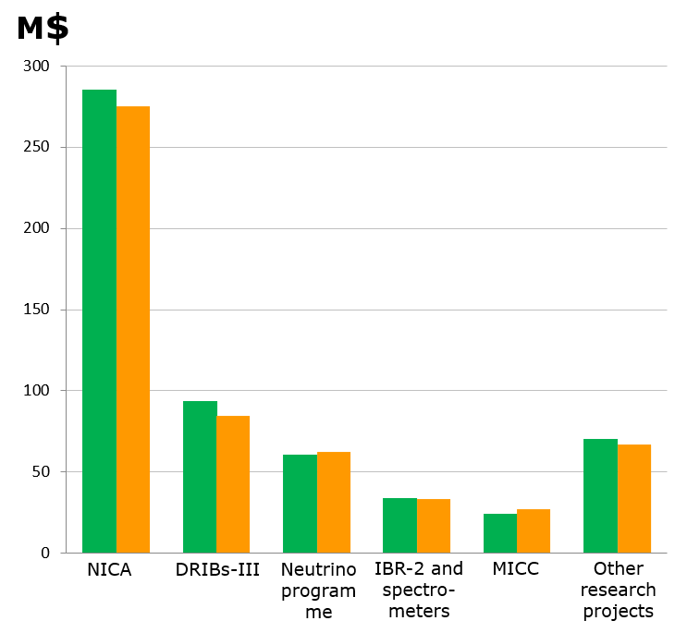
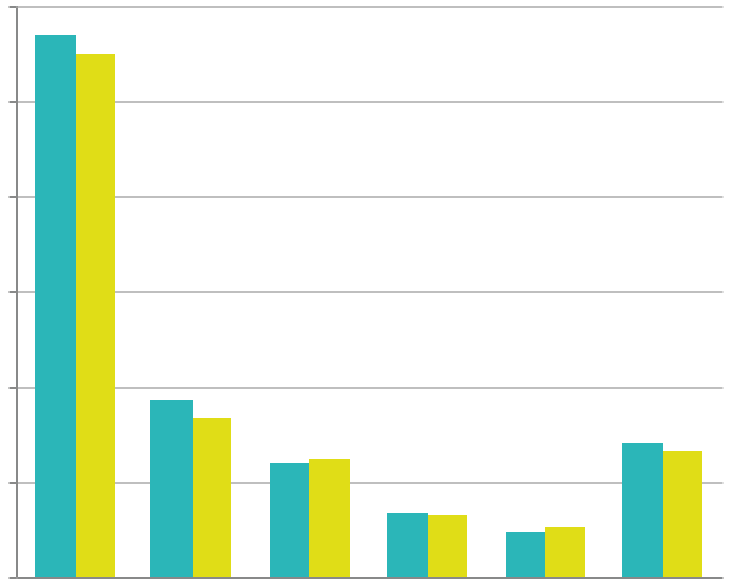
Material costs for the main research projects of the 7-Y Plan (2017-2023)
М$ | Plan | Actual | Execution
NICA | 285.2 | 275.0 | 96%
DRIBs-III | 93.6 | 84.5 | 90%
Neutrino programme | 60.2 | 62.6 | 104%
IBR-2 and spectrometers | 33.9 | 33.1 | 98%
MICC | 24.1 | 27.2 | 113%
Other research projects | 70.3 | 67.4 | 96%
Total | 567.3 | 549.8 | 97%

Slide 13
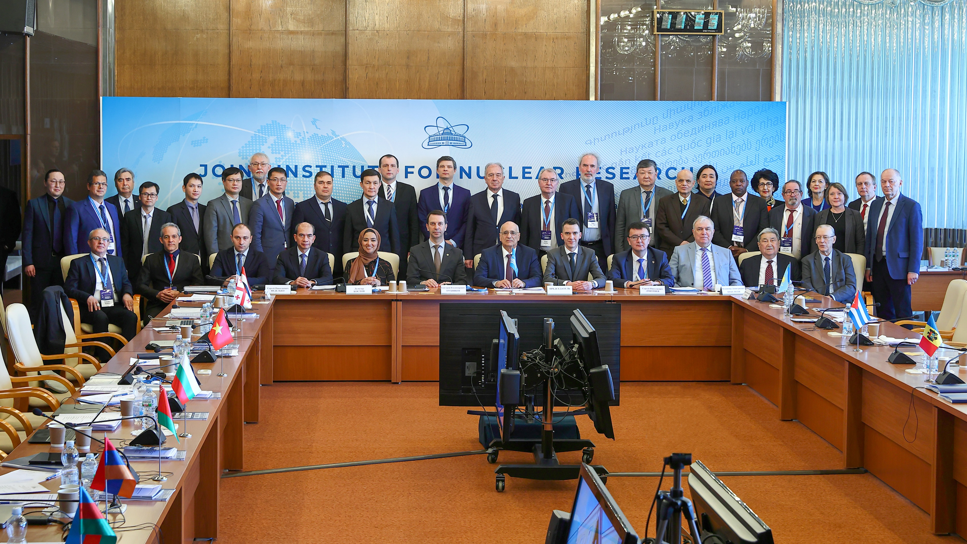
Information on the Resolution of the session of the JINR Committee of Plenipotentiaries, 22 March 2024, Dubna
Chair of the Committee of Plenipotentiaries ― representative of Georgia A. Khvedelidze

Slide 14
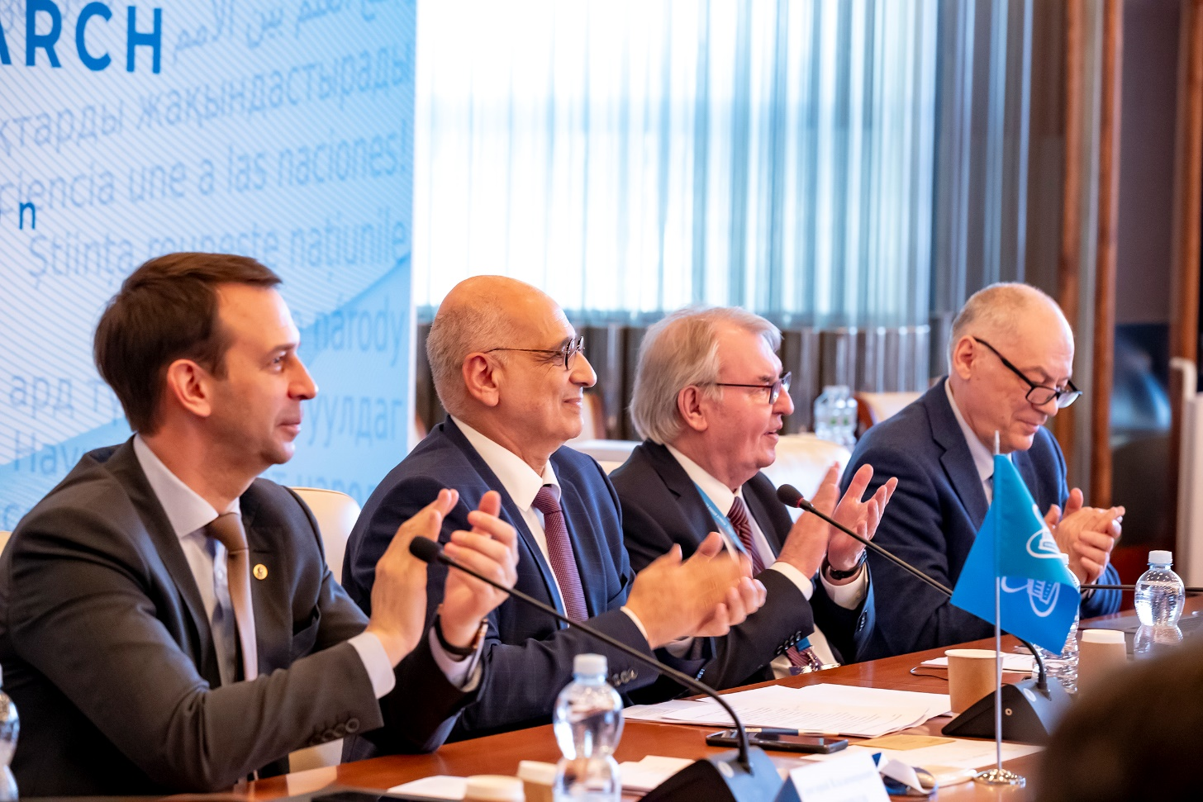
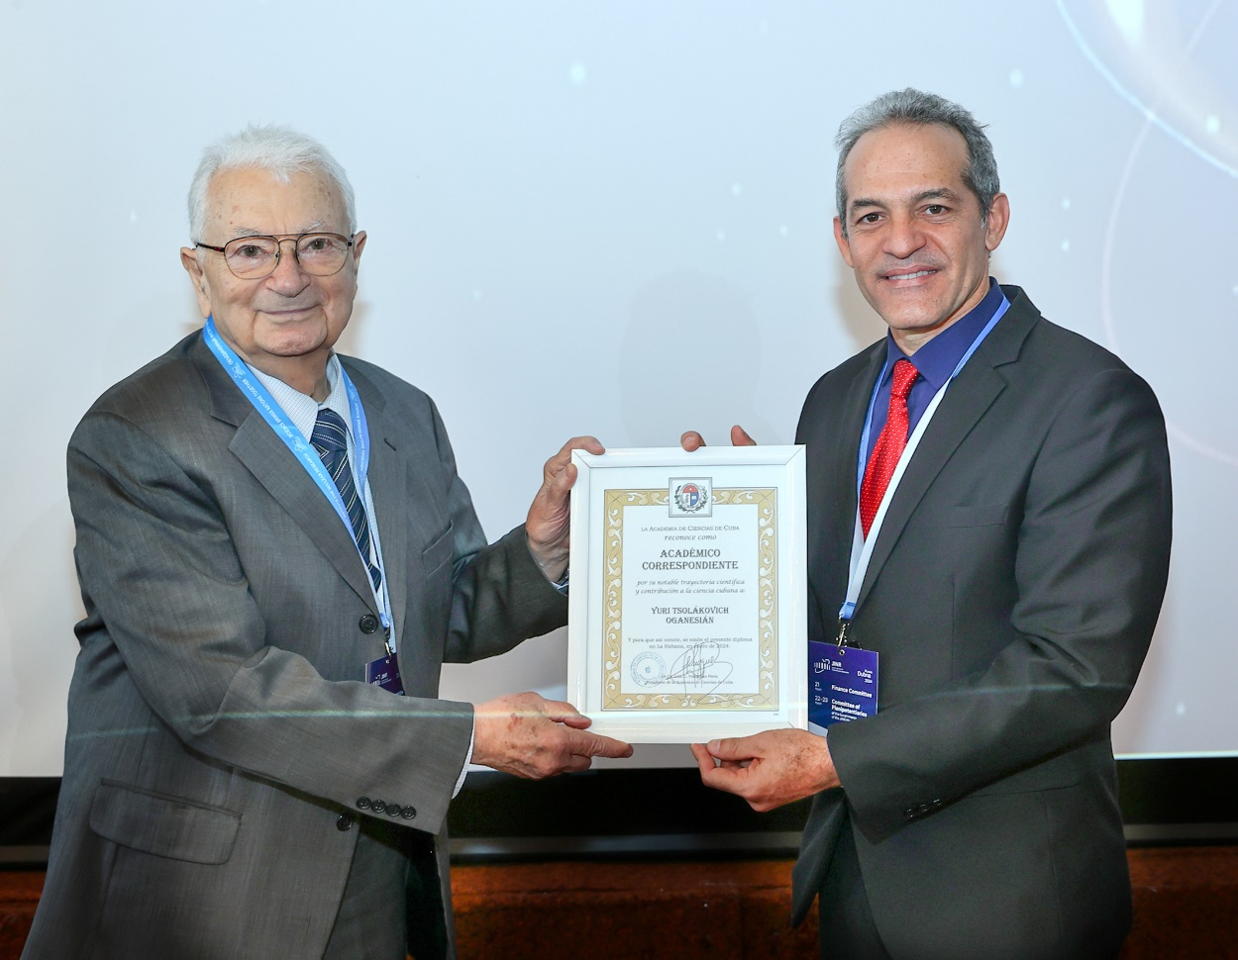
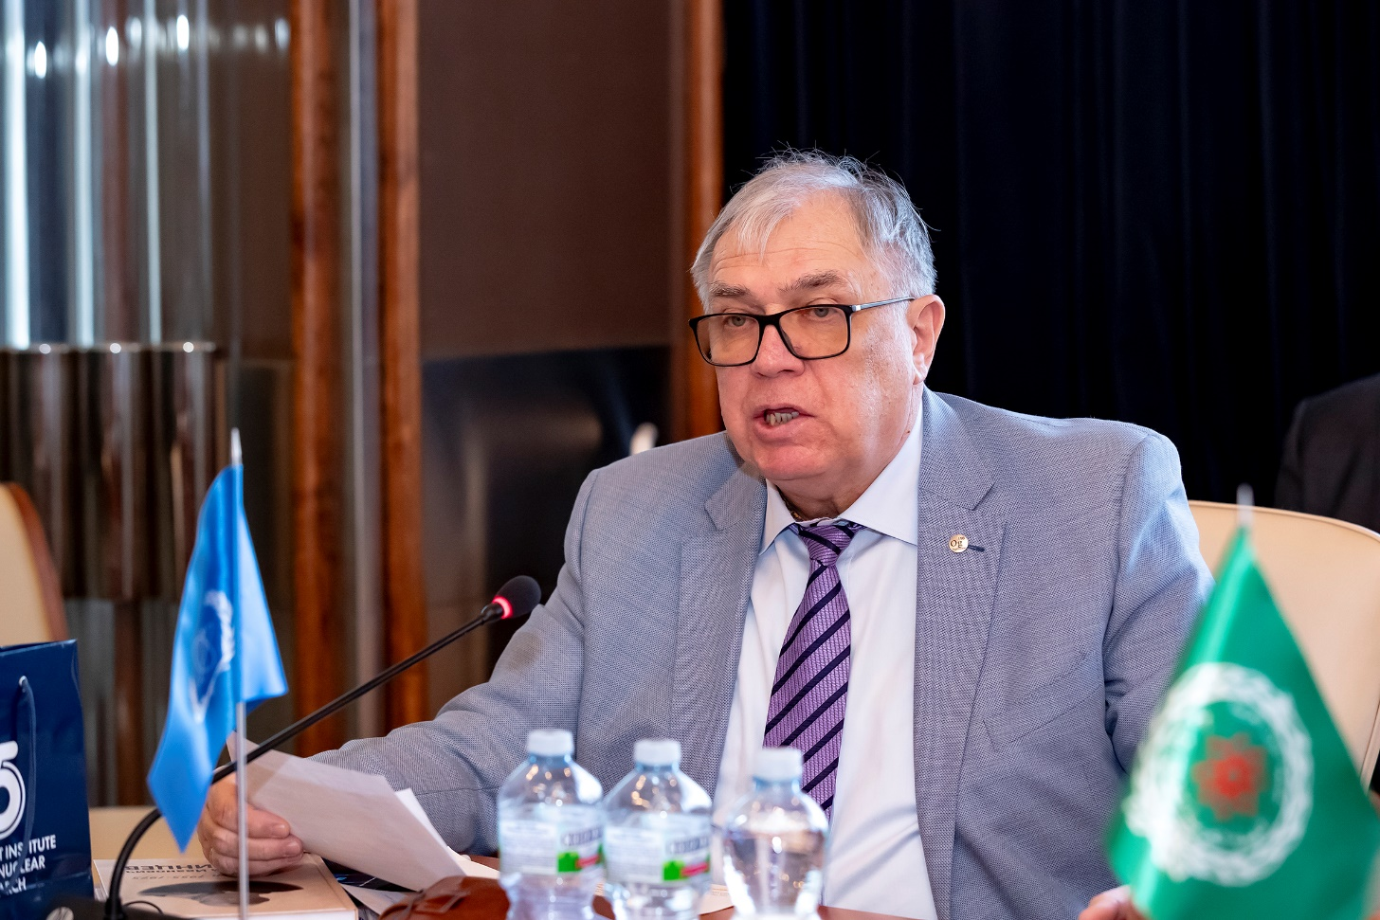
Session of the JINR CP
Plenipotentiary representatives of all JINR Member States attended the meeting of the CP sessions in person. The representatives of the IAEA & the Arab Atomic Energy Agency, Directorate of the Dubna city district and the Dubna State University, as well the relevant Deputy Ministers of Kazakhstan and Cuba participated at the session.
At the beginning, Deputy Minister of Science, Technology & Environment of the Republic of Cuba Armando Rodriguez Batista announced the awarding of the title of Corresponding Member of the Academy of Sciences of the Republic of Cuba to the Scientific Leader of LNR Yuri Oganessian
Deputy DG of the IAEA Mikhail Chudakov conveyed greetings from the Agency’s DG Rafael Mariano Grossi to the members of the CP.
Minister-Counselor for Science & Technology Affairs of
the Chinese Embassy in the Russian Federation Zhou Yu congratulated
the Joint Institute for Nuclear Research
on the 68th anniversary of its founding.

Slide 15
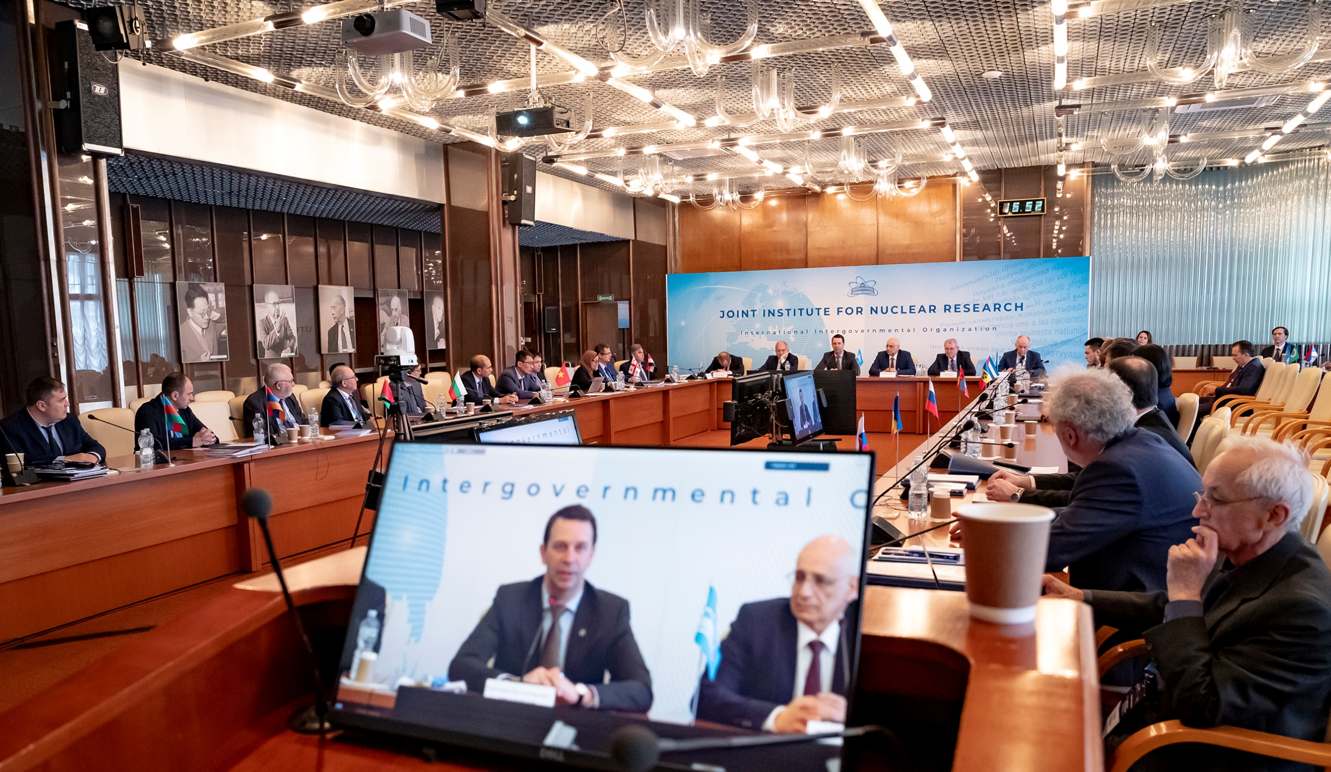
Session of the JINR CP
AGENDA
Report by the JINR Director - G. Trubnikov
2. Execution of the JINR budget for 2023 &
draft of the revised budget for 2024 - N. Kalinin
3. Results of the meeting of the JINR Finance
Committee held on 21 March ‘24 - A. Omelchuk
4. Proposals for amending the Rules of procedure
of the Finance Committee & the Rules of procedure of the Committee of Plenipotentiaries of JINR
— A. Kharevich
5. On the status of preparation and approval of the List of JINR officials - A. Kharevich
6. On the decision of the Republic of Moldova to withdraw from JINR - A. Khvedelidze
7. Amendments to the Regulation for the election of Directors & Deputy Directors of JINR Laboratories - S. Nedelko

Slide 16
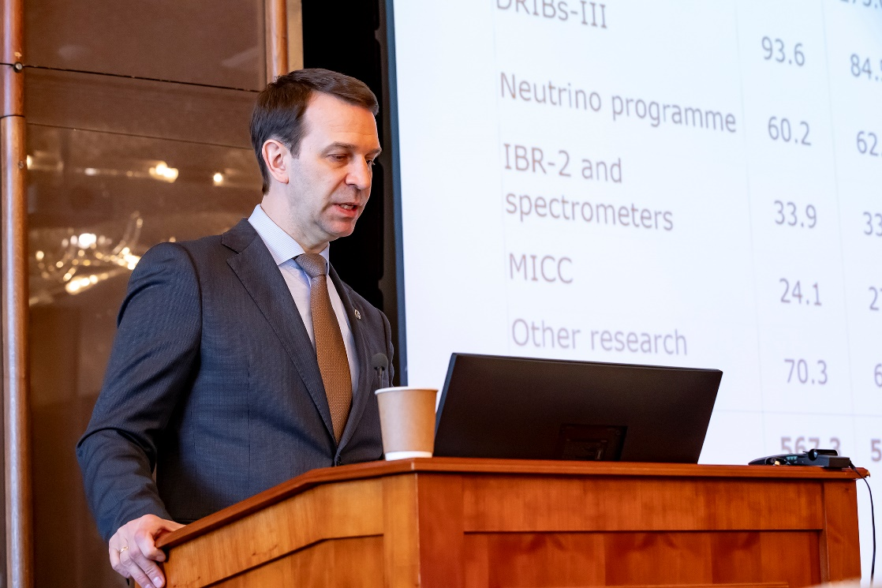
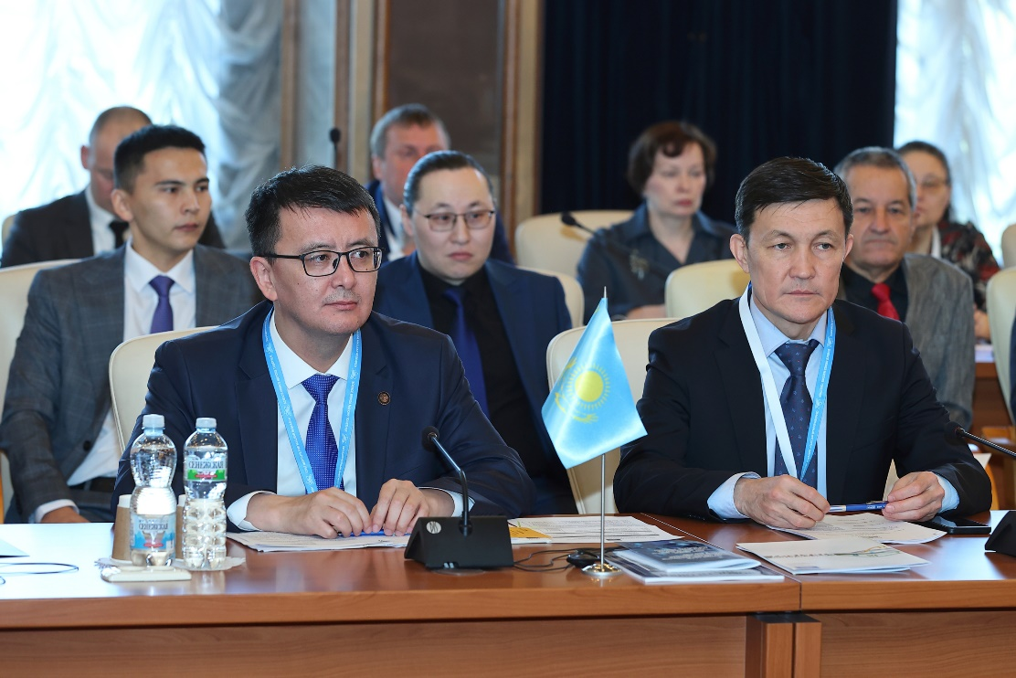
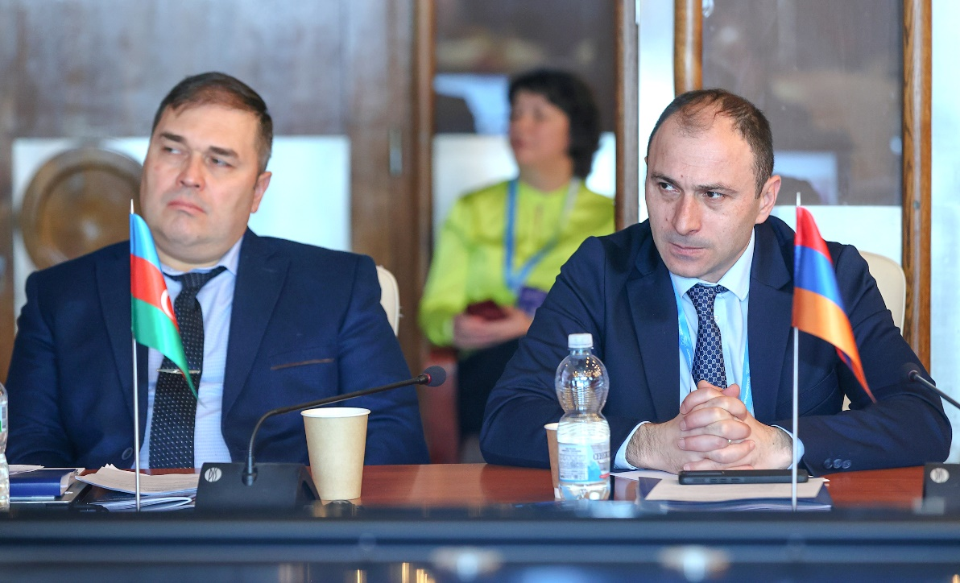
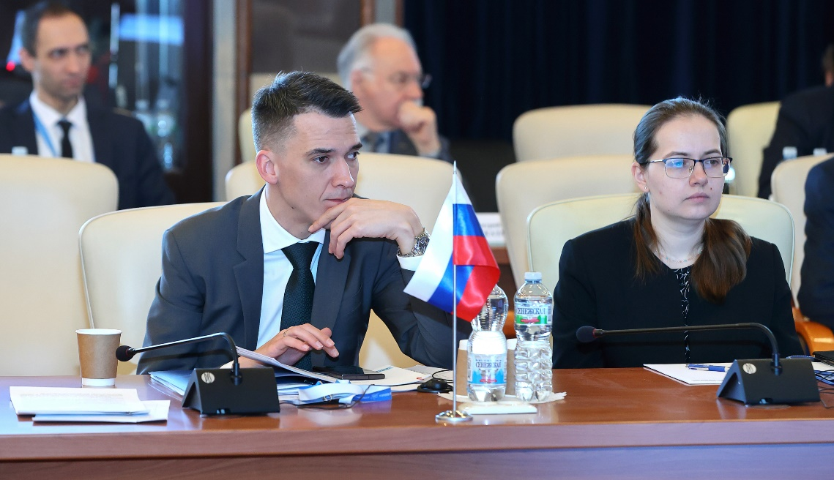
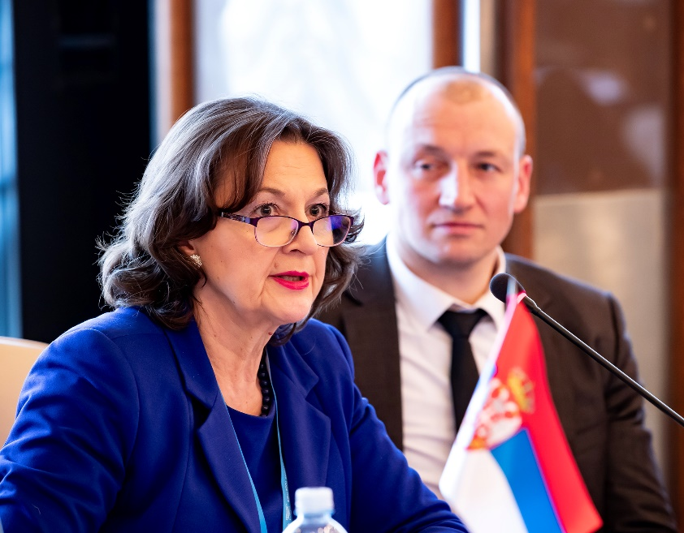
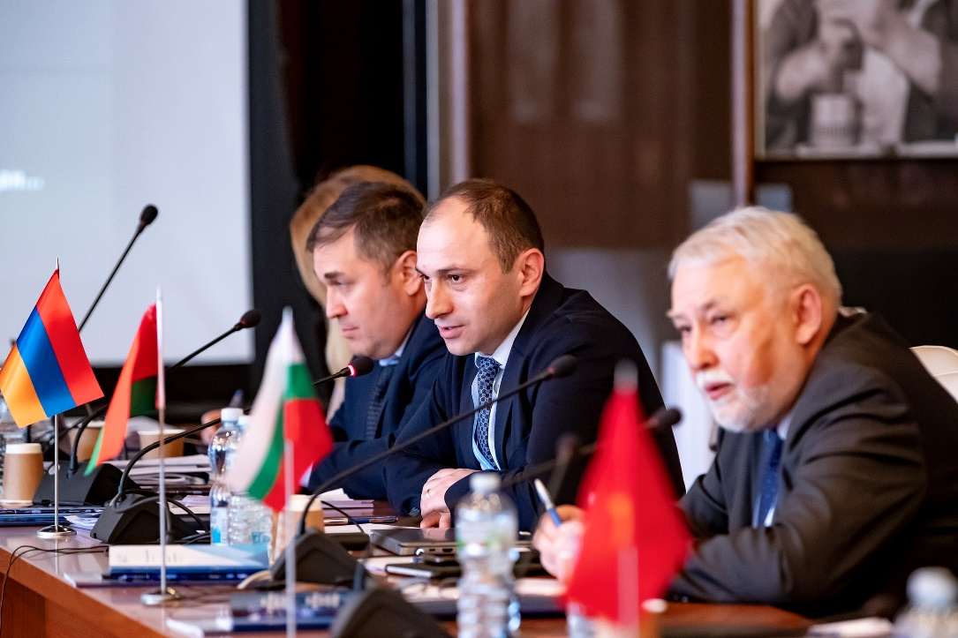
Session of the CP
Having heard the report presented by G. Trubnikov, the CP took note of the recommendations of the 135th session of the SC , the implementation of the current 7-year plan for the development of JINR, the efforts of the Member States towards realization of JINR’s large projects, the new scientific & technological results obtained, educational
activities and international cooperation.
The CP noted the high efficiency of the JINR’s activities in intensifying & expanding scientific cooperation with partner organizations of JINR MS & AM, increasing the level of interaction with the People’s Republic of China, the United Mexican States, the Federative Republic of Brazil, and the Republic of India.
The CP appreciated with satisfaction the progress in the current plan for research & development of the JINR scientific infrastructure, the successful participation in international collaborations, & achievements in strengthening international cooperation.

Slide 17
Session of the JINR CP
The CP took note the information on the transfer of the rights and
obligations of the general contractor under the contract “Installation of the heavy ion collider NICA at the site of VBLHEP JINR in Dubna with a partial reconstruction of the building №1of 18 Sept. 2015 to TES LLC from 1 March 2024.
The CP supported the efforts of the Directorate to renew & develop the social infrastructure (the restaurant of the H&R Complex “Dubna”, the complex of buildings on the territory “Ratmino”, the International Conference Centre) in accordance with the current 7-year plan.
The CP supported the initiative of the JINR Directorate to create an international innovation park of science & technology in Dubna, including, the construction of a modern university campus and comprehensive development of the surrounding areas, together with technologically advanced partners from JINR Participating Countries and partner countries, the SEZ “Dubna”, regional and federal executive authorities, Dubna State University.
The CP expressed gratitude to the IAEA & the JINR Directorate for supporting the initiative to hold a 2-week seminar at JINR in the frame of the IAEA Lise Meitner Program.
The CP endorsed JINR’s intensified participation in the International Decade of Basic Sciences for Sustainable Development (IDBSSD) under the auspices of UNESCO through JINR’s accession to the Earth Charter.

Slide 18
Session of the JINR CP
The CP supported the efforts of the JINR Directorate in the development of international scientific and technical cooperation and the creation of an integrated scientific and technological space in the field of neutron research at the unique neutron sources,
including research infrastructure of the “megascience” class.
The CP endorsed the accession of the JINR to the Consortium for the project to develop an International Research Center based on the Multipurpose Fast Research Reactor (MBIR) and to the International Association “Interdisciplinary Center for Neutron Research PIK” on conditions taking into account the special status of the Institute and the 7-Year Plan (2024–2030), as well as the interests of the JINR Member States.
The CP supported the initiative of the JINR Directorate
to establish a new scientific journal published by JINR.
The CP congratulated the staff of the Institute on the 40th anniversary of the commissioning of the IBR-2 pulsed neutron source, support the initiative of the JINR Directorate & the Frank Laboratory of Neutron Physics on naming the square near the IBR-2 reactor building
at the JINR DLNP Site after V. D. Ananyev.

Slide 19
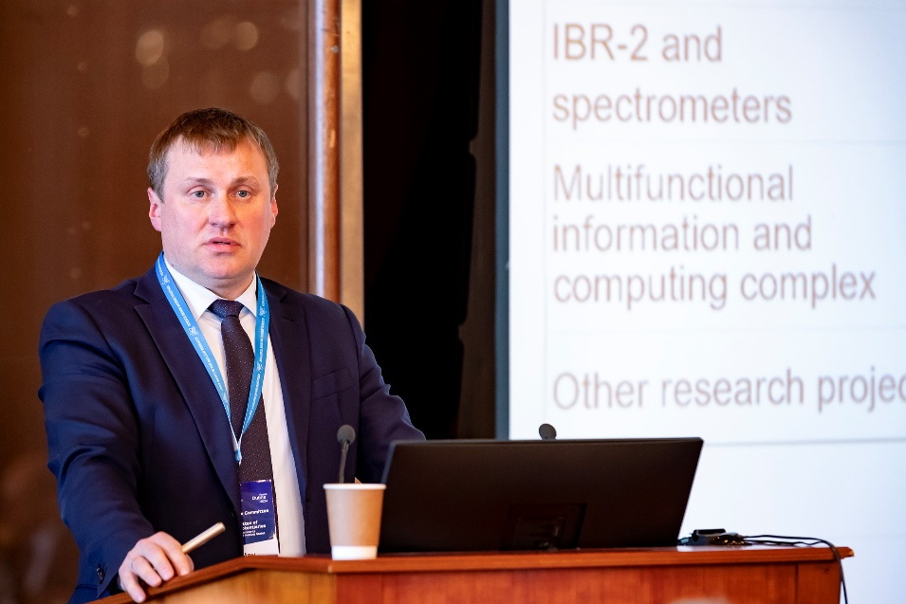
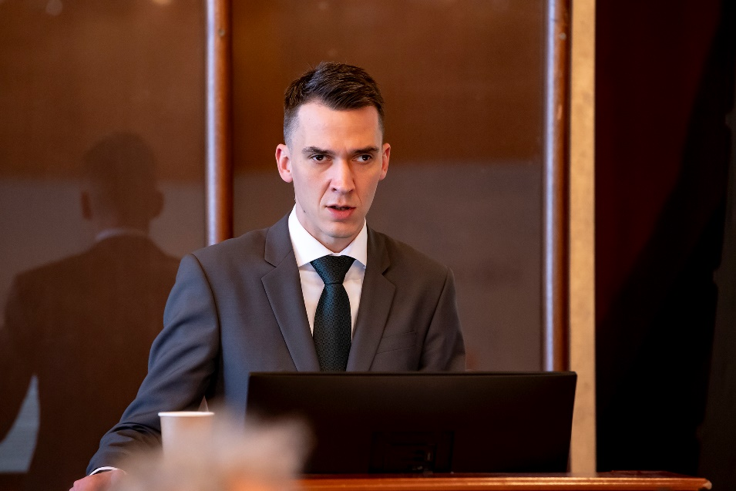
Session of the JINR CP
The CP approved the revised budget of JINR for 2024 with the
income amounting to US$ 214 124,5 k and the expenditure
amounting to US$ 286 818,2 k, taking into account the positive
opening balance amounting to US$ 56 749.0 k, as well as the
new forms of reports on the execution of the JINR budget.
The CP took note of the information
about the contribution arrears to the
JINR budget of the states that left the JINR membership in 2022.
The CP instructed the JINR Directorate and the Working Group under the CP Chair for JINR Financial Issues to develop an approach to determining the annual contributions of the Member States, taking into account the annual increase in the JINR budget by 5% during the 7-Year Plan (2024–2030) & the issue of abolishing the Rule for the lower contributions starting from 2025, & submit their proposals for consideration at the meeting of the Finance Committee and the CP session in November 2024.

Slide 20
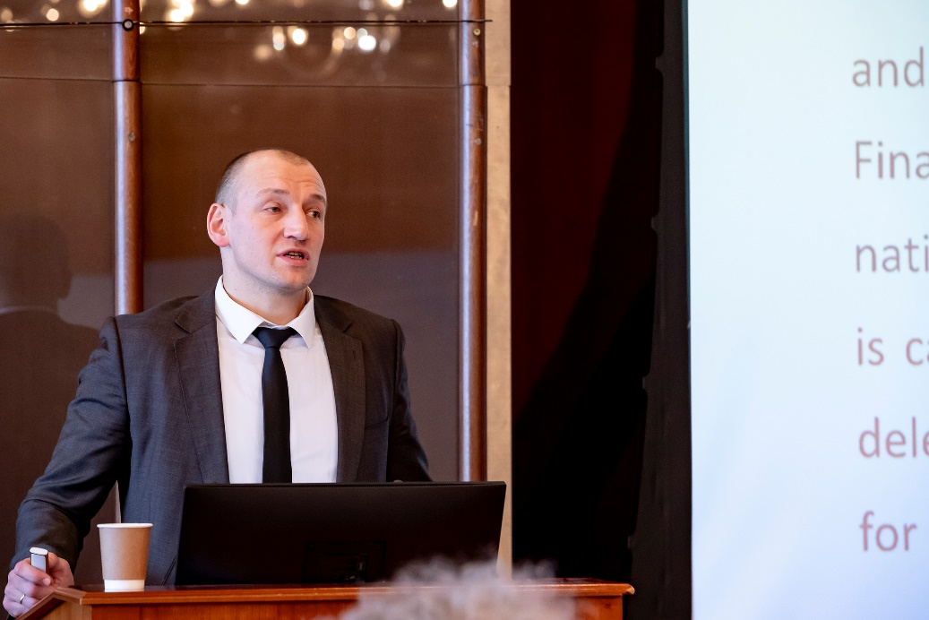
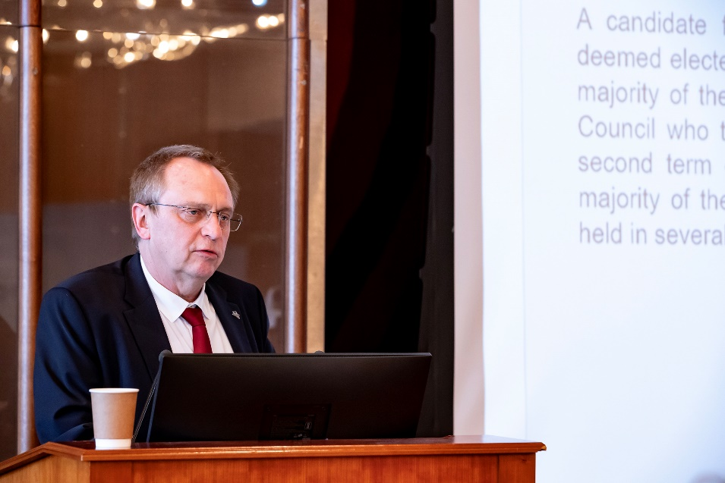
Session of the JINR CP
The CP took note of the notification of the Republic of Moldova on its withdrawal from the JINR and instructed the CP Chair to notify the Republic of Moldova about maintaining its full membership in the JINR during 2024 and the entry into force of its withdrawal from JINR from 1 January 2025.
Having heard and discussed the report “Amendments to the Regulation for the election of Directors and Deputy Directors of JINR Laboratories” presented by S. Nedelko, JINR Chief Scientific Secretary, the CP approved the new edition of the Regulation.

Slide 21
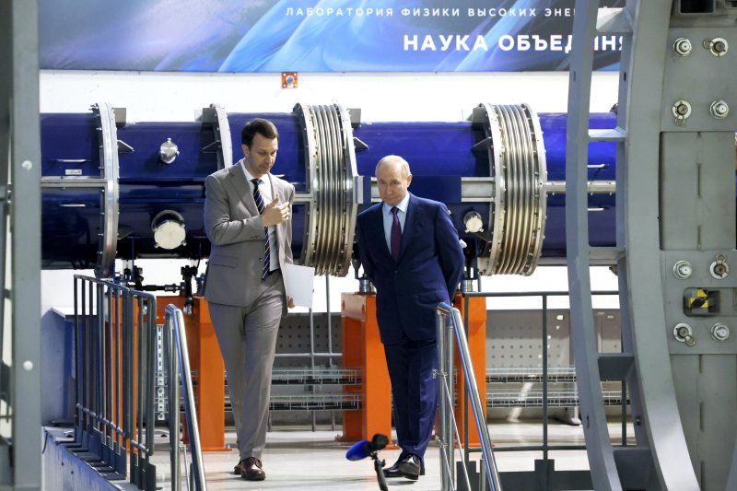
Thank you
Thank you

