Slide 1
Status of work on the project of
the new neutron source
Egor Lychagin
Joint Institute for Nuclear Research

Slide 2
Contents:
History of the project development
New results and progress
Plans for the near future
Conclusion

Slide 3

History of the project development

Slide 4
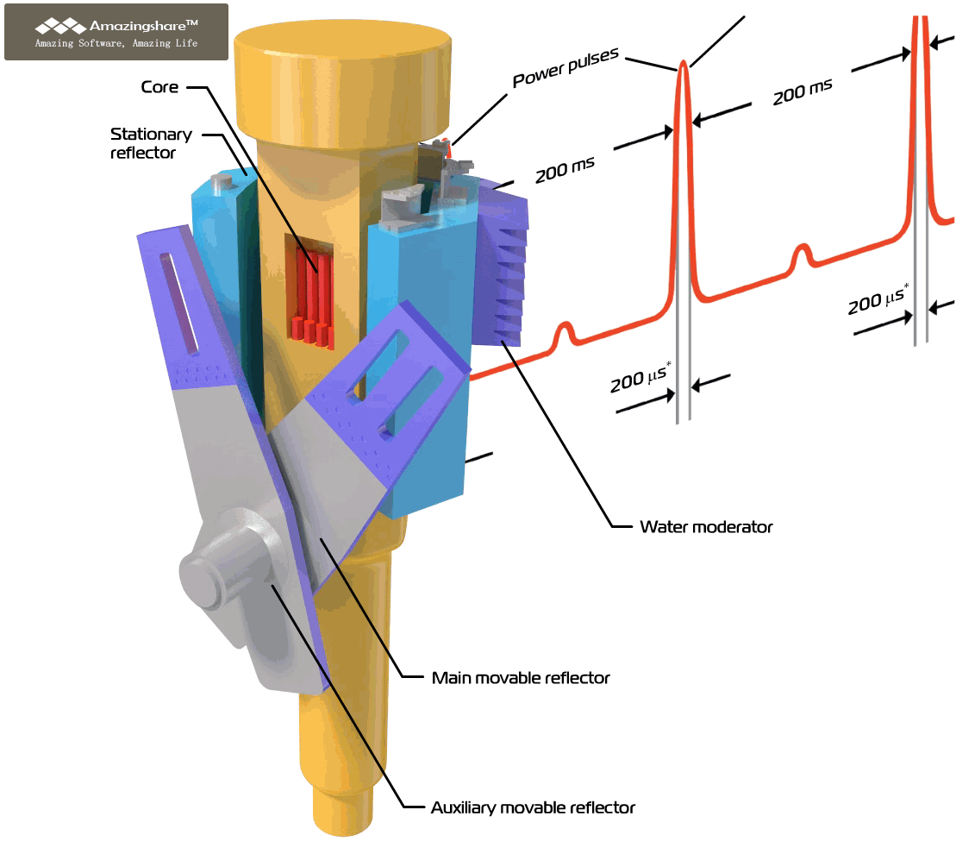
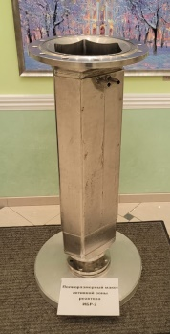
IBR-2 Pulsed Reactor
Average power, MW | 2
Fuel | PuO₂
Pulse repetiton rate, Hz | 5
Pulse half-width, µs: fast neutrons thermal neutrons | 200* 340
Rotation rate, rev/min Main reflector Auxiliary reflector | 600 300
MMR and AMR material | Nickel + steel
MR service life, hours | 55 000
Background, % | 7.5
Thermal neutron flux density from the surface of the moderator Time average Burst maximum | ~10¹³ n/cm² s ~10¹⁶ n/cm² s
1966 first technical
specifications
1977 physical start-up
1984 put into operation
2006-
2010 modernization
2022-
2024 shutdown
2029 fuel reloading
2042 decommissioning ?
V_{AC}<20 l
The process of developing the new source started in 2017

Slide 5
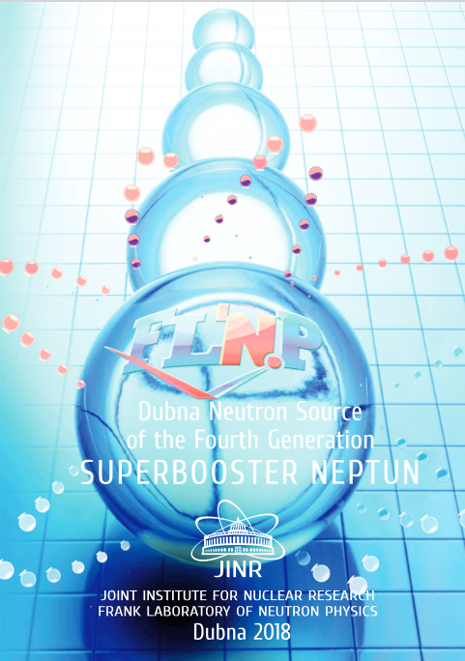
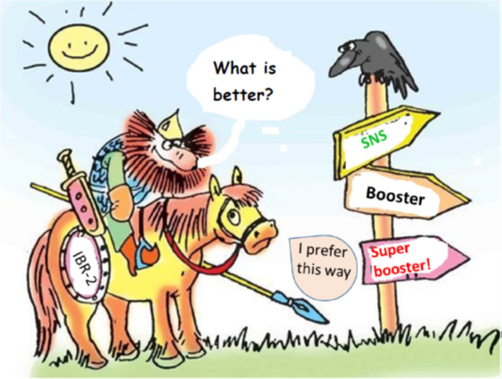
A pulsed source was primarily considered, since it takes maximum advantage of the experience and developments of FLNP. Such a source will further complement the PIK reactor under construction in Gatchina (Russia).
Conceptual requirements for the pulsed neutron source:
2017
• Density of the thermal neutron flux on the surface of a flat-water moderator of the source must be at least ~ 10¹⁴ n / (cm² s);
• Prompt thermal neutron flux density on the surface of a flat-water moderator of the source must be at least ~ 10¹⁷ n / (cm² s);
• Pulse width – 20-200 μs;
• Repetition rate – 10-30 Hz;
• It is necessary to ensure a high level of nuclear and radiation safety;
• Realizability.
A.M.Balagurov, M.V.Avdeev, V.I.Bodnarchuk, E.A.Goremychkin, S.E.Kichanov.
Workshop “Advanced Ideas for DNS-IV”,
December, 2018, Dubna
Was presented at 48th meeting of the PAC for Condensed Matter Physics Jun.2018
It is difficult to surpass the parameters of existing projects.
Russia does not have the necessary technologies.
Very expensive.
A la
SNS, CSNS, ISIS or ESS
?
2018
Vinogradov A.V., Pepelyshev Yu.N., Rogov A.D., Sidorkin S.F. “High-flux pulsed neutron source driven by a proton accelerator for beam research” JINR Preprint Р-13-2018-40 (in Russian)
E.P. Shabalin, V.L. Aksenov, G.G. Komyshev, A.D. Rogov “Highly Intense Pulsed Neutron Source Based on Neptunium” JINR Preprint P13-2017-57 (in Russian)
http://flnph.jinr.ru/images/content/Books/Blok.pdf (in English)
E.P.Shabalin

Slide 6

New Theme “Development of the Conceptual Design of a New Advanced Neutron Source at JINR”
50th Meeting of the PAC for Condensed Matter Physics, 17 June 2019
The main problem, according to NIKIET, is the impossibility of justifying the horizontal arrangement of fuel rods.
2019
Instability of the accelerator operation can lead to the appearance of a pulse that goes beyond the design limits. To date, there is no technology for creating a stable high-current linear proton accelerator.
Concept was developed by NIKIET in 2019. It was supported as a streamline by the 51st meeting of PAC for Condensed Matter Physics on June 20, 2020
«... the determining factor for the feasibility of the project is the production of fuel based on neptunium nitride... A difficult issue is the creation of an effective control system. In addition, it is important to determine the problems of dynamic instability...»
Rzyanin M. V., Shabalin E. P. JINR Preprint P3-2019-8
On the Issue of Stability and Safety of the Superbooster «Neptun»

Slide 7
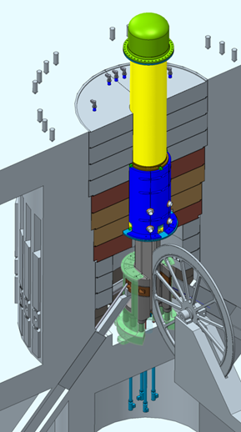
NIKIET (Chief Designer) has prepared a technical proposal for the reactor and 4 variants of its core configuration (different arrangement of fuel rods).
2020-2024
Work on the problem of reactor stability. Study of the phenomenon of dynamic bending of fuel rods.
Discussion with Chief Designer of a possible core configuration: a single fuel rod load or a one-piece core allows one to calculate the effect of fuel rod bending on the behavior of the reactor but does not ensure compliance with nuclear safety requirements.
As a result, the type of core assembly has not been finally determined and the search for optimal configuration of fuel assemblies is underway .
2020…
1. Shabalin E. P., Rzyanin M. V.
Analysis of the Pulsed Fast Reactor “Neptun” Dynamics: Comparison of Calculation Models. JINR Preprint P3-2020-13
2. Shabalin E. P., Hassan A. A., Rzyanin M. V., Podlesnyy M. M.
Method of Reducing the Level of Power Oscillation in the Pulsed Reactor «Neptune»
PEPAN Letters (Ru: 2021. Т. 18, № 3(235). p. 283–296)
3. Shabalin E. P.
Three Particular Properties of Periodically Pulsed Reactor Dynamics
JINR Preprint P13-2022-36

Slide 8
USA
NEPTUNE:
7⋅10¹⁵
Existing
Asia
λ = 1 Å
short-pulse
Europe
Planned
SNS-STS
SNS-FTS (2 MW)
ESS
(5 MW)
8⋅10¹⁴
The planned parameters of the new source should bring it to a leading position among existing sources and ongoing projects.
J-PARC
SNS-FTS
IBR-2
long-pulse
CSNS
ESS
(2 MW)
ISIS TS2
ISIS TS1
long-pulse
HFIR
ILL
FRM-II
PIK
PSI
steady-state
By A.Ioffe

Slide 9

New results and progress

Slide 10
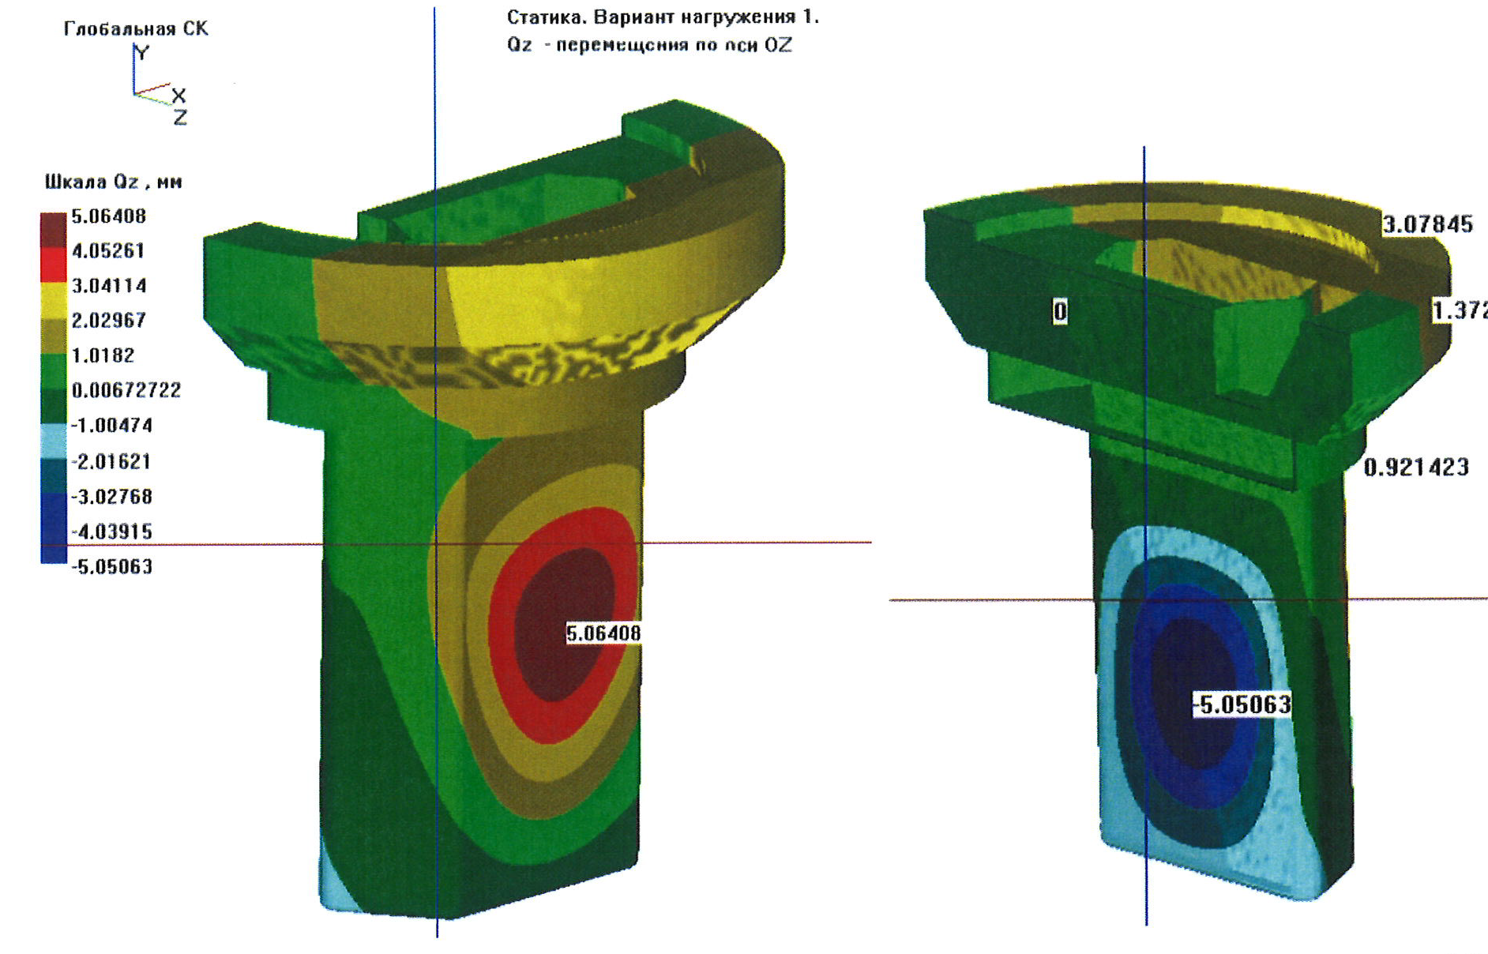
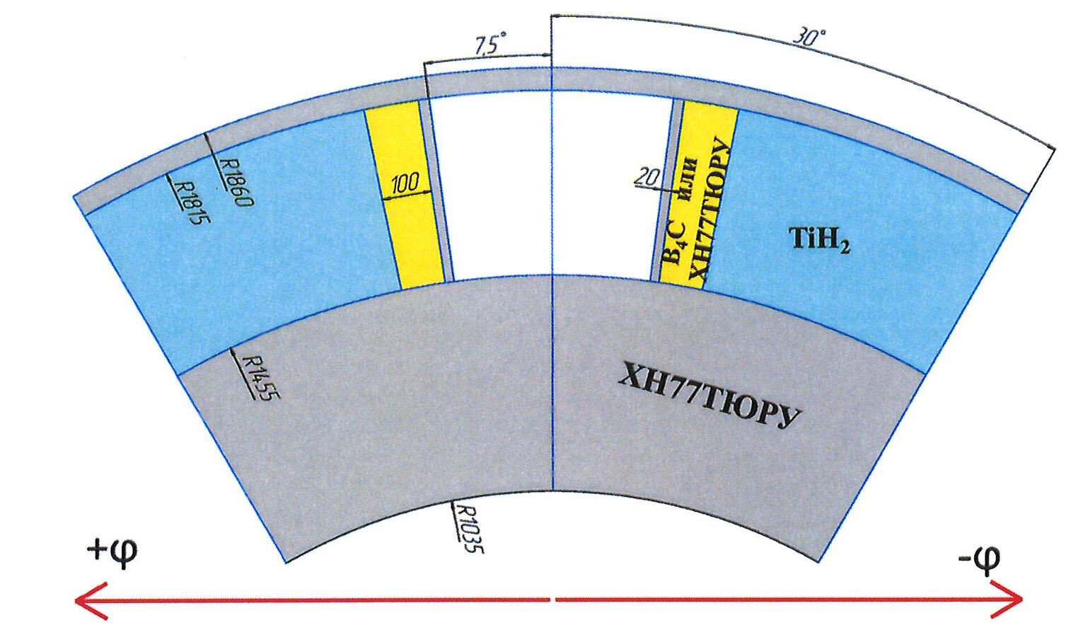
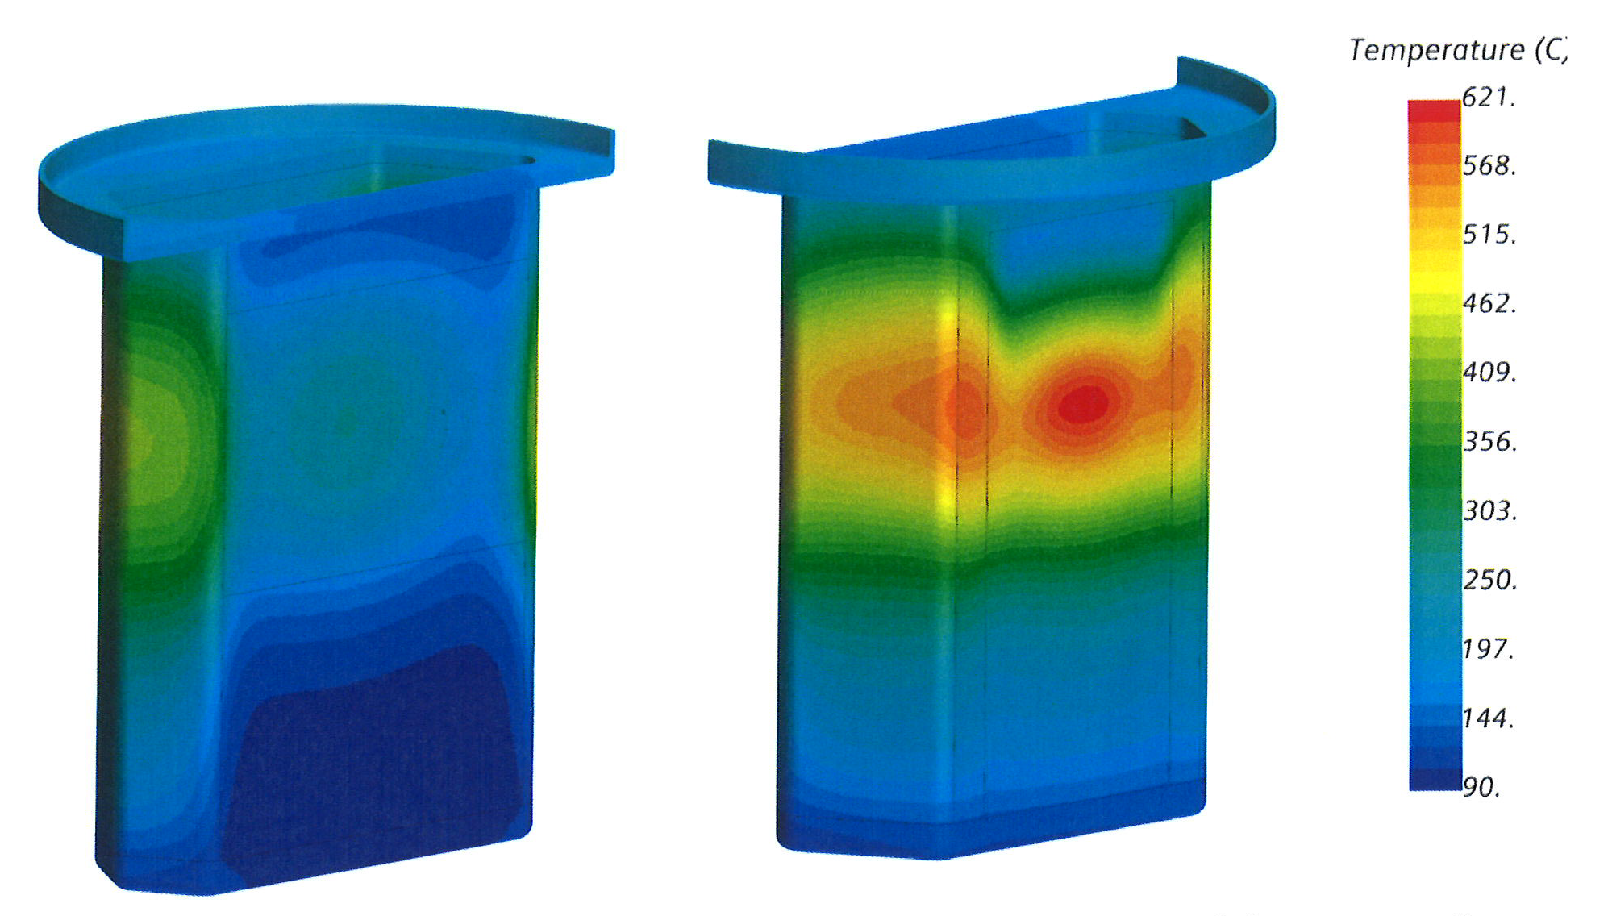
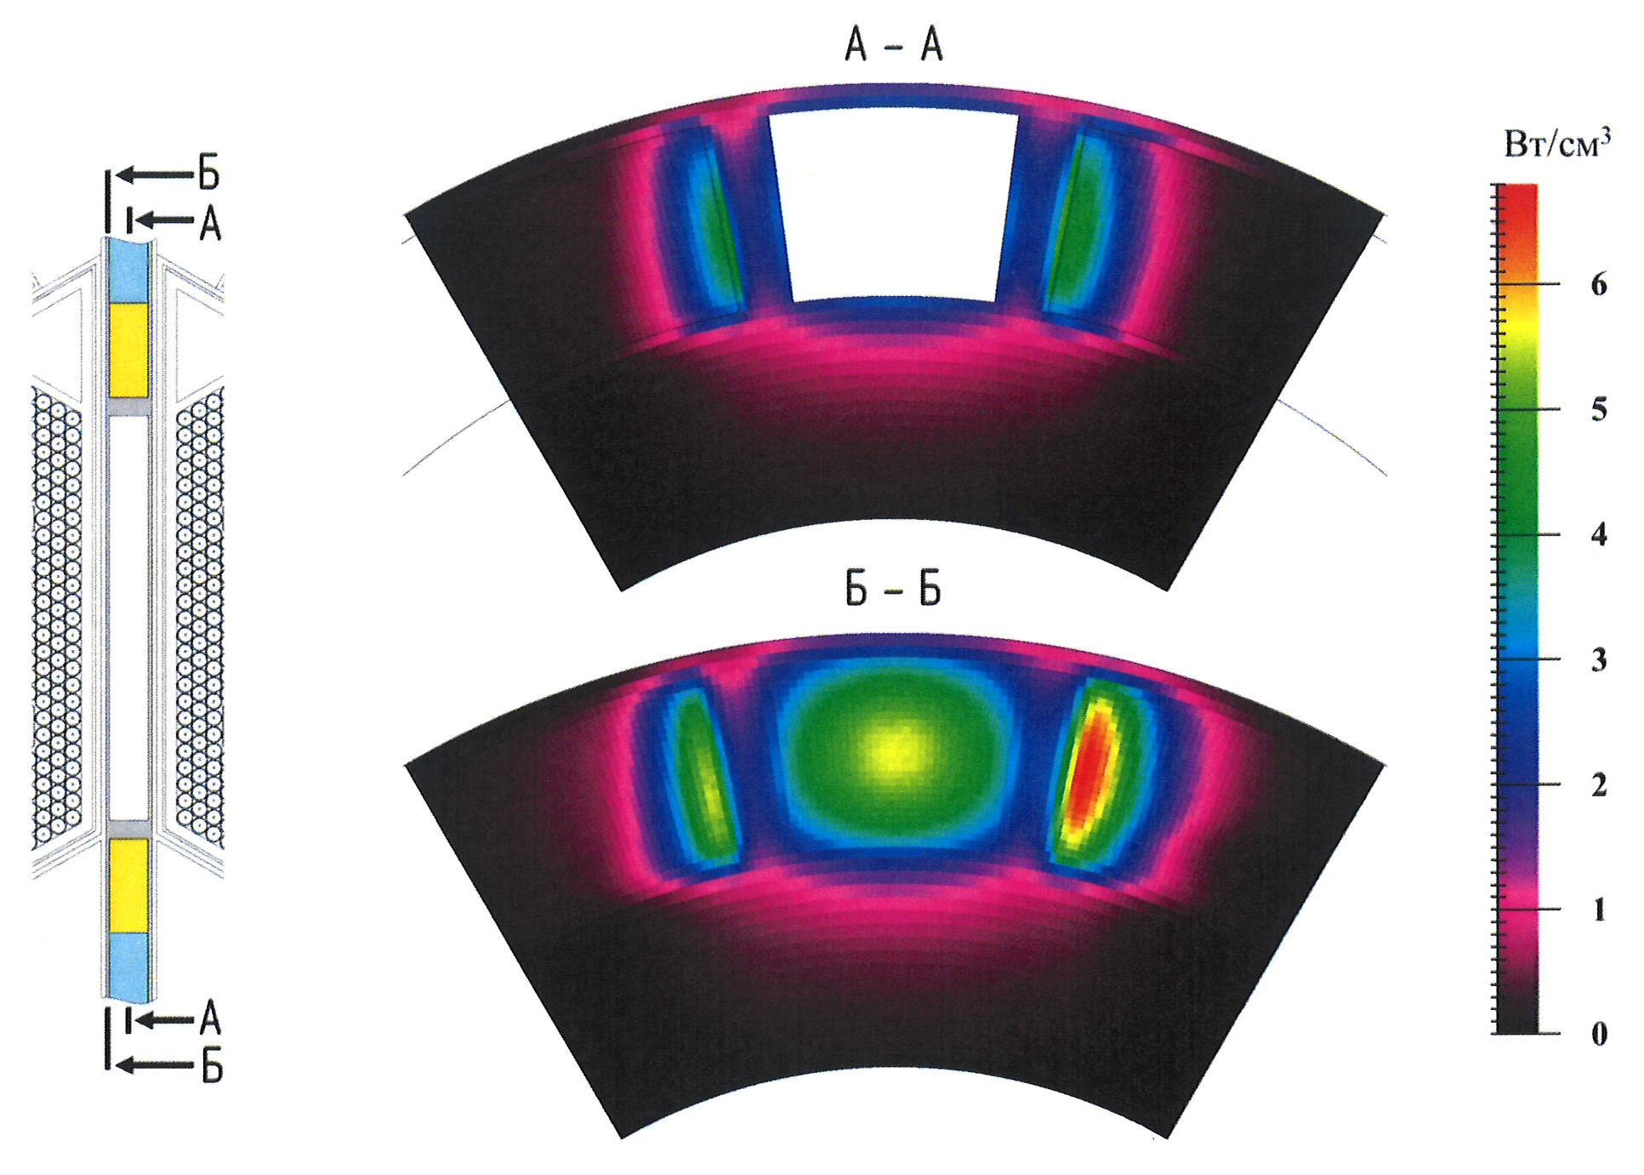
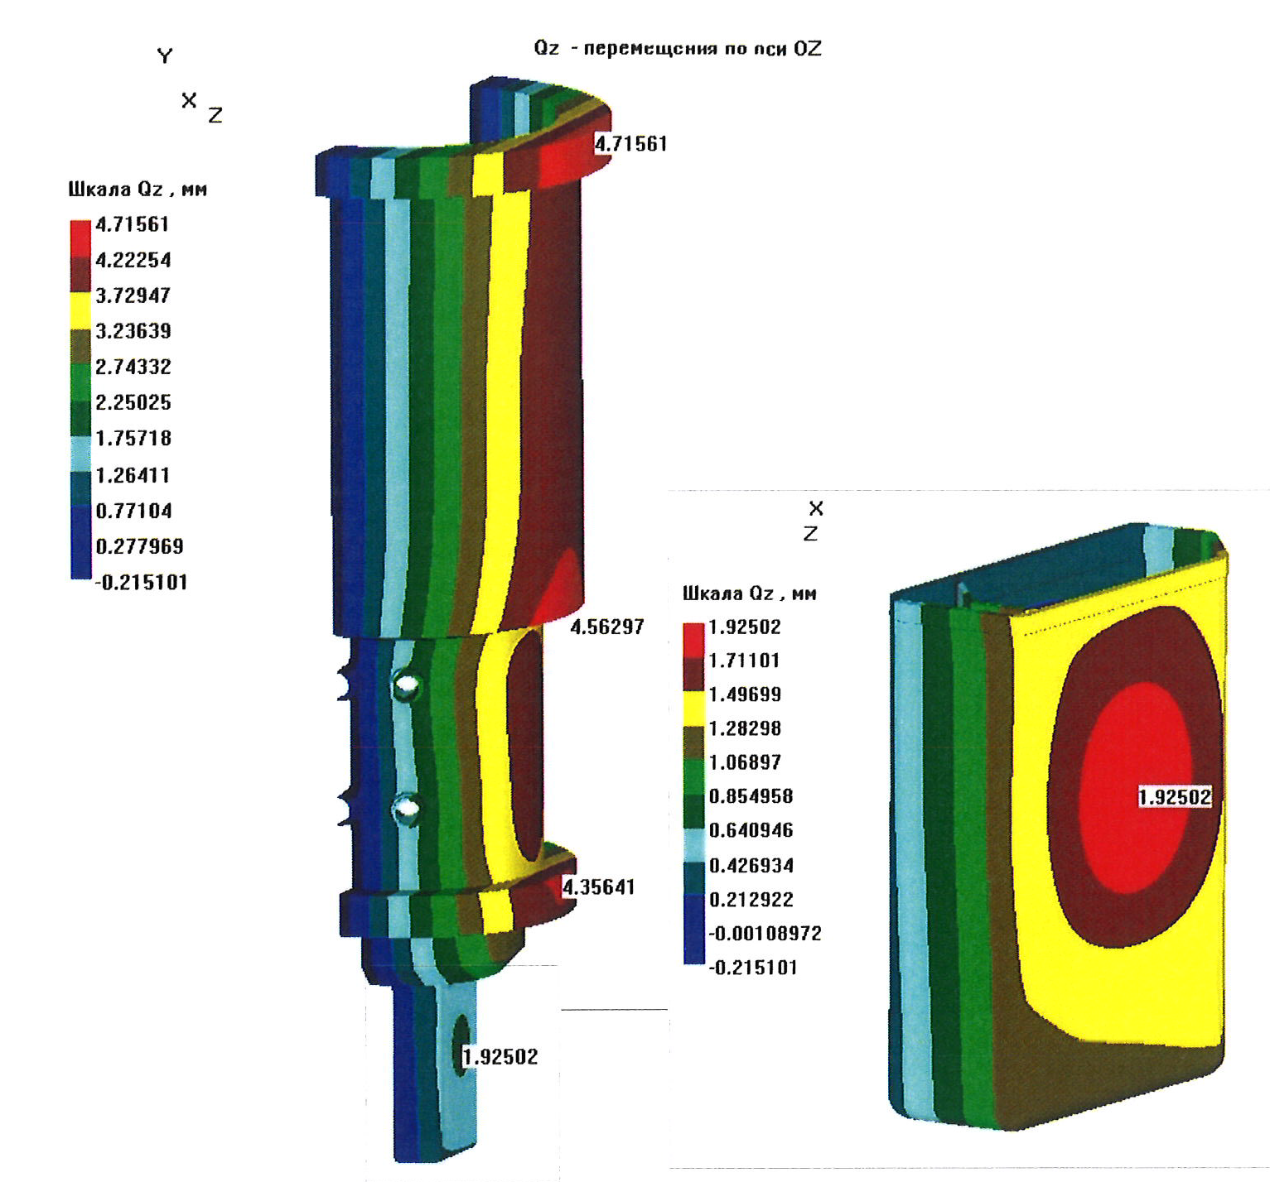
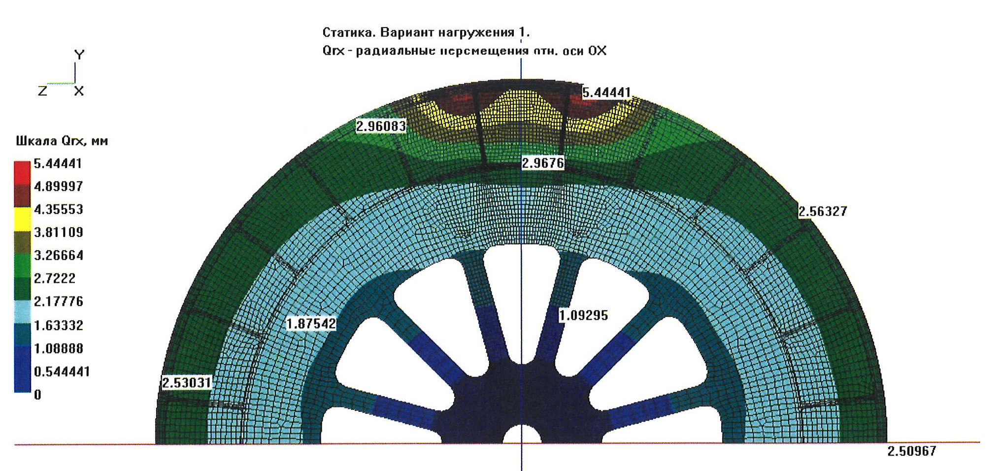
Thermal-hydraulic calculations of the reactivity modulator, core, housing and safety housing were performed by NIKIET in 2023-2024. The calculations were performed for two variants of the reactor body design for the single fuel rod load of the core:
- with reactivity modulator without a jacket;
- with reactivity modulator in a cooling jacket.
2023-2024
Deformations
Temperature
“It was shown that in both cases, at a power of 15 MW, the permissible temperature of the modulator is not provided, and the resulting deformations of the jacket are unacceptable.
Possible technical solutions to these problems may lead to deterioration in the reactor characteristics below the specified limits.”
Deformations
Temperature
Deformations
FLNP physicists continue to check these conclusions.
Next step: determine the facility parameters at which permissible deviations are achieved. This is a labor-intensive and expensive task.

Slide 11
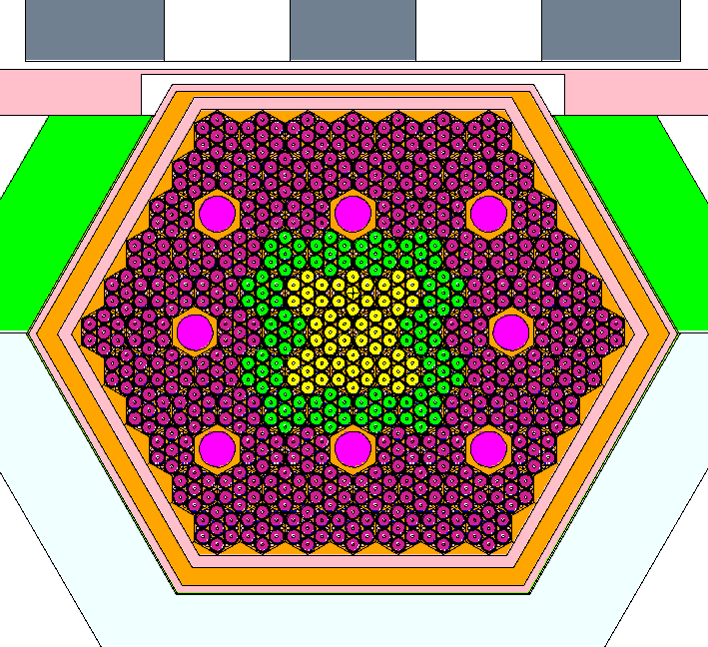
Another concept of the reactor from FLNP (2020-2024):
fuel as in IBR-2;
existing PO-3 modulator of reactivity for IBR-2
vessel is practically the same as the MBIR vessel;
new core design.
AM of CPS
Rotated
plug
Vessel
Parameter | value
Average power, MW | 4
Coolant | Sodium
Repetition rate, 1/s | 10
Fuel | PuO₂
Core volume, l | ~23,4
Thermal neutron flux density, 10¹³ n/cm² ∙s | up to 12*
Coolant exit
Core
Entrance
102 fuel assemblies,
86 fuel assemblies with plutonium dioxide,
8 control rods with enriched boron,
8 fuel assemblies – simulator cassettes to compensate for burnout,
13 fuel assemblies with tungsten inserts 6 cm long in the center of each fuel element.
Water
moderators
AMR
BMR
* depending on the thermal neutron pulse width.
Pepelyshev Yu. N. et al.
Preliminary Computations for the Pulsed Reactor IBR-4.
Basic Composition. JINR Preprint P13-2024-7
This concept has not been discussed with the Chief Designer yet.

Slide 12
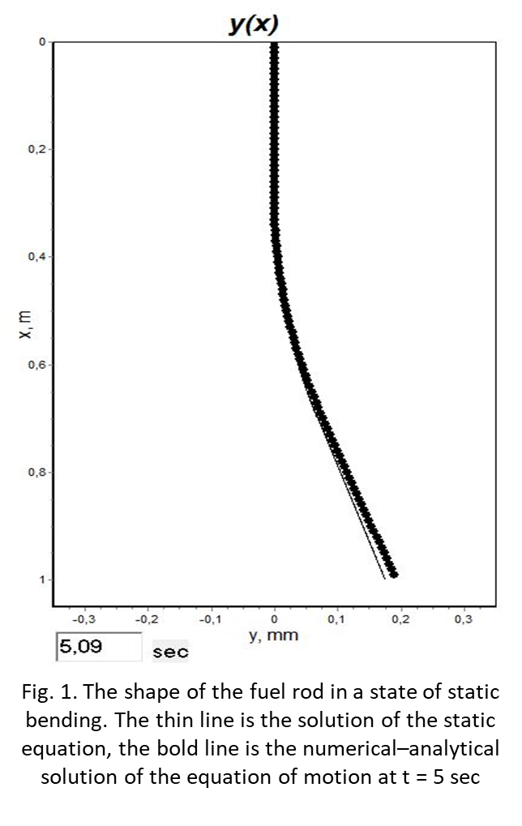
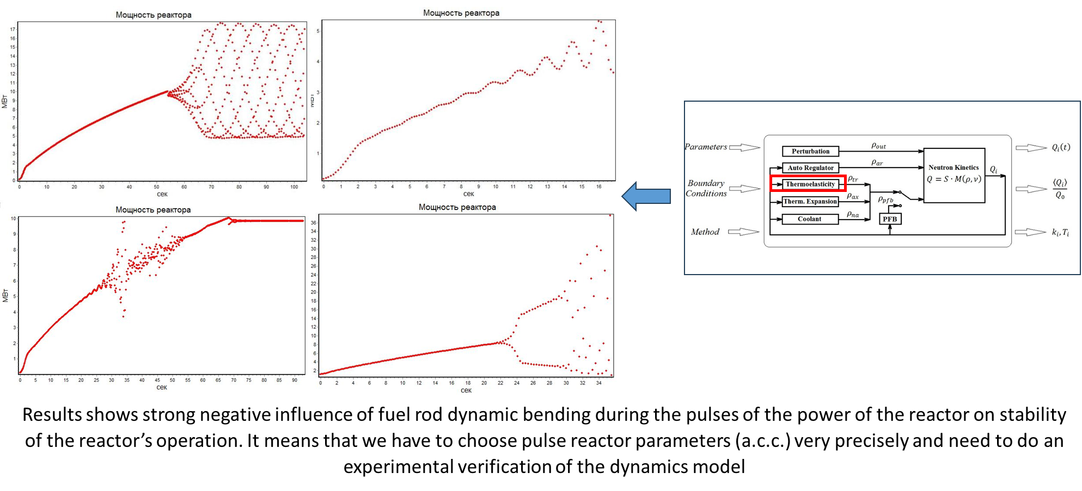
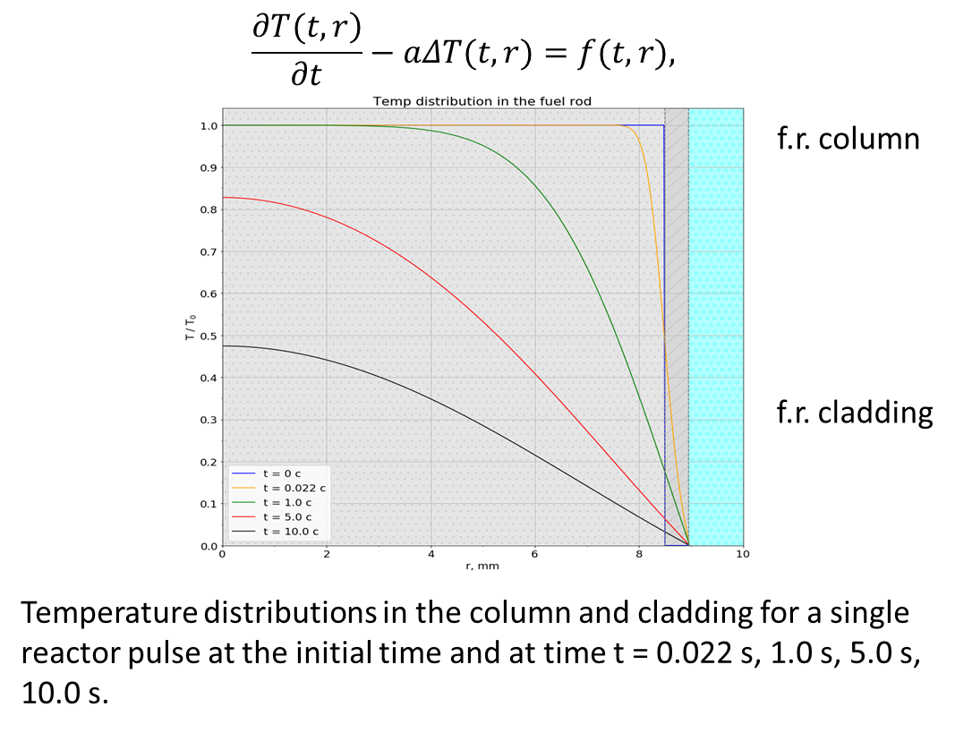
Key issues for any new pulsed reactor include the prediction of pulse energy fluctuations to keep them within acceptable limits, and the determination of reactor stability limits. The IBR-2 exploitation experience shows a strong dependence of fluctuations on the core configuration and its power.
Increasing the power of new facilities requires the creation of an adequate theory/model for predicting these characteristics. The model can be tested at low energies only on IBR-2.
Our physicists have been working on this problem for a long time. The problem of dynamic bending was found and partially studied, which is significant for single fuel rod loading into the core.
The results were presented at 55-57- PACs by Maxim Bulavin:
We plan to continue this work theoretically and in experiments together with VNIITF.

Slide 13

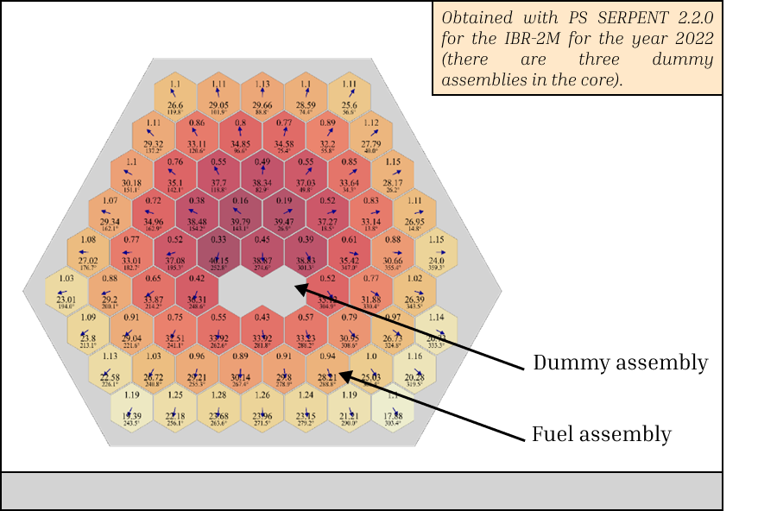
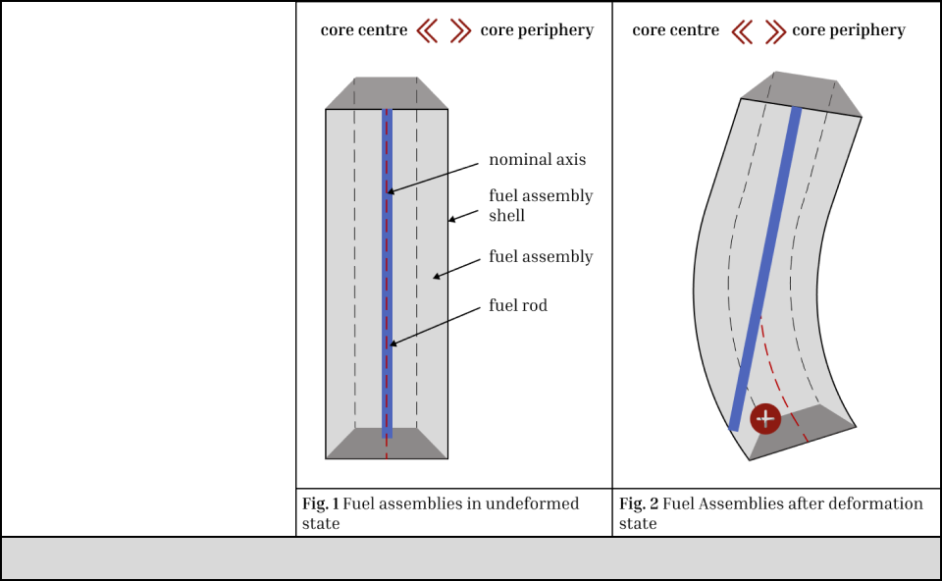

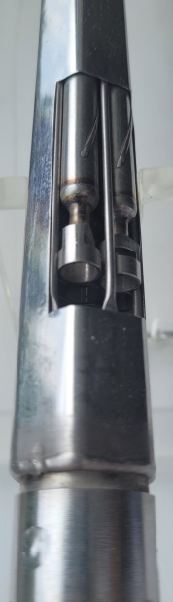
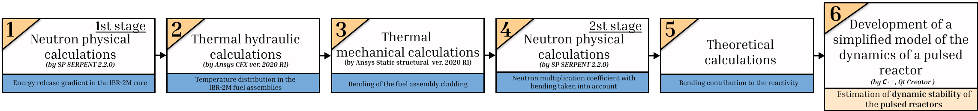
Evaluation of dynamic stability of pulsed reactors (IBR-2 example)
Energy release gradient in the IBR-2M core
Fuel element dynamic bending and its influence on reactivity effects
Notes:
Понимание процессов внутри реактора является ключевым моментом в разработке нового перспективного источника нейтронов в ОИЯИ т.к. позволяет определить границы устойчивости установки. Сегодня разрабатывается упрощенная модель, описывающая влияние изгиба ТВС на устойчивость пульсирующего реактора. Модель включает в себя три крупных блока расчетов: нейтронно-физические, теплогидравлические и термомеханические расчёты. На слайде приведены примеры таких расчетов для действующего пульсирующего реактора ИБР-2М.
Блок 1. Нейтронно-физические расчеты. Этап 1. Для реактора ИБР-2М была построена модель активной зоны с использованием программного комплекса SERPENT 2.2.0. В ходе расчёта проводилась симуляция работы реактора с учётом выгорания и последовательной замены имитаторов (dummy assembly) на топливные композиции в период с 2011 по 2022 годы. На слайде представлено полученное распределение энерговыделения по активной зоне реактора ИБР-2М с конфигурацией на 2022 год.
Блок 2. Теплогидравлические расчеты. На основе данных, полученных в блоке 1, был проведён стационарный расчёт для упрощённой модели ТВС, с использованием модуля SFX программного комплекса ANSYS. Упрощение модели касается ряда геометрических параметров: не учитываются концевики ТВС, упрощается форма стенок ТВС, представляющих собой шестигранник по всей длине. Модель включает вытеснители, а твэлы располагаются в соответствии с конструкцией, учитывается навивка. Твэлы имеют жесткое закрепление по всей поверхности (смещения и вращения запрещены). В ходе расчета было получено поле температур.
Блок 3. Термомеханические расчеты. На основе температурного поля (блок 2) был выполнен термомеханический расчёт деформации оболочки ТВС. Следует отметить, что смещение оболочки в модели описывает только частичный вклад в смещение всей ТВС, поскольку слишком плотная компоновка топлива препятствует значительному изгибу, оставляя только стационарный изгиб. В правой части слайда представлено упрощённое изображение ТВС, а также его деформации при изгибе. Как видно на изображении, изгиб ТВС приводит к появлению положительного эффекта реактивности.
Блок 4. Нейтронно-физические расчеты. Этап 2. При помощи ПК SERPENT создана новая модель, учитывающая изгиб ТВС (блок 3), и рассчитан эффективный коэффициент размножения нейтронов.
Блок 5. Теоретический расчет. Далее при помощи теоретических формул (с использованием данных, полученных в блоке 4), было рассчитано влияние изгиба на реактивность.
Блок 6. Разработка модели расчета динамики пульсирующего реактора. В данный момент ведется разработка программного средства, которое учитывает полученные результаты Блоков 1-5 и позволяет давать быструю оценку устойчивости реактора.
На сегодняшний день, расчёты показали, что деформация ТВС порядка 0.1 мм может оказывать значительное влияние на реактивность реактора, что является важным фактором при оценке его устойчивости и должно учитываться при разработке нового источника нейтронов.

Slide 14
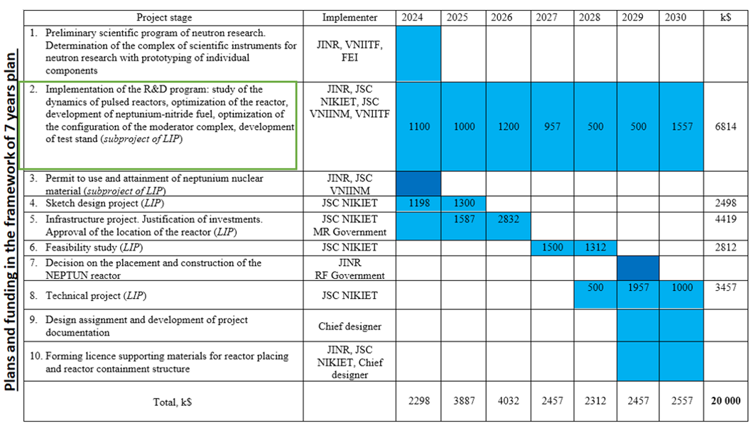
Should be postponed
Plans the framework of 7-years plan
it is not possible to speed up
The longest possible operation of IBR-2 comes to the fore.

Slide 15
Scientific program developing
International Workshop “Advanced Ideas and Experiments for DNS-IV”
(December 6 – 7, 2018, Dubna)
International Working Scientific Group working in 2018-2019
Two working groups (on the scientific program and instruments) are working at FLNP in 2022-2024
A number of seminars were organized by these groups
To summarize this work, we are going to publish 3 books:
Volume 1 “Directions of scientific research on the advanced pulsed neutron source at FLNP JINR”
Volume 2 “Technical parameters of the source and methods of conducting research on extracted beams”
Volume 3 “Concepts of instruments for conducting research on extracted beams”
Volume 1 is ready in Russian (163 p.).
We are going to present the English translated text at one of the next PAC meetings.

Slide 16


Plans for the near future:
Continue the theoretical study of the effect of bending of fuel rods and fuel assemblies on the stability of a pulsed reactor.
Consider the possibility of experimental testing of the developed models using model fuel rods/fuel assemblies on an experimental stand and using experimental data obtained during the exploitation of IBR-2.
Continue comparative analysis and search for optimal geometries for cold moderators made from various substances (work has been started, but not yet completed).
Reconsideration of other source concepts, taking into account developed models of the core behavior and the current level of technology.

Slide 17
Conclusions:
It is necessary to ensure maximum long-term and reliable operation of IBR-2. To this end, work has begun with the goal of obtaining a new fuel load for the reactor by 2028.
It is necessary to develop mathematical models that describe the processes leading to fluctuations in the reactor pulse energy. It is necessary to try to verify these models based on the experience of IBR-2 exploitation.
We will continue to work on developing the scientific program for the new reactor, now focusing on selecting priority techniques and moderators.
Work on developing the concept of the system for quickly changing the working substance for the cold moderator will continue.
It is necessary to reconsider other concepts of the source, taking into account developed models of reactor behavior and the current level of technology.

Slide 18
Thank you for attention

Slide 19
SEQUENCE AND CONTENT OF WORK IN PREPARING A DECISION ON THE LOCATING AND CONSTRUCTION OF A RESEARCH NUCLEAR REACTOR
(The plan was prepared taking into account the Decree of the Government of the Russian Federation of March 14, 1997 N 306 “On the Rules for Making Decisions on the Location and Construction of Nuclear Installations, Radiation Sources and Storage Facilities” (As amended by the Decree of the Government of the Russian Federation of 01.02.2005 N 49))
№ | Event | Performer | Deadline | Notes
1 | Preparation of a letter of intent and it submission to the Rosatom State Corporation and the Government of the Moscow Region | JINR | 2028 | The letter contains information about the goals, sources and investment opportunities, location options, construction and commissioning periods of the facility, technical and economic indicators, nuclear, radiation and environmental safety of the facility. This information will be prepared as a result of the development of the sketch design project of the reactor in 2027-2028.
2 | Development of investment justification | JINR or third-party organizations under agreements with JINR | 2028-2029 | The development of an investment justification is carried out on the basis of a positive decision on the letter of intent.
3 | Sending of investment justification to: - the Government of the Moscow Region for registration and approval selecting a land in accordance with Russian Federation law- the State Corporation Rosatom, the Ministry of Science and Higher Education, the Ministry of Natural Resources, the Ministry of Emergency Situations, the FMBA for examinations and preparing relevant conclusions | JINR | 2029 | The justification for investment includes approval documents, a decision on the preliminary location of the facility, the necessary infrastructure, as well as its sanitary protection zone.
4 | Investment justification approval | JINR | 2029-2030 | Investment justification based on the conclusions of state examinations asenvironmental, conclusions of the relevant federal authorities (Rosatom State Corporation, Ministry of Science and Higher Education, Ministry of Natural Resources, Ministry of Emergency Situations, FMBA) and the decision of the Moscow Region Government to approve the location of the facility. Investment justification materials can be used by the customer to conduct sociological research, public opinion polls on the possibility of constructing a facility, developing a business plan that provides confirmation to the lender or organization of the loan guarantee, solvency and financial stability of the enterprise in terms of the investor’s ability to fulfill its obligations.
5 | Development of a feasibility study (FS) | JINR and/or third-party organizations under agreements with JINR | 2030-2032 | The feasibility study is the main design document necessary for the location and construction of the facility. The feasibility study undergoes the necessary approvals, state examinations, including environmental, and is approved by the relevant federal executive body.
6 | Preparing an application to include the object to the federal program | State Corporation Rosatom (Government of the Russian Federation*) | 2032 | It is needed when constructing facilities using budget funds. It based on approved investment justifications or feasibility studies. * The decision on the location and construction of federal facilities not included in federal programs is made by the Government of the Russian Federation on the basis of a proposal from a federal executive body or an executive body of a constituent entity of the Russian Federation.
7 | Obtaining a license from Rostekhnadzor for the placement and construction of the facility | JINR | 2033-2034 | A license for the placement and construction of a facility is issued by Rostechnadzor at the request of the operating organization based on a review of the materials developed in the feasibility study.
8 | Begining of construction of the facility | JINR | 2034-2035

Slide 20
The time interval from completion of the sketch design project to the start of construction of the facility cannot be less than seven years, taking into account the necessary administrative steps, examination of documents and required approvals.
Thus, even if the preliminary design is completed in 2026-2027, construction may begin no earlier than 2034. Unfortunately, we cannot fall out of the global trend of increasing the time required for the creation of modern advanced neutron sources.
Meeting the deadlines is only possible if the interaction with Rosatom enterprises on this task changes significantly. Rosatom should become one of the investors.

