Slide 2

Distributed Heterogeneous Computing Infrastructure for NICA Data Processing
Igor Pelevanyuk
Researcher
21 May 2024

Slide 3
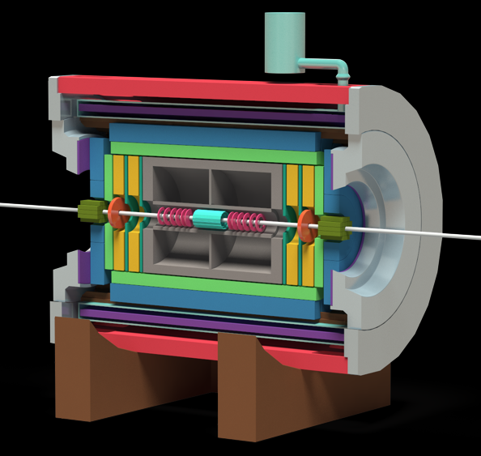
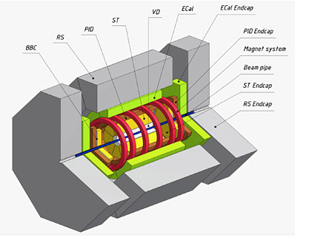



NICA experiments
Running
MC generation, Analysis,
Raw data processing
December 2025
MC generation, Analysis
~ 2028
MC generation, Analysis

Slide 4
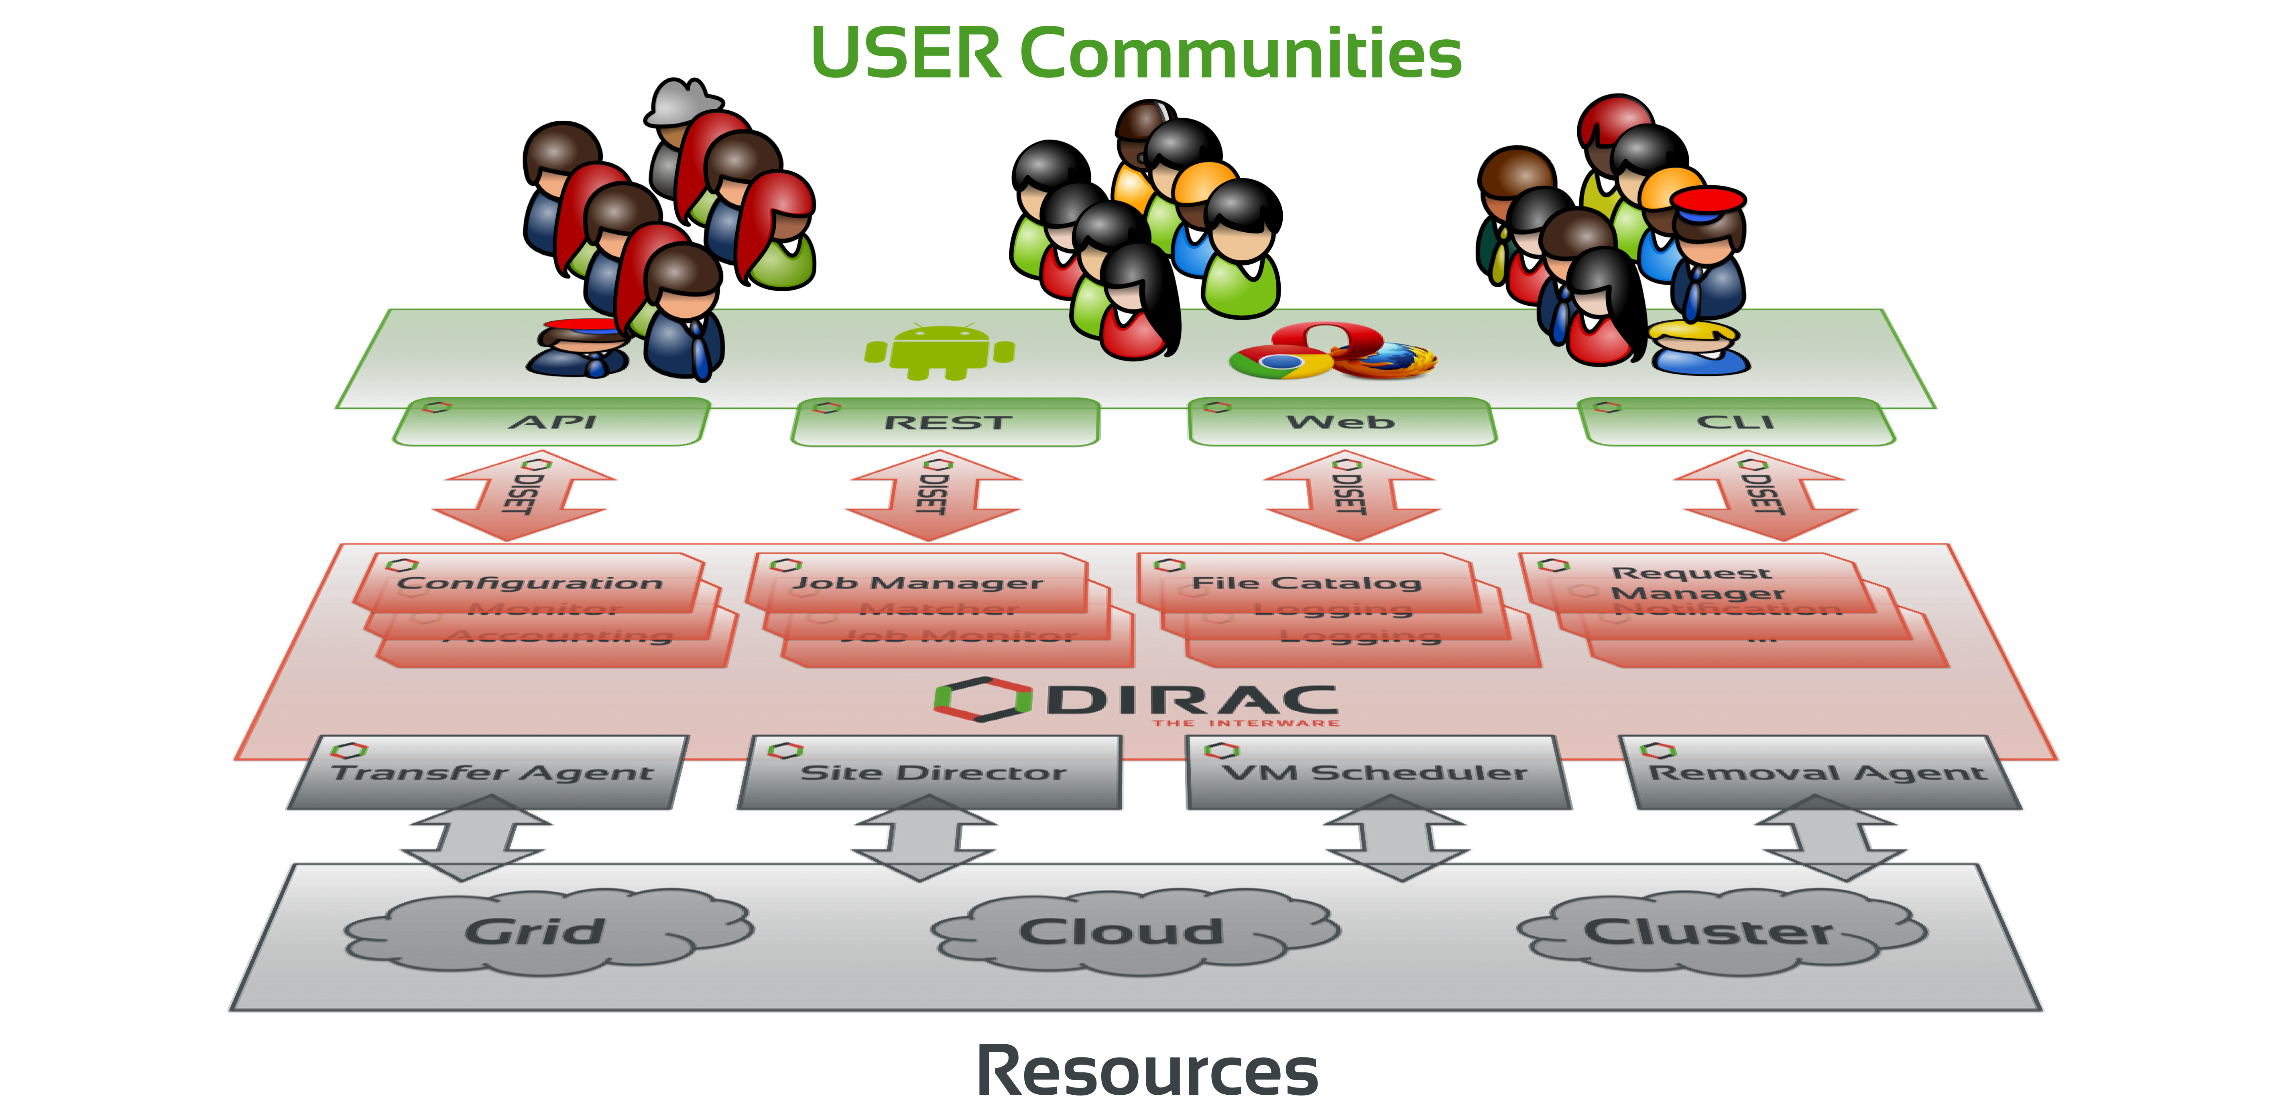
What is DIRAC?
DIRAC Interware was chosen as a platform for building distributed computing infrastructure.
DIRAC provides all the necessary components to build ad-hoc grid infrastructures interconnecting computing resources of different types, allowing interoperability and simplifying interfaces. This allows to speak about the DIRAC interware.
Web
CLI
API
REST

Slide 5

Why DIRAC?
1. Single system for all aspects of computing
User Interface
API
Central configuration
Workload management
Data management
Integration tools
File Catalog
Workflow management
Metadata management
Accounting
Management

Slide 6
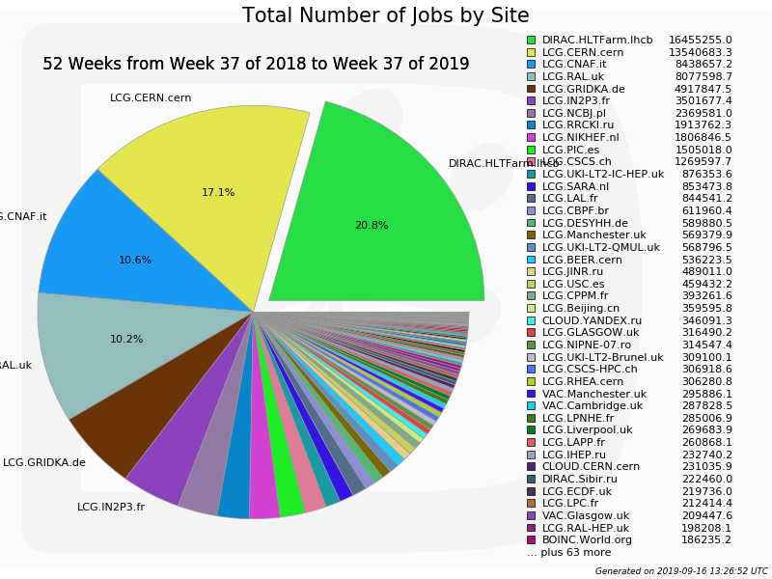
Why DIRAC?
2. Good performance

Slide 7
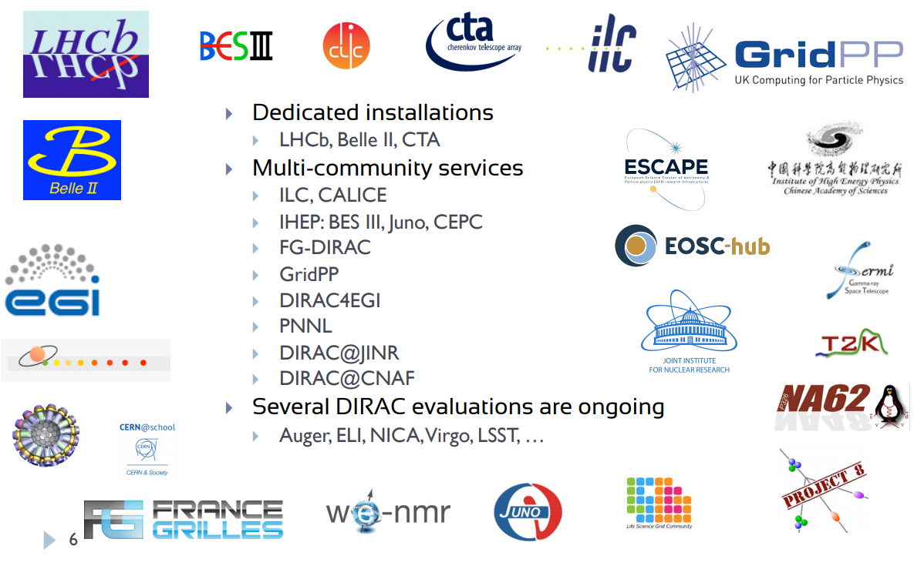
Why DIRAC?
3. Active users and developers community

Slide 8


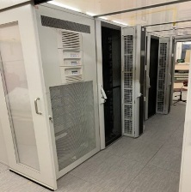




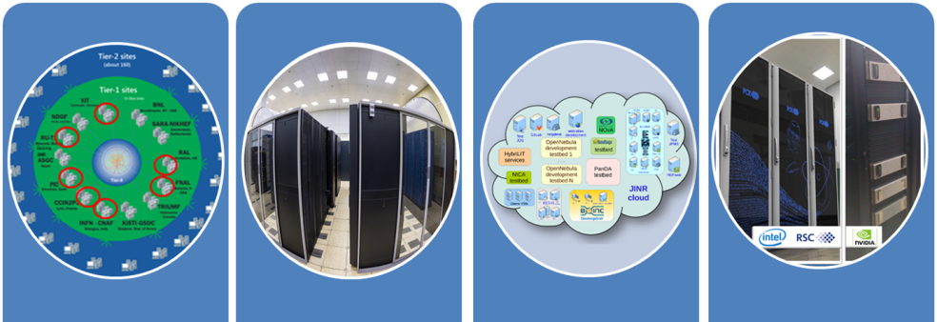

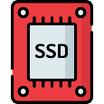














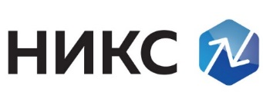
What was done in JINR
LHEP resources
MLIT MICC basic facility
DDC cluster
NICA cluster
MLIT EOS
DAQ computing
farm
MLIT CTA
Other/Collaboration resources
JINR Cloud
Tier-1
Tier-2
Govorun
UNAM
MEPHI
Lustre
Ultra-fast storage
Clouds
INP
MSC
Polytech
IMDT
NOSU
ASRT
IPANAS
PRUE
INP
SU
INRNE
INP

Slide 9
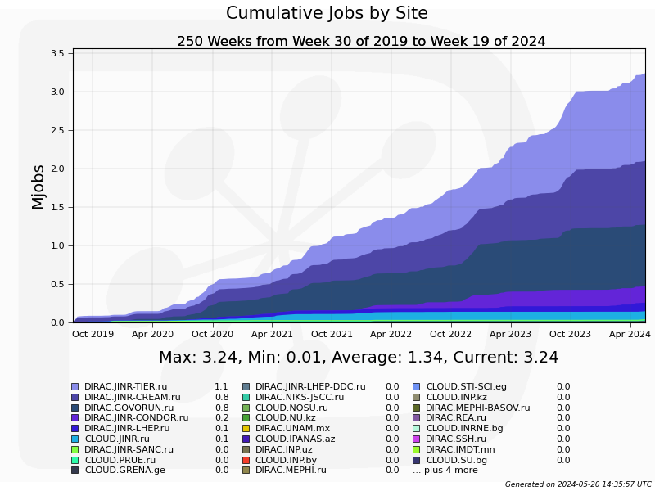
DIRAC@JINR Jobs Total
3 million jobs
Tier1
May 2021
Tier2
Govorun
JINR Cloud (Condor)

Slide 10
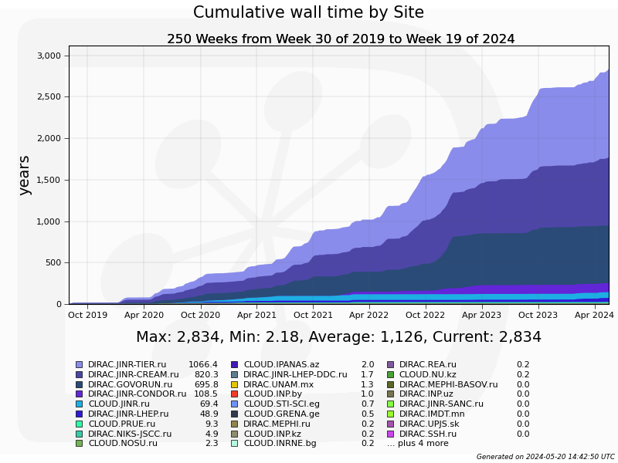
DIRAC@JINR Wall time
2834 years
3.25 M jobs
Each lasts ~ 7.6 hours
Tier1
Tier2
May 2021
Govorun

Slide 11
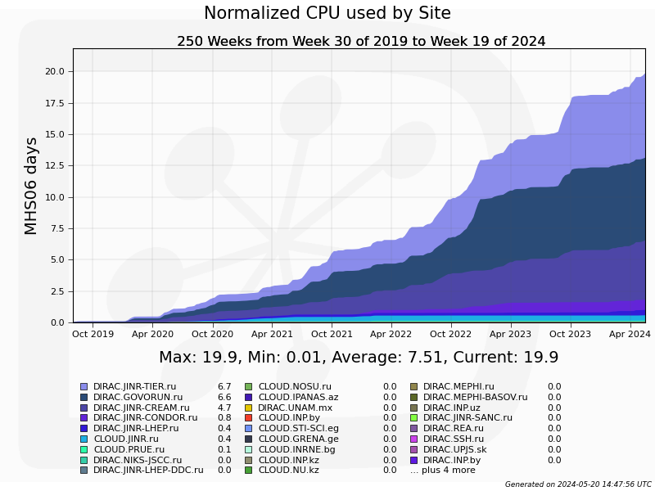
DIRAC@JINR Normalized time
Tier1
Govorun
May 2021
Tier2

Slide 12
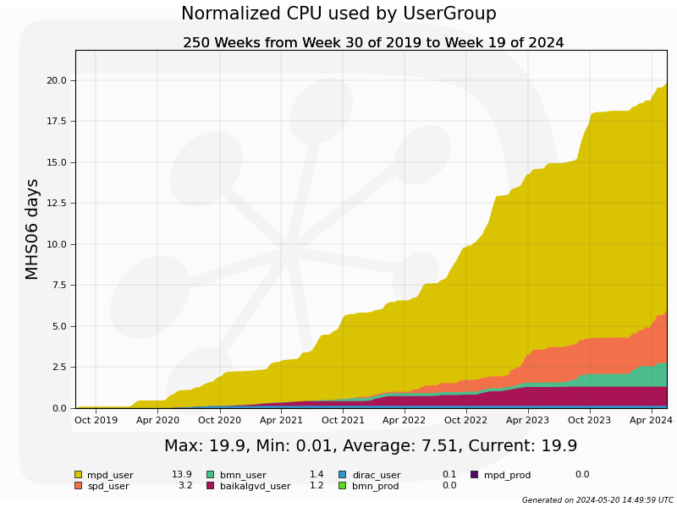
Experiments on DIRAC@JINR
May 2021

Slide 13
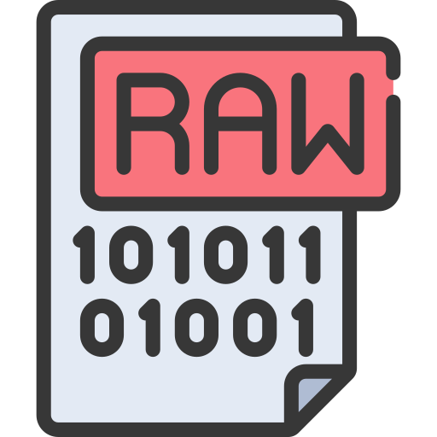

BM@N Workflow
RawToDigi
DigiToDst
~30000 Files
400 TB
DIGI
~30000 Files
60 TB
DST
~30000 Files
30 TB
For the first time JINR computing infrastructure united by DIRAC was used for raw data reconstruction not in test mode but in production.

Slide 14
Automatization
and
Tools

Slide 15
Questions that we always ask
How 100k jobs executes on heterogeneous distributed computing infrastructure?
Are we efficient?
If not, is network is responsible for inefficiency?
If it is not the network, what is the profile of the user job?
Having the information about jobs’ profile, network throughput and characteristics of the resources, can we guess how the workload will be executed?

Slide 16
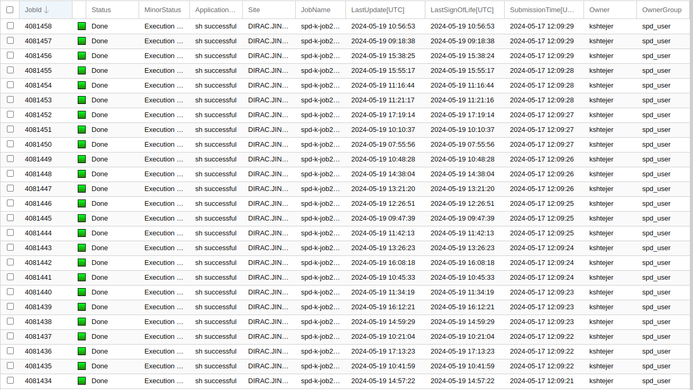
How we usually see jobs

Slide 17
Individual CPU core performance study
Centralized job management gives possibility for centralized and unified performance study of different computing resources.
Before running user jobs DIRAC Pilots execute benchmark for CPU core they are running on.
Benchmark is DiracBenchmark2012 or DB12. It evaluate just CPU core performance. Disk I/O, RAM speed, Network, CPU caches and other highly important aspects of performance are neglected by DB12.

Slide 18
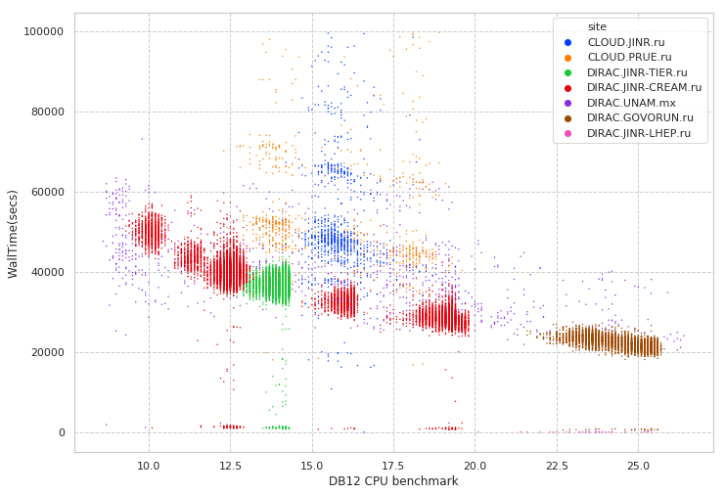
Performance evaluation in distributed infrastructures
Folding@Home
Job execution time (sec)
MPD MC
Errors during execution
Immediate errors or short jobs
DB12 Benchmark of a core on which jobs was executed

Slide 19
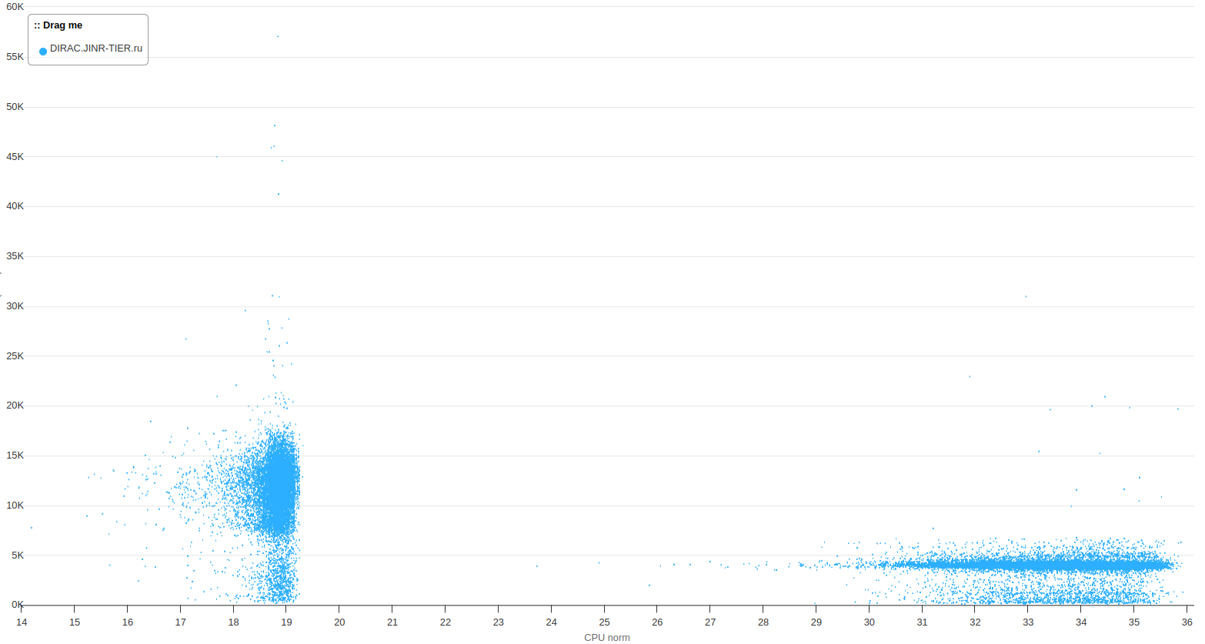
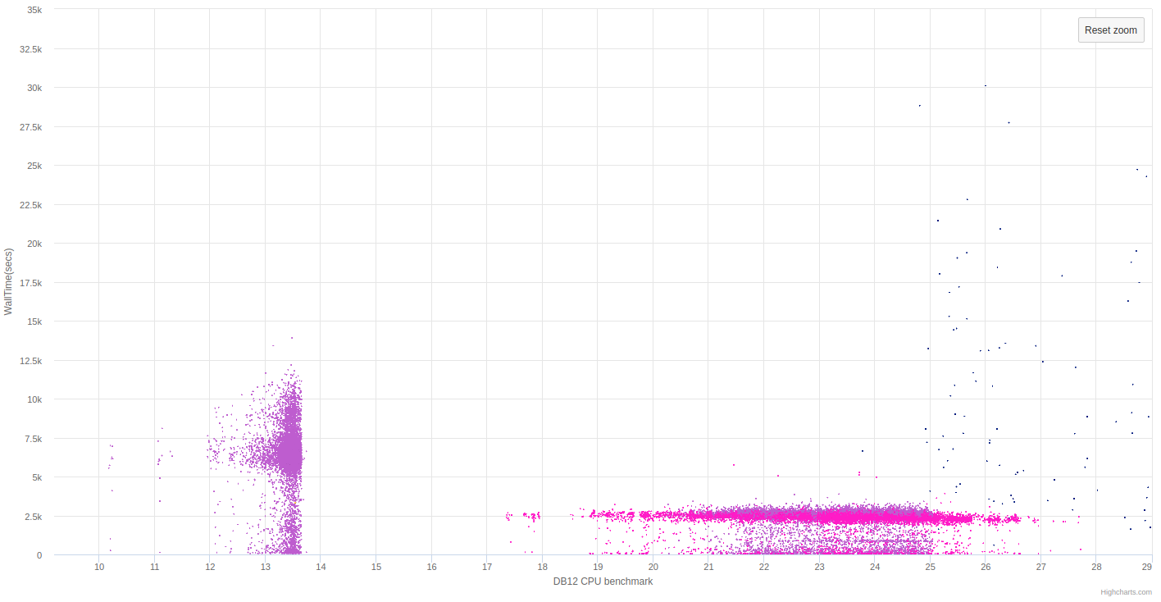
Comparison of production campaigns
We noticed that average Raw2Digi calculation time increased by 60%
(2500 -> 4000 seconds)
Web application for visualization of proposed method is mostly done by Anna Ilina

Slide 20
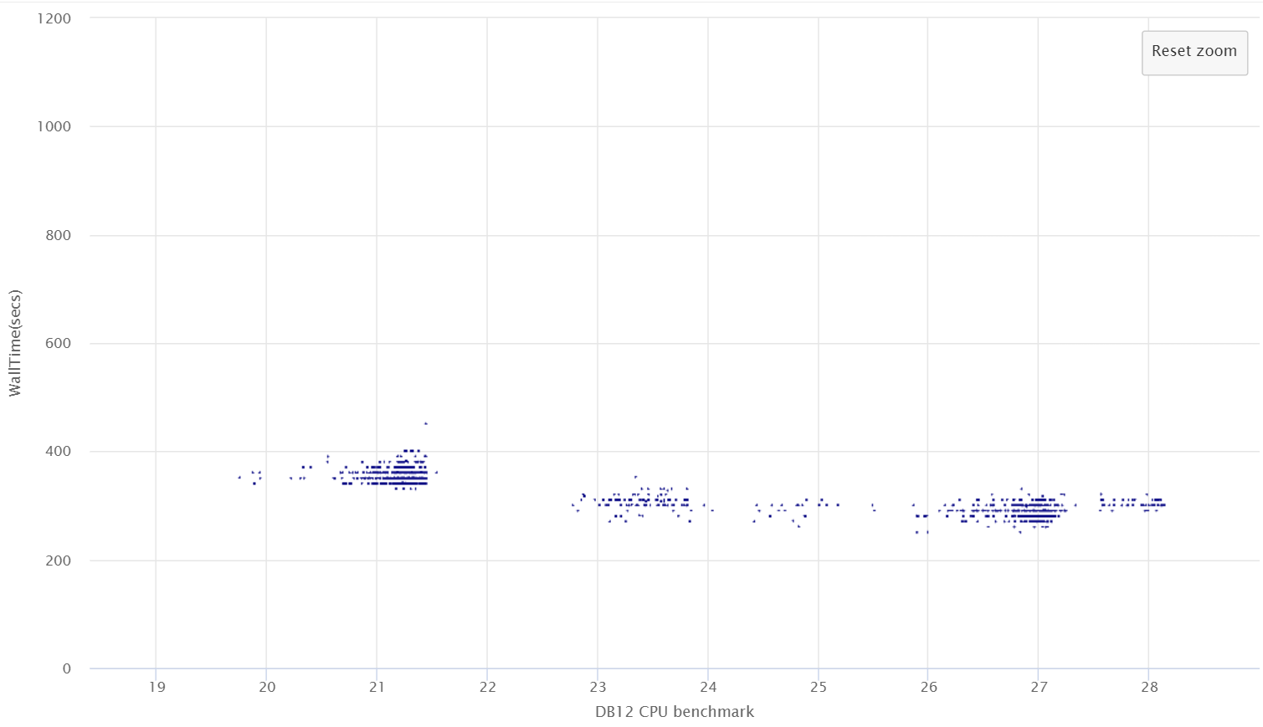
Testing configurations
Testing different CPU frequency settings on Govorun
Fixed in BIOS
Fixed on OS level
BIOS max performance
April 25, 2024
20

Slide 21
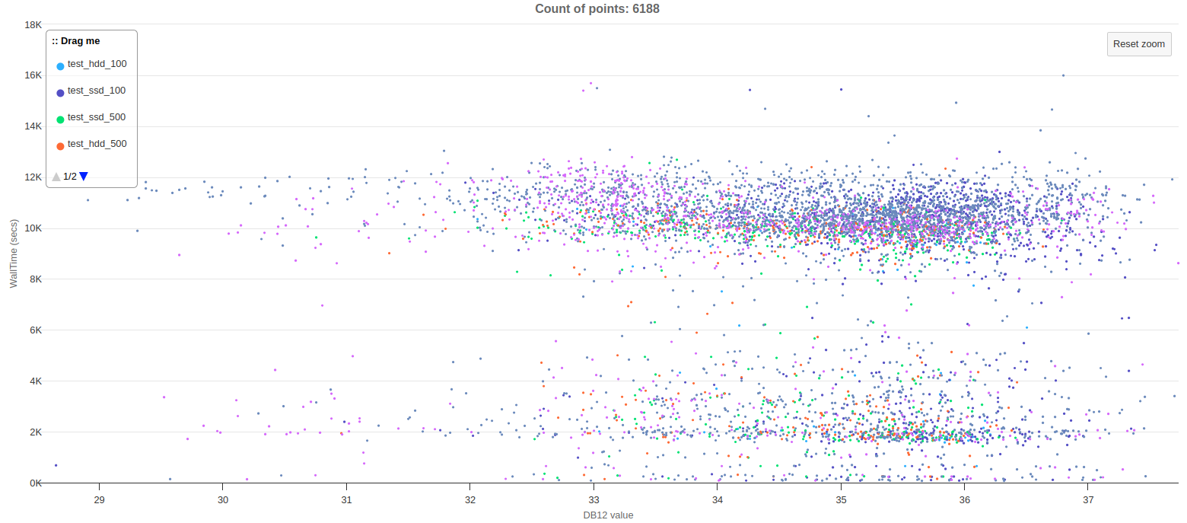
Testing DDC cluster
Testing DDC cluster with different amount of simultaneously running jobs on SSD storage and HDD storage.
Tests were performed with real BM@N DigiToDst jobs
So, we learnt that the difference between 1000 jobs running on HDD and 100 jobs running on SSD is negligible.

Slide 22
BM@N issue with RawToDigi jobs
Duration of a job
Each point is a job with particular duration on a core with particular perfomance the benchmark
Tier1 old cores
Expected job duration
Govorun
Tier1 new cores
and NICA cluster
CPU core performance on benchmarks

Slide 23
Individual job monitoring
Monitoring Database
job_monitoring
root RecoData.C(“input.raw”, ….)
Every 30 seconds for a process and its children check and submit to DB:
CPU usage (0-100%)
RAM usage (GB)
Disk write bytes since start of execution (GB)
Disk read bytes since start of execution (GB)
This information is connected to DIRAC Job ID

Slide 24
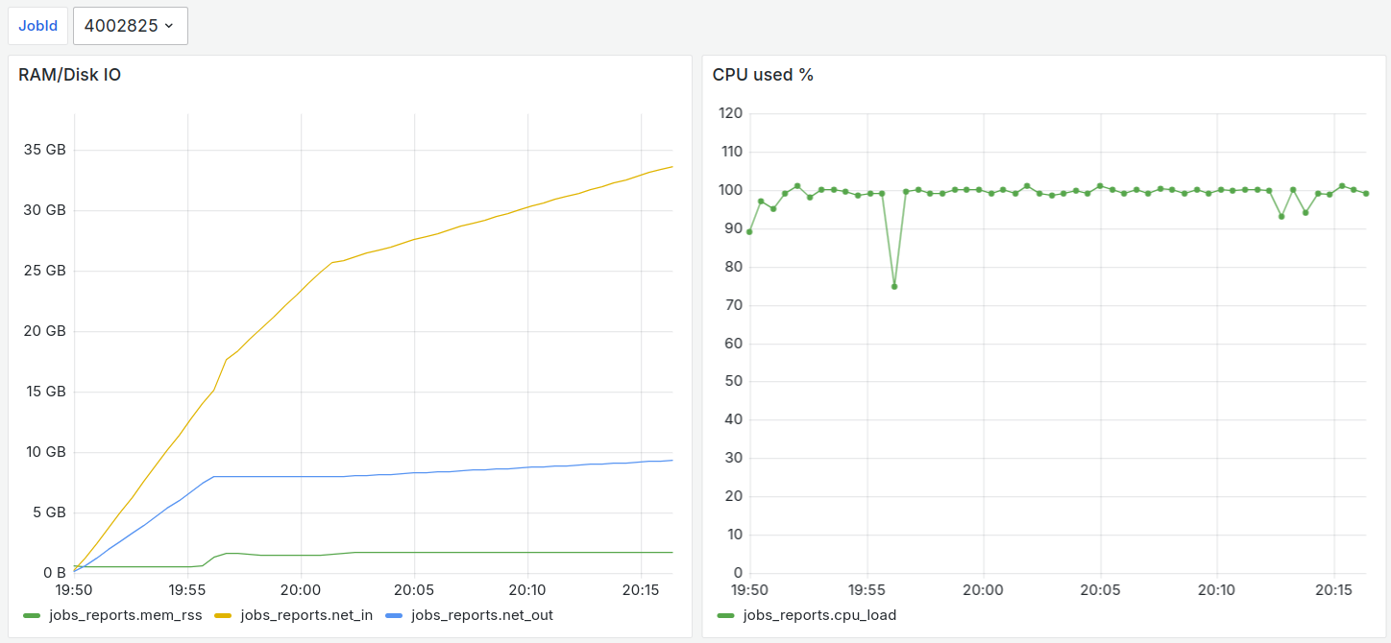
BM@N investigation: normal jobs
So, we learnt that BM@N RawToDigi jobs during processing of 15 GB raw file generate additional 7 GB temporary file and 1 GB resulting Digi file.
During execution the job reads in total ~35 GB from disk.

Slide 25
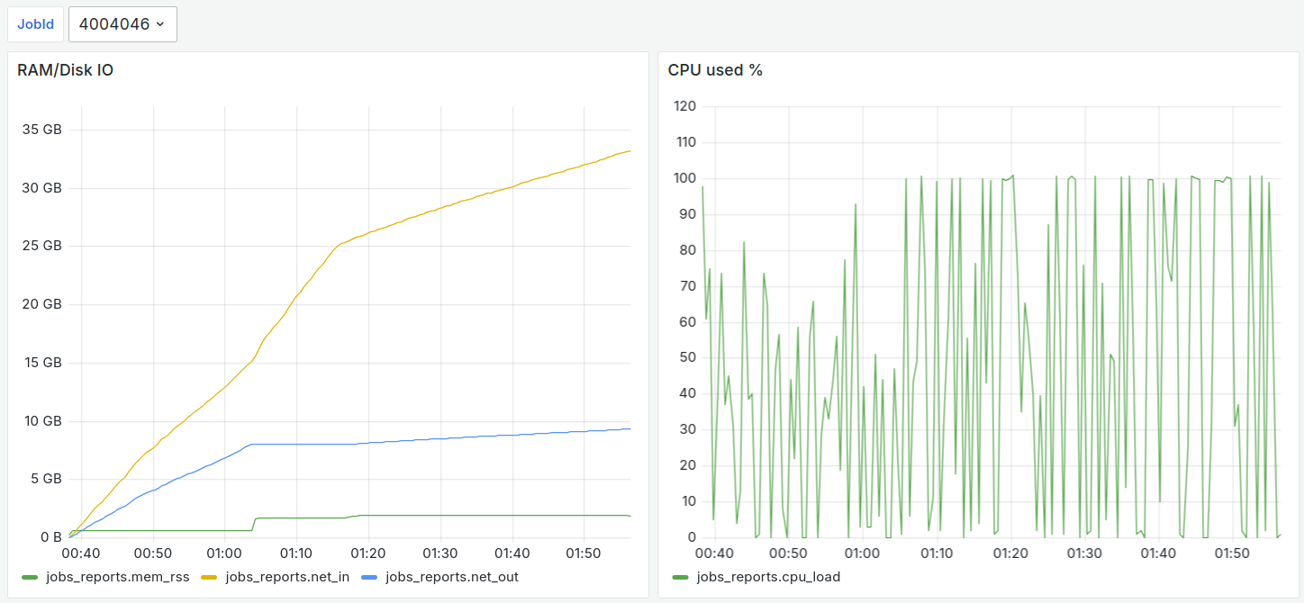
BM@N investigation: slow jobs

Slide 26
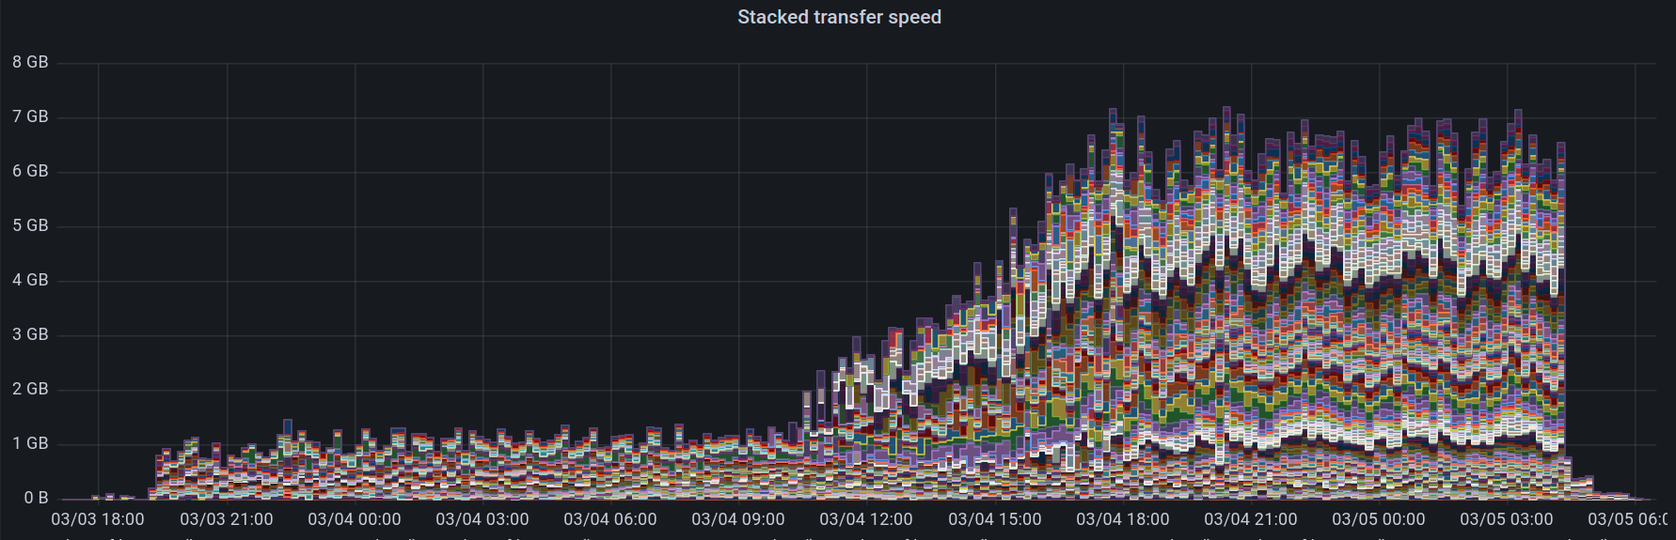
Data transfers monitoring
Monitoring Database
jinr-get-file
jinr-add-file
dirac-dms-get-file
dirac-dms-add-file
Storage

Slide 27
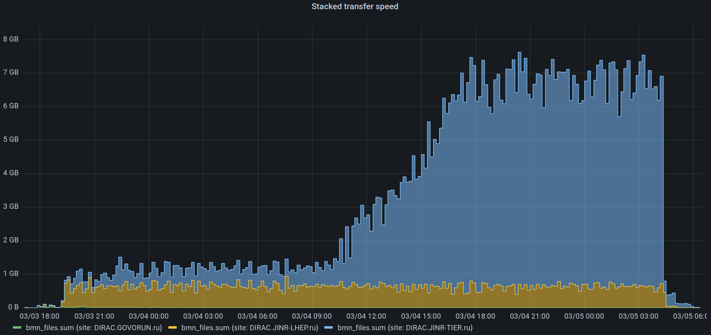
Data transfers monitoring
300 jobs running
4 MB/s per job
NICA Cluster
Tier1
1580 jobs running
4.1 MB/s per job
Maximal transfer speed (Read+Write) with EOS in MLIT – 7.5 GB/s

Slide 28
Simulation of job execution
JobQueue
Monitoring
Written in python to predict CPU, RAM, network and disk load
Uses data about performance of resources integrated in DIRAC
It is used to check the behavior of DIRAC jobs in our infrastructure.
Simulation is done every second, but period may be increased for speeding up simulation.
InfluxDB is used for storage.
Grafana is used for visualization.
Controller
Storage
Cluster
Worknode
Job
Task

Slide 29
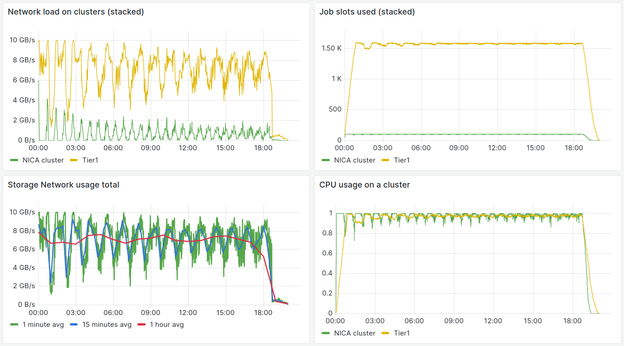
BM@N RawToDigi simulation
Standard schema of resources. Tier1 – 1500, pilot submission – 30/m

Slide 30
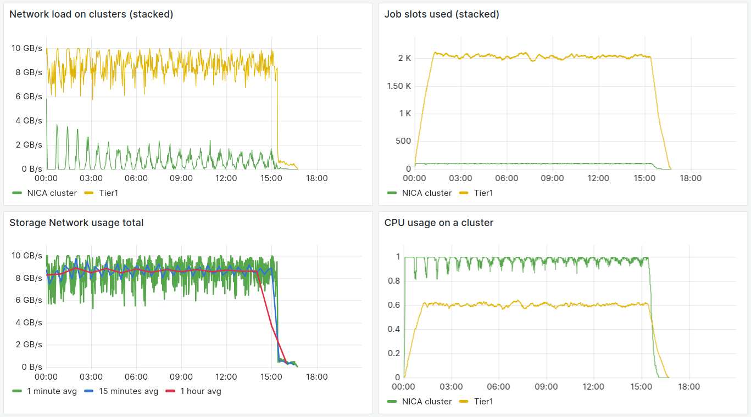
BM@N RawToDigi simulation
Tier1 3000 cores, pilot submission – 30/m

Slide 31
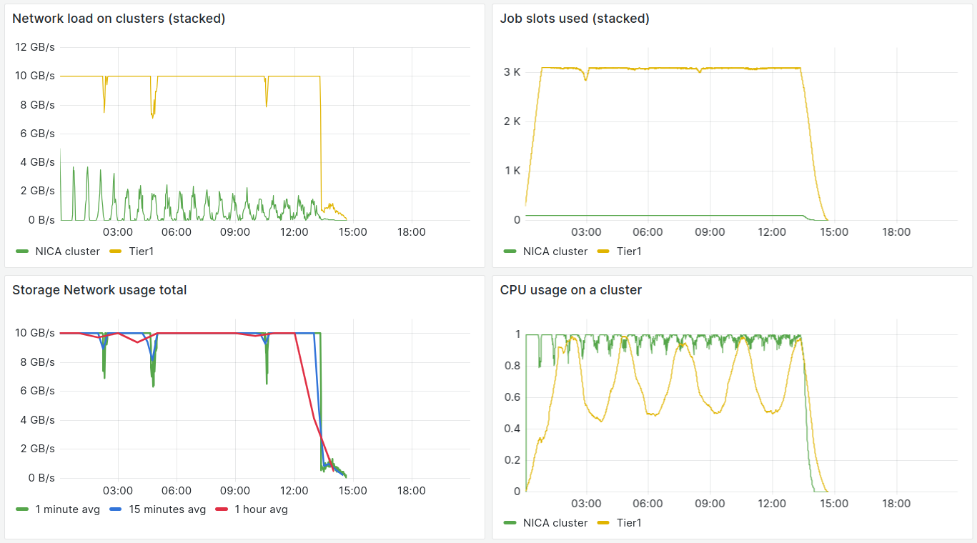
BM@N RawToDigi simulation
Tier1 3000 cores, pilot submission – 60/m

Slide 32
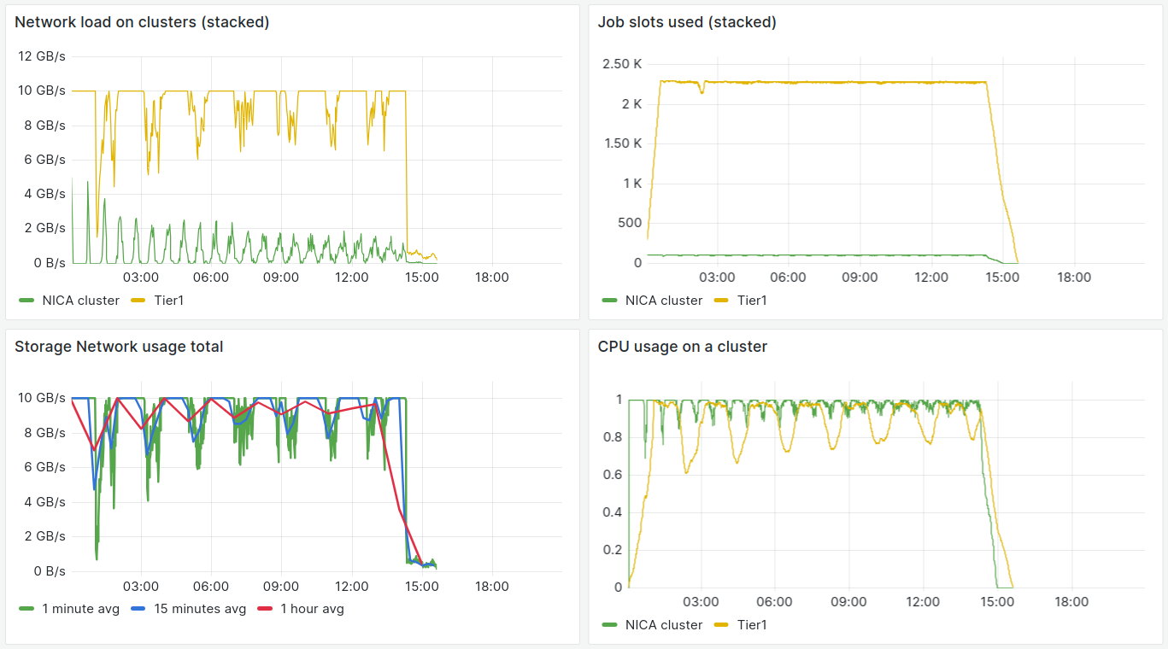
BM@N RawToDigi simulation
Tier1 optimal: ~2200 cores, pilot submission – 60/m

Slide 33
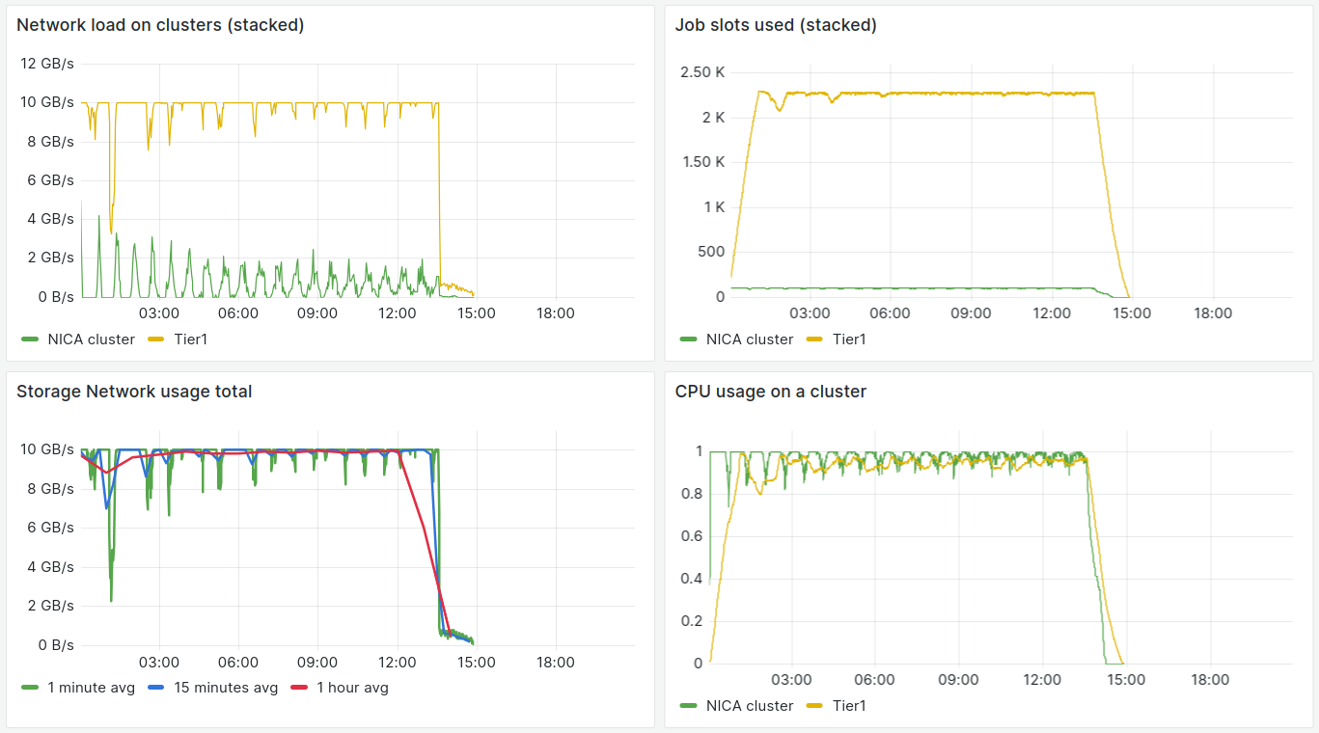
BM@N RawToDigi simulation
Tier1 optimal: ~2200 cores, pilot submission – 37/m

Slide 34
Other work related to distributed infrastructure

Slide 35
2023 Summer EOS failure
Failed files vs failed bytes
 | Файлы | GBs
Всего | 1401487 | 868
Испорчено | 218553 (15.6 %) | 301 (34 %)
DIRAC Jobs
MLIT
EOS
DIRAC
FileCatalog
File №1
3. Check checksum
File №1
1.Get file
2. File
File №1
Metadata:
status:ok
4. Set metadata
Metadata:
status:checksum
File №
1401487
File №
1401487

Slide 36
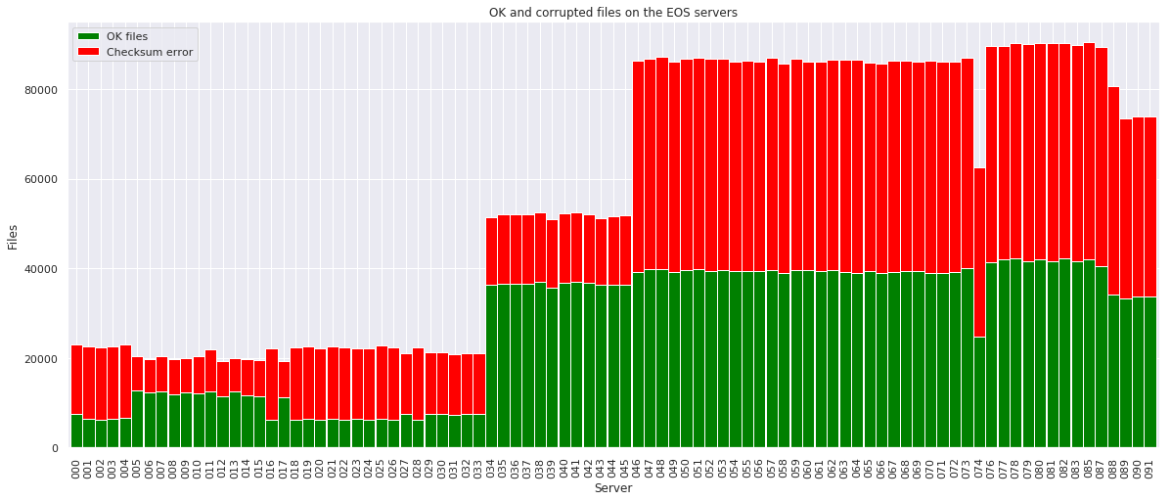
2023 Summer EOS failure
Broken files distribution among EOS servers
No clear evidence here of problems on a particular server. All servers looks equally filled with broken files.

Slide 37
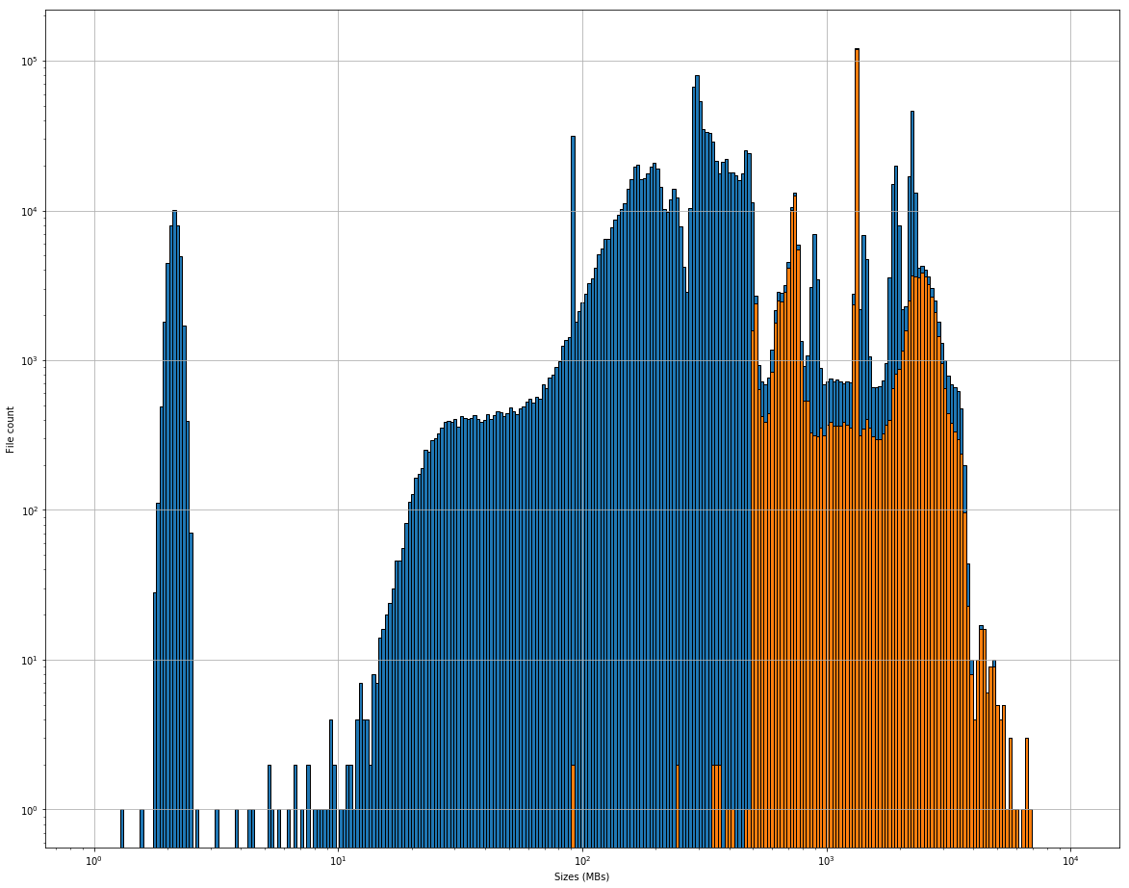
2023 Summer EOS failure
Broken files size
Amount of files,
logarithmic
<500 MB
>500 MB
File size,
logarithmic

Slide 38
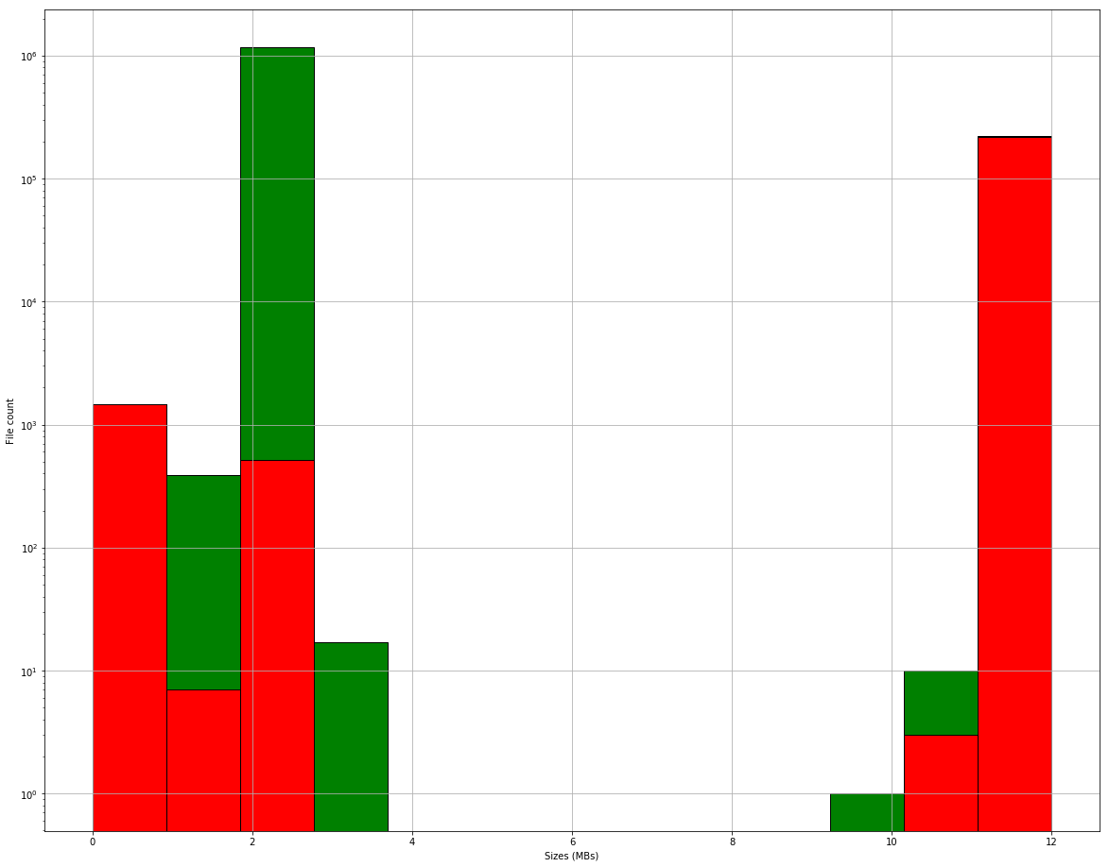
2023 Summer EOS failure
Amount of files,
logarithmic
All files with 12 replicas were broken
Amount of replicas

Slide 39
DIRAC: Igor Pelevanyk
MPD: Andrey Moshkin, Oleg Rogachevsky
BM@N: Konstantin Gertsenberger
SPD: Katherin Shtejer, Alexey Zhemchugov
Responsible for resources:
Tier-1,Tier-2, EOS: Valery Mitsyn
CTA Tape library: Vladimir Trofimov
Govorun: Oksana Streltsova, Dmitry Podgainy, Dmitry Belyakov, Aleksandr Kokorev, Maxim Zuev
NICA cluster: Ivan Slepov
DDC cluster: Ilia Slepnev
Network: Andrey Dolbilov
List of participants

Slide 40
Summary
Distributed Heterogeneous Computing Infrastructure build with DIRAC Interware is actively used by all NICA experiments: MPD, SPD and BMN.
Since 2019 August 3.24 million jobs were successfully executed. Their execution on a single core would take 2834 years.
Several tools were developed to improve our understanding of the behavior of built distributed heterogeneous computing infrastructure.
The use of DIRAC allowed investigation of the reason of summer EOS failure.

Slide 41
Publications and talks
There are 44 different publications. Full list may be seen on pin.jinr.ru or scopus.com.
37 of them indexed in Scopus. 15 of them published since 2021 (including).
More than 25 talks for since 2021 (including). 19 of them – were presented personally.

Slide 42
Scopus publications 1
Baginyan, A., Balandin, A., Balashov, N., Dolbilov, A., Gavrish, A., Golunov, A., Gromova, N., Kashunin, I., Korenkov, V., Kutovskiy, N., Mitsyn, V., Pelevanyuk, I., Podgainy, D., Streltsova, O., Strizh, T., Trofimov, V., Vorontsov, A., Voytishin, N., & Zuev, M. (2021). CURRENT STATUS of the MICC: AN OVERVIEW. CEUR Workshop Proceedings, 3041.
Kutovskiy, N., Pelevanyuk, I., & Zaborov, D. (2021). USING DISTRIBUTED CLOUDS for SCIENTIFIC COMPUTING. CEUR Workshop Proceedings, 3041.
Belov, S., Ilina, A., Javadzade, J., Kadochnikov, I., Korenkov, V., Pelevanyuk, I., Semenov, R., Tarabrin, V., & Zrelov, P. (2021). ANALYTICAL PLATFORM for SOCIO-ECONOMIC STUDIES. CEUR Workshop Proceedings, 3041.
Guskov, A., Akopov, N., Movsisyan, A., Shulyakovsky, R., Korjik, M. V., Lobko, A. S., Makarenko, V. V., Solin, A. A., Solin, A. V., Kuleshov, S., Zamora, J., Chen, L., Shi-Hai, J., Pei-Yu, L., Xiao-Mei, L., Jin-Xin, S., Hao, S., Peng-Fei, S., Yun-Yu, Z., … Sisakyan, A. N. (2021). Conceptual design of the Spin Physics Detector. In arXiv. https://doi.org/10.48550/arxiv.2102.00442
Balashov, N., Kuprikov, I., Kutovskiy, N., Makhalkin, A., Mazhitova, Y., Pelevanyuk, I., & Semenov, R. (2021). JINR DISTRIBUTED INFORMATION and COMPUTING ENVIRONMENT: PARTICIPANTS, FEATURES and CHALLENGES. CEUR Workshop Proceedings, 3041.
Moshkin, A., Pelevanyuk, I., & Rogachevskiy, O. (2021). DESIGN and DEVELOPMENT of APPLICATION SOFTWARE for the MPD DISTRIBUTED COMPUTING INFRASTRUCTURE. CEUR Workshop Proceedings, 3041.
Kutovskiy, N., Mitsyn, V., Moshkin, A., Pelevanyuk, I., Podgayny, D., Rogachevsky, O., Shchinov, B., Trofimov, V., & Tsaregorodtsev, A. (2021). Integration of Distributed Heterogeneous Computing Resources for the MPD Experiment with DIRAC Interware. Physics of Particles and Nuclei, 52(4). https://doi.org/10.1134/S1063779621040419
Pelevanyuk, I. (2021). Performance evaluation of computing resources with DIRAC interware. AIP Conference Proceedings, 2377. https://doi.org/10.1063/5.0064778

Slide 43
Scopus publications 2
Balashov, N. A., Kutovskiy, N. A., Makhalkin, A. N., Mazhitova, Y., Pelevanyuk, I. S., & Semenov, R. N. (2021). Distributed information and computing infrastructure of JINR member states’ organizations. AIP Conference Proceedings, 2377. https://doi.org/10.1063/5.0063809
Pelevanyuk, I., & Tsaregorodtsev, A. (2022). DIRAC Interware as a Service for High-Thoughput Computing in JINR. Physics of Particles and Nuclei Letters, 19(5). https://doi.org/10.1134/S1547477122050338
Belov, S. D., Filozova, I. A., Gavrilenko, Y. E., Ilina, A. V., Javadzade, J. N., Kadochnikov, I. S., Korenkov, V. V., Pelevanyuk, I. S., Priakhina, D. I., Semenov, R. N., Tarabrin, V. А., & Zrelov, P. V. (2022). Methods and algorithms of the analytical platform for analyzing the labor market and the compliance of the higher education system with market needs. Proceedings of Science, 429.
Korenkov, V., Pelevanyuk, I., & Tsaregorodtsev, A. (2023). DIRAC at JINR as a general purpose system for massive computations. Journal of Physics: Conference Series, 2438(1). https://doi.org/10.1088/1742-6596/2438/1/012029
Afanasiev, S., Agakishiev, G., Aleksandrov, E., Aleksandrov, I., Alekseev, P., Alishina, K., Atkin, E., Aushev, T., Babkin, V., Balashov, N., Baranov, A., Baranov, A., Baranov, D., Baranova, N., Barbashina, N., Baznat, M., Bazylev, S., Belov, M., Blau, D., … Zuev, M. (2023). Production of π + and K+ mesons in argon-nucleus interactions at 3.2 A GeV. Journal of High Energy Physics, 2023(7). https://doi.org/10.1007/JHEP07(2023)174
Ilina, A. V., & Pelevanyuk, I. S. (2023). System for Planning and Logging Excursions at JINR. Physics of Particles and Nuclei Letters, 20(5). https://doi.org/10.1134/S1547477123050382
Pelevanyuk, I. S., & Campis, D. (2023). Simulation of Job Execution in Distributed Heterogeneous Computing Infrastructures. Physics of Particles and Nuclei Letters, 20(5). https://doi.org/10.1134/S1547477123050618

Slide 44
Talks 1
ПКК по частицам (постер) – Distributed heterogeneous computing infrastructure for the MPD experiment, I. Pelevanyuk et al.
AYSS Alushta 2023 –BM@N Run 8 raw data production on distributed infrastructure with DIRAC, I. Pelevanyuk et al.
GRID 2023 – BM@N Run 8 data reconstruction on a distributed infrastructure with DIRAC, I. Pelevanyuk et al.
GRID 2023 – Automated Analysis and Monitoring of Scientific HTC Jobs on Distributed Heterogeneous Computing Resources, Anna Ilina I. Pelevanyuk
GRID 2023 – JINR grid infrastructure: status and plans, Tatiana Strizh, I. Pelevanyuk et al.
GRID 2023 – Changes and challenges at the JINR and its Member states cloud infrastructures, Nikolay Kutovskiy, I. Pelevanyuk et al.
AYSS 2023 Conference – BM@N Run 8 data production on a distributed infrastructure with DIRAC, I. Pelevanyuk et al.
DIRAC/Rucio Users’ Workshop 2023 – DIRAC@JINR, I. Pelevanyuk
MPD 12th Collaboration Meeting – DIRAC based MPD mass production and its automatization, I. Pelevanyuk et al.
BM@N 11th Collaboration Meeting – BM@N distributed computing status and analytic, I. Pelevanyuk et al.
Analysis & Software Meeting of the BM@N Experiment – Status of BM@N Mass Data Production for Run 8 using DIRAC, I. Pelevanyuk et al.
BM@N 10th Collaboration Meeting – BM@N Mass Data Production on distributed infrastructure for Run 8 using DIRAC, I. Pelevanyuk et al.
AYSS 2022, Dubna, Simulation of job execution in distributed heterogeneous computing infrastructures, I. Pelevanyuk

Slide 45
Talks 2
AYSS 2022, Dubna, System for planning and logging excursions at JINR, A. Ilina, I. Pelevanyuk
DIRAC Users Workshop 2022, DIRAC@JINR, I.Pelevanyuk, A.Tsaregorodtsev
BM@N collaboration meeting 2022, BM@N mass data production on the distributed computing infrastructure with DIRAC, K. Gertsenberger, I. Pelevanyuk
DLCP 2022, Dubna, Analytical platform for intellectual labour market analysis, A. Ilina, I. Pelevanyuk et al.
ПаВТ 2022, Дубна, Опыт использования объединённой суперкомпьютерной инфраструктуры для генерации и реконструкции событий эксперимента MPD, А. Мошкин, И. Пелеванюк и др.
GRID 2021, Dubna, Design and development of application software for MPD distributed computing infrastructure, I. Pelevanyuk et al.
GRID 2021, Dubna, The use of distributed clouds for scientific computing, I. Pelevanyuk et al.
SCD 2021, Moscow, Approaches, services, and monitoring in a distributed heterogeneous computational environment for the MPD experiment, I. Pelevanyuk et al
WNSSC 2021, Sofia, Use of distributed resources from the performance perspective, I. Pelevanyuk
AYSS 2021, Almaty, DIRAC Interware as a service for high-thoughput computing in JINR, I. Pelevanyuk et al
DIRAC Users’ Workshop 2021, DIRAC@JINR, I.Pelevanyuk, A. Tsaregorodtsev
ITTMM 2021, RUDN, Estimating processors performance with HEP workload, I.Pelevanyuk

Slide 46
History of DIRAC at JINR
2013 – Development of monitoring system for BES-III installation. First tries to setup and configure DIRAC infrastructure.
2017 – DIRAC Interware installed; basic configuration done. Used for educational purposes. dCache storage integrated, Tier2 integrated.
2018 – HybriLIT integrated. JINR cloud integrated using OCCI protocol. Tests of full cycle of Monte-Carlo for BM@N were performed.
2019 – Clouds of JINR Member-States integrated by module developed in JINR. MPD starts using DIRAC for massive Monte-Carlo production. Tier1, Govorun and EOS integrated in DIRAC.
2020 – Folding@Home jobs submitted to clouds via DIRAC. Baikal-GVD jobs submitted to JINR and PRUE clouds.
2021 – First tests for SPD Monte-Carlo successfully done. First million jobs done!
2022– Total walltime exceeds 1000 years. DIRAC in JINR updated to use Python 3.
2023 – Full BM@N data processing for Run 8

