Slide 1
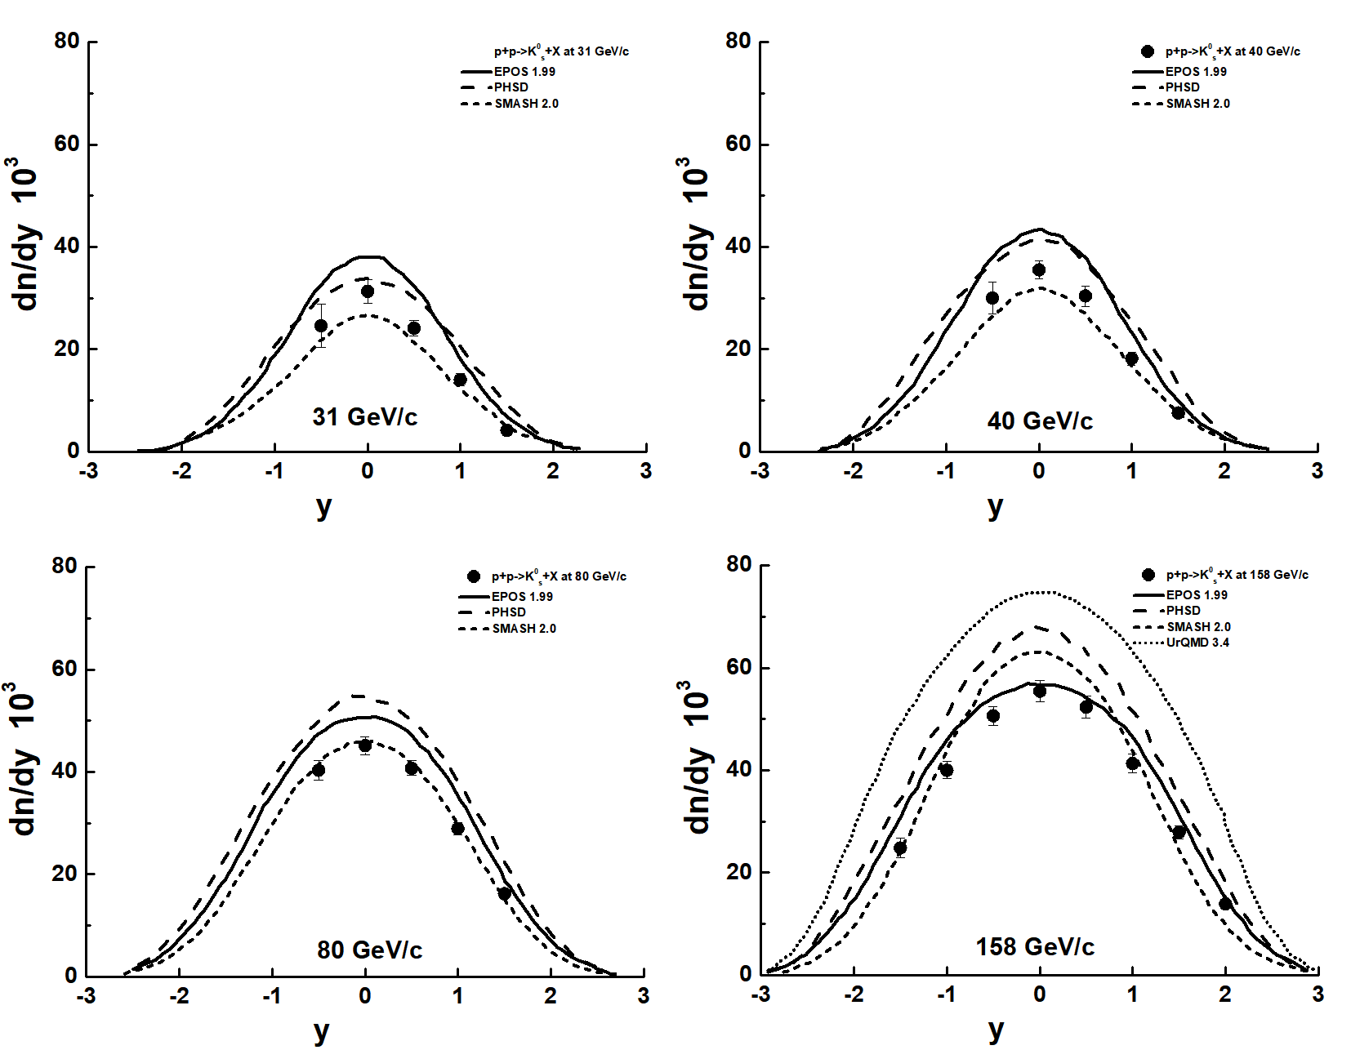
Transverse momentum correlations of K⁰_{s} meson production in hadronic interactions
A. Galoyan, A. Ribon, V. Uzhinsky 06.2024
NA61/SHINE Collaboration arXiv:2402.17025v1 [hep-ex] 26 Feb 2024
K0s meson production in inelastic p+p interactions at 31, 40 and 80 GeV/c beam momentum measured by NA61/SHINE at the CERN SPS
NA61/SHINE Collaboration (A. Acharya et al.), Eur. Phys. J/ C82 (2022)
SMASH is O.K at 80 GeV/c, EPOS O.K. at 158 GeV/c, PHSD - ???
1

Slide 2

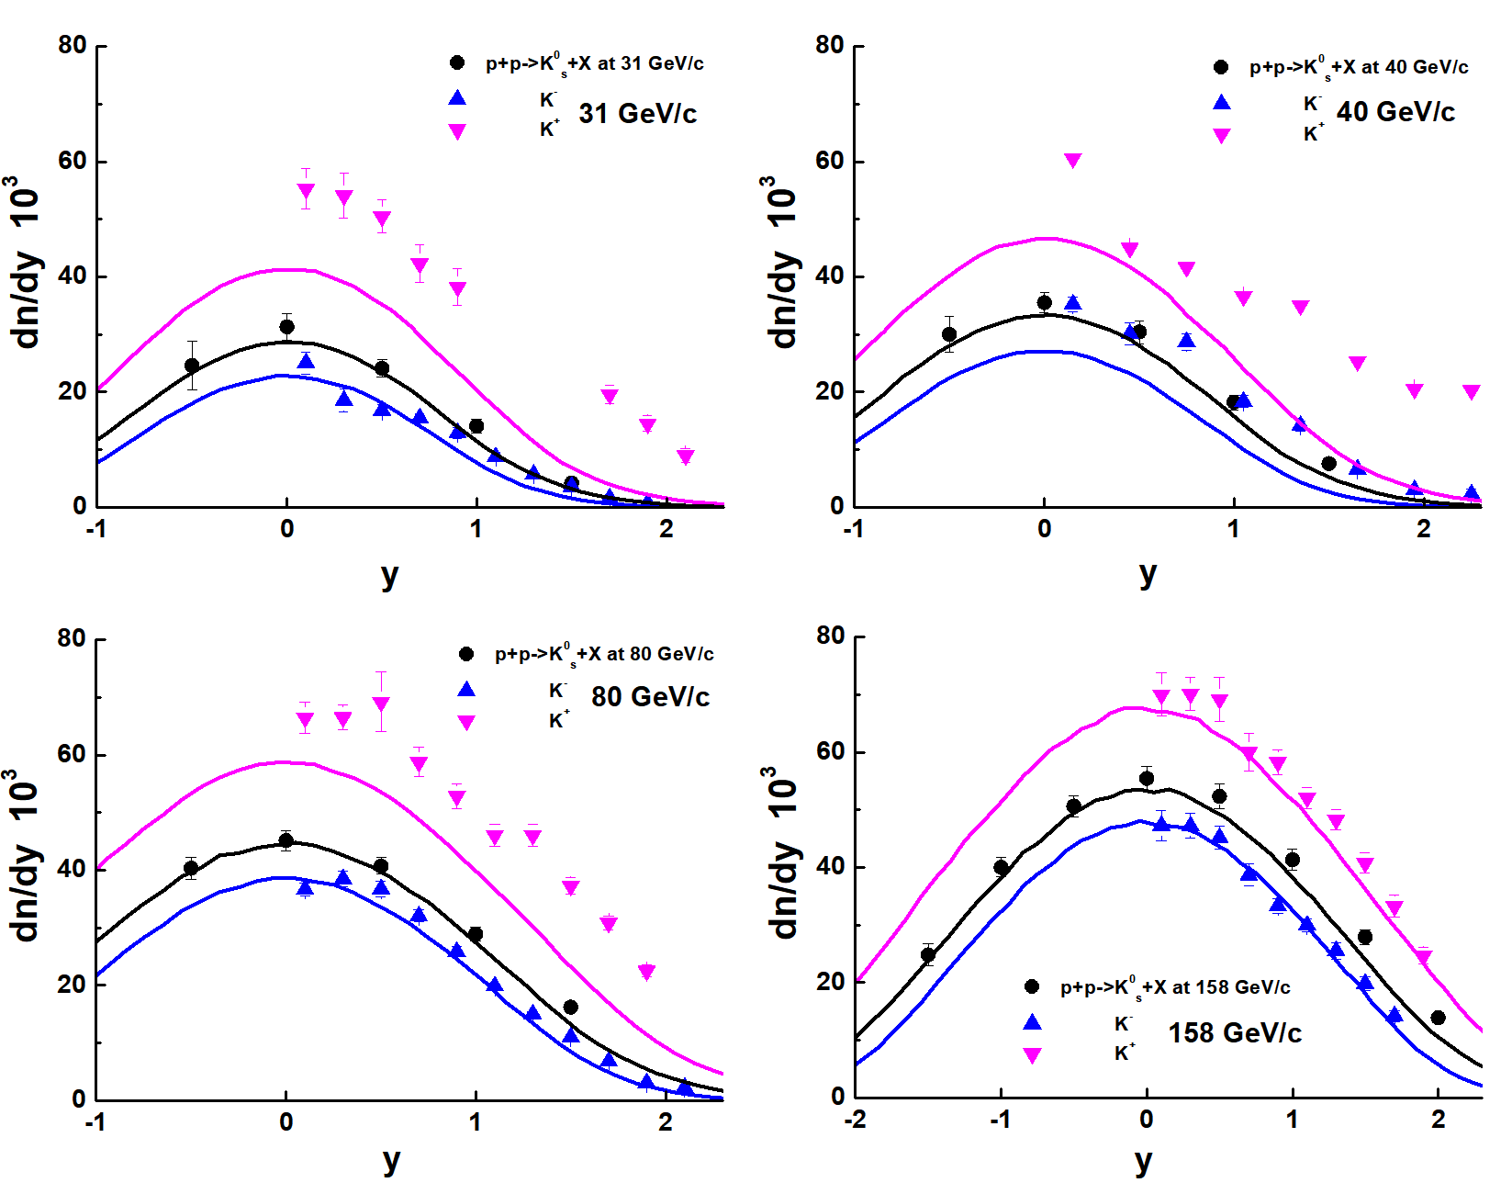
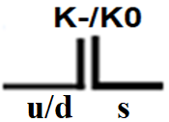


K+, K- and K0s in FTF model
The Schwinger model of quark’ pair
production from the vacuum in a strong color field.
Ps-sbar =12 %
Ps-sbar = 0.12*
[1 – (Mth/Mstr)^{2.5} ]
Dependence of Ps-sbar
on a string mass ?
exp. data:Pi+-,K+-,P,antiP, PP at Plab 20 - 158 GeV/c Eur. Phys. J. 77 C (2017) 671
PEPAN, V. 55, 2024
All O.K. with K⁰s. K- ~ O.K. There is exp. problem with K+!
2

Slide 3
Study of 2-particles transverse momentum correlations of K0s-mesons in proton-proton interactions
V.Abramov et al, Possible studies at the first stage of the NICA collider operation with polarized and unpolarized proton and deuteron beams, arXiv:2102.08477
Phys.Part.Nucl. 52 (2021) 6, 1044-1119
Spin effects in elastic scattering and hyperon production, study of multiquark correlation, dibaryon resonances, exclusive reactions, open charm and charmonia near threshold. Minimal bias interactions will be studied also at SPD.
2-particles transverse momentum correlations of Λ –hyperons in PP and DD interactions can be studied at SPD.
A. Galoyan, A. Ribon, V. Uzhinsky
MDPI Physics 5 (2023) 3, 823-831
1. The method of study of 2-particle Pt-correlations
2. 2-particle Pt correlations of Ks0-mesons in PP-interactions in Geant4/FTF model
3. The Pt correlations of Ks0-mesons in PP-interactions in Pythia model and comparison with FTF ones.
3

Slide 4
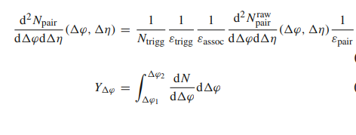
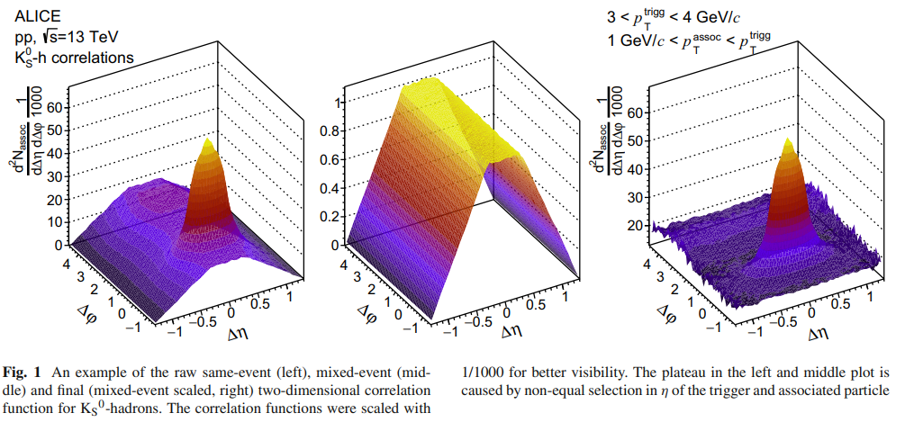
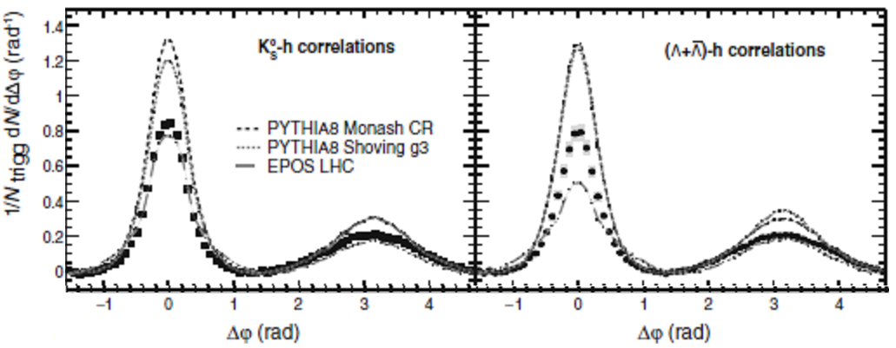
Eur. Phys. J. C (2021) 81:945
K_{S}⁰- (Λ or anti-Λ)- hadron correlations in pp collisions at √s = 13 TeV
ALICE Collaboration
Exp. data on K_{S}⁰-and (Λ anti-Λ)
- hadron correlations were
compared with predictions of
Pythia, EPOS models.
6

Slide 5
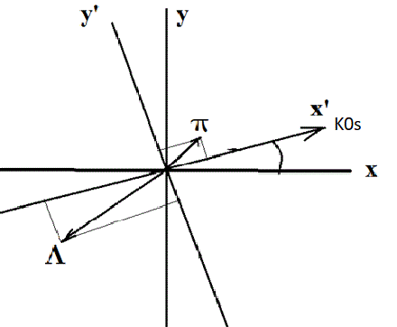


2-Particle Pt Correlations
There are 3 independent variables with
accounting the azimuthal symmetry –
|P_{T,triger}|, P_{x,track} and P_{y, track}
The correlations are connected
with Schwinger mechanism of
particle production
5

Slide 6
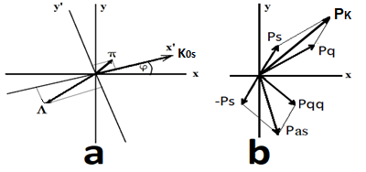
Method of study 2 particle’s Pt-correlations
1. We calculated 1000000 proton-proton interactions at √S=10 GeV using FTF and Pythia generators in SPDRoot version 4.1.6.1
2. We selected events with production of
Ks0-mesons, and calculated:
Cos(φ_K0s) = Px_ K0s / Pt_K0s
Sin( φ_K0s) = Py_K0s / Pt_K0s
3. For these events we transformed Px and Py momenta of
particles associated with Λ –hyperon in the new rotated
coordinate system:
Px’ = Px * Cos(φ_K0s) + Py * Sin(φ_K0s)
Py’ = - Px * Sin(φ_K0s) + Py * Cos(φ_K0s)
(It is obviously, that for K0s Px’=Pt; Py’=0)
4. We performed analysis of transformed Px’ and Py’² of particles
produced with K0s - mesons.
6

Slide 7
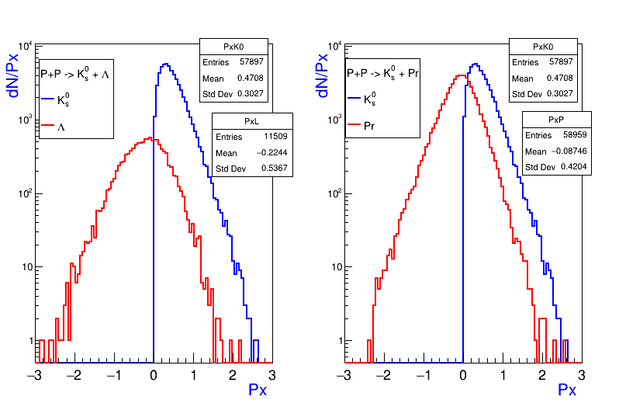
Comparison of Px’ of Λ-hyperons and protons associated with K⁰_{s} - mesons in PP- events calculated by FTF
<Px’_ K⁰_{s} > = 470.8 MeV/с, N_ K⁰_{s} = 57897
<Px’_Λ > = - 224 MeV/с, N_ Λ = 11509
<Px’_Pr> = - 87.5 MeV/с, N_Pr = 58959
7

Slide 8
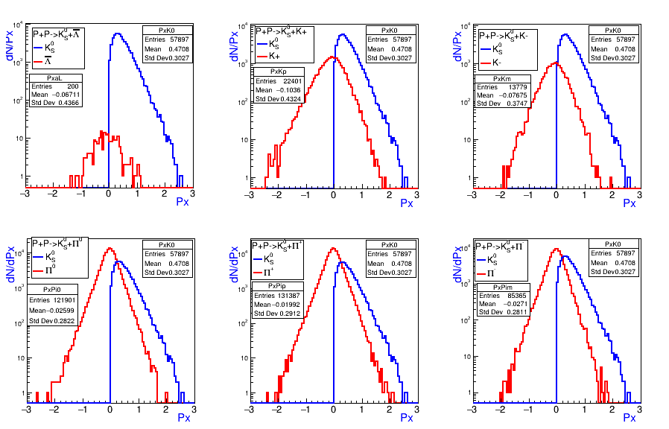
Px’ of particles associated with K⁰_{s} – meson
in PP-events calculated by FTF generator
<Px’_K⁰_{s} > = 470.8 MeV/c
<Px’_Λbar> = -67.1 MeV/с , <Px’_K+>=-103.6 MeV/с, <Px’_K- > = -78.8 MeV/с
<Px’_π0> = -26 MeV/с, <Px’_π+>=-20 MeV/с, <Px’_π- > = -27 MeV/с
8

Slide 9
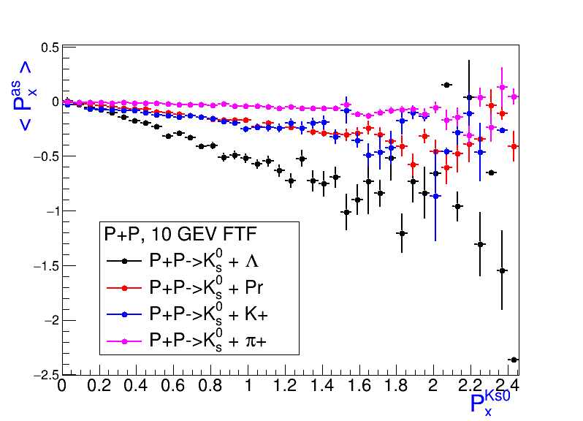
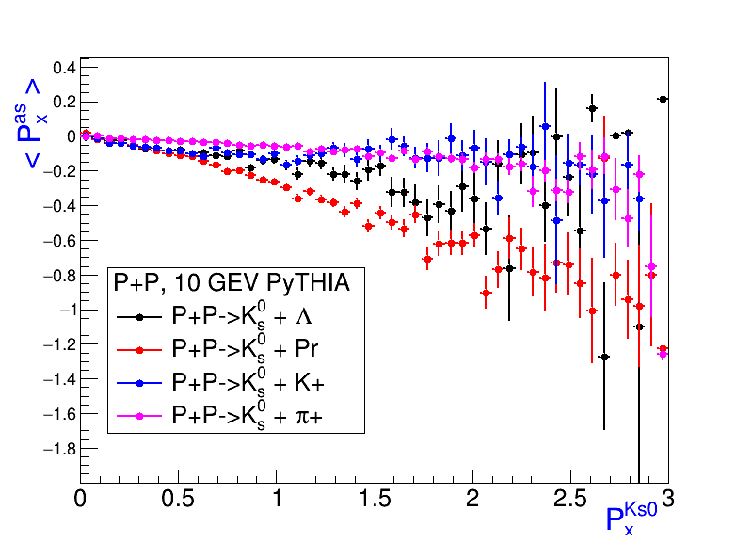
Correlations of mean Px’ of Λ-hyperons, K+, protons and π- mesons with K⁰_{s} – meson Px’ in PP-events calculated by FTF and PyTHIA
FTF
<Px’_Λ >= -224 MeV/с
<Px’_K+>=-103.6 MeV/с
<Px’Pr>= -87.5 MeV/с
<Px’_π+>= -20 MeV/с
PyTHIA
<Px’_Pr > = -128 MeV/с
<Px’_Λ> = -87.8 MeV/с
<Px’_K+> = -74.8 MeV/с
<Px’_π+> = - 31 MeV/с
11

Slide 10
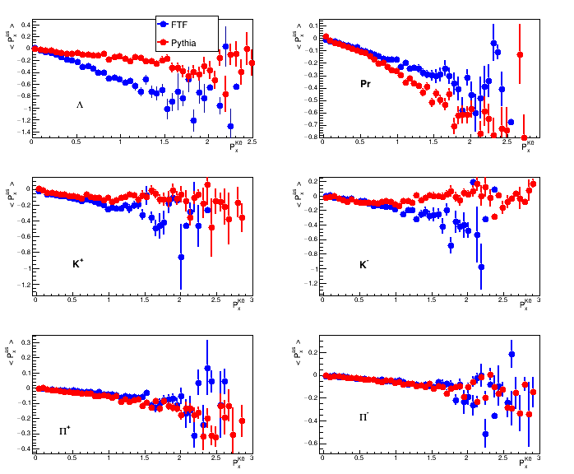
Comparison of correlations of mean Px’ of Λ hyperons, protons, K-mesons and π-mesons with K⁰_{s} – meson Px’ in events calculated by PYTHIA and FTF
FTF
PyTHIA
Beam reamnant
fragmentation
Where is
truth?
12

Slide 11
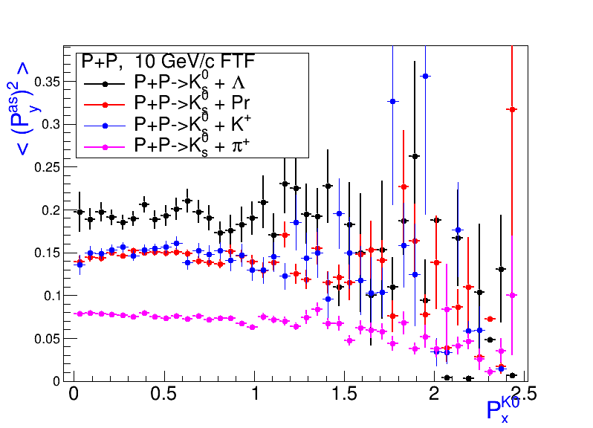
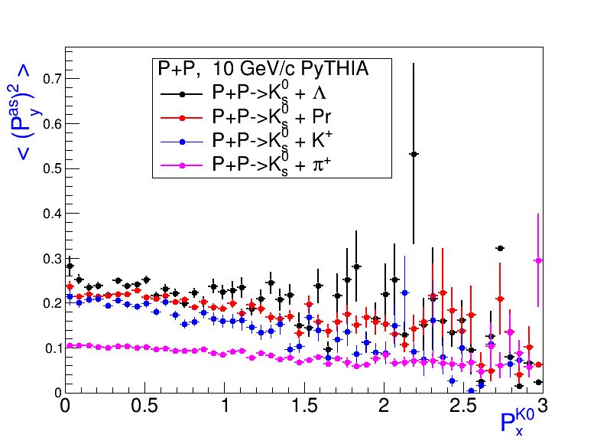
Correlations of mean Py’² of Λ- hyperons, protons K and π mesons with K⁰_{s} – meson Px’ in PP-events calculated by FTF and PyTHIA
FTF
<Py’² Λ>= 193 (MeV/c)²
< Py’² K+>= 151 (MeV/c)²
<Py’² Pr>= 147(MeV/c)²
< Py’² π+>= 75 (MeV/c)²
PyTHIA
<Py’² Λ>= 232 (MeV/c)²
< Py’² Pr>= 211 (MeV/c)²
<Py’² K+>= 188 (MeV/c)²
< Py’² π+>= 98 (MeV/c)²
13

Slide 12
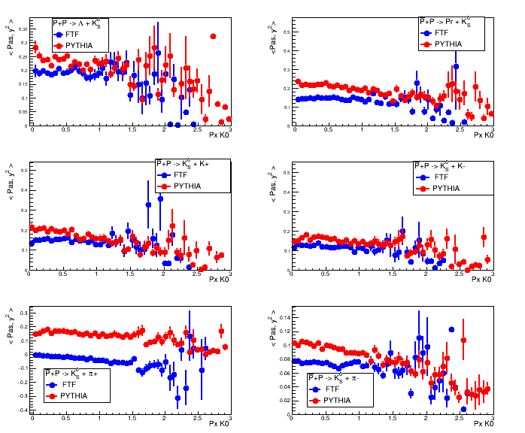
Comparison of correlations of mean Py’² of Λ hyperons, protons, K- and π- mesons with K⁰_{s} – meson Px’ in events calculated by FTF and PYTHIA
Mt scaling
Nadine Fischer
Torbjörn Sjöstrand
Thermodynamical String Fragmentation
JHEP 1701 (2017) 140
14

Slide 13
Table of Numbers and mean values of Px’ and Py’² of
particles associated with K⁰_{s} – meson in PP-events at √S = 10 GeV
Gene-rator | K⁰_{s} | Λ | K+ | K- | Λbar | Proton | π+ | π- | π0
FTF | N 57897 | N 11509 | N 22401 | N 13779 | N 200 | N 58959 | N 131387 | N 85365 | N 121901
Pythia | N 78850 | N 28219 | N 29466 | N 20857 | N 573 | N 74571 | N 201812 | N 129411 | N 182025
FTF | <Px> 471 | <Px> -224 | <Px> -104 | <Px> -77 | <Px> -67 | <Px> -87 | <Px> -30 | <Px> -27 | <Px> -26
Pythia | <Px> 523 | <Px> -88 | <Px> -75 | <Px> -63 | <Px> -77 | <Px> -128 | <Px> -31 | <Px> -33 | <Px> -34
FTF | <Py²> 0 | <Py²> 193 | <Py²> 151 | <Py²> 122 | <Py²> 202 | <Py²> 147 | <Py²> 75 | <Py²> 73 | <Py²> 72
Pythia | <Py²> 0 | <Py²> 232 | <Py²> 188 | <Py²> 158 | <Py²> 222 | <Py²> 211 | <Py²> 98 | <Py²> 97 | <Py²> 91
15

Slide 14
Summary
We observe strong 2-particle Pt correlations between K⁰_{s} mesons and
strange particles in PP interactions according to Geant4 FTF model.
2. Event generators – Pythia and Geant4 FTF give
different predictions for these correlations. FTF model predicts
stronger correlations between strange particles than Pythia model.
3. According to Pythia generator, Pt correlations between K⁰_{s} mesons
and protons stronger than in FTF generator.
4. FTF predicts lower values of mean Py’² of associated particles with
K⁰_{s} mesons than Pythia generator.
5. The Pt correlations are connected with main assumptions of various string models used in Pythia and Geant4 FTF .
Study of correlations allows tuning and calibration of the main
simulation generators -- Pythia and Geant4 in high energy physics!
16

Slide 15
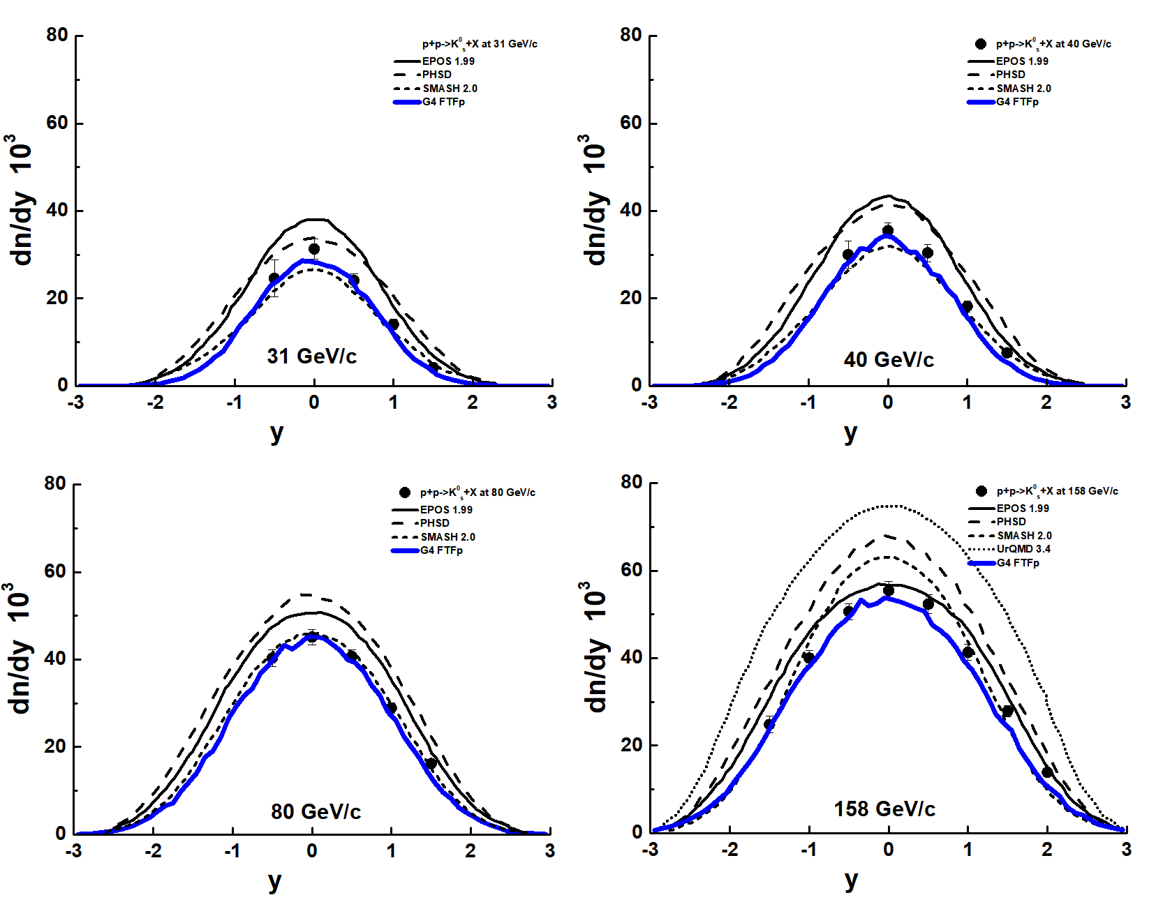
Experimental data and models + FTF
FTF is the best!
3

Slide 16
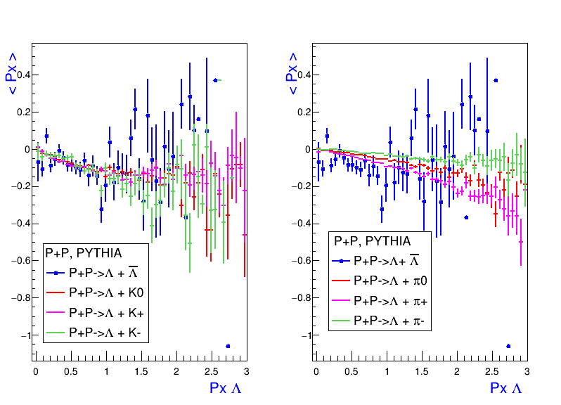
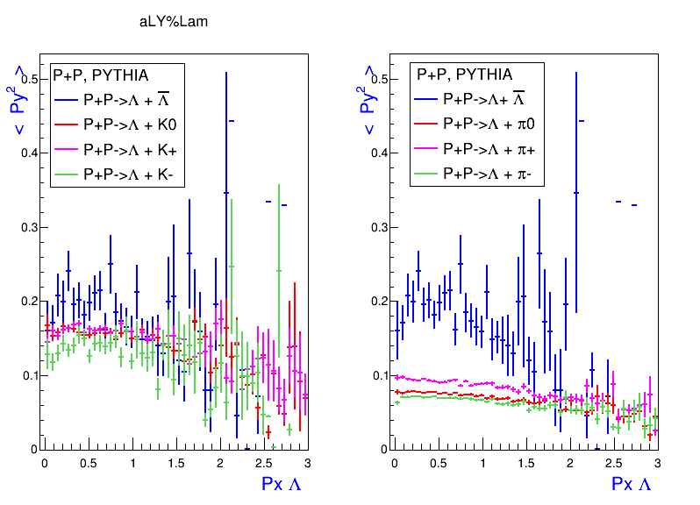
Correlations of mean Px’, Py’² of Λ-bar hyperons, K and π mesons with
Λ hyperon Px’ in PP-events calculated by PYTHIA
Mt scaling
Nadine Fischer and
Torbjörn Sjöstrand
Thermodynamical String Fragmenta-
tion
JHEP 1701 (2017) 140
<Py’² Λbar> = 193 (MeV/c)² <Py’² K0> = 156 (MeV/c)² <Py’² π0> = 74 (MeV/c)²
16

Slide 17
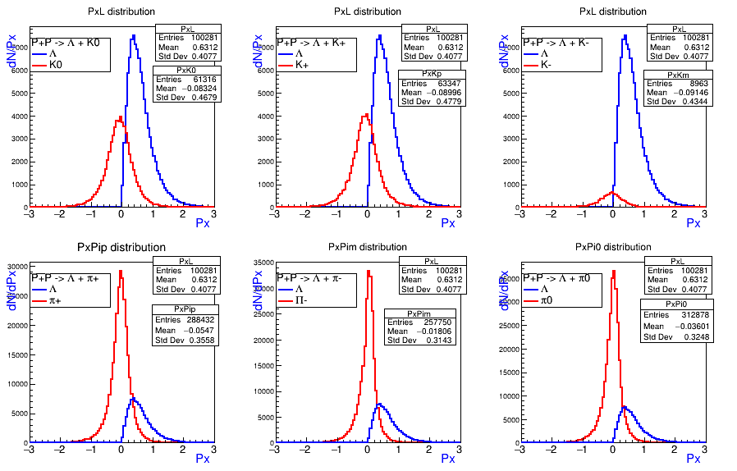
Px’ of particles associated with Λ hyperons
in PP- events calculated by Pythia
We calculated 1000000 PP-events at √S=10 GeV using Pythia in SPDRoot
<Px’_Λ> = 613 MeV/c, N_ Λ=100281; <Px’_Λbar>=-80 MeV/c, N_ Λbar=2731
<Px’_K0> = -83 MeV/c, <Px’_K+>=-90 MeV/c, <Px’_K- > = -91 MeV/c
<Px’_π0> = -36 MeV/c, <Px’_π+>=-55 MeV/c, <Px’_π- > = -18 MeV/c
17

Slide 18
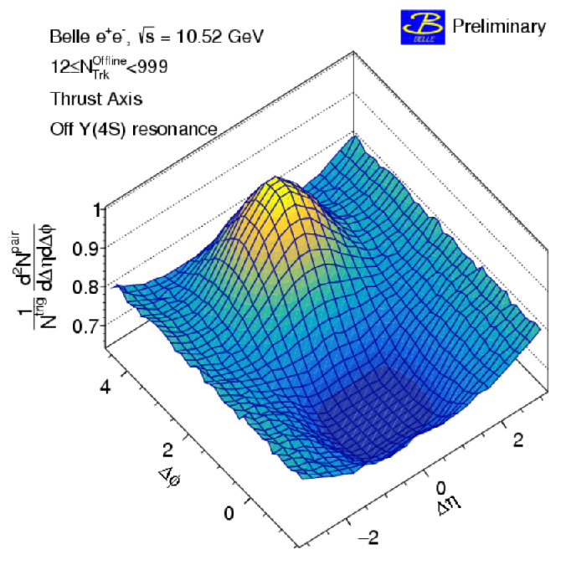
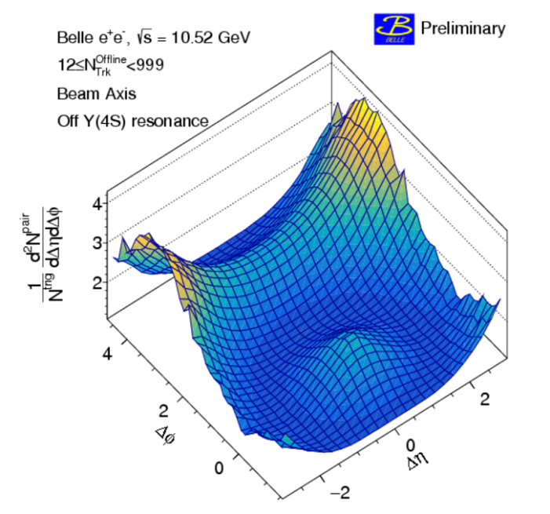
Towards Study of 2-Particle Pt Correlations
PHYSICS REPORTS 107 (1984) 59
e+e- PHYSICS AT PETRA –
THE FIRST FIVE YEARS,
Sau Lan WU and DESY.
Jets in High
Energy Physics
Two-particle correlation functions
for beam (left) and thrust (right)
axis analyses with offline multiplicity Noffline Trk ≥ 12.
What to do at lower energies when jets are not produced?
5

