Slide 1
Test setup ROC chamber + TPC DAQ. Monitoring of r/o channels noise and study influence harmonics from CAEN LV power system and DAQ to r/o channel noise
Y.Ghoniem*, V.Chepurnov, A.Piliar, D.Potapov, S.Vereschagin, A.Ribakov, O.Fateev, S.Zaporojets

Slide 2
Abstract
The MPD detector is one of two at NICA collider. The Time Projection Chamber (TPC) is the main tracking and particle identification detector of MPD experiment. FE electronics for ROC chamber r/o system based on SAMPA chip and FPGA (for data collection and transmission to controller). Charge sensitive amplifier of SAMPA chip has bandwidth with max at 1 MHz and ADC clock - 10 MHz.
Controller based on ARRIA-5 FPGA. Optics and cooper links used for data transmission with speed 2.5 Gbps. Clocks are 100 MHz and 320 MHz. The Master SCADA 4D was chosen for design TPC detector control system (TPC DCS). The TPC LV and HV systems are based on CAEN equipment and OPC UA server protocol.
CAEN power supplies operate at frequencies in the range of 100-125 kHz. So, some frequencies and harmonics appeared in the SAMPA output signal. Electromagnetic environment around of the ROC chamber with DAQ system was studied with help of vector analyzer, DAQ system monitoring and SC system monitoring. ROC chamber parameters are presented after some improvements.

Slide 3
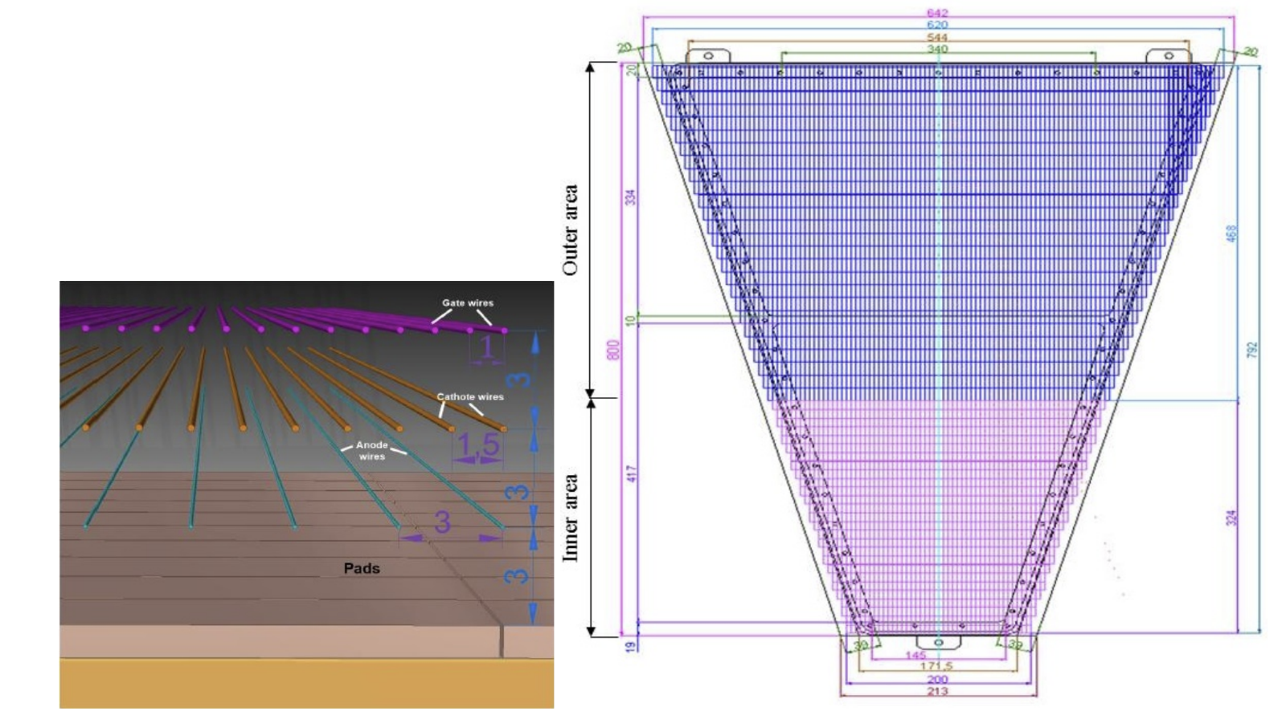
“Roc” Chamber
Readout chambers
The TPC readout system is based on the Multi-Wire Proportional Chambers (MWPC) with cathode pad readout (ROC). The end-cap readout plane is covered by 12 trapezoidal sectors of the ROC chamber with the bases of 213 mm and 642 mm and the height of 800 mm, each covering 30◦ in azimuth.
The active zone length of the ROC in the radial direction is 796 mm. The dead zone between chambers is 29 mm. It includes the width of the wire framework (13 mm for every chamber) and a gap (3 mm) between chambers. The full active area of the ROC chambers is equal to 7.65 m².
Pad sizes are 5x15 mm and 5x18 mm. Each pad connected to r/o electronics. Total – 3968 pads (r/o channels) per each ROC chamber.
Schematic view of ROC chamber (left) and pad plane electrode (right)

Slide 4
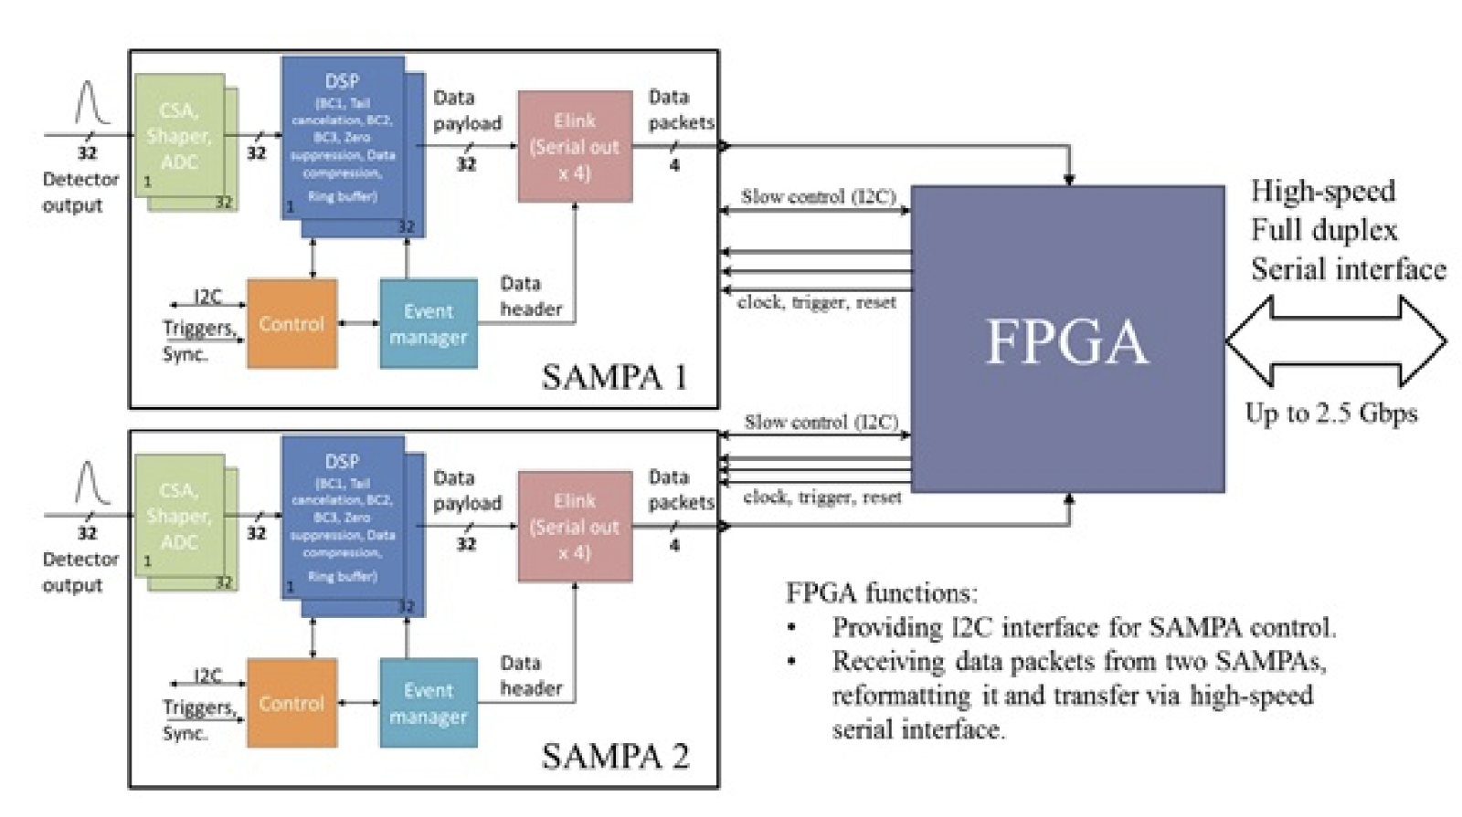
TPC FE Electronics
Structural scheme of the FE card FEC64SAM
The SAMPA FE card comprises two SAMPA chips (32 channels each) and one FPGA with the embedded gigabit transceivers and other circuits.
The signal flow starts with the analogue signal transported through two flexible cables from ROC chamber pads to connectors at the FE card end.

Slide 5
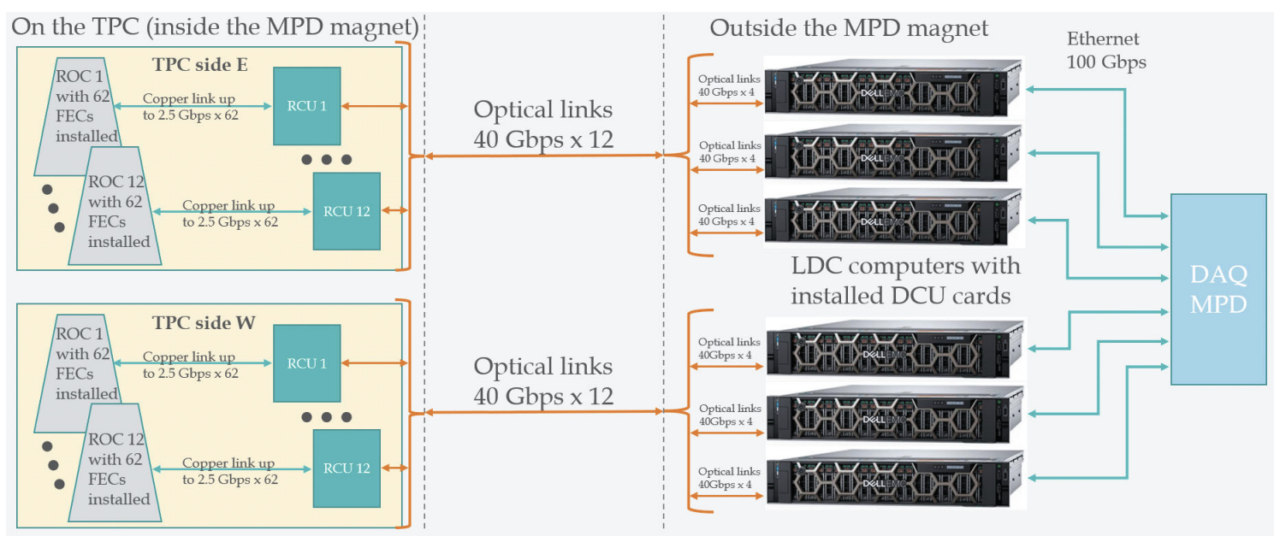
DAQ
DAQ subsystem is an identical element of the entire TPC DAQ system consisting of the same 24 elements.
The subsystem includes: 62 FECs and 1 RCU. Each FEC multiplexes a data stream from 64 channels, and one RCU multiplexes the data stream from 62 FECs.
Thus, a DAQ subsystem transmits the data from 3968 registration channels.

Slide 6
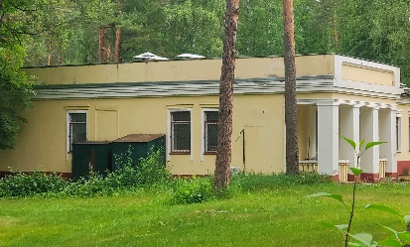
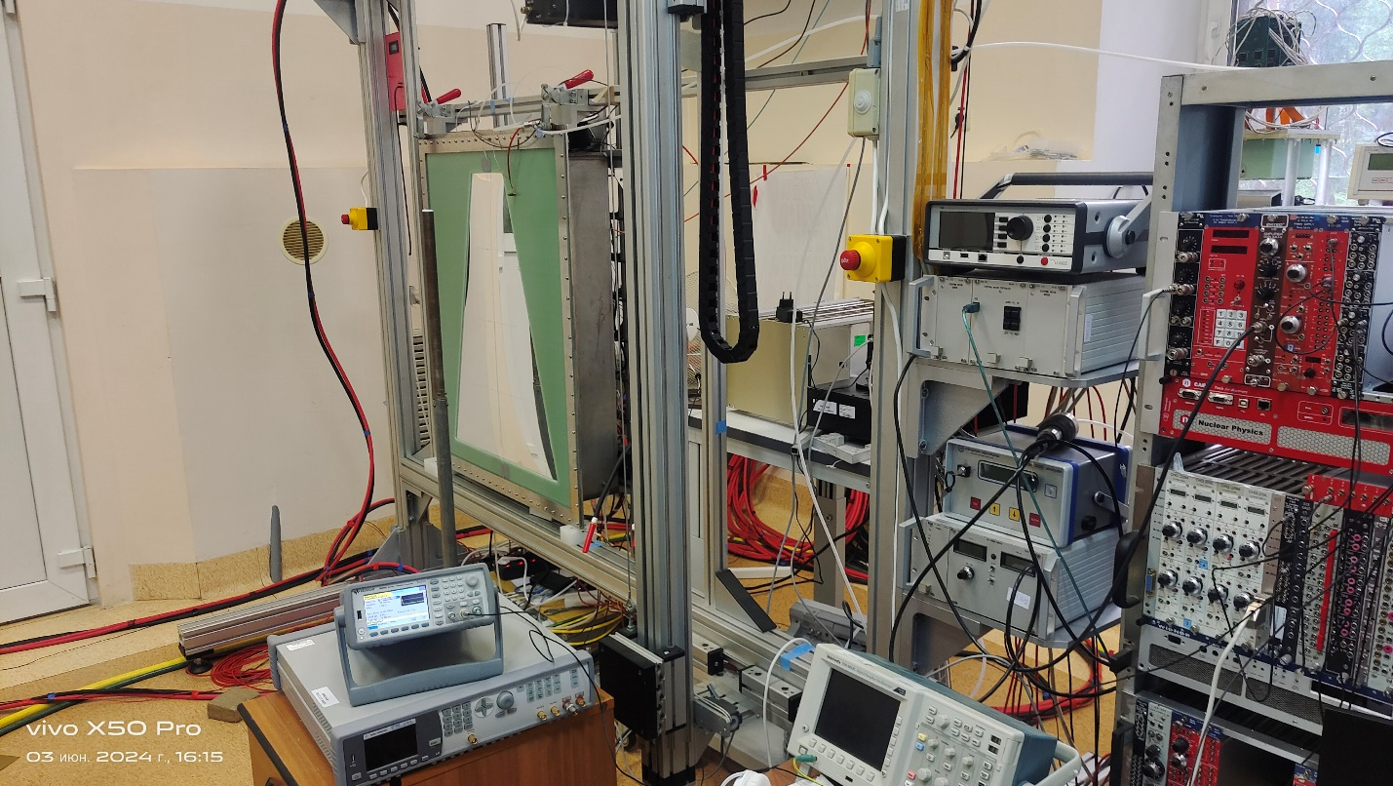
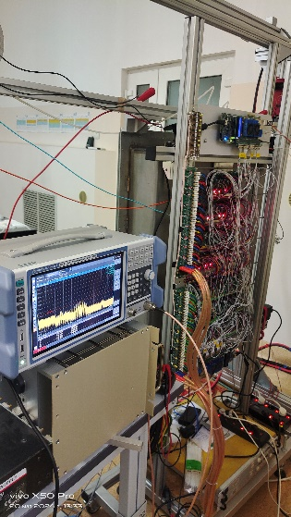
Test setup (Bld.40)

Slide 7
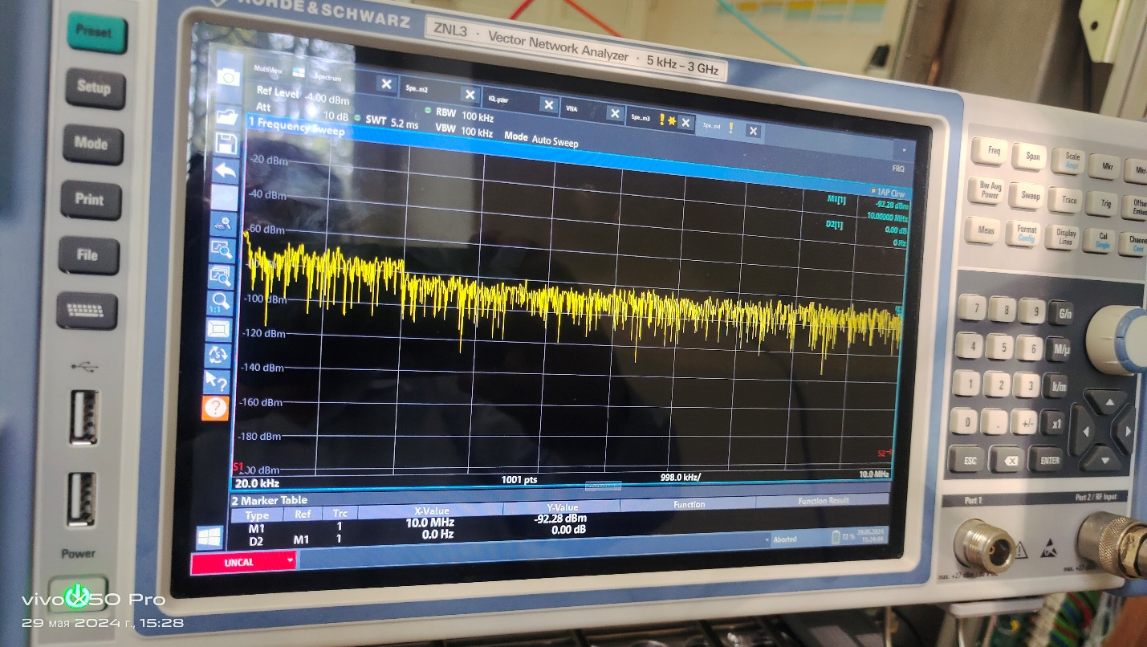
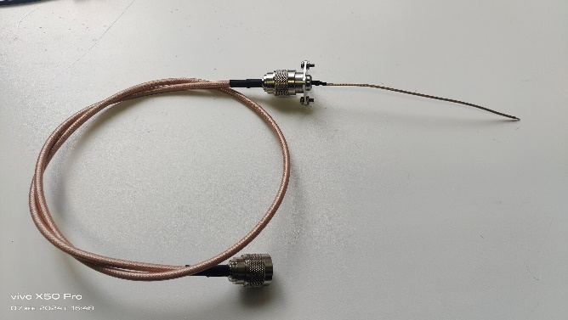
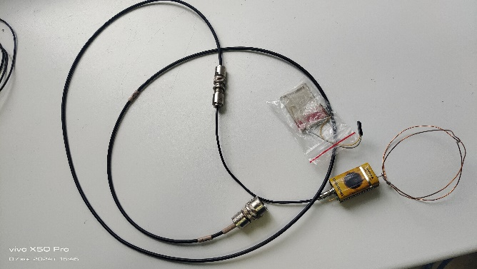
Vector Analyzer Rohde@Schwarz ZNL3 (5 kHz – 3 GHz)
Antennas
Input R – about 1 MOhm
Output R – 50 Ohm
Bandwidth – up to 100 MHz

Slide 8
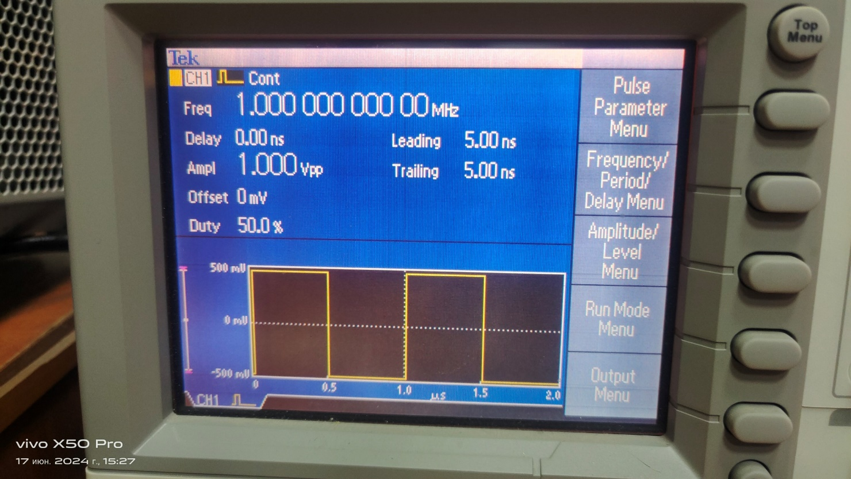
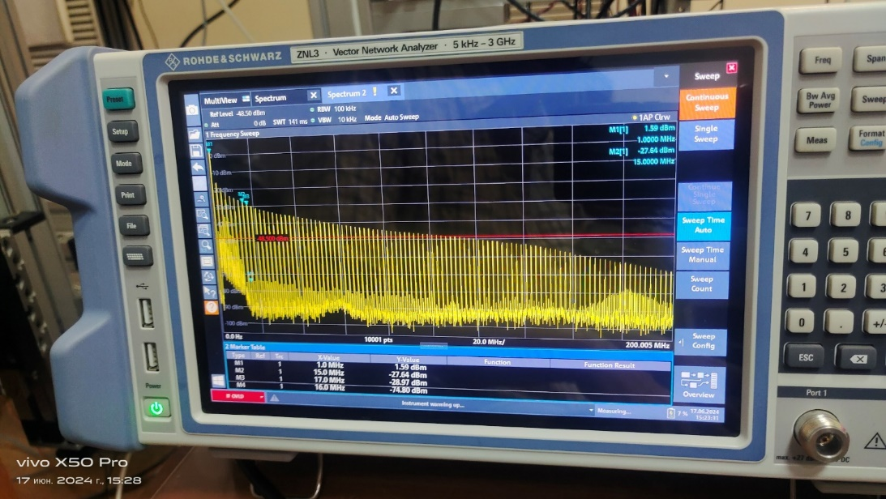
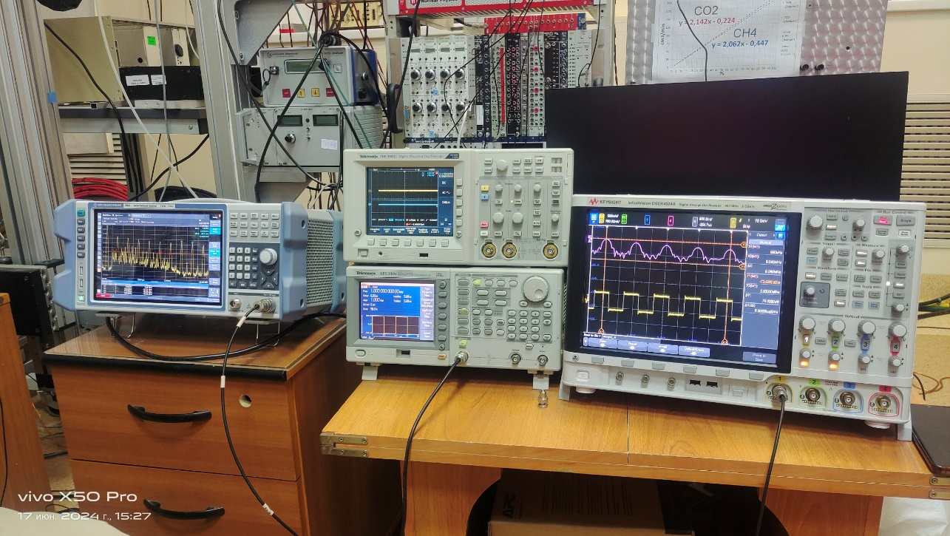
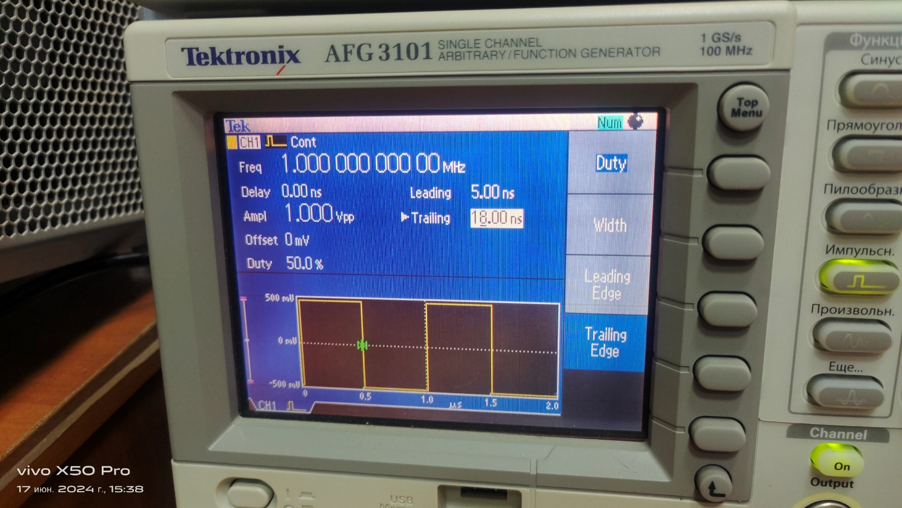
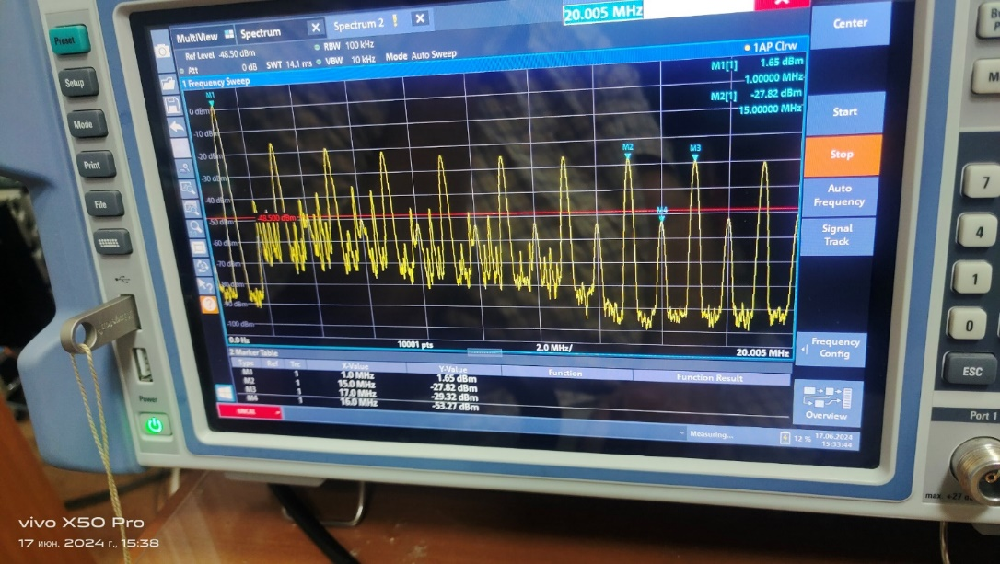
Test Of Vector Analyzer With Generator Pulse
F=1 MHz, leading = trailing = 5 ns
Only Odd harmonics
Test Setup
Main F= 1 MHz
Harmonics: F1= 3 MHz, F2= 5 MHz, F3= 7 MHz,
F4= 9 MHz and so on …
trailing or leading = 18 ns
Odd + even harmonics
Harmonics: 2 MHz, 4 MHz, 6 MHz, 8 MHz and so on

Slide 9
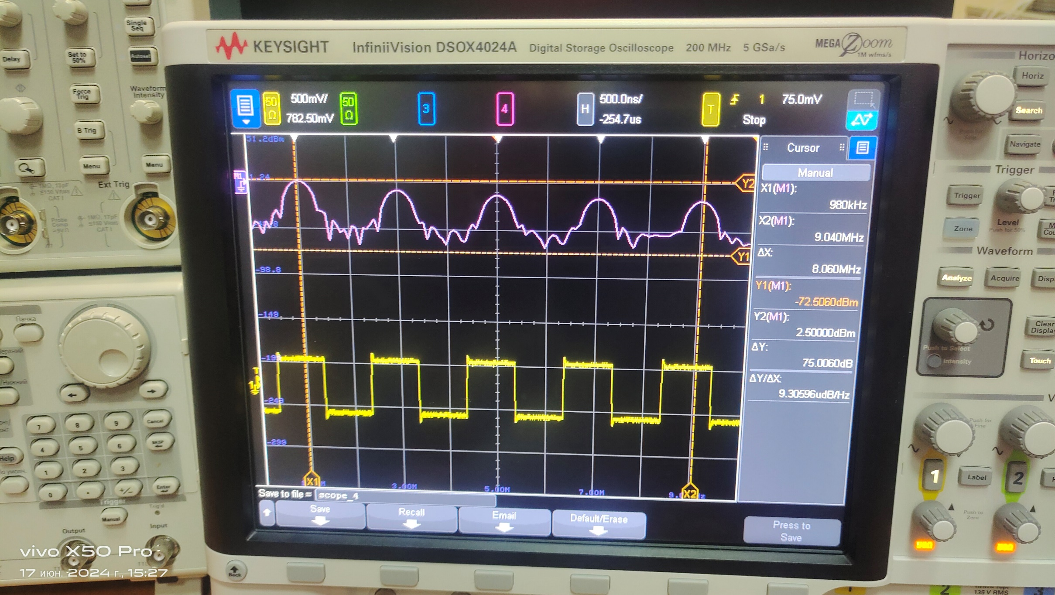
Test Of Keysight Oscilloscope With Generator Pulse (FFT)
Main F= 1 MHz
Harmonics:
F1= 3 MHz
F2= 5 MHz
F3= 7 MHz
F4= 9 MHz
and so on …
dF=2 MHz
If change leading and trailing pulse time than to appear even harmonics – 2 MHz, 4 MHz, 6 MHz and so on

Slide 10
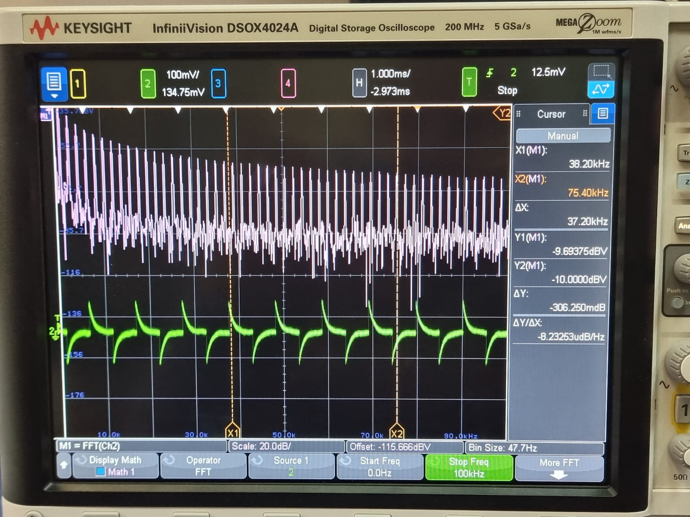
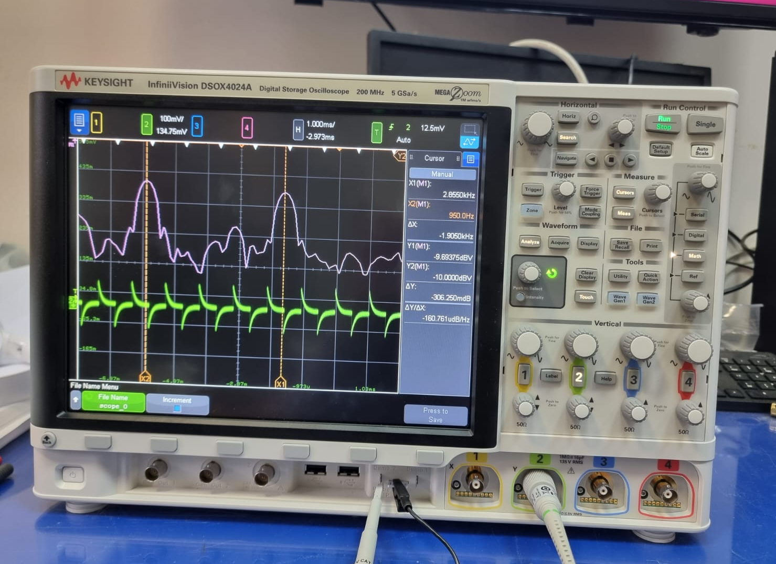
Test of Keysight oscilloscope with generator pulse (FFT)
Frequency Domain
Frequency Domain (zoom)
Main F= 1 kHz
Harmonics: F1= 3 kHz, F2= 5 kHz, F3= 7 kHz, F4= 9 kHz and so on …
X1-X2 ~ 2 kHz
Results from vector analyzer and Keysight scope are compatible

Slide 11
Antenna Results

Slide 12
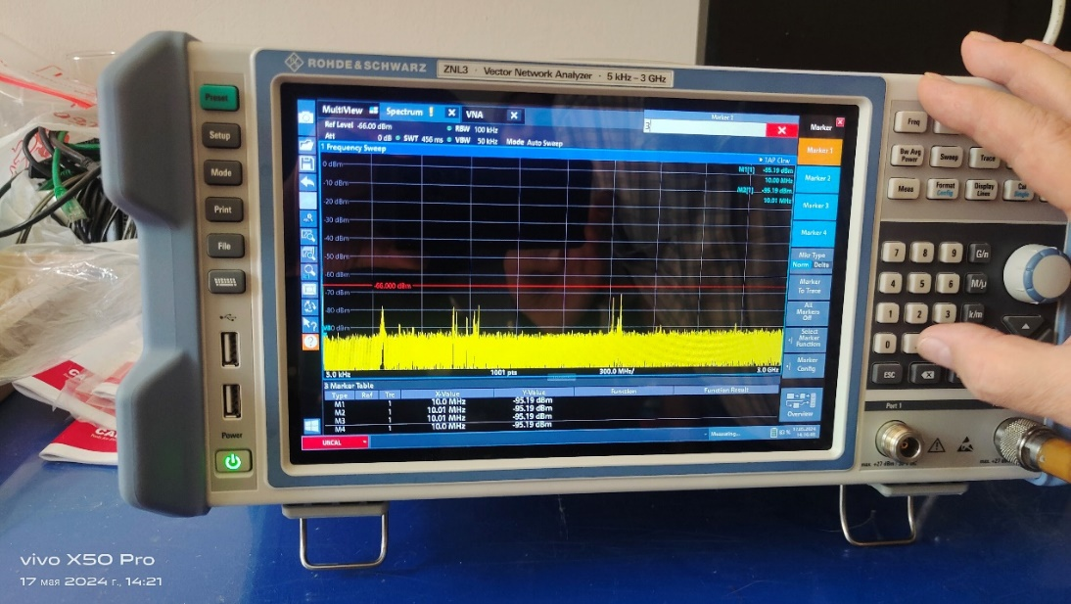
360 MHz (-70 dBm) and bunches at 1 GHz и 2 GHz -(70-80) dBm vector analyzer noise - 90 dBm
Antenna Results

Slide 13
Test Setup (ROC Chamber +FEC) Study DAQ – OFF CAEN – ON + Computer - ON

Slide 14
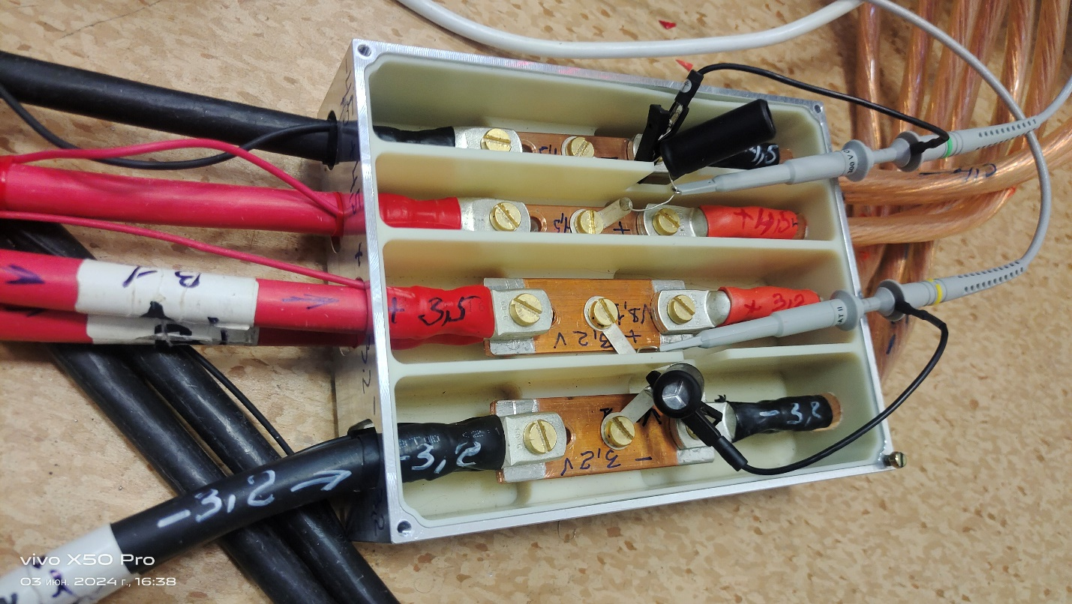
Test setup (Bld.40)
LV feeder box

Slide 15
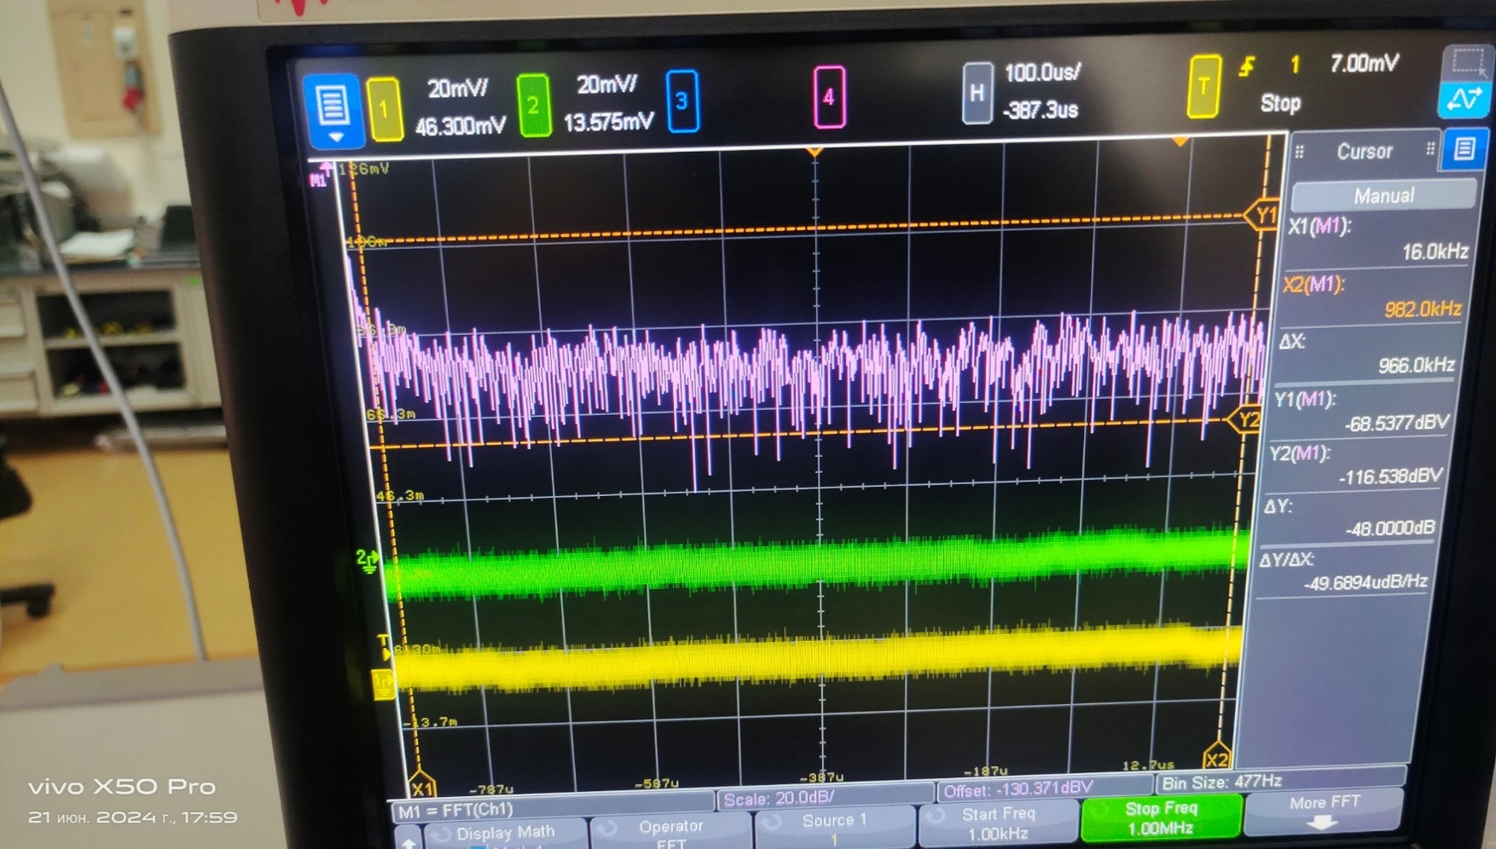
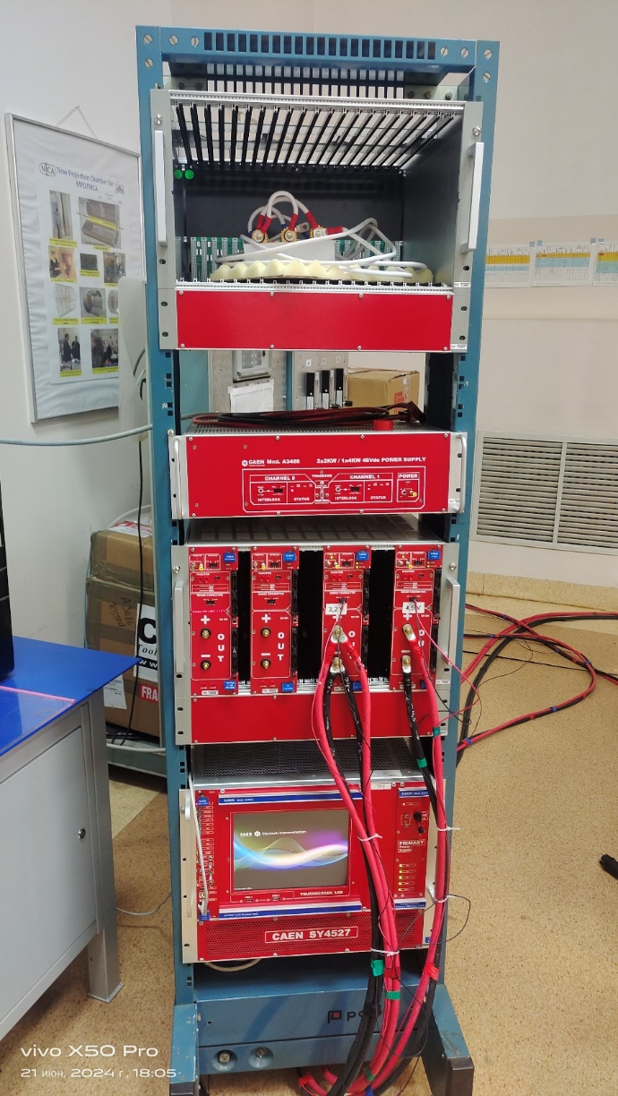
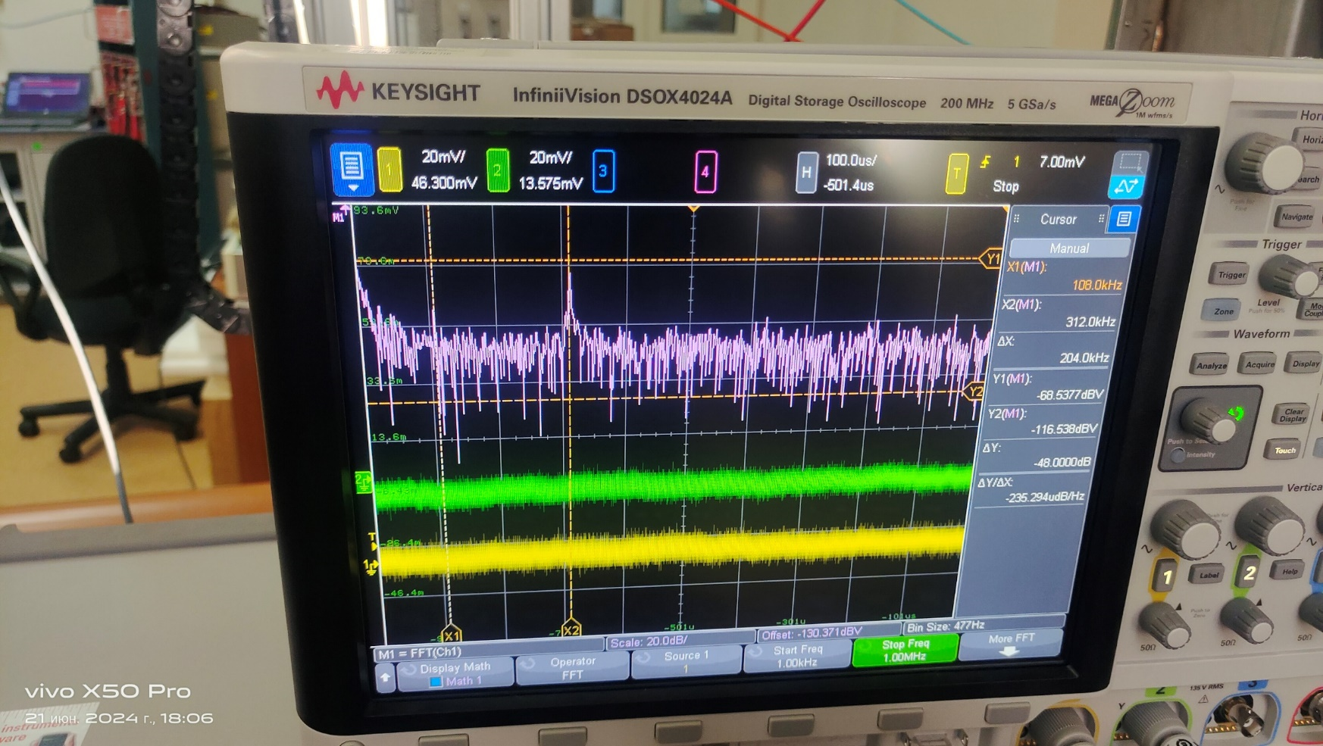
CAEN LV power supply system - ON
Base U noise=-105 dBV
(peak-to-peak = 20 mV)
OFF
F = 320 kHz
U=(105-70)=35 dBV
ON

Slide 16
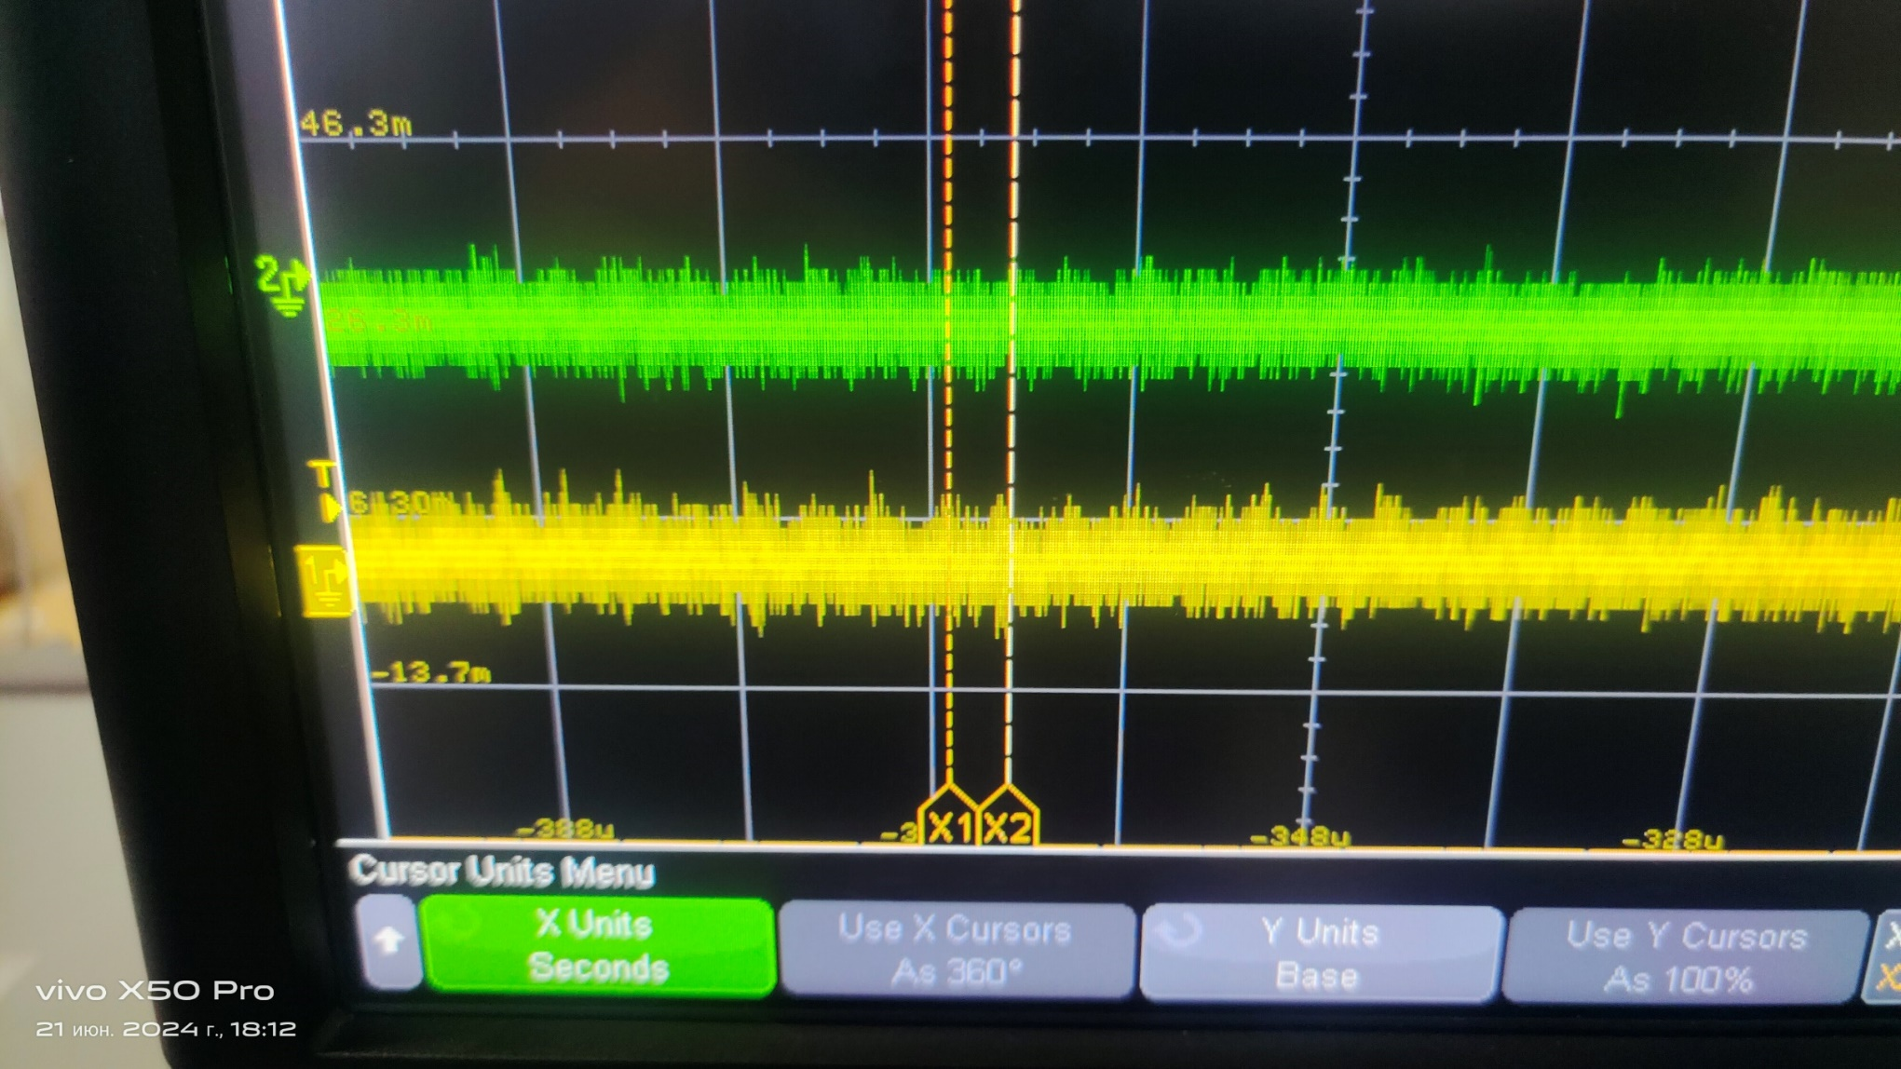
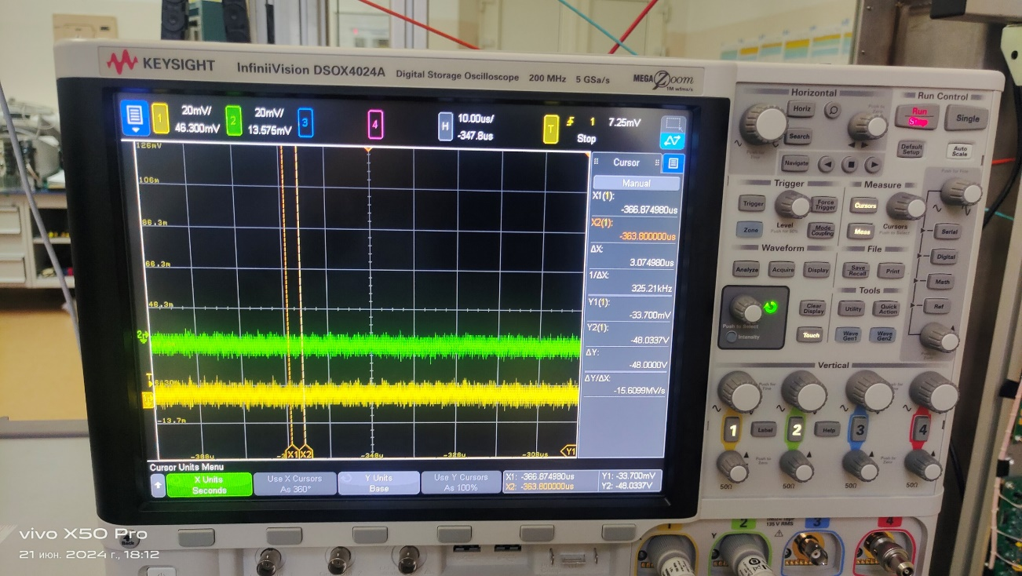
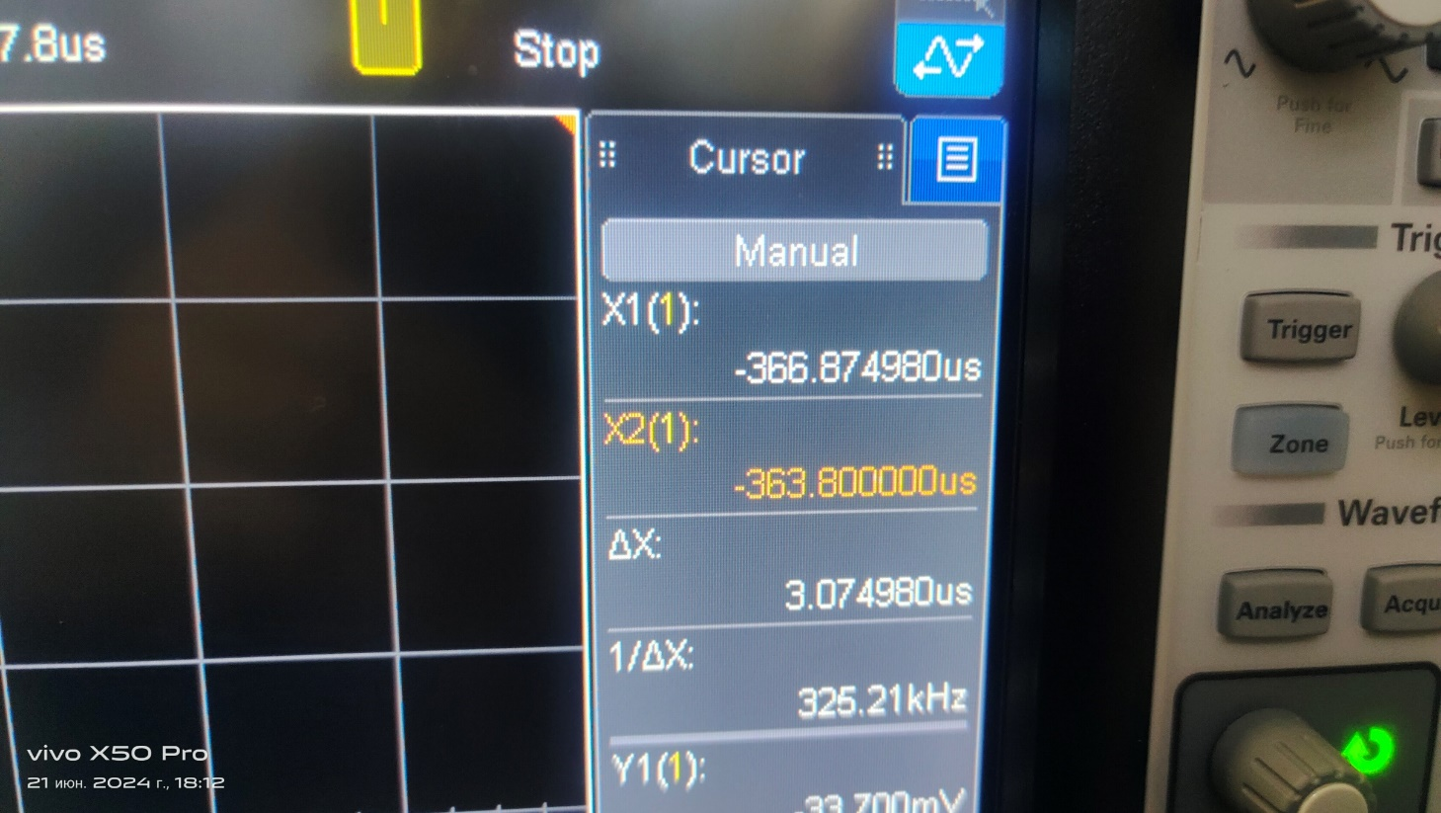
Check oscillations with oscilloscope
T~3 µsec (X2-X1)
F=320 kHz
U (peak-to-peak) =
25 mV
U noise=20 mV
Oscillation amplitude:
+/-2.5 mV
(25-20)=5 mV

Slide 17
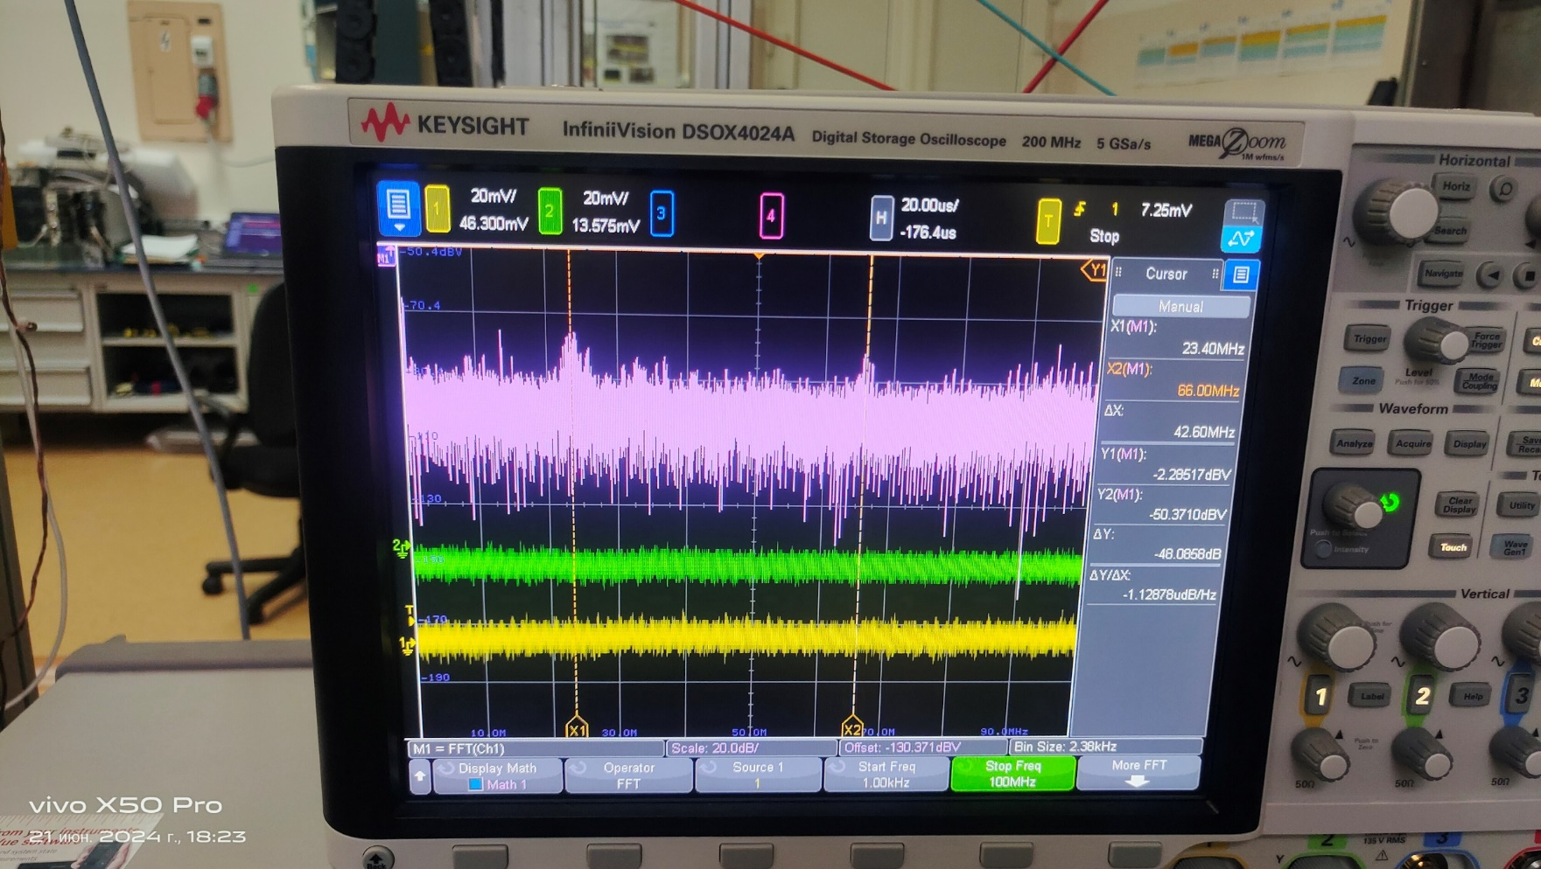
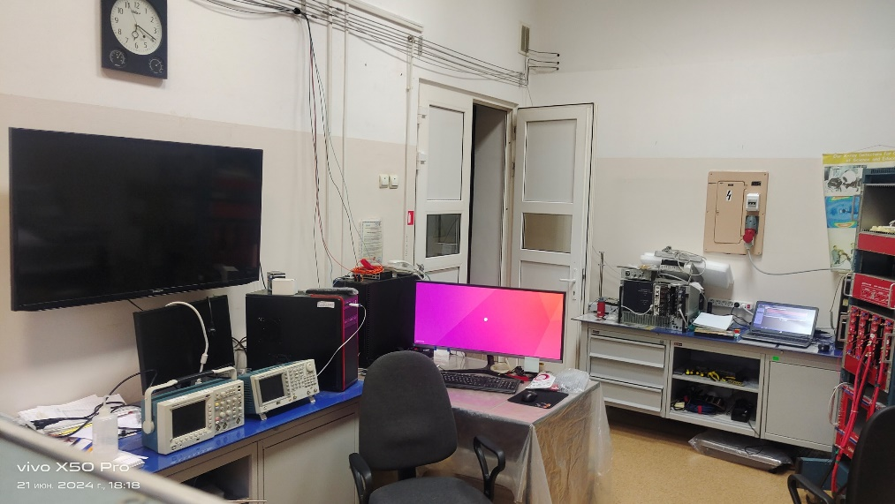
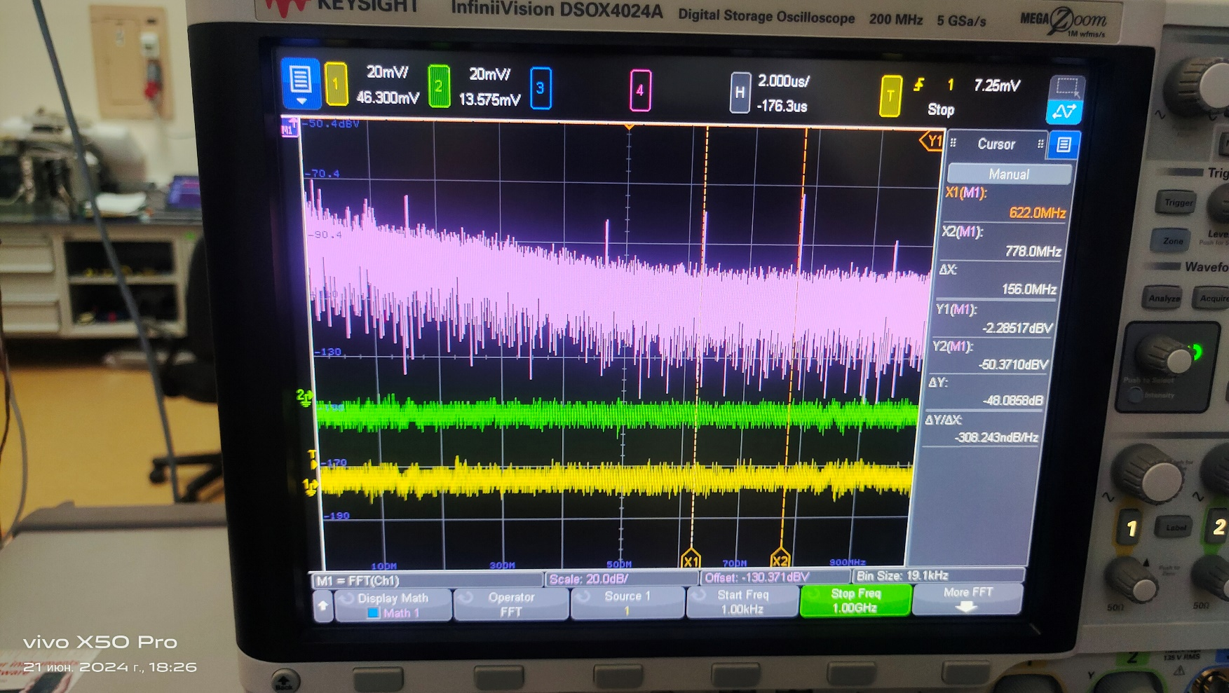
Computer - ON
Harmonics:
F1= 23 MHz
F2= 66 MHz
F3= 100 MHz
dF=43 MHz
U=-80 dBV
Harmonics:
F4= 154 MHz
F5= 466 MHz
F6= 622 MHz
F7= 778 MHz
F8= 934 MHz
dF=156 MHz
U=-80 dBV

Slide 18
Consequence-1
Check environment (in the air) with antenna:
360 MHz and bunches at 1 GHZ and 2 GHz
CAEN LV power supply:
Main frequenсy: F1=320 kHz
Computer:
Main frequencies: F2=23 MHz + harmonics (66 MHz and 100 MHz ) and
F3=154 MHz + harmonics (466 MHz, 622 MHz, 778 MHz, 934 MHz)

Slide 19
Test Setup: ROC Chamber With The LV Passive board

Slide 20
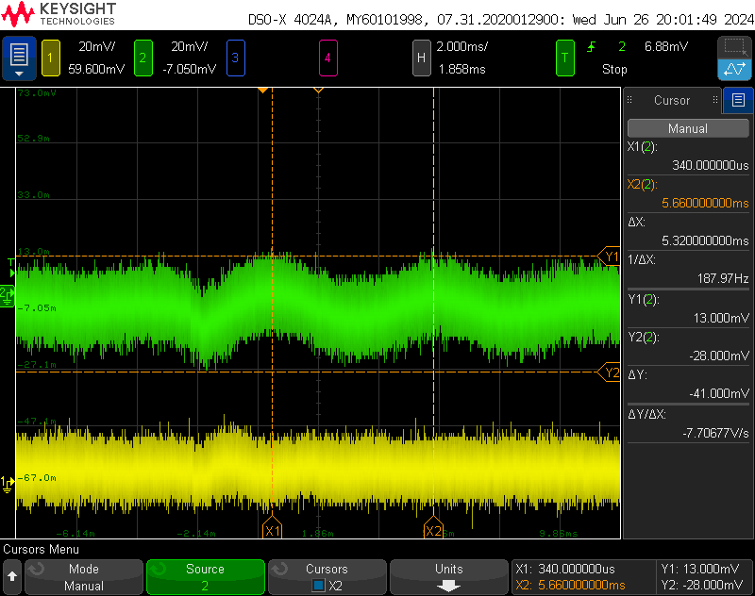
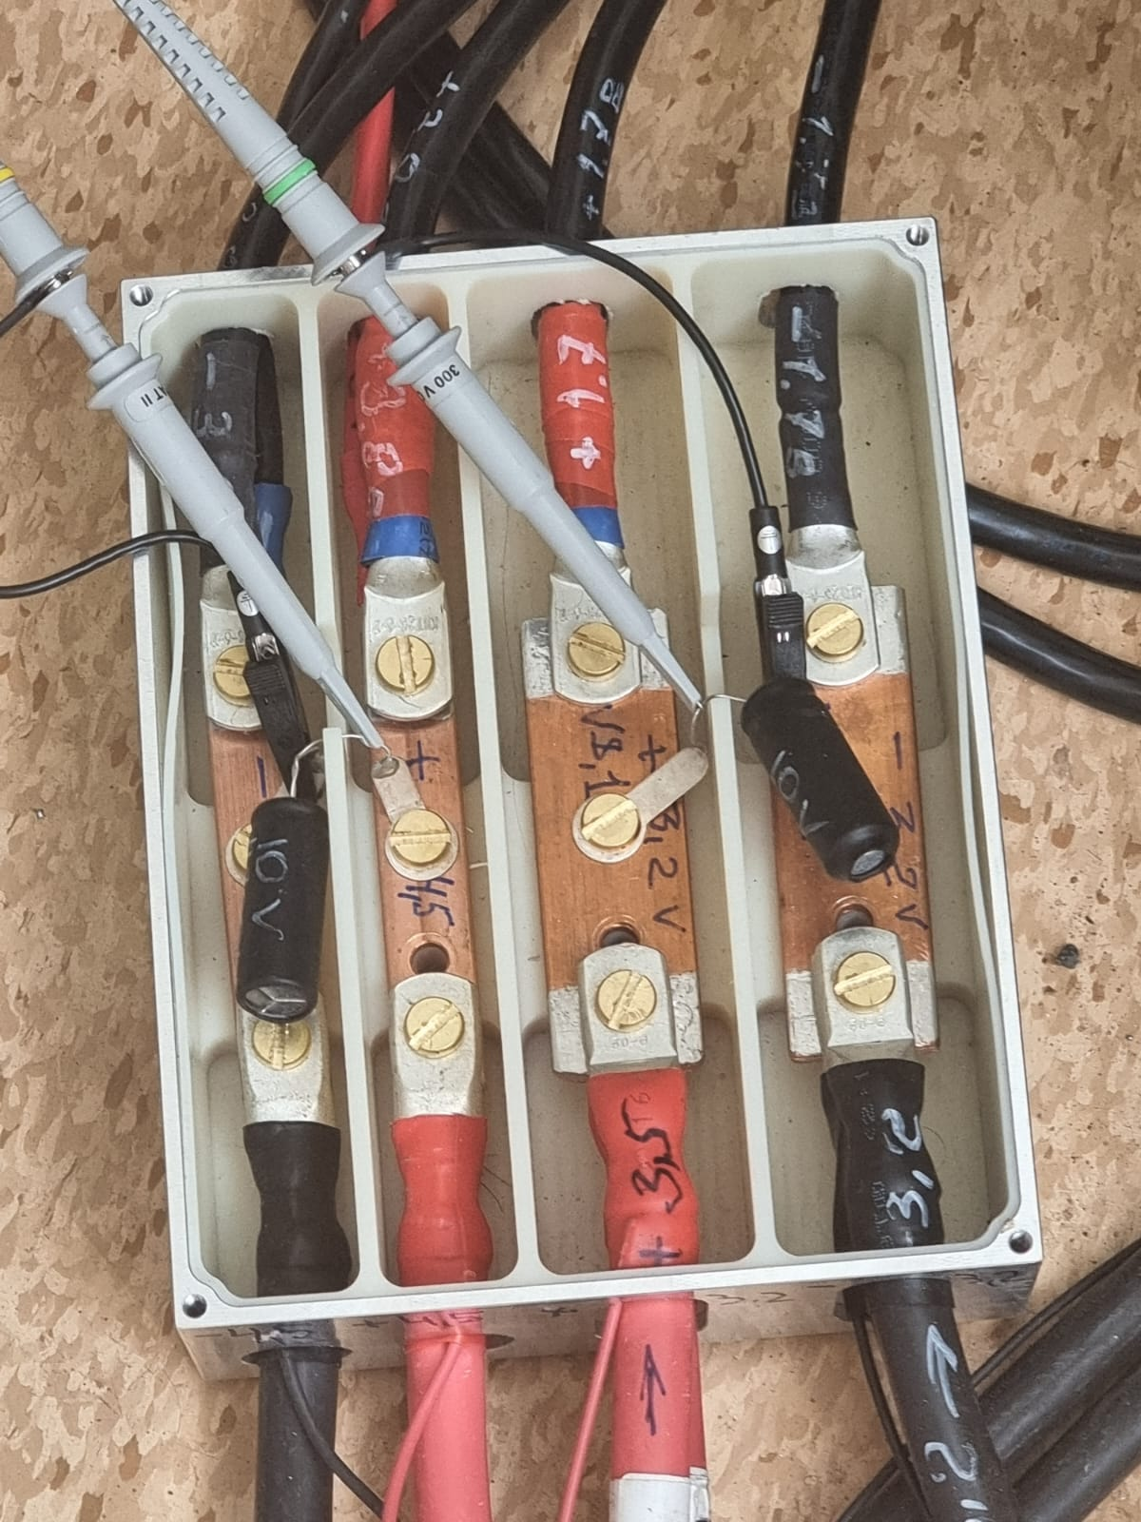
Check Oscillation On Power Feeder With Oscilloscope According To passive Board Installment.
Power feeder:
+3.2 V (analog)
+4.5 V (digital)
Green (digital) – 40 mV
Yellow (analog) – 30 mV

Slide 21
Test Setup (ROC Chamber With LV Active Board )

Slide 22
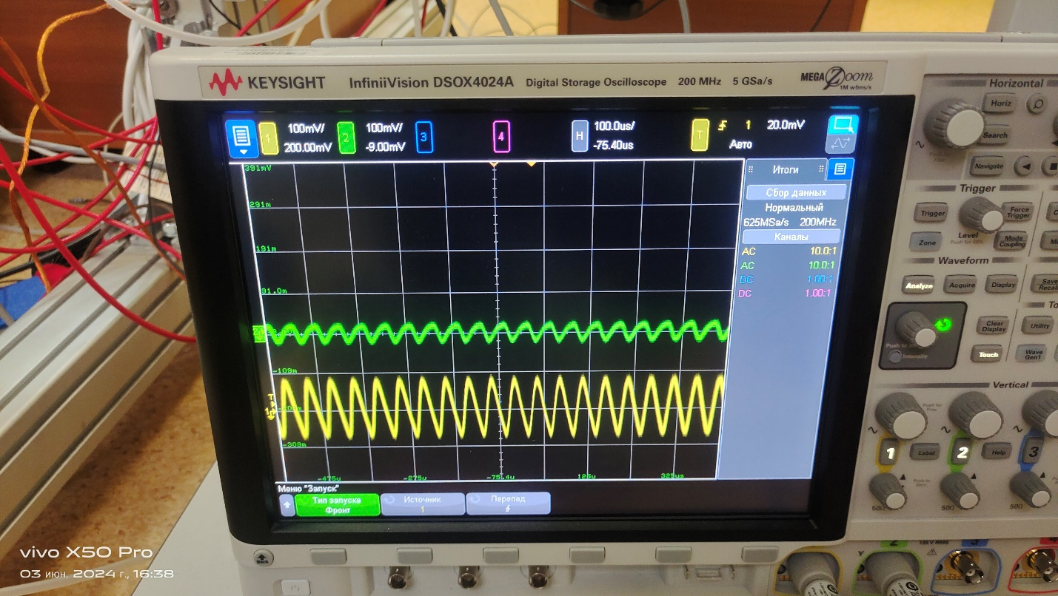
Check Oscillation On Power Feeder With Oscilloscope According To active Board .
Power feeder:
+3.2 V (analog)
+4.5 V (digital)
Green (digital) – 100 mV
Yellow (analog) – 200 mV

Slide 23
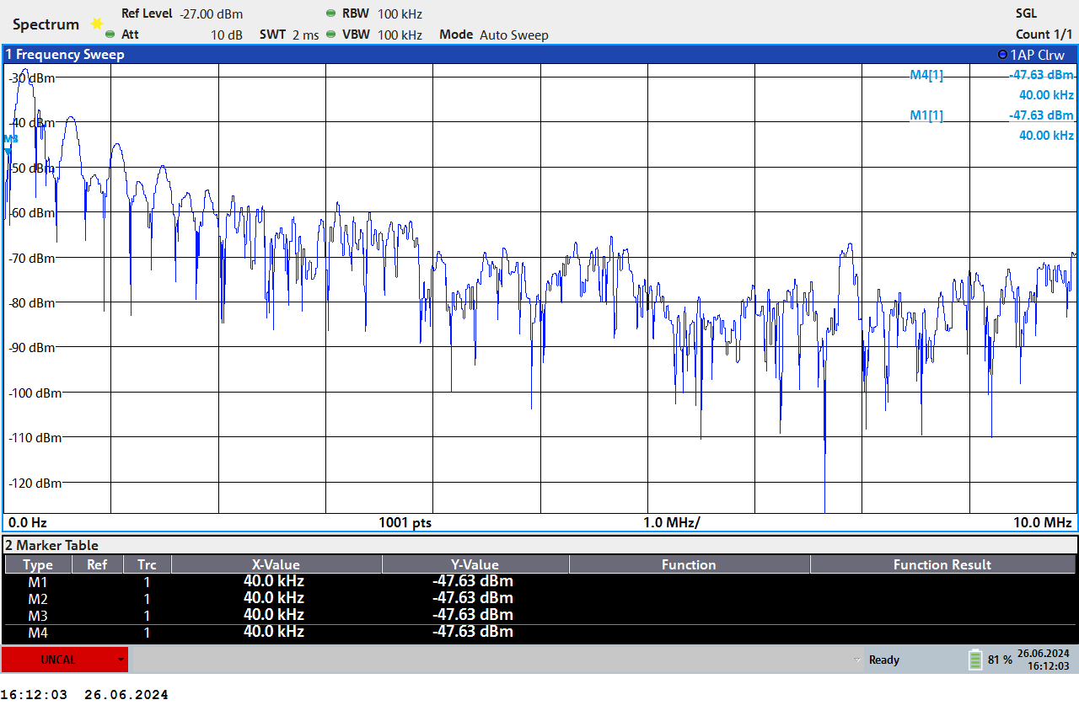
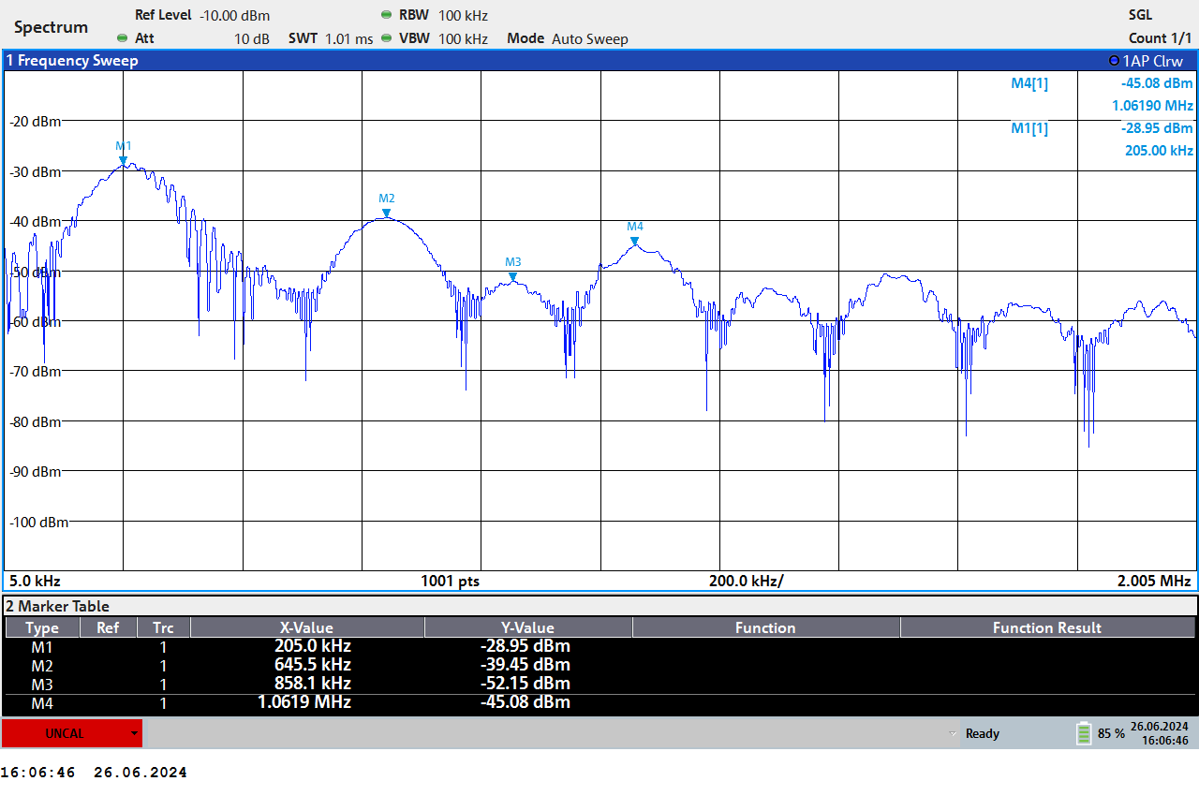
Check Harmonics With Active Antenna for Passive Board
Many peaks in the range (5 KHz ÷ 1 MHz)
205 kHz+ harmonics 645,858, 10620 kHz
Scale of Amplitude in dBm

Slide 24
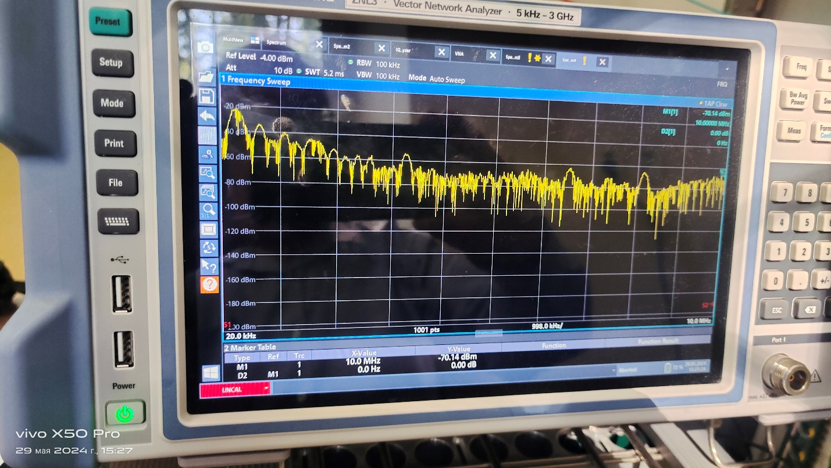
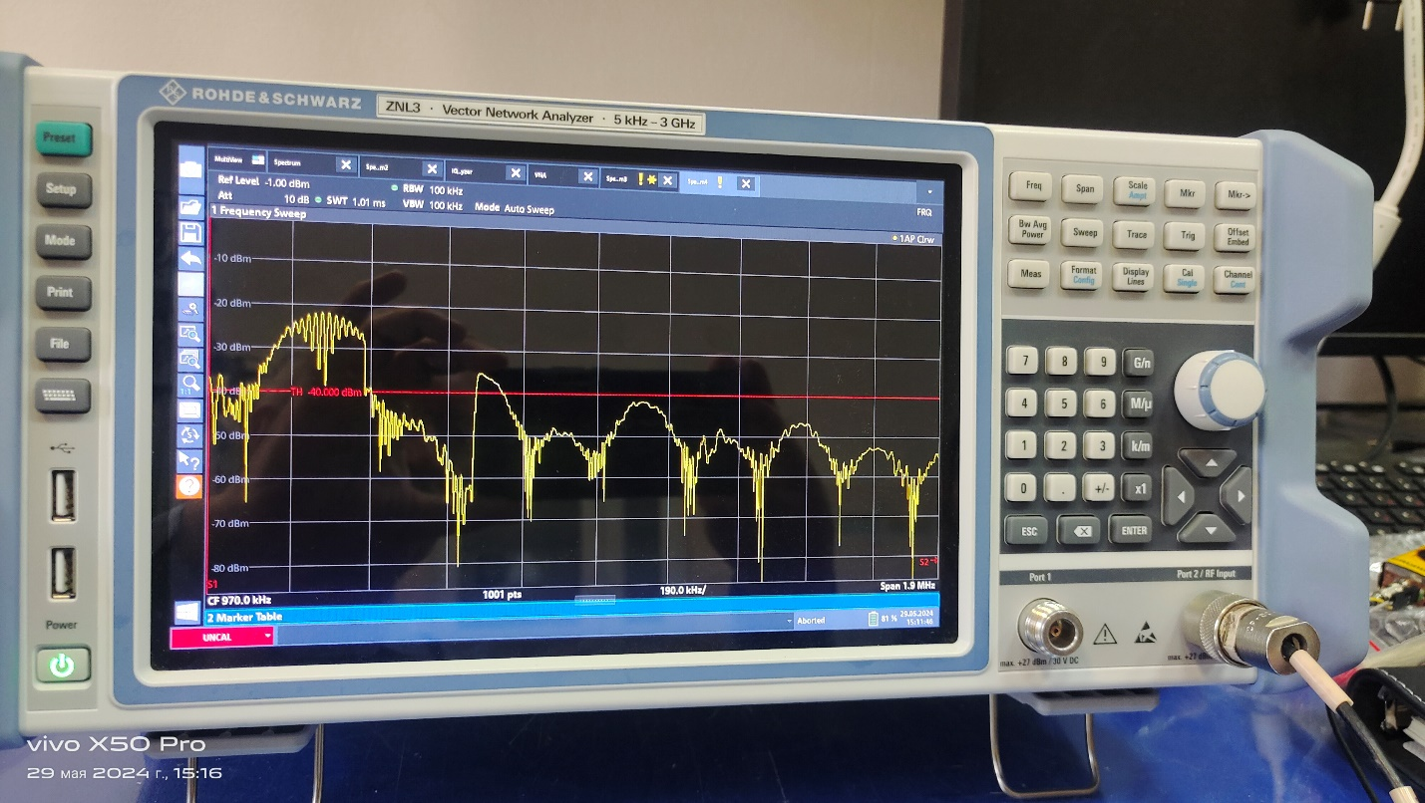
Check Harmonics With Active Antenna for Active Board
Many peaks in the range (20 KHz ÷ 10 MHz)
300 kHz and 450 KHz + harmonics
Scale of Amplitude in dBm

Slide 25
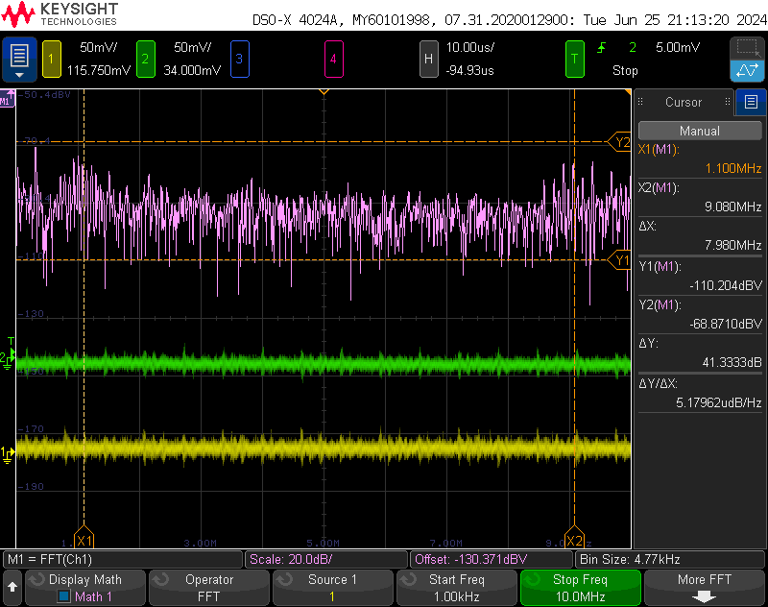
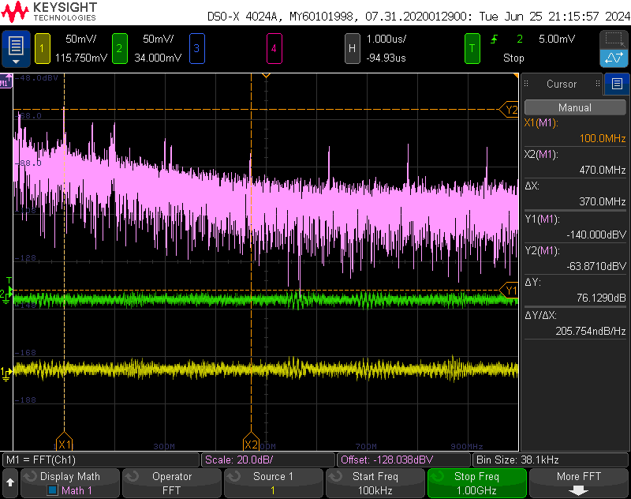
Scope FFT for +3.2V Analog with Passive Board
Many peaks in the range (1 KHz ÷ 10 MHz)
100 MHz and 470 MHz + harmonics
Scale of Amplitude in dBV

Slide 26
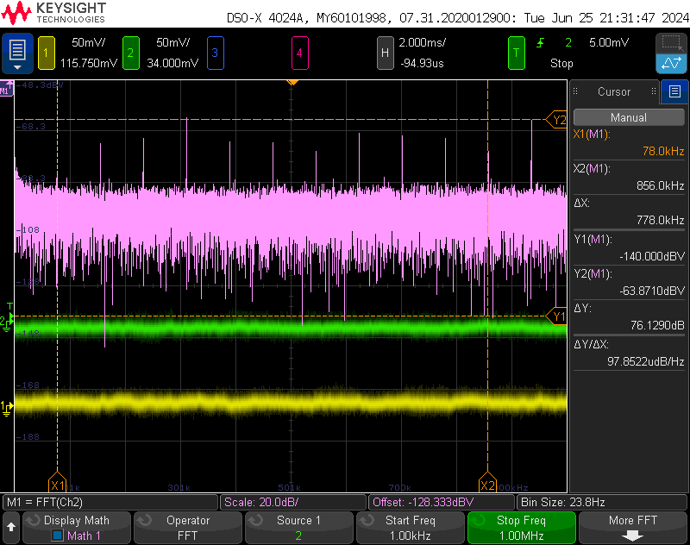
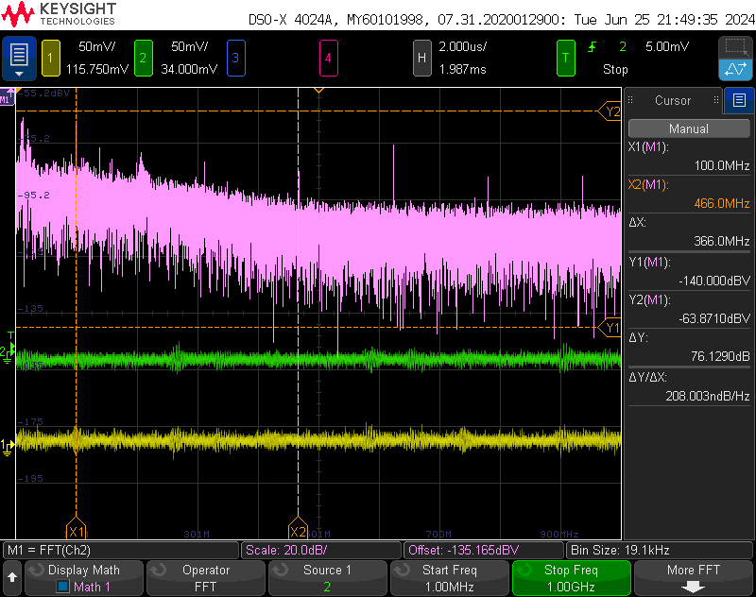
Oscilloscope FFT Measurment for +4.5 V Digital with Passive Board Installment
Many peaks in the range (1 KHz ÷ 1 MHz),
Step 78 kHz
100 MHz and 466 MHz + harmonics
Step 100 MHz
Scale of Amplitude in dBV

Slide 27
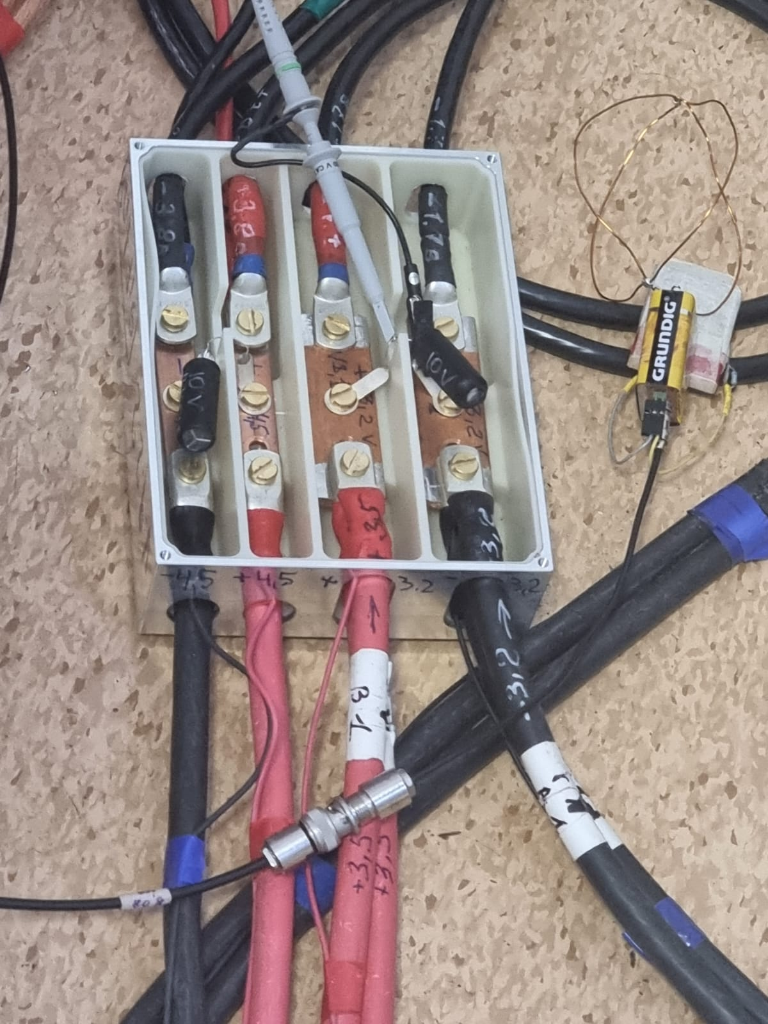
Active Antenna Measurement Close To LV Feeder box

Slide 28
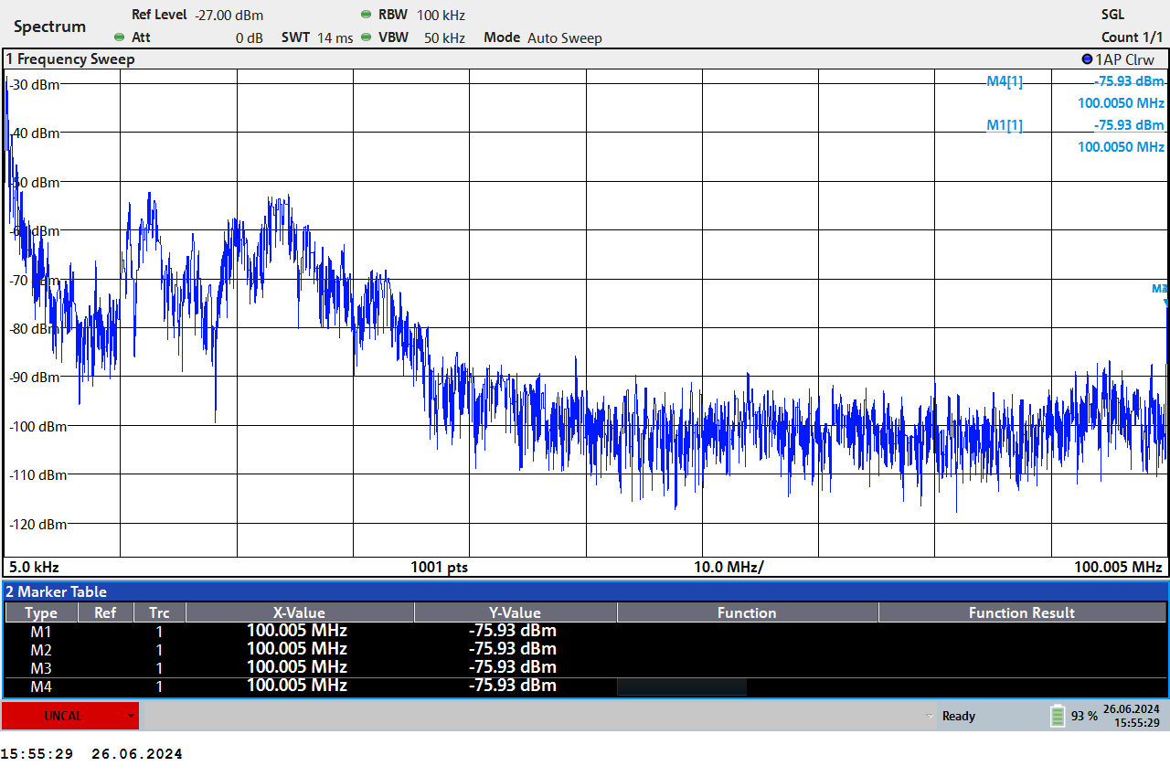
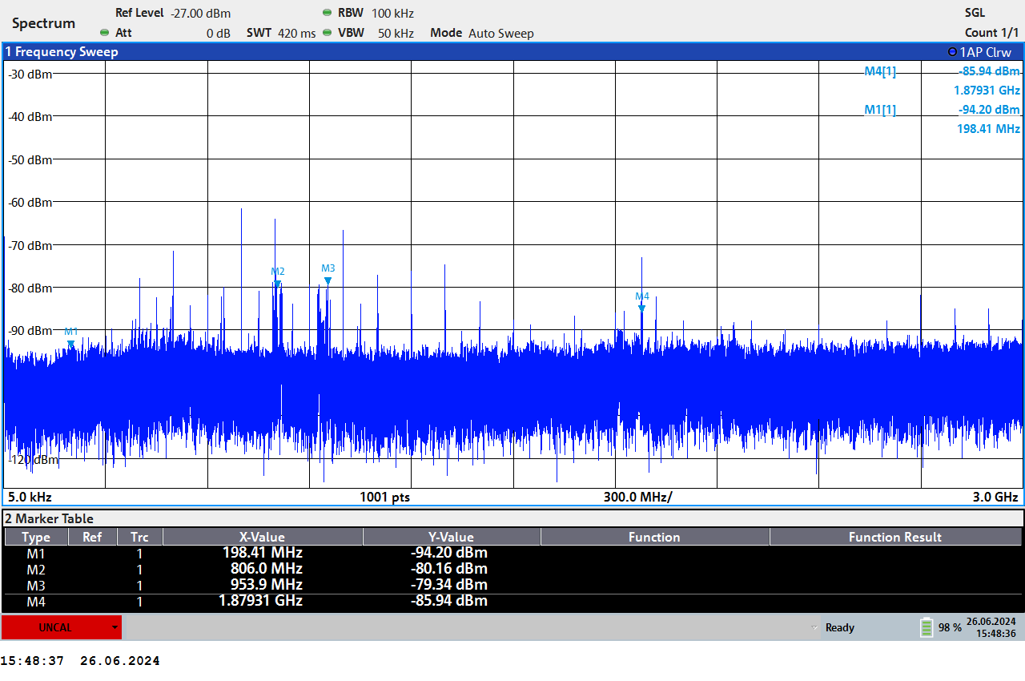
Check Harmonics With Active Antenna on Ground Measurement , Passive board
Peaks in the range 2÷6 MHz and 8.3 MHz and from 200 MHz up to 2 GHz with step of 100 MHz
Scale of Amplitude in dBm

Slide 29
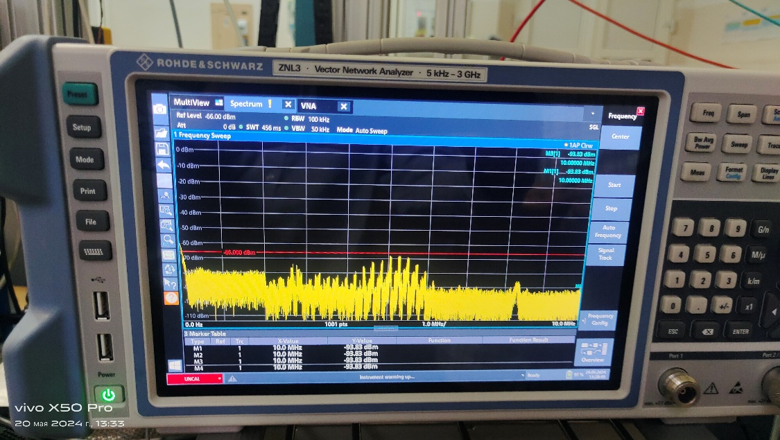
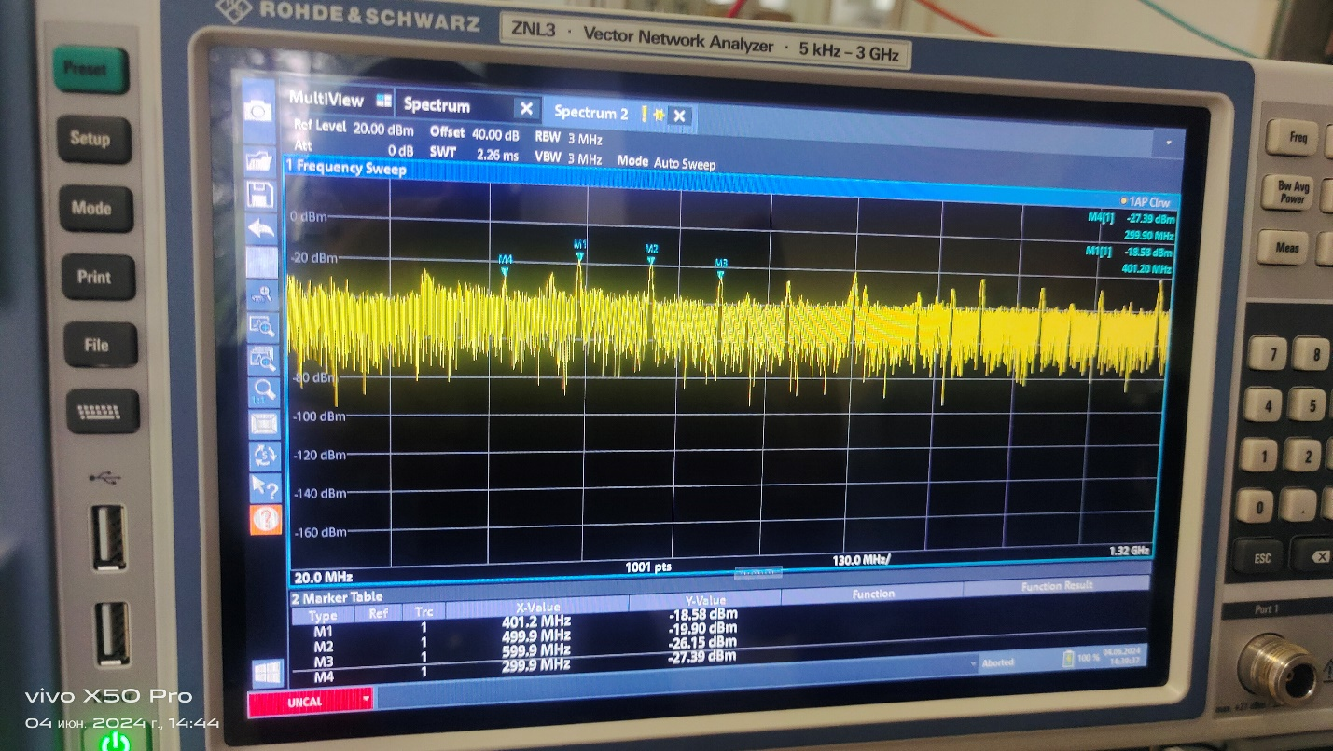
Check Harmonics With Active Antenna On ground Measurement, Active Board
Peaks in the range 2÷6 MHz and 8.3 MHz and from 300 MHz up to 2 GHz with step of 100 MHz
Scale of Amplitude in dBm

Slide 30
Test setup (ROC chamber + DAQ: Harmonics Study) With LV Passive Board DAQ - ON

Slide 31
DAQ Monitoring
we find two technical issues:
1. There are some high noise levels in the channels => (2÷4) ADC instead (1÷1.5) ADC
2. Three FEC cards out of 31 (do not work properly).
So, we start to solve these ones, making two assumptions as a source for these detected technical issues.
Starting with the assumption that there is not efficient energy for initialization (so a lack of power supply) that should arrive to the FEC cards;
up to the second possibility, it is related to the data transmission system.

Slide 32
DAQ Monitoring (Channels Noise), Before Improvement
ENC= 1.5 ch

Slide 33
Initiating our procedure with the analysis of the data acquisition system, we studied:
The noise level in the channels.
How many cards are properly working?

Slide 34
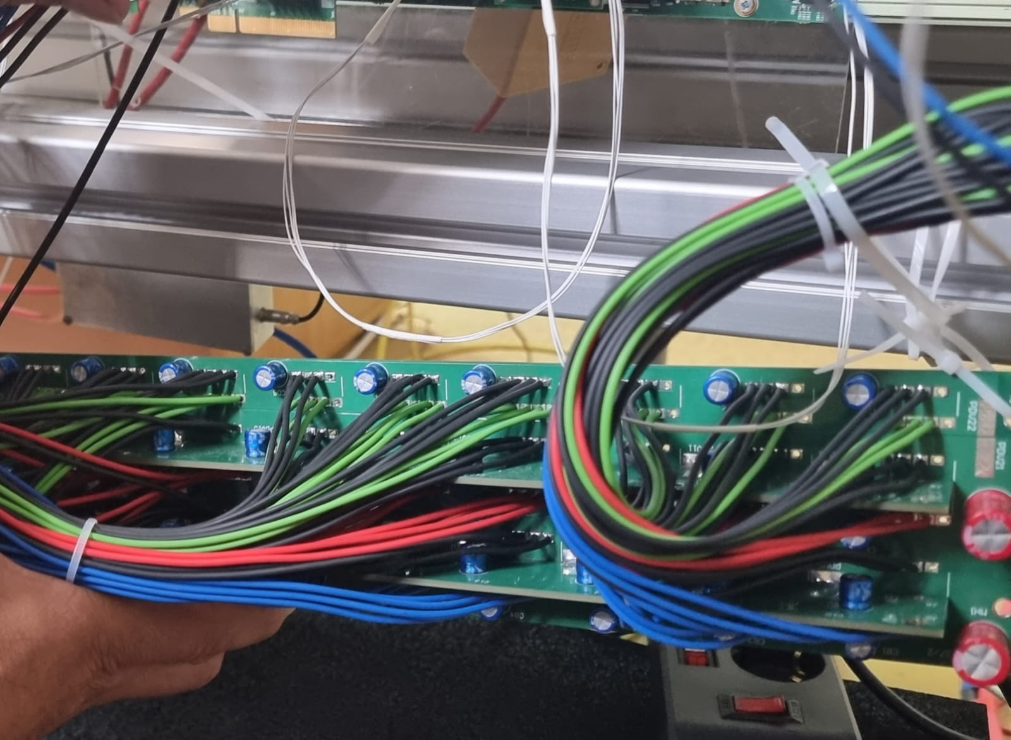
Passive stabilization Board + Set Of Capacitors
Based on the first assumption, with the lack of power supply transmitted to the FEC cards, we added some capacitors.
In the following figure, the results of the DAQ monitoring (after applying the capacitors) is shown.

Slide 35
DAQ Monitoring (Channels Noise) , After adding Capacitors in Passive stabilization board

Slide 36
Test setup (ROC chamber + DAQ: Harmonics study) With LV Active Board DAQ - ON

Slide 37
DAQ Monitoring
we find two technical issues:
1. There are some high noise levels in the channels => (2÷4) ADC instead (1÷1.5) ADC
2. Three FEC cards out of 31 (do not work properly).
So, we start to solve these ones, making two assumptions as a source for these detected technical issues.
Starting with the assumption that there is not efficient energy for initialization (so a lack of power supply) that should arrive to the FEC cards;
up to the second possibility, it is related to the data transmission system.

Slide 38
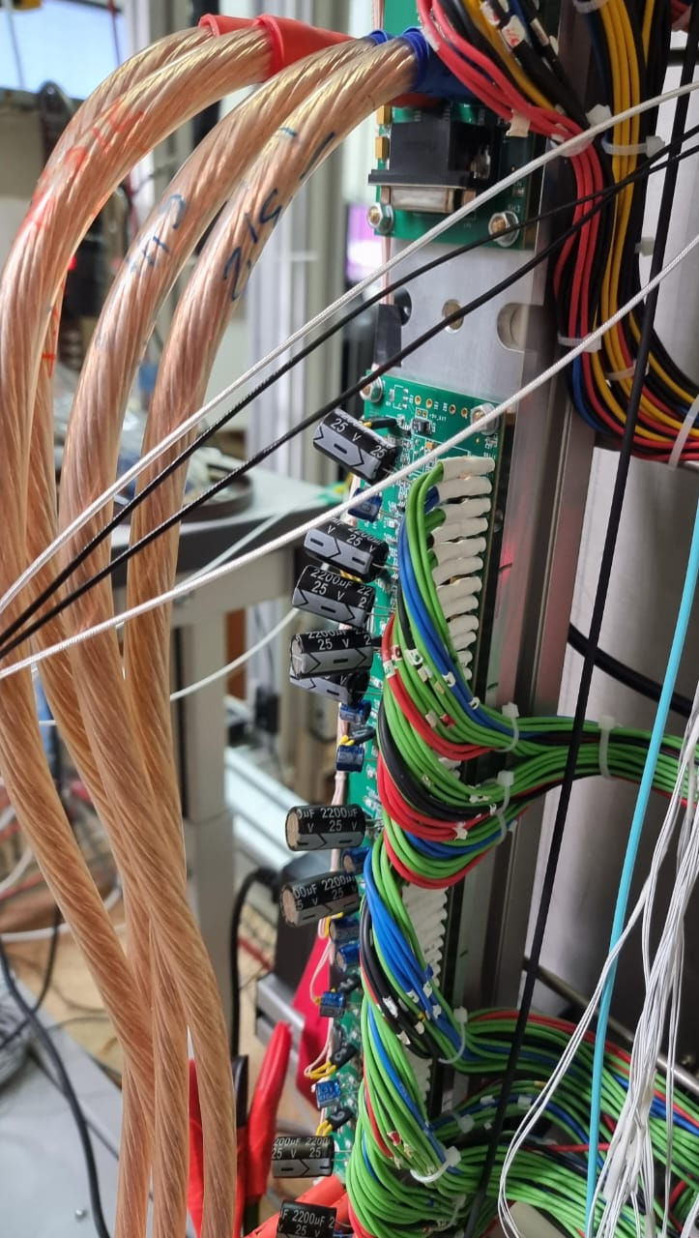
Active Stabilization Board + Set Of Capacitors
Based on the first assumption, with the lack of power supply transmitted to the FEC cards, we added some capacitors, and it is really helped => so all the FEC cards started working properly.
In the following figure, the results of the DAQ monitoring (after applying the capacitors) is shown.

Slide 39
DAQ Monitoring (Channels Noise), After Adding capacitors in Active stabilization Board
ENC= 1.2 ch
Noise of Channels still searching to know the other sources of it .
ENC= 1.2 ch

Slide 40
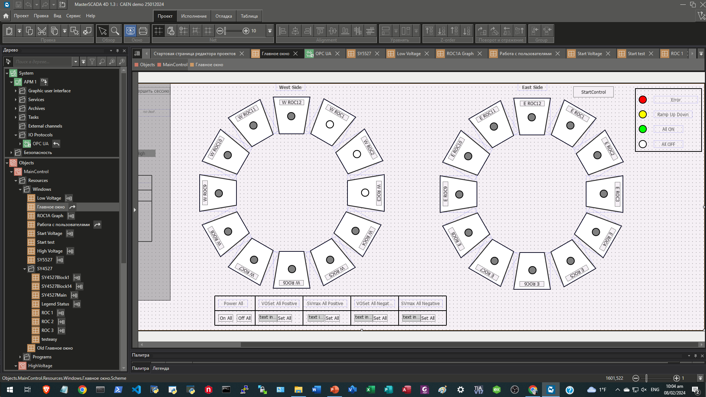
Results for HV and LV Control, Monitoring Using Master SCADA, Main window Interface.

Slide 41
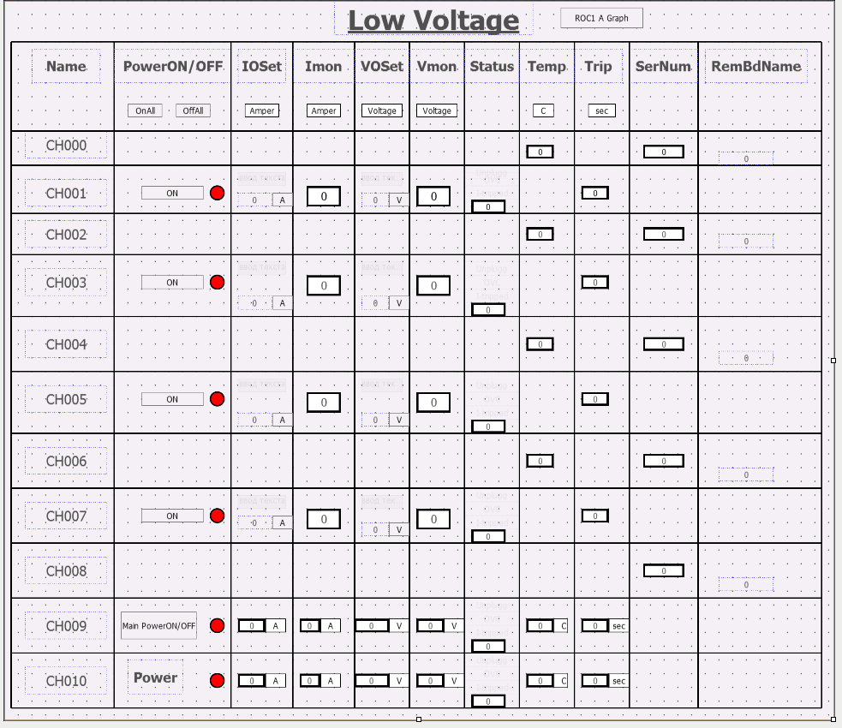
Low Voltage interface
62_84 85_84 69_84 75_84

Slide 42
Overall Conclusion
A vector analyzer with rod and spherical (active) antennas is a convenient tool for detecting additional frequencies when ROC chamber tested with FE cards and DAQ.
The charge-sensitive amplifier with a 4th order shaper with piking time Tp=250ns has a maximum gain K=18 mV/fC in the range about of 1 MHz (ASIC SAMPA) . The appearance of additional interference frequencies in the range about 1 MHz leads to an increase in the “noise” in the readout channals . The specified limit on the noise level of the recording channel is about ENC =1000e (or 0.15 fC = 1 ADC) with a thermal noise value ENC =550e with zero detector capacitance and ENC = (600÷800) e - with detector capacitance Cd = (20÷40) pF.
When DAQ is operating, additional interference is observed in the frequency range of 20 kHz ÷ 10 MHz and a set of frequencies from 200 MHz up to 1.3 GHz (in increments of 100 MHz, presumably from the operation of data transmission links from FE cards to the controller). Interference from DAQ leads to an increase "noise" value up to ENC = (1.5-2) ADC and more.

Slide 43
Overall Conclusion Followed
A qualitative study of the appearance of additional frequencies (interference) from the DAQ will allow us to minimize it influence on the amount of noise in the channel ( ENC ).
Eliminating generation on the power buses using capacitive filters at the outputs of the LVN9 power stabilization boards made it possible to stabilize the operation of the readout electronics and reduce the noise level of the channels from ENC = 1.8 ADC to ENC = 1.5 ADC.
Further reduction of noise in the channels is possible by improving the readout electronics (power buses rated at +3.2V to each FE card), ground lines in the input flat cables from the ROC chamber to the FE cards, and eliminating the clock signal data transmission links in the frequency range 100 MHz-1.3 GHz.

Slide 44
Overall Conclusion Followed
CAEN LV power supply:
Main frequenсy: F1=320 kHz
Computer:
Main frequencies: F2=23 MHz + harmonics - 66 MHz and 100 MHz and
F3=154 MHz + harmonics – 466 MHz, 622 MHz, 778 MHz, 934 MHz
TPC DAQ harmonics:
from 20 kHz up to 6 MHz + 8.3 MHz and from 300 MHz up to 2 GHz (with step 100 MHz)
Additional Study Needed…

Slide 45
Acknowledgement
I am appreciative of everyone's assistance and cooperation with this Work.
I want to express my sincere gratitude to Dr. Sergey Movchan for all of his assistance and guidance in helping us to finish our research project and poster.

Slide 46
Thanks for your Attention
Scan here for PPT
Full Name
Youmna Ghoneim
Telegram Contact
Tel.: +7 (923) 40 80 895
E-mail: youmnasami24@gmail.com, Ghoneim@jinr.ru
27.06.2024

