Slide 1
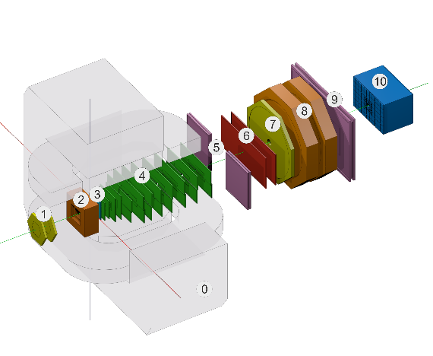
Status of the Geometry and Configuration Information systems for BM@N
E. Alexandrov¹, I. Alexandrov¹, A. Chebotov¹, I.Filozova¹, K.Gertsenberger¹, D.Priakhina¹, I.Romanov¹, G.Shestakova¹, A. Yakovlev¹
¹JINR, Dubna
13th Collaboration Meeting of the BM@N Experiment at the NICA Facility, Dubna,VBLHEP JINR, 8-10 October, 2024
Joint Institute for Nuclear Research

Slide 2
Outline
Status of the Geometry Information System
Status of the Configuration Information System
Notes:
set of various configuration hardware parameters
required for setting the detectors into operation modes (like working voltage)

Slide 3
Status of the Geometry Information System
Geometry server is available and last versions are uploaded
https://bmn-geometry.jinr.ru/
Versions 24.04.0 and dev_14.04.2024 is the same (may be need delete dev_14.04.2024).
Version 24.09.0 and dev_08.10.2024 is the same too.
Three detectors was changed between 24.09.0 and 24.04.0 (TOF, NDET, ZDC)
Notes:
set of various configuration hardware parameters
required for setting the detectors into operation modes (like working voltage)

Slide 4
Configuration: Possibilities
can store and provide configuration data for online processing :
set of various detectors configuration parameters (working voltage etc.)
setup data including sequences of software tasks with their dependencies
can start, stop and monitor setup tasks during experiment sessions
can use web interface to supports data bases and operations with setup tasks
Notes:
set of various configuration hardware parameters
required for setting the detectors into operation modes (like working voltage)

Slide 5
BM@N Configuration Information System and online processes diagram
bmn-config-he.jinr
bmn-config-w1-he.jinr
bmn-config-he.jinr
bmn-config-he.jinr

Slide 6
Configuration Manager started panel.
Online processes to be controlled by Configuration manager

Slide 7
Configuration Manager tasks started panel.
Online processes to be controlled by Configuration manager

Slide 8
Configuration Manager finished panel.
Online processes to be controlled by Configuration manager

Slide 9
Configuration: Example of task view (zoomed)

Slide 10
Upgrades of the Configuration Information System
Configuration manager
multithreaded errors fixed (floating error with writing into DB)
bug with number of Config Manager run fixed
log support corrections
stop/start sessions: refresh of DDS server
Web Configuration manager
imprpvements of Run Manager panel
added Config manager logs panel with scrollbar
keep in panel running tasks statuses
some bugs with refresh and freeze of panel fixed

Slide 11
Configuration System: Next steps
Configuration manager log panel
add messages status filter
add Grafana monitoring of both Configuraation manager itself and WEB components
moving to use REST API in all public communications

