Slide 1



08-10 October 2024
13th Collaboration Meeting of the BM@N Experiment at NICA
Development of Infrastructure for BM@N Information Systems
Alexander Chebotov
Konstantin Gertsenberger
Ilya Romanov
JINR, LHEP

Slide 2


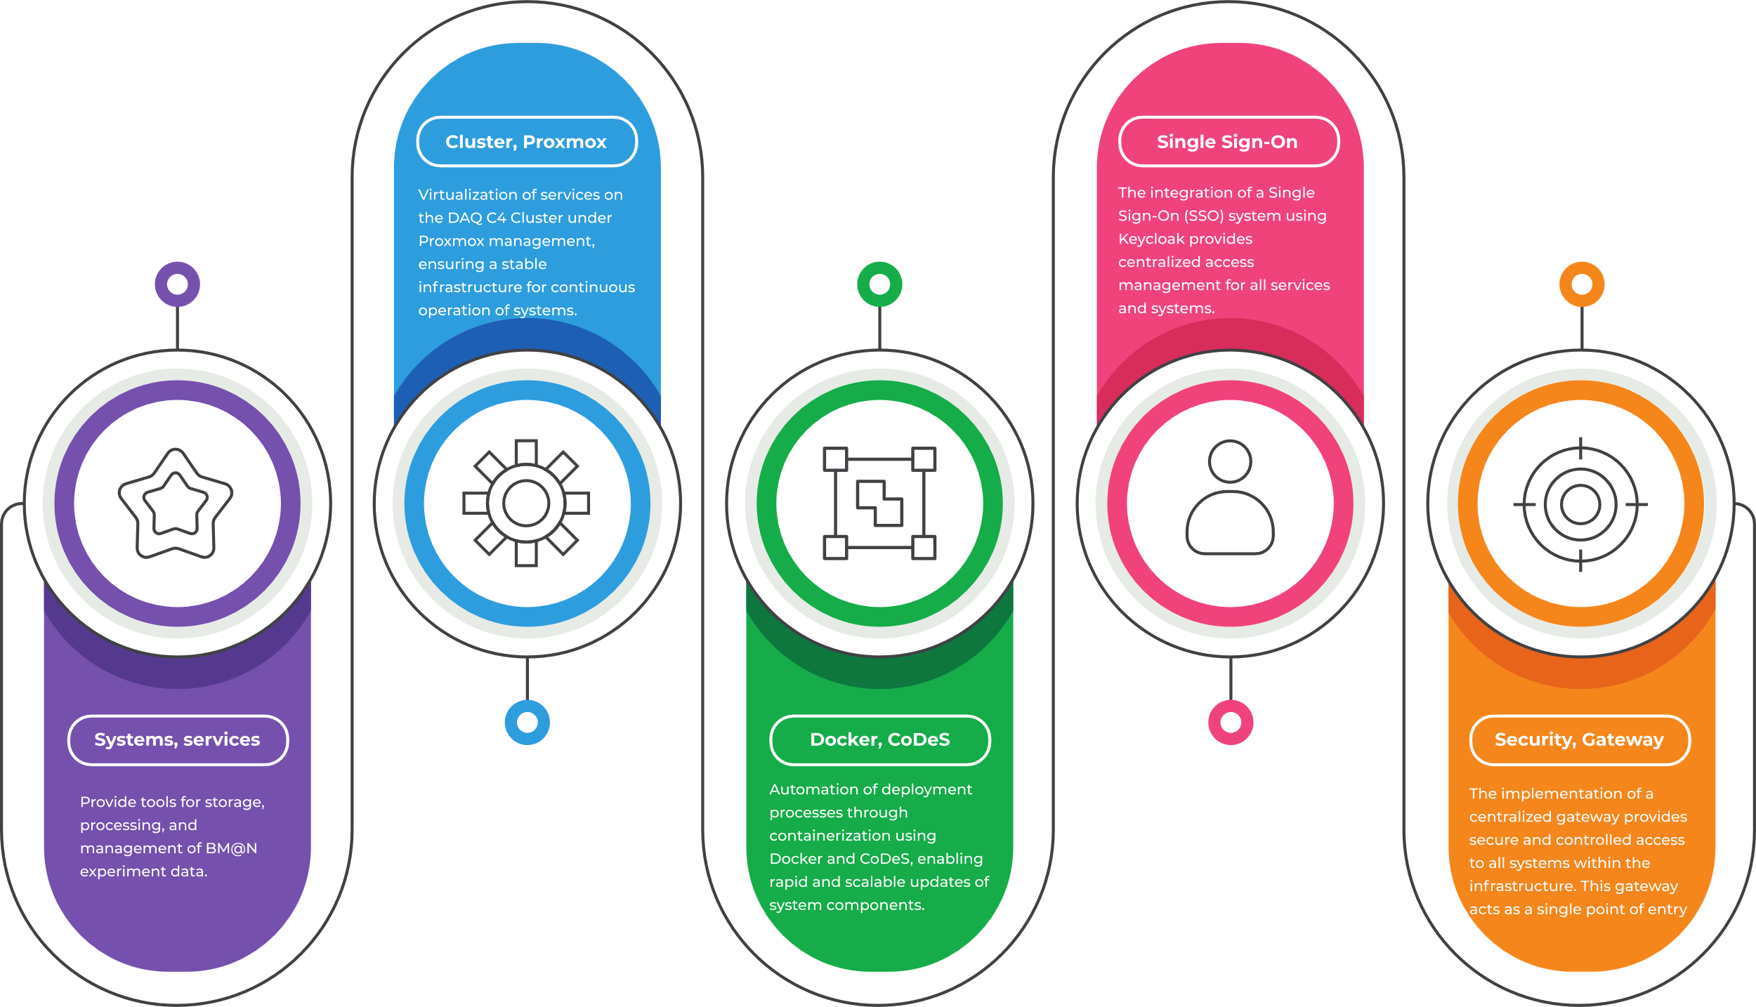

OUTLINE

Slide 3

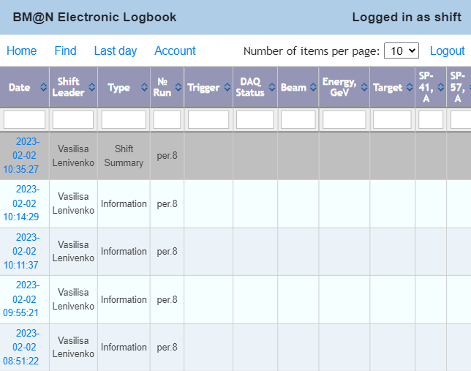
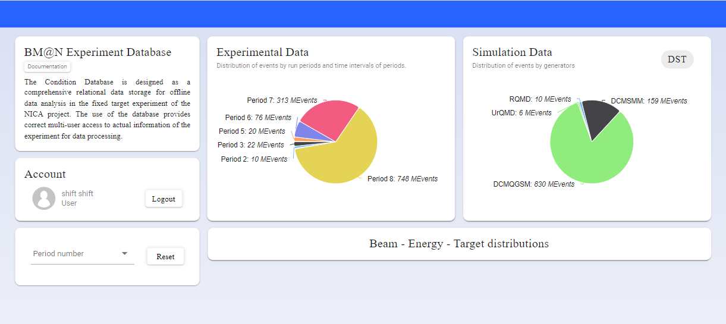
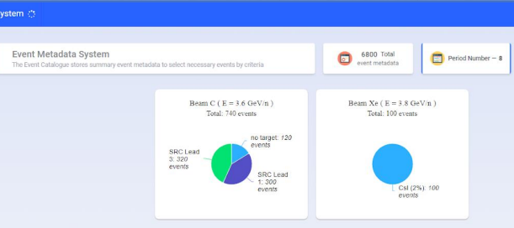
Electronic Logbook (e-Log)
The Online Logbook System allows collaboration members to record information about events, system states, and detector operation during experiments, such as particle type, energy, magnetic field, and triggers. This data is crucial for analyzing particle collisions, making multi-user access essential for high-energy physics experiments.
Condition Database(UniConDa)
The Condition Database is designed for storing and managing parametric information related to the experiment systems, which is essential for data processing.
Event Metadata System
The Event Metadata System is built on the Event Database (Event Catalogue), which contains summary information about recorded particle collision events and allows for the quick selection of only those events needed for specific physical analysis.

Slide 4
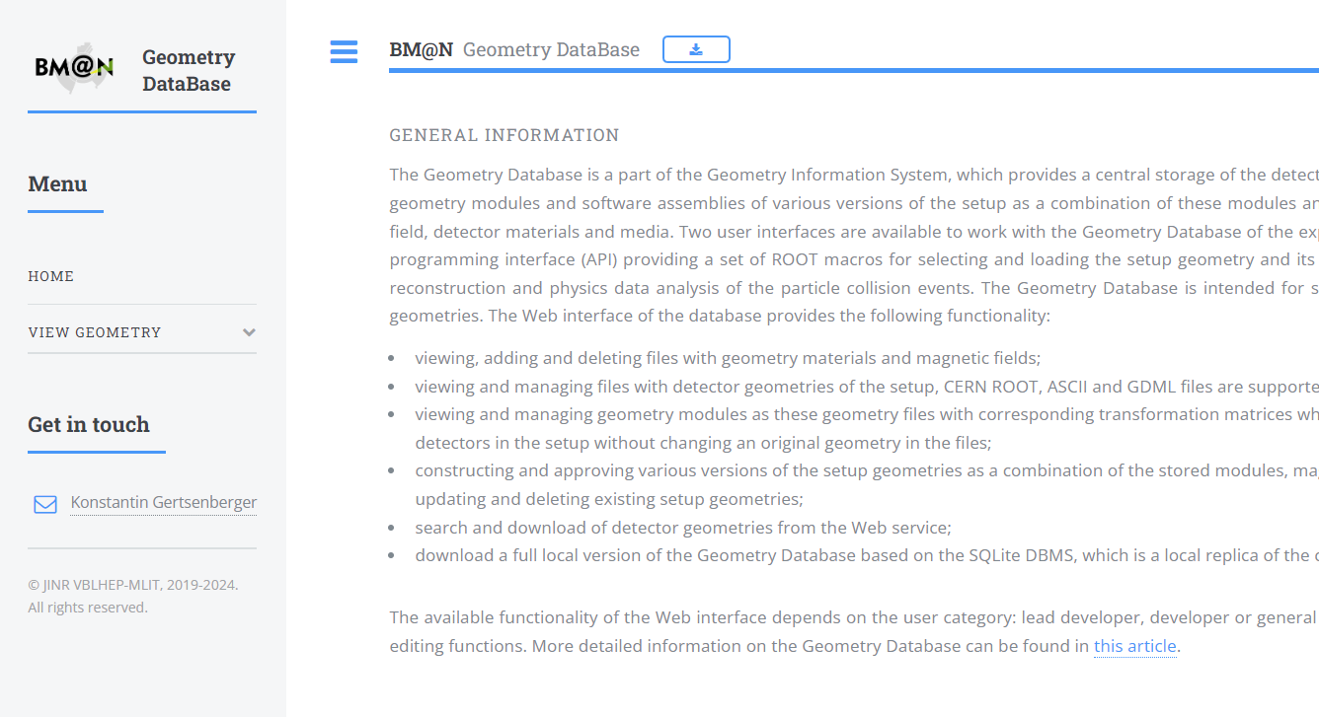
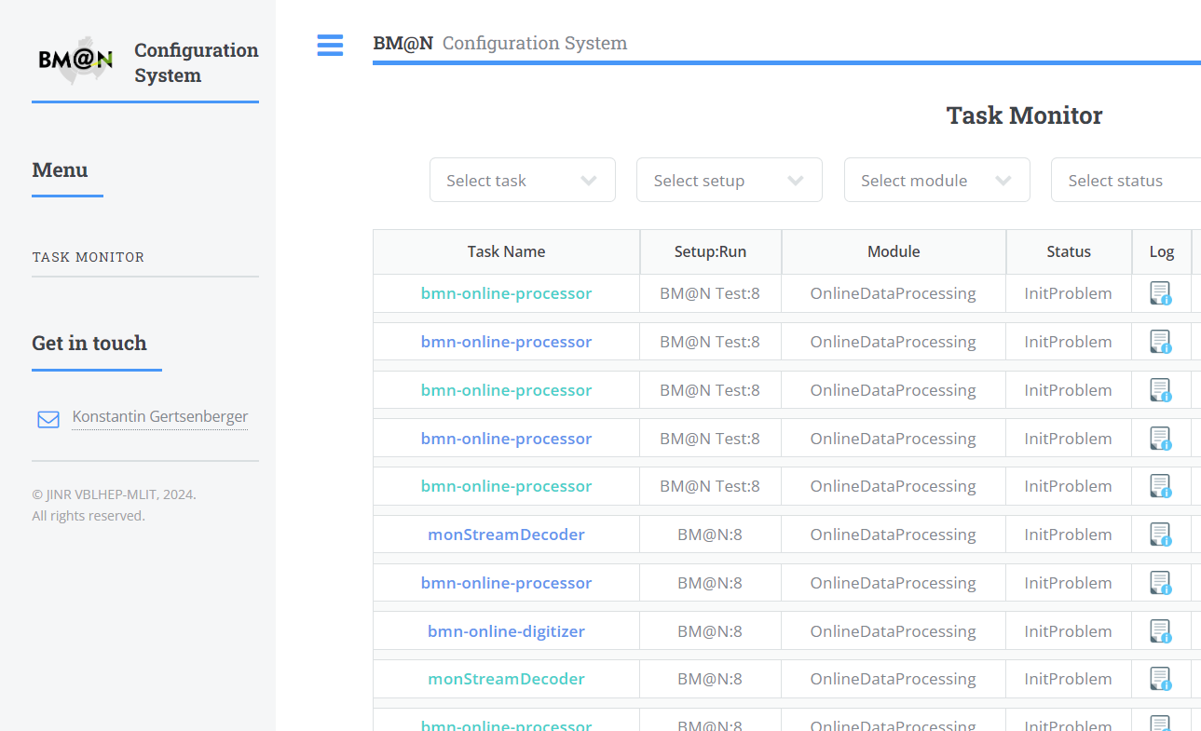
Geometry System
The geometry information system, based on the geometric database, stores and processes data about the composition and geometric structure of detectors used in experiments, providing a centralized repository for geometries.
Configuration System
The Configuration Information System is used to store and provide data on the configuration of hardware and software systems of the experiment during online data collection from the detectors.

Slide 5
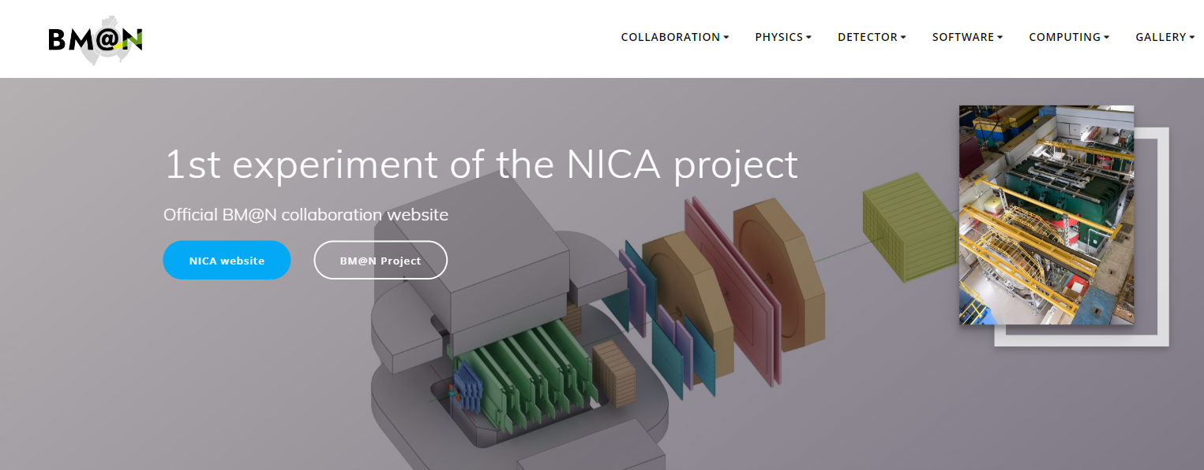
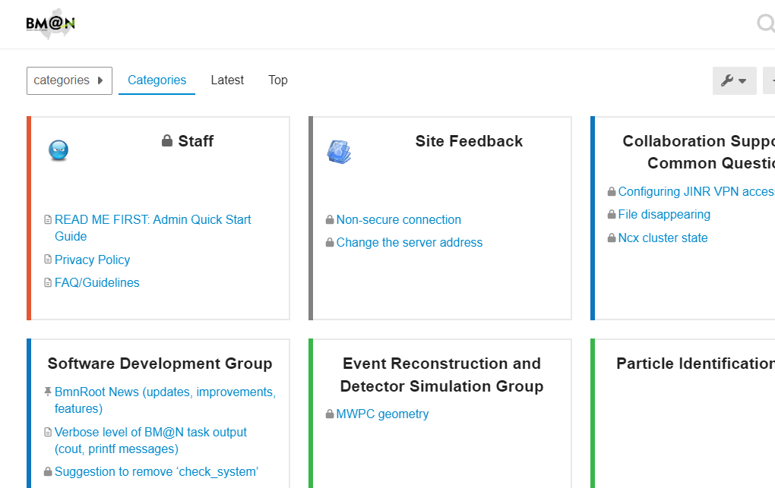
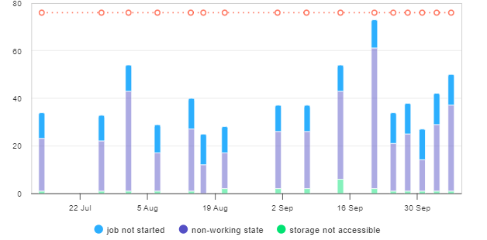
Official BM@N Website
Our website is the official BM@N website, serving as a crucial source of information about the experiment, participants, results, and project-related news and events.
BM@N Forum
This is a place where our scientists and participants can discuss, exchange ideas and experiences, explore new directions, and collectively address important questions.
Scheduler Interface
Scheduler is a module for the ROOT and FairRoot frameworks that simplifies task distribution on clusters using existing batch processing systems (SLURM, SGE, Torque) and supports parallel task execution.
BM@N Tango
BM@N Tango is a viewer for hardware parameters of the slow control system.
Cluster Inspector File Inspector
…………………………………..

Slide 6
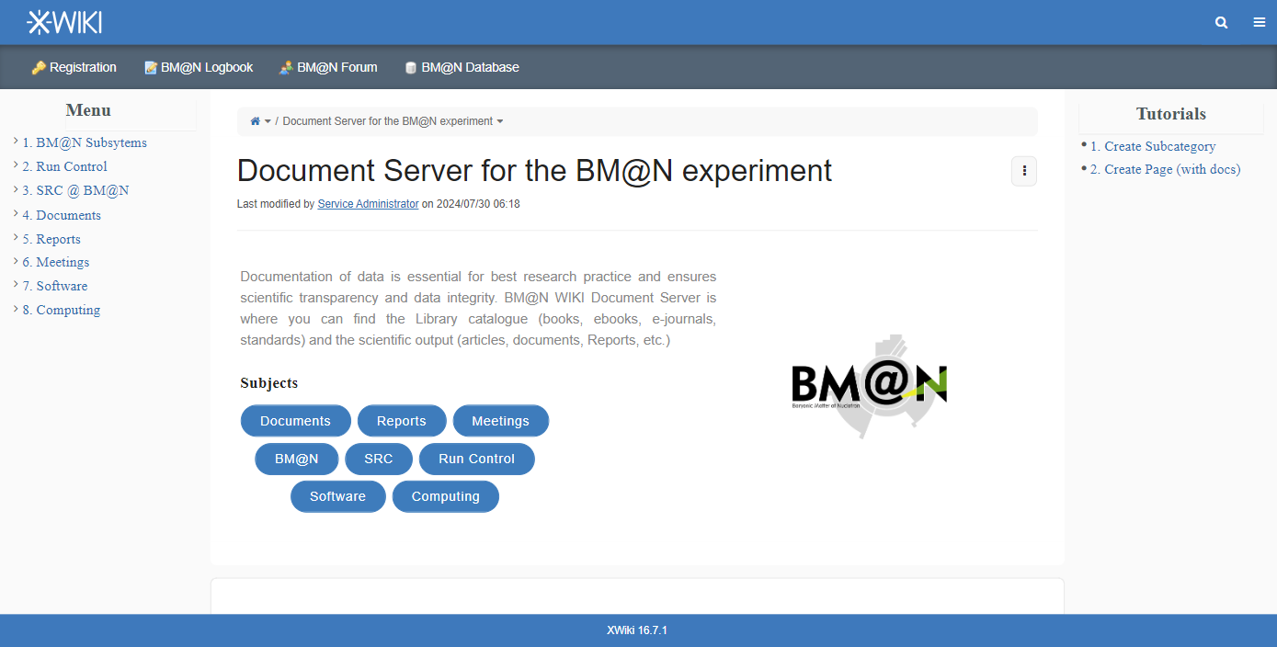

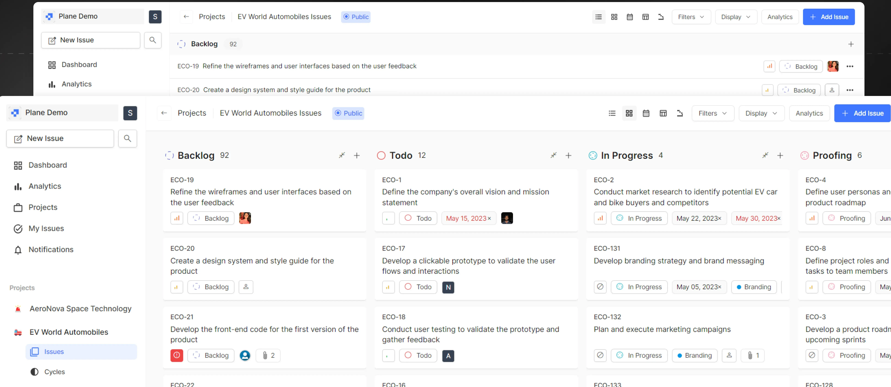
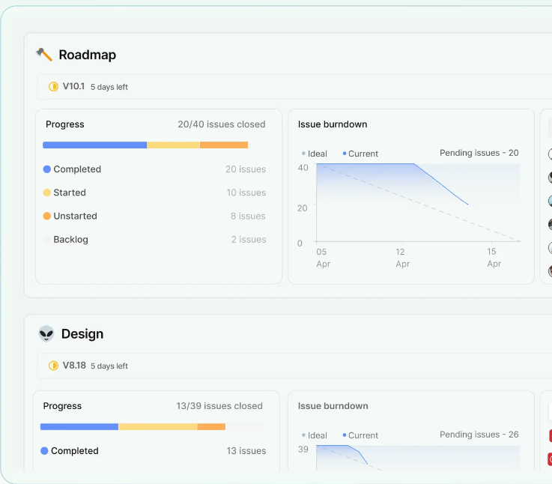
BM@N WIKI
The use of a content management system in experiments provides centralized storage and access to a variety of materials and documentation.
BM@N Project Manager
BM@N Project Manager is a project management tool that enables efficient task coordination and optimization of workflows.
Intuitive Interface
Progress Tracking
Real-time task updates
SSO-enabled
Kanban boards
Lists
Timelines

Slide 7
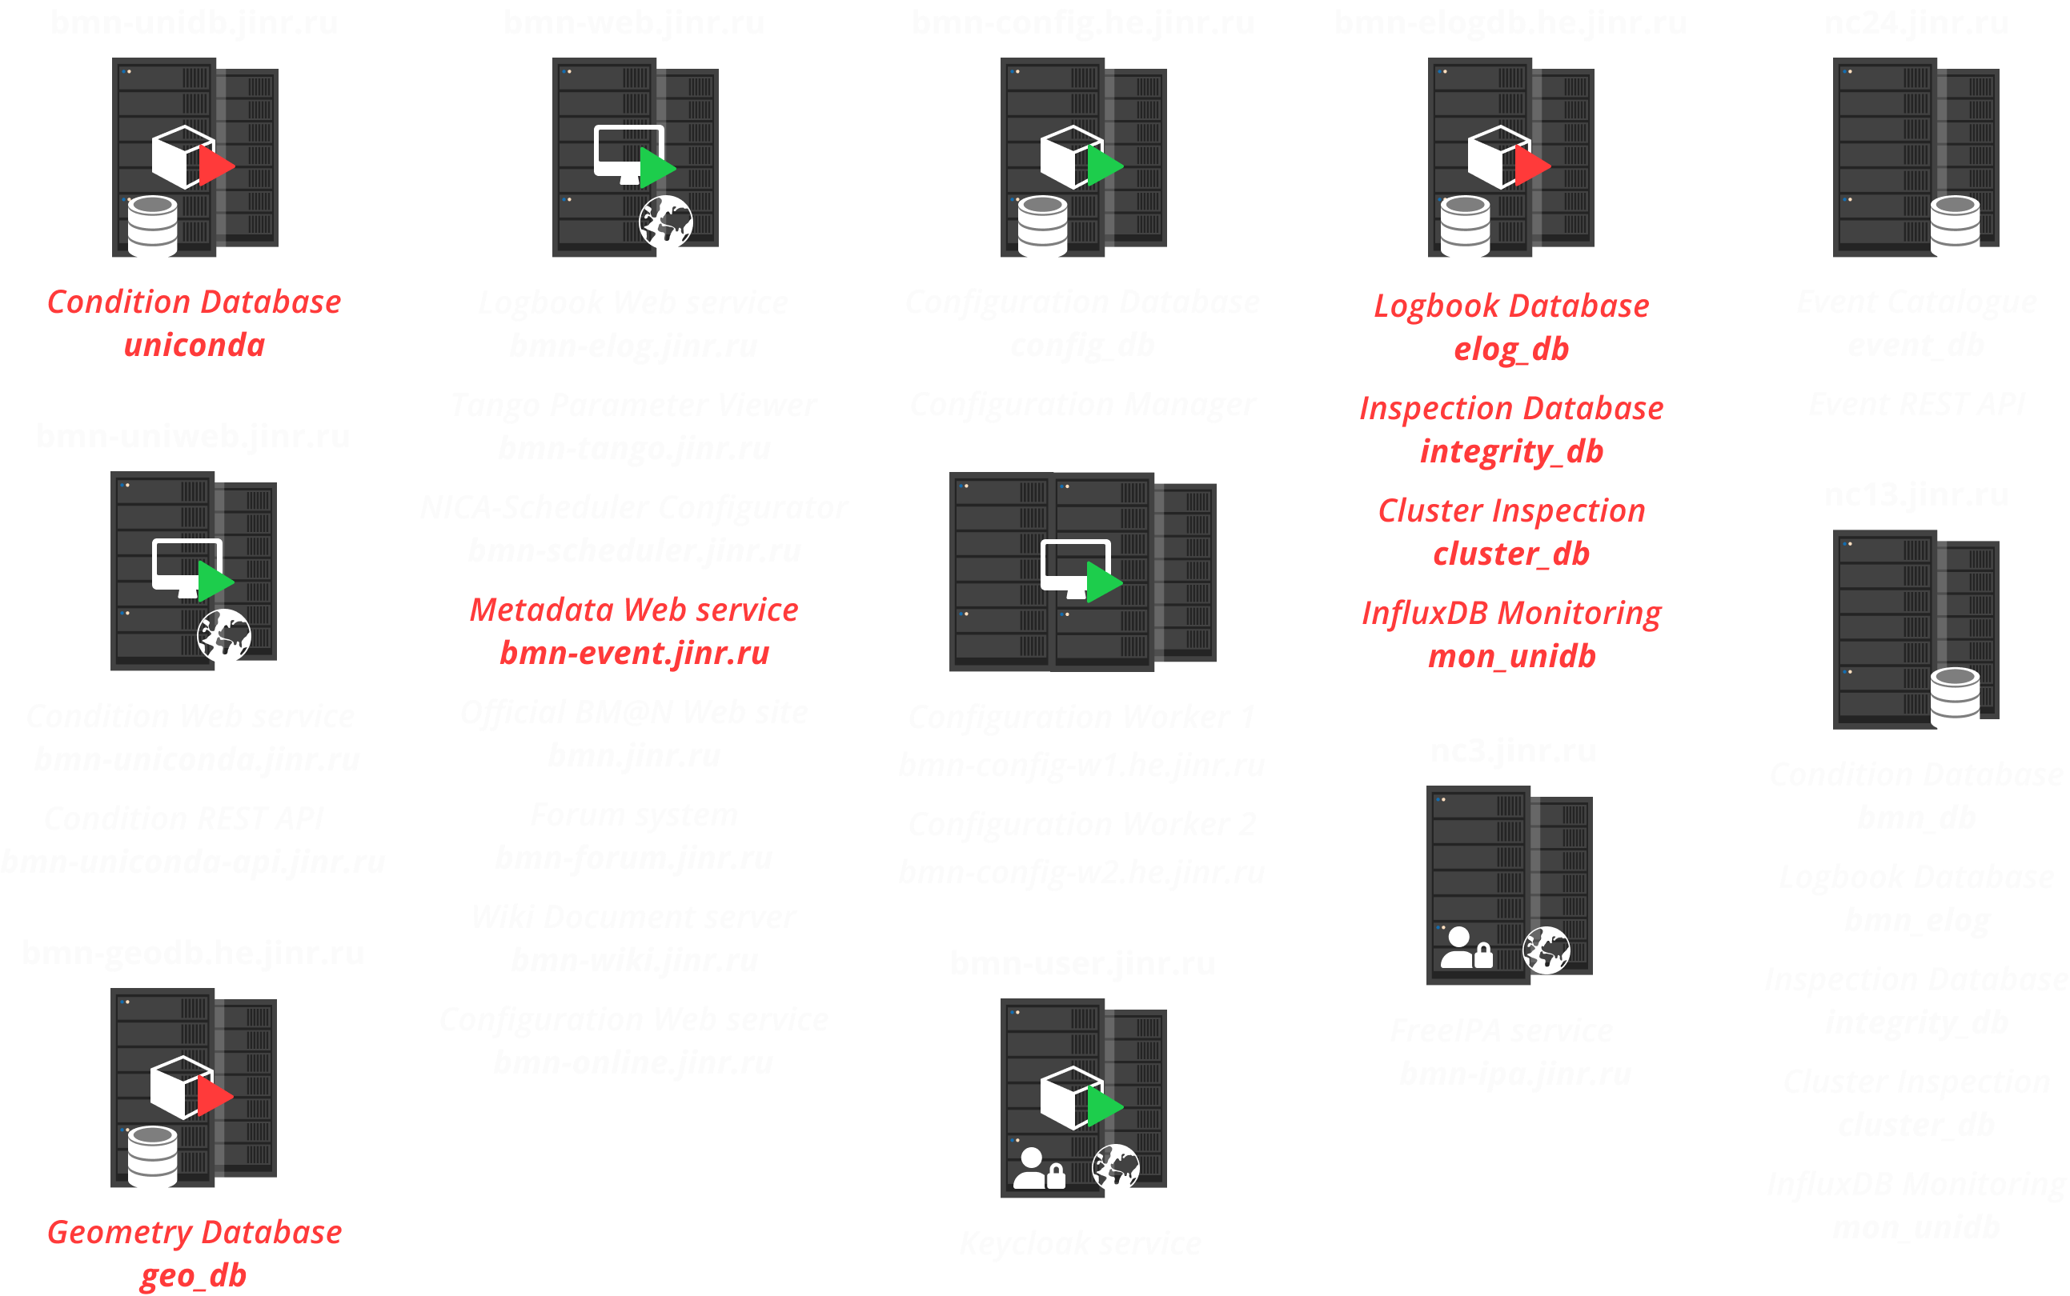
Past Infrastructure
Security vulnerability
Difficult to control
Limited scalability and conflicts
Lack of modern technologies

Slide 8
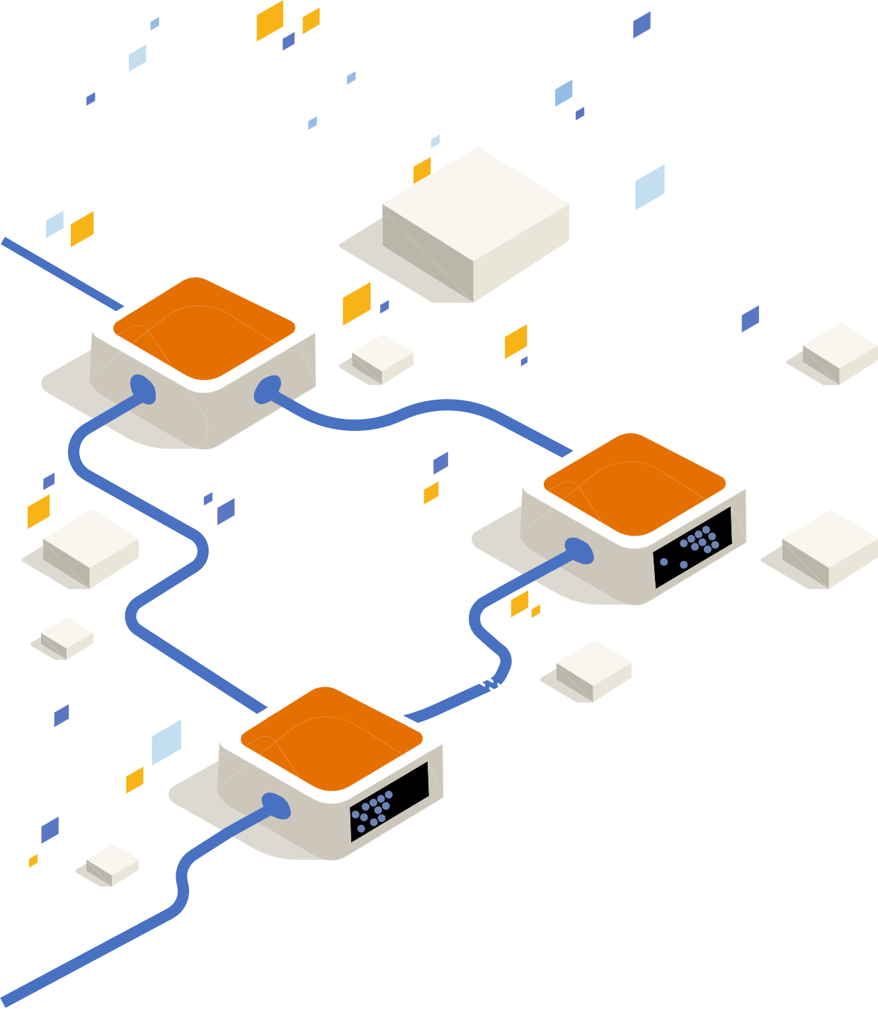




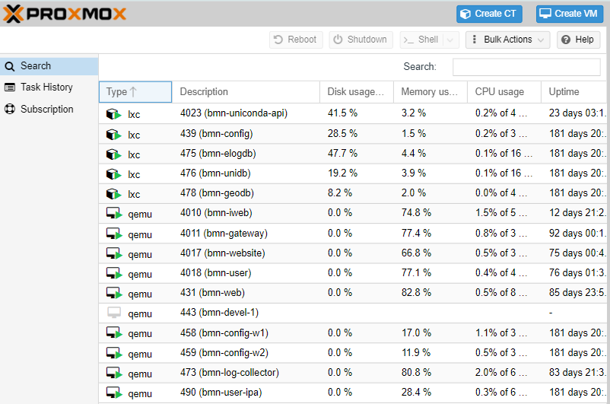
DAQ C4 Cluster
Proxmox is a virtualization and resource management platform that allows you to create VMs and containers using virtualization technologies such as KVM for VMs and LXC (Linux Containers) for containers.
Versatility: Support for virtual machines and containers.
High-Performance Storage: Utilizing Fast SSD Storage.
Convenient Interface: Web interface for managing all aspects of virtualization.
Backups and Recovery: Integrated tools for creating backups.
Performance: Good performance for virtual machines with KVM.
Free Software: Software based on open-source code.

Slide 9

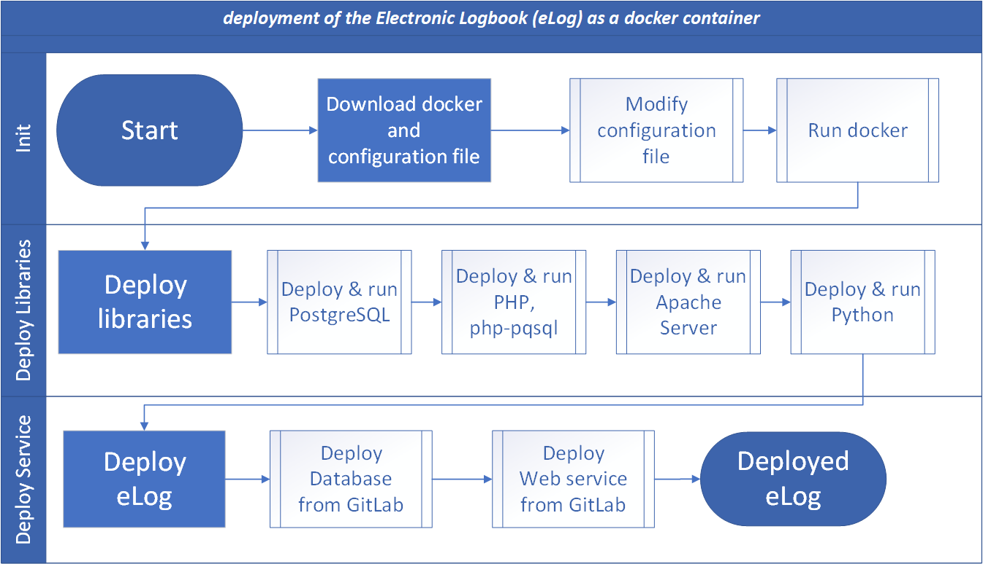






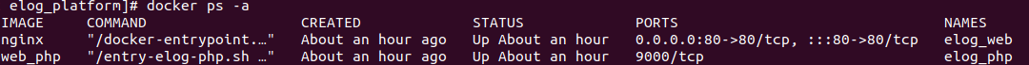





Deployment and Service Management with Docker and CoDeS
We use Docker containerization and the CoDeS system for efficient deployment and management of our services.
Isolated environment
Image portability
Resource efficiency (lightweight)
Base server (Web)
Run deploy script
Centralized configuration management
Updates and scaling
Uniformity
Tracking updates
The Common Deployment System is based on Docker containers and shell scripts

Slide 10


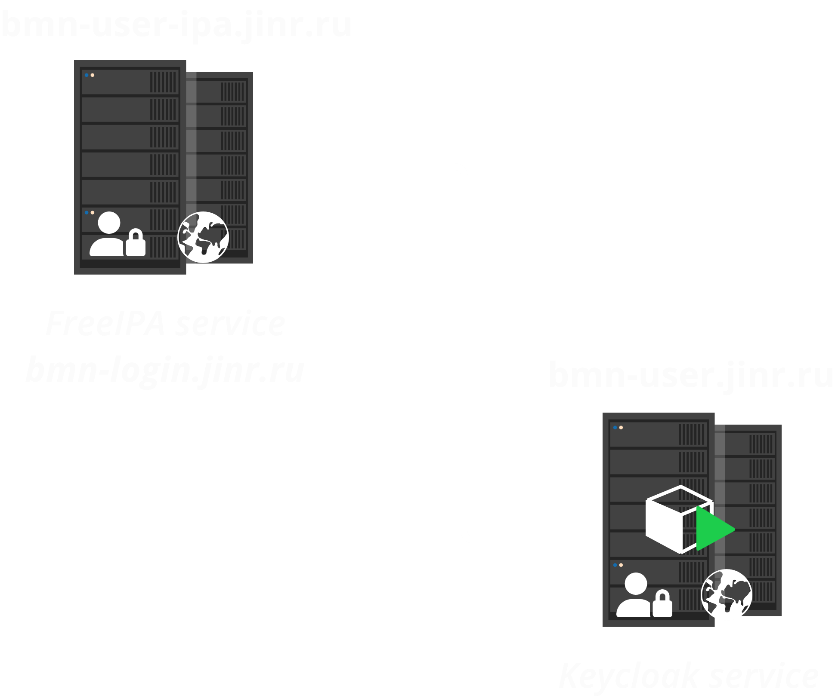

Implementation of a Single Sign-On (SSO)
Keycloak—a modern and reliable solution for identity and access management.
Migrating to Keycloak for implementing Single Sign-On offers numerous benefits, including centralized management, user convenience, and enhanced security.
User Federations
User Convenience
Enhanced Security
Centralized User Management
Keycloak is based on two important protocols, OpenID Connect and OAuth 2.0

Slide 11






Slide 12

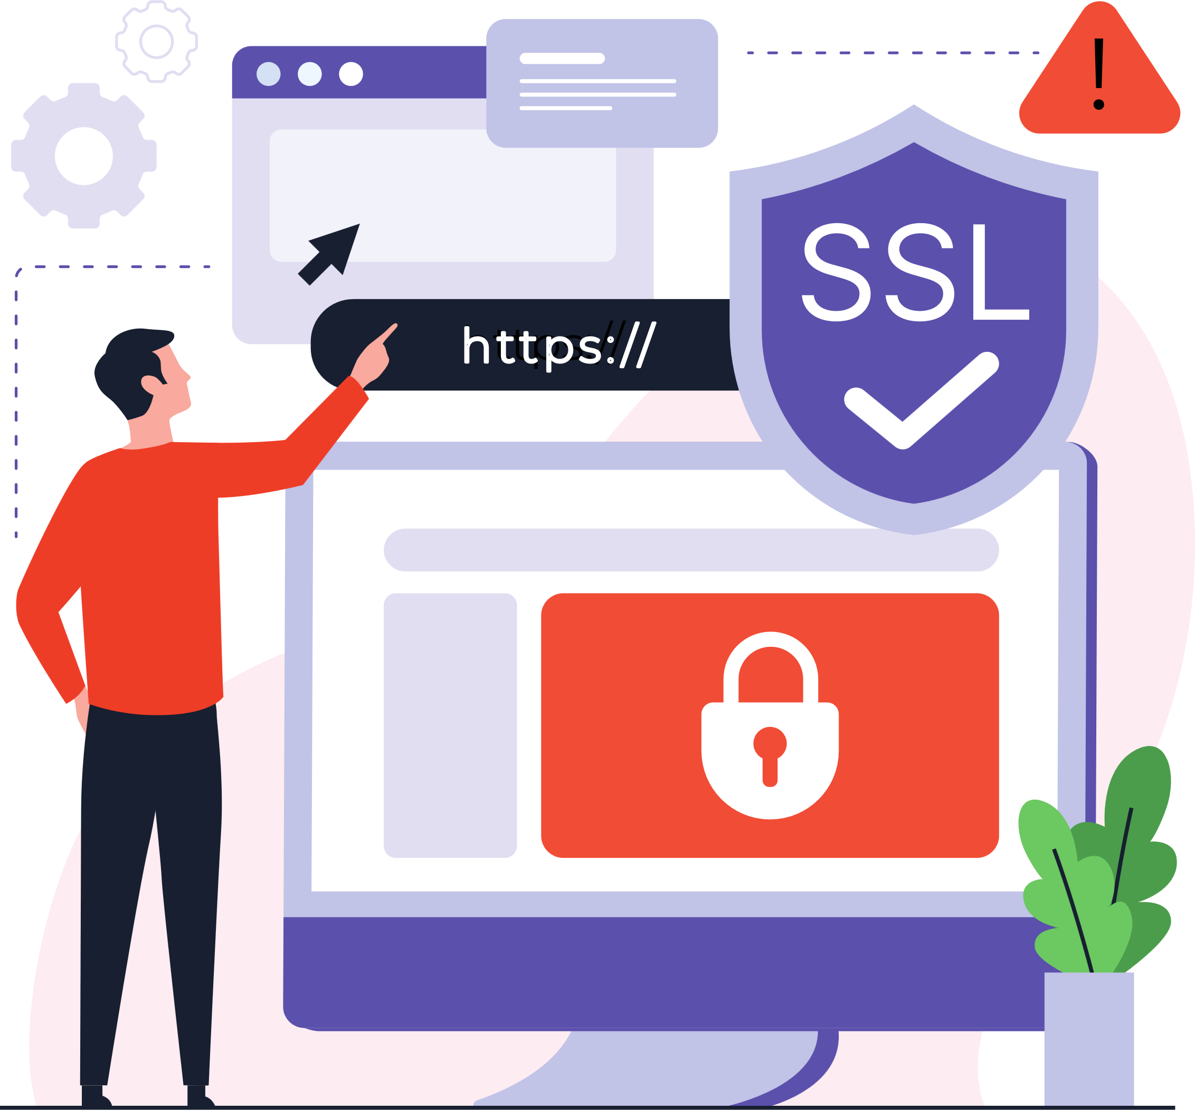



Details of protection implementation
SSL Termination
Reverse Proxying
Traffic Protection and Filtering
Performance Optimization(GZIP)
Centralized Logging
NGINX is a high-performance web server and reverse proxy that plays a crucial role in managing traffic and ensuring security within our infrastructure.
NGINX not only helps manage traffic but also protects the infrastructure, ensuring flexibility, security, and scalability.
Reverse Proxy

Slide 13


Details of protection implementation
IPTABLES: Traffic filtering at the Linux kernel level.
Fail2Ban: Automated IP blocking on suspicious activity.
Regular Updates: Keeping systems and packages up to date to patch vulnerabilities.
Logging and Analysis: Monitoring and analyzing all events to prevent threats.
Rate Limiting
Authentication Protection
Malicious Bot Detection
Sensitive File Protection
Traffic Filtering
Optimized performance.
Simplified system management.
Ilya Romanov
Development of Contemporary Log Management Solution for the Information Infrastructure of the BM@N Experiment

Slide 14
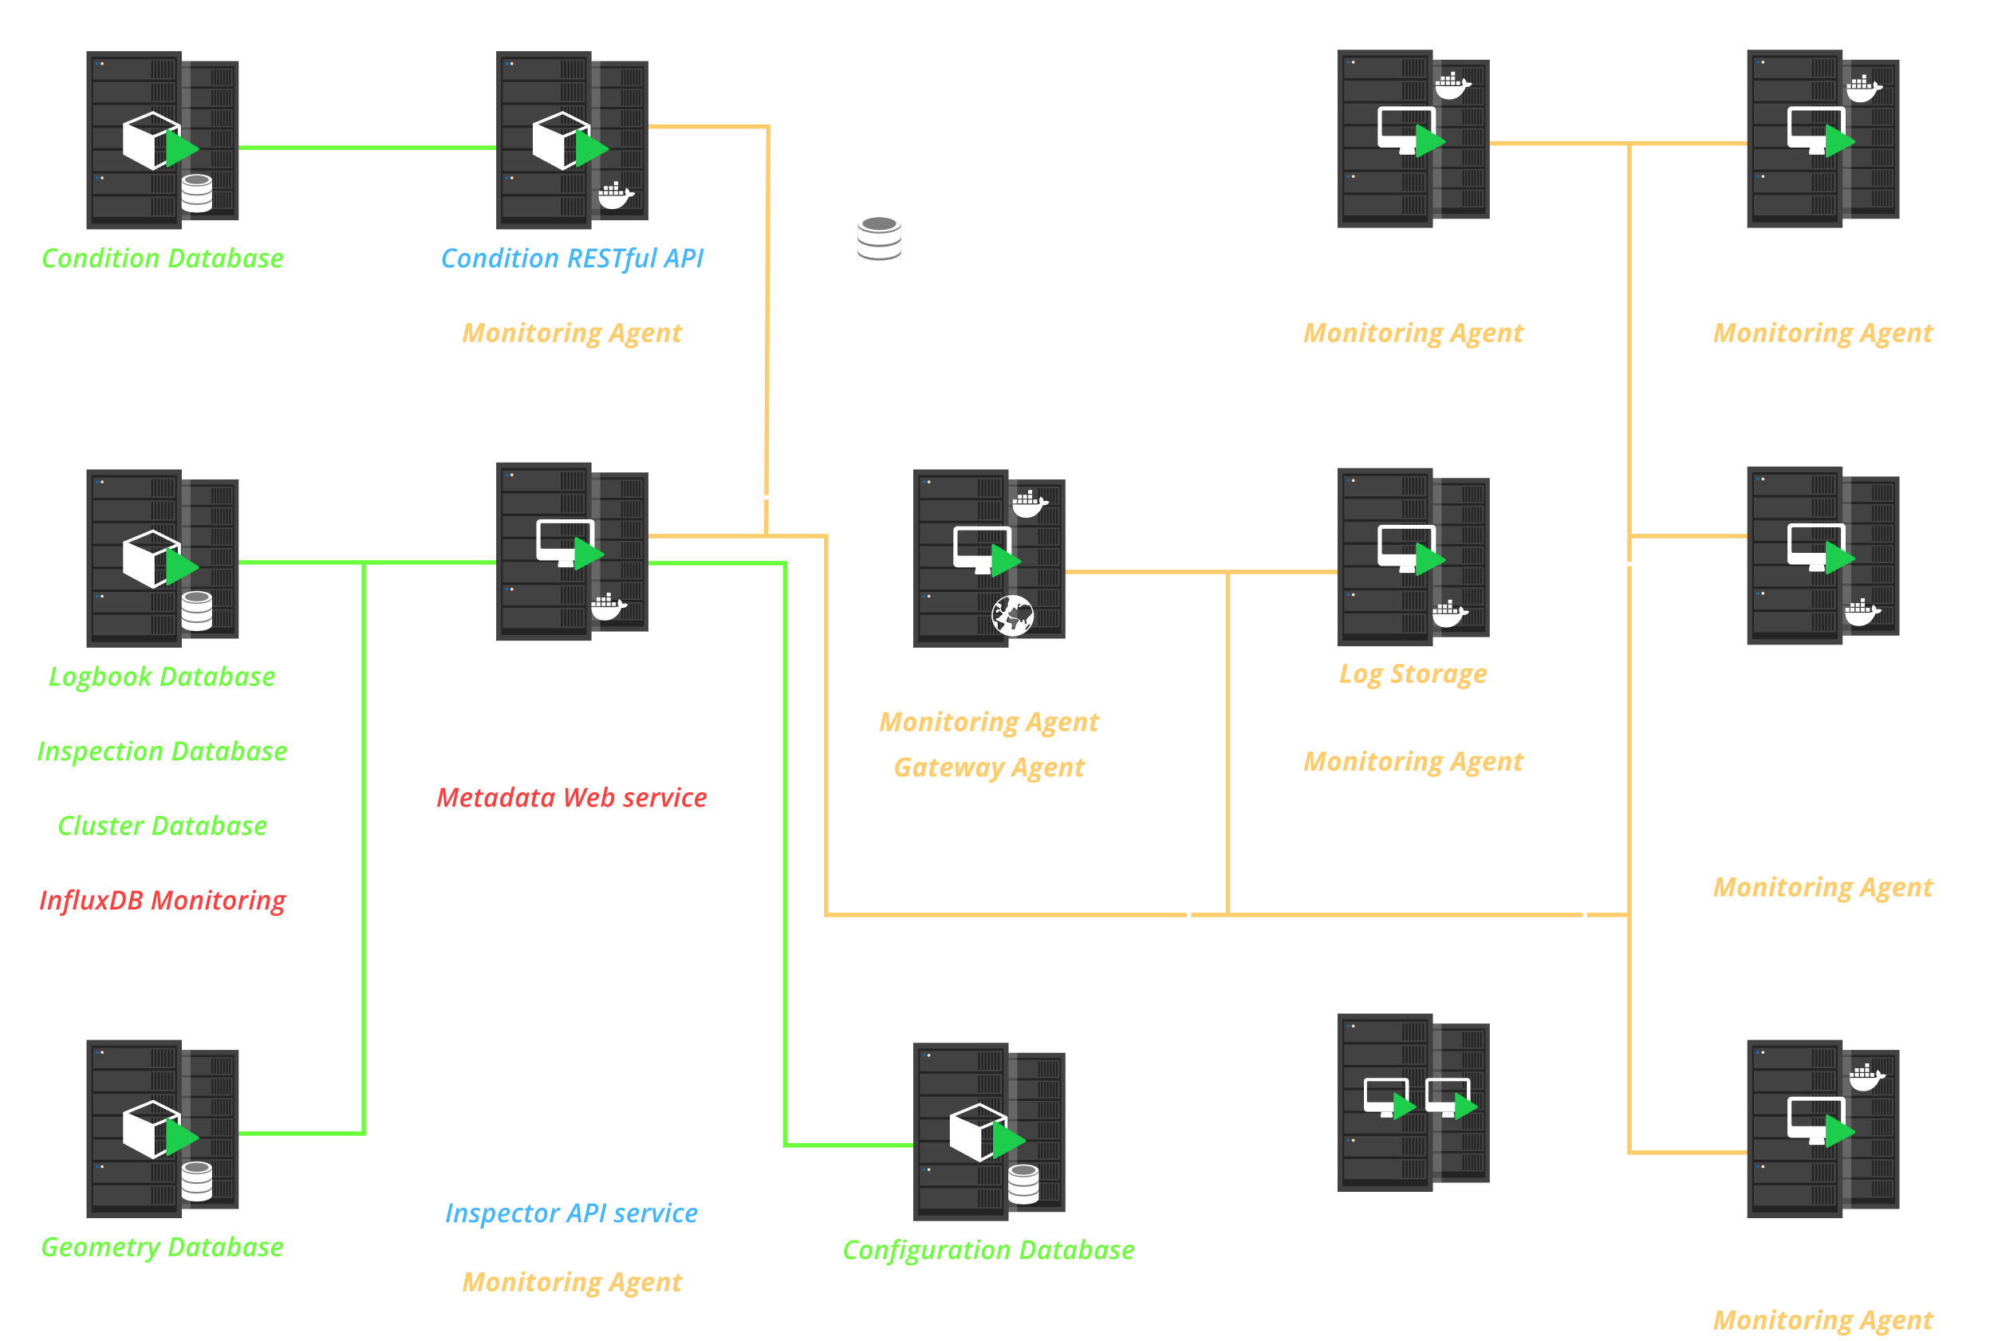
Current Infrastructure

Slide 15

Conclusions
We have made significant progress in deploying new services, systems, and databases, ensuring a smooth transition to the new infrastructure.
The integration of these services with Keycloak strengthens authentication and authorization processes, providing a higher level of security.
We are committed to optimizing system performance and ensuring its seamless operation for the BM@N experiment.

Slide 16


Focus on further development
New service integration: Expanding functionality with new tools and applications.
Enhanced security: Implementing advanced threat detection and prevention systems.
Staff training and external courses: It would be great if we were sent to professional courses.

Slide 17

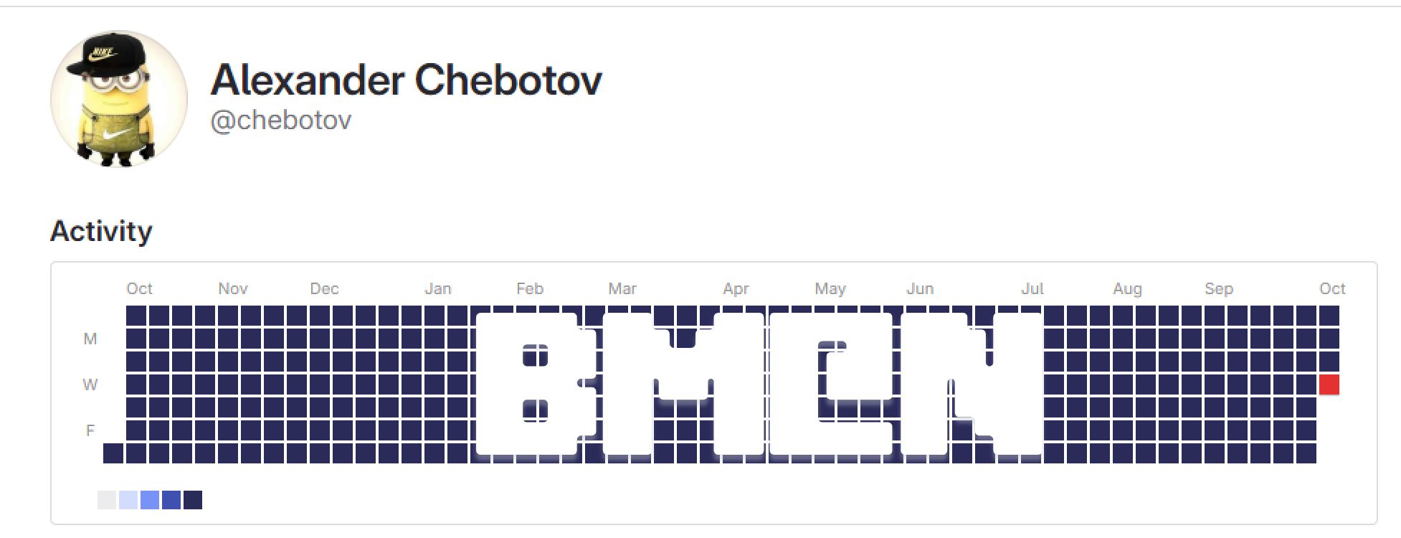
Thank you
for your attention!

