Slide 1
Status of the geometry alignment for GEM detectors of the BM@N experiment
Zarif Sharipov
13th Collaboration Meeting of the BM@N Experiment at the NICA Facility

Slide 2
Introduction to Alignment
y
β
z
γ
α
x

Slide 3
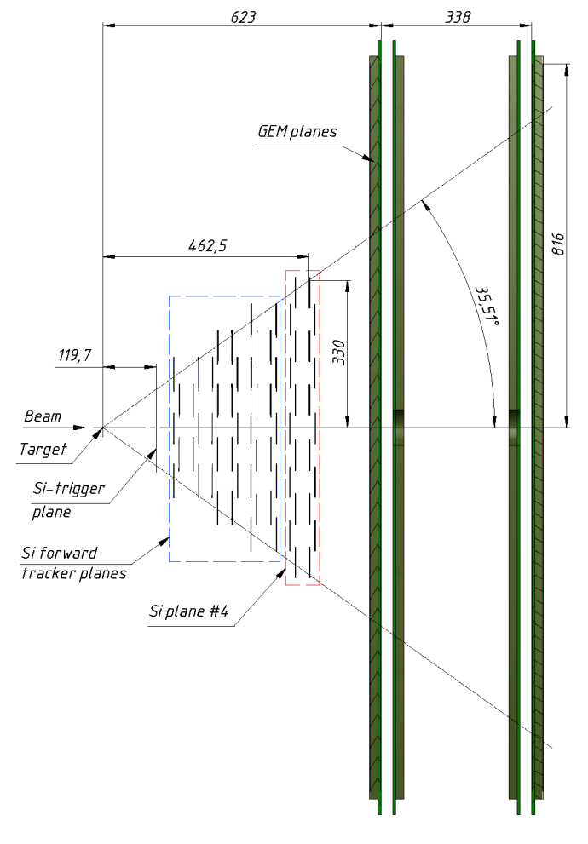
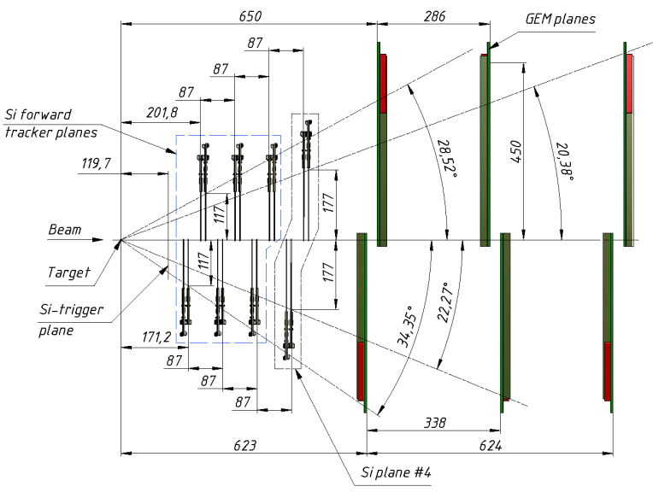
Schematic view of Forward Silicon detectors including 4th Si plane and first large apperture GEM (𝜎=150 mkm[Васильев С.Е. и др. Письма в ЭЧАЯ .2019.Т.16. №6. С.643-652]) stations in YZ (left) and XZ (right) projections.

Slide 4
Introduction to Alignment
.
o

Slide 5
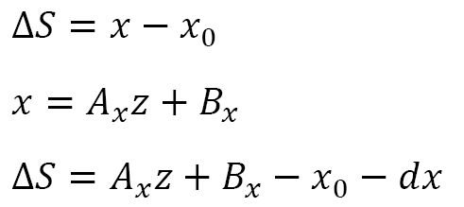
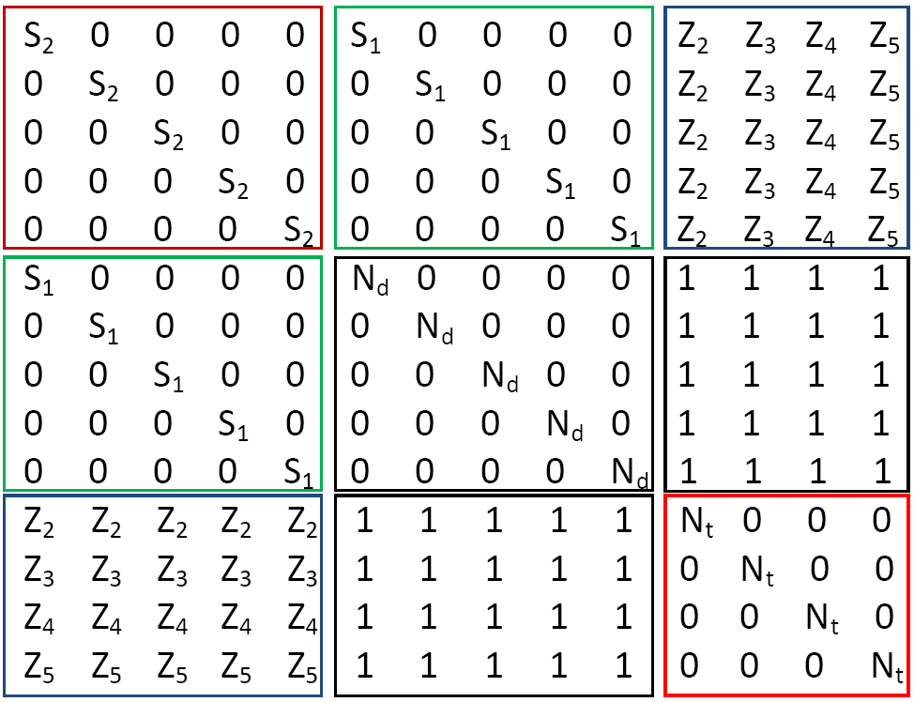
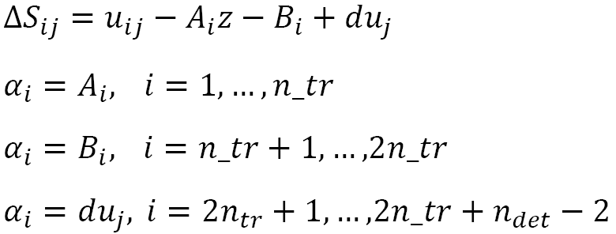
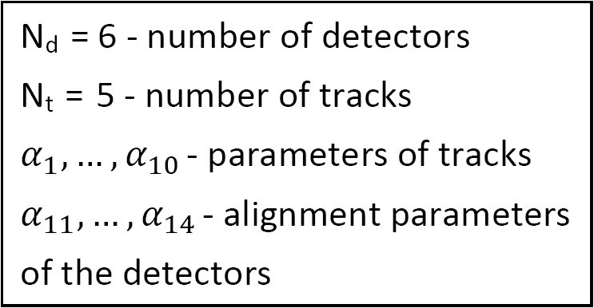
Alignment for x and y
Notes:
example

Slide 6
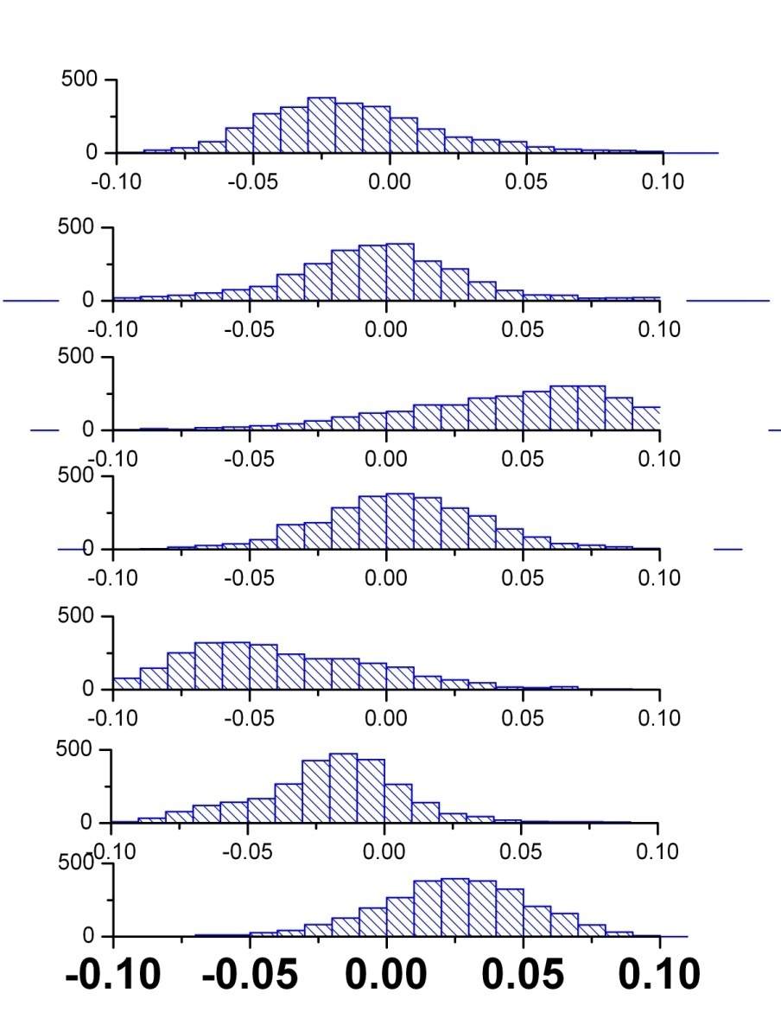
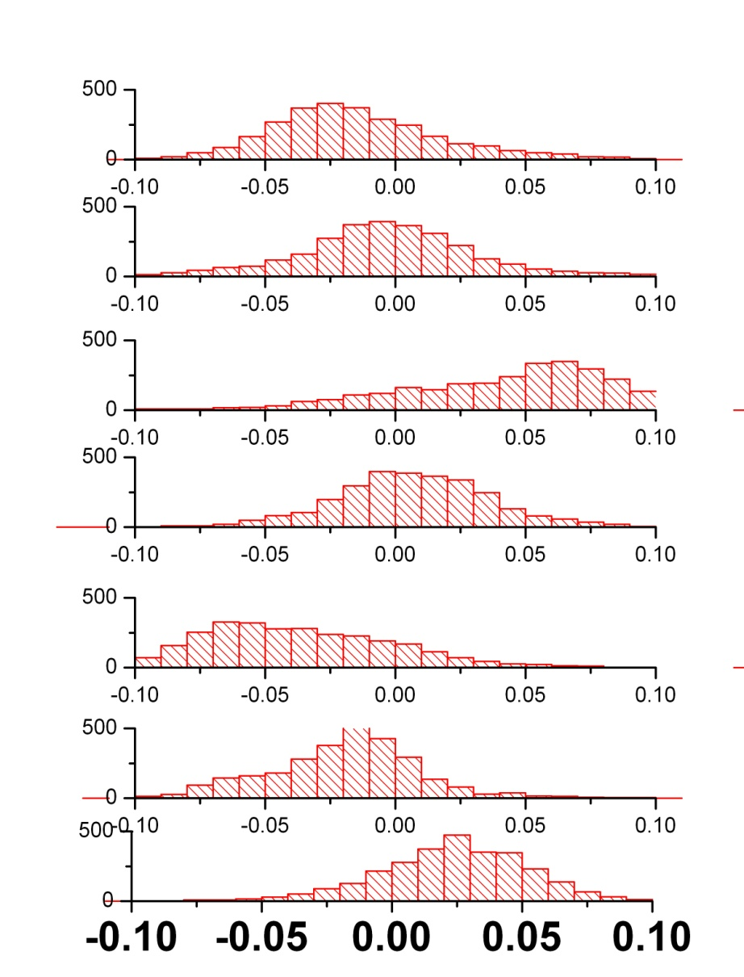
Alignment for x and y
m0_run8_7839_00 N_track = 2724
m0_run8_7840_00 N_track = 2853

Slide 7
Alignment for x and y
m0_run8_7839_00 N_track = 2724
dx SD
-----------------------
-0.01361 0.03274
-----------------------
-0.00393 0.03515
-----------------------
0.04388 0.04072
-----------------------
0.00575 0.03059
-----------------------
-0.03744 0.03591
-----------------------
-0.0191 0.02815
-----------------------
0.02445 0.02802

Slide 8
Alignment for x and y
m0_run8_7840_00 N_track = 2853
dx SD
--------------------
-0.0143 0.0716
--------------------
-0.00174 0.09513
--------------------
0.04103 0.06192
--------------------
0.00648 0.03411
--------------------
-0.0362 0.04125
--------------------
-0.01867 0.04005
--------------------
0.02341 0.02899

Slide 9
Alignment for x and y
m0_run8_7839_00 N_track = 2724
m0_run8_7840_00 N_track = 2853
dx SD
-----------------------
-0.01361 0.03274
-----------------------
-0.00393 0.03515
-----------------------
0.04388 0.04072
-----------------------
0.00575 0.03059
-----------------------
-0.03744 0.03591
-----------------------
-0.0191 0.02815
-----------------------
0.02445 0.02802
dx SD
--------------------
-0.0143 0.0716
--------------------
-0.00174 0.09513
--------------------
0.04103 0.06192
--------------------
0.00648 0.03411
--------------------
-0.0362 0.04125
--------------------
-0.01867 0.04005
--------------------
0.02341 0.02899

Slide 10
Alignment for x and y
m0_run8_7839_00 N_track = 2724
m0_run8_7840_00 N_track = 2853
dy SD
--------------------
0.1102 0.16946
--------------------
-0.12816 0.15997
--------------------
0.04362 0.18782
--------------------
-0.11603 0.1598
--------------------
0.07636 0.11392
--------------------
-0.04355 0.1042
--------------------
0.05758 0.12282
dy SD
---------------------
0.10893 0.17303
---------------------
-0.12339 0.17045
---------------------
0.04238 0.20107
---------------------
-0.1178 0.16855
---------------------
0.07206 0.12108
---------------------
-0.03993 0.11008
---------------------
0.05775 0.12743

Slide 11
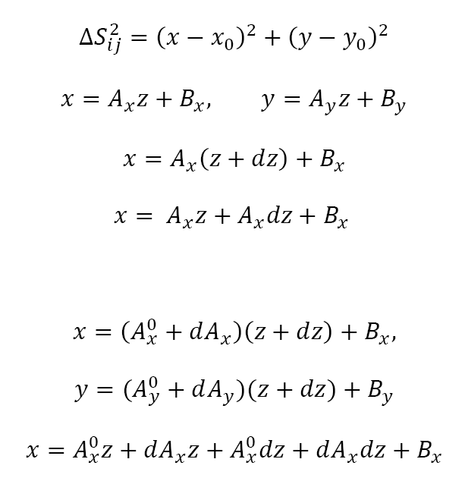
Alignment for x, y and z

Slide 12
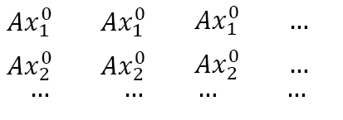
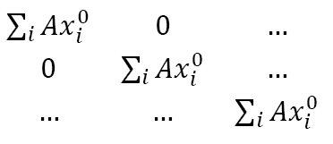
Alignment for x, y and z
dAx_i
Bx_i
dx_i
dz_i

Slide 13
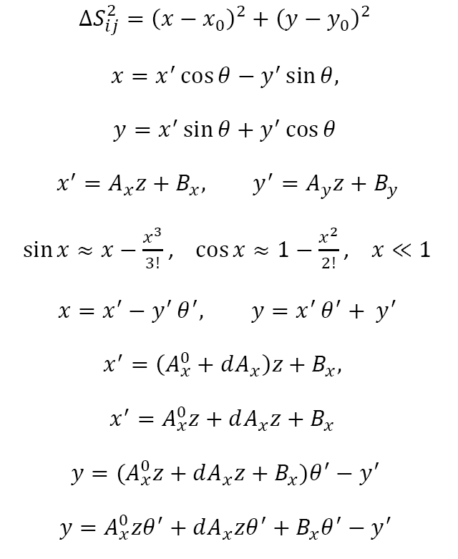
Alignment for x, y and 𝜃

Slide 14
Alignment for x, y , z
x
dAx, Bx
dAx, Bx
0
0
0
dx
0
dAy, By
0
x
dAy, By
0
0
dx
dy
0
dy
dz
dz

Slide 15
Principle of alignment
1. Volker Blobel, Claus Kleinwort. A New method for the high precision alignment of track detectors (https://arxiv.org/abs/hep-ex/0208021)
2. IMSL Fortran Library
(https://www.imsl.com/products/imsl-fortran-libraries)
3. Millepede-II
( https://www.desy.de/~kleinwrt/MP2/doc/html/draftman_page.html)
4. Белотелов И.И. Влияние точности позиционирования модулей трековых детекторов на реконструкцию физического сигнала в экспериментах Hera-B и CMS и геометрическое выравнивание внешнего трекера детектора Hera-B. Диссертация на соискание ученой степени к.ф.-м. наук., Дубна, 2006г.

