Slide 1
$φ_{0}$signal observation in the BM@N experiment
Ramin Barak
13th Collaboration Meeting of the BM@N Experiment at NICA, Dubna, October 8-10, 2024

Slide 2
Introduction
Collisions of heavy relativistic ions allow us to study nuclear matter at extreme density and temperature.
At sufficiently high temperature and energy density, the so-called Quark-Gluon Plasma (QGP) is formed [1]:
Formation of strange particles.
Theoretical models offer different descriptions [2],[3]:
New experimental data is needed for clarification.
[1] Kapishin.M, “Studies of baryonic matter at the BM@N experiment (JINR).” Nuclear Physics A 982 (2019) 967–970.
[2] J. A. et al Nucl. Phys., vol. A 757, pp. 102–183, 2005.
[3] K. A. et al Nucl. Phys., vol. A 757, pp. 184–283, 2005.

Slide 3
Goal
Observation of $φ_{0}$signal in the MC and experimental data.

Slide 4
Data
Experimental data obtained in the physical session at the beginning of 2023 with a beam energy of 3.8 AGeV, a CsI target and Xe beam.
Dubna Cascade Model - Statistical Multifragmentation Model (DCM-SMM) and BOX Monte Carlo generators were used to model the data.
About 0.8 million Monte Carlo and 22 million experimental events were analyzed.

Slide 5
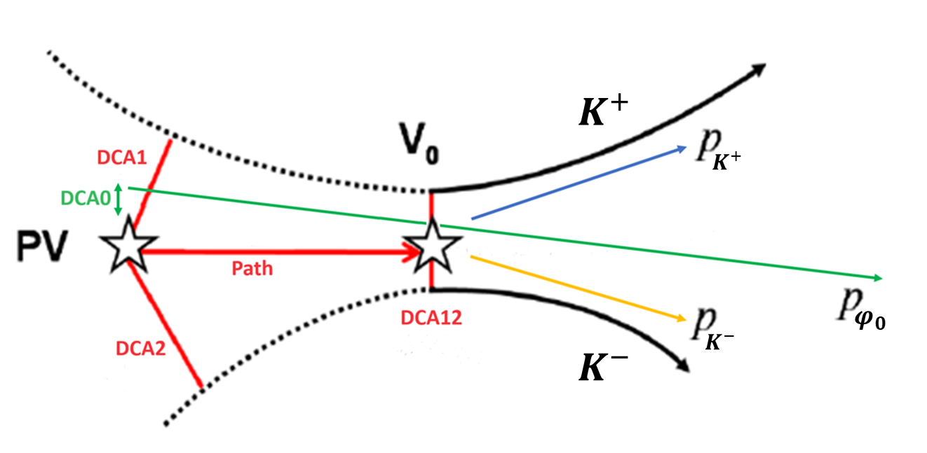
Data processing procedure
Reconstruction of particle tracks was carried out.
Mathematical algorithms were developed and implemented to search for the $φ_{0}→ K^{+}+ K^{−}$decay:
shuffling pairs of particles with different signs
calculation of invariant mass
imposing a number of geometric restrictions (4) on the parameters of each pair
PV – primary vertex.
Path – the distance traveled by $φ_{0}$ from the primary vertex to the point of its decay.
DCA0 – the distance between the primary vertex and the projection of momentum of $φ_{0}$.
DCA1 – the shortest distance from $K^{+}$to the vertex.
DCA2 – the shortest distance from $K^{−}$ to the vertex.
DCA12 – the distance between $K^{+}$and $K^{−}$at the decay point of $φ_{0}$.
Event topology

Slide 6
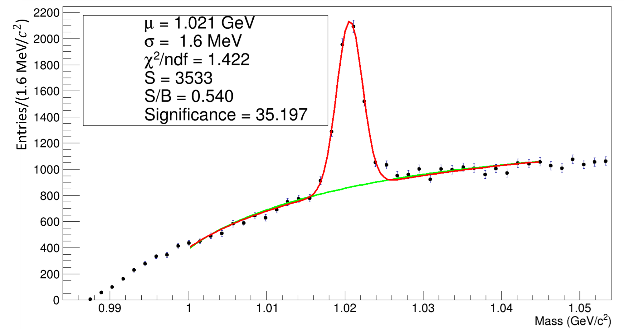
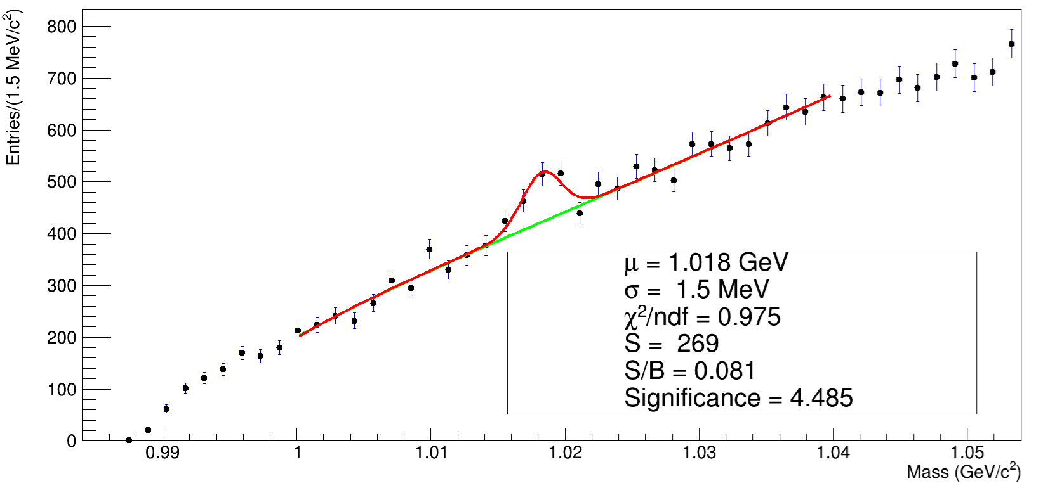
Results
MC
EXP
Efficiency = 0.44 %

Slide 7
Conclusion and future work
Phi meson signal was observed in both MC and experimental cases.
Put more stringent constraints on certain cuts and more lenient ones on others.
Increase the number of analyzed events in order to improve the results regarding experimental data.
Derive more realistic values for kinematic parameters by means of other MC generators (UrQMD, PYTHIA).
Compare MC results with experimental ones.
Perform phase space analysis.

Slide 8
Backup

Slide 9
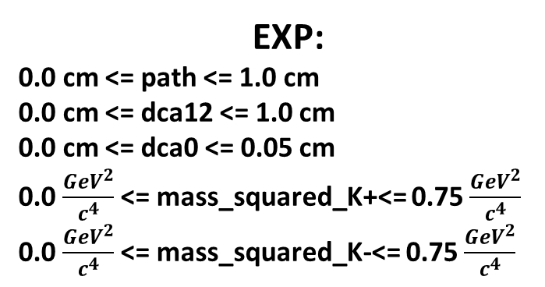
Cuts
MC:
0.0 cm <= path <= 5.0 cm
0.0 cm <= dca12 <= 2.0 cm
0.0 cm <= dca0 <= 1.0 cm
0.15 $\frac{{GeV}^{2}}{c^{4}}$ <= mass_squared_К+<= 0.35 $\frac{{GeV}^{2}}{c^{4}}$
0.7 $\frac{GeV}{c}$ <= momentum_К+<= 2.5 $\frac{GeV}{c}$
-2.5 $\frac{GeV}{c}$ <= momentum_К-<= -0.7 $\frac{GeV}{c}$
EXP:
0.0 cm <= path <= 1.0 cm
0.0 cm <= dca12 <= 1.0 cm
0.0 cm <= dca0 <= 0.05 cm
0.0 $\frac{{GeV}^{2}}{c^{4}}$ <= mass_squared_K+<= 0.75 $\frac{{GeV}^{2}}{c^{4}}$
0.0 $\frac{{GeV}^{2}}{c^{4}}$ <= mass_squared_K-<= 0.75 $\frac{{GeV}^{2}}{c^{4}}$

